Slide 1




Introduction to the “MIT Thermal Energy Networks (MITTEN) Plan
for Rapid, Cost-Effective Campus Decarbonization
Susan Murcott
MIT Alumni for Climate Action (MACA) – MIT Campus Group / Geo@MIT (student group)
Geothermal Energy Networks Workship
Jan. 30 – 31, 2025

Slide 2
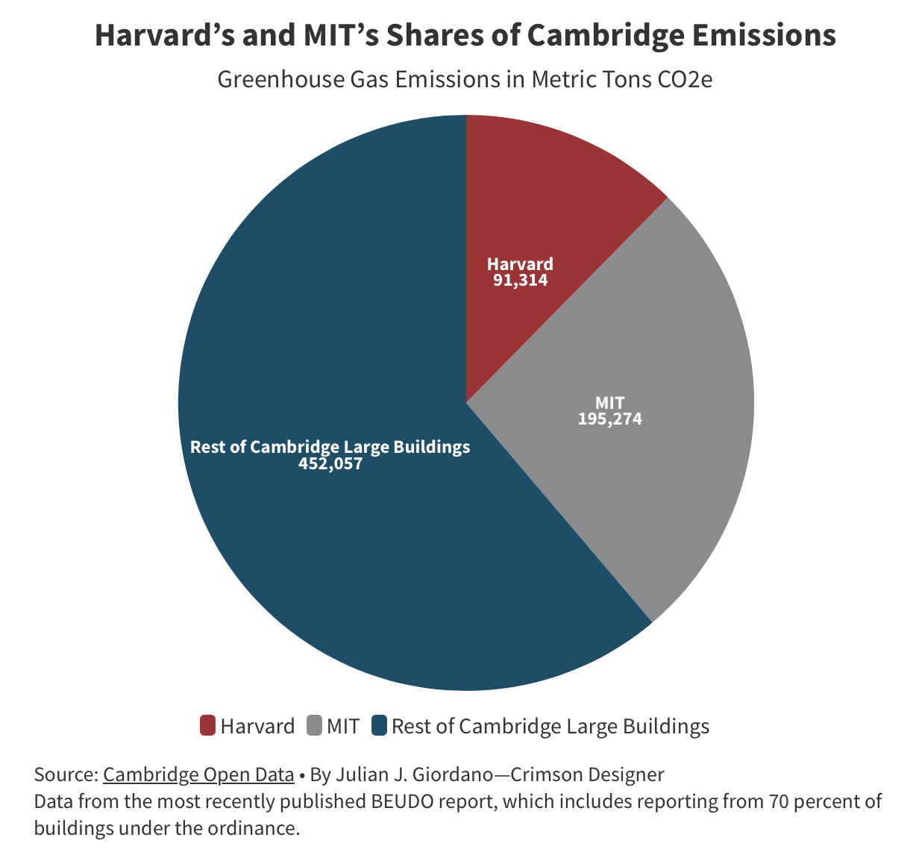
MIT’s Decarbonization Challenge
97% of MIT’s greenhouse gasses are from the operations of its buildings.*
26% of all Cambridge’s greenhouse gases are from MIT.
* MIT Office of Sustainability Website:
© Julian J. Giordano. All rights reserved. This content is excluded from our Creative Commons license. For more information, see https://ocw.mit.edu/help/faq-fair-use/

Slide 3
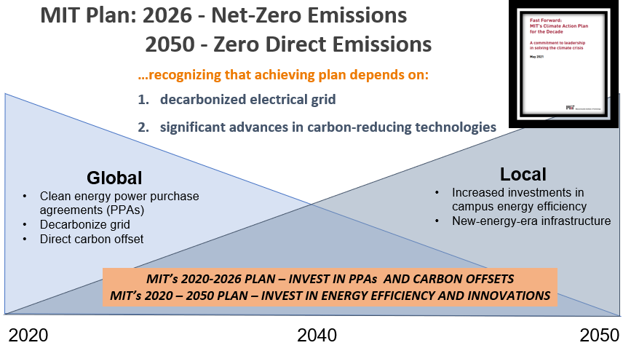
MIT’s Climate Action Plans (2016) and (2021) postpone significant investment in direct MIT Campus Decarbonization until later.
Slide credit: Steve Lanou, MITOS, 2023

Slide 4
The MIT Thermal Energy (MITTEN) Decarbonization Plan
All-electric campus fueled by carbon-free power.
Implementing energy conservation measures including waste heat recovery from ventilation systems to reduce heating and cooling demand.
Installing high-efficiency Water Source Heat Pumps in each building for heating and cooling

Slide 5
MITTEN Decarbonization Plan (con’t)
Repurposing existing chilled water loop to an Ambient Loop, circulating 45-85ºF water year-round to WSHPs in each building
Repurposing oil tanks at the CUP for thermal storage
Energy Transfer Stations operated by the Cambridge Water Department exchange heat with the Ambient Loop. If not possible, connect to existing wastewater sewerage or drill geothermal boreholes

Slide 6
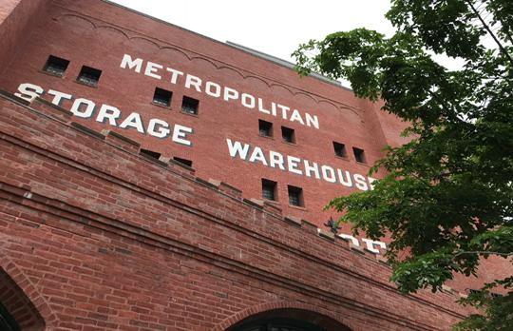

MITTEN: Thermal Energy Network Advantages
MITTEN plan is the most cost-effective and energy-efficient way to heat and cool campus buildings:
Demonstrates MIT’s leadership,
Leverages MIT’s investment in existing infrastructure,
Eliminates cost impact of maintaining separate systems because WSHPs provide both heating and cooling;
Eliminates energy transmission losses;
Enables the capture of “free energy” when there is concurrent heating and cooling on campus;
Might tap into federal and state subsidy program.
Met Building (W41) demonstration project is already underway!

Slide 7
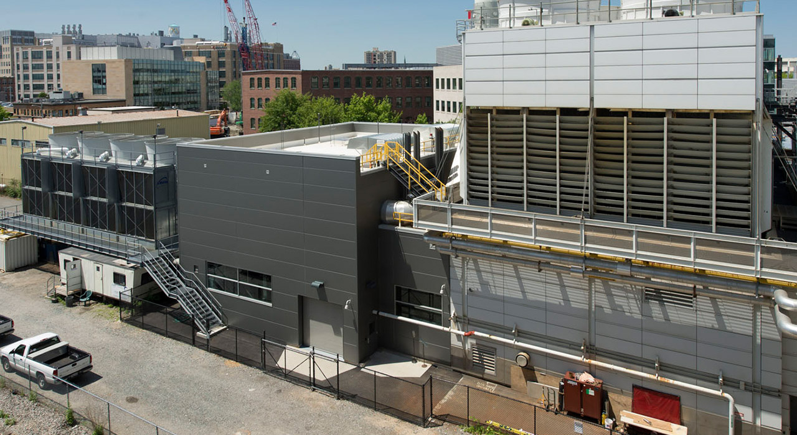
How Is Campus Heated/Cooled Now?
  Central (CUP) with co-generating gas turbines.
  Produces steam and hot water.
  Operates steam-driven chiller.
  Generates over 22MW electric power.
  Connected to steam distribution system
  Connected to chilled water distribution to most buildings
  Cooling load is high and most affected by global warming

Slide 8
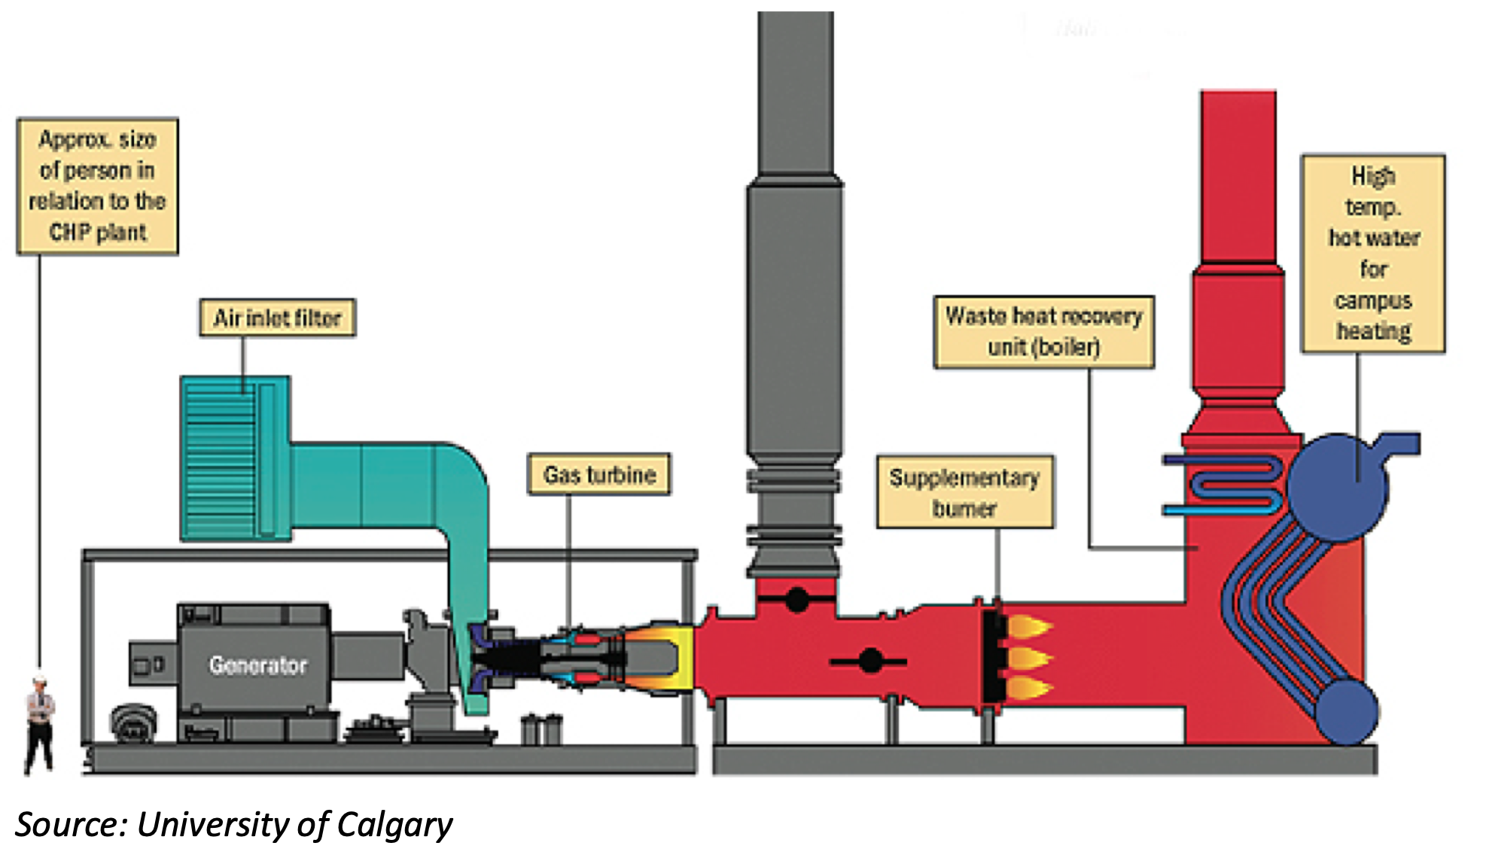
DECARBONIZATION ISSUES WITH EXISTING CENTRAL PLANT:
  Grid decarbonization is rapidly reducing carbon once touted for Combined Heat and Power (CHP)
  Fossil Fuel Backup is necessary.
  Efficiency of 50-55% source to output.
  Low Turndown Ratio (30%)
  High Thermal Loss in the steam distribution system (10%-20%)
  Non-zero losses in the Chilled Water System (5%-15%?)
  BTW: Hot water district systems have losses in the 15%-20% range due to additional piping.
Source: public domain

Slide 9
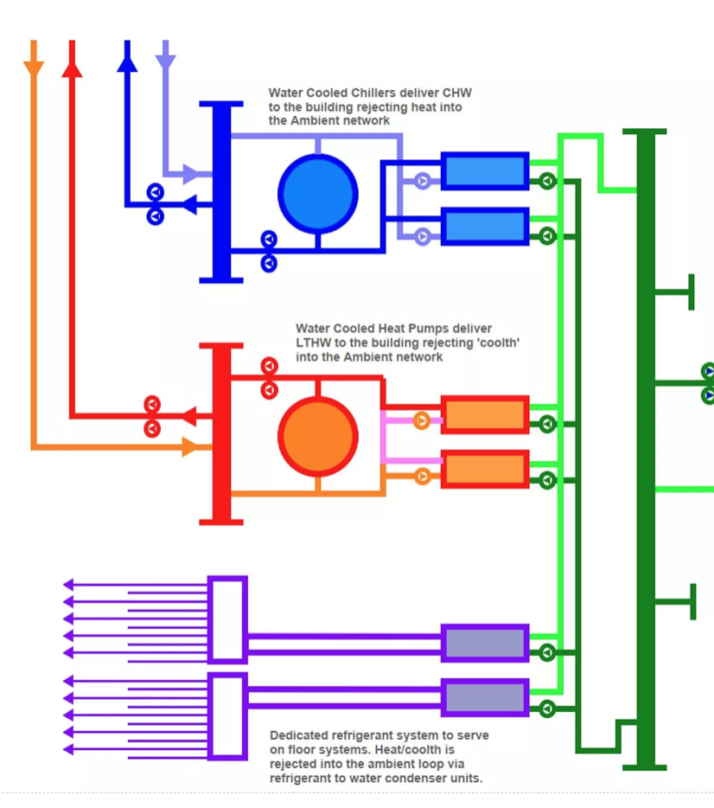
HOW WOULD MITTEN HEAT AND COOL THE CAMPUS?
  DISTRIBUTED HEAT PUMPS CONNECTED INTO A NETWORK OF SOURCES AND SINKS.
  NO ONE SOLUTION SINCE THE BUILDINGS RANGE OVER A HISTORY OF 100 YEARS.
  USE OF BUILDING TO BUILDING AND BUILDING IN BUILDING SOURCES AND SINKS.
  USE OF THERMAL STORAGE AND GROUND COUPLING.
    CAMBRIDGE WATER THERMAL ACCESS
    SEWER THERMAL ACCESS
    GROUND THERMAL EXCHANGERS
© Mott MacDonald. All rights reserved. This content is excluded from our Creative Commons license. For more information, see https://ocw.mit.edu/help/faq-fair-use/

Slide 10
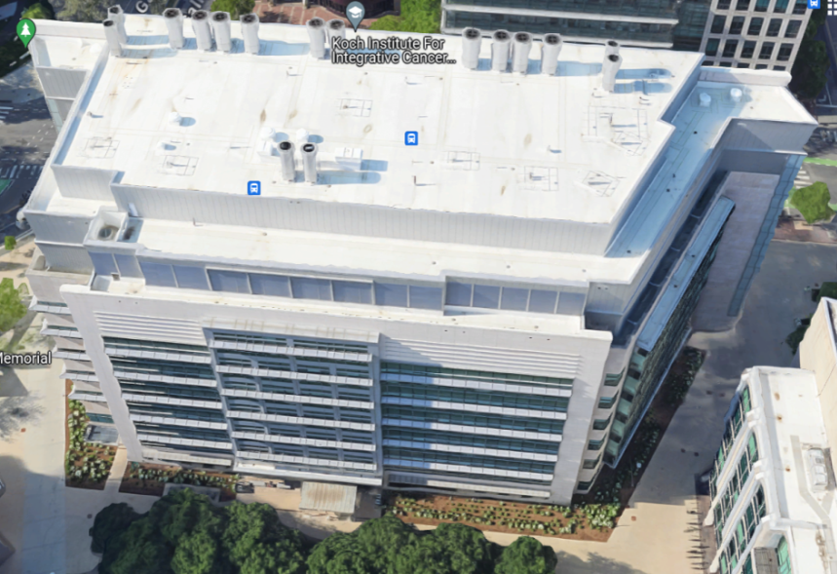
5th/6th Generation District HVAC Decarbonization
Key Transitions:
Ambient Loop
Exhaust Recovery
Distributed WSHPs
Thermal Storage,
ASHP, GHEX
Municipal Water Thermal, CSP Solar, Other
2
Make
Up
50,000 CFM Lab Exhausts
Exhaust
Air Coils
Air Coils
MIT Bldg 76
100% Ventilation
Cancer Labs
Air Flows
Water Coil
3-Way Heat Pumps
Heat Pumps
Air Coil
Water Coil
Reheat Coil
3
Campus Ambient Loop (existing)
Below Ground Elements
1
Thermal Batteries
Ground Heat Exchangers
5
City Water Thermal Connection
4
4
Sewer Energy Recovery

Slide 11
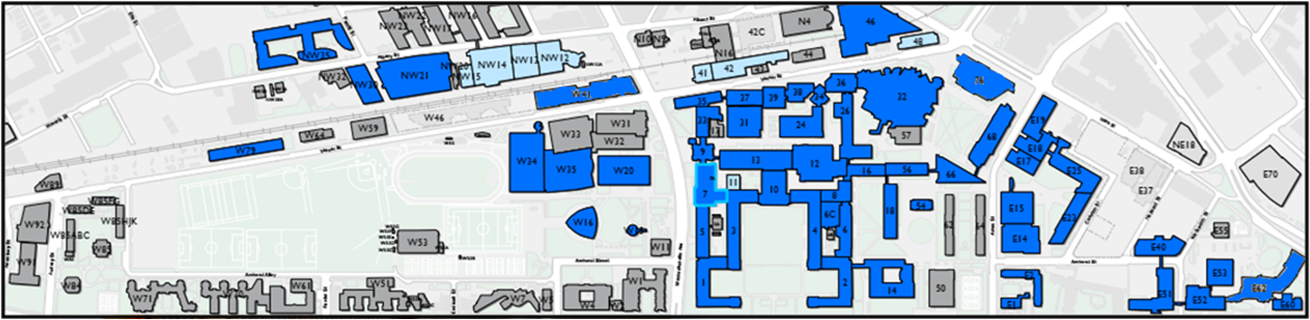
The MIT Solution: Chiller Loop to Ambient Loop Conversion:
Same 2 pipes w/o thermal limits, add heat pumps and sources/sinks
6th Generation
Almost no new piping
New Ambient/CW
Very little new pipe needed
All new pipe HDPE/PP fusion welded
  Will outlast the buildings!
  Far less costly to install
  Can use horizontal boring to install

Slide 12
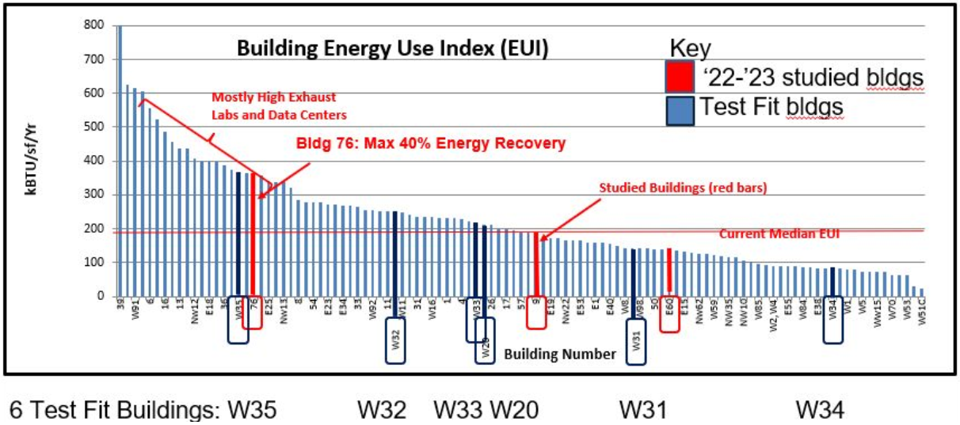


MIT Buildings:
Wide Range of Energy Efficiencies, All High!
UNCA

Slide 13
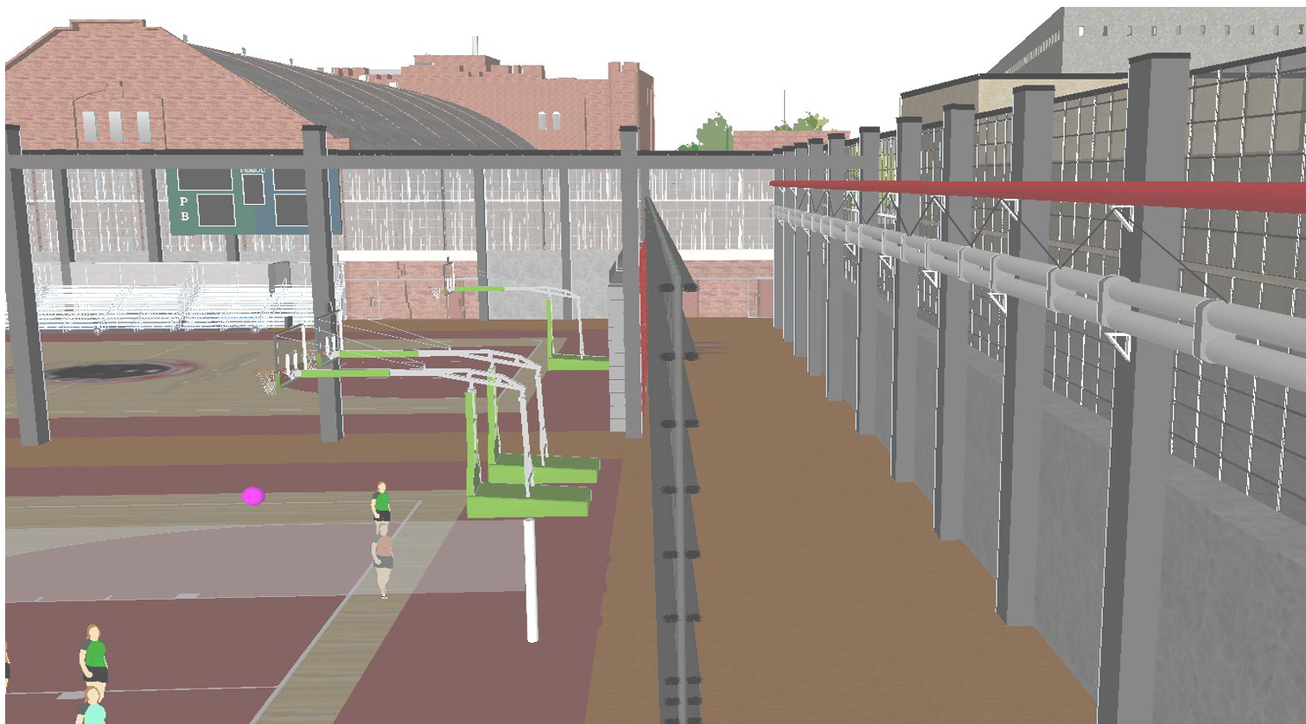


Adding New Ambient Loop Pipe in W33
3D Graphic - Hanging Pipe in Available Space

Slide 14
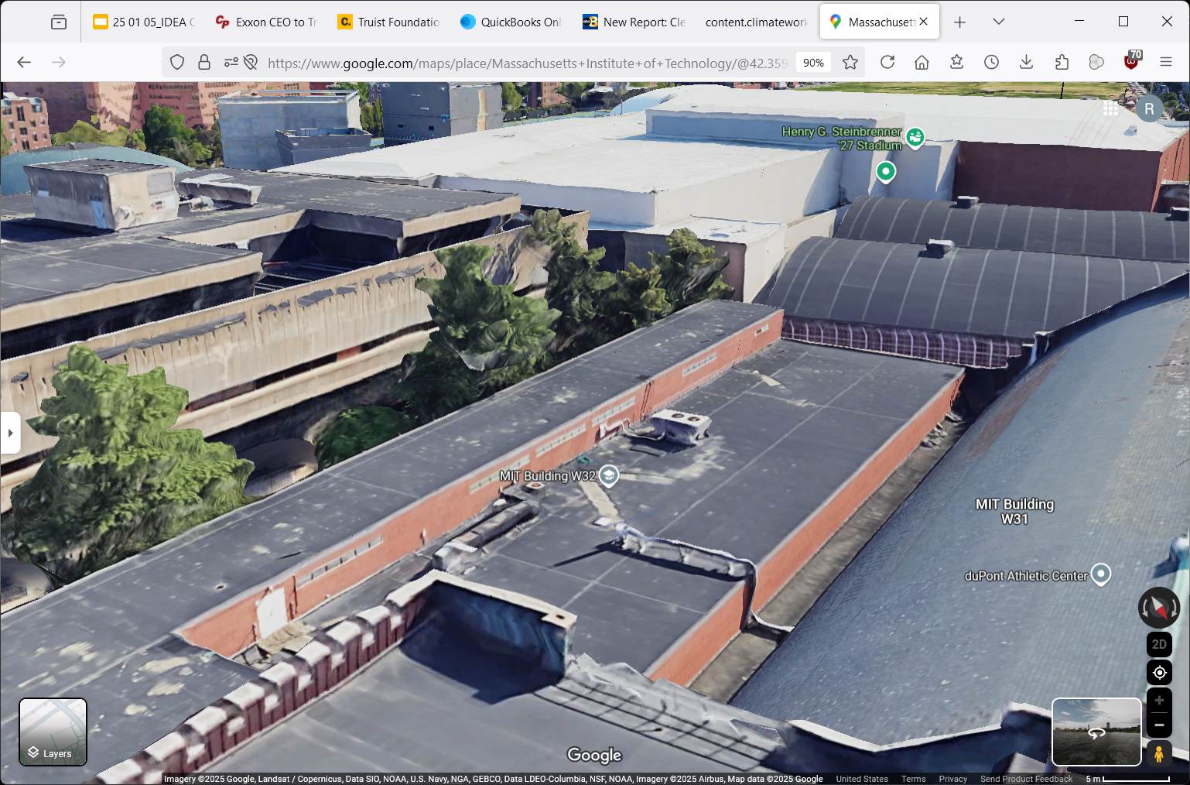
14

Slide 15

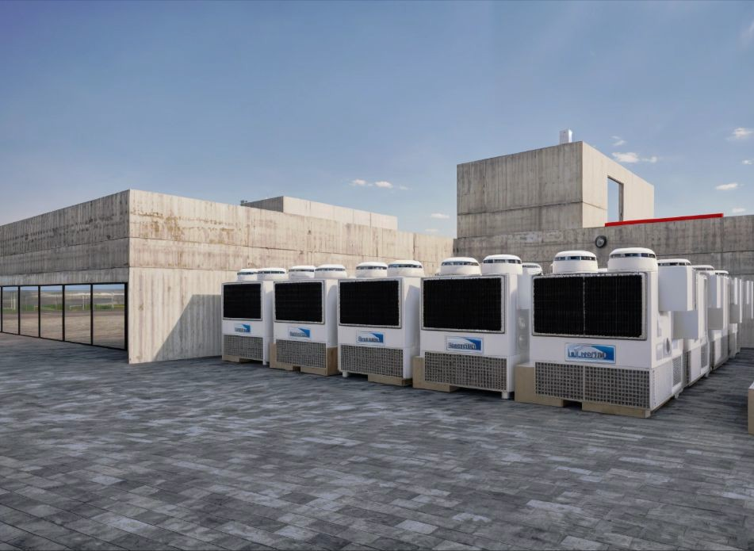

W2
W20
Multi-Stack Heat Pump Units
on Roof of Stratton Building
3D Infographic
Electrical room Mechanical room
N

Slide 16
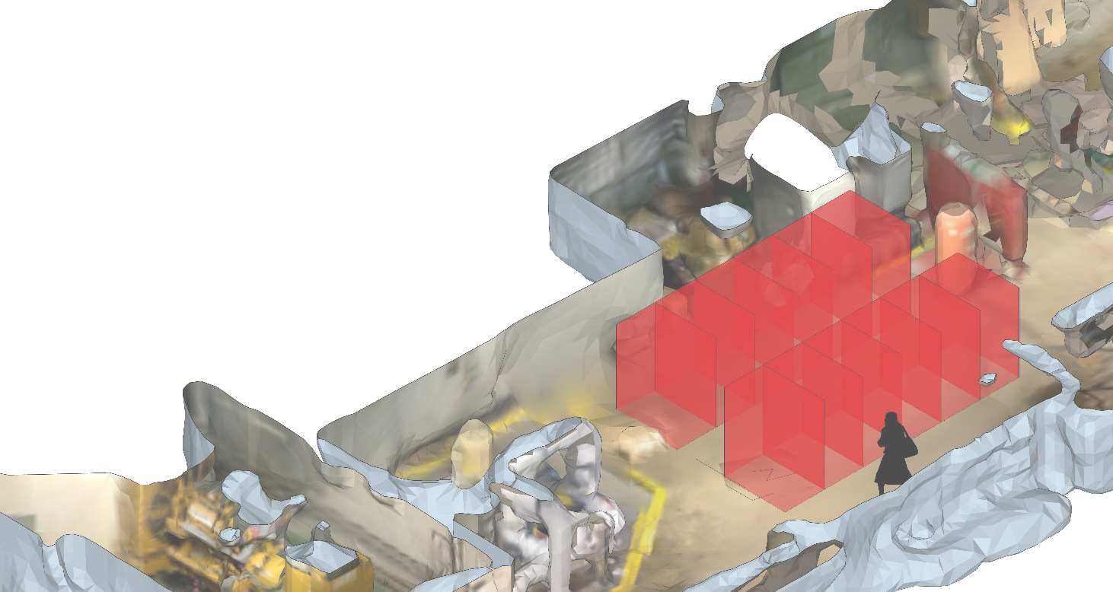
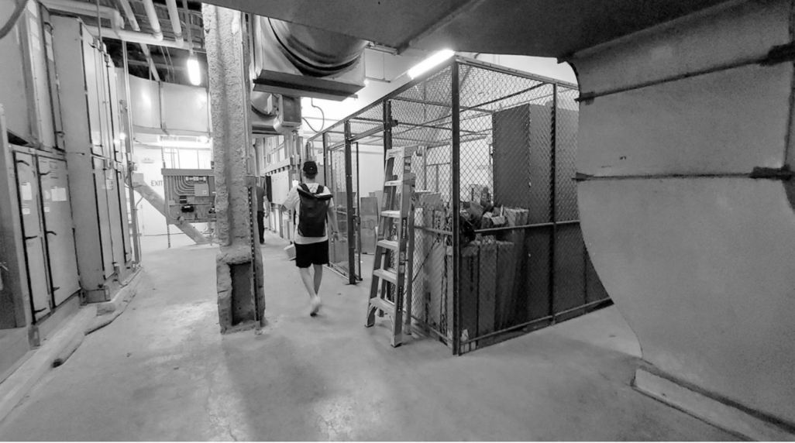


Multistack
W34
Modular units
Dimensions (12 Units)
Option 1: Multistack -> Mech Room (W34-228)
H:60”
W:50”
D:32”
Distance equipment
offset distance
W:42”
D:36”
3D Infographic
W34
Source: Figure created by the author
Electrical room
Mechanical room
Also used photo analysis
Ice Exchanger
9 x AAON SA-23
4 x ??
(exhaust)

Slide 17
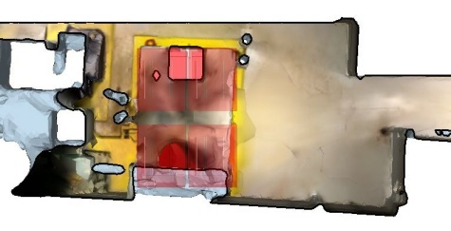
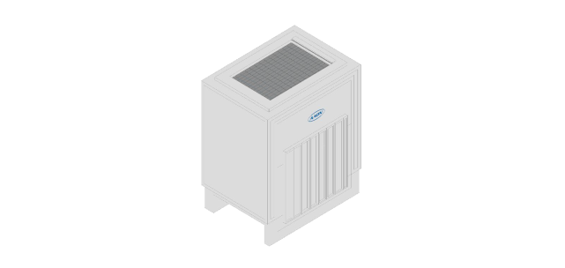
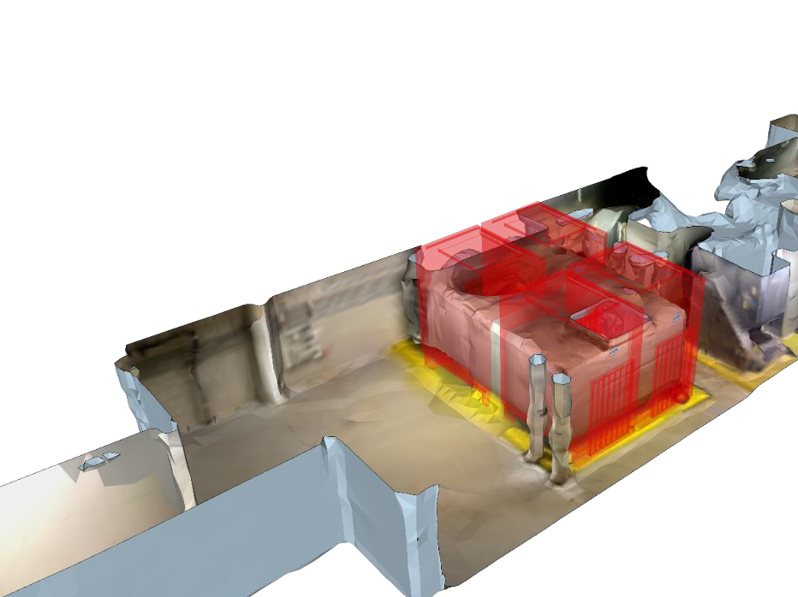


W34
N
Modular units dimensions
(4) UNITS
H:9’ W:6.2’ D:5’
Option 2: AAON SA-23
Heat Pumps -> Mech Room (W34-125M)
3D Infographic
Electrical room
Mechanical room
N

Slide 18
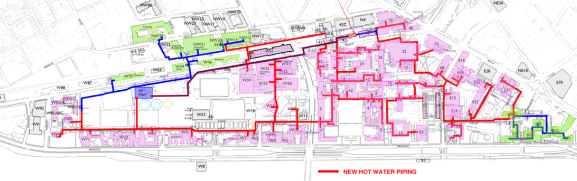
Distributed
2-pipe Network
Almost no new piping!
New Ambient/CW
Central Plant
4-pipe Distribution
Massive new piping!

Slide 19
Hot Water for Heating
Central Thermal Plant vs Distributed Heat Pumps
COP ~3.0
Bldg
Pump
Heat Losses in Transmission
Less Efficient
Added Electricity
Centralized System
Bldg
MITTEN System
COP 5.0

Slide 20
MIT HQ Fiduciary Responsibility
Top-Line Comparison of Approaches
Task | MITTEN | Centralized
Meets Bldg HVAC Specs | √ Yes | √ Yes
Achieves zero emissions | √ Yes | √ Yes
Achieves by 2035 -BEUDO | √ Yes | x No
Minimal Disruption | √ Yes | x No
Pilot to Confirm Projections | √ Yes | X No
Easy Upgrade Over Time | √ Yes | X No
Fiscally Responsible | √ Yes | x No
MIT Seriously Considering | ??? | √ Yes
20
Why not?

Slide 21
Thermal transition “leapfrog”
Existing
Current Option
Goal
Skip !
Steam/Chiller
Fossil Fuel
Central New Thermal Plant
Hot Water Piping
Not Economical
Distributed Thermal Energy Network
Least cost
Lowest power consuming
Notes:
Campuses today with central utility plants are almost all 4-pipe with separate heating and cooling, or 3-pipe with chilled water and steam. Other campuses are individual buildings. All would be optimized with thermal energy networks
Campuses today are almost all 4-pipe with separate heating and cooling. Many new secondary schools are 2-pipe ... the same for military new buildings.
Most campuses are individual buildings with individual HVAC, others have central utilities
If upgrading from steam to hot water, you’re wasting money. Should just go direct from steam to thermal energy networks
Deleted
Centralized Fossil Fuel-Based Systems
steam/hot water boilers
Chilled water plants
Individual Building Systems (i.e. standalone HVAC units)
High-Temperature Distribution Networks
Steam or traditional heating and cooling

Slide 22
Summary
At the end of the day, this project is not about Public Relations, it should result in Real Progress.
Central Utility Plant will play an important role in the MITTEN solution.
MITTEN plan is available now, cost-effective, will eliminate carbon emissions, and be minimally disruptive.
Let's show the world how to decarbonize! MIT is the world's foremost research institution and should do something no one else has done at scale.
Next steps: pilot!
Notes:
At the end of the day, this project is not about Public Relations, it should result in Real Progress.
Let's show the world how to decarbonize! MIT is the world's foremost research institution and should do something no one else has done at scale.
MIT should use the campus as a laboratory, possibly implementing different decarbonization solutions for different campus districts and comparing the results.
No technology option should be taken off the table if it is proven, through preliminary public review, available now, cost-effective, successful in providing substantial decarbonization and minimally disruptive.
Central Utility Plant will play an important role in every solution, including distributed water source heat pumps, but it does not need to take center stage.
Next steps: pilot!

Slide 23
“Climate change and its mounting consequences is the greatest scientific and societal challenge of this or any age…We need energy and expertise from every MIT school and the college, from every lab and every center, from every member of the faculty—and from every one of you.”
President Sally Kornbluth, Inauguration Speech 2023
Notes:
Highlight that this is a institute priority, give context on climate project, climate action plan, new VP of climate

Slide 24
The Goal: Zero-Emissions by 2035
We are proposing a rapid, cost-effective decarbonization solution.
MIT, when can we start?

Slide 25
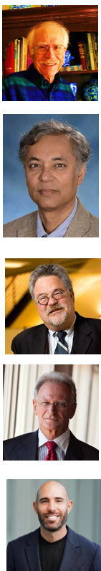

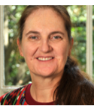
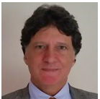
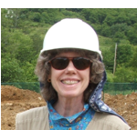

MACA-MIT Campus/Geo Core Team (2025)
(top to bottom, left to right)
John Dabels, MIT ’79, Sloan School of Management
Shiladitya DasSarma, MIT Biochemistry, Founder MACA. Team advisor.
David T. Williams, MIT ‘82 (affiliated with ‘81), Mech Eng. P.E.
Herb Zien MIT ’73, Sloan School of Management
Tunca Alikaya, MIT ’24, Sloan Executive-MBA
Susan Murcott, MIT ‘90, ’92, Civil and Env. Eng.
Rick Clemenzi, MIT’81, Computer Science; CGD certification, P.E.
Judy Siglin. Director, Net Zero Foundation;
Kevin Johnson, Harvard ‘25. GSD Architecture Engineering
Jillian James, MIT ‘10, Aerospace Engineering ; ’16, AeroAstro Engineering
Jason Chen, MIT ‘25 Mechanical
Olivia Chen, MIT ‘26 Mechanical Engineering;
Megan Lim, MIT ’24 Sloan School of Management
+ a lot of new students in Fall 2024!

Slide 26


Acknowledgements
MACA – MIT Alumni for Climate Action
Geo@MIT – MIT student team
D-Lab
MIT Administration and Staff
Joe Higgins, VP Campus Services and Stewardship
Julie Newman, MIT Office of Sustainability
Dept of Facilites Management & Staff
Karen Bowes
Carlo Fanone
Vasso Mathes
Mark Cataldo and Dave Luria– Facilities Guides
Josh Raines
Kim Bigelow, Paula Tierney, Helen Balzano - Logistics Support
MIT Video Productions

Slide 27
MIT OpenCourseWare
https://ocw.mit.edu/
RES.ENV 007 Geothermal Energy Networks (GENs): Transforming our Thermal Energy System
IAP 2025
For information about citing these materials or our Terms of Use, visit: https://ocw.mit.edu/terms.

