Slide 1

Thermal Energy Network Evolution of the Penn South Community in Manhattan
NYSERDA PON 4614: Community Heat Pump Systems

Slide 2
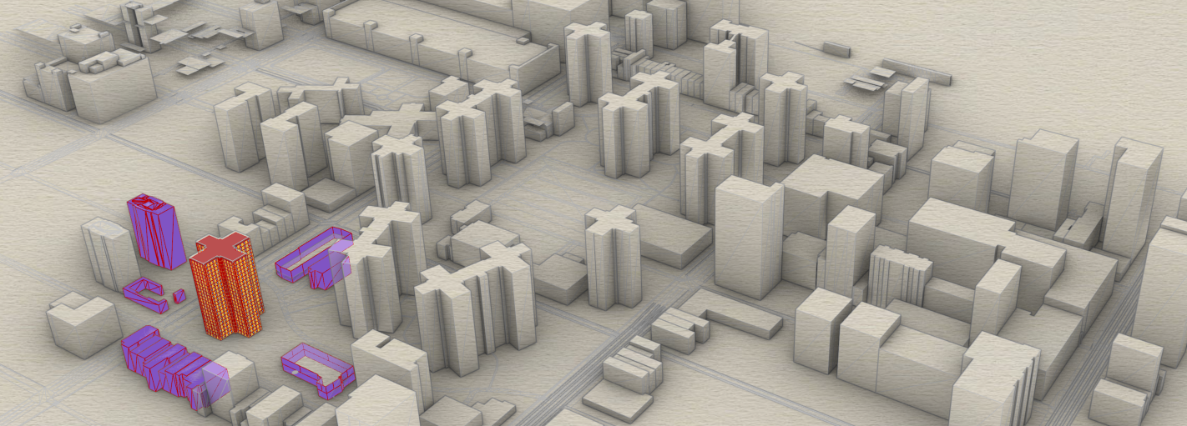
District Scale Building Energy Simulation Started, February 2021

Slide 3
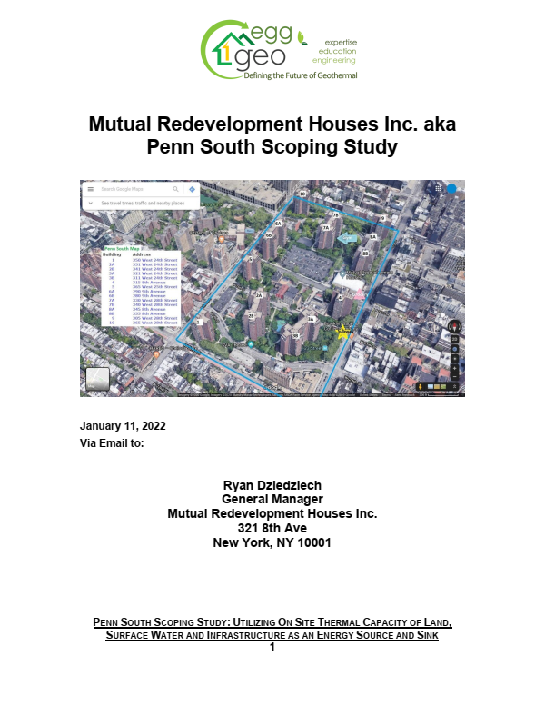
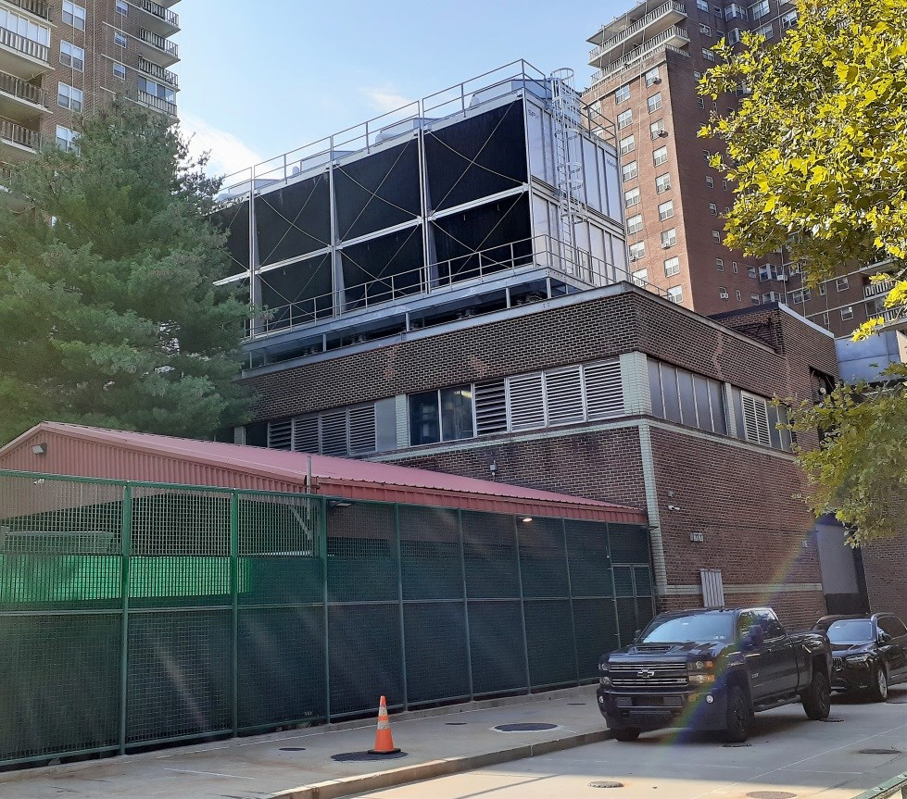

Geothermal Query:
How To Decarbonize (15) 22 Story Residential Buildings?
During the 2021 scoping study, A (5) MW heating load was identified; The complex is home to 2500 families living in downtown Manhattan. The 5 MW boiler and 1800 central chiller plant located in the middle of the complex.

Slide 4
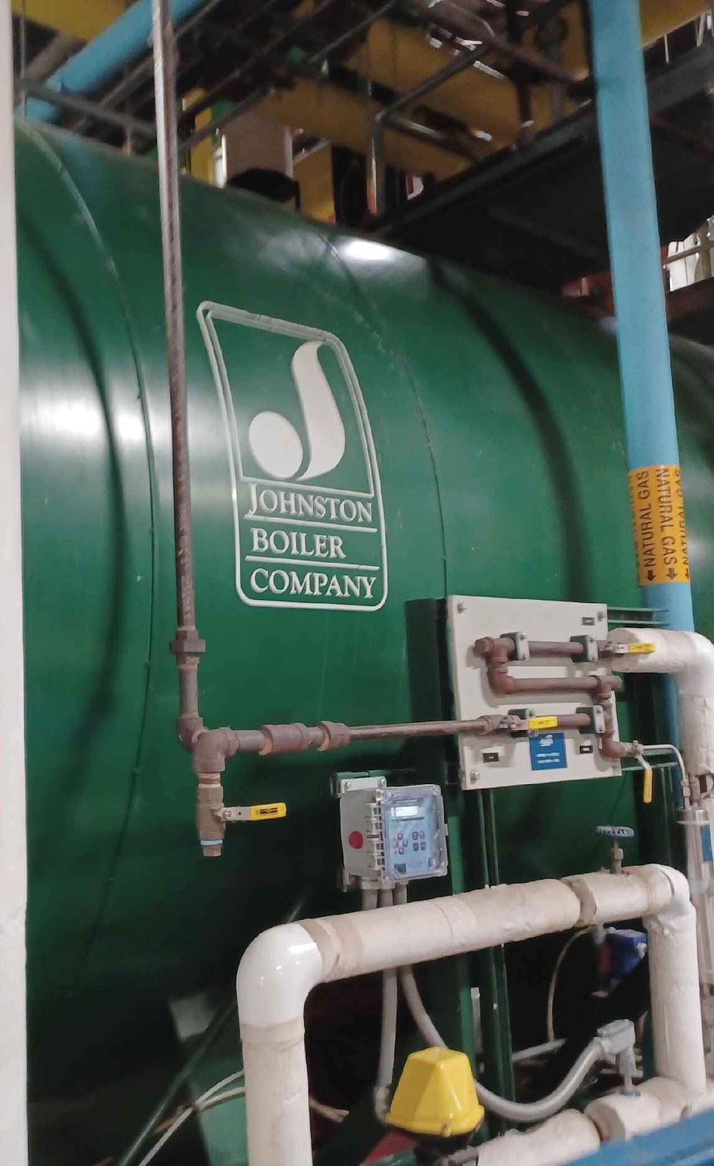
GENERAL OBSERVATIONS; LOCAL LEGISLATION
LL38, LL97, IMMINENT THREATS OF FINES
The heat gain and loss loads of the Penn South site have the potential
capacity of thermal exchange within the site boundaries, providing ample reason to move to the funding, feasibility and engineering stages.
Ample decarbonization funding mechanisms exist to move from
researching the energy transition at Penn South, through full feasibility,
and onto the front-end engineering stages.
Proceeding now with decarbonization opportunities at Penn South will further mitigate the facilities inherent exposure to LL38, LL97, and
unforeseen future legislative action.
There are other commercial buildings onsite & offsite in the area that may be able to tie into a geothermal energy network with Penn South. These should be further vetted, and letters of intent should be drafted during the feasibility stage, or for any application to NYSERDA PON 4614.

Slide 5
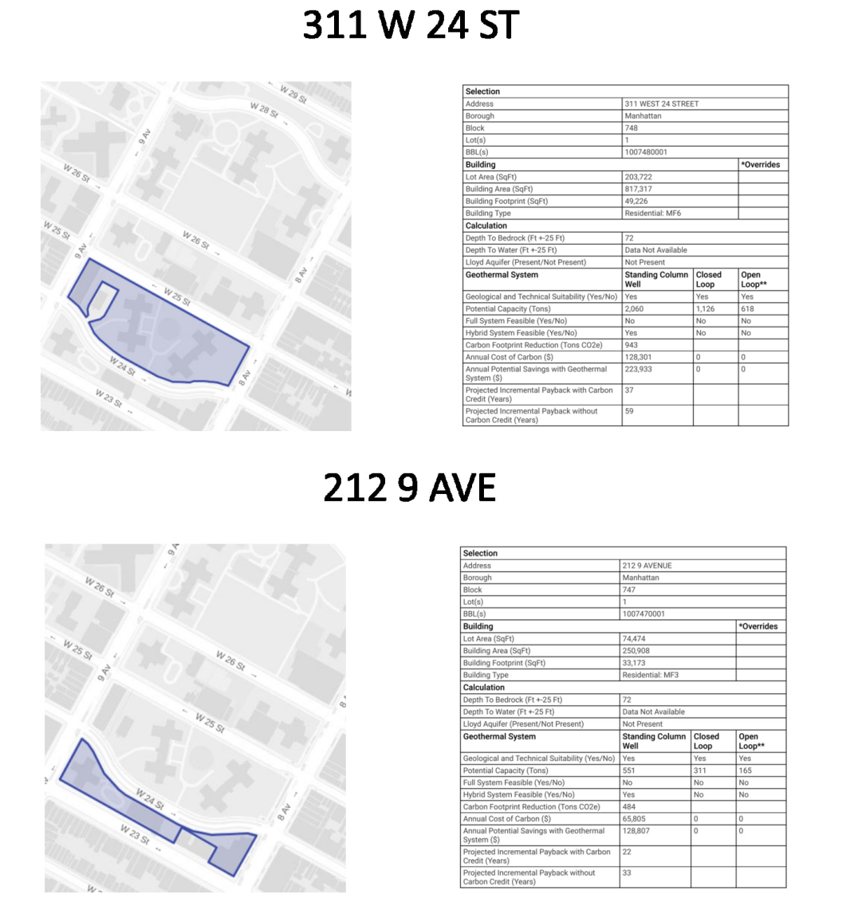
Decision To Move Forward With An Application For Public Opportunity Notice 4614
NYSERDA PON 4614 is a “Community Heat Pump Systems” funding opportunity
Building owners and participants do not need to be system benefits charge payers to join
Anchor loads, like those from government buildings and offices, are important for gaining NYSERDA PON 4614 support
NYC buildings qualify for PON 4614 – direct from NYSERDA
Higher performance, lower energy consumption, given larger load diversity between residential and commercial buildings

Slide 6

Load Diversity (Pumping Heat From Building To Building)
The US Postal Service to the northwest has up to 8 megawatts of thermal rejection through its cooling towers.
Much of that energy can be tapped to assist in the heating loads for proposed heat pump chillers at the central energy plant for Penn South play

Slide 7
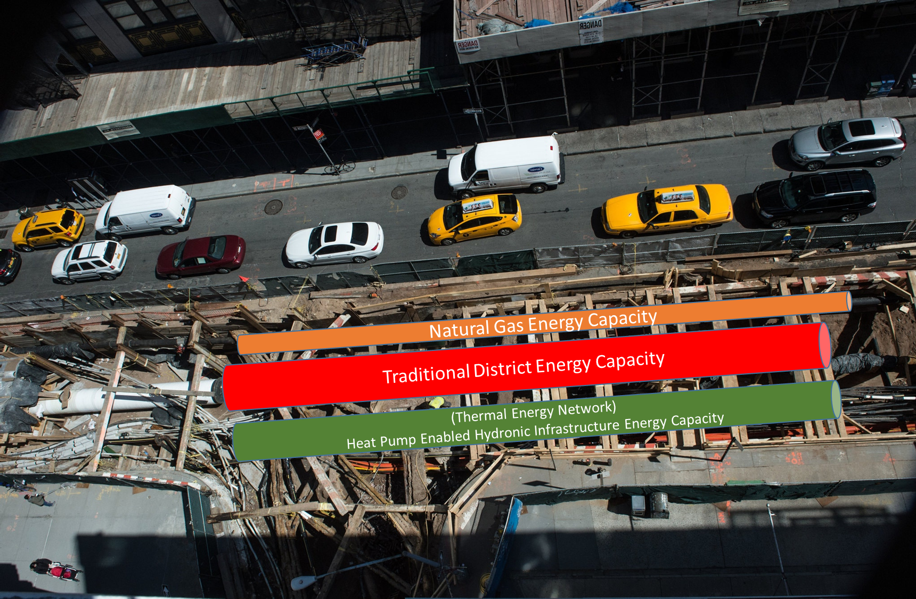
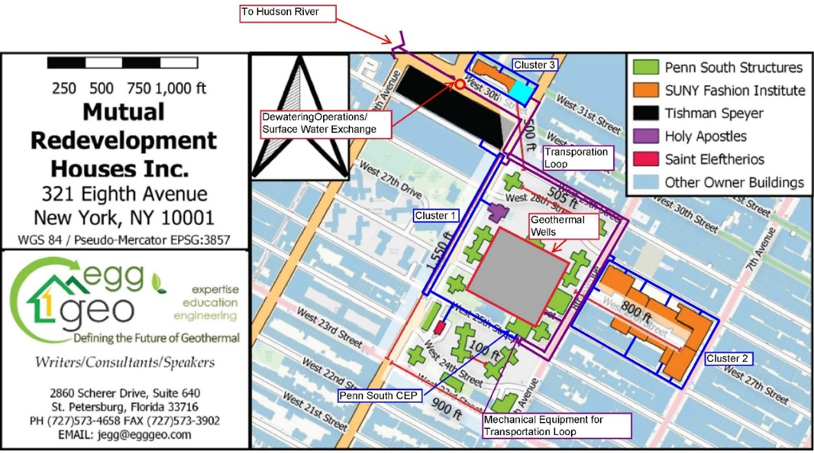
Working Within The City’s Existing Infrastructure Is Expensive And Complicated

Slide 8
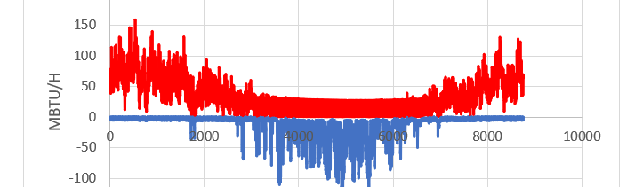
JANUARY 16, 2025, UPDATE
Current Objective
After identifying ground source heat exchange and wastewater energy recovery as potential sources and sinks for the Penn South site in previous work, this report aims to determine optimal energy source combinations and develop a conceptual design. Technical and economic feasibility of the conceptual design is explored through the lens of each resource. Site layout, sub grade infrastructure, and ability of the design to meet consumption are outlined along with an assessment of design alternatives and a sensitivity analysis.

Slide 9
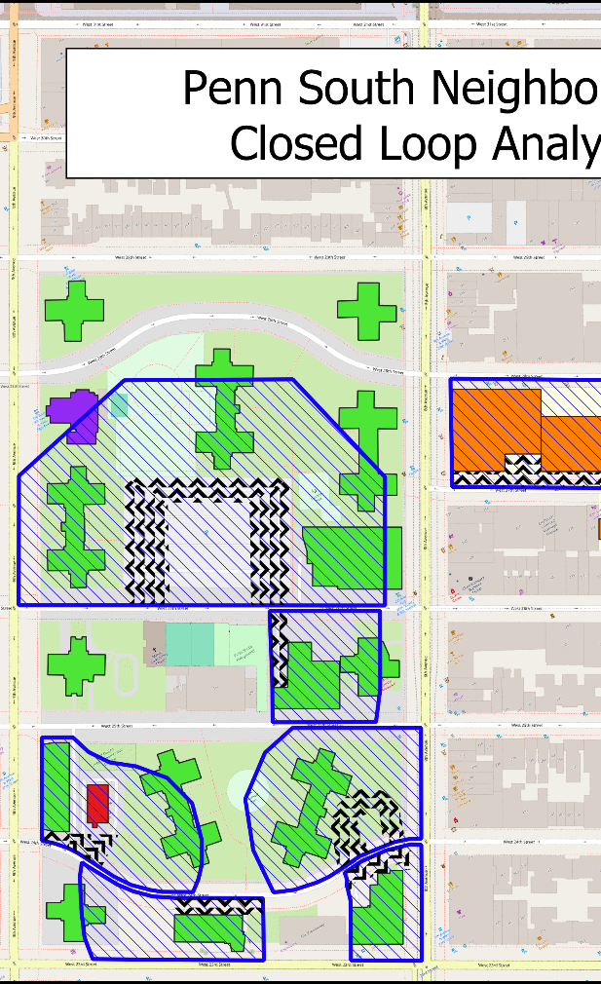
POTENTIAL DRILLING SPACE
(CLOSED LOOP OPTION)
Drilling contractors recommend drilling no deeper than 850 vertical feet. Additionally, the maximum angle they are capable of drilling is 15 degrees. A simple equation was used to calculate the lateral length (b) based on the depth of the borehole (a)=850ft, and angle (ß)=15 degrees. b, or the lateral distance we are able to access with the use of inclined drilling is 228 feet (Figure & Figure ). This was applied as a buffer to selected sides of potential drilling spaces to determine how far under partner-owned buildings we are able to drill for additional heat exchange area. Care was taken to avoid drilling under streets and buildings not owned by project partners. This area (open drilling space + lateral accessible subsurface) was used in GLHEPro as part of the closed loop analysis to reflect the additional load able to be met due to the use of inclined drilling. This software does not have options to consider the use of inclined boreholes, so the additional space described above and displayed in Figure was used to reflect this technique.

Slide 10
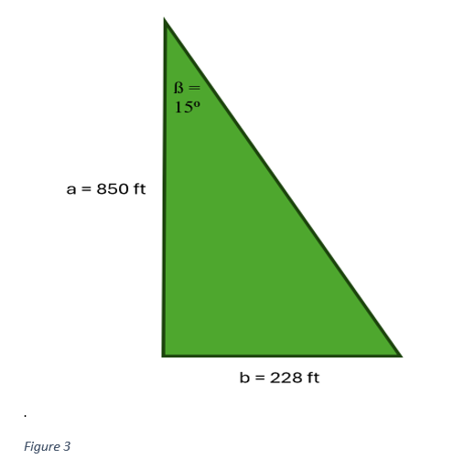
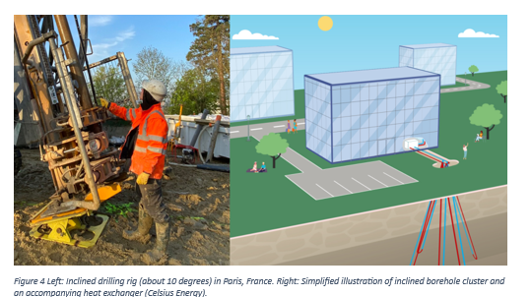
Angled Drilling In Order To Maximize Footprint To Heat Exchange Capacity Ratio
© Celsius Energy. All rights reserved. This content is excluded from our Creative Commons license. For more information, see https://ocw.mit.edu/help/faq-fair-use/

Slide 11
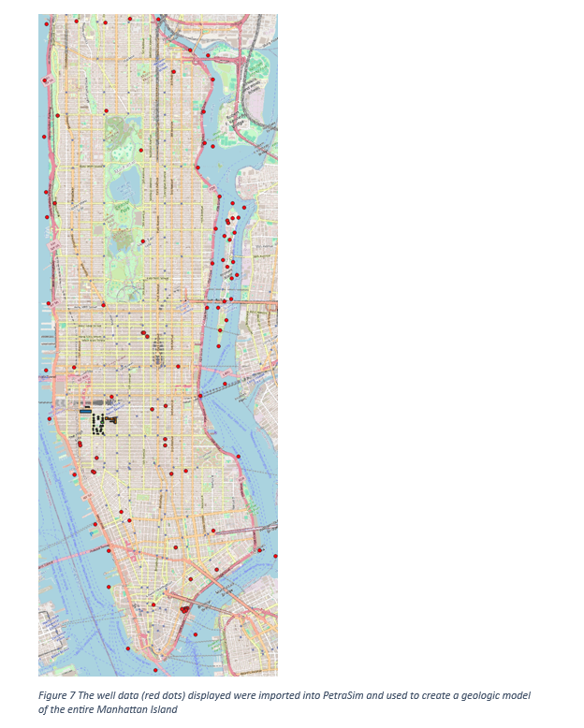
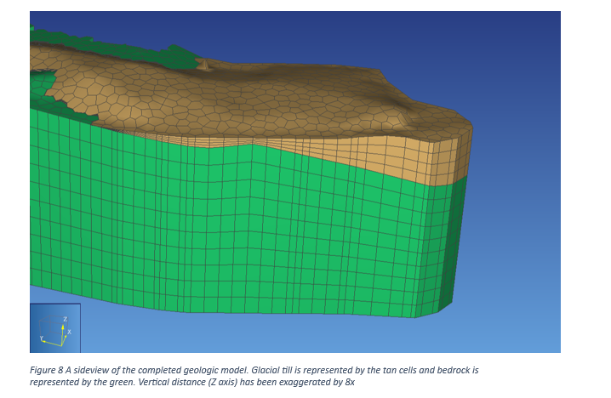
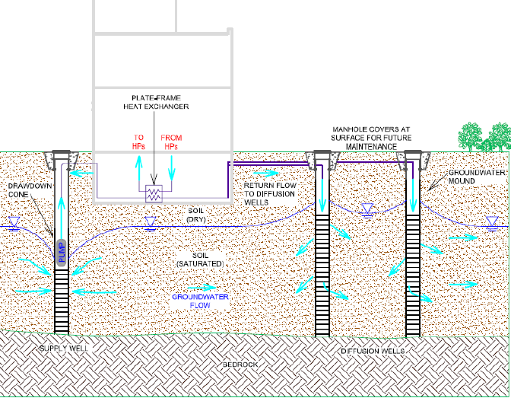
Aquifer Coupled Opportunities Identified at the Chelsea Location (Penn South) due to the presence of glacial till

Slide 12
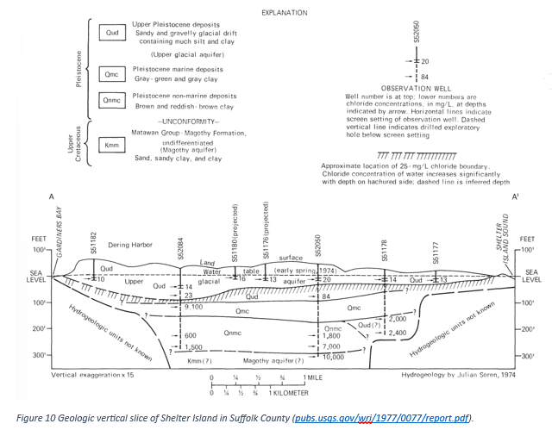
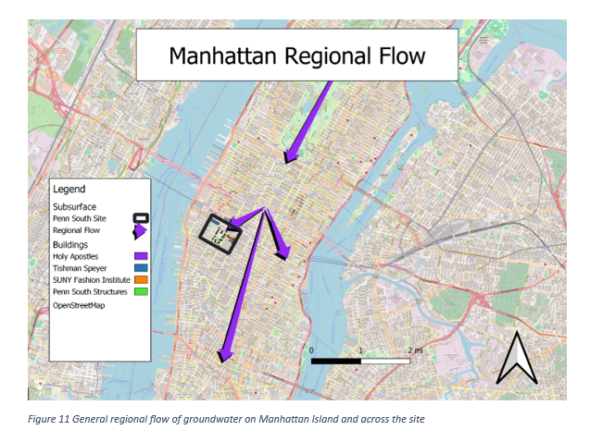
Hydrogeologists Studied Subterranean Water Flow To Analyze Thermal Communication And Saturation
Source: public domain

Slide 13
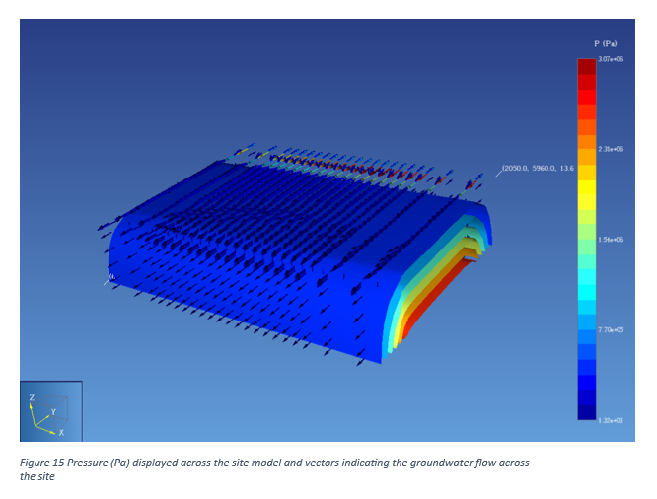
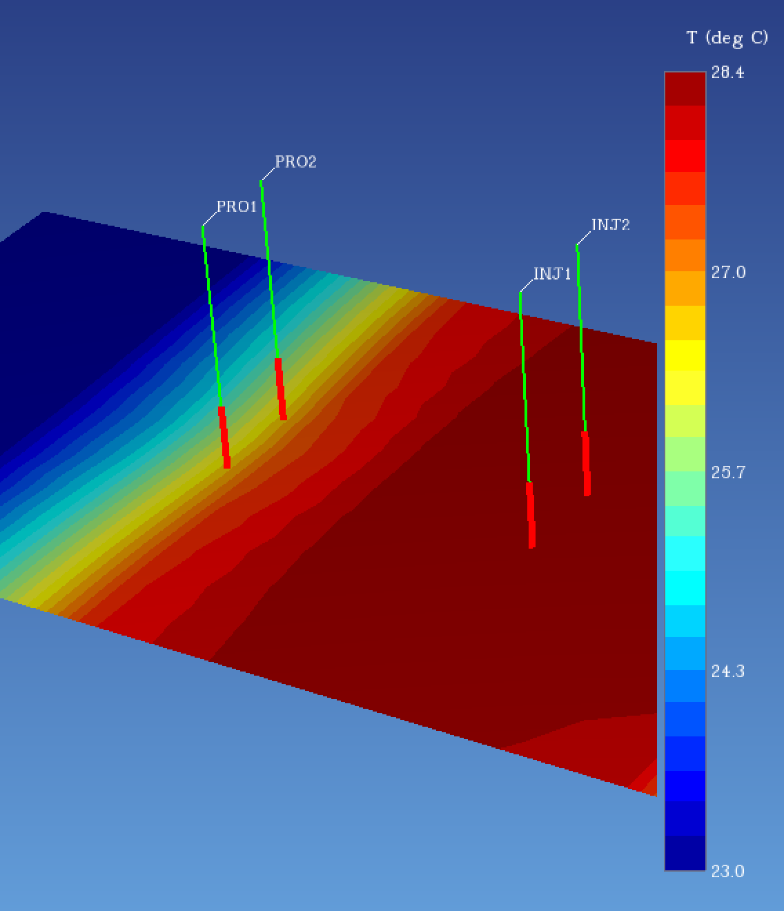
Flow & Thermal Effect Over 25 Years Is Computed And Digitized

Slide 14
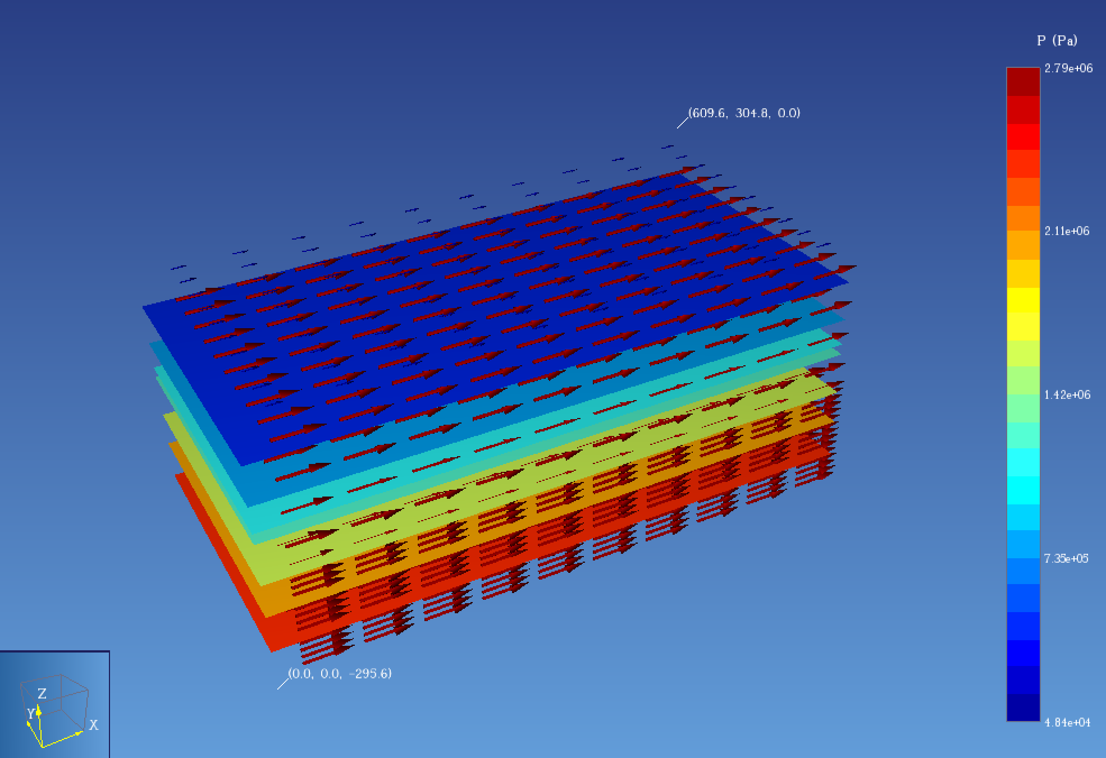
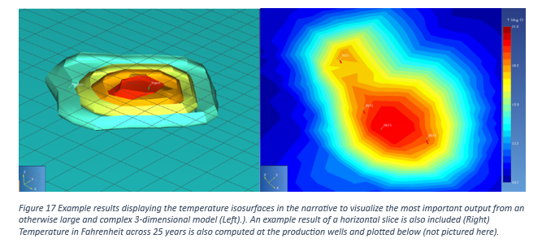
Flow & Thermal Effect Over 25 Years Is Computed And Digitized

Slide 15
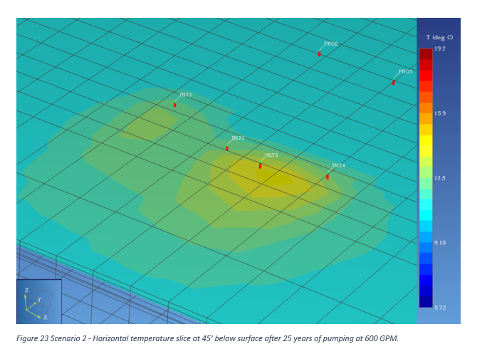
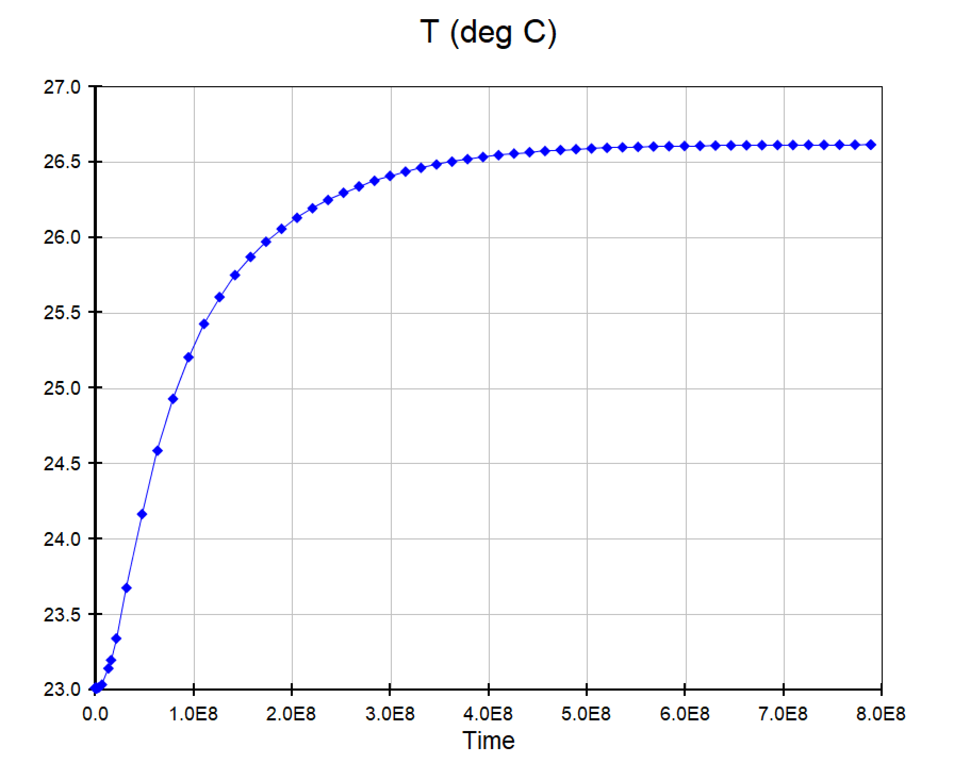
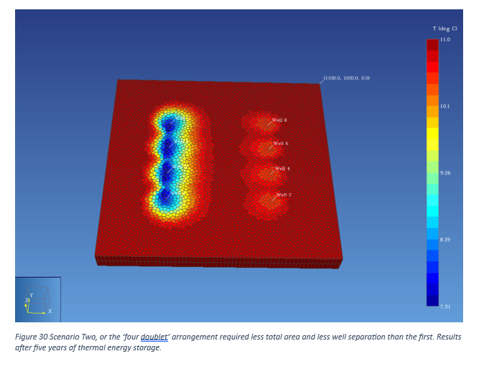
The Result Of Thermal Influence After 25 Years Of Pumping At 600 GPM. Also Modeled With Four Doublets Over Five Years

Slide 16
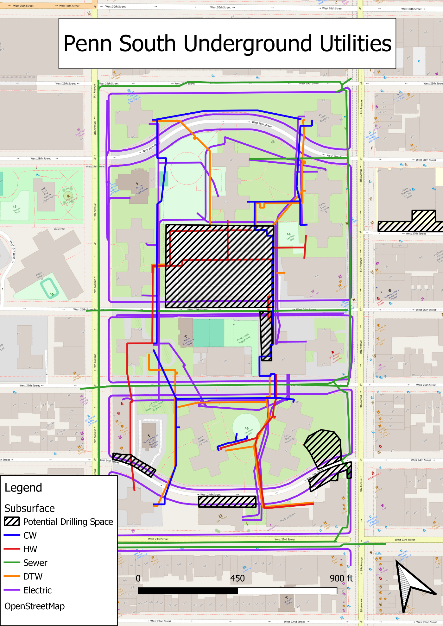
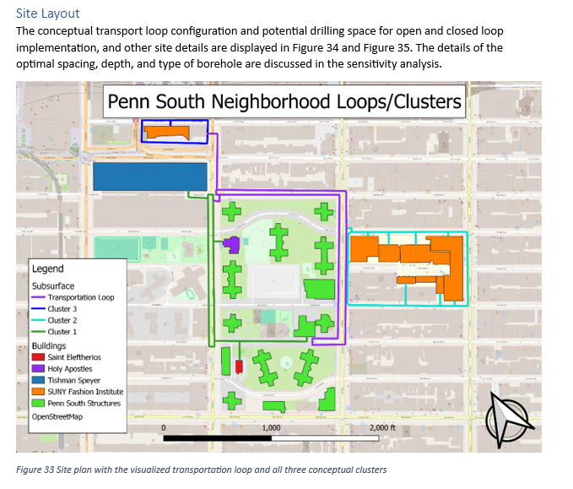
The Thermal Energy Neighborhood Is Identified And Piping Arrangements Are Proposed

Slide 17
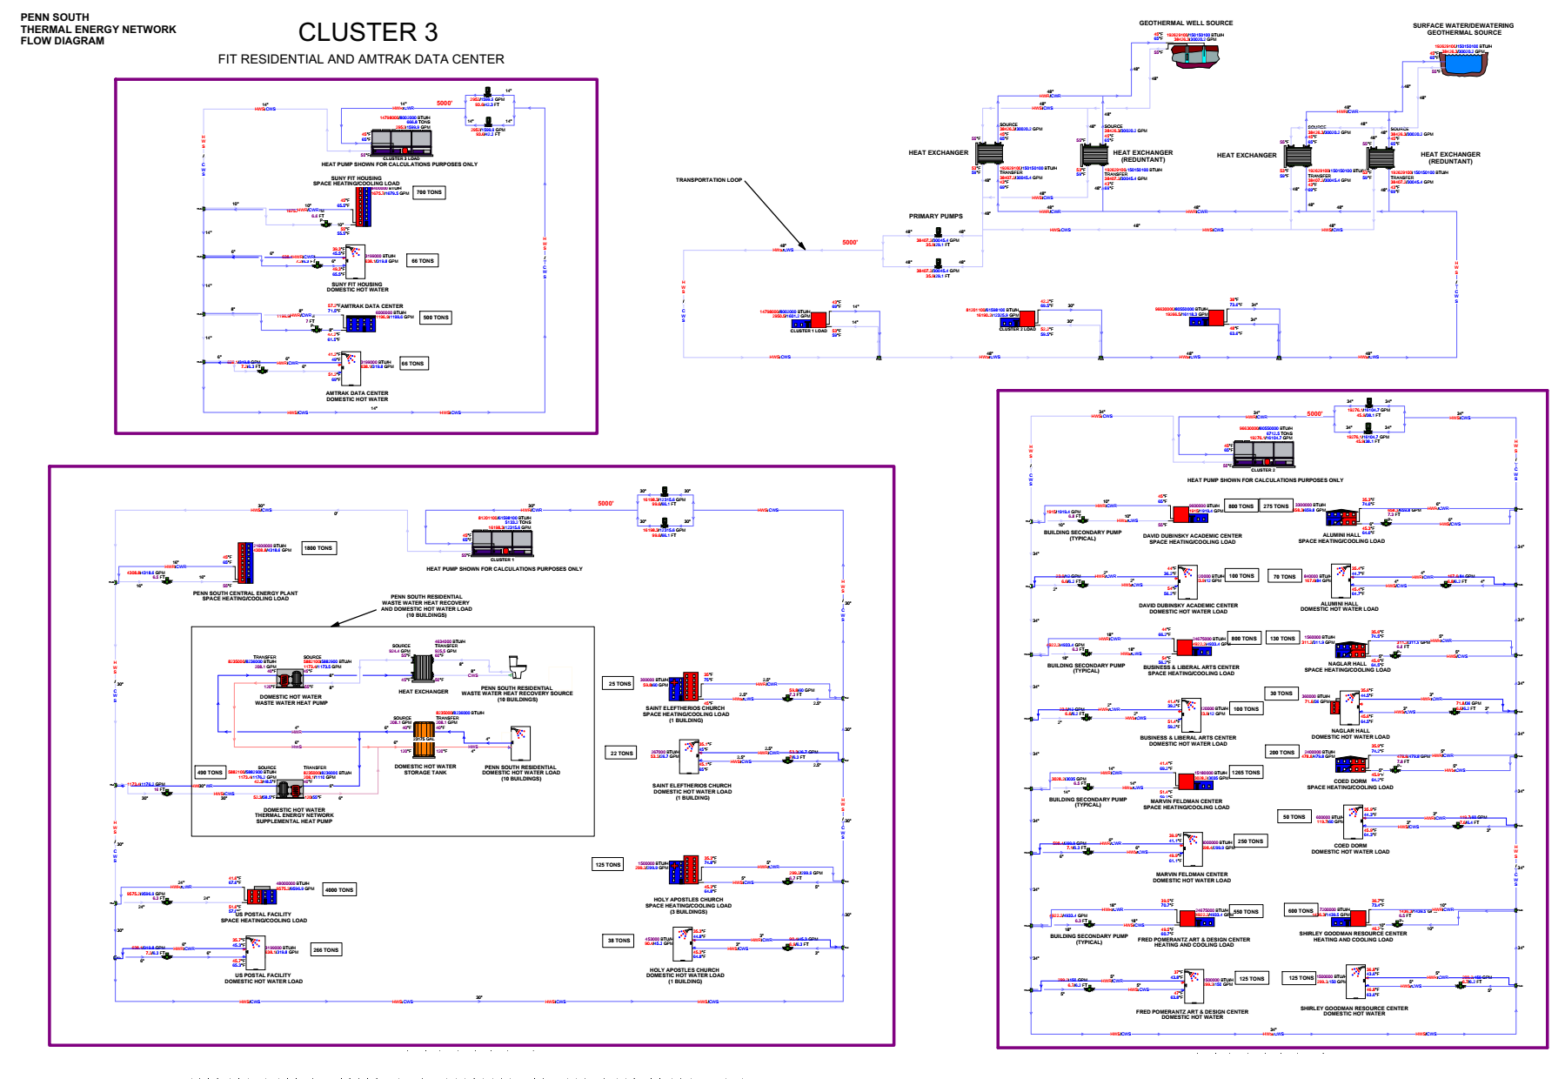
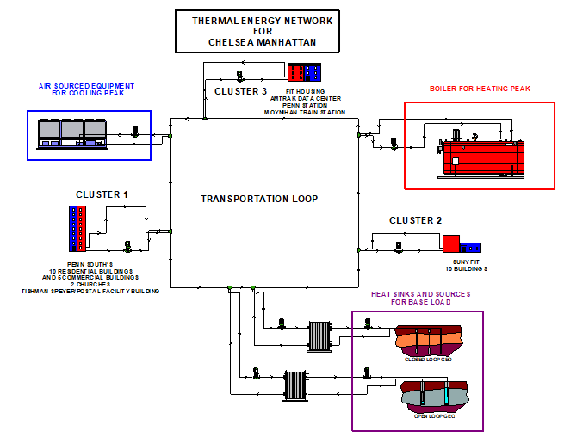
Hydronic Arrangement Of Three Clusters Decoupled To A Central Thermal Energy Transportation Loop

Slide 18
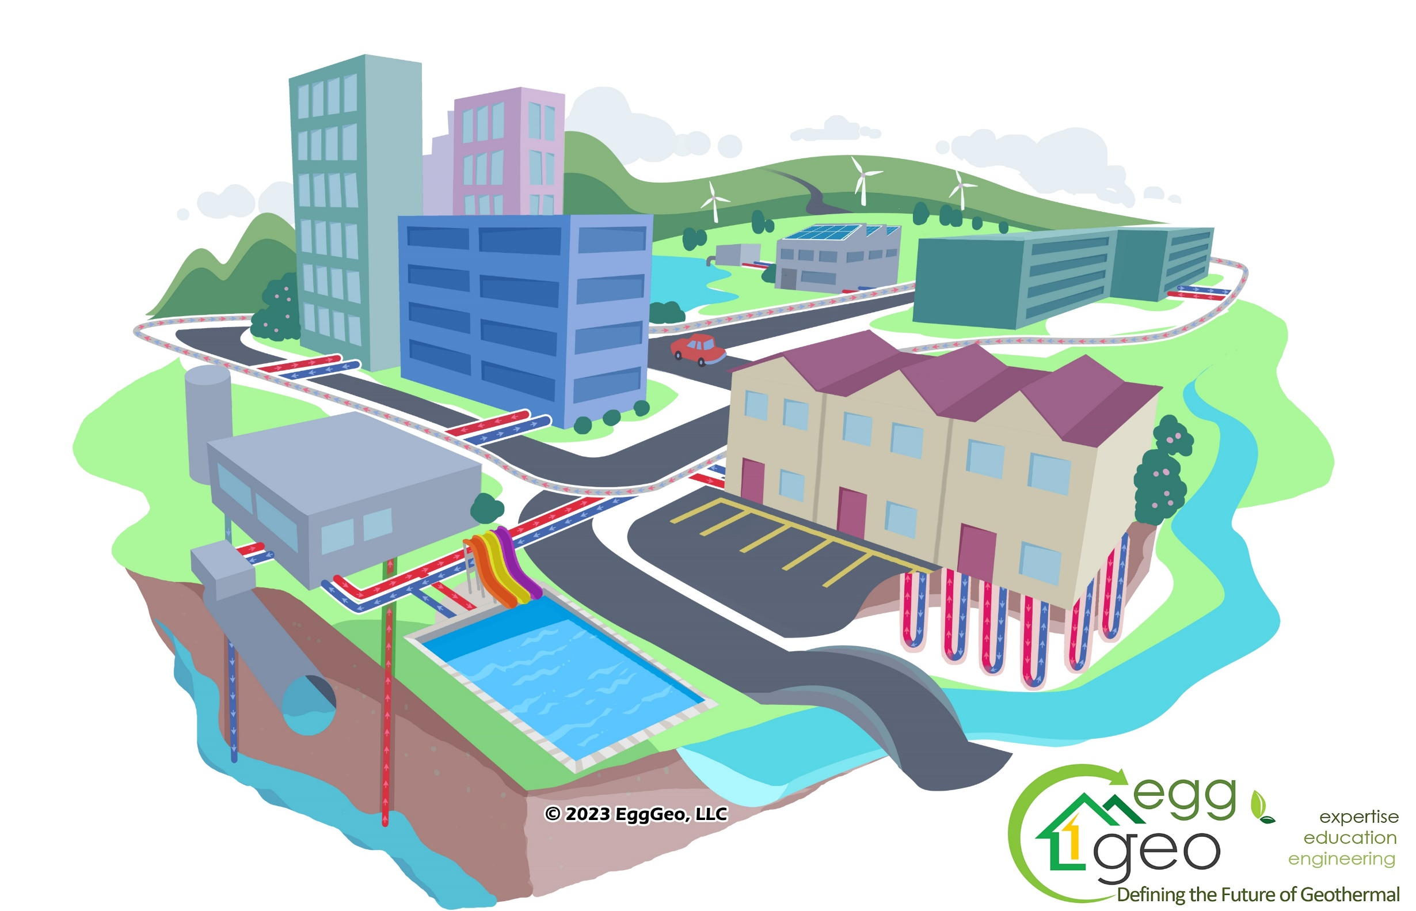
Components of a Geo-
Thermal
Energy
Network
(TEN)
Thermal Energy Networks are utility-scale infrastructure projects that connect multiple buildings into a shared network with sources of thermal energy like geothermal boreholes, surface water, and wastewater.
1
2
Wastewater Energy Transfer (WET) systems extract and reject heat from the sewers.
3
Heat (Thermal Energy) is conducted in/out of the mechanical system of buildings.
Various geothermal exchange resources absorb or reject thermal energy.
4
8
5
3
1
3
1
Power generation facilities of all types can provide waste heat to a “TEN”
5
9
10
Recreational facilities such as ice rinks and waterparks may be connected.
6
1
7
Geothermal exchangers under buildings (Piles)…
8
Surface Water Exchange
(Rivers, Lakes, Etc.)
6
7
2
Office buildings and data centers are cooling dominant, meaning, they reject heat all year long.
Eligible
for IRA
Incentives up to… …40% (or more)
9
4
10
Thermal Storage & Energy Exchange facilities

Slide 19
MIT OpenCourseWare
https://ocw.mit.edu/
RES.ENV 007 Geothermal Energy Networks (GENs): Transforming our Thermal Energy System
IAP 2025
For information about citing these materials or our Terms of Use, visit: https://ocw.mit.edu/terms.

