Slide 1


“Geothermal Energy Networks (GENs) - Transforming Thermal Energy System” HEET/MIT IAP Course
January 31, 2025

Slide 2
Framingham, Massachusetts
UTEN Pilot Project - Overview
Owner: Eversource Energy
Single pipe (Ambient) system design of approximately 1 mile of main distribution piping with integral provisions for expansion.
37 buildings with approximately 140 individual customers.
Commercial customers include a large school building.
90 vertical and angled boreholes to depths of 600 feet – 720 feet via 3 distributed borefields.
Approximately 375 tons of supply capacity.

Slide 3
Framingham, Massachusetts
UTEN Pilot Project - Setting the Stage
A unique “coming together” of seemingly disparate stakeholders.
A NatGas utility company undertaking an energy system project with NO natural gas revenue potential (Eversource).
a non-profit organization with a mission to drive energy systems change through an ethical and efficient thermal energy transition (HEET).
The result: A successful pilot project becoming operational!

Slide 4
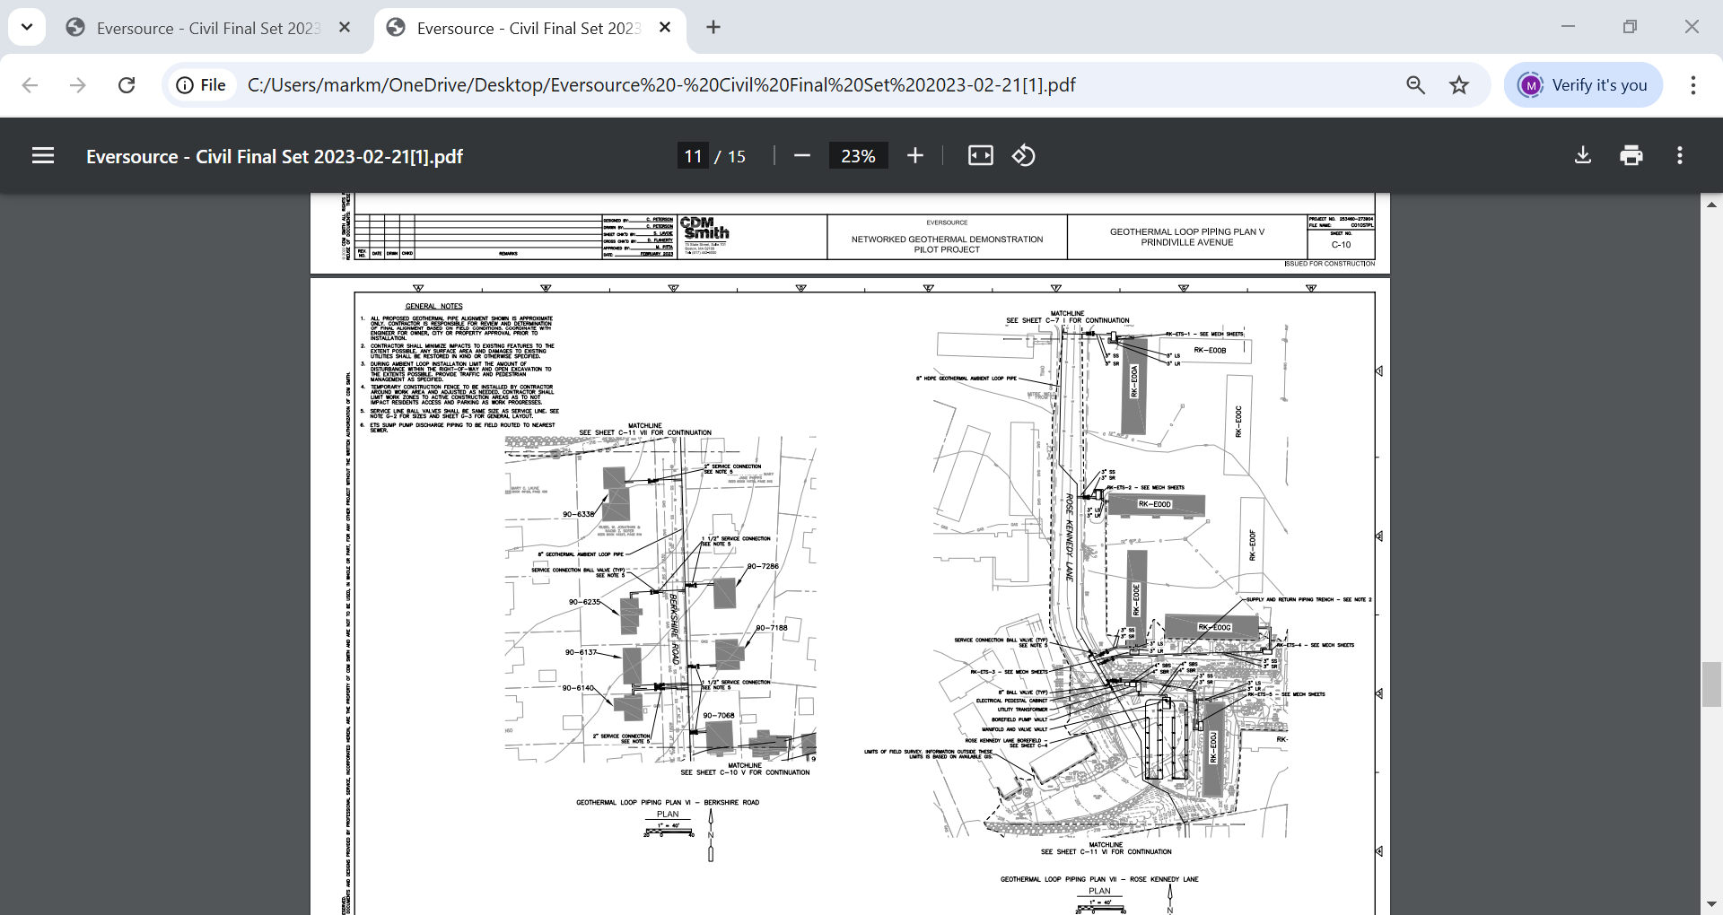
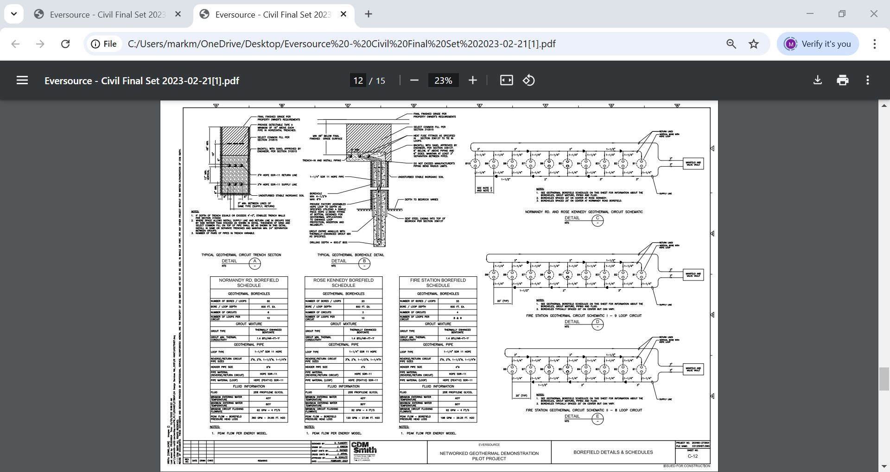
Engineering Overview
A comprehensive 1200 page + detailed written specification for all aspects of project installation.
37 detailed drawings depicting each required procedure.
Exhaustive clarification submissions from contractors requiring detailed responses and agreement / resolution.

Slide 5
Changes Happen
Vertical Boreholes were changed to angled boreholes for 1 of the 3 borefields.
Single U – bends in the angled boreholes were changed to “double U – bends” or “quad – loops”.
Total drilled footage in the angled boreholes was change from 600 feet to approximately 720 feet.
North American compliant collection vaults for borefields were changed to European spec collection vaults for the angled borefields.
Angled boreholes extended below wetland designated zones.

Slide 6
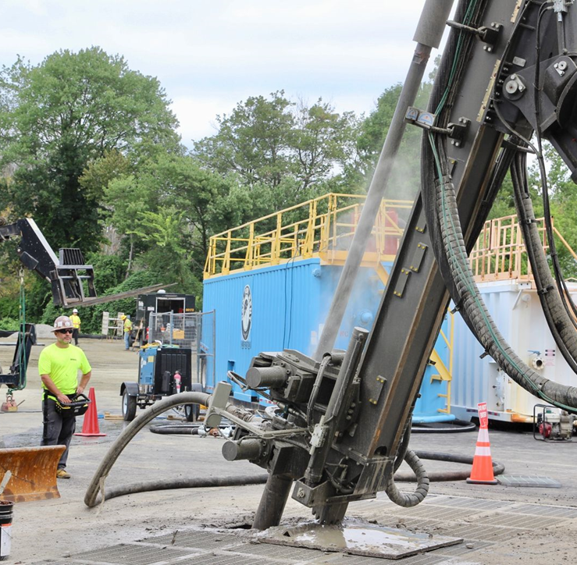
Angled Drilled BoreHoles

Slide 7
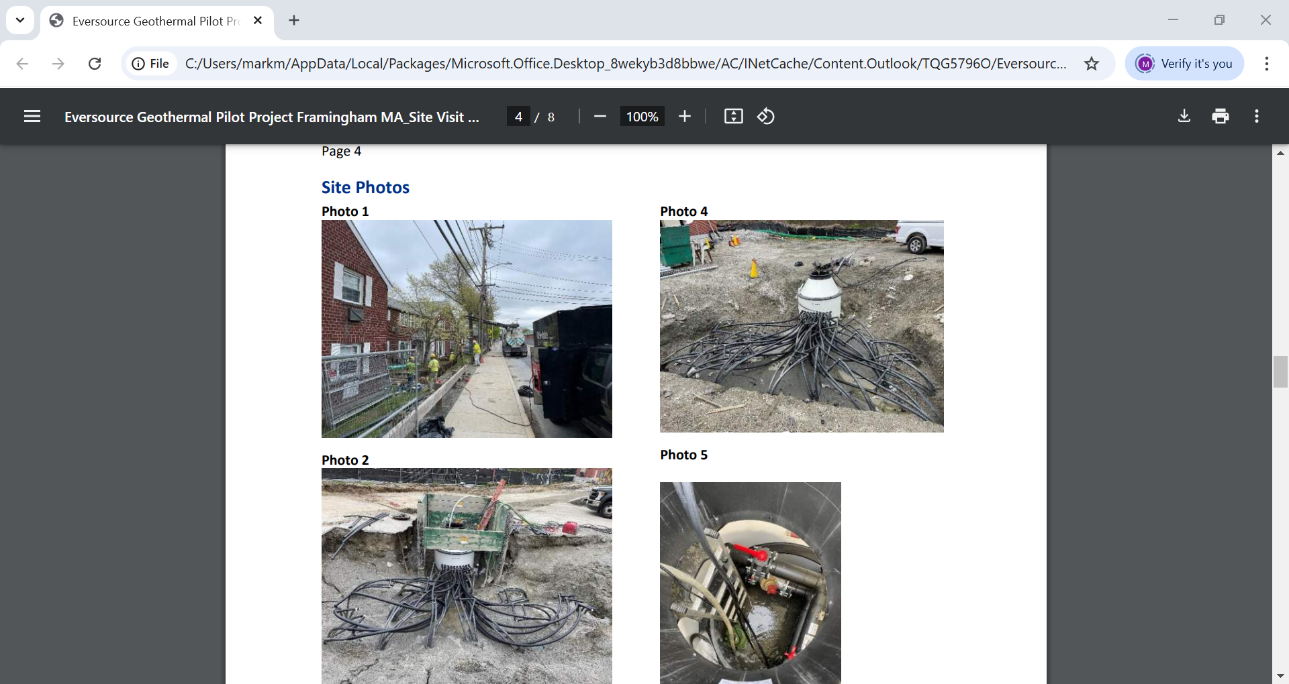
European Spec Vaults

Slide 8
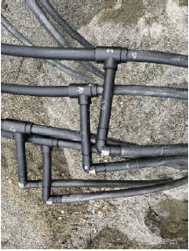
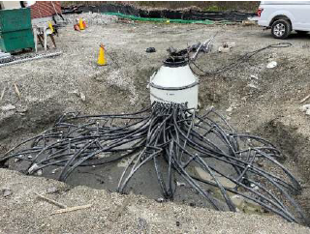
European Spec Vaults

Slide 9
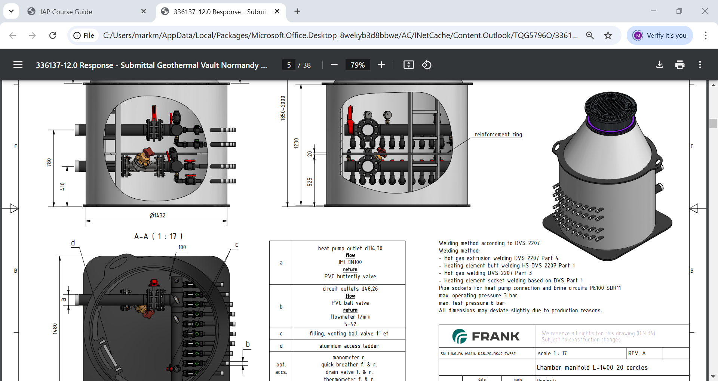
European Spec Vaults

Slide 10
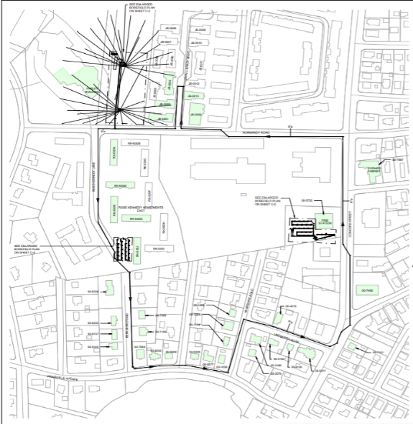
Drilling Below Wetlands

Slide 11
Takeaways
Communication between all parties with respect to design changes is key for successful project execution.
Changes from a single U – bend per borehole to double U – bends (quad loops) per borehole for one of three borefields adds complexity to ground loop design to ensure expected capacities are met.
The use of European specification materials creates uncertainty with respect to compliance with the CSA / ANSI / IGSHPA C448 Bi – National Standard.

Slide 12
MIT OpenCourseWare
https://ocw.mit.edu/
RES.ENV 007 Geothermal Energy Networks (GENs): Transforming our Thermal Energy System
IAP 2025
For information about citing these materials or our Terms of Use, visit: https://ocw.mit.edu/terms.

