Slide 1
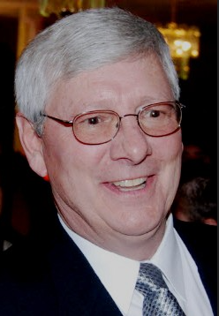
Cary Smith CEM CGD CEA CGI AEE Fellow
President Sound Geothermal Corporation
  26 Years in Oil & Gas Industry, 27 years in Groundsource.
  AEE Fellow and founding Member of The GreyEdge Group.
  Primary design-developer of Ambient Temperature Loops (ATL) one-pipe district systems.
  Chair - IAPMO USHGC Code and ATL Standard Committee Member IAPMO Uniform Mechanical Code Committee.
  Working on innovative low, medium and high temperature ground source systems.
SGT is an innovative design group focusing on energy saving building technologies utilizing ground source heat pump systems and/or other renewable energy systems as a core technology. SGT has contributed to the development and innovation of low temperature geothermal applications.

Slide 2

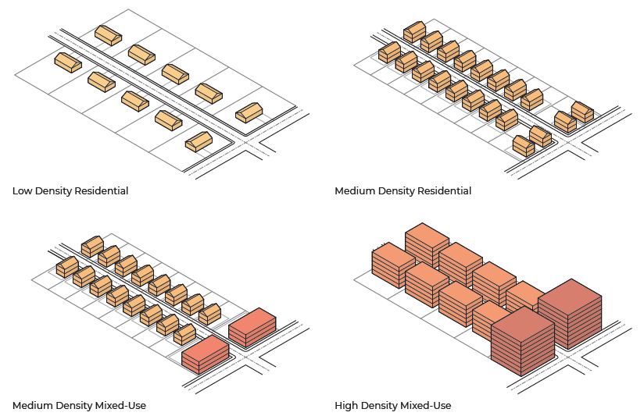

Ambient Temperature Loops (ATL’s):
The Thermal (Energy) Highway
ATL District Systems Overview
Energy harvested, moved, and reused
Cary Smith CGD CEM CEA CGI
Powered by R-718 Technology ©

Slide 3
ATL - A Subset of TENs
Ambient Temperature Loops are a unique and versatile solution.
  One-pipe system
  Captures diversity
  Emphasizes borehole thermal storage
  Distributed part load assets
  Low temperature, no antifreeze

Slide 4
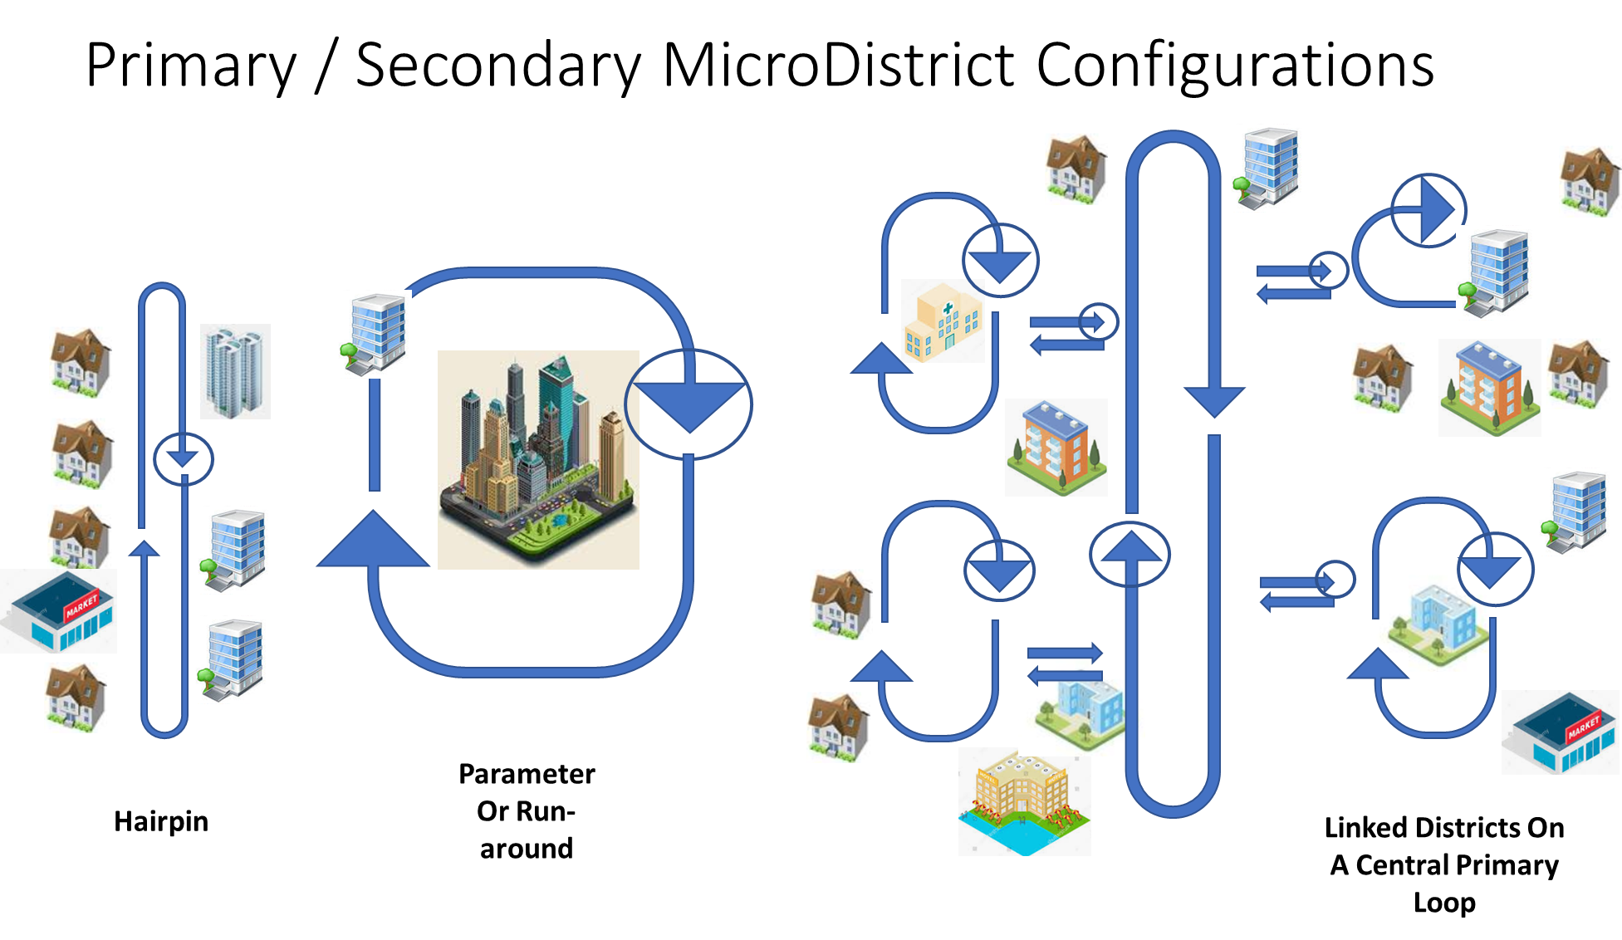
Ambient Temperature One-Pipe District Loops
© Sound Geothermal Corporation 2021. All rights reserved. This content is excluded from our Creative Commons license. For more information, see https://ocw.mit.edu/help/faq-fair-use/
Sound Geothermal Corporation 2021©
Duplication and Use allowed with proper credit

Slide 5
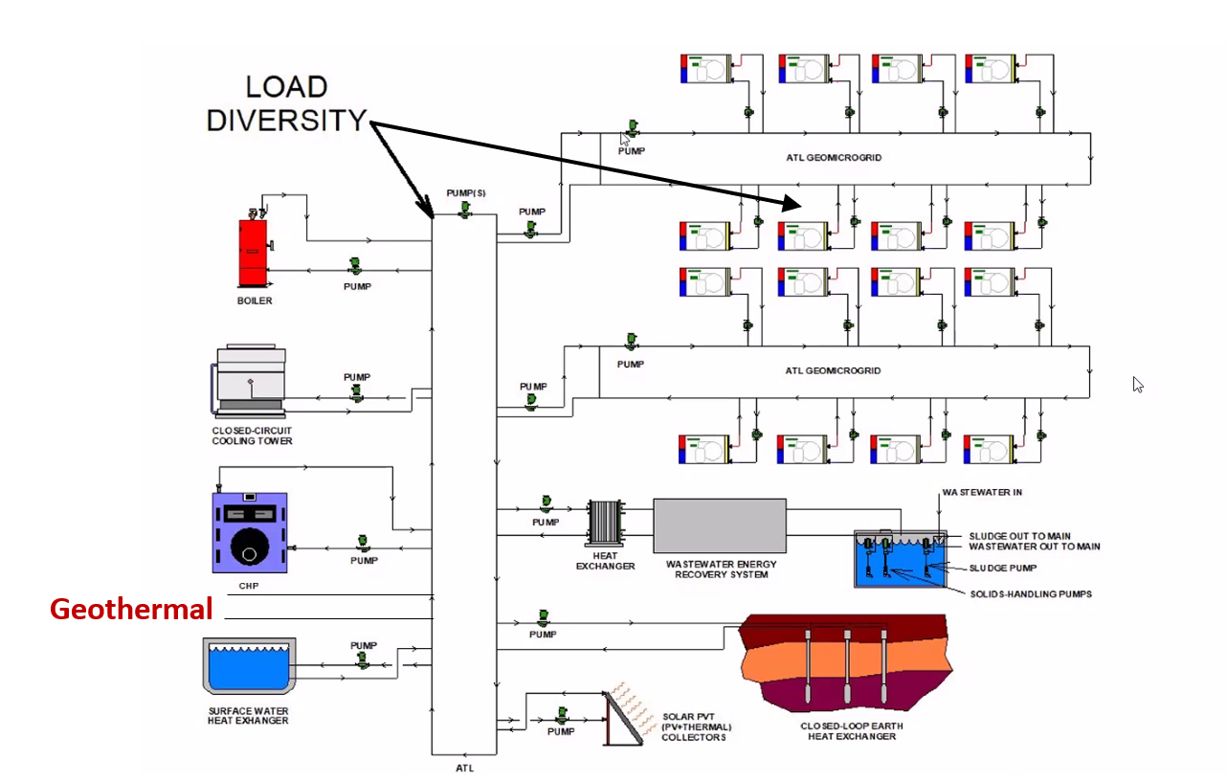
ATL One-pipe Plug and Play Diagram - Assets
Copywrite: Sound Geothermal Corporation 2021©
Duplication and Use allowed with proper credit
© Sound Geothermal Corporation 2021. All rights reserved. This content is excluded from our Creative Commons license. For more information, see https://ocw.mit.edu/help/faq-fair-use/

Slide 6

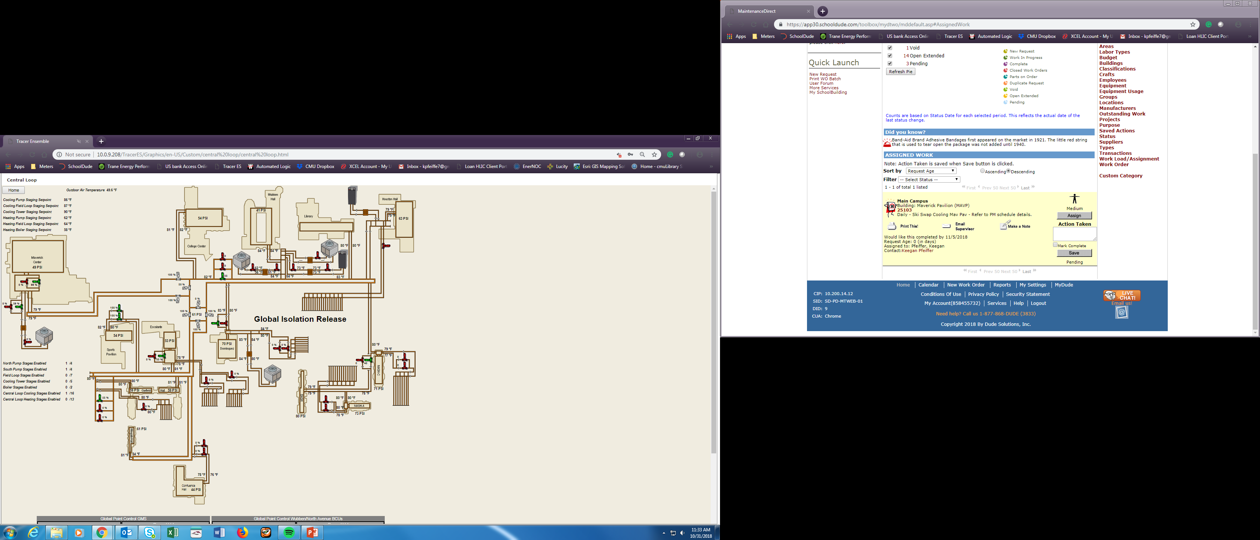
CMU’s Central Loop & GMS
Global Demand Limit
Sound Geothermal Corporation 2021©
Duplication and Use allowed with proper credit
© Sound Geothermal Corporation 2021. All rights reserved. This content is excluded from our Creative Commons license. For more information, see https://ocw.mit.edu/help/faq-fair-use/

Slide 7
Integrated Plug and Play
Electric / Thermal Energy Systems
Cooling Heating
Dominant Balanced Dominant
Solar PVT
Buildings
Residential, Commercial, Industrial
PV
Panels
Heat
Exchange
Panels
Electric
Storage
Vehicle
Charging
Multi-Source Heat Pumps
Chillers
Wastewater
Heat Exchangers
Industrial
Waste Heat Capture
Air Source
Heat Pumps
Ground Source
Heat Pumps
Conventional CHP
Cooling Towers
Recycled Thermal Energy
Inter-Connected Thermal Distribution Circuits
Micro-Grid
Isolation
Ambient Temperature Water (45-85 Degrees)
Emissions Free
Electric Power
Emissions Free CHP+S Sites
Emissions Free CHP+S Sites
Ground Heat Exchangers
Electric
Storage
Thermal
Storage
Run-of-River
Turbines
Water
Source
Heat Exchangers
Telecom
Utility
Solar
PVT
Farm
Grid-Enabled
Monitoring
& Intelligent
Control
Heat Exchanger Panels
PV Panels
Sound Geothermal Corporation 2021©
Duplication and Use allowed with proper credit
© Sound Geothermal Corporation 2021. All rights reserved. This content is excluded from our Creative Commons license. For more information, see https://ocw.mit.edu/help/faq-fair-use/

Slide 8
MIT OpenCourseWare
https://ocw.mit.edu/
RES.ENV 007 Geothermal Energy Networks (GENs): Transforming our Thermal Energy System
IAP 2025
For information about citing these materials or our Terms of Use, visit: https://ocw.mit.edu/terms.

