Slide 1
Techno-economic modeling of GENs with HEATNETS model
Presenter: Juliet Simpson, Ph.D.​
National Renewable Energy Laboratory
Contributors: Rebecca Barney, Abra Gold, Guangdong Zhu
1
Notes:
We’ve been hearing all about thermal energy networks, and more specifically geothermal energy networks, for the last day and half. Now I want us to think about modeling them. Why modeling matters and how to do it.

Slide 2


Techno-economic modeling
Technical
+
Economic
Techno-economic analysis (TEA)
Consider trade-offs between technical design and operation vs the economic impact
Notes:
I’m going to talk through a techno-economic model we’ve been developing at NREL. But first, what does that mean?

Slide 3
Modeling can answer questions like…
Before design and build:
Does a GEN make sense in this community?
Use only geothermal boreholes? Or a combination of thermal sources?
What monthly payment required from customers?
After build:
Can we add one more house to the loop?
Will the system efficiency improve if we lower the set temperature?

Slide 4
Important components to consider for modeling GENs
Physical system
  Building loads
  Thermal resources (boreholes, etc.)
  Distribution system (thermal inertia, working fluid composition, etc.)
  Heat pump
Economics
  Capital cost
  Operational cost
  Maintenance
  Cost recovery plan (Debt, IRR, customer payments)

Slide 5
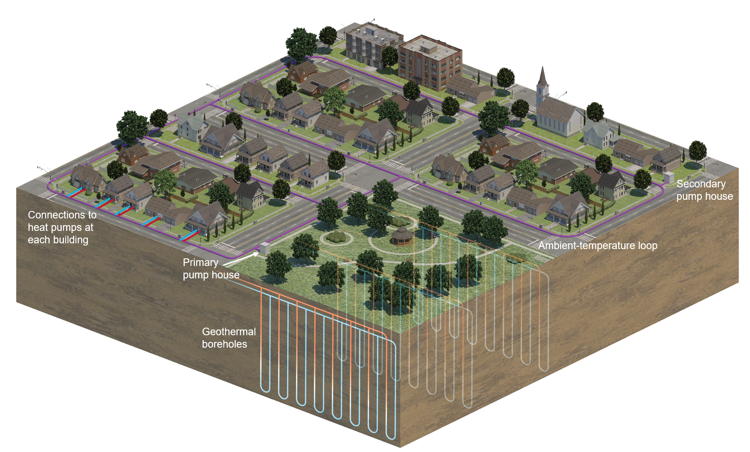
HEATNETS model
Heat and Economic Analysis Tool for NEtworked Thermal Systems
Two parts, written in Python:
  Physics-based reduced-order model to capture flow of energy around the network and use of electricity over time
  Economic model to estimate capital cost and calculate economic metrics
Graphic from Besiki Kazaishvili, NREL.
Simpson, et al. GRC Transactions, 2024.
Source: public domain
Notes:
HEATNETS model created by NREL in collaboration with HEET as part of the LeGUp project.
System level modeling of the thermal loop, connected buildings, and borehole fields for improved understanding of the system control & operation.
Unique attributes:
Captures thermal inertia of the loop and load cancelling, without including complex building or borehole models, reducing computational time
Built-in capital cost and economic model
Economic model looks for thermal energy price (TEP) needed to recoup system costs

Slide 6
Reduced-order model for physics-based simulation
Heat pump COP curve based on data sheets
Estimating building loads via URBANopt, using EnergyPlus/OpenStudio
Semi-transient model for thermal loop, capturing heat and mass transfer and inertia
Simple relations for circulation pump, auxiliary heating and cooling, and control decisions
Look-up tables, regressions, or simple models to represent thermal sources
“Geothermal district heating and cooling are catching on", By Hyunjun Oh, Juliet G. Simpson and Koenraad Beckers. (c) 2024 International District Energy Association. ALL RIGHTS RESERVED. Changes were made.
Oh et al. District Energy Magazine, 2024.
Notes:
-go through major components
-things to consider:
Scale? (Looking at 5 houses? A neighborhood? City? Country?)
Do you need to represent individual buildings or combined load?
How spread out are the buildings? How significant is modeling the thermal loop?
Locations of thermal sources?
Operation? Not all components will always run

Slide 7
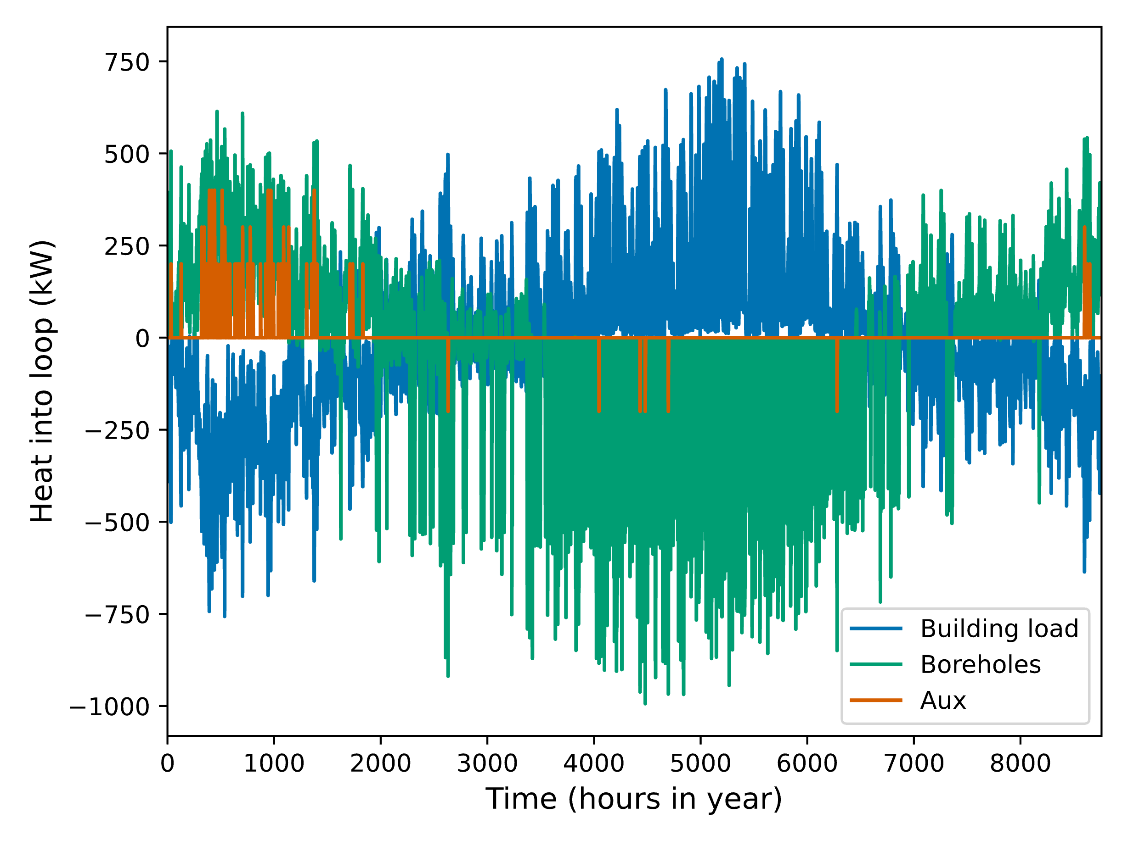
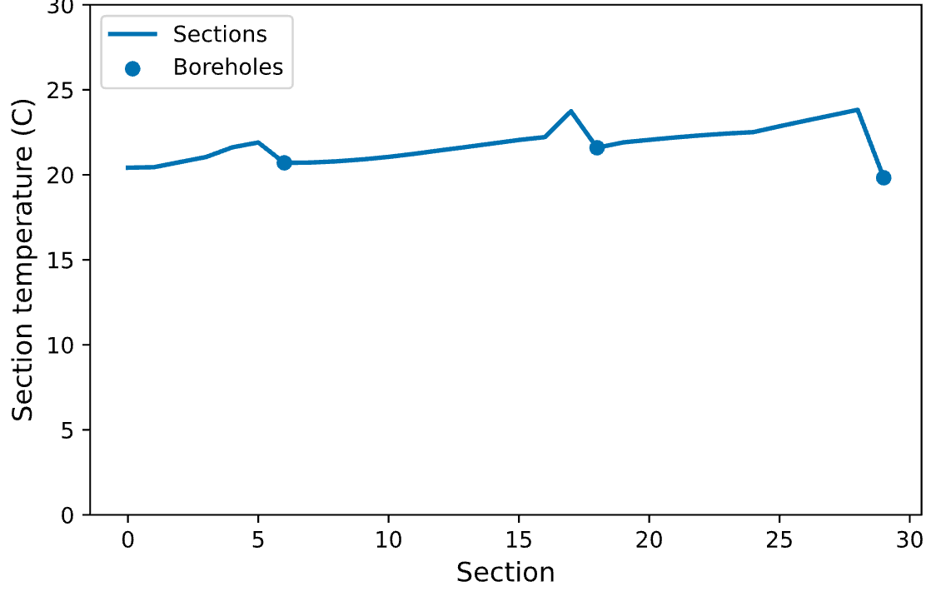
Example results: spatial and temporal trends
Detached
single-family houses
Larger borehole field, pump,
and auxiliary
Smaller borehole fields
Full loop, ~1600 m (~1 mile)
Modeled results are subject to ongoing development.

Slide 8
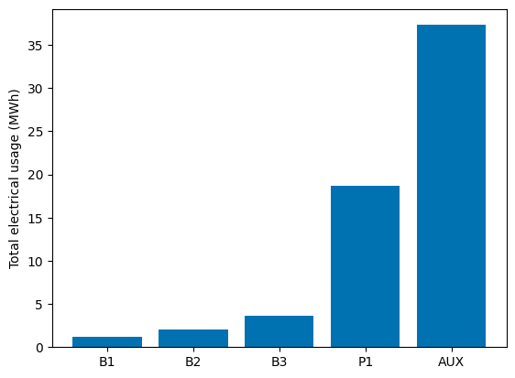
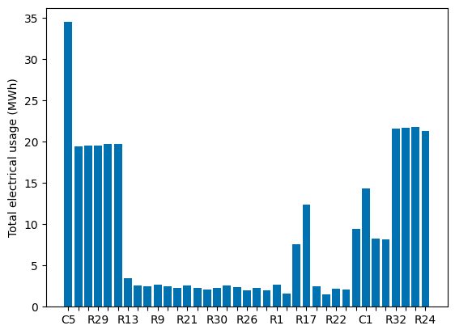
Example results: annual energy usage
Utility components:
Borehole fields (B), Circulation pump (P), auxiliary heating/cooling (AUX)
Buildings, in order around the loop:
Commercial (C) and Residential (R)
Modeled results are subject to ongoing development.

Slide 9
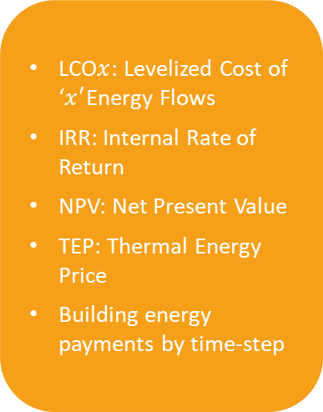
Economic model
System Specifications
LCO$x$: Levelized Cost of ‘$x^{′}$Energy Flows
IRR: Internal Rate of Return
NPV: Net Present Value
TEP: Thermal Energy Price
Building energy payments by time-step
Capital Costs
Calculated from physics-based modeling
Component Costs
Financial Assumptions
Electricity Consumption
Building Thermal Loads
Electricity Pricing
Electricity Costs
Model Inputs
Intermediary Variables
Model Outputs
Notes:
-does some intermediate calculation such as system capital cost and electricity cost
-then calculates final economic metrics
LCOx = holistic consideration of energy flows, heating/cooling and electricity. Heating and cooling are grouped together as one energy price, electricity consumption is considered as part of O&M costs

Slide 10

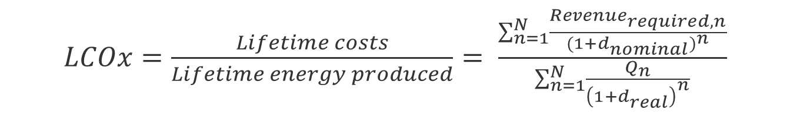

LCO$x$ Base Equation
Capital cost +
Cost of Electricity to Operate System
$LCOx=\frac{Lifetime costs}{Lifetime energy produced}= \frac{\sum_{n=1}^{N}{\frac{{Revenue}_{required,n}}{{(1+d_{nominal})}^{n}}}}{\sum_{n=1}^{N}{\frac{Q_{n}}{{\left(1+d_{real}\right)}^{n}}}}$
Geothermal Heating/Cooling
Levelized cost of ‘$x^{′}$Energy Flows
Builds off a standard LCOE equation
Modified to fit our system’s needs via “required revenue”
Thermal Energy Price (TEP) calculation wrapped into the LCO$x$ calculation
Notes:
LCOX equation is pretty standard,
Revenue required is how we’re modifying it to accommodate the key attributes
Note how LCOX model derives PPA and IRR

Slide 11
HEATNETS Economic Model
Inputs
Input Financial Assumptions.
Basic Cash Flow Model
Capital Costs (Direct and Indirect)
Operation and Maintenance Costs
Target Internal Rate of Return (IRR)
And more…
Tax and Insurance
Federal and State Tax
Sales Tax
Project Term Debt
Tax Credits
Federal and State Tax Credits
Property Tax
Intermediary Variables Calculated from Thermal Loads.
From physics-based modeling
  Hourly Thermal Load (kWh), by component
  Hourly Electricity Usage, by component
Notes:
Target IRR = minimum required IRR
Target year IRR, price of electricity charged, inflation rate, discount rate, project lifetime
Cost escalation rates
Time of delivery factor schedules
Options to include more financial parameters to increase complexity

Slide 12
HEATNETS Economic Model: Sample
Outputs
Example output for a single-family home
Annual Energy Consumption (kWh) | Annual Payment in Year 1 ($) | Monthly Payment in Year 1 ($) | Daily Payment in Year 1 ($)
12,417 | 2,635.11 | 219.59 | 7.22
Supported Metrics:
Financial Outputs
  TEP price in Year 1 ($/kWh)
  Nominal/Real LTEP ($/kWh)
  Nominal/Real LCO𝑥 ($/kWh)
  NPV ($)
  IRR in target year (%)
  IRR at end of project (%)
  Minimum Debt Service Coverage Ratio
Energy Payments by time step
Simulation output report in Microsoft Word
Modeled results are subject to ongoing development.
This example is for a single residential building & includes HP cost.
Notes:
TEP = calculated base price per unit of energy in year 1. (similar to PPA in SAM model when a target IRR is specified.
Currently assumed single owner, and owner pays for electricity consumption of both utility & non-utility components. Future – toggle will be implemented to allow for flexibility in who the ‘owner’ is and what they pay for (will consumer heat pump electrical loads be included as system cost). Also can change whether or not heat pumps are included when generating the electricity consumption file.

Slide 13
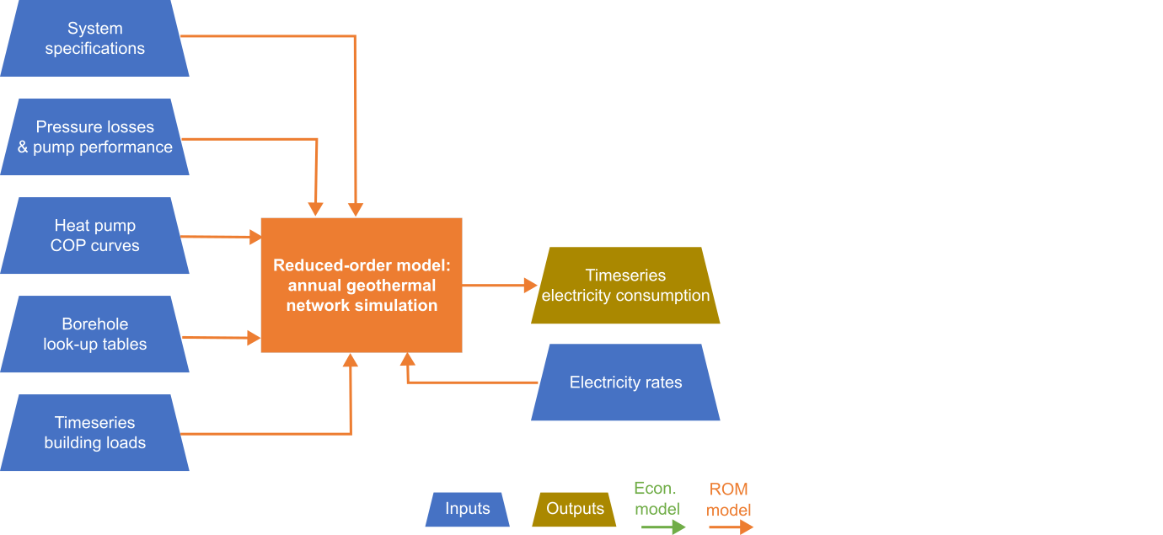
HEATNETS model data flow

Slide 14
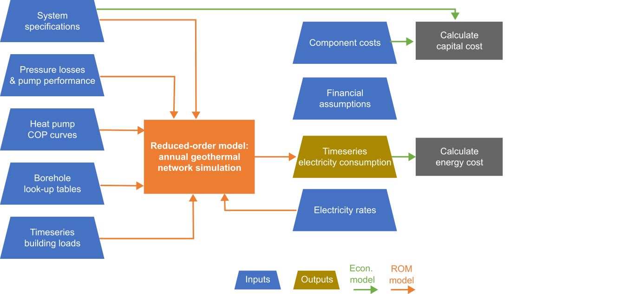
HEATNETS model data flow

Slide 15
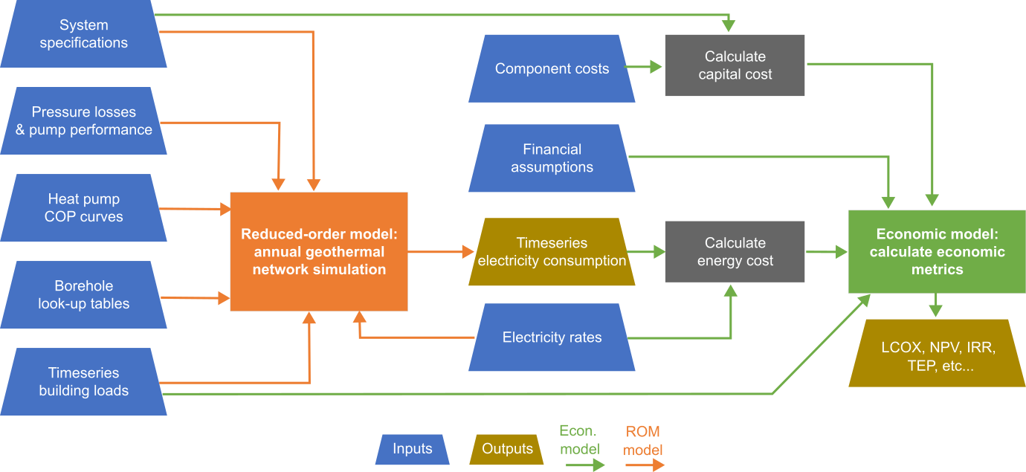
HEATNETS model data flow

Slide 16
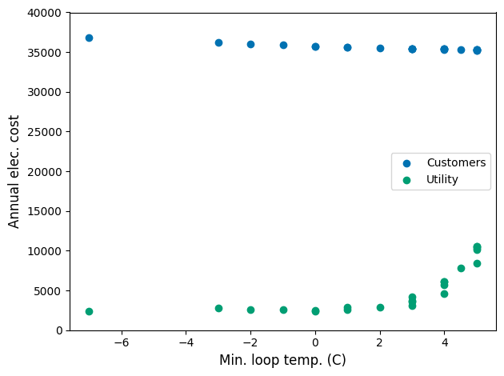
What happens if…?
…the minimum loop temperature is changed?
In this case study, as the minimum temperature increases, the utility cost rises significantly while the customer cost drops slightly
Benefits may not be seen equally for all parties involved in the GEN
Modeled results are subject to ongoing development.

Slide 17
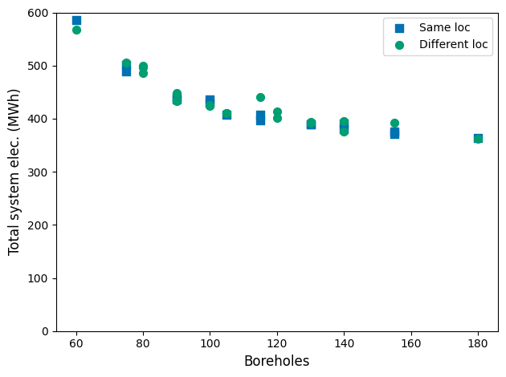
What happens if…?
…the number and location of boreholes changes?
In this case study, adding additional boreholes to the system reduces the total system electricity usage annually
Operational benefits must be weighed against economic impacts
Modeled results are subject to ongoing development.

Slide 18
Summary
Modeling can answer key questions for GENs
HEATNETS model includes both physics-based reduced-order model and economic model
HEATNETS allows for analysis of design and operational decisions, considering impacts to performance and economics
Graphic from Besiki Kazaishvili, NREL.
Simpson, et al. GRC Transactions, 2024.
Source: public domain
Notes:
HEATNETS model created by NREL in collaboration with HEET as part of the LeGUp project.
System level modeling of the thermal loop, connected buildings, and borehole fields for improved understanding of the system control & operation.
Unique attributes:
Captures thermal inertia of the loop and load cancelling, without including complex building or borehole models, reducing computational time
Built-in capital cost and economic model
Economic model looks for thermal energy price (TEP) needed to recoup system costs

Slide 19
Questions?
Juliet.Simpson@nrel.gov
This work was authored by the National Renewable Energy Laboratory, operated by Alliance for Sustainable Energy, LLC, for the U.S. Department of Energy (DOE) under Contract No. DE-AC36-08GO28308. Support for the work was provided by the Home Energy Efficiency Team (HEET) under FIA-22-23124, supported by a grant from the Massachusetts Clean Energy Center (MassCEC) to HEET entitled: Learning from the Ground Up (LeGUp). The views expressed herein do not necessarily represent the views of the DOE, the U.S. Government, or MassCEC.
19

Slide 20
Additional slides
20

Slide 21
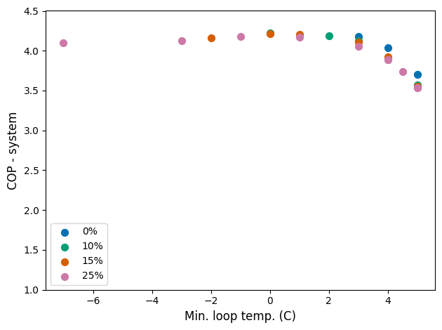
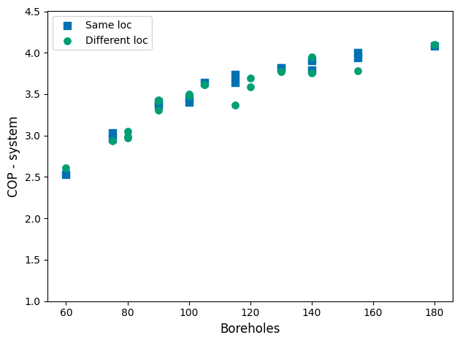
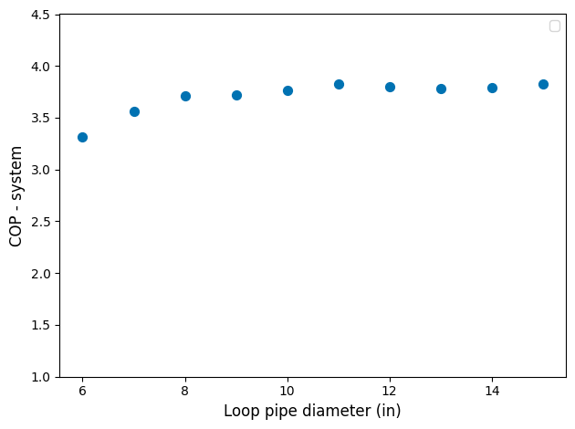
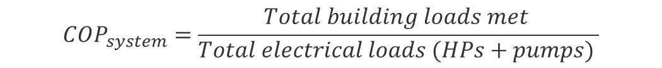
Compiled System COP results
$$COP_{system}=\frac{Total building loads met }{Total electrical loads (HPs+pumps) }$$
Modeled results are subject to ongoing development.
Notes:
The number of boreholes has the largest effect on system COP results.

Slide 22
What questions are researchers still considering?
How to best balance geothermal boreholes with other thermal sources such as thermal storage, solar thermal, or waste heat?
  Who is it best for?
How densely populated does an area need to be for GENs to be economical?
How many boreholes vs a peaking system?

Slide 23
HEATNETS overview
Heat and Economic Analysis Tool for NEtworked Thermal Systems
Python-based, open-source, reduced-order model
Simulates a single pipe 5G DES (TENs)
Combines physics-based reduced order model and a cost estimating and economic analysis model to do a full techno-economic analysis of TENs
Focused on thermal loop and thermal sources, is not suited for detailed design, but can be used to compare design and operation options
Work is produced by NREL as a part of the LeGUp project

Slide 24
NREL’s role in HEET’s LeGUp project
Create a reduced-order model for fast simulation of the geothermal thermal energy networks for heating and cooling
Create a techno-economic model to understand the economic viability of different designs
Simulate the pilot installations
Optimize system operation and explore alternative designs
Consider grid impact
Graphic from Besiki Kazaishvili, NREL.
Simpson, et al. GRC Transactions, 2024.
Source: public domain
Notes:
System level modeling of the thermal loop, connected buildings, and borehole fields for improved understanding of the system control & operation

Slide 25
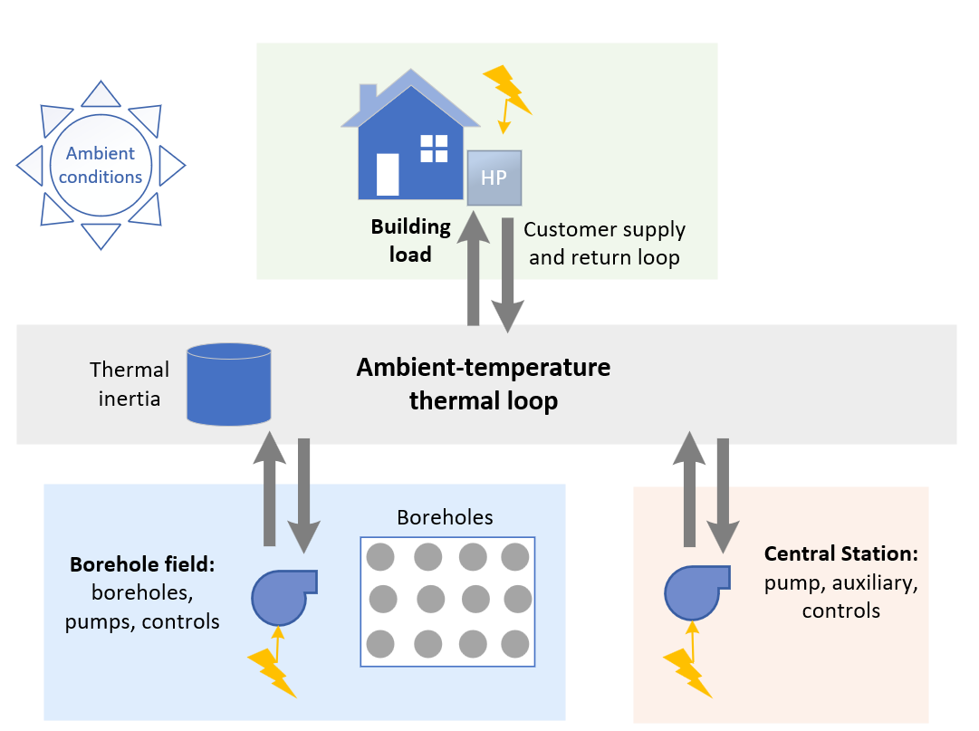
NREL’s reduced-order model will focus on connecting major components with the thermal loop
Simpson & Zhu (2024)
Source: public domain
Notes:
Simpson, Juliet G, and Guangdong Zhu. “An Efficient Annual-Performance Model of a Geothermal Network for Improved System Design, Operation, and Control: Preprint.” In 49th Stanford Geothermal Workshop. Stanford, California, 2024.

Slide 26
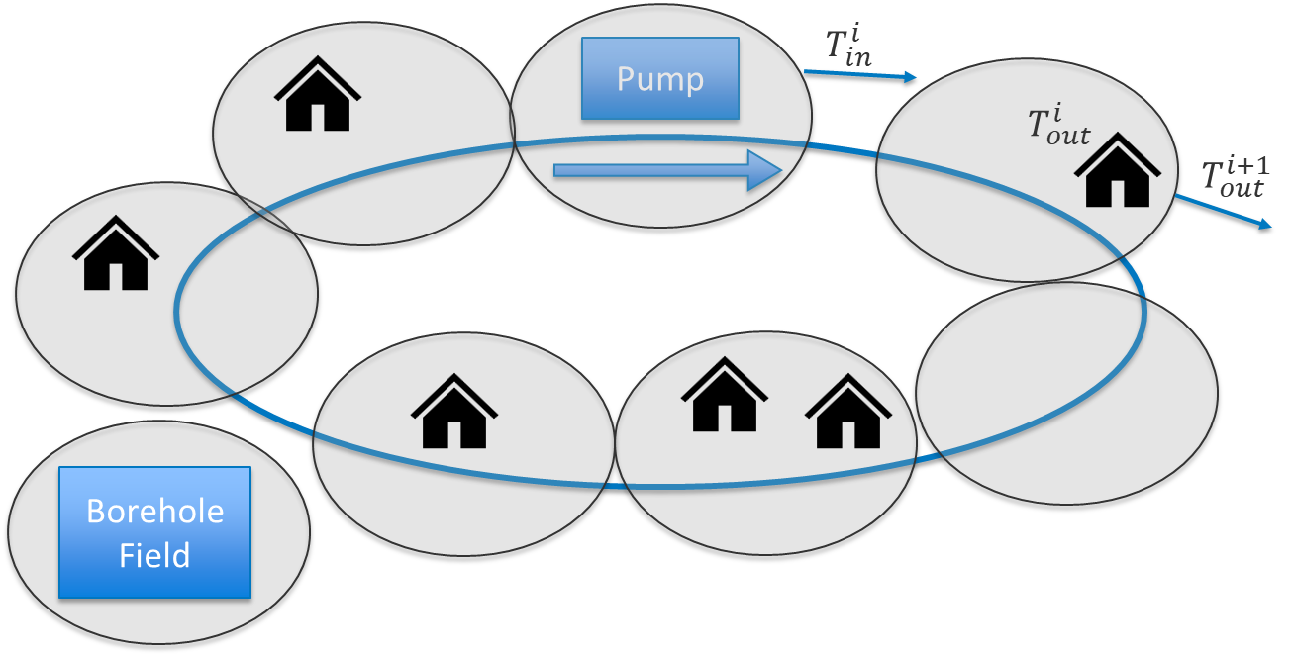
ROM divides loop into sections for thermal analysis
For each hourly timestep (i):
  Set loop flow rate and auxiliary heating (if used/needed)
  Subdivide into smaller timesteps based on loop flow rate
  Calculate heat and mass balance for sections, accounting for thermal inertia within the loop and flow of working fluid
  Save results on an hourly timestep
Post-process data
Notes:
(30 equally-sized sections)
Operational options:​
Design equipment, operated as designed​
Ex: constant flow rate through boreholes when operating​
Design equipment, different control​
Ex: varying flow rates and time of use for borehole fields​
Different equipment, different control​
Ex: larger range of circulation pump flow rates

Slide 27




ROM divides the loop into sections
$$T_{in}^{i}$$
Pump
$$T_{out}^{i}$$
$$T_{out}^{i+1}$$
Borehole Field

Slide 28
Ongoing Development/Next Steps
ROM model inputs
TEA model inputs
Model outputs
Economic outputs
System Specifications
Calculate capital cost
Pressure losses/pump performance
Component Cost
Energy Flow around the network
Heat Pump COP curves
Electricity Consumption
Timeseries electricity consumption
Calculate energy cost
Borehole outlet temperatures
Electricity Rates
Electricity Rates
Timeseries building loads
Timeseries building loads
Notes:
We are continuing to develop and validate our model. We currently are in the process of combining the technical model and TEA model so that there is one code to run to get the desired outputs.
Further we plan to create more sensitivity analyses, continue grid impact analyses, and continue updating the code to reflect real systems

Slide 29
MIT OpenCourseWare
https://ocw.mit.edu/
RES.ENV 007 Geothermal Energy Networks (GENs): Transforming our Thermal Energy System
IAP 2025
For information about citing these materials or our Terms of Use, visit: https://ocw.mit.edu/terms.

