Slide 1


Learning from Geothermal Energy Networks
Presented by Isabel Varela
January 31, 2025

Slide 2
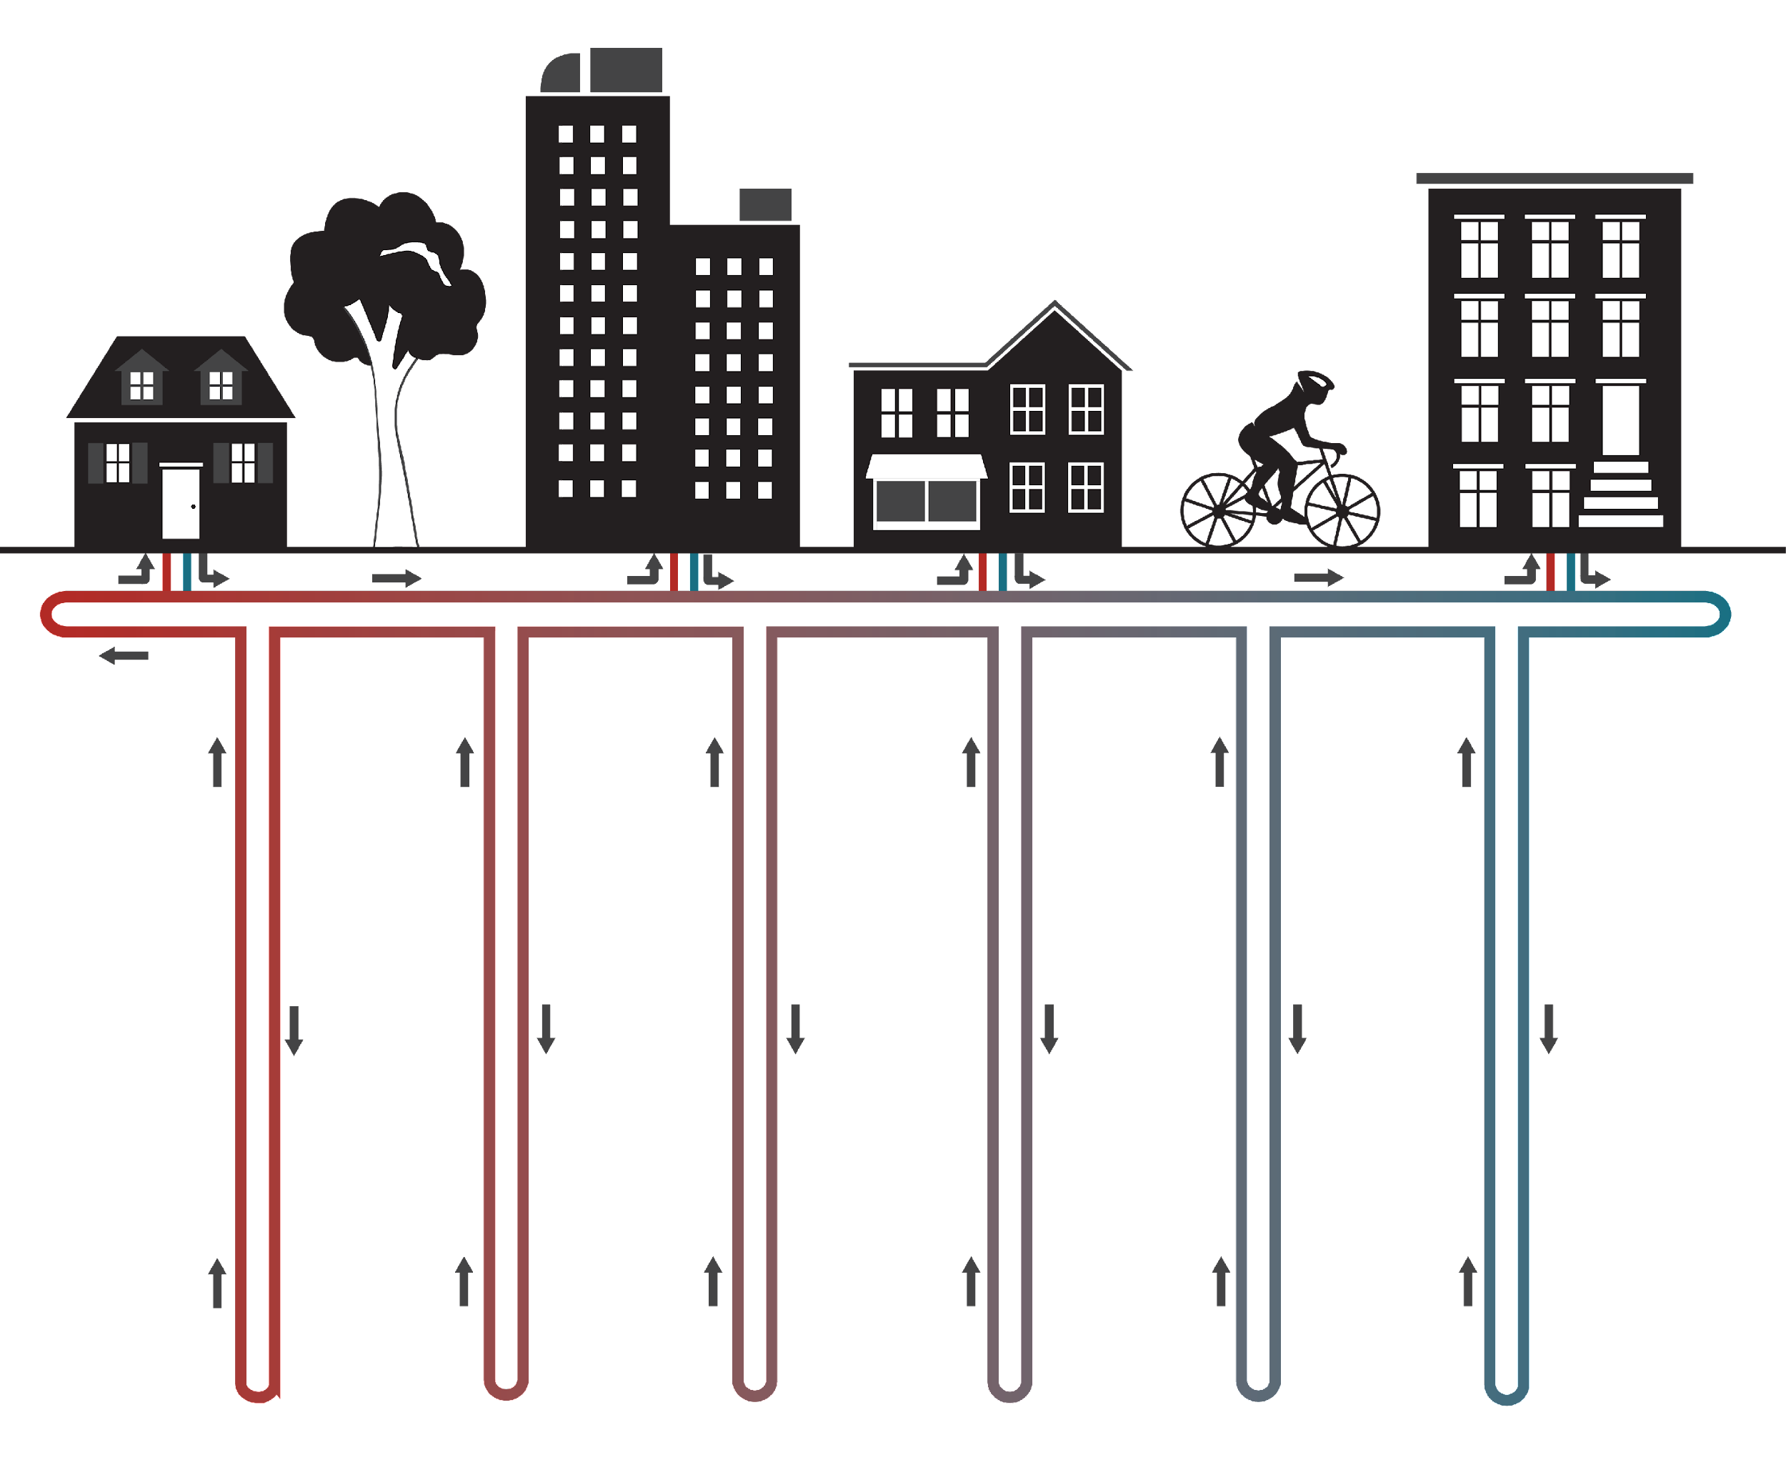
LeGUp RESEARCH PROJECT
Goals
Evaluate the potential of networked geothermal to deliver heating and cooling in Massachusetts
Increase understanding and optimization of this technology
Engage with and share findings with stakeholders (e.g., Department of Public Utilities, gas utilities, communities)
Notes:
So, after that introduction to what networked ground-source heat pump systems are, let’s move on to what the Learning from the Ground Up, or LeGUp project is about.
Our project includes research, innovation and systems change goals. Broadly speaking, the first goal is to evaluate the potential of networked geothermal systems to deliver heating and cooling. This includes measuring and modeling system performance, cost drivers, and impact. It also includes determining the positive impacts and the limitations of the technology.
The second goal is to engage with and share finding with stakeholders, this means engaging in two-way conversations throughout the project to align all stakeholders, which include department of public utilities, gas utilities and communities.
And the third goal is to prepare communities to adopt change, which means engaging in conversations with communities, and providing resources and knowledge so that they can access change.

Slide 3
LeGUp Org Chart
Core Modeling
Cost Studies
Data Governance Board
GeoDataBank
NREL
BuroHappold
HEET
HEET
LBNL
NREL
UCB: SRG
Communications,Community & Outreach
Scientific Advisory
LeGUp
Governance
Equity, Health, Ecology & Env.
Kickstart Feasibility Studies
BU
BUSPH
Umass Lowell
HEET
HEET
Statewide Scaling
HEET
NREL
HEET
Buro Happold
Utilities
Grid
Impacts

Slide 4
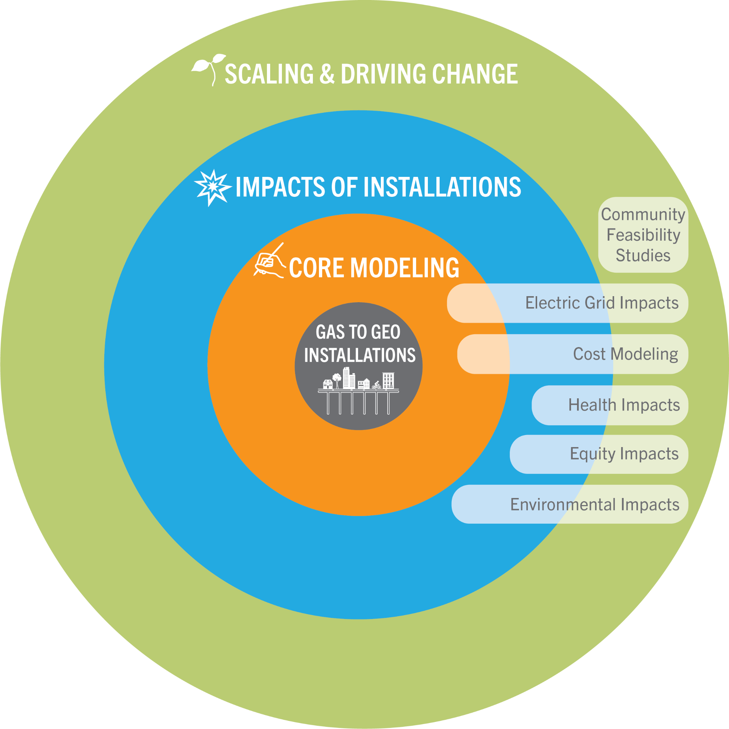
Project Connections
Notes:
The framework that we chose to address these questions is to work backwards from our desired outcome: scaling and driving systemic change.To help us meet our climate goals, we need to compare the potential of networked geothermal systems to meet our goals. Network geothermal systems must reliably deliver affordable heating in an equitable way. They must be safe to run and install. They also must have lower emissions profiles than other net zero technologies for heating. We must understand the impact of scaling the technology on the health of people and our planet. Finally, we must ensure that running these geothermal networks does not over burden the electrical grid - even in extreme weather days, such as heat waves, cold spells, or winter storm Uri. In other words, we must understand the impacts of scaling the technology on “externalities” such as the electrical grid, health, equity and the environment. And of course to do this with any degree of accuracy, we must develop data-driven models of geothermal networks that closely mimic reality, and use the data and models to engage all stakeholders in driving change.

Slide 5
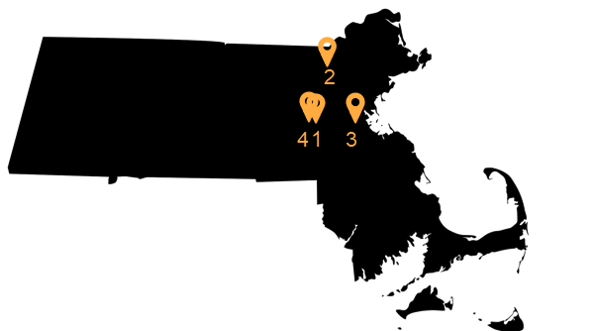

DATA: PILOT INSTALLATIONS IN MA
Motivation: MA Decarb Roadmap mandates net-zero emissions by 2050, 32% of emissions from building sector (MA)
1. Framingham Eversource Gas
2. Franklin Field National Grid
3. Framingham extension Eversource Gas
Notes:
The LeGUp project is centered on the data from two of these neighborhood installations that are in a pilot phase in two communities in Massachusetts.
A reminder of the motivation behind this project is that Massachusetts in its Decarbonization Roadmap has a mandate to achieve net-zero emissions by 2050. And in the state currently 32% of the emissions come from the building sector.
The pilot that is more advanced is operated by Eversource Gas and is located in Framingham, Massachusetts, about half an hour west from Boston, where the boreholes are being drilled as we speak and the pipes are going in the ground. It is very exciting to see this project develop. Drilling is expected to finish this Fall and the system will be up and running in the Spring.
The systems covers about 40 buildings, including a firestaton, a community college, public housing from the Framingham Housing Authority, private residences, and even a gas station and a CVS pharmacy.
The second pilot that is now in the design phase, is located in Lowell, Massachusetts and is operated by National Grid.
There is also a third grant for a site in the Merrimack Valley in MA that has been approved, but a site or operator haven’t been selected yet.

Slide 6
Temperature Data Acquisition
Team
Soga lab: Jiahui Yang, Kecheng Chen, Yaobin Yang, and Sumeet Sinha
HEET: Eric Juma, Victor Oyeleke, and Isabel Varela
Working closely with Eversource, RH White, Celsius, Berkeley, and Midwest Geo
Objective: Install fiber in 15 boreholes across the whole system connected to an interrogator device on each borefield
Status: All 15 boreholes instrumented. Permanent interrogator installed at Farley. HEET working with Senecal for installation of two other interrogators
Borehole instrumentation
Q3 2023
Q4 2023
Q1 2024
Q2 2024
Q3 2024
Q4 2024
Jul
Aug
Sep
Oct
Nov
Dec
Jan
Feb
Mar
Apr
May
Jun
Jul
Aug
Sep
Oct
Nov
Dec
Borehole fiber installation
Connecting fiber installation
Interrogator installation
Monitoring active

Slide 7
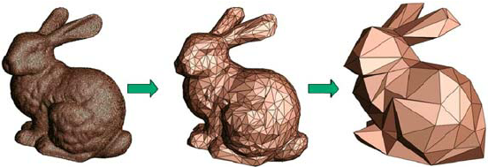
DEVELOP CORE MODELS
Develop Full Physics and Reduced Order models using data from the first few installations:
Core Modeling
© CIMNE, Barcelona, 2023. All rights reserved. This content is excluded from our Creative Commons license. For more information, see https://ocw.mit.edu/help/faq-fair-use/
Notes:
The modeling step, as I mentioned, uses data from the two pilots that are underway in Massachusetts. And there are two sets of earth models being developed. One is a full physics model that is being worked on by Lawrence Berkely Labs, and the other is a simplified or reduced order model developed by the National Renewable Energy Lab or NREL.
The idea is that after the full physics model is completed, approximations can be made that can inform the simplified or reduced order model. The vision is that in the future, if it is well characterized, a reduced order model may be sufficient when studying these systems.
Build digital twin based on measured data
Optimize design and installation
Monitor and optimize system operation
Allow predictive modeling (e.g., health, emissions)
Develop tools to model scaling
-------------------
NREL: simplified or reduced order model
Lawrence Berkely Labs: Full physics model

Slide 8
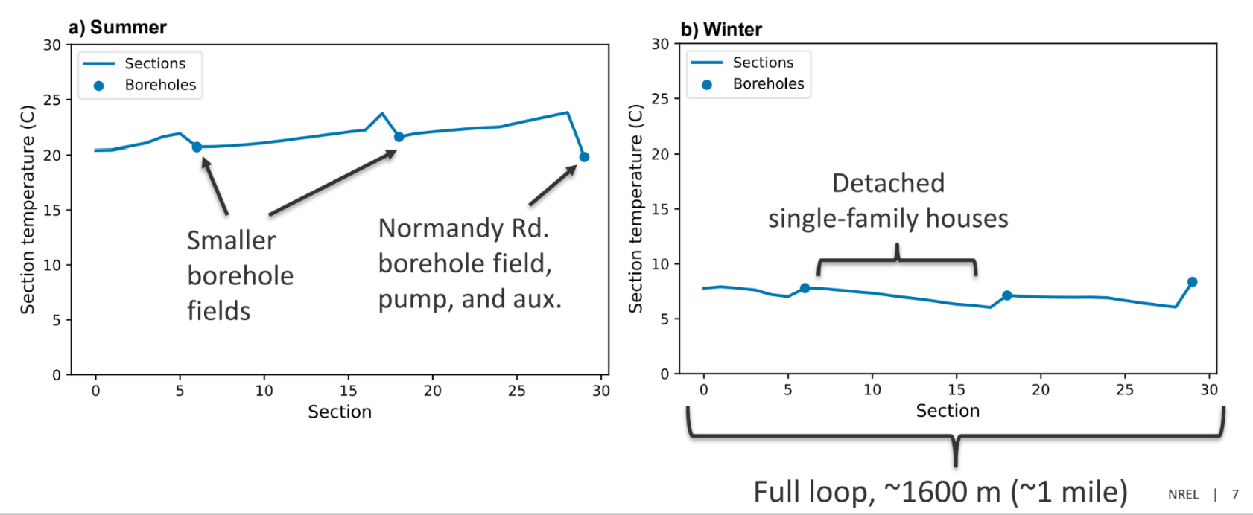
DEVELOP CORE MODELS: Reduced Order Model
Core Modeling
Notes:
The modeling step, as I mentioned, uses data from the two pilots that are underway in Massachusetts. And there are two sets of earth models being developed. One is a full physics model that is being worked on by Lawrence Berkely Labs, and the other is a simplified or reduced order model developed by the National Renewable Energy Lab or NREL.
The idea is that after the full physics model is completed, approximations can be made that can inform the simplified or reduced order model. The vision is that in the future, if it is well characterized, a reduced order model may be sufficient when studying these systems.
Build digital twin based on measured data
Optimize design and installation
Monitor and optimize system operation
Allow predictive modeling (e.g., health, emissions)
Develop tools to model scaling
-------------------
NREL: simplified or reduced order model
Lawrence Berkely Labs: Full physics model

Slide 9
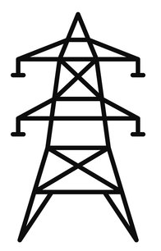
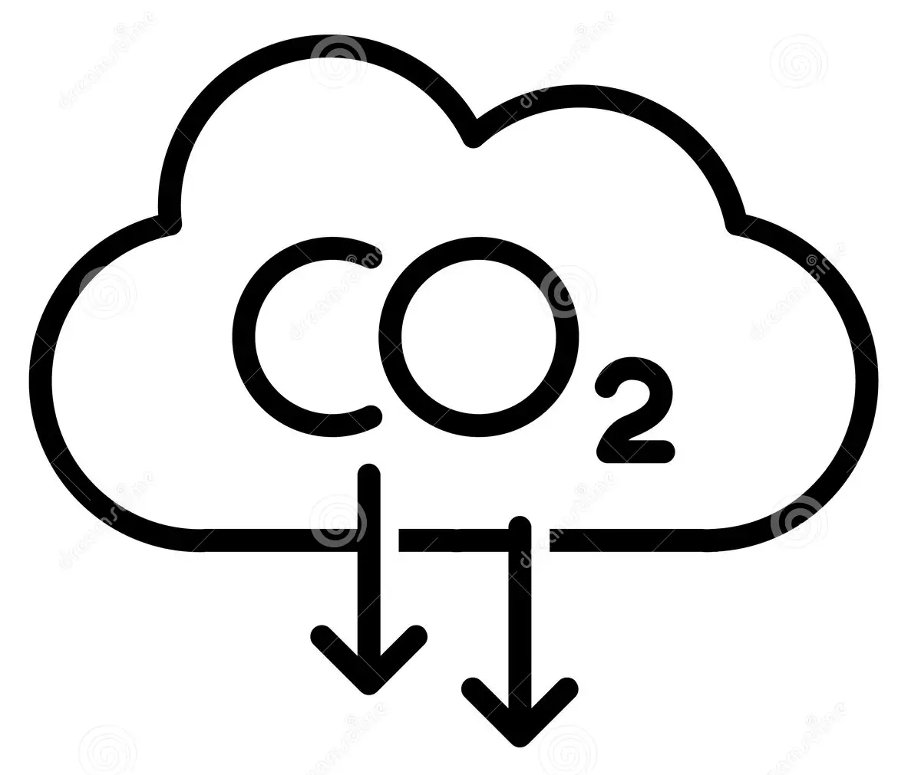




MODEL AND MONITOR IMPACT OF INSTALLATIONS
Develop data-driven models and test predictions:
Emissions
Grid
Costs
IMPACT OF INSTALLATIONS
Ecology
Health
Equity
Notes:
Step two involves making data-driven models and test predictions using NREL’s reduced order model.
The impacts that are being considered include equity, which is worked on by HEET in collaboration with Energy Solutions.
Ecology, which is being worked on by Boston University, Emissions and Health, which is being worked on by the BU school of public health.
The impacts on the electrical grid are being worked on by MIT and the costs are being worked on by the National Renewable Energy Lab as well as Buro Happold, which is an engineerng firm.
--------------------
HEET/Energy Solutions: Equity
BU: Ecology
BU School of Public Health: Health & Emissions
MIT: Electrical grid impact
NREL/Buro Happold: Costs

Slide 10
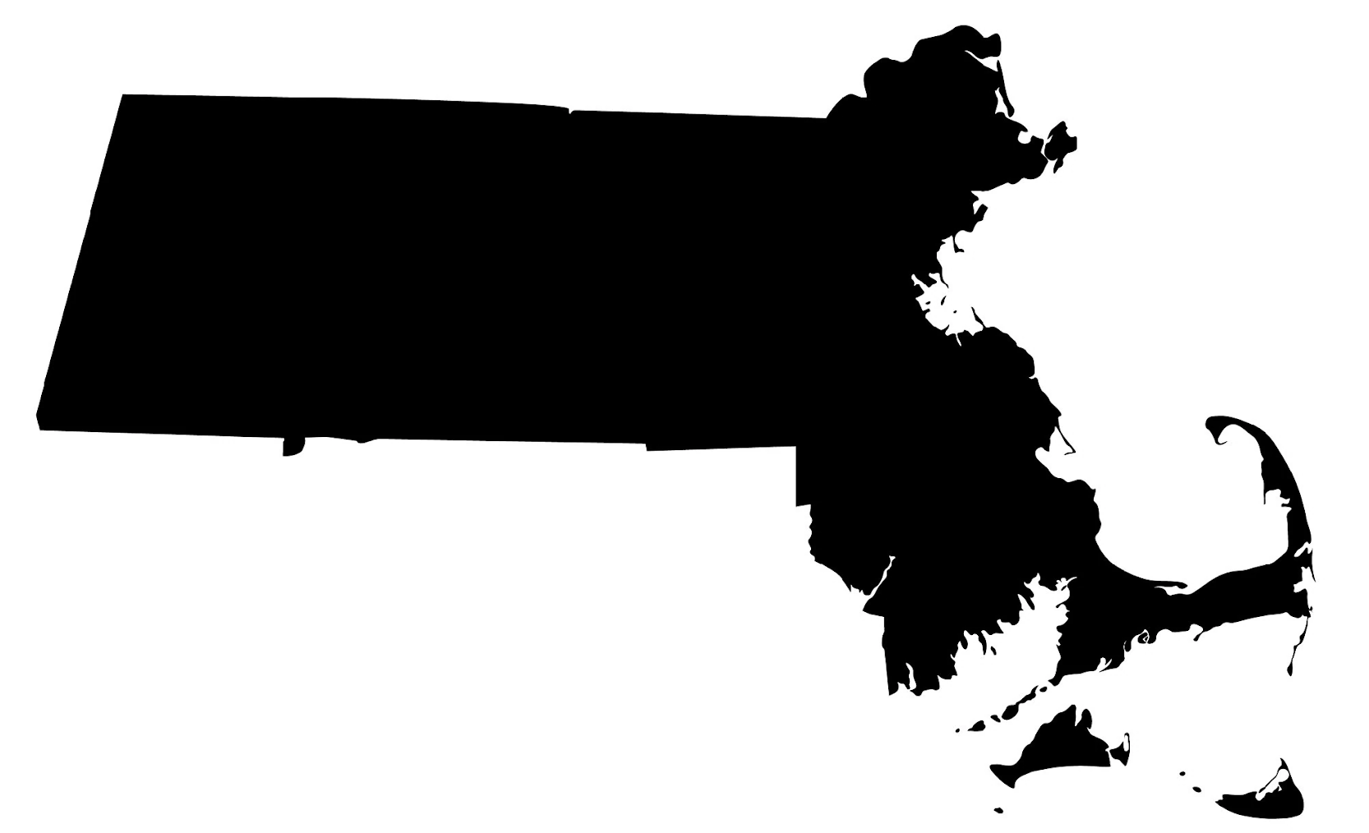

Regional Assessment
Develop scaling projections from the Core Models
Measure and maximize impact
SCALING AND DRIVING CHANGE
Notes:
This all feeds into a final statewide assessment of scaling this technology for the entire state of Massachusetts. Buro Happold, is taking the lead on this part of the project, which involves scaling up projections from the core models to improve not only speed of design and installation, but also system efficiency and equity deployment, as well as minimizing installation costs and emissions.
Develop scaling projections from the Core Models
Improve speed of design and installation, system efficiency and equity of deployment
Minimize installation and operation costs and emissions
Measure and maximize impact
Affordability
Safety and Health
Reliability
Security
Equity
Emissions and Environmental Impact
As a commentary, I’ll mention that the Department of Public Utilities in Massachusetts approved the first two pilots in the state and is awaiting the results from these pilots to approve further installations of these systems. The combined results from the LeGUp research project, including the statewide assessment may also be used by the Department of Public Utilities as they evaluate the approval of future projects.

Slide 11
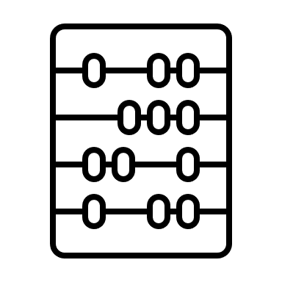

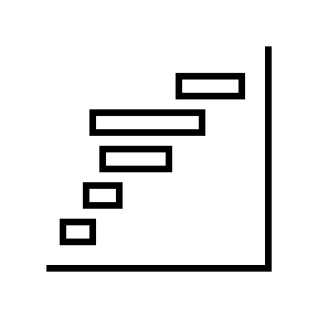

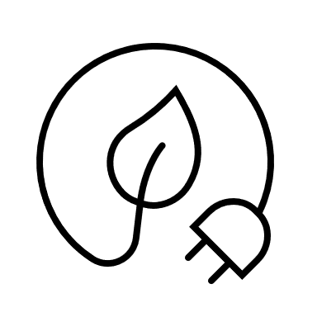




Databank for Geothermal Networks
Enable quantitative comparison
Contribute to prediction models
Inform planning & optimization of future systems
Record costs related to heating and cooling
Identify costs and energy use by stages
Catalyze & derisk the adoption of these networks
Demonstrate impacts on emissions, environment and human health
Support development of data-driven legislation & regulation
11
Notes:
So what are the goals of this database? First to enable a quantitative comparison between these systems,
To have datasets that can contribute to simple prediction models about how these systems work
To inform planning
—------------
1. Enabling the quantitative comparison of these systems by identifying parameters that may be significantly influencing the overall coefficient of performance and costs;
2. Contributing to prediction models that estimate the future performance of existing installations;
3. Informing the planning and optimization of parameters for future installations through analyses made possible by this database;
4. Recording costs related to heating and cooling of buildings with the legacy systems versus the geothermal network system, which will allow quantification of cost differentials;
5. Identifying costs and energy use by stages, such as thermal resources, distribution, and buildings, which will allow for fair comparison with other heating systems.
6. Catalyzing the adoption of geothermal network technology through increased knowledge of their efficiency or coefficient of performance and costs;
7. Demonstrating impacts on emissions, environment, and human health, by recording emissions and air quality effects before and after the installation of geothermal network;
8. Supporting the development of data-driven legislation and regulation related to the proliferation of geothermal network systems;

Slide 12
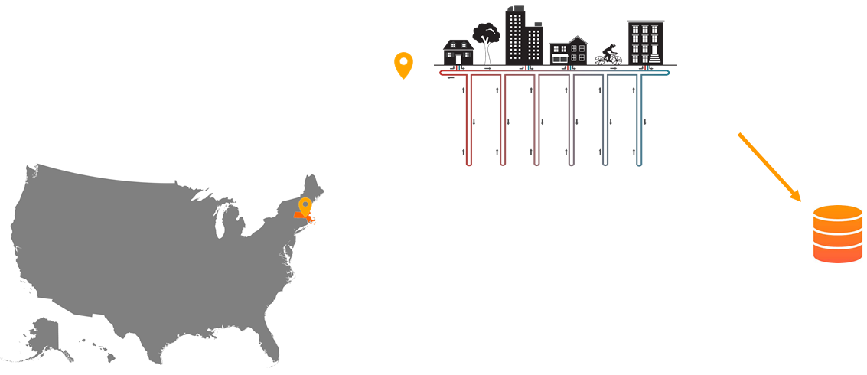

Databank for Geothermal Networks
What? A public data bank of geothermal network installations
Why? to inform and facilitate future developments, enabling societal-scale building decarbonization
How? Interface with HEET website. Database saved in perpetuity in Harvard Dataverse. Open access.
12

Slide 13
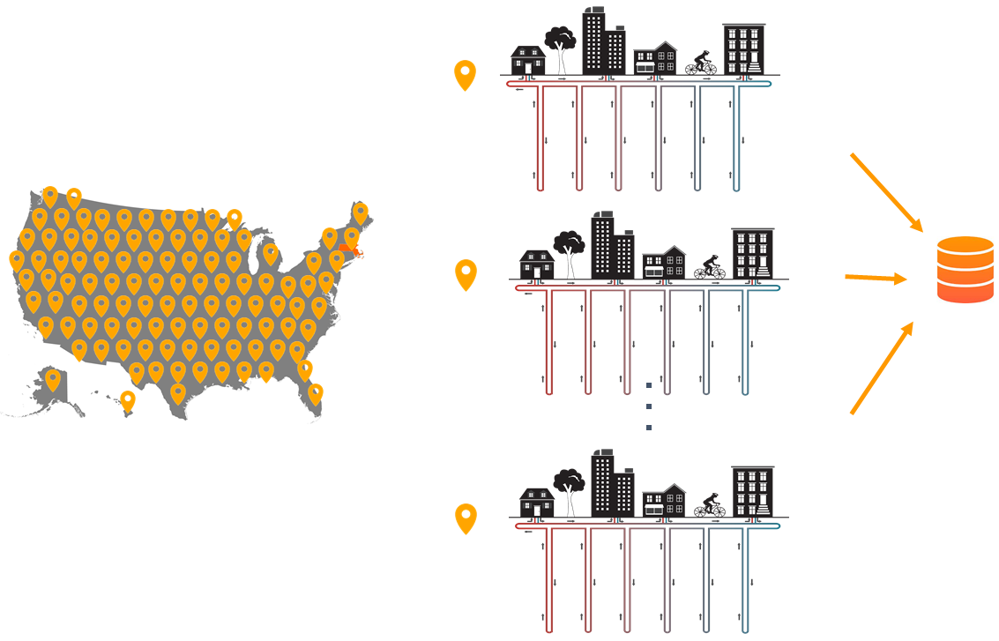
Databank for Geothermal Networks
What? A public data bank of geothermal network installations
Why? to inform and facilitate future developments, enabling societal-scale building decarbonization
How? Interface with HEET website. Database saved in perpetuity in Harvard Dataverse. Open access.
13

Slide 14
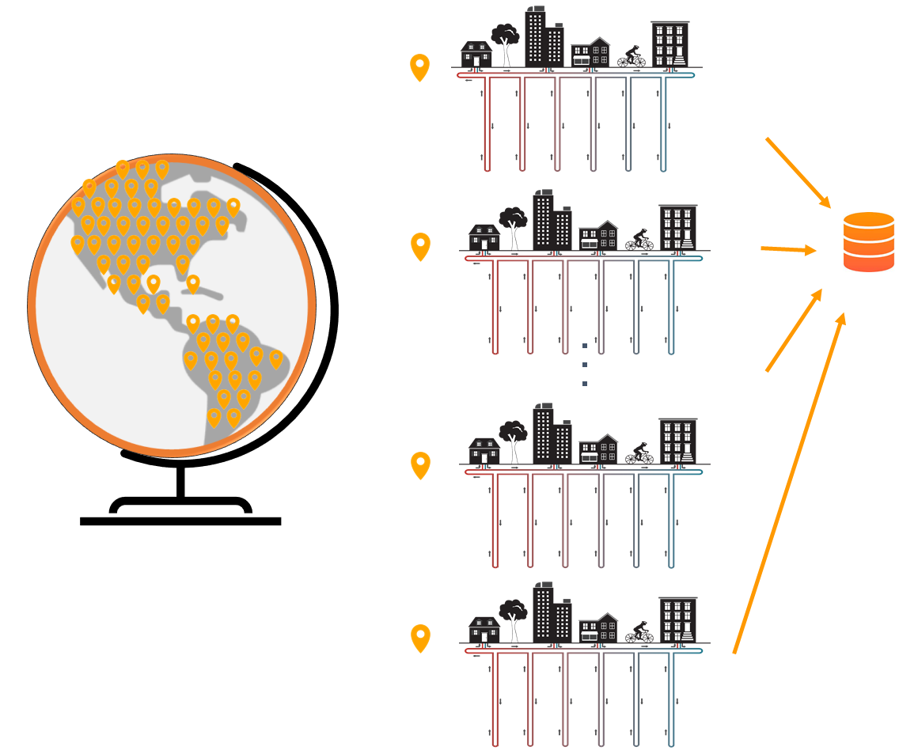
Databank for Geothermal Networks
What? A public data bank of geothermal network installations
Why? to inform and facilitate future developments, enabling societal-scale building decarbonization
How? Interface with HEET website. Database saved in perpetuity in Harvard Dataverse. Open access.
14

Slide 15
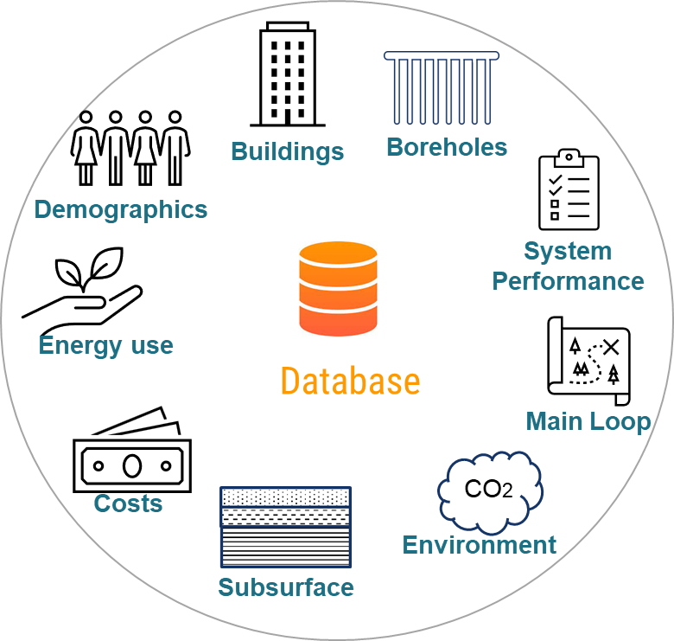
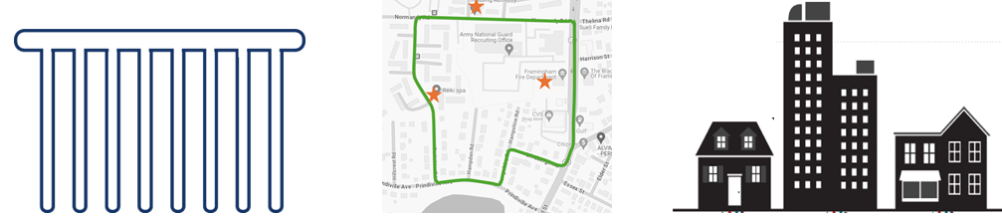
Databank for Geothermal Networks
Categories
Stages
Thermal Resources
Distribution
End-user
Boreholes
Main Loop
Buildings
15

Slide 16

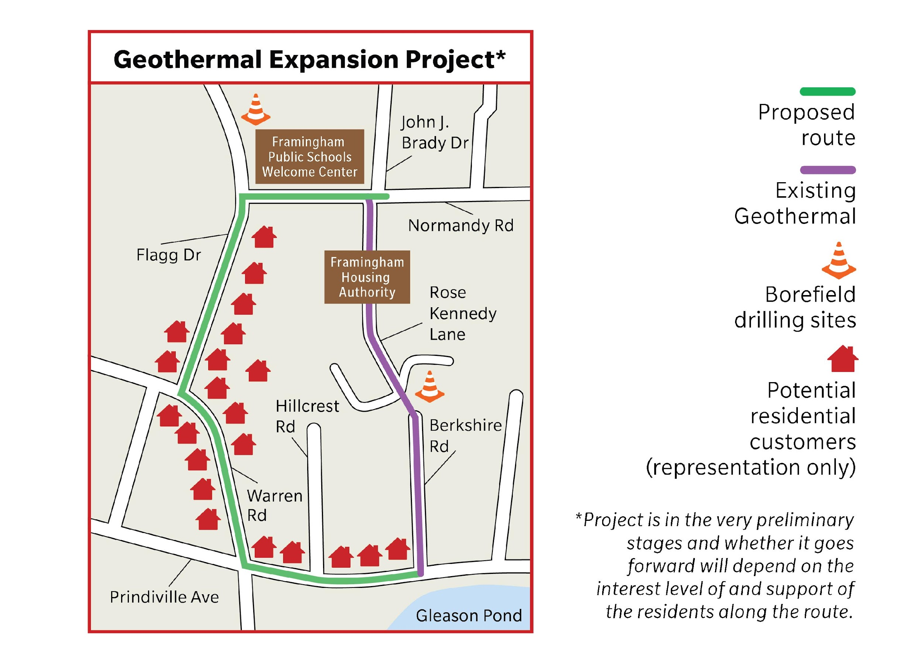
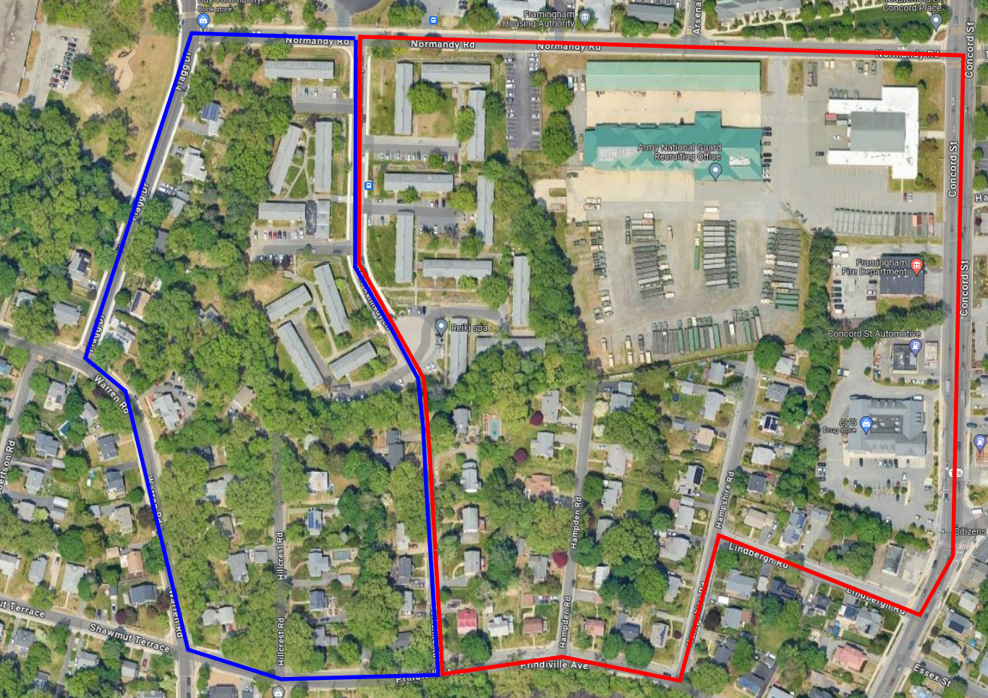
DOE Community Geothermal Grant

Slide 17

Questions & Discussion

Slide 18
Project Accomplishments & Timeline
Oct
2022
Jan 2023
Jan
2024
Jan
2025
Teams setup
Test boreholes drilled
TRT Framingham and Lowell
Construction start at Framingham
DFOS installs completed at Framingham
NREL reduced order model & publication
LBNL ground water flow and full physics model
Soga Research Lab TRT publication
BUSPH equity dashboards live
Kickstart program launched
DEP depth to bedrock maps
Framingham construction finished, commissioning underway
Lowell design completed with review
Franklin Field design RFP being designed
Framingham 2nd loop design completed

Slide 19
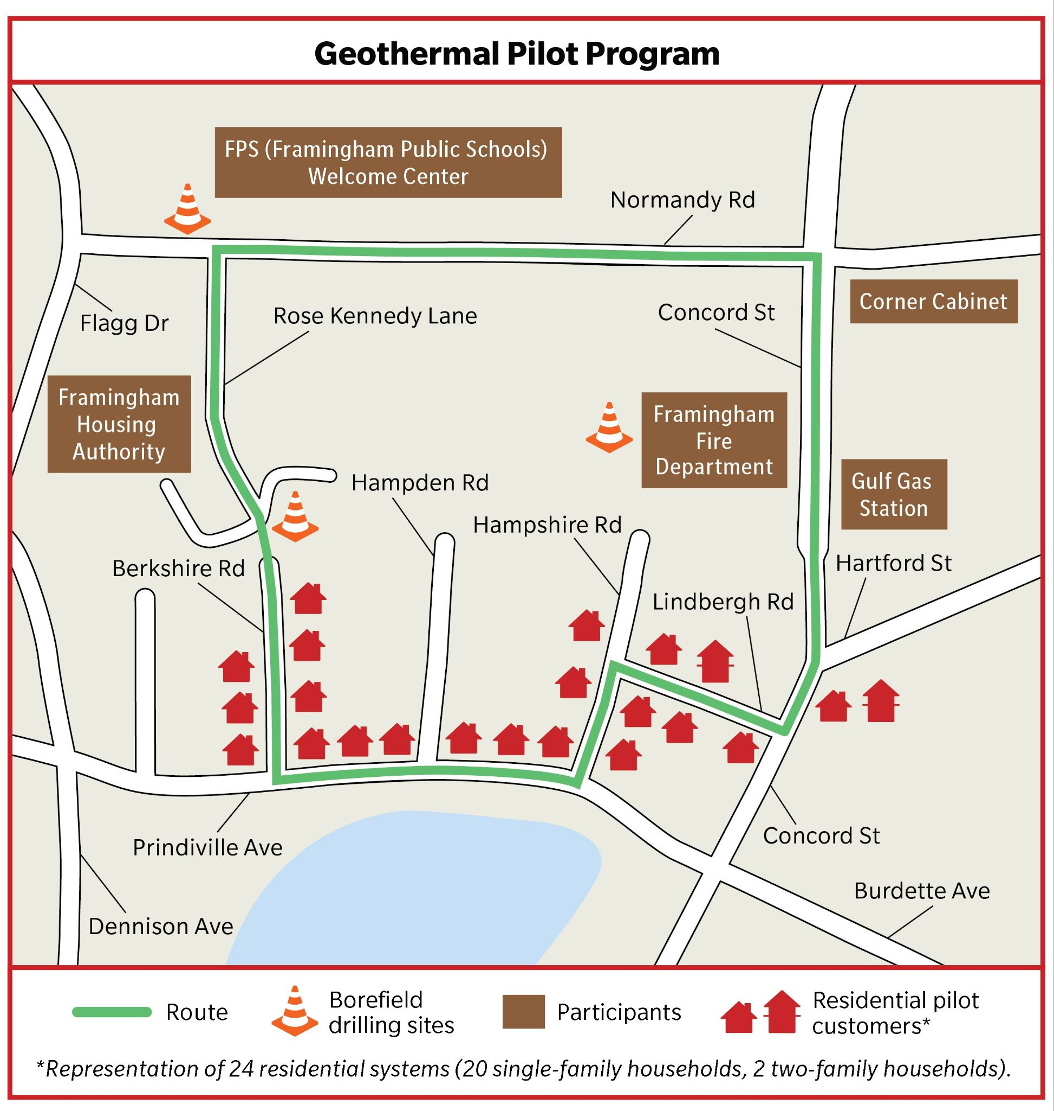
DOE Community Geothermal Grant
Phase 1: Design, grant awarded
Announcement: April 25, 2023, DOE awards HEET and partners a Community Geothermal Grant. Grant starts Oct 1.
Project uniqueness: First extension to an existing geothermal network run by a utility
Planned Project: A utility-managed geothermal network in the City of Framingham to meet 100% of the heating and cooling needs of the buildings connected to the system.
Grant components
  Design of system (current status: 60% design completed)
  Community Engagement (current status: completed for this BP)
  Workforce development (current status: tutorial completion today!)
Phase 2: Construction, application for DOE grant by Sept 30 2024

Slide 20
DOE Community Geothermal Grant

Slide 21
MIT OpenCourseWare
https://ocw.mit.edu/
RES.ENV 007 Geothermal Energy Networks (GENs): Transforming our Thermal Energy System
IAP 2025
For information about citing these materials or our Terms of Use, visit: https://ocw.mit.edu/terms.

