Slide 1
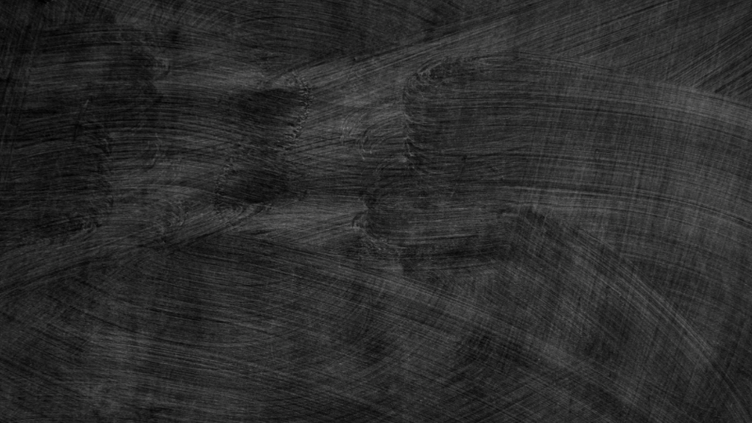
“Introduction to Drilling Geothermal Boreholes"
Brock Yordy – Global Drilling Trainer & SME

Slide 2
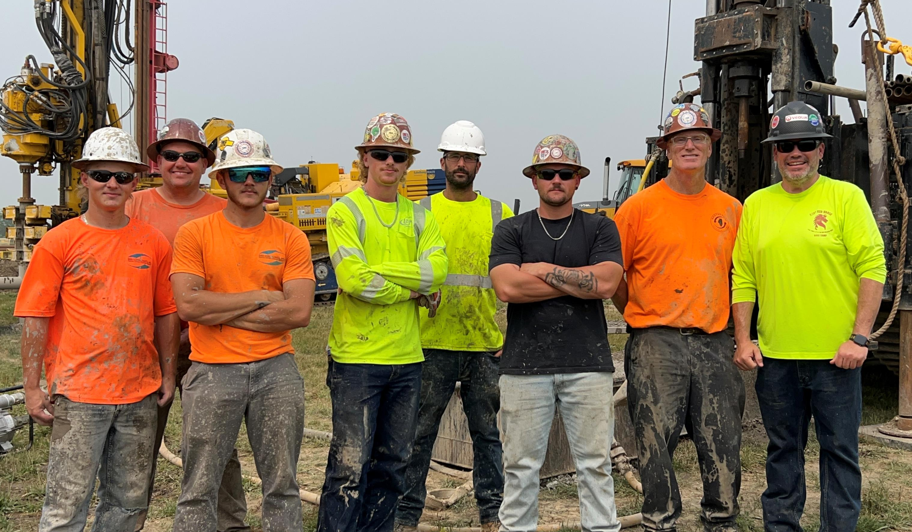
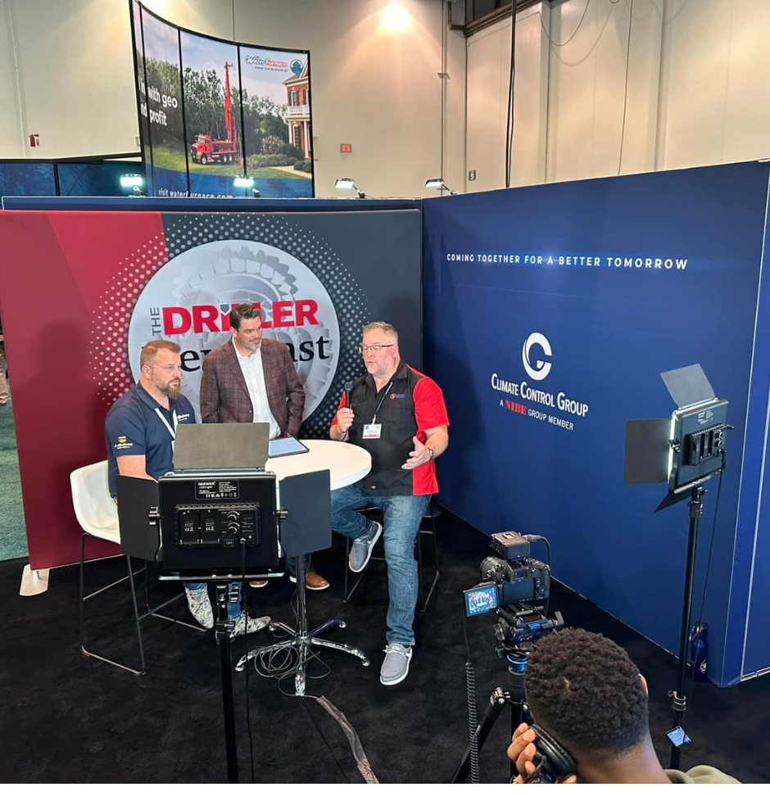

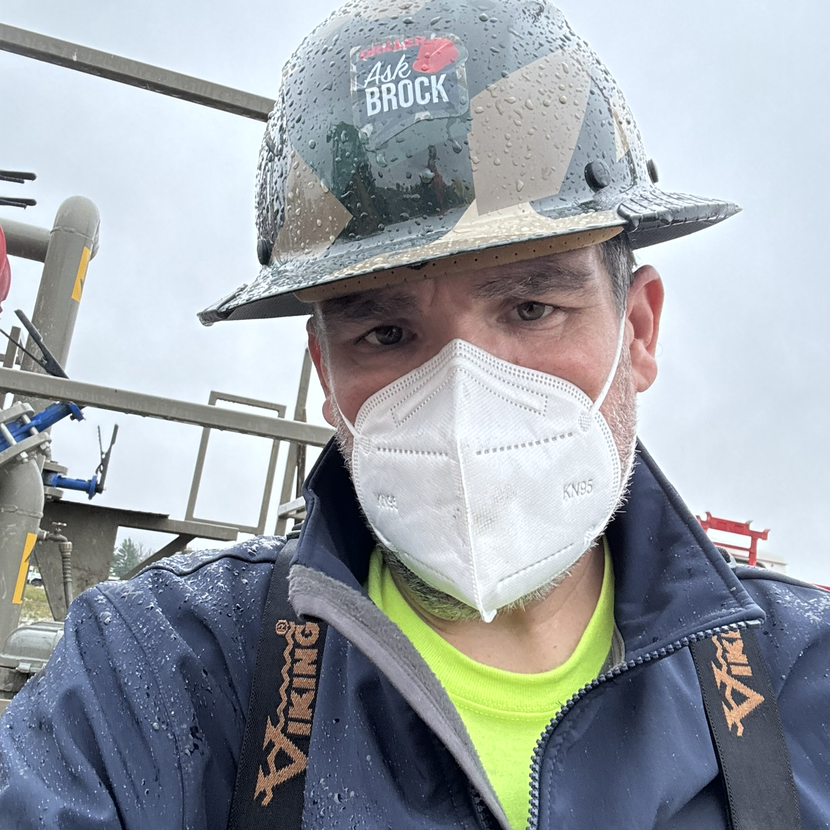
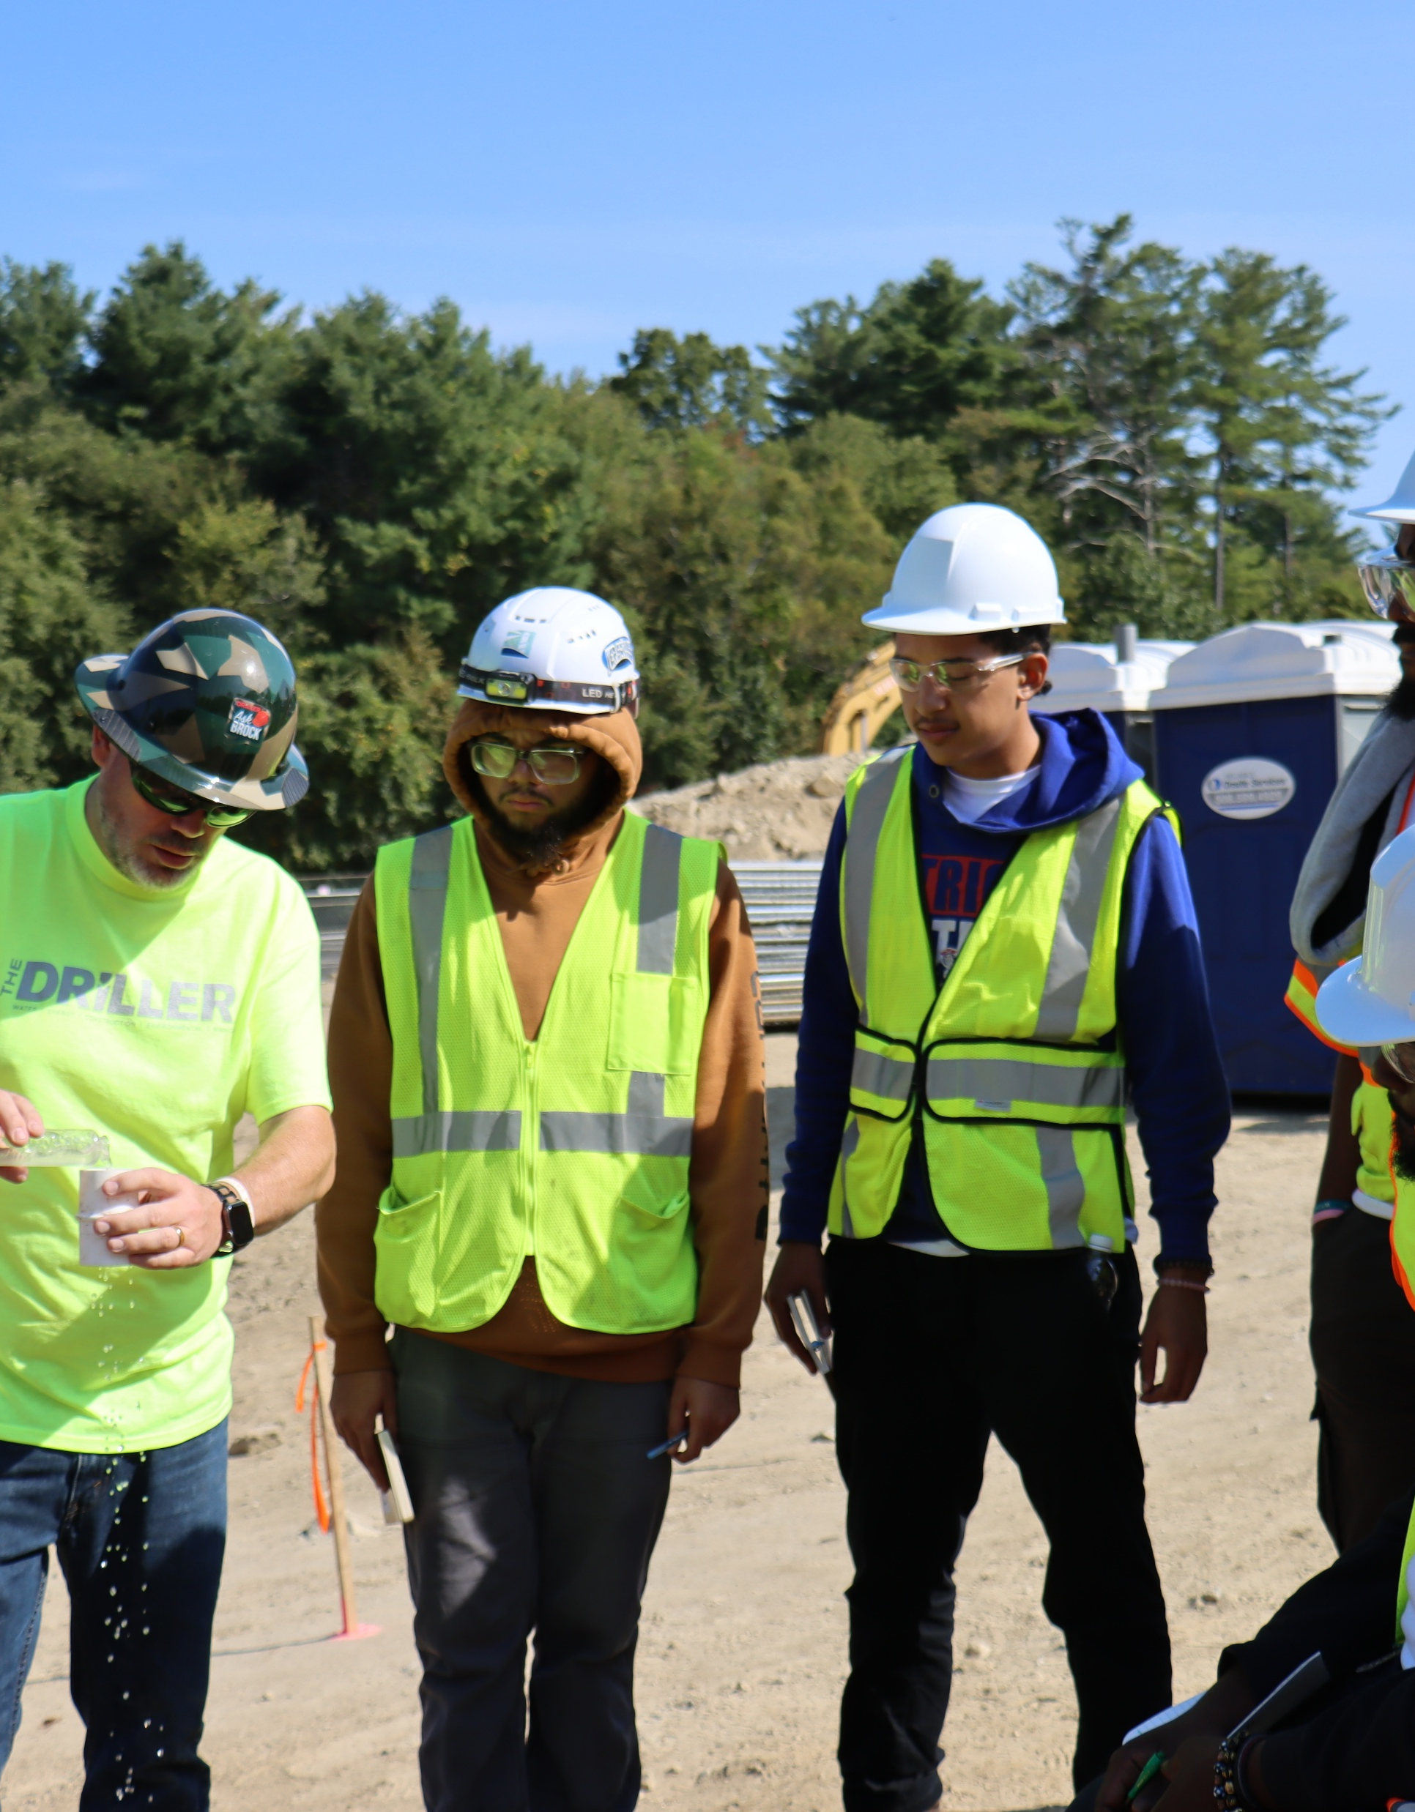
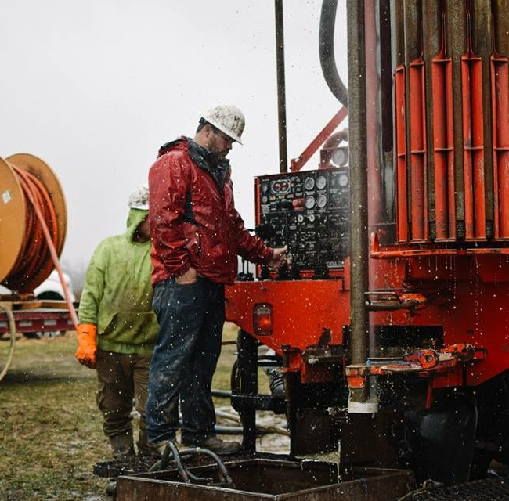
Proud Father, Husband &, 3rd Generation Driller
Water - Geothermal- Construction Drilling SME
Prof Experience – Baroid, Suez, Veolia
Drilling Workforce Development
DoL – IGSHPA – HEET
NYSERDA: Geothermal Drilling SME
HEET: Advisory Board Member
Co-Founder Geothermal Drillers Association
Owner Developed Well Group
Drilling Programs, Consulting, & Training

Slide 3
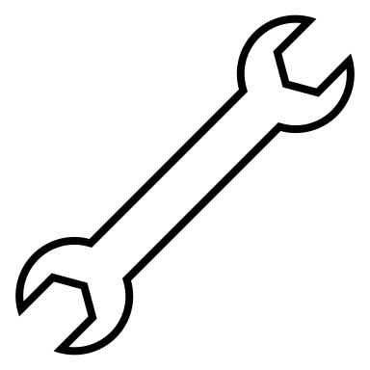

WARNING
The following presentation features tribal drilling knowledge acquired by drilling professionals or under the supervision of geothermal professionals. Accordingly, Brock Yordy must insist that everyone who engages with this presentation consider the following advice.

Slide 4
Applying Tribal Knowledge to Engineered Specifications
Drilling is the imperfect combination of science, physics, and self-taught tribal knowledge compounded over years of success and failure.
Drilling is a disruptive process; the key to success lies in your conscious choice of the drilling program that minimizes the impact on the surrounding environment.
Drillers, Contractors, Engineers, Scientists, and Clients have entered a powerful partnership to uncover the mysteries of the subsurface.

Slide 5
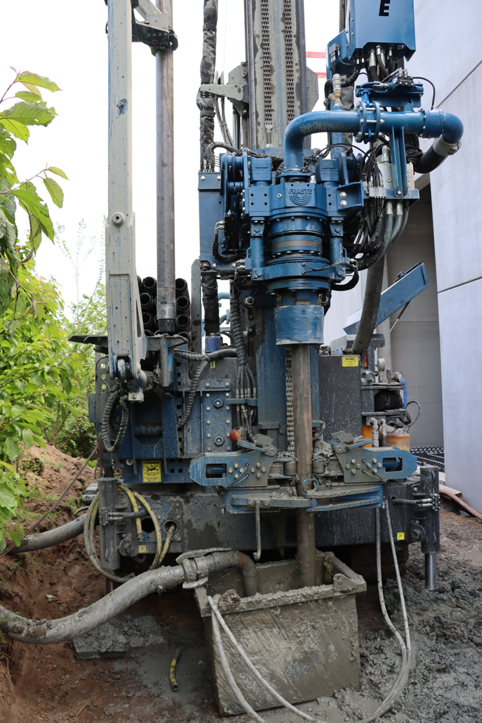
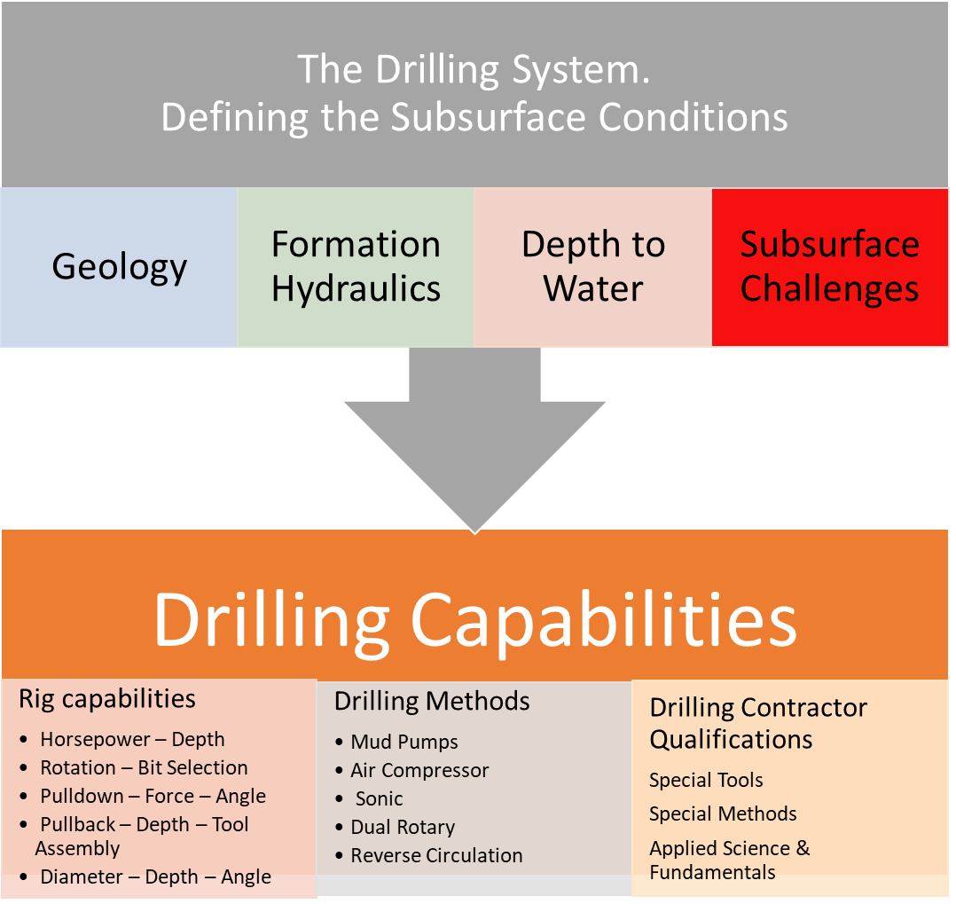

Slide 6
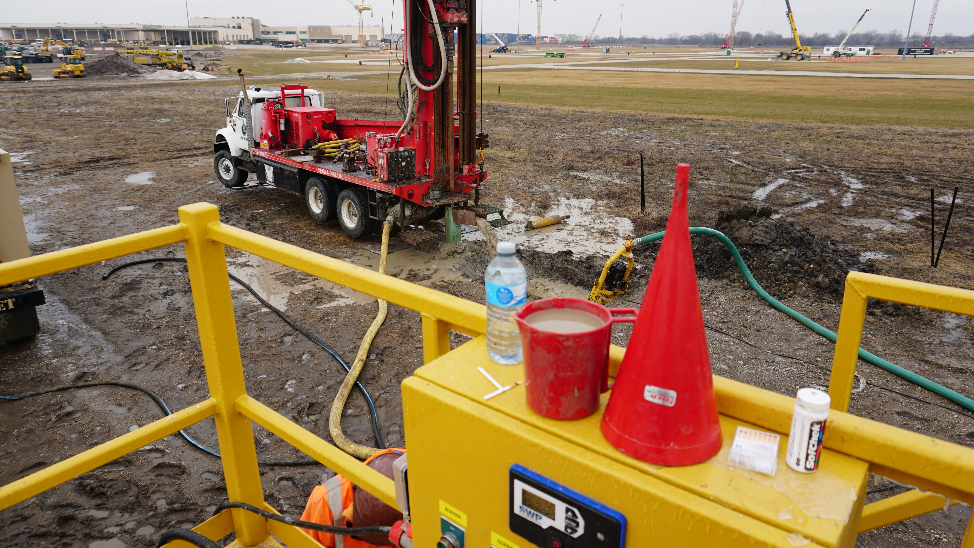
The Drill Crew – Critical System Operation
Safety First
Goal for the day
Quality Installations
Site & Environment Management
Goal for project completion
Preparation & Planning
  Foreseen Issues
  Unforeseen Issues

Slide 7
Roles & Responsibilities
Driller: Rig Operation, Product Installation, Resource Extraction, Project Completion, & Record Keeping.
Assistant Driller: Rig Support, Tool Handling, Product Assembly, Product Installation, & Project Wrap-Up.
Field Technician: Solids Control Management, Tooling Layout, Product Layout, Product Assembly, Product Installation, & Clean Up

Slide 8
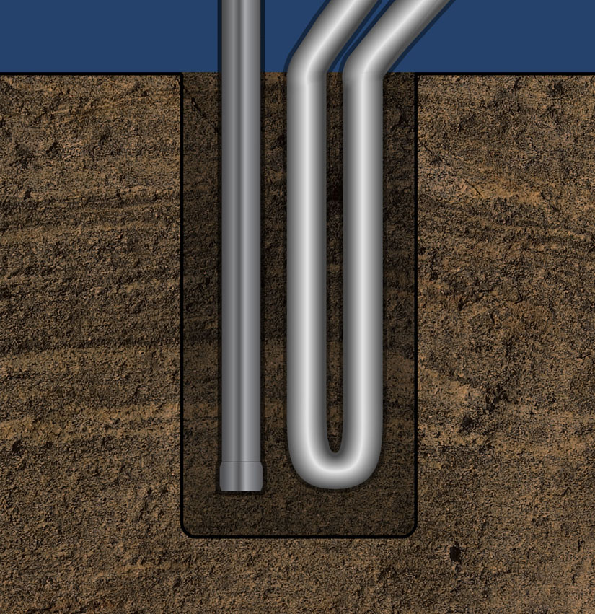
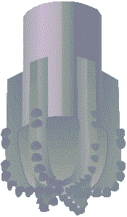
Borehole Creation
Pressure + Cutting Force
  Rotation
  Percussion
  Velocity
  Frequency
Cuttings Removal
  Mechanical
  Flushing
    Water
    Air
    Drilling Fluids

Slide 9
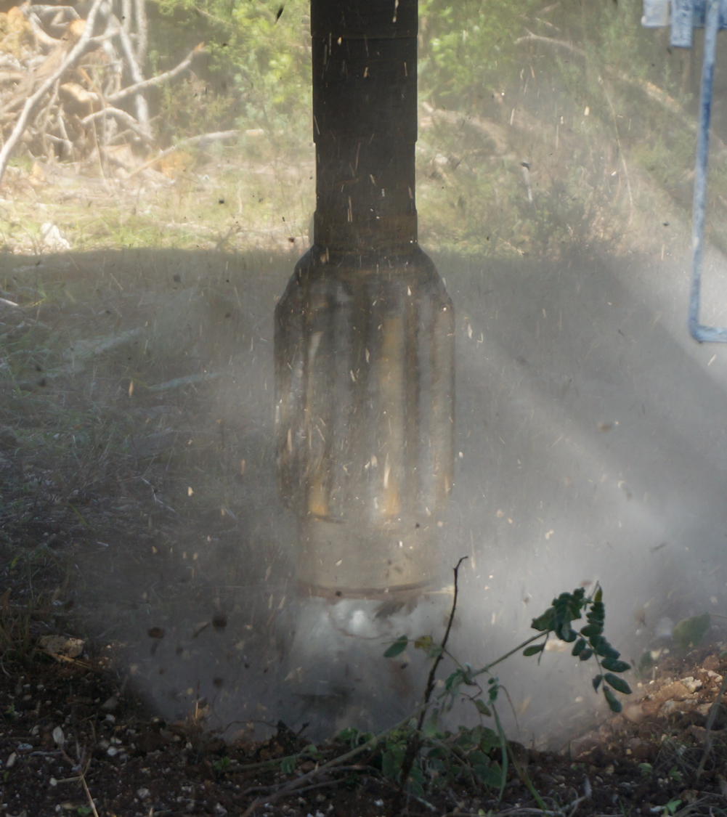
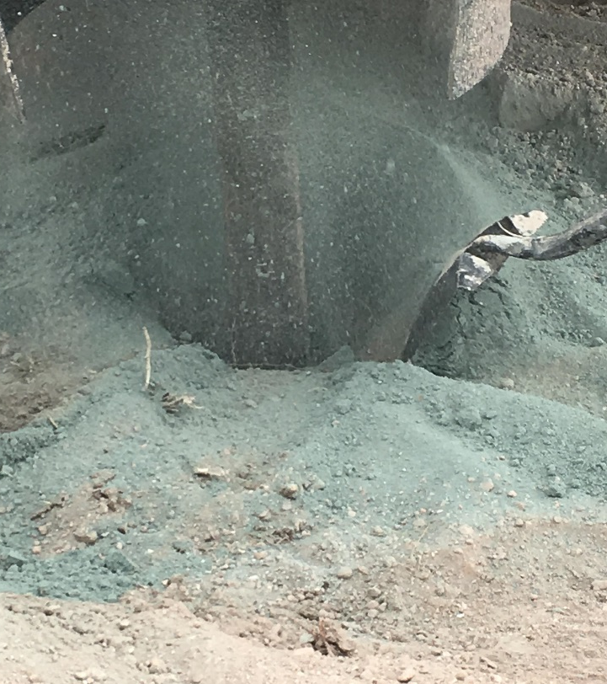
Direct Air Rotary
9

Slide 10
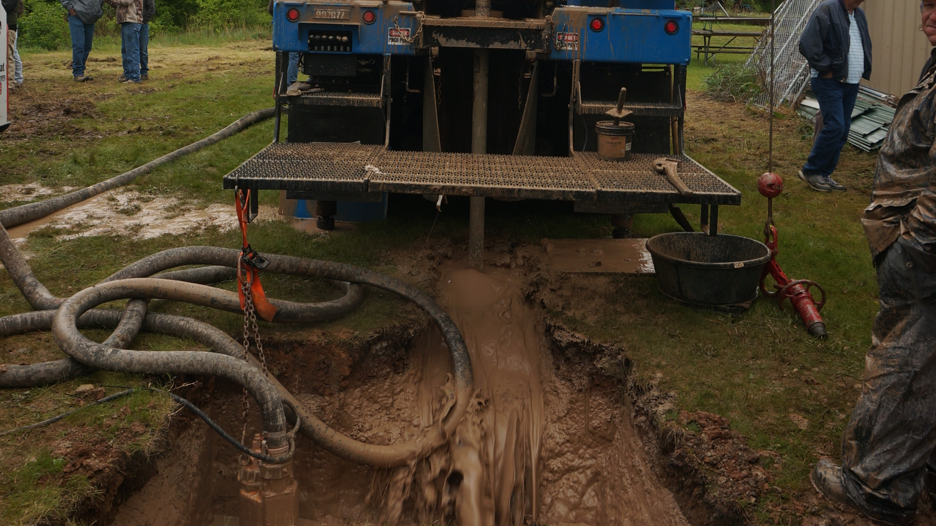
Conventional Mud Rotary

Slide 11
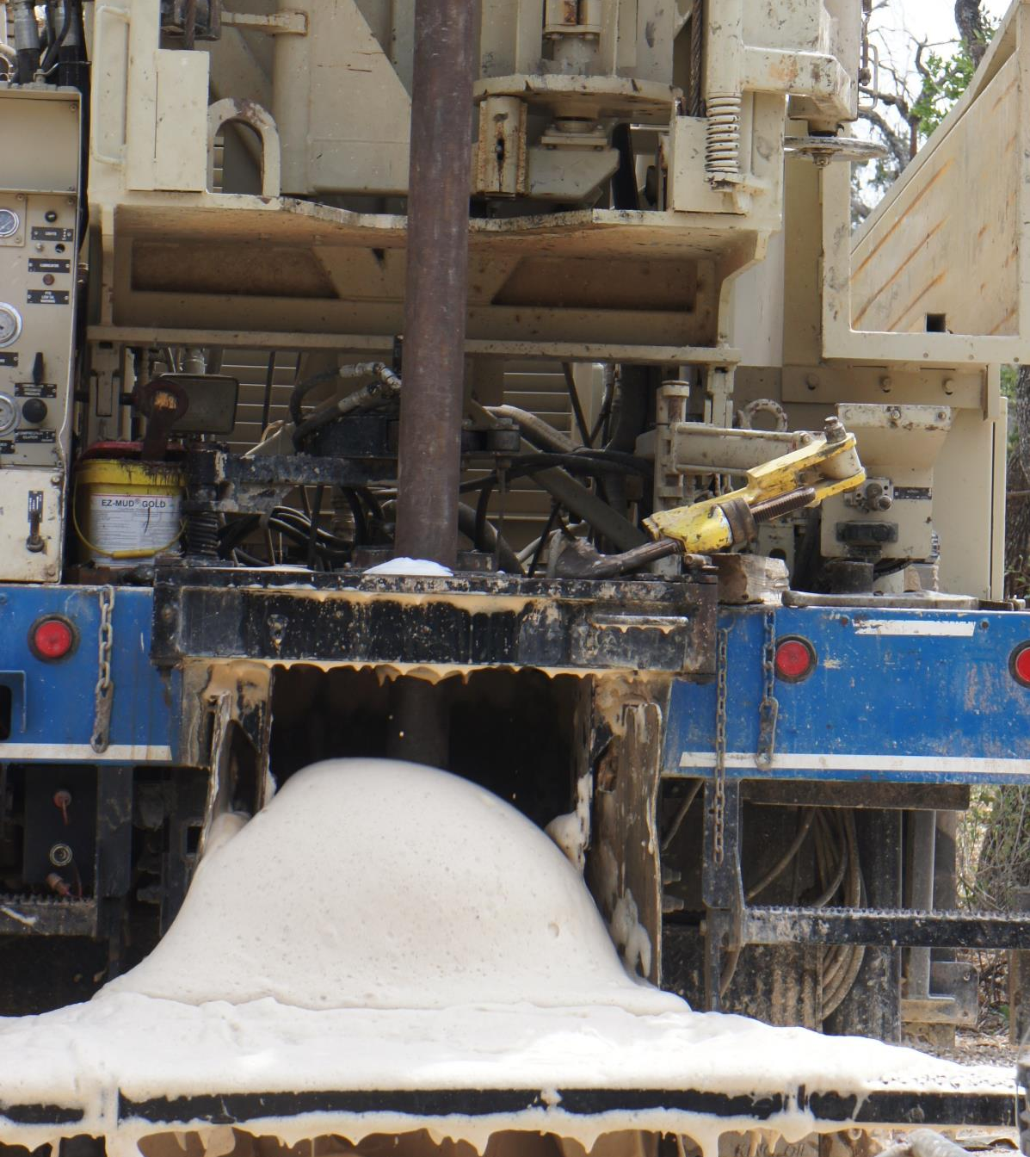
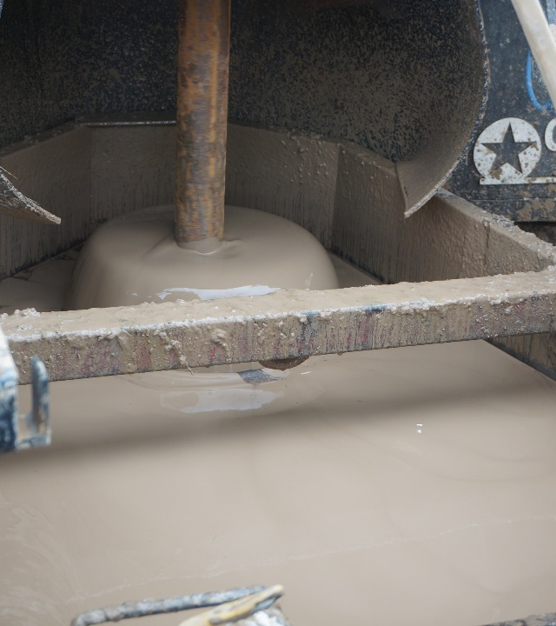
Engineered Drilling Fluids
Air Drilling
Siff Foam
Engineered Drilling Fluids
Mud Drilling
Water Bentonite Polymers

Slide 12
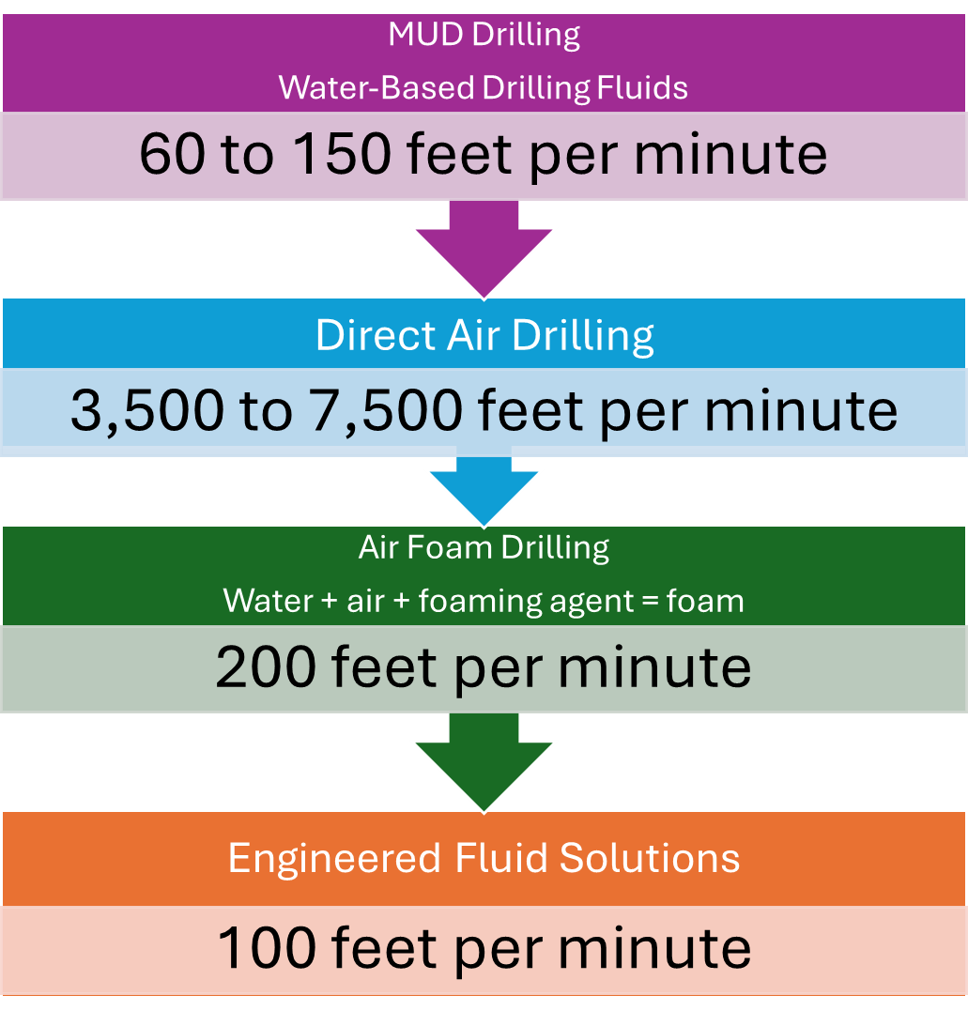
Target Up Hole Velocity

Slide 13
Drilling Program Objectives
Efficient Rate of Penetration: Matching Ideal Drilling System with geologic conditions.
Minimal Impact: The Borehole has minimal impact or influence on the surrounding environment, both subsurface and surface.
  Fragile Subsurface Formations.
  Water Production: Fresh, Brackish, Salt Water
  Volatile Gas: CO², H²S, Methane
  Dust, Noise, Drill Cuttings
Data Gathering: Realtime analysis of subsurface information: changes in geology, subsurface challenges, loss zones.
Discovering the unknown together!

Slide 14
Results of Proper Borehole Creation
Open: Borehole free of drilling cuttings and solids from surface to bottom.
Gauge: The hole diameter maintained within the specified diameter and direction from surface to total depth. Diameter within 2/32nd of the bit diameter.
Stable: Borehole integrity is free from swelling or collapse while tooling is out of the hole.
Straight: Drilled to the desired direction or angle specifications
Seamless Product Installation
  Loop to Bottom
  Annular Seal to Top
Efficient Resource Extraction

Slide 15
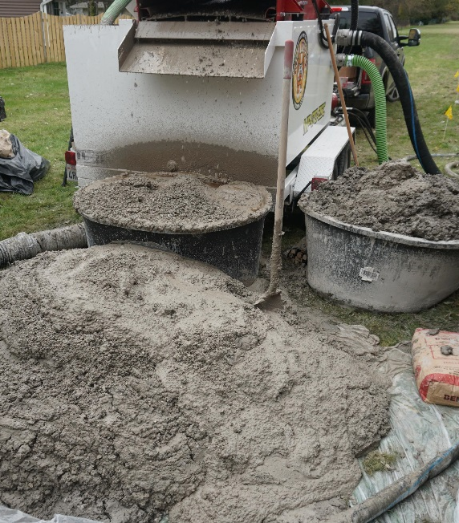
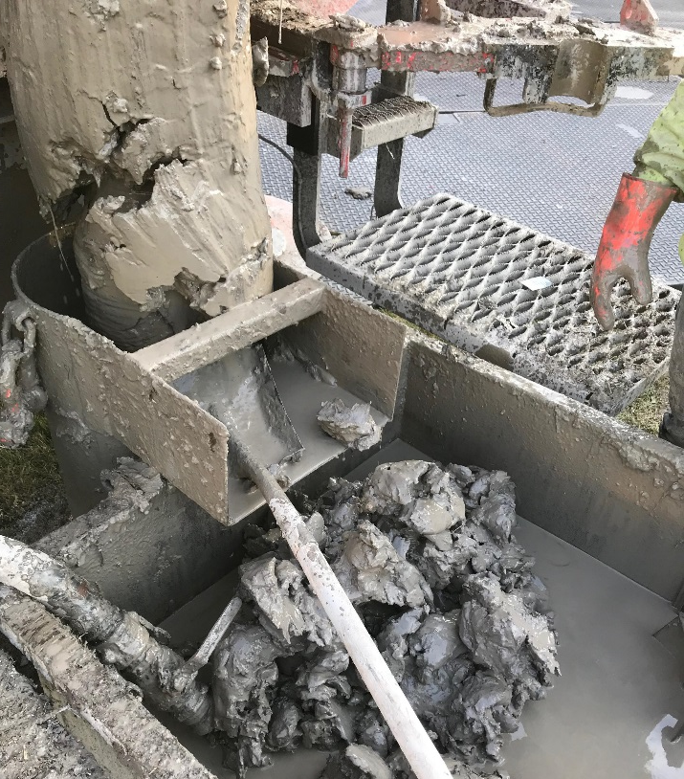
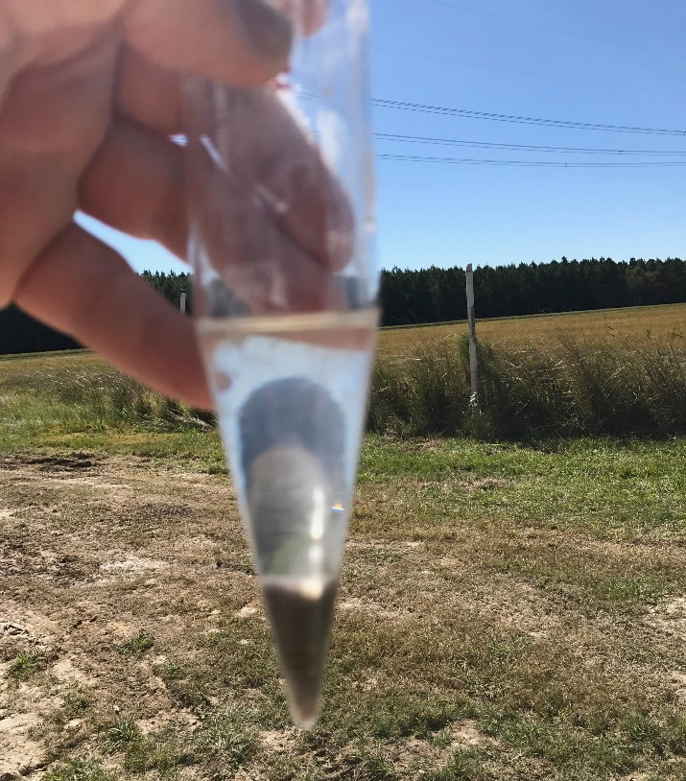
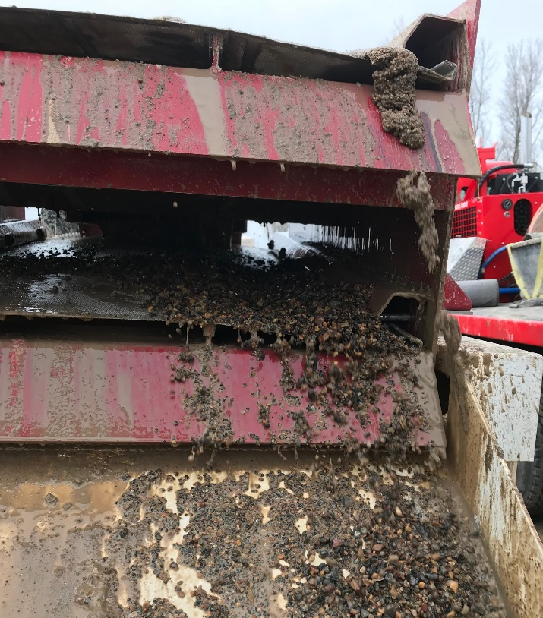
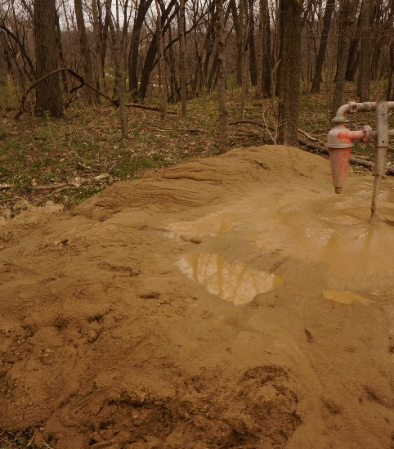
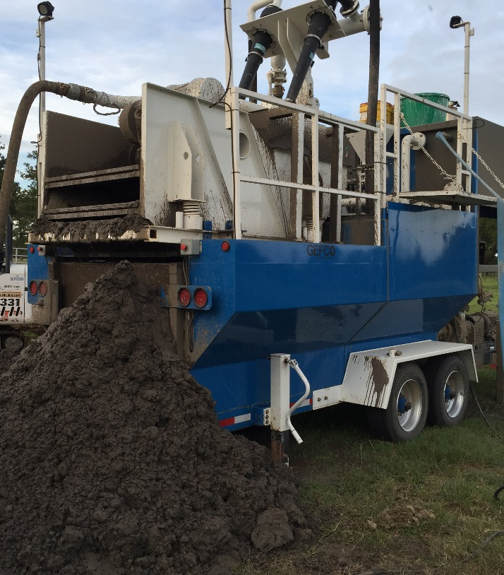
Drilling Cuttings
Drill Solids
Spoils
Results of Borehole Creation

Slide 16
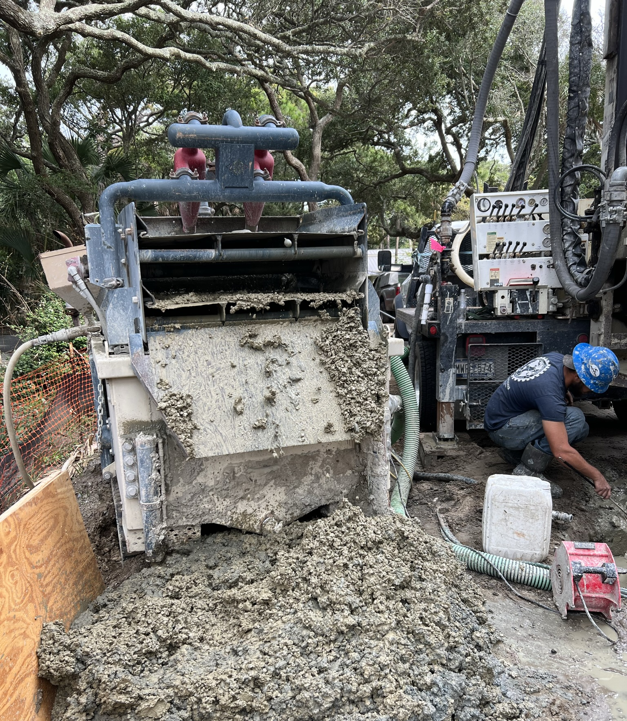

6” x 400’ = 2.9 CY
6” x 850’ = 6.17 CY
Dump truck = 10 CY
16

Slide 17
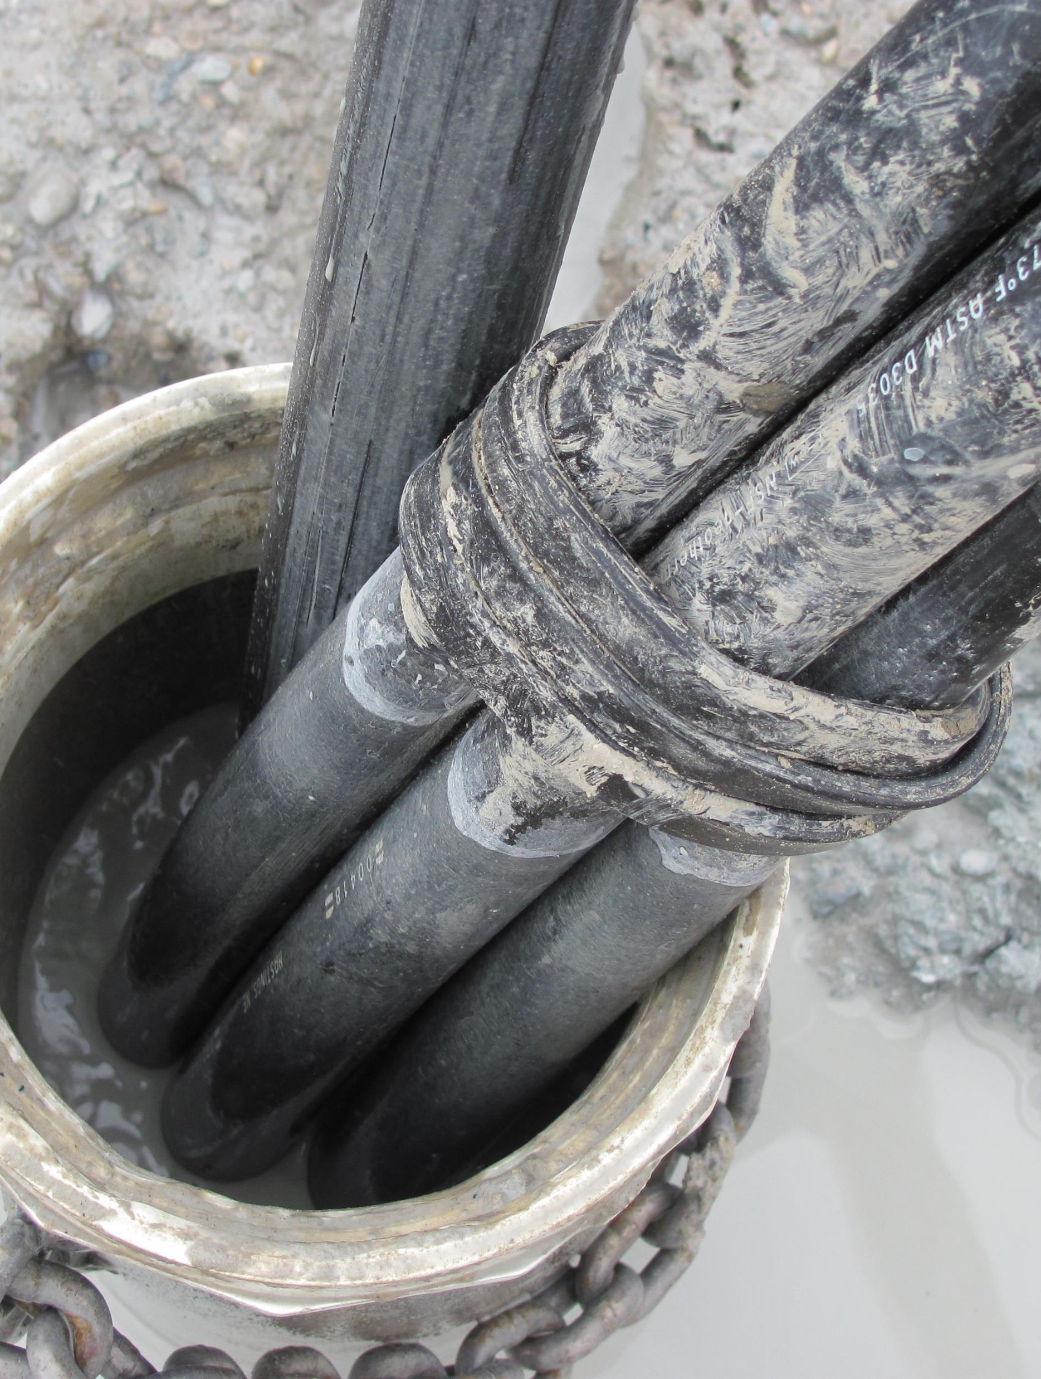
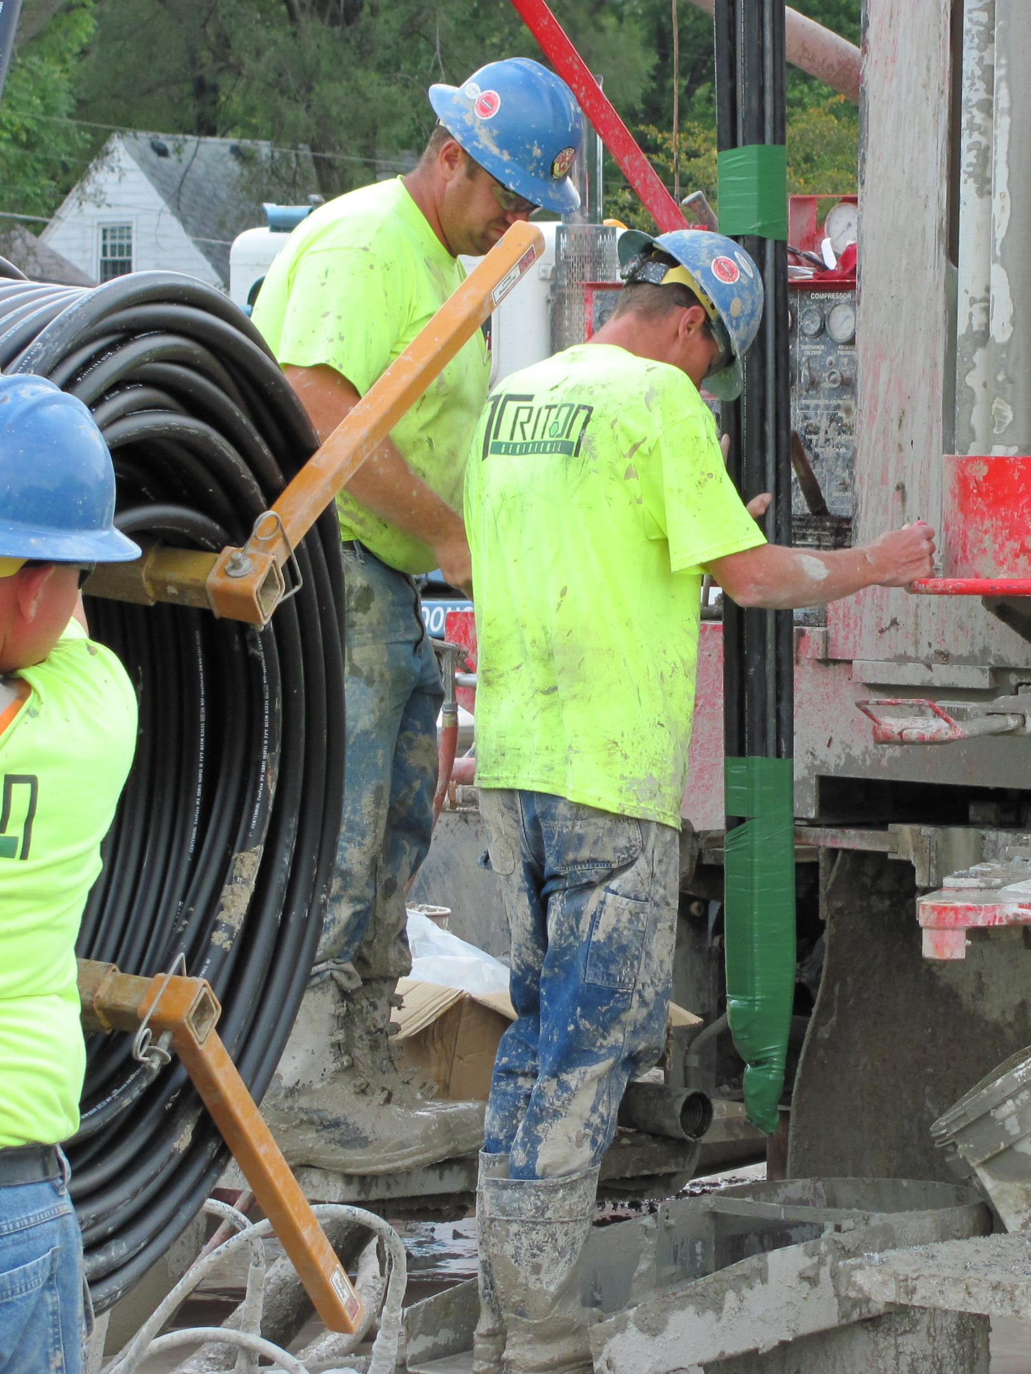
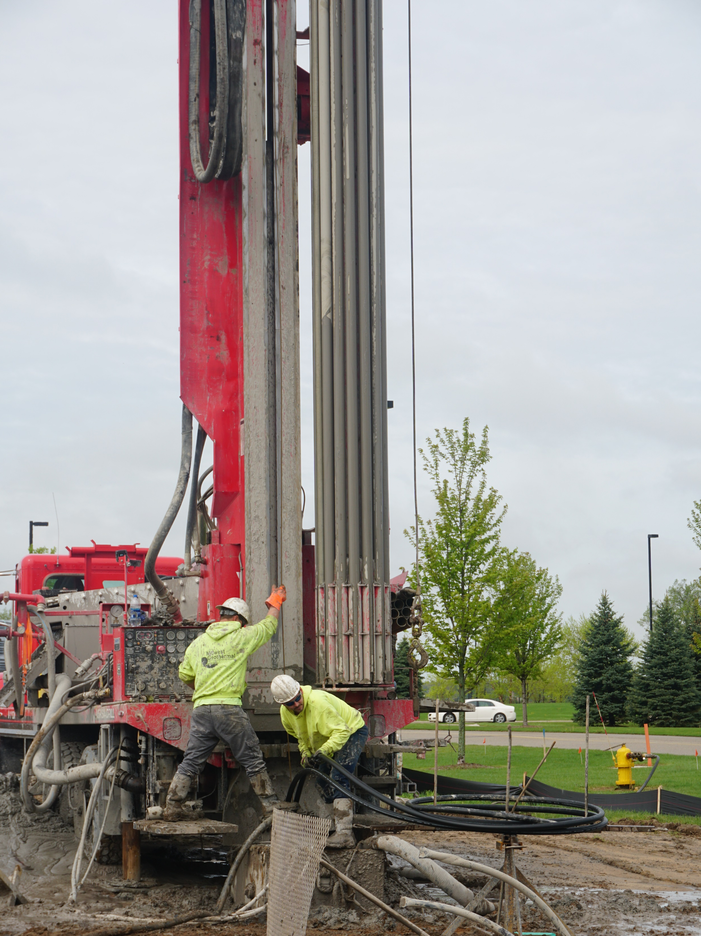
Loop Specifications
1.25 - 1.5 HDPE U-Bends or Alternative Engineered Designs

Slide 18
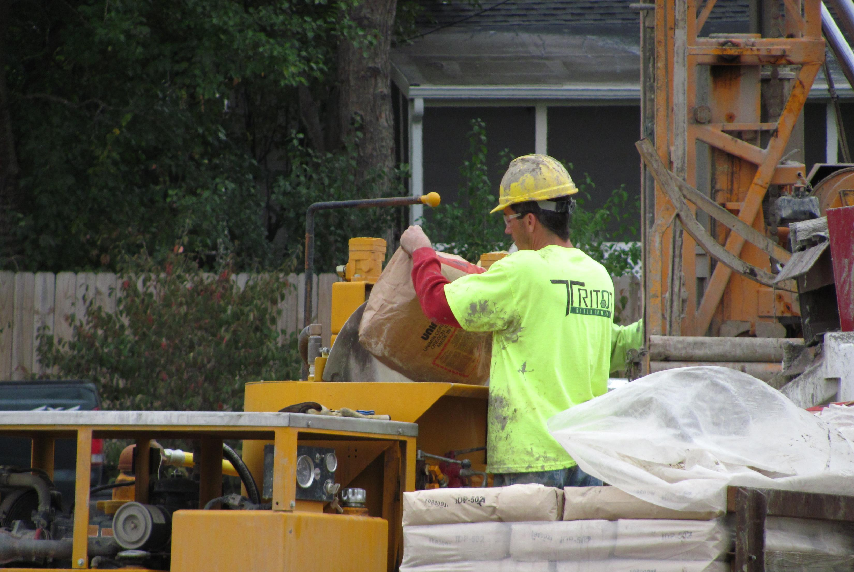
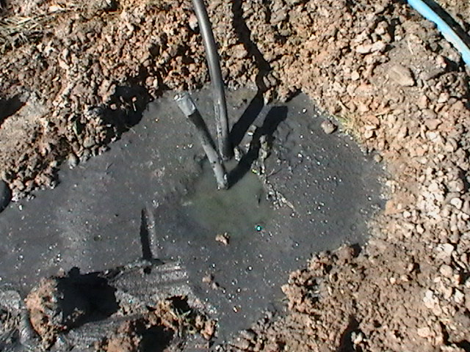
The Grouting Process

Slide 19
Tremie Line
Borehole
Borehole

Slide 20
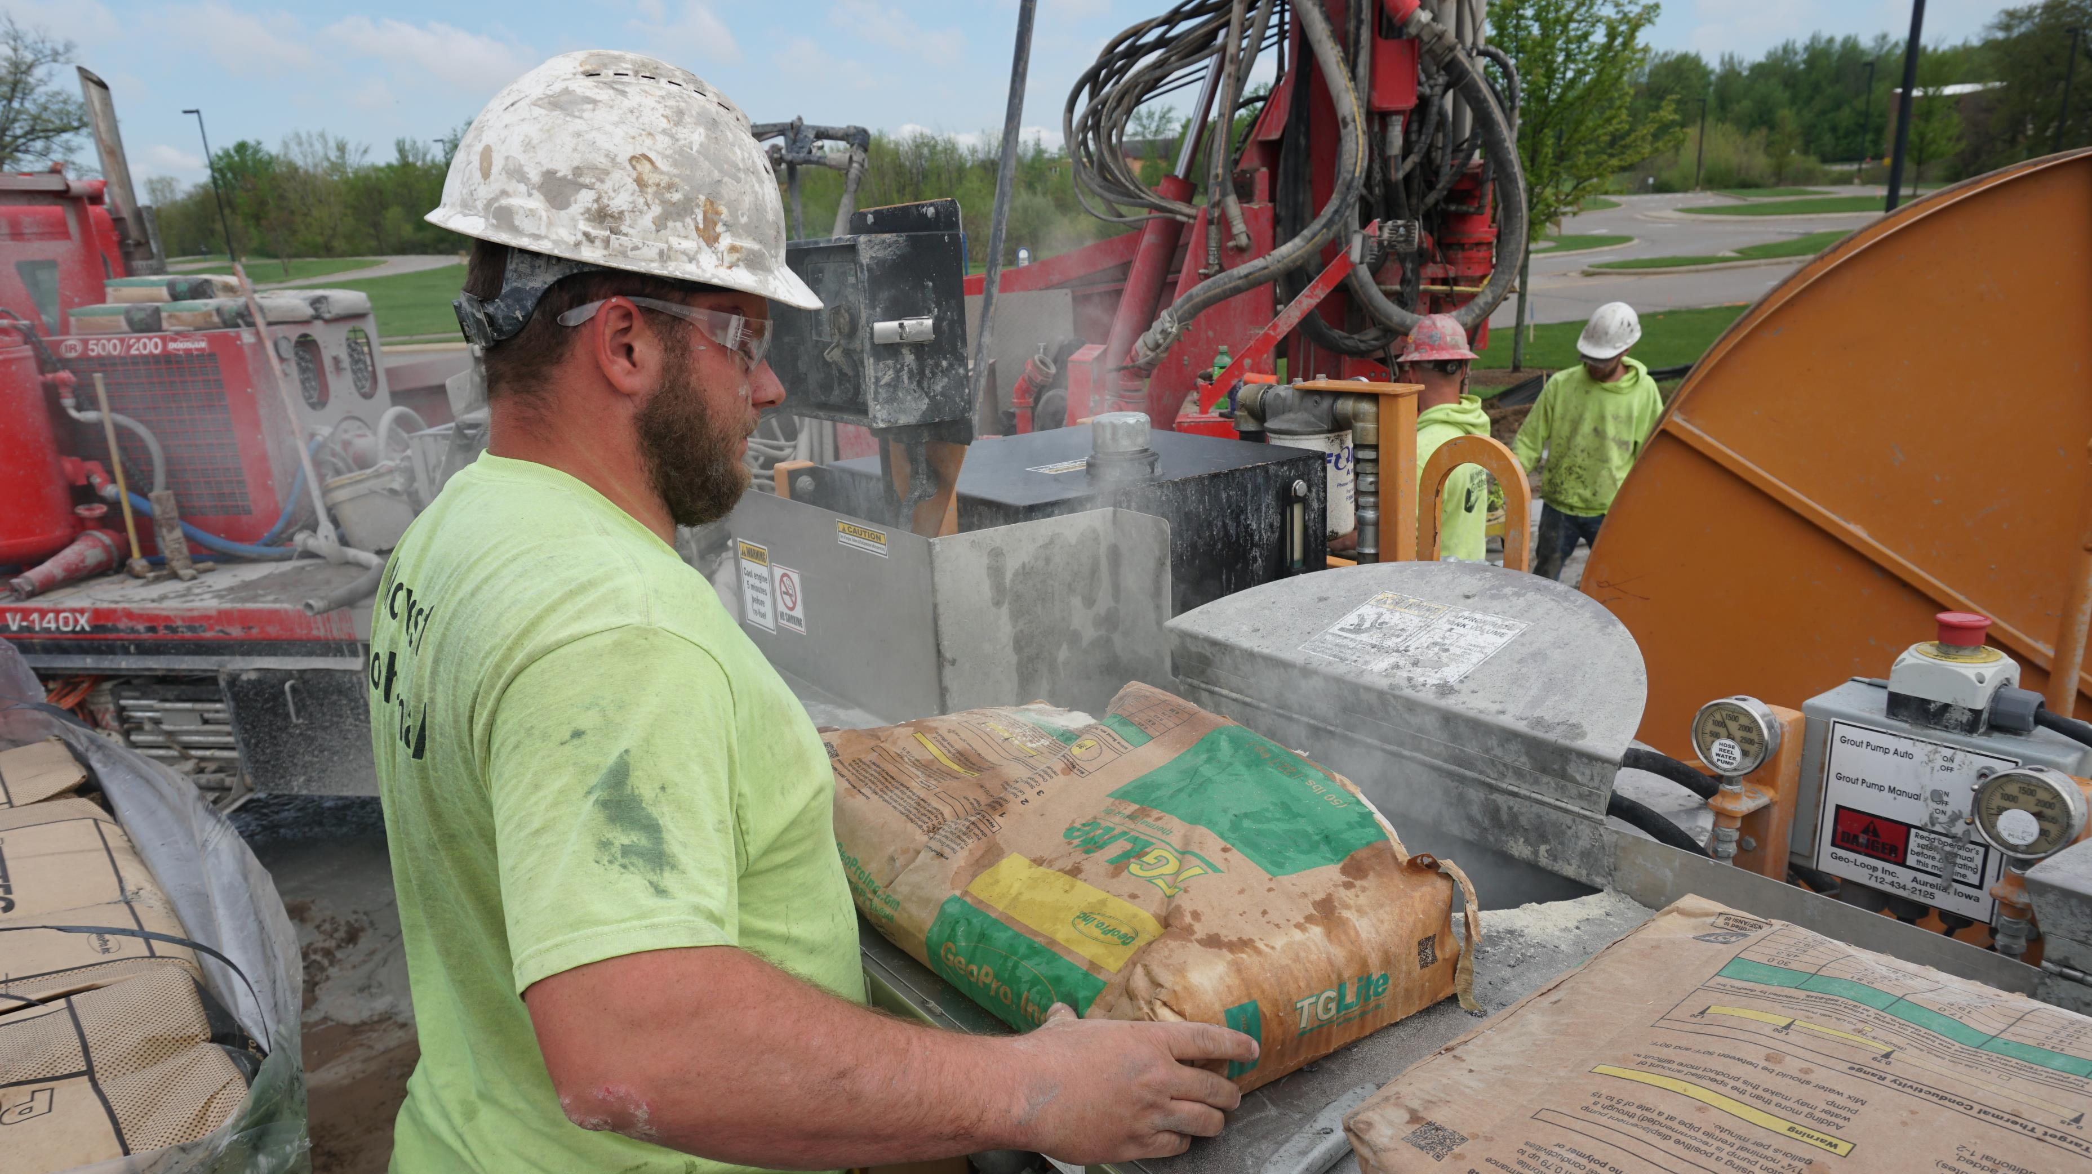

Slide 21
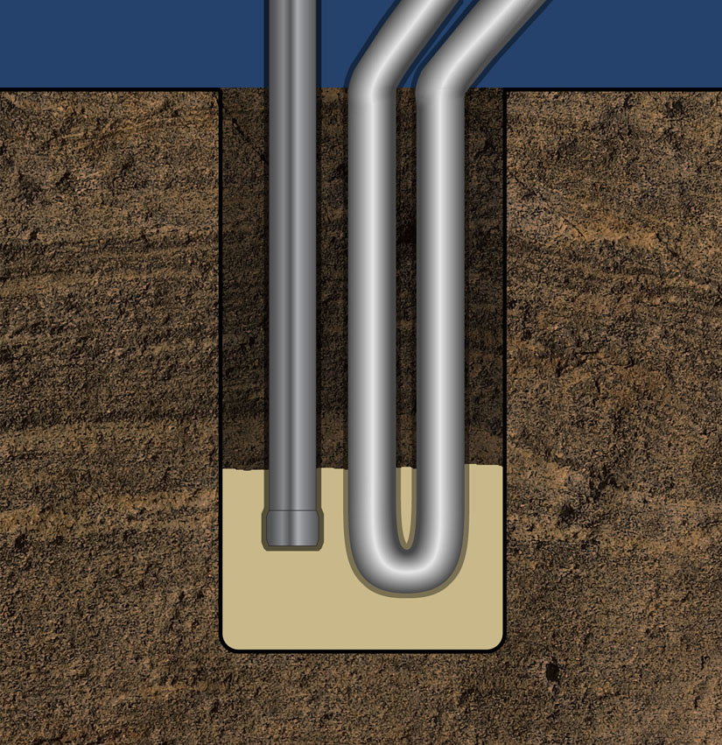

Slide 22
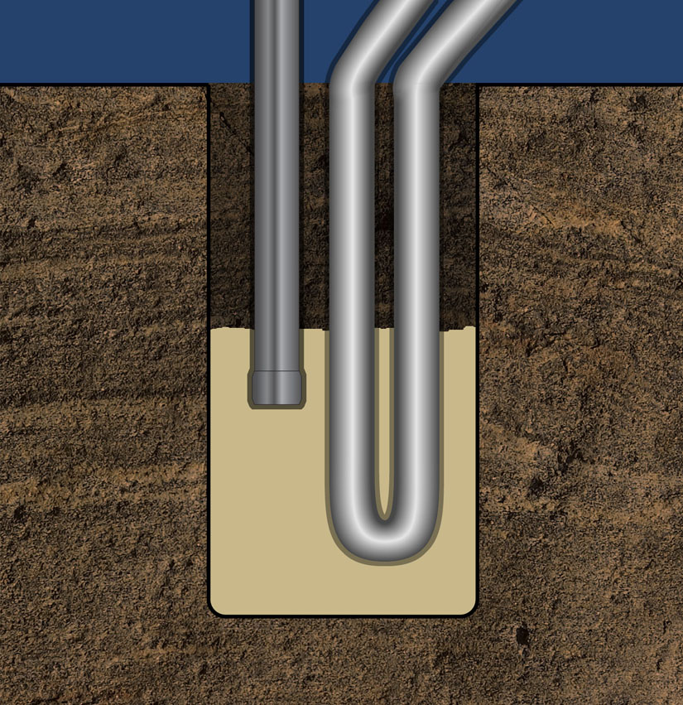

Slide 23
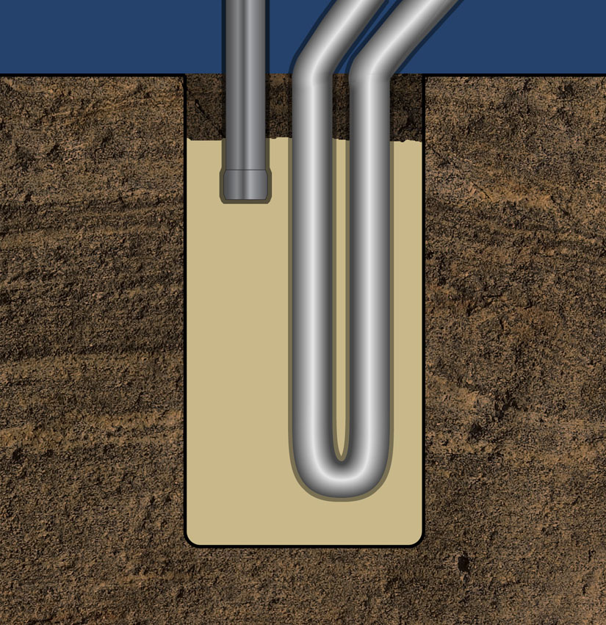

Slide 24
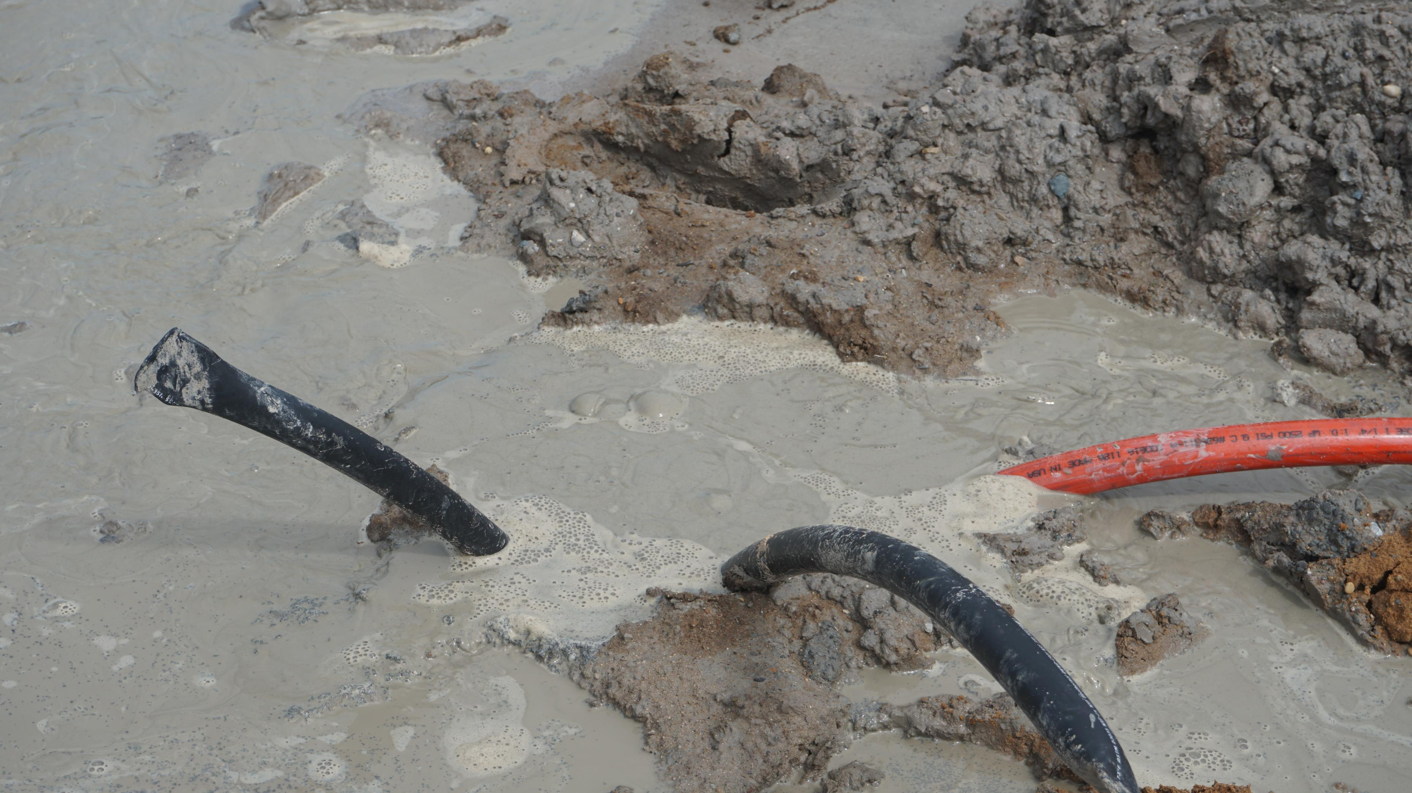

Slide 25
Grouting Geothermal Boreholes
To replace the Native Material with a media that meets or exceeds the sealing qualities of the native formation.
To ensure continuous contact between the loop and borehole annulus.
To completely seal the annular space
  Prevent Commingling of Aquifers
  Prevents Surface Contamination
To comply with Federal, State, and Local Well Construction Codes
To meet engineered specifications
  Thermal conductivity
  Borefield Integrity

Slide 26
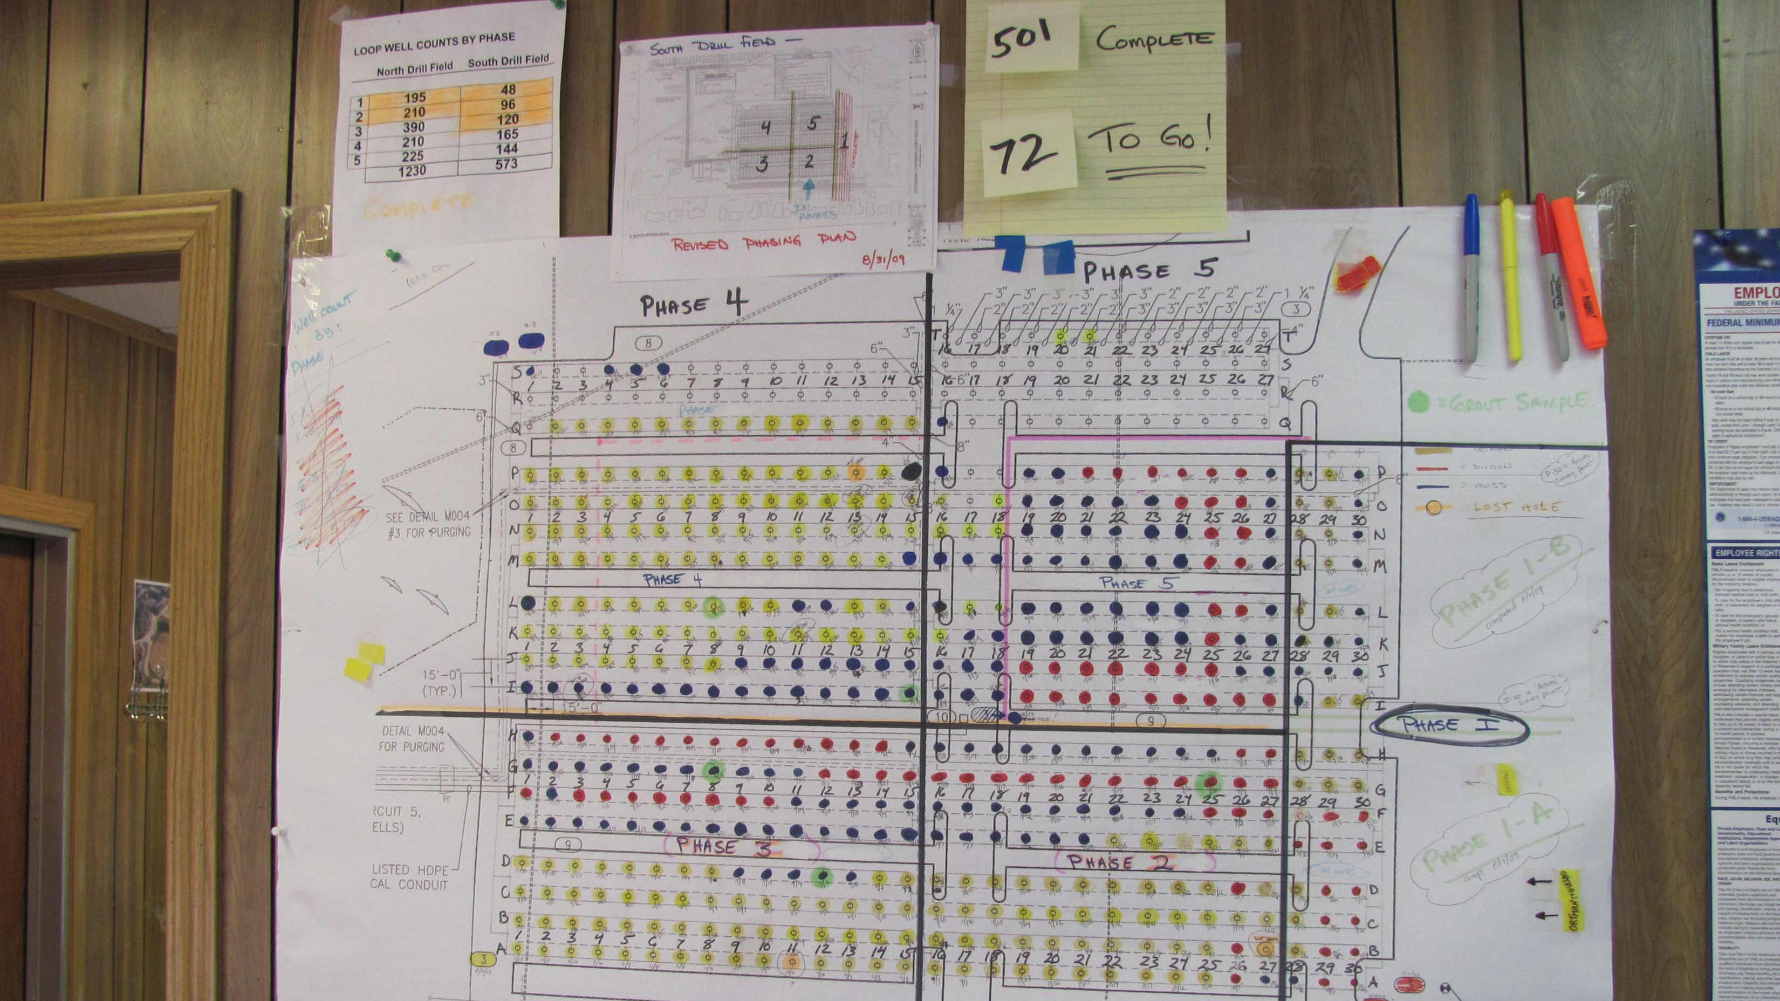
Life Cycle of a Borefield
Borehole Design
Method of Drilling
Subsurface
Conditions
Incorporation of drill solids
Method of Solids Control
& Site Management
Disposal & Site Restoration

Slide 27
Planning for
Success
Project
Timeline
Location
Local Regulations
Manmade Obstructions
Neighbors
Site Size
Weather
Site Management
Other Construction Operations & Activities
Sharing the Site
Drilling Project Management

Slide 28
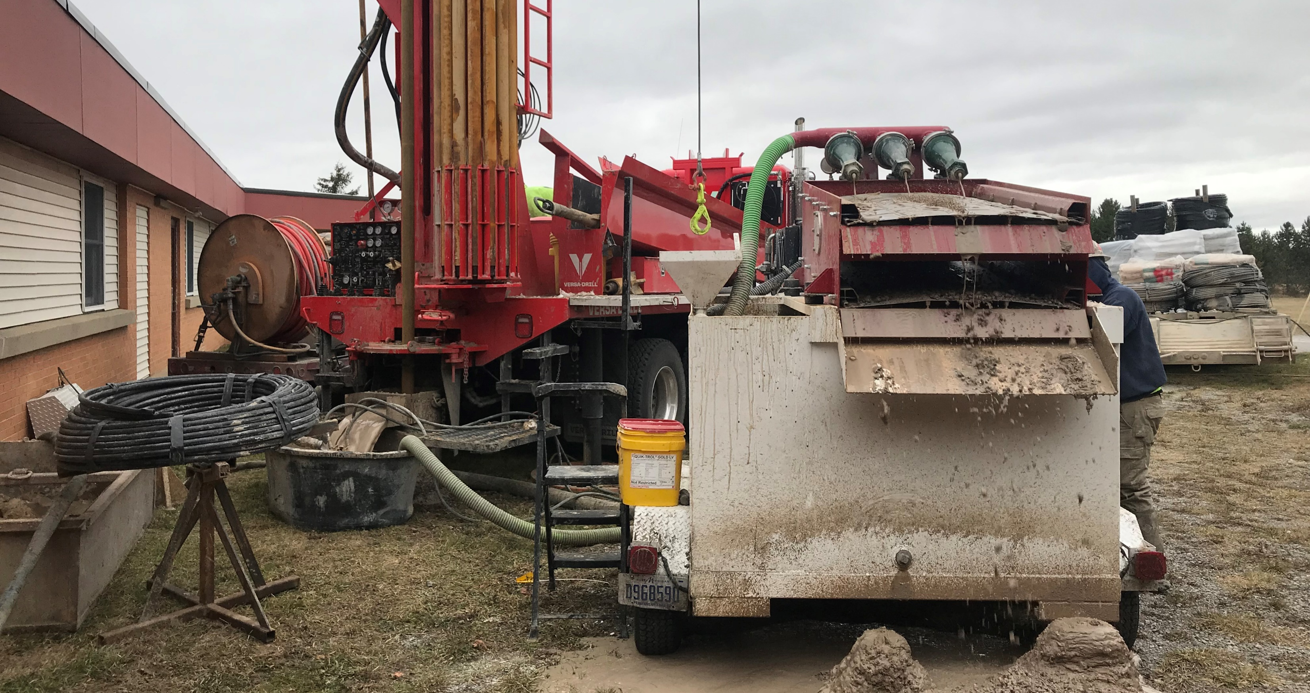
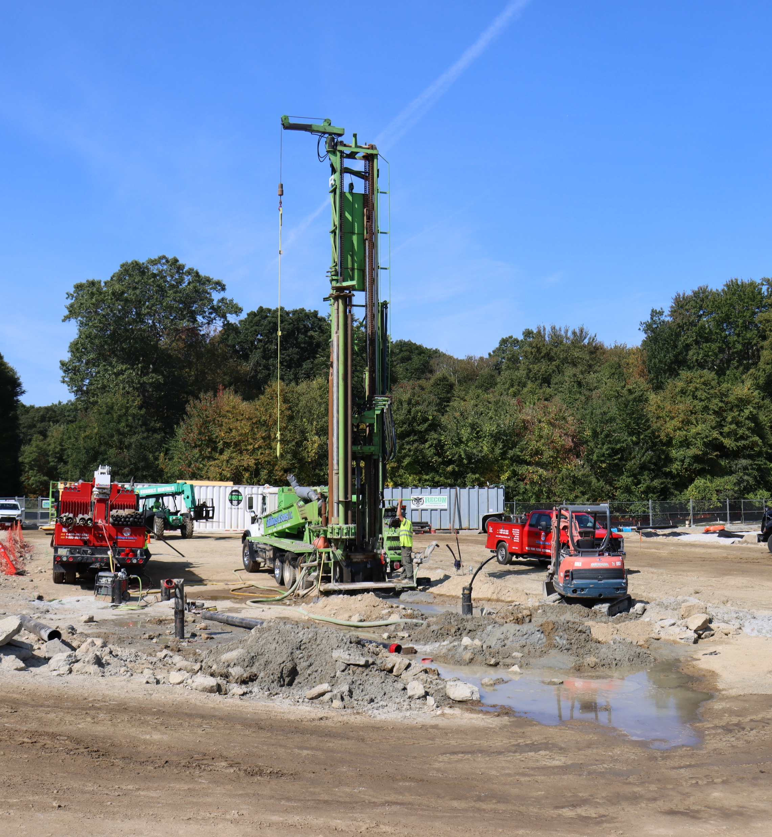
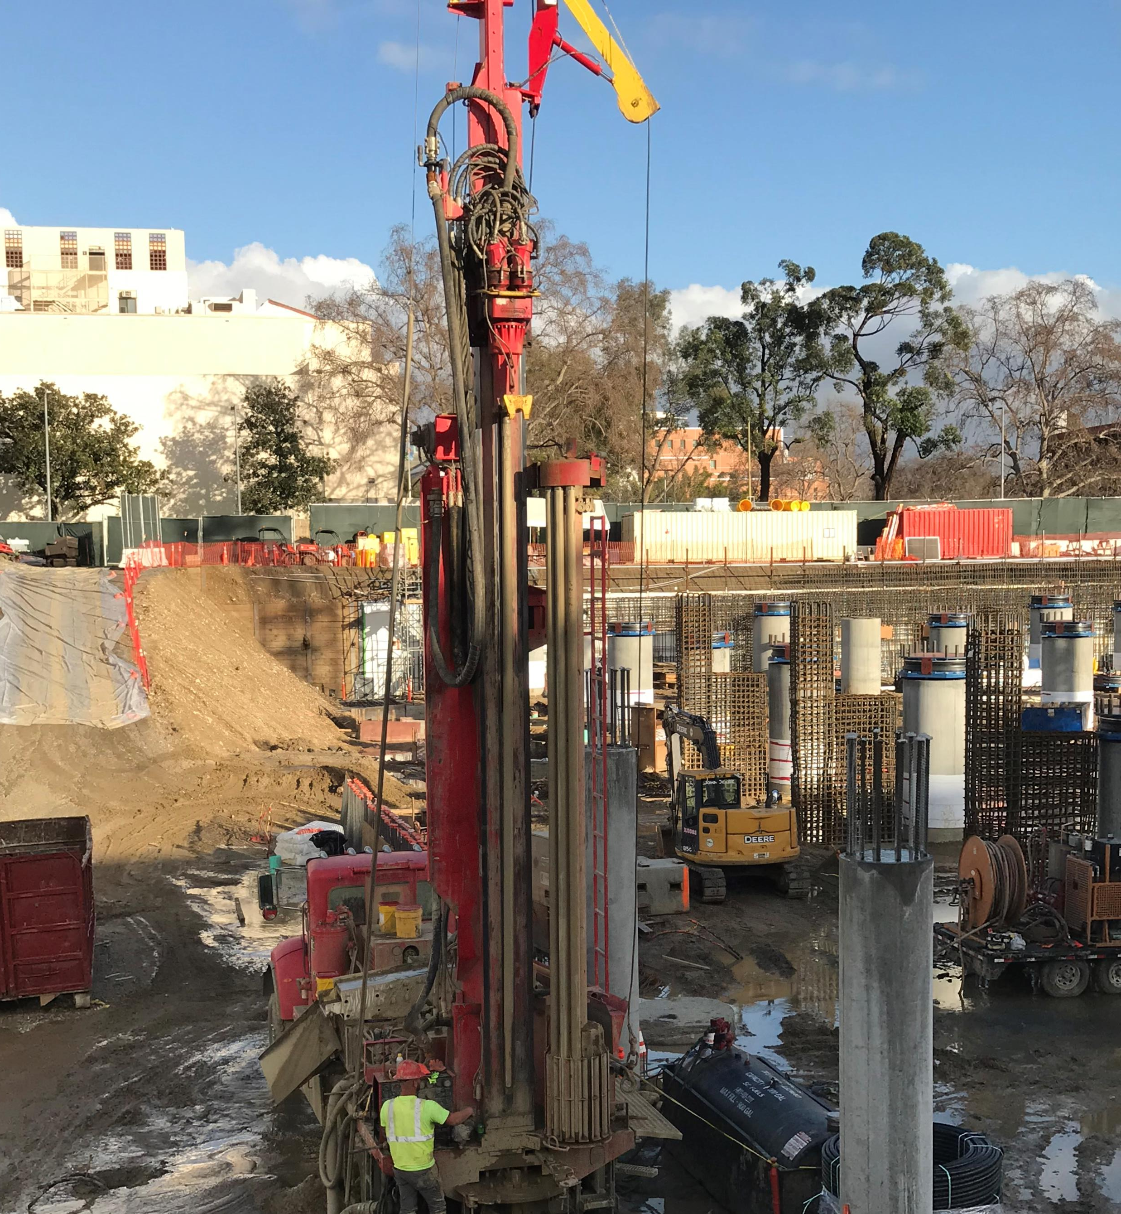
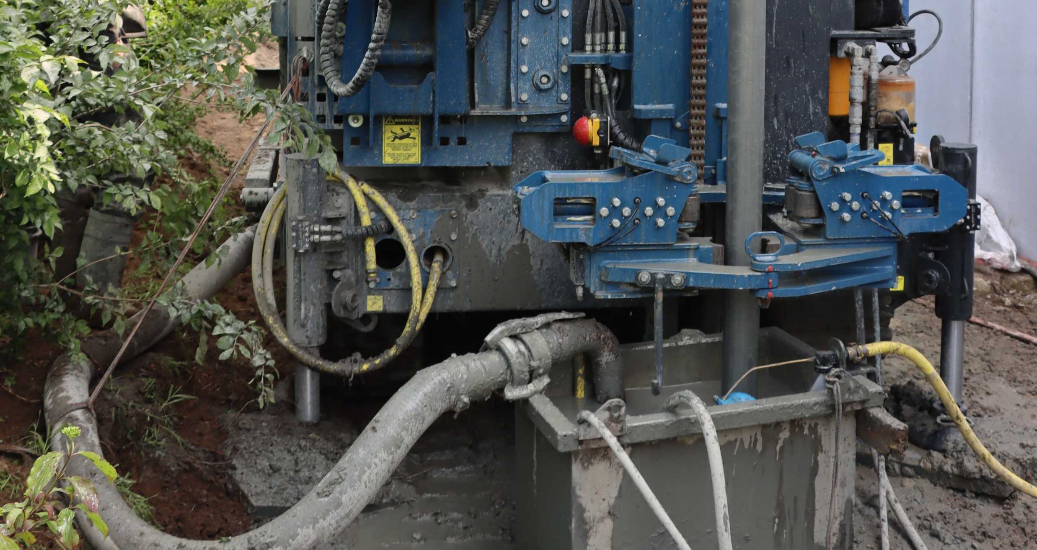
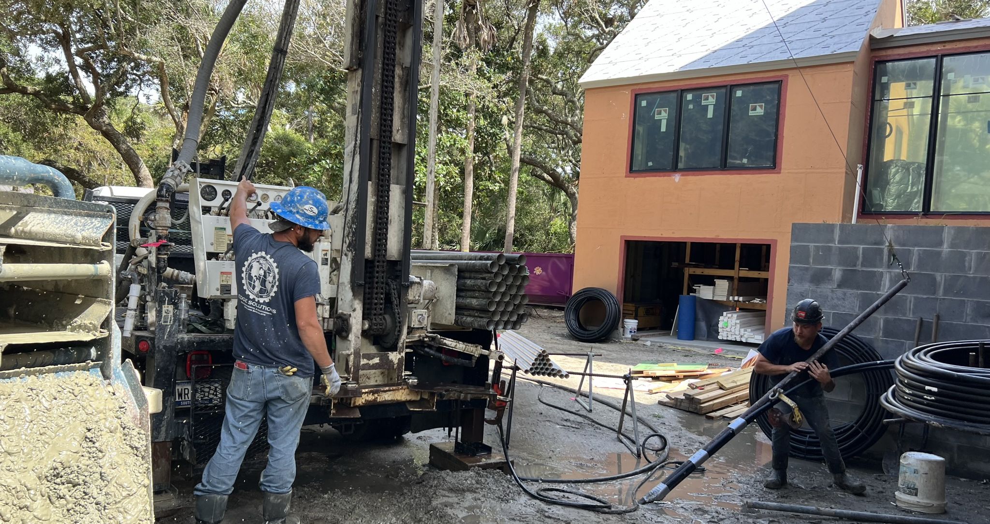
The Reality of Success

Slide 29
Manmade Subsurface Obstructions & Contaminates
Problematic Subsurface
Conditions
FORMATION HYDRAULICS
Fragile Formations
Cobbles – Boulders
Loss Zones, Fractures, Voids
Water
High Volume Zones
Well Head Protection Areas
Artesian Flow
Methane
H2S
Volatile Gas
Impacts to project success
Local Geology
Sand
Gravel
Rock
Clay
Shale
Utilities
Old Building
Old Dump
Industrial Pollution
Drilling Program
Management

Slide 30
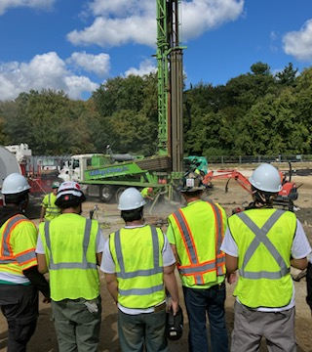
Contractor Qualifications
Equipment
  Availability
  Tooling
  Drilling Method
Compatibility Location
  Geology
  Site Footprint
  Environmental Demands
  Site Management
Project Timeline
Borehole Design
  Diameter
  Loop Type
  Grout
Project Restoration, Clean up and Disposal
Workforce
  License Qualifications, State Drilling License, IGSHPA
  Safety Certifications
  Insurance Standards
  Quality Installations

Slide 31
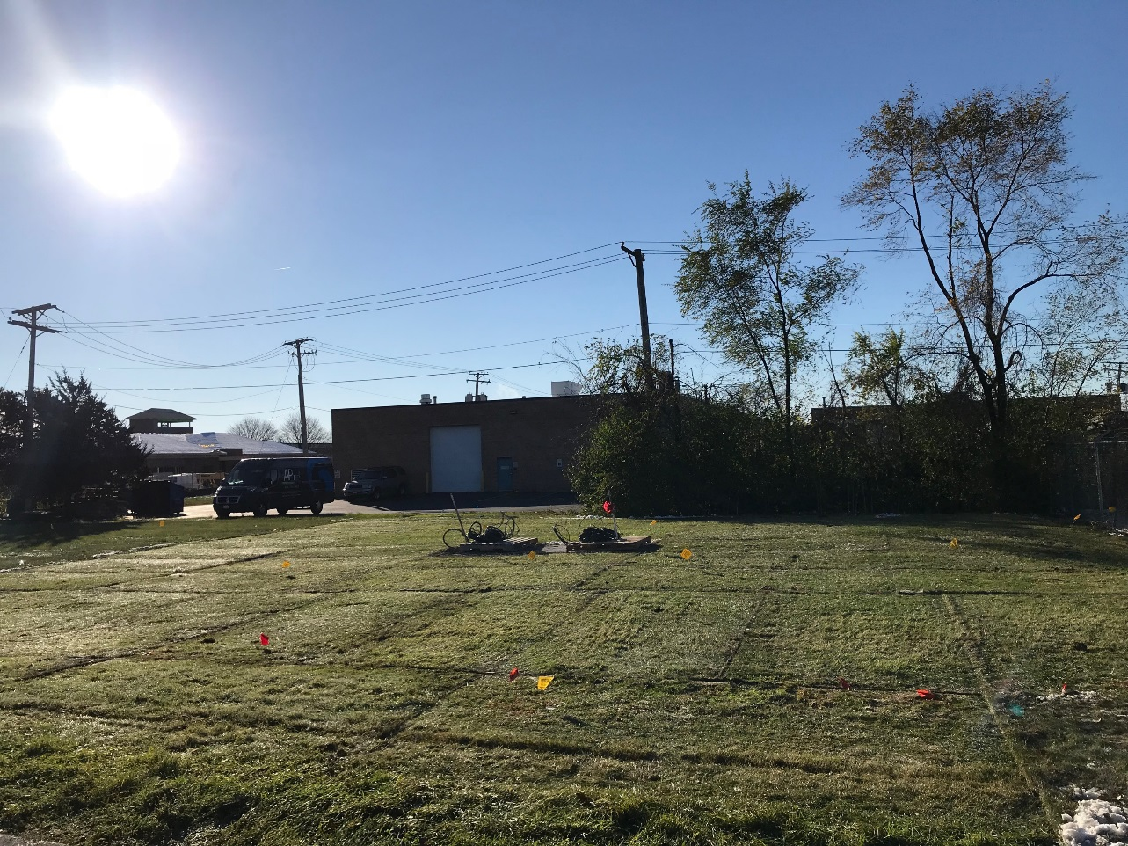
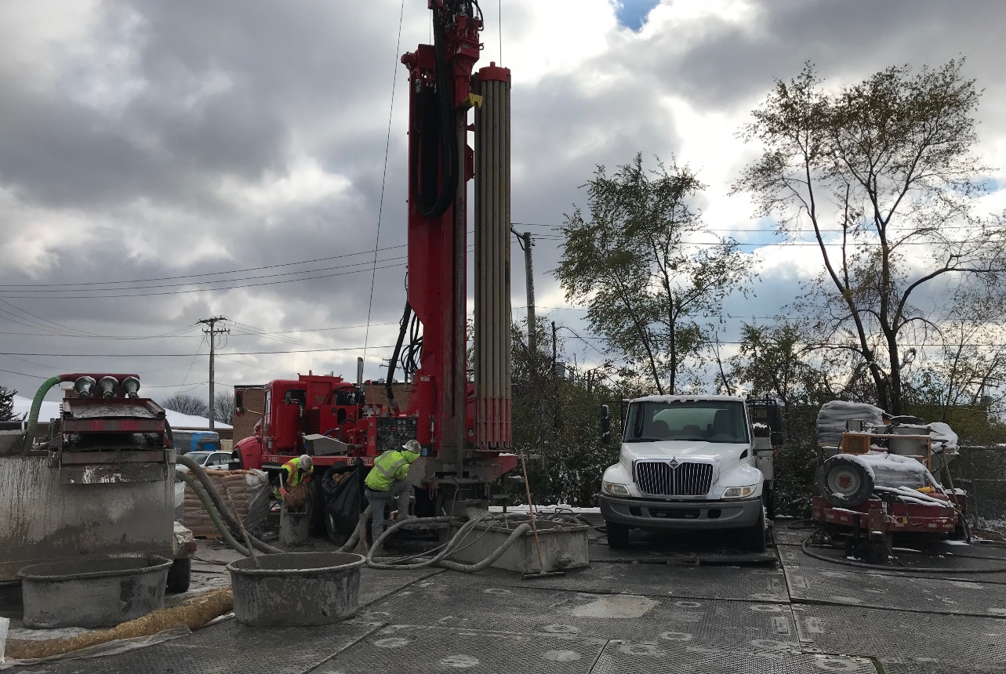
Surgical Execution

Slide 32
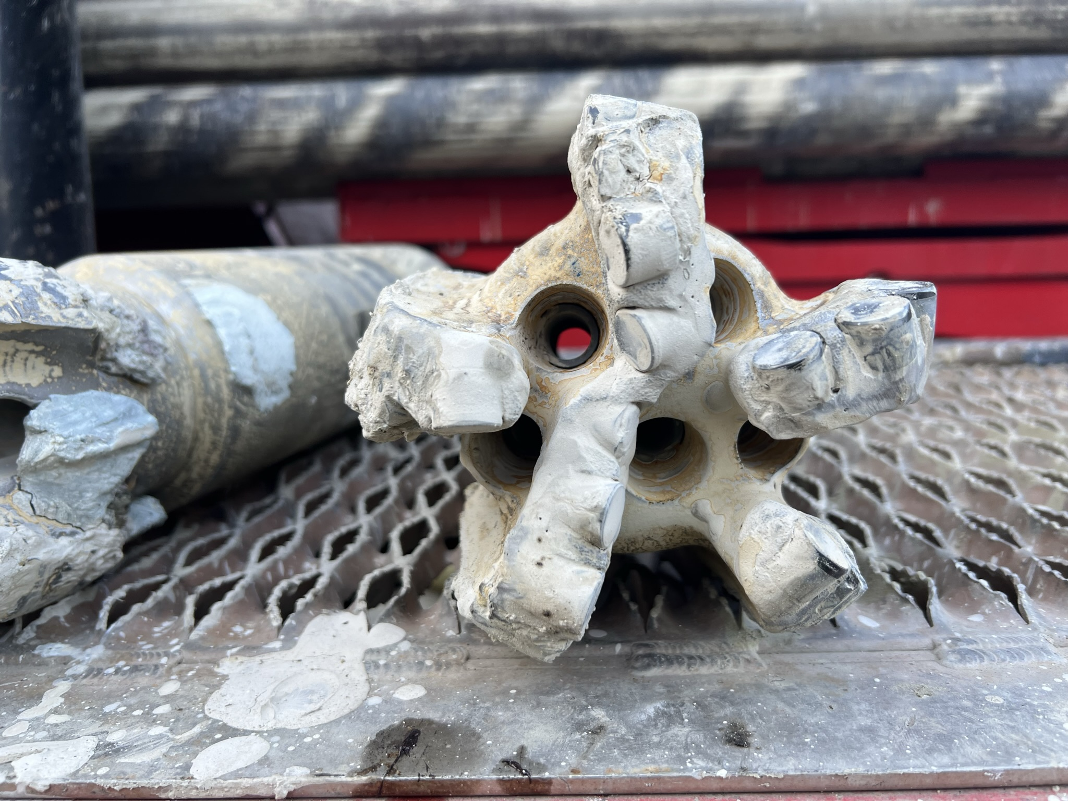
Lessons Learned
Regardless of the geographic location or geologic conditions, a competent drilling company will approach a project with the following objective:
To safely complete the project with the best drilling methods, equipment, and tooling available while minimizing risk to the company and client.
Every project has the opportunity for a more optimized drilling method, equipment, or tools to increase productivity. Often, equipment availability and cost supersede maximizing drilling efficacy.

Slide 33

Lessons Learned in the Past 22 Years
Trust in the Qualified Contractors
Specified Drilling Method & Driller Recommendation
Test Holes & Representative Samples
Test Holes vs Test Wells
  What we can learn from the municipal water well approach.
Bore Fields & Bore Hole Specifications
  Early 2000s to Today
Equipment Capabilities & Limitations
Loop & Grout Installation shallow to deep.

Slide 34
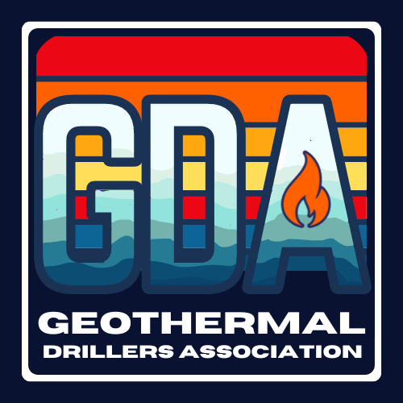
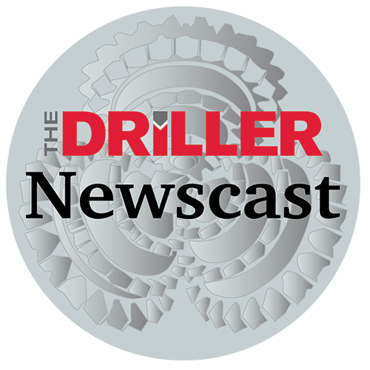
Thanks
Brock Yordy
Co-Founder The Geothermal Drillers Association
Geothermal Drilling SME, Educator, Trainer, and Journalist

Slide 35
MIT OpenCourseWare
https://ocw.mit.edu/
RES.ENV 007 Geothermal Energy Networks (GENs): Transforming our Thermal Energy System
IAP 2025
For information about citing these materials or our Terms of Use, visit: https://ocw.mit.edu/terms.

