Slide 1
CSA / ANSI / IGSHPA C448
2025 New Edition –
Overview & Highlights
January 31, 2025
© 2018 CSA GROUP TESTING & CERTIFICATION INC. | ALL RIGHTS RESERVED.
1

Slide 2

Brief Overview & History
2

Slide 3
Codes and Standards
What’s the Difference?
Code: A code is a set of regulations, rules, and guidelines established by a recognized authority or government agency. Codes define minimum requirements and are legally enforceable and compliance with them is mandatory, and failure to adhere to the code may result in penalties or restrictions.
Standard: A standard is a document or specification developed by a recognized standard-setting organization. Standards are voluntary guidelines that establish a consistent and accepted approach to processes, products, services, or systems. Unlike codes, compliance with standards are not legally mandated, but adherence to standards is often seen as a mark of quality, safety, and best practices.
3

Slide 4
Codes and Standards
What’s the Difference?
  However ……
  A standard can become code if a code body such as the International Association of Plumbing and Mechanical Officials (IAPMO) or International Code Council (ICC) adopts a standard into their codes.
4

Slide 5
Agenda
Feedback from Industry on 2016 Standard
Standard Outline for 2025
General Applications Section Outline
Notable Changes
Additions
Next Steps
5

Slide 6
Feedback from
Industry on 2016 Standard
Review of the 2016 Standard was undertaken by the IGSHPA Standards Committee in 2019. Comments were provided to all task force members for consideration at the beginning of the new standard development cycle which began in June 2021.
Recommendations included moving away from the 2016 format which was meant to be standalone by heat exchanger type to a more concise standard which eliminated a lot of the redundancy by addressing common requirements in the General Applications Section.
In addition to recommended edits for each section of the standard, there were specific recommendations to review and update:
  In situ (formation) thermal conductivity test
  Piping materials
  Heat transfer fluids for GSHP systems
  Hydrostatic pressure testing
6

Slide 7
Standard
Outline for 2025
The ANSI/CSA/IGSHPA C448 Series now consists of the following parts:
ANSI/CSA/IGSHPA C448.0, Design and installation of ground source heat pump systems — General applications for all systems;
ANSI/CSA/IGSHPA C448.1, Design and installation of ground source heat pump systems for residential and other small buildings;
ANSI/CSA/IGSHPA C448.2, Design and installation of ground source heat pump systems for commercial and institutional buildings;
ANSI/CSA/IGSHPA C448.3, Planning, design, installation and commissioning of district energy systems;
ANSI/CSA/IGSHPA C448.4, Installation of vertical configured closed-loop ground source heat pump systems;
7

Slide 8
Standard
Outline for 2025
Continued
ANSI/CSA/IGSHPA C448.5, Installation of horizontal configured closed-loop ground source heat pump systems;
ANSI/CSA/IGSHPA C448.6, Design and installation of surface water heat pump systems;
ANSI/CSA/IGSHPA C448.7, Design and installation of groundwater systems;
ANSI/CSA/IGSHPA C448.8, Installation of standing column well heat pump systems;
ANSI/CSA/IGSHPA C448.9, Design and installation of ground source heat pump systems connected to energy foundations; and
ANSI/CSA/IGSHPA C448.10, Installation of direct exchange heat pump systems.
8

Slide 9
Informative
Annexes for
2025
Electrical, environmental, and other guidelines for ground source heat pumps and underground thermal energy storage (UTES) systems
Installation checklist for open- and closed-loop ground source heat pump systems
Site Survey/As-built Worksheet
Annual energy requirements based on modified ASHRAE bin hour method
Wastewater Energy Transfer Systems Design and Installation
Bibliography
9

Slide 10
General
Applications
Section Outline
The General Applications section of this Standard covers minimum requirements for equipment and material selection, site survey, system design, installation, testing and verification, documentation, and commissioning and decommissioning.
Clause 1 – Scope
Clause 2 – Reference publications
Clause 3 – Definitions
Clause 4 – General
Clause 5 – Equipment, Materials, and Handling
Clause 6 – Site Survey Requirements
Clause 7 – Design
Clause 8 – Installation
Clause 9 – System testing, verification, and delivery
Clause 10 –Decommissioning and abandonment
10

Slide 11
Notable
Changes:
Definitions
Clarifications and clean-up of C448.0 Clause 3 Definitions, for example:
Designer – the entity legally responsibility for the ground-source heat pump system design.
Ground heat exchanger - a variety of heat exchangers, external or below a building, that use the ground, groundwater, wastewater, or surface water as a heat source and sink.
Note: Ground heat exchangers include vertical loop ground heat exchangers, horizontal loop ground heat exchangers, submerged heat exchangers, and groundwater heat exchangers
Ground-source heat pump systems – a variety of systems that use the ground, groundwater, or surfaces of water as a heat source and sink. The general terms include ground-coupled heat pump (GCHP), groundwater heat pump (GWHP), and surface water heater pump (SWHP).
11

Slide 12
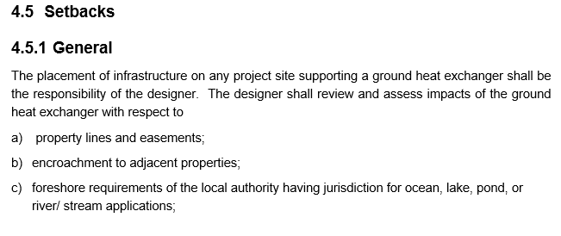
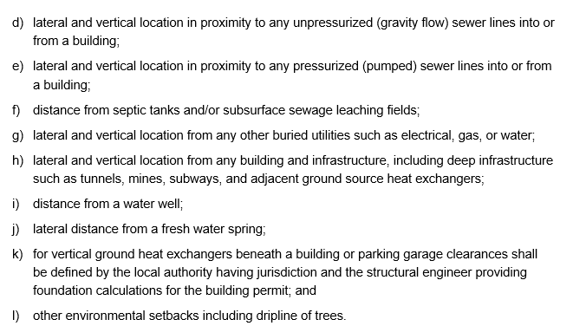
Notable
Changes:
Setbacks
12

Slide 13
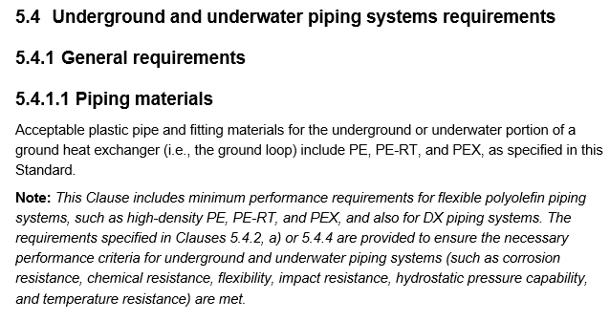
Notable Changes:
Piping materials
Note: CPVC/PVC is no longer listed as an acceptable piping material for field headers, manifolds, and indoor piping associated with GSHP systems.
13

Slide 14
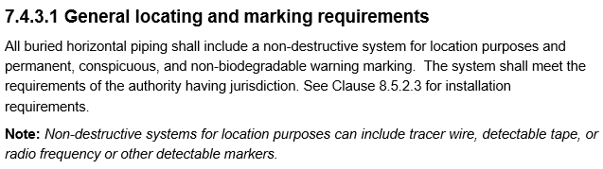
Notable Changes:
Horizontal piping locations
Updated C448.0 Clauses 7.4.3 Horizontal piping location and 8.5.2.3 Locating and marking buried pipes.
14

Slide 15
Notable Changes:
Heat Transfer
Fluids
C448.0 Clause 5.7
5.7.1 System preparation
5.7.1.1 General
5.7.1.2 System cleaning process
5.7.1.3 System disinfection process
5.7.2 Water quality requirements
5.7.2.1 Water analysis
5.7.2.1.2 Water quality specification
5.7.2.2 Corrosion inhibitors
5.7.2.3 Scale inhibitors
5.7.3 Heat transfer fluids with anti-freeze
5.7.3.1 General
5.7.3.2 Acceptable fluids
5.7.3.3 Flammable heat transfer fluids
5.7.3.4 Chemical inhibitors
5.7.3.5 Properties of anti-freeze fluids
15

Slide 16
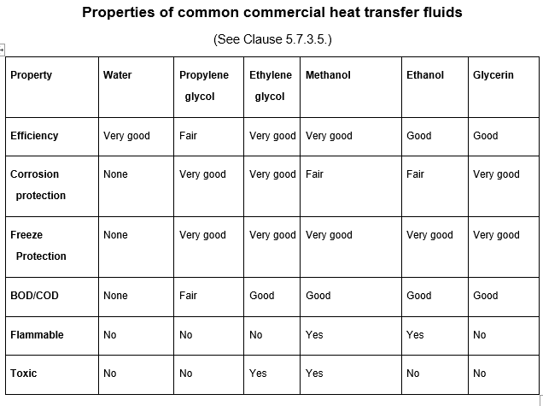
Notable Changes:
Heat Transfer
Fluids
Feedback from Industry on 2016 Standard
Standard Outline for 2024
General Applications Section Outline
Notable Changes
Next Steps
16

Slide 17
Notable
Changes:
Pressure
Testing
C448.0 Clause 9.1.2 Hydrostatic pressure tests.
  Individual borehole U-bend assembly short term test (optional)
  Ground heat exchanger hydrostatic pressure testing
  Changes to note:
  Pressure test requirements are based on ASTM F2164 but adapted to this Standard specifically for ground heat exchangers.
  Test includes an initial expansion phase, a stabilization phase and then the pressure is set to the test pressure (established by the designer) and a 60-minute test is conducted. A passing test in indicated if no visual leak is observed and the test pressure does not reduce by more than 5% during the 60-minute test.
17

Slide 18
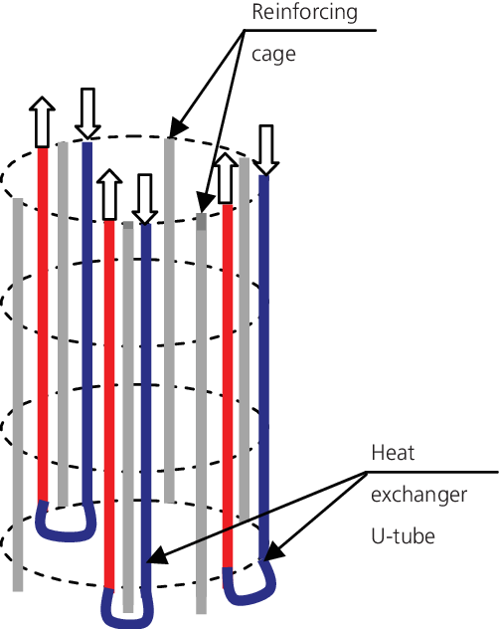
Additions:
Energy Foundations
New standard C448.9: Design and Installation of ground source heat pump systems connected to energy foundations.
18

Slide 19
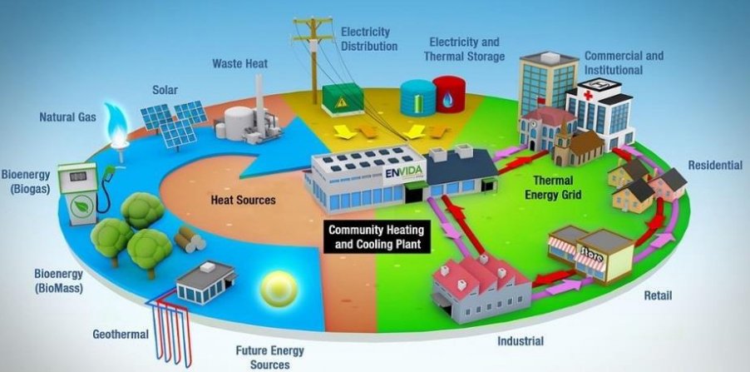
Additions:
District Energy
Systems
ANSI/CSA/IGSHPA C448.3, Planning, design, installation, and commissioning of district energy systems
District energy systems definition
Inclusions
Exclusions
© Envida Community Energy Inc. All rights reserved. This content is excluded from our Creative Commons license. For more information, see https://ocw.mit.edu/help/faq-fair-use/
Image from Interreg North-West Europe4DHC technology guide
19

Slide 20
A slight deviation from the standard format:
0 Introduction
1 Scope
2 Reference publications
3 Definitions
4 Project Planning
  Master planning
  Pre-planning
  Site Survey
  Geothermal suitability assessment
  Preliminary concept plan
  Confirmatory investigations
  Refined concept plan
  Detailed engineering design
5 Equipment and materials
6 Design of district energy systems
7 Installation of systems
8 System start-up
9 System commissioning
10 Decommissioning and abandonment

Slide 21
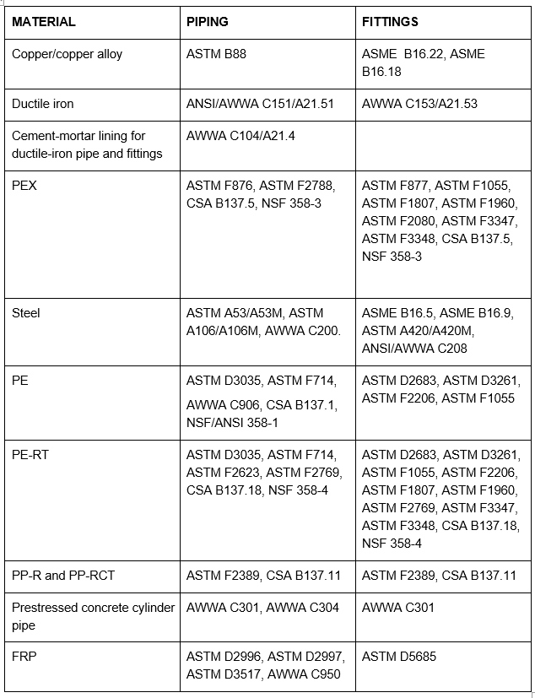
Distribution piping materials

Slide 22
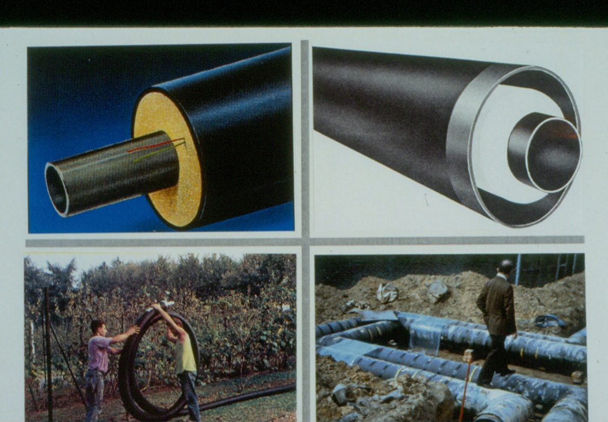
Insulated piping and pre-insulated piping
Nomenclature for two buried pipes, Fig. 4.11, DCG; Fig. 6.6, DHG; Fig. 10, Ch. 12, 2020 ASHRAE Handbook

Slide 23
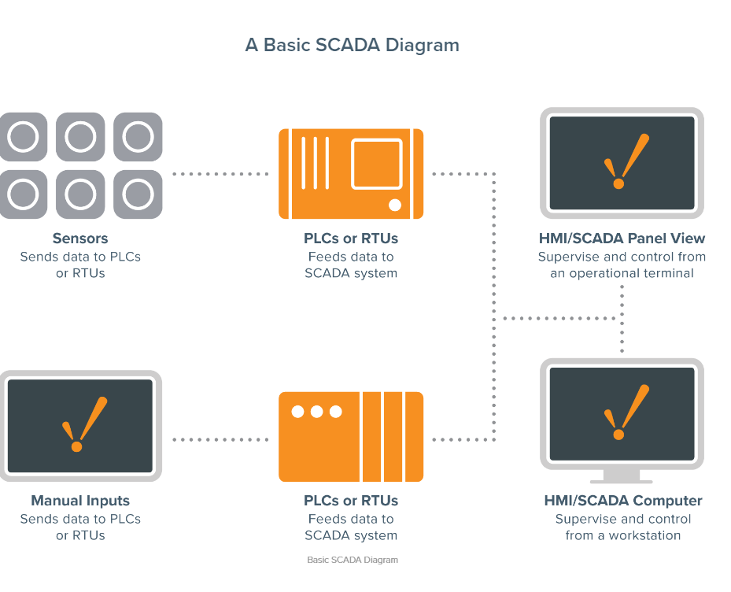
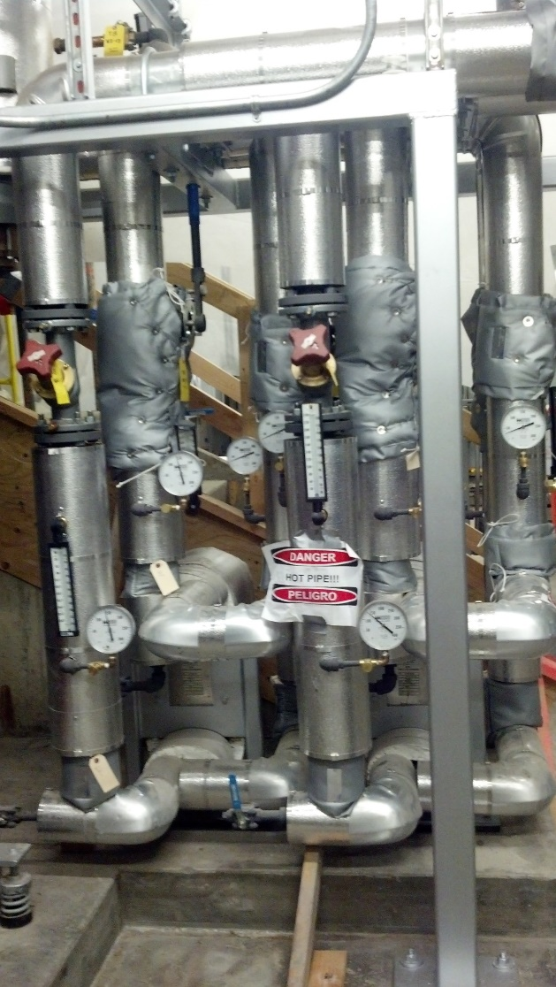
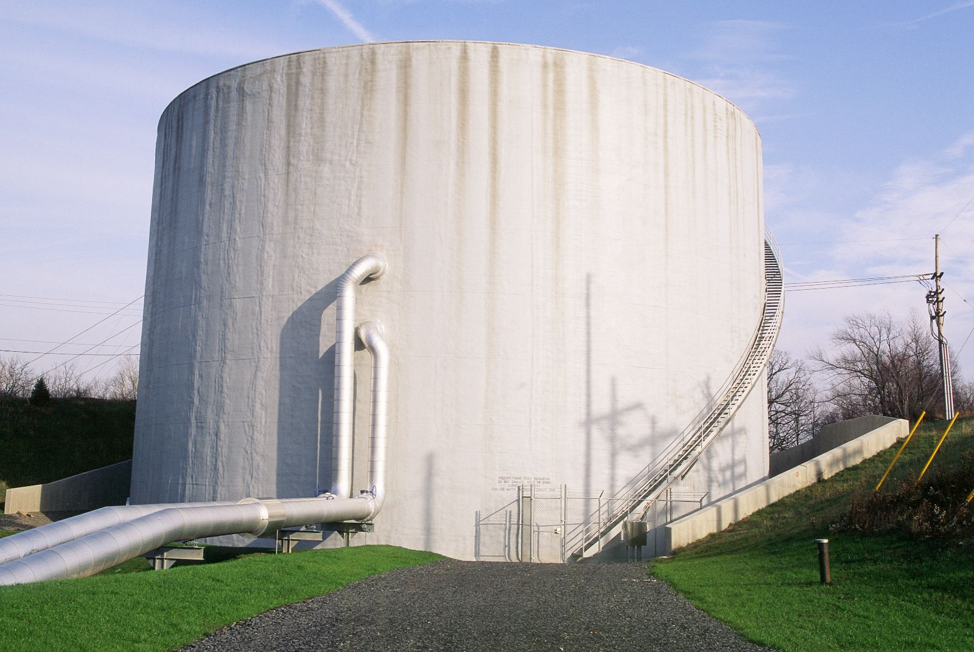
Energy Transfer Stations, Communications, and Storage

Slide 24
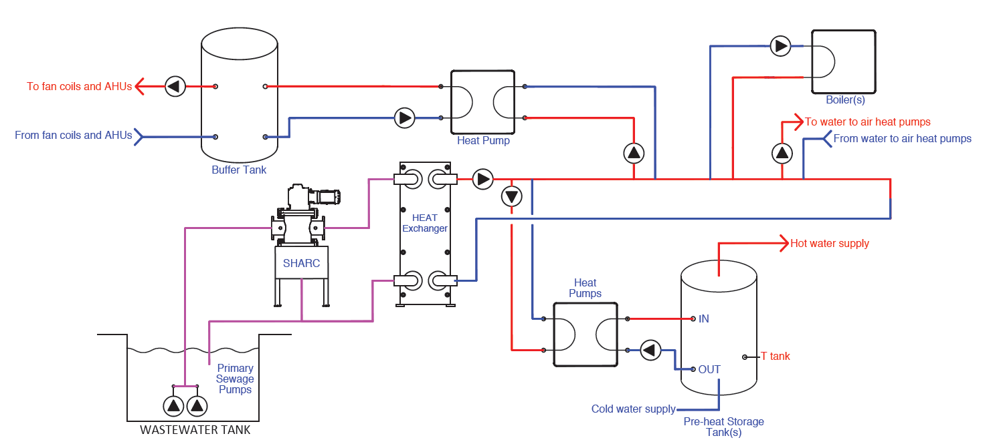
Additions:
Annex E
CSA / ANSI / IGSHPA C448 – Annex E
Wastewater energy transfer systems design and installation
Pumped heat exchangers
© SHARC Energy. All rights reserved. This content is excluded from our Creative Commons license. For more information, see https://ocw.mit.edu/help/faq-fair-use/`
Courtesy of SHARC Energy Systems
24

Slide 25
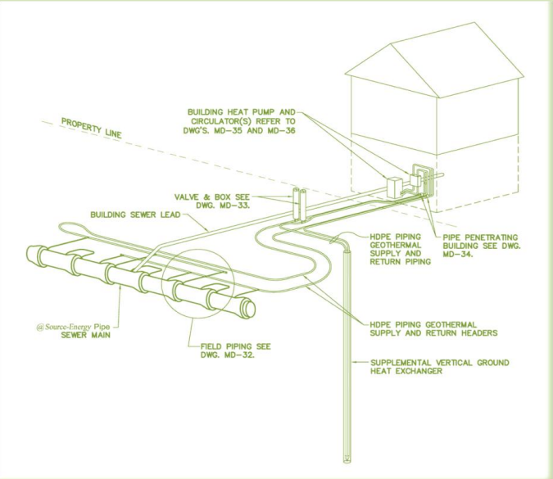
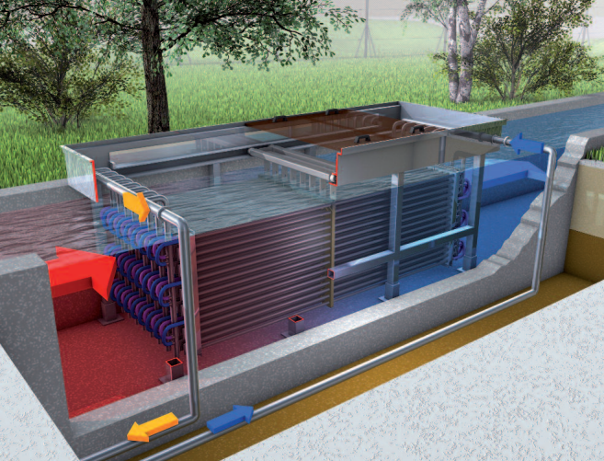
ANSI/CSA/IGSHPA C448 – Annex E
In-pipe or in-trench energy exchangers
In-tank/channel heat exchangers
Courtesy of Renewable Resource Recovery, Corp.
Courtesy of Huber Technology Wastewater Solutions
© Renewable Resource Recovery, Corp. All rights reserved. This content is excluded from our Creative Commons license. For more information, see https://ocw.mit.edu/help/faq-fair-use/`
© HUBER SE. All rights reserved. This content is excluded from our Creative Commons license. For more information, see https://ocw.mit.edu/help/faq-fair-use/

Slide 26
Final notes on Annex E
Wastewater energy transfer systems design and installation
Inclusions
Exclusions
Reference: German Association for Water Management, Wastewater, and Waste: DWA Set of Rules, Leaflet DWA-M 114, April 2020.

Slide 27
Next Steps
Public review ended August 6, 2024
Editing by CSA staff – ongoing
Approval ballot by CSA C423 Technical Committee on Ground and Water Source Heat Pumps
Final production/editing by CSA Staff
Targeted release date: May 2025
27

Slide 28
Conclusion
The International Ground Source Heat Pump Association (IGSHPA) board of directors voted to sunset the 2017 IGSHPA Standards when the next edition of the Bi - National C448 Standard is published to promote consistency of design and installation in the U.S. and Canada.
Through the Bi - National Standard the ground-source heat pump industry continues to come together to create a reasonable and relevant standard which may be applied by designers, installers, and building owners. Additionally, this document will provide useful guidance and references for regulators and their jurisdictions as this industry continues to grow.
As we move through this next standards cycle this Standard will continue to evolve and adapt to reflect the coming changes in the ground source heat pump industry including
A2L refrigerants
Equipment rating standards
District energy systems
and will continue to support the global effort to reduce green house gasses in North America.
© 2018 CSA GROUP TESTING & CERTIFICATION INC. | ALL RIGHTS RESERVED.
28

Slide 29

Opportunities and
Challenges
We face them together
29

Slide 30
Thank you
&
Questions
Mark Metzner - ViceChair, TC C423
30

Slide 31
MIT OpenCourseWare
https://ocw.mit.edu/
RES.ENV 007 Geothermal Energy Networks (GENs): Transforming our Thermal Energy System
IAP 2025
For information about citing these materials or our Terms of Use, visit: https://ocw.mit.edu/terms.

