Slide 1
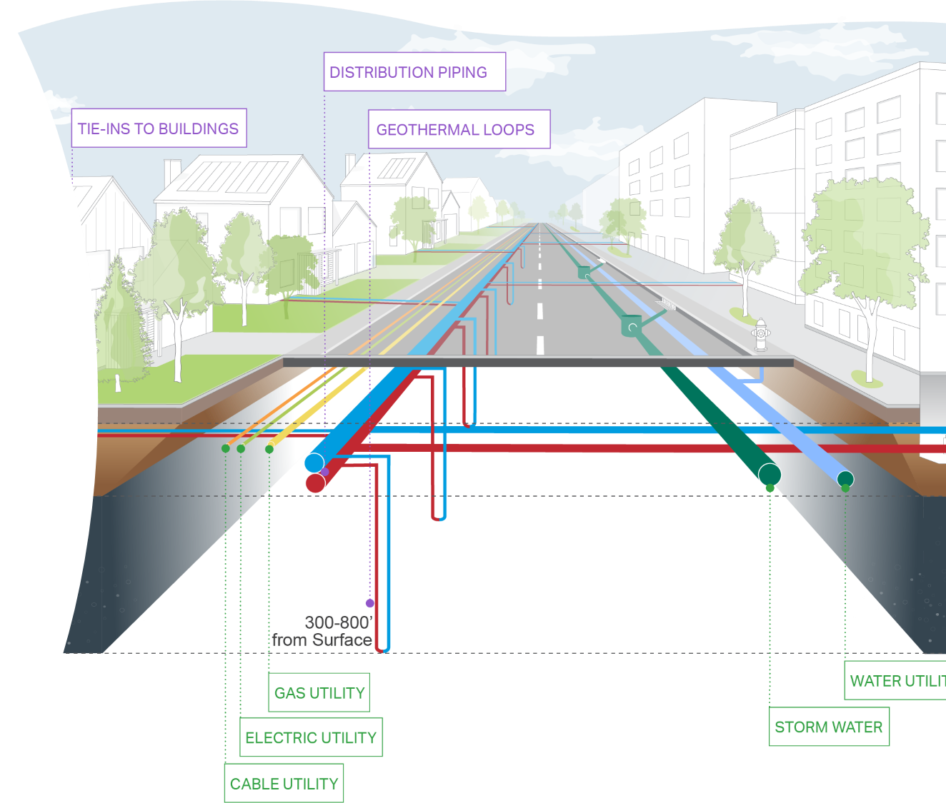
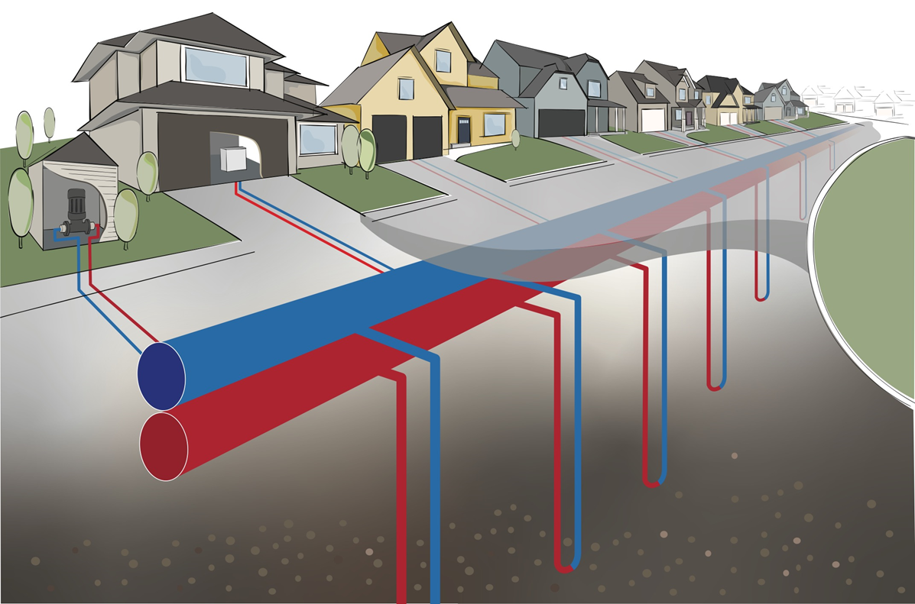
Geothermal Energy Networks (GEN);
Introduction to design of GEN’s
Presented By
Brian Urlaub
Director of Geothermal Operations
1

Slide 2
Design Considerations
Site Selection
Thermal Resources
Single Pipe vs. Two Pipe
  ETS – Yes or No
Pump Houses
  Above grade or below grade
Dynamic Modeling of total system components, loads, and energy sources to provide accurate simulation and optimization.
Design for Future Expansion of the system
2

Slide 3
Site Selection
Finding a site that is most suitable for a GEN system would incorporate the following technical aspects:
More than one thermal resource that is available and accessible.
Building stock that has a diverse use and load profile, preferrable some larger commercial with residential. Commercial building(s) should be cooling dominant (in heating dominant climate zones).
Building density – less piping between buildings to connect reduces overall cost.
Site has areas that can be used for infrastructure systems or have the ability to develop access agreements for siting the infrastructure.
Building age – older usually means more envelope improvements are needed, and HVAC system is more challenging to retrofit
3

Slide 4
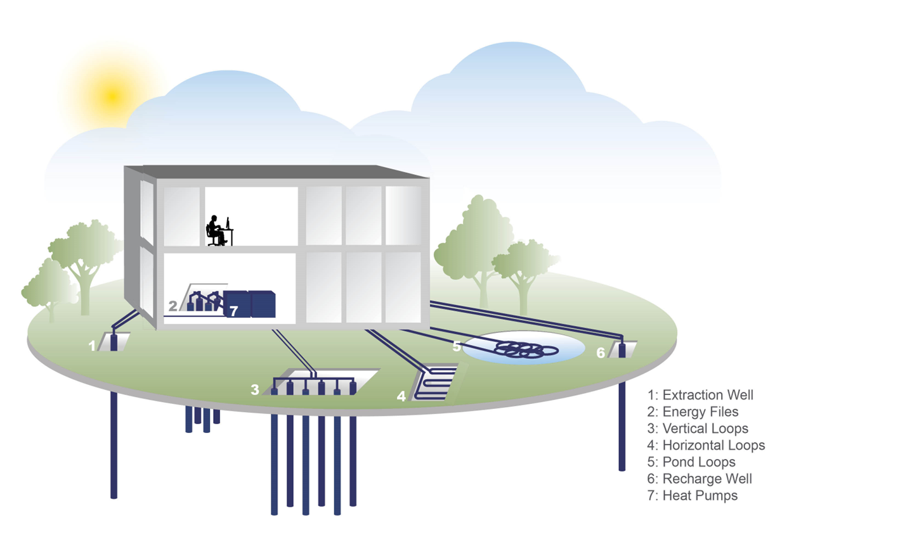
Thermal Resources
4
8. Sewage HX
9. Waste Heat

Slide 5
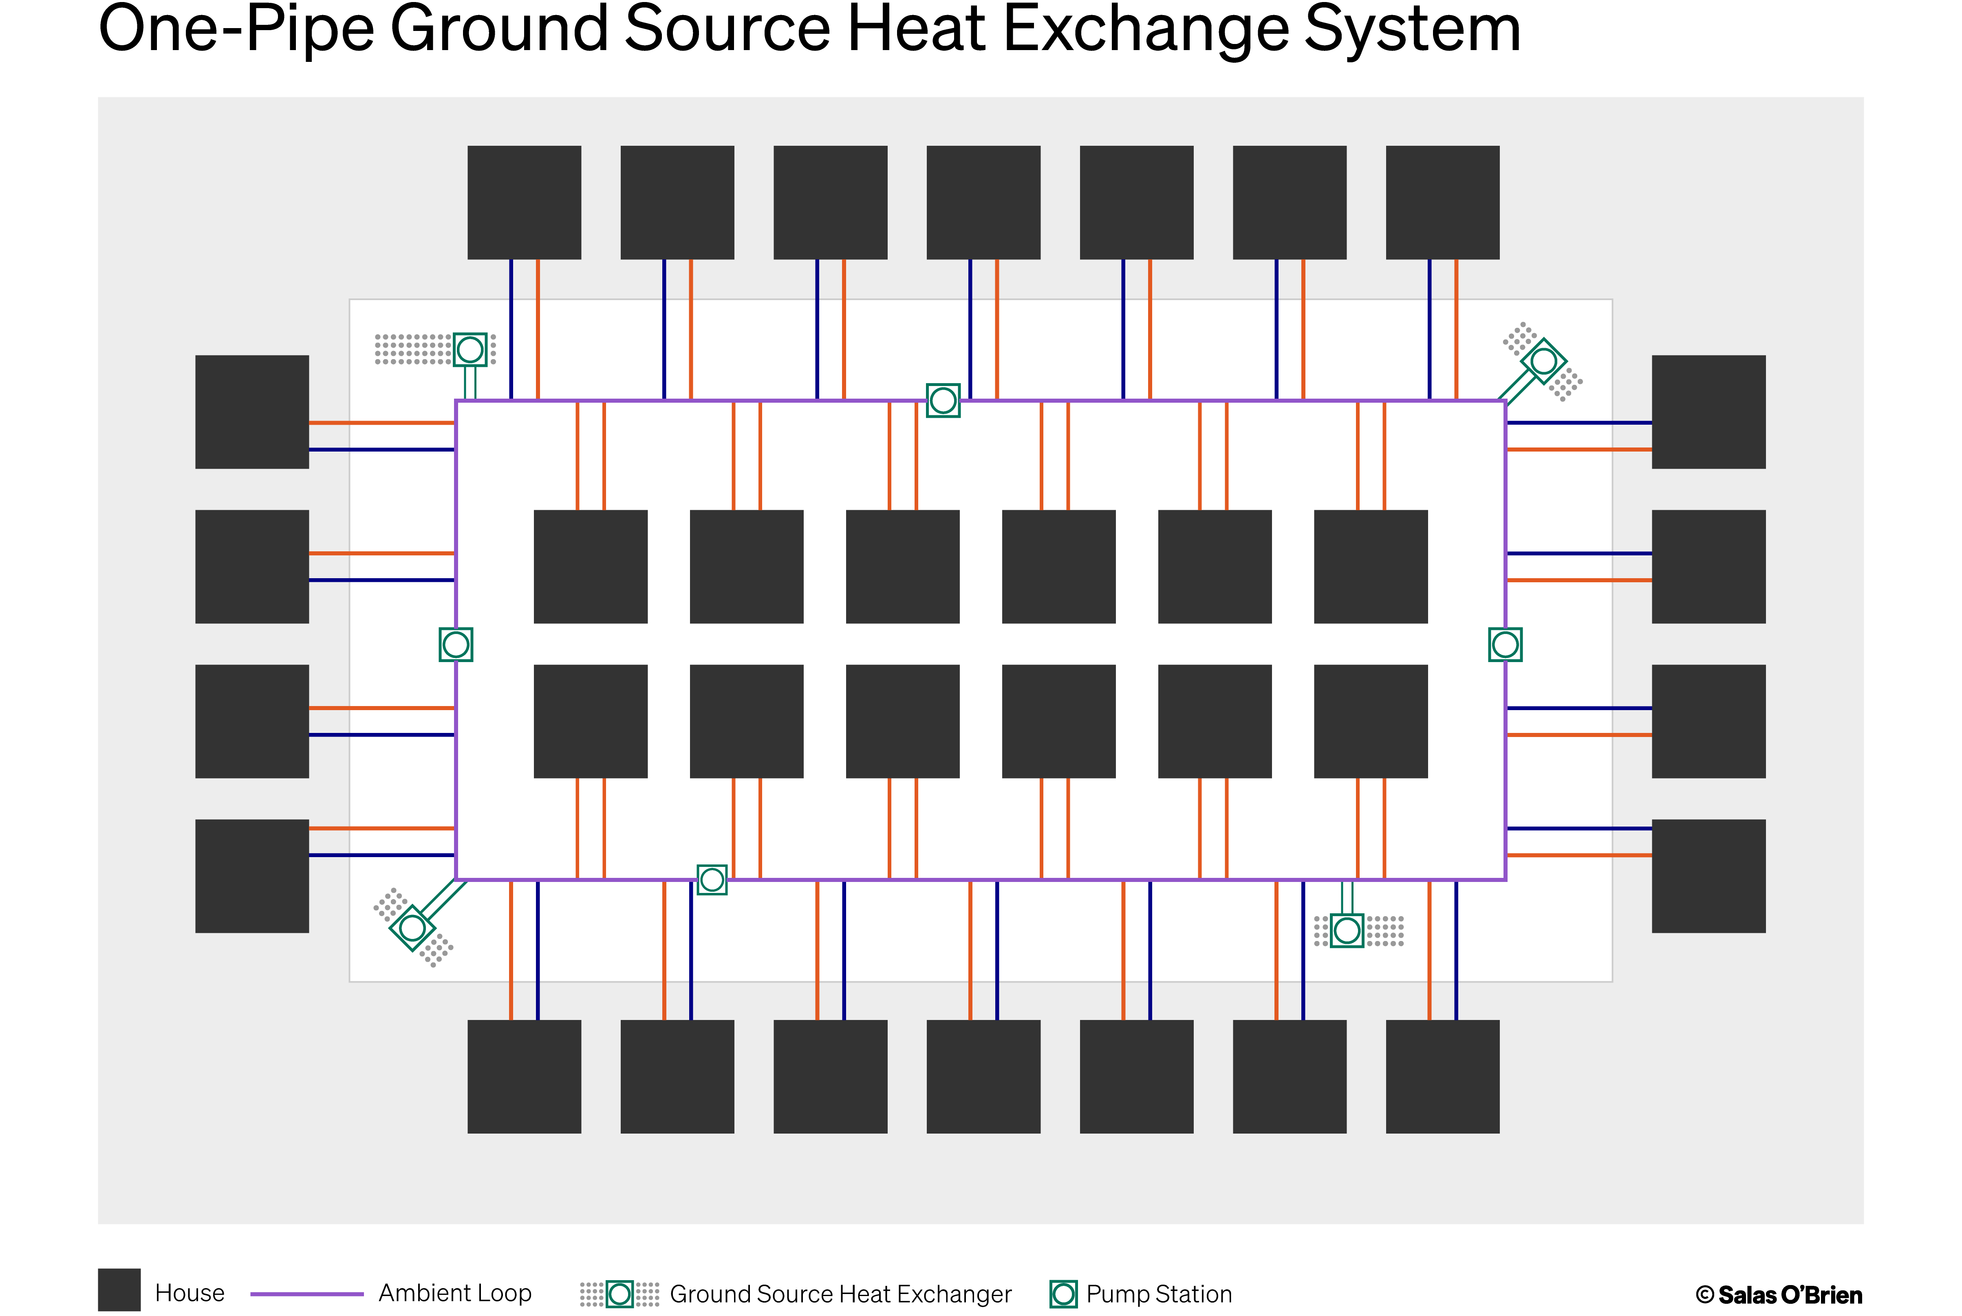
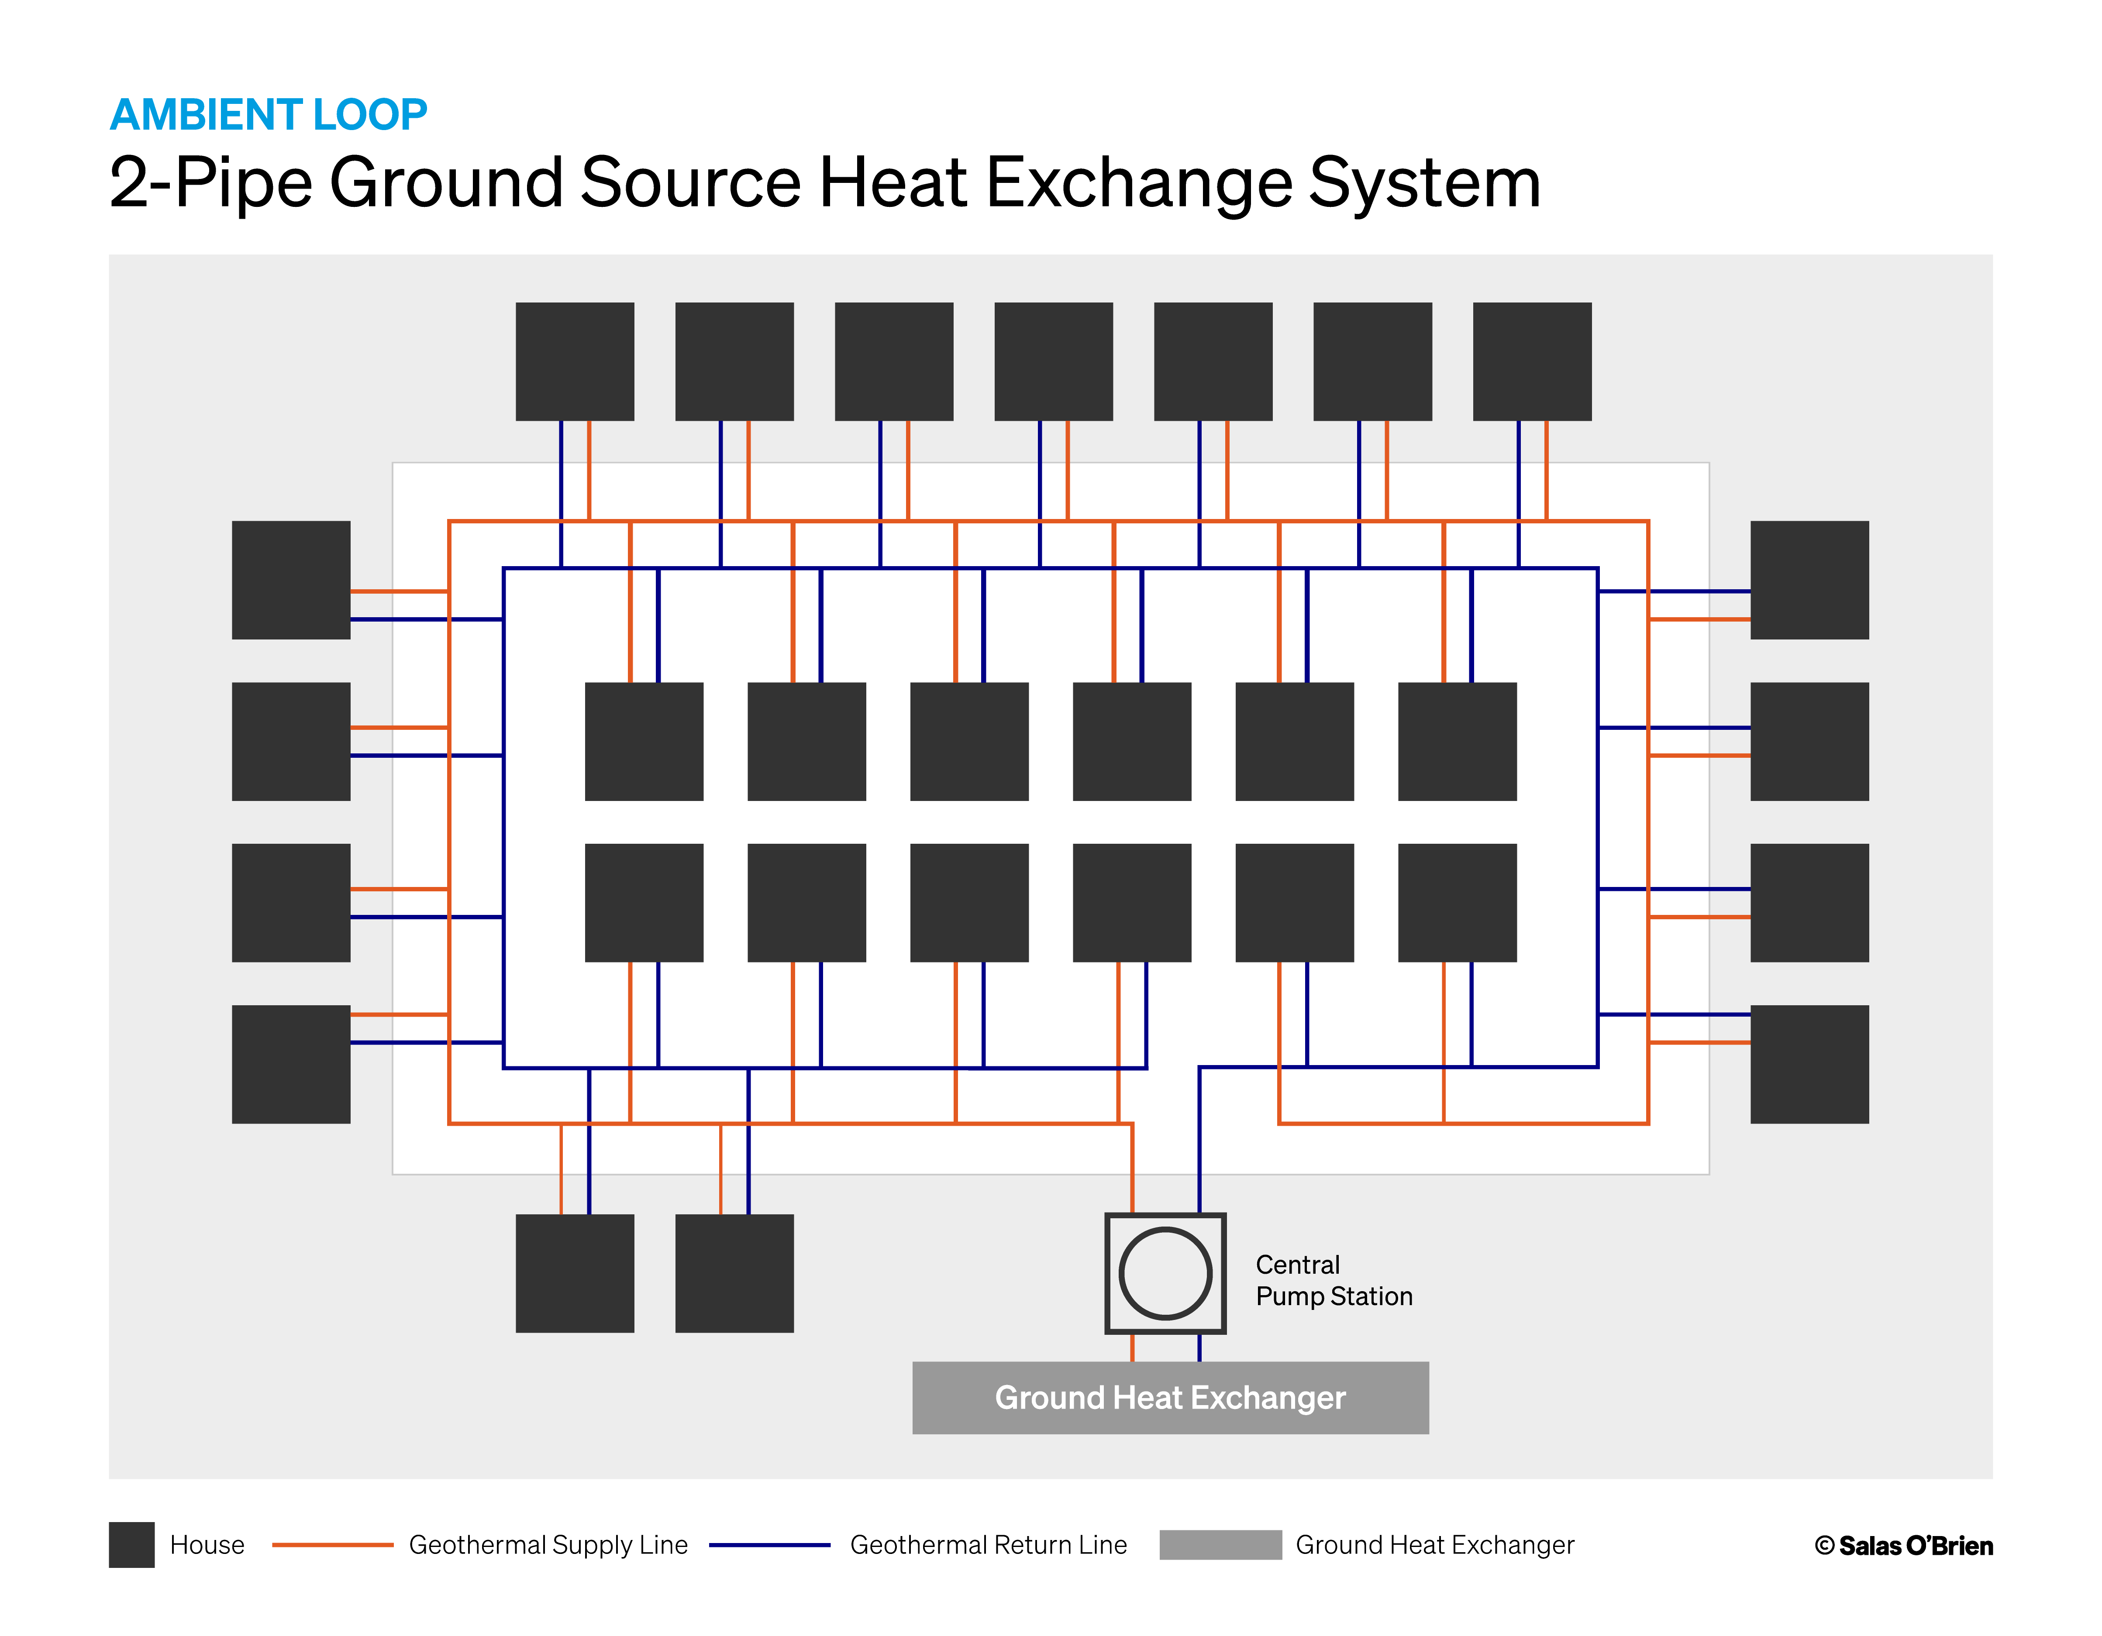
Single Pipe vs. Two Pipe ATL’s
1-Pipe offers greater flexibility with locating thermal resources, expansion of the system, as well as easier coordination/installation in streets working around other utilities.
1-Pipe has reduced flow rates when designed with multiple thermal resources, which reduces pipe sizes, pump sizes, pump energy, and overall installation costs.
2-Pipe provides each end user the same fluid temperature whereas the 1-pipe the temperatures between the first and last end user between each thermal resource would receive +/-5F different fluid temperatures.
5

Slide 6
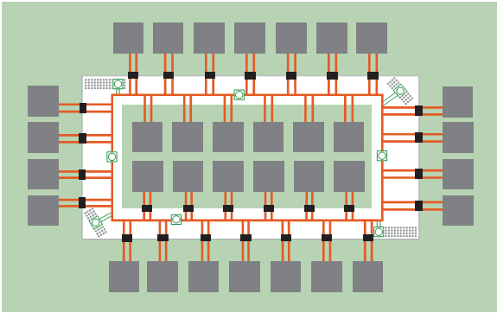
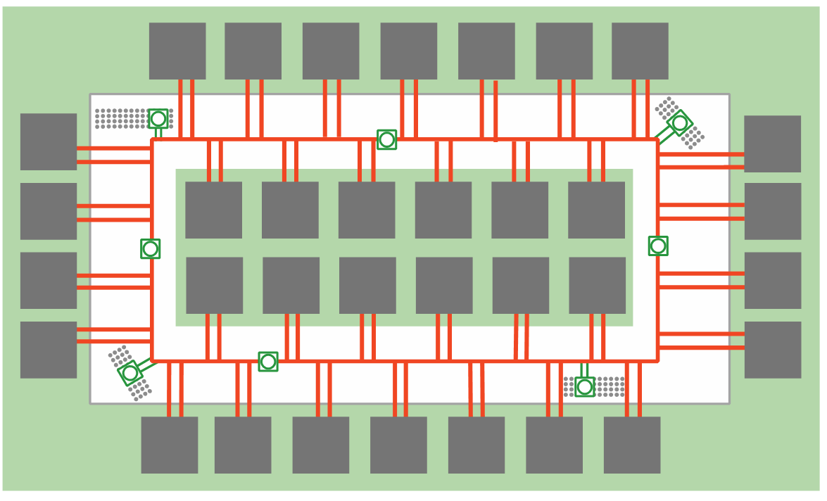
ETS – Yes or NO
1-Pipe GEN with ETS
1-Pipe GEN w/o ETS
ETS = Energy Transfer Station or Heat Exchanger to isolate fluids (usually in the building)
6

Slide 7
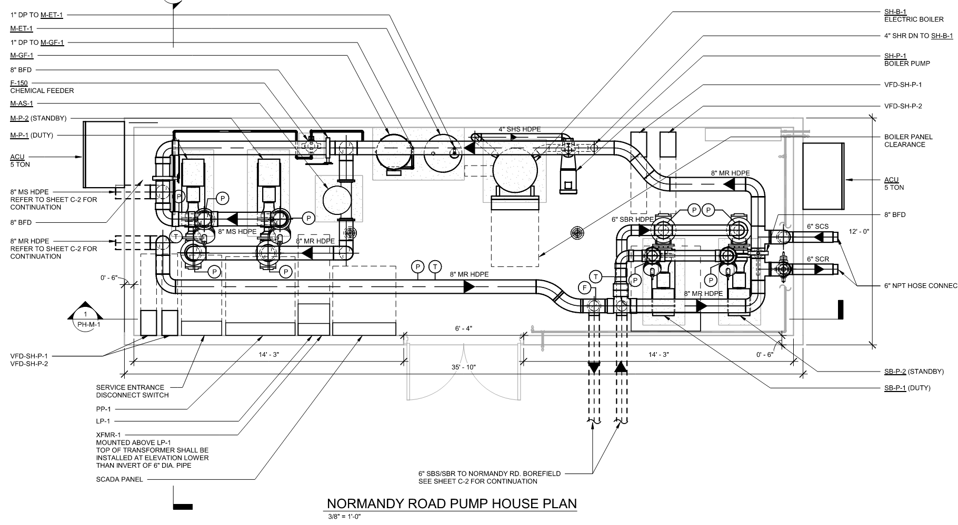
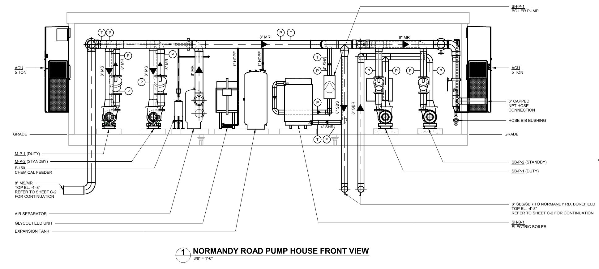
Above Grade Pump House
Above grade super structure
Conditioned space
Controls Hardware location
Architectural Design to meet city standards
7

Slide 8
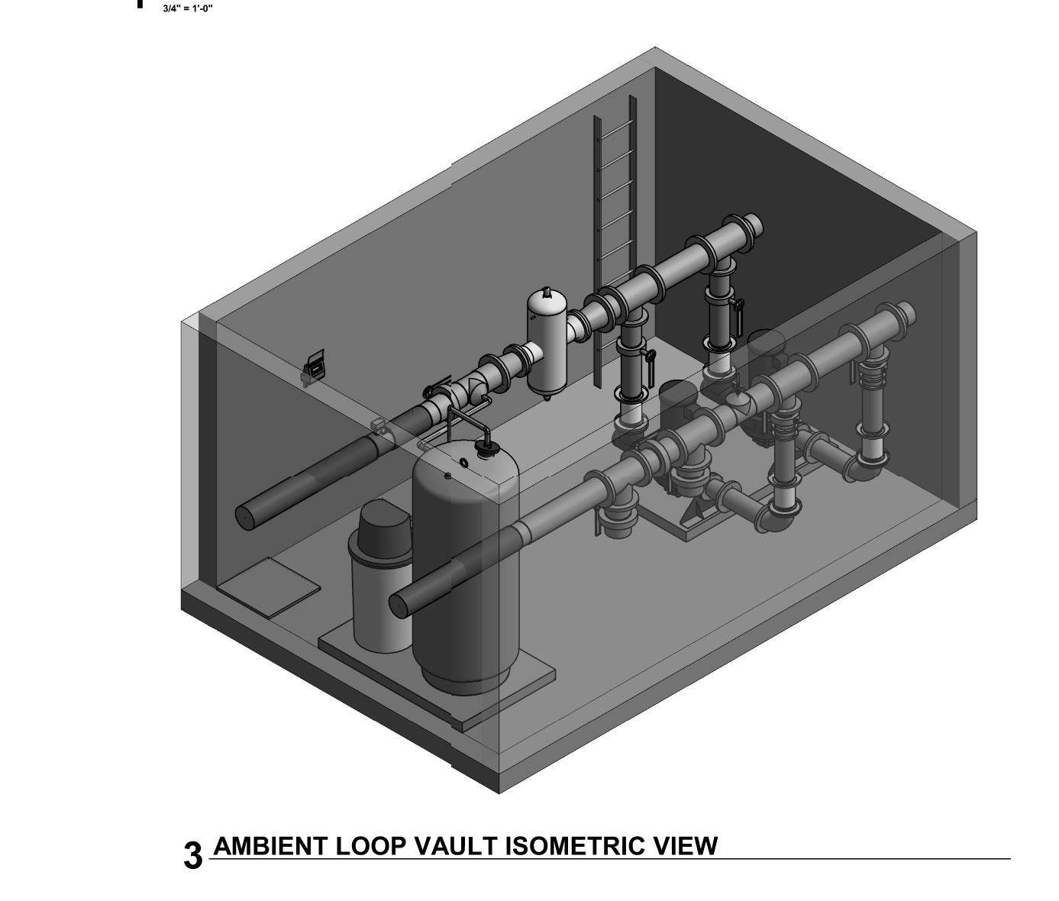
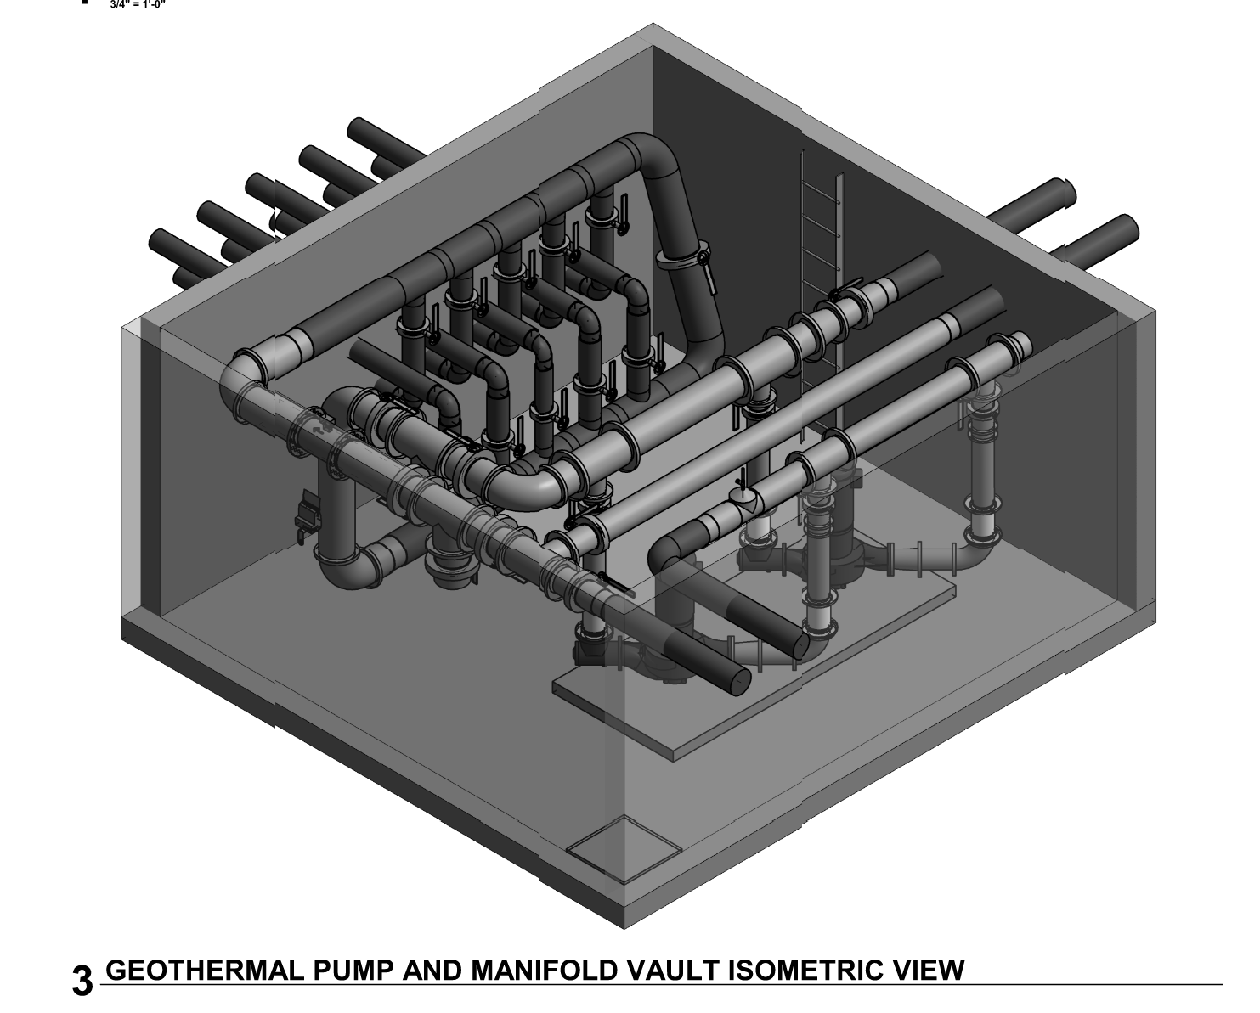
Below Grade Pump Vaults
8

Slide 9
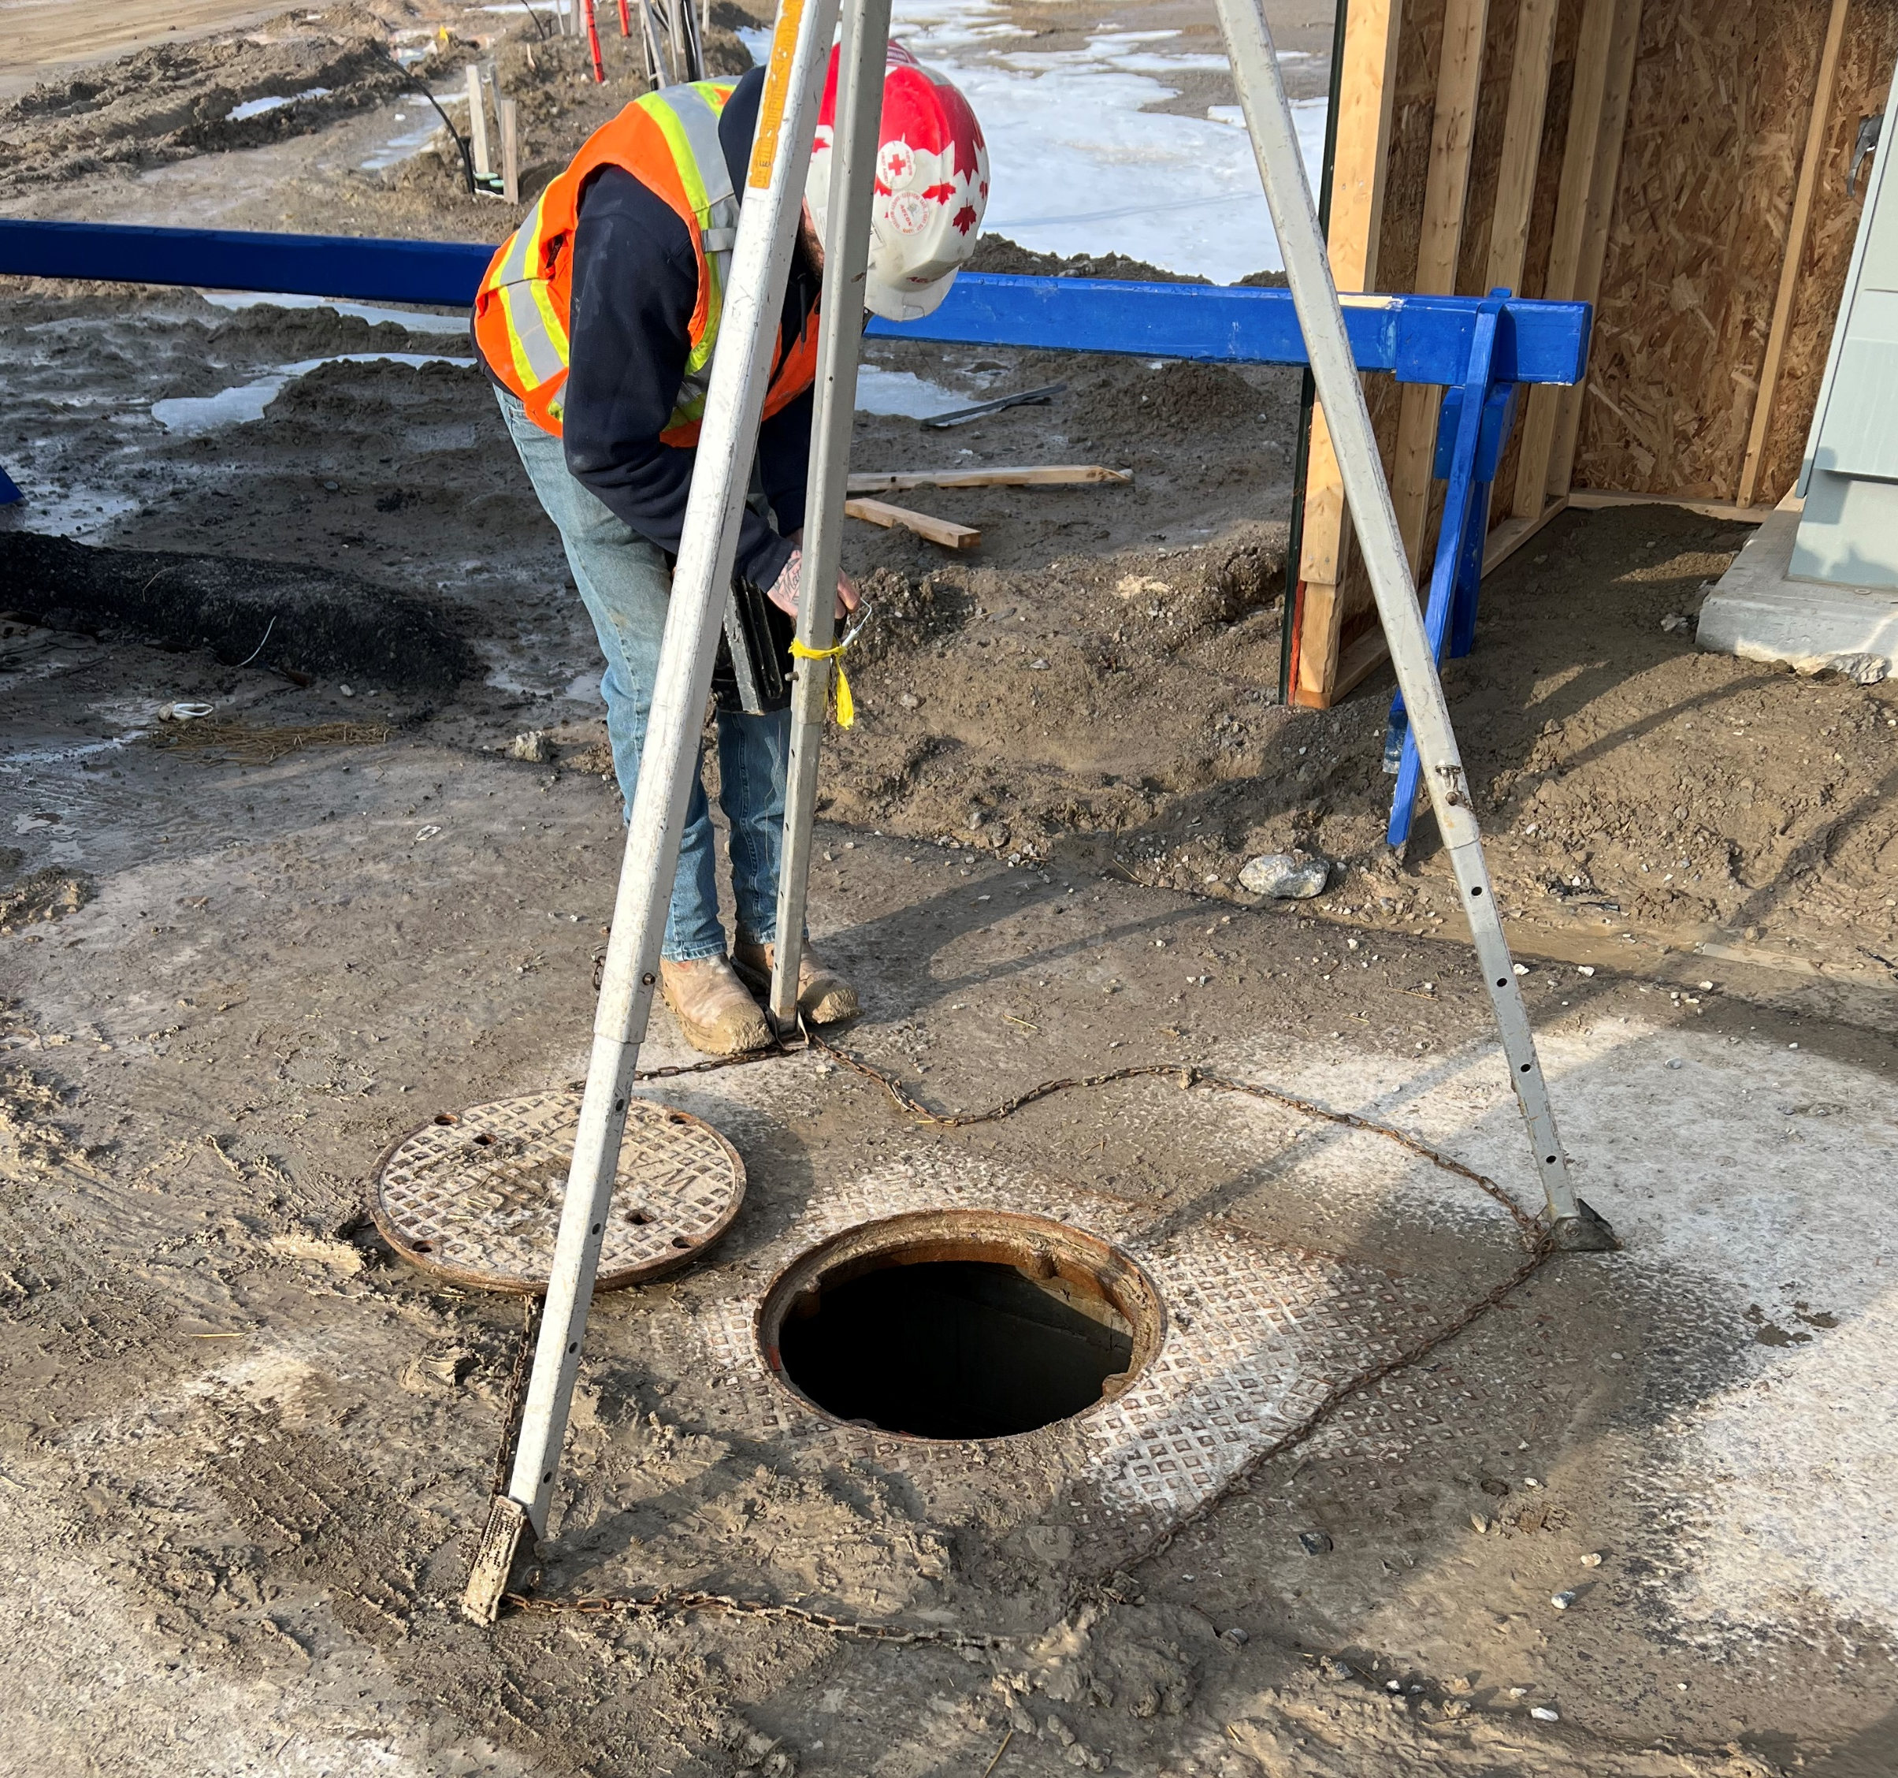
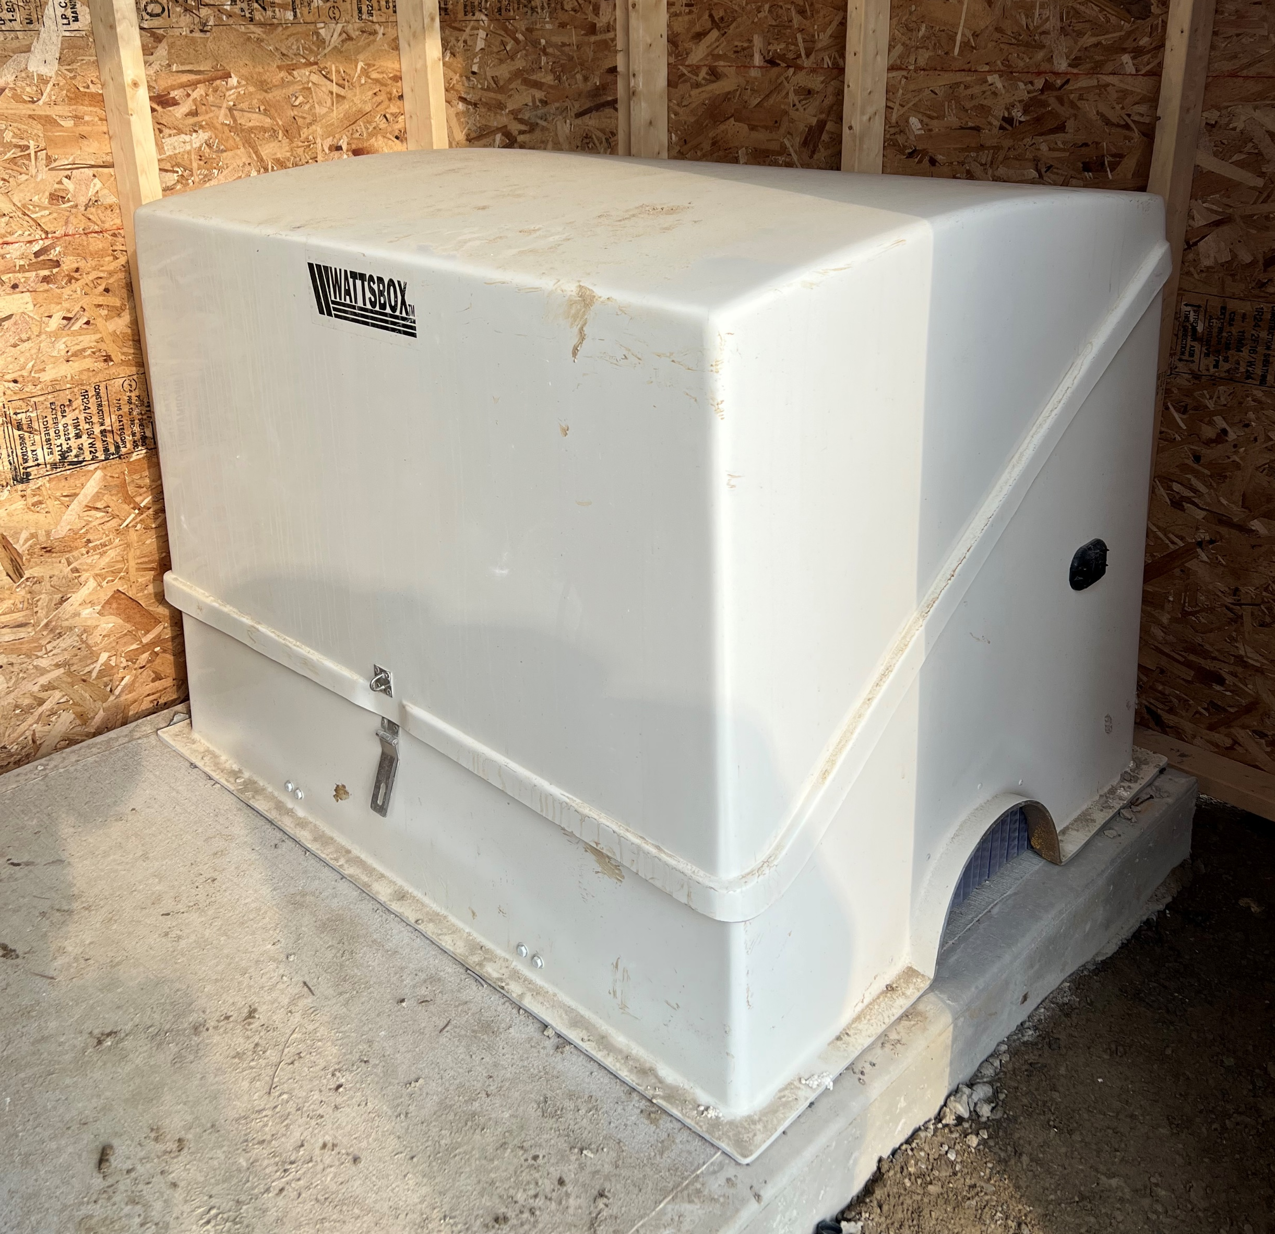
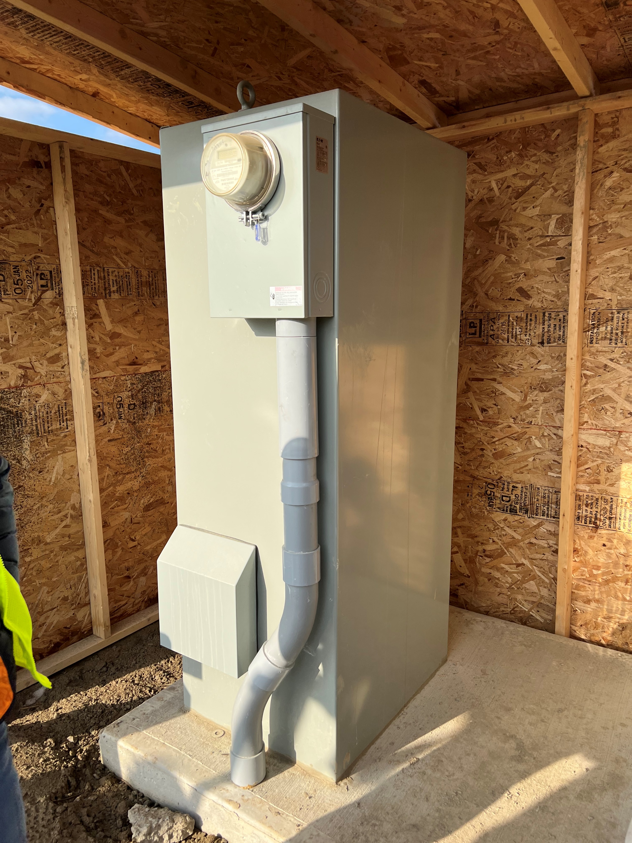
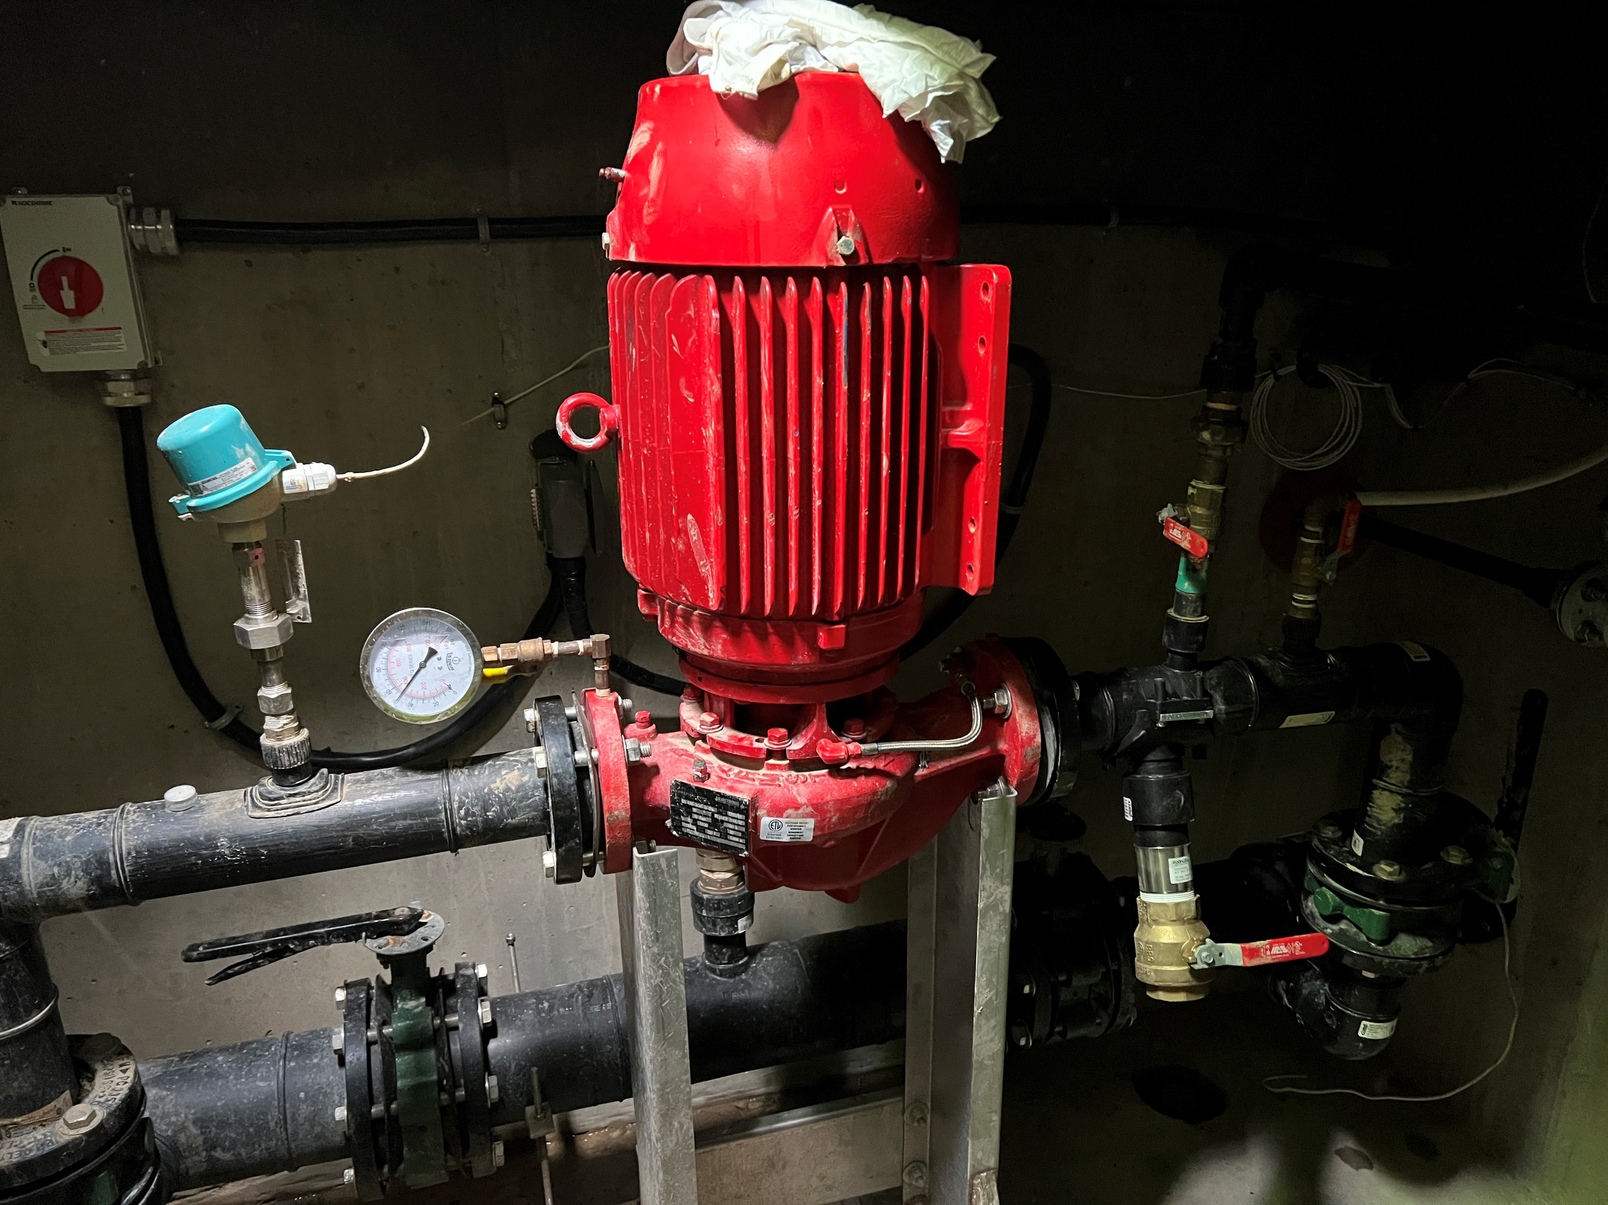
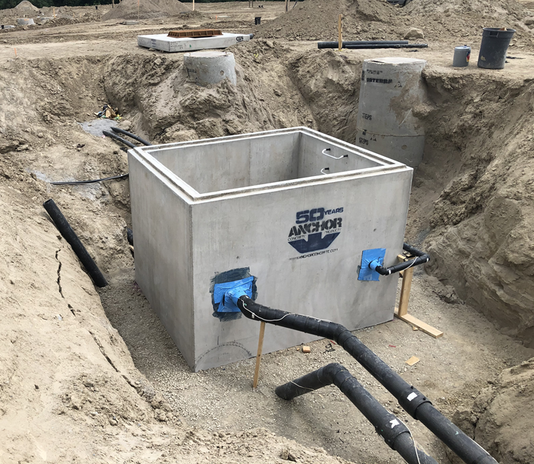
9

Slide 10
Dynamic Transient Modeling
10

Slide 11
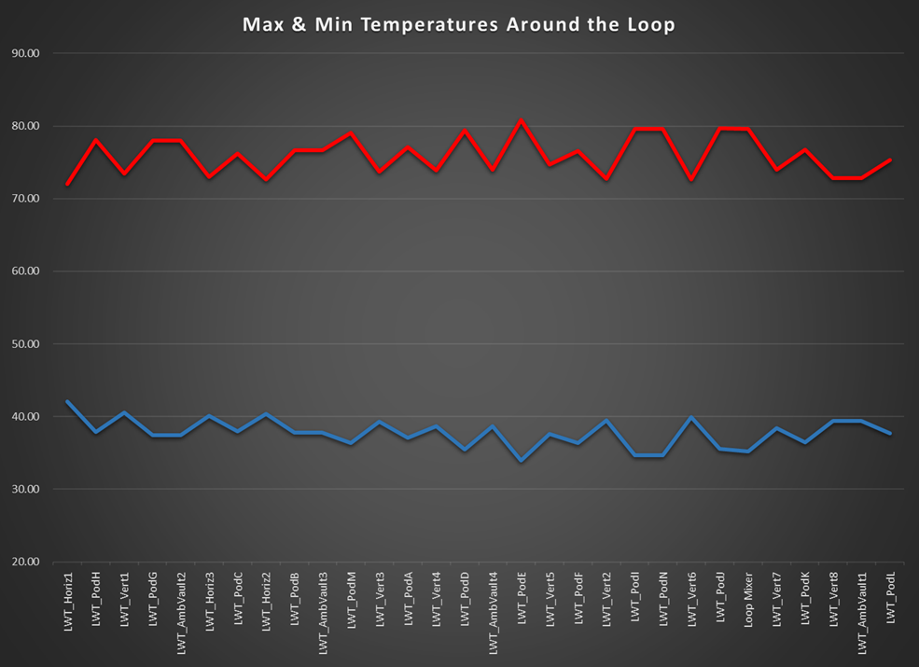
Temperature Profile of Ambient Loop
11

Slide 12
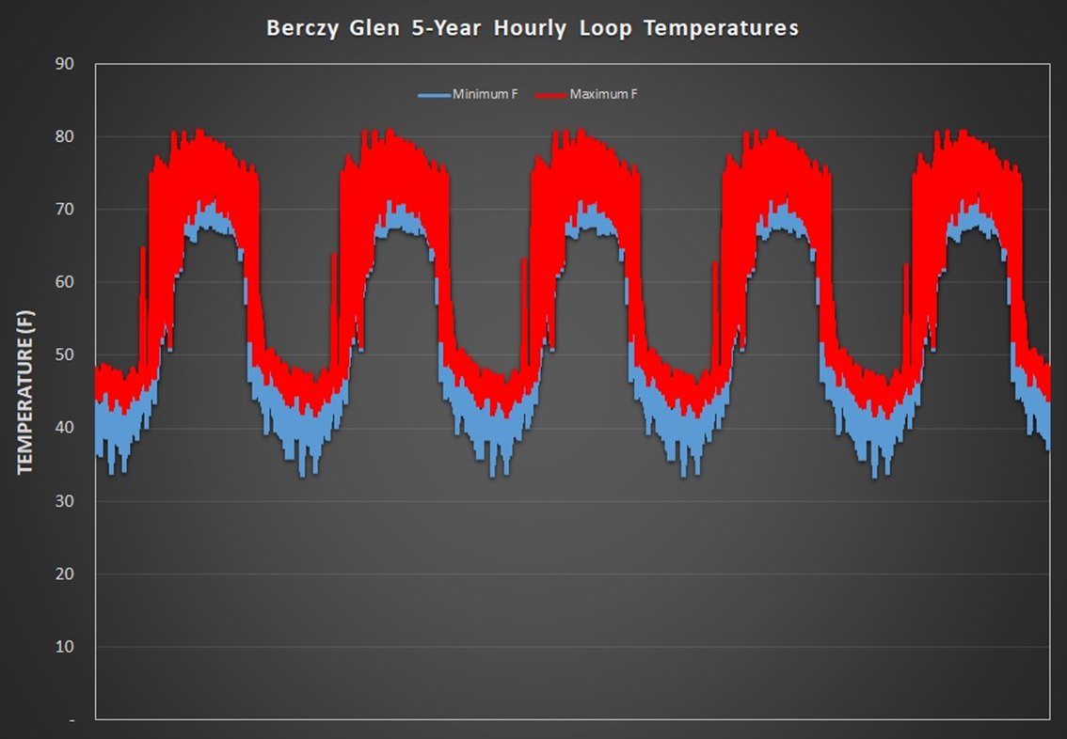
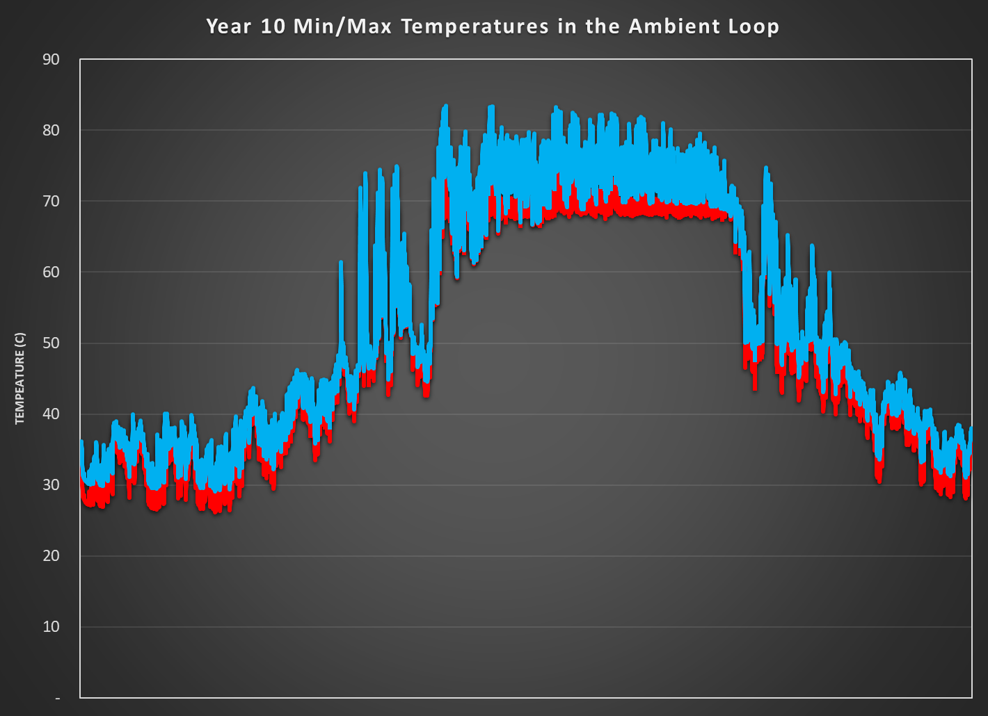
Long Term GLHE Temperature Profiles
12

Slide 13
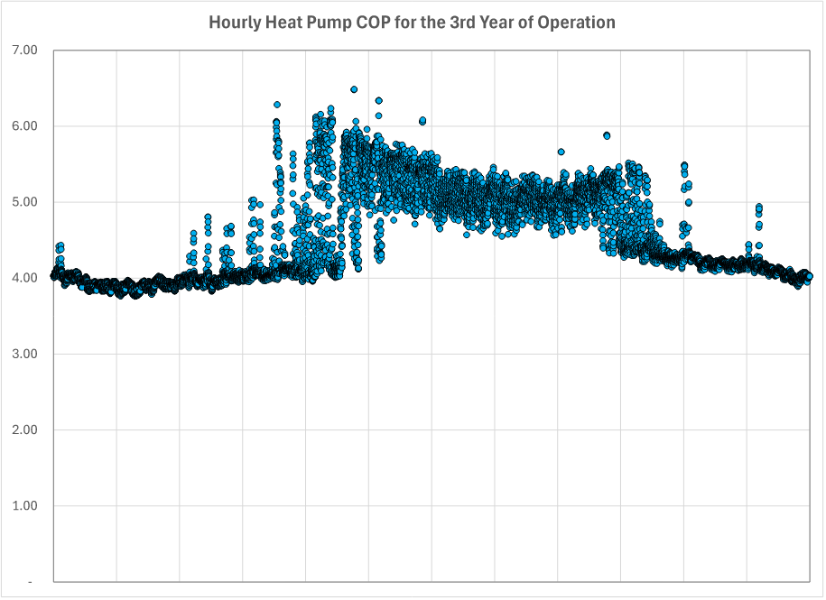
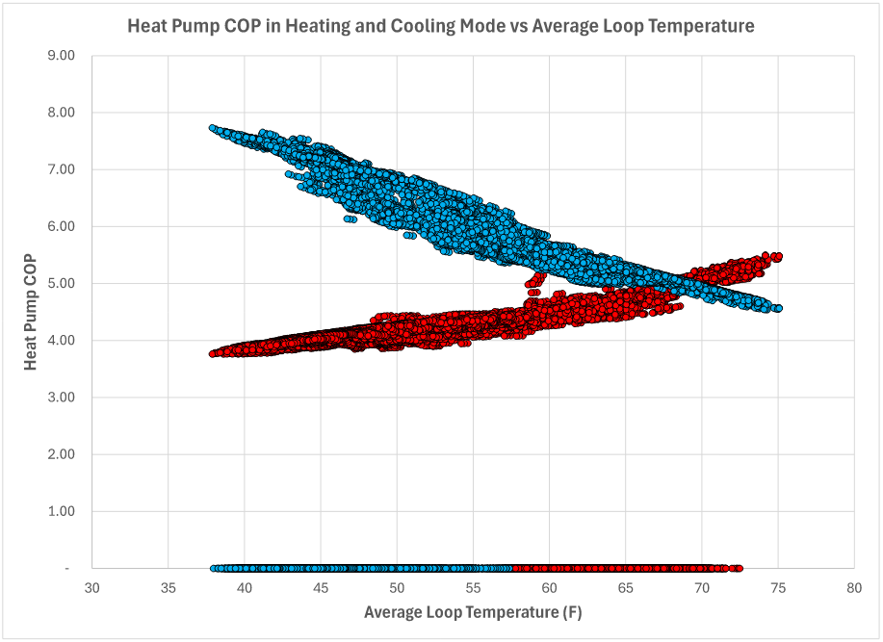
Aggregate COP of the System (hourly)
13

Slide 14
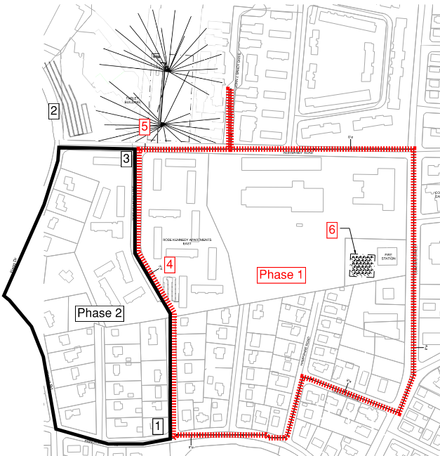
Expansion of GEN’s
1: Phase 1 and 2 converge into one pipe.
2: Phase 2 GLHX by Farley Building
3: Phase 1 and 2 converge into one pipe.
4: Phase 1 GLHX by Rose Kennedy
5: Phase 1 GLHX by Farley Building
6: Phase 1 GLHX by Fire Station
14

Slide 15
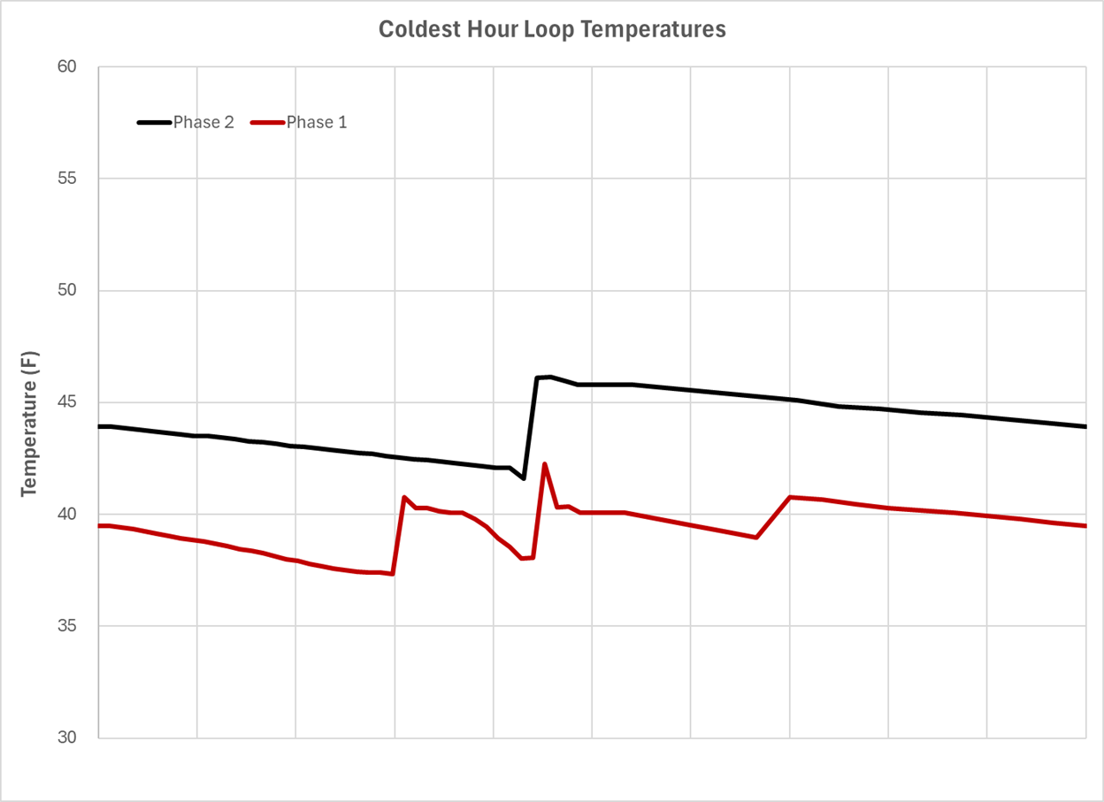
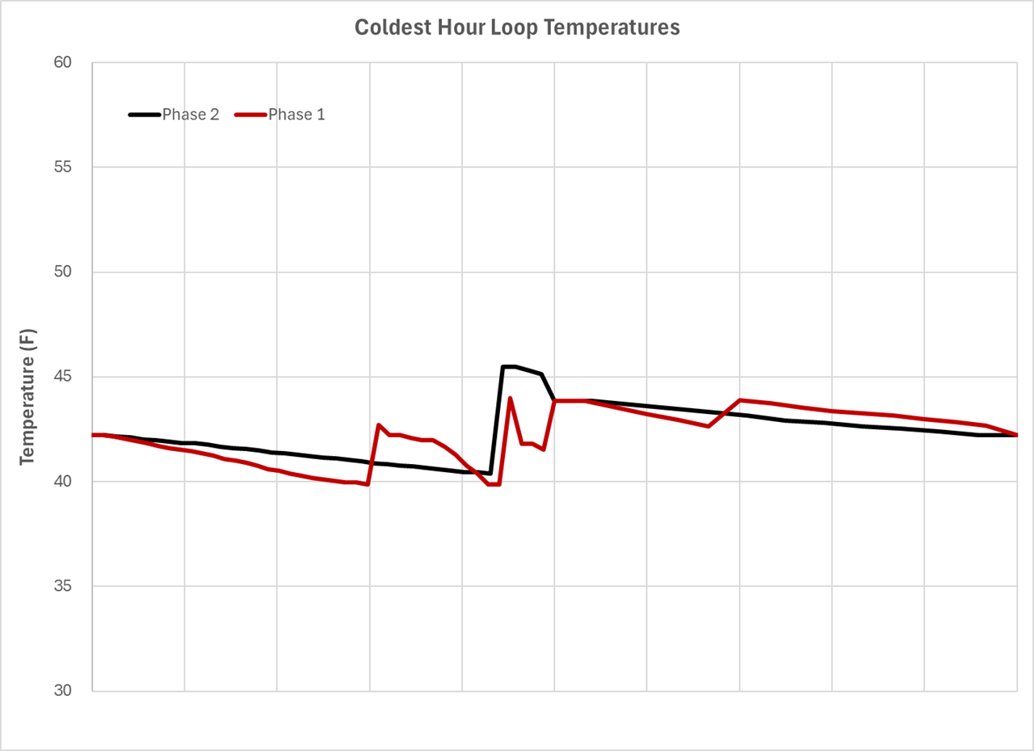
Sharing energy through mixing loops
No Mixing
Mixing
15

Slide 16
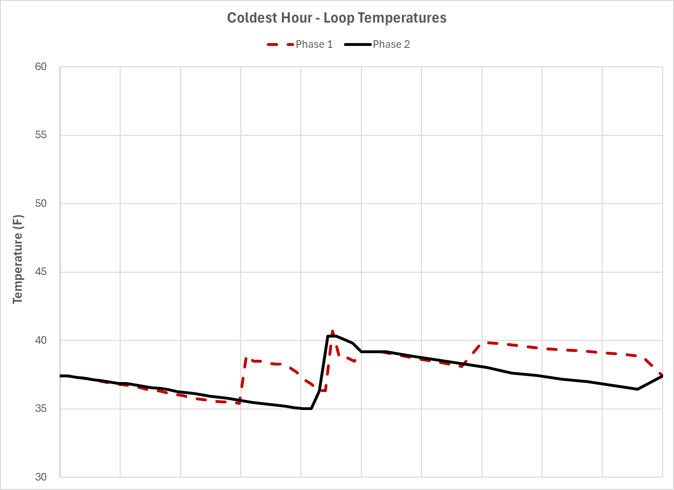
TRNSYS Runs v19 Graph – Coldest Hour
Coldest hour loop temperatures
GLHX Phase 2: 80 Bores
Minimum Temperature: 35.02ºF
5
4
6
1
1
3
2
16

Slide 17
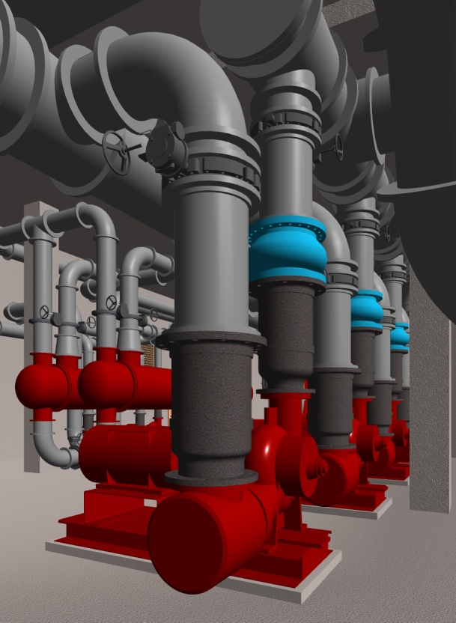
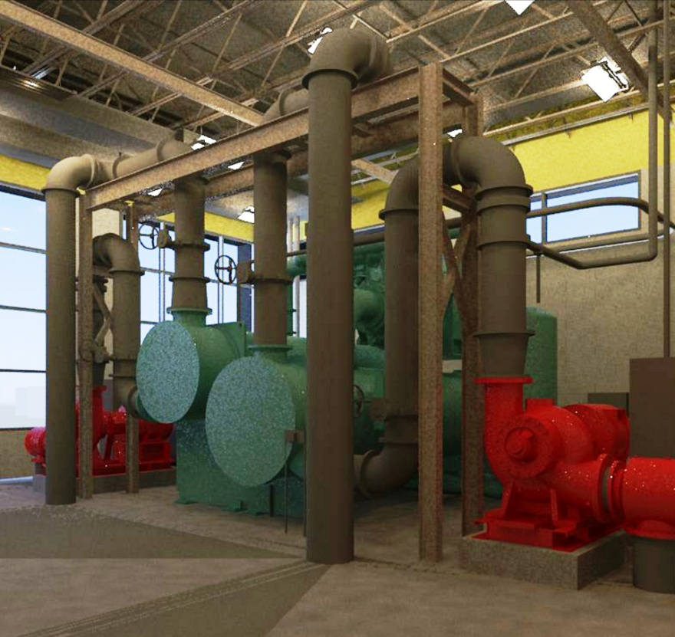
Q & A?
Thank You!
17

Slide 18
MIT OpenCourseWare
https://ocw.mit.edu/
RES.ENV 007 Geothermal Energy Networks (GENs): Transforming our Thermal Energy System
IAP 2025
For information about citing these materials or our Terms of Use, visit: https://ocw.mit.edu/terms.

