Slide 1
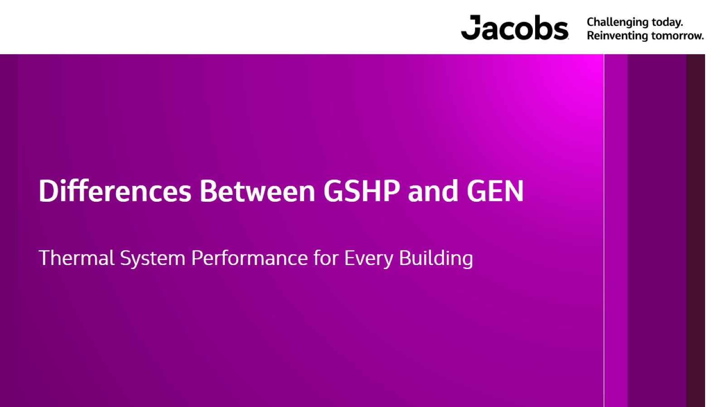
Differences Between GSHP and GEN

Slide 2
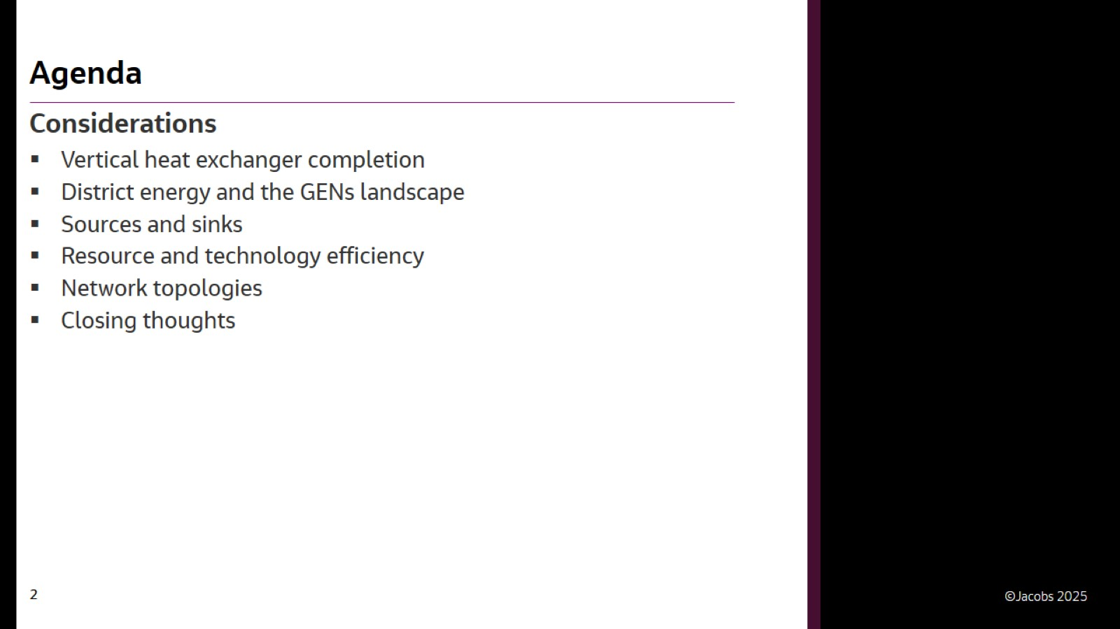
Agenda

Slide 3
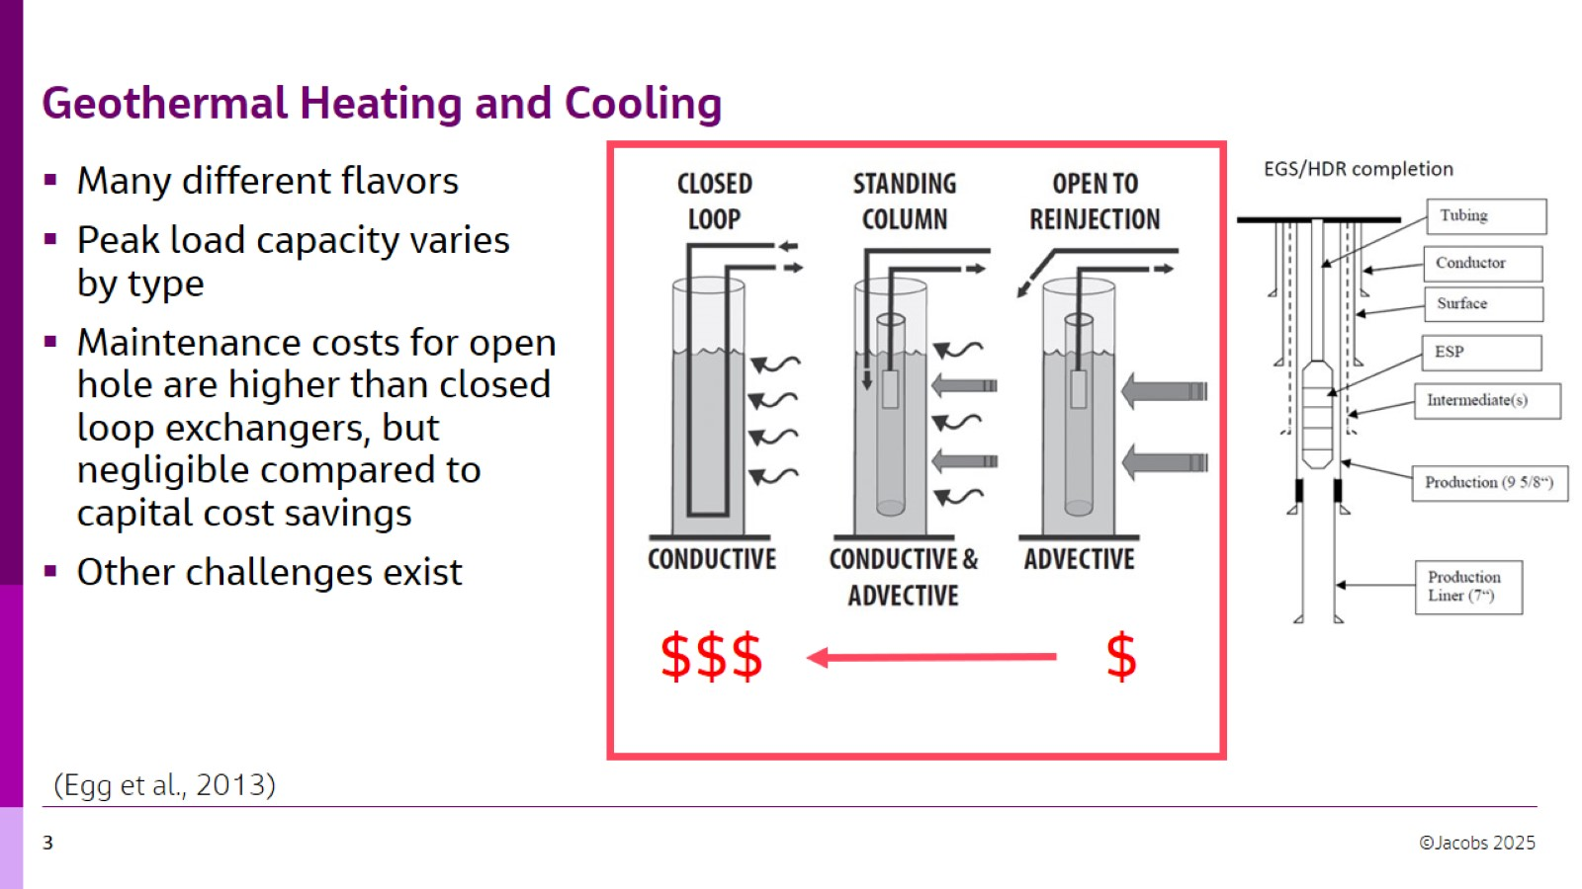
Geothermal Heating and Cooling
McGraw Hill. All rights reserved. This content is excluded from our Creative Commons license. For more information, see https://ocw.mit.edu/help/faq-fair-use/

Slide 4
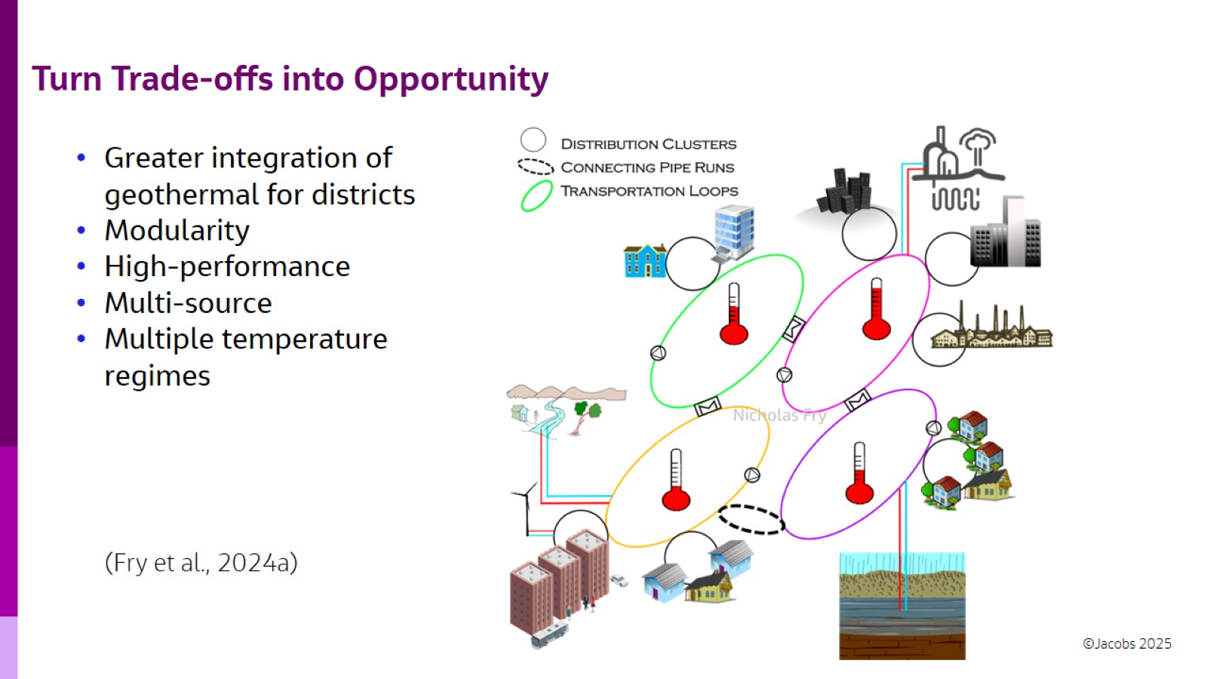
Turn Trade-offs into Opportunity
Courtesy of Fry, N., Adebayo, P., Tian, R. et al. "A review of district energy technology with subsurface thermal storage integration". Published 18 August 2024. Used with permission. Creative Commons Attribution 4.0 International License - http://creativecommons.org/licenses/by/4.0/. No changes were made.

Slide 5
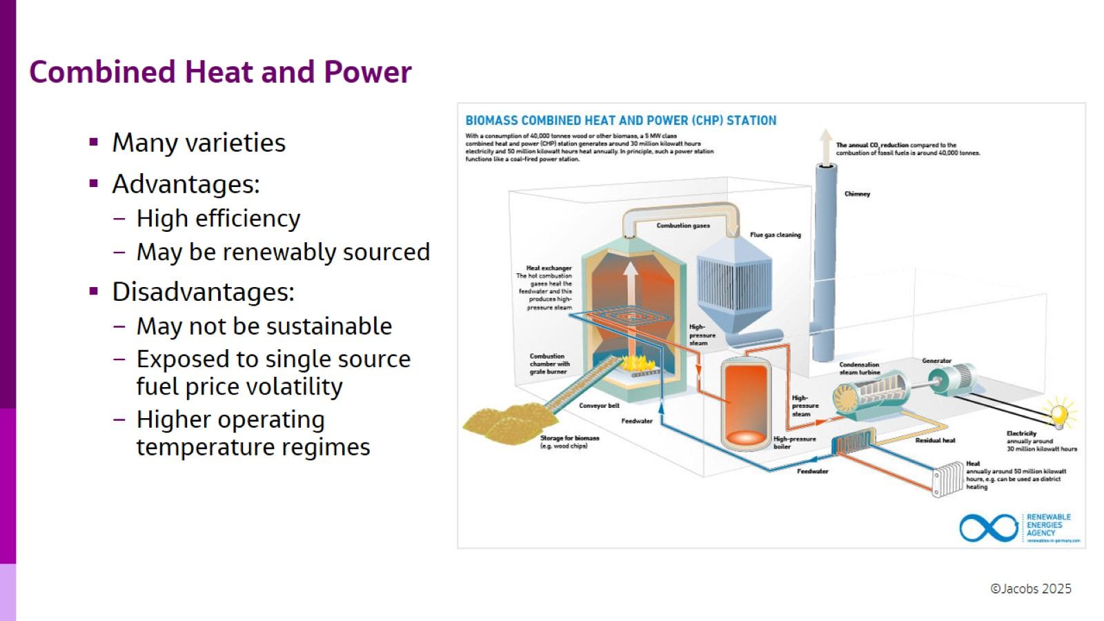
Combined Heat and Power
© Renewable Energies Agency. All rights reserved. This content is excluded from our Creative Commons license. For more information, see https://ocw.mit.edu/help/faq-fair-use/

Slide 6
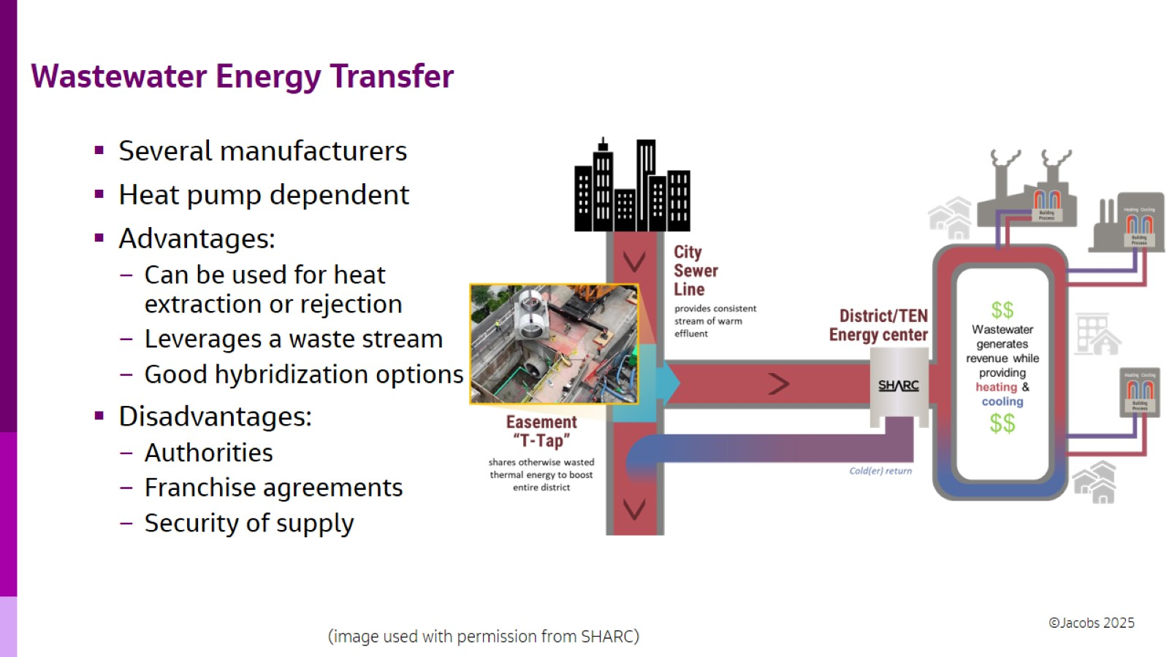
Wastewater Energy Transfer
Courtesy of SHARC Energy. Used with permission.

Slide 7
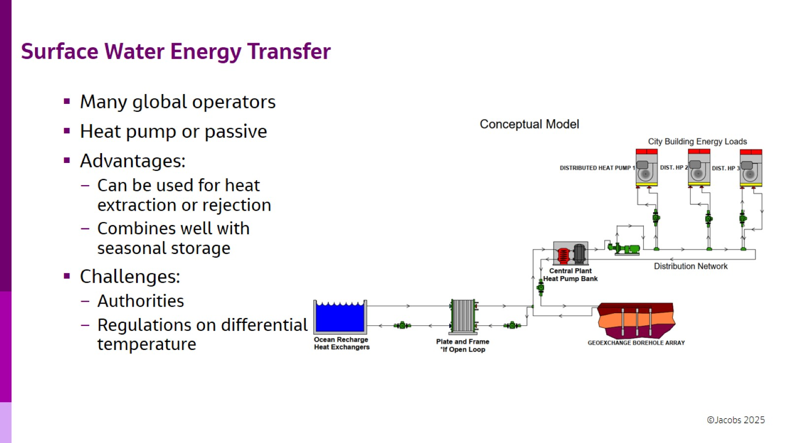
Surface Water Energy Transfer

Slide 8
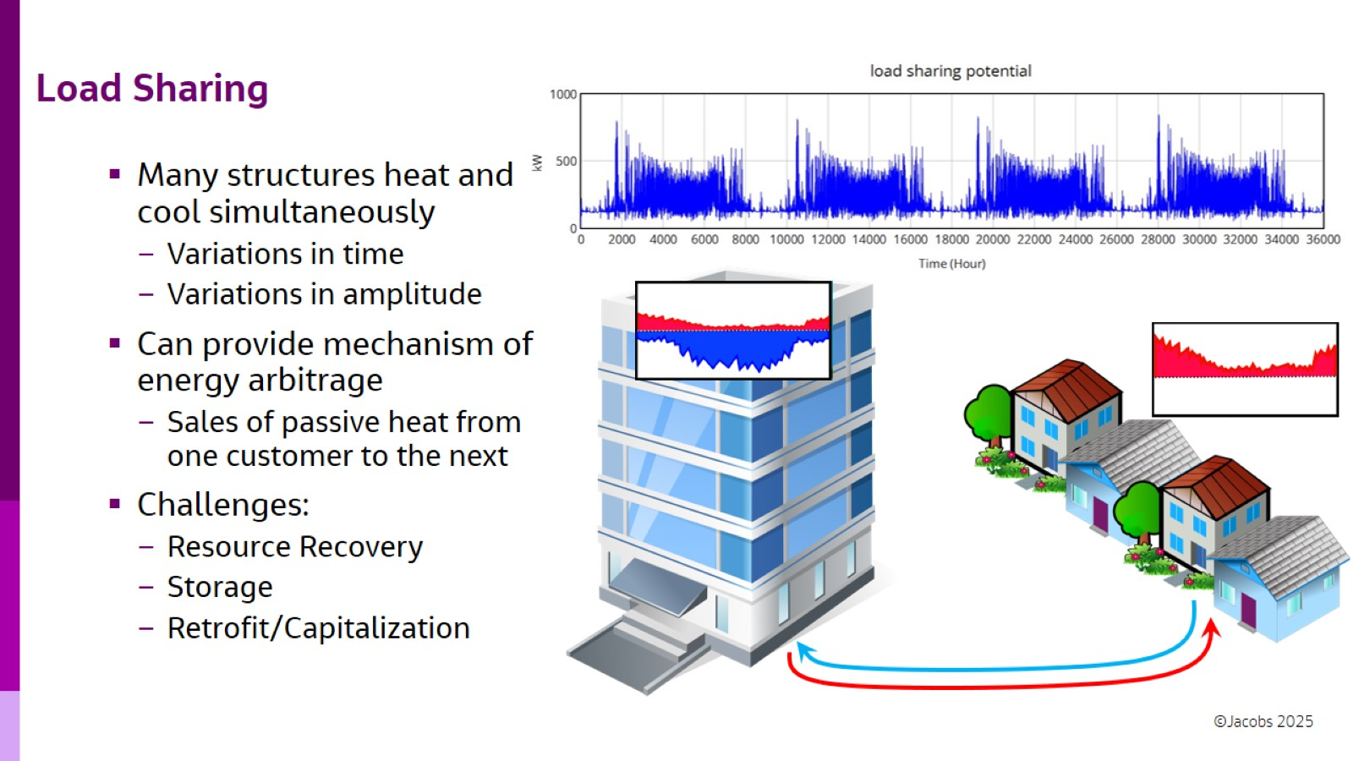
Load Sharing

Slide 9
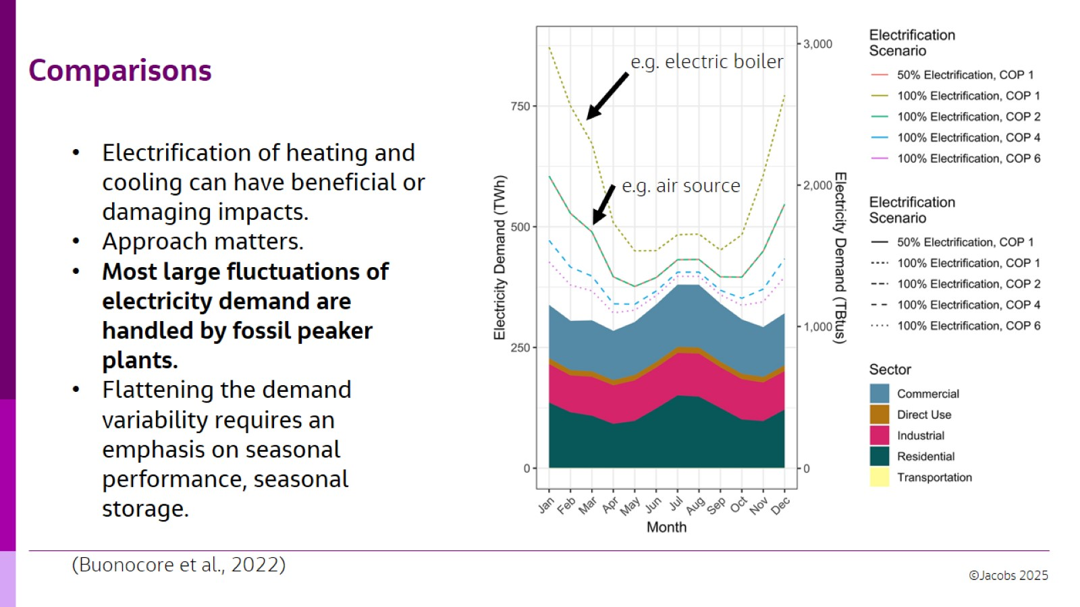
Comparisons
Courtesy of Buonocore, J. J., Salimifard, P., Magavi, Z., & Allen, J. G. (2022). Inefficient building electrification will require massive buildout of renewable energy and seasonal energy storage. Scientific Reports, 12(1), 11931. Used with permission. Creative Commons Attribution 4.0 International License - http://creativecommons.org/licenses/by/4.0/. Changes were made.

Slide 10
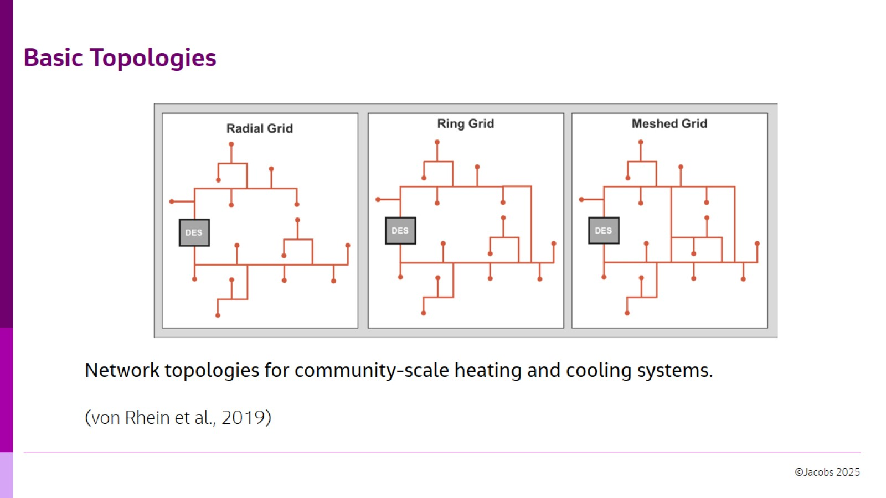
Basic Topologies
Courtesy of Elsevier, Inc., https://www.sciencedirect.com. Used with permission.

Slide 11
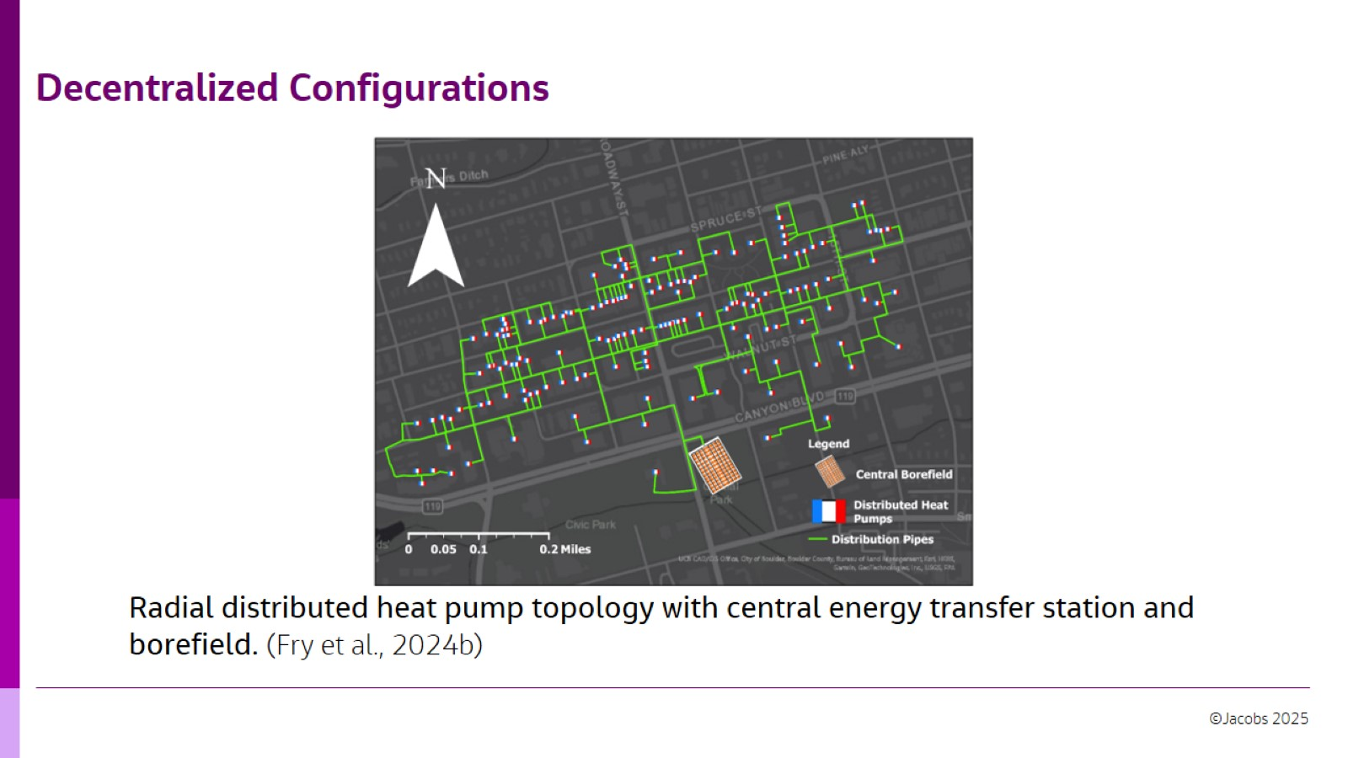
Decentralized Configurations
© Fry, N. et al. All rights reserved. This content is excluded from our Creative Commons license. For more information, see https://ocw.mit.edu/help/faq-fair-use/

Slide 12
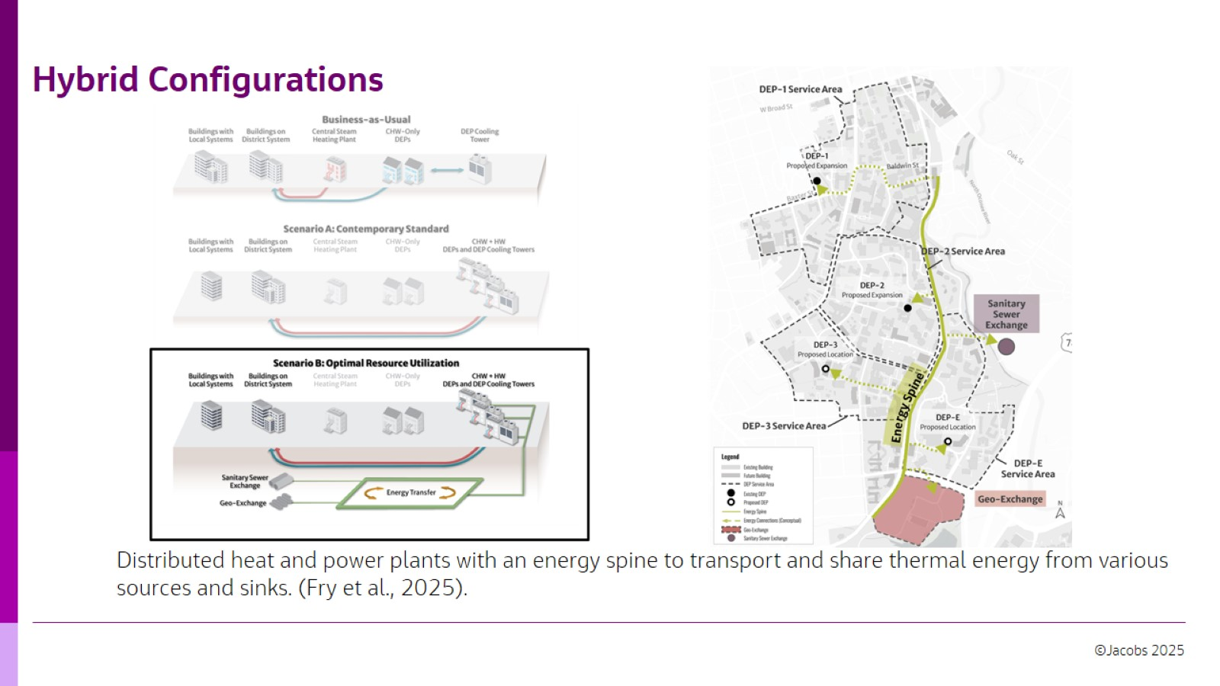
Hybrid Configurations
© Fry, N., Perry, J., Littlefield, M., & Willeford, J. All rights reserved. This content is excluded from our Creative Commons license. For more information, see https://ocw.mit.edu/help/faq-fair-use/

Slide 13
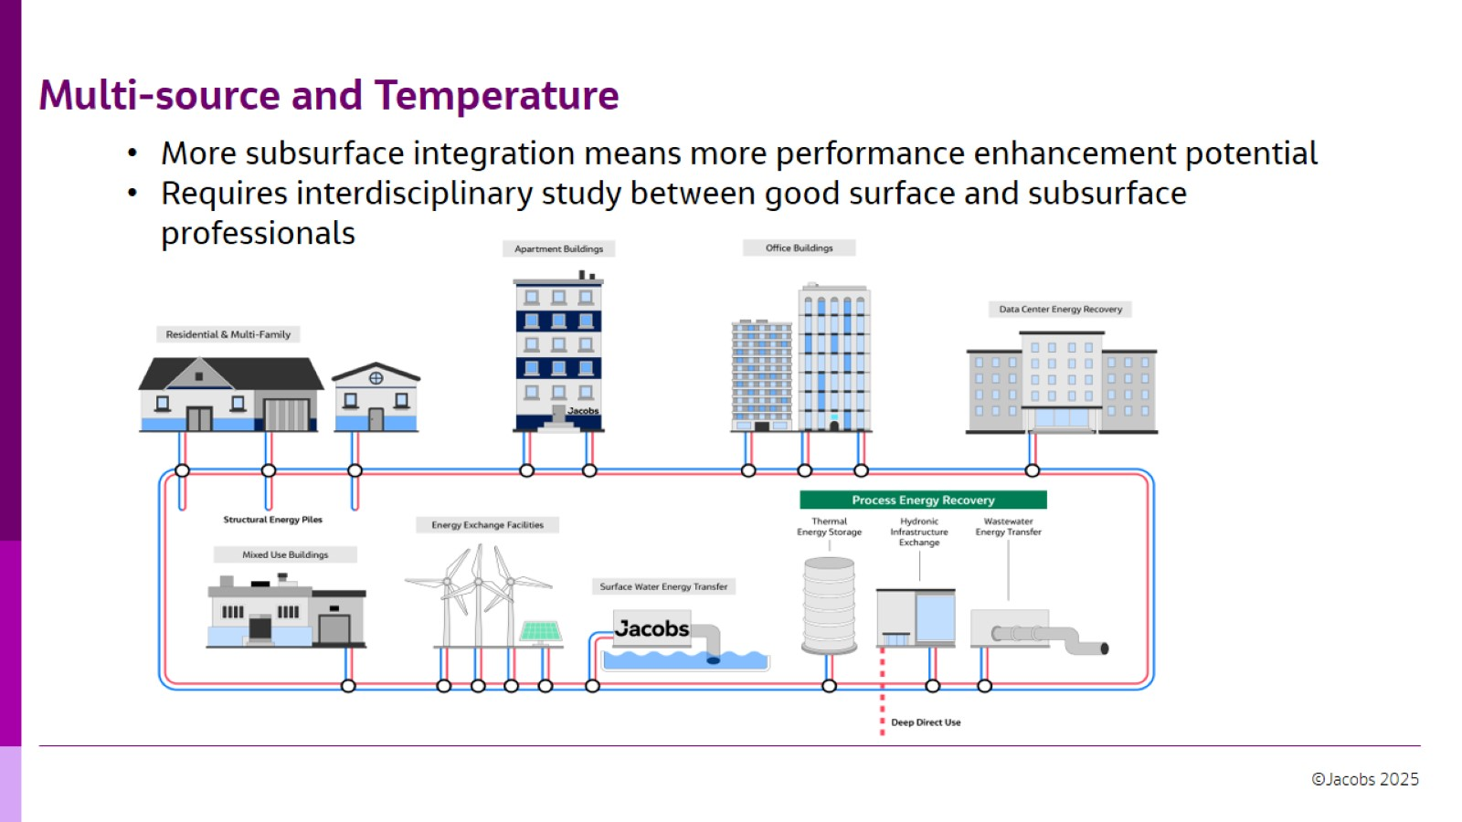
Multi-source and Temperature

Slide 14
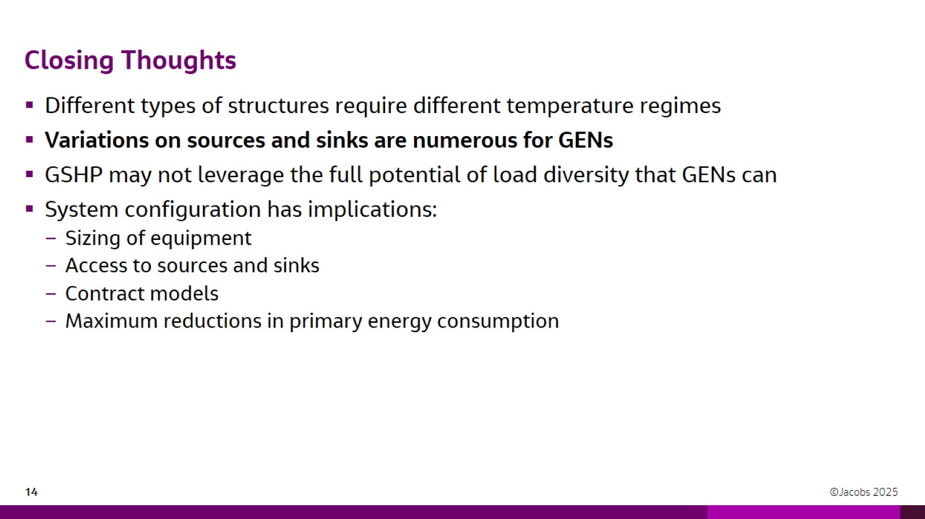
Closing Thoughts

Slide 15
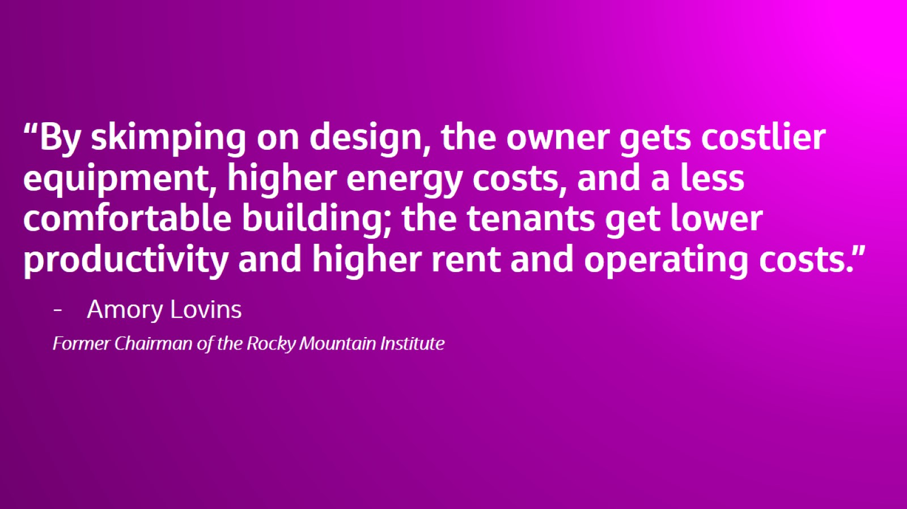
“By skimping on design, the owner gets costlier equipment, higher energy costs, and a less comfortable building; the tenants get lower productivity and higher rent and operating costs.”

Slide 16
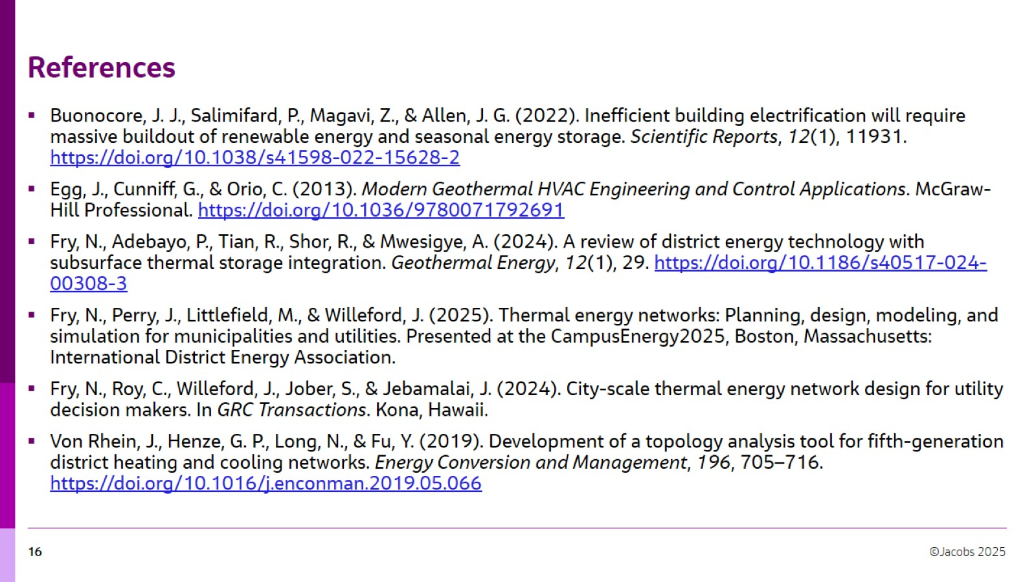
References

Slide 17
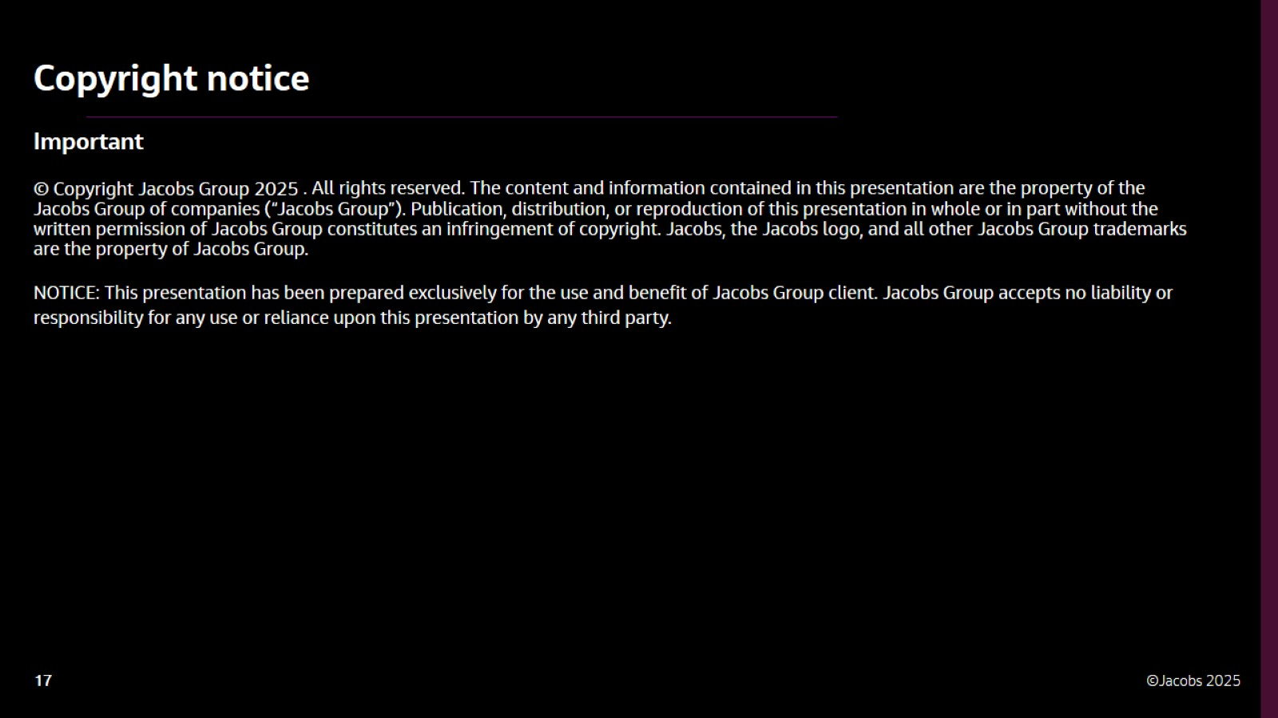

Slide 18

Thank you!

Slide 19
MIT OpenCourseWare
https://ocw.mit.edu/
RES.ENV 007 Geothermal Energy Networks (GENs): Transforming our Thermal Energy System
IAP 2025
For information about citing these materials or our Terms of Use, visit: https://ocw.mit.edu/terms.

