Slide 1

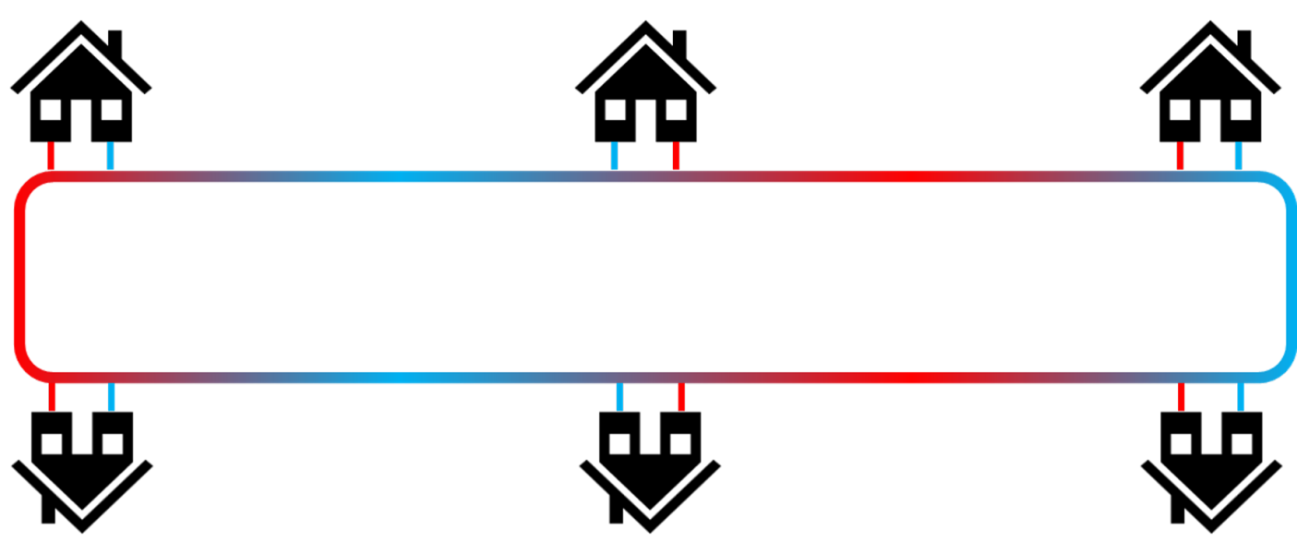
Introduction to Ground Source Heat Pumps
Connor Dacquay, Dr. Eng, PE, CGD
1

Slide 2
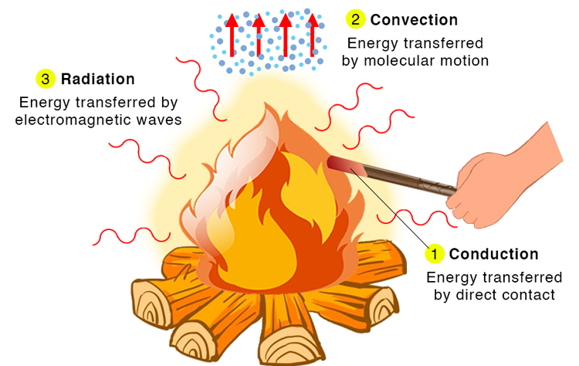
Heat Transfer
Conduction
Convection
Radiation
© Science Facts. All rights reserved. This content is excluded from our Creative Commons license. For more information, see https://ocw.mit.edu/help/faq-fair-use/
Image credit https://www.sciencefacts.net/heat-transfer.html

Slide 3
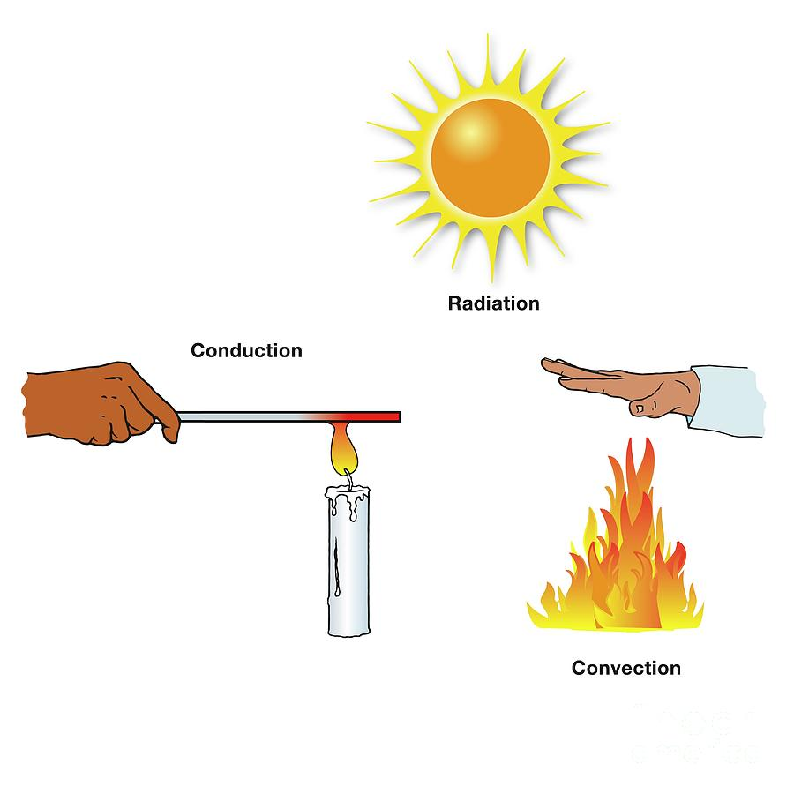
Conduction
When heat is directly transmitted through a substance when there is a difference of temperature.
© sciencephotogallery.com. All rights reserved. This content is excluded from our Creative Commons license. For more information, see https://ocw.mit.edu/help/faq-fair-use/
Image credit https://sciencephotogallery.com/featured/2-conduction-science-photo-library.html

Slide 4
Convection
The rising motion of warmer areas of a liquid or gas, and the sinking motion of cooler areas of liquid or gas.
© sciencephotogallery.com. All rights reserved. This content is excluded from our Creative Commons license. For more information, see https://ocw.mit.edu/help/faq-fair-use/
Image credit https://sciencephotogallery.com/featured/2-conduction-science-photo-library.html

Slide 5
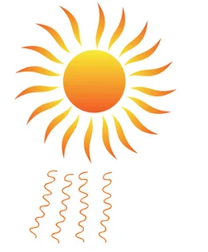
Radiation
The process where heat energy is transferred from one object to another through the emission of electromagnetic waves.
© sciencephotogallery.com. All rights reserved. This content is excluded from our Creative Commons license. For more information, see https://ocw.mit.edu/help/faq-fair-use/
Image credit https://depositphotos.com/vectors/convection-heat.html

Slide 6



Earth Energy Resource
Geo: relating to the earth
Thermal: relating to heat
10°F
90°F
70°F
70°F
50°F
50°F
Notes:
So the word ‘geothermal’ comes from geo … and thermal… but why is it a worthwhile topic to discuss and why is it efficient?

Slide 7
Earth Energy Resource
Plastic pipe transfers heat to volume of earth
Heat exchange fluid is pumped through the pipe
Pipe is connected to a heat pump
70°F
Notes:
To gain access to the thermal energy in the ground, we need to build a heat exchanger in the ground. The geothermal heat pump industry uses either high-density polyethylene pipe or cross linked polyethylene pipe to build the heat exchanger. The pipe is buried in the ground around or under the building.
To move the energy to and from the ground, fluid is circulated through the heat exchanger piping. The fluid is circulated through the pipe to heat pumps in the building. The heat pumps cool the fluid and transfer the energy to the building, or take heat from the building and warm the fluid. By creating the temperature difference between the fluid and the ground around the pipe, heat transfers from one to the other.
Water is an efficient medium for carrying energy (heat). A closed loop GHX is a proven and effective device to harness this efficiency to use the earth as an efficient heat source or heat sink.

Slide 8
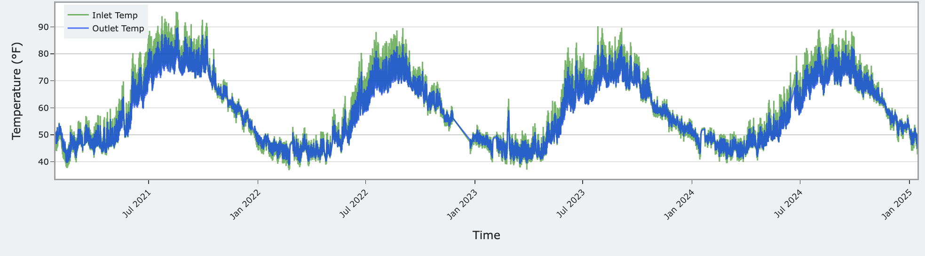

Earth Energy Resource
Ground heat exchanger (GHX) typically designed to deliver fluid temperatures to heat pumps between 30 and 90°F
Horizontal GHX temperature data over 4 years shows stable temperatures
GHX Temperature (°F)

Slide 9
Heat Pump Components
Evaporator: transfers heat with external environment (air, ground, water)
Compressor: compresses refrigerant, increasing pressure and temperature
Condenser: condenses refrigerant vapor into liquid, phase change transfers large amount of heat
Expansion valve: reduces pressure / temperature to prepare for heat transfer
Expansion valve
Decreases refrigerant pressure / temperature
Evaporator
Extracts heat from heat source
Condenser
Dissipates heat to heat sink
Compressor
Increases refrigerant pressure / temperature
9

Slide 10
Heat Pump Components - Heating
Heat is extracted from GHX
Compressor uses electricity to compress and heat refrigerant
Hot refrigerant pushed through condenser, rejects heat to air in building
Expansion valve
Decreases refrigerant pressure / temperature
Evaporator
Extracts heat from heat source
4 units of heat to building
Condenser
Dissipates heat to heat sink
Reversing Valve
Changes refrigerant flow direction
Compressor
Increases refrigerant pressure / temperature
1 unit of heat from compressor & pumps
3 units of heat from
GHX
10

Slide 11
Heat Pump Components - Cooling
Heat extracted from air in building, vaporizing refrigerant
Compressor compresses and heats refrigerant
Hot refrigerant pushed through condenser, rejects heat to fluid in GHX
Expansion valve
Decreases refrigerant pressure / temperature
3 units of heat from building
Condenser
Dissipates heat to heat sink
Evaporator
Extracts heat from heat source
Reversing Valve
Changes refrigerant flow direction
Compressor
Increases refrigerant pressure / temperature
1 unit of heat from compressor & pumps
4 units of heat to GHX
11

Slide 12



Earth Energy Resource Engineering
GSHP systems require analysis of total ‘demand’ to determine ‘supply’
Conventional HVAC system does not consider total annual heating and cooling loads
The gas line and cooling tower are sized on peak loads
Energy from finite mass of earth
Notes:
It’s important to understand that a ground heat exchanger is not an infinite energy source or heat sink. When the energy around the GHX piping is depleted, it’s gone…the building will need another heat source. Conversely, when too much energy is rejected to the ground, the building will need an alternate place to dissipate the heat taken from the building.
When the mass of earth surrounding the GHX piping is warmed or cooled to a different temperature than the soil and rock around it, energy will gradually flow to or from the soil around the GHX piping, but it moves fairly slowly through the earth. If more energy is continuously added to the GHX than is removed, the temperature of the mass of earth will gradually increase…or decrease if more energy is removed than is returned to it. (ADVANCE)…The ground can become too warm or too cold for the heat pumps connected to it to operate efficiently.
(ADVANCE) The most immediate energy source is, in effect, the building itself. Energy transferred from the building to the ground when it is being cooled, has a much greater influence on the ground temperature. That’s because energy rejected to the GHX doesn’t easily move away from the pipe, or alternately, energy removed from the ground around the pipe isn’t absorbed from the earth further away quickly.
In effect, a GHX operates much like a large energy storage tank. The greatest change in the temperature of the GHX is created by heat moving to or from the building, even though some energy moves through the ground to the GHX field.

Slide 13
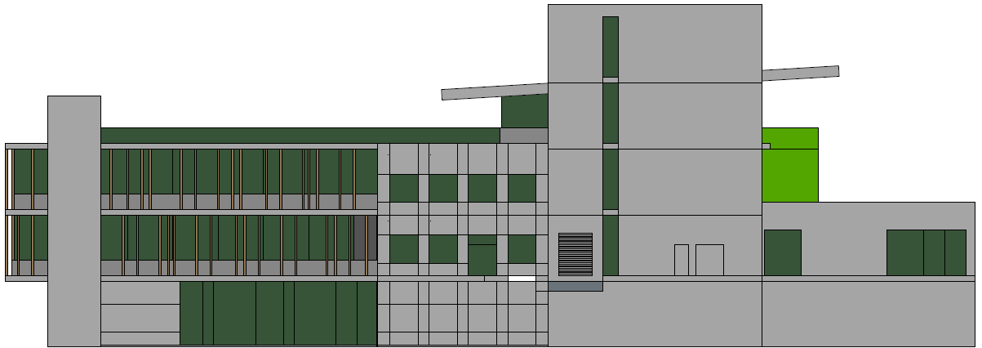
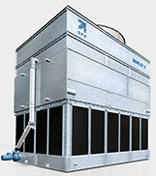

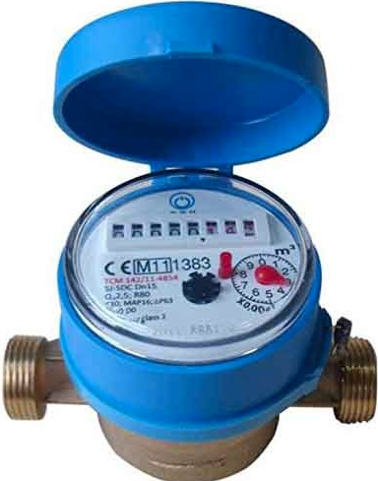
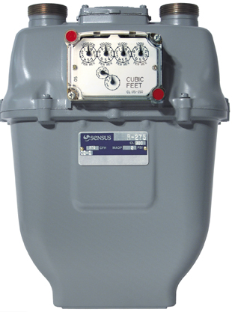

Conventional HVAC System Design
Pipeline large enough to meet peak heating load on the coldest day
Cooling tower dissipates heat by evaporating water
Energy is available if utility is paid
Heat blown away by the wind
Infinite energy source from gas utility
Infinite heat sink from water utility

Slide 14



Peak Loads vs. Total Loads
Church, retail store and apartment
Peak cooling loads are identical – 480 kBtu/hr (40 tons)
Peak heating loads are identical – 385 kBtu/hr (385 MBH)
Peak cooling: 480 kBtu/hr
Peak cooling: 480 kBtu/hr
Peak cooling: 480 kBtu/hr
Peak heating: 385 kBtu/hr
Peak heating: 385 kBtu/hr
Peak heating: 385 kBtu/hr

Slide 15
Peak Loads vs. Total Loads
Different occupancy creates different annual total heating and cooling loads
Heating / cooling ratio impacts sustainability of GHX
2.8 to 1
2.0 to 1
0.7 to 1

Slide 16
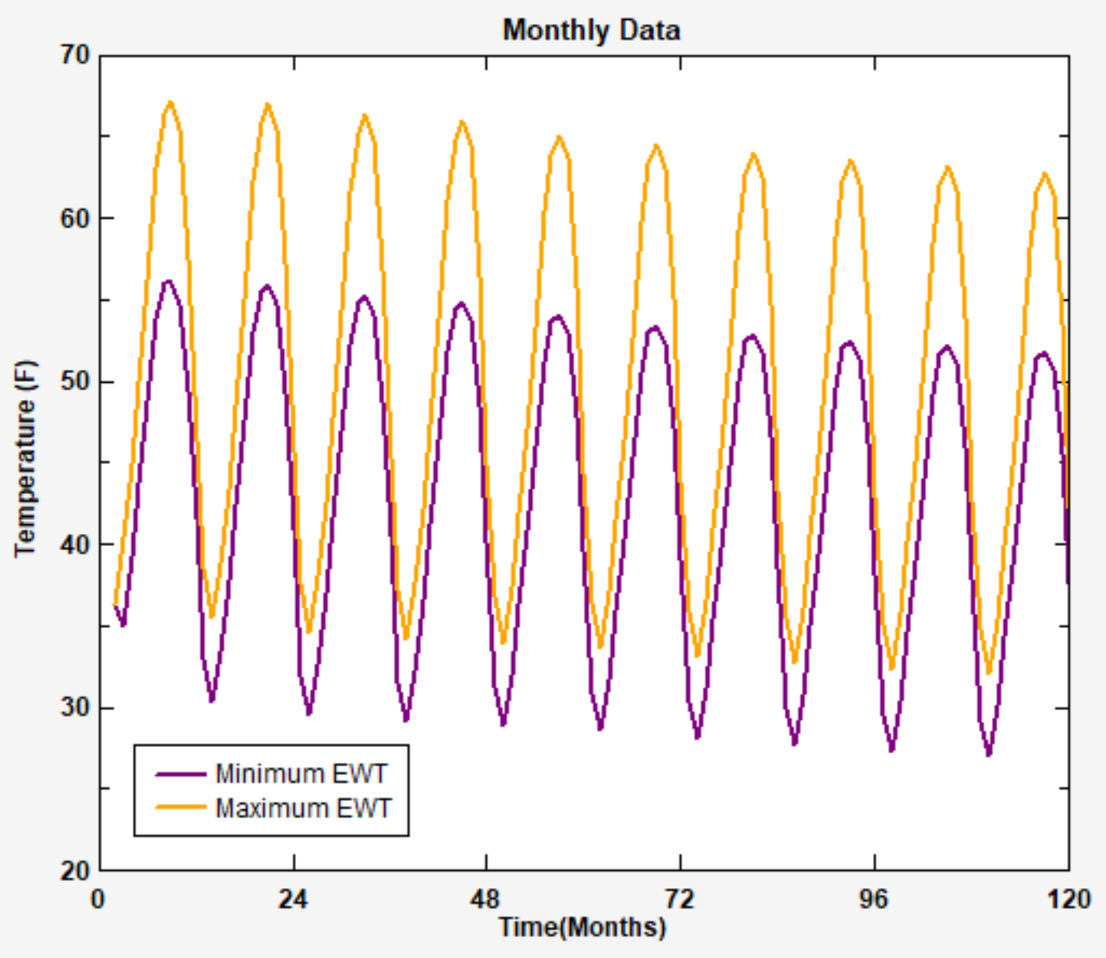
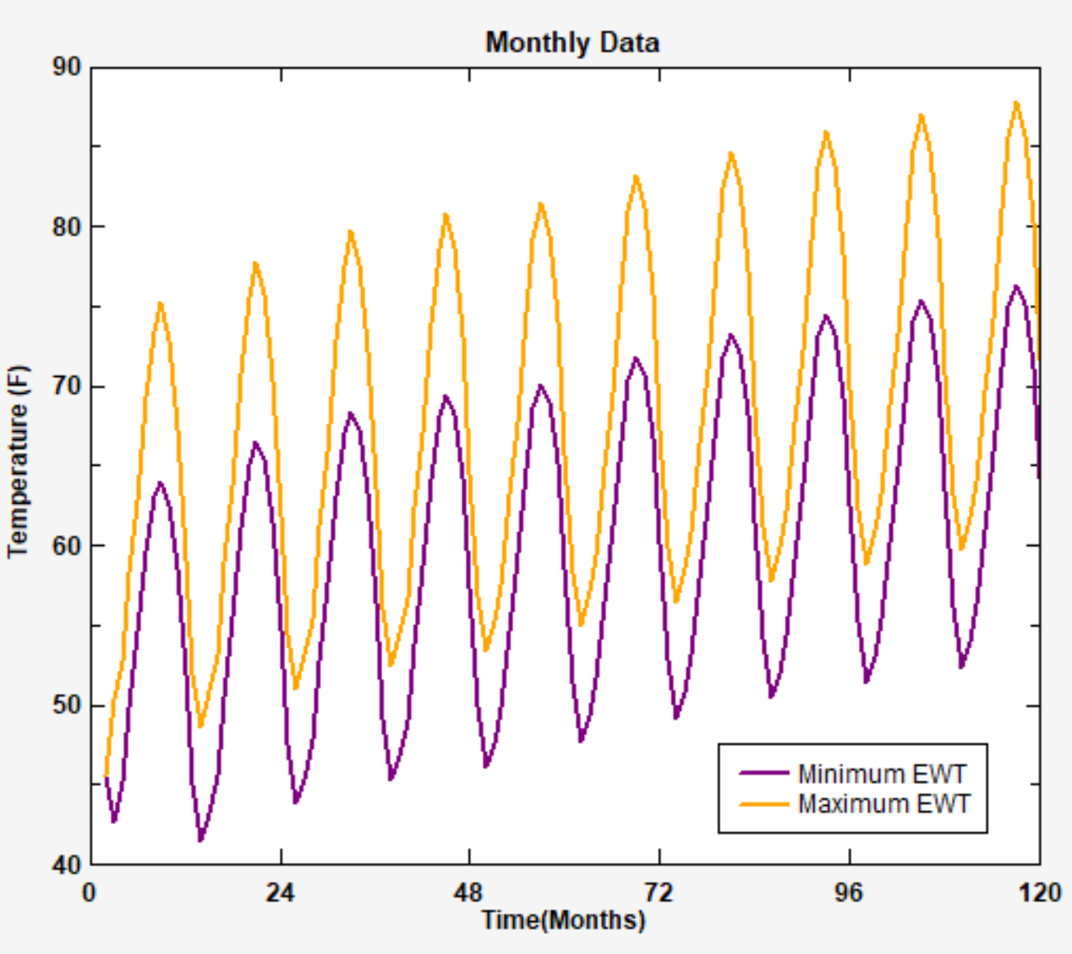
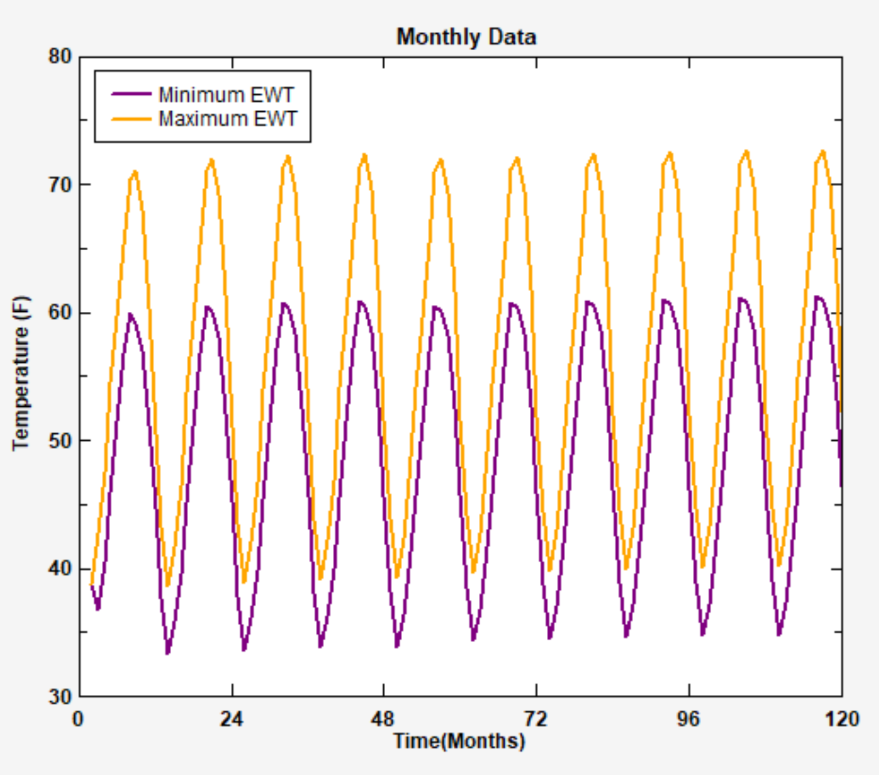
Peak Loads vs. Total Loads
GHX more similar to a battery compared to a conventional system
GHX temperature for church and retail store fall outside efficient operating parameters
Can’t design off of peak loads and rules of thumb
Church
Retail
Apartment

Slide 17
GSHP System Design Process
Feasibility
Client wants GSHP system
The Building
Mechanical System
Site & geology
Hybrid Options
Vertical
Horizontal
Surface Water
Aquifer
Wastewater
Standing column
Integrated Design Process
Energy Cost
Construction Cost
Confirm assumptions
Test Drill / Excavation TC Test
Detailed design
Design GHX
Design system
Specifications & Drawings
Implementation
Design conventional HVAC system if capital cost too high or site unsuitable for GCHP system
Construction, QA / QC
Commissioning
Operation
Operator training

Slide 18
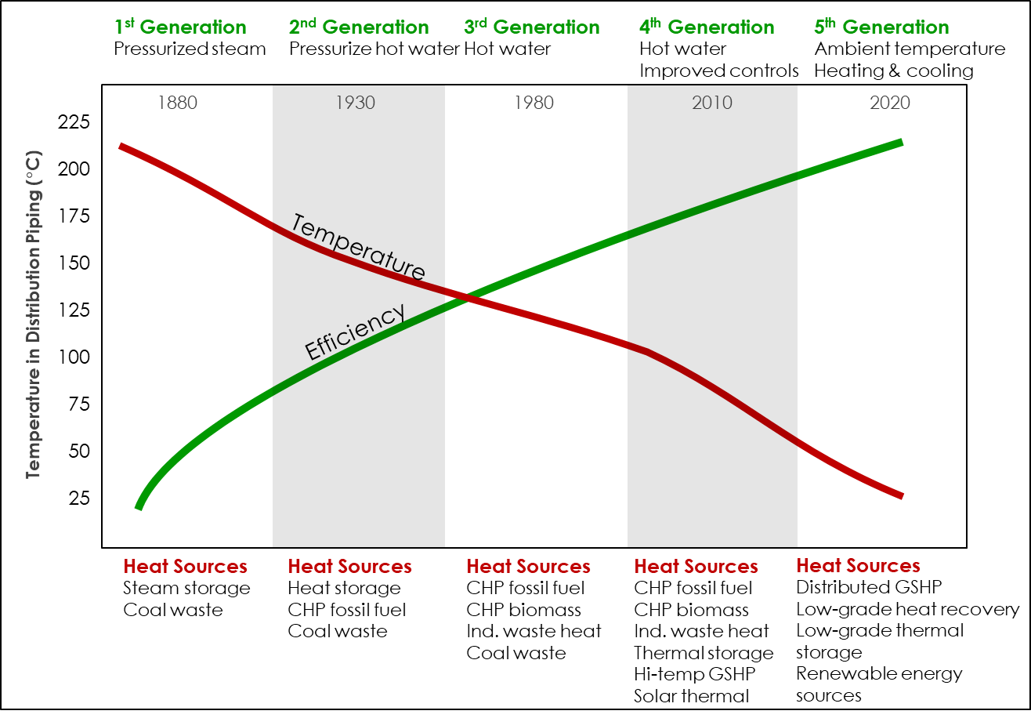
History of District Energy Systems
450
400
350
300
250
200
150
100
50
Temperature in Distribution Piping (F)
Notes:
Nic fry talking about district GSHP systems after
Mixed audience, some non-technical – some MIT grad students

Slide 19
Introduction to Ground Source Heat Pumps
Connor Dacquay, Dr. Eng, PE, CGD
19

Slide 20
MIT OpenCourseWare
https://ocw.mit.edu/
RES.ENV 007 Geothermal Energy Networks (GENs): Transforming our Thermal Energy System
IAP 2025
For information about citing these materials or our Terms of Use, visit: https://ocw.mit.edu/terms.

