Slide 1

Awakening the Sleeping Giant – Geothermal Energy Source
Expanding Geothermal Energy Networks at a Global Scale
Hela Cheikhrouhou
Regional Vice President for the Middle East, Central Asia, Türkiye, Afghanistan, and Pakistan
International Finance Corporation | World Bank Group
January 2025

Slide 2

Why should IFC care about geothermal energy
Reliability & Scalability
Energy Security
Energy Transition
Poverty Reduction

Slide 3
Massive deployment of GENs strengthens country economics
Surface geothermal combined with GSHPs could provide low-cost heating and cooling solutions almost everywhere
High-Capacity Factor
High Coefficient of Performance
Low Land and Water Intensity
Enhanced energy security of supply
Reduced contingent liabilities
Strengthened industry competitiveness
Increased job opportunities
Decreased GHG emissions
Low Intensity in Critical Minerals
Low GHG Emissions
Low Geo-Political and Market Risks
values to the Governments
No Resource Risks
Not Subject to Price Volatility
No Contingent Liability for Government
Positive Externality on System Costs
Opportunities for Local Jobs and SMEs
Partial Hedge against Inflation

Slide 4
How IFC plans to help
Full Engineering Design for Demonstration Project
Stakeholder Engagement
Policy Landscape and National Strategy
Capital Mobilization

Slide 5
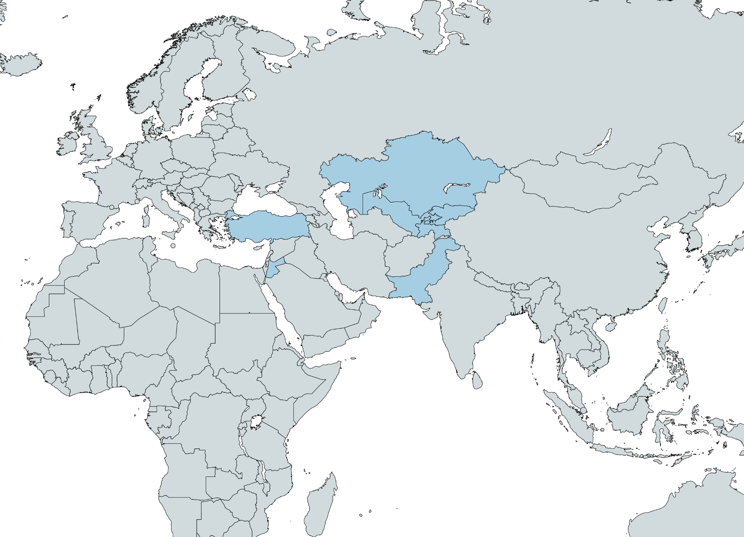
IFC’s “Networked GSHP for Heating and Cooling” programs
Türkiye
Kazakhstan
Kyrgyzstan
Jordan
Tajikistan
Uzbekistan
Pakistan
Map created with MapChart: https://www.mapchart.net/

Slide 6
Thank You
Hela Cheikhrouhou
Regional Vice President for the Middle East, Central Asia, Türkiye, Afghanistan, and Pakistan
International Finance Corporation | World Bank Group
January 2025

Slide 7
MIT OpenCourseWare
https://ocw.mit.edu/
RES.ENV 007 Geothermal Energy Networks (GENs): Transforming our Thermal Energy System
IAP 2025
For information about citing these materials or our Terms of Use, visit: https://ocw.mit.edu/terms.

