Slide 1
Business Models for Community Networked Geothermal Heating and Cooling
Donald Lessard
Professor Emeritus, MIT Sloan
Advisory Board Member, HEET
January 29, 2025

Slide 2
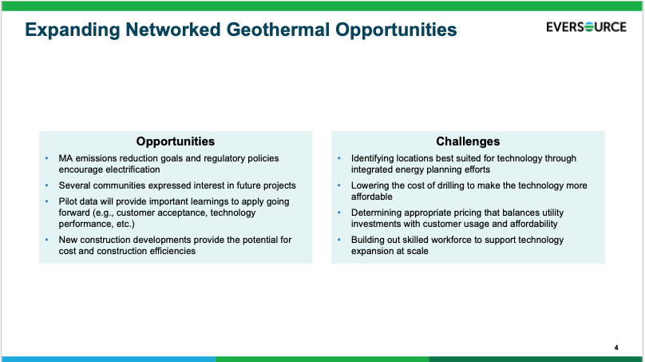

Slide 3
The challenge
High capital cost
1/3 boreholes
1/3 system
1/3 customer system/conversion
All in monthly cost to customer “near” current electric + gas bill.

Slide 4
Elements of solution
High capital cost
1/3 boreholes
1/3 system
¼ customer system/conversion
Reduce capital cost
Allocate only a portion of CAPEX to customer
Monetize other benefits/apply to reduce capital
Spread recovery of remaining capital over 30 years in constant real terms
Standardized design
Learning curve
Competitive bidding on standardized designs
“Right size” design
Allocate based on capacity provided (tons), not % of total cost. Transfer ”excess capacity” to thermal rate base for future deployment
Transfer a development/ learning curve allocation on early deployments to thermal base
MA heat pump grant
Investment tax credit
Payment from electric utility for avoided peak capacity
Other
Service fee plus direct capital recovery or
All in cost including service fee and rate-based capital recovery (for geothermal customers only)
Monthly cost to homeowner “near” current electric + gas bill.

Slide 5
Learning curve
Although all of the elements of networked geothermal systems are known technologies, experience with designing/installing these systems in different locations is in its early stages, and the costs of these systems costs are likely to decrease substantially as overall and specific (within a a state - regulatory context and utility experience- and metro region -contractor/installer experience) experience increase.
In Framingham, MA, for example, per household system costs have fallen 50% from network 1 to network 2.
Studies of many renewable energy technologies suggest that a learning curve of 10-11% (reduction in cost) per doubling of activity are feasible. (See Glenk et al 2023)

Slide 6
Excess capacity/pooling for reliability
In Framingham pilot, Loop # 1 was over-dimensioned relative to served demand (450 tons vs. 275), raising the cost/ton.
Loop # 2 was able to take advantage of pooling with Loop #1 (and experience with Loop #1) and “added excess capacity” was considerably smaller.

Slide 7
Mechanisms to monetize benefits
Assignment of carbon tax (avoided) or renewable energy standard impact to reduce capital cost of GT systems
Linkage of various incentive systems so that investment tax credits (federal), federal and state incentives for clean energy, support for housing upgrades for low-income households, etc, can all be used to offset cost of GT systems, even if the equipment is owned by the utility. A household should be able to claim the household-specific benefits so that these could be used to reduce the “amount financed.” The ideal result would be neutral for BM I, II, III, or IV.
Assignment of avoided cost credits from electrical utility – assignment of relevant proportion to reduce capital cost assigned to consumers regardless of BM 1, II, III, or IV

Slide 8
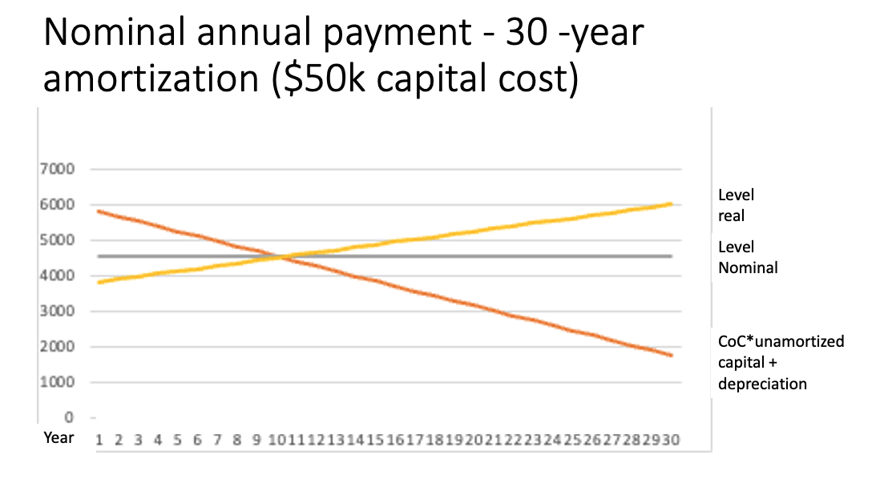
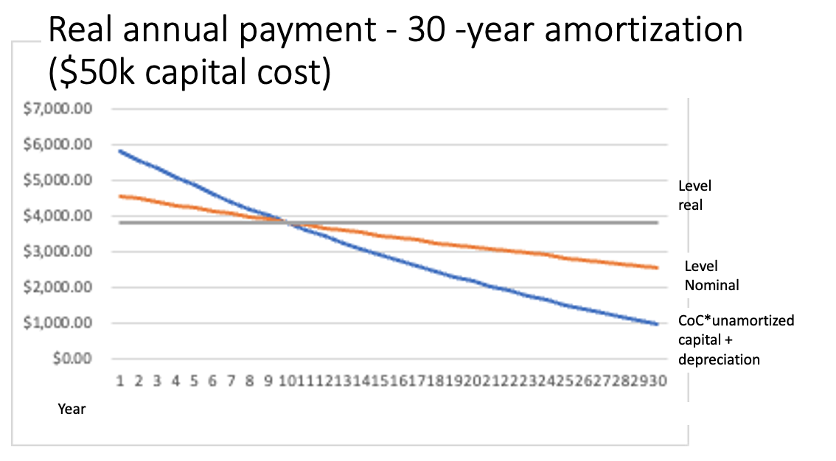
Capital recovery model
A critical determinant of the initial monthly/annual cost of the system under any of the four business models is how the capital investment is recovered over the lifetime of the system.
With current rate-based system, customers would be charged for their share of the investment in the system ($50k). The first-year capital charge charge would be 11.3% of the investment (8.3% cost of capital, 3.33% depreciation with an assumed 30-year life). For BM III or IV his comes to $5817 a year, or $485 a month, clearly a non-starter.
However, this amount is “tilted toward the present” (it decreases in nominal terms) as the base is depreciated as shown in figure 1a). The payments are even more tilted to the present in real terms, shown for 2% inflation (figure 1 b).
If the payments were set to be level in real terms over thirty years, on the other hand, the initial annual payment would be $3825 ($319 a month – 33% less. When the cost of electricity and operating expenses is added to this amount, the initial charge is still almost double the existing monthly cost of AC/gas, but it is within reach with matching the investment tax credits and energy savings credits (say 15k which reduce the investment to 35k for ASHPs), reasonable assumptions regarding the learning curve, and capture of only some of the benefits of NGT.

Slide 9
Constant real capital recovery
Possible to recover capital at constant real rate with two alternative systems
  Nominal payments set initially for every year to be constant in ex ante real terms.
  Payments indexed annually by rate of inflation so that they are constant in ex post real terms)
Both methods are laid out for the case of mortgage financing (Modigliani and Lessard 1975). The choice is a matter of preference of regulators given that both pass the ”Brandeis test” that forms the basis of existing utility regulation (Schmalensee 1989, Schmalensee and Joskow, 2024)
With a constant real payment, the monthly change in all years (in 2024 $) would be on the order of $325 per 50k of investment.

Slide 10
Alternative pricing models for networked geothermal
Capital costs on order of $50K* per residence
  1/3 boreholes,
  1/3 circulation system,
  1/3 in home
Operating costs (electricity) for typical user on order of $50* month.
System operation cost ?? $25 month?
Current gas + electricity bills on order of $200-250*.
 | Consumer purchases in home components/ Utility supplies heating/cooling services | Utility supplies heading cooling services including in home components
Utility charges for thermal usage based on volume used | I | II
Utility charges for thermal services based on capacity installed | III | IV
*(illustrative -- more exact figures -to come)

Slide 11
The path forward
Useful to think about NGT transition in three stages:
In the pilot stage, the Business Model should be to set initial monthly charges for networked geothermal at parity with existing gas/AC charges, with annual increases in line with general inflation. Any gap between revenues and costs should be assigned to utilities’ general rate base as part of the learning/scaling investment in the new business model, with some proportion going to the utilities’ bottom line to incentivize learning, economic operation ,etc.
At this stage, NGT systems not sufficiently mature to compute/assign cost of specific thermal services, so some form of capacity charge is the only viable route. One possibility would be to begin with a fixed charge based on initial provided capacity, with the possibility of adjusting the capacity figure after say three-years based on average usage. Households would still have some incentive to limit thermal demand, as they would be paying the electricity to drive their heat pumps, and this could be complemented by showing usage relative to the average household in the same network. Utilities might also impose a “not to exceed” level of thermal services during periods of peak demand..
In the roll-out stage, NGT’s will still be only a part (initially small) of total system and the “average” system will be quite young. Periodic charges should be determined using level real capital recovery of NGT “pool” with some reductions for additional learning curve, overcapacity, etc.
In steady state, NGT would be a large portion of total system and would include full vintage range so the tilt effect is not as serious. Charges could be linked to pooled cost per unit of NGT capacity and/or pooled cost per unit of thermal services.
Pilot stage
Roll -out stage
Steady state

Slide 12
Consideration for low income/low wealth households
The most straightforward way to address the needs of low income/low wealth households is to a) separate the monthly charge for the NGT services into two components:
  a) community-level services (boreholes and circulating system capital costs + recurring operating expense)
  b) in home systems including heat pump(s), distribution for heating/cooling, and envelope upgrades as needed
The “in home” component could then be “bought down” through a) proper spreading of capital recovery over time, b) additional subsidies/incentives that could be applied to reduce capital cost, c) outright grants or subsidies.
This would be an ideal entry point for impact investors, ideally via a foundation(s) that could also provide one-stop advice to households for the transition to NGT.
Households could then have the three options re the in-home component:
  a) finance themselves,
  b) have financed “on bill” as part of overall utility service, or
  c) separately financed through a foundation.

Slide 13
Appendices
Real (inflation-adjusted) payments for alternative capital recovery models
Illustrative buy-down model for low income/low wealth households
References

Slide 14
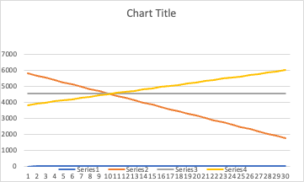
Nominal annual payment - 30 -year amortization ($50k capital cost)
Level real
Level
Nominal
CoC*unamortized capital + depreciation
Year

Slide 15
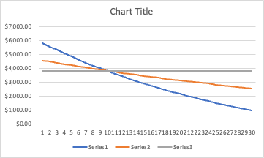
Real annual payment - 30 -year amortization ($50k capital cost)
Level real
Level
Nominal
CoC*unamortized capital + depreciation
Year

Slide 16
Models for buydown of “in home systems (assume cost is 1/3*50K = 16.67
Initial annual charge at CoC*unamortized investment + depreciation = $1939
Annual charge with level real payment at CoC = $1522
Annual charge with level real payment at bond rate + 50 basis points (4.5%) = $812
These figures do not reflect heat pump or other credits.
An impact investor could finance this third alternative and earn a market return on its investment.

Slide 17
Select references
Gunther Glenk, Gunter, Philip Holler, and Stefan Reichelstein, “Advances in power-to-gas technologies: cost and conversion efficiency”, Energy and Environmental Science, 2023,16, 6058.
Lessard, Donald, and Franco Modigliani. "Inflation and Housing Finance: Problems and Potential Solutions." New Mortgage Designs for Stable Housing Finance in an Inflationary Environment, Federal Reserve Bank of Boston, Cambridge, Mass (1975).
Modigliani, Franco. "The Inflation-Proof Mortgage: The Mortgage for the Young." (1989).
Schmalensee, R. (1989), “An Expository Note on Depreciation and Profitability Under Rate of Return Regulation,” Journal of Regulatory Economics, 1(3): 293-298.
Schmalensee, Richard and Paul Joskow, ”Cost of Service Regulation of Electricity Distribution Services in the U.S.” Handbook on Electricity Regulation, Jan-Michel Glachant, Micheal Pollitt, and Paul Joskow, Editors. Edward Elgar Press, Chapter 3, June, 2025.

Slide 18
MIT OpenCourseWare
https://ocw.mit.edu/
RES.ENV 007 Geothermal Energy Networks (GENs): Transforming our Thermal Energy System
IAP 2025
For information about citing these materials or our Terms of Use, visit: https://ocw.mit.edu/terms.

