Slide 1
Utility Perspective on Scaling
Deploying Geothermal Networks At City and Country Scale
1
Notes:
1

Slide 2
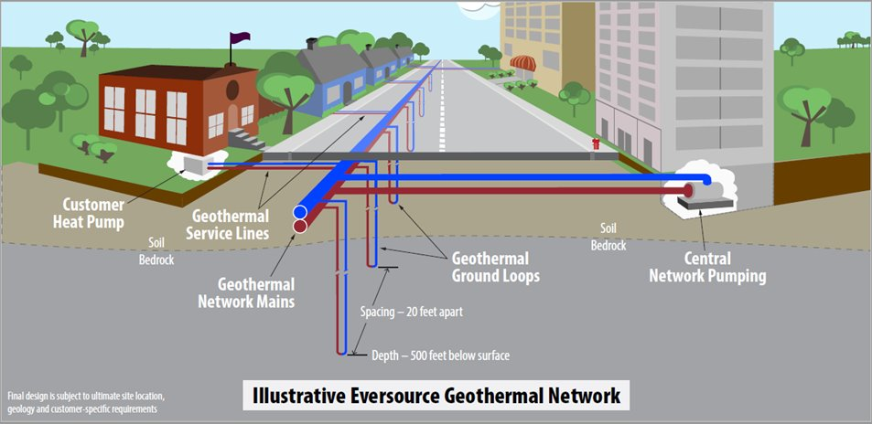
Framingham Geothermal Pilot
Timeline:
2019: Initial pilot proposed in natural gas rate case
2020: Project approved by DPU
2021: Feasibility, site selection: Framingham, MA established as host community
2023: Primary construction begins
2024: System commissioned – customers connected
2025: Formal data collection begins
System:
One pipe design, approx. 1 mile of main
37 buildings, approx. 135 individual customers
5 commercial customers including large school building
90 boreholes to provide capacity of approx. 375 tons of load

Slide 3
Framingham Expansion – A Unique Opportunity
HEET, the leading funding applicant for the joint team, received $715K from DOE in 2023 to design an expansion of Eversource’s existing pilot
Second DOE funding opportunity (up to $10M) was submitted earlier this year by joint applicants:
    HEET:
      Primary recipient of the DOE grant; collaborating on network design, community engagement and workforce development initiatives
    City of Framingham:
      Community partner advocating for project
    Eversource Clean Technologies Team:
      Execution partner responsible for customer, construction, operations, and maintenance of the networked geothermal system
If awarded, the grant could help fund construction of the loop and demonstrate cost savings of adding to an existing geothermal project

Slide 4
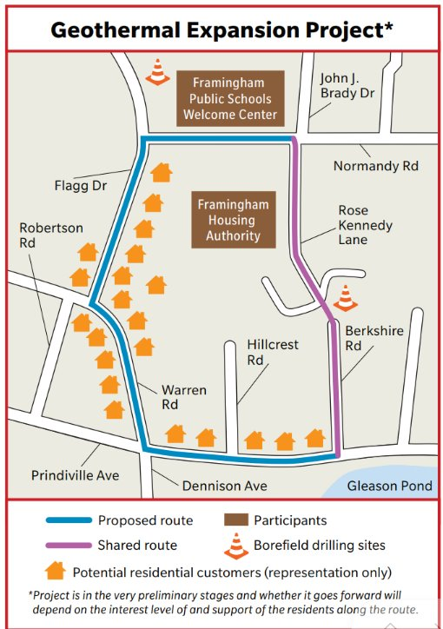
Capacity: 400 tons of load
Potential Customer Mix: approximately 180 with mix of 23 residential, 13 Framingham Housing Authority and 1 commercial buildings
Estimated In-Service: 2027
Projected Facilities: 2000 feet of main, up to 50 boreholes, pump vault and instrumentation

Slide 5
Expanding Networked Geothermal Opportunities
Opportunities
MA emissions reduction goals and regulatory policies encourage electrification
Several communities expressed interest in future projects
Pilot data will provide important learnings to apply going forward (e.g., customer acceptance, technology performance, etc.)
New construction developments provide the potential for cost and construction efficiencies
Challenges
Identifying locations best suited for technology through integrated energy planning efforts
Lowering the cost of drilling to make the technology more affordable
Determining appropriate pricing that balances utility investments with customer usage and affordability
Building out skilled workforce to support technology expansion at scale

Slide 6
End Slide
6

Slide 7
MIT OpenCourseWare
https://ocw.mit.edu/
RES.ENV 007 Geothermal Energy Networks (GENs): Transforming our Thermal Energy System
IAP 2025
For information about citing these materials or our Terms of Use, visit: https://ocw.mit.edu/terms.

