Slide 1
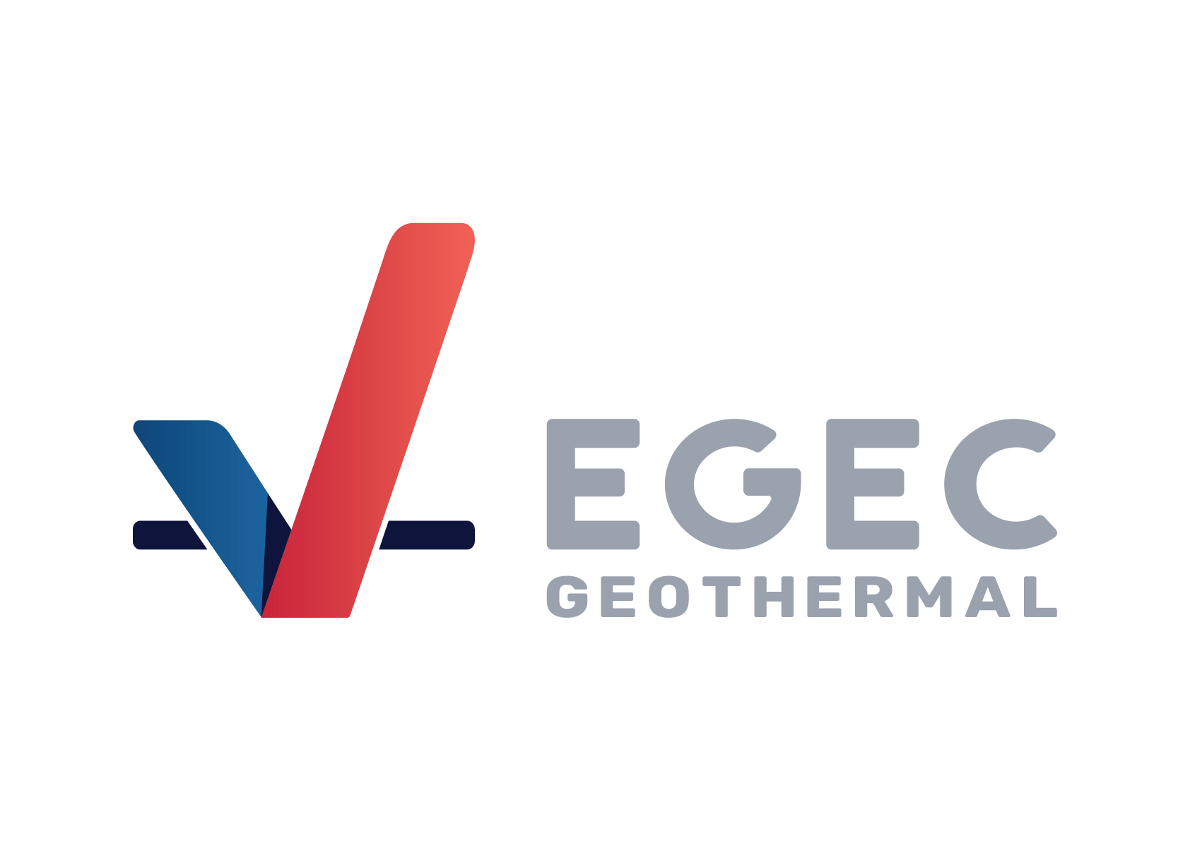
Networked geothermal:
The European experience
30 January 2025
#GeothermalNOW
Sanjeev Kumar
Head of Policy
www.egec.org

Slide 2
Content
1. Where we are
2. What’s needed….

Slide 3



U
U
6 million people 400 cities, farms & factories
supplied by geothermal district heating & cooling.
11 million consumers
supplied by Geothermal electricity.
10 million people
supplied by Geothermal heat pumps.

Slide 4
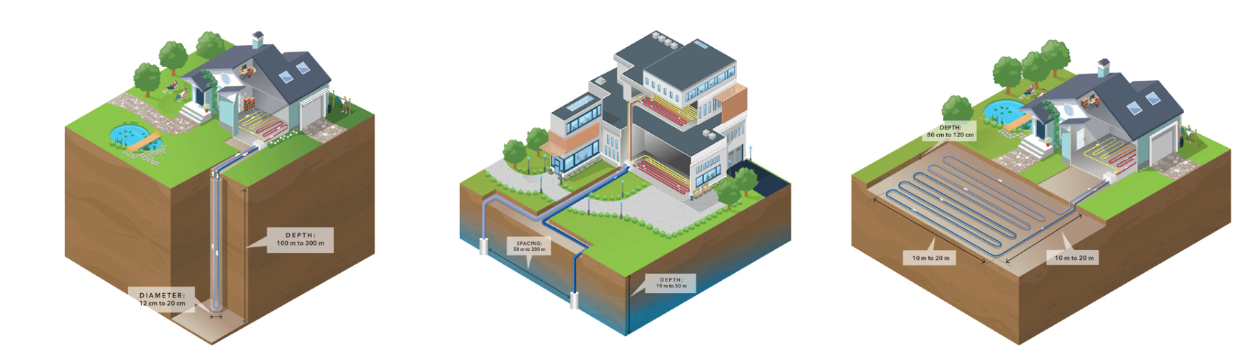
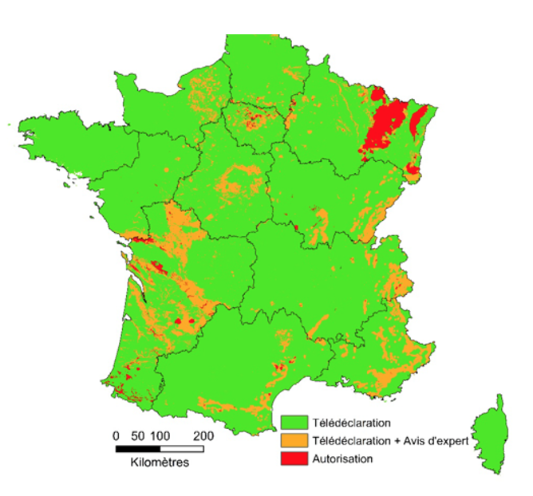
European heating & cooling market
Legacy: Nearly 75% of heating is fossil-based. Biomass is the main alternative. Heat pumps (air and geothermal) and geothermal direct use growing in market share but considerably smaller.
District heating and cooling systems are about 10% of the heating market. Linked to coal, gas and waste incineration plant.
Networked geothermal competes against this.
Land in Europe is scarce. Environmental protection is key. Shallow geothermal (which includes geothermal) is governed by the EU Water Framework Directive and its two main legal bases:
  Surface Water Directive https://environment.ec.europa.eu/topics/water/surface-water_en
  Ground Water Directive https://eur-lex.europa.eu/eli/dir/2006/118/oj
© GRETA – Interreg Alpine Space ERDF. All rights reserved. This content is excluded from our Creative Commons license. For more information, see https://ocw.mit.edu/help/faq-fair-use/
Different types of geothermal heat pumps
© Bureau de Recherches Géologiques et Minières. All rights reserved. This content is excluded from our Creative Commons license. For more information, see https://ocw.mit.edu/help/faq-fair-use/
BRGM, French geological agency geothermal permitting map.

Slide 5
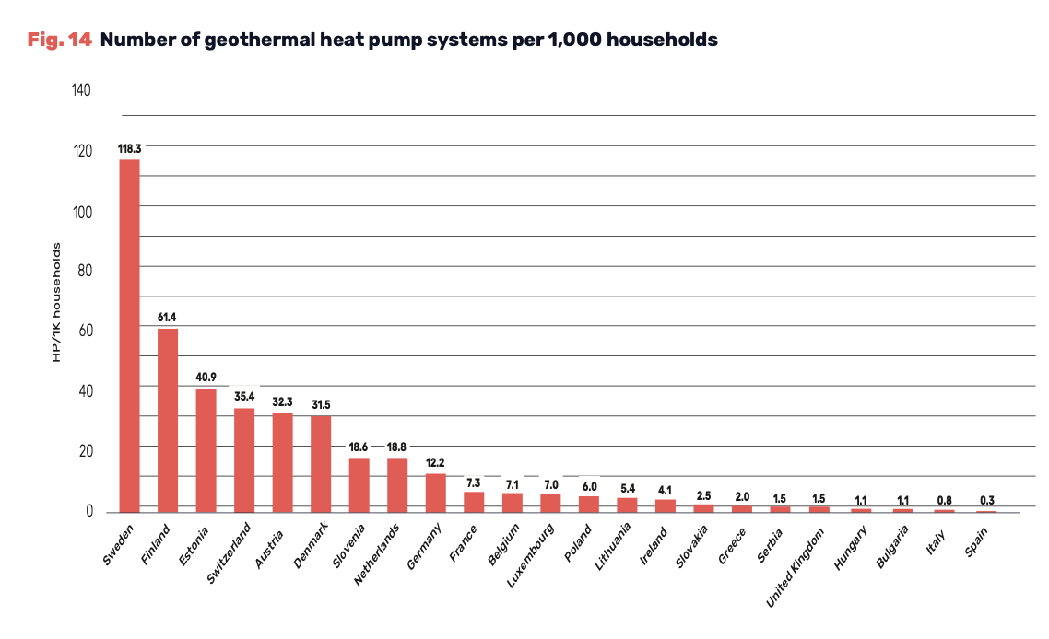
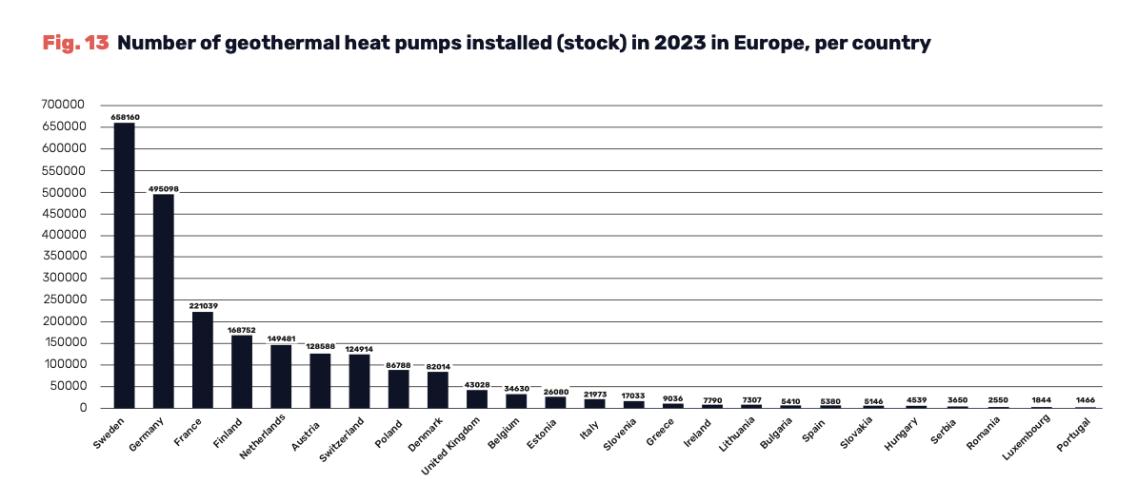
GHPs are the largest geothermal market
Installed GHP capacity per country
EGEC Market Report 2023

Slide 6
Networked Geothermal
District heating
Individual installations
Planning

Slide 7
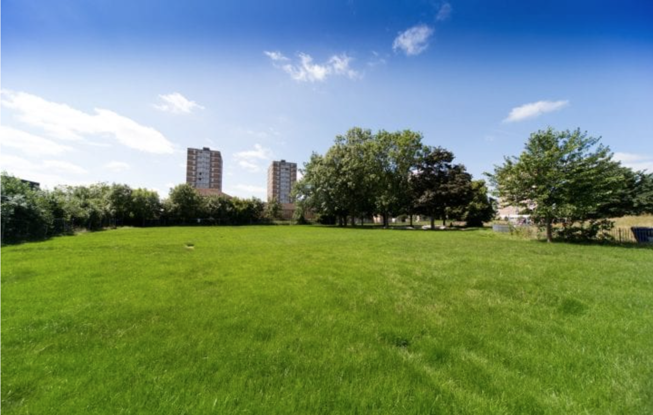
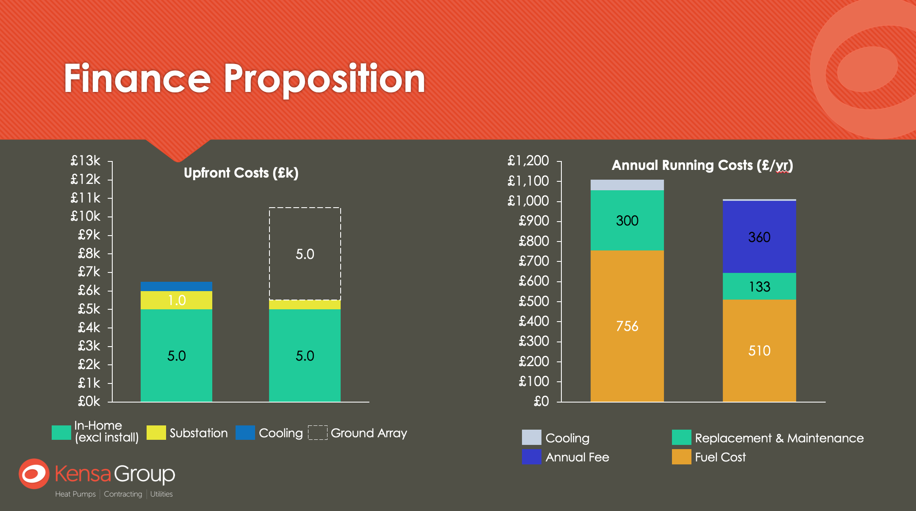
Enfield Council, UK
4 tower blocks with 400 apartments.
Kensa shoebox heat pump installed in each apartment with hot water cylinder.
16 heat networks building connecting the 4 tower blocks.
12 month project was completed with the occupants remaining in their apartments.
100 boreholes drilled (197-227m depth) in 2 sites in the nearby park.
Tower blocks used underfloor heating from electricity supplied by Enfield local government. Heating bills were around £800-£1,100 per flat which caused social and fuel poverty problems.
The geothermal system led to savings of £450 – £700 per year in heating and hot water costs, nearly £9 million in collective cost savings over the projected 40 year lifespan of the system.
£7.3 million contract from the local government for the installation.
© Kensa Group. All rights reserved. This content is excluded from our Creative Commons license. For more information, see https://ocw.mit.edu/help/faq-fair-use/

Slide 8
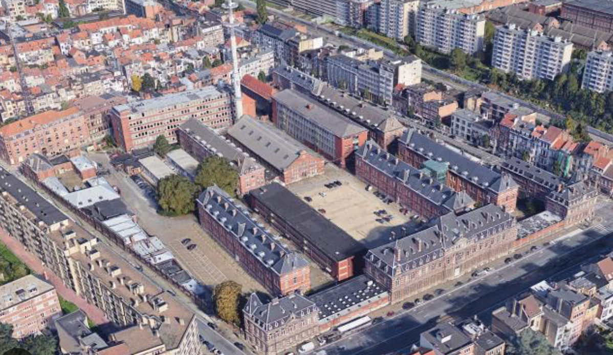
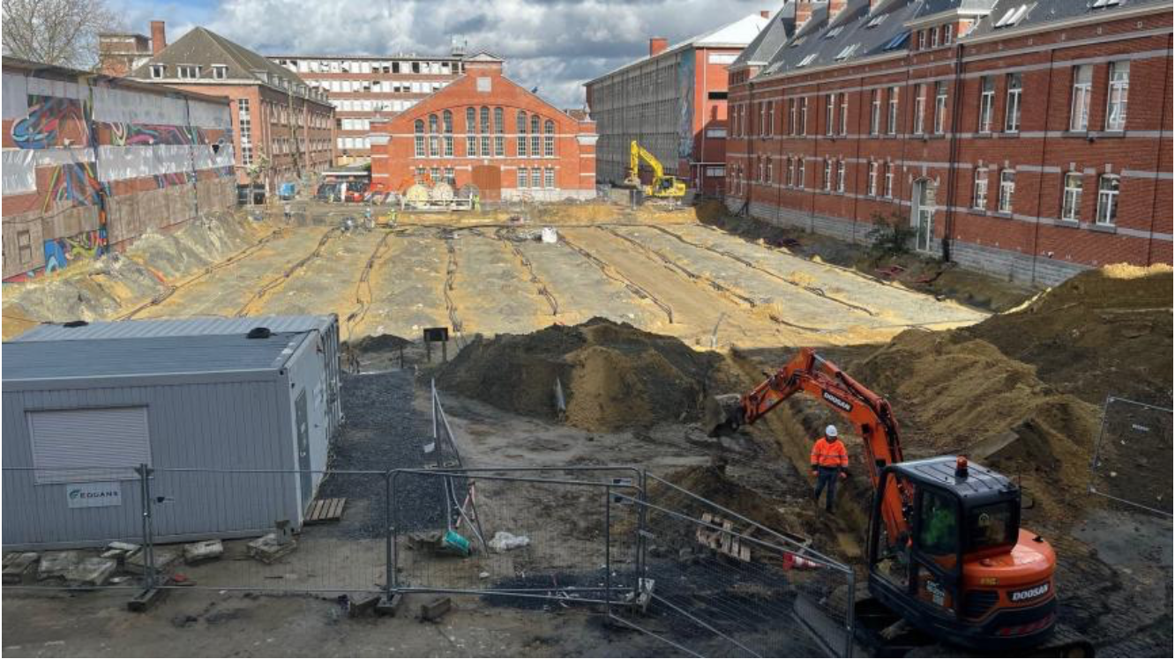
Ixelles, Brussels
Located in the heart of Brussels. Demonstrates that networked geothermal can be applied to protected buildings in busy city centres.
The Network comprises 460 student rooms, 130 family apartments, shops, offices, a school for autistic children and a food hall.
4 hectares total size of the land.
132 boreholes at a depth of 130 meters providing heating and cooling.
Total cost of the project - €5 million.
To be recuperated by the property developer – Usquare - through utility bills for heating and cooling.
Construction will take 6 years. Requires renovations to a listed building (ancient armoury).

Slide 9
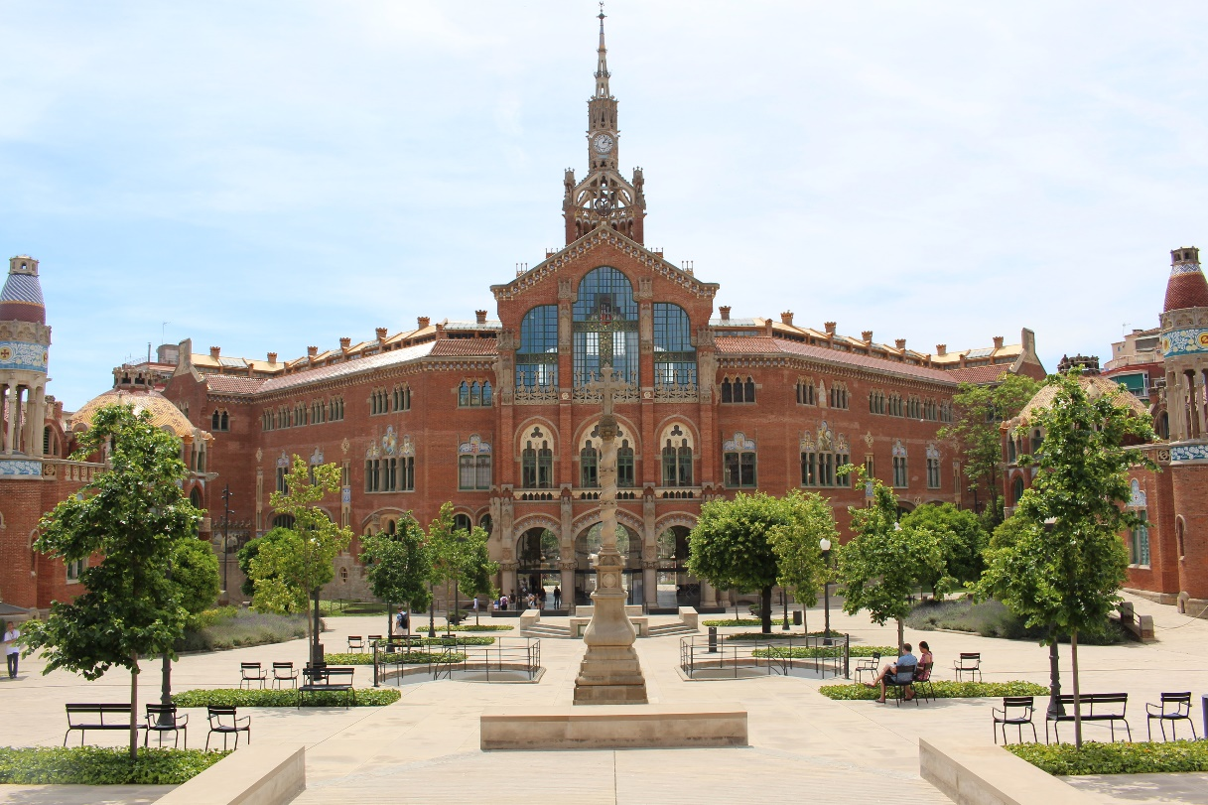
St Pau Hospital, (Barcelona) Spain
The Sant Creu i Sant Pau Hospital started off as a welfare house 600 years ago. It was converted to a modern hospital complex between 1905-1930.
The "city within a city” extends over 13.5 hectares occupying 9 blocks in Barcelona’s Eixample district and is a UNESCO World Heritage Site.
It is one of the largest geothermal systems in Southern Europe.
360 wells at a depth of 120 meters supply the geothermal system. It led to a reduction of 4,200 MWh/year of energy and 486 tons of CO₂ per year.
IDEA, the Spanish energy agency, provided €4.1 million to the project.

Slide 10
Content
1. Where we are
2. What’s needed….

Slide 11
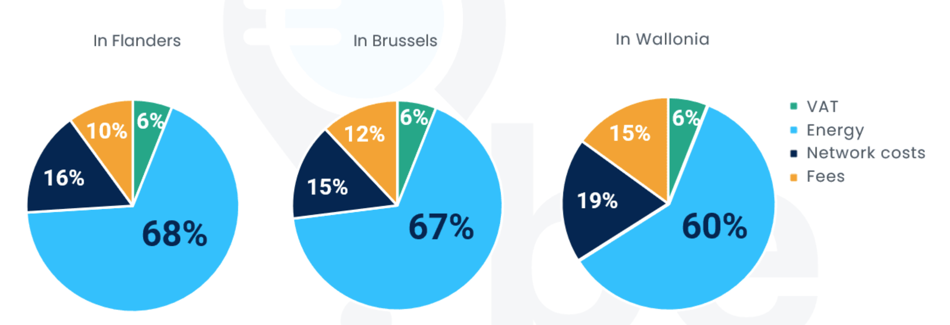
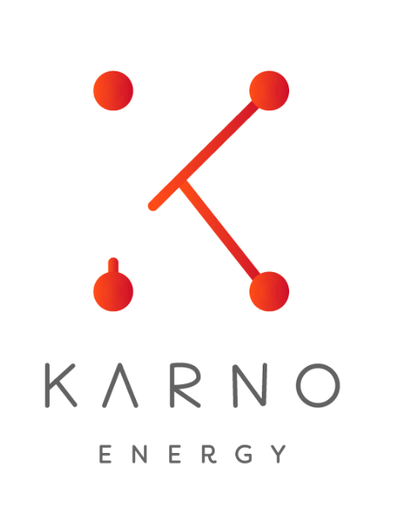

Policy matters…
  Wallonia (Belgium)
  Problem: cost of fossil gas was €4,218.71 in Brussels in 2022; € 4,278.70 in Flanders; and € 3,67.85 in Wallonia.
  ER 2030 (Renewable Energy plan 2030) published in 2018. Targeted 2,037 GWh by 2030 from geothermal heat pumps (was 341 GWh in 2020).
  €35 million grant for a programme of geothermal demonstration projects in public (hospitals and airports) and residential buildings in urban and rural areas.
    34 projects approved from a tender (24 private and 10 public). These include:
          11 networked geothermal systems in rural houses (new build) by Karno, the local energy company,
                A new hospital in Charleroi;
                Banks;
                Pairai Diaza zoo;
                and pharmaceutical buildings.
Cost structure of household heating bills

Slide 12
Trend 3: Plans really are indispensable
Planning is indispensable
Regulatory drivers (Energy Efficiency & Renewable Energy Directives (2023)) shift emphasis from individual investments to collective heating and cooling solutions. Mandate on local authorities to prepare local, renewable heating and cooling plans.

Slide 13
Narrative & campaign foundations
Words matter.
Business models are key.
Focus on who makes the investment.
Drilling is sexy.
Competition among suppliers is vital.
Industrial policy is the real winner.

Slide 15
MIT OpenCourseWare
https://ocw.mit.edu/
RES.ENV 007 Geothermal Energy Networks (GENs): Transforming our Thermal Energy System
IAP 2025
For information about citing these materials or our Terms of Use, visit: https://ocw.mit.edu/terms.

