Slide 1
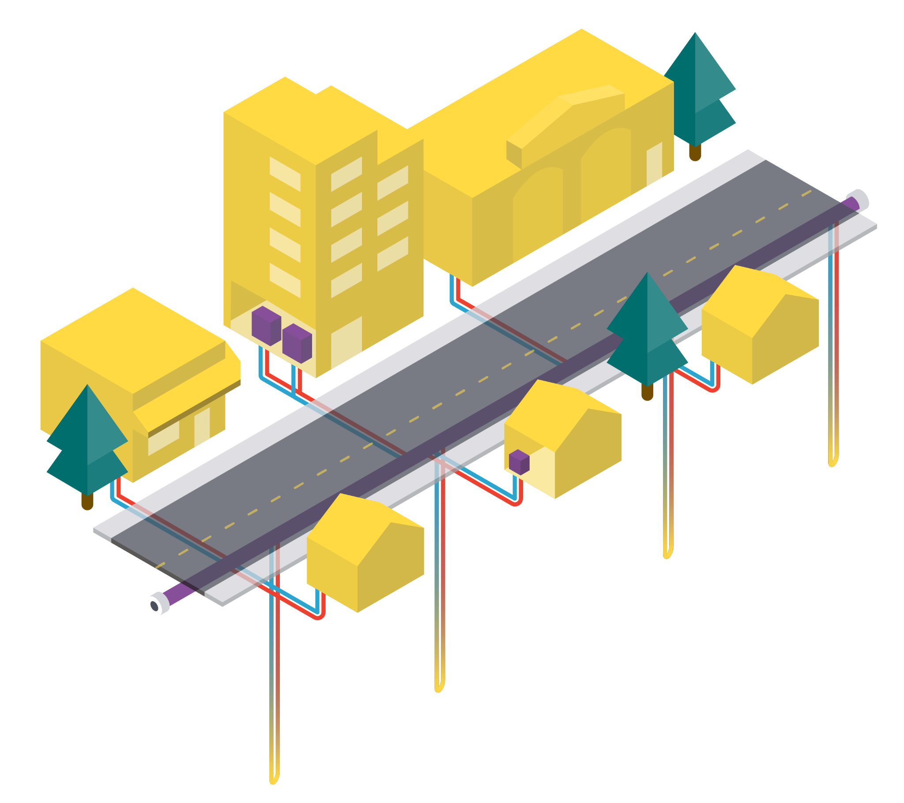
(Geo) Thermal Energy Networks
U.S. Policy Landscape
Ania Camargo Cortes
Associate Director, Thermal Networks
January 30th, 2025
1

Slide 2
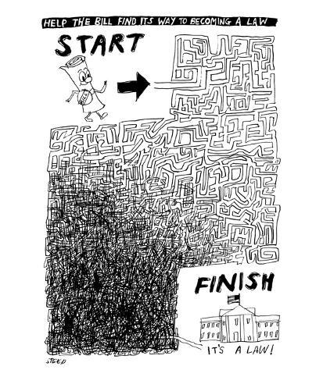
How a Bill Becomes Law
© Condé Nast. All rights reserved. This content is excluded from our Creative Commons license. For more information, see https://ocw.mit.edu/help/faq-fair-use/

Slide 3
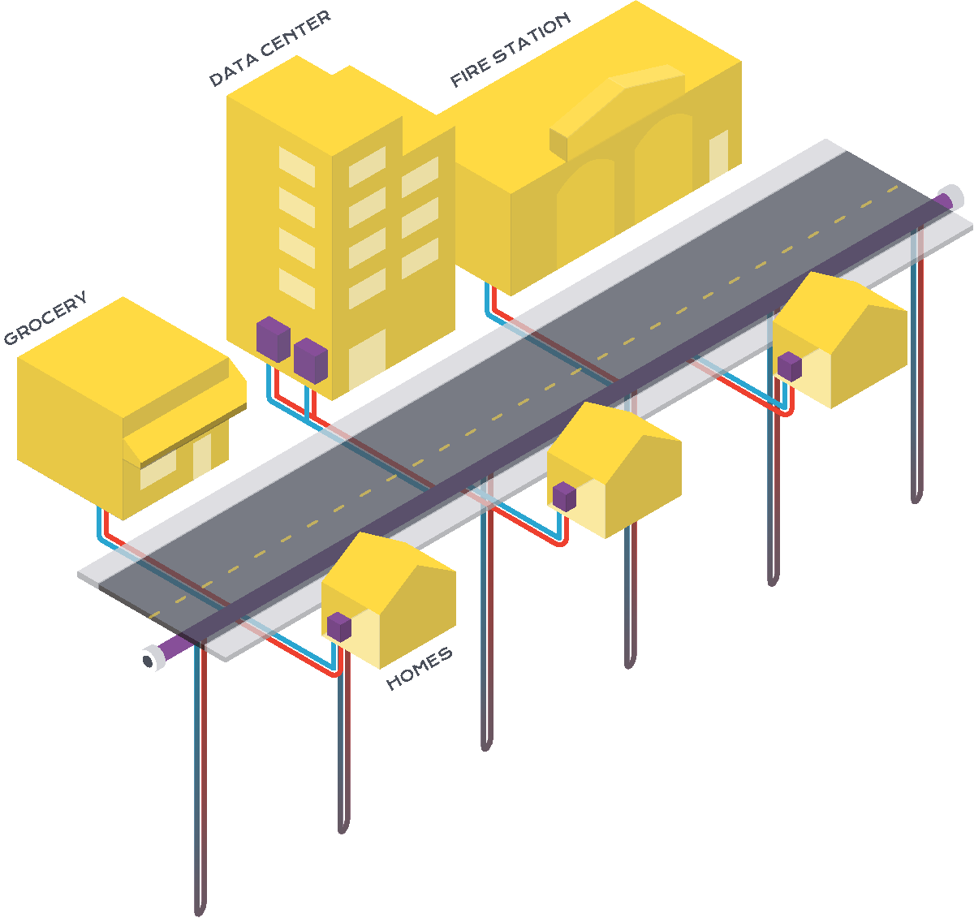

Utility (Geo)Thermal Energy Network General Journey
Advocacy
EJ & Rate Payer Advocates
Communities
Labor
Enviros
Legislators
TENs Regulation
Construction
TENs Legislation
Utility Pilot Proposals:
Site selection, design,budget,etc
Data Collection & Pilot Evaluation
Climate Commitments
Future of Gas Proceedings
Deployment Readiness
Feasibility studies, workforce,
supply chain & community outreach

Slide 4

Thermal Energy Network Legislation
MA - An Act Driving Clean Energy (2021, 2022, 2024)
MN - Natural Gas Innovation Act (2021 + 2 bills w/TENs in 2024)
NY - Utility Thermal Network
& Jobs Act (2022)
CO - Thermal Energy Act (2023, 2024)
WA - Promoting the Establishment
of Thermal Energy Networks (2024)
MD - WARMTH Act (2024)
VT - Act relating to Thermal Energy Networks (2024)
CA - Gas corporations: ceasing service: priority neighborhood decarbonization zones (2024)
Passed Legislation
Considering Legislation
Updated 9/15/2024

Slide 5
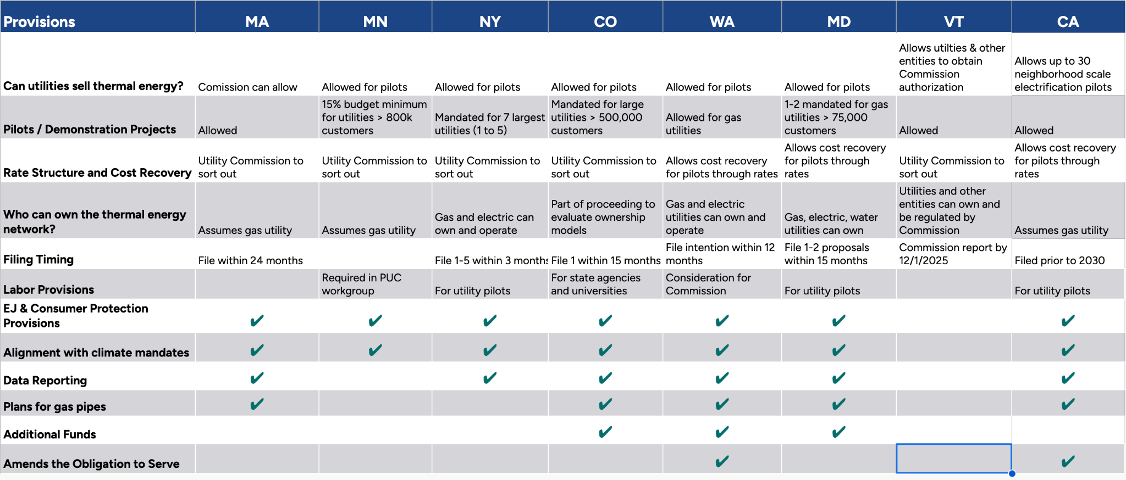

U.S. Thermal Energy Network Legislation Detail
5
Notes:
A lot of detail, you can look it up but shows states are learning from each other and adding provisions

Slide 6

Policy Phases:
Demonstration
Allow or mandate pilots
Definitions
Ownership
Labor standards
Environmental justice
Consumer protections
Environmental protections
Cost recovery / financing
Pilot data collection and reporting
6
Notes:
So one question you might have is how could this be enacted in a distribution system. You’d start perhaps with an innovation period, where “pilots” are allowed. We think of them actually as demonstration installation since the technology has been around for decades. The question being asked is more where is this sytem financially viable for investor owned utilities.
Potentially the first installation can be selected for avoided costs, such as in a new development, or where the pipes are leakprone or where there’s gas constraints. There can be a single gas heater at the end of the street providing the potential for supplemental backup heat if ever needed. There is a case study in Colorado Mesa University of a system like this and it’s supplemental backup heater has hardly ever had to be turned on. .

Slide 7
Policy Phases:
Demonstration
Development
Interim rate design
Amended obligation to serve
Joint gas/electric planning/prioritization
  Gas pipe transition
  Capacity constraints
  New development
Notes:
The system can interconnect like lego blocks, so if you think of the gas system as a tree, you can basically move down that “tree”, grafting on a new system, replacing the gas system while you go. As the networked geothermal system becomes larger, it becomes easier to maintain the temperature of the water in the system, since the more residential and commercial buildings attached to the system, the greater the chance a few of them will always be using heating and cooling in different ways.

Slide 8
Policy Phases:
Demonstration
Development
Deployment
Thermal market
Integrated utilities
Waste heat recovery
Tactical transition plans for cities/regions
Final rate design
  Joint rate base?
  Allowable cost recovery
  Avoided cost integration
Notes:
In the end you have a mature system, where combustion of some kind as a supplemental backup heat might be needed only in the densest urban areas or perhaps for a few industrial hard-to-decarbonize processes.

Slide 9
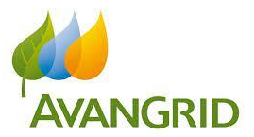










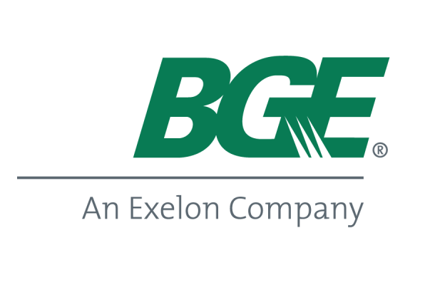








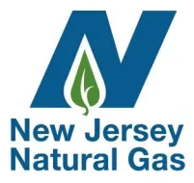




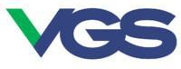
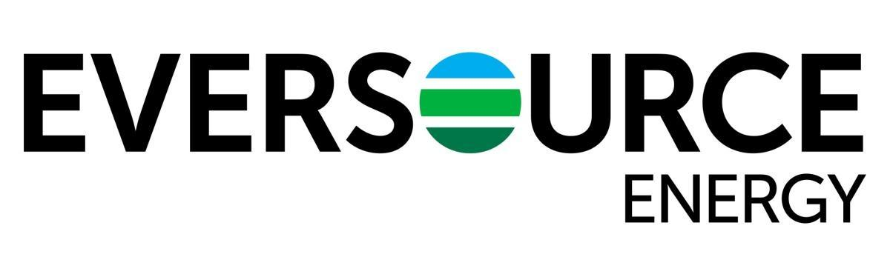
Utility Interest
Gas Utility Pilots
Utility NetGeo Collaborative

Slide 10
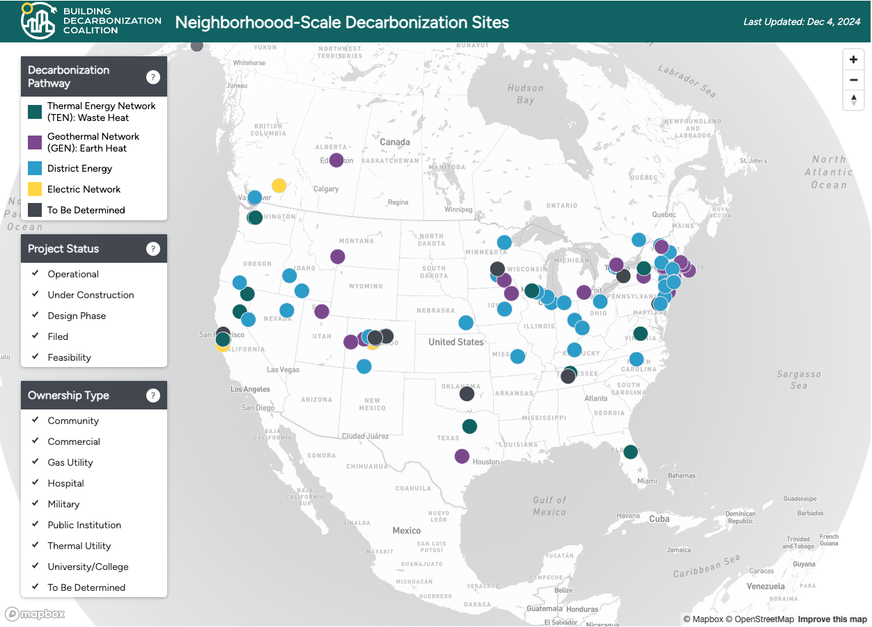
Neighborhood-Scale Building Decarbonization Sites
Notes:
.

Slide 11
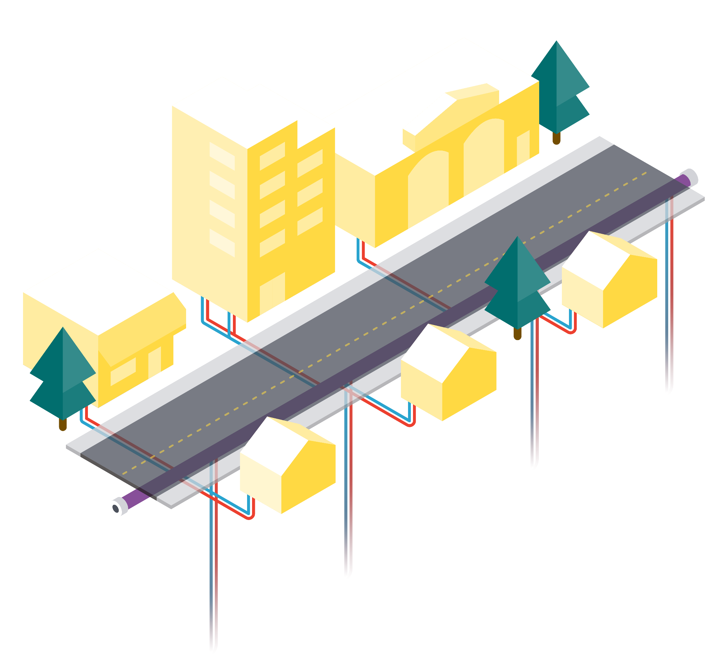
Questions?

Slide 12
Future of Gas Proceedings & Climate Commitments
BOTH Future of Gas Proceedings and Climate Commitments
GHG and RPS/CEPS Commitments (no FoG)

Slide 13
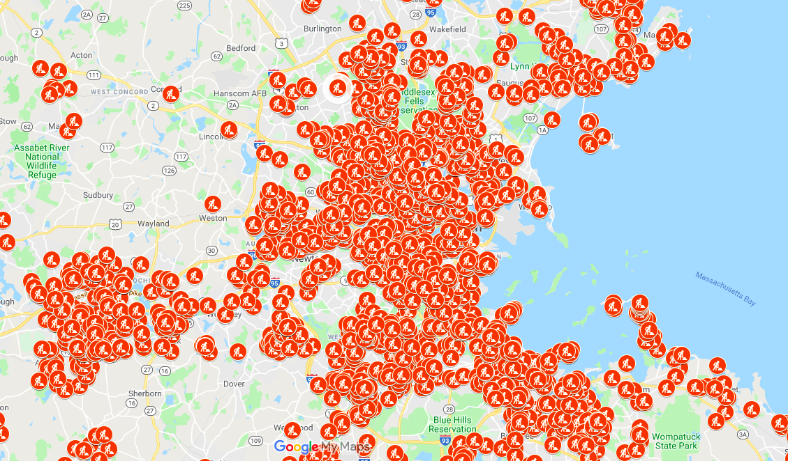
Costly gas distribution pipe replacement programs
NY > $28 billion to replace by 2043
MA > $34 billion to replace by 2039
Philadelphia > $8 billion to replace by 2055
IL > $80 billion
National Estimate > $740 billion by 2040
Case Studies of Geothermal Energy Networks
Case Studies of Geothermal Energy Networks

Slide 14
MIT OpenCourseWare
https://ocw.mit.edu/
RES.ENV 007 Geothermal Energy Networks (GENs): Transforming our Thermal Energy System
IAP 2025
For information about citing these materials or our Terms of Use, visit: https://ocw.mit.edu/terms.

