Slide 1
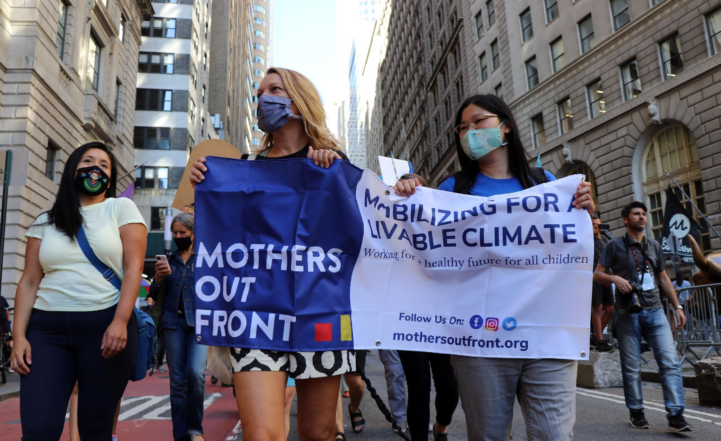
© Mothers Out Front. All rights reserved. This content is excluded from our Creative Commons license. For more information, see https://ocw.mit.edu/help/faq-fair-use/

Slide 2




CLIMATE CHANGE IS ABOUT POWER
$ $ $
Fossil Fuel & Petrochemical Industry,
Allies and Investors
Status Quo
The seeming lack of power of ordinary citizens
VS.

Slide 3


WE HAVE POWER TOGETHER!

Slide 4
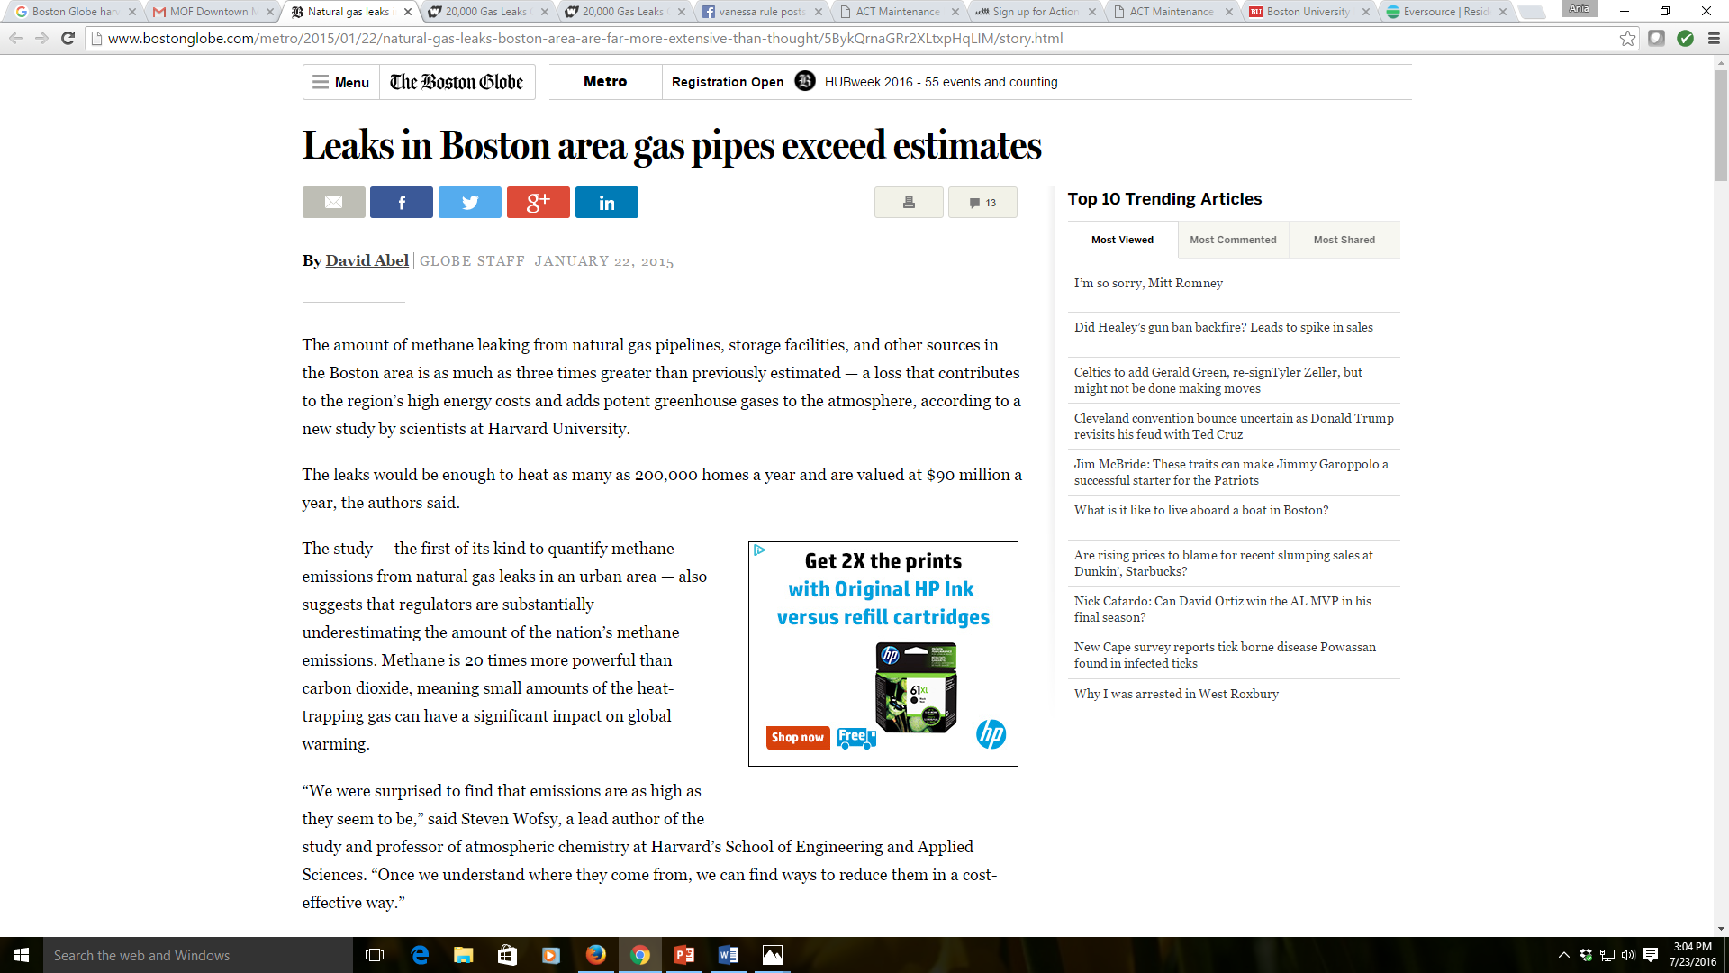
STARTED WITH A BOSTON GLOBE ARTICLE
January 22, 2015
© Boston Globe Media. All rights reserved. This content is excluded from our Creative Commons license. For more information, see https://ocw.mit.edu/help/faq-fair-use/
A 2015 Harvard study found…Methane levels in the Boston urban area are 2-3x WORSE than previously estimated. These leaks, if stopped, could heat 200,000 homes per year.
4

Slide 5
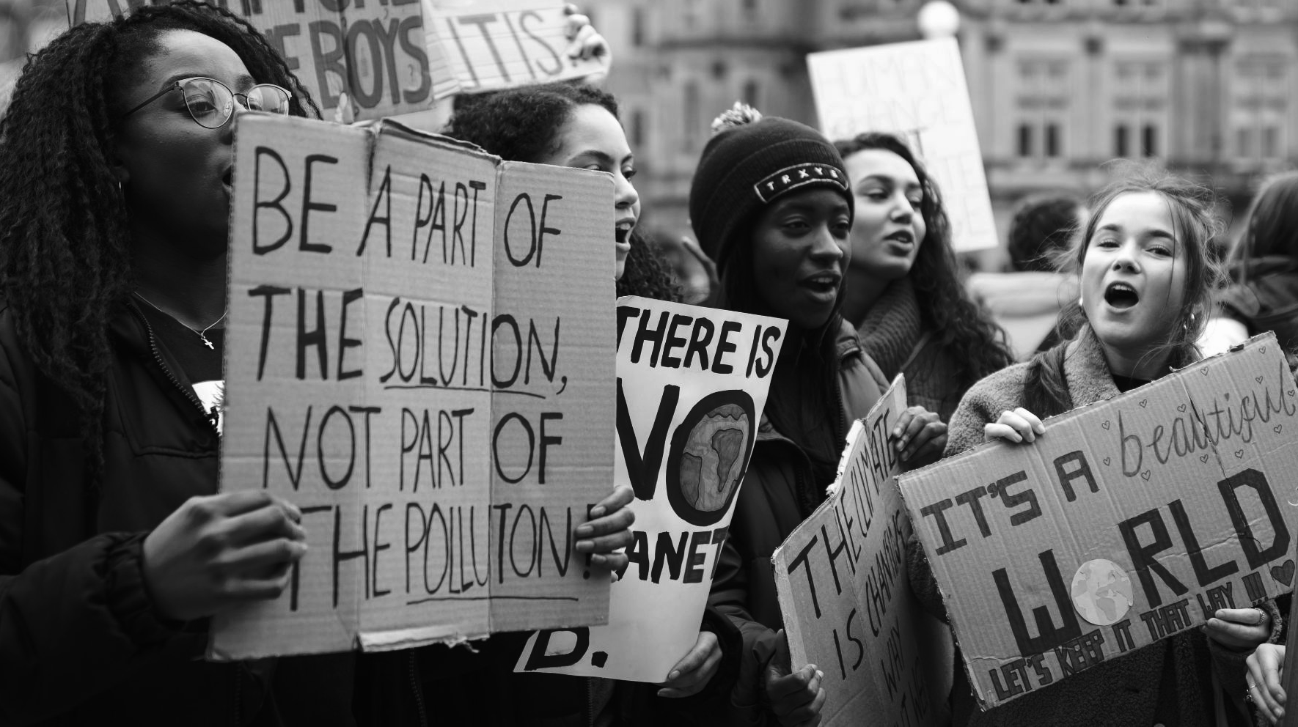
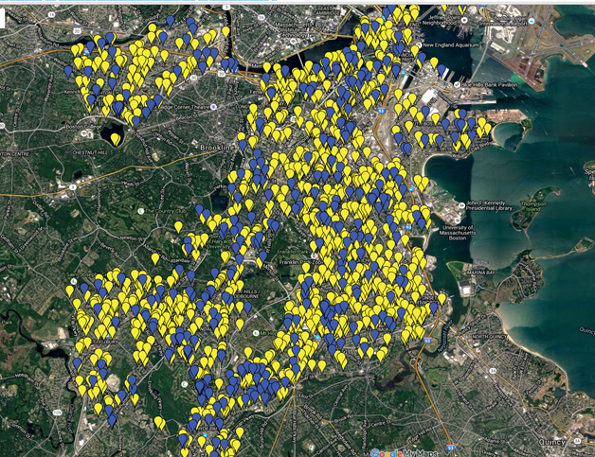

Unrepaired leak
Missing leak
1,462 unrepaired leaks in Springfield
368 missing leaks

Slide 6
WE LEVERAGED OUR COMMUNITY TEAM NETWORK
All 16 of our Community Teams got involved.
Acton Amherst Arlington Bedford Boston – downtown Boston – JP | Brookline Cambridge Concord Lexington Lincoln Northampton | Newton Somerville Waltham Winthrop
6
Notes:
Brookline, Cambridge, Pioneer Valley – tagged leaks, Lexington held a hearing, Belmont had a community meeting, Belmont participated in fair plus march
Publicity: local papers, Boston Globe, WGBH, WBUR, Fox25, NECN, Channel 5

Slide 7
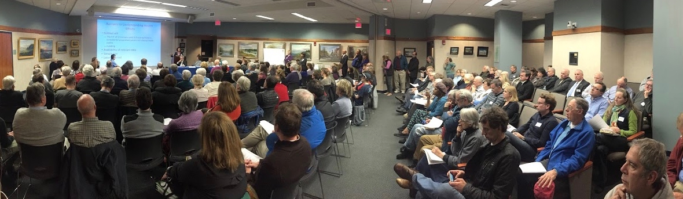
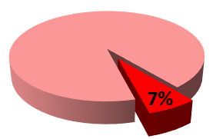
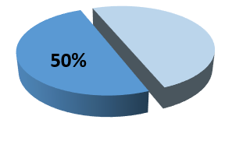
Natural Gas Leaks
Methane Emissions
7
Notes:
But even with PEOPLE POWER like we have here in this room at one of many, many Gas Leaks Forums, 16,000 leaks is a lot of leaks…
SO, JUST IN TIME, one of our allies published research showing that not all leaks are equal – there are in fact, just a few that are gushing most of the gas.
If you fix them first, you are fixing half the problem. So that sounded actionable…. #FIXBIGGASLEAKSFIRST…
Four months later the state legislature passed a law requiring the prioritized repair of those ‘environmentally significant’ leaks.
NOT the end.
Then we find out the utilities had NO idea how to find the largest leaks in our streets. Size never mattered before – just whether it might explode.
(which is important)

Slide 8
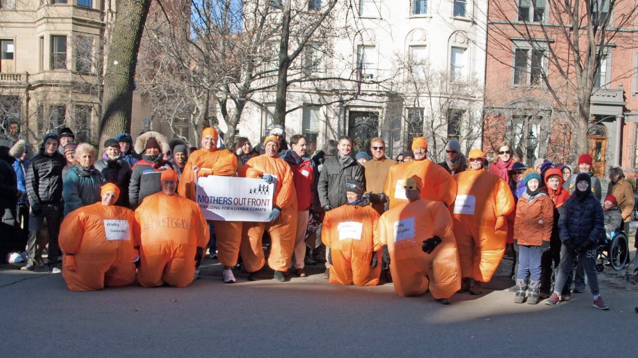
8

Slide 9
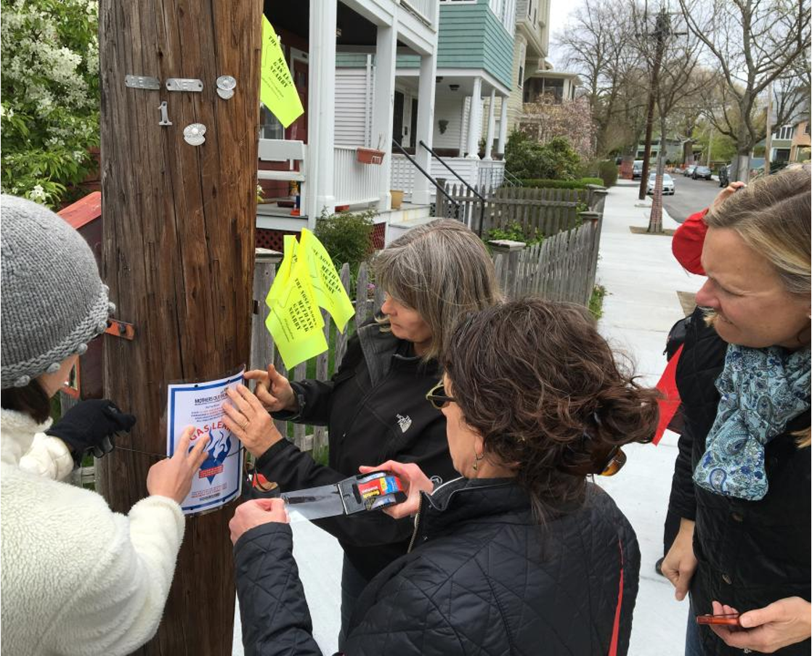
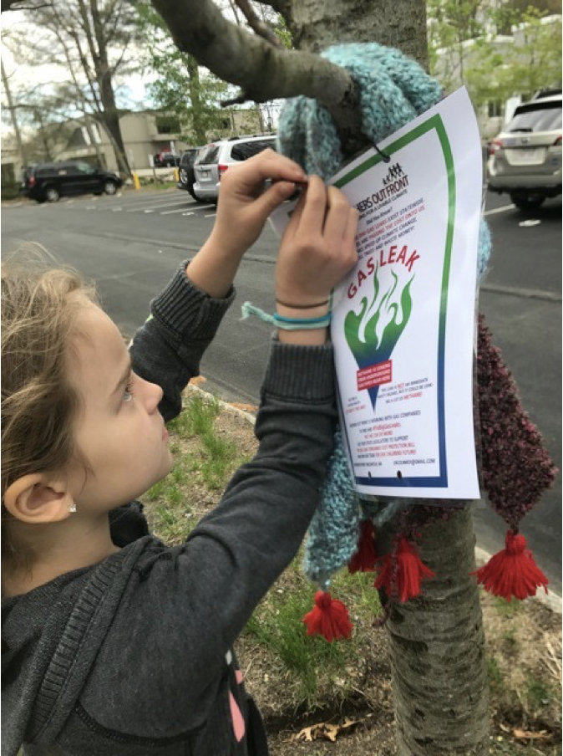
9

Slide 10
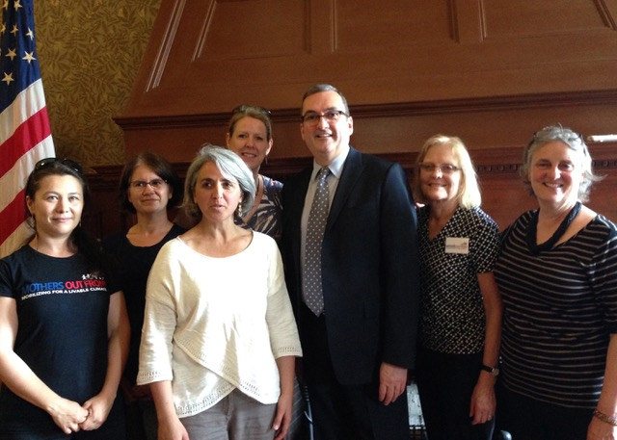
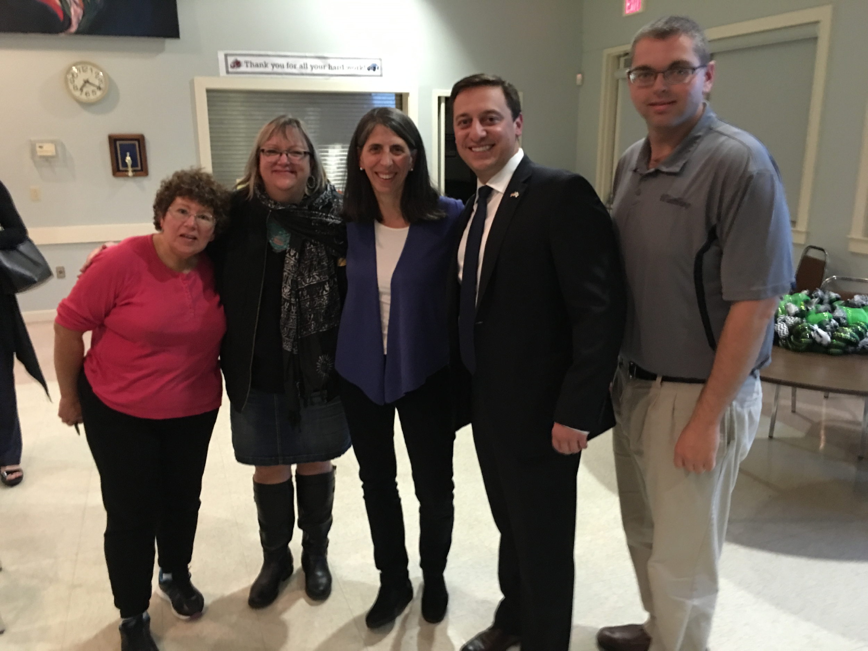

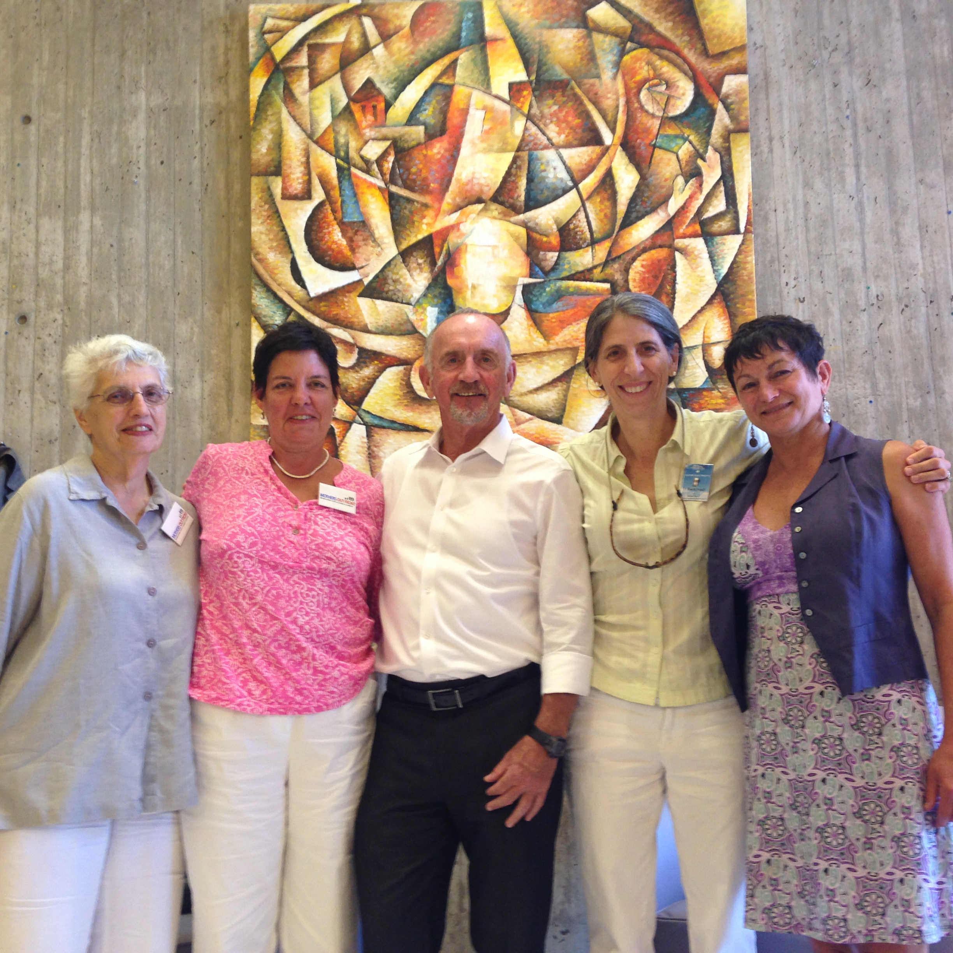
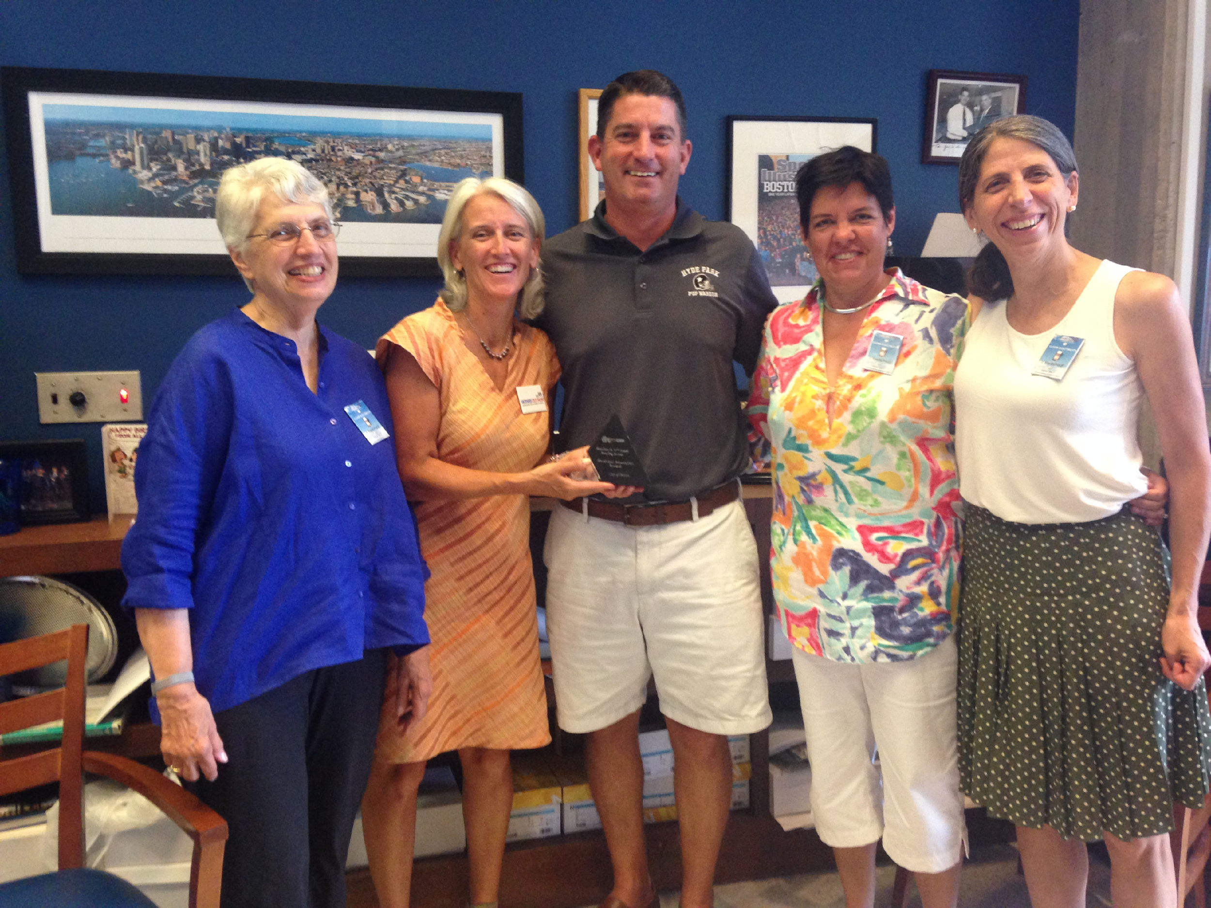
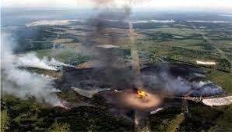
We met with elected officials
10

Slide 11
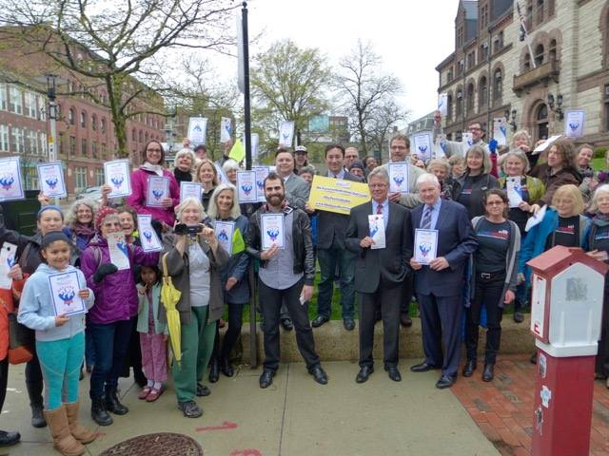
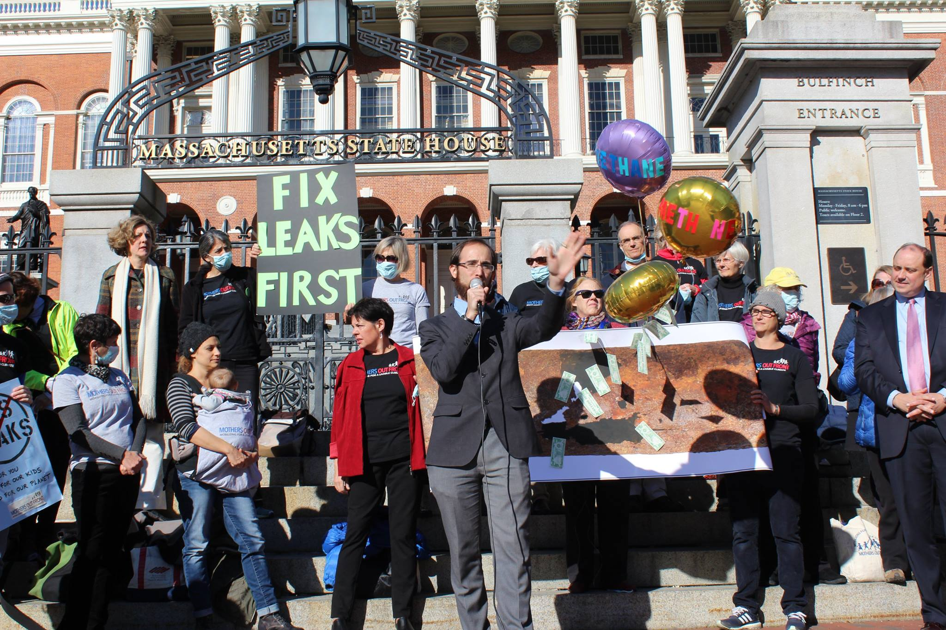
We rallied
11
Notes:
Rally for

Slide 12
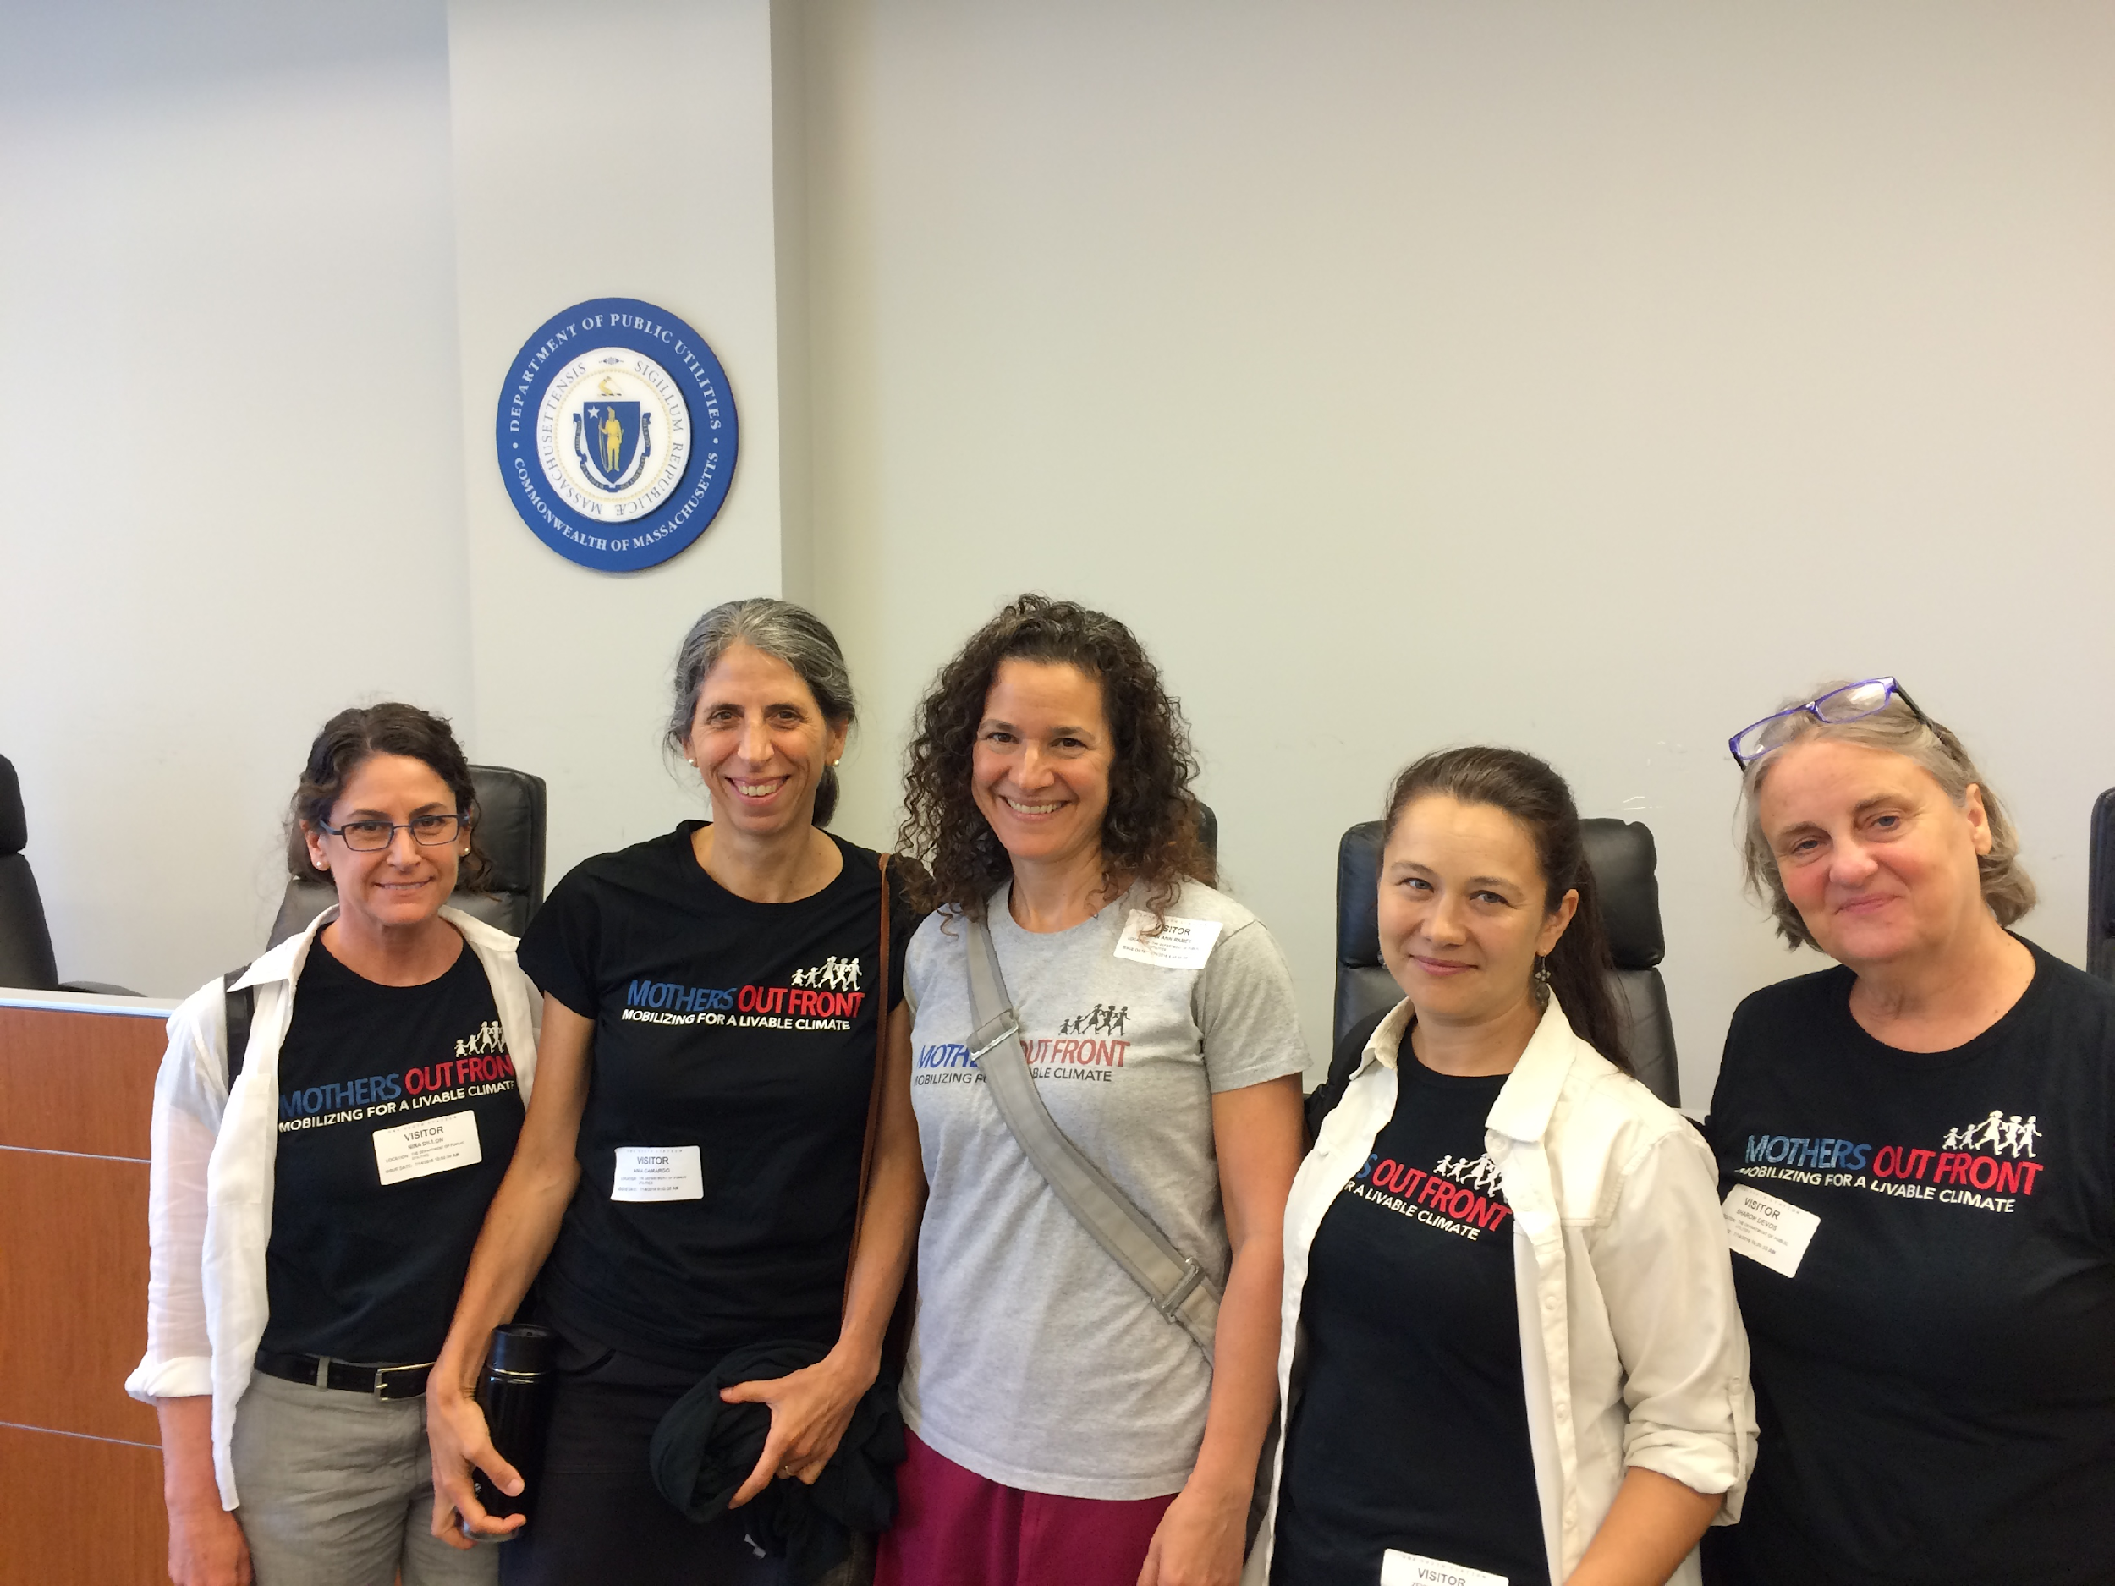
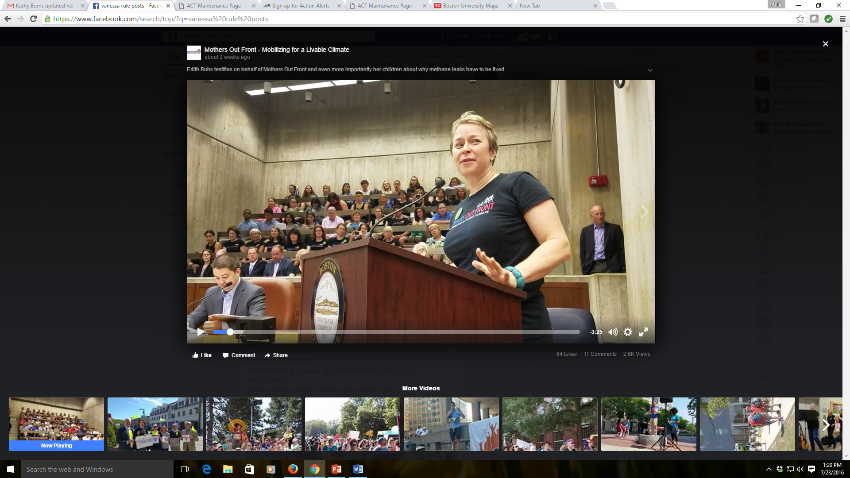
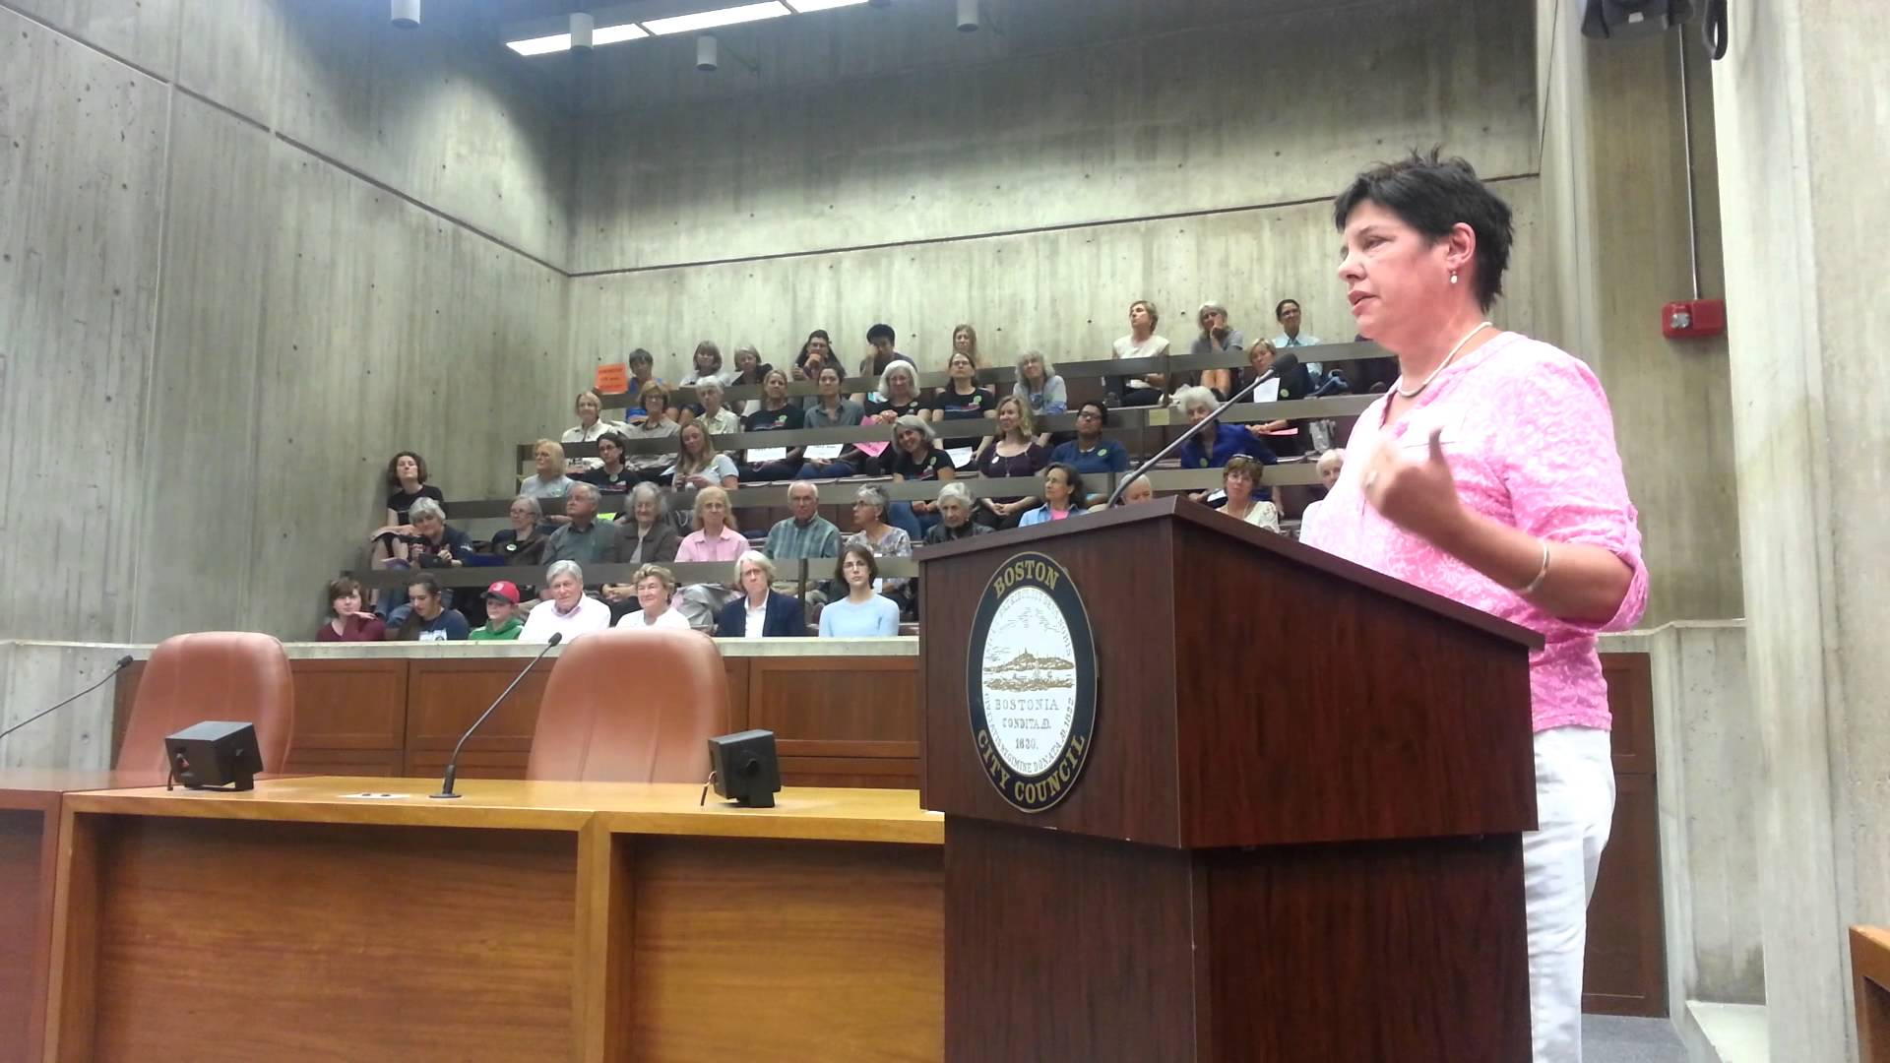
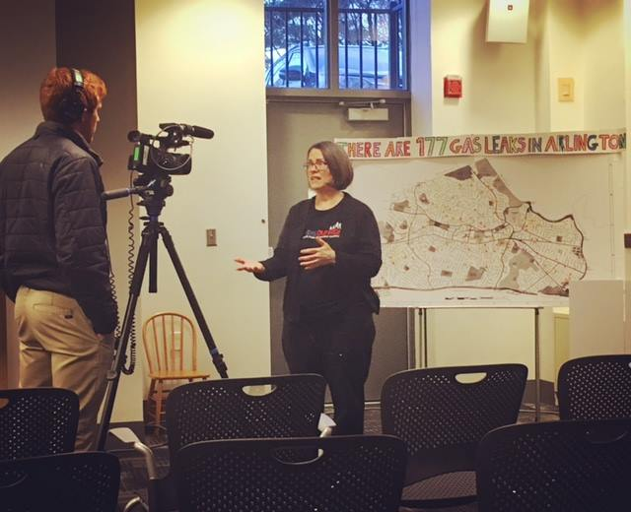
We spoke up and we testified
12

Slide 13

















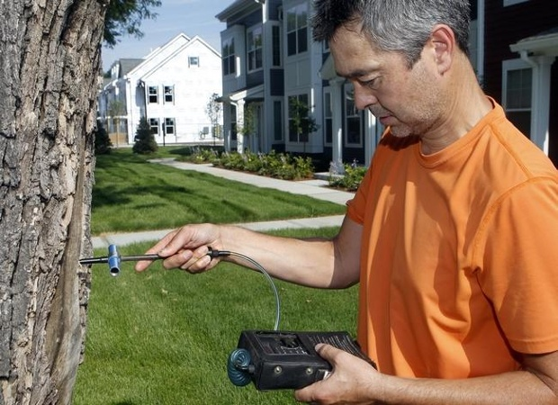



WE COLLABORATED
BU Professor Nathan Phillips
13

Slide 14
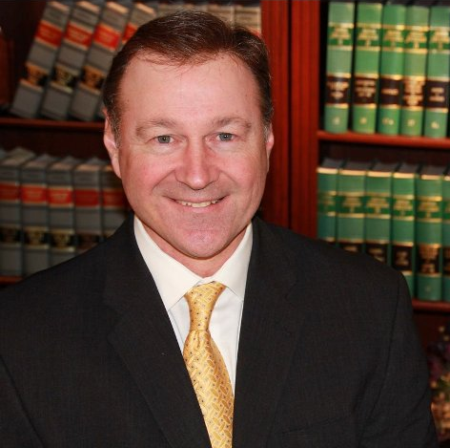


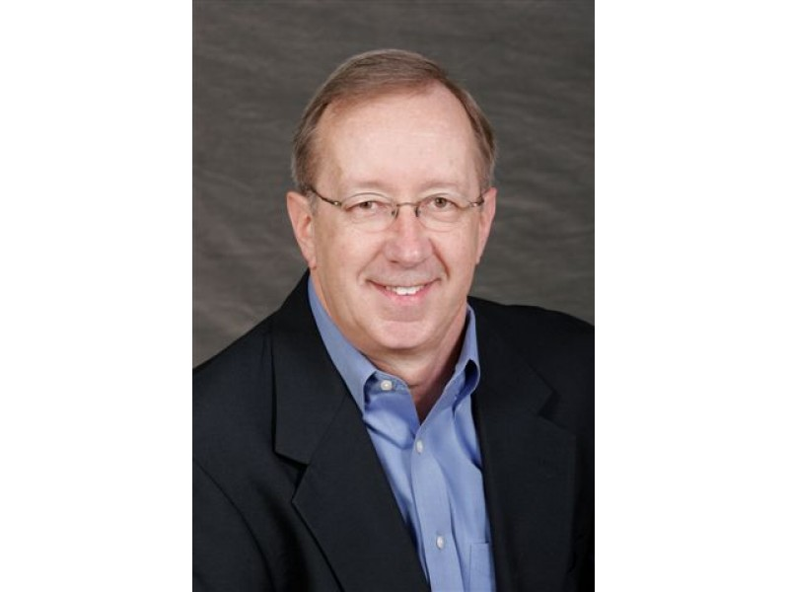

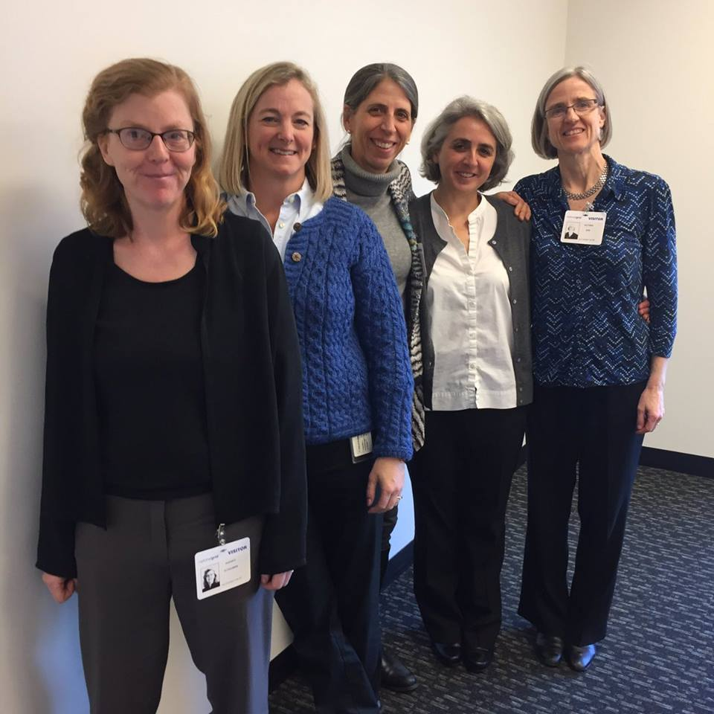
WE SOUGHT OUT UNLIKELY PARTNERS
14

Slide 15
MIT OpenCourseWare
https://ocw.mit.edu/
RES.ENV 007 Geothermal Energy Networks (GENs): Transforming our Thermal Energy System
IAP 2025
For information about citing these materials or our Terms of Use, visit: https://ocw.mit.edu/terms.
15

