Slide 1


How Geothermal Energy Networks (GENs) Can Meet Environmental Justice Priorities
Chris Rabe
Education Program Director (ESI)

Slide 2
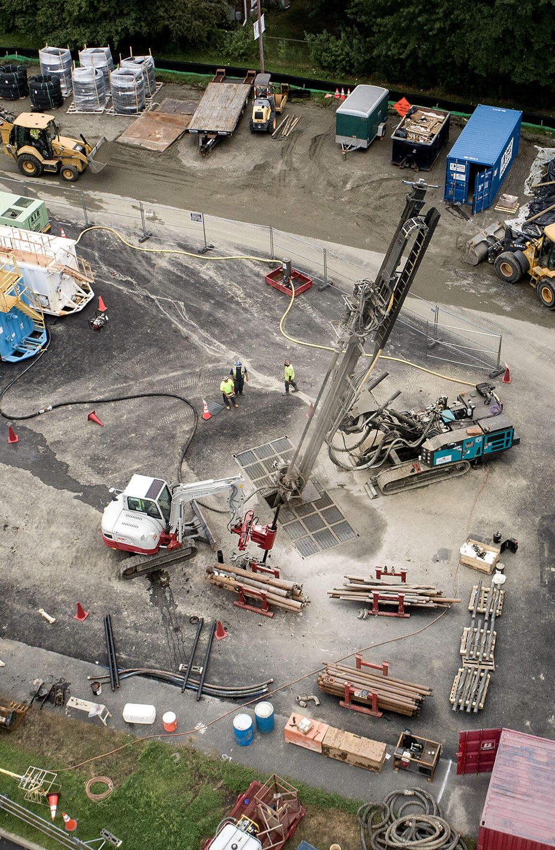


Pilot Project in Framingham
Overview
An EJ Framework
Review EJ Concerns with existing gas networks
How GENs Can Meet EJ Priorities
Next Steps for EJ and GENs

Slide 3
Defining Environmental Justice
Foundations, definitions and theory

Slide 4
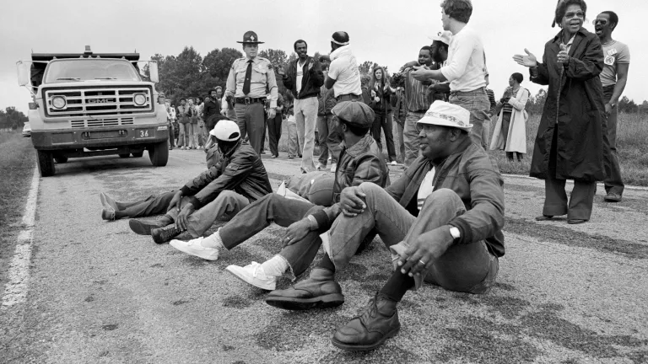
What is Environmental Justice?
  The (modern) Environmental Justice (EJ) Movement began in the early 1980s as communities of color protested the inequitable distribution of pollution in their communities.
  This led to two landmark reports:
    Siting of Hazardous Waste Landfills and Their Correlation with Racial and Economic Status of Surrounding Communities (General Accounting Office, 1983)
    Toxic Waste in the United States (United Church of Christ, 1987) - this report coined the term "environmental racism"
Protestors block the delivery of toxic PCB waste to a landfill in Afton, North Carolina, 1982. Credit: Ricky Stilley. Retrieved from https://www.nrdc.org/stories/environmental-justice-movement
© Ricky Stilley/nrdc.org. All rights reserved. This content is excluded from our Creative Commons license. For more information, see https://ocw.mit.edu/help/faq-fair-use/
EPA and Environmental Justice
  Environmental Justice is the fair treatment and right to safe environment for all people regardless of social identity.
  See also Critical Environmental Justice (Pellow 2016)

Slide 5
Indigenous Rights
These movements led to the EJ field with various sub areas
Expanded in both depth, breadth & methodology
Energy Justice
Food Justice
The Field of Justice Environmental
Climate Justice
Housing Justice
Continues to theorize “justice” and “equity”
Helped redefine the environment

Slide 6
Theory: Conceptualizing Justice
Distributive
Participative
Procedural
Recognition
Historic/
Restorative
Epistemic

Slide 7
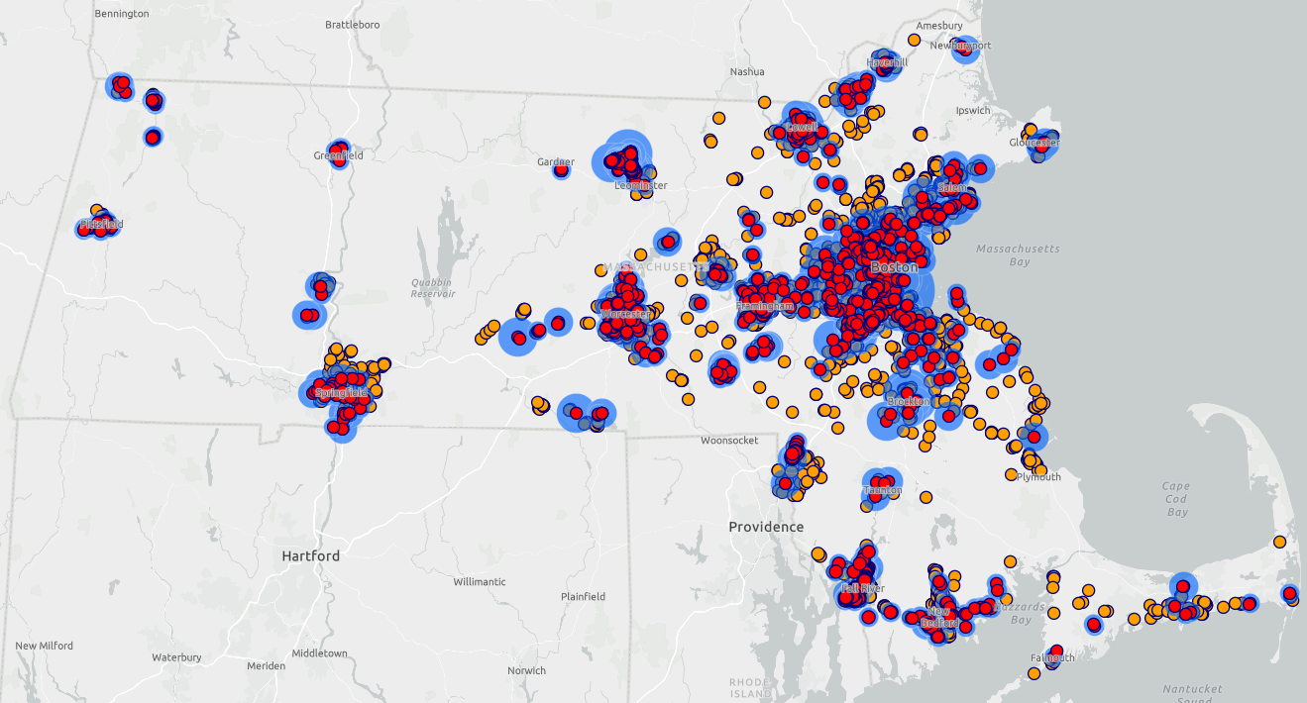
What are some EJ concerns in the Energy Transition in relation to GENs?

Slide 8
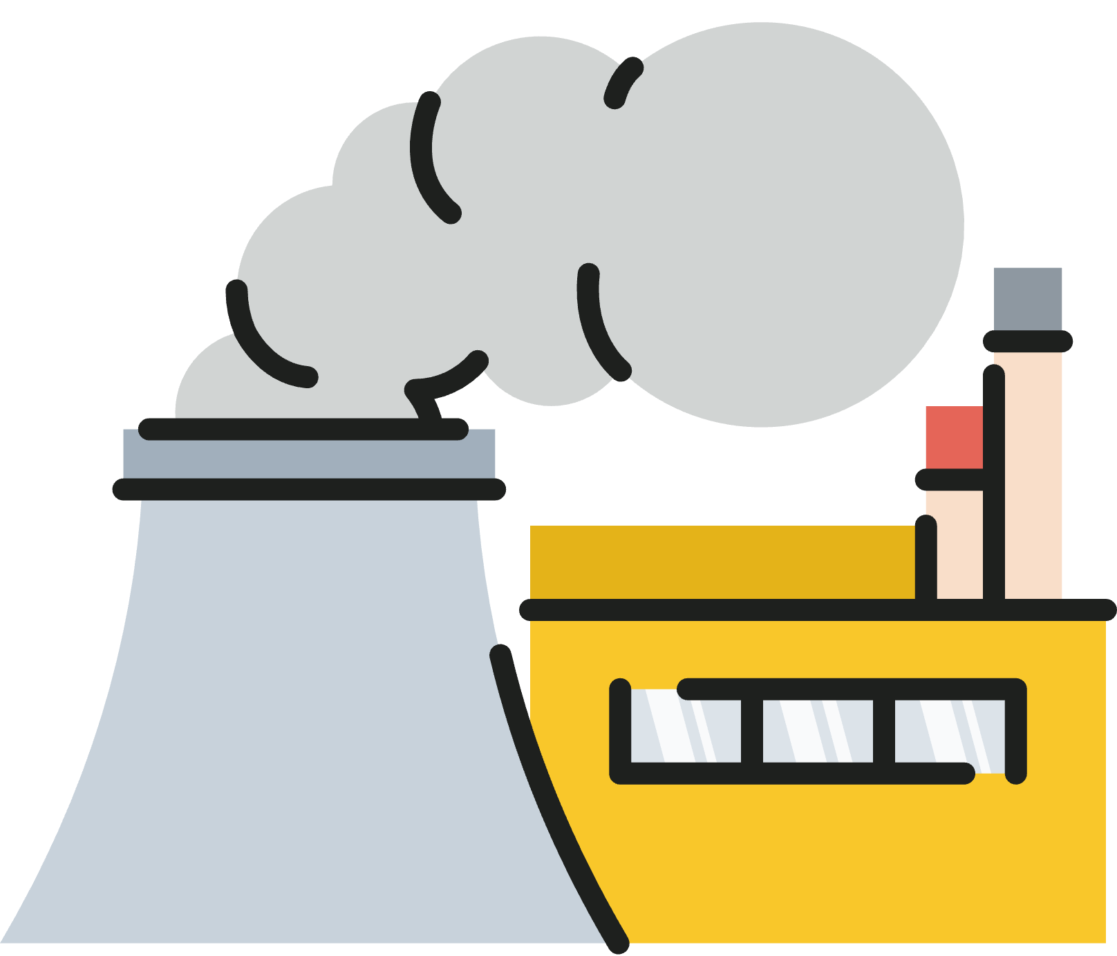

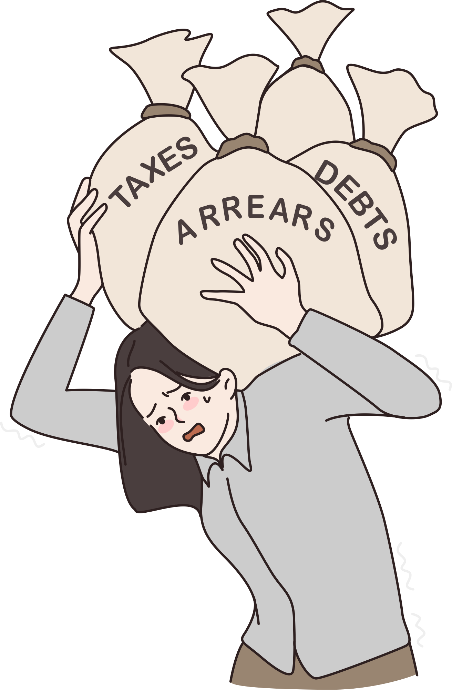
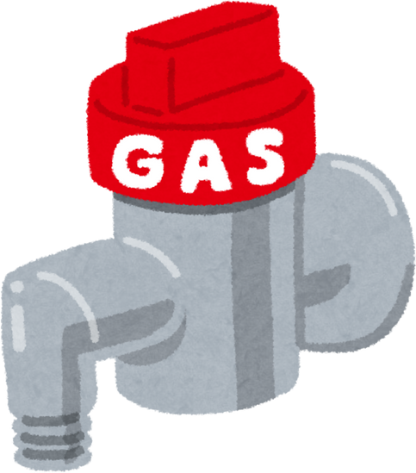
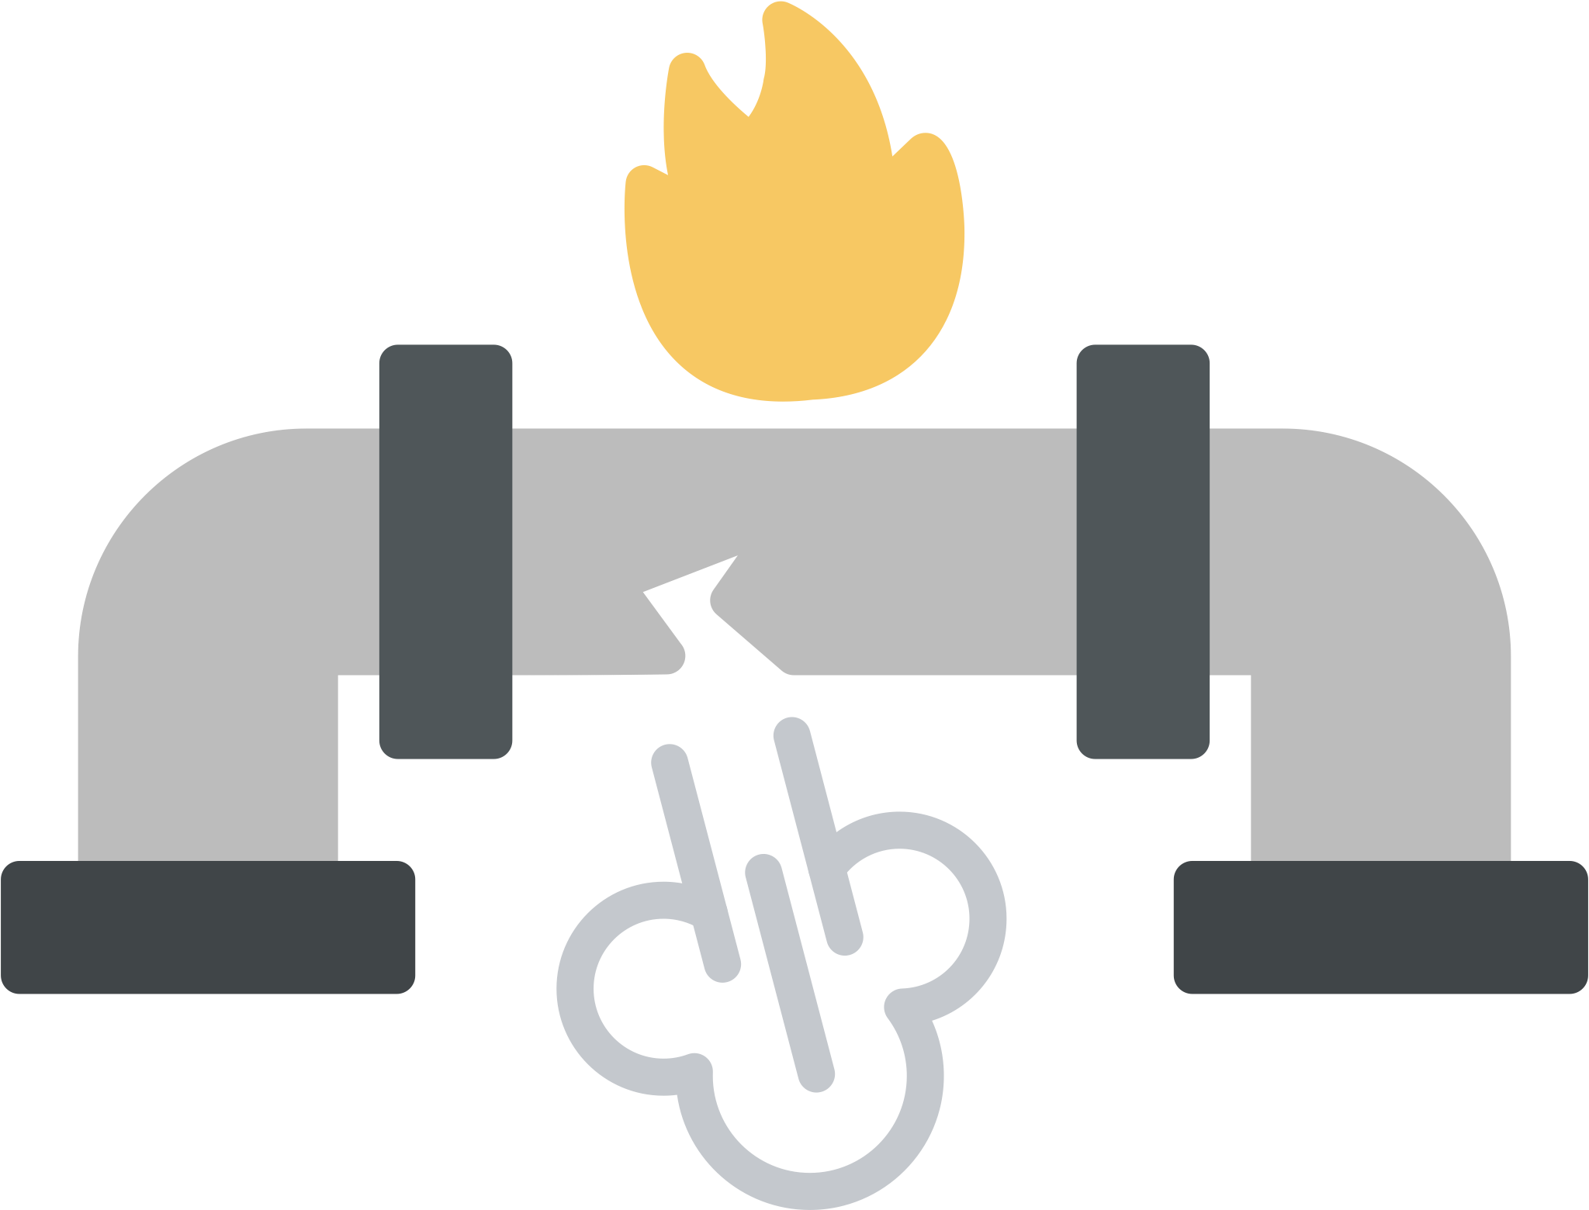
EJ Concerns with Heating and Cooling (Renewable Energy Transition)
Camargo et al. 2024
Buildings Account for 30% of US Emissions; (1/2) from On-site Combustion
Gas Customer-Base Goes Down: *Double the economic burden on low-income families by 2050
Individual Home Market Model
for Residential Energy Change; Exacerbates inequity
Declining Rate Payer Leaves Gas Utilities Vulnerable in Shift
Gas Leaks: 16,000 in MA; Poses safety & Logistical Challenges
Notes:
A declining customer base for gas service results in higher rates for customers
that remain on the gas system; these customers are often the households that are least likely to be
able to afford an increase and the most vulnerable to energy burdens (Walsh and Bloomberg
2023, Aas et al. 2020).

Slide 9
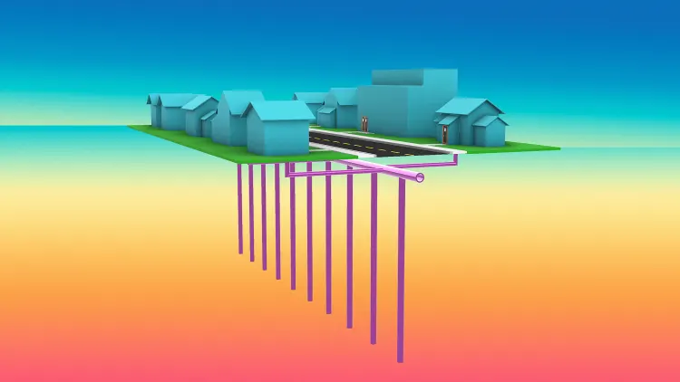
How Can Geothermal Energy Networks (GENs) Meet EJ Priorities?

Slide 10
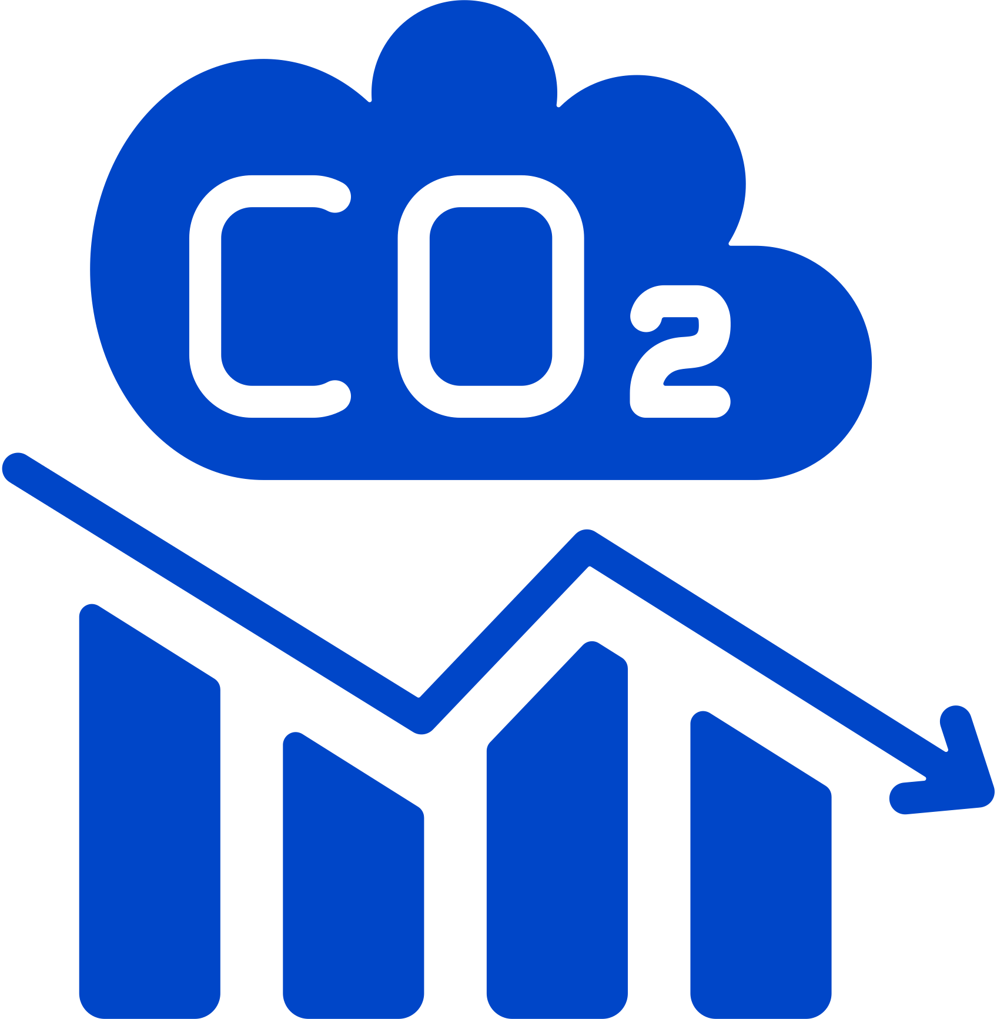

Massive Reduction in Emissions & Increased Affordability
Colorado Mesa University’s geothermal network has reduced campus emissions by 17,742 tons of CO2 each year (Colorado Mesa University, n.d.)
  GENs can allow for 195 million in savings over 30 years (Anderson, 2022);
  Increased energy efficiency - less peak demand on grid; significant savings

Slide 11
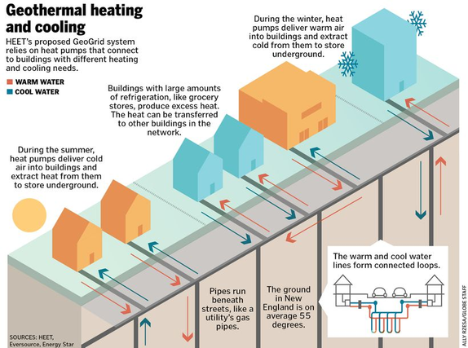
From Gas to Geo: Safe and Healthy Transition
Gas
GENs
© Ally Rzesa/Boston Globe Staff. All rights reserved. This content is excluded from our Creative Commons license. For more information, see https://ocw.mit.edu/help/faq-fair-use/
Old Gas Pipe Infrastructure:
3 million miles of gas pipe in the US (Sevier, 2023).
Safe, healthy, reliable heating & cooling: better model for gas utilities; can better address urban heat islands

Slide 12
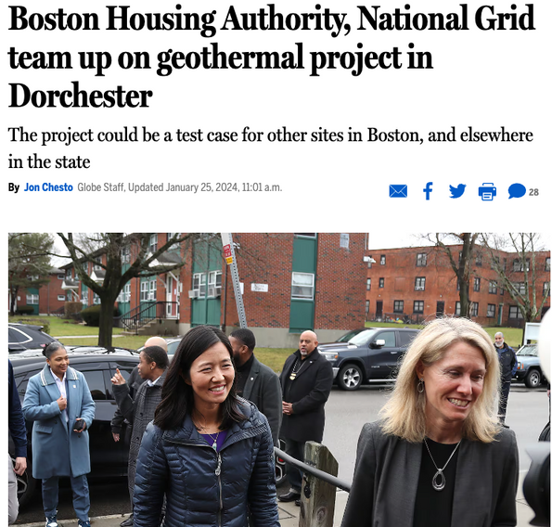


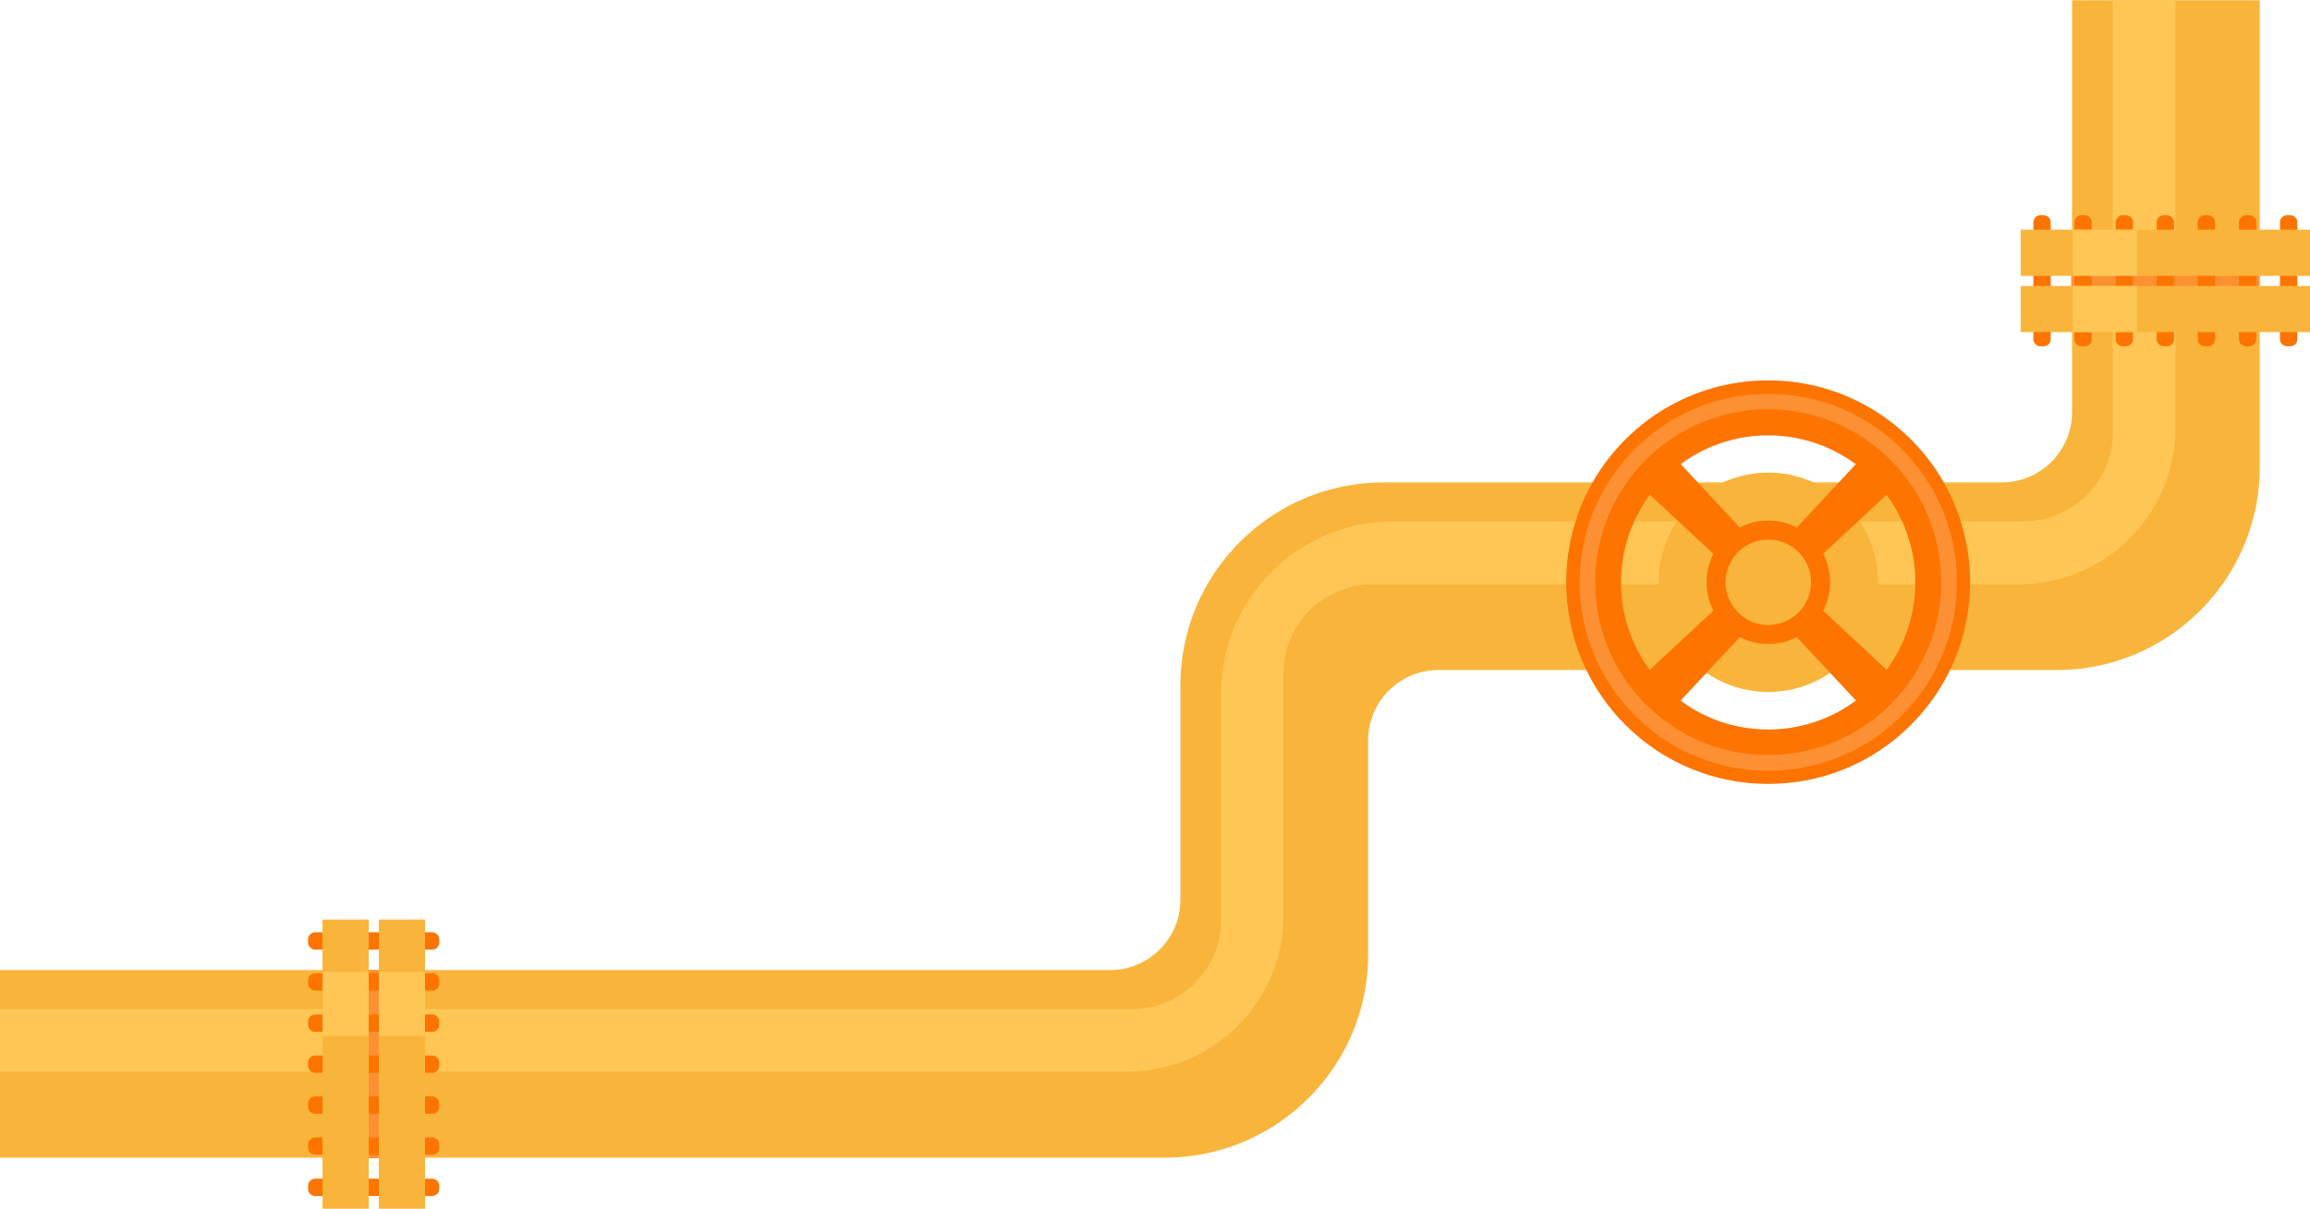
Equitable Distribution and Sharing of Energy Resources
Chelsea, NY
Dorchester, MA
Public Housing Community
Data Center
© Boston Globe Media. All rights reserved. This content is excluded from our Creative Commons license. For more information, see https://ocw.mit.edu/help/faq-fair-use/
Prioritize EJ communities - “heating and cooling to every building on the network regardless of the residents’ income level or homeownership status” (Camargo et al. 2024, p.6)
(Consolidated Edison Company of New York, Inc. 2023).

Slide 13
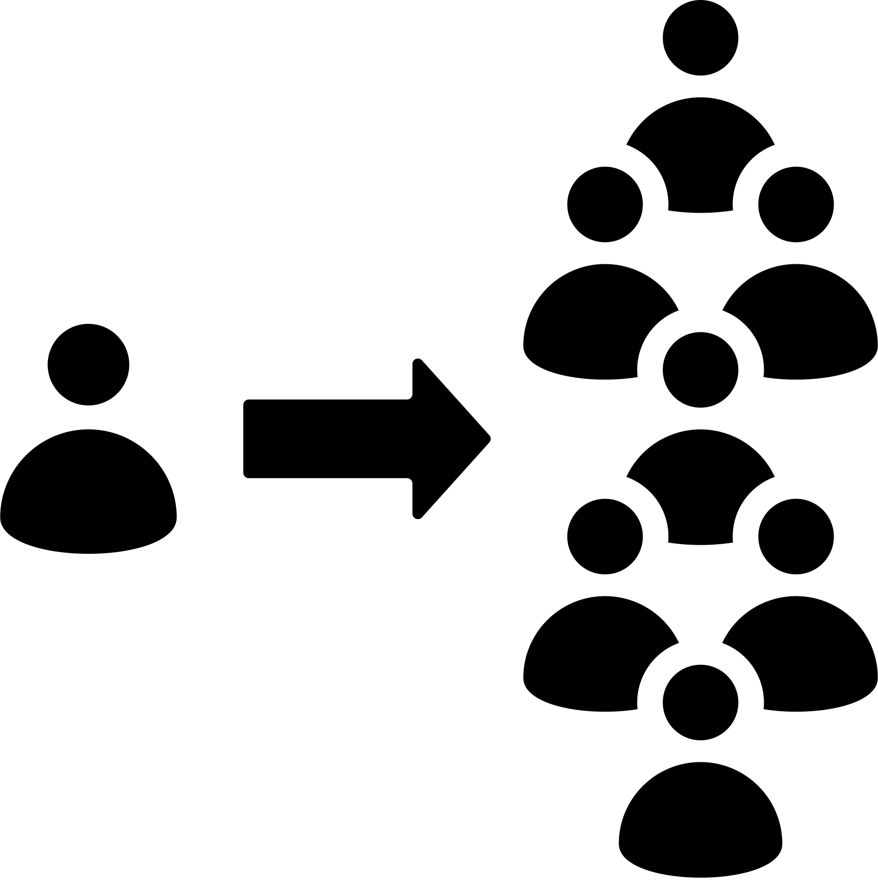
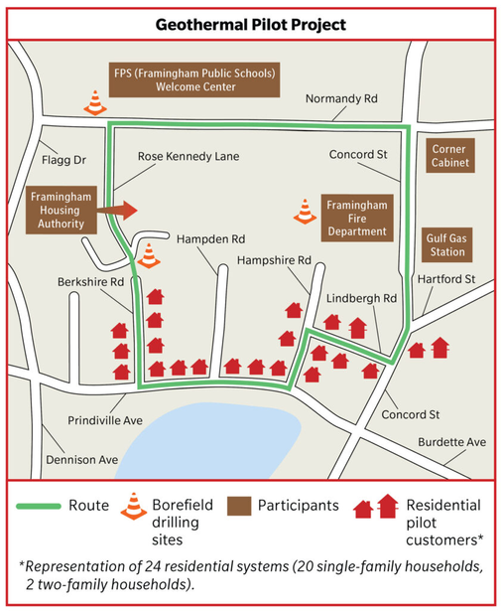
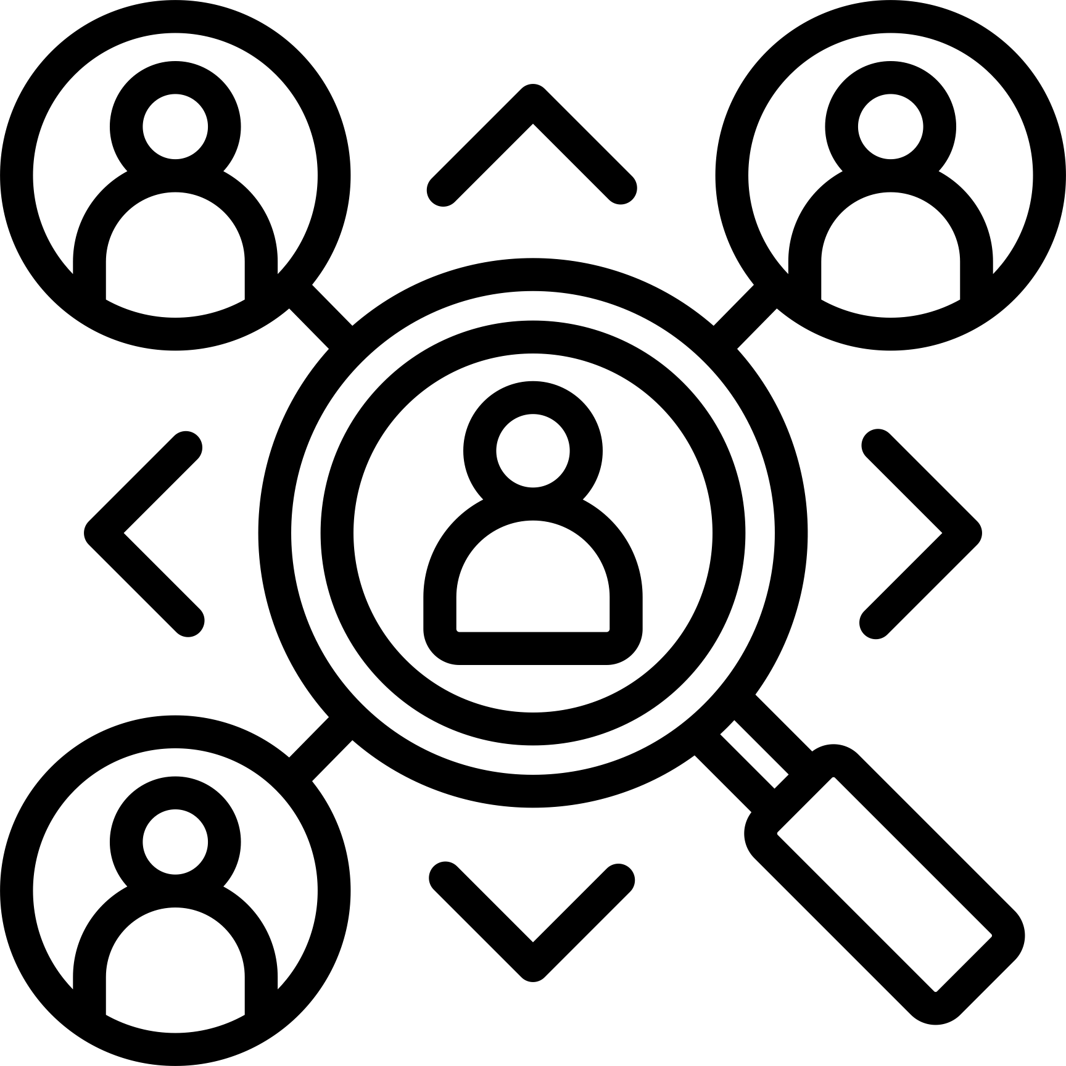
Equitable Community Participation & Decision Making
Renewable Energy Facility Siting Clinic @MIT
© Eversource. All rights reserved. This content is excluded from our Creative Commons license. For more information, see https://ocw.mit.edu/help/faq-fair-use/
From Individual to Community Systems
Community Engagement
Stakeholder Assessment & Engagement

Slide 14
Conceptualizing Justice
Participative
Distributive
Procedural
Forms of Justice
Recognition
Epistemic
Historic/
Restorative

Slide 15
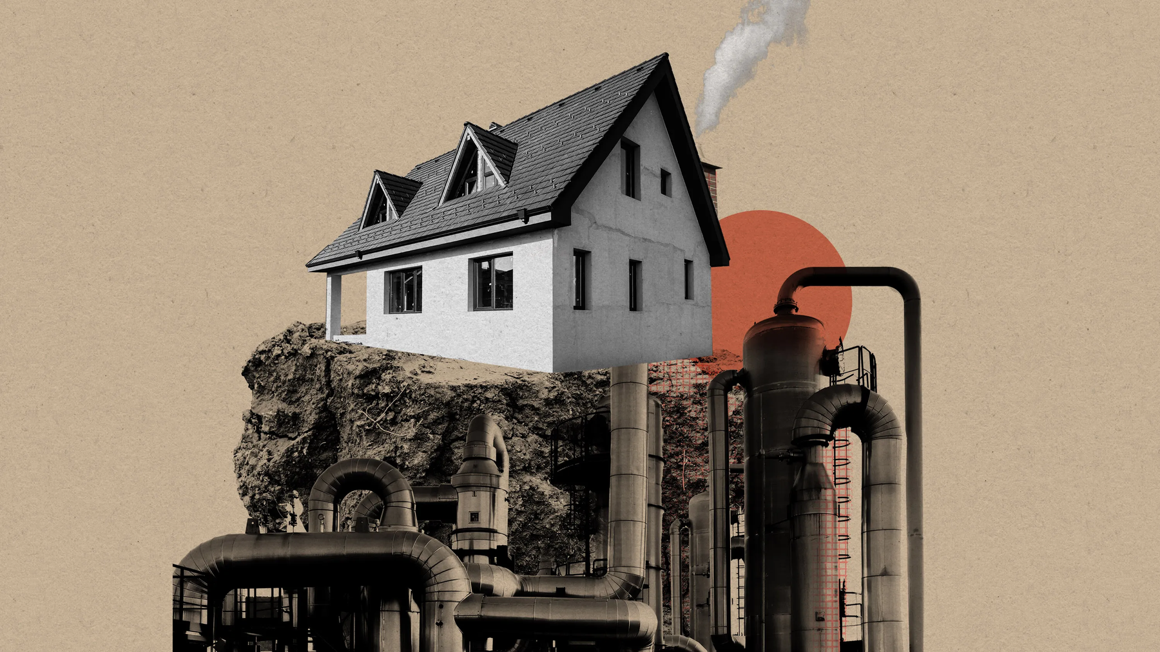
Next Steps for GENs and EJ...

Slide 16
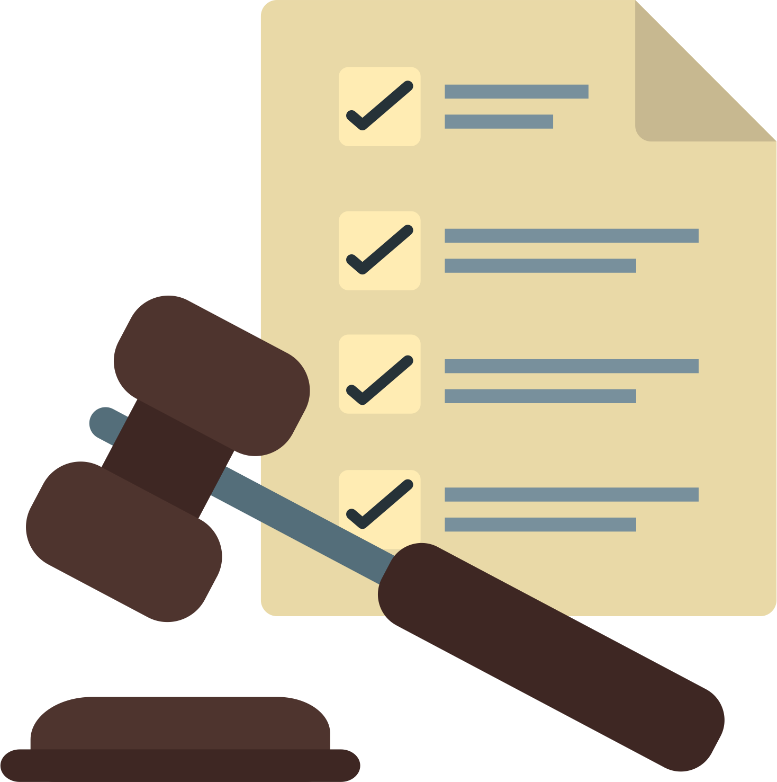



Next Steps for GENs and EJ Priorities
Improved Participation Across Sectors
Education & Awareness
Action at Every Level
Legislation

Slide 17

Next Steps for GENs and EJ Priorities
Questions for Reflection:
How can we make sure that an EJ framework or perspective is included in future Geothermal Energy Network (GENs) projects & initiatives?
How can we make sure that all forms of justice are considered?

Slide 18
Thank you for your attention.
Chris Rabe
Educaiton Program Director - ESI

Slide 19
MIT OpenCourseWare
https://ocw.mit.edu/
RES.ENV 007 Geothermal Energy Networks (GENs): Transforming our Thermal Energy System
IAP 2025
For information about citing these materials or our Terms of Use, visit: https://ocw.mit.edu/terms.

