Slide 1
An Ecological View of the Energy Transition
Nathan Phillips
Boston University
Jan 30, 2025
HEET/MIT/IAP Course

Slide 2
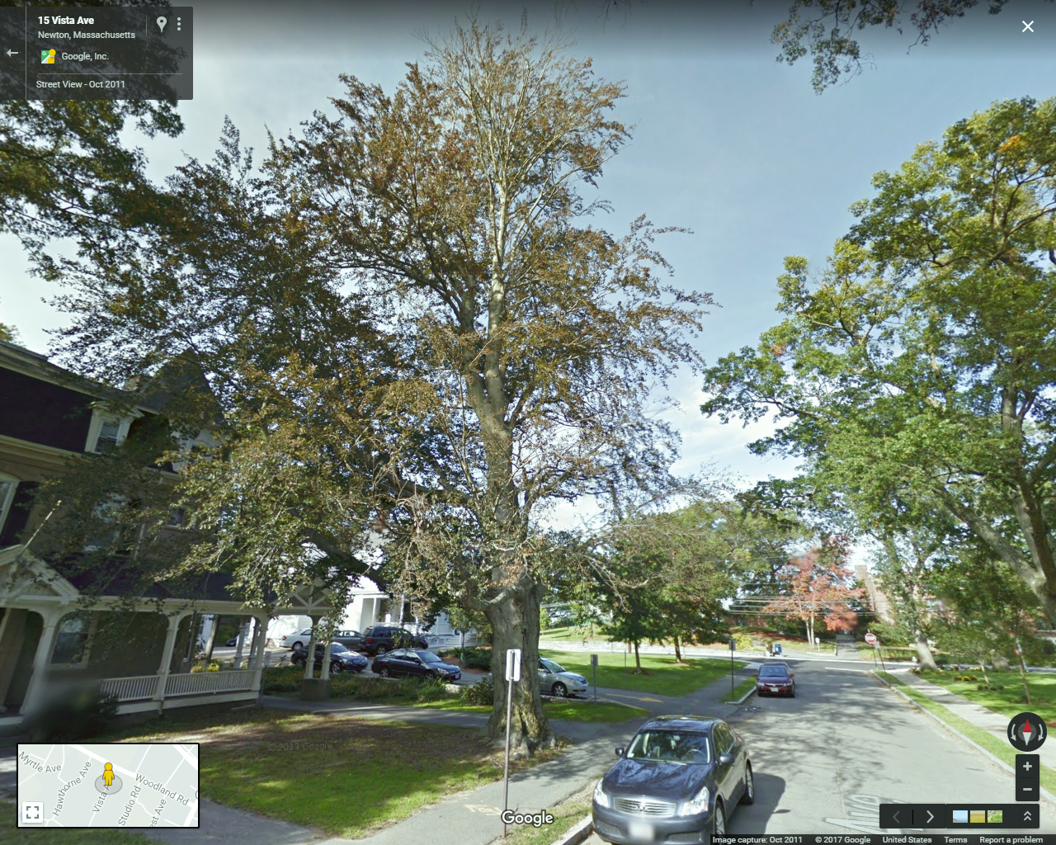
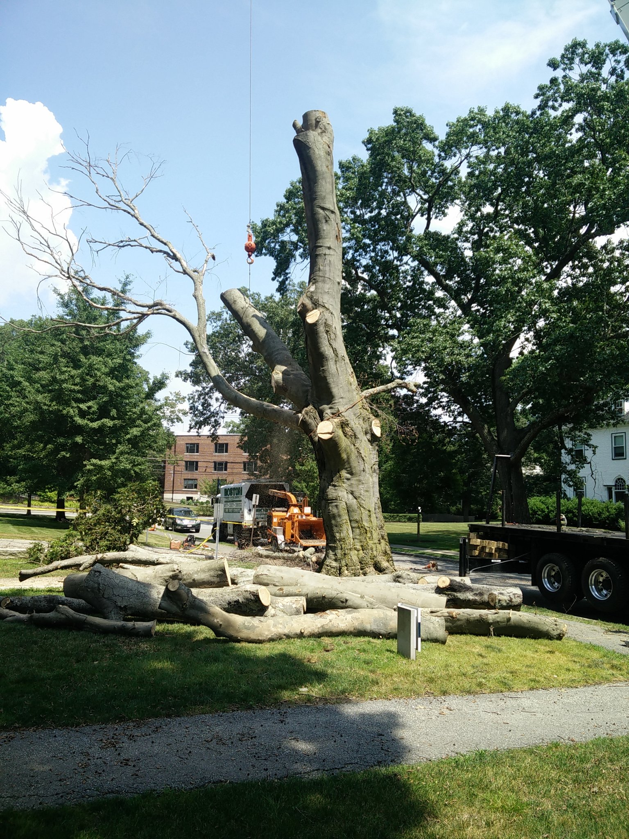

Slide 3
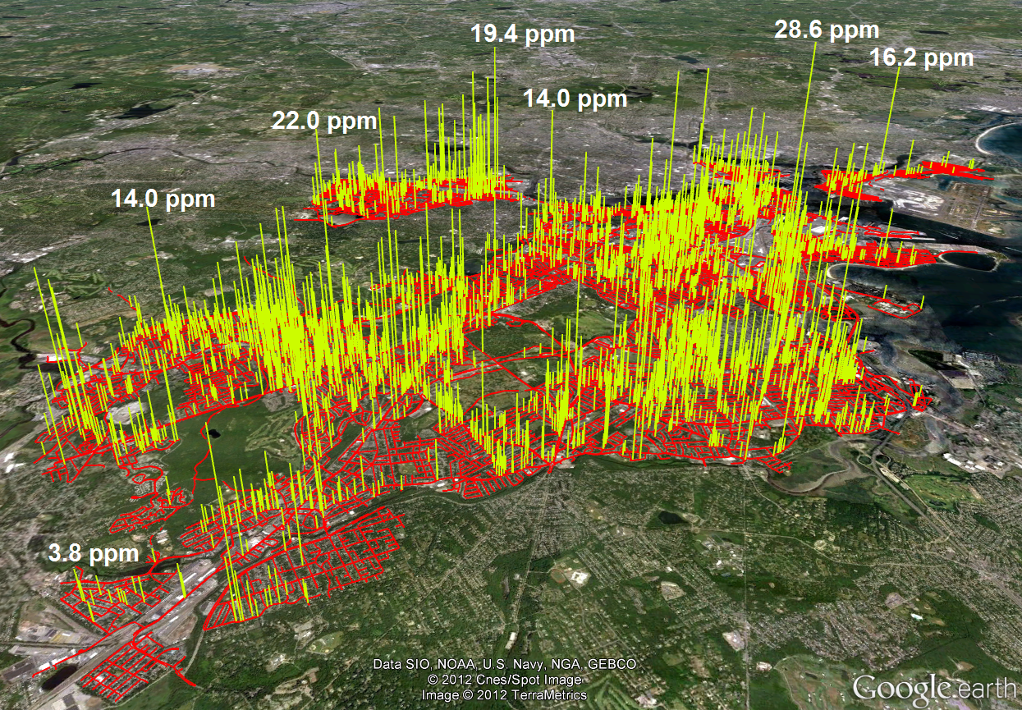
© TerraMetrics, LLC. All rights reserved. This content is excluded from our Creative Commons license. For more information, see https://ocw.mit.edu/help/faq-fair-use/
3356leaks > 2.5ppm; range: 1.80 - 28.6 ppm; mode = 2.07 ppm

Slide 4
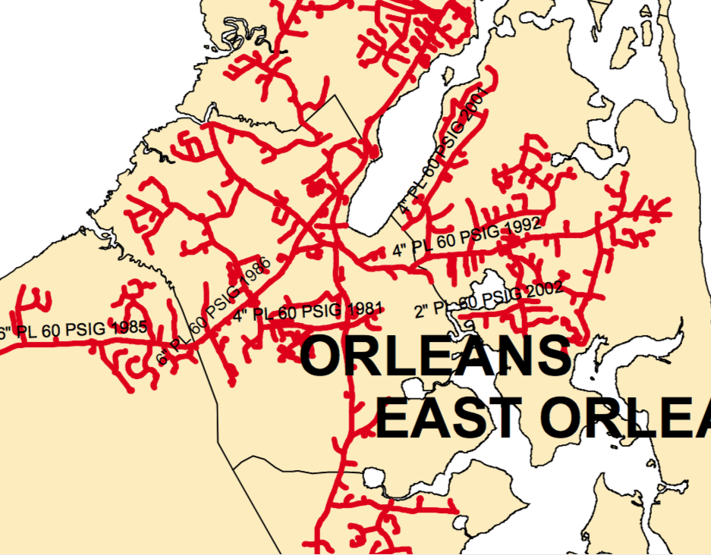

Slide 5
Making the ecological problem bigger

Slide 6
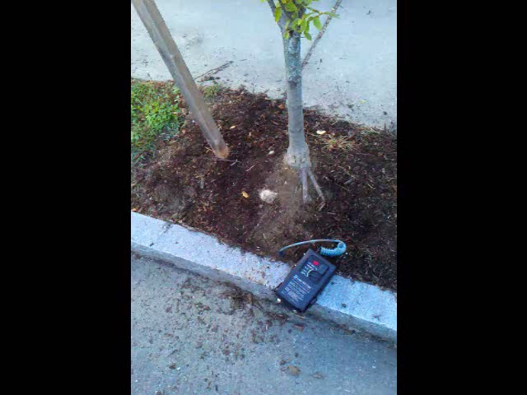

Slide 7
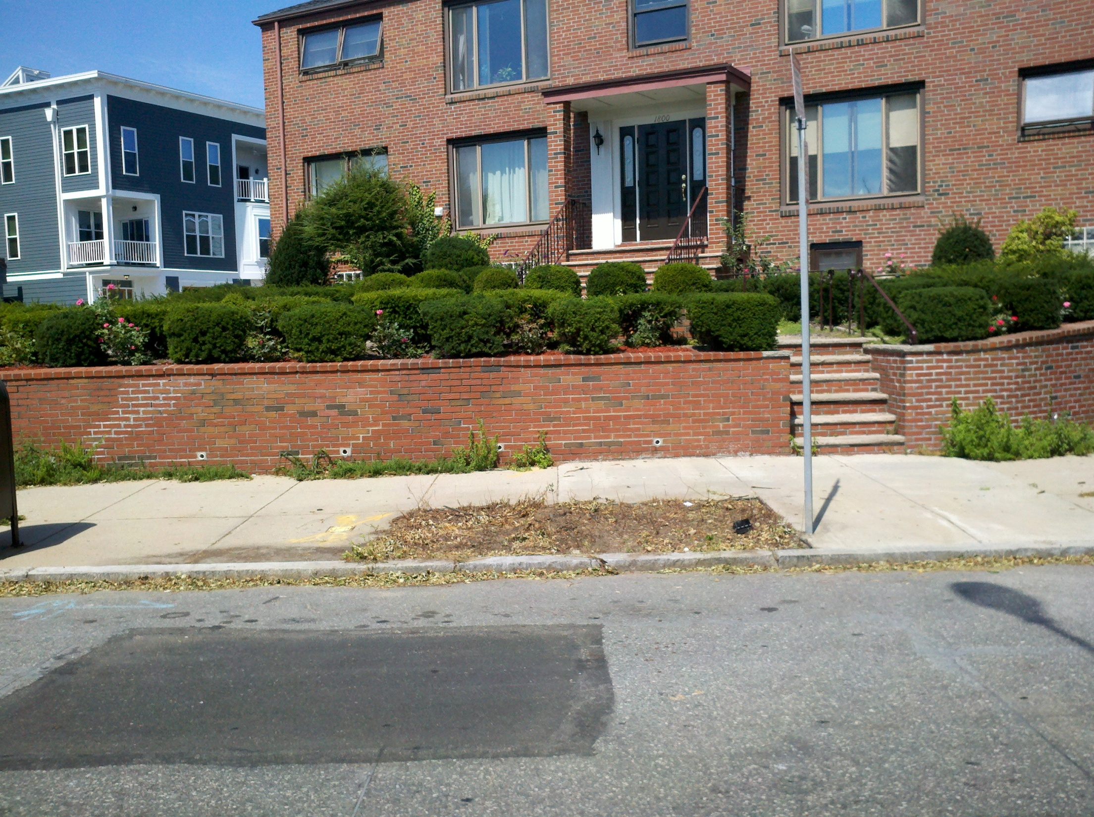

Slide 8
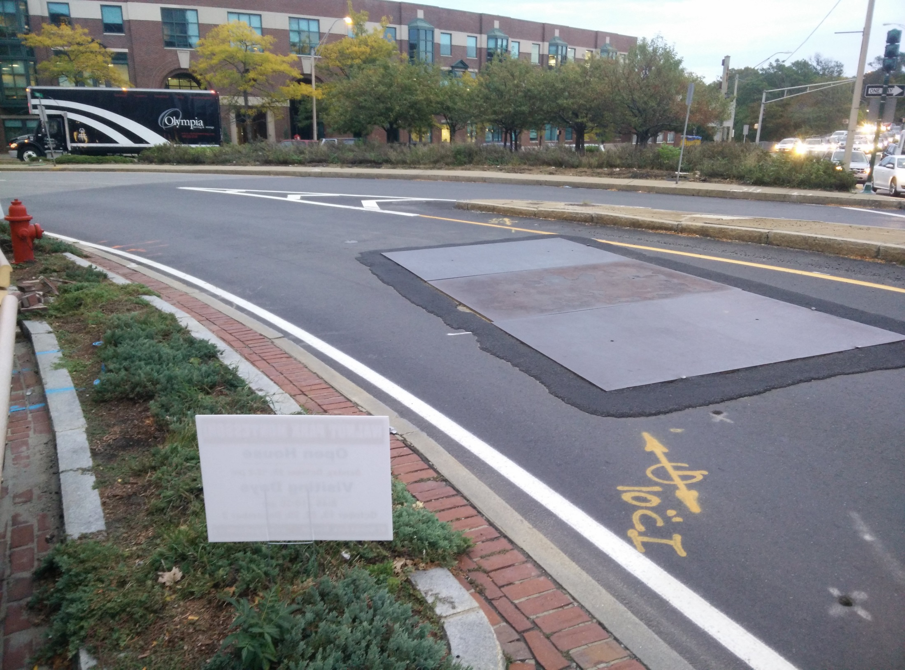

Slide 9
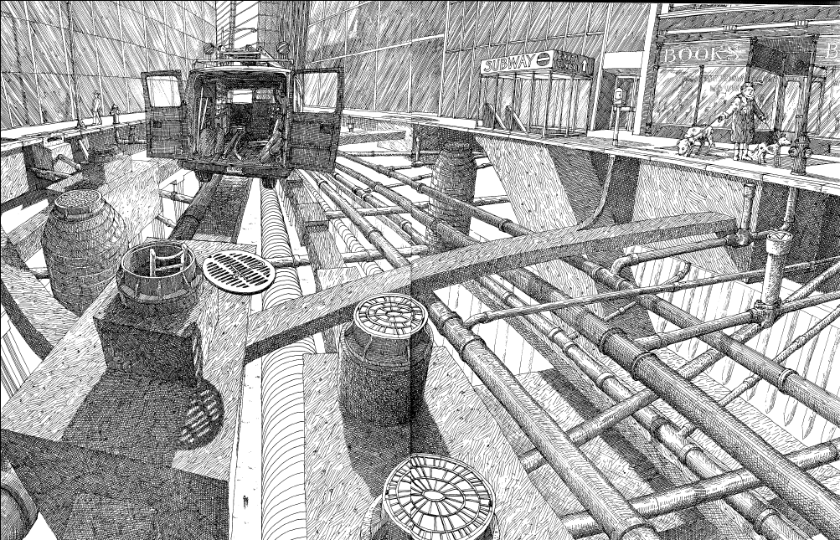
From pruning the tree to growing an infrastructure ecosystem
© Clarion Books. All rights reserved. This content is excluded from our Creative Commons license. For more information, see https://ocw.mit.edu/help/faq-fair-use/
David Macaulay, Underground

Slide 10
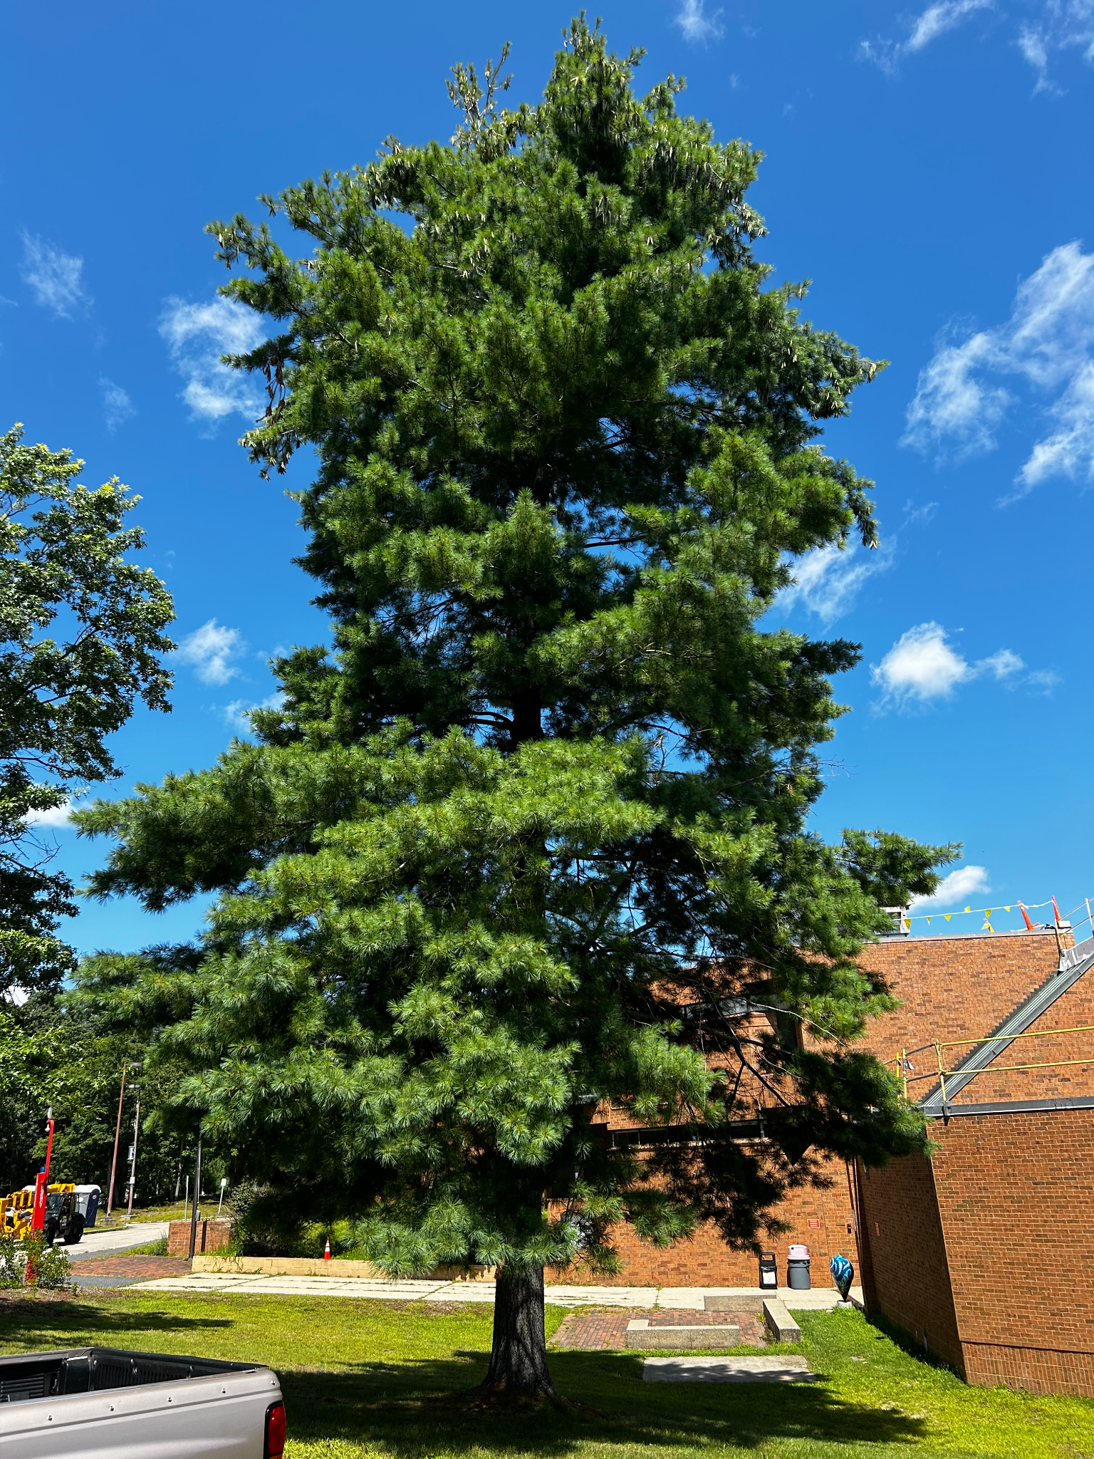
Infrastructure Ecology in a Thermal Energy Network
Nathan Phillips, Alanna Martins
Boston University

Slide 11



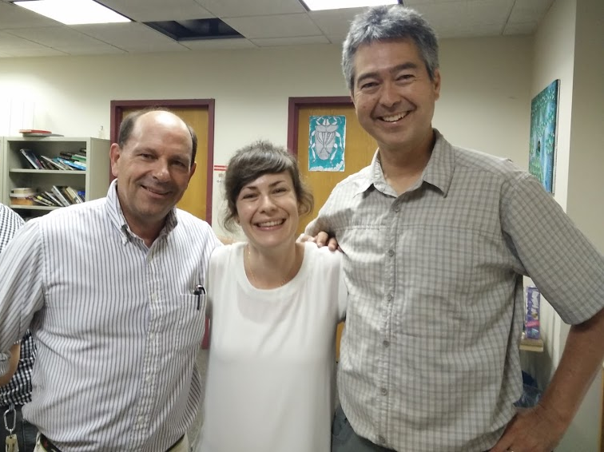











Thank you!

Slide 12
MIT OpenCourseWare
https://ocw.mit.edu/
RES.ENV 007 Geothermal Energy Networks (GENs): Transforming our Thermal Energy System
IAP 2025
For information about citing these materials or our Terms of Use, visit: https://ocw.mit.edu/terms.

