Slide 1

FOUNDATIONAL MODULE
Mining & Climate
Justice Case Studies

Slide 2
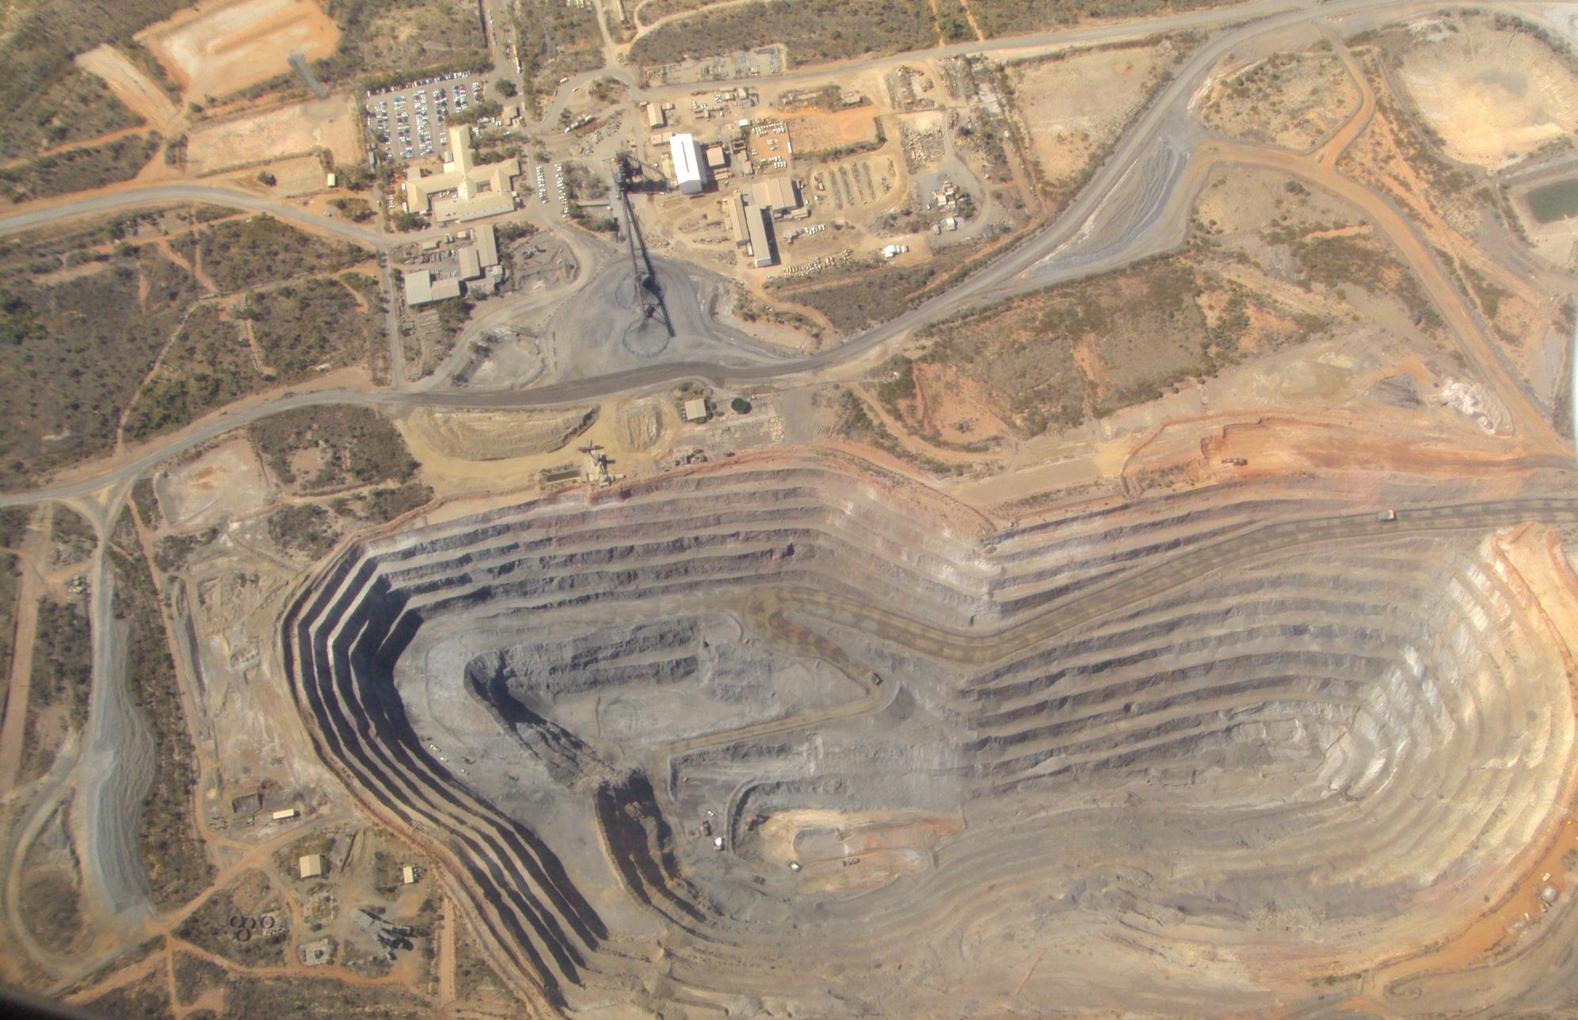
Photo courtesy of denisbin on Flickr. License: CC BY-ND This content is excluded from our Creative Commons license. For more information, see https://ocw.mit.edu/help/faq-fair-use/ .
What’s in this module?
Contents
This module focuses on the question of ethical and just resource extraction, and discusses the importance of mined materials in our daily lives. It utilizes case studies from MIT researchers and scientific articles.
Activities
Key Resources
3 parts
1 video
5 readings
3 activities
2 project options
  How Can U.S. Safely Mine Minerals Critical to a Carbon-Free Economy?
  Hydrosocial Displacements: Climate Change and Community Relations in Chile's Mining Regions
  Indigenous Environmental Network

Slide 3
Learning Objectives
01
02
03
04
Recognize how current mining practices affect climate justice issues
Understand the role and impacts of mining
Examine community roles and energy demands
Discover solutions to mining issues

Slide 4
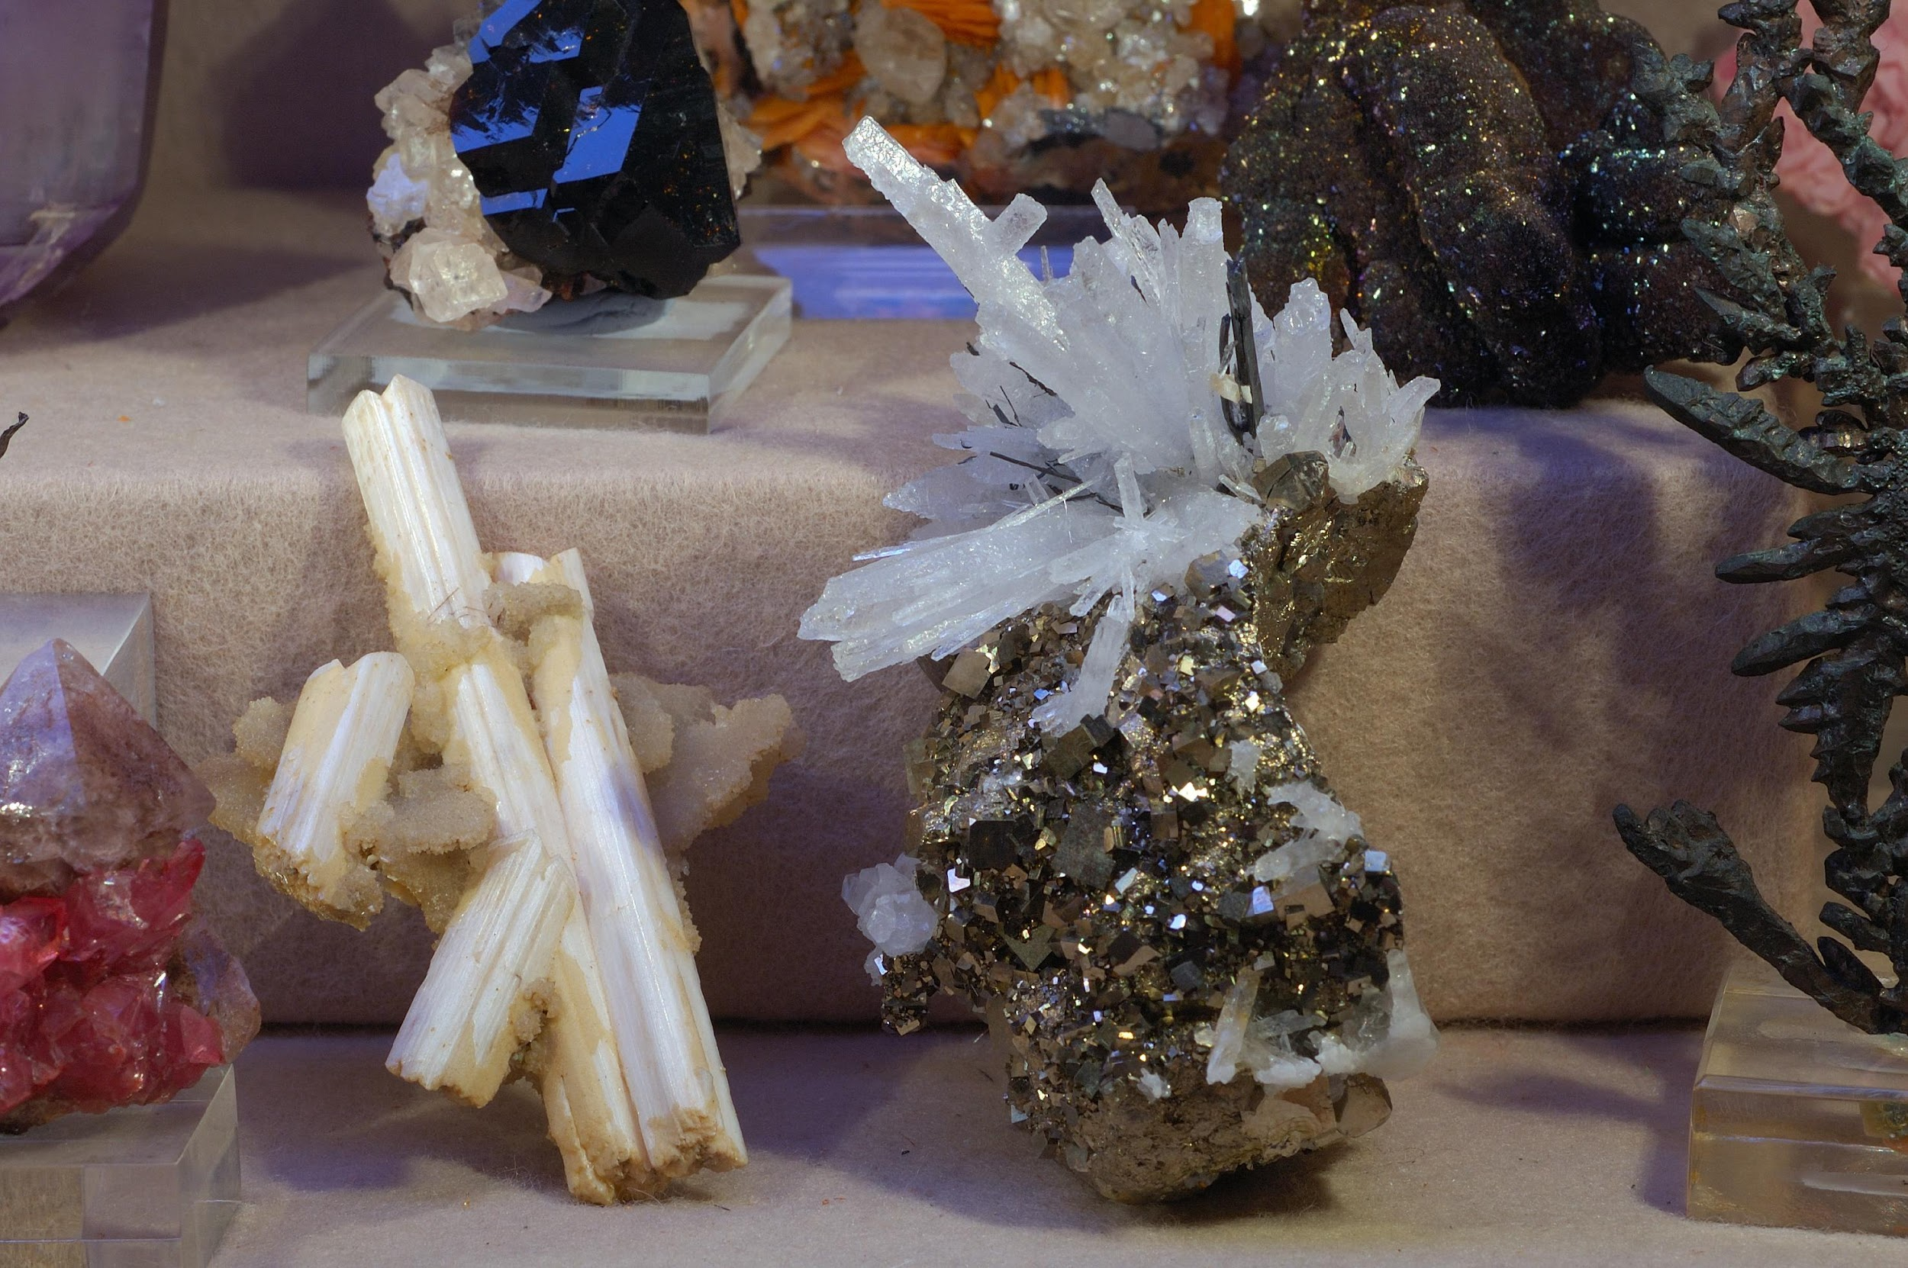
Warm up
Warm up
Why do we mine? What minerals/metals power our daily lives?
Turn to a partner or small group and brainstorm.
Photo courtesy of Eric Hunt on Flickr. License: CC BY-NC-ND. This content is excluded from our Creative Commons license. For more information, see https://ocw.mit.edu/help/faq-fair-use/ .

Slide 5
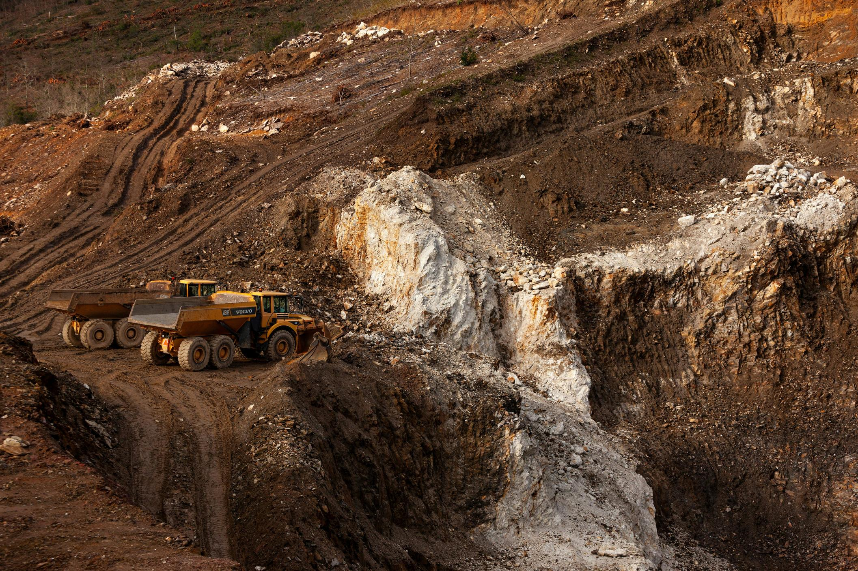
Introduction
PART 1
Photo by MiningWatch Portugal on Unsplash

Slide 6
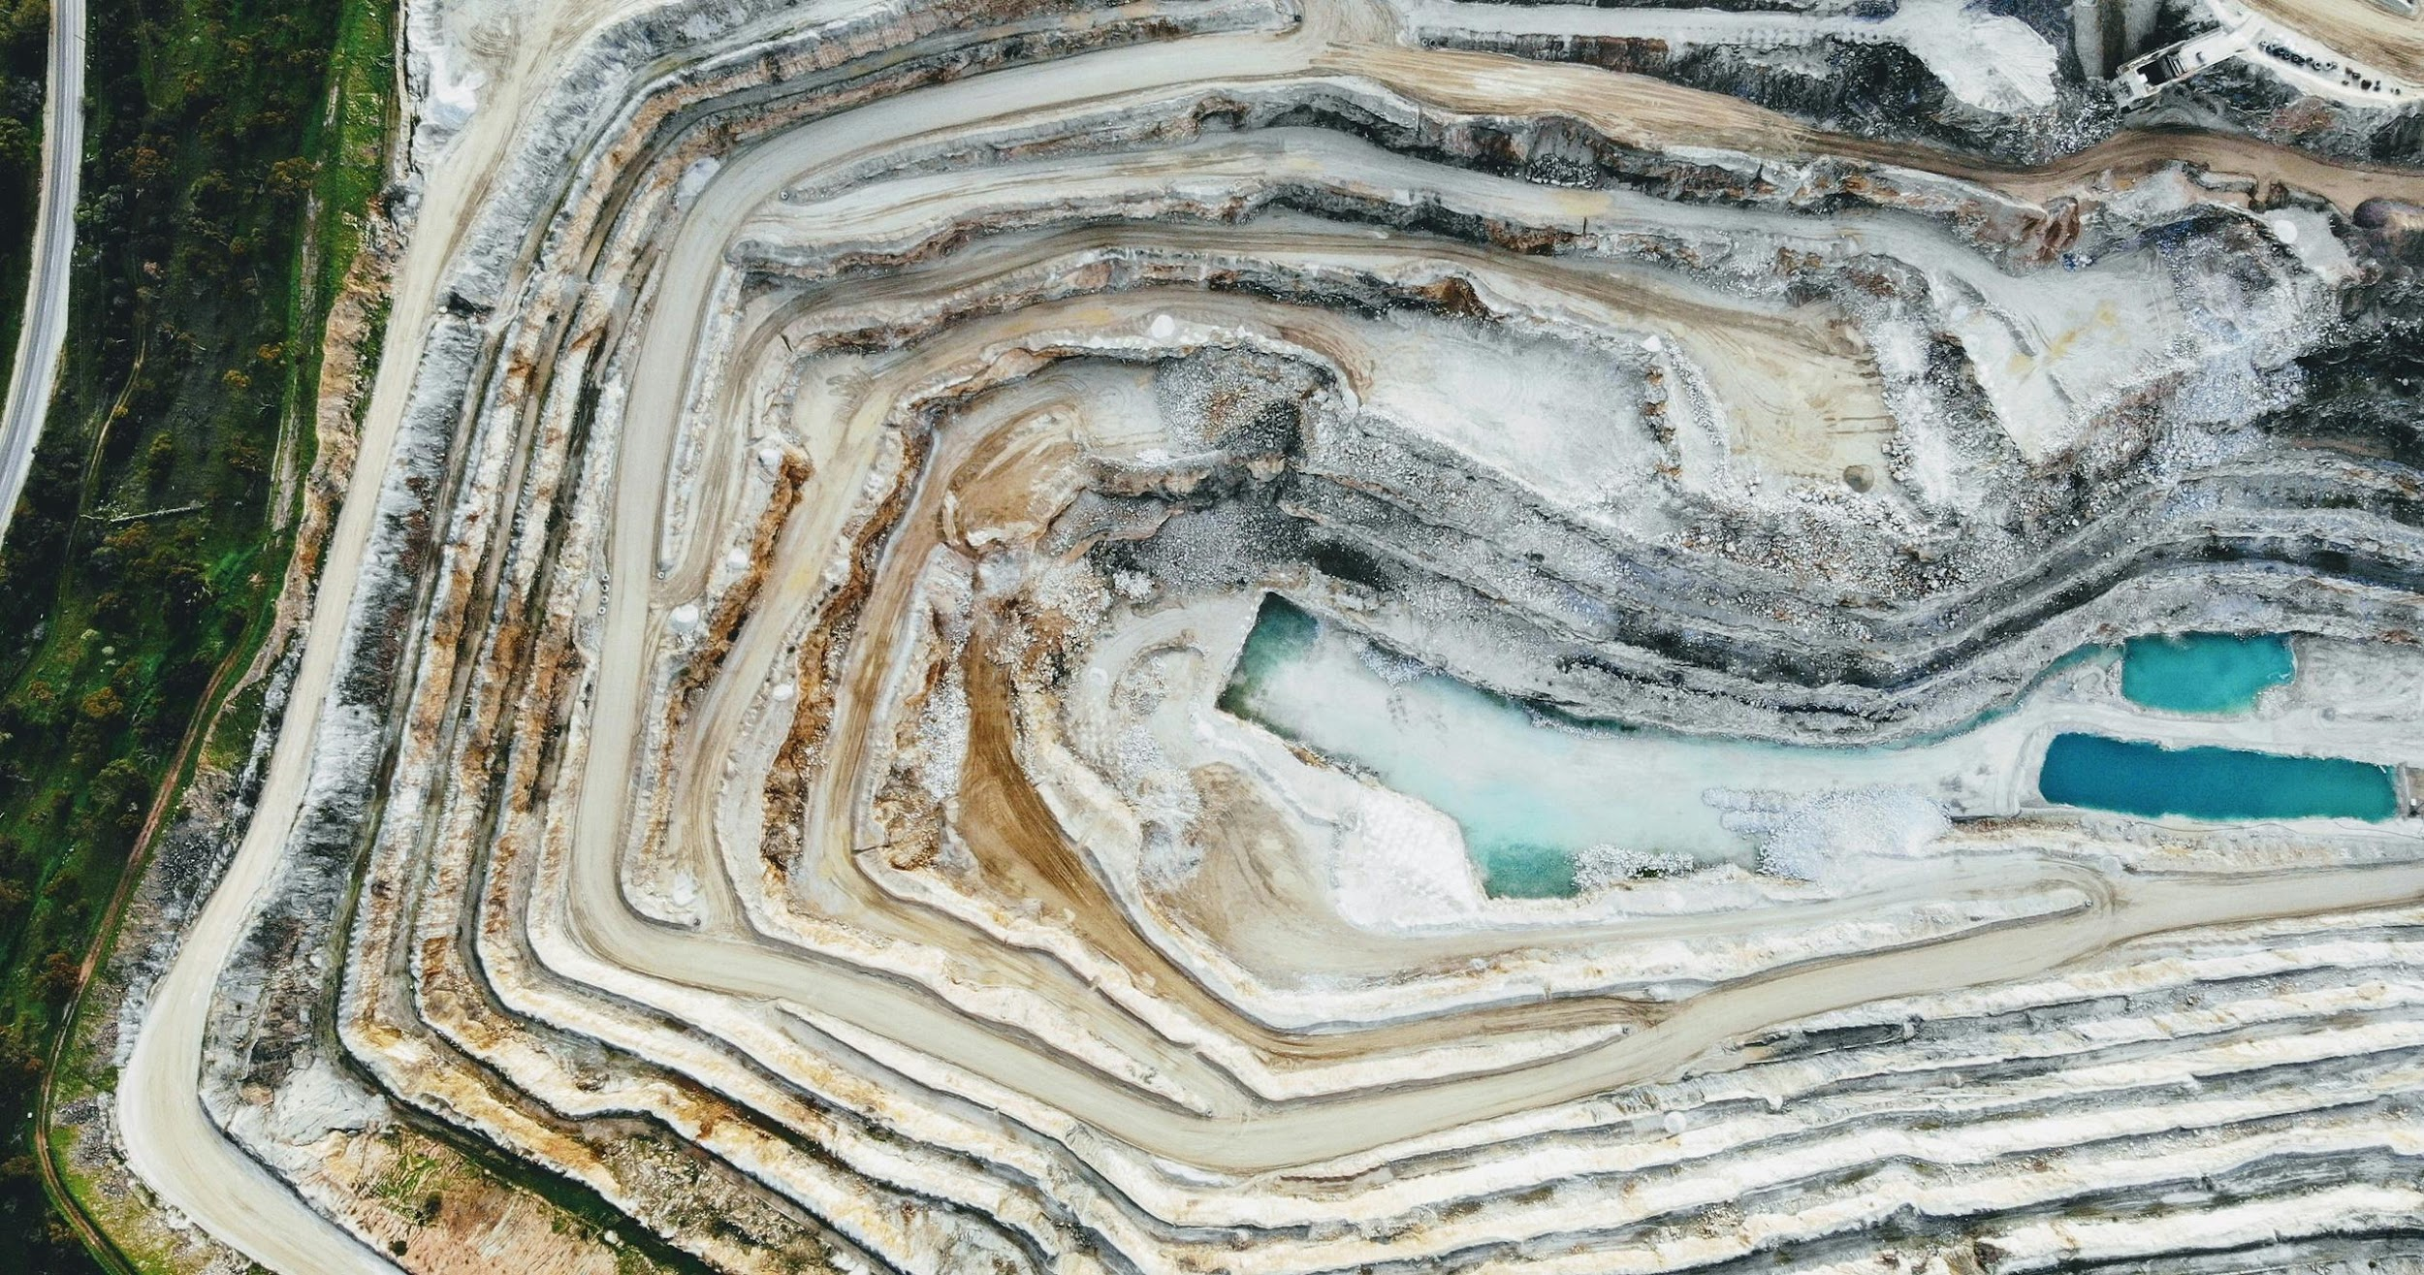
Mining
Definition
Mining is the process of extracting minerals of economic value from the earth's crust. (NatGeo & Gregory, 2021)
Background
Mining dates back to prehistoric times where flint was used to produce tools and weaponry. Metals and minerals are separated, processed, and refined because they are most valuable in their pure form. Two common mining methods are called surface mining and underground mining.
Impacts
  Accidents, adverse health conditions and effects
  Water pollution (ex. acid mine drainage)
  Erosion
  Deforestation
  Release of contaminants such as lead, zinc, and copper
Photo by Dion Beetson on Unsplash

Slide 7
Common Metals and Minerals in Batteries
Lithium
Nickel
  Also used in glass and ceramics
  Major producers: Australia, Chile, China
  Vital to stainless steel production
  Major producers: Philippines, Indonesia, Russia, Australia, Canada
Manganese
  Also critical to iron and steal production
  Major producers: South Africa, Australia, China, Gabon, Brazil
Copper
  Used in building construction, electronics (cables, plumbing heating, etc)
  Major producers: Chile, Peru, China, US, Australia
Cobalt
  Also used in superalloys for turbine engines, carbides, sharp tools, chemicals
  Major producers: Congo, China, Canada, Russia, Australia, Zambia

Slide 8

Indigenous Perspectives Against Mining
Indigenous people are often against the idea of ‘green mining’, and for the move towards the Just Transition.
Examine Indigenous perspectives
HonorEarth and Indigenous Environmental Network talk about the importance protecting sacred places. Take 10 minutes to look through these resources.
Discussion
  What is ‘green colonialism’?
  What are some examples of green colonialism that you came across in your reading?
  What are some ways in which green colonialism is perpetuated?
© Indigenous Environmental Network. All rights reserved. This content is excluded from our Creative Commons license. For more information, see https://ocw.mit.edu/help/faq-fair-use/ .

Slide 9

Indigenous Perspectives on Inclusive Mining
Reading
I’m Indigenous Australian, and I work for a mining company
Discussion
  What do you think of this alternate perspective?
  How does Lees frame his work?
  How has his work been accepted or rejected by people in his community?
  How can inclusivity in mining help bring a more just transition?
Photo courtesy of denisbin on Flickr. License: CC BY-ND This content is excluded from our Creative Commons license. For more information, see https://ocw.mit.edu/help/faq-fair-use/ .

Slide 10
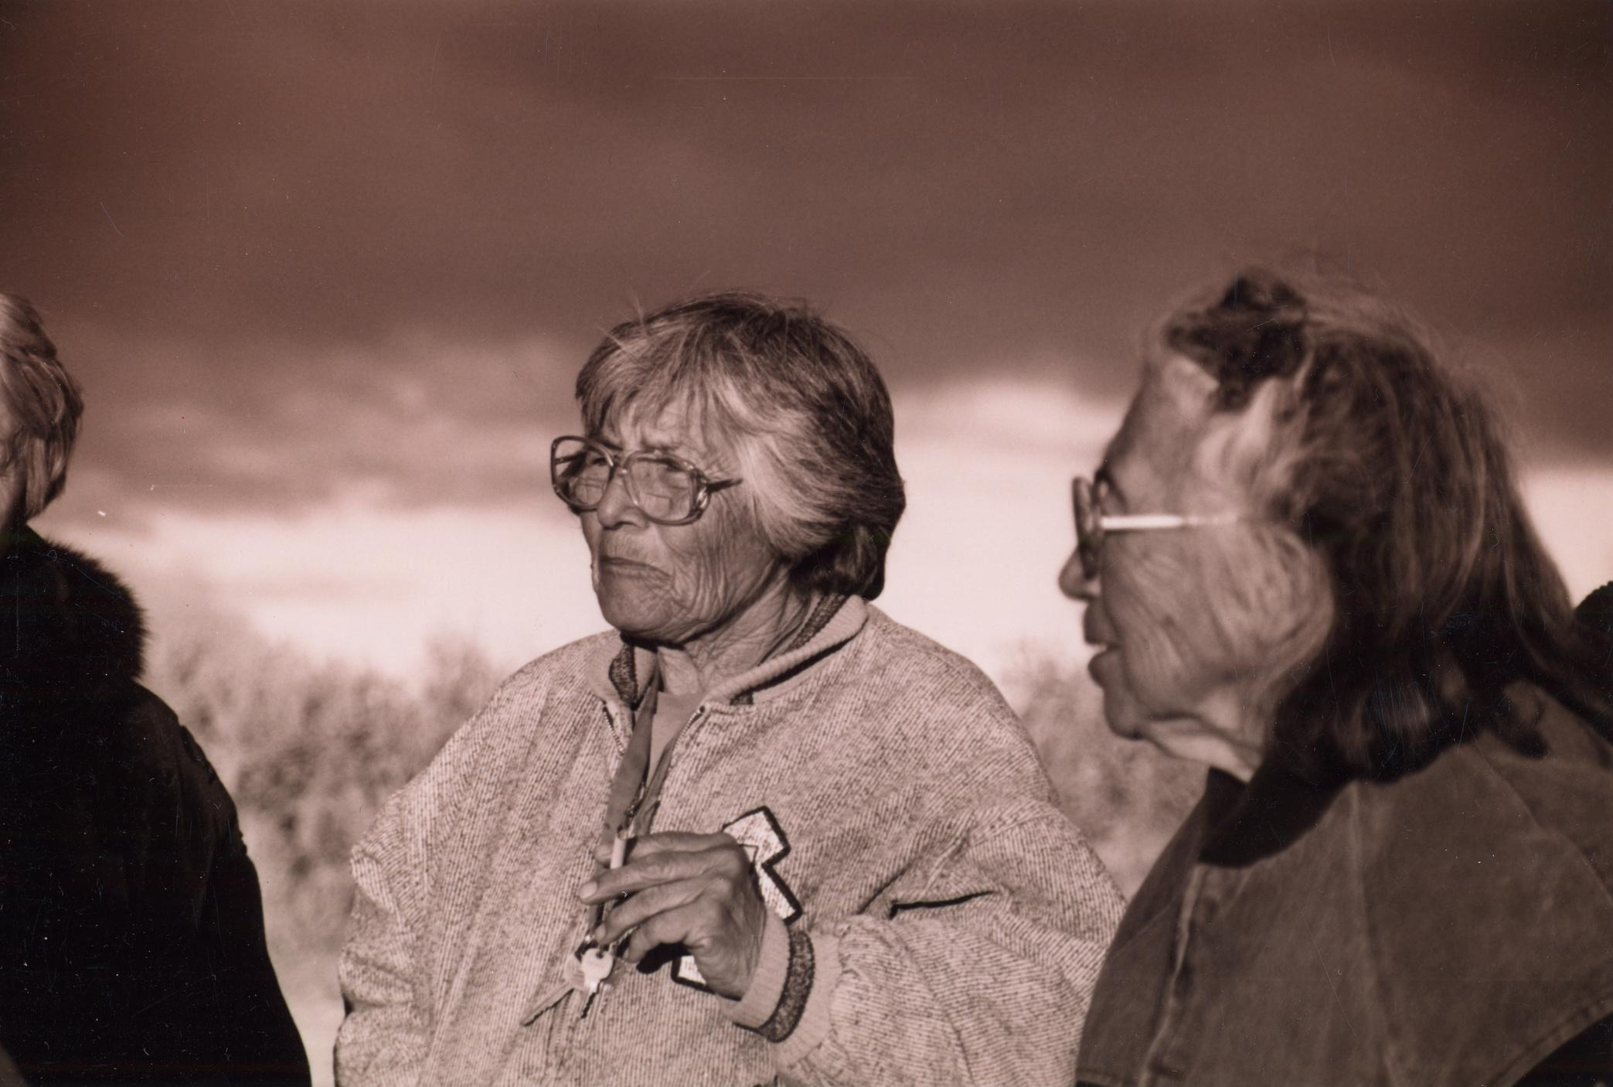
CASE STUDY #1
Terrascope Case Study
One particular indigenous organization that has protested against major mining projects in Nevada through lawsuits and community advocacy efforts is the Western Shoshone Defense Project, founded by Western Shoshone sisters Carrie and Mary Dann in 1991.
Key Readings for Background
Listen to this podcast*
  Western Shoshone Defense Project
  The Dann Sisters: Searching for Reciprocity for the Western Shoshone
A Rock in a Hard Place: The Lithium Conundrum in Nevada
Discussion
  What impact has the Western Shoshone Defense Project had on mining operations?
  How can their methodologies with protesting against mining be applied to other aspects of climate justice?
*Additional project information of Terrascope, an MIT First-Year Learning Community
© source unknown. All rights reserved. This content is excluded from our Creative Commons license. For more information, see https://ocw.mit.edu/help/faq-fair-use/ .

Slide 11
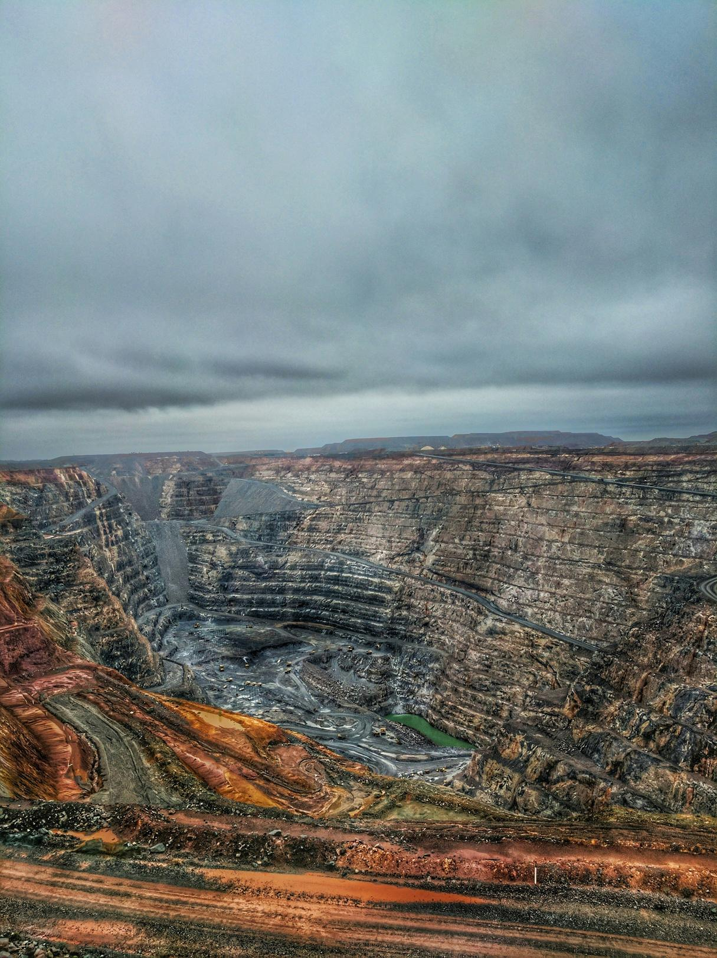
Mining and Climate Justice
PART 2
Photo by Matthew de Livera on Unsplash

Slide 12
ACTIVITY #1
AN INTRODUCTION TO MINING AND CJ: THE IMPACTS OF LITHIUM MINING
Discussion questions
  What is the "lithium triangle" and how does the massive yield of water for lithium refinement affect one of the driest regions on earth?
  How many gallons of brine produce enough lithium for one electric car battery? Do you consider electric cars a viable sustainable solution? Why or why not?
  With the use of desalinated water proposed as a solution to freshwater depletion due to lithium mining, what issues would still remain? Is the use of desalinated water a viable solution? Why or why not?
  Why do locals working for mining companies not experience the increased profits of this rapidly-growing industry? How will the increased demand for water likely affect communities economically?
  How has colonialism affected the mining industry?
Watch
The True Cost of The Lithium Mining Boom Powering Electric Cars
Before watching
  Where is the thumbnail photo from?
  What are the pools in the photo?
  Where is lithium mined?

Slide 13
Pillars of Mining and Climate Justice
01
02
03
04
Economy
Community
Sustainability
Renewable energy
Can an equal distribution of profits cover the cost of mining effects?
Must communities suffer in order to support energy demands?
What does sustainability entail in a fundamentally unsustainable industry?
How do we balance energy needs with the impacts of consumption?
Activities 2-5 each address one of these pillars

Slide 14
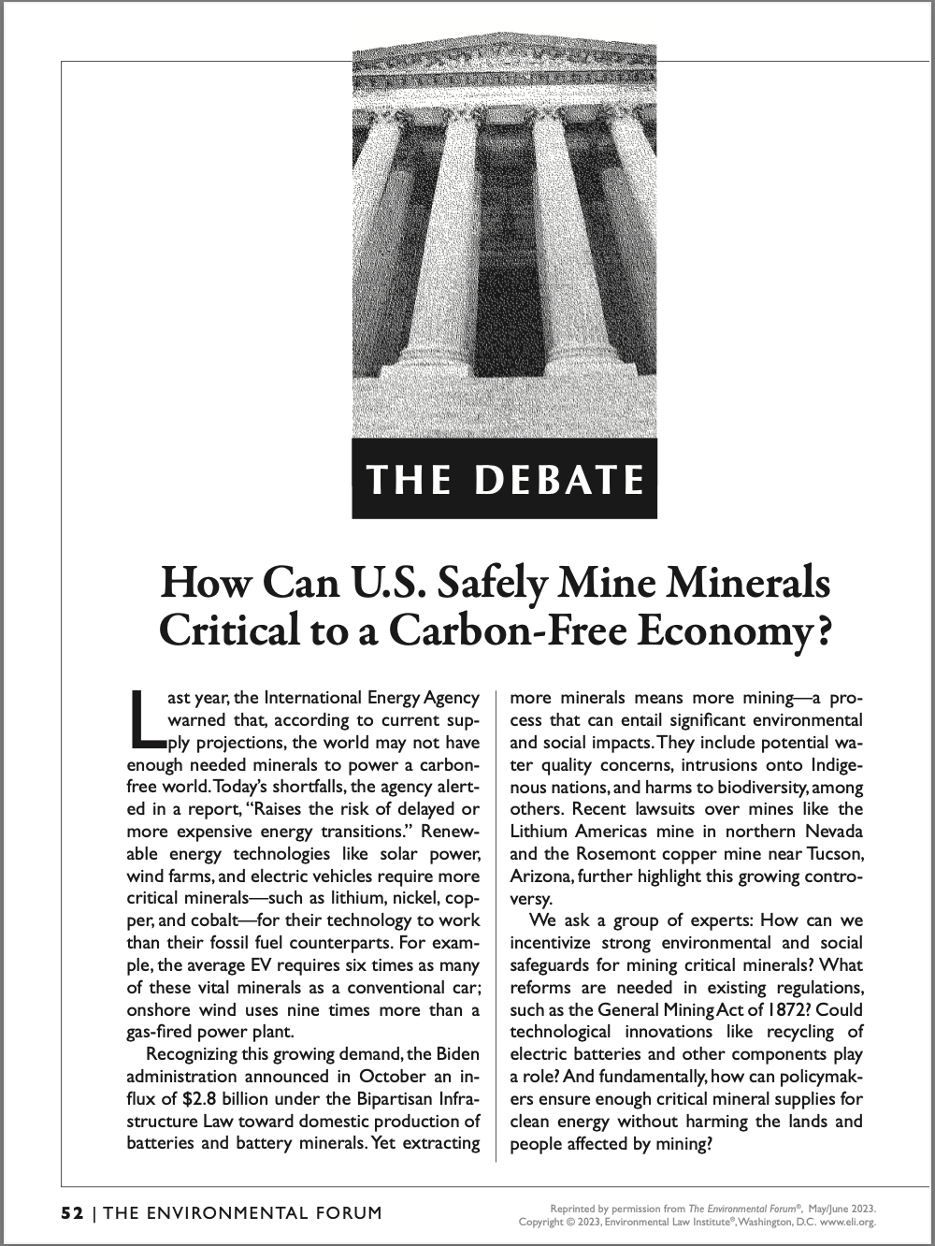
ACTIVITY #2
MINING AND THE ECONOMY
Read
How Can U.S. Safely Mine Minerals Critical to a Carbon-Free Economy?
See the next slide for discussion questions
© Environmental Law Institute. All rights reserved. This content is excluded from our Creative Commons license. For more information, see https://ocw.mit.edu/help/faq-fair-use/ .

Slide 15
ACTIVITY #2
MINING AND THE ECONOMY
Group 3: Electricity
Mergen addresses claims that lithium mines are essential to a net-zero economy despite continued opposition and failed land protection. What solutions does Mergen propose? Do you think that this monetary proposal is enough? Why or Why not?
Group 1: Supply chain
  Compton expresses skepticism regarding matching energy demand with a stream of recycled metals. Is this skepticism warranted? Why or why not?
  What solutions does Compton propose? How can these be realized on both an individual & community level?
Group 4: International cooperation
Odell addresses the US's high GHG emissions and large import rates of mined goods causing environmental & social harms in many regions, including Latin America. What does Odell propose in terms of country relations and internal solutions? How can these proposed solutions be exercised on an individual & community level?
Group 5: Just transition
Mergen addresses claims that lithium mines are essential to a net-zero economy despite continued opposition and failed land protection. What solutions does Mergen propose? Do you think that this monetary proposal is enough? Why or Why not?
Group 2: Reform and energy
Henderson outlines the health damage & continued neglect for native communities on public land. What solutions does Henderson outline? How can these proposed solutions be exercised on an individual & community level?
Group 6: US mineral potential
Mergen addresses claims that lithium mines are essential to a net-zero economy despite continued opposition and failed land protection. What solutions does Mergen propose? Do you think that this monetary proposal is enough? Why or Why not?

Slide 16
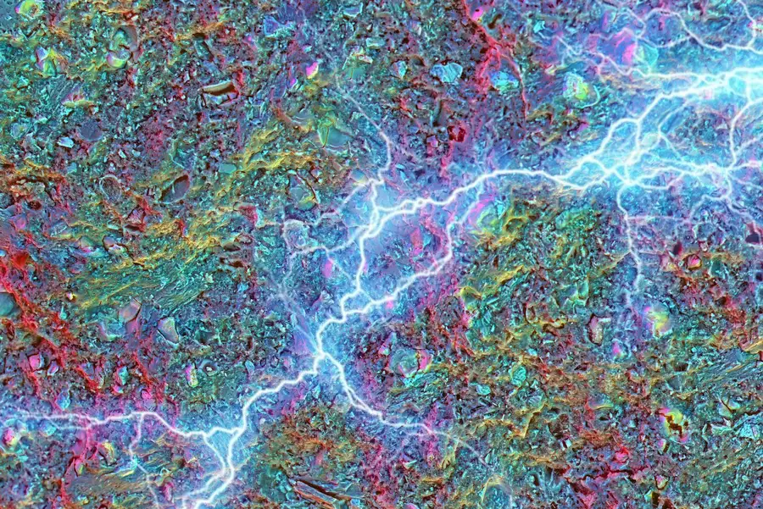
ACTIVITY #3
MINING AND SUSTAINABILITY
Discussion prompt
Form connections between these three readings by discussing the feasibility of replacing batteries with new technologies.
Read
  An overview of sustainability challenges
  A discussion of innovative technologies
  The 5 proposed solutions of the MIT Mission project
Before reading
Define hydrosocial conflict. What are some examples?
© PNAS. All rights reserved. This content is excluded from our Creative Commons license. For more information, see https://ocw.mit.edu/help/faq-fair-use/ .

Slide 17
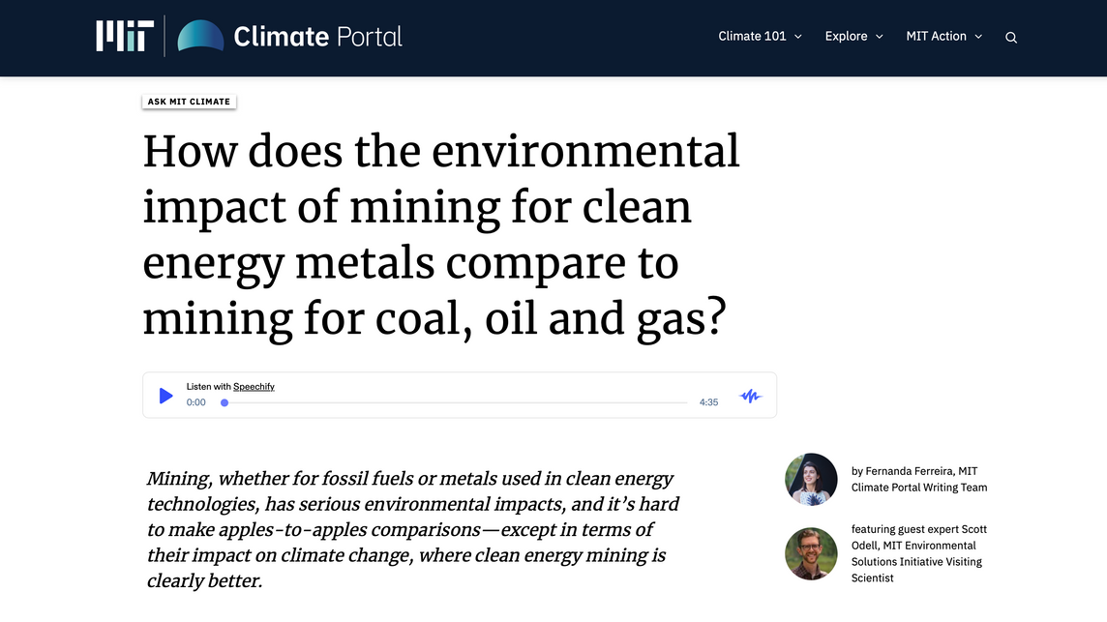
ACTIVITY #4
MINING AND RENEWABLE ENERGY
Propose solutions
Odell discusses three fundamental changes in order for clean energy mining to be possible:
  Reduce energy consumption by investing in public transportation and walkable cities
  Reuse minerals to advance the circular economy
  Raise industry standards and adopt regulations for responsible mining
Propose solutions on an individual and community level for these fundamental changes.
Read
How does the environmental impact of mining for clean energy metals compare to mining for coal, oil, and gas?

Slide 18
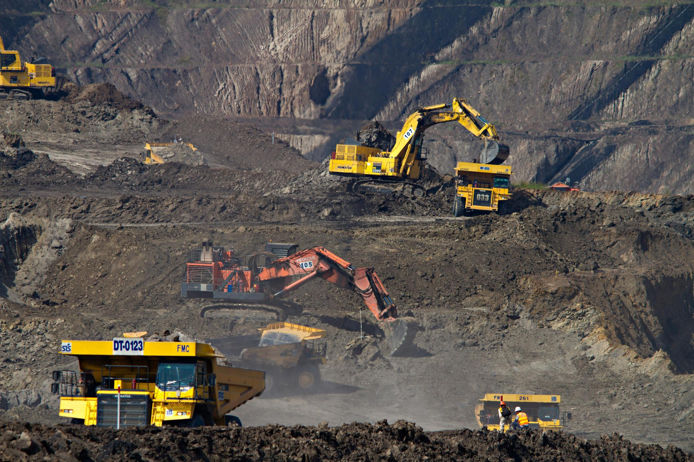
Beyond the Module
PART 3
Photo by Dominik Vanyi on Unsplash.

Slide 19
METALS & CLIMATE JUSTICE
PROJECT OPTION #1
Topic-Specific Exploratory Project
COBALT MINING
ENVIRON-MENTAL RISKS
Prompt suggestion
Within a group or individually, pick a topic within the intersection of mining and climate justice to present in any format to the class.
SACRIFICE ZONES
E-WASTE
MINING FOR CLEAN ENERGY
PUBLIC & PRIVATE COMPANIES
MODERN COMPUTING
E-WASTE & SOLUTIONS
CLEAN ENERGY REQUIRE-MENTS
COSMETIC MINING

Slide 20
Additional Resources
COBALT MINING
COSMETIC MINING
METALS & CLIMATE JUSTICE
E-WASTE
ENVIRON-MENTAL RISKS
SACRIFICE ZONES
CLEAN ENERGY REQUIRE-MENTS
MINING FOR CLEAN ENERGY
PUBLIC & PRIVATE COMPANIES
MODERN COMPUTING
E-WASTE & SOLUTIONS

Slide 21

For more resources on climate and environmental justice: Please explore other modules in the Climate Justice Instructional Toolkit.

Slide 22
Module References
  Aaron Kroll. (2022, December 1). Mining for the clean energy transition. MIT News | Massachusetts Institute of Technology.
  The All We Can Save Project. (n.d.). Assignments to spark action. The All We Can Save Project.
  Crawford, I., & Odell, S. (n.d.). Will mining the resources needed for clean energy cause problems for the environment? MIT Climate Portal.
  DW Documentary. (2023, July 19). The cobalt challenge - the dark side of the energy transition | DW documentary. YouTube.
  Ferreira, F., & Odell, S. (n.d.). How does the environmental impact of mining for clean energy metals compare to mining for coal, oil and gas? MIT Climate Portal.
  Green European Foundation. (2021, August 16). Metals and climate justice - mining our way into a climate-neutral future. YouTube.
  Gregory. (2001). A concise history of mining (Rev. ed.). A.A. Balkema.
  Herrington, R. (2021). Mining our green future. Nature Reviews Materials, 6(6), 456–458.
  Hsu, J. (2023, August 9). Energy-storing concrete could form foundations for solar-powered homes. New Scientist.
  Iea. (2021). Mineral requirements for Clean Energy Transitions – the role of critical minerals in Clean Energy Transitions – analysis. IEA.
  Insider News. (2023, July 13). Are lithium batteries for electric vehicles costing the Earth? | true cost | insider news. YouTube.
  J. Willard Marriott Library and the Utah Museum of Fine Arts. (n.d.). Health and Environmental Effects Mining the West: Primary Elements. J. Willard Marriott Library Exhibits.
  Lees (2023). I’m Indigenous Australian, and I work for a mining company. Zocalo Public Square.
  MIT. (2016). Environmental Risks of Mining.
  MIT. (2016). Environmentally Sensitive “Green” Mining.
  National Geographic. (n.d.). Mining. Education.
  NMA. (n.d.). 40 common minerals and their uses - national mining association. NMA.

Slide 23
Module References
  Odell, S. D. (2021). Hydrosocial displacements: Climate Change and Community Relations in Chile’s Mining Regions. MIT-ESI Mining, Environment & Society Program, 102305.
  Odell, S. D., & Bebbington, A. (2023). Mine ownership and Community Relations: Comparing hydrosocial dynamics of public and private companies in Chile. Resources Policy, 81, 103380.
  Porter, G., & Guo, Y. (2022). CSE 291 / The Environmental Impact of Modern Computing / Spring 2022. CSE 291 F00 - Spring 2022/classes/sp22/cse291-f/.
  The Documentary Channel. (2019, August 23). Blame game - e waste in Africa and solutions (documentary). YouTube.
  The Environmental Forum®. (2023, May). How can U.S. safely mine minerals critical to a carbon-free economy? L. Environmental Law Institute®.
  Sanzana Calvet, M., & Castán Broto, V. (2020). Sacrifice zones and the construction of Urban Energy Landscapes in Concepción, Chile. Journal of Political Ecology, 27(1).
  “Mining: Indigenous Environmental Network.” Indigenous Environmental Network | Respecting and Adhering to Indigenous Knowledge and Natural Law, January 12, 2023.
  “Talon Mine.” Honor The Earth. Accessed August 31, 2023.

Slide 24
MIT OpenCourseWare
https://ocw.mit.edu
RES.11-003 Climate Justice Instructional Toolkit Spring 2025
For more information about citing these materials or our Terms of Use, visit https://ocw.mit.edu/terms.

