Slide 1
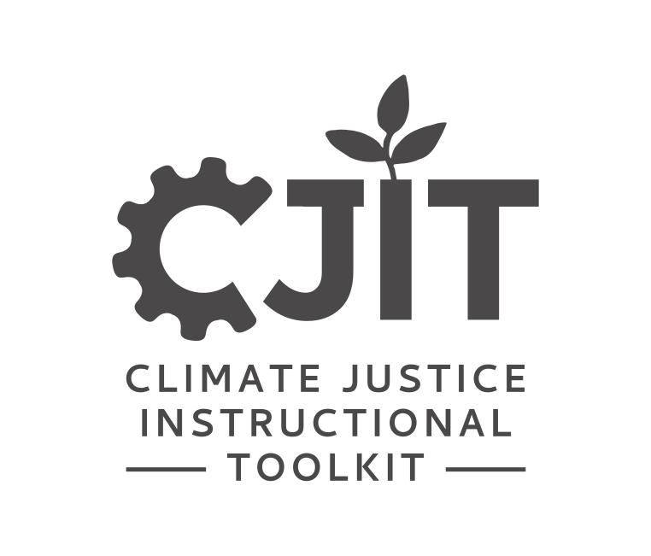
FOUNDATIONAL MODULE
Mapping
Environmental Justice
II

Slide 2
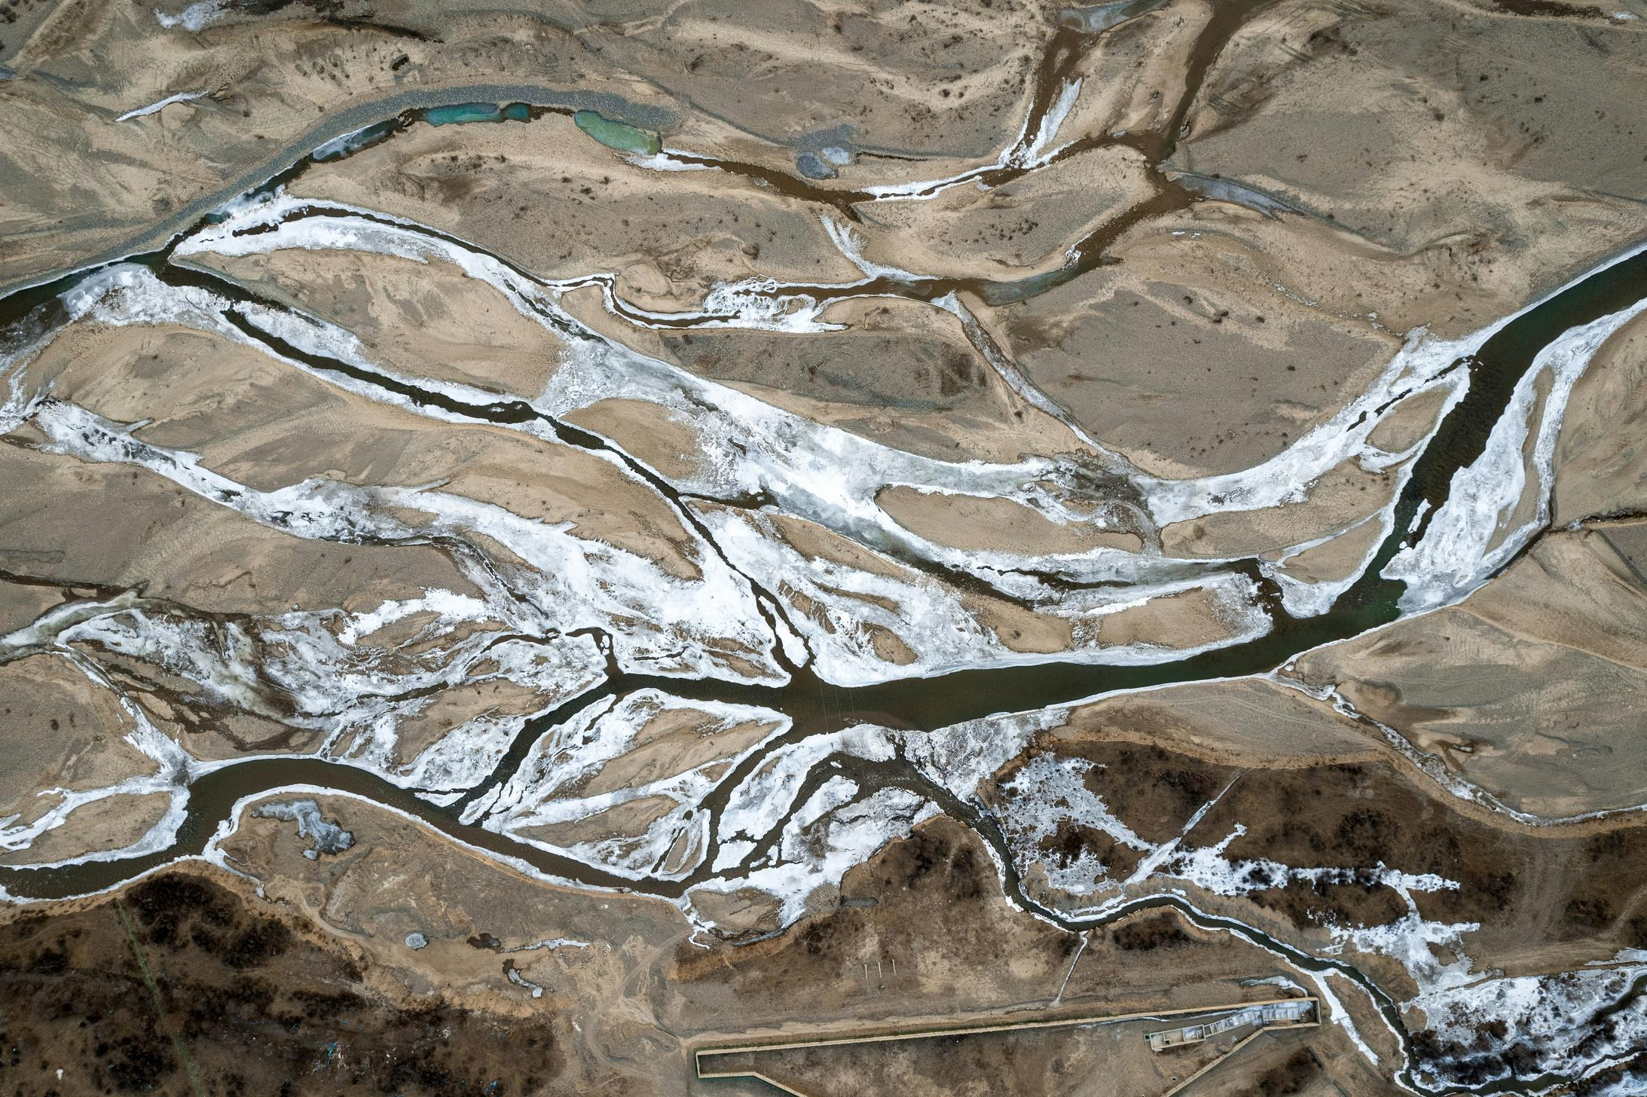
PHOTO BY ダモ リ ON UNSPLASH
What’s in this module?
Contents
Graduate students or advanced undergraduates with prior exposure to GIS or environmental justice concepts.
Contents
Part I focuses on how environmental data is collected and structured to build indices: what gets counted, and what’s left out? Part II examines how index design and mapping choices shape accessibility, legibility, and narrative. Part III explores the limits of these tools, and provides an activity that brings students either in conversation with each other, or outside, to talk about how they experience place.
Activities
3 parts
3 activities
Photo by darmau on Unsplash.

Slide 3
Learning Objectives
01
02
03
04
Describe the lifecycle of environmental justice data and how decisions at each stage shape decision making.
Critically evaluate the design and construction of environmental justice multi-criteria weighted indices.
Create your own environmental justice index, recognizing its limitations and exploring other participatory mapping methods.
Explore how environmental justice indices are used in policy, planning, and advocacy

Slide 4
Introduction
“Examining power means naming and explaining the forces of oppression that are so baked into our daily lives—and into our datasets, our databases, and our algorithms—that we often don’t even see them.”
– DATA FEMINISM (D’IGNAZIO & KLEIN, 2020)
D’Ignazio, C., & Klein, L. (2020). 1. The Power Chapter. In Data Feminism. Retrieved from https://data-feminism.mitpress.mit.edu/pub/vi8obxh7

Slide 5
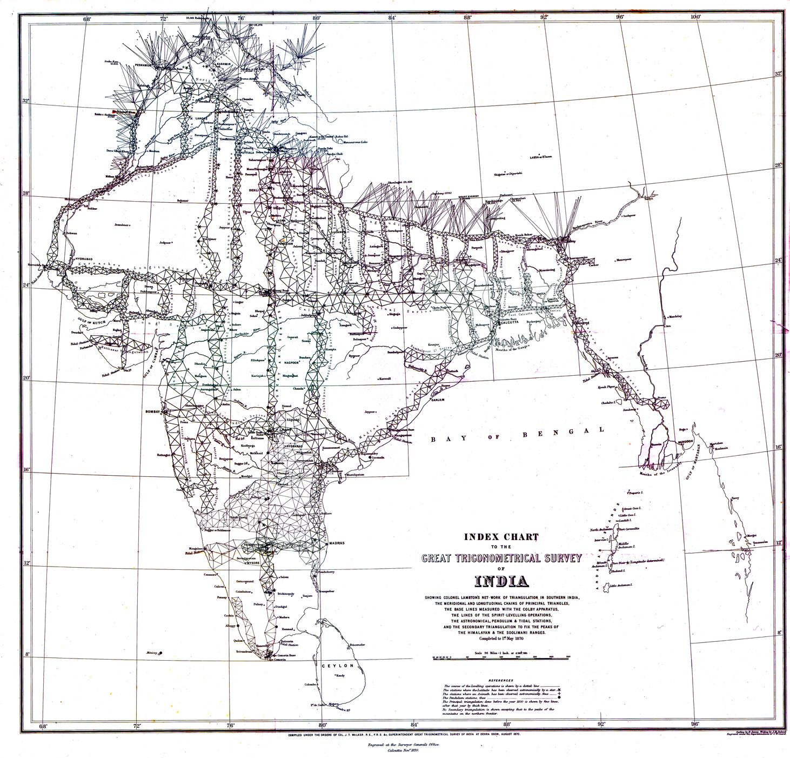
Example: The Great Trigonometrical Survey of India
Mapping and Power
Critical Cartography is a field that recognizes how maps are not neutral documents. As a term used both to describe mapping practices and theoretical critique, it “...challenges academic cartography by linking geographic knowledge with power, and thus is political.” (Crampton & Krygier, 2015)
When reading a map, a critical cartographer may ask:
  What gets measured?
  How is it measured?
  What data is included (and excluded)?
  How is data visualized?
  How are places named?
  Who uses the map – and for what reasons?
  Did communities have a say in how data was collected or used?
This map is in the public domain.
The Great Trigonometrical Survey was undertaken by the British East India Company starting in 1802, with the aim of mapping the Indian subcontinent using “objective” scientific precision. However, both its production and its impacts were deeply political—designed to serve colonial aims by enabling land taxation, consolidating territorial control, and erasing Indigenous systems of knowledge and land use. (Xaxa 2024; Edney 1997)

Slide 6
The Lifecycle of Spatial Data
PART 1

Slide 7
Spatial Data Lifecycle
Understanding the lifecycle of environmental justice data means asking critical questions about power at every stage—who collects the data, how it's structured, where it's stored, and how it’s ultimately used. Each phase shapes what environmental harms are made visible, whose experiences are centered, and what kinds of action are possible.
Simplified Data Lifecycle:
1. ACQUISITION
2. PROCESSING
3. VISUALIZATION
4.STORAGE
5.DECISION MAKING
The process of collecting raw environmental or demographic data—through monitoring devices, surveys, remote sensing, etc.
The stage where data is cleaned, categorized, and transformed. Sometimes, this includes creating multi-criteria weighed indices.
The process of designing maps and other data visuals. Choices like color, scale, and language influence who can understand and use the information.
How and where data is stored, or archived, determines where data is kept, who owns it, who can access it, and who can erase it.
The phase where data is interpreted and applied to shape policies, funding, or advocacy. This is a process that reflects whose priorities are acted on.
Data Lifecycle Steps Adapted From:
Roth, Silke, and Markus Luczak-Roesch. 2018. “Deconstructing the Data Life-Cycle in Digital Humanitarianism.” Information, Communication & Society 23 (4): 555–71. doi:10.1080/1369118X.2018.1521457.

Slide 8
Spatial Data Lifecycle
Understanding the lifecycle of environmental justice data means asking critical questions about power at every stage—who collects the data, how it's structured, where it's stored, and how it’s ultimately used. Each phase shapes what environmental harms are made visible, whose experiences are centered, and what kinds of action are possible.
Simplified Data Lifecycle:
1. ACQUISITION
2. PROCESSING
3. VISUALIZATION
4.STORAGE
5.DECISION MAKING
The process of collecting raw environmental or demographic data—through monitoring devices, surveys, remote sensing, etc.
The stage where data is cleaned, categorized, and transformed. Sometimes, this includes creating multi-criteria weighed indices.
The process of designing maps and other data visuals. Choices like color, scale, and language influence who can understand and use the information.
How and where data is stored, or archived, determines where data is kept, who owns it, who can access it, and who can erase it.
The phase where data is interpreted and applied to shape policies, funding, or advocacy. This is a process that reflects whose priorities are acted on.
What questions should we ask at each stage?
Data Lifecycle Steps From:
Roth, Silke, and Markus Luczak-Roesch. 2018. “Deconstructing the Data Life-Cycle in Digital Humanitarianism.” Information, Communication & Society 23 (4): 555–71. doi:10.1080/1369118X.2018.1521457.

Slide 9
Spatial Data Lifecycle
Understanding the lifecycle of environmental justice data means asking critical questions about power at every stage—who collects the data, how it's structured, where it's stored, and how it’s ultimately used. Each phase shapes what environmental harms are made visible, whose experiences are centered, and what kinds of action are possible.
Simplified Data Lifecycle:
1. ACQUISITION
2. PROCESSING
3. VISUALIZATION
4.STORAGE
5.DECISION MAKING
  Who collected this data?
  What data was collected?
  What was left out?
  Who decided what to collect?
  How was the data cleaned, categorized, or combined?
  What indicators were created?
  What assumptions were made?
  Who is the intended audience for this map or dashboard?
  What story does the visualization tell?
  Is this visualization designed to be accessible to disabled users and those using assistive technologies?
  Where is this data stored, and who has access to it?
  Is it open, proprietary, downloadable?
  Has it been archived?
  Who uses this data and to what ends?
  How does it influence policy, funding, or organizing?
  What systems of power does action generated from this data challenge, or reinforce?
Data Lifecycle Steps From:
Roth, Silke, and Markus Luczak-Roesch. 2018. “Deconstructing the Data Life-Cycle in Digital Humanitarianism.” Information, Communication & Society 23 (4): 555–71. doi:10.1080/1369118X.2018.1521457.

Slide 10
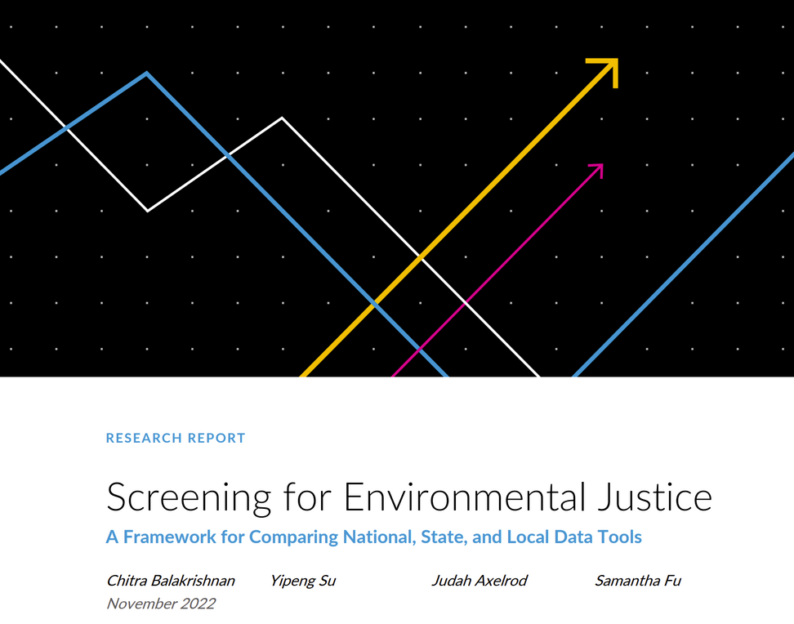
ACTIVITY #1
MAPPING THE DATA LIFECYCLE OF EJ TOOLS
Step 4:
Come together as a full class or share in cross-group pairs to share back:
  Key observations about power and design choices
  Gaps, limitations, or missing voices
  One recommendation to improve the tool
Goal
Analyze how power operates across the data lifecycle of the Massachusetts Environmental Justice Populations tool using the five-stage framework: Acquisition → Processing → Visualization → Storage → Decision Making
Step 1:
Split into 5 groups, and assign each group one stage of the spatial data lifecycle.
Step 2:
Read the summary of the Urban Institute’s report on EJ screening tools: Screening for Environmental Justice
Step 3:
Focus on the Massachusetts Environmental Justice Populations tool and, in your groups, ask the questions relevant to you group’s stage that are on Slide 9.
© Urban Institute. All rights reserved. This content is excluded from our Creative Commons license. For more information, see https://ocw.mit.edu/help/faq-fair-use/ .
Notes:
During the exercise, return to slide 9 so students can refer to the questions.
Note that another variation of this activity could involve students selecting a screening tool of their choice from the Urban Institute's List and conducting a shorter walkthrough of all five stages of the spatial data lifecycle for that tool.

Slide 11

Scale and EJ Mapping
Scale | Examples | Strengths | Limitations
Federal | CEJST, EJScreen (Both archived)
State | CalEnviroScreen, Massachusetts EJ Populations
Local / City | EJNYC Mapping Tool
Notes:
A segue from the exercise into this slide could look like:
"Now that we’ve talked about how maps are made and how power shows up at every stage of their design, it’s essential to think about scale.
The scale of a map, or a mapping tool, is made at, whether it's federal, state, or local, shapes what gets measured, how precise the data can be, and what kinds of decisions it can support.
Let’s take a closer look at how scale affects the strengths and limitations of different EJ mapping efforts."
If there is enough time, navigate to one of the examples provided at each scale. Then, ask the class what they think should go in the Strengths and Limitations boxes for each row.

Slide 12
Scale and EJ Mapping
Scale | Examples | Strengths | Limitations
Federal | CEJST, EJScreen (Both archived) | (+) Consistent coverage across U.S. (+) Often tied to major, federal funding programs (Ex: Justice40) | (-) Relies on broad-scale indicators (Ex: census data) and generic weighting
State | CalEnviroScreen, Massachusetts EJ Populations | (+) Can include state-specific hazards (Ex: oil wells, wildfires) (+) More timely updates | (-) Varies by state; some states lack tools entirely (-) Still may rely on generalized proxies
Local / City | EJNYC Mapping Tool | (+) May better reflect local conditions (+) Can integrate higher quality data collected at a city level | (-) Often underfunded (-) Harder to compare across regions or advocate for state/federal action
Notes:
Depending on class engagement on the last slide, this slide could also be an opportunity to ask students what is missing from this list of Strengths and Limitations.
Archived datasets (for accessing datasets that have recently been removed, in an archive format: https://screening-tools.com/archived-data

Slide 13

Scale and EJ Mapping
For each of these scenarios – which scale of environmental justice tool (federal, state, or local) is most appropriate? What else (besides a mapping tool) would you need to make an informed and just decision?
A community board in the your neighborhood asks for your help identifying a site for a new cooling center that will serve mothers with children. What scale of map or tool would be most suitable for this use case?
You’re writing a national grant proposal to fund community air monitoring projects in the most climate-vulnerable census tracts. Which scale of mapping tool helps you decide where to target, and what are its tradeoffs?
You’ve been hired by your state’s Department of Health to identify neighborhoods most at risk of heat-related illness to target for health interventions. You only have budget for 5 cities. What kind of index would help you decide which cities are a part of this project?
Notes:
Depending on how much students already know, the appropriate scale (local, state, or federal) will likely be clear based on the language in the scenario, such as “neighborhood,” “state department,” or “national grant.”
In those cases, focus this mini-discussion around the second part of the question: What else (besides a mapping tool) would you need to make an informed and just decision?
Encourage students to think beyond quantitative data -- real-time info, community input, politics, history, etc.

Slide 14
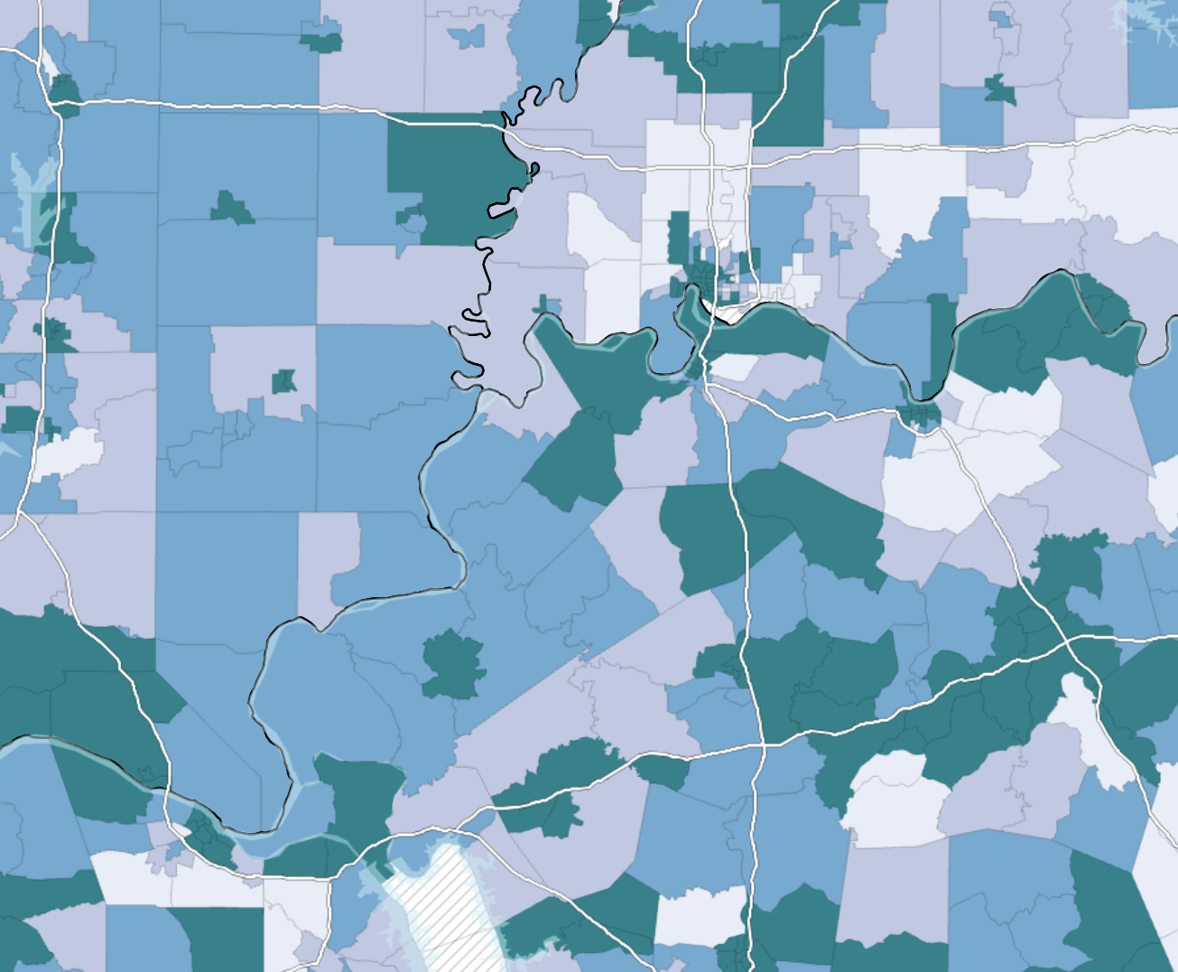
The Making of an Index
PART 2
Image Source: Screenshot from the CDC’s Environmental Justice Index .This map is in the public domain.

Slide 15


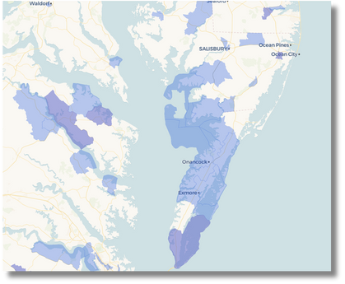
What is an Index?
What Makes an Index?
  Multiple indicators (e.g., air pollution, asthma rates, poverty)
  Weighting (some factors count more than others)
  Aggregation (indicators combined into a score or rank)
  Geographic unit (e.g., census tract, ZIP code, block group)
An index is a type of dataset that combines multiple indicators, such as pollution levels, income, and health data, into a single score or classification. Environmental Justice indices are used to identify EJ communities and reveal patterns of vulnerability or risk. Often times, they are created to aid in the distribution of resources. (Osakwe et. al. 2024; Huynh et. al. 2024)
Factor #1
Different data sources
Factor #2
Factor #3
Weighting
EJ Index
Important Distinction:
Not all environmental justice maps are indices. Some maps show single datasets (e.g., heat risk, flood zones) or use narrative, participatory, or visual methods. Indices are composite tools, one kind of EJ mapping, but not the only kind.

Slide 16

What Goes Into an EJ Index?
Multiple
Indicators
Indicator
Weighting
+
Geographic Unit
+
Defining Place Designations
X

Slide 17
What Goes Into an EJ Index?
Multiple
Indicators
Indicator
Weighting
+
Geographic Unit
+
Defining Place Designations
X
Possible Indicators May Include:
Environmental
Social
Health
Infrastructure
  Air quality
  Water quality
  Access to green space
  Heat vulnerability
  Income
  Race / Ethnicity
  Education
  Age
  Asthma rates
  Heart disease
  Low birth weight rates
  Life expectancy
  Housing quality
  AC access
  Transit access
  Flood control infrastructure

Slide 18
What Goes Into an EJ Index?
Multiple
Indicators
Indicator
Weighting
+
Geographic Unit
+
Defining Place Designations
X
Indicator weighting refers to how much each indicator affects the final EJ score. Not all indicators may be equally as relevant to a community’s vulnerability, therefore, it is important for an index to reflect local priorities. There are different weighting approaches (Dean 2022), which generally fall within two categories:
  Participatory Multi-Criteria Analysis: Stakeholders define indicator weights through a participatory process.
  Analyst-Led Multi-Criteria Analysis: A non-participatory approach whereby a specialist, or team of specialists, undertakes the analysis and determines, amongst other things, indicator weights.

Slide 19
What Goes Into an EJ Index?
Multiple
Indicators
Indicator
Weighting
+
Geographic Unit
+
Defining Place Designations
X
The geographic unit is the scale at which data is processed and communicated in the index. Depending on the intended end-user and use case, different scales may be more suitable.
  Census Block Group – Fine-scale, Suitable for neighborhood-level analysis, limited data availability.
  Census Tract – Common in EJ tools, balances detail with broad data coverage, aligned with other data reporting.
  Neighborhood / Community District – Useful in cities, may align with local governance.
  County – Broad view, may work for policy or funding decisions taking place at a state or national level, but can obscure local disparities.

Slide 20
What Goes Into an EJ Index?
Multiple
Indicators
Indicator
Weighting
+
Geographic Unit
+
Defining Place Designations
X
Different EJ Indices take different approaches for making sense of the data: communicating which geographies are Environmental Justice communities, or experience some degree of vulnerability. These approaches, defined by the Urban Institute (Balakrishnan et. al. 2022), include:
  Binary: A place is either “disadvantaged” or not, based on a fixed threshold. This creates clear eligibility lines but can exclude communities just below the cutoff.
  Tiered: Places are ranked relative to others (ie, by percentile), better reflecting the spectrum of how risk and injustice are experienced, but possibly requiring more interpretation for policy and funding decisions to be made.

Slide 21
NON-GIS VERSION
ACTIVITY #2
BUILD YOUR OWN SPATIAL DATA INDEX
Step 4: Assign Your Weights (10 minutes) Individually:
  You have 100 points to divide across the five indicators.
  Assign more points to indicators you think matter more for heat vulnerability. Reflect on what you know about heat, as well as social vulnerability in your city.
  Multiply each indicator value (100) by your assigned weight to calculate a score.
Step 5: Compare, Combine, Reflect (10 minutes)
Regroup with your partner and compare how you weighted the indicators, and how this affected the final weighted “Score”. Where did you align or differ? Why did you choose certain weights? What assumptions were baked into your decisions? Who might be helped or left out because of how you built your index? What data do you wish you had but couldn’t include?
Step 1: Situating Yourself (5 minutes)
Extreme heat is the deadliest climate disaster. Your task is to build a mini index to identify which neighborhoods in your city are most vulnerable. You are pretending to advise the City on where to prioritize funding for cooling interventions.
Step 2: Meet Your Partner + Select Your Neighborhood (5 minutes)
Find a partner and together, pick a real or imaginary neighborhood in your city. You will pretend to represent that neighborhood when assigning values to indicators later. For the purposes of this activity, each “neighborhood” will have the same value of 100 for each of the following indicators:
  % of Households Without AC Access
  % Energy-Burdened Households
  Surface Temperature / Lack of Tree Cover
  % of Population Over 65 Living Alone
  Percent of Neighborhood With Tree Canopy Coverage
Articles About Extreme Heat for Reference:
  Who Is At Most Risk To Extreme Heat? NIHHIS
  The Unequal Burden of Heat American Scientist
  41 million Americans are simmering on urban heat islands Grist
Notes:
Option 1: no access to GIS tools

Slide 22
GIS VERSION
ACTIVITY #2
BUILD YOUR OWN SPATIAL DATA INDEX
This version of the activity uses an ArcGIS Learn module and requires access to ArcGIS Pro. It is designed for students with some prior experience using GIS tools.
Step 1: Launch the Learn Module (5 minutes)
Go to the ArcGIS Learn project:
👉 Create an Environmental Justice Index Map
Sign in to ArcGIS Pro and download all of the listed datasets in the tutorial.
Step 3. Customize the Weighting (10–15 minutes)
Using the Smart Map Search tool:
  Revisit the indicators and try adjusting the weights.
  Consider how shifting the weights changes which neighborhoods are classified as vulnerable. What are the real world implications of these decisions?
Step 2: Follow the Tutorial Instructions (35–45 minutes)
As you work through the steps, pause to reflect on:
  What indicators are being used?
  Who might have selected them?
  What indicators are left out?
Step 4: Reflect + Discuss (10 minutes)
  What are the strengths and limitations of this tool?
  What data is missing?
  How does changing weights reflect different stakeholder priorities?
  How can this process be made more just, or equitable?
Notes:
Option 1: no access to GIS tools

Slide 23
What the Data Misses
PART 3

Slide 24

Photo by nrd on Unsplash.
What are the Limits of Digital EJ Maps and Indices?
  Scale Misalignment: Because many EJ indices report data at the Census Tract level, disparities between blocks may be missed.
  Technical Barriers: The creation and use of digital mapping tools, particularly indices, exclude people like the elderly who lack the necessary technical skill sets or communities without internet access.
  Lack of Community Input: While many indices, like CalEnviroScreen, are developed with input from the public, the scale at which these tools are developed (often at a city, state, or national level) precludes representative participation.
  Quantification Limits: Not all forms of harm can be easily measured. Things like emotional stress or cultural loss are not captured in typical data sets.
One example of how groundtruthing can complement mapping using aerial imagery, or data collected in a top-down manner, is in mapping access to fresh fruits and vegetables. Stores change often, and some vendors of fresh produce may be street vendors.
Conducting an on-the-ground survey can be an effective way to ensure that data is accurate and up to date (Dean et al., 2011). Conducting this type of fieldwork in partnership with communities may make it even more effective in understanding how people experience injustice on the ground.

Slide 25
ONLINE VERSION
ACTIVITY #3
FIELD PAPERS
This version of the activity is designed for a group to use online, suitable for in-person classrooms or online classrooms, where spending time outdoors in a neighborhood is not feasible.
Step 1. Pick a Place You Know (5 Minutes)
Based on your own lived experience, pick a neighborhood that you know well. This neighborhood can be anywhere in the world.
Step 5. Partner Sharing + Interview (10 Minutes)
Exchange maps with your partner. Each take five minutes to interview one another and ask the following prompts:
  Why did you choose to map this place?
  What stories do you associate with these spots?
  What does this map leave out?
  How has this place changed over time?
Step 2. Open Field Papers and Print Maps (15 Minutes)
Go to the Field Papers website:
👉 Field Papers
This tool is an Open Source tool – meaning that it can freely be used, or modified. Under the “Make” tab, navigate to the neighborhood you want to spotlight, and then click “Make Atlas”. Download your map and print it.
Step 6. Group Reflection (Optional: 5–10 minutes)
Regroup as a class and discuss:
  What kinds of knowledge came out through conversation that were not visible on the map?
  How does your partner's understanding of place differ from how it looks from above?
  How is this exercise relevant to mapping environmental justice issues in communities?
Step 3. Find a Partner and Introduce Your Neighborhood (5 Minutes)
Locate a partner, and show them your neighborhood. Explain why you picked this place, and what your relationship to it is.
Step 4. Mark Up Your Map (10 Minutes)
With your partner, go through the following prompts and make marks on your map or a blank sheet of paper indicating the following:
  Where people gather
  Where you would take a friend who was visiting
  Places that are important to the people in this neighborhood
Notes:
This activity requires a personal computer, internet access, a printer, and pens or markers.
If internet access is not available, instructors can pre-print field maps for a place near the instructional site that students are familiar with and distribute these printouts at this time.
If printer access is not available, then students can use Field Papers to make their maps on their personal computers, then use a blank sheet of paper when working with their partner.

Slide 26
OUTDOORS VERSION
ACTIVITY #3
FIELD PAPERS
This version of the activity is designed for a group to use when they are able to go outdoors and walk around a small area – this could be a section of a campus, around a block, or a local park.
Step 1. Find a Partner and Distribute Field Papers (5 Minutes)
Students should find a partner for the activity, and each pair should receive one printed version of Field Papers corresponding to the area they will be exploring (ie, a part of a campus, a local park, a city block).
Step 5. Partner Sharing + Reflections (10 Minutes)
Sitting with your partner, reflect on the following questions:
  What aspects of this neighborhood were invisible on the map but clear on the ground?
  What did the data or digital map suggest that wasn’t apparent during your walk?
  How might your own perspective or lived experience shape what you noticed or overlooked?
Jot down a few shared insights to bring back to the group.
Step 2. Digital Exploration (15 Minutes)
Before going outside, students should explore the area from a digital perspective. Using the EDF’s Climate Vulnerability Index, take 10 minutes to summarize what you learn from the census tract the area you will be walking based on data alone:
👉The U.S. Climate Vulnerability Index (EDF, Texas A&M)
Spend 5 minutes discussing what you find with your partner.
Step 6. Group Reflection (Optional: 5–10 minutes)
Regroup as a class and discuss:
  How does this kind of hands-on mapping help us better understand environmental justice issues?
  How should digital data and lived experience work together when it comes to documenting and addressing injustice?
Step 3. Walking Observations (20-30 Minutes)
Pairs now spend between 20 and 30 minutes walking around the area mapped on Field Papers, and taking notes at things they observe on the Field Papers. These can include:
  Where people gather
  Places that look cared for
  Places that look like they require care
  Small businesses, community landmarks, or other forms of neighborhood infrastructure
Notes:
This activity requires a personal computer, internet access, a printer, and pens or markers.
If internet access is not available, instructors can pre-print field maps for a place near the instructional site that students are familiar with and distribute these printouts at this time.
If printer access is not available, then students can use Field Papers to make their maps on their personal computers, then use a blank sheet of paper when working with their partner.

Slide 27
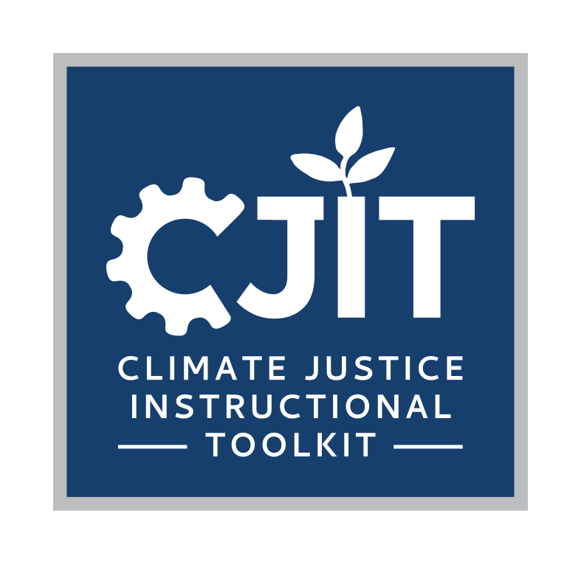
For more resources on climate and environmental justice: Please explore other modules in the Climate Justice Instructional Toolkit.

Slide 28
Module References
  Crampton, Jeremy W., and John Krygier. 2005. “An Introduction to Critical Cartography.” ACME: An International Journal for Critical Geographies 4 (1): 1. https://doi.org/10.14288/acme.v4i1.723.
  Dean, Dr Marco. 2022. A Practical Guide to Multi-Criteria Analysis.
  Roth, Silke, and Markus Luczak-Roesch. 2018. “Deconstructing the Data Life-Cycle in Digital Humanitarianism.” Information, Communication & Society 23 (4): 555–71. doi:10.1080/1369118X.2018.1521457.Denieul-Pinsky, Léa. 2025. “Mapping Colonial Archives as Counter Practice.” ACME: An International Journal for Critical Geographies 24 (1): 1. https://doi.org/10.14288/acme.v24i1.2397.
  Edney, Matthew H. 1999. Mapping an Empire: The Geographical Construction of British India, 1765-1843. University of Chicago Press. https://press.uchicago.edu/ucp/books/book/chicago/M/bo3683502.html.
  Huynh, Benjamin Q., Elizabeth T. Chin, Allison Koenecke, et al. 2024. “Mitigating Allocative Tradeoffs and Harms in an Environmental Justice Data Tool.” Nature Machine Intelligence 6 (2): 187–94. https://doi.org/10.1038/s42256-024-00793-y.
  Osakwe, Nnamdi C., Alison A. Motsinger-Reif, and David M. Reif. 2024. “Environmental Health and Justice Screening Tools: A Critical Examination and Path Forward.” Frontiers in Environmental Health 3 (September). https://doi.org/10.3389/fenvh.2024.1427495.
  Sklar, Alyssa. n.d. “Research Guides: Critical Cartography: Home.” Accessed June 8, 2025. https://researchguides.library.vanderbilt.edu/critical-cartography/home.
  Tubino de Souza, Daniele, Karolien van Teijlingen, Rutgerd Boelens, and Gabriela Ruales. 2025. “Seeing Rivers Otherwise: Critical Cartography as a Form of Critical Pedagogy.” Geoforum 158 (January): 104167. https://doi.org/10.1016/j.geoforum.2024.104167.
  Xaxa, Aashish. 2024. “Dismantling Colonial Cartography: Indigenous Urbanism as Spatiality, India.” In SDGs in the Asia and Pacific Region. Springer, Cham. https://doi.org/10.1007/978-3-031-17463-6_82.

Slide 29
MIT OpenCourseWare
https://ocw.mit.edu
RES.11-003 Climate Justice Instructional Toolkit Spring 2025
For more information about citing these materials or our Terms of Use, visit https://ocw.mit.edu/terms.

