Slide 1
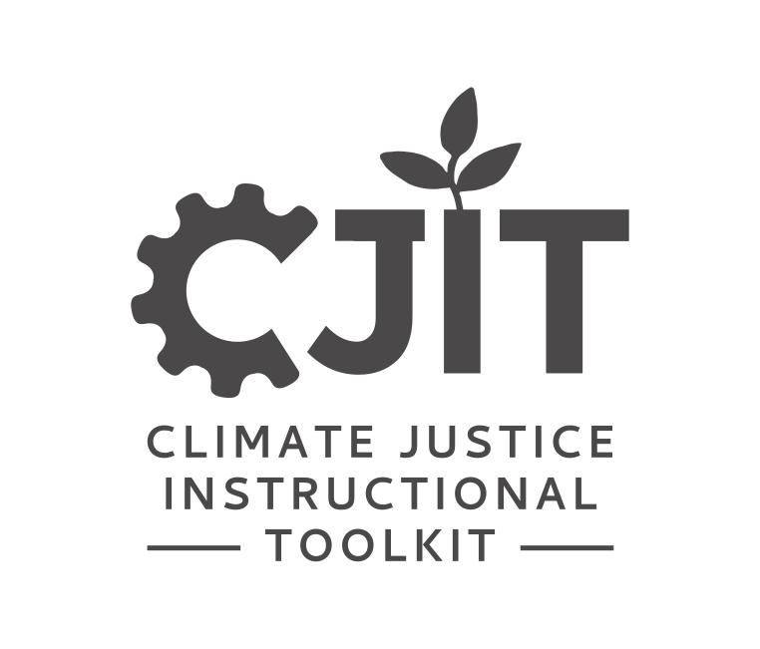
FOUNDATIONAL MODULE
Mapping
Environmental Justice

Slide 2
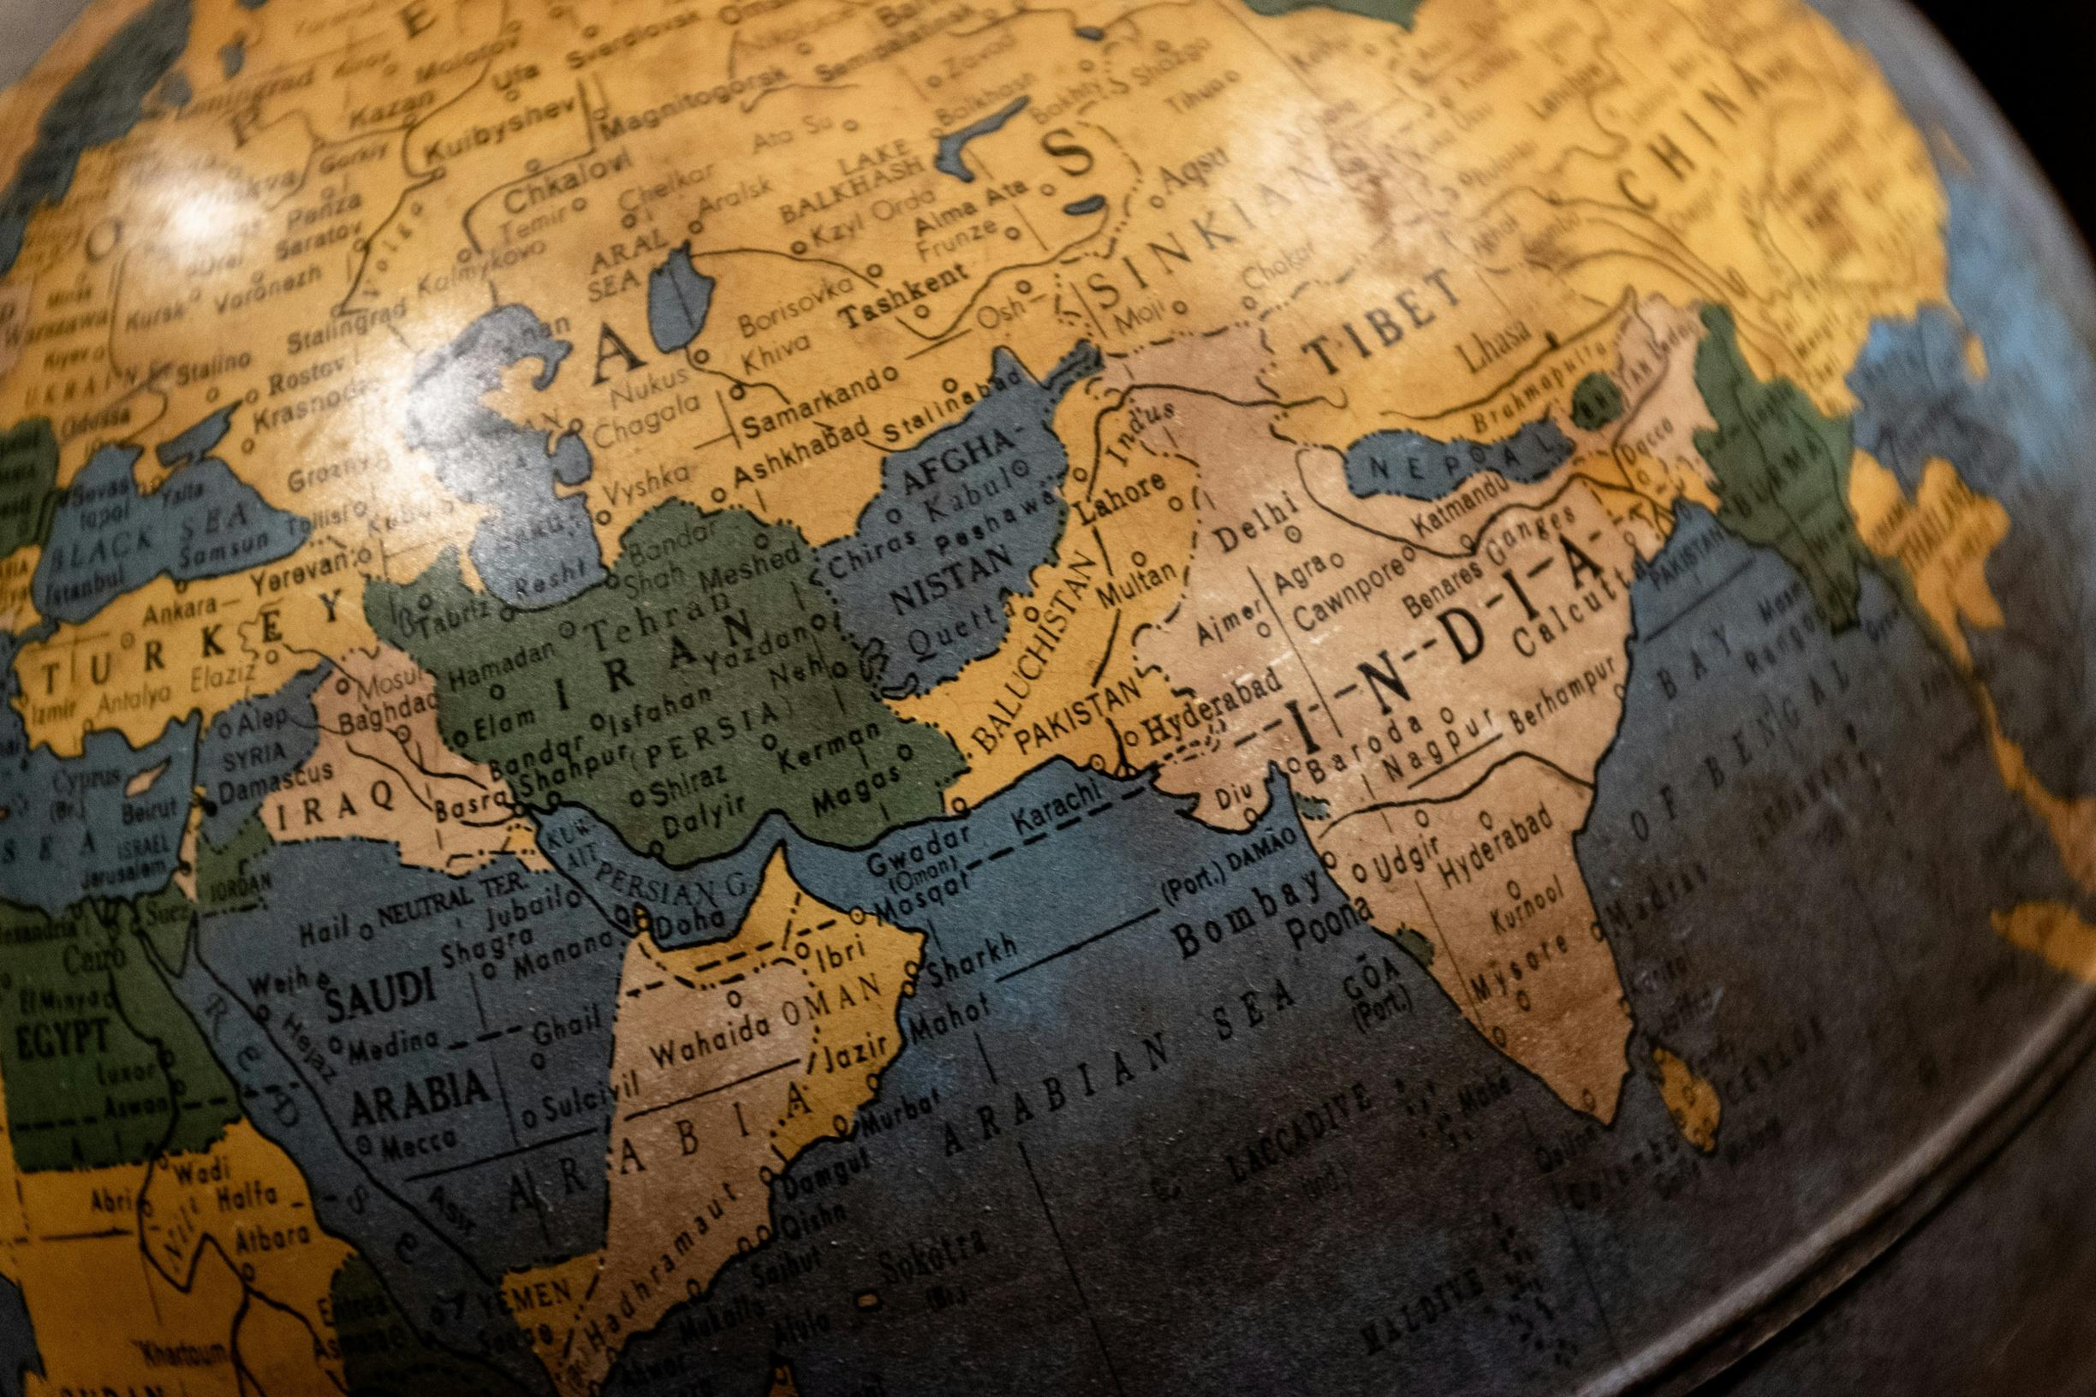
Photo by Joshua Olsen on Unsplash.
What’s in this module?
Contents
This module uses mapping to demonstrate explore issues of environmental justice. It is divided into three parts. Part 1 and 2 focus introducing and exploring features from the EJAtlas and EJScreen tools. Part 3 provides assignment and projects for applying concepts from this module in future study.
Activities
Key Resources
3 parts
5 readings
9 activities
2 project options
  EJAtlas
  EJScreen
*Disclaimer: As you may know, recently, some climate-related websites have been taken down. We have done our best to find archived links or alternate sites. Please email us at cjrabe@mit.edu if you find a broken link.

Slide 3
Learning Objectives
01
02
03
04
Learn basic mapping practices using different tools
Identify how environmental justice can be explored through mapping
Consider EJ case studies from around the world, and more locally
Develop a working understanding of
EJ Atlas and/or EJ Screen

Slide 4
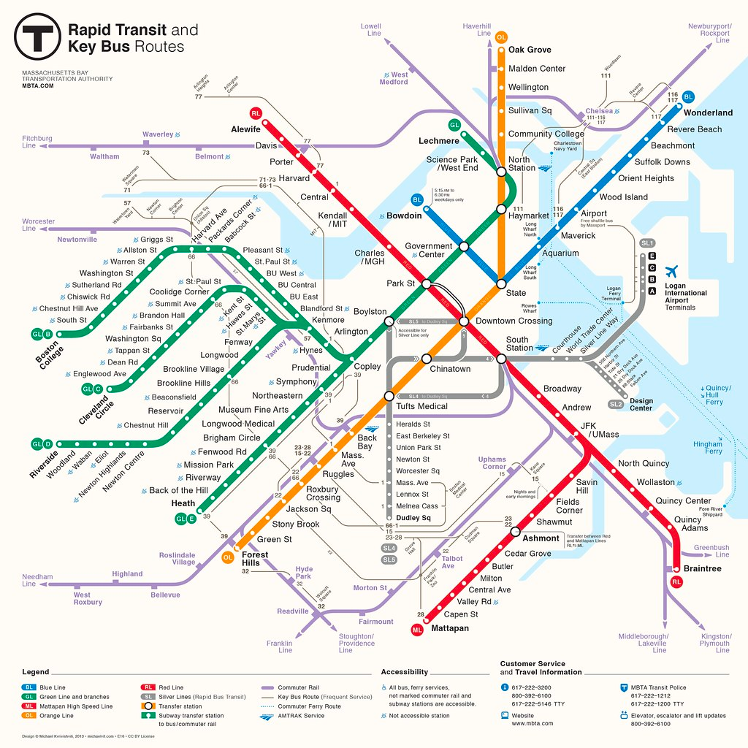
Image courtesy of Michael Kyrivishvili on Flickr. License: CC BY.
Introduction
Mapping geospatial data centering on environmental justice plays a huge part of understanding how to mitigate climate injustices.
Mapping geospatial data can:
  Track, and then ultimately manage and measure, the effects of climate change (Ordnance Survey).
  Track things like environmental risk, air pollution, landscape change, and more.
  Provide a better understanding of the social issues that occur in different areas as well.
  Allow us to understand not only environmental concerns, but issues of environmental injustice—we learn what groups are most affected, and how we might mitigate these consequences.

Slide 5
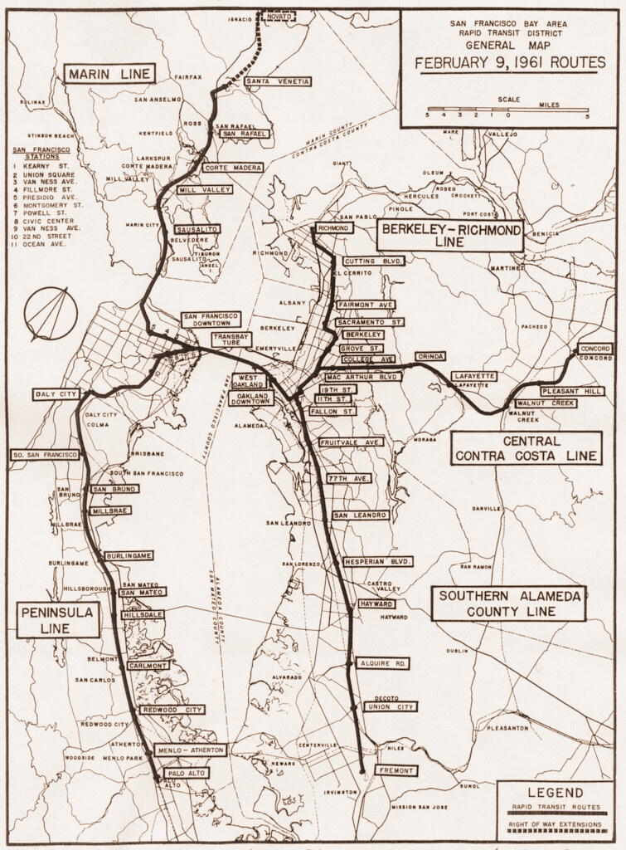
Introduction
The two landmark studies that started the field of EJ:
  Siting of Hazardous Waste Landfills and Their Correlation with Racial and Economic Status of Surrounding Communities (General Accounting Office, 1983)
  Toxic Waste in the United States (United Church of Christ, 1987) - this report coined the term "environmental racism"
Both of these studies examined the inequitable placement of environmental harms on communities of color.
© San Francisco Bay Area Rapid Transit District. All rights reserved. This content is excluded from our Creative Commons license. For more information, see https://ocw.mit.edu/help/faq-fair-use/ .
For more, see the Introduction to Climate Justice module

Slide 6
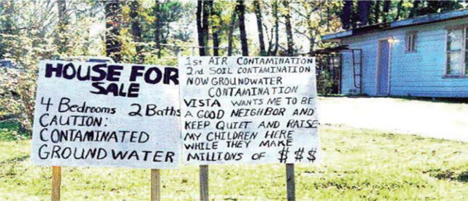
ACTIVITY #1
LEARNING ABOUT AN IMPLICATION OF EJATLAS
Present
Give a 2 minute mini-presentation to the class summarizing the section(s) that your group read.
Group and assign
Split into 5 or 10 small groups. Assign either 1 or 2 sections (from sections 2 through 11) to each group. If there are 5 groups, each group get 2 sections. If there are 10 groups, each group gets 1 section.
Joan Martinez-Alier, "Mapping ecological distribution conflicts: The EJAtlas,"The Extractive Industries and Society 8(4), 2021, Courtesy of Elsevier, Inc., https://www.sciencedirect.com. Used with permission.
Read
IN
Read the introduction and your group’s assigned section(s) from Mapping ecological distribution conflicts: The EJAtlas.

Slide 7
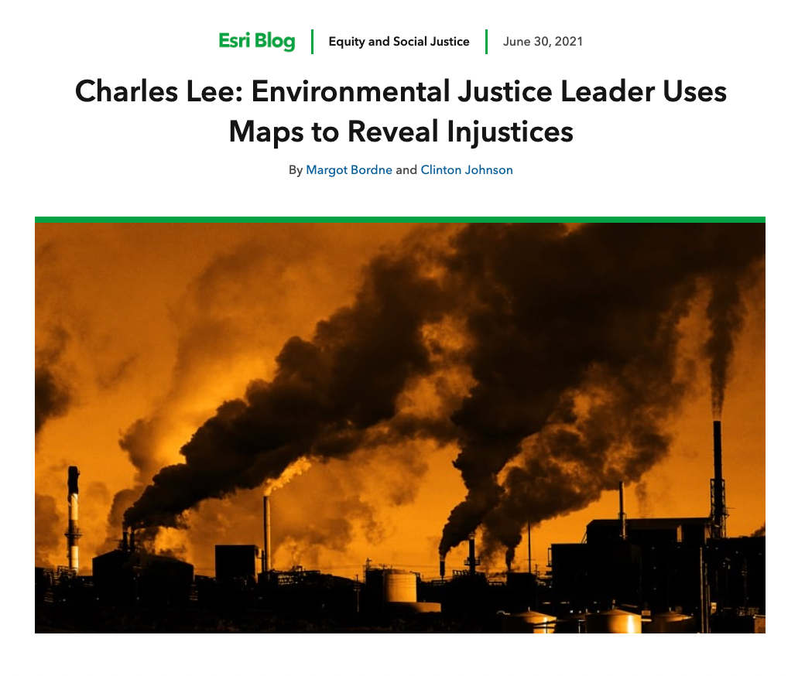
ACTIVITY #2
ACTIVIST PERSPECTIVES ON MAPPING
Read
Charles Lee: Environmental Justice
Leader Uses Maps to Reveal Injustices
Discuss with a partner
  How are EJ and CJ leaders using maps?
  How do maps highlight critical areas for environmental justice?
  How is this perspective different than the previous academic article?
© ESRI. All rights reserved. This content is excluded from our Creative Commons license. For more information, see https://ocw.mit.edu/help/faq-fair-use/ .

Slide 8
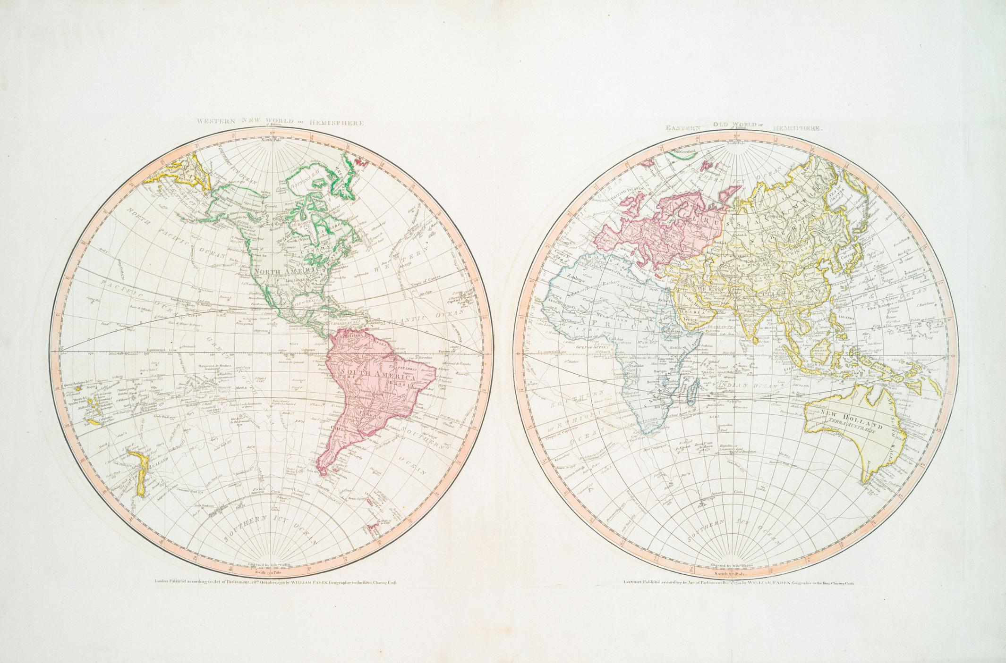
EJAtlas
PART 1
This image is in the public domain.

Slide 9
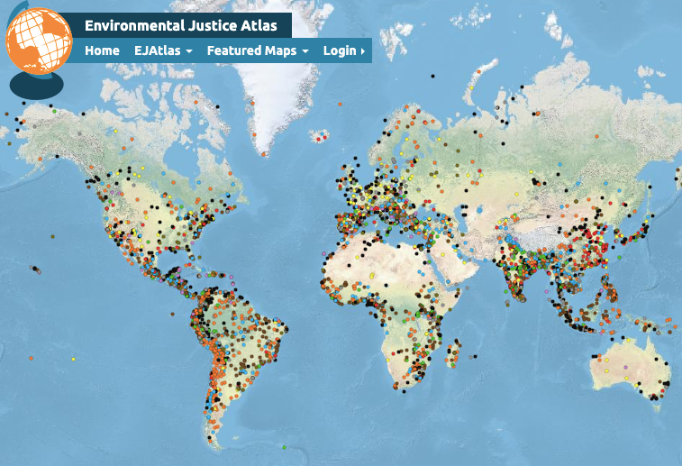
Overview of EJAtlas
What is the EJAtlas?
The EJAtlas is an online platform and tool developed to make visible and systematize contemporary struggles against environmental injustice worldwide—with and for affected groups. EJAtlas documents social, often invisible, conflicts around environmental issues worldwide. Users can explore the page by kinds of issues, country maps, and more.
Learn more about the EJAtlas
Take a few minutes as a class to read about the EJAtlas here.
Map courtesy of EJ Atlas.

Slide 10
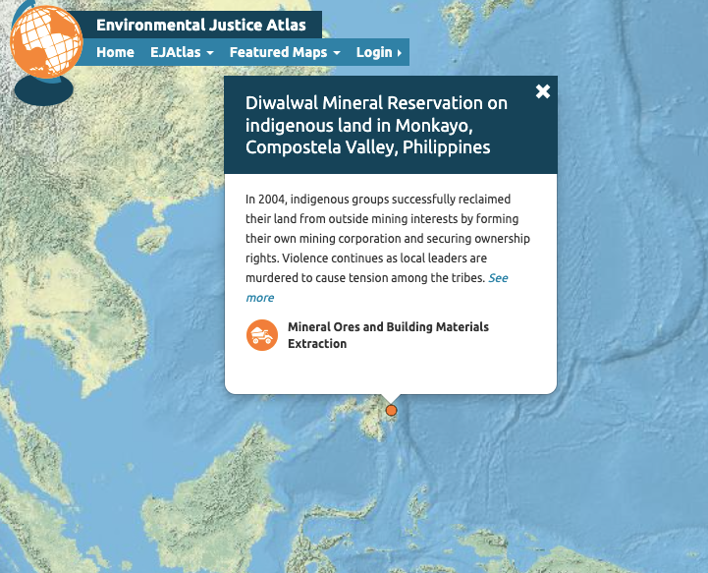
ACTIVITY #3
EXPLORING EJATLAS
Explore
Take 15 minutes to look through the EJAtlas to familiarize yourself with the platform.
Initial guiding questions
  What kinds of case studies does the platform show in the legend?
  Are there any important ones you can think of that aren't on EJAtlas already?
  What trends and patterns do you notice? One trend might be that certain countries see a certain kind of problem more prominently.
  What qualifies as an EJ conflict or not?
Case Study Research
Identify two case studies that involve similar types of conflict—one from a location near your hometown and one from a distant or international setting. Compare and contrast the contexts, causes, and outcomes.
Map courtesy of EJ Atlas.

Slide 11
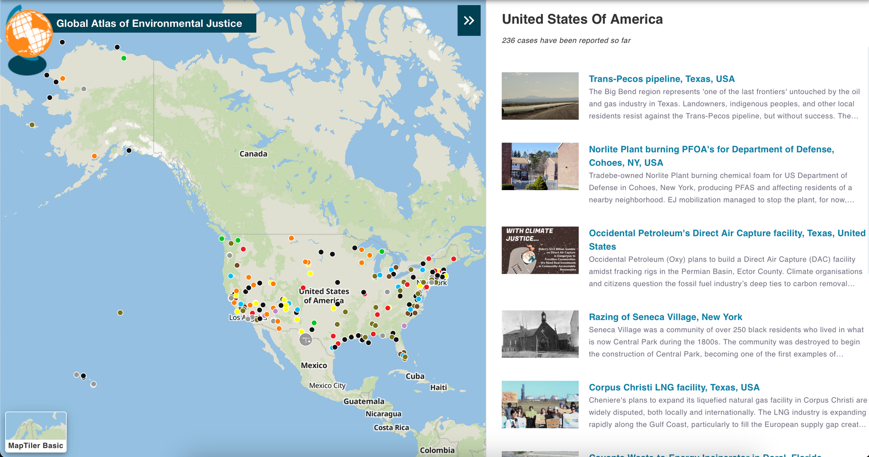
ACTIVITY #4
LEARNING ABOUT AN IMPLICATION OF EJATLAS
Present
To the rest of the class, present:
  Your findings
  At least one case study
  Any trends that you discovered
Group and select a country
Split up into groups of 3, and pick a country to explore more deeply. To filter by country, click on 'Browse Maps' and then 'Country'.
Explore
Take 20-30 minutes to take more detailed look at the case studies that pop up for your country, and see what trends you find across the country.
Map courtesy of EJ Atlas.

Slide 12
ACTIVITY #5
CASE STUDY RESEARCH AND DYAD
Consider
  Why did you choose this case?
  What environmental injustice struggle is happening? Why? What role does power at play in this case?
  What are the potential solutions to this case, what tools from your current course/major of study would be helpful in addressing the problems? Why?
  What aspect of environmental or climate justice did you learn while investigating this case?
Choose a case study
Choose a case study that interests you from around the world. Spend 10 minutes looking through it, looking at news stories from it (under 'Sources and Materials').
Engage in a dyad
Participate in a 2 minute dyad, where in pairs you will each have 2 minutes to talk about your thoughts about these questions. Listeners should not interject, and instead focus on being an active listener.

Slide 13
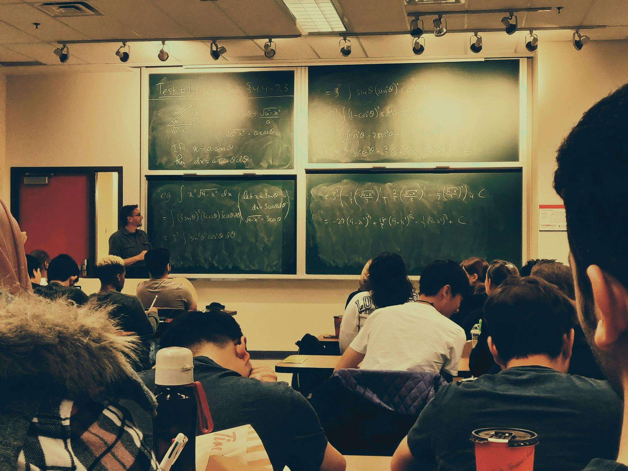
ACTIVITY #6
CLASS DISCUSSION
Discussion Questions
  Why is (or why not) is the EJ Atlas an important tool to address global and environmental issues?
  What suggestions might you have for improving a tool like EJ Atlas?
Photo by Shubham Sharan on Unsplash

Slide 14
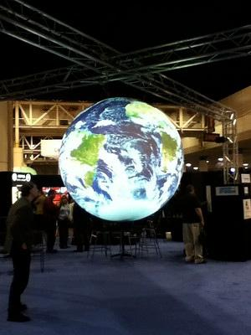
EJScreen
PART 2
Photo courtesy of apbeatty on Flickr. License: CC BY..

Slide 15
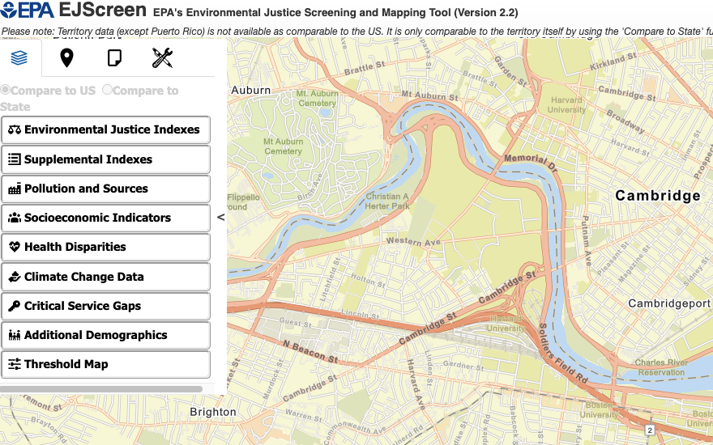
Overview of EJScreen
What is the EJScreen?
EJScreen is an EPA's environmental justice mapping and screening tool that provides EPA with a nationally consistent dataset and approach for combining environmental and demographic socioeconomic indicators.
All of the EJScreen indicators are publicly-available data. EJScreen simply provides a way to display this information and includes a method for combining environmental and demographic indicators into EJ indexes.
How to use EJ Screen
Choose a geographic area and the tool will provide demographic, socioeconomic, and environmental information for that area.
© source unknwown. All rights reserved. This content is excluded from our Creative Commons license. For more information, see https://ocw.mit.edu/help/faq-fair-use/ .

Slide 16
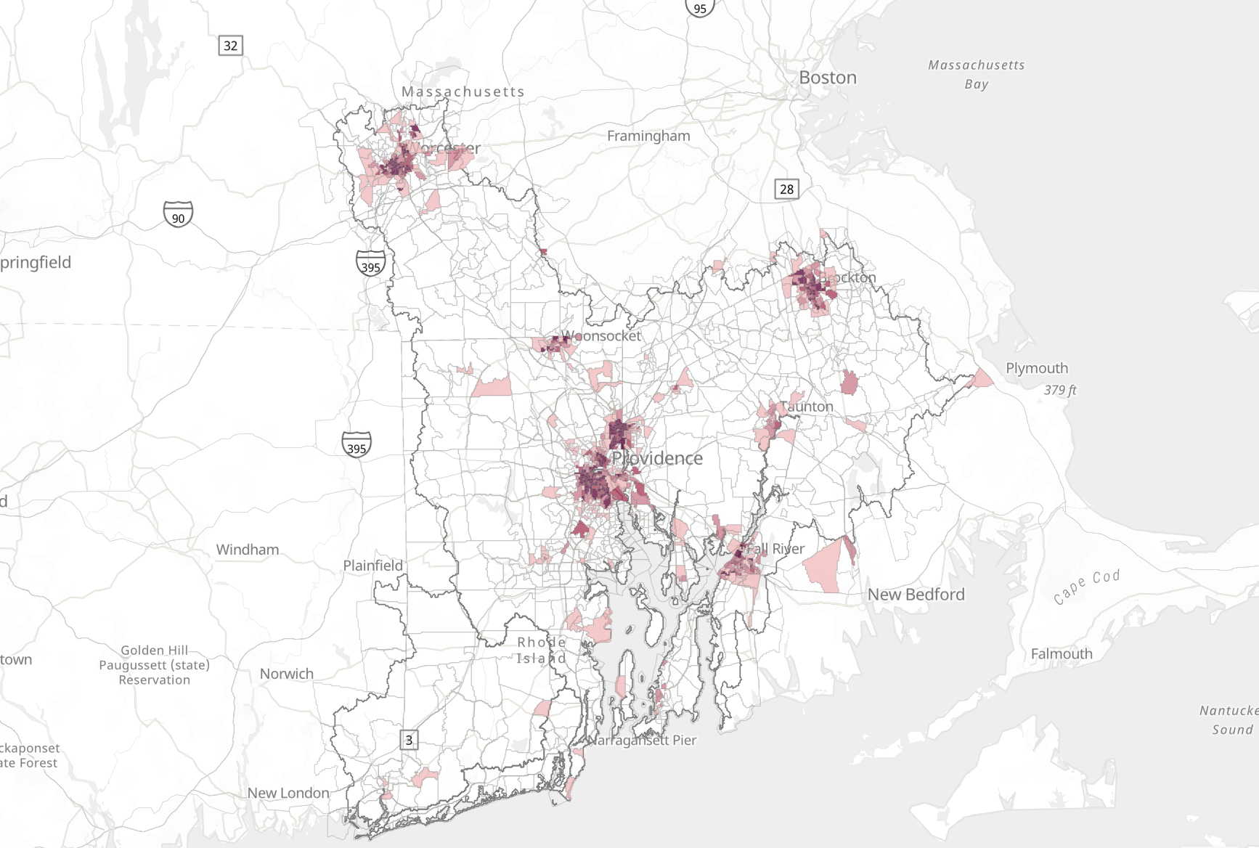
© Narragansett Bay Estuary Program. All rights reserved. This content is excluded from our Creative Commons license. For more information, see https://ocw.mit.edu/help/faq-fair-use/ .
ACTIVITY #7
ACTIVIY #7
EJSCREEN MAPPING IN ACTION
Read
Environmental Justice in the Narragansett Bay Region
Pay attention to the Methods section, which describes how the authors of this article sourced data from EJScreen.
Learn how to use EJScreen
Skim through this EPA website that teaches you how to use EJScreen.

Slide 17
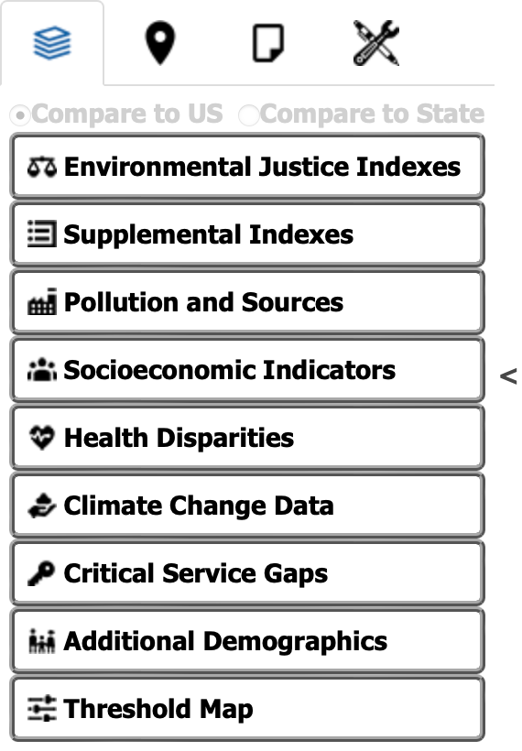
ACTIVITY #8
ACTIITY #7
EXPLORE EJSCREEN TOOLS
Explore EJScreen
Spend 10-15 minutes exploring EJScreen. Try to use as many tools as you can.
Guiding Questions
  What kinds of indexes and subsections does the platform show in the legend?
  Are there any important climate-related ones you can think of that aren't on EJScreen already?
  What are some benefits of using certain types of indexes for certain types of research?

Slide 18
ACTIVITY #9
CASE STUDIES AND CLASS PRESENTATION
Questions to consider for your presentation
  How is this a problem of environmental justice? What resources are being utilised? Who is most affected?
  Trace the problem back—where did the case study you chose originate? Who/what were factors/perpetrators?
  Use other indexes to help! Take a look at schools, prisons, hospitals, in areas around where your study is located, etc, and see what you find (Click on the location icon entitled 'places'). Whatever can help inform your research is great!
Choose a case study
Split up into 3 groups and pick a case to take a deep dive into.
  Superfund Sites in Woburn, Massachusetts
  Air Toxics Cancer Risk in Suffolk County, Massachusetts
  Hazardous Waste in Middlesex County, Massachusetts

Slide 19
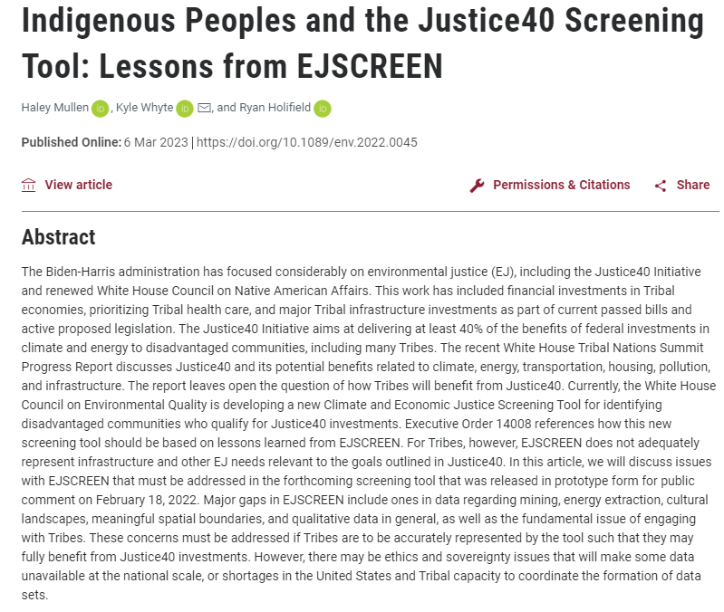
ACTIVITY #10
A CRITIQUE OF EJSCREEN
Reflection questions
  What personal reflections do you have about your research with one of these EJ Mapping Tools?
  Do you feel that you have a better understanding on how EJ mapping works?
  What additional features might EJScreen add that would be beneficial for your research/ future users?
Read
Indigenous Peoples and the Justice40 Screening Tool: Lessons from EJSCREEN
Discuss
  What were the problems highlighted in the article?
  What are the implications of the article?
  What are other ways the EJ Screen may be flawed?
© Sage Publishing. All rights reserved. This content is excluded from our Creative Commons license. For more information, see https://ocw.mit.edu/help/faq-fair-use/ .

Slide 20
Beyond the Module
PART 3

Slide 21
PROJECT OPTION #1
EJAtlas Case Study
Prompt suggestion
On EJAtlas, create your own case study, using resources from MIT—this might include D-lab, research done by MIT professors in the area, or even research you have done in a previous class.
Consider how MIT (or your institution) can do better to mitigate the problem you are researching.

Slide 22

PROJECT OPTION #2
Use EJScreen to Examine Local Issues and Impact
Prompt suggestion
Look at some issues in near MIT (or near your institution). Learn about your institution’s impact on the issue. Make a recommendation for how your institution can advance climate solutions to this issue.
Prepare a short presentation of your findings and share it with the class or write an open letter presenting your ideas for solutions.
© Emily Dahl / MIT News. All rights reserved. This content is excluded from our Creative Commons license. For more information, see https://ocw.mit.edu/help/faq-fair-use/ .

Slide 23
Taking Action
Questions for further thought and/or discussion
  What are the different ways in which EJAtlas and/or EJScreen can help us with understanding problems of Environmental Justice?
  How could these mapping tools relate to/assist your work in your major/ academic discipline?
  How could these mapping tools help us take action at an individual, social or political level?
Personal research
Use EJAtlas and/or EJScreen to explore a research question close to your research interests. It could be a question related to your home, a class that you're in—anything that is relevant and important to you!
"Nature" by _elvin is licensed under CC BY-SA 2.0.

Slide 24
Additional Resources
  ArcGIS: User friendly interactive mapping site
  StoryMaps: Use mapping technology to guide your readers to your favorite places, illustrate trends or even take them on an interactive tour

Slide 25

For more resources on climate and environmental justice: Please explore other modules in the Climate Justice Instructional Toolkit.

Slide 26
Module References
  Bordne, Margot, Clinton, Johnson. “Charles Lee: Environmental Justice Leader Uses Maps to Reveal Injustices”. Esri blog. 2021.
  "Delhi - Urban Air Pollution" by jenspie3 is licensed under CC BY 2.0.
  “Environmental Justice Timeline.” Archive.org, EPA, June 6, 2024, Accessed June 11, 2025.
  “Mapping Ecological Distribution Conflicts: The Ejatlas.” The Extractive Industries and Society, February 23, 2021.
  “Envjustice.” EJAtlas. Accessed August 12, 2023.
  Ejolt. “Ejatlas: Mapping Environmental Justice.” Environmental Justice Atlas. Accessed August 12, 2023.
  "Talking to womens groups about Menstrual Cups" by Sustainable sanitation is licensed under CC BY 2.0.
  “What Is EJScreen?” EPA. Accessed August 12, 2023.
  “Environmental Justice in the Narragansett Bay Region.” ArcGIS StoryMaps, September 14, 2021.
  “Learn to Use EJScreen | US EPA” EPA, July 5, 2024, Accessed June 11, 2025.
  Mullen, Haley, Kyle Whyte, and Ryan Holifield. “Indigenous Peoples and the Justice40 Screening Tool: Lessons from EJSCREEN.” Environmental Justice, 2023.
  "2011 Student Research Fellows" by NWABR is licensed under CC BY 2.0.
  "Nature" by _elvin is licensed under CC BY-SA 2.0.
  "Tracking Drought" by U.S. Geological Survey is marked with Public Domain Mark 1.0.

Slide 27
MIT OpenCourseWare
https://ocw.mit.edu
RES.11-003 Climate Justice Instructional Toolkit Spring 2025
For more information about citing these materials or our Terms of Use, visit https://ocw.mit.edu/terms.

