Slide 1

FOUNDATIONAL MODULE
Introduction to Climate &
Environmental Justice

Slide 2
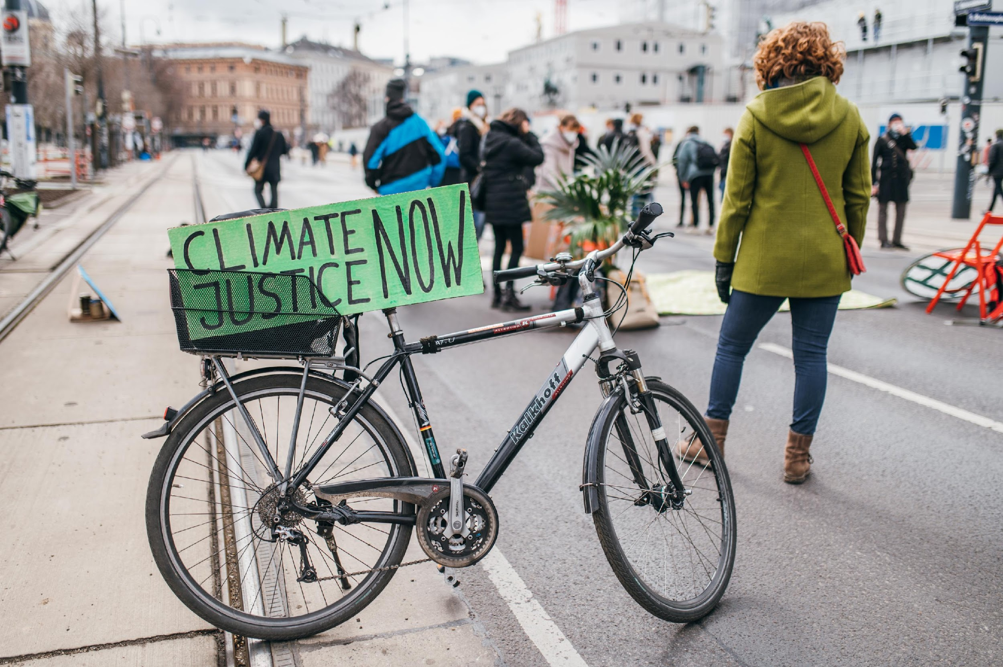
Photo courtesy of Ivan Radic on Wikimedia Commons. License: CC BY.
What’s in this module?
Description
This module is broken into 4 parts. Parts 1 & 2 introduce environmental and climate justice. Part 3 provides 5 case studies from the environmental/climate justice movements . Part 4 provides 4 different project or assignment options. This module could be broken into 3-4 class sessions or it could be used for an entire unit.
Contents
Key Resources
4 parts
2 videos
4 readings
4 activities
4 optional projects
  Environmental Justice (Mohai et al., 2009)
  Climate Inequality: Forgotten History (Martinez & Gupta, 2013)
  A colonized COP: Indigenous exclusion and youth climate justice activism at the United Nations climate change negotiations (Grosse & Mark, 2020)

Slide 3
Learning Objectives
01
02
03
04
Review origins of climate and environmental justice with readings, discussion and lecture
Brainstorm and communicate definitions of climate & environmental justice
Compare, contrast, and critique definitions from both academics and activists
Explore stories & voices from the climate & environmental justice movements

Slide 4
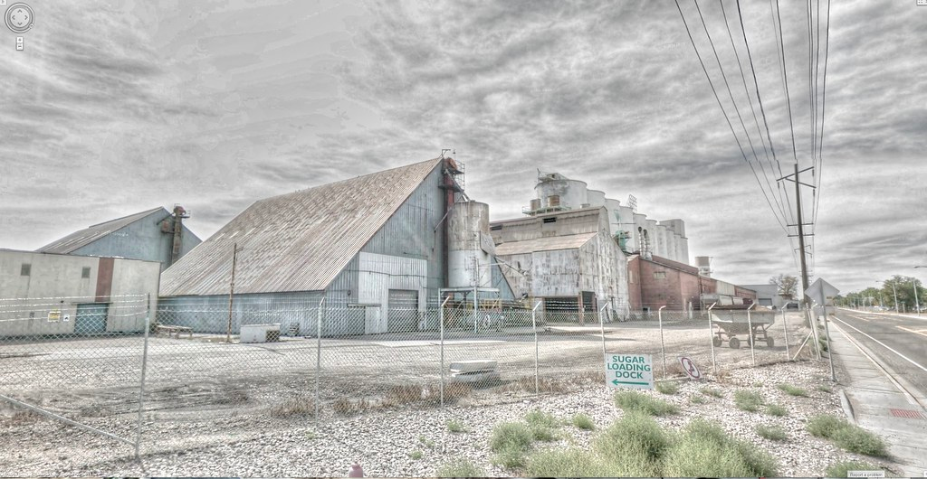
© Google / Kevin Dooley. All rights reserved. This content is excluded from our Creative Commons license. For more information, see https://ocw.mit.edu/help/faq-fair-use/ .
Warm up
How do you define climate and/or environmental justice? What might be the difference between these terms?
Turn to a partner or small group and brainstorm your ideas.

Slide 5
Introduction to Environmental Justice
PART 1

Slide 6
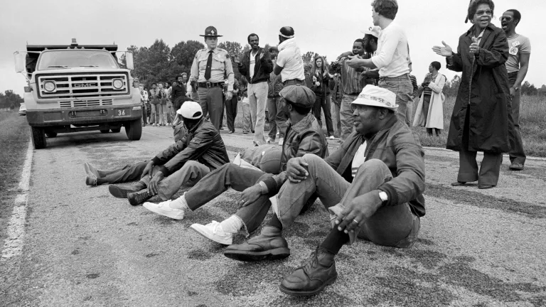
Introduction
The (modern) Environmental Justice (EJ) Movement began in the early 1980s as communities of color protested the inequitable distribution of toxins in their communities.
This led to two landmark reports
  Siting of Hazardous Waste Landfills and Their Correlation with Racial and Economic Status of Surrounding Communities (General Accounting Office, 1983)
  Toxic Waste in the United States (United Church of Christ, 1987)
    This report coined the term "environmental racism"
© Ricky Stilley/Henderson Dispatch. All rights reserved. This content is excluded from our Creative Commons license. For more information, see https://ocw.mit.edu/help/faq-fair-use/ .
The impact of the reports
These two reports led to the establishment of The Field of Environmental Justice and the creation of the U.S. Environmental Protection Agency (EPA)’s National Environmental Justice Advisory Council
For more see the EPA EJ Timeline

Slide 7
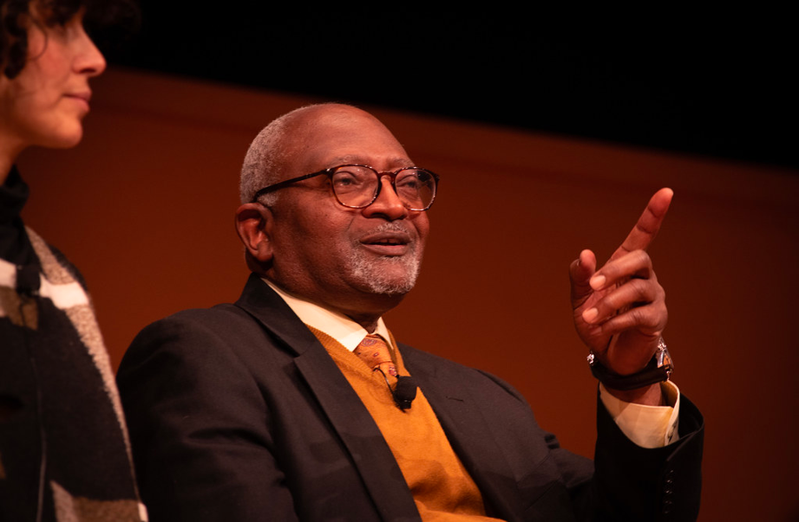
Early EJ Definitions
The EPA and Robert Bullard (a founder of EJ studies), originally defined EJ as the right to a safe and healthy environment for all.
Robert Bullard
“All people and communities are entitled to equal protection of environmental and public health laws and regulations.”
EPA
“The fair treatment and meaningful involvement of all people regardless of race, color, national origin, or income with respect to the development, implementation, and enforcement of environmental laws, regulations, and policies. Fair treatment means that no population, due to policy or economic disempowerment, is forced to bear a disproportionate share of the negative human health or environmental impacts of pollution or environmental consequences resulting from industrial, municipal, and commercial operations or the execution of federal, state, local and tribal programs and policies”
Photo courtesy of UM-SEAS on Flickr. License: CC BY.
For much more on the history of the field of EJ, please see Mohai et al., 2009.

Slide 8
ACTIVITY #1
NARRATIVES OF THE EJ MOVEMENT: ACADEMIC AND ACTIVIST
Post-reading discussion questions
  For Yeampierre and Taylor, what are the roots of the environmental justice movement?
  What are some specific examples they give?
  How are the roots intertwined with history of systemic racism and discrimination in the U.S.?
  How do their personal experiences connect to environmental justice issues?
  What are their arguments for the future of environmental justice both for environmental organizations and for future government policy?
  What other insight do these articles give you about the environmental justice movement, both from an academic and activist perspective?
  How do these activists and scholars define environmental justice?
  Which perspective stood out to you more? Why?
Read and analyze
  The future of environmental justice is true equality
  This environmental justice activist breaks down deep ties between racism and climate change
Before reading
  What are the origins of the EJ movement dating before the early 1980's?
  How are environmentalism and racism connected?

Slide 9
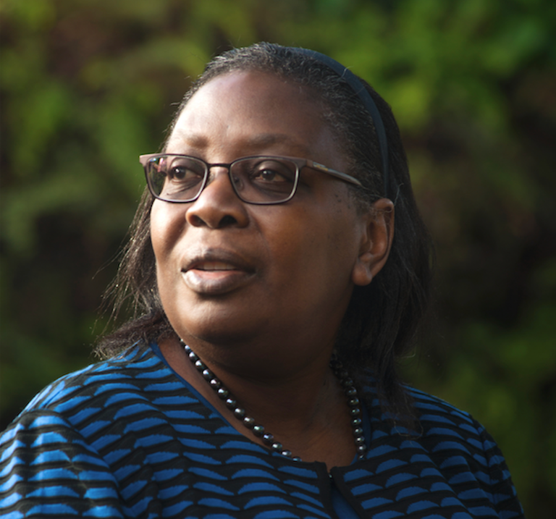
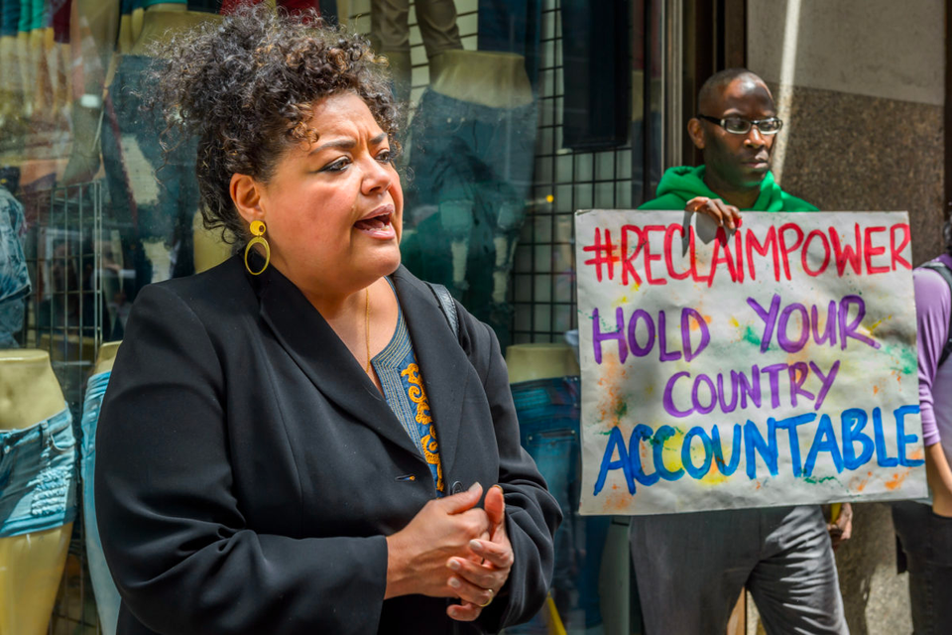
ACTIVITY #1
Left: © Matthei / Dr. Dorceta Taylor. Right: © Erik McGregor/Pacific Press/LightRocket via Getty Images. All rights reserved. This content is excluded from our Creative Commons license. For more information, see https://ocw.mit.edu/help/faq-fair-use/ .
NARRATIVES OF THE EJ MOVEMENT: ACADEMIC AND ACTIVIST
Learn more about the authors
  Elizabeth Yampierre is a internationally recognized Puerto Rican attorney and environmental and climate justice leader of African and Indigenous ancestry born and raised in New York City.
  Dorceta E. Taylor is an American environmental sociologist known for her work on both environmental justice and racism in the environmental movement.
Dorceta E. Taylor
Elizabeth Yeampierre
Author of: The future of environmental justice is true equality
Author of: This environmental justice activist breaks down deep ties between racism and climate change

Slide 10
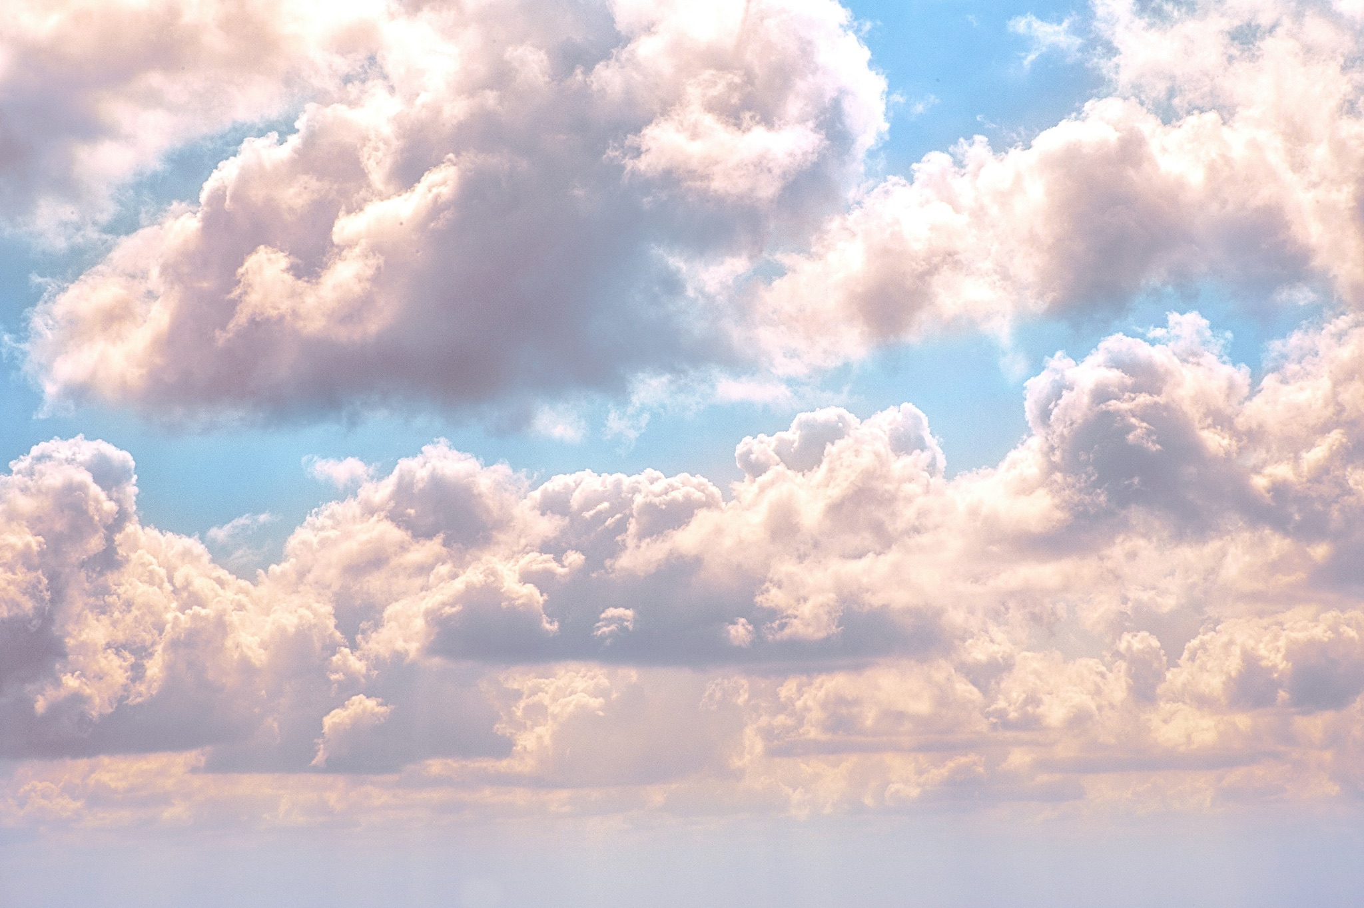
ACTIVITY #1
NARRATIVES OF THE EJ MOVEMENT: ACADEMIC AND ACTIVIST
Reflection and Critique
  Do the EJ definitions we have seen or read miss anything or anyone?
  What critiques or questions do you have so far?
  How do these readings compare and contrast with your own knowledge of EJ?
Photo by Billy Huynh on Unsplash

Slide 11
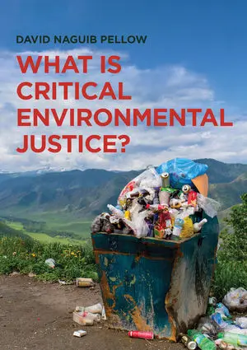
© David Naguib Pellow. All rights reserved. This content is excluded from our Creative Commons license. For more information, see https://ocw.mit.edu/help/faq-fair-use/ .
Evolution of EJ Definitions
More recent definitions of EJ have evolved to take on a more critical stance.
David Pellow’s Four Pillars of Critical Environmental Justice
  Emphasis on the intersectionality of multiple inequalities and axes of oppression—including domination of nonhuman species—rather than on single categories of difference
  Attention to multiple spatial and temporal scales of environmental justice problems and solutions
  A focus on state power as reinforcing and reproducing deeply embedded social inequalities
  Recognition of the indispensability of marginalized populations and species that are often treated as expendable
What is Critical Environmental Justice (Pellow, 2017)

Slide 12
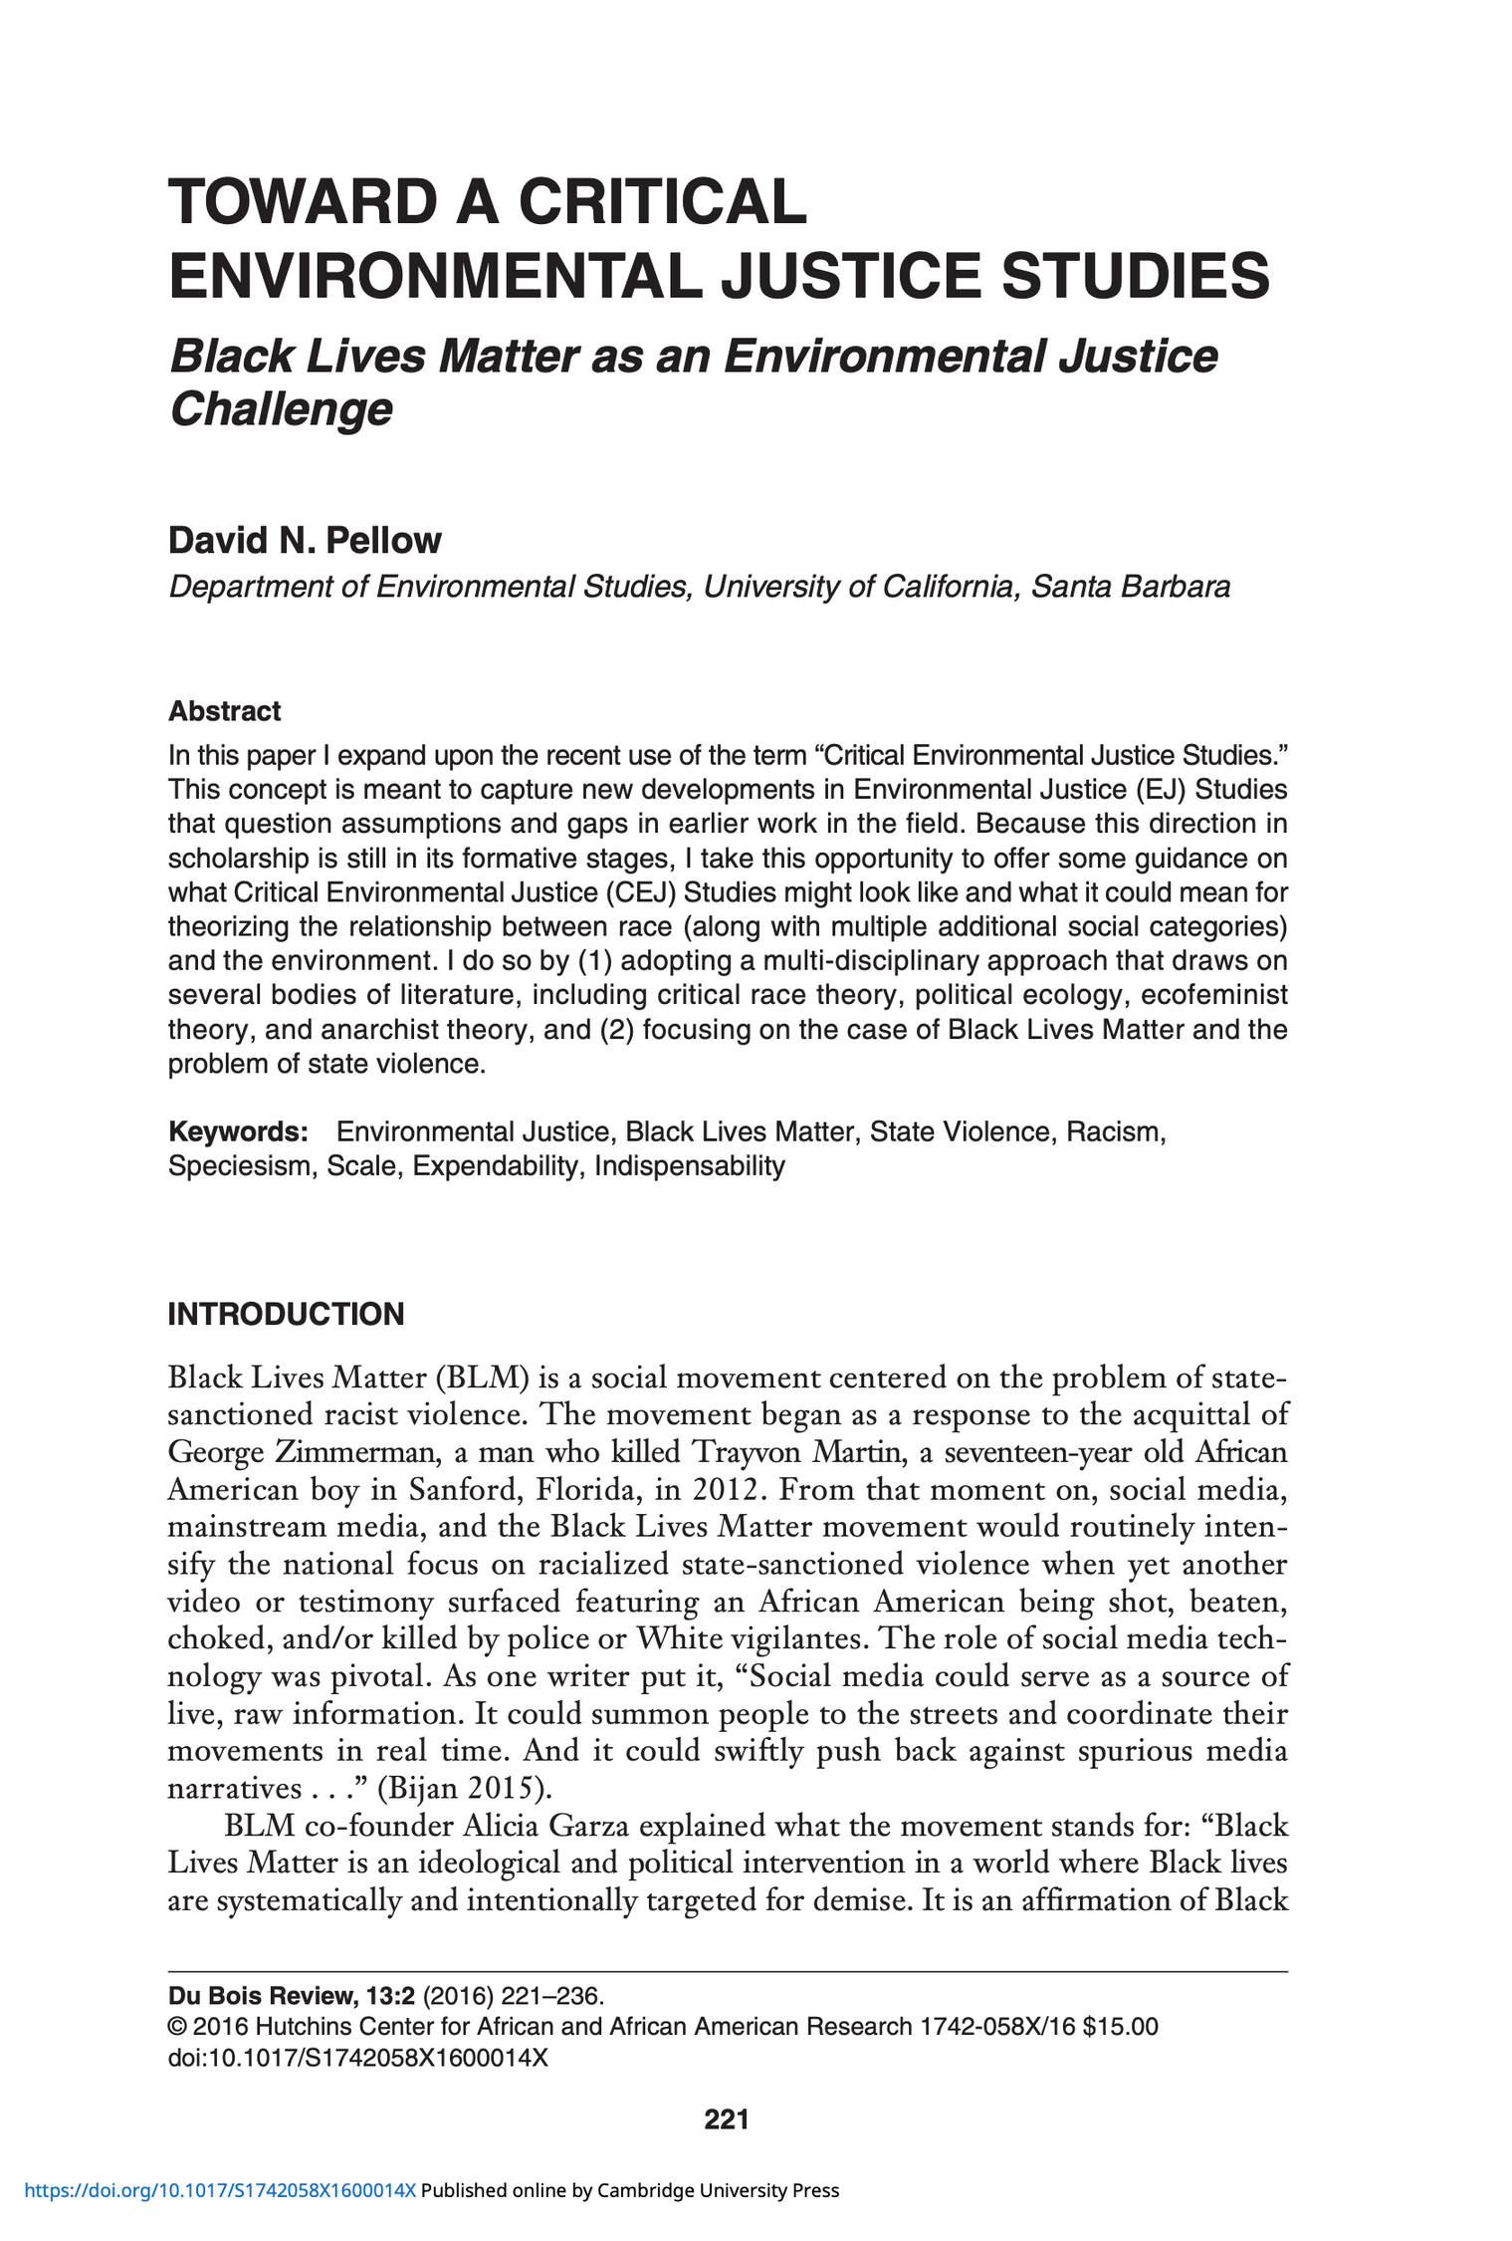
Further Reading
Toward a Critical Environmental Justice Studies: Black Lives Matter as an Environmental Justice Challenge (Pellow, 2016)
Questions to consider after reading:
  What theoretical perspectives does Pellow rely on to conceptualize “critical” environmental justice? Why?
  How does EJ relate to the Black Lives Matter Movement?
  What is the difference between 1st generation EJ studies and 2nd generation?
  How does critical EJ studies take into account more “social categories of difference”? How does the concept of intersectionality help describe this?
  What are your reflections and analysis on the four pillars of critical EJ?

Slide 13
Introduction to Climate Justice
PART 2

Slide 14
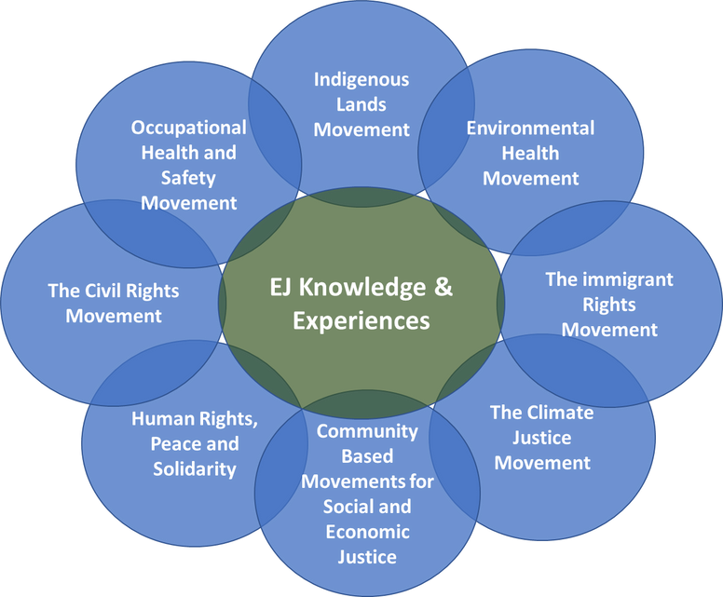
A Coalescence of Movements
Structure of the EJ Movement
The EJ Movement evolved with a coalescence of various movements happening simultaneously, both at the U.S. level and globally including different groups, perspectives and issues.
Evolution of the Climate Justice Movement
The Climate Justice Movement was one of many, overlapping movements that sought to broadly understand the injustices of climate change on the world’s most vulnerable populations at both local and global levels, which involved a wealth of topics including energy, human rights, food, indigenous rights, trade, technology and more.

Slide 15
A Coalescence of Movements
Food Justice
Energy Justice
The Just Transition
Impact
The Field of Environmental Justice
These movements led to the field of EJ studies with various sub areas which continues to grow and expand in both depth and breadth.
Global/ Climate Justice
Housing Justice
Indigenous Climate Justice

Slide 16
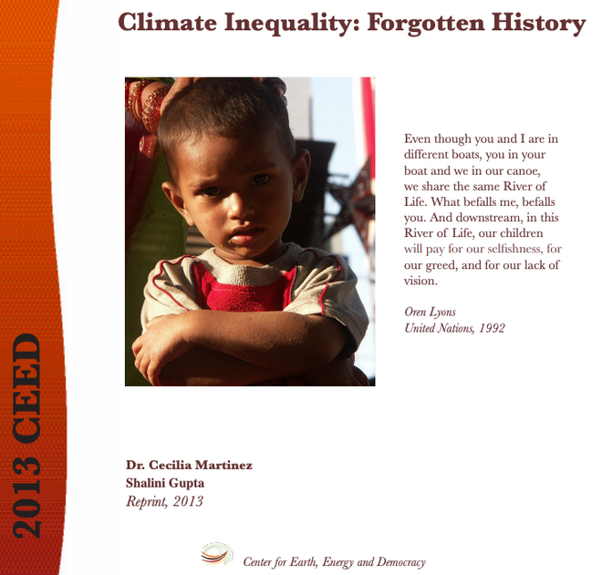
ACTIVITY #2
NARRATIVES OF THE EJ MOVEMENT: ACADEMIC AND ACTIVIST
Post-reading discussion questions:
  How does this historical piece define climate justice?
  What aspects of history are critical when defining or understanding climate justice? Why?
Read and define
To build foundational knowledge, read Climate Inequality: Forgotten History, which describes the historical nature of climate change, which was rooted in inequality and injustice.
© Center for Earth, Energy, and Democracy. All rights reserved. This content is excluded from our Creative Commons license. For more information, see https://ocw.mit.edu/help/faq-fair-use/ .

Slide 17
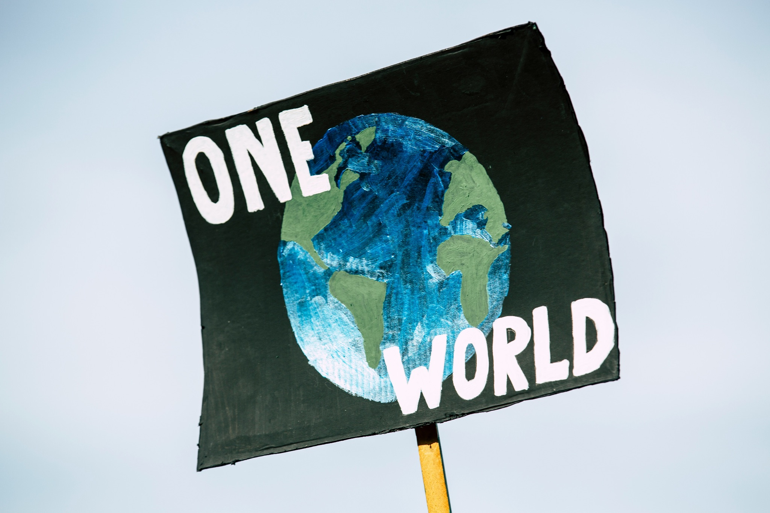
Further Reading
Want to see other definitions of climate justice? Here’s some optional reading for more context:
  What is ‘climate justice’? (Yale Climate Connections)
  Climate Justice Explainer (MIT Climate Portal)
Photo by Markus Spiske on Unsplash

Slide 18
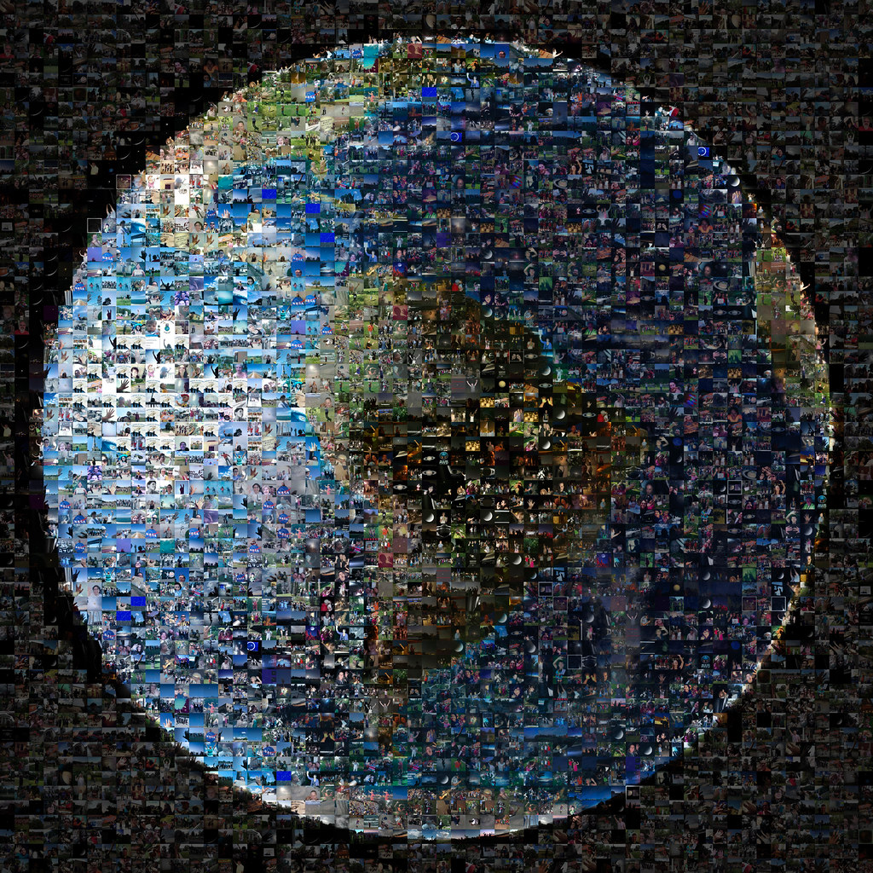
This image is in the public domain.
Specific CJ Definitions
Lisa Sun-Hee Park and David Pellow
“Climate justice begins with an acknowledgement of climate injustice and views this problem not as an unfortunate byproduct of climate disruption, but as one of its core elements, and one that must be confronted if climate disruption is to be reversed.” See more here.
Corrie Gross and Brigid Mark
“The atmosphere is an ecological commons. Climate justice demands that this commons not be enclosed by a handful of polluters. Climate justice also demands that people be compensated for the impact of climate chaos caused by the actions of others. But above all, climate justice demands that every person, every community, every society have the freedom to create and defend economies that cause no harm to the climate or to other people.” See more here.

Slide 19
Specific CJ Definitions
Climate debt is two-fold.
EMISSIONS DEBT
“...amassed by rich countries from their excessive consumption of the limited atmospheric space: they have left almost no space for developing countries to increase their greenhouse gas emissions if climate change is to be contained.”
ADAPTATION DEBT
“...through their emissions, rich countries have disproportionately contributed to the impacts of climate change being felt by developing countries.”
CJ and Climate Debt
“The climate justice movement builds on grassroots traditions often led by black, Indigenous, and people of colour resisting legacies of colonialism and enslavement and focuses on climate debt as a key organizing arena.” (Gross & Mark, 2020)
“These are central values and goals of the climate justice movement. Addressing this debt requires a restorative approach: ‘the environmental space of the developing countries must be returned, decolonized.’”

Slide 20
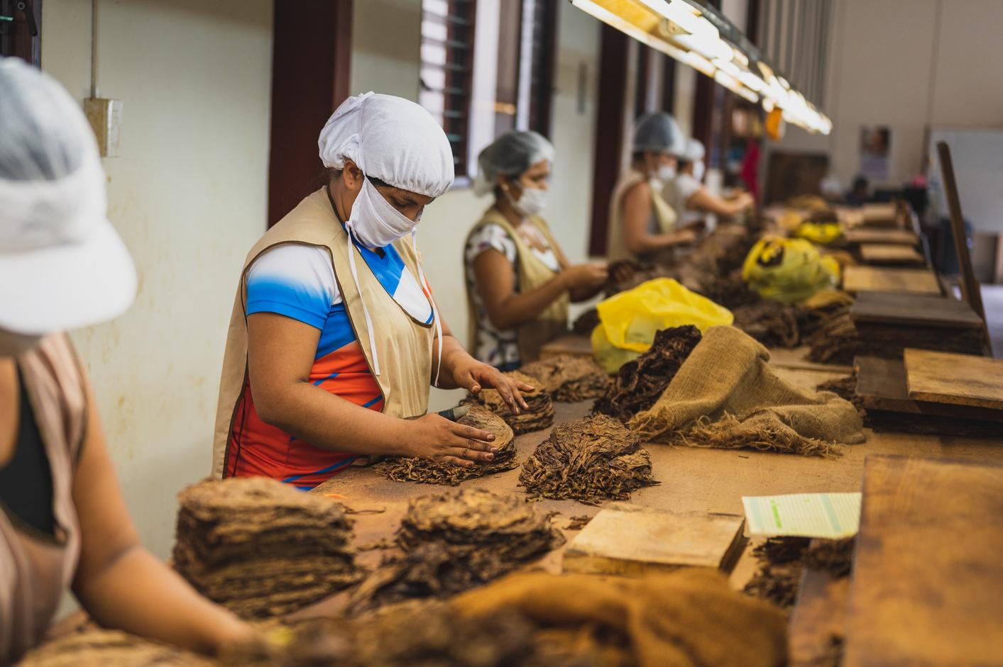
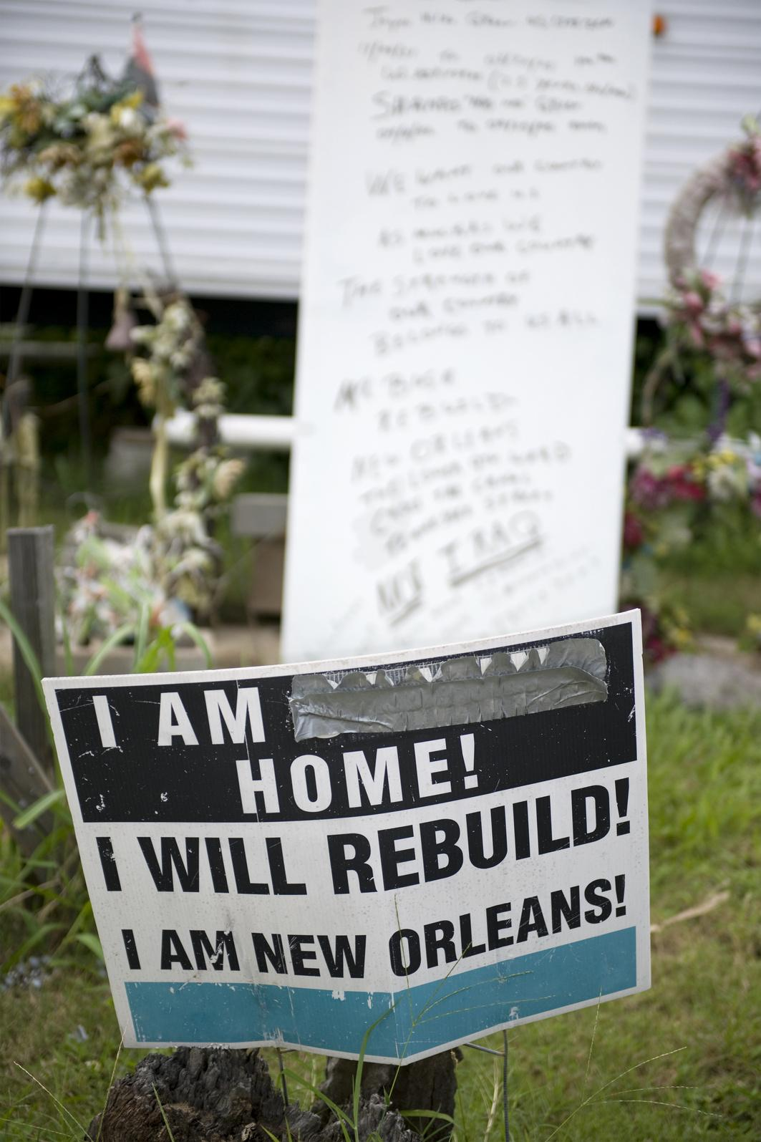
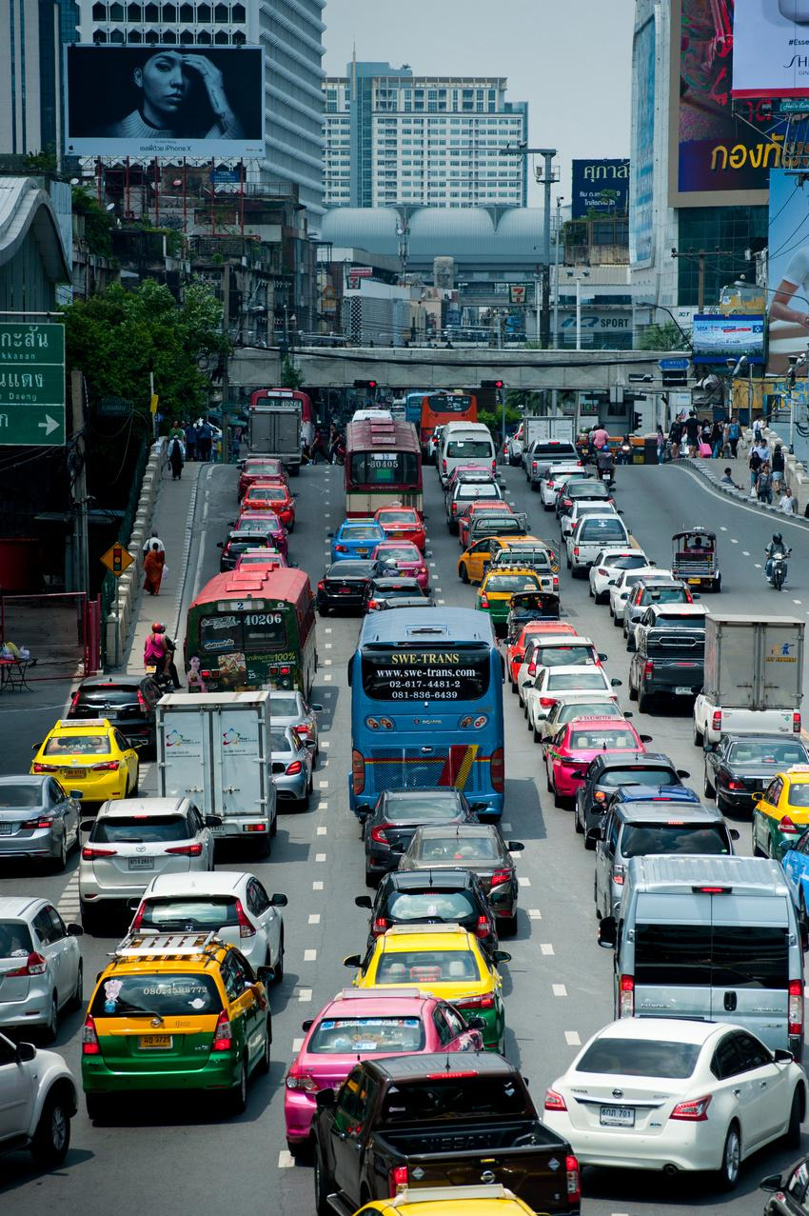
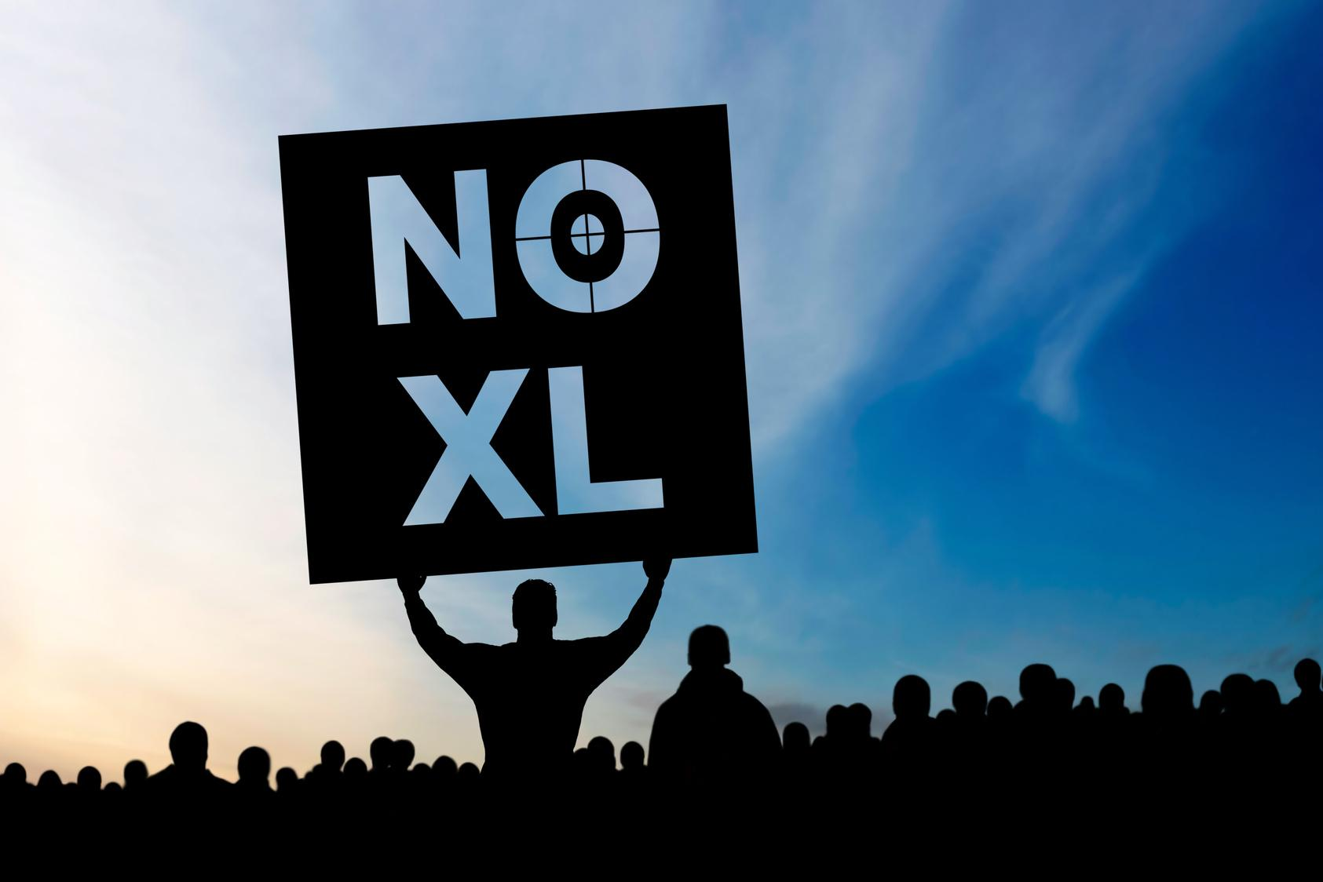
Top left: © Thibault Luycx; top right © Eric Isselee / Shutterstock; bottom right: © istockphoto.com / sharply done. All rights reserved. This content is excluded from our Creative Commons license. For more information, see https://ocw.mit.edu/help/faq-fair-use/ . Top right: photo courtesy of UNEP. License: CC BY.
ACTIVITY #3
BRAINSTORM AND SHARE OUT LOCAL CJ ISSUES
What is an example of a climate justice issue in your city, country, or region?
What are the causes of these issues? How do they intersect with social issues?
Are you interested or involved in any of these issues?

Slide 21
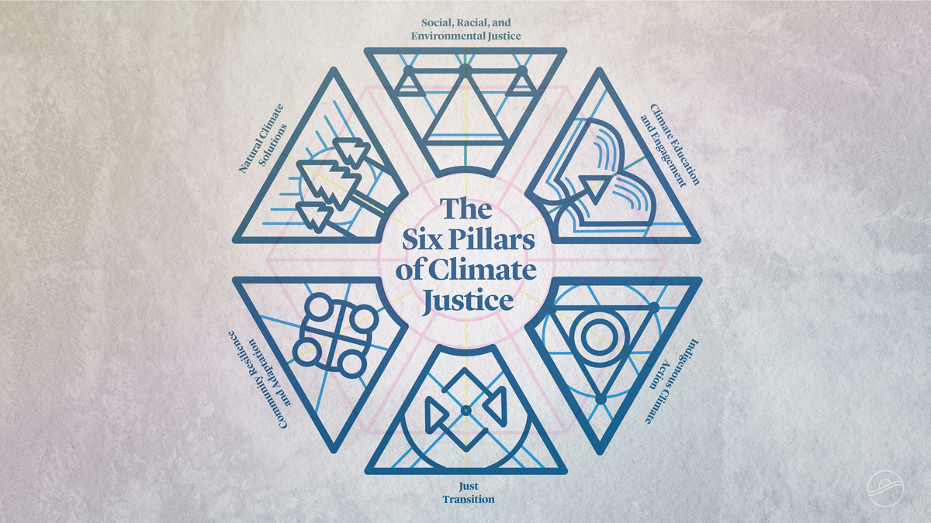
ACTIVITY #4
A DEEP DIVE ON THE 6 PILLARS OF CLIMATE JUSTICE
Choose and Review
Choose one of the Six Pillars of Climate Justice from the UCAL Center for Climate Justice, and review the text and video individually or in groups.
Present
  How would you explain this pillar in a few sentences?
  How does this pillar advance climate justice and for whom?
  Can you provide 1-2 examples that are given in this pillar?
  Do you see this pillar being sufficiently enacted where you live or where you are from?
  What critique do you of this pillar if any? Why?
© Center for Climate Justice, University of California. All rights reserved. This content is excluded from our Creative Commons license. For more information, see https://ocw.mit.edu/help/faq-fair-use/ .

Slide 22
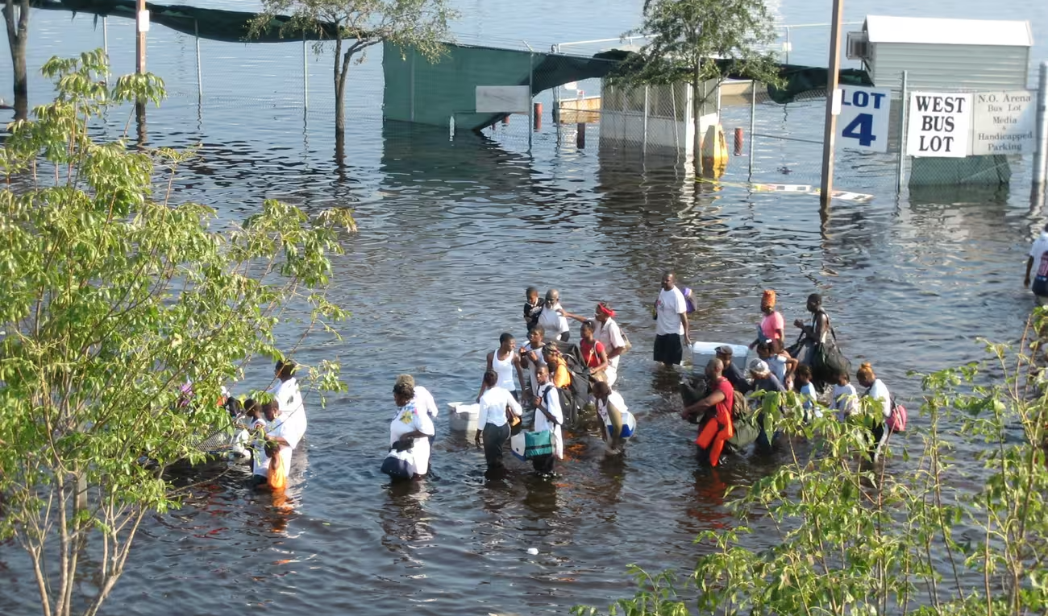
ACTIVITY #5
WHY IS CLIMATE CHANGE AN ENVIRONMENTAL JUSTICE ISSUE?
Before Reading
  How are climate change and environmental justice connected?
  How are communities of color often more affected by climate change?
  What are some other examples of environmental justice?
  What are some steps needed to achieve Environmental Justice?
  Which ones most resonate with you?
  What examples of EJ have you experienced or learned more about through your communities?
Read and analyze
“Why Climate Change is an Environmental Justice Issue”
Post-reading discussion question
After reviewing definitions and reading these articles, what are some tools and strategies for addressing climate justice issues?
Hurricane Katrina 2005 (Photo: News Muse)

Slide 23
Important Principles for Climate Justice
01
02
03
04
Equity in distributing the burdens and sharing the benefits of climate change in communities and among nations
Social and political processes that recognize currently or previously marginalized groups as rightful participants in the governance and management of climate change
Freedom of peoples to make choices that maximize their capabilities to survive now and in the future
Rebuilding damaged historical relationships between parties, correcting past wrongs against humanity, and restoring the Earth
For more, see Climate Justice and Inequality (Harlan et al., 2015)

Slide 24
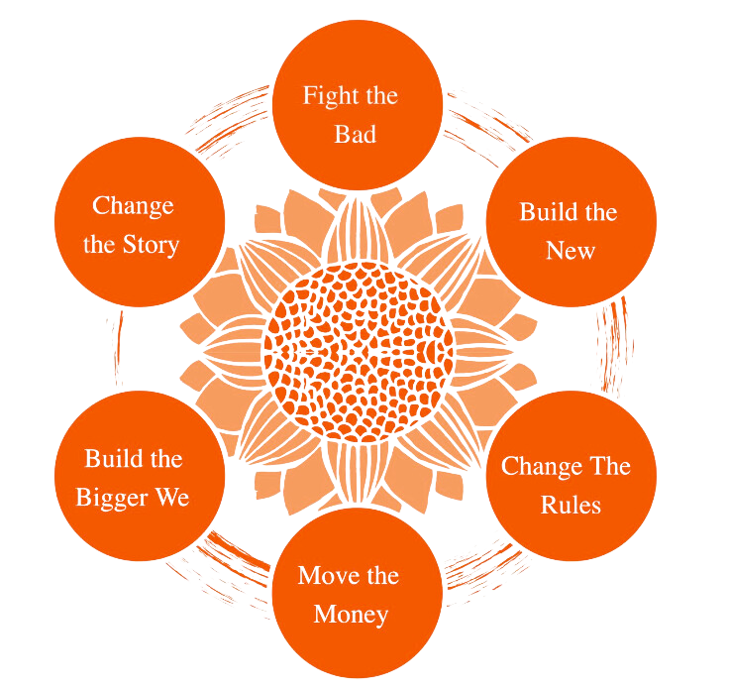
© Climate Justice Alliance. All rights reserved. This content is excluded from our Creative Commons license. For more information, see https://ocw.mit.edu/help/faq-fair-use/ .
The Climate Justice Alliance
Questions
  How does this framework for action compare to the previous slide? What’s missing?
  What would be your role as a student or young professional?
  As you read more about climate justice activists, how do they implement some of these steps?
See the CJA’s website to learn how they organize climate justice systemic change, depicted in the graphic above.
For more, see the Global Center for Climate Justice website

Slide 25
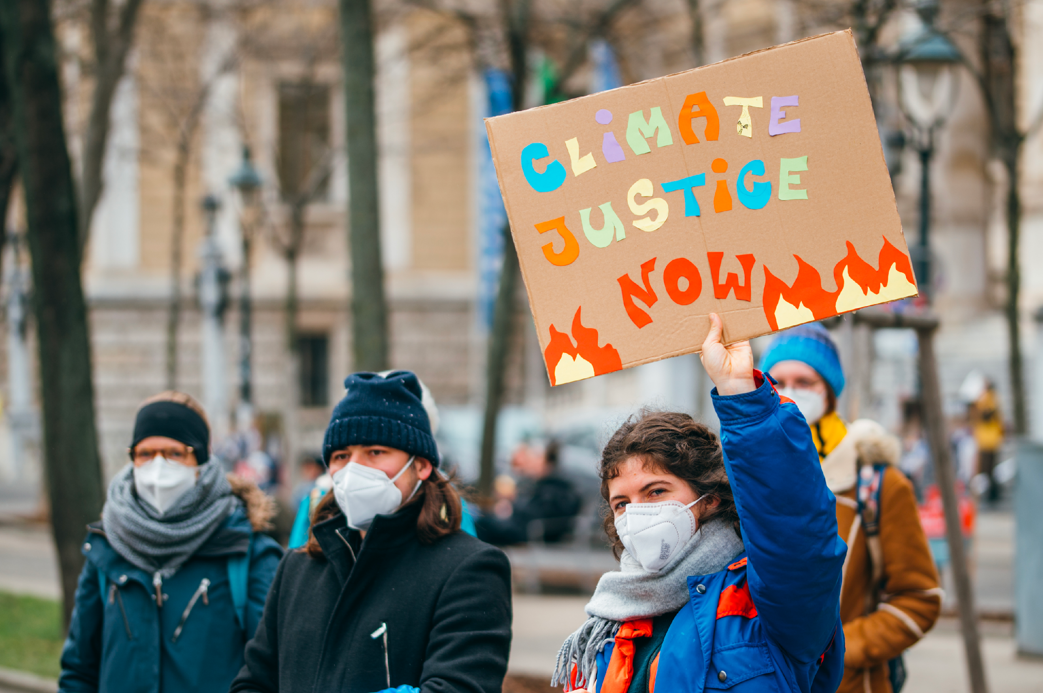
Photo courtesy of Ivan Radic on Flickr. License: CC BY.
Explore Stories from the CJ & EJ Movements
PART 3
Project Option: Students break into groups and research one of these stories or find their own to present to the class

Slide 26
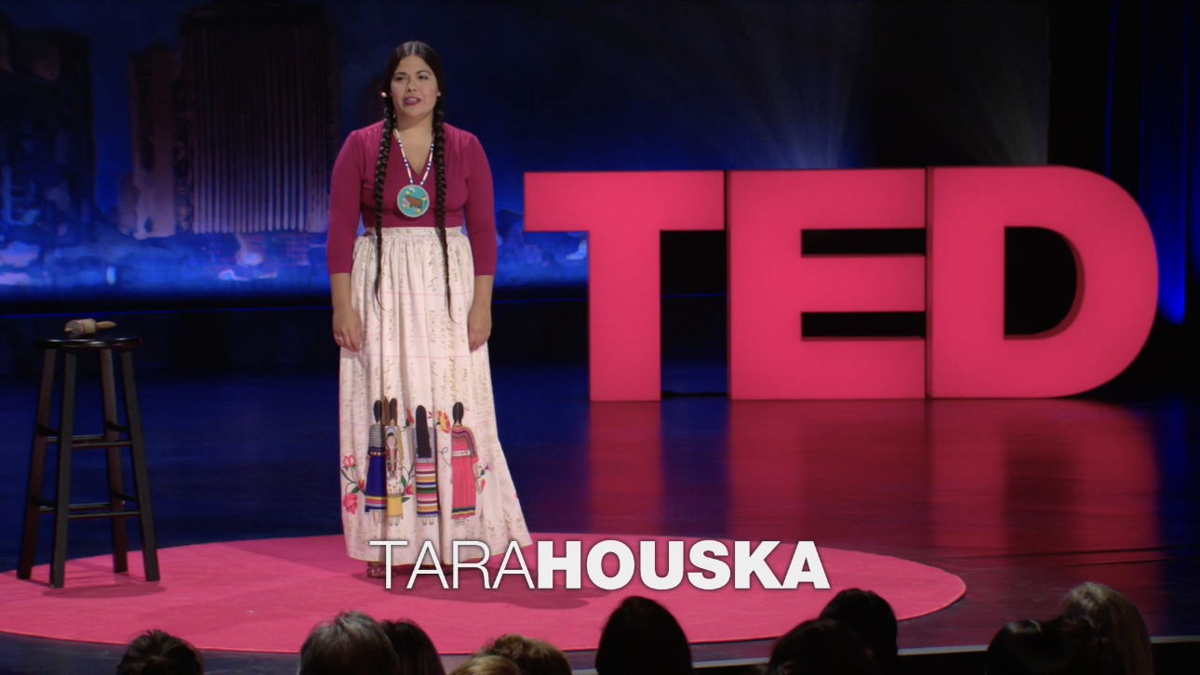
ACTIVITY #6
TARA HOUSKA AND INDIGENOUS RIGHTS
Questions for Exploration
  What did you learn about Indigenous history that is important for the EJ movement?
  What does Houska say about how Indigenous people’s are impacted by climate change?
  What are the costs of pipeline constructions?
  According to Houska, why was Standing Rock important? What did she learn in her experiences there and at other pipelines?
  What can we (you) do to help engage in this issue?
Watch
The Standing Rock Resistance and Our Fight for Indigenous Rights
More Resources
  The Dakota Access Pipeline, Environmental Injustice, and U.S. Colonialism (Whyte, 2017)
  Indigenous Climate Action module
  The Standing Rock Resistance Is Unprecedented (Donnella, 2016)

Slide 27
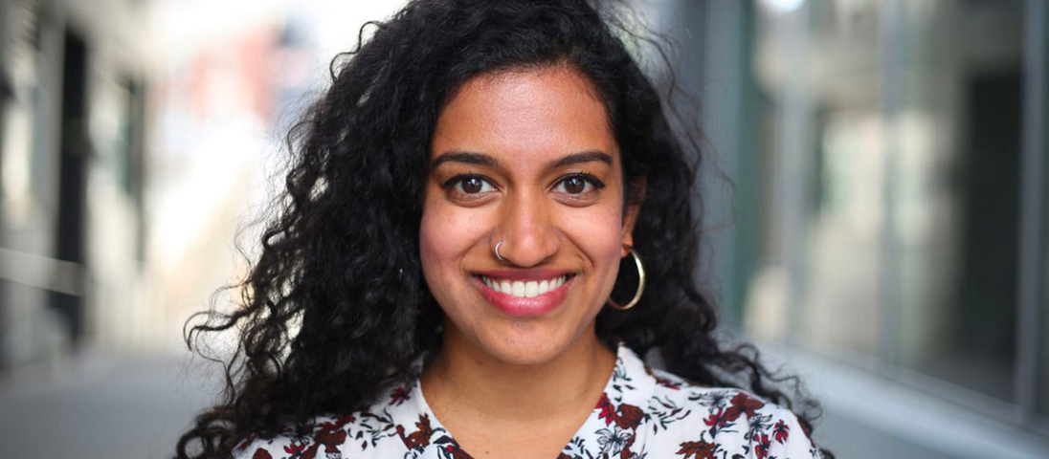

ACTIVITY #7
TWO FOUNDERS OF THE SUNRISE MOVEMENT
Questions for Exploration
  What led them to their climate activism work?
  What insights can be gained by the four lessons Prakash has learned from youth movements?
  What role does “organizing” play in the climate justice movement according to Jaye?
Read
  Varshini Prakash on Redefining What's Possible
  Dyanna Jaye: Bringing the urgency of organizing to climate policy
Left: © Varshini Prakash. Right: Jaypix Belmer. All rights reserved. This content is excluded from our Creative Commons license. For more information, see https://ocw.mit.edu/help/faq-fair-use/ .
More Resources
  The Sunrise Movement website
  Climate Justice Policy module
  The Just Transition module
Varshini Prakash
Dyanna Jaye

Slide 28
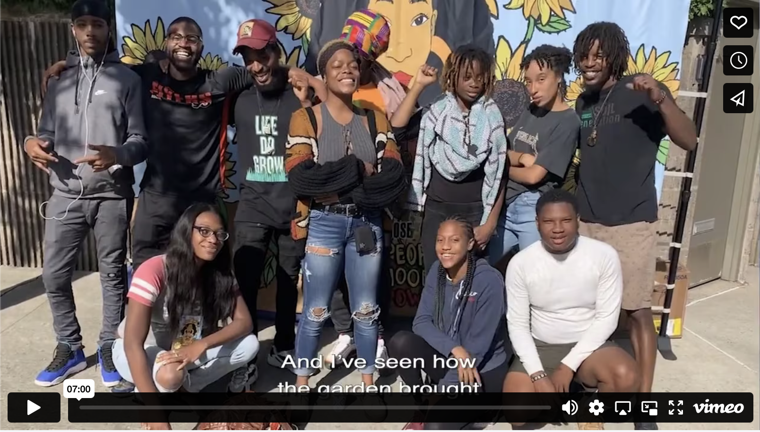
ACTIVITY #8
YOUTH ORGANIZERS FOR CLIMATE JUSTICE: The Climate Justice Alliance
Questions for Exploration
  How does youth organizing around the country alter your views on climate justice action?
  What quotes from the different youth leaders stand out to you?
  What is needed from policy or education to better support these youth leaders and their organizations?
Watch
Front Line Youth: Fighting for Climate Justice
Review
  The bios of the youth leaders featured in the video
  The Instagram takeover that several youth influencers led

Slide 29
ACTIVITY #9
EQUITABLE & JUST NATIONAL CLIMATE PLATFORM: STORIES FROM THE MOVEMENT
Questions for Exploration
  What are the specific strategies, or tools that these different communities use to take action and create change?
  What are the similarities and differences between stories?
  What insights can be taken from all of these stories about how communities can rise up and confront environmental/climate injustices?
Explore Three Stories
  A Community’s Stand Against Pollution in Newark
  A community’s fight against environmental racism in Savannah
  No Community Left Behind: Mossville, Louisiana
More Resources
Equitable & Just National Climate Platform

Slide 30
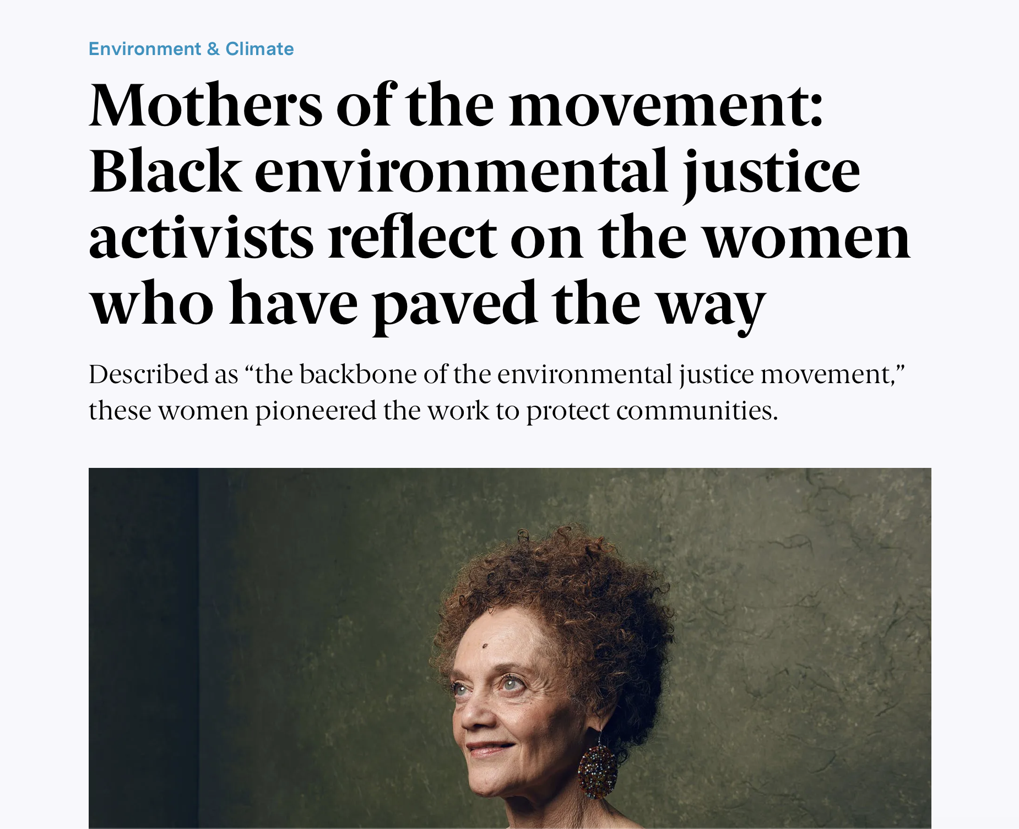
ACTIVITY #10
MOTHERS OF THE MOVEMENT
Read
Mothers of the movement: Black environmental justice activists reflect on the women who have paved the way (Henry & Kutz, 2023)
Questions for Exploration
  What are some common threads among these activist women and the issues they were involved in?
  What issues did they help uncover?
  What traits do they have - similar and different - that helped them lead successful climate and environmental action?

Slide 31
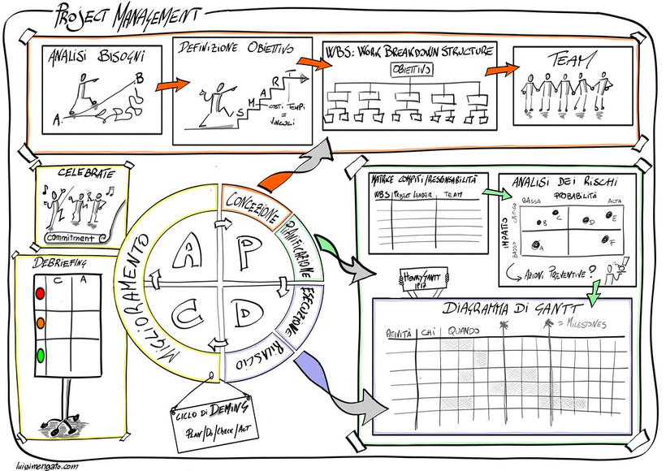
Beyond the Module
PART 4
"sketchnote project management" courtesy of Luigi Mengato on Flickr. License: CC BY.
Note: During these projects, students can be encouraged to connect their major, coursework, or research focus to climate justice issues

Slide 32

Photo by Markus Winkler on Unsplash
PROJECT OPTION #1
Essay on Creating Climate/Environmental Justice Definitions
Prompt suggestion
How do you define climate or environmental justice? How does your definition connect to your work or lived experiences?
  What is the main differences/similarities between the definitions we have reviewed?
  What is the difference between environmental and climate justice?
  What is missing in these definitions? What would you like to add?
  How have definitions evolved over time?
"British Money and magnify glass" by Images_of_Money is licensed under CC BY 2.0.

Slide 33
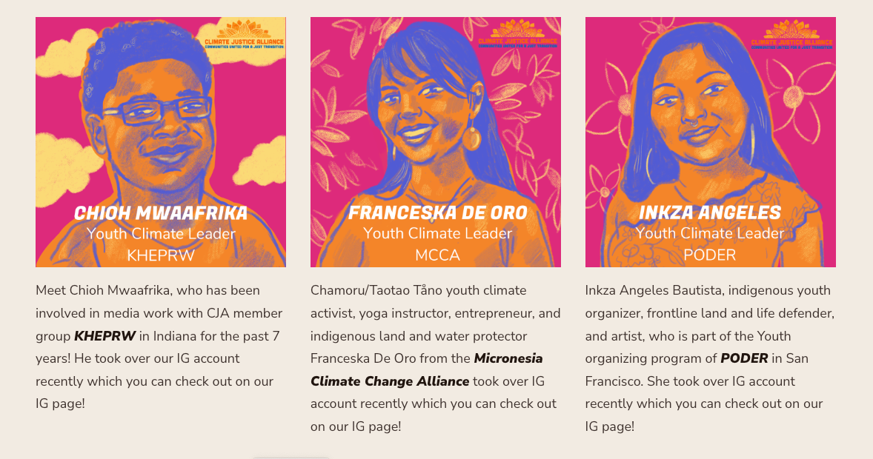
PROJECT OPTION #2
Climate Justice Youth Activist Profiles
Prompt suggestions
  Choose a CJA youth activist and research their work to present to the class. What aspects of their work make them successful? What could be learned to share or replicate in other contexts?
  Choose a CJA youth activist and do research on the their Instagram takeover. Present their work and create your own instagram story regarding a personal or community environmental issue you are passionate about.
  Research and choose an EJ or CJ activist from anywhere around the world that speaks to you, and develop a presentation or paper related to their work.
© Climate Justice Alliance. All rights reserved. This content is excluded from our Creative Commons license. For more information, see https://ocw.mit.edu/help/faq-fair-use/ .

Slide 34
PROJECT OPTION #3
Community Engagement
Prompt suggestion
Guiding Questions
This project has several options, as long as students engage with community in working towards addressing a climate or environmental justice issue. Students can share or reflect on this project either in writing or presentation form.
  What are the opportunities and limitations that community organizations face in response to EJ/CJ issues?
  How can universities/educational institutions better listen to or support community orgs.?
  How can this expereince help you critique academic concepts or theories? Do they function in real-world contexts?
Option 1
Volunteer or engage in activities with a particular community organization. This may include attending meetings, or providing labor (whether physical, digital, scholarly, etc.).
Option 2
Students can launch their own community initiative. Examples include a petition drive, a letter writing campaign, a social media project, or a new campus student group that interacts with the local community.

Slide 35
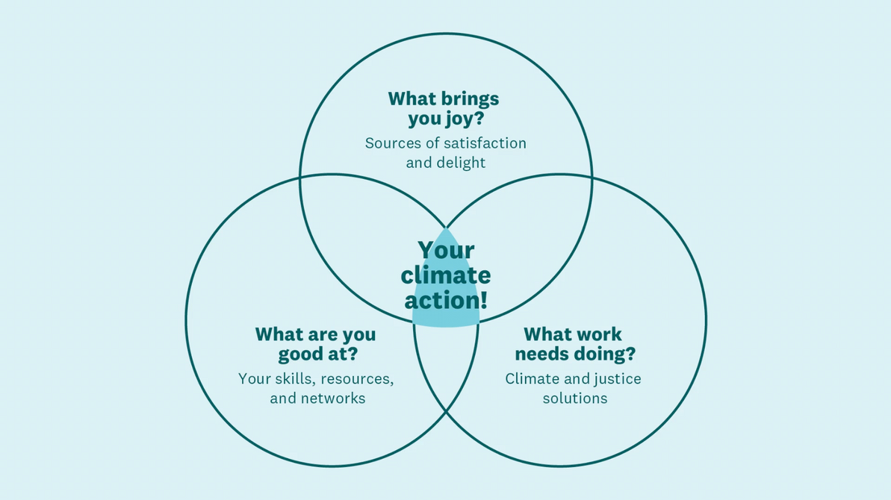
PROJECT OPTION #4
Structured Reflection: Finding your role in climate action
Prompt suggestions
Students can first watch the TED talk by Ayana Johnson, and fill out their own venn diagram. Then, based on their venn diagram they can work individually or in groups to write an essay, engage in a campus/community initiative, or create a presentation on how they can use their unique talents and strengths in the on-going movement for climate action. During this process, students can also reflect on the emotional, psycholgical and personal dimensions of the climate crisis.
For more on this topic, please see the module on Climate Justice and Emotions

Slide 36
Further Reading
Academic Articles
  Climate and the Personal Essay — A Reading List (Martines, 2020)
  Environmental Justice (Mohai et al., 2009)
  Trends and Directions in Environmental Justice: From Inequity to Everyday Life, Community, and Just Sustainabilities (Agyeman et al., 2016)
  Evolution of the environmental justice movement: activism, formalization and differentiation (Colsa Perez et al., 2015)
  From environmental to climate justice: climate change and the discourse of environmental justice (Schlosberg & Collins, 2014)
  The Dakota Access Pipeline, Environmental Injustice, and U.S. Colonialism (Kyle Powys Whyte, 2017)
  Theorising environmental justice: the expanding sphere of a discourse (Schlosberg, 2013)
  Transforming knowledge creation for environmental and epistemic justice (Temper & Del Bene, 2016)
  Climate Justice in the US. What Next? (Dayaneni, 2009)

Slide 37
Further Reading
Online Readings
  Wealth inequality and carbon emissions in high-income countries (Knight et. al., 2017)
  Why we can't have climate justice without social justice (Global Landscapes Forum, 2023)
  Higher Education's Role in Advancing Climate Justice (Briscoe et. al., 2022)
From the Climate Justice Movement
  All We Can Save (Johnson & Wilkinson, 2020)
  Climate and the Personal Essay — A Reading List (Martines, 2020)
  To Free Ourselves, We Must Feed ourselves (Penniman, 2020)

Slide 38

For more resources on climate and environmental justice: Please explore other modules in the Climate Justice Instructional Toolkit.

Slide 39
Module References
  Environmental Protection Agency (EPA). (2023, July, 7) Environmental Justice.
  Equitable and Just National Climate Platform. Stories.
  Frontline Youth: Fighting for Climate for Climate Justice. Climate Justice Alliance.
  General Accounting Office. (1992). Siting of Hazardous Waste Landfills and Their Correlation with Racial and Economic Status of Surrounding Communities: Report. The Office.
  Grosse, C., & Mark, B. (2020). A colonized COP: Indigenous exclusion and youth climate justice activism at the United Nations climate change negotiations. Journal of Human Rights and the Environment, 11(3), 146-170.
  Henry & Kutz (2023) Mothers of the movement: Black environmental justice activists reflect on the women who have paved the way. The 19th.
  Houska, T (2017) The Standing Rock resistance and our fight for Indigenous rights. TED Talk.
  Johnzon, E. (2022) How to find joy in climate action. TED Talk.
  C. Martinez, S. Gupta (2013) Climate Inequality: Forgotten History.
  Mohai, P., Pellow, D., & Roberts, J. T. (2009). Environmental justice. Annual review of environment and resources, 34, 405-430.
  MIT Climate Portal. (2023, July, 7). Climate Justice.
  Pellow, D.N., and L. Sun-Hee Park (2009), ‘From Climate Change and Climate Disruption to Climate Justice: Analysis and Policy Considerations for African American Communities’, Department of Sociology, University of Minnesota. Pellow, D. N. (2017). What is critical environmental justice?. John Wiley & Sons.
  Pellow, D. N. (2016). Toward a critical environmental justice studies: Black Lives Matter as an environmental justice challenge. Du Bois Review: Social Science Research on Race, 13(2), 221-236.

Slide 40
Module References
  Prakash, V. (2020) Varshini Prakash on Redefining What's Possible. Sierra Club.
  The Climate Justice Alliance. How we Work.
  Rosado, L. (2023) Dyanna Jaye: Bringing the urgency of organizing to climate policy.
  Taylor, Dorceta (2020) The Future of Environmental Justice is True Equality.
  United Church of Christ. Commission for Racial Justice. (1987). Toxic wastes and race in the United States: A national report on the racial and socio-economic characteristics of communities with hazardous waste sites. Public Data Access. Chicago.
  What is Climate Justice? University of California Center for Climate Justice, (2023, July, 7).
  What is Climate Justice? Yale Climate Connections (2020, July).
  Why Climate Change is an Environmental Justice Issue. Colombia Climate School, State of the Planet, Renne Cho (2020)
  Yale Environment 360 (2020) This Environmental Justice Activist breaks down deep ties between racism and climate change.

Slide 41
MIT OpenCourseWare
https://ocw.mit.edu
RES.11-003 Climate Justice Instructional Toolkit Spring 2025
For more information about citing these materials or our Terms of Use, visit https://ocw.mit.edu/terms.

