Slide 1

FOUNDATIONAL MODULE
Indigenous
Climate Action

Slide 2
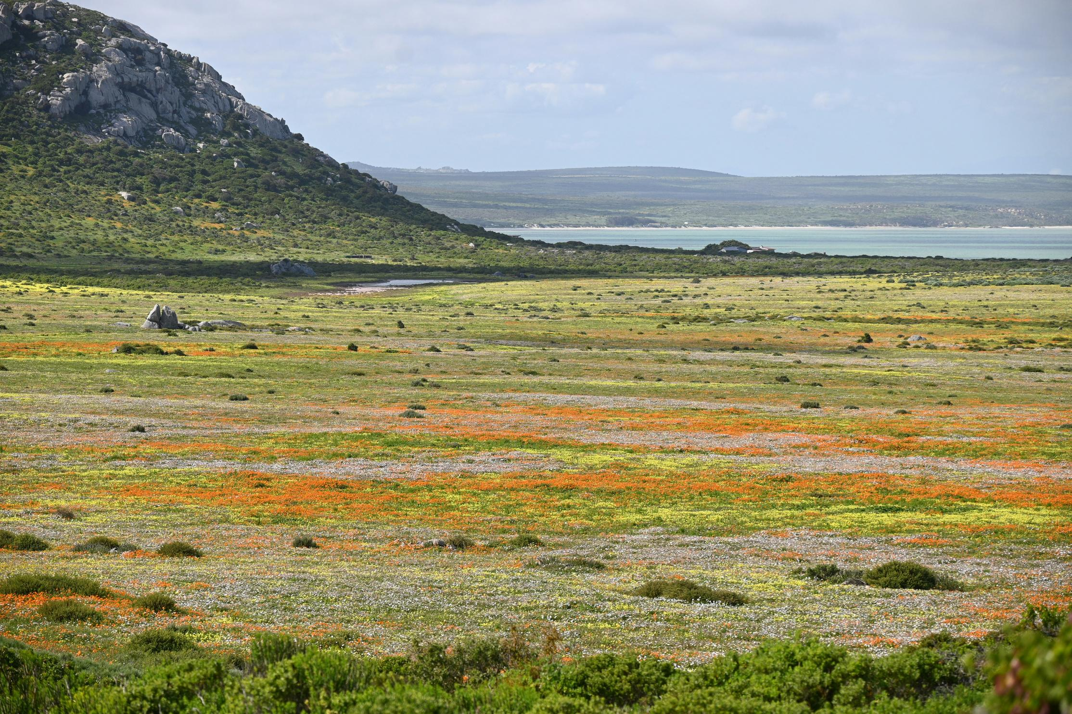
What’s in this module?
Contents
This module discusses climate justice, climate change, Indigenous practices, and the fight for climate equity. The module focuses on a case study of the Metlakatla Indian Community of Alaska’s climate action and adaptations.
Activities
Key Resources
1 video
1 reading
4 activities
2 project options
  Indigenous Peoples and Climate Justice (Video)
  Indigenous Leadership for Transformative Climate Action (Article)
Photo by Tanya Paquet on Unsplash

Slide 3
Learning Objectives
01
02
03
Examine the relationship between colonialism and climate change
Learn about indigenous participation in international climate mitigation efforts
Research indigenous-led efforts to mitigate and prevent climate change

Slide 4
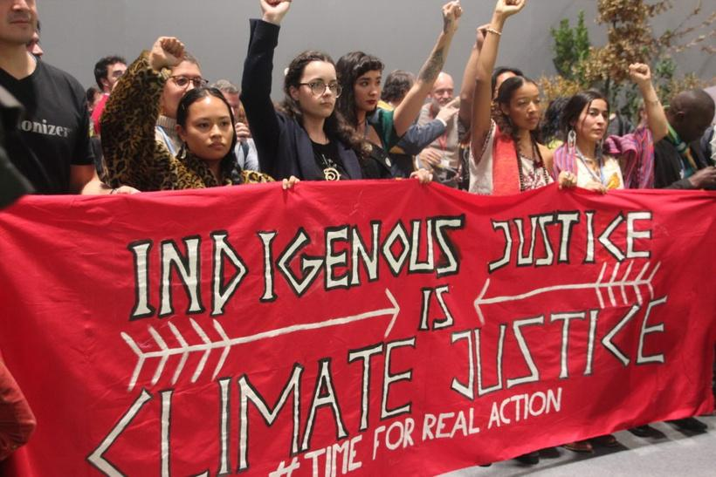
Warm up
How is climate change an issue of colonialism for indigenous people?
Turn to a partner or small group and discuss any thoughts and feelings invoked by this question. Write them down to revisit it later.
Photo courtesy of John Englart on Flickr. License: CC BY-SA. This content is excluded from our Creative Commons license. For more information, see https://ocw.mit.edu/help/faq-fair-use/.

Slide 5
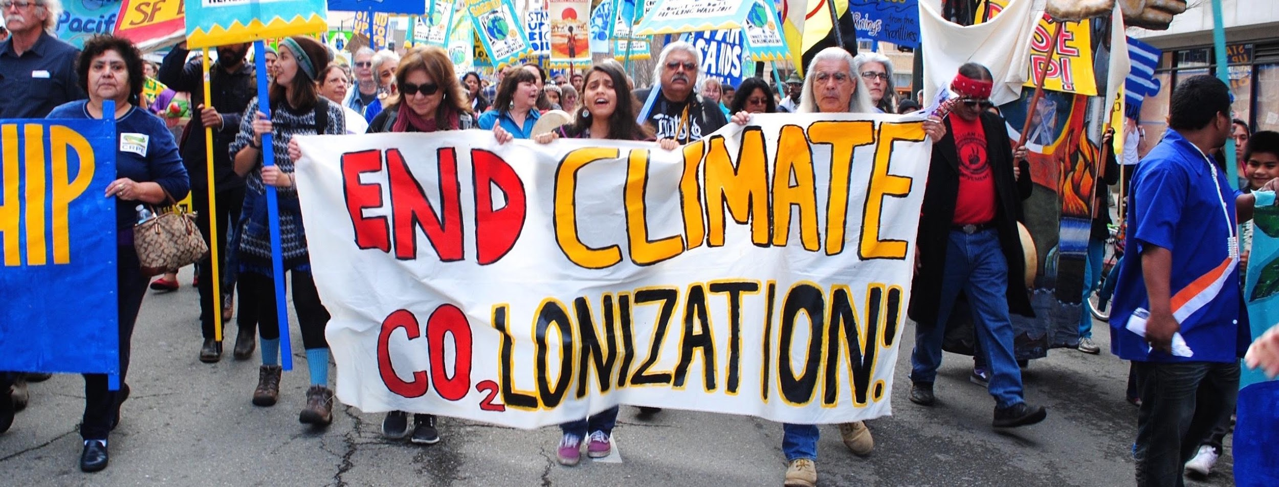
ACTIVITY #1
INTRODUCTION TO INDIGENOUS PEOPLES AND CLIMATE JUSTICE
Watch this video lecture
Indigenous Peoples and Climate Justice
Revisit the warm-up question: How is climate change an issue of colonialism for indigenous people?
  What have you learned after watching the video?
  Has your response changed?
© Feministing. All rights reserved. This content is excluded from our Creative Commons license. For more information, see https://ocw.mit.edu/help/faq-fair-use/.
Learn more about Kyle Whyte

Slide 6
Introduction
PART 1
by Giovanni Prete is licensed under CC BY-SA 2.0

Slide 7
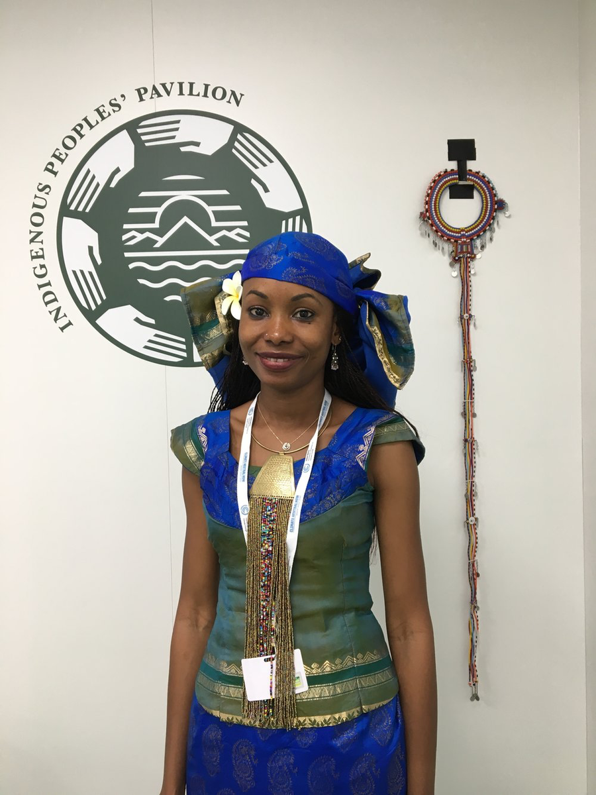
© Joel Cerda. All rights reserved. This content is excluded from our Creative Commons license. For more information, see https://ocw.mit.edu/help/faq-fair-use/ .
Indigenous Participation in Climate Change Conferences (CCCs)
The history of Indigenous participation at world CCCs
  Indigenous leaders have been present at world climate change conferences since they began in 1979
  The International Indigenous Peoples Forum on Climate Change (IIPFCC) was formed in 2008, but indigenous voices did not begin to be heard until the adoption of the Facilitative Working Group of Local Communities and Indigenous Peoples’ Platform (LCIPP) workplan by COP21 in 2015
  The workplan recognized the importance of indigenous knowledge and practices in climate change policies and actions.

Slide 8
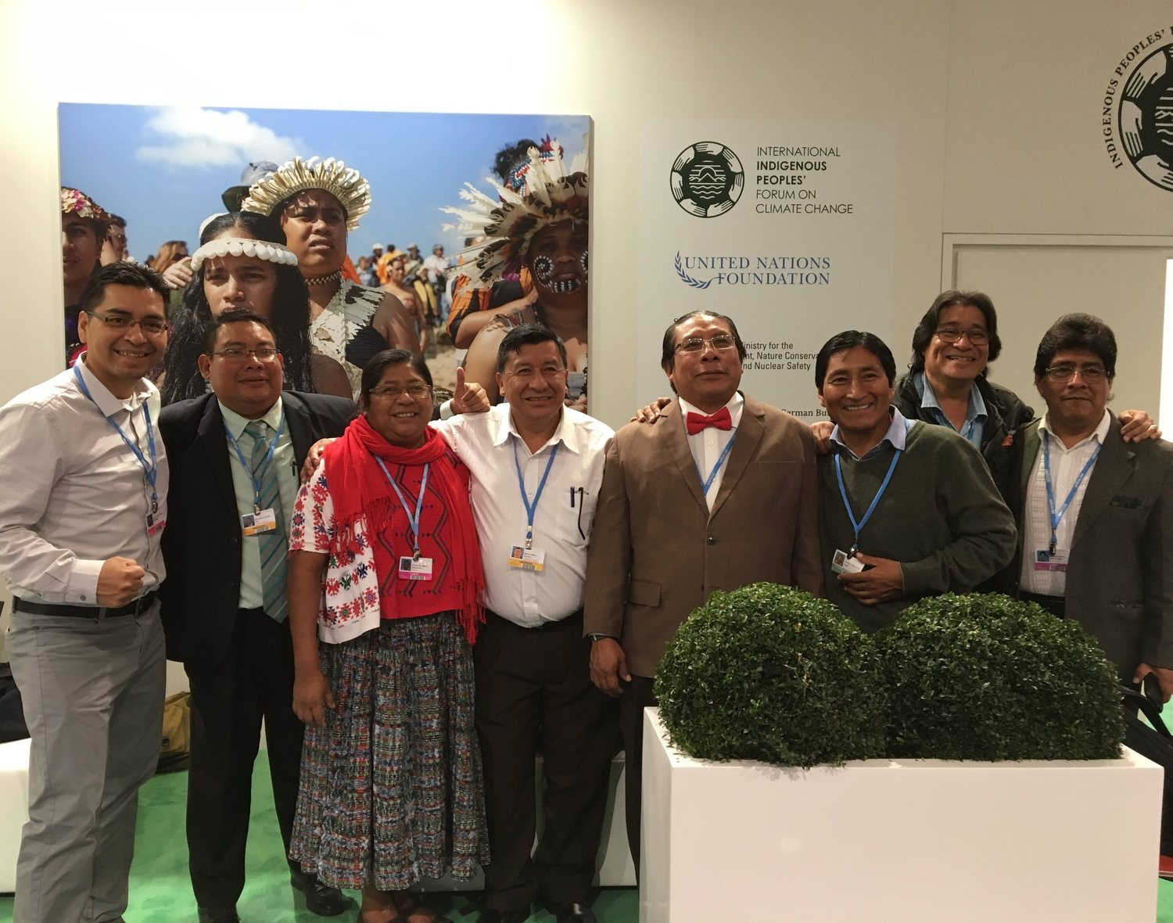
© Joel Cerda. All rights reserved. This content is excluded from our Creative Commons license. For more information, see https://ocw.mit.edu/help/faq-fair-use/ .
Indigenous Participation in Climate Change Conferences
The future of Indigenous participation at world CCCs
Although progress has been made, there is still a significant lack of including indigenous input towards developing solutions and recognition of indigenous people as most impacted by climate change at these conferences.
Exploratory questions
  Why isn’t Indigenous presence at climate conferences enough?
  How can these challenges be addressed beyond one conference?

Slide 9
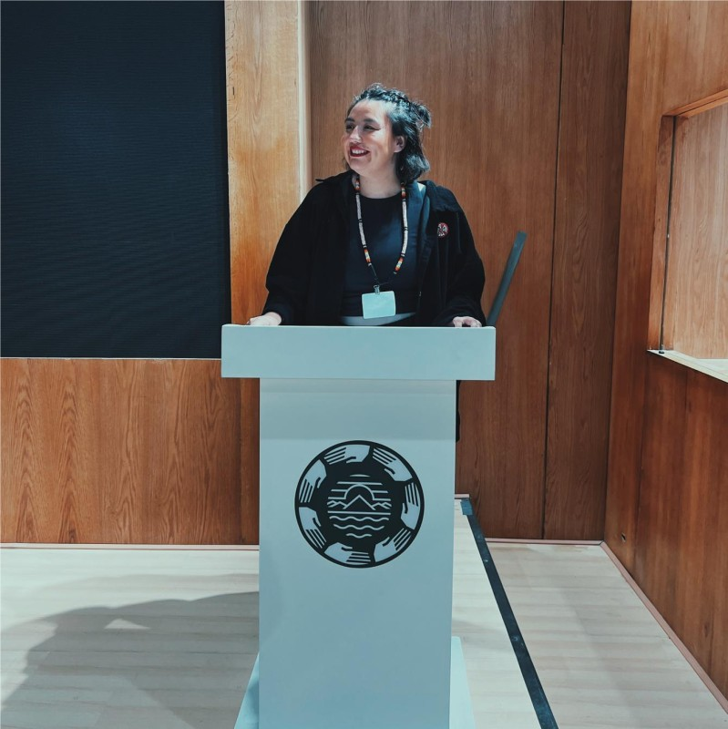
© Sunshine Dunstan-Moore. All rights reserved. This content is excluded from our Creative Commons license. For more information, see https://ocw.mit.edu/help/faq-fair-use/ .
Reflecting on COP27
Skw’akw’as Dunstan-Moore, a Nlakapamux and Yakama Youth Leader, at the Closing Plenary of COP27
"We were clear with our expectations: the rights of Indigenous Peoples must be mainstreamed across all agenda items, and we must see those who have caused the climate crisis be accountable for fixing it.... Yet instead of delivering on the bold promises, COP27 has otherwise come to an end with the feeling of apathy and disappointment...by false solutions... that delay real reductions, replicate new forms of climate colonialism, and fall short of 1.5. Weak or absent language on human rights, the Rights of Indigenous Peoples, and the rights of Persons with Disabilities in many agenda items, means that this COP has compromised on the uncompromisable...."

Slide 10

ACTIVITY #2
CONNECTING SELF-DETERMINATION AND CLIMATE ACTION
Read an excerpt from Required Reading
Indigenous Leadership for Transformative Climate Action
Consider this question
How does self-determination and climate action go hand-in-hand?
© NDN Collective. All rights reserved. This content is excluded from our Creative Commons license. For more information, see https://ocw.mit.edu/help/faq-fair-use/ .

Slide 11
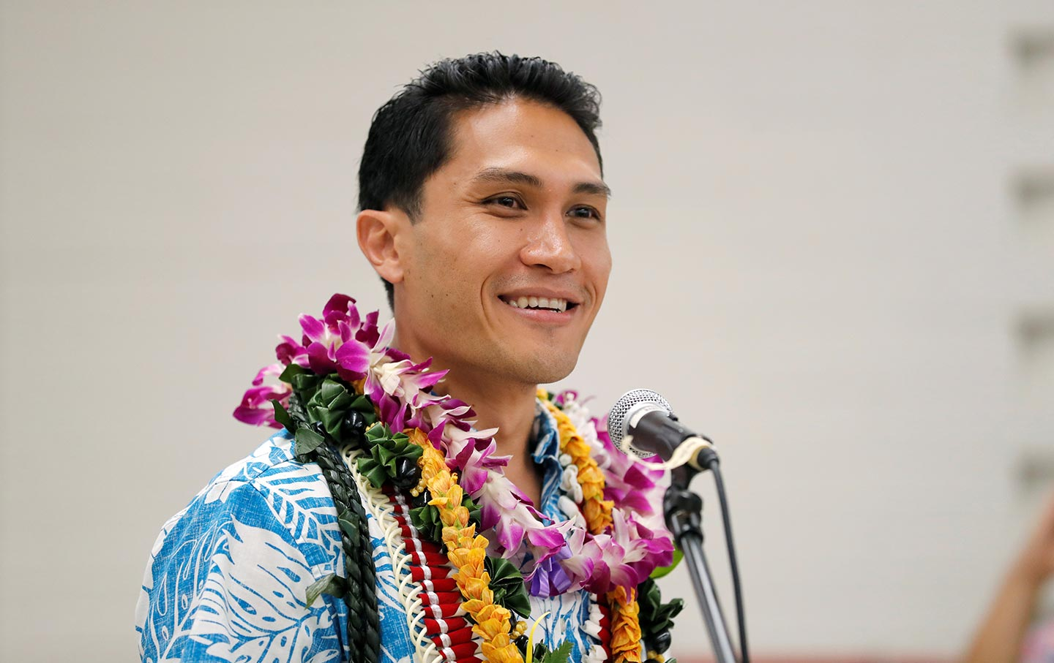
© Reuters / Marco Garcia. All rights reserved. This content is excluded from our Creative Commons license. For more information, see https://ocw.mit.edu/help/faq-fair-use/ .
Required Reading: CJ Adaptation and Investing in Indigenous Power
Kaniela Ing, Hawaiian Climate Justice Activist
"Climate justice requires us to radically restore our relationship with the natural world around us and transform our political and economic systems to support this deep cultural change. No one is better equipped to lead this vision than the Indigenous people who have maintained reciprocal relationships with their homelands for millennia."

Slide 12
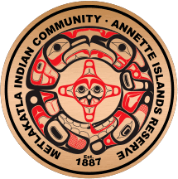
Indigenous Climate Action
Indigenous climate adaptation plans and strategies
Since 2008 over 50 indigenous tribes and inter-tribal organizations in North America have created climate adaptation plans & strategies to mitigate and monitor the impacts of climate change.
See this list of all Indigenous plans and strategies.
© Metlakatla Indian Community. All rights reserved. This content is excluded from our Creative Commons license. For more information, see https://ocw.mit.edu/help/faq-fair-use/ .

Slide 13
Case Study
PART 2

Slide 14
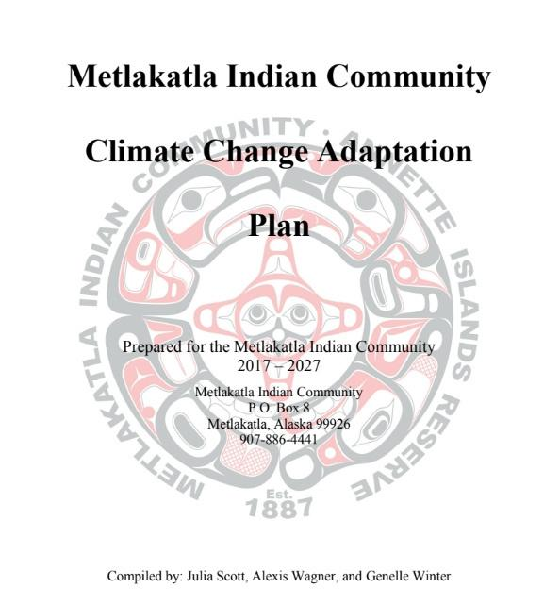
© Metlakatla Indian Community. All rights reserved. This content is excluded from our Creative Commons license. For more information, see https://ocw.mit.edu/help/faq-fair-use/
ACTIVITY #3
CASE STUDY: Metlakatla Indian Community Climate Change Adaptation Plan
Review case study
Background
Coastal erosion
Invasive species
Salmon
Shifting precipitation patterns
Subsistence practices
Human health
Reference
Metlakatla Climate Change Adaptation Plan

Slide 15
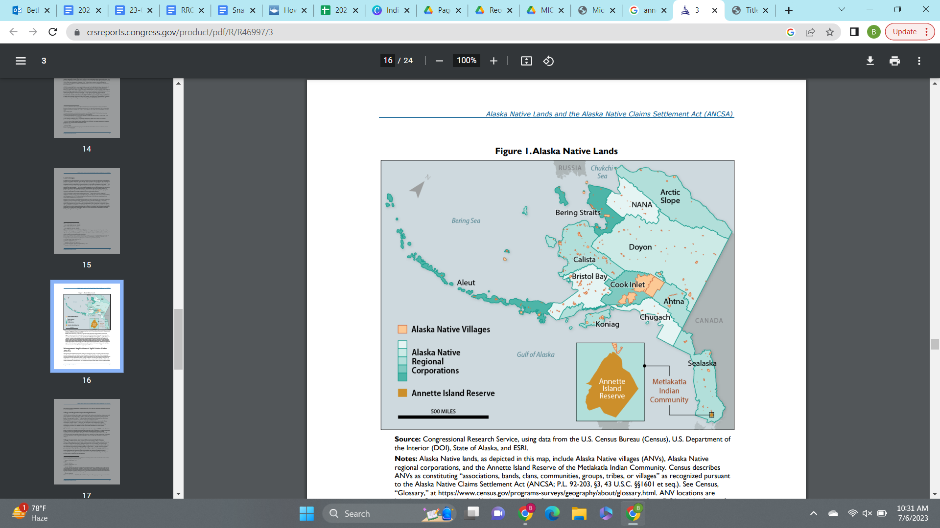
CASE STUDY #1
Background
The Metlakatla Indian Community is located on the Annette Islands Reserve (AIR) in Alaska.
The adaptation plan addresses the following:
  Coastal erosion
  Invasive species
  Salmon
  Shifting precipitation patterns
  Overall subsistence practices including yellow cedar, berries, and shellfish
  Human health
This map is in the public domain.

Slide 16
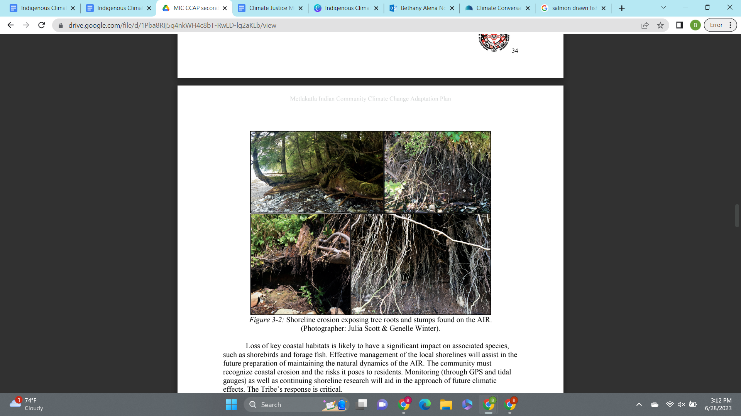
CASE STUDY #1
Coastal Erosion
Figure 3-2: Shoreline erosion exposing tree roots and stumps found on the AIR. (Photographer: Julia Scott & Genelle Winter).
The tribe has acknowledged the visible signs of coastal erosion.
Some adaptation strategies include:
  Collaboration with the Annette Island School District—methods for monitoring coastal erosion is likely to be incorporated within the science curriculum.
  Nourishment of the coast through new stabilization using natural materials, vegetation planting, bio-engineering techniques, forming hard barriers such as seawalls or breakwaters.
© Metlakatla Indian Community. All rights reserved. This content is excluded from our Creative Commons license. For more information, see https://ocw.mit.edu/help/faq-fair-use/ .

Slide 17
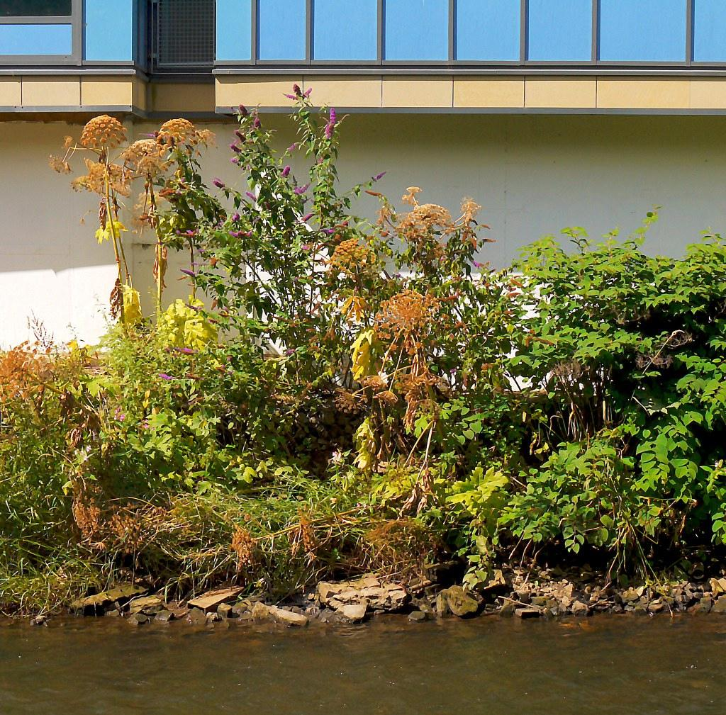
CASE STUDY #1
CASE STUDY
Invasive Species
The tribe has identified many invasive species within the AIR and has outlined solutions in their pre-existing Invasive Species Management Plan.
These solutions include:
  Usage of a vehicle/vessel decontamination system to prevent the spreading of potential contamination.
  Treatment or removal of invasive species immediately when detected for the reduction and likelihood of establishment.
  A consistent community education program to ensure new infestations are noted and managed.
"three invasive plant species on the bank of the kelvin" by tom clearwood is licensed under CC BY-NC-SA 2.0.

Slide 18
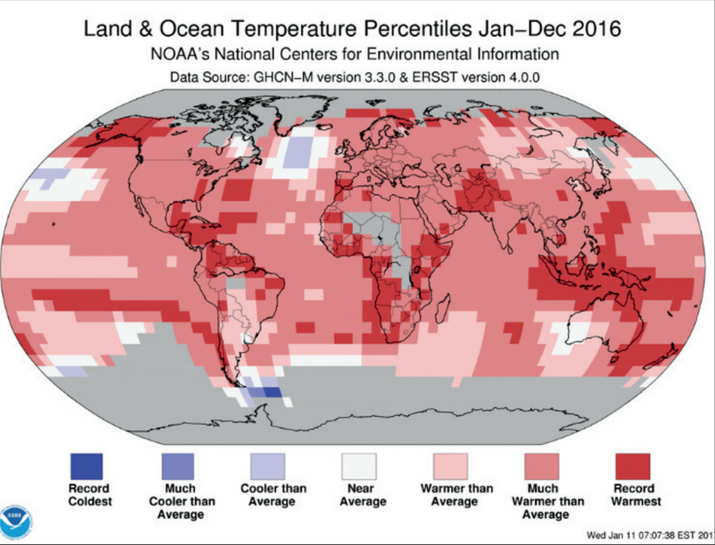
CASE STUDY #1
CASE STUDY
Salmon
To address declines in salmon populations in the AIR, the tribe has proposed the following measures:
  The Tribe’s Fisheries Department will continue to set limitations on the amount of species harvested and timing of the harvesting.
  Improvement and expansion of fisheries management through stream monitoring water quality and aquatic populations.
  Attempt to minimize stressors to fish species by voluntarily setting limitations on local disturbances by restoring water systems, removing unnecessary and potentially harmful barriers is necessary.
  Track trends and forming assessments on local impacts to annual recreation, tourism, commercial, and subsistence fishing.
Land and Ocean Temperature Percentiles: Jan - Dec 2016. State of the Climate: Global Climate Report, Feb 2016. This map is in the public domain.

Slide 19
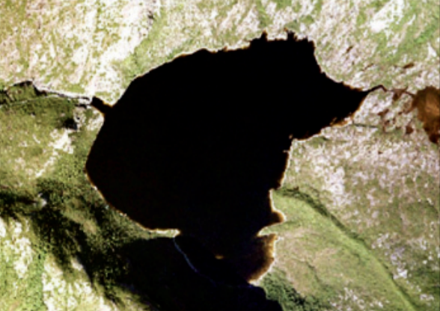
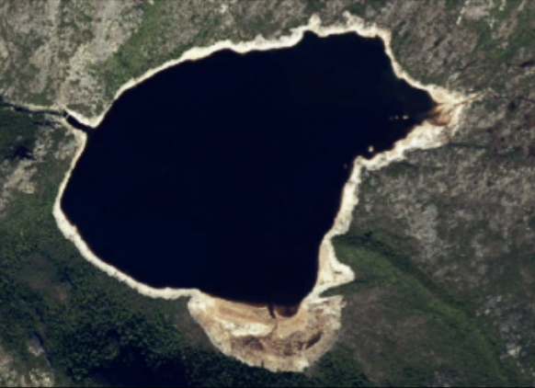
CASE STUDY #1
CASE STUDY
Shifting Precipitation Patterns
Chester Lake, 2003.
Metlakatla Indian Community.
The tribe is reliant on hydropower from two lakes as sources of municipal water and hydropower, but as precipitation patterns vary water levels drop.
Proposed measures to adapt to changing precipitation patterns:
  When water levels in the municipal supply drop below threshold levels, community conservation practices will be enforced.
  Promote and make accessible water saving nozzles, showerheads and other tools to reduce water consumption.
  Larger efforts like increasing the capacity of available water reservoir, increasing the size of the existing dam, or increasing the number of storage tanks used to treat and circulate municipal water supply.
Chester Lake, 2016.
Metlakatla Indian Community.
© Metlakatla Indian Community. All rights reserved. This content is excluded from our Creative Commons license. For more information, see https://ocw.mit.edu/help/faq-fair-use/

Slide 20
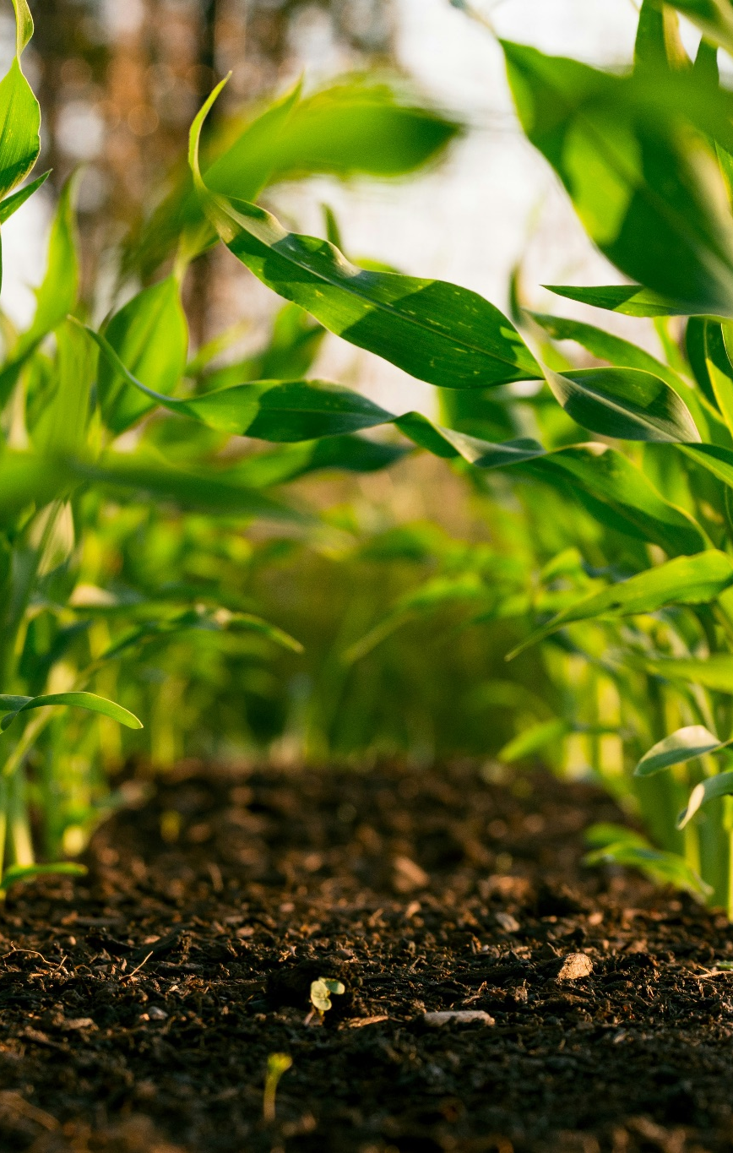
CASE STUDY #1
CASE STUDY
Subsistence Practices
Traditional harvest times of essential materials or food items have been undergoing changes as the climate changes.
Some strategies that will be used to adapt to these changes:
  Enforcing the cataloguing of Alaskan Yellow Cedar harvest.
  Increase forestry staff on the AIR.
  Update and maintain existing GIS data to be as accurate as possible.
  The Tribe’s Landscaping or Forestry Department can collect seeds of each berry species and gift them to reliable community members.
  Test shellfish samples on both individual and community level to prevent PSP and PST poisoning.
Photo by Steven Weeks on Unsplash

Slide 21
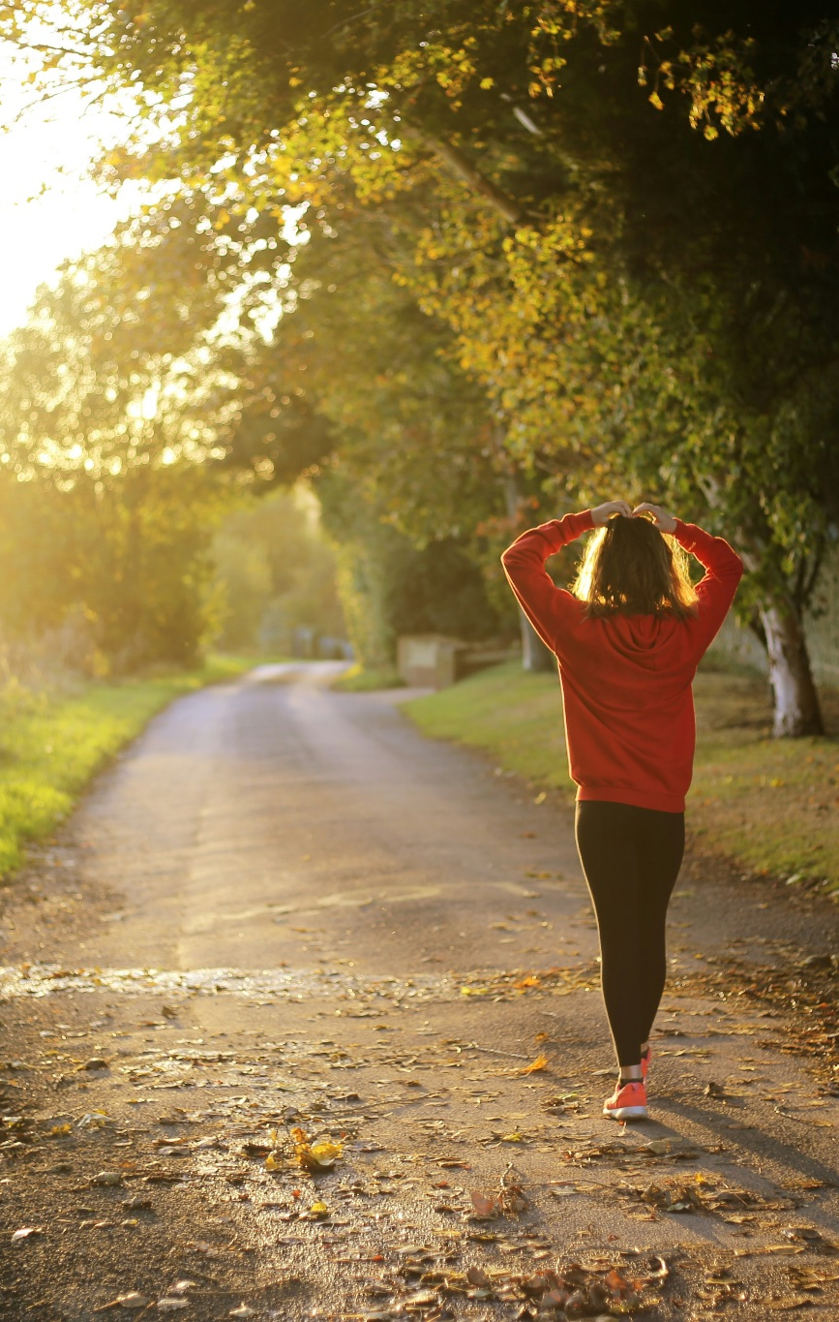
Photo by Emma Simpson on Unsplash
CASE STUDY #1
CASE STUDY
Human Health
Climate change is estimated to impact the health of tribe members through an increase in diseases, allergies, and changes in food production & distribution.
Proposed adaptation measures:
  Develop more recreation trails to create a community-wide effort to change lifestyles and gain healthy habits.
  Create a better sidewalk system is to protect pedestrians in a safe walking zone, which will encourage residents to walk more.
  Collaborate with the Emergency Preparedness Task Force for implementing emergency plans and warning systems community wide.

Slide 22
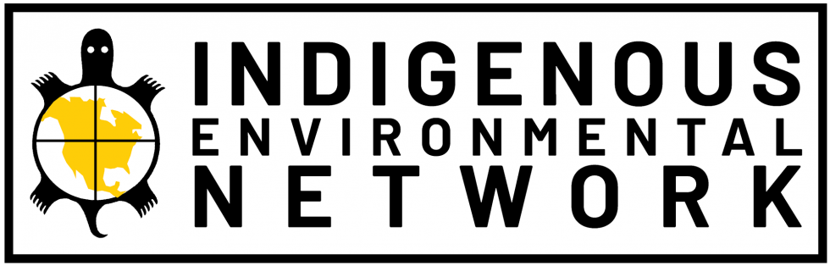
ACTIVITY #4
RESEARCHING INDIGENOUS-LED CAMPAIGNS
Share your findings with the class
  Sentence 1: Goal of the campaign
  Sentence 2: Summary of the efforts to achieve this goal
  Sentence 3: What you found most interesting. Did you learn anything new?
Select a campaign
Visit the Indigenous Environmental Network’s website, click on “programs” and then “campaigns” to see the list of campaigns.
© Indigenous Environmental Network. All rights reserved. This content is excluded from our Creative Commons license. For more information, see https://ocw.mit.edu/help/faq-fair-use/ .
Investigate
Individually, or in small groups, investigate the campaign of your choosing.

Slide 23
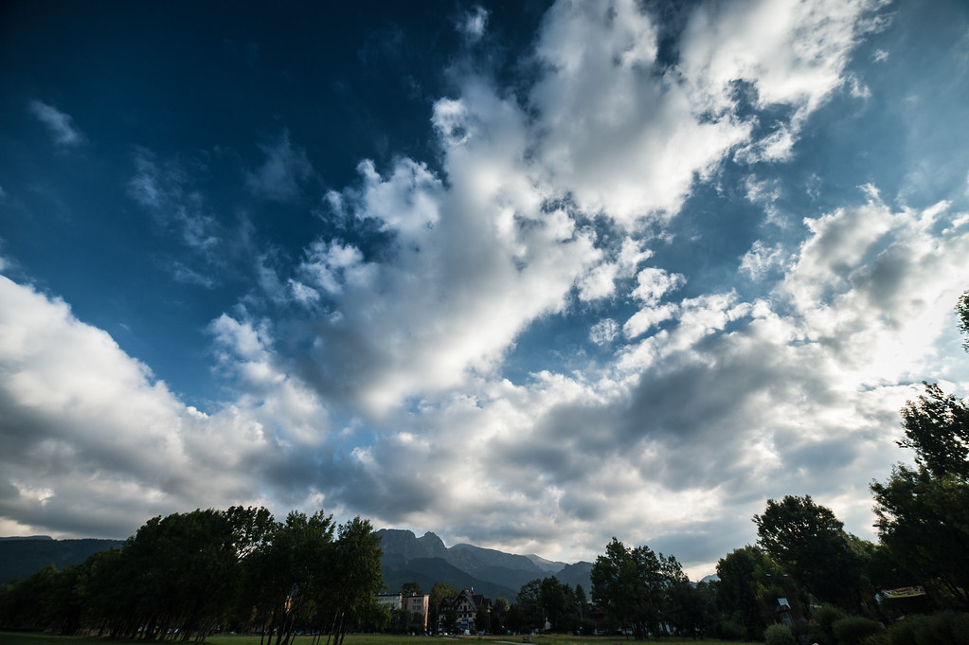
Beyond the Module
PART 3
"Clouds" by Kamil Porembiński is licensed under CC BY-SA 2.0.

Slide 24
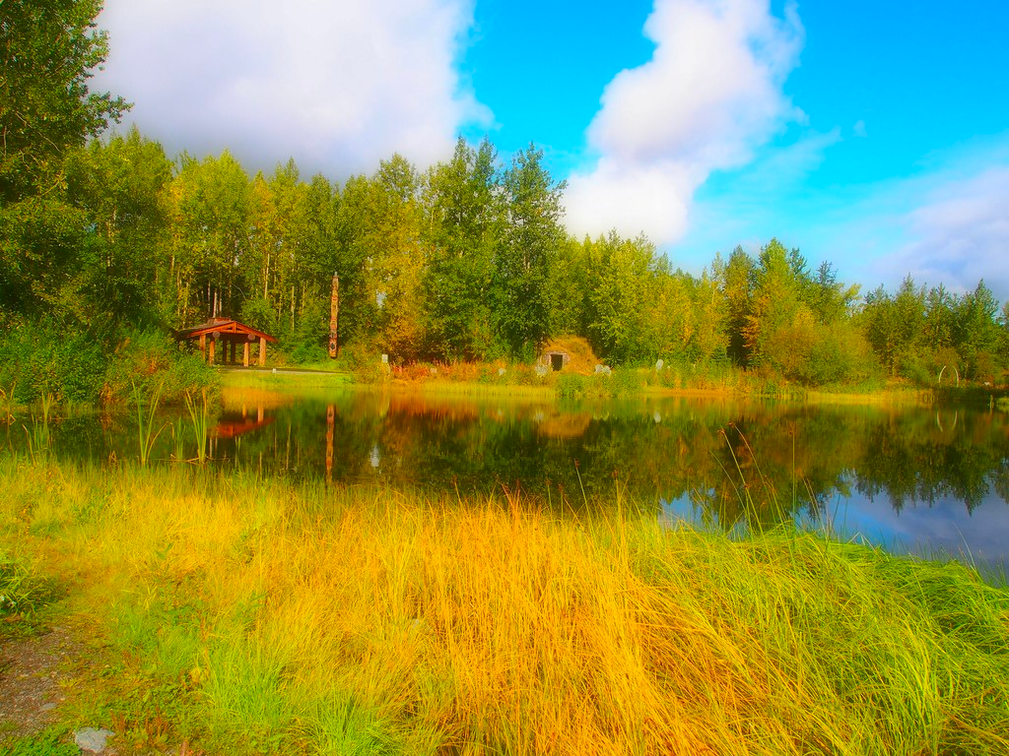
"Alaska Native Heritage Center" by Mind on Fire Photography is licensed under CC BY-SA 2.0. This image is excluded from our Creative Commons license. For more information, see https://ocw.mit.edu/help/faq-fair-use/ .
PROJECT OPTION #1
Present a Profile of an Indigenous Climate Action Leader
Prompt suggestion
Discuss the background and work of your climate action leader and consider how their work connects to your classes and future.
Presentation options
Students could present to the entire class, or in small groups.

Slide 25
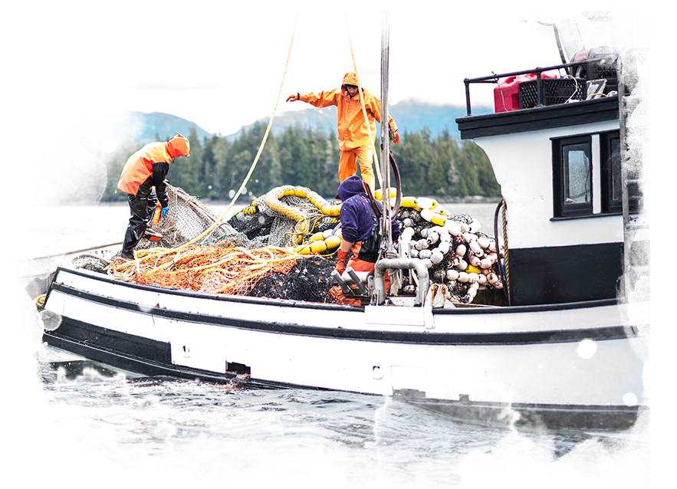
© source unknown. All rights reserved. This content is excluded from our Creative Commons license. For more information, see https://ocw.mit.edu/help/faq-fair-use/
PROJECT OPTION #2
Essay on Metlakatla Indian Community Climate Change Adaptation Plan
Prompt suggestion
How can you support indigenous led climate change solutions? How can your work can connect to the Metlakatla Indian Community Climate Change Adaptation Plan?
Fishers in the Metlakatla Indian Community

Slide 26
Additional Resources
Academic Resources
  We Are Water Protectors (book)
  Does renewable electricity promote Indigenous sovereignty? Reviewing support, barriers, and recommendations for solar and wind energy development on Native lands in the United States (article)
Other Resources
  Autumn Peltier: Known as 'the water protector', Anishinaabe Indigenous Rights advocate raised in the Wiikwemkoong First Nation.
  The RED Nation
  The North American Indian Center of Boston

Slide 27

For more resources on climate and environmental justice: Please explore other modules in the Climate Justice Instructional Toolkit.

Slide 28
Module References
  Powys Whyte, Kyle (2018, April 18). Indigenous Peoples and Climate Justice by Kyle Powys Whyte. Bedrock Lectures on Human Rights and Climate Change, Spring Creek Project. Retrieved from the University of California Center for Climate Justice and YouTube.
  Farrell, J., Burow, P. B., McConnell, K., Bayham, J., Whyte, K., & Koss, G. (2022, June 6). Effects of land dispossession and forced migration on Indigenous peoples in North America.
  (2024) Indigenous Environmental Network. ienearth.org.
  (2024) Partnership for Tribal Governance (PTG) Projects and Resources. National Congress of American Indians.
  Ing, Kaniela, NDN Collective (2021, November 17). Indigenous Leadership for Transformative Climate Action. YES! Media.
  Dolma Sherpa, Pasang (2019, December 30). The Historical Journey of Indigenous Peoples in Climate Change Negotiation. International Union for Conservation of Nature and Natural Resources.
  International Indigenous Peoples' Forum on Climate Change (2022, November 20). Indigenous Peoples Challenge Lack of Ambition and Rights at COP27 Close. Cultural Survival.
  Metlakatla Indian Community staff, Tribal Executives, Tribal Council (2017). Metlakatla Indian Community Climate Change Adaptation Plan. Compiled by Julia Scott, Alexis Wagner, and Genelle Winter.
  Fitzpatrick, Tana. (2021, December 22). Alaska Native Lands and the Alaska Native Claims Settlement Act (ANCSA): Overview and Selected Issues for Congress. Congressional Research Service.

Slide 29
MIT OpenCourseWare
https://ocw.mit.edu
RES.11-003 Climate Justice Instructional Toolkit Spring 2025
For more information about citing these materials or our Terms of Use, visit https://ocw.mit.edu/terms.

