Slide 1
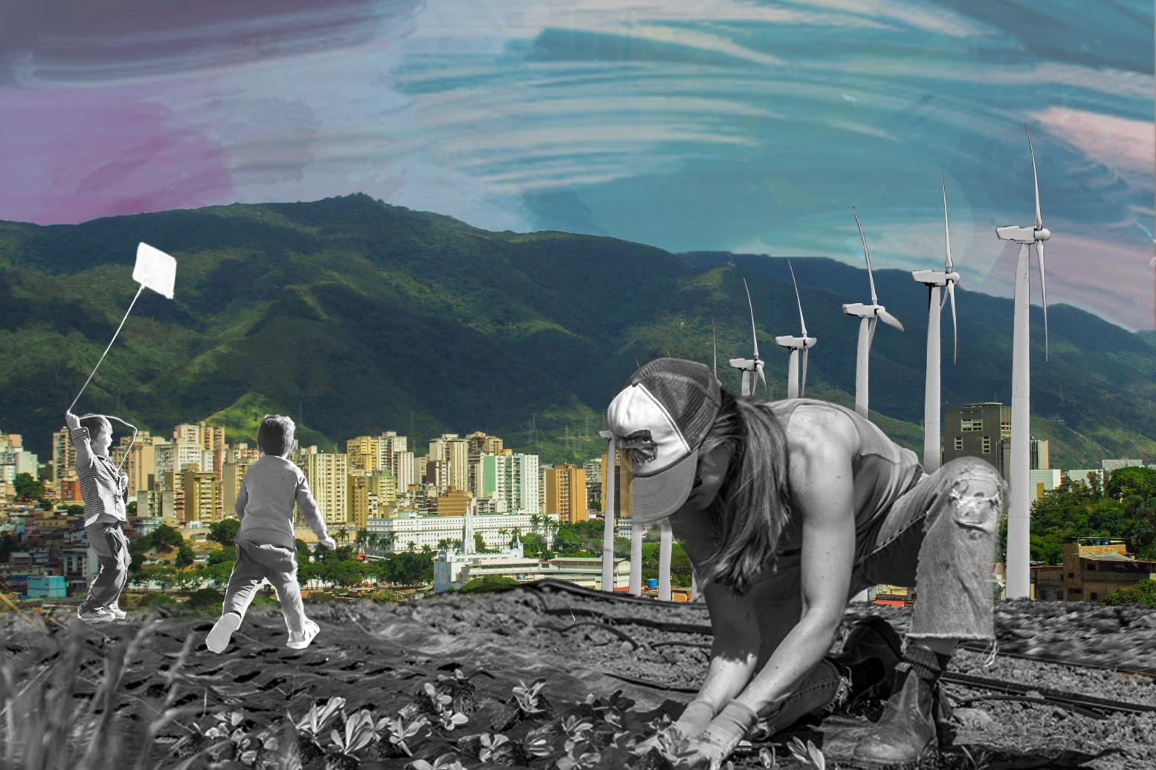

DISCIPLINE-SPECIFIC MODULE
From Mining to E-Waste
2.0
The Environmental and Climate Justice Implications of the Electronics Hardware Life Cycle

Slide 2
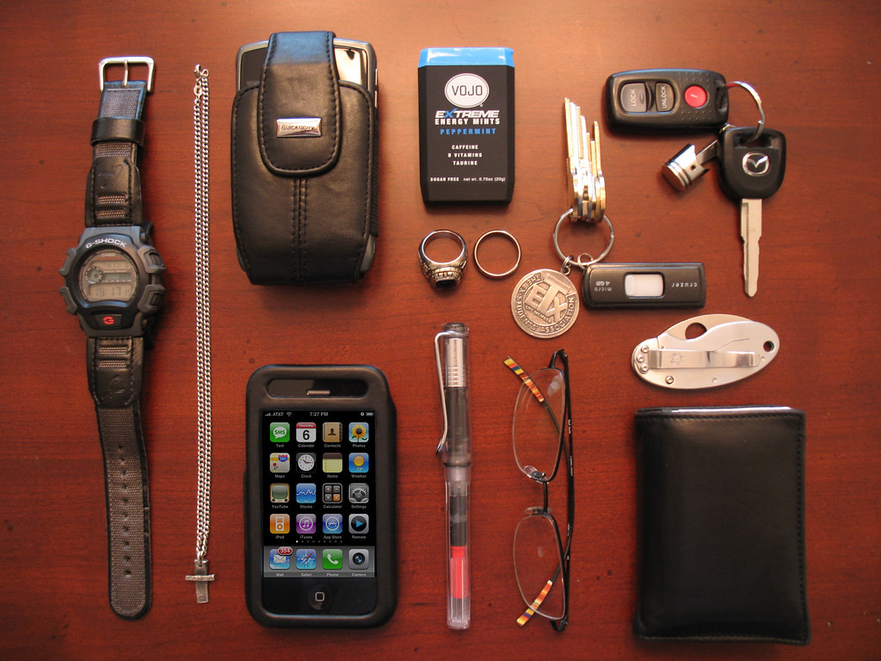
What’s in this module?
Description
This module consists of a case study that introduces the three main stages of the global electronics hardware cycle. Students will learn how to utilize life cycle assessment and circular economics as a mechanism to assess and understand climate justice disparities.
Activities
Key Resources
4 parts
1 video
1 reading
2 activities
3 optional projects
  From Mining to E-waste: The Environmental and Climate Justice Implications of the Electronics Hardware Life Cycle
  Bandi Mbubi: Demand a fair trade cell phone
  Ted Talk: Sanika Bhave Your Phone Is Destroying The Planet
Photo courtesy of maczter on Flickr. License: CC BY.

Slide 3
Learning Objectives
01
02
03
04
Digest core concepts of Environmental justice and sustainability to assess the socio-environmental impacts across the life cycle of a product
Learn to identify stakeholders most impacted by the electronic waste life cycle
Explore implications of the electronic hardware life cycles on diverse communities across the globe
Propose methods with which to minimize the socio-environmental impact of electronics

Slide 4
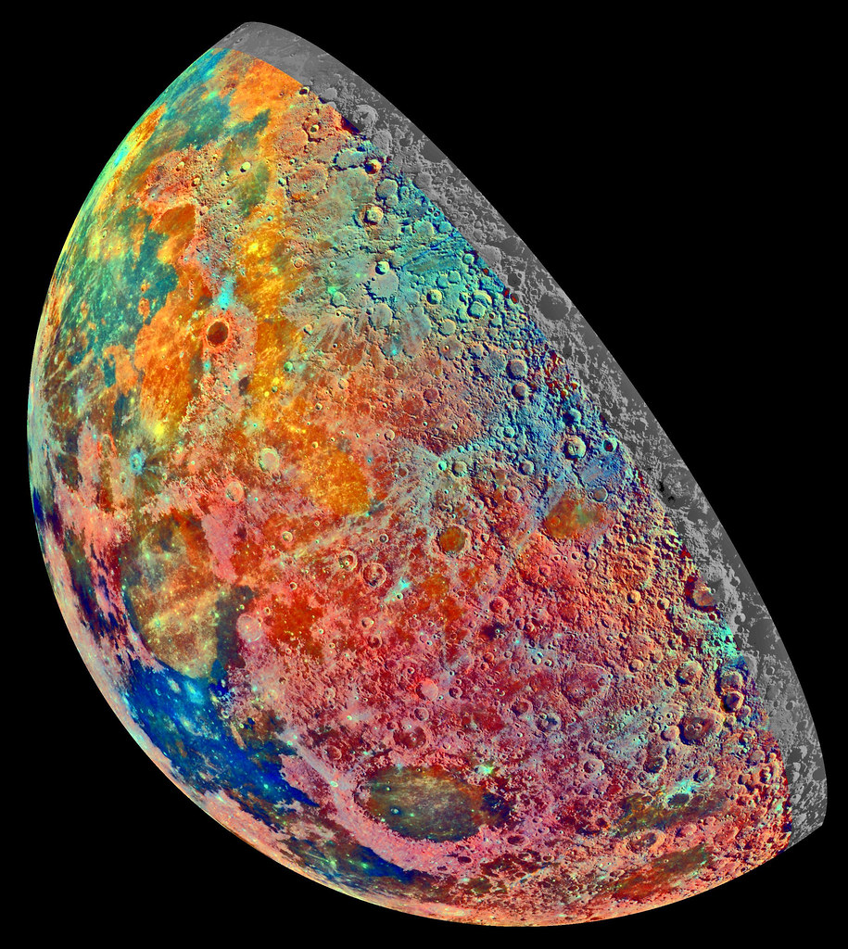
Warm up
Warm up
What do you do with your old devices (phones,laptops, etc.) after you are done with them? What do you think happens to them?
Turn to a partner or small group and discuss.
This image is in the public domain. Credit: NASA/JPL.

Slide 5
Introduction
PART 1

Slide 6
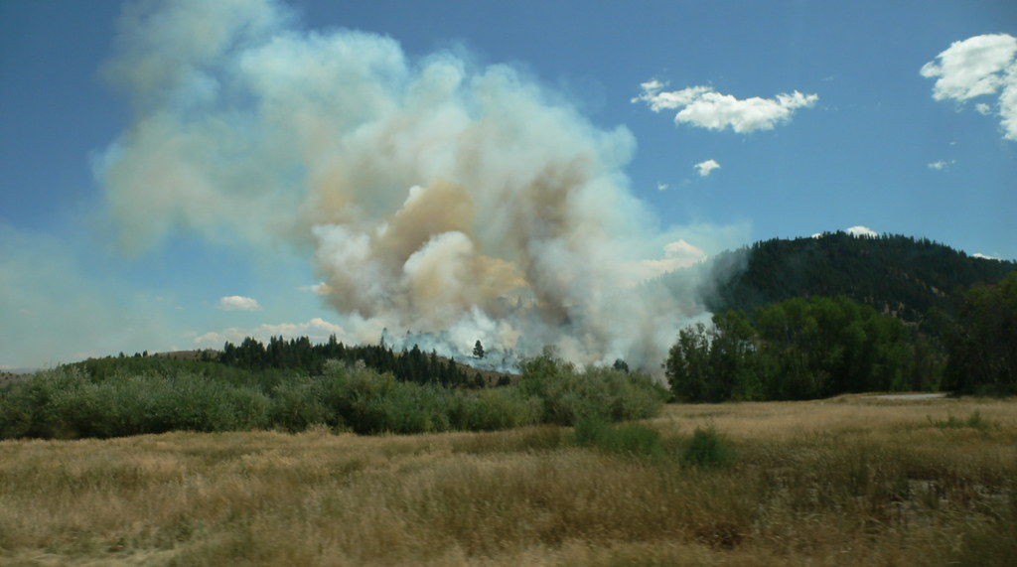
Introduction
What is climate justice?
“Climate justice recognizes the disproportionate impacts of climate change on low-income and BIPOC communities around the world, the people and places least responsible for the climate crisis.” (Center for Climate Justice)
Connection between E-waste and CJ
Climate justice is crucial to understanding the global electronics cycle. All stages of mining, manufacturing, and disposal contribute to a variety of inequities across the globe. These include health issues, labor rights abuses, greenhouse gas emissions, and environmental contamination. Much of which disproportionately affects low-income and BIPOC communities across the world and must be addressed.
Photo courtesy of kjell on Flickr. License: CC BY-SA. © kjell. All rights reserved. This content is excluded from our Creative Commons license. For more information, see https://ocw.mit.edu/help/faq-fair-use/ .

Slide 7
Key Definitions
PART 2

Slide 8
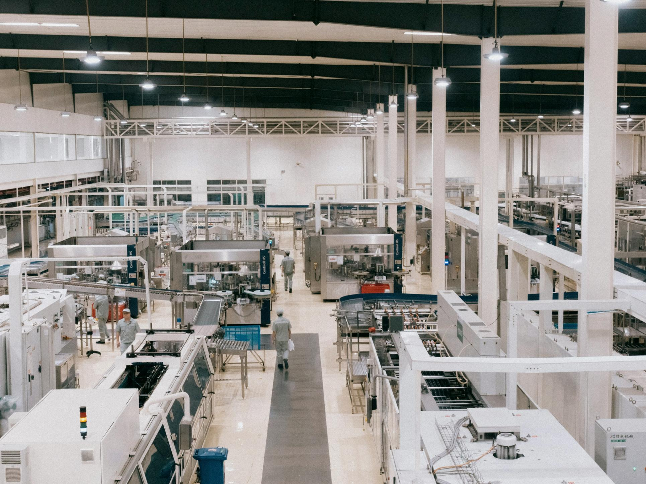
KEY TERMS
Crufting
01
This term has historical relevance to MIT and has been described by MIT alumni as “being able to take cruft [junk, discarded items] and make it work again, or do something new and useful” (B., 2008).
A way in which MIT students participate “in the cycle of electronic device consumption, which involves material extraction, production, use, and disposal” (B., 2008).
Photo by Creator on Unsplash

Slide 9
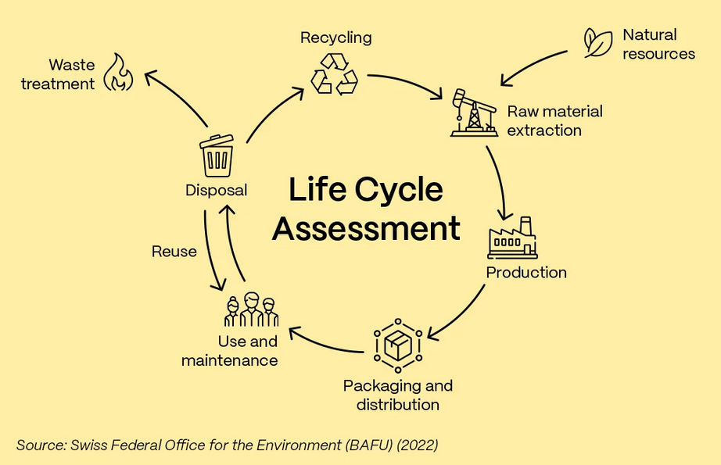
KEY TERMS
Life Cycle Assessment
02
Life Cycle Assessment (LCA) is used to evaluate the environmental, economic, and social impacts of products throughout their life cycle.
LCA is often quantitative in nature and focuses on GHG and chemical emission for example.
Extra Resources:
  A Path Toward Systemic Equity in LCA and Decision-Making
  An overview of LCA and research-based teaching in renewable and sustainable energy education
  A comprehensive understanding of life cycle assessments (LCAs)
© Swiss Federal Office for the Environment. All rights reserved. This content is excluded from our Creative Commons license. For more information, see https://ocw.mit.edu/help/faq-fair-use/ .

Slide 10
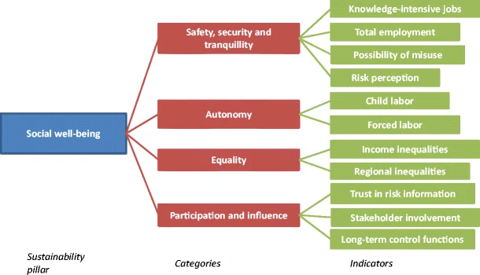
KEY TERMS
Social LCA
03
Social-LCA is a methodology to assess the social impacts of products and services across their life cycle (Benoît et al., 2020).
– United Nations Environmental Program
Extra Resources:
  Guidelines for Social LCA
  Introduction to evaluating energy justice across the life cycle
  Social LCA: An Introduction
Figure courtesy of van Haaster et al. License: CC BY.

Slide 11
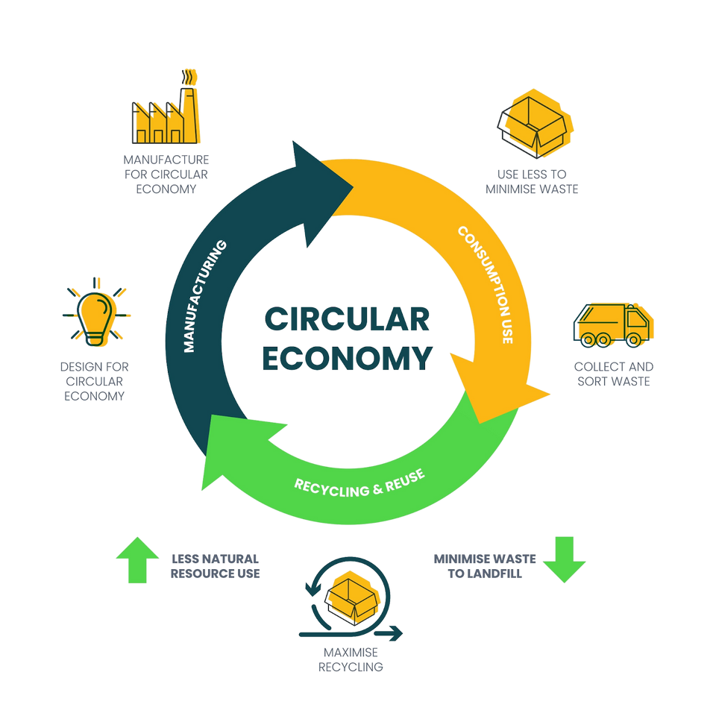
KEY TERMS
Circular Economy
04
“The idea of a CE is rooted in decreasing the use of raw materials by maximizing the reuse and recycling of resources, materials, and waste in order to make consumption and production more sustainable and efficient” (Peña et al., 2020).
To design a circular economy, the most important components are designing sustainability, regenerating natural systems, and maintaining the usability of products for as long as possible.
© Fortna, Inc. All rights reserved. This content is excluded from our Creative Commons license. For more information, see https://ocw.mit.edu/help/faq-fair-use/

Slide 12
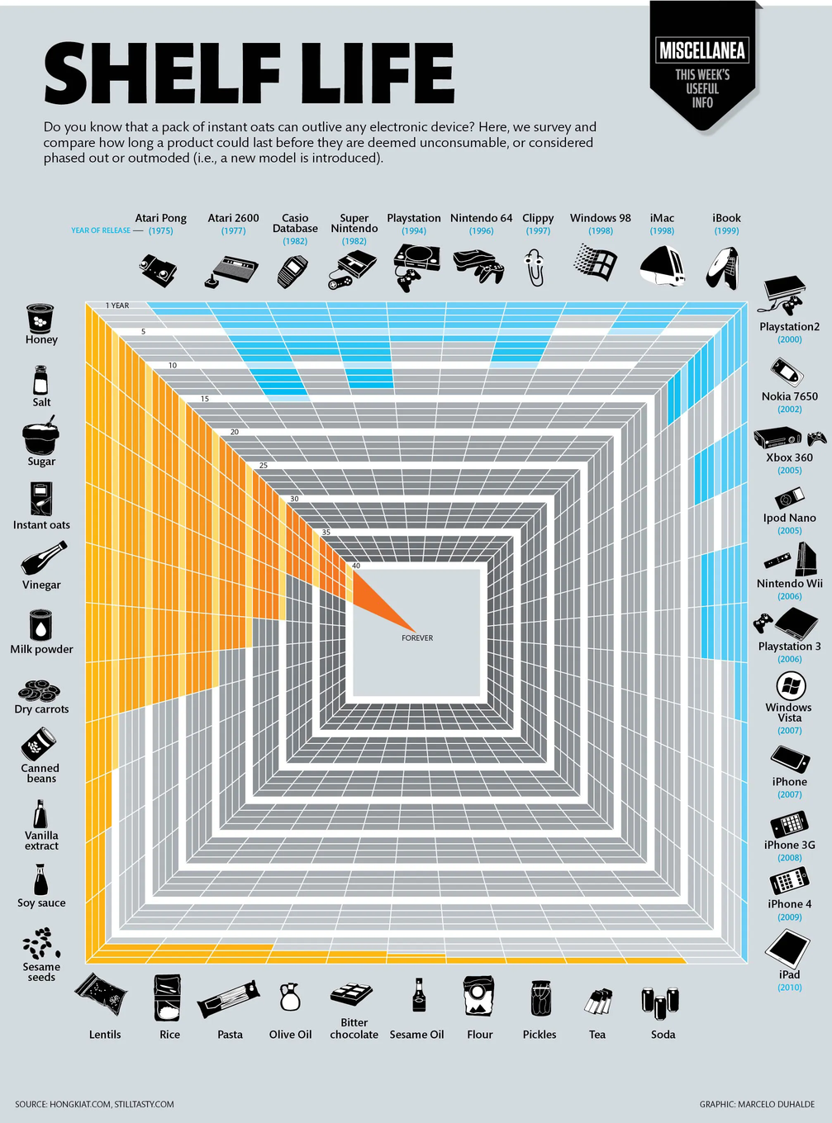
KEY TERMS
Right to Repair
05
“If you own something, you should be able to repair it yourself or take it to a technician of your choice. Right-to-repair advocates argue that modern tech, especially anything with a computer chip inside, is rarely repairable” (NY Times).
06
Planned Obsolescence
06
Planned obsolescence is “a business strategy in which the obsolescence (the process of becoming obsolete) of a product is planned and built into it from its conception, by the manufacturer” (Kramer, 2012, p. 13).
© Marcelo Duhalde. All rights reserved. This content is excluded from our Creative Commons license. For more information, see https://ocw.mit.edu/help/faq-fair-use/ .

Slide 13
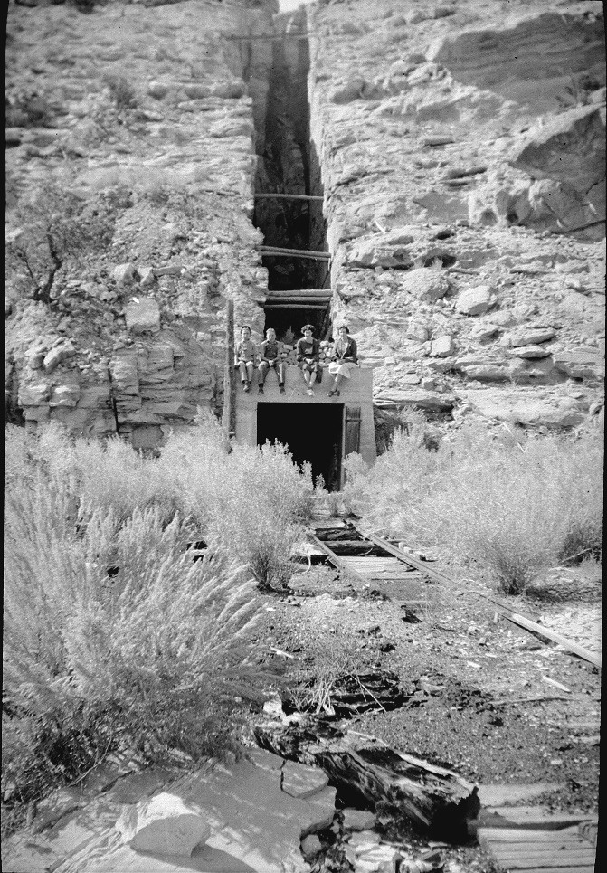
KEY TERMS
Conflict Minerals
07
Conflicts minerals are mined in order to “influence and finance armed combat” (Earthworks). For example, demand for cobalt in phones and electric vehicles fuels genocide and conflict in the Democratic Republic of the Congo.
Critical Minerals
08
Critical minerals are those critical to manufacturing and technological needs across the globe. The criticality of a mineral is determined by economic importance and risk of disruption (UNN).
Extra Resources:
  Bandi Mbubi: Demand a fair trade cell phone
  How Conflict Minerals make it into our phones
Photo courtesy of Ed Yourdon on Flickr. License: CC BY-NC-SA.

Slide 14
Case Study
PART 3

Slide 15
CASE STUDY #1
ELECTRONICS LIFE CYCLE CASE STUDY
Step 2: Group discussion
In your group, spend 10 minutes reading your assigned section and reviewing the discussion questions. Take some bullet point notes on your answers. Then, be prepared to discuss your answers in a full class discussion.
Step 1: Group and assign
Split the class into 4 groups and assign each group one section of From Mining to E-waste:
  Mining, Deforestation and Forest Fires
  The Socio-environmental Costs of Electronics Manufacturing
  The Growing E-Waste Crisis
  Higher Education's Role in Expanding Awareness
Step 3: Share out
Allow 5-10 minutes for each group to share the summary of their section and pose their discussion question to the class.
Step 4: Reflect in groups
Now turn to your partners and reflect on the important action steps to address the impacts of the electronic lifecycle. What are the most important things to work on in the future?

Slide 16
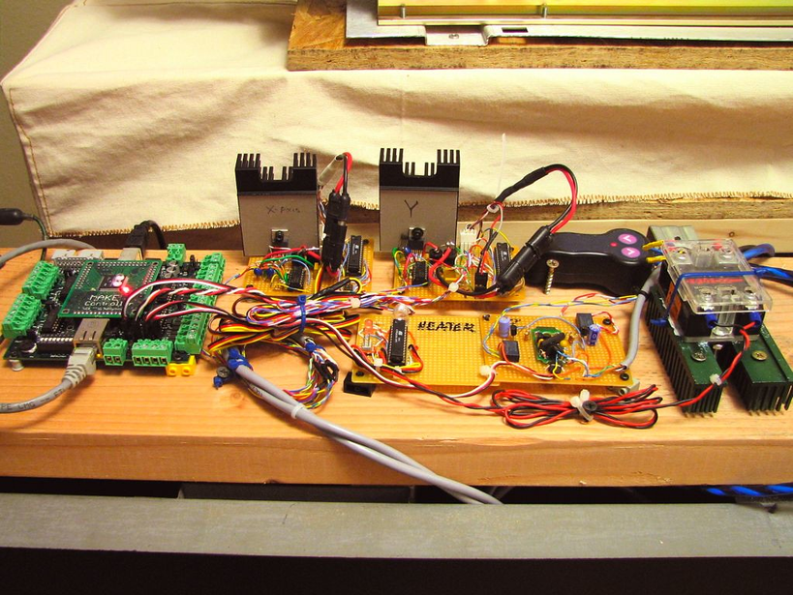
CASE STUDY #2
DEBATE
Step 2: Set Up Debate
  Split the class into two groups
  Choose a prompt:
    Responsibility for the environmental harms should be shared equally among corporations, governments, and consumers
    The global electronics industry perpetuates environmental inequity
    Transitioning to circular economy for the electronics economy is feasible
Step 1: Read
From Mining to E-waste: The Environmental and Climate Justice Implications of the Electronics Hardware Life Cycle
Step 3: Debate
  Each side presents an argument (2-5 minutes)
  Time given for rebuttals (5 min)
  Conclusions (5 min)
Photo courtesy of Windell Oskay on Flickr. License: CC BY..

Slide 17
Beyond the Module
PART 4

Slide 18
PROJECT OPTION #1
Life Cycle Analysis (LCA)
Instructions
  Review the case study introduction and definitions of LCA and SLCA
  Choose an approach: LCA (environmental) or SLCA (social)
  Map out the plan using the 4 LCA phases:
    Goal and Scope- Define purpose, system boundaries, and functional unit
    Inventory- identify data needed and possible sources
    Impact Assessment- determine the impacts assessed
    Interpretation- hypothesize findings and limitations
  Collect Sample data and present findings to the class (optional)

Slide 19
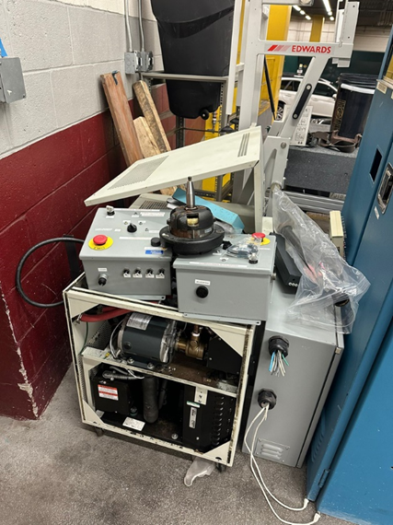
PROJECT OPTION #2
Crufting Experience & Discussion
Instructions
  Read From Mining to E-waste: The Environmental and Climate Justice Implications of the Electronics Hardware Life Cycle
  Scout for Cruft: explore dumps, recycling centers, free piles, etc for discard electronics and materials
  Brainstorm: In your group discuss possible inventions or new uses for the materials collected
  Design and Build: Sketch your concept, assign roles, and work to assemble your new creation
Discussion prompt
What does crufting reveal about how we value materials/objects?
Photo by Ellie Bultena. License: CC BY-NC.

Slide 20
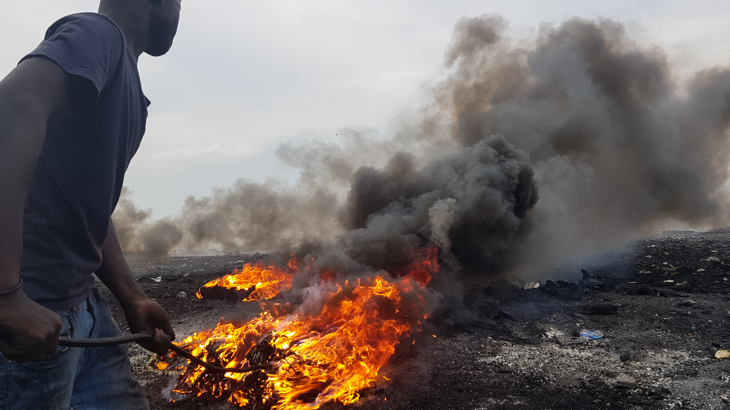
PROJECT OPTION #3
Case Studies
Have students work in groups to create a presentation (poster, google slides) describing another instance of inequities within the global electronics cycle.
Suggested prompts
  Where does this event take place?
  Who are the affected groups?
  What are the potential solutions?
  What is the community response?
Example topics
  Mining in the global south
  Electronics manufacturing in China
  Burden of e-waste disposal on Ghana
Photo courtesy of synth85 on Wikimedia. License: CC BY-SA. This content is excluded from our Creative Commons license. For more information, see https://ocw.mit.edu/help/faq-fair-use/ .

Slide 21
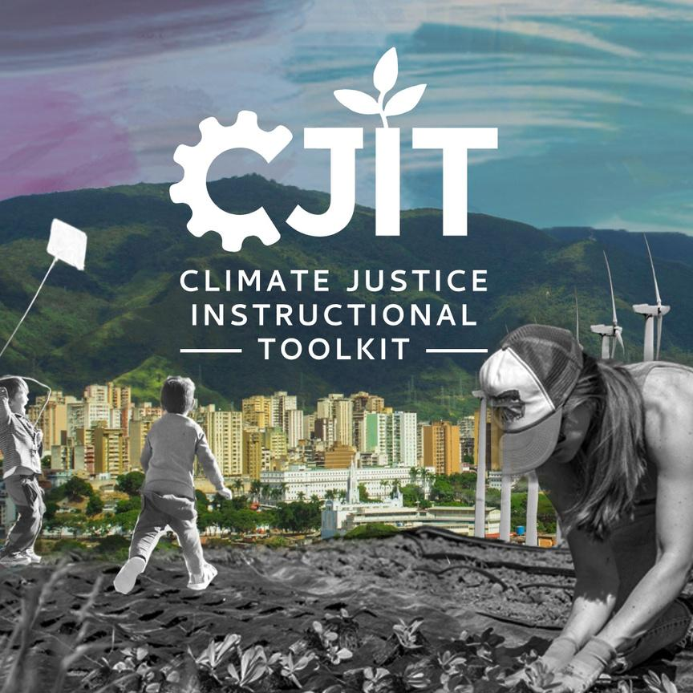
For more resources on climate and environmental justice: Please explore other modules in the Climate Justice Instructional Toolkit.

Slide 22
Module References
  Andrews, E. S., Barthel, L. P., Beck, T., Benoît, C., Ciroth, A., Cucuzzella, C., Gensch, C. O., Hébert, J., Lesage, P., Manhart, A., Mazeau, P., Mazjin, B., Methot, A. L., Moberg, A., Norris, G., Parent, J., Prakash, S., Reveret, J. P., Spillemaeckers, S., . . . Weidema, B. (2009). Guidelines for Social Life Cycle Assessment of Products (C. Benoît & B. Mazijn, Eds.; DTI/1164/PA). United Nations Environment Programme. https://www.unep.org/resources/report/guidelines-social-life-cycle-assessment-products
  B., P. (2008, August 19). Speaking in MITese. MIT Admissions. https://mitadmissions.org/blogs/entry/speaking_mitese/
  Earthworks. (2025). Conflict Minerals. https://earthworks.org/issues/conflict-minerals/
  Hampton, L., Schlegel, M., Bultena, E., Liu, J., Dunca, A., Singha, M., Lim, S., Higgins, L., & Rabe, C. (2024). From Mining to E-waste: The Environmental and Climate Justice Implications of the Electronics Hardware Life Cycle. MIT Case Studies in Social and Ethical Responsibilities of Computing. https://doi.org/10.21428/2c646de5.2cbc88c6
  Klosowski, T. (2021, July 15). What You Should Know About Right to Repair. Wirecutter. https://www.nytimes.com/wirecutter/blog/what-is-right-to-repair/
  Kramer, K. (2012). User Experience in the Age of Sustainability: A Practitioner’s Blueprint (1st ed.). Elsevier. https://shop.elsevier.com/books/user-experience-in-the-age-of-sustainability/kramer/978-0-12-387795-6
  Peña, Claudia, Bárbara Civit, Alejandro Gallego-Schmid, Angela Druckman, Armando Caldeira- Pires, Bo Weidema, and Eric Mieras. (2020). Using Life Cycle Assessment to Achieve a Circular Economy. Life Cycle Initiative. https://www.lifecycleinitiative.org/wp-content/uploads/2020/07/Using= LCA-to-achieve-circular-economy-LCI-July-2020.pdf
  Valverde, J. (2024, May 2). What Are Critical Minerals, and Why Are They So Important? UNU-MERIT Working Papers. https://unu.edu/merit/news/what-are-critical-minerals-and-why-are-they-so-important
Stock images found on Canva were used in this module.

Slide 23
MIT OpenCourseWare
https://ocw.mit.edu
RES.11-003 Climate Justice Instructional Toolkit Spring 2025
For more information about citing these materials or our Terms of Use, visit https://ocw.mit.edu/terms.

