Slide 1
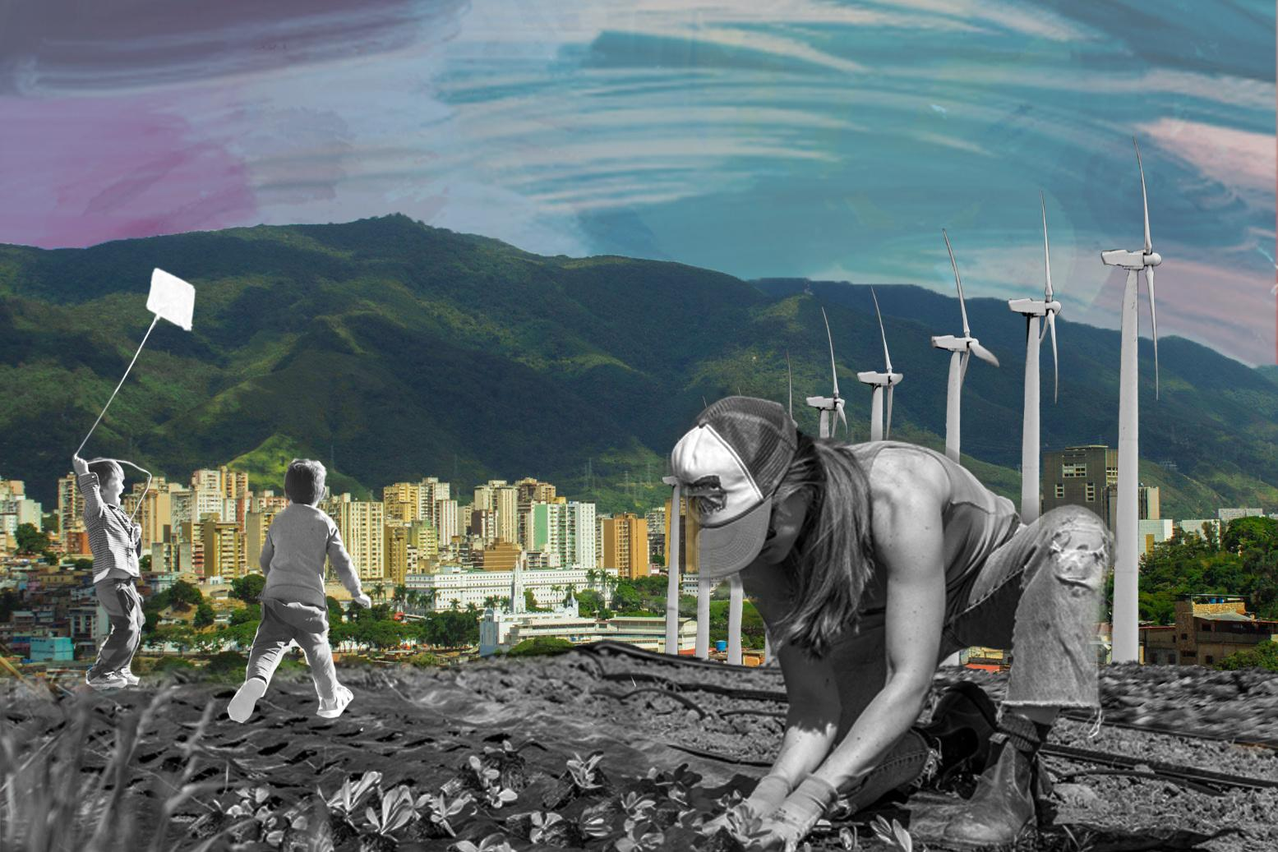

DISCIPLINE-SPECIFIC MODULE
Environmental Justice &
2.0
Technical Innovation

Slide 2

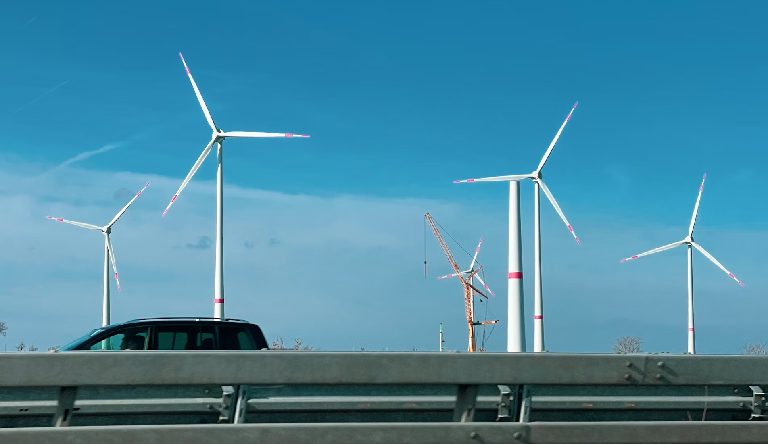
What’s in this module?
Description
This module explores current paradigms, goals, and cultures of technological innovation, & the intersection with environmental justice practices, or lack thereof. It explores case studies where technological innovation in sectors like agriculture and digital technology has had unintended negative consequences, particularly for marginalized communities, and then reviews emerging solutions.
Activities
Key Resources
4 parts
2 readings
3 activities
2 optional projects
  When the implication is not to design (technology)(Baumer and Silverman, 2011)
  The Karlskrona Manifesto for Sustainability Design (2014)
Photo by Bernd Dittrich on Unsplash

Slide 3
Learning Objectives
01
02
03
04
Understand the core principles of environmental justice and how they intersect with technological innovation.
Examine the goals and cultures that drive dominant paradigms of technological innovation and their potential impacts.
Analyze case studies where technological advances have resulted in harm.
Apply environmental justice principles to tech design and development.

Slide 4
Environmental Justice & Tech Innovation
PART 1

Slide 5

Environmental Justice
What is Environmental Justice?
Environmental justice, as defined by Dr. Robert Bullard (2001), is the principle that “all people and communities are entitled to equal protection of environmental and public health laws and regulations” (Environmental Factor, NIH)
Additionally, Dr. Dorceta Taylor states that environmental injustice is experienced through heightened exposure to pollution and corresponding health risks, limited access to adequate environmental services, and loss of land and resource rights. (Toxic Communities)
Photo by Dhilip Antony on Unsplash

Slide 6
Environmental Justice and Tech Innovation
The Urgent Need for Environmental Equity in Tech Innovation
Mainstream approaches to technological development may perpetuate social inequities by prioritizing rapid advancement over environmental and community well-being. Dominant tech paradigms may prioritize profit and novelty at the expense of the needs of marginalized communities most affected by environmental harm.
Without incorporating environmental justice (EJ) principles, technological solutions can exacerbate existing disparities, as seen in locations like “Cancer Alley”, a stretch of land in southern Louisiana where industrial decisions were made at the expense of local health and safety (Paul & Minns, 2024).

Slide 7
ACTIVITY #1
READING AND REFLECTION
Post-reading discussion questions
  How do concepts like “sacrifice zones” reflect the broader relationship between technological development and environmental justice - the notion of equal protection from environmental hazards and harms?
  In what ways can integrating environmental justice principles reshape the innovation process to avoid reinforcing social inequities?
  Why might “tech for good” initiatives be insufficient to address systemic inequities? Alternatively, if these initiatives might be sufficient, why is that the case?
  What role do marginalized communities play in pioneering sustainable solutions, and how can these contributions be better recognized within environmental and tech sectors?
  How do cultural and ethical considerations influence what different societies value as “progress” or “innovation”?
Read
  Upgrading Environmental Innovation for the 21st Century
  Sacrifice Zones: A Genealogy and Analysis of an Environmental Justice Concept
Notes:
Instructions for Facilitators:
Have students read: Sacrifice Zones: A Genealogy and Analysis of an Environmental Justice Concept.
Discuss how “sacrifice zones” relate to technological advancement

Slide 8
Perspectives on Technological Innovation
PART 2

Slide 9
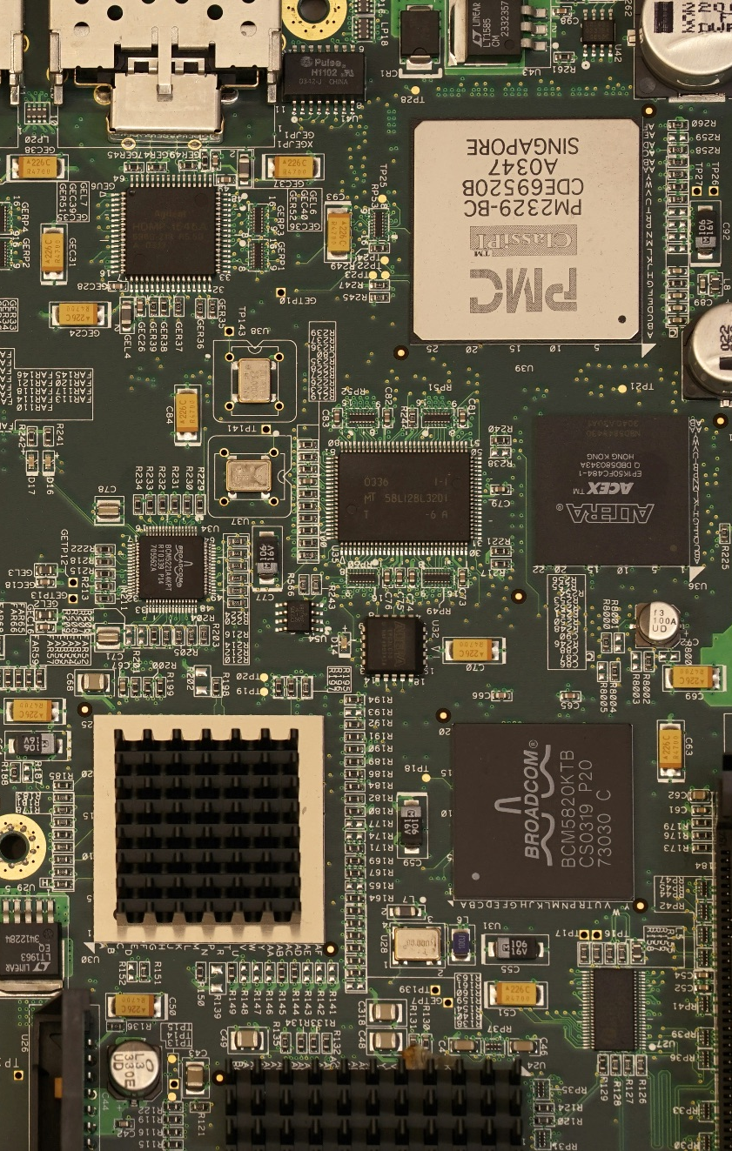
Environmental Justice in the Innovation Paradigm
Drawing from Bruno Latour's actor-network theory and the field of science and technology studies (STS), technological innovation processes are deeply embedded in complex socio-technical networks that may prioritize certain interests over others. (ScienceDirect)
Dominant technological paradigms are primarily centered around market-based forces and economic gains and tend to prioritize novelty and urgency — an approach that allowed humanity to reach the moon and develop vaccines but also emit billions of tons of pollution and develop deadly weapons that enable large-scale warfare.
Photo by Bartosz Kwitkowski on Unsplash

Slide 10
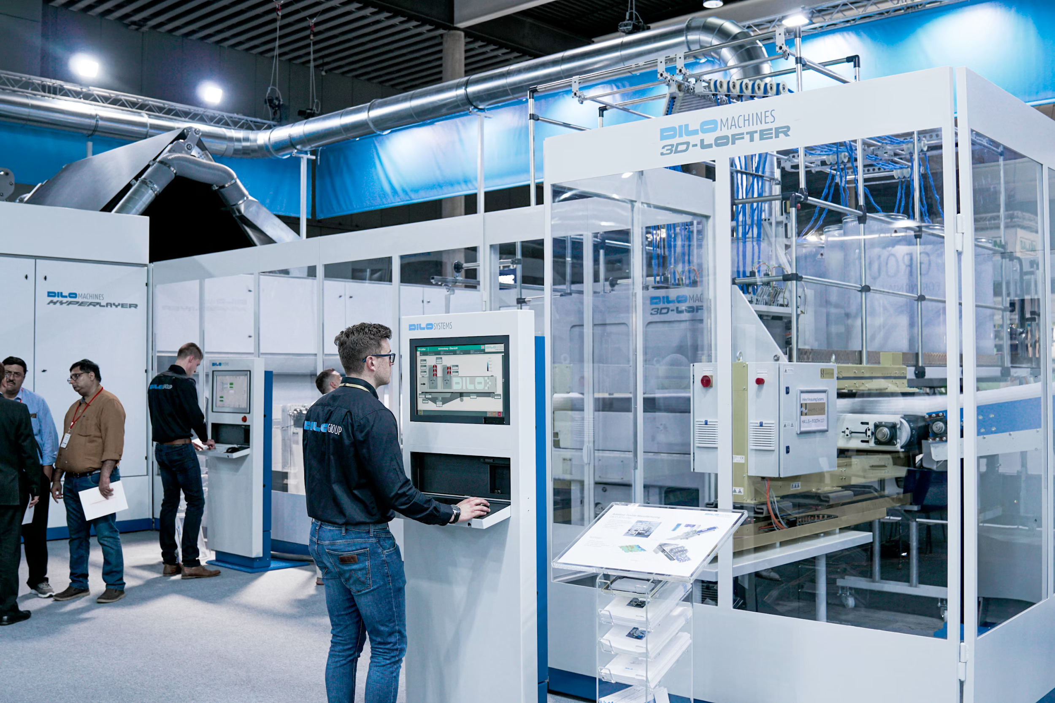
Trends in Tech Innovation
The landscape of technological innovation in 2025 is full of rapid advancements and paradigm shifts, particularly in artificial intelligence (AI), automation, and digital transformation. Across sectors ranging from healthcare and agriculture to finance and manufacturing, the notion of “innovation” is primarily driven by goals of economic efficiency, scalability, and profitability. (Aghion et al 2021, Hernandez-Cortes and Meng 2020, Sanchez-Henriquez and Pavez, 2021)
Photo by Jonas Morgner on Unsplash

Slide 11

Cultural Influences and Power Dynamics
The culture of technological innovation is generally shaped by a complex interplay of stakeholders, including corporations, governments, research institutions, and startups. The dominant narratives prevalent in tech spaces, ranging from startups to governments, often emphasizes technological optimism: the belief that innovation will solve major societal challenges, including environmental problems. However, this optimism can sometimes obscure the risks of unintended consequences or the concentration of power and benefits among a limited set of actors. (Vogel, Rainie and Anderson 2020, Alsaleh 2024)
Photo by Christina @ wocintechchat.com on Unsplash

Slide 12
ACTIVITY #2
POWER MAPPING: ENVIRONMENTAL JUSTICE GAPS/ OPPORTUNITIES IN TECH
Activity
  Identify Stakeholders (10 minutes)
    Brainstorm key players in the ecosystem (tech companies, regulators, communities, etc.).
    Write each stakeholder on a sticky note and place them in the High, Medium, or Low Power sections.
  Map Relationships (15 minutes)
    Draw arrows between stakeholders to show influence or connections (e.g., funding, policy).
    Think about who influences whom and where decisions flow.
  Highlight EJ Gaps (15 minutes)
    Use a different color sticky note to mark missing EJ elements:
    Where are community voices absent?
    Where are power imbalances affecting outcomes?
    Label specific gaps (e.g., lack of community input, transparency issues).
  Reflect and Discuss (10 minutes)
    Share findings:
      What EJ gaps did you find?
      Where could power shift to support justice?
Set Up
  Materials: Whiteboard/paper, sticky notes (3 colors), markers.
  Divide board into 3 sections: High Power, Medium Power, Low Power.
Notes:
This activity helps us visualize power structures in tech innovation. Often, communities most impacted by environmental harm have the least power in decision-making.
For example, in AI-driven climate modeling, tech companies and researchers hold high power, but affected communities have low influence despite facing direct consequences. Identifying these gaps allows us to rethink how innovation can be more equitable.

Slide 13
ACTIVITY #2
POWER MAPPING: ENVIRONMENTAL JUSTICE GAPS/ OPPORTUNITIES IN TECH
Activity
  Identify Stakeholders (10 minutes)
    Brainstorm key players in the ecosystem (tech companies, regulators, communities, etc.).
    Write each stakeholder on a sticky note and place them in the High, Medium, or Low Power sections.
  Map Relationships (15 minutes)
    Draw arrows between stakeholders to show influence or connections (e.g., funding, policy).
    Think about who influences whom and where decisions flow.
  Highlight EJ Gaps (15 minutes)
    Use a different color sticky note to mark missing EJ elements:
    Where are community voices absent?
    Where are power imbalances affecting outcomes?
    Label specific gaps (e.g., lack of community input, transparency issues).
  Reflect and Discuss (10 minutes)
    Share findings:
      What EJ gaps did you find?
      Where could power shift to support justice?
Set Up
  Materials: Whiteboard/paper, sticky notes (3 colors), markers.
  Divide board into 3 sections: High Power, Medium Power, Low Power.
Notes:
This activity helps us visualize power structures in tech innovation. Often, communities most impacted by environmental harm have the least power in decision-making.
For example, in AI-driven climate modeling, tech companies and researchers hold high power, but affected communities have low influence despite facing direct consequences. Identifying these gaps allows us to rethink how innovation can be more equitable.

Slide 14
ACTIVITY #2
POWER MAPPING: ENVIRONMENTAL JUSTICE GAPS IN TECH
Step 3: Map relationships
  Draw arrows between stakeholders to show influence or connections (e.g., funding, policy)
  Think about who influences whom and where decisions flow
Step 1: Set up
Step 4: Highlight EJ gaps
  Materials: Whiteboard/paper, sticky notes (3 colors), markers
  Divide board into 3 sections: High Power, Medium Power, Low Power
  Use a different color sticky note to mark missing EJ elements:
    Where are community voices absent?
    Where are power imbalances affecting outcomes?
  Label specific gaps (e.g., lack of community input, transparency issues)
Step 2: Identify stakeholders
  Brainstorm key stakeholders (i.e. tech companies, regulators, communities)
  Write each stakeholder on a sticky note and place them in the High, Medium, or Low Power sections
Step 5: Reflect and discuss
Share out your findings using these guiding questions:
  What EJ gaps did you find?
  Where could power shift to support justice?
Notes:
This activity helps us visualize power structures in tech innovation. Often, communities most impacted by environmental harm have the least power in decision-making.
For example, in AI-driven climate modeling, tech companies and researchers hold high power, but affected communities have low influence despite facing direct consequences. Identifying these gaps allows us to rethink how innovation can be more equitable.

Slide 15
Case Studies
PART 3

Slide 16
CASE STUDY #1
Agriculture: Automation & Digital Tools
Benefits and Risks of Agricultural Automation
Unintended Consequences and Equity Concerns
  Increased Productivity and Resilience: Automation, including tractors, robotics, and AI, may boost farm outputs, improve resource efficiency, and help adapt to climate change.(Mana et al 2024)
  Potential for Inclusive Gains: When adopted responsibly, it is possible that automation can benefit smallholders, improve working conditions, and create new skilled jobs, especially in regions with labor scarcity.
  Environmental Impact: Automation can lead to more precise use of inputs, reducing overuse of water, fertilizers, and pesticides, and thus supporting environmental sustainability (Aijaz et al 2025)
  Job Displacement and Unemployment: In regions where much employment relies on agricultural work, automation can displace workers, leading to unemployment and reduced remittances for migrant families (FAO)
  Deepening Inequality: Access to automation technologies is uneven, often favoring large producers over smallholders, youth, and women. This can exacerbate existing inequalities (Hackfort 2021, Rotz 2019)
  Land Consolidation and Environmental Degradation: Uneven adoption can drive land consolidation, marginalizing small farmers and leading to environmental issues such as land degradation (Union of Concerned Scientists)

Slide 17
CASE STUDY #2
Digital Technologies: AI, Big Data, & Social Media
Amplified Inequalities and Bias
Surveillance and Social Impact
  Algorithmic Bias: AI and big data systems in hiring, lending, and policing have been shown to replicate and amplify societal biases (OECD 2023)
  Digital Exclusion: The digital divide persists, with rural, elderly, and low-income populations often lacking access to digital tools and the internet. (Yang et al 2024)
  Increased Surveillance: Digital surveillance technologies, such as facial recognition and predictive policing, are deployed more frequently in marginalized communities, raising privacy and civil rights concerns. (Lee and Chin-Rotman, 2022)
  Social Media and Polarization: Big data and social media algorithms can amplify misinformation, polarization, and hate speech, further marginalizing vulnerable groups. (Awasthi 2025)

Slide 18
Beyond the Module
PART 4

Slide 19

PROJECT OPTION #1
Develop an Environmental Justice Impact Assessment Tool
Prompt Suggestion
Create an Environmental Justice Impact Assessment Tool designed to evaluate new technologies through an equity-focused lens. This tool should include clear instructions and guidelines to help users assess potential environmental, social, and economic impacts on marginalized communities. Define the target audience, specifying whether this tool is for policymakers, tech developers, or environmental advocates, to ensure it effectively supports informed, justice-centered decision-making in technology development.
Photo by Pakata Goh on Unsplash

Slide 20
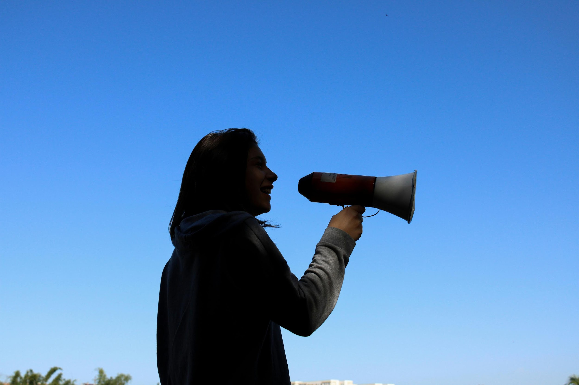
PROJECT OPTION #2
Create a Sample Campaign to Advocate for EJ Principle Adoption
Prompt Suggestion
Design an advocacy campaign to encourage a tech company or industry association to adopt environmental justice principles in their operations and products. Define the campaign type—whether political, social media-driven, or business-focused—and develop key personas representing stakeholders, such as community advocates, ethical investors, or environmentally-conscious consumers. This campaign will use targeted messaging and strategies to build awareness, drive stakeholder engagement, and push for actionable commitments to equity and justice in tech development.
Photo by Juliana Romão on Unsplash

Slide 21
Additional Resources
  Computing for Sustainability : Computer Science professor Samuel Mann’s website exploring sustainable practice in computing
  Indigenous Innovation Initiative: Empowering First Nation, Inuit and Métis innovators and communities
  Critically Conscious Computing: A digital, living book exploring the technical and pedagogical foundations of CS education
  Data and Society Research Institute’s program on Climate, Technology and Justice: A program exploring environmental justice intersections with technology
  Graceful Degradation: A paper discussing the concept of graceful degradation in design
  Jugaad: An introduction to the regional innovation concept of Jugaad

Slide 22
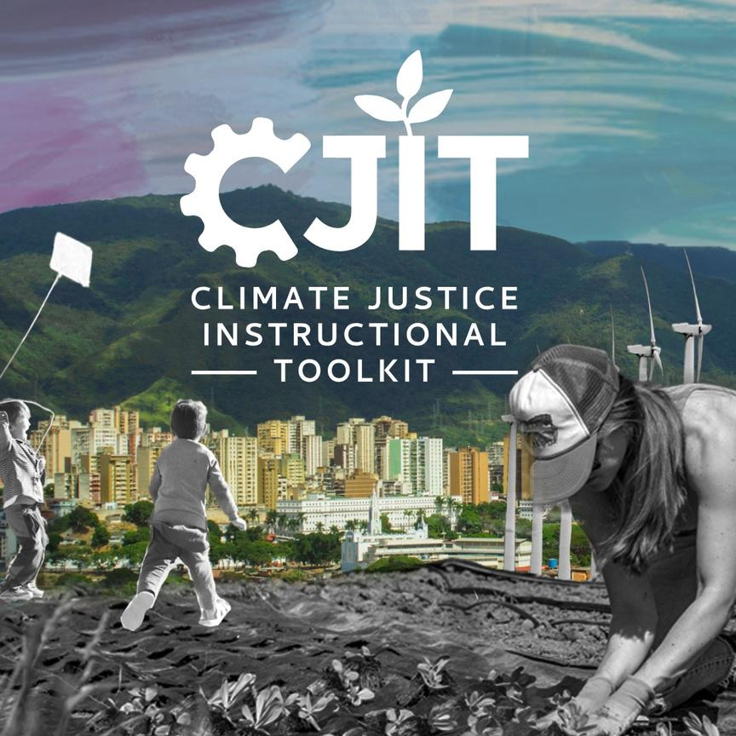
For more resources on climate and environmental justice: Please explore other modules in the Climate Justice Instructional Toolkit.

Slide 23
Module References
  Bullard, R. D. (2001). Environmental justice in the 21st century: Race Still Matters. Phylon (1960-), 49(3/4), 151. https://doi.org/10.2307/3132626
  Christensen, K. (2022, November). Environmental injustices still felt by many, says Robert Bullard (Environmental Factor, November 2022). National Institute of Environmental Health Sciences. https://factor.niehs.nih.gov/2022/11/feature/2-feature-robert-bullard
  Hackett, E. J., Amsterdamska, O., Lynch, M. E., & Wajcman, J. (2007). The Handbook of Science and Technology Studies, third edition. National Geographic Books.
  International Encyclopedia of Human Geography. (2009). Elsevier.
  Juskus, R. (2023). Sacrifice zones. Environmental Humanities, 15(1), 3–24. https://doi.org/10.1215/22011919-10216129
  Latour, B. (1996). On actor-network theory: A few clarifications. Soziale Welt, 47(4), 369–381. http://www.jstor.org/stable/40878163
  Paul, S., & Minns, C. (2024). Upgrading environmental innovation for the 21st century. In Centre for Media, Technology and Democracy. McGill University. https://static1.squarespace.com/static/5ea874746663b45e14a384a4/t/6664bc78b5b58227d30d92b8/1717877880529/CJT_Paul+%26+Minns.pdf
  Project, P. B. (2024, February 5). Tools for participatory democracy: Spectrum of community engagement to ownership - Participatory budgeting. Participatory Budgeting Project. https://www.participatorybudgeting.org/tools-for-participatory-democracy-spectrum-of-community-engagement-to-ownership/
  Taylor, D. (2014). Toxic communities: Environmental Racism, Industrial Pollution, and Residential Mobility. NYU Press.
  The Responsible Innovation Project. (2022, May 2). Home - the Responsible Innovation Project. https://responsibleproject.com/
Stock images found on Canva were used in this module.

Slide 24
MIT OpenCourseWare
https://ocw.mit.edu
RES.11-003 Climate Justice Instructional Toolkit Spring 2025
For more information about citing these materials or our Terms of Use, visit https://ocw.mit.edu/terms.

