Slide 1
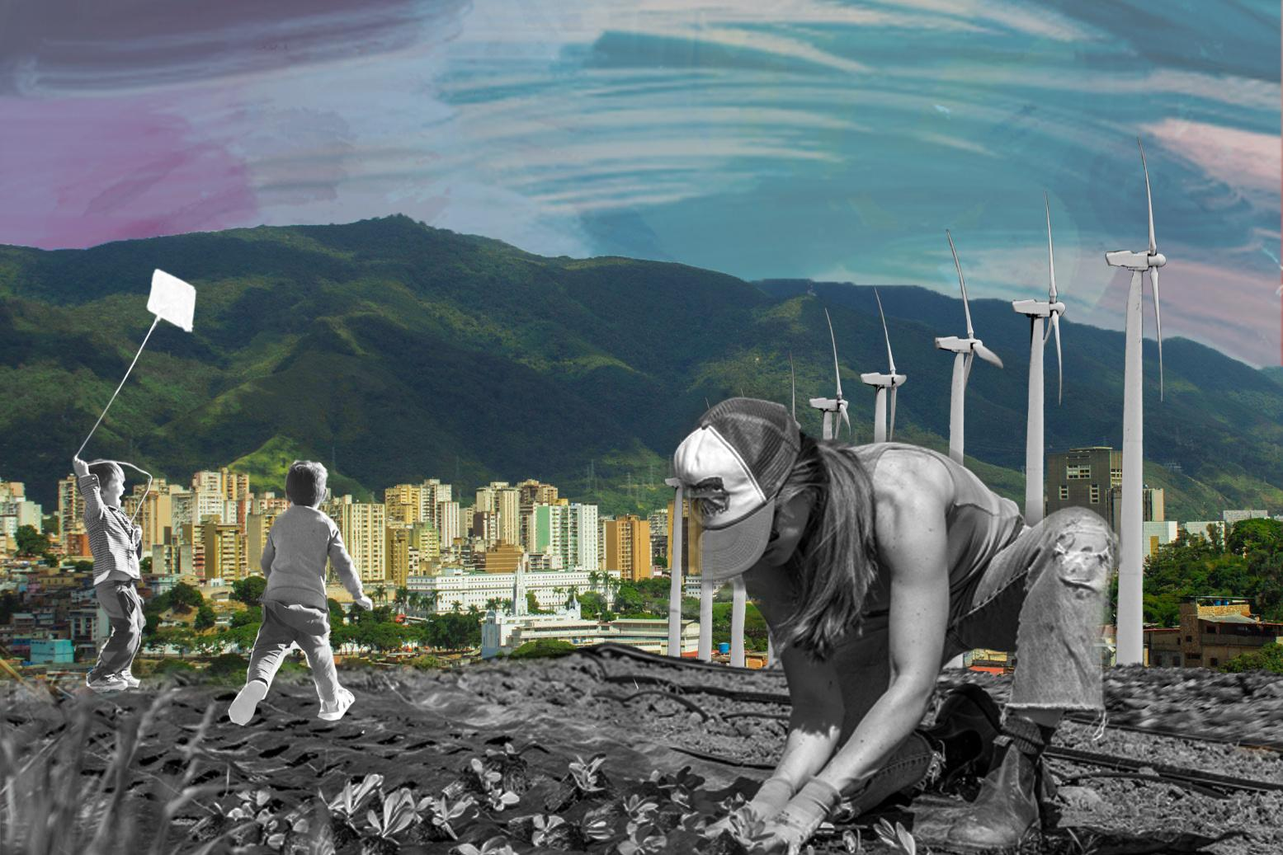

DISCIPLINE-SPECIFIC MODULE
Engineering and Climate Justice 2.0
2.0

Slide 2
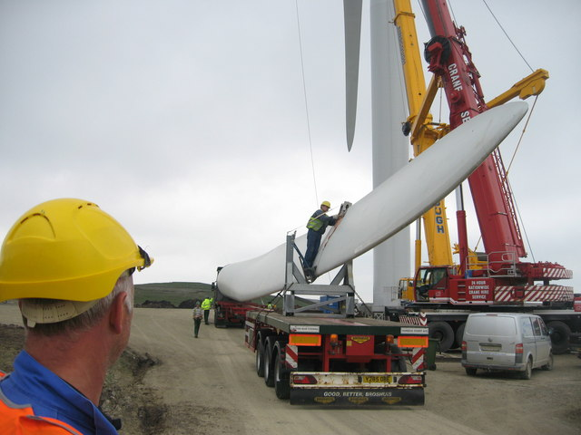
What’s in this module?
Description
This module builds upon the first Engineering Climate Justice Module by examining two major climate events through the lens of engineering and climate justice. Students will apply their engineering knowledge to real world challenges. The goal is to encourage students to think critically about how engineering solutions can perpetuate or address disparities that affect different groups of people.
Activities
Key Resources
4 parts
1 video
22 readings
2 activities
1 optional project
  Empowering Practicing Engineers and planners to advance environmental justice
  Environmental Engineering for the 21st Century: Increasing Diversity and Community Participation to achieve Environmental and Social Justice
  Centering Environmental Justice in the U.S.
Photo by Paul Anderson on geograph. License: CC BY-SA. This content is excluded from our Creative Commons license. For more information, see https://ocw.mit.edu/help/faq-fair-use/ .

Slide 3
Learning Objectives
01
02
03
Apply Engineering Design Principles to real-world problems
Recognize how inequalities shape climate vulnerability
Build empathy and ethical reasoning as an engineering practice

Slide 4
Introduction
PART 1

Slide 5
Distinctions between “Justice” Terms
While this module focuses on climate justice, it is essential to understand the distinctions between Environmental Justice, Climate Justice, and Energy Justice. Each concept highlights different aspects of how communities are impacted by environmental and engineering decisions (UCS).
ENVIRONMENTAL JUSTICE
CLIMATE JUSTICE
ENERGY JUSTICE
“The fair treatment and meaningful involvement of all people regardless of race, color, culture, national origin, income, and educational levels with respect to the development, implementation, and enforcement of protective environmental laws, regulations, and policies.”- Environmental Protection Agency
“Climate justice recognizes the disproportionate impacts of climate chnage on low-income communities and communities of color around the world, the people and places least responsible for the problem.”- University of California Center for Climate Justice
“Energy justice refers to the goal of achieving equity in both the social and economic participation in the energy system, while also remediating social, economic, and health burdens on those historically harmed by the energy system (“frontline communities”).” - Initiative for Energy Justice

Slide 6
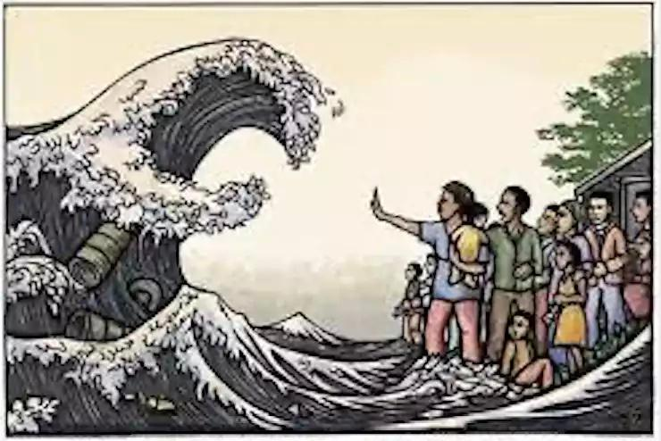
Frontline Communities
Frontline communities experience the most immediate and worst impacts of climate change.
Specific communities of concern
  Black, Indigenous, and People of Color (BIPOC)
  Low-income and working-class families
  Rural, coastal, and under-resources communities
  Communities near pollution producing industries
Resource to review
The US Climate Vulnerability Index uses data to visualize cumulative vulnerabilities on communities across the U.S.
Image by Ricardo Levins Morales, courtesy of Heidi de Vries on Flickr. License: CC BY.

Slide 7
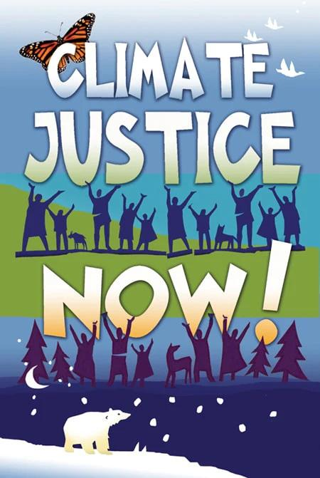
Connection Between Engineering and CJ
Climate justice is a movement that emerged in recent decades, and is something that has begun turning into a priority for engineering and design. This module explores some of the ways in which engineering and climate justice interact, looking at the ways in which engineering and design can help mitigate climate injustices. This module follows the Engineering Climate Justice module 1.0 by assessing real-world examples of climate injustice and thinking through potential engineering solutions.
© Syracuse Cultural Workers. All rights reserved. This content is excluded from our Creative Commons license. For more information, see https://ocw.mit.edu/help/faq-fair-use/ .

Slide 8
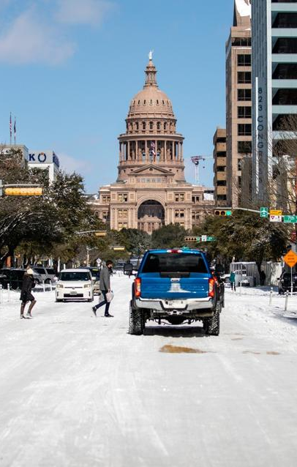
Case Study: Texas Winter Storm Uri
PART 2
© Montinique Monroe / Getty Images. All rights reserved. This content is excluded from our Creative Commons license. For more information, see https://ocw.mit.edu/help/faq-fair-use/ .

Slide 9
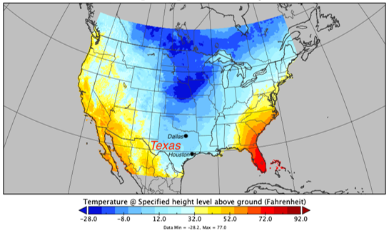
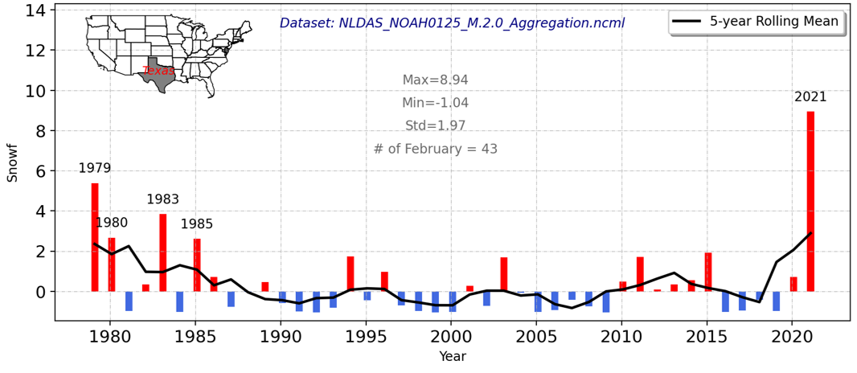
CASE STUDY #1
WEATHER EVENTS, THEIR CAUSES, AND IMPLICATIONS
Map of air temperature across the US on February 16, taken from the North American Land Data Assimilation System (NLDAS-2).
The map shows the air temperature in Texas dropped to 1 - 10°F.
Readings
  Extremely cold Texas in February 2021
  The Great Texas Freeze
Discussion Questions
The years that are labeled exceed the standard deviation. February 2021 was the snowiest February in 43 years.
  What meteorological events led to the development of Texas Winter Storm Uri?
  How do polar vortex contribute to energy disruptions?
Figures from NASA EARTH DATA paper. This content is in the public domain.

Slide 10
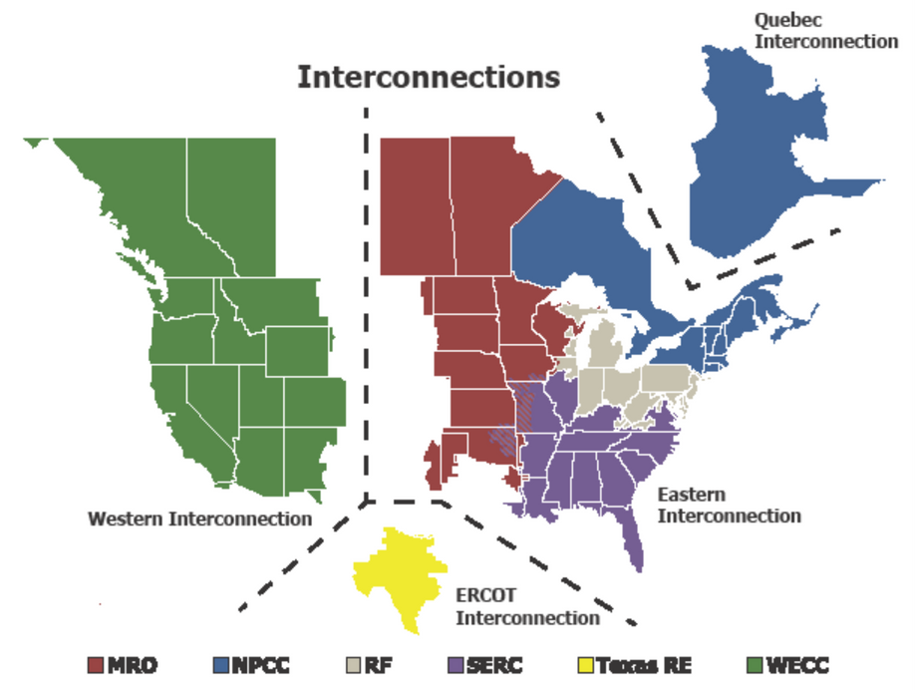
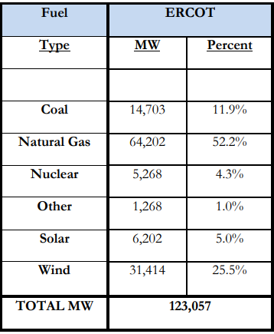
© North American Electric Reliability Corporation. All rights reserved. This content is excluded from our Creative Commons license. For more information, see http://ocw.mit.edu/fairuse .
CASE STUDY #1
ENERGY GENERATION AND DISTRIBUTION
Readings
  ERCOT Winter Storm Report
  Hourly Electric Grid Monitor
Discussion Questions
  What is ERCOT, and how does its independence from other US grids influence its ability to respond to emergencies?
  How do transmission and distribution systems contribute to or limit energy access during a crisis?
  How does the balance between baseload and peaking generation affect reliability during extreme weather?

Slide 11
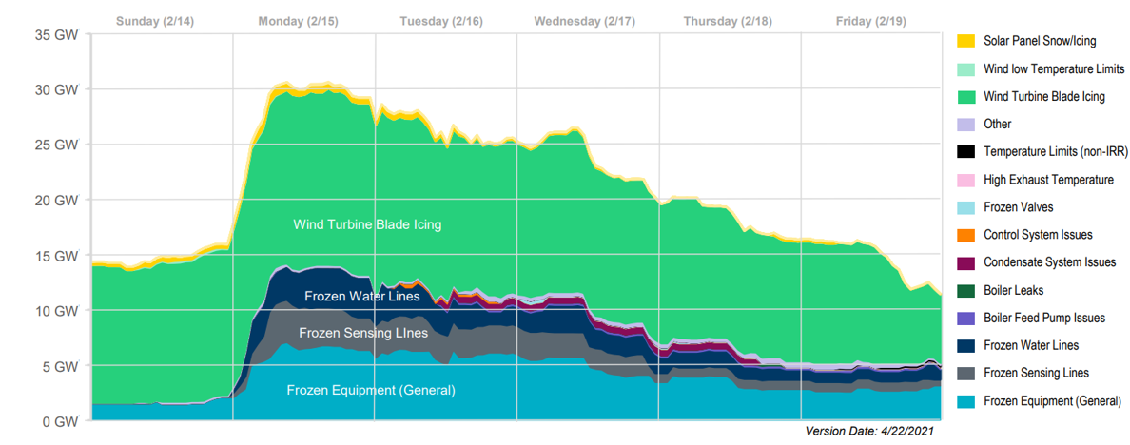
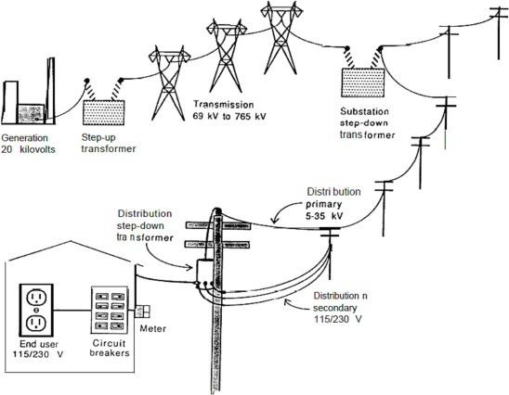
CASE STUDY #1
ERCOT GENERATOR OUTAGES
Readings
  ERCOT Winter Storm Report Pages – 8 - 20
  ERCOT Preliminary Report
Source: North American Electric Reliability Corp (NERC)
Discussion Questions
  Why did natural gas systems fail?
  What could have been done before the storm to prevent blackouts?
Figure from Benjamin K. Sovacool, Sanya Carley, Lynne Kiesling, “Energy justice beyond the wire: Exploring the multidimensional inequities of the electrical power grid in the United States,” Energy Research & Social Science (111), 2024. Courtesy of Elsevier, Inc., https://www.sciencedirect.com. Used with permission.

Slide 12
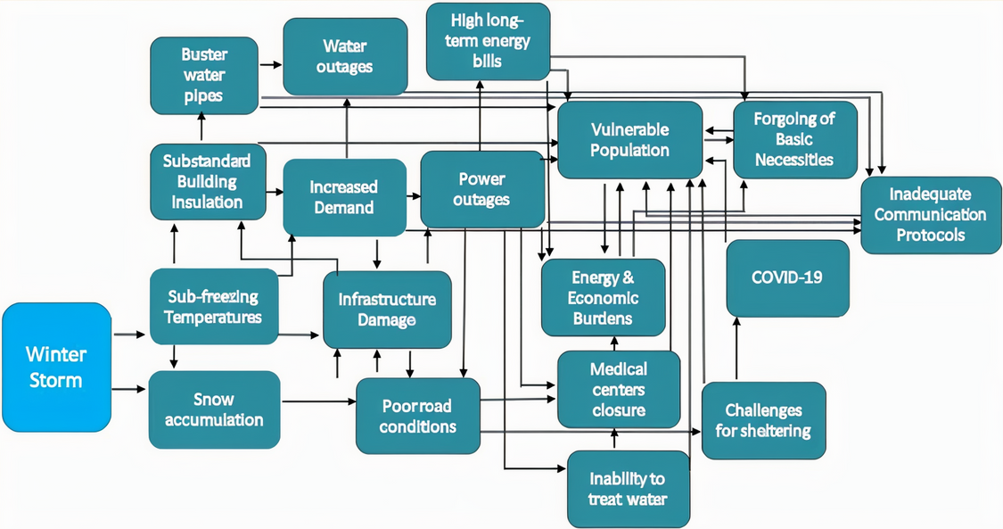
CASE STUDY #1
EXPLORING THE INTERCONNECTED CHALLENGES OF CLIMATE AND ENERGY JUSTICE
Discussion Questions
  Which communities in Texas were most affected by power outages and why?
  In what ways did the winter storm expose the intersection of climate vulnerability and social inequality?
  How does underinvestment in public infrastructure relate to the scale of damage experienced?
Readings
  A synthesis review of exacerbated inequalities from the 2021 Winter Storm (Uri) in Texas
  Energy Justice behind the wire
Flow chart highlighting the system interdependencies related to the winter storm. (Figure from Castellanos et al., 2023, License: CC BY.)

Slide 13
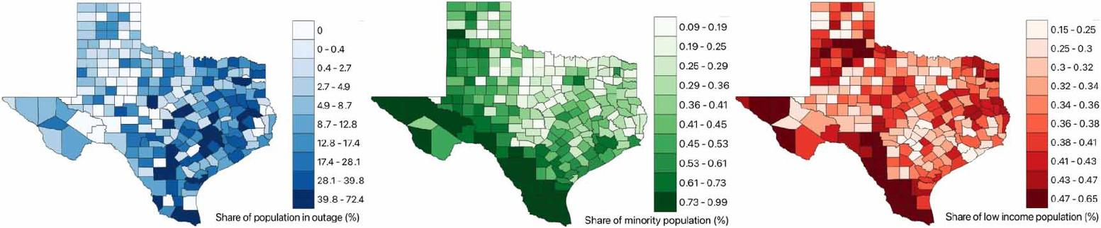
CASE STUDY #1
HOW CAN DATA BE USED TO QUANTIFY CLIMATE INJUSTICE?
Reading
  The inequitable distribution of power interruptions during the 2021 Texas winter storm Uri
Figures from Shah et al. (2023). License: CC BY.
Discussion Questions
  How can we use data to inform recovery plans and prioritize resource distribution after climate disasters?
  How can data transparency from utilities or the government promote accountability?

Slide 14
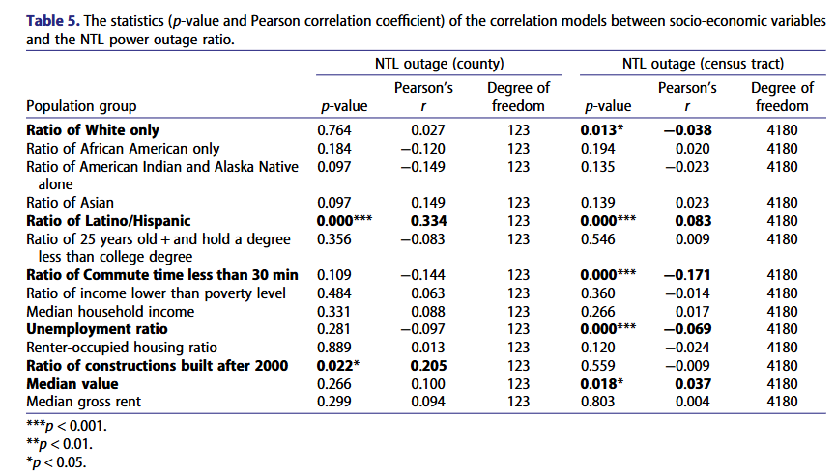
CASE STUDY #1
CLIMATE JUSTICE
Reading
  Power Outage and Environmental Justice
Discussion Questions
  How is energy burden used as a metric of energy injustice? What other metrics should be considered?
  What statistical methods can be used to link infrastructure failure with socioeconomic or racial disparities?
Xu et al. (2023)

Slide 15
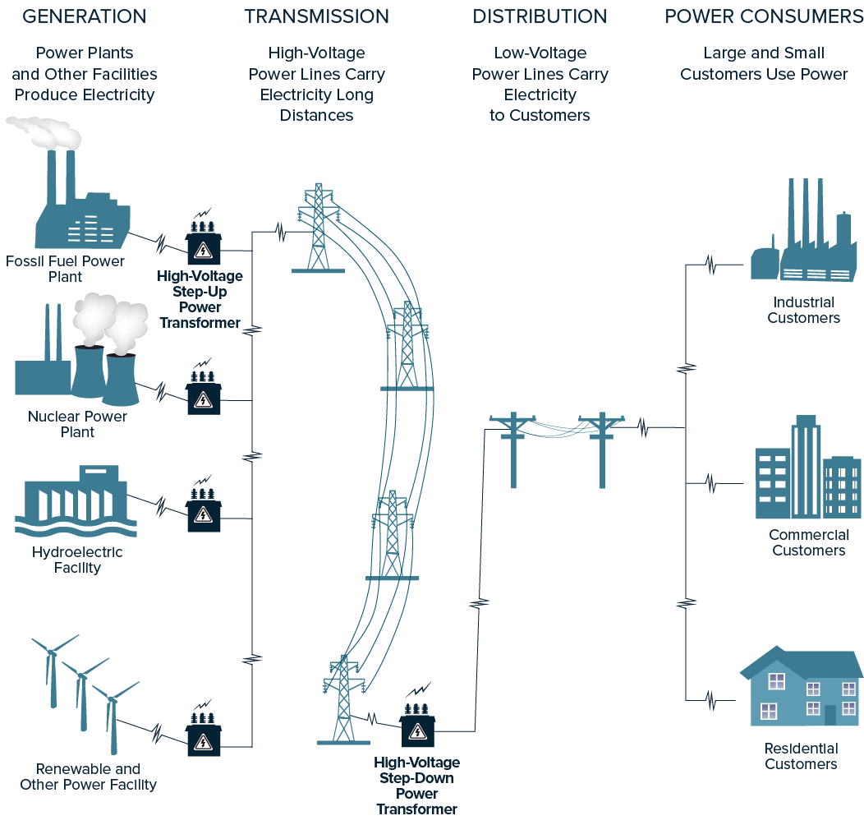
ACTIVITY #1
DIAGRAMING A JUST GRID
Create a diagram
Create a flow diagram of system failures and interdependencies in Texas. Highlight how grid modernization can incorporate principles of climate justice.
Discuss
How might we design a system that ensures the most vulnerable communities remain protected?
© Connecticut House Democrats. All rights reserved. This content is excluded from our Creative Commons license. For more information, see https://ocw.mit.edu/help/faq-fair-use/ .

Slide 16
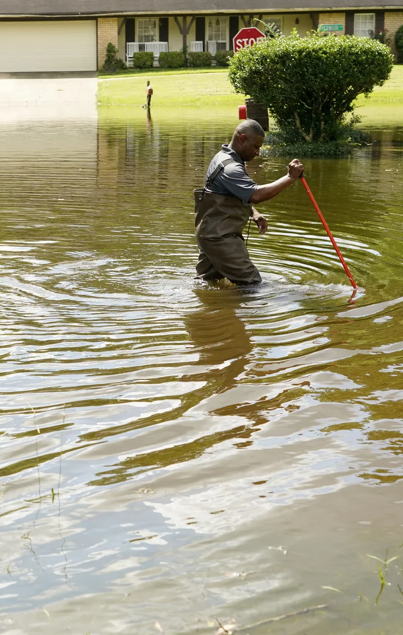
Case Study: Water Crisis Jackson, MS
PART 3
© Rogelio V. Solis / AP. All rights reserved. This content is excluded from our Creative Commons license. For more information, see https://ocw.mit.edu/help/faq-fair-use/ .

Slide 17
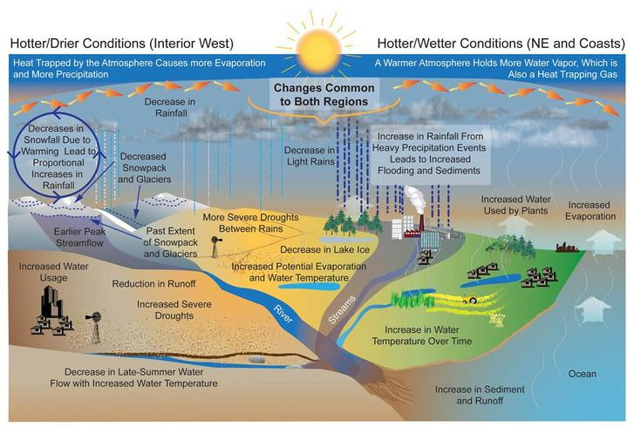
CASE STUDY #2
How Climate Change Impacts Water
Readings
  The Crisis in Jackson shows how Climate Change is threatening water supplies
  Flooding Treatment plant failure leaves Jackson, Mississippi without drinking water
  Lack of State Financial Support and Local Capacity Prolonged Jackson, Mississippi Drinking Water Issues (p. 1 - 7)
Discussion questions
  How are climate change and water infrastructure connected?
  Why are historically underfunded systems like Jackson more vulnerable to climate events?
  Who should be responsible for funding and implementing climate adaptation strategies in cities like Jackson?
This image is in the public domain.

Slide 18
CASE STUDY #2
Understanding the Technical Failures of the Jackson Water Crisis
Readings
  Decrepit pipes put Jackson, Mississippi on the Edge of a Catastrophe.
  Big Companies Cashed in on Mississippi’s Water. Small Towns Paid the Price
  Jackson water crisis reveals perils of neglected infrastructure
Discussion questions
  What specific engineering systems failed during the crisis?
  What are the typical components of a municipal water system? How do they react under stress?
  How do engineers typically assess the resilience of infrastructure systems?
  How do they design for these disasters? Identify gaps in the design process.

Slide 19
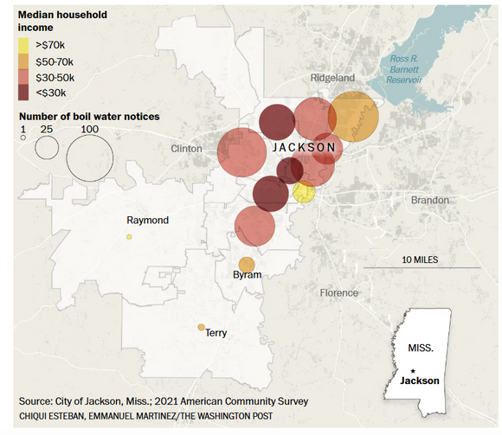
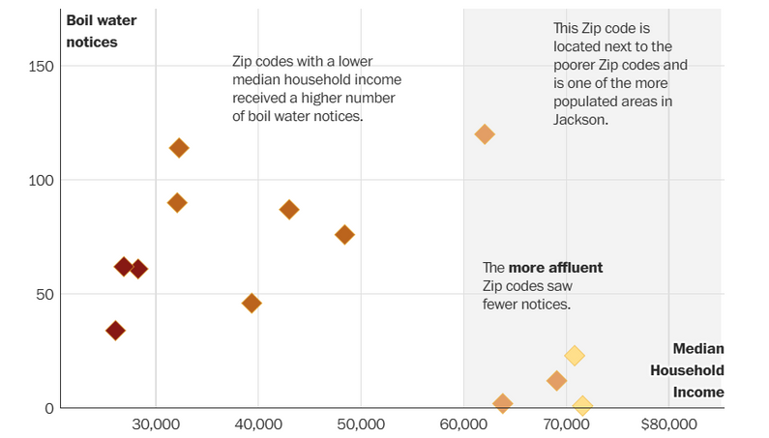
CASE STUDY #2
RESPONSIBILITY, INFRASTRUCTURE, & DISPROPORTIONATE IMPACTS
Neighborhoods where the median household income was less than 50k saw double the boiling notices compared to neighborhoods with higher income
Readings
  Decrepit pipes put Jackson, Mississippi on the Edge of a Catastrophe.
  Big Companies Cashed in on Mississippi’s Water. Small Towns Paid the Price
  Jackson water crisis reveals perils of neglected infrastructure
Poorer neighborhoods experience more problems with water connections
Discussion Questions
  Why did Jackson—an overwhelmingly Black and low-income city—experience such severe consequences from a climate-related water crisis?
  How would the response have differed if this crisis occurred in a wealthier or whiter city?
  How should engineers prioritize projects when resources are limited—efficiency, cost, or justice?
Images from Washington Post

Slide 20
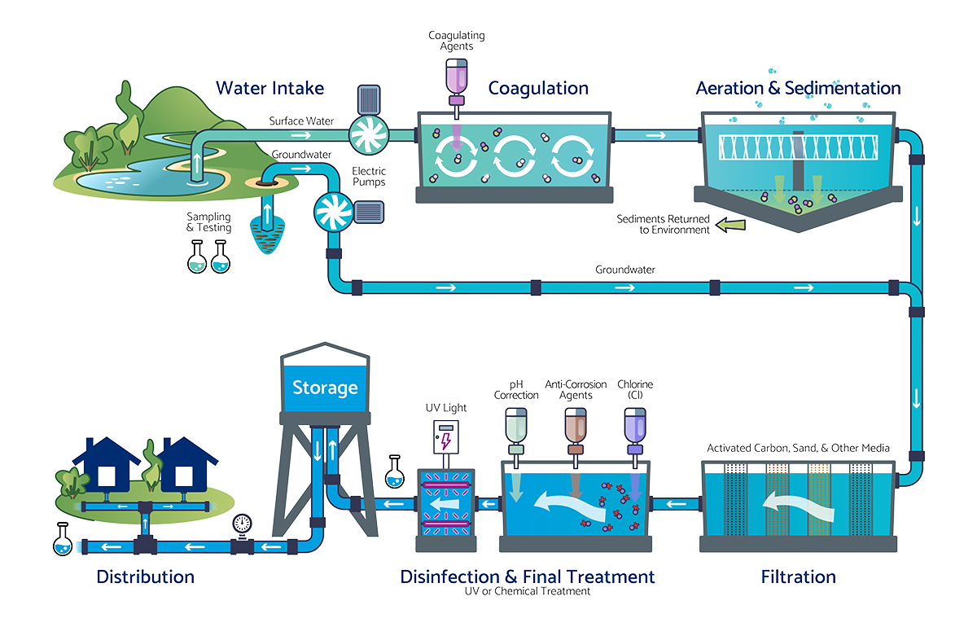
ACTIVITY #2
DESIGN
Choose 2 different components of a water distribution system. Describe how these components failed, then provide redesign suggestions of these components to maintain access to clean water during a climate-related emergency (e.g., flood, freeze, or power outage), using Jackson as a model.
Consider the following:
  Budgetary concerns (low-cost)
  Resiliency
  Population and location
© Nexus Water Group. All rights reserved. This content is excluded from our Creative Commons license. For more information, see https://ocw.mit.edu/help/faq-fair-use/ .
Image from Tennessee Water Service

Slide 21
Beyond the Module
PART 4

Slide 22

PROJECT OPTION #1
Case Study Analysis
Prompt suggestion
Work in groups to create a presentation describing the technical details of an engineering-related case study and its climate justice aspects.
Guiding questions
  What was the cause of the event?
  Who was impacted?
  How was the impact measured?
  What was the community response?
Photo by ThisisEngineering on Unsplash

Slide 23
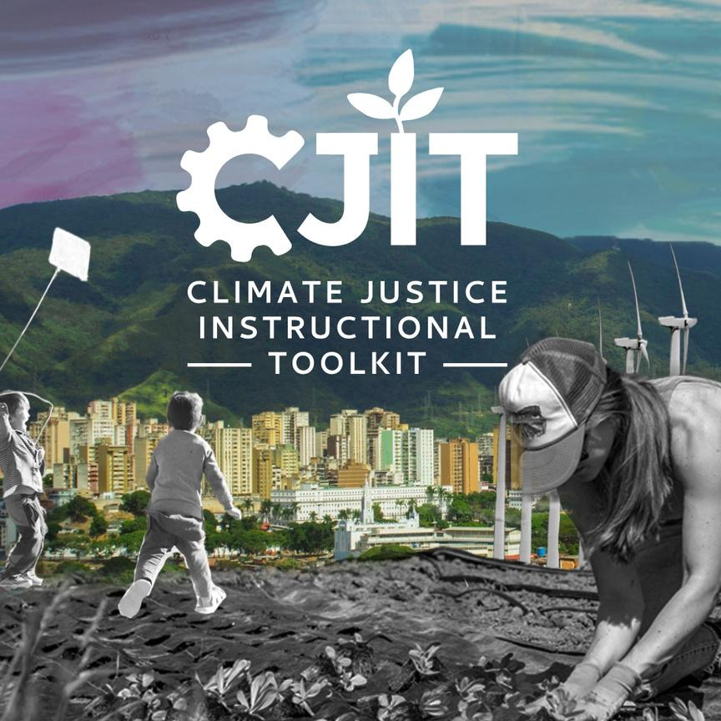
For more resources on climate and environmental justice: Please explore other modules in the Climate Justice Instructional Toolkit.

Slide 24
Module References
  Bloom, J. B., Burks, M., Liu, C.-Y., Taylor-Upshaw , G., Walker , K., & McCowan, L. (2024, May 13). Lack of State Financial Support and Local Capacity Prolonged Jackson, Mississippi Drinking Water Issues. Office of Inspector General.
  Castellanos, S., Potts, J., Tiedmann, H., Alverson, S., Glazer, Y. R., Robison, A., Russo, S., Harmon, D., Ken-Opurum, B., Weisz, M., Acuna, F., Stephens, K. K., Faust, K., & Webber, M. E. (2023). A synthesis and review of exacerbated inequities from the February 2021 winter storm (Uri) in Texas and the risks moving forward. Progress in Energy, 5(1), 012003.
  Darshan M. A. Karwat, Blakley, J. R., Castillo, E. A., Squitieri, A., Oyler, A., & Macias, M. M. (2025). Empowering Practicing Engineers and Planners to Advance Environmental Justice. Journal of Civil Engineering Education, 151(3).
  Environmental Justice, Climate Justice, and Energy Justice—What Do They Mean? (2025). Union of Concerned Scientists.
  ERCOT Preliminary Report. (2021, April 6). ERCOT.
  FERC -NERC -Regional Entity Sta Report: The February 2021 Cold Weather Outages in Texas and the South Central United States Federal Energy Regulatory Commission North American Electric Reliability Corporation Regional Entities. (2021).
  Fowler, S., & Doyle, R. (2024, February 5). Big Companies Cashed In on Mississippi’s Water. Small Towns Paid the Price. The New York Times.
  Judin, N. (2024, August 16). Decrepit Pipes Put Jackson, Mississippi, on the Edge of Catastrophe. State Regulators Didn’t Act. ProPublica.

Slide 25
Module References
  Klasing, A. (2022, September 2). Mississippi Water Crisis a Failure Decades in the Making. Human Rights Watch.
  Landers, J. (2022, November 7). Jackson water crisis reveals perils of neglected infrastructure. Www.asce.org.
  Lott, J. (2023, February 18). The problems in the pipes. Washington Post.
  Méndez, M., Shah, S. H., Golembeski, C., Bedsworth, L., Mijin Cha, J., Goldsmith, L., Holmes, T. J., Maldonado, J., Manning, B. R. M., Méndez-Barrientos, L. E., & Mills-Novoa, M. (2025). Centering environmental justice in United States (U.S.) National Climate Assessments (NCAs): a historical and contemporary analysis. Climatic Change, 178(5).
  Meng, Q. (2022). Urban Water Crisis Causes Significant Public Health Diseases in Jackson, Mississippi USA: An Initial Study of Geographic and Racial Health Inequities. Sustainability, 14(24), 16325.
  Montoya, L. D., Mendoza, L. M., Prouty, C., Trotz, M., & Verbyla, M. E. (2021). Environmental Engineering for the 21st Century: Increasing Diversity and Community Participation to Achieve Environmental and Social Justice. Environmental Engineering Science, 38(5), 288–297.
  National Centers For Environmental Information. (2023, February 23). The Great Texas Freeze: February 11-20, 2021. National Centers for Environmental Information (NCEI).
  Neuman, S. (2022, September 7). The crisis in Jackson shows how climate change is threatening water supplies. NPR.
  Pan , X., & Rui , H. (2023). GES DISC. Nasa.gov.
  Real-time Operating Grid - U.S. Energy Information Administration (EIA). (2025, June 30). Www.eia.gov

Slide 26
Module References
  Shah, Z., Juan Pablo Carvallo, Hsu, F.-C., & Taneja, J. (2023). The inequitable distribution of power interruptions during the 2021 Texas winter storm Uri. Environmental Research: Infrastructure and Sustainability, 3(2), 025011–025011. https://doi.org/10.1088/2634-4505/acd4e7
  Sovacool, B. K., Carley, S., & Kiesling, L. (2024). Energy justice beyond the wire: Exploring the multidimensional inequities of the electrical power grid in the United States. Energy Research & Social Science, 111, 103474–103474. https://doi.org/10.1016/j.erss.2024.103474
  Xu, J., Qiang, Y., Cai, H., & Zou, L. (2023). Power outage and environmental justice in Winter Storm Uri: an analytical workflow based on nighttime light remote sensing. International Journal of Digital Earth, 16(1), 2259–2278. https://doi.org/10.1080/17538947.2023.2224087
  Yang, J. (2022, August 30). Flooding, treatment plant failure leaves Jackson, Mississippi without drinking water. PBS NewsHour.

Slide 27
MIT OpenCourseWare
https://ocw.mit.edu
RES.11-003 Climate Justice Instructional Toolkit Spring 2025
For more information about citing these materials or our Terms of Use, visit https://ocw.mit.edu/terms.

