Slide 1

DISCIPLINE-SPECIFIC MODULE
Engineering
Climate Justice

Slide 2
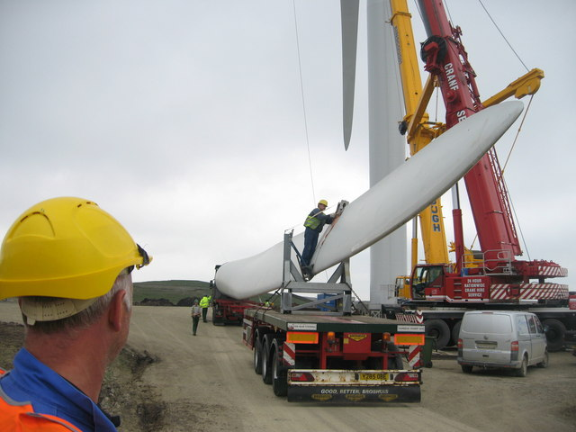
What’s in this module?
Contents
This module combines engineering with concepts of climate justice, discusses how engineering decisions impact people’s lives, and encourages students to discuss how justice is at the heart of engineering.
Activities
Key Resources
3 parts
1 video
5 readings
5 activities
3 optional projects
  Engineering climate justice: how can we contribute to equitable global decarbonization?
  Engineering for the People: Putting Peace, Social Justice, and Environmental Protection at the Heart of All Engineering
  The climate is changing. Engineering education needs to change as well.
Photo by Paul Anderson on geograph. License: CC BY-SA. This content is excluded from our Creative Commons license. For more information, see https://ocw.mit.edu/help/faq-fair-use/ .

Slide 3
Learning Objectives
01
02
03
04
Understand engineering as a proactive approach to climate justice
Identify the intersection between environmental justice and engineering
Discuss personal responsibilities as engineers
Explore case studies from MIT

Slide 4
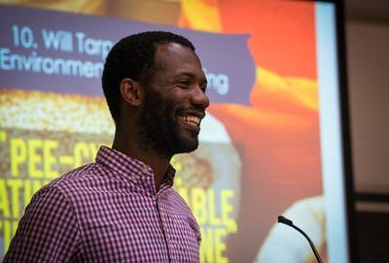
Introduction
PART 1
"Will Tarpeh, Civil and Environmental Engineering “Pee-cycling: Creating Sustainable Fertilizer from Urine”" Photo courtesy of umseas on Flickr. License: CC BY.

Slide 5
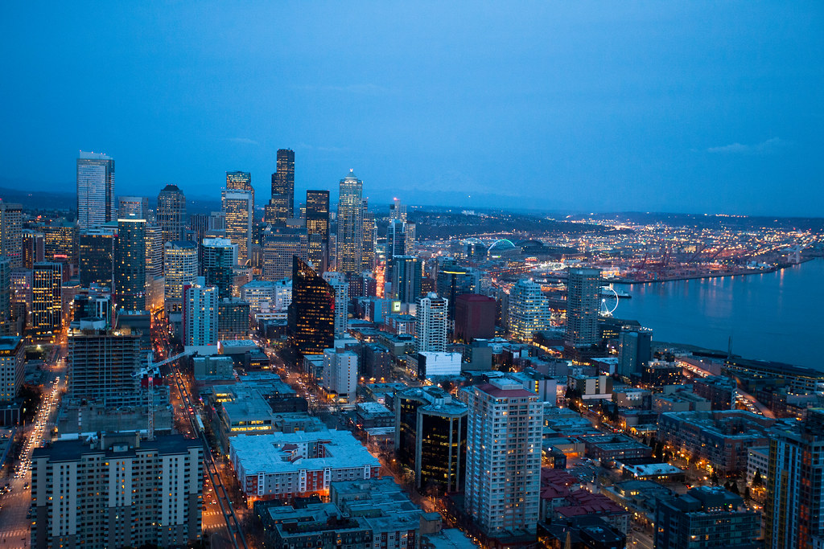
Photo courtesy of John Tregoning on Flickr. License: CC BY.
Introduction
What is climate justice?
“As engineering continues to move society forward in innovative, exciting ways, it also interacts with the ongoing climate crisis. Climate justice recognizes the disproportionate impacts of climate change on low-income and BIPOC communities around the world, the people and places least responsible for the climate crisis.” (Center for Climate Justice)
Connection between engineering and CJ
Climate justice is a movement that emerged in recent decades, and is something that has begun turning into a priority for engineering and design. This module explores some of the ways in which engineering and climate justice interact, looking at the ways in which engineering and design can help mitigate climate injustices.

Slide 6
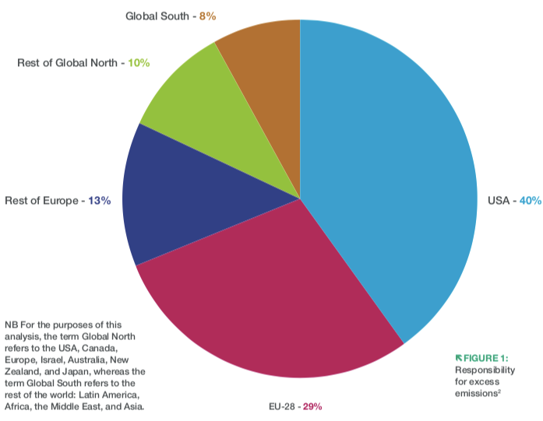
Review: Engineering Climate Justice
Key point
High income countries need to focus on decarbonizing faster, and engineers have a role to play in pushing for infrastructure changes that work towards these goals.
People in lower-income countries face a triple injustice
  A disproportionately large impact from climate change
  Structural disadvantage
  A block on development
Figure 1: Global Responsibility for Excess Emissions - adapted from (Newby, 2022)

Slide 7
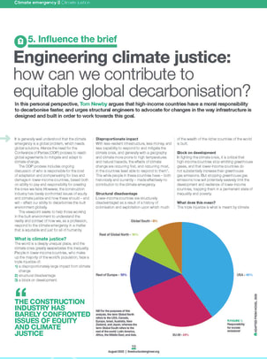
ACTIVITY #1
AN INTRODUCTION TO ENGINEERING CLIMATE JUSTICE
Read
Engineering Climate Justice: how can we contribute to equitable global decarbonisation?
Post-reading discussion questions
  Discuss the triple injustice; can you think of examples of each kind?
  How are engineers' moral obligations also pragmatic ones?
  What are the implications of climate justice for engineers?
  What critiques do you have of this article?
© The Institution of Structural Engineers. All rights reserved. This content is excluded from our Creative Commons license. For more information, see https://ocw.mit.edu/help/faq-fair-use/ .

Slide 8
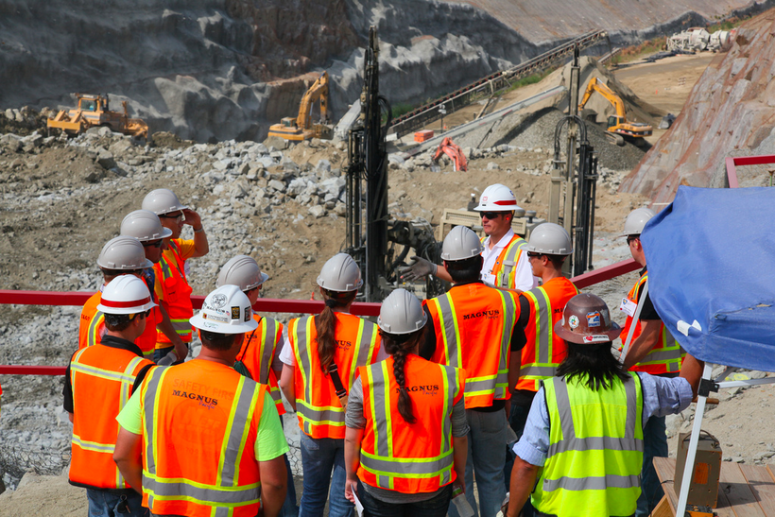
ACTIVITY #2
DIVING DEEPER INTO ENGINEERING CLIMATE JUSTICE
Post-reading discussion questions
  How is community and community engagement centered in this article? How does community participation and impact bring together engineering and environmental justice?
  What notions of justice are covered in this article? What notions of justice are important when considering how engineering processes impact communities?
Read
Engineering and Environmental Justice
U.S. Army Corps of Engineers photo by Michael J. Nevins. This image is in the public domain.

Slide 9
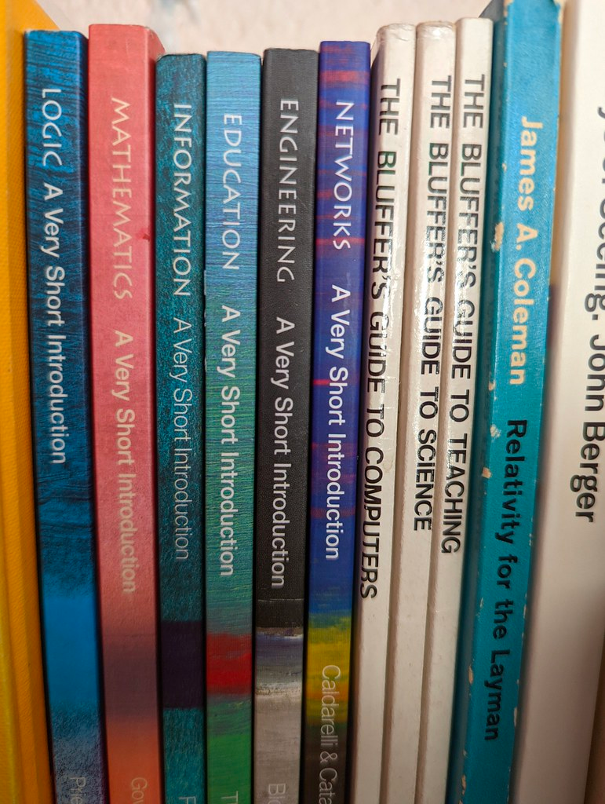
Climate Justice in Engineering Education
PART 2
Photo courtesy of dullhunk on Flickr. License: CC BY.

Slide 10
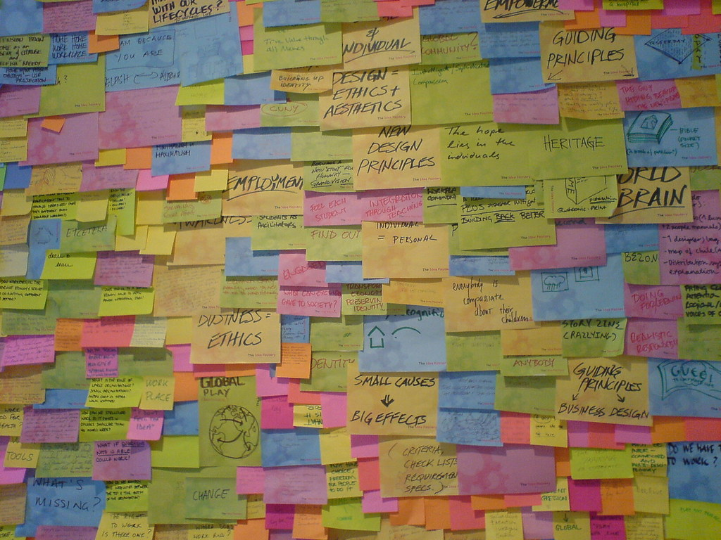
Brainstorm
How should engineering education change to better address issues of environmental & climate justice?
“Empowering engineers with the skills to address the challenges created by climate change requires adapting both the technological and philosophical frameworks used in engineering education”
– The Research Journal for Engineering Education
Photo by Jacob Bøtter on Flickr. License: CC BY.

Slide 11
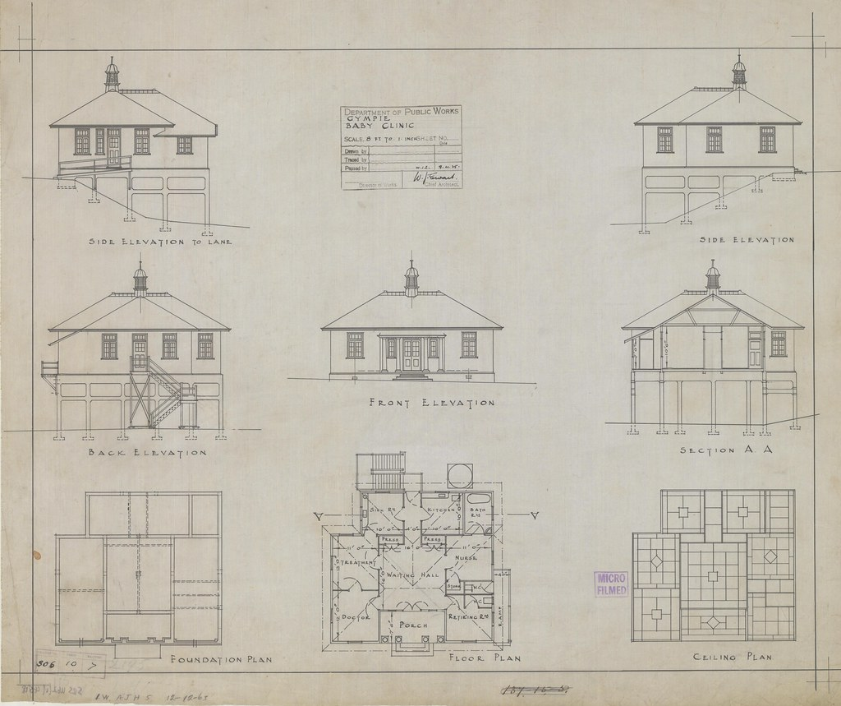
This image is in the public domain.
Review: The climate is changing. Engineering education needs to change as well.
Discuss your thoughts
  According to the article, how should engineering education change in the face of climate change and climate justice?
  What are the engineering skill sets in relation to climate justice , and why is are they necessary? Which skill set stands out most to you and why?
  In your opinion and experience, have the engineering classes you have taken sufficiently included issues of climate and climate justice? Why or why not?

Slide 12
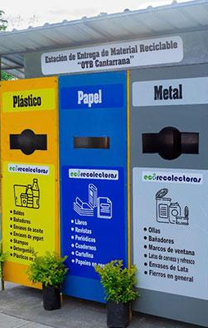
Climate Justice: The Design Challenge
PART 3
Photo from MIT D-Lab’s work with the adaptive design center in Mexico
© Frankie Schulte / MIT D-Lab. All rights reserved. This content is excluded from our Creative Commons license. For more information, see https://ocw.mit.edu/help/faq-fair-use/ .

Slide 13
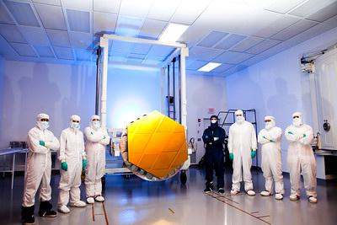
"Gold-coated Engineering Design Unit (EDU) Primary Mirror Segment" by James Webb Space Telescope is licensed under CC BY 2.0.
Brainstorm
How should climate justice be incorporated as a critical component of engineering design?

Slide 14
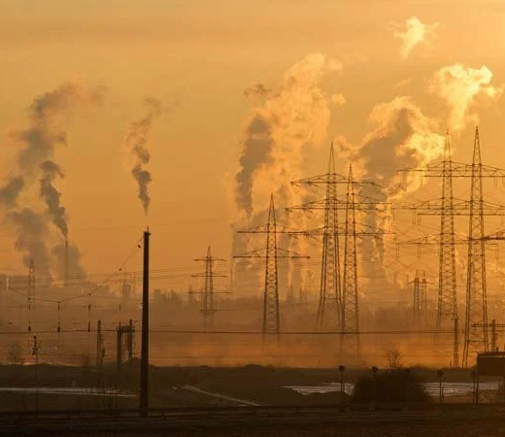
ACTIVITY #3
FURTHER EXAMINATION OF JUSTICE
Read
Climate Justice is the design challenge of our lives
Post-reading discussion questions
  In what ways is the climate crisis an issue of social justice?
  According to the article, how do engineers interact with underserved communities?
  As engineers, how do we benefit from solving problems of injustice?
  What would it mean to adopt climate justice as a foundational principle of design? What would a climate justice design protocol look like?
Image by Ralf Vetterle from Pixabay is in the public domain (CC-0).

Slide 15
ACTIVITY #4
CASE STUDIES AND JIGSAW ACTIVITY
Read and discuss
In your groups, spend about 5-10 minutes reading about your case study and taking note of how it relates to climate justice and design. Then, take another 5 minutes to briefly discuss within your groups what you took note of.
Group and pick a case study
In 3 groups, pick one of these case studies to research:
  Anthro-Engineering in Mongolia
  Environmental Engineering and Climate Justice: An Interview with Juliana Mitkiewicz
  Xylem Water Filters
Jigsaw discussion
Get into groups of 3, where each person read a different case study, give a brief outline of the case study that you read about and then discuss these questions:
  What helped with the success in the project? What roles did the engineers of the project play? How were community members or organizations included in the design process?
  What are some ideas can you take with you to implement in future projects (either climate justice related or not)?
  What were some elements of climate justice or social justice that you noticed?

Slide 16
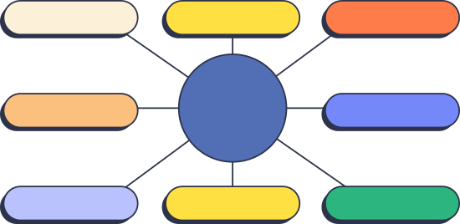
ACTIVITY #5
BUILDING A CONCEPT MAP
Create a concept map
Make a concept map for how engineering can consider and address issues of climate injustice. Think about how different sectors of engineering might have different opportunities and capabilities, and brainstorm any possible incentives for engineers and engineering firms to consider and address climate justice.
Read
Engineering for the People: Putting Peace, Social Justice, and Environmental Protection at the Heart of All Engineering
Discussion questions
In groups of 3-5 people, discuss these questions and think about real life examples:
  How can we bring CJ closer to the heart of engineering’s goals?
  Which subfields of engineering need to grow to meet the new demands of a changing climate and ensure greater social parity? Which fields within engineering need to diminish, or be transformed?

Slide 17
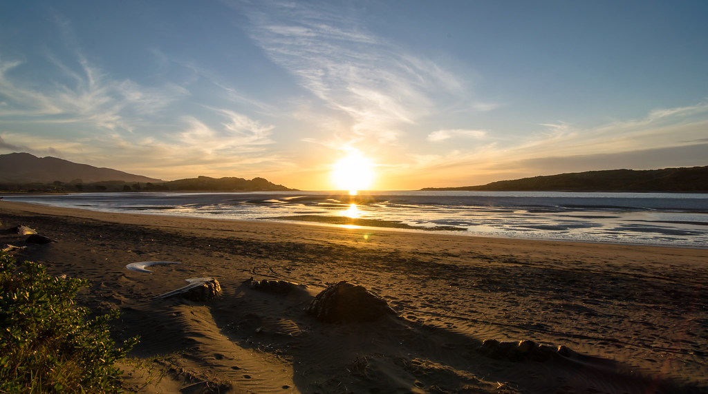
Beyond the Module
PART 3
Photo by Tom Hall on Flickr. License: CC BY.

Slide 18
PROJECT OPTION #1
Develop a Climate Justice Design Protocol
Prompt suggestion
Work with a group to develop a Climate Justice Design Protocol.
Guiding Questions
  How would it inform engineers or designers that are not familiar with climate justice?
  What key climate or environmental justice concepts from this module could be included as critical parts of this protocol?
  How would the protocol include voices and experiences from community members or organizations that face climate related problems and threats?

Slide 19
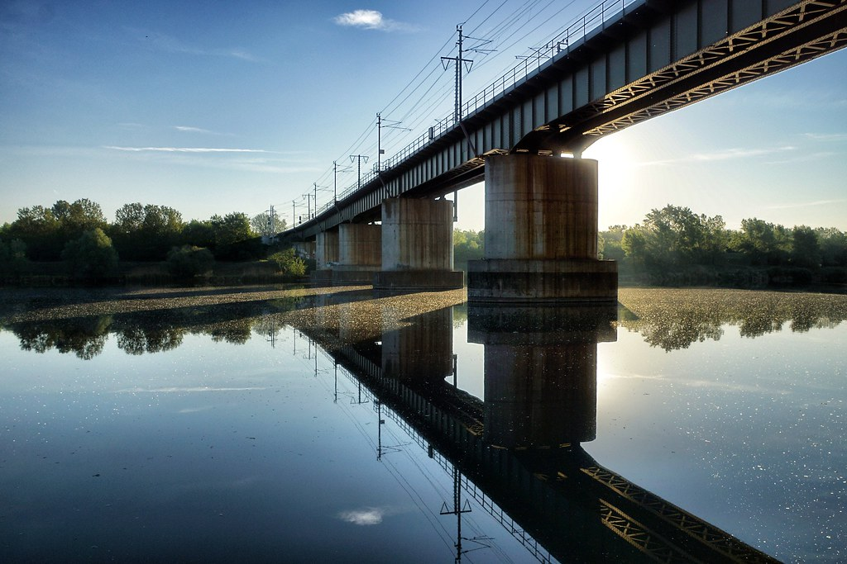
PROJECT OPTION #2
Presentation Connecting What You’ve Learned to a Previous Project
Prompt suggestion
Create a presentation on a current or past project you are working on and explain how Tom Newby’s discussion of climate justice could be included in the design process.
What principles from his article (facts, theories, arguments) are critical to include in civil and environmental engineering?
Photo by David McGregor on Flickr. License: CC BY-SA. © [include copyright holder]. This content is excluded from our Creative Commons license. For more information, see https://ocw.mit.edu/help/faq-fair-use/ .
891faf28a?q=bridge&p=4

Slide 20
PROJECT OPTION #3
Essay on Implementing CJ Concepts into an Important Project
Prompt suggestion
Imagine you were designing a needed engineering or design project of your choice in Massachusetts or in a community you know well.
How could you implement climate justice concepts into a design— considering how engineering has a relationship with both the earth and social injustices?

Slide 21
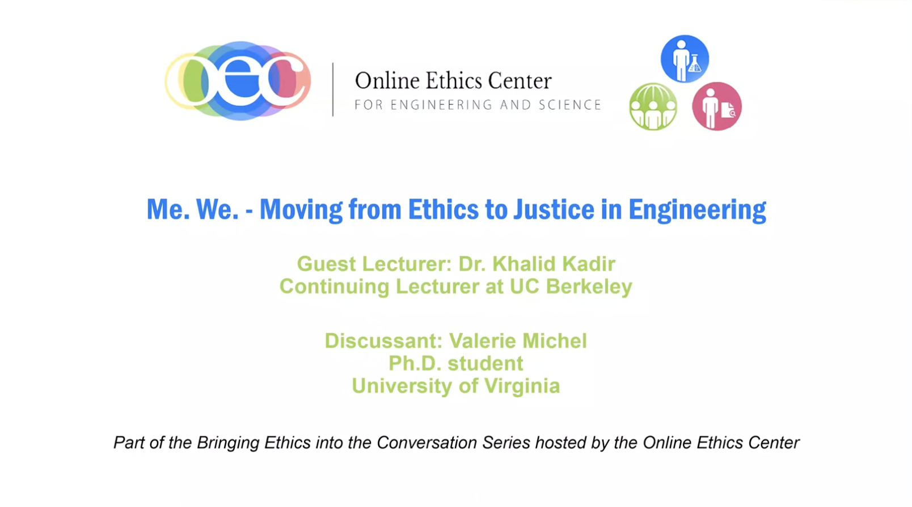
Additional Resource
  Video lecture from Khalid Kadir: Me. We. - Moving from Ethics to Justice in Engineering
© Online Ethics Center / UVA. All rights reserved. This content is excluded from our Creative Commons license. For more information, see https://ocw.mit.edu/help/faq-fair-use/ .

Slide 22

For more resources on climate and environmental justice: Please explore other modules in the Climate Justice Instructional Toolkit.

Slide 23
Module References
  University of California Center for Climate Justice. (2023). What is Climate Justice? Centerclimatejustice.universityofcalifornia.edu.
  Daly, L. A. (2023). Climate justice is the design challenge of our lives. Leoadaly.com.
  Jye , J. (2023). Powering the future in Mongolia. MIT News | Massachusetts Institute of Technology.
  KARWAT, D. M. A. (2018). Engineering for the People: Putting Peace, Social Justice, and Environmental Protection at the Heart of All Engineering. National Library of Medicine.
  Xylem water filter. MIT D-Lab. (n.d.).
  Adeshokan, O. (2020). How Makoko, Nigeria’s floating slum went digital with new Mapping Project. CNN.
  Martin, M.J., Diem, S.J., Karwat, D.M.A., Krieger, E.M., Rittschof, C.C., Bayon, B., Aghazadeh, M., Asensio, O., Zeilkova, T.J., Garcia-Cazarin, M., Alvelo Maurosa, J.G. and Mahmoud, H. (2022). The climate is changing. Engineering education needs to change as well. J Eng Educ, 111: 740-746.
  Newby, T. (2023). Engineering climate justice: How can we contribute to equitable global decarbonisation?. The Institution of Structural Engineers, Volume 100, Issue 8.

Slide 24
MIT OpenCourseWare
https://ocw.mit.edu
RES.11-003 Climate Justice Instructional Toolkit Spring 2025
For more information about citing these materials or our Terms of Use, visit https://ocw.mit.edu/terms.

