Slide 1

FOUNDATIONAL MODULE
Energy
Justice

Slide 2
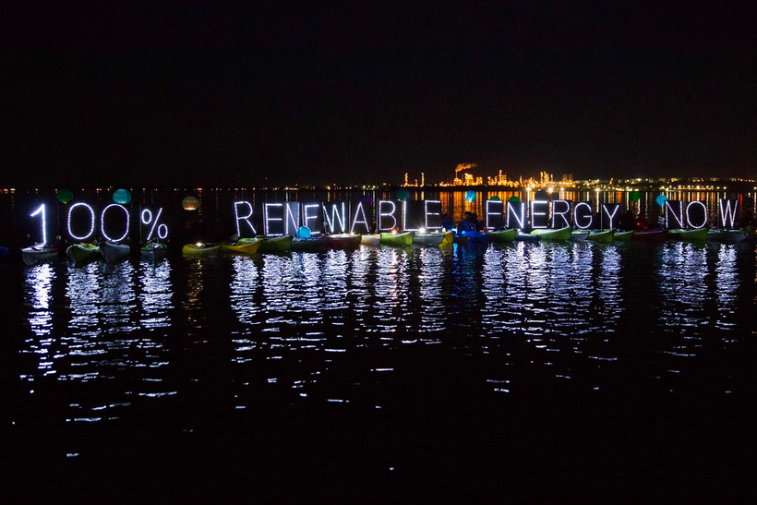
What’s in this module?
Description
This module includes content from energy justice activists, policy makers, scientists, community organizations, and other individuals. The module contains an introduction to energy justice, an overview of the U.S. energy system, special topics in energy justice, perspectives on energy justice, energy justice conflict, and information on the Just Transition.
Contents
Key Resources
7 parts
3 videos
1 podcast
3 readings
9 activities
3 project options
  MIT Interview with Shalanda Baker
  Energy Justice Initiative
  MIT Renewable Energy Clinic
  The Climate Justice Alliance
Photo by Alex Garland, courtesy of Backbone Campaign on Flickr. License: CC BY.

Slide 3
Learning Objectives
01
02
03
04
Understand energy justice in policy, research, science, and technology
Discover local and international energy justice case studies
Understand and analyze the Just Transition framework
Identify how you can implement energy justice in your work and life

Slide 4
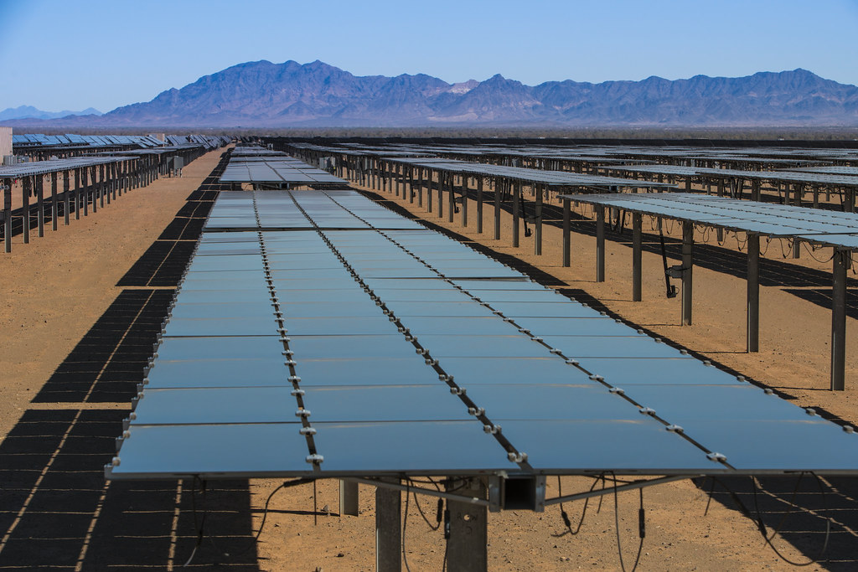
Introduction to Energy Justice
PART 1
"Renewable Energy Development in the California Desert": photo by Tom Brewster Photography, courtesy of Bureau of Land Management on Flickr. License: CC BY.

Slide 5
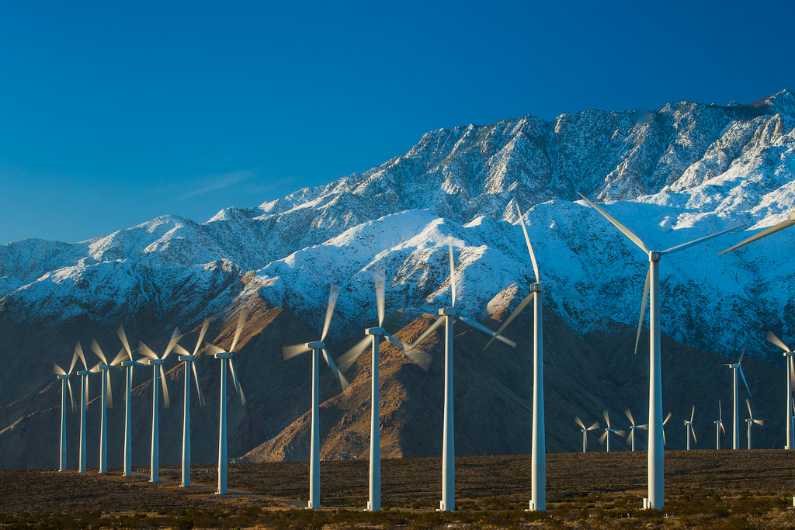
Photo by Tom Brewster Photography, courtesy of Bureau of Public Lands on Flickr. License: CC BY.
What is Energy Justice?
Definition
Energy justice emphasizes equitable energy transitions for marginalized communities and including communities in energy policy research, discussion, development, and implementation.
Objective
Energy justice aims to understand the socio-political and historical factors that determine what energy people use, why they use it, how much they consume, and where they access it from.

Slide 6
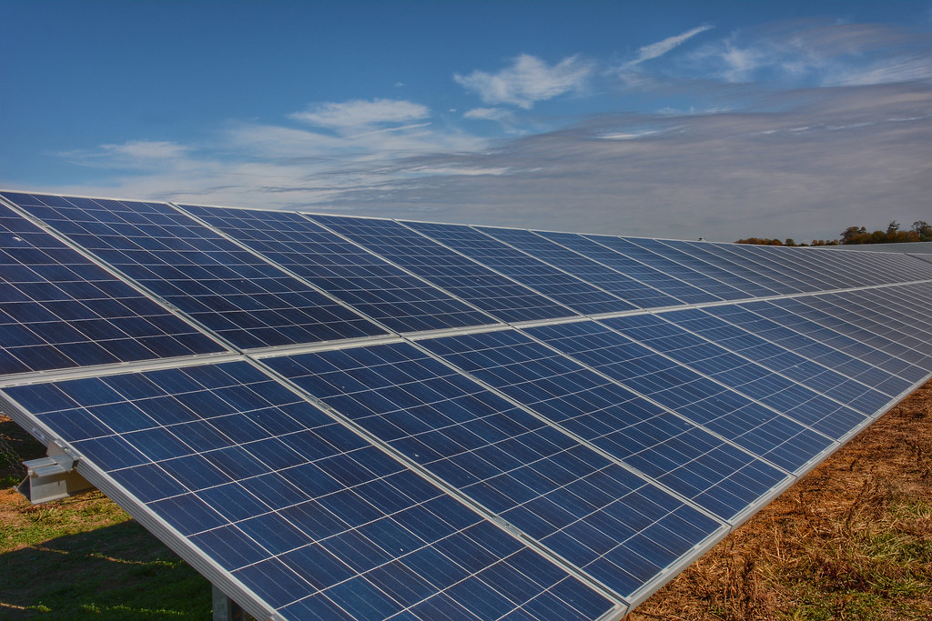
Photo by UD Cooperative Extension on Flickr. License: CC BY.
Initial Discussion of Energy Justice
Discuss these questions in small groups
  Do you think this energy justice explanation is complete? What would you add?
  Can you think of examples of energy justice in your community, country, or the world?
  How do you think energy justice can help the climate justice movement?
  How do science and technology impact social justice?
  How can energy developments be more equitable?
For more see the Just Transition and Intro to Climate Justice modules

Slide 7
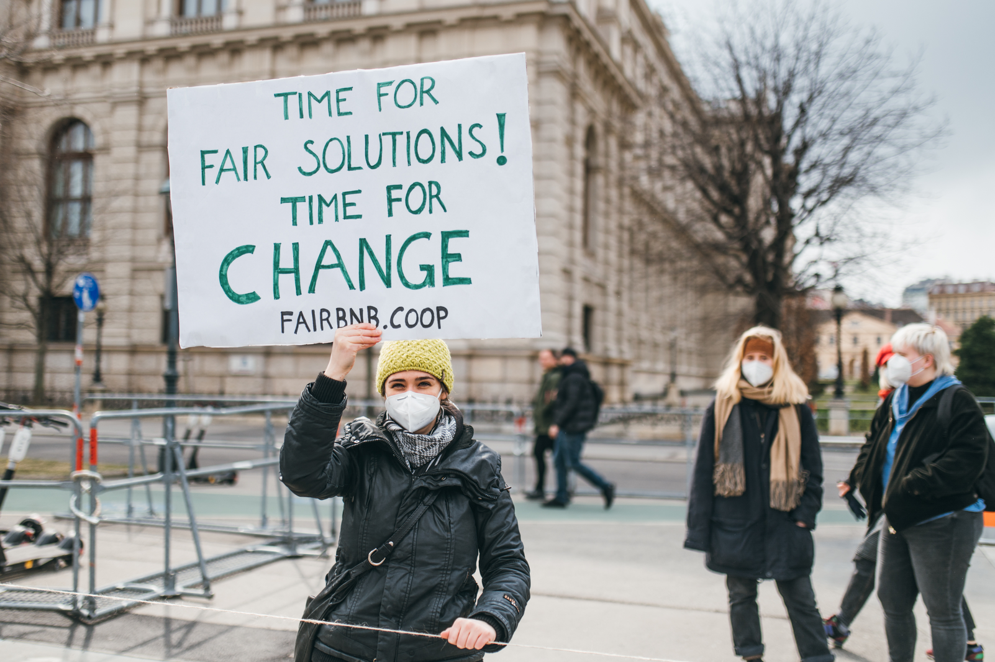
ACTIVITY #1
THE HISTORY OF THE ENERGY JUSTICE MOVEMENT
Discussion questions
  When did Energy Justice start as a sub-movement of Environmental Justice?
  How is Energy Justice similar and dissimilar to Environmental and Climate Justice?
  What events are pivotal to energy justice?
Browse and analyze
Browse and analyze this timeline of Environmental Justice from the Congressional Black Caucus Foundation.
Photo courtesy of Ivan Radic on Flickr. License: CC BY..

Slide 8
Energy Justice Policy Areas
01
02
03
04
05
Access to energy
Utility structure
Community solar energy
Net energy metering
100% renewable energy
Including connection to the grid, as well as access to affordable and functional renewable energy as a human right.
The transition to renewables does not have to follow the centralized grid model.
Allowing communities to collectively address their energy needs with renewables.
Policy to encourage rooftop solar by crediting customers for solar energy they produce on their bill.
The goal of 100% or near 100% renewable energy in cities and towns can be met through many paths and sectors

Slide 9
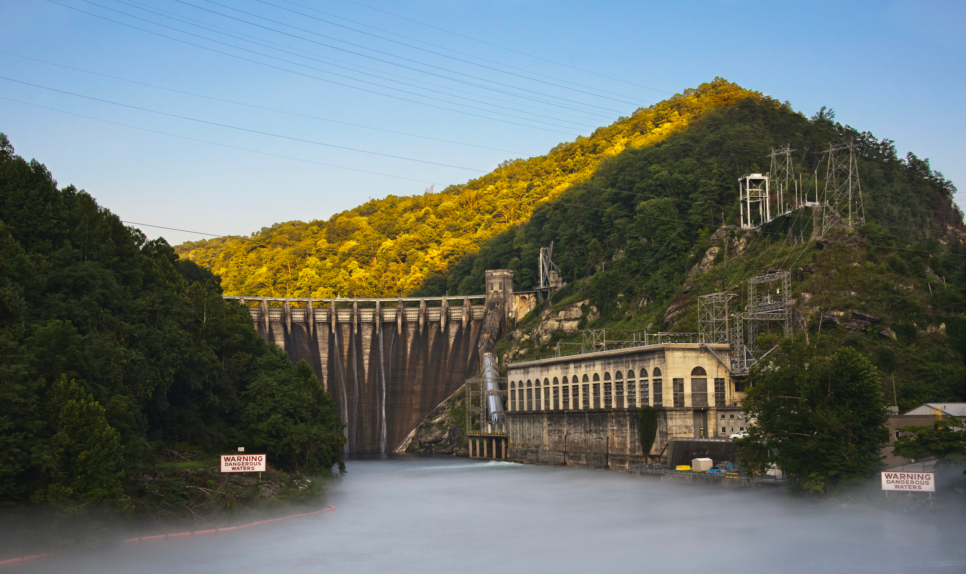
"Cheoah Hydroelectric Dam Graham Co NC" courtesy of Dantripphoto on Wikimedia. License: CC BY-SA. This content is excluded from our Creative Commons license. For more information, see https://ocw.mit.edu/help/faq-fair-use/ .
The U.S. Energy System
PART 2

Slide 10
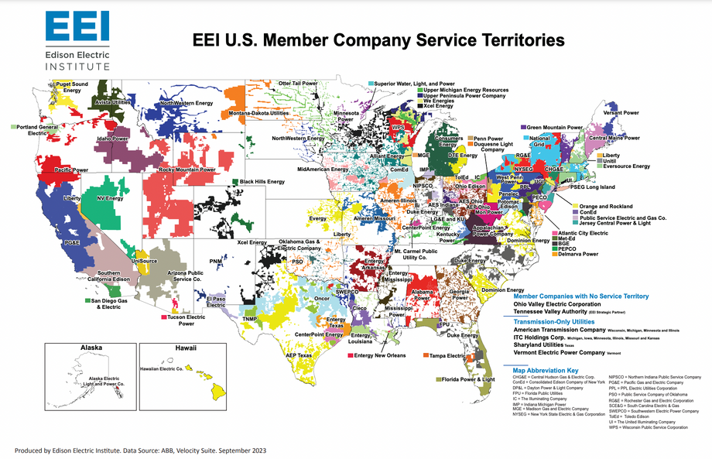
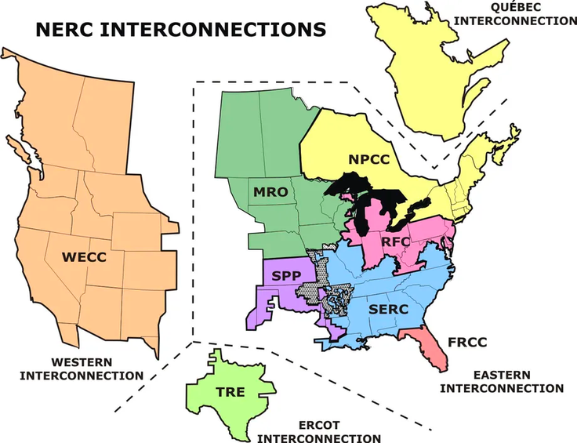
© EEI. All rights reserved. This content is excluded from our Creative Commons license. For more information, see https://ocw.mit.edu/help/faq-fair-use/ .
The Basics
History of the U.S. energy system
Energy demands have been on the rise throughout history. Since the 1950s, most of the energy consumption in the U.S. has come from petroleum.
Structure of the U.S. energy grids
  The U.S. has a divided energy system with the Eastern, Western, and Texas power grids
  While power is shared within each grids, grids cannot easily send energy to locations in other grids
  Within each grid, different regions receive power from a handful of companies

Slide 11
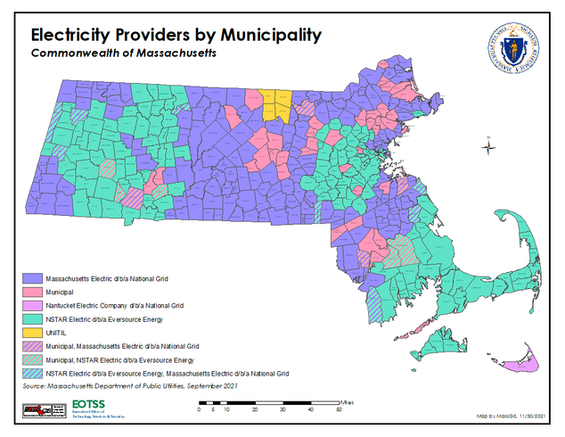
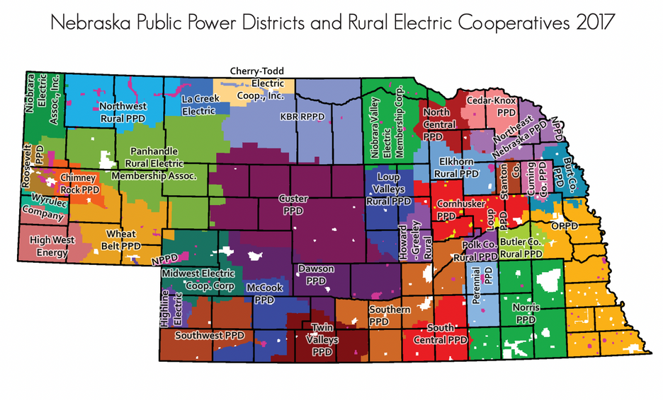
ACTIVITY #2
COMPARING ENERGY SYSTEMS: MA V. NE
Takeaways
  Energy in both NE and MA comes from a number of sources, but their grids are organized differently
  Different power systems and monopolized power providers leave the US vulnerable to grid failures as climate change increases extreme weather events
  The grid’s design leaves some people struggling for energy access, and makes it more difficult to electrify or make the switch to renewables
Massachussetts
Energy in MA is provided by Eversource, National Grid, UNITIL, and municipal electric companies, which are all are registered with the Federal Energy Regulatory Commission.
Nebraska
Energy in NE is provided by consumer-owned non-profit electric cooperatives, municipalities, and public power districts.
© Mass GIS. All rights reserved. This content is excluded from our Creative Commons license. For more information, see https://ocw.mit.edu/help/faq-fair-use/ .
© Nebraska State Legislature. All rights reserved. This content is excluded from our Creative Commons license. For more information, see https://ocw.mit.edu/help/faq-fair-use/ .

Slide 12
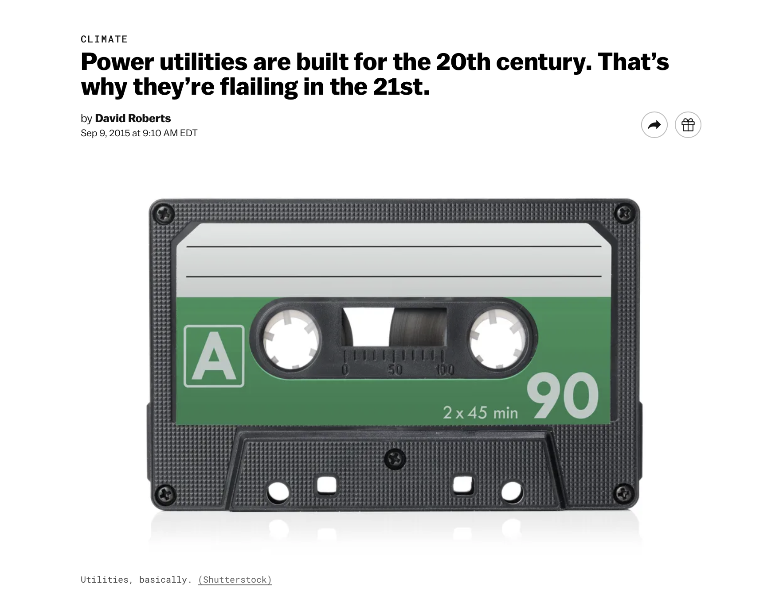
ACTIVITY #3
U.S. ENERGY SYSTEM WRAP-UP READING
Read
Power utilities are built for the 20th century. That’s why they’re flailing in the 21st.
Post-reading discussion questions
  After reading, what are your thoughts on the current energy system in the U.S?
  Do you agree with the author?
  How do you think the energy system can be improved?

Slide 13
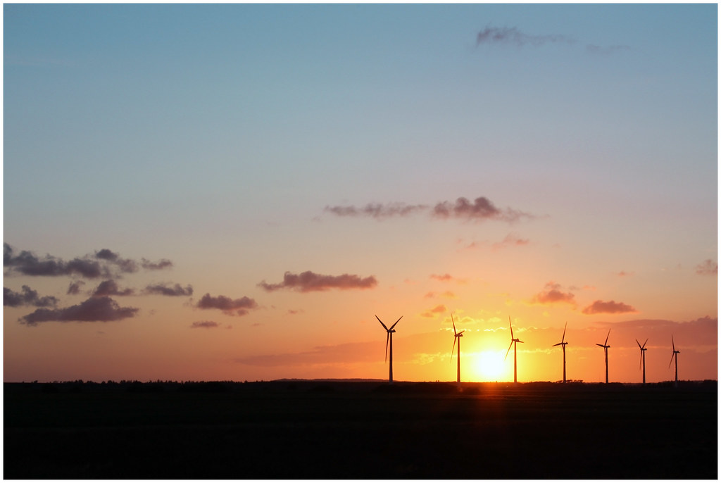
Special Topics in Energy Justice
PART 3
Photo courtesy of Ole Houen on Flickr. License: CC BY.

Slide 14
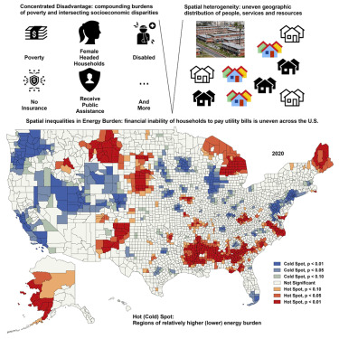
Energy Insecurity
Figure from Chen, Feng, et al., “Localized energy burden, concentrated disadvantage, and the feminization of energy poverty,” iScience 25(4), 2022.Courtesy of Elsevier, Inc., https://www.sciencedirect.com. Used with permission.
Who it affects
Addressing energy insecurity is a key issue for energy justice activists because it affects hundreds of thousands of people in the U.S.
How can we equitably and economically provide people with cleaner energy solutions?

Slide 15
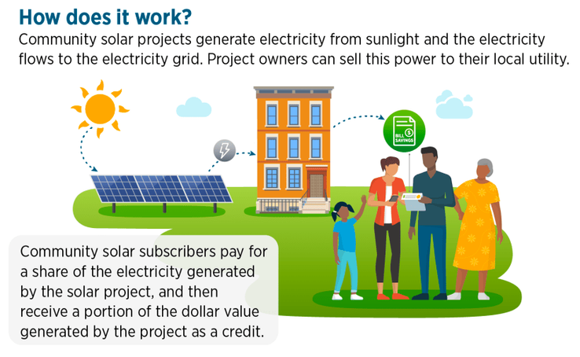
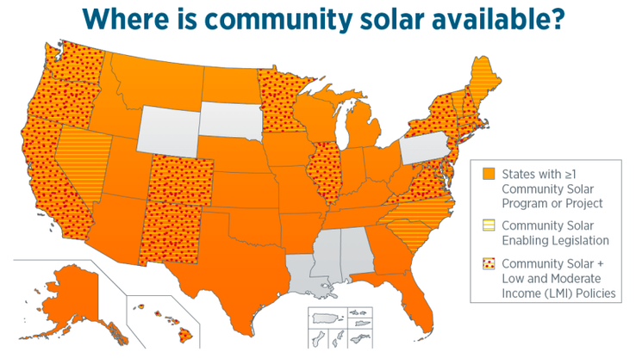
This image is in the public domain.
Community Solar Energy
What is community solar energy?
Community solar includes projects that benefit multiple energy consumers in one geographic location.
Instead of placing the burden on individuals to fund and maintain their own solar, community energy projects work for many people.
More Information
  See Native Renewables for information on Native Community Energy Projects
  US DOE Community Solar Basics

Slide 16

ACTIVITY #4
INTRODUCING DR. SHALANDA BAKER
Discuss the video and the paper
  How is energy justice a complicated issue?
  How is this demonstrated by wind farms in Oaxaca?
  How can we meet growth sustainably?
Watch
MIT Energy Justice with US DOE's Dr. Shalanda Baker
Read
Mexican Energy Reform, Climate Change, and Energy Justice in Indigenous Communities
© Northeastern University. All rights reserved. This content is excluded from our Creative Commons license. For more information, see https://ocw.mit.edu/help/faq-fair-use/ .
Dr. Shalanda Baker

Slide 17
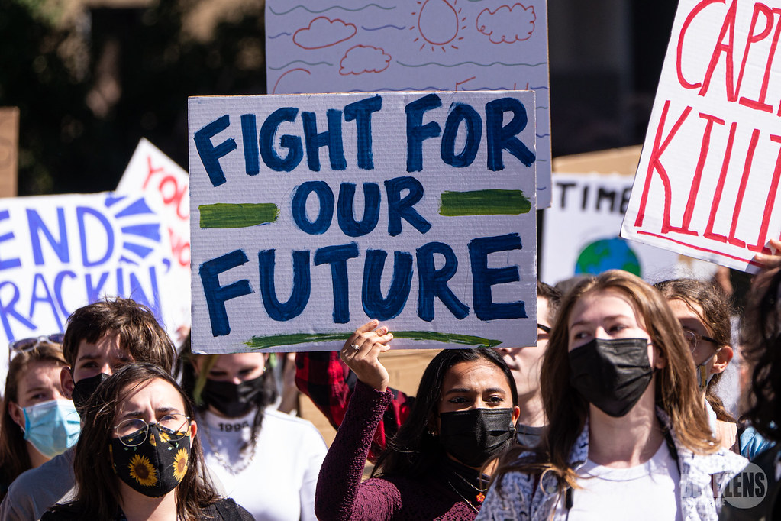
Photo courtesy of Mark Dixon on Flickr. License: CC BY.
Case Studies: Perspectives on Energy Justice
PART 4

Slide 18

CASE STUDY #1
INDIGENOUS PERSPECTIVE
Listen
Jihan Gearon: Towards a Just Transition
Discuss
BMWC has been working for just, renewable energy on the Navajo nation for over 20 years.
How is the Navajo Nation working towards a Just Transition?
Jihan Gearon
Executive Director, Black Mesa Water Coalition
Photo © KXCI. All rights reserved. This content is excluded from our Creative Commons license. For more information, see https://ocw.mit.edu/help/faq-fair-use/ .

Slide 19
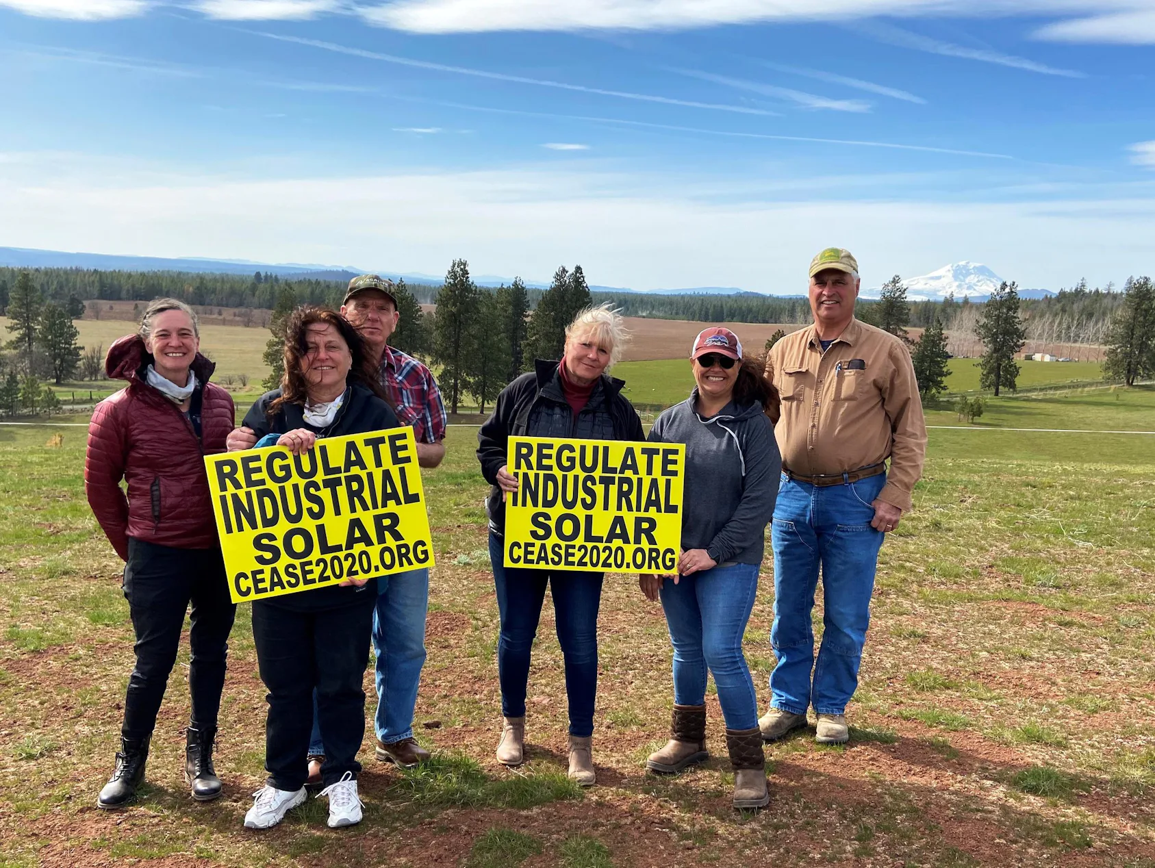
© Courtney Flatt / NWPB. All rights reserved. This content is excluded from our Creative Commons license. For more information, see https://ocw.mit.edu/help/faq-fair-use/ .
CASE STUDY #2
RURAL PERSPECTIVE
Watch
Even in the bright of day, some Central Washington residents have a solar energy ‘nightmare’
Discuss
  What is the conflict arising in rural areas over clean energy?
  What do you see as a potential solution to this problem?

Slide 20
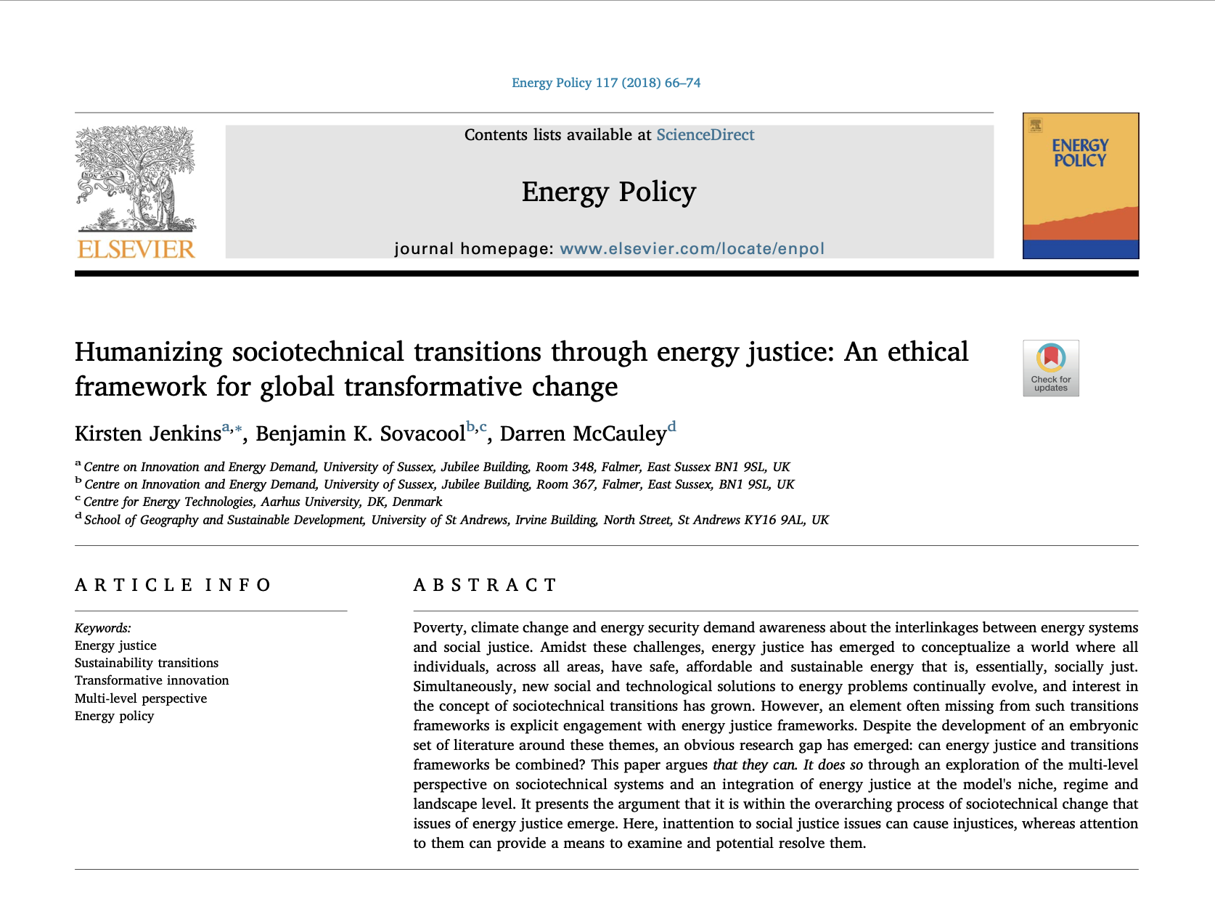
Kirsten Jenkins, Benjamin K. Sovacool, Darren McCauley, ”Humanizing sociotechnical transitions through energy justice: An ethical framework for global transformative change,” Energy Policy, 117, 2018, pp. 66-74.
Courtesy of Elsevier, Inc., https://www.sciencedirect.com. Used with permission.
CASE STUDY #3
INTERNATIONAL PERSPECTIVE
Read
Humanizing sociotechnical transitions through energy justice: An ethical framework for global transformative change
Discuss
What do the authors suggest for an ethical energy transformation?

Slide 21
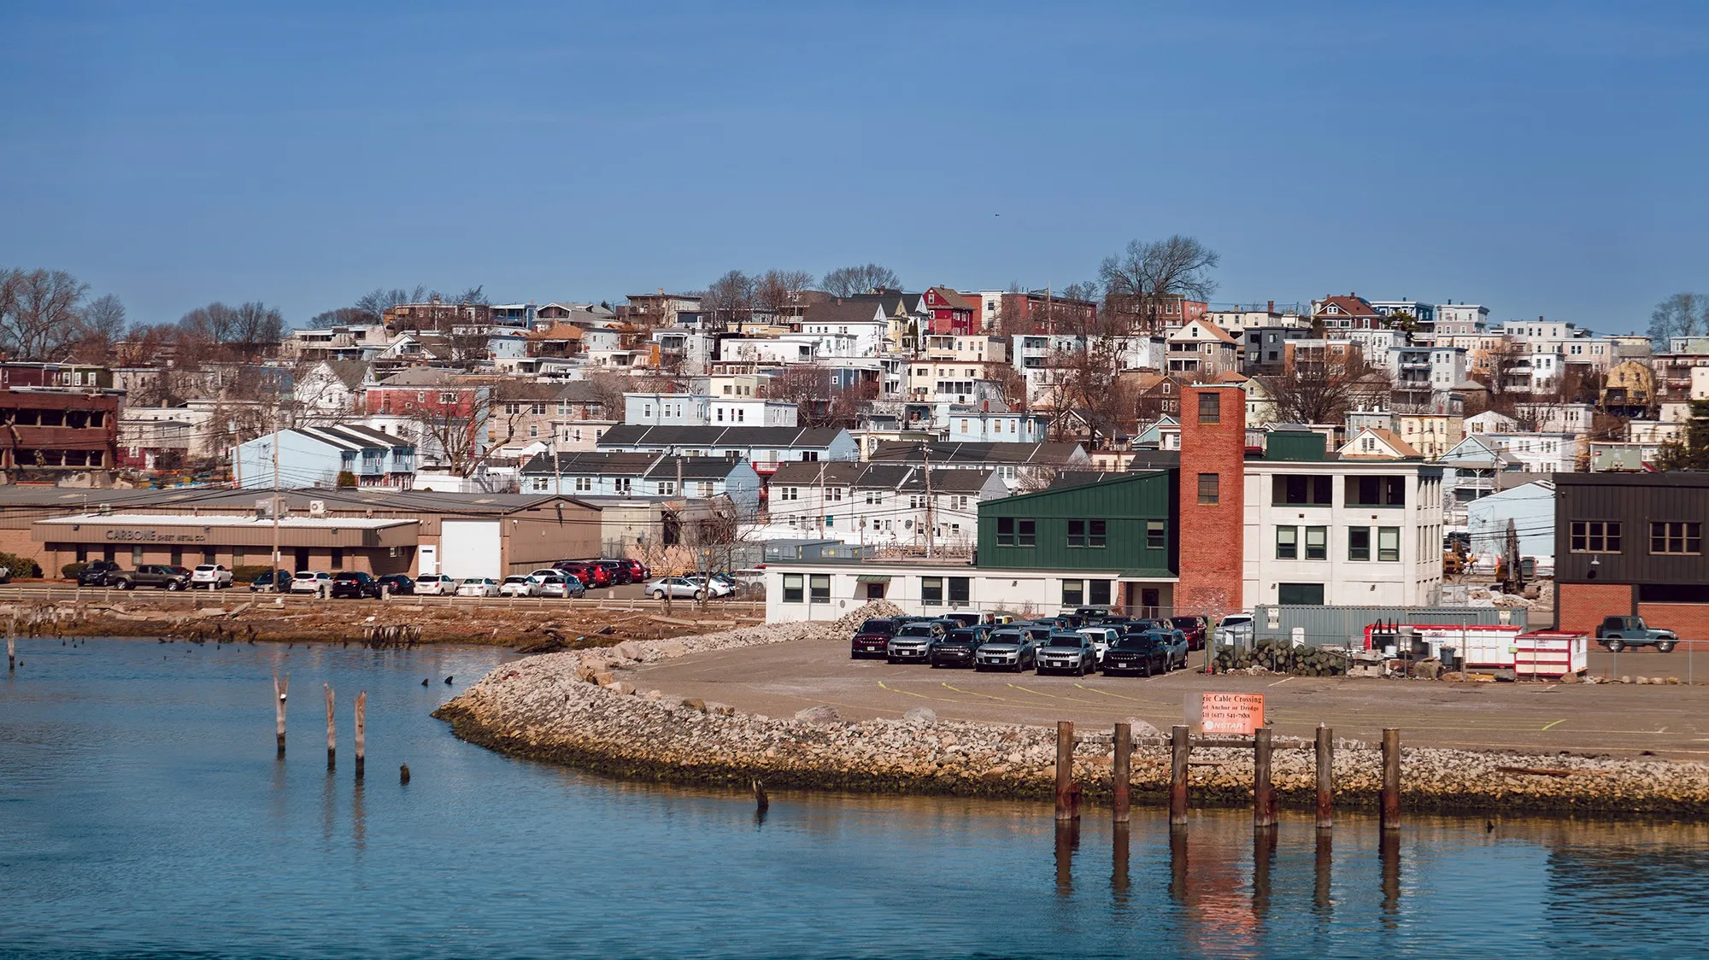
Chelsea as seen from across the creek in East Boston, both industrial communities vulnerable to flooding. © Ryan Christopher Jones / Mother Jones / The Center for Investigative Reporting. All rights reserved. This content is excluded from our Creative Commons license. For more information, see https://ocw.mit.edu/help/faq-fair-use/ .
CASE STUDY #4
LOCAL PERSPECTIVE
Read
The Little City That Could: For Chelsea, Massachusetts, a new microgrid means energy resilience.
Discuss
  How has the community had to fight to build a microgrid?
  What does energy resilience mean for vulnerable communities?

Slide 22
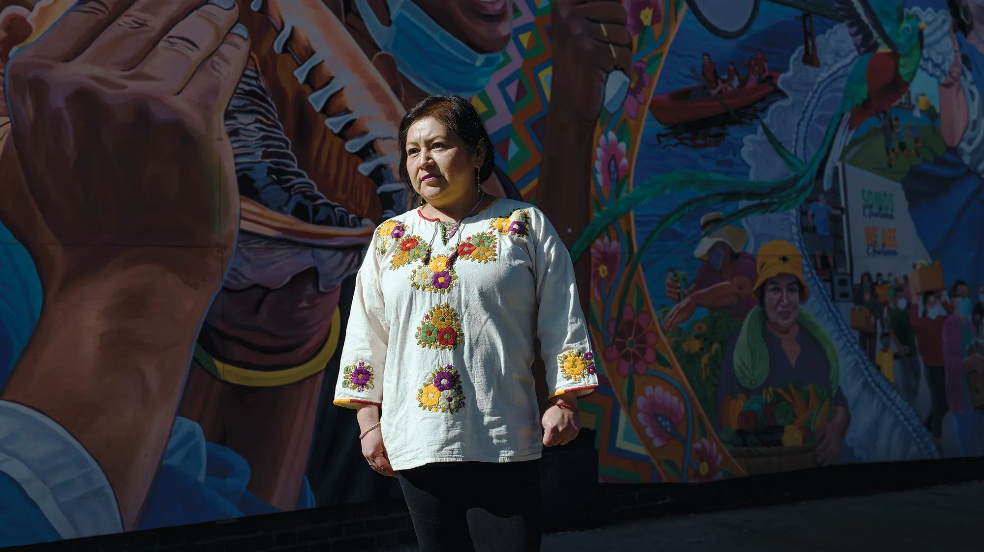
GreenRoots volunteer Nohemi Lobato, pictured in front of the David Fitcher mural “Chelsea Resilient,” was among the local activists pushing for a microgrid project. © Ryan Christopher Jones / Mother Jones / The Center for Investigative Reporting. All rights reserved. This content is excluded from our Creative Commons license. For more information, see https://ocw.mit.edu/help/faq-fair-use/ .
CASE STUDY #5
COMPARING PERSPECTIVES
Choose a case study
Split into 4 groups, and choose one of the perspectives on energy justice from slides 18-21 to review as a group.
Share out with the class
Compare the similarities and differences of each discussed perspective. What leads to the differences in people’s opinions and perspectives on energy justice and how it is implemented? How can we remediate conflicting beliefs?

Slide 23
Energy Justice Conflict
PART 5

Slide 24
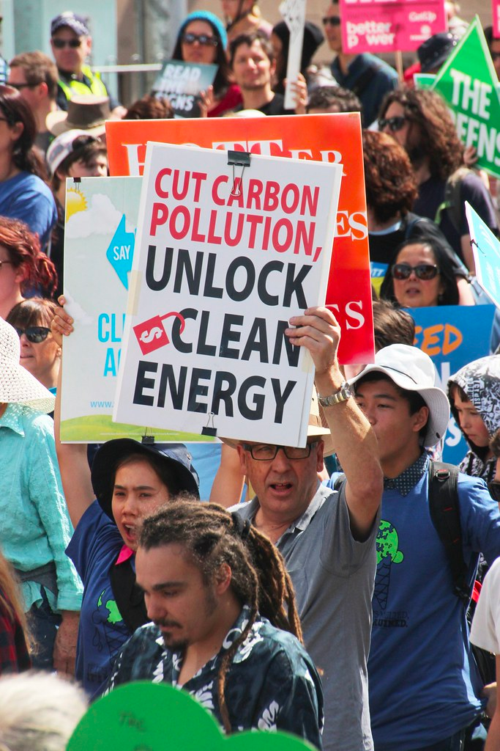
Renewable Energy Projects
Renewable energy isn’t a simple transition
Community groups, Indigenous tribes, local conditions, and government interests all play a different role in the Just Transition.
Discuss with a partner
  What conflicts can you imagine arising from a transition to clean energy?
  How can we reconcile competing interests to promote clean energy without violating a community’s rights?
Photo courtesy of John Englart on Flickr. License: CC BY_SA. This content is excluded from our Creative Commons license. For more information, see https://ocw.mit.edu/help/faq-fair-use/ .

Slide 25
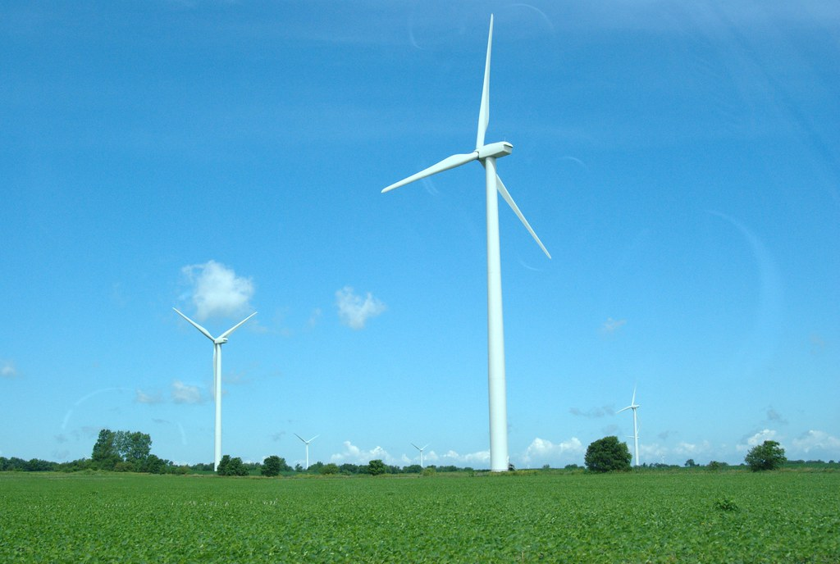
Photo courtesy of Patrick Finnegan on Flickr. License: CC BY.
ACTIVITY #5
ACTIVITY #5
MIT ENERGY CONFLICT MITIGATION
Explore and review case studies
MIT Renewable Energy Siting Clinic
Discuss as a class
  What factors are most important for expanding renewable energy?
  What are the key conflicts you noticed?
  What concerns do people have?
  What are commonalities between the case studies on the map?
  Why mitigation?

Slide 26
The Just Transition
PART 6

Slide 27

Introduction
What is the Just Transition?
The Just Transition is a vision-led, unifying and place-based set of principles, processes, and practices that build economic and political power to shift from an extractive economy to a regenerative economy.
The origins of the Just Transition
Just Transition strategies were created by low-income communities of color fighting against environmental injustice, aiming to phase out industries that bring disproportionate harm to the workforce.
The goals of the Just Transition
  Shift economic control to communities
  Democratize wealth and the workplace
  Advance ecological restoration
  Drive racial and social equity
  Relocalize most production and consumption
  Retain and restore cultures and traditions
Photo courtesy of MIKI Yoshihito on Flickr. License: CC BY.
See the Climate Justice Alliance website to learn more

Slide 28
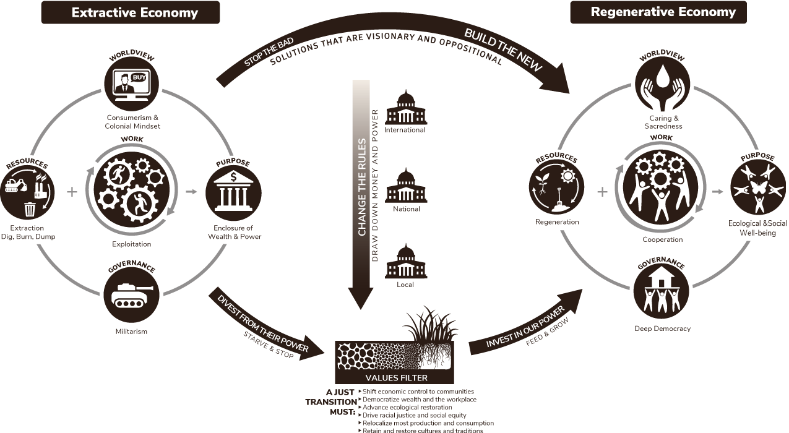
The Just Transition Framework
© People's Economy Lab. All rights reserved. This content is excluded from our Creative Commons license. For more information, see https://ocw.mit.edu/help/faq-fair-use/ .

Slide 29
CJA’s Principles of the Just Transition
Requires Regenerative Ecological Economics
Creates Meaningful Work
Upholds Self Determination
Equitably Redistributes Resources and Power
Advance ecological resilience, reduce resource consumption, restore biodiversity and traditional ways of life, and undermine extractive economies that erode the ecological basis of our collective wellbeing.
A Just Transition centers on the development of human potential and creating opportunities for people to learn, grow, and develop to their full capacities and interests.
The people who are most affected by the extractive economy have the resilience and expertise to be in the leadership of crafting solutions.
Fights to reclaim capital and resources for the regeneration of geographies and sectors of the economy where these inequities are most pervasive.
Moves us Toward Buen Vivir
Retains Culture and Tradition
Embodies Local, Regional, National and International Solidarity
Builds What We Need Now
The rights of peoples, communities and nature must supersede the rights of the individual.
Just Transition must create inclusionary spaces for all traditions and cultures, recognizing them as integral to a healthy and vibrant economy.
We must build and flex the muscles needed to meet our communities needs.
Our solutions call for local, regional, national and global solidarity that confronts imperialism and militarism.

Slide 30

ACTIVITY #6
ACTIVITY #5
REAL PEOPLE, REAL CHANGE: GLOBAL CASE STUDIES
Choose a country to read about
  Poland
  India
  Canada
  Indonesia
  Egypt
  Ukraine
Read your country’s case study
Real people, Real Change (p.17-34)
Discussion questions
Work in groups of 3-4 with students who read about different countries. Work with each other to share information about the country you read about. Then, consider these questions:
  What stood out to you most?
  What similarities and differences are there in each countries experience?
  What kind of framework could be created for just transitions based on these case studies?
© 2018 International Institute for Sustainable Development. All rights reserved. This content is excluded from our Creative Commons license. For more information, see https://ocw.mit.edu/help/faq-fair-use/ .

Slide 31
ACTIVITY #7
ACTIVITY #5
FOLLOW-UP ON THE PRINCIPLES OF THE JUST TRANSITION
Share out
Participate in a 2 minute dyad, where in pairs you will each have 1 minute to talk about your thoughts about these principles. Listeners should not interject, and instead focus on being an active listener.
Brainstorm
Individually brainstorm the principle that stands out to you most, considering these questions:
  How does this principle advance the Just Transition?
  How does it apply to your personal concerns? What about professional ones?
  Where/how have you seen this principle being acted upon?
  Does your institution do a good job of enacting it?
BUEN VIVIR
MEANINGFUL WORK
SELF-DETERMINATION
EQUITABLY REDISTRIBUTES RESOURCES AND POWER
REQUIRES REGENERATIVE ECOLOGICAL ECONOMICS
CULTURE AND TRADITION
Local, Regional, National and International Solidarity
BUILDS WHAT WE NEED NOW

Slide 32
ACTIVITY #8
ACTIVITY 8
ACTIVITY #5
UNDERSTANDING WHAT THE JUST TRANSITION LOOKS LIKE THROUGH CASE STUDIES
Discussion questions
  How do they address the principles of the just transition?
  What are some ways each of these could improve? What communities, if any, were missing from the conversation?
  How do they talk about how the Just Transition has been helpful for different communities?
  What can governments, businesses, and institutions do to ethically engage resource stakeholders?
Pick a case study
  Climate Conversation: An Appalachian Perspective on Just Transitions
  Changing Woman: One Navajo’s Fight for a Just Transition
  Legacies of Coal: In Search of a Just Transition Panel
  Changes in the contribution of coal to tax revenues in Greene County, PA, 2010-2019
This activity can be structured as a mini-presentation, group discussion, or another dyad/triad so that each person learns about a case study they didn't look at.

Slide 33
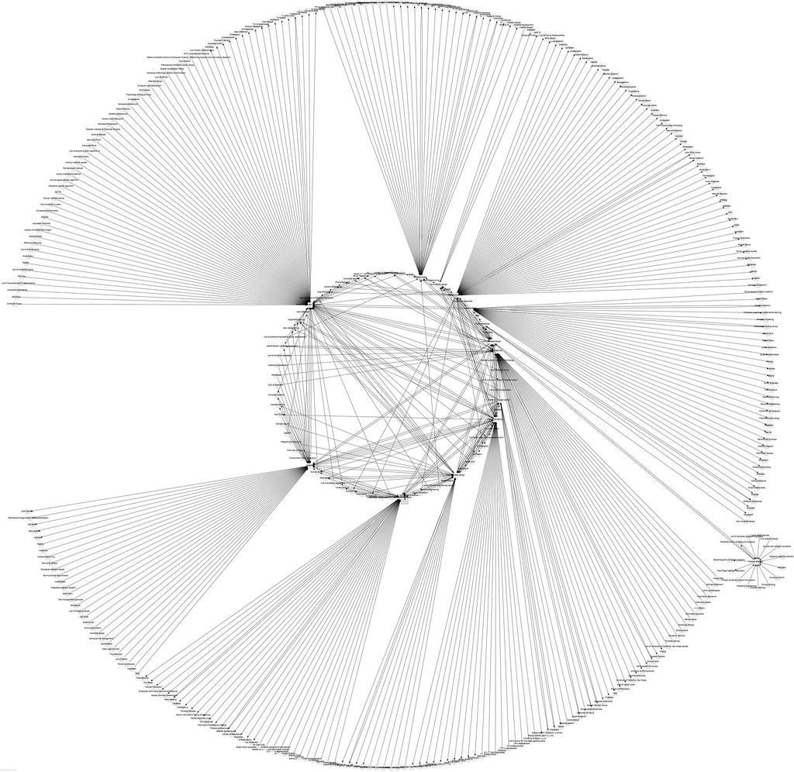
ACTIVITY #9
ACTIVITY #5
DIVING DEEPER INTO THE JUST TRANSITION FRAMEWORK
Create a concept map
Construct a concept map of a Just Transition framework, centering the case study that you studied in Activity #8.
This activity builds off of Activity #8.
Image courtesy of Juhan Sonin on Flickr. License: CC BY.

Slide 34
Beyond the Module
PART 7
Photo courtesy of Mark Dixon on Flickr. License: CC BY.

Slide 35
PROJECT OPTION #1
Taking Action on a Just Transition
How does a Just Transition relate to your life?
Explore the “Take action by assessing + proposing climate action at your school” section of All We Can Save’s “Assignments to spark action.“ The section can be found in the list of Level 2 (Taking action: Community level) assignments.
Research ways the Just Transition might be supported better by your institution
Guiding questions: What labs/groups on campus are focusing on Just Transition ideas already? Where should there be more conversations around these ideas?
Share out your ideas with the class and consider these questions
  How would you go about making these changes?
  Who would you have to convince, and what voices would you want to uplift?
  How would you reach out to different communities and stakeholders on campus to make this change realized?

Slide 36
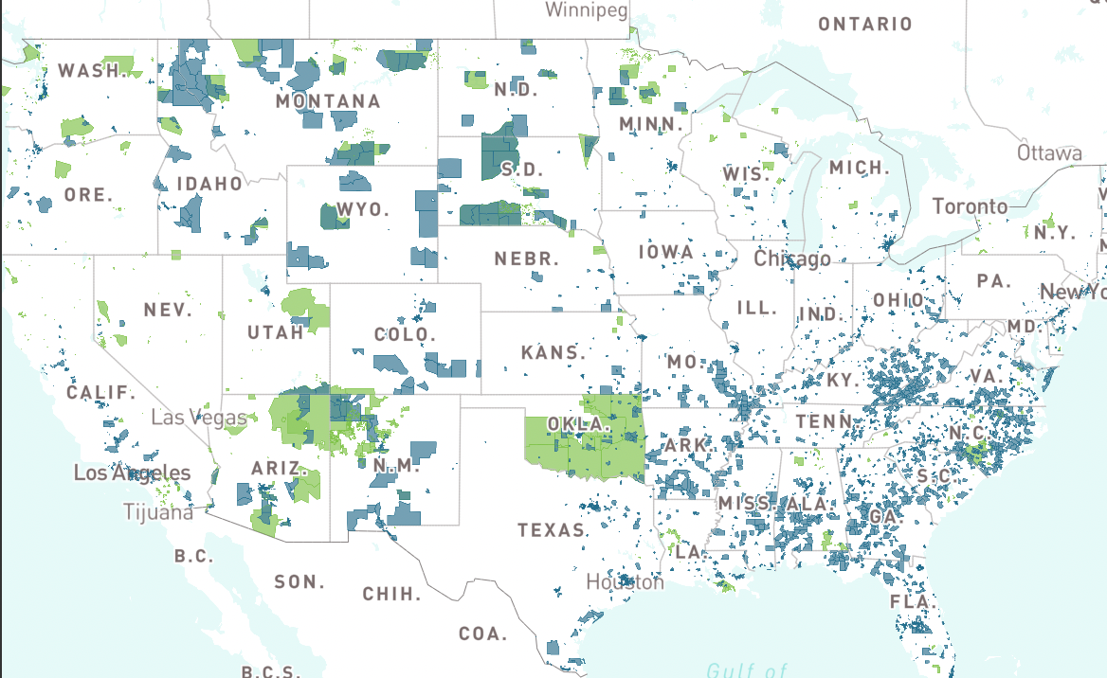
PROJECT OPTION #2
PROJECT OPTION #1
A US Energy Justice Dashboard Data Report
Prompt suggestion
Research socioeconomic, demographic, and industry data of the city/county using DATA USA. Look at neighborhoods near each other or near you, what do you notice about energy burdens? What are the common themes of statistics in high energy burden communities?
Respond in a report analyzing one area with differing energy burdens.
© source unknown. All rights reserved. This content is excluded from our Creative Commons license. For more information, see https://ocw.mit.edu/help/faq-fair-use/ .

Slide 37
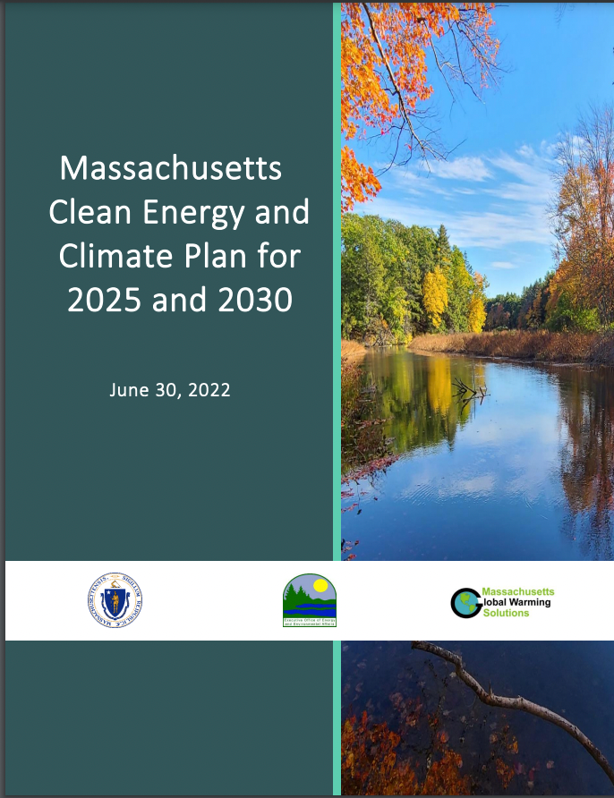
PROJECT OPTION #3
Energy Policy
Analysis
Prompt suggestion
Analyze this piece of energy policy with the Energy Justice Scorecard.
Share your rating with the people near you/with the class. Where do you rate it the same? What aspects are different?
© Commonwealth of Massachusetts. All rights reserved. This content is excluded from our Creative Commons license. For more information, see https://ocw.mit.edu/help/faq-fair-use/ .

Slide 38
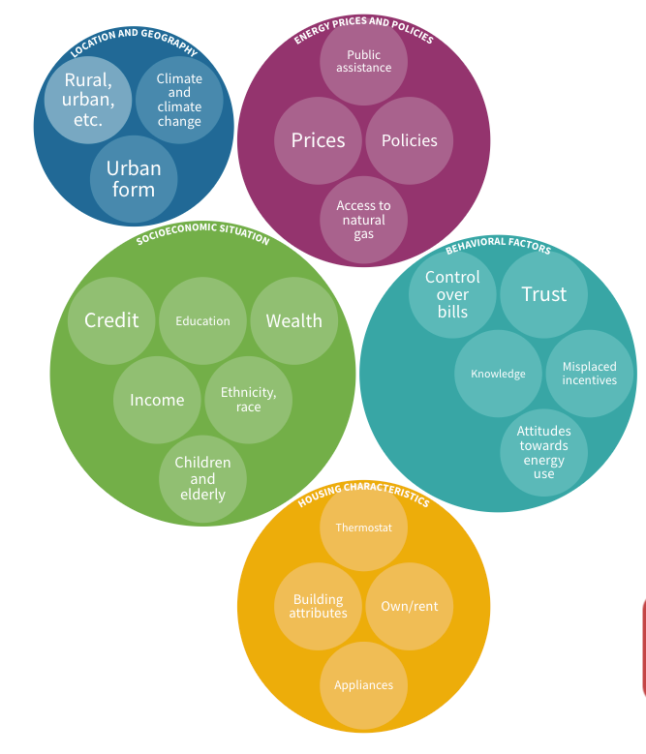
PROJECT OPTION #4
Energy Justice Data Visualization
Prompt suggestion
Break into groups and explore BU Energy Justice questions/case studies. Pose your question to class and explain how data is used to demonstrate issues of energy justice.
Then, have students explore their own energy justice question and create their own data visualization or story through research.

Slide 39
Additional Resources
  Energy Justice Resources
  Just Energy: Reducing Pollution, Creating Jobs Toolkit
  Clean Energy Jobs
  Internships, Fellowships, Graduate and Postdoctoral Opportunities
  Fighting for Energy Justice
  Climate Justice Alliance's Just Transition: Framework for Change

Slide 40

For more resources on climate and environmental justice: Please explore other modules in the Climate Justice Instructional Toolkit.

Slide 41
Module References
  Baker, S. H. (2016). Mexican Energy Reform, climate change, and Energy Justice in indigenous communities. UNM Digital Repository.
  Baskin, K. (2021, January 27). Why energy justice is a rising priority for policymakers. MIT Sloan.
  Chien-fei Chen, Jimmy Feng, Nikki Luke, Cheng-Pin Kuo, Joshua S. Fu, Localized energy burden, concentrated disadvantage, and the feminization of energy poverty, iScience, Volume 25, Issue 4, 2022, 104139, ISSN 2589-0042, https://doi.org/10.1016/j.isci.2022.104139.
  Climate Justice Alliance. (2023, March 15). Just Transition. Climatejusticealliance.org.
  ClimateX Team. (2017, November 8). Climate Conversations S2E1: An Appalachian Perspective on Just Transition. MIT Climate Portal.
  ClimateX Team. (2018, January 18). Climate Conversations S2E8: Indigenous Perspectives on Just Transitions. MIT Climate Portal.
  Department of Energy. How Does Solar Work?. Solar Energy Technologies Office.
  EEI U.S. Member Company Service Territories. Edison Electric Institute. (2023).
  Initiative for Energy Justice. (2023, May 17).
  Flatt, C. (2021, May 5). Even in the bright of day, a solar-powered “nightmare.” KUOW.
  Gass, P. (2019, April 8). In search of just transition: Examples from around the world. International Institute for Sustainable Development.
  Gearon, J. (2016). Jihan Gearon: Towards a just transition. KXCI.
  Kirsten Jenkins, Benjamin K. Sovacool, Darren McCauley, Humanizing sociotechnical transitions through energy justice: An ethical framework for global transformative change, Energy Policy, Volume 117, 2018, SSN 0301-4215, https://doi.org/10.1016/j.enpol.2018.02.036.
  Massachusetts Institute of Technology: Energy Justice. CERAWeek 2023 On Demand - External. (n.d.).
  Parshley, L. (2023, April 18). The Little City That Could. Mother Jones.
  Shalanda H. Baker, Mexican Energy Reform, Climate Change, and Energy Justice in Indigenous Communities, 56 Nat. Res. J. 369 (2016).

Slide 42
Module References
  Solar Energy Technologies Office. (n.d.). Community solar basics. Energy.gov.
  Timeline. Black Congressional Caucus Foundation. (n.d.).
  The history of energy in the United States. National Grid Group. (2022).
  What is wind power?. WINDExchange. (n.d.).
  Zinecker et. al. (2018, December). Real People, Real Change – Strategies for just energy transitions. International Institute for Sustainable Development.

Slide 43
MIT OpenCourseWare
https://ocw.mit.edu
RES.11-003 Climate Justice Instructional Toolkit Spring 2025
For more information about citing these materials or our Terms of Use, visit https://ocw.mit.edu/terms.

