Slide 1

FOUNDATIONAL MODULE
The Emotions of
Climate Justice

Slide 2
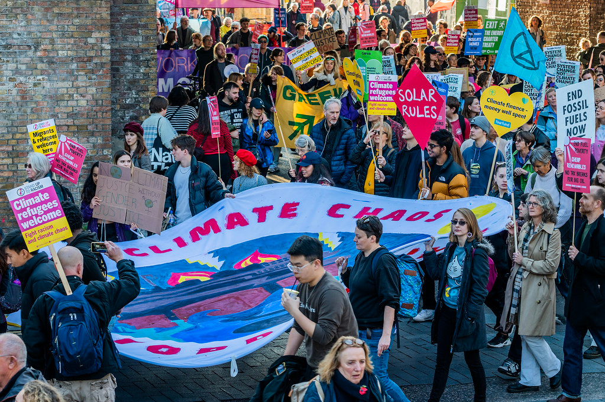
What’s in this module?
Description
This module demonstrates the many emotional responses elicited by climate change and climate justice, and asks students to reflect on their experiences.
Contents
Key Resources
4 parts
2 videos
3 readings
3 activities
4 project options
  Feeling climate (in)justice
  Finding Joy in Climate Action
  Climate Change Isn’t the First Existential Threat
  The Climate Anxiety Discussion Has a Whiteness Problem
Public domain image courtesy of Insure Our Future on Flickr.

Slide 3
Learning Objectives
01
02
03
04
Identify the causes of climate change emotions
Recognize different responses to climate change
Understand the unequal psychological impacts of climate change
Discuss strategies of systematically addressing climate anxiety

Slide 4
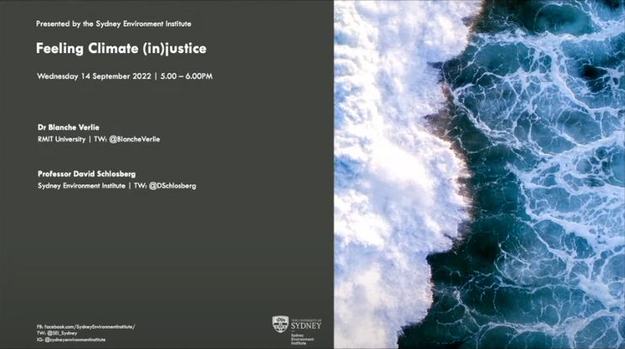
© Blanche Verlie. All rights reserved. This content is excluded from our Creative Commons license. For more information, see https://ocw.mit.edu/help/faq-fair-use/ .
Warm up
Discuss the content of the video assigned before class “Feeling climate (in)justice.”
Turn to a partner or small group and discuss using these guiding questions:
  In what ways can the discussion of climate change and climate feelings be changed to help individuals feel more supported?
  Do you agree or disagree with her argument about climate anxiety blaming individuals? What about greenhouse gaslighting?

Slide 5
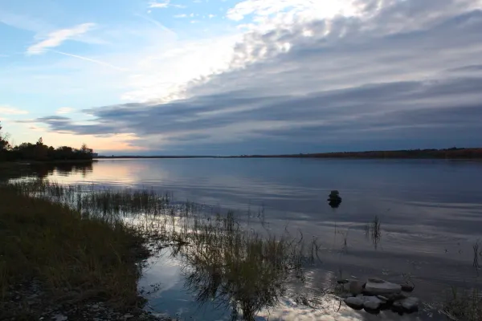
Photo courtesy of igooo101 on Flickr. License: CC BY.
Introduction
PART 1

Slide 6

Joy
Thoughts and Feelings about the Environment
Climate Anxiety
Anger
Guilt
Hopelessness
The way we perceive the environment affects the emotional responses we have to topics like climate change, climate justice, and environmental degradation.
Optimism
Doubt
The emotions of climate change and justice

Slide 7
Climate Change Cognition
01
02
03
Psychological distance
Past experiences
Prior knowledge & education
How psychologically near or far an object, event, or idea is perceived as being. Something that is psychologically near is perceived as being more concrete.
People's experiences with nature, positive, neutral, or negative, act as a lens through which they take in information and think about the environment.
The teaching a person receives about the environment forms the basis of their understanding of the environment.

Slide 8
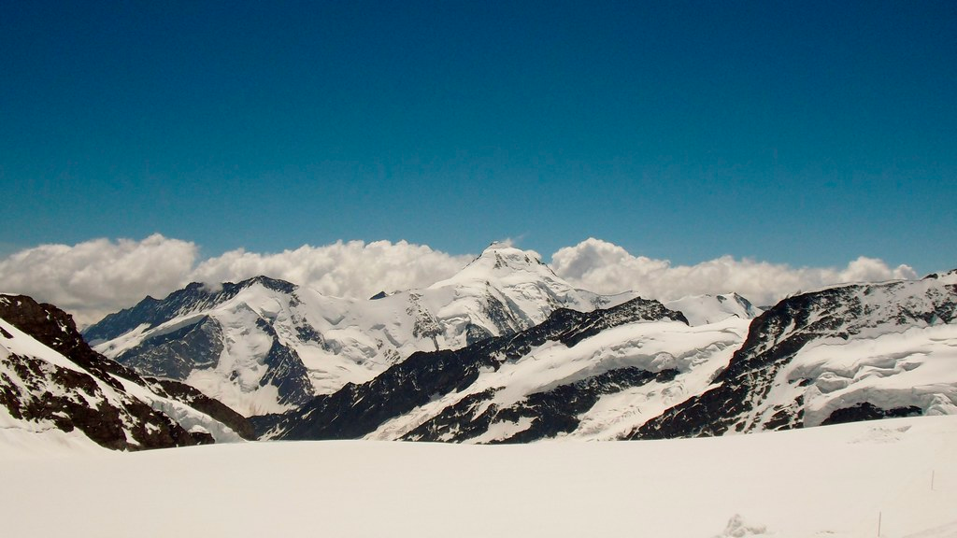
Photo courtesy of oatsy40 on Flickr. License: CC BY.
Feeling Climate Distress
PART 2

Slide 9
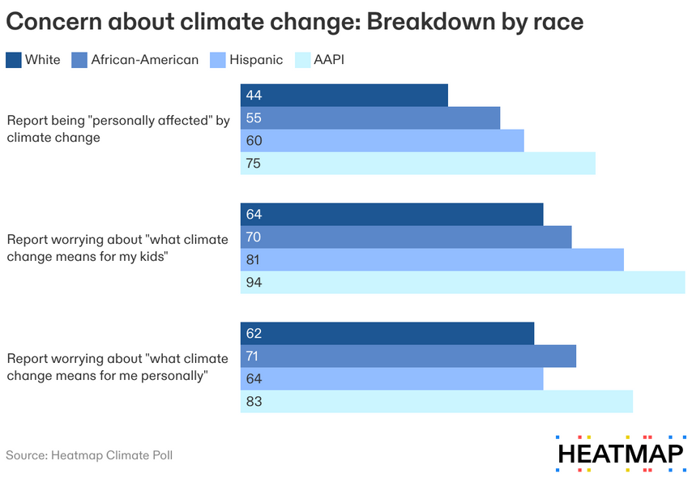
Climate Anxiety
Definition
The feeling of dread or helplessness relating to the effects climate change will have on one's self, family, future generations, animals, and plants.
Climate change does not impact all people equally and neither does climate anxiety.
Whiteness often dominates the conversation of climate distress. According to the Heatmap survey, people of color actually experience more climate anxiety than white respondents.
How can the discussion change to include more voices?

Slide 10
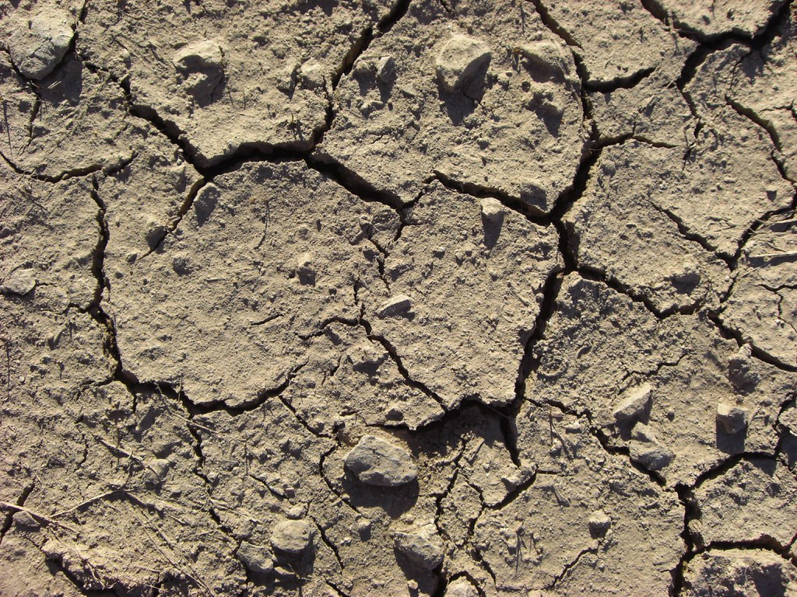
Unequal Effects of Climate Change
Disproportionate impact
The most vulnerable populations who experience the most drastic effects of climate change often had the least hand in causing the problem.
Effects of climate change
Climate change is causing increased extreme weather events than can temporarily displace people, render their homes uninhabitable, cause economic losses, loss of life, and personal injury.
Photo courtesy of DanielleGrace on Flickr. License: CC BY.

Slide 11
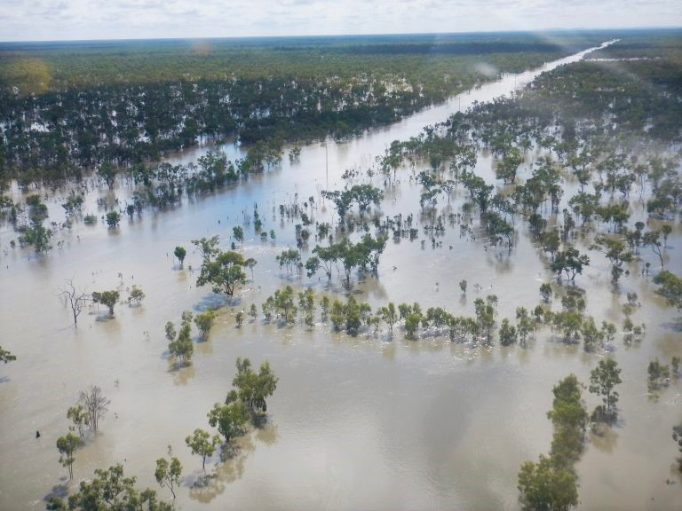
Threats to Health
Threats or perceived threats to the health or well-being of oneself, family, friends, and future lead to psychological distress
  People living in areas contaminated by pollutants are vulnerable to the physical/mental health consequences that come with exposure.
  Location, mobility, available amenities, housing stability, and structural integrity all important variables that factor into an individuals' level of psychological distress from climate change.
  Many women face a unique challenge with the uncertainty of climate change: the decision to have children or not.
"Flooding near Croydon from Cyclone Nora" Photo courtesy of Rolf Straatemeier/QPS on Wikimedia Commons. License: CC BY.

Slide 12
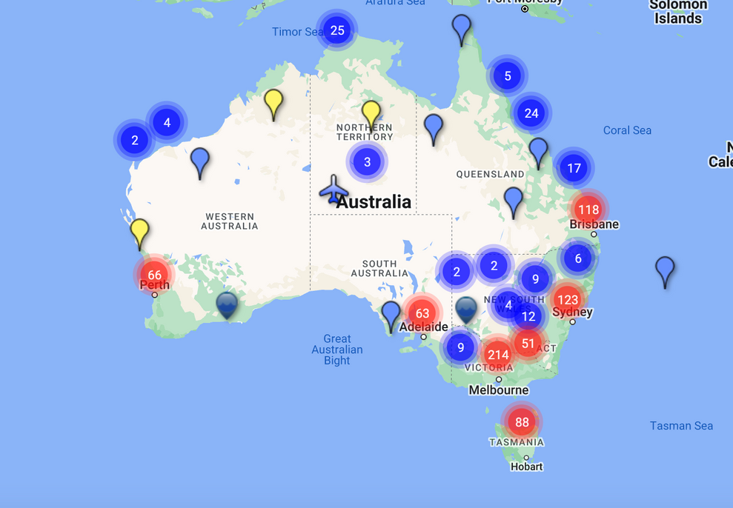
Exposure to Contaminants
Living in polyfluoroalkyl substance (PFAS) contaminated communities in Australia was associated with greater instances of self-reported psychological distress than in control communities.
Nina Lazarevic
"In contrast with acute environmental disasters, which follow more defined stages from warning and threat through to eventual recovery and rehabilitation, individuals in chronically contaminated areas are caught in a perpetual state of warning and threat"
© source unknown. All rights reserved. This content is excluded from our Creative Commons license. For more information, see https://ocw.mit.edu/help/faq-fair-use/ .

Slide 13
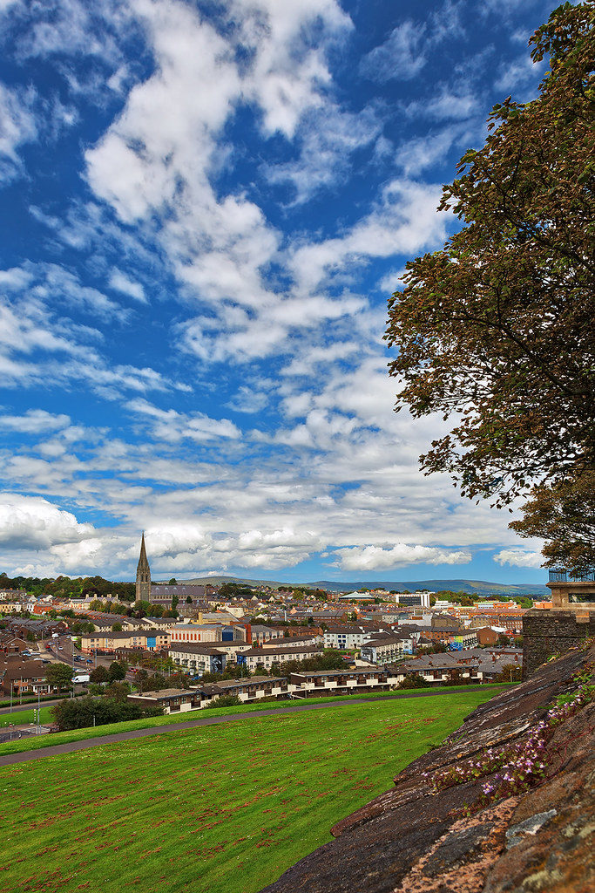
Living Conditions
Cultural and personal attachment
People can have cultural and personal attachments to their homes or land. In the Pacific Islands, one's home can be thought of as an extension of one's self, loss of home leads to psychological stress.
Heating and cooling systems
Heating and cooling systems, air circulation, and the ability to withstand extreme weather events are intrinsic to protecting physical and mental health in the face of climate change.
Homelessness and housing instability
For people experiencing houselessness or housing instability, the lack of protection from the elements exacerbates the negative mental health impacts of climate change.
Photo courtesy of Nicolas Raymond on Flickr. License: CC BY.

Slide 14
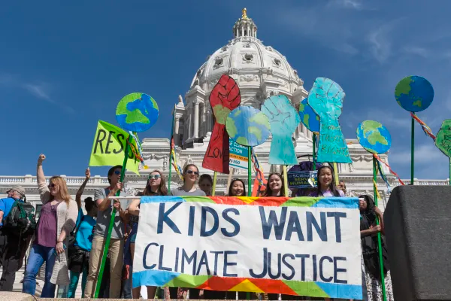
Photo courtesy of Lorie Shaull on Flickr. License: CC BY.
Burdens on Women
Many women are citing climate anxiety, increased potential for complications during pregnancy, and fears for their children's future as reasons why they do not want to have children during this climate crisis.
Factors that influence women's climate anxiety and reluctance to have children
  Pollution
  Extreme heat
  Exposure to wildfire smoke
Read more about how climate change affects children’s health & pregnancy

Slide 15
ACTIVITY #1
CASE STUDIES: WOMEN'S CLIMATE ANXIETY AROUND CHILDBIRTH
Discuss
Within your group, discuss the contents of the reading and consider these two questions:
  Do you think this impacts women's decisions to have kids?
  How could decreasing fertility rates affect a society at large?
Then, share out the main points of your group’s discussion with the class.
Assign the case studies
Divide the class into 3 groups. Then, assign each group one case study:
  Pollution and fertility
  Extreme heat and adverse pregnancy outcomes
  Exposure to wildfire smoke and preterm birth
Read and summarize
Skim the reading for your case study and summarize its findings.

Slide 16
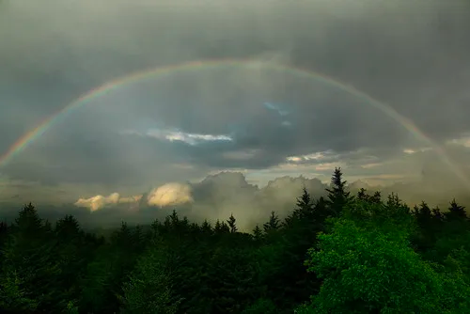
Photo courtesy of NatureWander.com. License: CC BY-SA. This content is excluded from our Creative Commons license. For more information, see https://ocw.mit.edu/help/faq-fair-use/ .
Addressing Climate Distress
PART 3

Slide 17
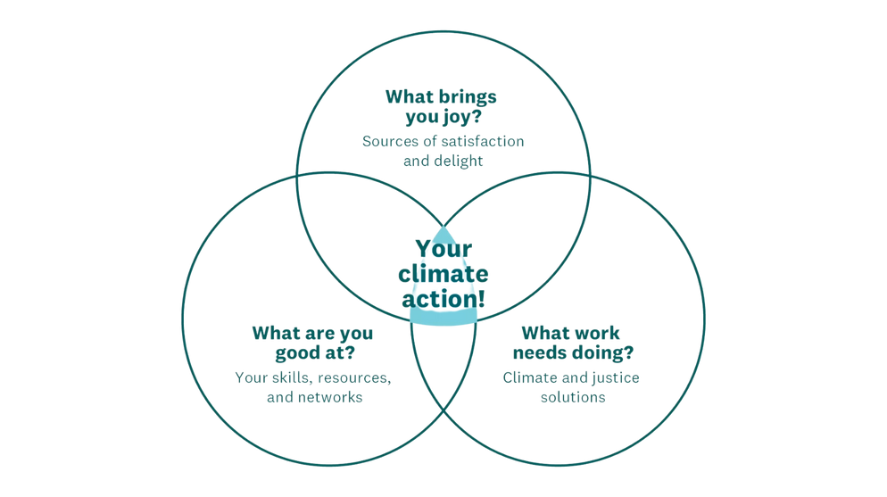
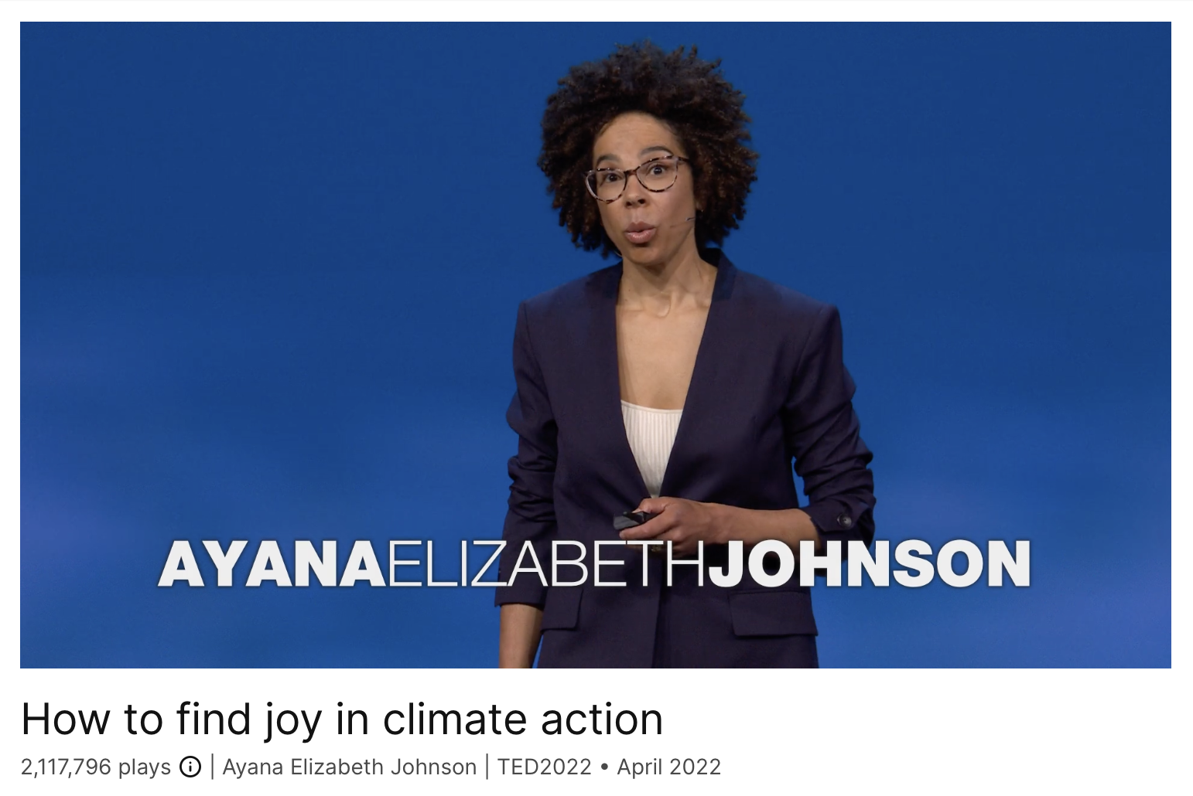
ACTIVITY #2
DISCOVER CLIMATE OPTIMISM
Make your own venn diagram of climate action
Identify the actions you are good at, actions that are needed, and actions that bring you joy, and find the center of your venn diagram.
Consider these questions as you make your venn diagram:
  Is it something you are already doing?
  Is it something you could start doing?
  How can this help address climate anxiety?
Watch
How to Find Joy in Climate Action
© Ayana Elizabeth Johnson. All rights reserved. This content is excluded from our Creative Commons license. For more information, see https://ocw.mit.edu/help/faq-fair-use/ .

Slide 18
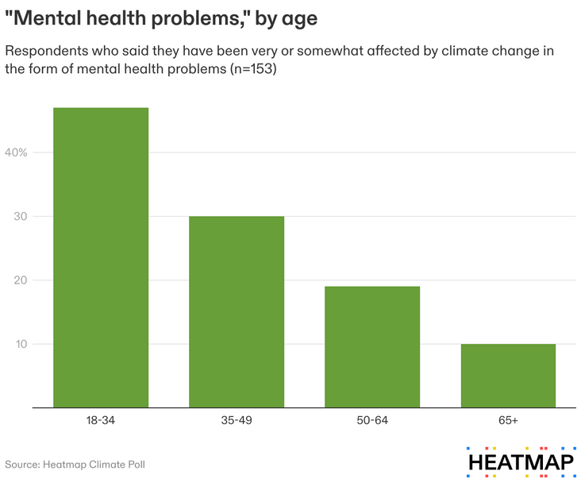
Addressing Climate Anxiety at Scale
Addressing climate anxiety at the individual level
Increasing access to mental health services, legitimizing people's worries and fears, and building networks for people feel climate anxious can address climate anxiety on the individual scale.
Addressing climate anxiety at the systemic level
  We must stop blaming individuals for their experiences of climate distress—these widespread mental health problems merit systems-level changes to the discussion of climate change.
  Climate justice must include actions to prevent the climate change induced threats that disproportionately impact vulnerable populations to promote better mental health.

Slide 19
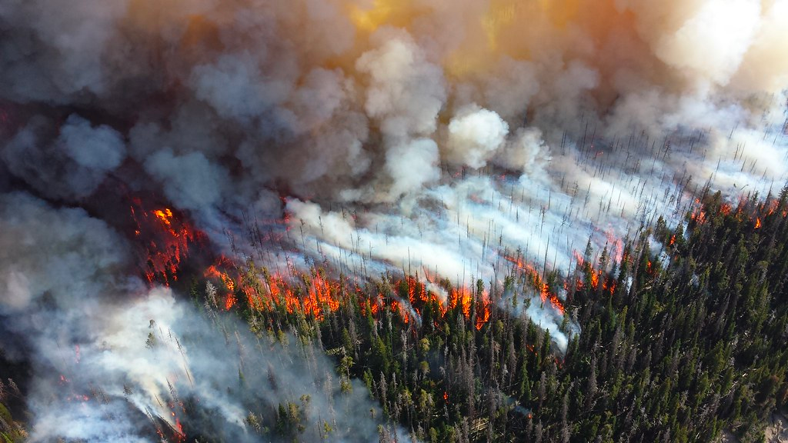
ACTIVITY #3
DISCUSSION OF THE METHODS TO ADDRESS CLIMATE ANXIETY
Discuss
In pairs or small groups of no more than 4 people, discuss possible methods of addressing and mitigating the impacts of climate anxiety.
Guiding questions
  How can we make access to these strategies more equitable and effective?
  How can climate justice help us confront climate distress/anxiety?
  How can we change the way climate change is talked about?
  How can we include more voices in the climate distress discussion?
  Can you identify more tactics of addressing climate distress?
This image is in the public domain.

Slide 20
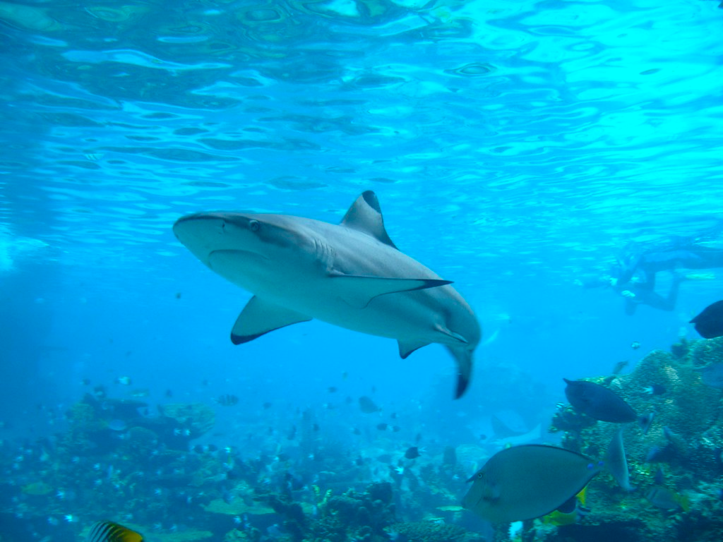
Beyond the Module
PART 4
Photo courtesy of Allan Lee on Flickr. License: CC BY..

Slide 21
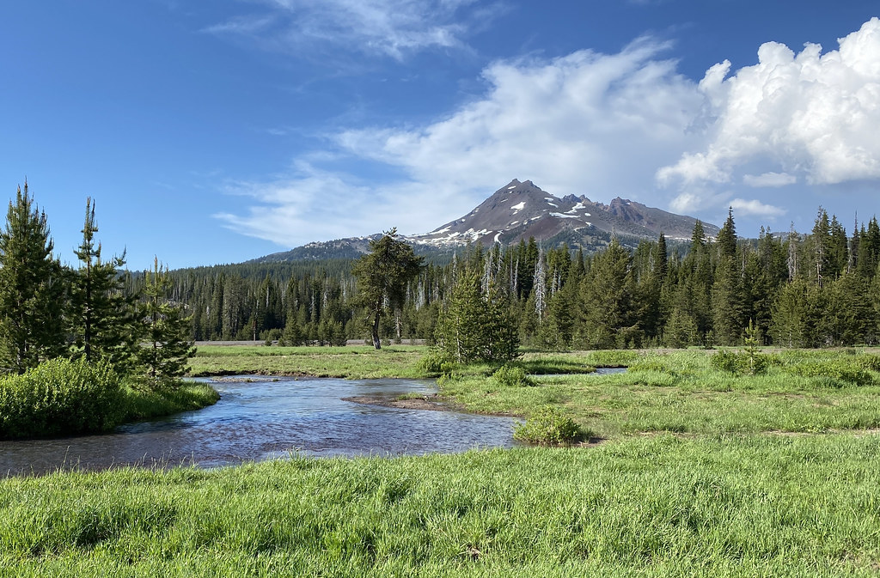
ACTIVITY #4
SELF-REFLECTION
Self-reflect on what you learned
Think about your own experiences learning about climate change, sustainability, and climate justice.
Guiding questions
  Has the climate change education you received included climate justice?
  How do you think climate justice impacts people's lives?
  How can you include climate justice in your coursework or career?
  How do you feel when you are learning about climate change or experiencing climate change?
  What do you think can help people experiencing climate distress?
Public domain image courtesy of Bonnie Moreland.

Slide 22
PROJECT OPTION #1
PROJECT OPTION #1
Critical Essay
Prompt suggestion
Choose one of the activities in this module and write a short paper in response to the articles.
Consider these questions:
  How does the content of the article relate to what you study?
  What are some local examples of what the article discusses?
  What are the gaps in the article?

Slide 23
PROJECT OPTION #2
PROJECT OPTION #2
Policy Memo
Prompt suggestion
Write a policy memo about modifying climate change messaging to help people suffering from climate distress.
Consider:
  Key points and lessons learned from the resources (videos, articles, etc.) in this module
  What is needed
  What messaging currently exists, if it’s effective, and if it needs to be changed
  The scale of change (individual or systemic)
Photo by Diana Polekhina on Unsplash

Slide 24
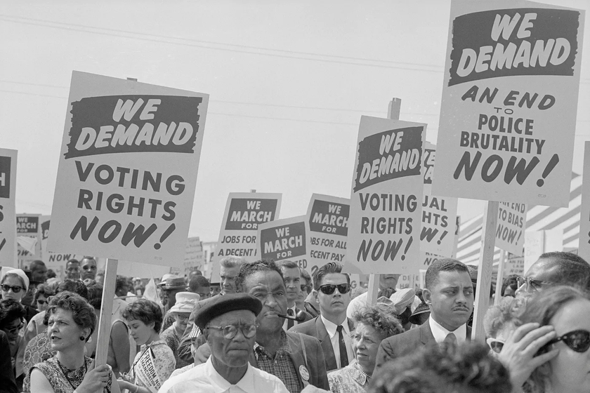
© Library of Congress/Interim Archives/Getty Images. All rights reserved. This content is excluded from our Creative Commons license. For more information, see https://ocw.mit.edu/help/faq-fair-use/ .
Photo: Library of Congress/Interim Archives/Getty Images
PROJECT OPTION #3
PROJECT OPTION #3
Historical Essay on the Emotions of the Climate Justice Movement
Prompt suggestion
Read Climate Change Isn't the First Existential Threat* and write a short paper including your thoughts on the article.
What can we learn about building and handling the emotional responses of a movement for environmental protection from America's ongoing fight for civil rights?
*Content warning for disturbing images and references to slavery and the Jim Crow era

Slide 25
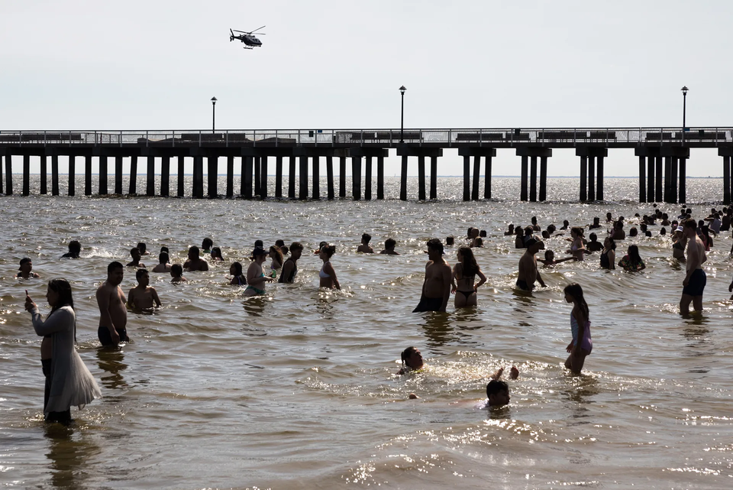
© Yuki Iwamura / Getty Images. All rights reserved. This content is excluded from our Creative Commons license. For more information, see https://ocw.mit.edu/help/faq-fair-use/ .
PROJECT OPTION #4
Essay on the The White- Centric Discussion of Climate Anxiety
Prompt suggestion
Read The Climate Anxiety Discussion Has a Whiteness Problem and write a short paper including your thoughts on the article. Consider these guiding questions:
  How have POC activists and affected individuals been left out of the climate anxiety discussion?
  What do you think can be done to address all types of climate anxiety?
  How can we include more voices in the discussion?

Slide 26

For more resources on climate and environmental justice: Please explore other modules in the Climate Justice Instructional Toolkit.

Slide 27
Module References
  Abdo, M., Ward, I., O’Dell, K., Ford, B., Pierce, J. R., Fischer, E. V., &amp; Crooks, J. L. (2019, October 2). Impact of wildfire smoke on adverse pregnancy outcomes in Colorado, 2007–2015. MDPI.
  Browne, G. (2022, July 11). The climate anxiety discussion has a whiteness problem. Wired.
  Heglar, M. A. (2020, February 18). Climate change isn’t the first existential threat. Medium.
  Johnson, A. E. (2022). How to Find Joy in Climate Action. TEDTalk. TED.
  Lange, J. (2023, March 29). Who suffers from climate anxiety? not exactly who you might think. Heatmap News.
  Lazarevic, N., Smurthwaite, K. S., Batterham, P. J., Lane, J., Trevenar, S. M., D’Este, C., Clements, A., Joshy, A. M., Hosking, R., Gad, I., Lal, A., Law, H. D., Banwell, C., Randall, D. A., Miller, A., Housen, T., Korda, R. J., &amp; Kirk, M. D. (2023, March 1). Psychological distress in three Australian communities living with environmental per-and polyfluoroalkyl substances contamination. Science of The Total Environment.
  Li, Q., Zheng, D., Wang, Y., Li, R., Wu, H., Xu, S., Kang, Y., Cao, Y., Chen, X., Zhu, Y., Xu, S., Chen, Z.-J., Lui, P., &amp; Qiao, J. (2020, November 7). Association between exposure to airborne particulate matter less than 2.5 μm and human fecundity in China. Environment International.
  McDonald, R. I., Chi, H. Y., &amp; Newell, B. R. (2015, October 21). Personal experience and the “psychological distance” of climate change: An integrative review. Journal of Environmental Psychology.
  McElroy, S., Ilango, S., Dimitrova, A., Gershunov, A., &amp; Benmarhnia, T. (2021, October 6). Extreme heat, preterm birth, and stillbirth: A global analysis across 14 lower-middle income countries. Environment International.
  McNamara, K. E., Wetsoby, R., Clisshold, R., & Chandra, A. (2021, June 17). Understanding and responding to climate-driven non-economic loss and damage in the Pacific Islands. Climate Risk Management.
  PFAS Australian map. Australian PFAS Chemicals Map. (2018, August 8).
  Schmidt, C. (2023). Climate anxiety. Harvard Medicine.

Slide 28
MIT OpenCourseWare
https://ocw.mit.edu
RES.11-003 Climate Justice Instructional Toolkit Spring 2025
For more information about citing these materials or our Terms of Use, visit https://ocw.mit.edu/terms.

