Slide 1
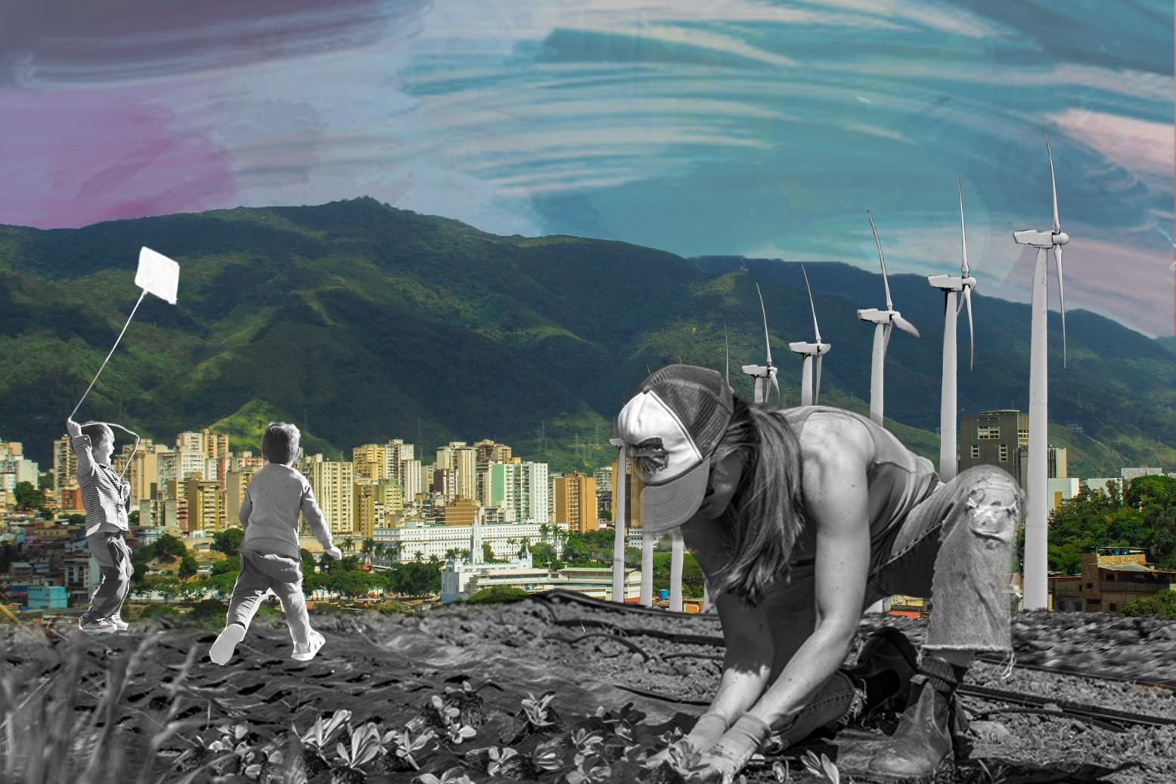

DISCIPLINE-SPECIFIC MODULE
Computing &
2.0
Climate Justice

Slide 2
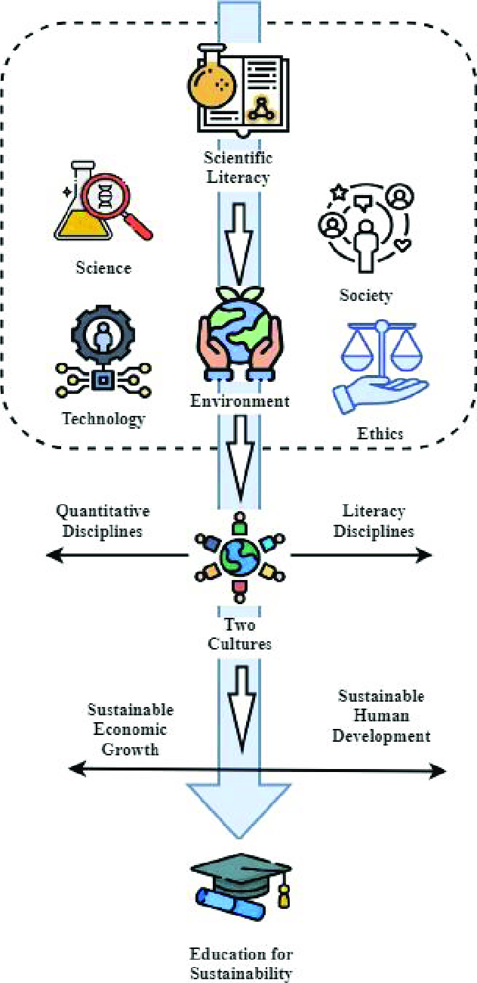
What’s in this module?
Description
This module provides a curriculum that integrates climate justice (CJ) and machine learning (ML) for practical real-world applications. Part 1 explores why ML is useful to advance CJ, ethical considerations, and sociotechnical frameworks. Part 2 discusses how to move from data to impact. Part 3 explores urban heat disparities as a case study for interpretable ML applications. Parts 4 and 5 explore climate health equity in heat-related illness.
Activities
Key Resources
4 parts
10 readings
2 optional projects
  The Future of Conservation Lies in Justice-led Technology (Longdon, 2024)
  Indigenous agents fight deforestation with drones and AI in Brazilian Amazon (Ennes and Chaves, 2021)
Figure from Tan, Huang, & Xian, 2024. License: CC BY.

Slide 3
Learning Objectives
01
02
03
04
Understand why ML is useful to study climate justice, social justice frameworks for applied ML, and the ethical implications.
Learn how to leverage machine learning to quantify and address societal disparities in climate change related outcomes.
Gain deeper insights into climate justice patterns through machine learning interpretability techniques.
Construct a project with an external climate justice related dataset that considers context.

Slide 4
Introduction
PART 1

Slide 5
Why ML for CJ?
Advanced Modeling
ML models go beyond parametric assumptions, providing capabilities for highly non-linear and non-parametric modeling that can capture more complex patterns in the data.
Predictive Power
ML enables us to answer the question: “What factors are most predictive of our outcomes of interest?” This is a prominent question in quantitative social science and policy development.
Pattern Recognition
Advances in interpretability methods for black-box ML models help us gain deeper insight into models to advance our understanding of complex societal patterns concerning climate issues.

Slide 6
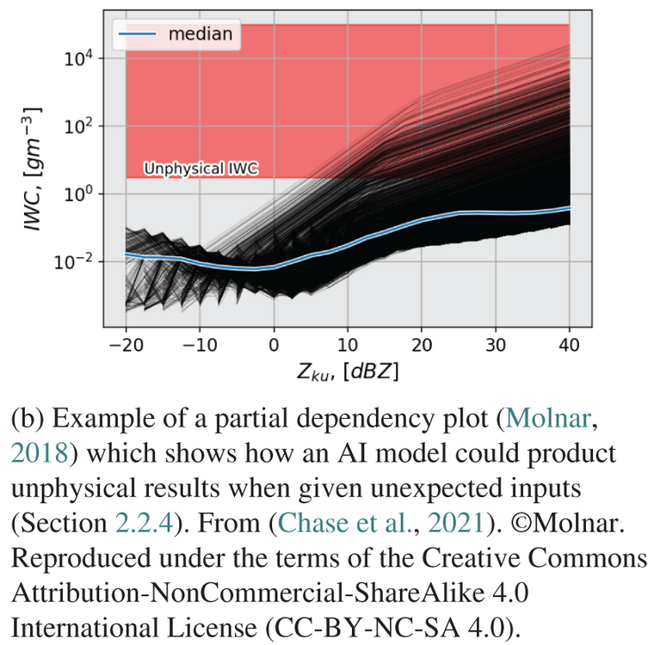
Ethical Considerations
Technical Solutionism |  | ML is not a cure all; it is only one tool to approach climate justice issues. A simpler model might perform the same as a deep learning model and permit interpretability for stakeholders. Qualitative data is also informative (e.g., interviews, testimonials, etc.).
Fairness, Accountability, Transparency, and Ethics |  | Models could exacerbate existing social disparities. Aim for participatory ML (i.e., nothing about us without us) and transparency in models (e.g., explaining the model’s decisions to stakeholders).
High Carbon Output |  | Some approaches to ML for climate currently use very high dimensional data (e.g., satellite images) and large neural networks which can lead to high carbon output. Aim for transparency on the emissions for deep learning models. Provide critical discussion on why you feel the benefits outweighed the cost.
Graph originally from A dual-frequency radar retrieval of two parameters of the snowfall particle size distribution using a neural network.
Above from: Why we need to focus on developing ethical, responsible, and trustworthy artificial intelligence approaches for environmental science

Slide 7
Roles for Computing in Climate Justice
01
02
03
04
Diagnostic
Formalizer
Rebuttal
Synecdoche
Computing research can help us to understand and measure social problems related to climate change with precision and clarity.
The process of formalizing a problem can serve as a site of contestation for frontline communities and discussion of equitable climate policy.
Computing can clarify the limits of technical interventions, and of policies premised on them, helping to justify the non-computational changes that are necessary for effective reform.
Media outlets can bring broad attention to applications of machine learning to climate justice research, making climate justice issues further salient in the public eye.
Reference: Roles for Computing in Social Change, Rediet Abebe et al. (2020)

Slide 8
Examples: Roles for Computing in Climate Justice
01
02
03
04
Diagnostic
Formalizer
Rebuttal
Synecdoche
Machine learning can highlight the factors that make certain urban areas hotter than others, providing further information to policymakers.
An algorithm to allocate green infrastructure that prioritizes trees can be contested in hurricane-prone areas where fallen trees may destroy housing.
While models often formalize the environmental factors of urban heat, they often do not formalize historical and contextual factors such urban planning, housing policy, and transportation policy.
Media outlets can bring broad attention to applications of machine learning to climate justice research, making climate justice issues further salient in the public eye.
Reference: Roles for Computing in Social Change, Rediet Abebe et al. (2020)

Slide 9
Contextualizing Our Work
CONSIDER THE CONTEXT
Data feminism asserts that data are not neutral or objective. They are the products of unequal social relations, and this context is essential for conducting accurate, ethical analysis.
Source: Data Feminism by D’Ignazio and Klein
“The Data Don’t Speak for Themselves” - Data Feminism
It is important to consider a) the context of the setting we are considering (e.g., sea level rise in Louisiana) and b) the context of the data (e.g., the origin, collection, limitations, etc.).
Historical Factors
Current circumstances are mediated by historical factors. It is important to both acknowledge and consider these in our work.
Community Input
Communities often have their own perspectives and they may differ from academia/industry. Frontline communities know better what information they need than academics.

Slide 10
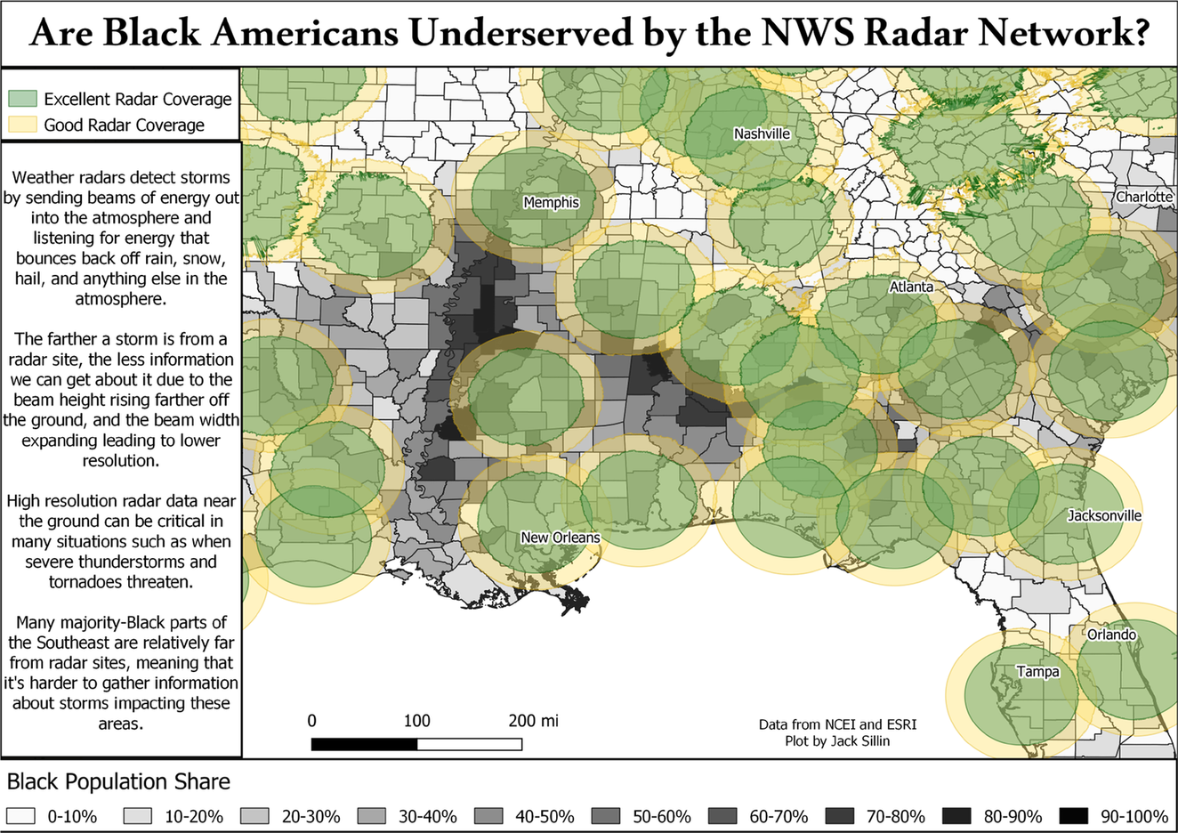
Consider Context
One common task in weather modeling is using discrete station measurements to estimate continuous weather patterns in places without stations.
This graph highlights gaps in coverage in rural, Black areas.
What could happen if we developed a machine learning model to interpolate the NWS radar network data?
© Jack Sillin. All rights reserved. This content is excluded from our Creative Commons license. For more information, see https://ocw.mit.edu/help/faq-fair-use/ .

Slide 11
From Data to Impact
PART 2

Slide 12

From Research to Engagement
Data Science Helped Propel the Environmental Justice Movement
The field of environmental justice studies helps inform EPA policy. Many quantitative studies of air pollution have led the EPA to apply regulations that have led to overall reductions. Little research exists to inform CJ with ML, and you can be a pioneer in the field.
Broader Impact (e.g., policy, grassroots activism)
ML4CJ can provide important insights to inform policy (e.g., the Justice40 initiative and urban/regional planning) as well as grassroots activists who rely on research to advocate for their communities and fight for change.
Photo by Hannah Busing on Unsplash

Slide 13
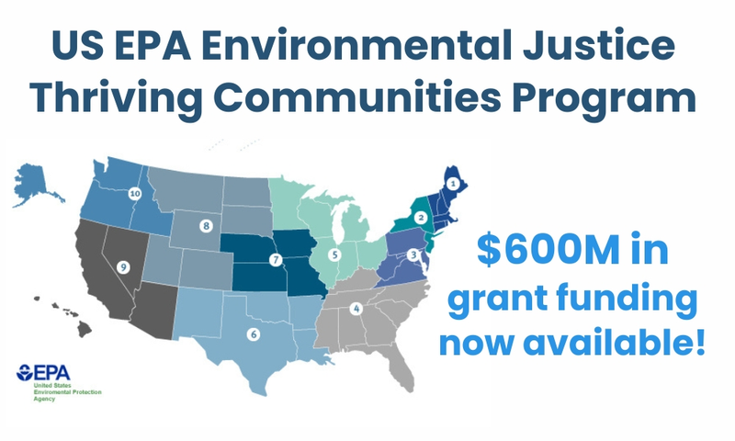
From Data to Impact
Resources for Communities
Your research can provide justification for a community grant proposal to the EPA and philanthropic organizations.
Data science can provide information for communities to advocate for themselves, e.g., dashboards. Data science can also support allocation of funding to frontline communities.
Education
Data science can educate people on the issues facing their community. A climate justice oriented data science education can encourage students to be civically engaged.
Retrieved from EPA
Policy
This map is in the public domain.
Data science can provide background and justifications for policy proposals.

Slide 14
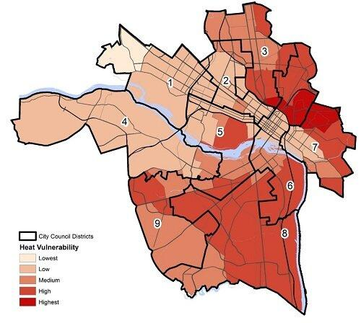
© City of Richmond, VA. All rights reserved. This content is excluded from our Creative Commons license. For more information, see https://ocw.mit.edu/help/faq-fair-use/ .
CASE STUDY #1
Urban Heat in Richmond, VA
City of Richmond, VA: RVAgreen 2050
Collaborative Data Science
In partnership with the Science Museum of Virginia, Virginia Commonwealth University, University of Richmond, and Groundwork RVA, the City of Richmond mapped its urban heat islands, land cover, and vulnerable demographics.
Broader Impact
The city leveraged this data to center equity in its RVAgreen 2050 plan for climate action and resilience. For example, the city partnered with community organizations to enhance green infrastructure and reduce the urban heat island effect.
Heat vulnerability corresponds to places that are both hotter and have demographic/health vulnerability to heat. More vulnerable places tend to have less greenspace and closer proximity to roads.
Further Reading at RVAgreen 2050

Slide 15
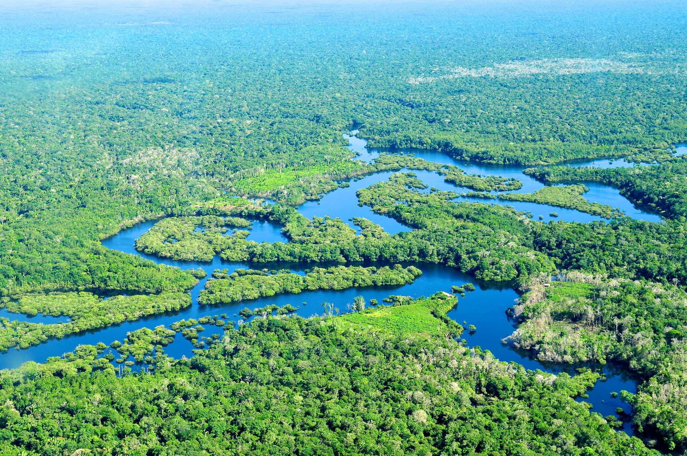
CASE STUDY #2
Climate Injustice in the Brazilian Amazon
Deforestation
Amazonian Indigenous communities face deforestation of their lands (e.g., for mining, agriculture).
Mining/Forest Fires
Fires are used to clear the forest for mining against the will of Indigenous people. These forest fires present serious human health threats due to air pollution.
Preservation
Indigenous communities are fighting to preserve the Amazon rainforest even amidst threats of violence.
Photo courtesy of Neil Palmer/CIAT. License: CC BY-NC-ND. This content is excluded from our Creative Commons license. For more information, see https://ocw.mit.edu/help/faq-fair-use/ .

Slide 16
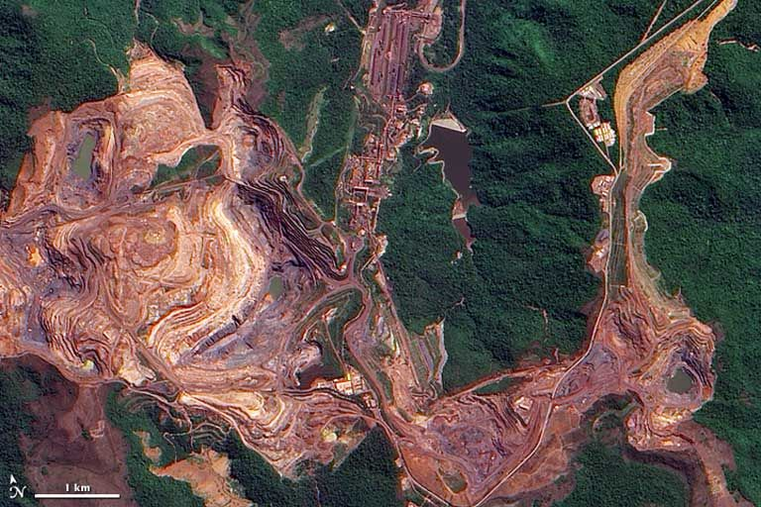
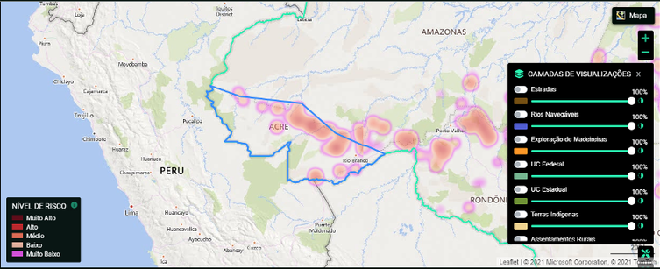
CASE STUDY #3
Data to Preserve the Brazilian Amazon
Public domain image by Jesse Allen, courtesy of NASA EO-1 team.
Remote Sensing
Indigenous people in the Amazon use satellite images and drones to monitor and respond to deforestation.
Air Pollution Sensors
They also use PM2.5 sensors to measure air pollution resulting from forest fires, highlighting the unjust distribution of pollution in Indigenous communities.
PrevisIA
In collaboration with local Indigenous groups, PrevisIA provides an open sources platform that integrates AI to monitor deforestation risk.
© Mongabay/PrevisIA. All rights reserved. This content is excluded from our Creative Commons license. For more information, see https://ocw.mit.edu/help/faq-fair-use/ .
Further Reading: Indigenous agents fight deforestation with drones and AI in Brazilian Amazon

Slide 17
Urban Heat Islands
PART 3

Slide 18
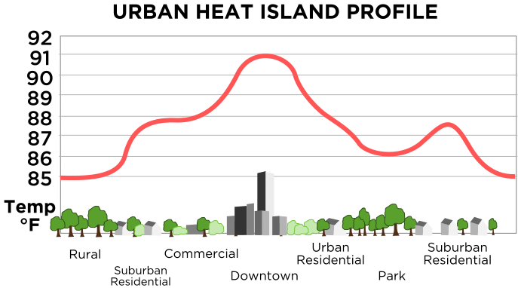
Urban Heat Island Profile
Based on this graph, which places are hottest? Which places are cooler?
Looking at the pictures, what differences do you notice between different areas? Relate the differences to temperature.
Public domain image courtesy of TheNewPhobia on Wikimedia.Originally created by NOAA.
Explainer: Urban Heat Islands by MIT Climate Portal

Slide 19
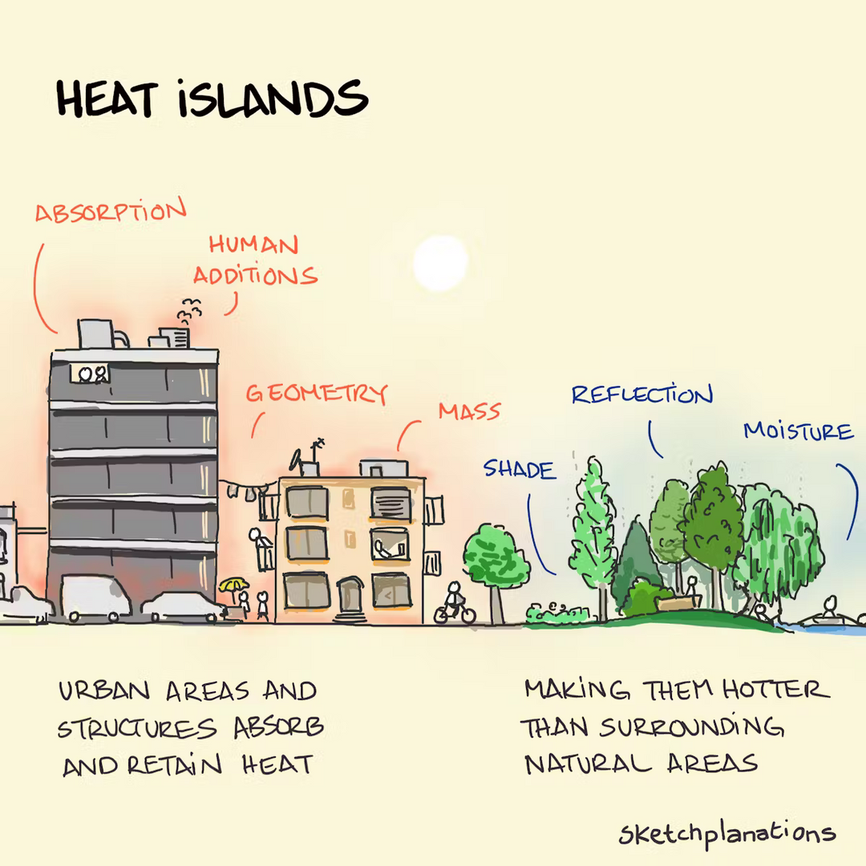

© Jono Hey / Sketchplanations.com. All rights reserved. This content is excluded from our Creative Commons license. For more information, see https://ocw.mit.edu/help/faq-fair-use/.
Why are cities hotter?
Jono Hey, Sketchplanations

Slide 20
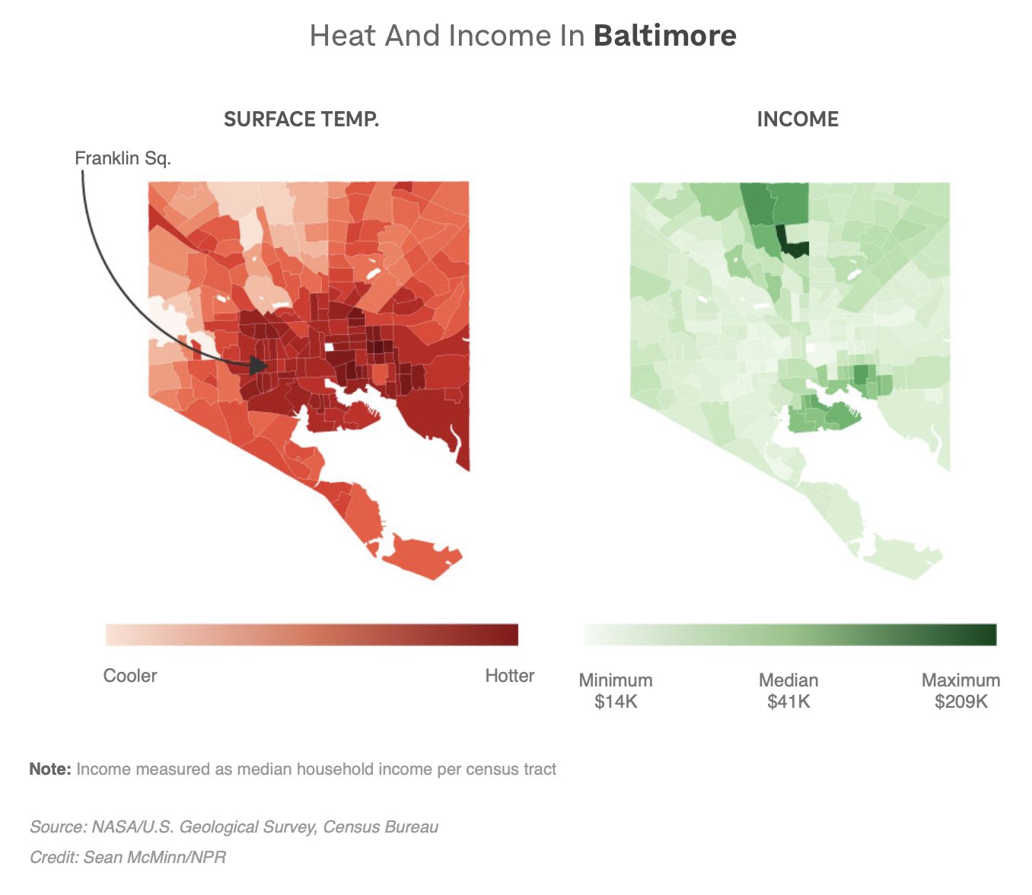

© Sean McMinn / NPR. All rights reserved. This content is excluded from our Creative Commons license. For more information, see https://ocw.mit.edu/help/faq-fair-use/ .
Urban heat is not distributed equally.
Reference: As Rising Heat Bakes U.S. Cities, The Poor Often Feel It Most

Slide 21
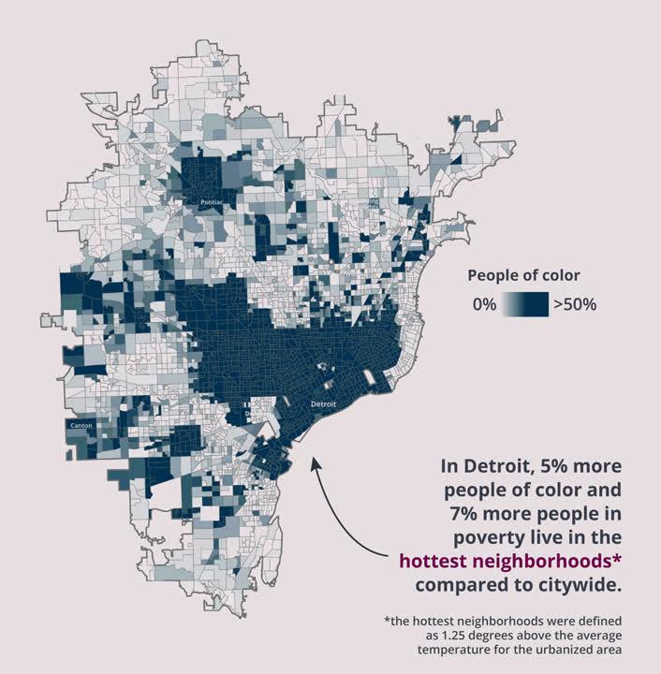
© American Forests. All rights reserved. This content is excluded from our Creative Commons license. For more information, see https://ocw.mit.edu/help/faq-fair-use/.
UHI Disparities
Ample Evidence
Many research studies have found disparities in exposure to urban heat. Marginalized communities often have more impervious surfaces and less greenspace, making their neighborhoods hotter than average.
Redlining
Redlined neighborhoods tend to be hotter their counterparts, partially due to less tree coverage and more impervious surface.
Urban Heat Equity - An American Forests Data Short

Slide 22
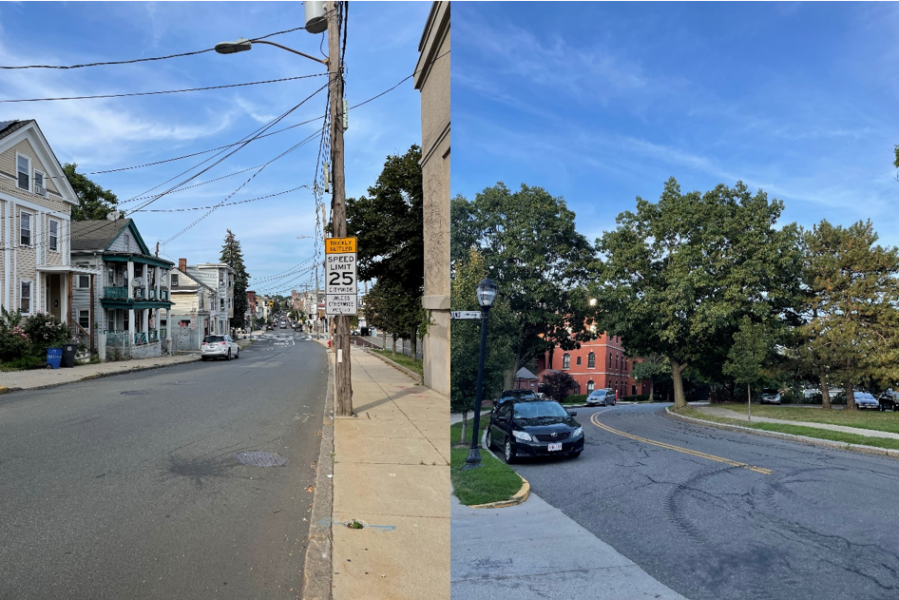
Photo by Susana © Union of Concerned Scientists. All rights reserved. This content is excluded from our Creative Commons license. For more information, see https://ocw.mit.edu/help/faq-fair-use/ .
Historic Context of UHIs
Source: Boston Area Communities Work Together to Beat the Heat
Historic Underinvestment
Marginalized communities have historically experienced under- and dis-investment (e.g., redlining, refusal to provide African American WWII veterans VA loans). Greenspace requires investment.
Environmental Injustice/ Urban Planning Disparities
Marginalized communities tend to be zoned for higher density and industrial use, resulting in increased impervious surfaces and anthropogenous sources of heat. Urban planners have historically placed roads, which have higher albedo, near marginalized communities.
“On the left is the view of Chestnut Street standing at Beacon Street. The lack of trees and vegetation is notable, particularly given the proximity to the loud and dirty Tobin Bridge. On the right is Boatswain Way, a block away. This street, and the rest of Admiral’s Hill, has an abundance of trees and vegetation that offer protection from the heat as well as the air and noise pollution of the Tobin Bridge. I am hopeful that when city officials see these photos, they’ll see how much inequity is present throughout the city.” - Susana

Slide 23
Heat Vulnerability Index
PART 4

Slide 24
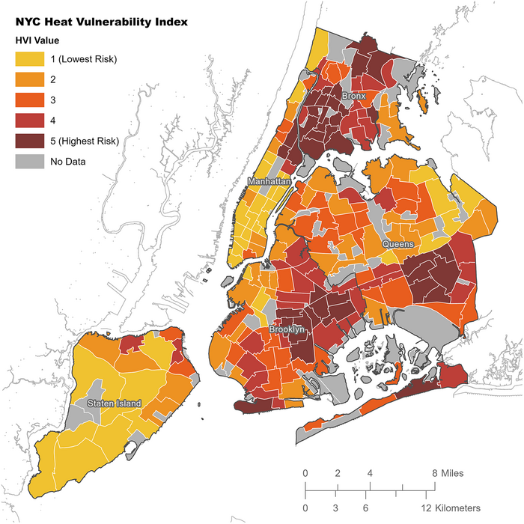
Heat Vulnerability Index
What is it?
A heat vulnerability index (HVI) is a metric that combines data related to heat, demographics, and sometimes health and the environment. Ideally, the HVI will be correlated to heat-related health outcomes.
Methodology
The HVI for New York City identifies neighborhoods where the risk of death associated with extreme heat episodes is higher.
PCA and average percentiles is common. A statistical model may be used to estimate the variance between heat mortality and dependent variables.
Drawbacks
For unsupervised methods, the heat vulnerability index may not be predictive of health outcomes. Due to its sensitivity, fine-grained heat-related health data is not publicly accessible, making some HVIs difficult to validate.
Source: NPCC4: Climate change and New York City's health risk.”. Image courtesy of T. Matte et al. License: CC BY-NC.

Slide 25
Heat EMS Risk Scores
PART 5

Slide 26
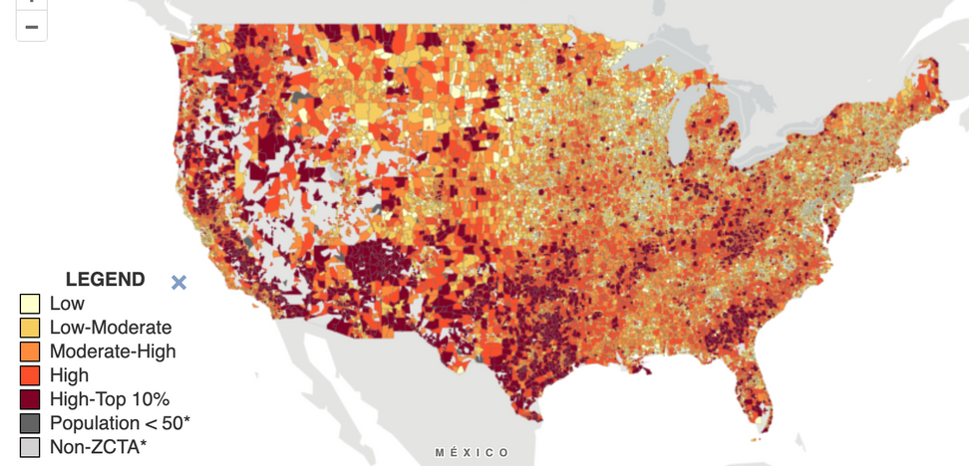
Heat EMS Activations
Heat Emergency Medical Services Activations
Summer months see a spike in heat-related emergency service (EMS) activations (i.e., emergency calls that lead to EMS arriving).
Heat EMS and Social Vulnerability
Heat EMS activations have been shown to be correlated with social vulnerability (e.g., poverty), existing health conditions, and impervious surfaces.
What is a risk score?
The CDC Heat and Health Index (HHI) combines data related to heat EMS activations, heat waves, trees/impervious surfaces, and socioeconomic vulnerability. Public domain map courtesy of US CDC.
A risk score represents the level of vulnerability toward some health outcome. In clinical machine learning, logistic regression provides the probability of an event occurring.

Slide 27
Beyond the Module
PART 6

Slide 28
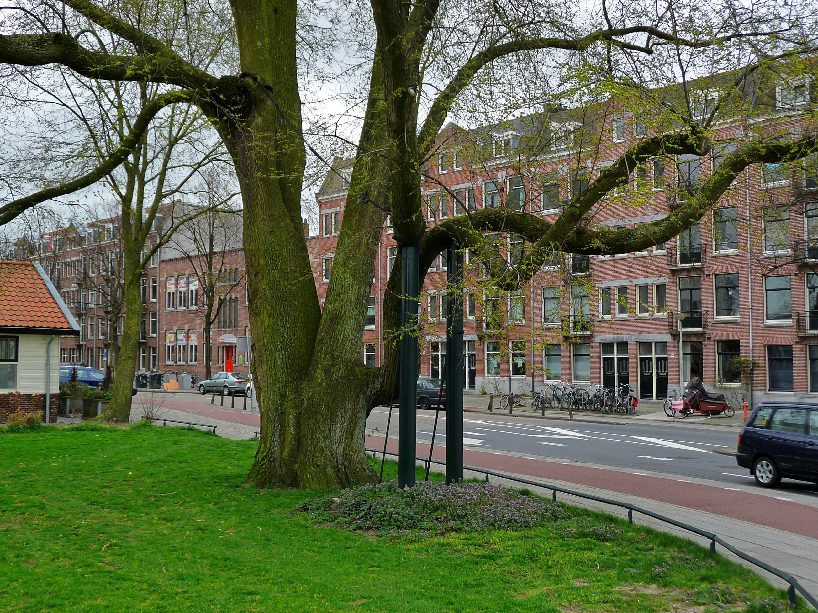
PROJECT OPTION #1
ML for Green Infrastructure
Help plant trees!
Use satellite imagery and orthography to estimate where an urban area could plant trees or place parks to respond to heat. Estimate the benefits to vulnerable groups.
Example Datasets
  GEE Tree Cover Data
  National Agriculture Imagery Program
  Reforestation Hub
Further Reading
  The tree cover and temperature disparity in US urbanized areas
  How Upstream Tech’s Lens Platform and Planet Imagery Help One Tree Planted Visualize The Future of Global Reforestation
Photo courtesy of FotoDutch on Wikimedia. License: CC BY-SA. This content is excluded from our Creative Commons license. For more information, see https://ocw.mit.edu/help/faq-fair-use/.

Slide 29
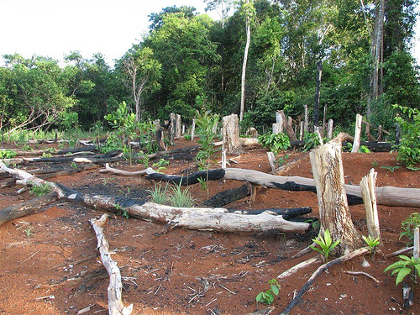
PROJECT OPTION #2
Deforestation
Monitoring Driving Factors of Deforestation in the Global South
Forests serve many purposes (economic, food source, carbon sinks) to local communities in the Global South. Yet they are at risk of deforestation for private gain. Use satellite imagery to monitor the effects of mining, agriculture, conflict, etc. on deforestation.
Example Datasets
  Forest Data
Further Reading
  A pantropical assessment of deforestation caused by industrial mining
  Disentangling the numbers behind agriculture-driven tropical deforestation
  What peace means for deforestation: An analysis of local deforestation dynamics in times of conflict and peace in Colombia
Photo courtesy of Dr. Blofeld on Wikimedia. License: CC BY_SA. This content is excluded from our Creative Commons license. For more information, see https://ocw.mit.edu/help/faq-fair-use/.

Slide 30
More Resources
Climate and Economic Justice Screening Tool
U.S. Climate Resilience Toolkit
NASA Applied Sciences
Climate Central
NASA SEDAC
Google Earth Engine
Environmental Data and Governance Initiative
Climate Change AI
Thriving Earth Exchange

Slide 31

For more resources on climate and environmental justice: Please explore other modules in the Climate Justice Instructional Toolkit.

Slide 32
Module References
  Abebe, R., Barocas, S., Kleinberg, J., Levy, K., Raghavan, M., & Robinson, D. G. (2020, January). Roles for computing in social change. In Proceedings of the 2020 conference on fairness, accountability, and transparency (pp. 252-260).
  Anderson, M., McMinn, S., Eckert, N., Underwood, N., Mussenden, S., Ready, R., & Diffendal, T. (2019). As rising heat bakes US cities, the poor often feel it most. National Public Radio.
  Benz, S. A., & Burney, J. A. (2021). Widespread race and class disparities in surface urban heat extremes across the United States. Earth's Future, 9(7), e2021EF002016.
  Chase, R. J., Nesbitt, S. W., & McFarquhar, G. M. (2021). A dual-frequency radar retrieval of two parameters of the snowfall particle size distribution using a neural network. Journal of Applied Meteorology and Climatology, 60(3), 341-359.
  Conlon, K. C., Mallen, E., Gronlund, C. J., Berrocal, V. J., Larsen, L., & O’Neill, M. S. (2020). Mapping human vulnerability to extreme heat: A critical assessment of heat vulnerability indices created using principal components analysis. Environmental Health Perspectives, 128(9), 097001.
  DeVine, A. C., Vu, P. T., Yost, M. G., Seto, E. Y., & Busch Isaksen, T. M. (2017). A geographical analysis of emergency medical service calls and extreme heat in King County, WA, USA (2007–2012). International Journal of Environmental Research and Public Health, 14(8), 937.
  D'ignazio, C., & Klein, L. F. (2023). Data Feminism. MIT press.
  Ennes & Chaves (2021) Indigenous agents fight deforestation with drones and AI in Brazilian Amazon. Mongabay.
  Hsu, A., Sheriff, G., Chakraborty, T., & Manya, D. (2021). Disproportionate exposure to urban heat island intensity across major US cities. Nature Communications, 12(1), 2721.

Slide 33
Module References
  Manware, M., Dubrow, R., Carrión, D., Ma, Y., & Chen, K. (2022). Residential and race/ethnicity disparities in heat vulnerability in the United States. GeoHealth, 6(12), e2022GH000695.
  Matte, T., Lane, K., Tipaldo, J. F., Barnes, J., Knowlton, K., Torem, E., ... & Yuan, A. (2024). NPCC4: Climate change and New York City's health risk. Annals of the New York Academy of Sciences, 1539(1), 185-240.
  McGovern, A., Ebert-Uphoff, I., Gagne II, D. J., & Bostrom, A. (2022). Why we need to focus on developing ethical, responsible, and trustworthy artificial intelligence approaches for environmental science. Environmental Data Science, 1, e6.
  Ramesh, T., Wozniak, G. D., & Yu, H. (2024). County-level disparities in heat-related emergencies. JAMA Network Open, 7(3), e242845-e242845.
  Twichell (2024) Urban Heat Equity - An American Forests Data Short. American Forests.
Stock images found on Canva were used in this module.

Slide 34
MIT OpenCourseWare
https://ocw.mit.edu
RES.11-003 Climate Justice Instructional Toolkit Spring 2025
For more information about citing these materials or our Terms of Use, visit https://ocw.mit.edu/terms.

