Slide 1
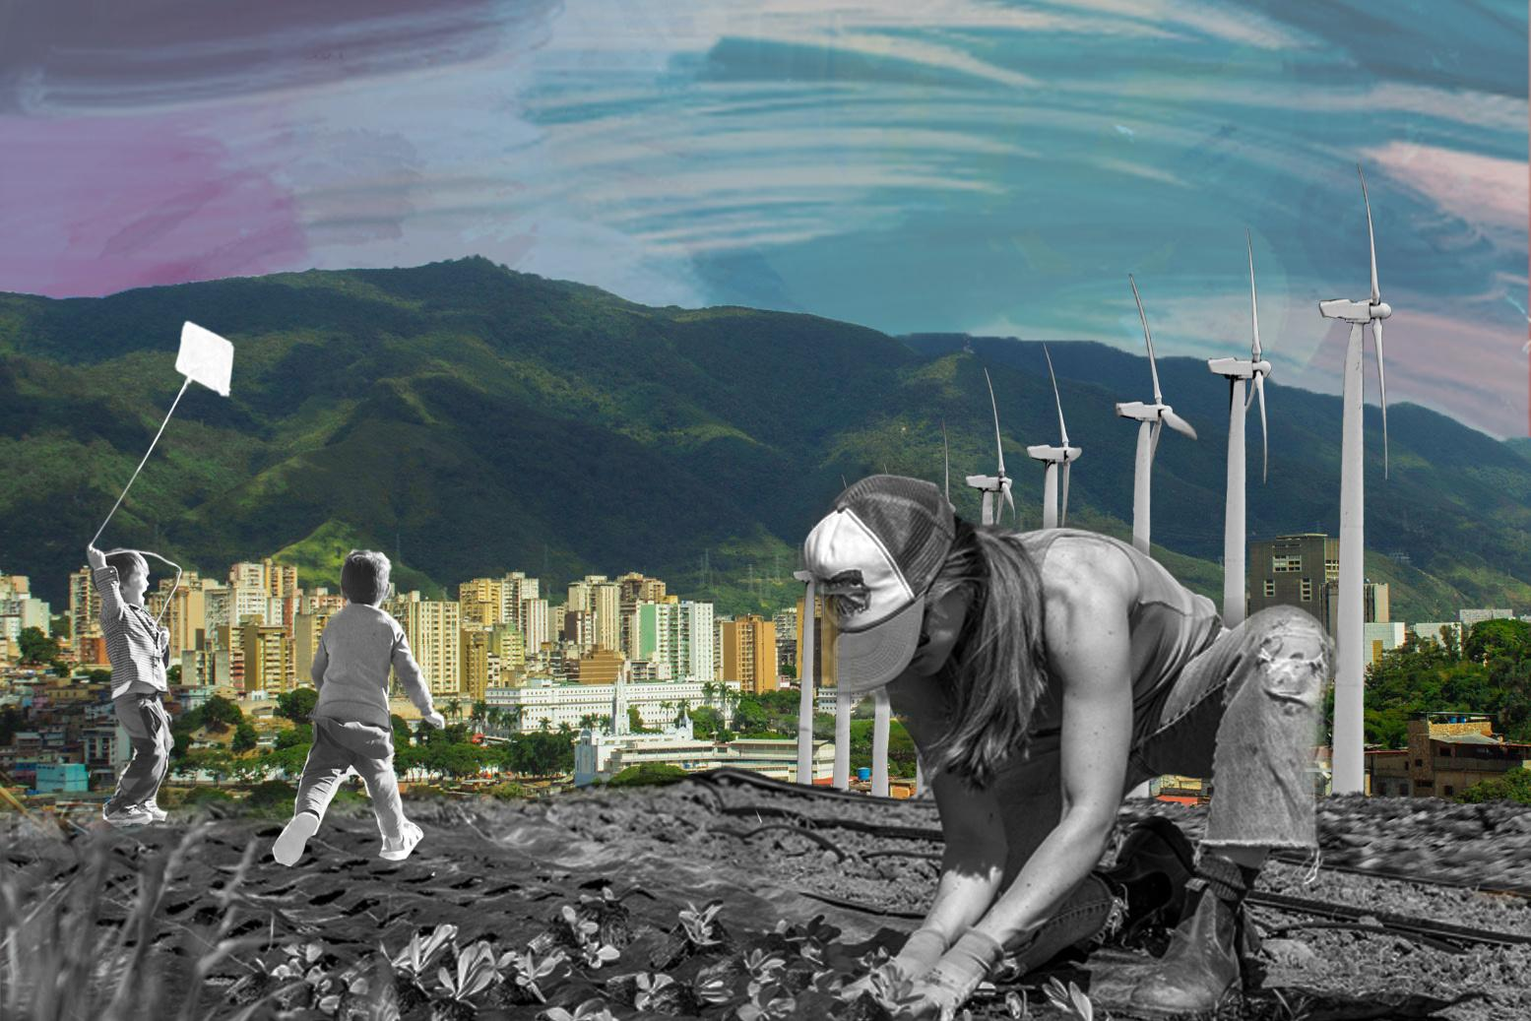

DISCIPLINE-SPECIFIC MODULE
Climate Justice &
2.0
Socio-Technical Systems

Slide 2

Photo courtesy of Calistemon on Wikimedia, License: CC BY-SA. This content is excluded from our Creative Commons license. For more information, see https://ocw.mit.edu/help/faq-fair-use/.
What’s in this module?
Description
Introduce students to the application of climate justice skills in the context of socio-technical systems. Students will learn how to analyze technology through a socio-technical lens, with real-life applications to machine learning, climate justice mapping tools, and small-scale research projects.
Activities
Key Resources
5 parts
4 videos
9 readings
6 activities
2 optional projects
  Computing & Climate Justice template
  Climate Justice & Environmental Data template

Slide 3
Learning Objectives
01
02
03
04
Understand how technical systems interact with people and the environment to become socio-technical systems
Learn how to critique interaction between socio-technical systems’ and the environment and climate
Explore how mapping and quantifying communities are used in relation to climate justice
Propose ways to design socio-technical systems with climate justice in mind

Slide 4
Introduction
PART 1

Slide 5

What do technical systems have to do with climate and people?
Human-centered design has long focused on creating systems with users in mind.
Computing and data systems have an enormous environmental impact, especially as the energy demands of systems like AI have grown exponentially in recent years.
In this module...
  we will use the framework of climate justice to examine these challenges. Climate justice inherently considers the unequal ways in which people are affected by the climate crisis
  we will explore inequities people face from socio-technical systems

Slide 6
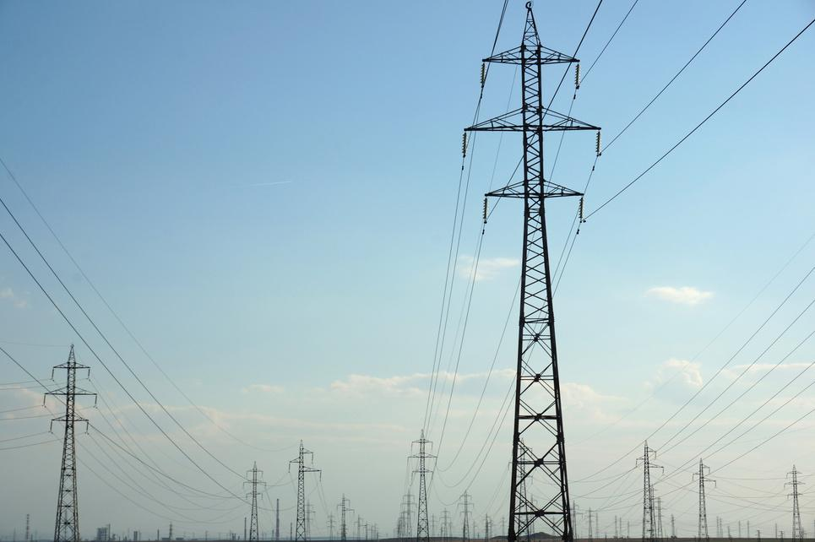
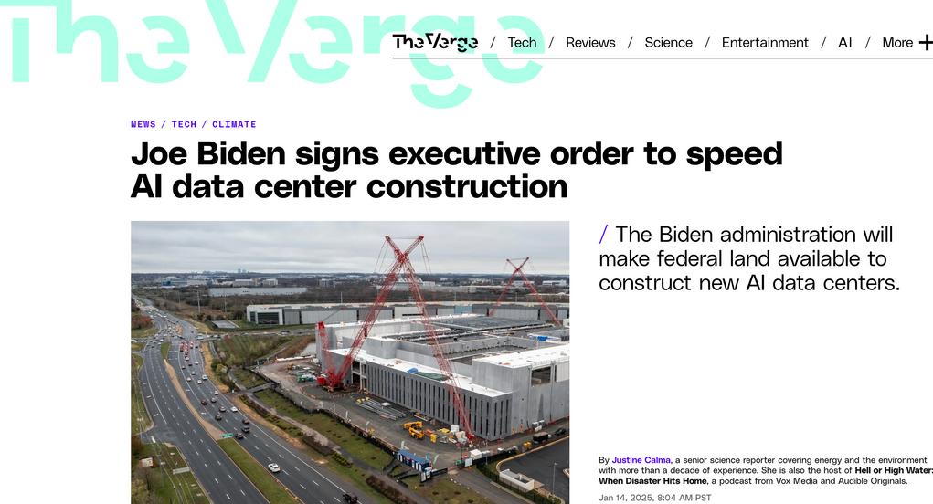
Left: Photo courtesy of World Bank Photo Collection on Flickr. License: CC BY-NC-ND. This content is excluded from our Creative Commons license. Right: Photo © Vox Media. All rights reserved. This content is excluded from our Creative Commons license. For more information, see https://ocw.mit.edu/help/faq-fair-use/.For more information, see https://ocw.mit.edu/help/faq-fair-use/.
ACTIVITY #1
INTRODUCING THE ENVIRONMENT + SOCIOTECHNICAL SYSTEMS
Step 3: Small Group Sharing
  Have students share their photos and news stories in small groups (2-4) [see examples of photos and news stories below].
  You can prompt students to map the linkages between the photos and news stories they brought in. They can use parts of the reading to create links between the different artifacts they brought in.
  Gather the class and do a group gallery walk. Have each small group present to the whole class the map they created linking each of their news stories and photos.
Step 1: Watch
Breaking down the climate impact of AI
Step 2: Assignment Prompts
  Bring in a photo of when you see technology interacting with the environment
  Bring a news story about how computing or technology may be affecting the environment
Sample photo
Sample news story

Slide 7
What is a sociotechnical system?
PART 2

Slide 8
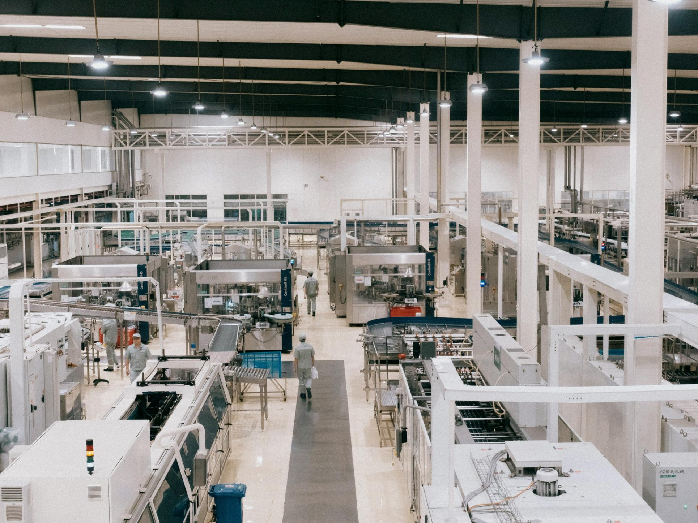
Photo by Creator on Unsplash
Definitions of socio-technical systems
Definition
For this module, we’re going to take a socio-technical approach. Broadly defined, this means thinking and designing with technology, people, and communities in mind. We want to think beyond just specifications and parameters of technical systems.
What does this mean?
There’s a significant amount of literature on socio-technical systems. In this module, we’ll focus on them as a way to understand technology within a broader social context. Machines and technologies have always required users and impacted people, so this is not a new way of thinking.

Slide 9

Socio-technical Gap
Researchers spend a lot of time thinking about the gap between what people want from technology and what technology can deliver.
This gap has become a central focus of research, with studies exploring how technology can be made more socially aware, how it shapes our social experiences, and how it can enhance existing societal functions. Collectively, this work addresses the socio-technical gap, aiming to better support social activities and communities through thoughtful technological integration.
Further Resource
Ackerman, M. S. (2000). The Intellectual Challenge of CSCW: The Gap Between Social Requirements and Technical Feasibility. Human–Computer Interaction, 15(2–3), 179–203.
Photo by Sam Balye on Unsplash

Slide 10
ACTIVITY #2
UNDERSTANDING SOCIO-TECHNICAL SYSTEMS
Step 3: Class discussion questions
  How does the socio-technical system design differ from the socio-technical-ecological systems approach?
  Think about a specific system that you use every day (ie: text messaging). What is a socio-technical-ecological approach to thinking about the system?
  How might your own field or research take a socio-technical-ecological system approach?
  What are the downsides of a socio-technical-ecological approach? Does adding the ecological drop something from the socio-technical system approach?
  How does the socio-technical-ecological approach speak to what you know about environmental, climate or energy justice?
Step 1: Read and analyze
  Socio-Technical System Design
  Bringing Technology into Social-Ecological Systems Research—Motivations for a Socio-Technical-Ecological Systems Approach
Step 2: Pre-reading questions
  Do you think about social impacts when you write code or design products now?
  How do you think about the environment in the systems?

Slide 11
Auditing Machine Learning
PART 3

Slide 12
Context
Auditing traditional machine learning systems usually means measuring some part of their inputs and some part of their outputs.
Biased or unfair machine learning have been shown to lead to unfair incarceration and deny people housing. Many people hope auditing may make these system more fair and equitable.
Researchers, journalists, and others use auditing to identify when algorithms cause harm. However, simply identifying harm doesn’t guarantee just outcomes. Audits often focus on protected classes like race, gender, and age, but where do the environment and climate fit in? As discussed in Part One, all technical systems carry ecological and environmental costs.

Slide 13
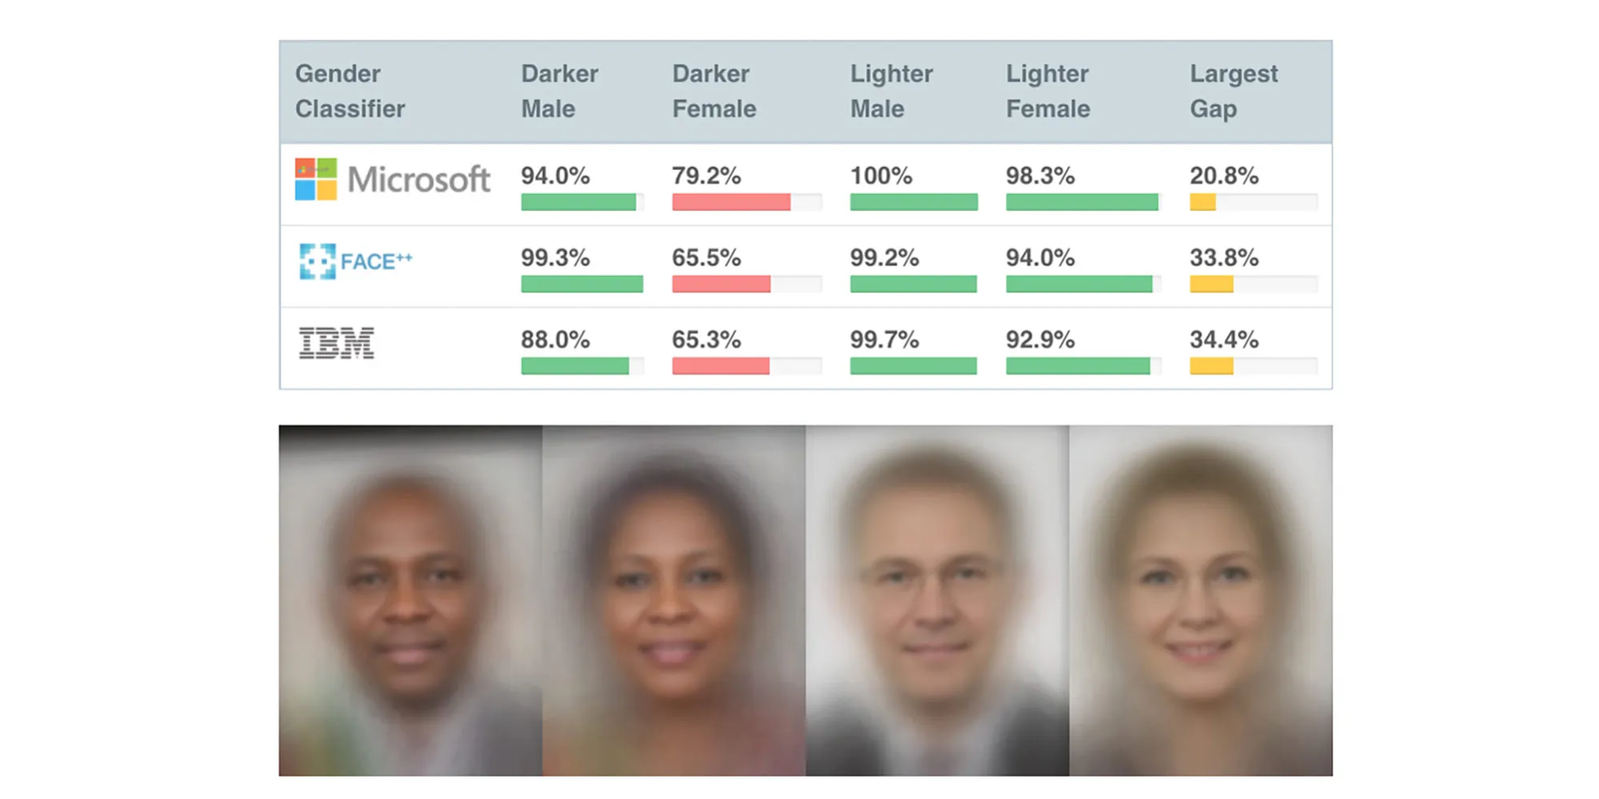
Image by Joy Buolamwini. License: CC BY-NC-ND. This content is excluded from our Creative Commons license. For more information, see https://ocw.mit.edu/help/faq-fair-use/.
ACTIVITY #3
CASE STUDY: AUDITING FACIAL RECOGNITION
In 2018, Joy Buolamwini and Timnit Gebru demonstrated that popular facial recognition tools had significantly worse performance on identifying faces of darker-skin women.
In this case, Buolamwini and Gebru audited on the basis of skin color (using the Fitzpatrick scale) and gender by building a dataset of images from global policymakers.
Depending on student’s technical levels the following resources can be used to introduce the concept of auditing:
Buolamwini, J. & Gebru, T. (2018). Gender Shades: Intersectional Accuracy Disparities in Commercial Gender Classification. (Academic Paper)
Gender Shades. (Video on Paper)
Coded Bias (Available through MIT libraries)

Slide 14
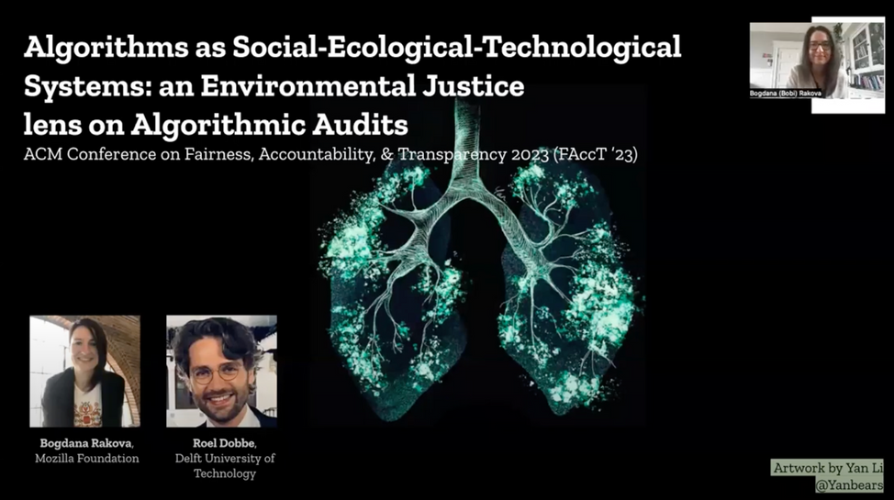
ACTIVITY #4
EXTENDING ALGORITHMIC AUDITING TO THE ENVIRONMENT
Step 2: Questions for Exploration
  How do you think the paper draws from environmental justice and climate justice to develop their version of algorithmic audits?
  How would the audit system they propose change the type of audit carried out by Joy Buolamwini and Timnit Gebru?
    This can be extended to fill in a table using the dimensions of Social-Ecological, Ecological-Technological, Social-Technological by Practice and materiality, Community, identity, and attachment, and Human and non-human assemblages like in Table 2 of the paper.
  Based on the paper’s policy recommendations, what are some ways an assessment could be designed on an existing algorithm you use?
Step 1: Read or watch
Algorithms as Social-Ecological- Technological Systems: an Environmental Justice Lens on Algorithmic Audits (video version)
More Resources
  Mitigating allocative tradeoffs and harms in an environmental justice data tool
  Climate Justice and Computing Module
© Bogdana Rakova and Roel Dobbe. All rights reserved. This content is excluded from our Creative Commons license. For more information, see https://ocw.mit.edu/help/faq-fair-use/.

Slide 15
Environmental Justice and Climate Justice Mapping
PART 4

Slide 16
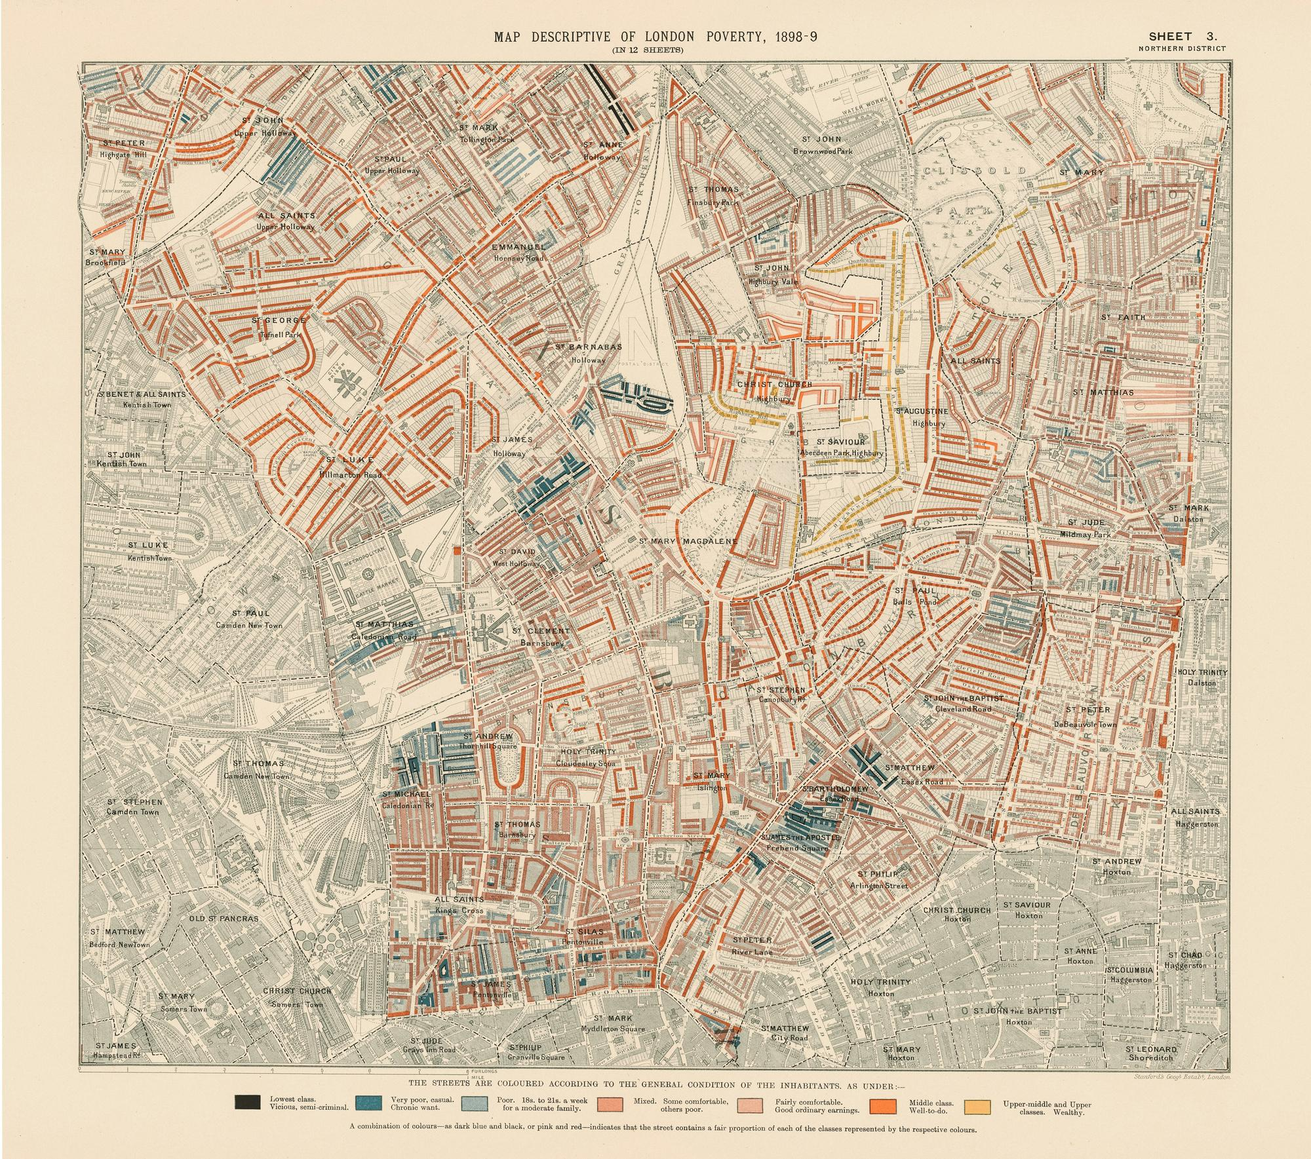
Context
There are a lot of socio-technical systems in development to assist in climate action.
These systems are usually designed to distill environmental and social data for people to use. This data might be used to inform actions such as interventions or grantmaking with the aims of prioritizing communities impacted by environmental, climate, and social harms.
We want to think about how these systems try and represent social and environmental data, and also how the environment and users might interact with these systems.
This image is in the public domain.

Slide 17
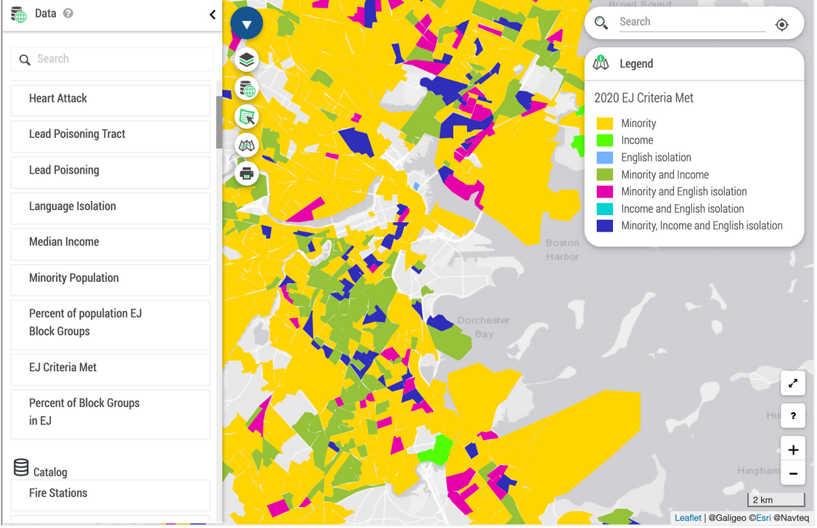
© Commonwealth of Massachusetts. All rights reserved. This content is excluded from our Creative Commons license. For more information, see https://ocw.mit.edu/help/faq-fair-use/.
Local EJ Tools
The state of Massachusetts has its own way to identify communities overburdened by environmental injustices.
“The MA DPH EJ Tool is intended to facilitate the use of the EOEEA EJ Policy, to enhance inclusive community planning for environmental assessment, and to inform a wide range of activities such as siting, permitting, Brownfields clean-up, Massachusetts Environmental Policy Act review, grant applications, transportation projects, and community, health, or climate-related impact assessments.” (Massachusetts Environmental Public Health Tracking)

Slide 18
ACTIVITY #5
COMPARING ENVIRONMENTAL JUSTICE MAPPING
Step 3: Groups compare using the tools
Groups should choose a location in Massachusetts. Explore each of these locations on the Climate and Economic Justice Screening Tool and MA EJ Tool.
Take notes on the following as a group:
  What are these tools measuring?
  What are the sources of data?
  Who is the intended audience? Who do you think uses it?
  Is the tool easy to use? Is it difficult to use?
Step 1: Setup
Divide students into groups of two or three
Step 2: Read
Have students read the following:
  Climate and Economic Justice Screening Tool FAQ*
  MA Environmental Public Health Tracking Environmental Justice
Step 4: Small Group Report Back (optional)
Have groups come back and speak about their findings. You can also explore how these tools engage in data. Is this data representative of real climate justice issues in communities?
Optional Variation: Have groups pick different state level environmental/climate justice screening tools. Compare different states approaches to mapping these injustices.
You can opt for another local screening tool if another locale is more relevant to students (for more options see Activity #3)

Slide 19
ACTIVITY #5
ENVIRONMENTAL JUSTICE MAPPING AT THE NATIONAL SCALE
Step 3: In-class discussion
  How can the suggestions for future frameworks be incorporated into the existing tools (ie: Climate and Economic Justice Screening Tool)?
  What role do you think quantification and prioritization among communities does?
Step 1: Read and Analyze
  Screening for Environmental Justice: A Framework for Comparing National, State, and Local Data Tools
Step 4: Optional addition from Activity #2
  How do the notes your group generated compare to the Urban Institute’s tool dimensions? What do you wish you had added?
  If you developed one of the tools from Activity #2, how would you go about redesigning your tool with the recommendations from the Urban Institute?
  What local context might you be missing from the address you initially analyzed?
Step 2: Pre-reading questions
  Who do you think uses environmental justice mapping tools?
  How are people in communities represented by these maps?
The metadata at the Screening for Environmental Justice report includes links to multiple screening tools the Urban Institute analyzed. These tools can be used to supplement Activity #2.

Slide 20
Designing Small Systems: Sustainable Human-Computer Interaction
PART 5

Slide 21

Context
Sustainable human-computer interaction (SHCI) is a field of study that explores how to design computing systems to be more sustainable or encourage users towards sustainable behaviors.
The field draws its origins to the 2000s to an important paper about how technology could promote users to be more sustainable and how technology design often encourages waste (Blevis, 2007). Many researchers have used this sub-field to explore issues related to the climate crisis and also individual behaviors around climate.
The field has gone through critiques of not engaging critically enough with other work in the climate space and not being focused enough on specific sustainability goals.
Photo by Jonas Leupe on Unsplash

Slide 22
ACTIVITY #6
EVALUATING SHCI SYSTEMS
Step 2: Evaluate these designs in a group
  How do the authors design their artifact to engage with the climate crisis?
  Do the authors consider principles of climate justice in their design? If they don’t, how do you think those principles could’ve been incorporated into the design?
  What is the design gap the authors define that their artifact is trying to fill?
  Do you think these artifacts are helpful or beneficial to the wider world?
  What do you think it would be like to interact with the systems described in the paper?
Step 1: Form groups and select one of the projects to learn about
  High Water Pants: Designing Embodied Environmental Speculation
  Understanding factors of successful engagement around energy consumption between and among households
  Interactions with Climate Change: a Data Humanism Design Approach
Step 3: Group Presentation and Discussion
  Each group delivers a 5-10 minute presentation on the paper they read, and the questions above.
  In a larger class group, guide a discussion on how these papers engage with designing with a social-ecological-technological system approach (for more see Activity #2).

Slide 23
More SHCI-Relevant Resources
Seminal sustainable human-computer interaction paper
“Sustainable Interaction Design: Invention & Disposal, Renewal & Reuse” (Blevis, 2007)
Literature review of design projects in SHCI
“Interaction for Crisis: A Review of HCI and Design Projects on Climate Change and How They Engage with the General Public” (Ferreira, Valentina & Nunes, 2022)
Literature reviewing connecting previous SHCI work to the UN SDG Goals
“A Decade of Sustainable HCI: Connecting SHCI to the Sustainable Development Goals” (Hansson, Cerratto-Pargman, & Pargman, 2021)
Interview study on how climate justice activists use data
“Autonomy, Affect, and Reframing: Unpacking the Data Practices of Grassroots Climate Justice Activists” (Flawn & Soden, 2024)

Slide 24
Beyond the Module
PART 6

Slide 25

Photo by NordWood Themes on Unsplash
PROJECT OPTION #1
Photovoice in Environmental Justice Mapping
Have students walk around the neighborhood they live in or location they chose in Activity 4. Prompt students to take photos of environmental or social issues in their community. Students should come back and talk through the stories of their photos.
More resources:
  Community Stories: Using photovoice to narrate the stories of our communities and our people — A zine exploring how communities use this method to discuss EJ mapping
  Using photovoice as a tool for community engagement to assess the environment and explore environmental health disparities — A paper exploring photovoice in this context

Slide 26
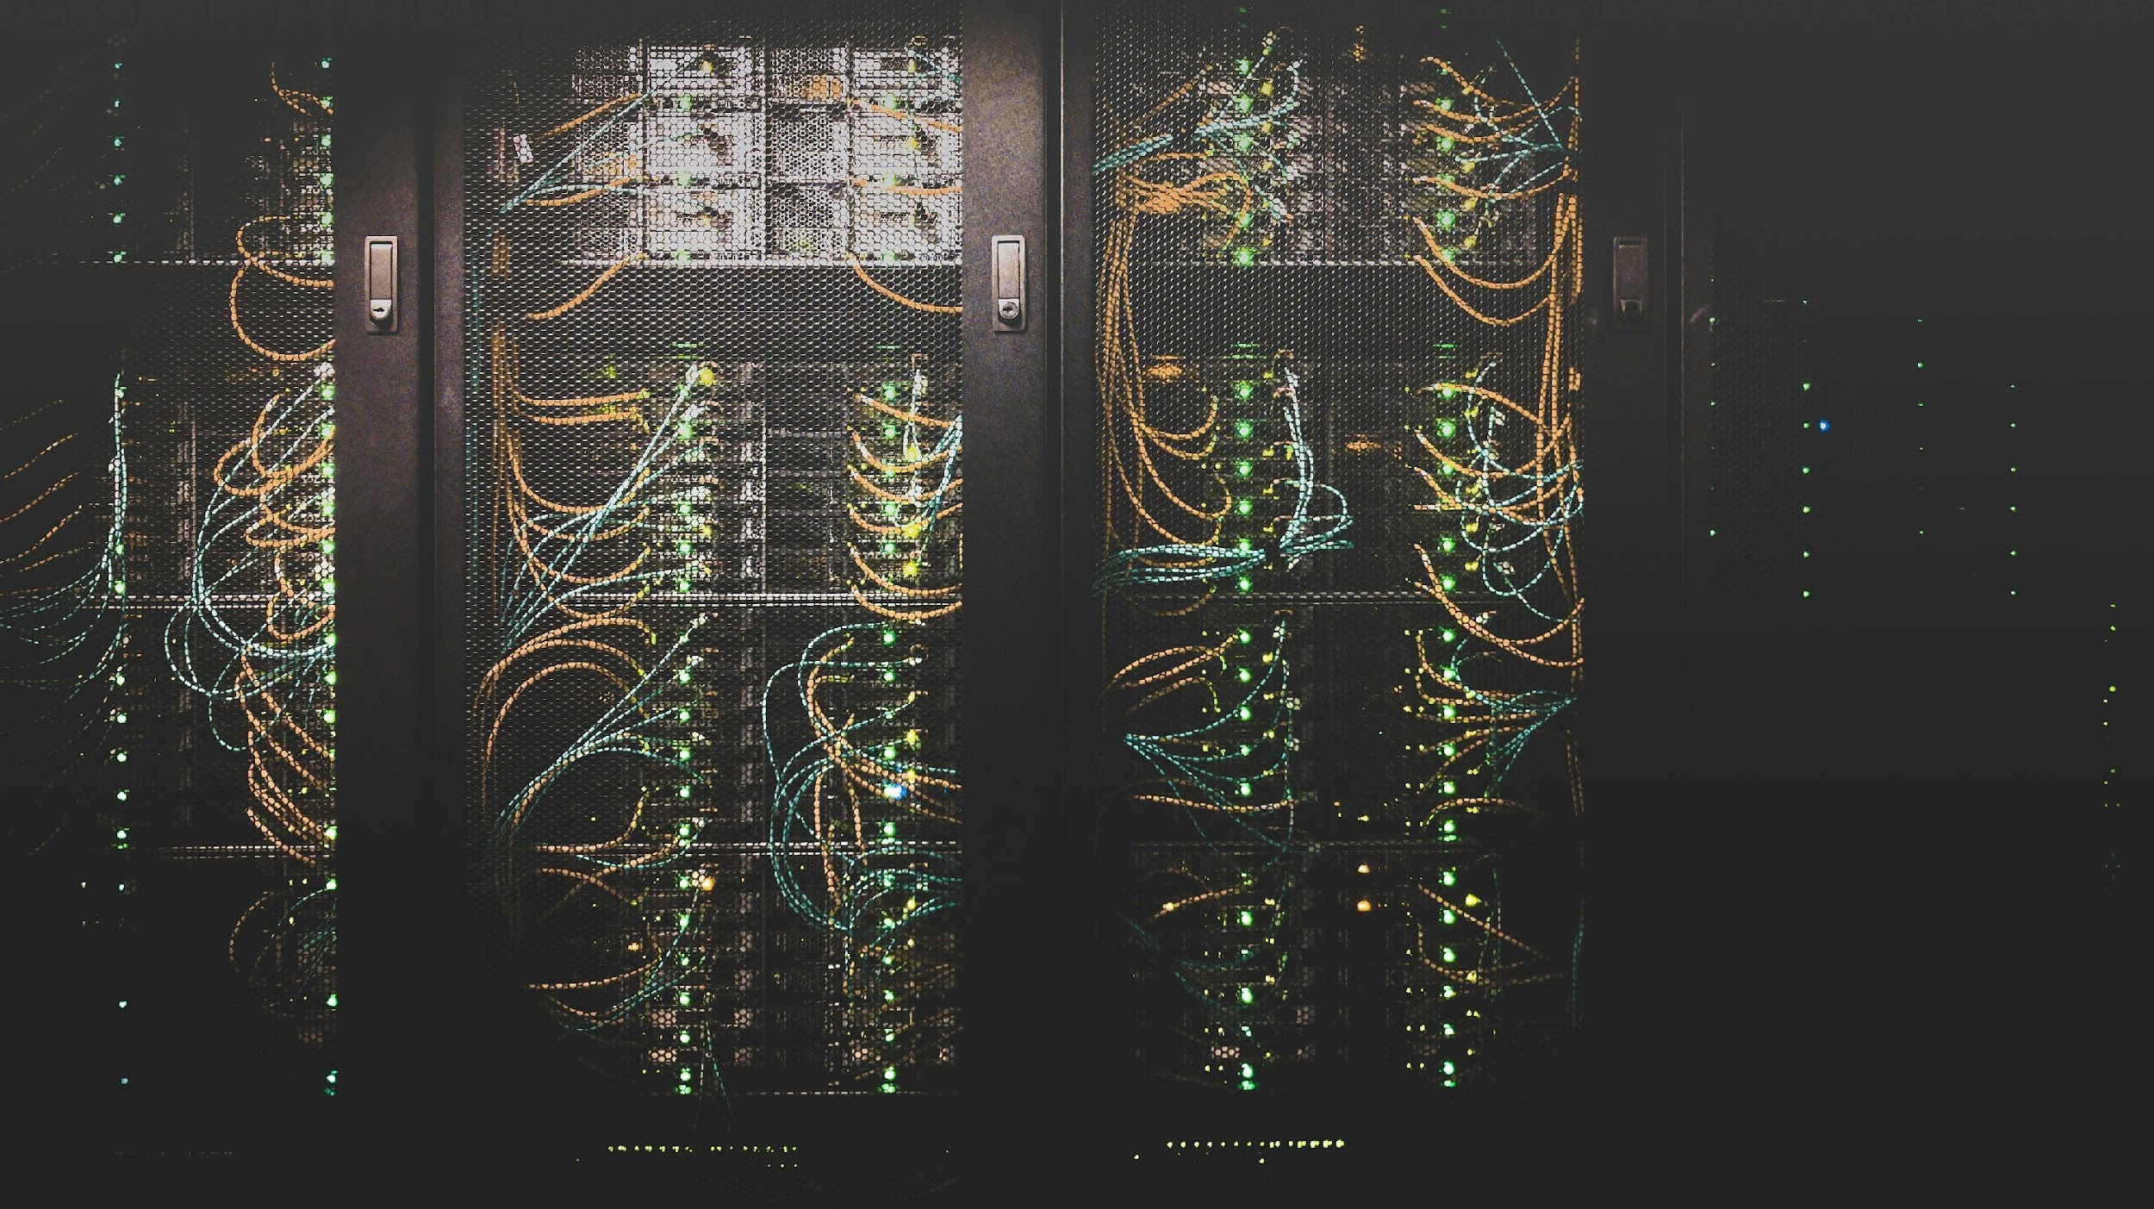
PROJECT OPTION #2
Data Center Fights
Students can choose a recent data center siting controversy. Have students present or write a report exploring the different voices in the community about why the support or oppose local data centers. This can include social media pages, events, and local journalism.
More resources:
  Fighting back against data centers, one small town at a time — A news article exploring several local fights about data centers
  The environmental campaigners fighting against data centres — A news article about why environmental campaigners fight against data centers
  Data flows and water woes: The Utah Data Center — A paper exploring an environmental case study of a NSA data center
  ‘How come I can’t breathe?': Musk’s data company draws a backlash in Memphis — Article exploring Memphis organizing against xAI
Photo by Taylor Vick on Unsplash

Slide 27

For more resources on climate and environmental justice: Please explore other modules in the Climate Justice Instructional Toolkit.

Slide 28
Module References
Activity 1
  Crawford K. (2021). Earth. In The Atlas of AI: Power, Politics, and the Planetary Costs of Artificial Intelligence (pp. 23–51). Yale University Press. https://doi.org/10.2307/j.ctv1ghv45t.4
Activity 3
  Shelby, Rismani, Henne, Moon, Rostamzadeh, Nicholas, Yilla-Akbari, Gallegos, Smart, Garcia, and Virk. (2023). Sociotechnical Harms of Algorithmic Systems: Scoping a Taxonomy for Harm Reduction. Proceedings of the 2023 AAAI/ACM Conference on AI, Ethics, and Society (AIES '23), 723–741. doi: 10.1145/3600211.3604673
Activity 4 + 5
  Holifield, R. (2014). ENVIRONMENTAL REVIEWS AND CASE STUDIES: Accounting for Diversity in Environmental Justice Screening Tools: Toward Multiple Indices of Disproportionate Impact. Environmental Practice, 16(1), 77–86. doi:10.1017/S1466046613000574
  Osakwe, Motsinger-Reif, and Reif. (2024). Environmental health and justice screening tools: a critical examination and path forward. Frontiers in Environmental Health, 3. doi: 10.3389/fenvh.2024.1427495
Project 1
  Lu, Sannon, Moy, Brewer, Green, Jackson, Reeder, Wafer, Ackerman, and Dillahunt. (2023). Participatory Noticing through Photovoice: Engaging Arts- and Community-Based Approaches in Design Research.Designing Interactive Systems Conference (DIS '23). https://doi.org/10.1145/3563657.3596041

Slide 29
Module References
  Ackerman, M. S. (2000). The Intellectual Challenge of CSCW: The Gap Between Social Requirements and Technical Feasibility. Human–Computer Interaction, 15(2–3), 179–203.
  Angwin, Larson, Mattu and Kirchner. (2016). Machine Bias. ProPublica. https://www.propublica.org/article/machine-bias-risk-assessments-in-criminal-sentencing
  Balakrishnan, C., Su, Y., Axelrod, J. & Fu, S. (2022). Screening for Environmental Justice: A Framework for Comparing National, State, and Local Data Tools. Urban Institute. https://www.urban.org/research/publication/screening-environmental-justice-framework-comparing-national-state-and-local
  Burns, R. (2023). Artificial Intelligence Is Making The Housing Crisis Worse. The Lever. https://www.levernews.com/artificial-intelligence-is-making-the-housing-crisis-worse/
  Buolamwini, J. & Gebru, T. (2018). Gender Shades: Intersectional Accuracy Disparities in Commercial Gender Classification. Proceedings of the 1st Conference on Fairness, Accountability and Transparency. https://proceedings.mlr.press/v81/buolamwini18a.html
  Grudin, J. (2012). Introduction: A Moving Target: The Evolution of Human–Computer Interaction. In J. A. Jacko (Ed.), Human Computer Interaction Handbook (3rd ed.). CRC Press. https://doi.org/10.1201/b11963

Slide 30
MIT OpenCourseWare
https://ocw.mit.edu
RES.11-003 Climate Justice Instructional Toolkit Spring 2025
For more information about citing these materials or our Terms of Use, visit https://ocw.mit.edu/terms.

