Slide 1

FOUNDATIONAL MODULE
Climate Justice
Policy

Slide 2
What’s in this module?
Description
This module discusses current climate and environmental justice policy in the US and in international law, including the Paris Agreement and the Green New Deal.*
Contents
Key Resources
6 parts
2 videos
3 readings
4 activities
3 case studies
2 optional projects
  Global Center for Climate Justice: The Green New Deal Resource Hub
  How can policy and policymaking foster climate justice? A qualitative systematic review
  Climate Plans Remain Insufficient: More Ambitious Action Needed Now
  The Federal Funding Primer on Climate Justice: Executive Summary
*Disclaimer: Some climate-related government websites have been taken down. We have done our best to find archived links or alternate sites. Please email us at cjrabe@mit.edu if you find a broken link.

Slide 3
Learning Objectives
01
02
03
04
Understand the importance of policies in realizing climate justice goals
Examine currently implemented and proposed climate policies
Evaluate the effectiveness of real world climate justice policies
Research and assess local climate justice policies in the Boston area

Slide 4
Warm up
What climate justice policies are you aware of?
  What do you know about them?
  In your opinion, how effective are they?
Turn to a partner or small group and brainstorm your ideas.
Grist/ Getty Images

Slide 5
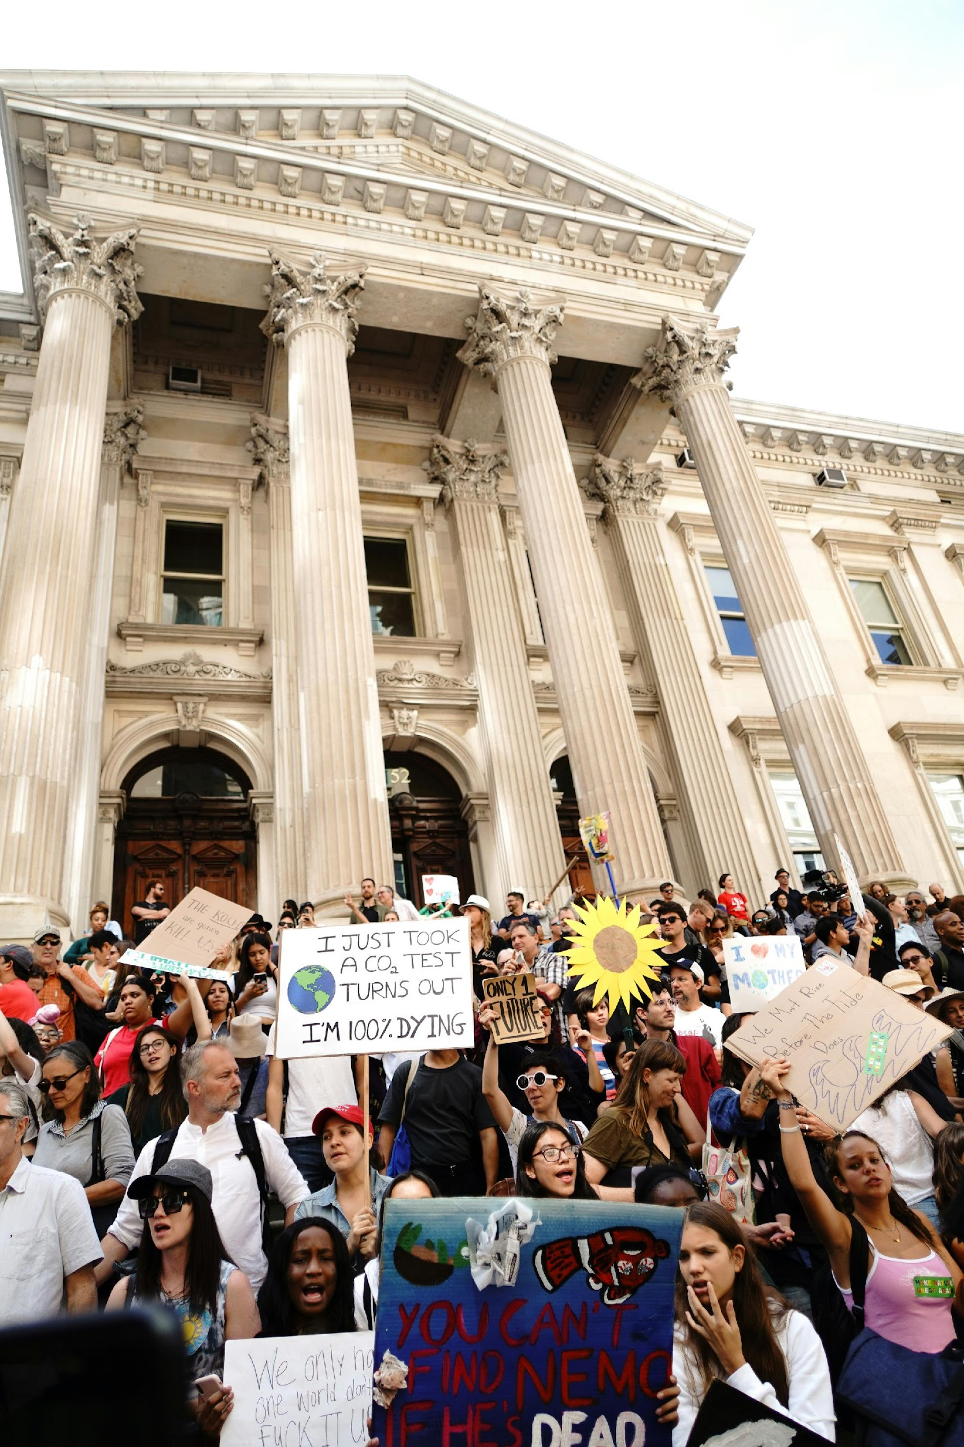
Photo by Katie Rodriguez on Unsplash
Introduction
PART 1

Slide 6
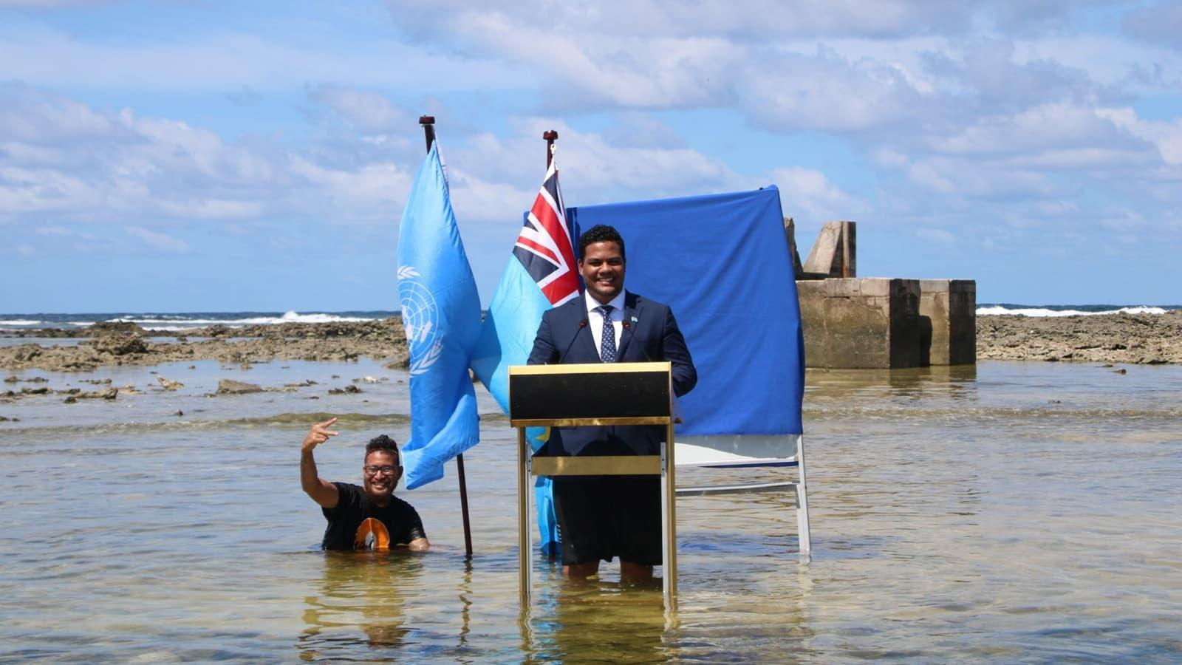
Tuvalu’s Minister for Justice, Communication & Foreign Affairs Simon Kofe gives a COP26 statement while standing in the ocean in Funafuti, Tuvalu November 5, 2021. © Tuvalu Foreign Ministry / Reuters. All rights reserved. This content is excluded from our Creative Commons license. For more information, see https://ocw.mit.edu/help/faq-fair-use/ .
What is Climate Justice Policy?
Definition
Climate justice policy refers to actions, strategies, and regulations aimed at addressing the unequal distribution of climate change impacts and promoting fairness, equity, and human rights in climate action. These policies recognize that certain populations bear a disproportionate burden of the consequences of climate change, despite contributing less to its causes.
CJ Policy takes a human rights approach to climate action
This ensures that individuals and communities have access to clean air, water, food security, health services, and a safe environment, regardless of their socioeconomic status or background.

Slide 7
The Different Levels of CJ Policy
01
02
03
04
International
National
Regional
Local
The UN Loss and Damage Fund would provide financial support to countries that are especially vulnerable to the harmful effects of climate change. Funded by wealthy nations, philanthropists, and actors within the private sector, the current commitments amount to about $661 million.
The Environmental Justice for All Act aims to remedy the history of environmental racism and injustice in the U.S. by strengthening existing civil rights and environmental laws, and making community input and cumulative assessment required in federal decision-making processes.
The Fulton County Environmental Justice Initiative is an environmental health initiative with the goal to ensure that no demographic group is disproportionately affected by adverse environmental conditions created when pollution sources are located in BIPOC and low-income communities.
The Municipal Bank of Los Angeles (MBLA) is a non-profit financial institution owned by the city that aims to support economic growth, community reinvestment, and financial stability by investing in projects that support energy-efficient affordable housing, climate justice, and small businesses.
See parts 2-4 for a deeper dive on each level of CJ policy

Slide 8
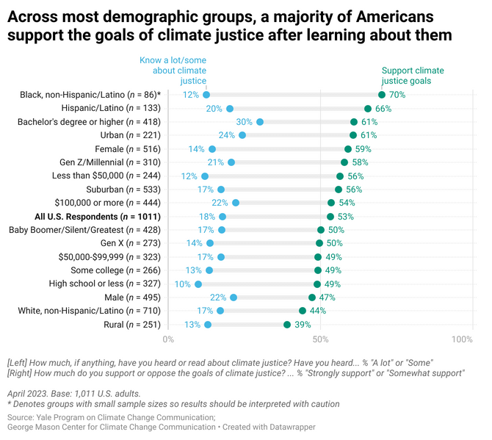
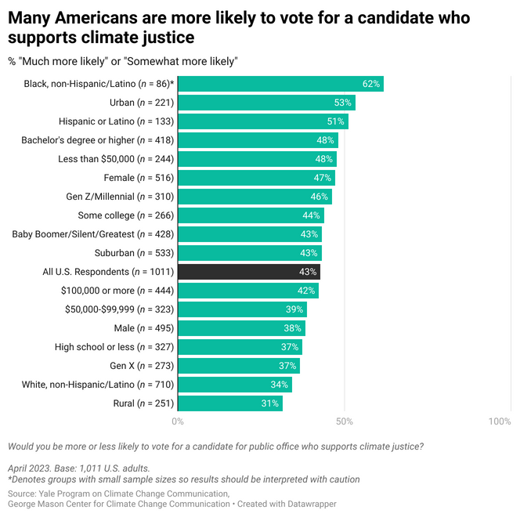
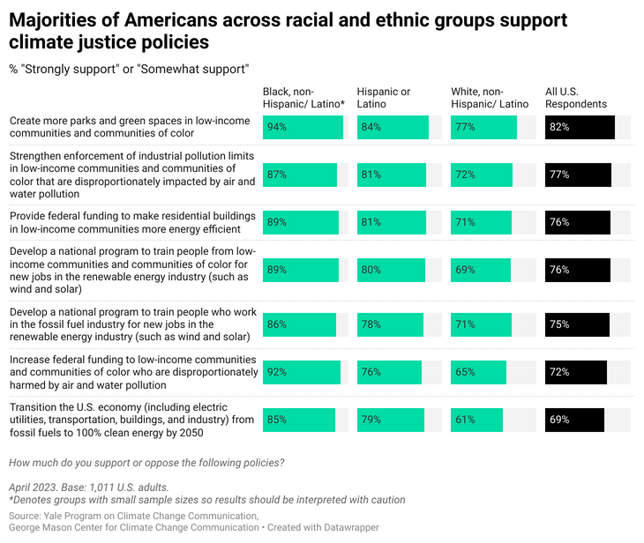
Who Supports Climate Justice in the US?
01
02
03
Climate Justice Awareness and Support
Voting for Candidates Who Support Climate Justice
Climate Justice Policy Support
Figures from Carmen et. al. (2023)
Learn more from the Yale Program on Climate Change Communication

Slide 9
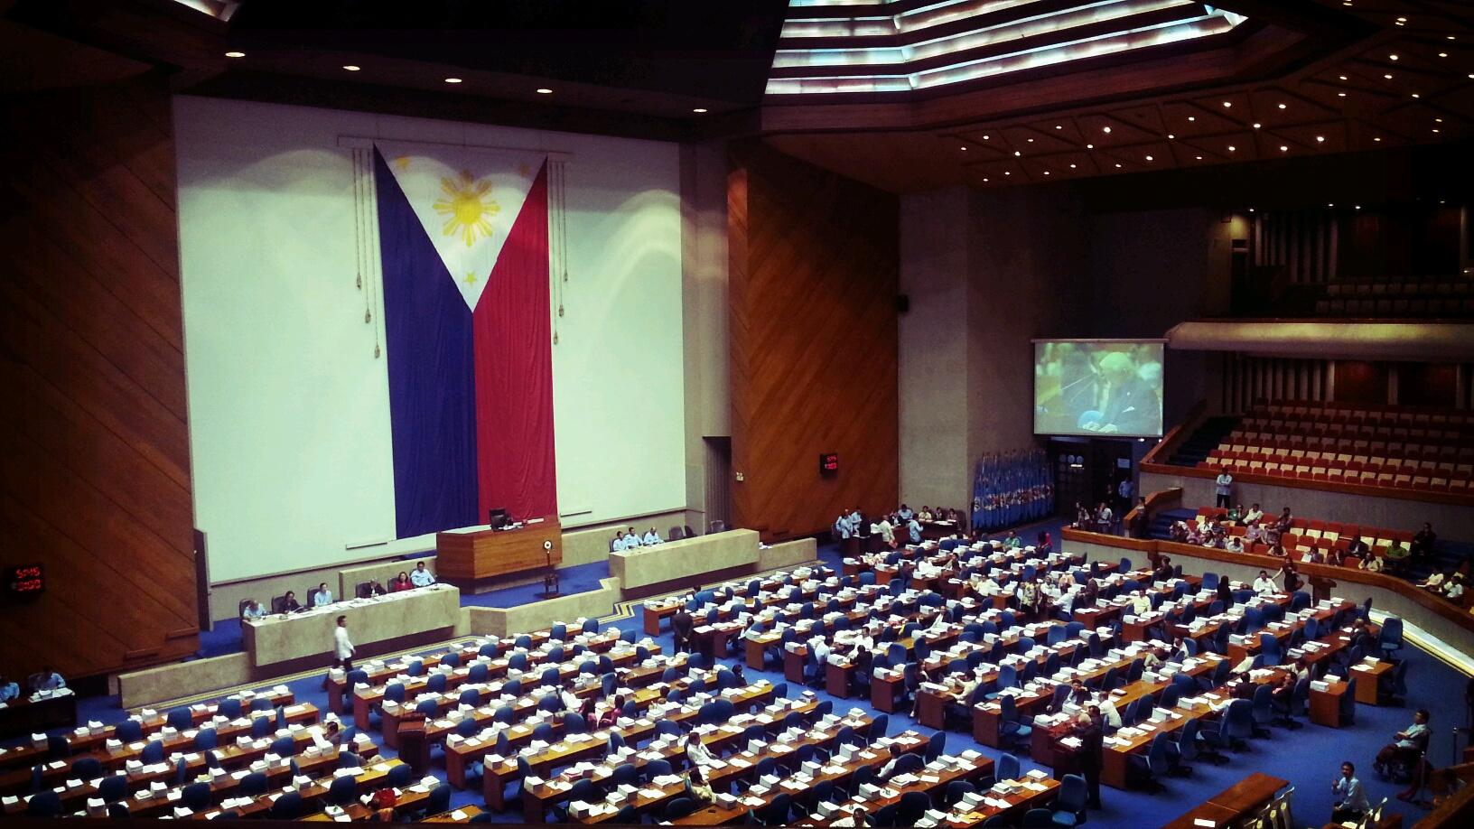
Review: How can policy and policymaking foster climate justice?
Photo courtesy of Rolandave Bola on Flickr. License: CC BY.
Summary of argument
  There is disproportionately low attention to climate justice even when attention to climate change is high
  This lack of energy for reform relates to a losing battle of ideas
  There needs to be radical changes to policy and policymaking to transform the economy and society while addressing climate change
  There is a major gap between what is required and what happens
  These problems prompt debates among climate justice scholars (and activists) about how to responda
What are some ideas you have for how policy(making) can foster climate justice?

Slide 10
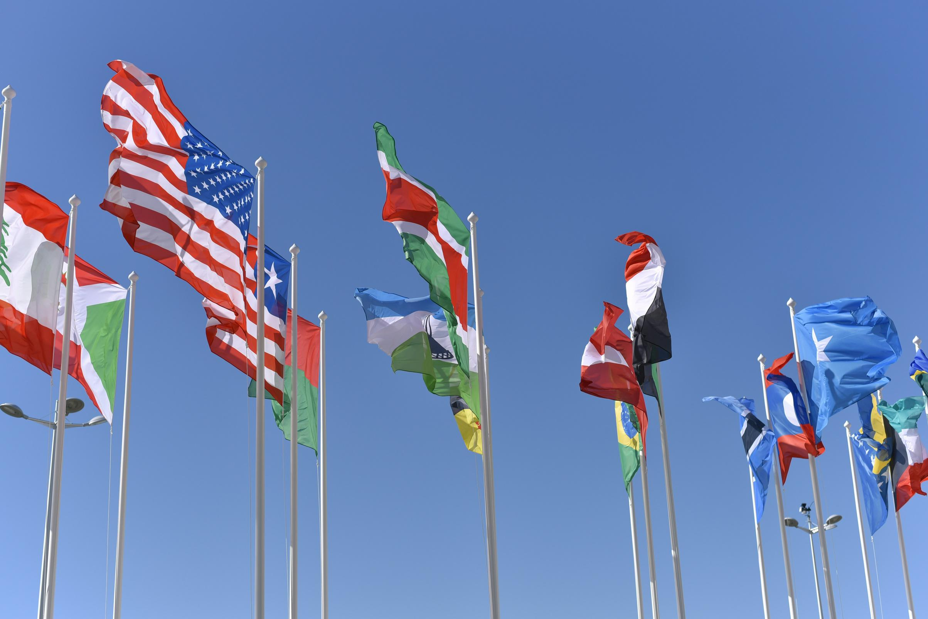
CJ Policy at the International Level
PART 2
Photo by Vladislav Klapin on Unsplash

Slide 11
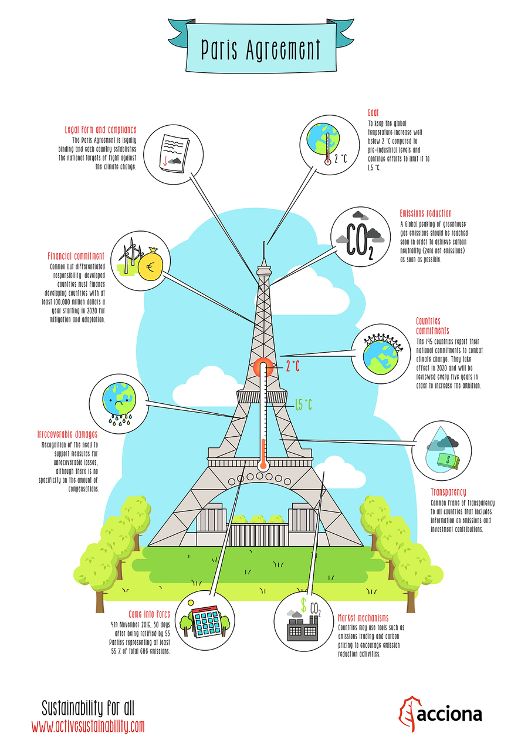
The Paris Agreement
Definition
The Paris Agreement is a legally binding international treaty on climate change that was adopted by 196 Parties at the UN Climate Change Conference (COP21) in Paris, France, on 12 December 2015.
The goal of the Paris Agreement
The goal is to keep the global average temperature below 2°C above pre-industrial levels, but ideally strive for a temperature increase of only 1.5°C above pre-industrial levels.
Watch this video from the UN to learn more
What is the 'Paris Agreement', and how does it work?
© Acciona. All rights reserved. This content is excluded from our Creative Commons license. For more information, see https://ocw.mit.edu/help/faq-fair-use/ .

Slide 12
ACTIVITY #1
AN INTRODUCTION TO NATIONALLY DETERMINED CONTRIBUTIONS
Post-video discussion question
Based on what you saw in the previous video, do you think NDCs are an effective way to enforce environmental standards?
Compare and Contrast
Watch
  From the public UN registry of NDCs, pick two countries of interest, preferably one developed nation and one developing nation.
  Click under "Title" to read over each country's NDC goals.
What are Nationally Determined Contributions?
Discussion questions
  Between the two nations, what differences do you notice?
  How are their contributions framed differently in terms of mitigation goals, strategies, and resources?

Slide 13
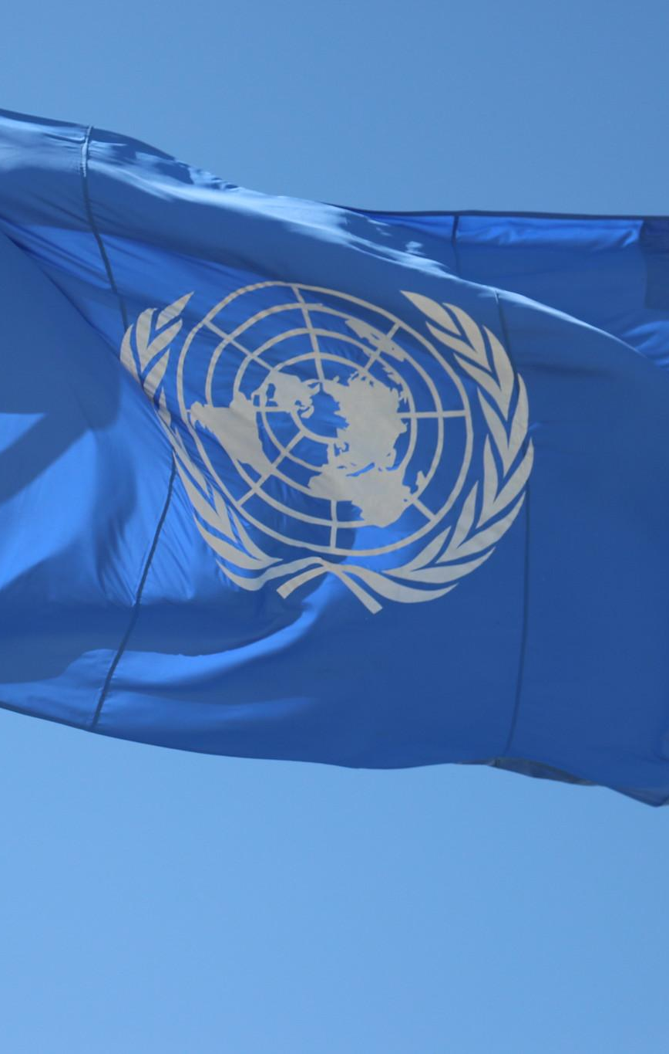
Review: Climate Plans Remain Insufficient
Key Argument
“We are still nowhere near the scale and pace of emission reductions required to put us on track toward a 1.5 degrees Celsius world. To keep this goal alive, national governments need to strengthen their climate action plans now and implement them in the next eight years.” – Simon Stiell, Executive Secretary of UN Climate Change
What does this article reveal to you about the efficacy of international agreements like the Paris Agreement in furthering climate justice?
Consider whether climate justice can be achieved without successfully combating climate change first.
Photo courtesy of UNclimatechange on Flickr. License: CC BY.

Slide 14
ACTIVITY #2
A DEEPER DIVE INTO INTERNATIONAL CLIMATE JUSTICE POLICY
Read and annotate
Read your group’s assigned article and make annotation of key points, data, quotes, etc. The goal is to be familiar with the findings of your reading ahead of the next class meeting.
Before class
Small group discussion
Create three groups and assign each group one reading:
  The domestic politics of international climate commitments
  Climate policy co-benefits: a review
  A sectoral perspective on international climate governance
Allow each group to meet for 10-15 minutes to discuss their takeaways from the reading and come up with a uniform summary that can be shared with the class. Consider using a shared presentation (i.e. Google Slides) that each group can add a bullet point summary to.
Share out with the class
Each group should share a summary of the article’s key points with the class. The goal is to give enough information so that people who didn’t read the article still have a sufficient understanding of its content and significance.

Slide 15
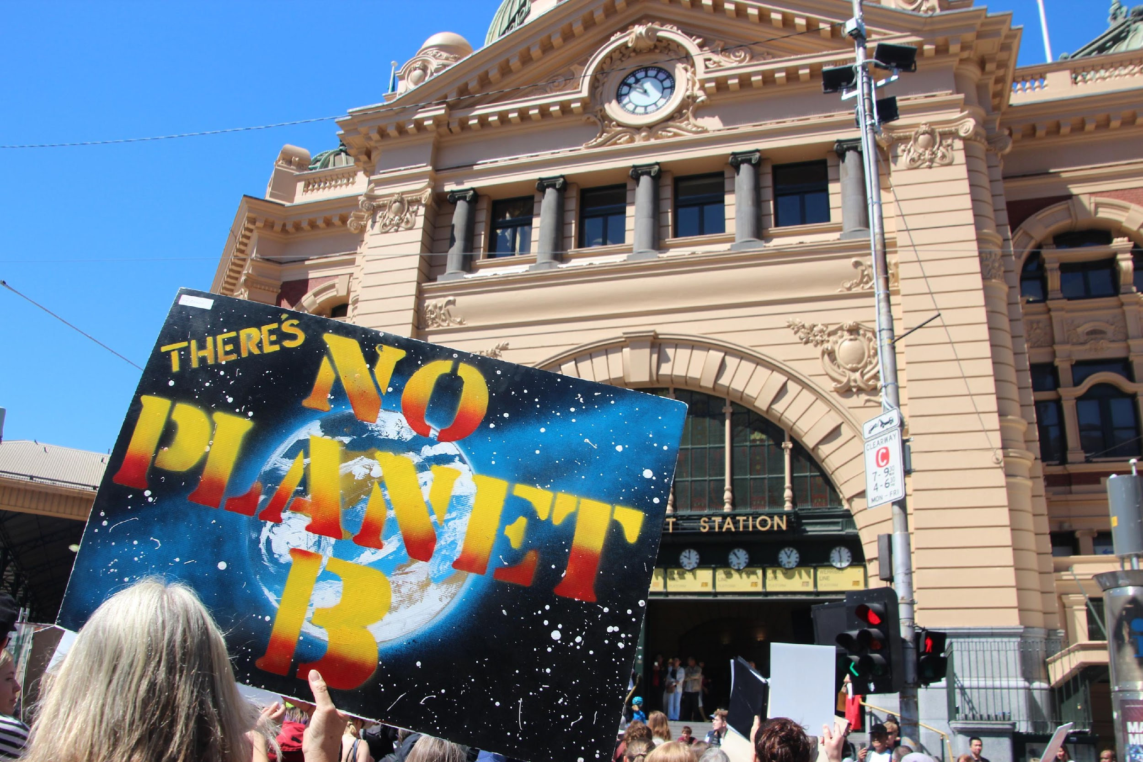
Photo courtesy of John Englart on Flickr. License: CC BY-SA. This content is excluded from our Creative Commons license. For more information, see https://ocw.mit.edu/help/faq-fair-use/ .
CJ Policy at the National Level in the U.S.
PART 3

Slide 16
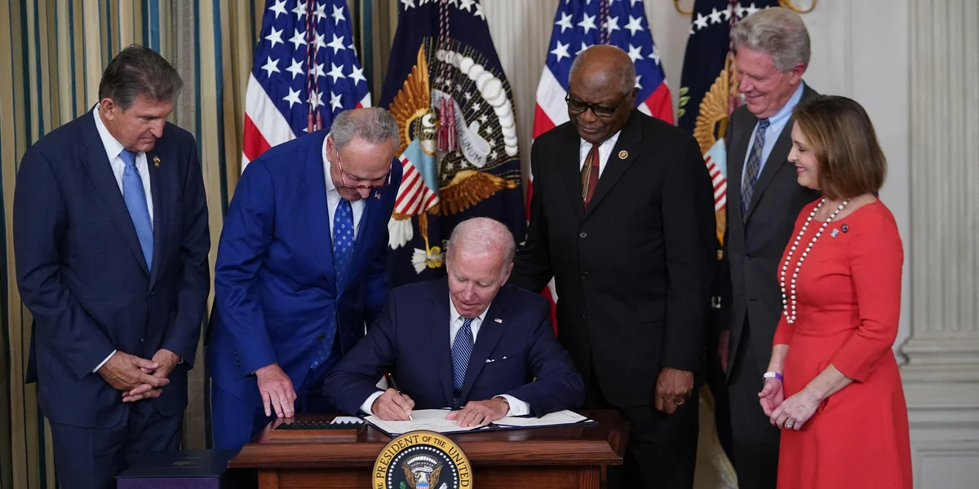
© MANDEL NGAN / AFP / Getty Images. All rights reserved. This content is excluded from our Creative Commons license. For more information, see https://ocw.mit.edu/help/faq-fair-use/ .
The Inflation Reduction Act (IRA)
What is the IRA?
The Inflation Reduction Act (IRA) was signed into law in 2022, and offers $370 billion in grants, loans, rebates, incentives, and other investments to build a new clean energy economy. So far, funding from the IRA is financing 119 federal programs.
How does the IRA further climate justice?
The IRA “prioritizes creating shared prosperity, making the nation more resilient to growing threats to health and well-being, and driving critical
economic investments to historically underserved communities, particularly those living with legacy pollution.”

Slide 17
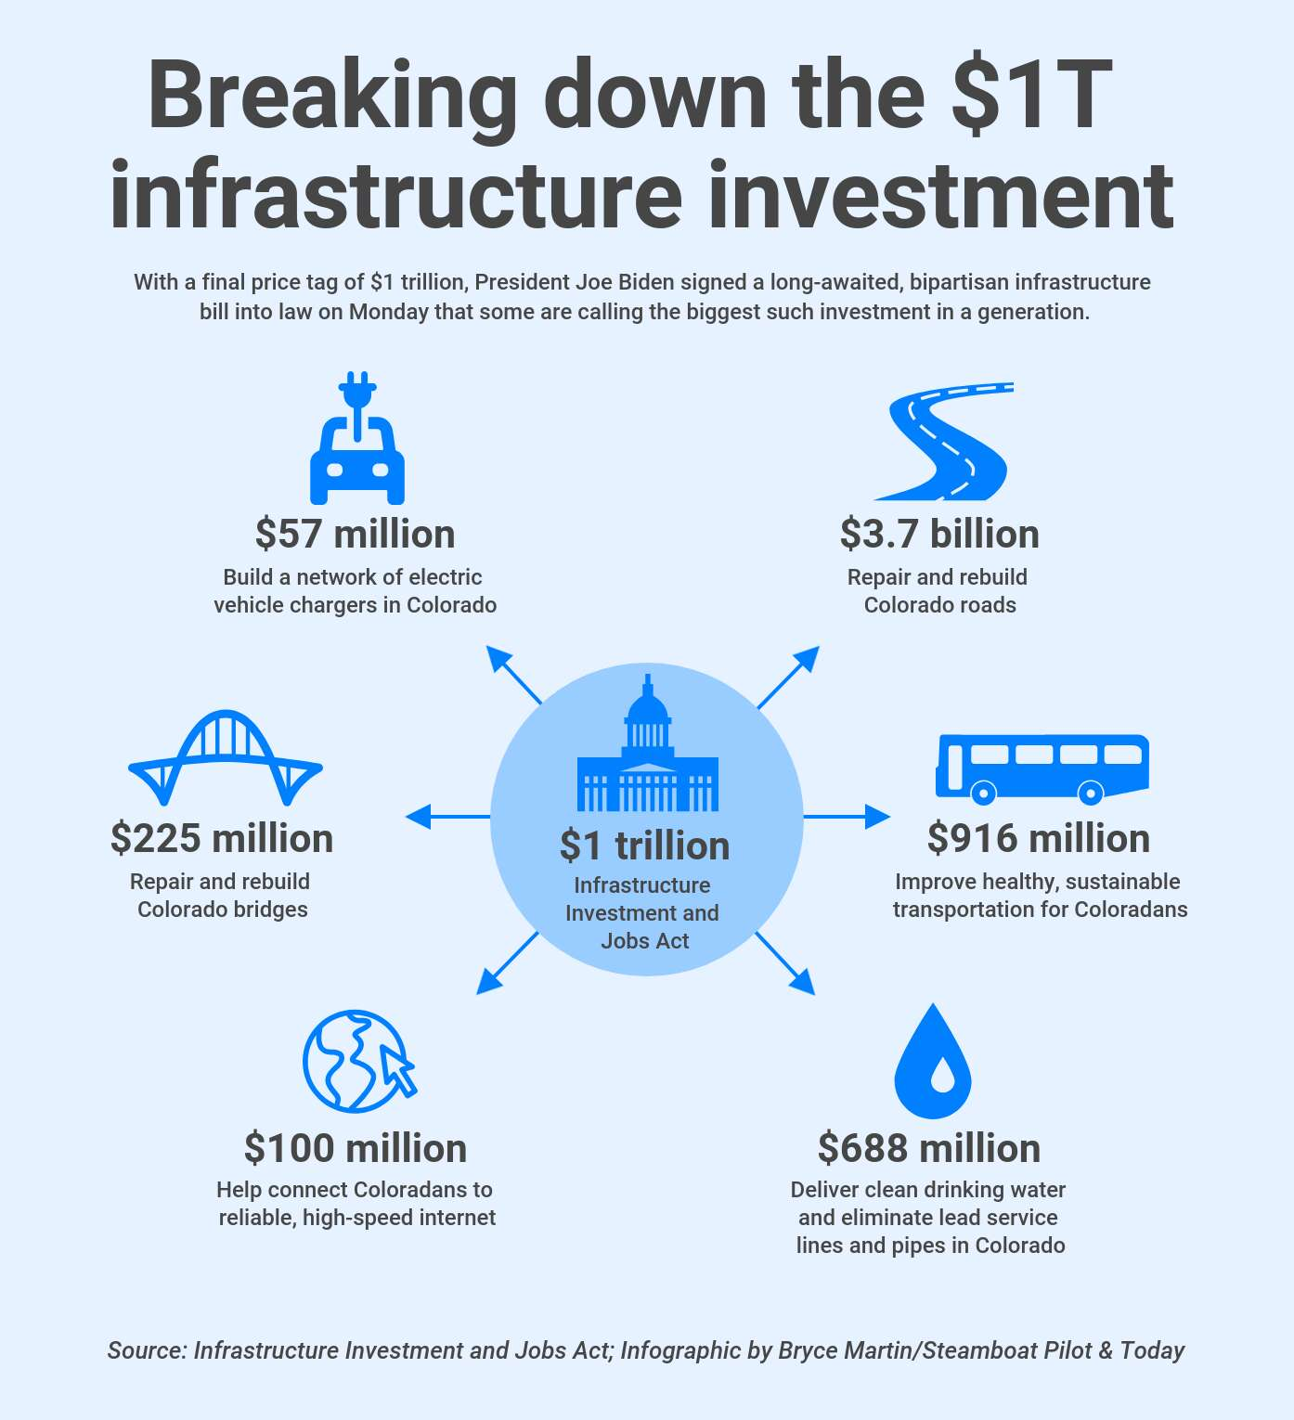
The Bipartisan Infrastructure Law (BIL)
What is the BIL?
The $550 billion Bipartisan Infrastructure Law, signed in 2021, aims to improve U.S. infrastructure. It focuses on funding projects related to transportation, broadband internet, and climate, energy, and the environment. So far, the BIL is supporting over 350 federal programs.
How does the BIL further climate justice?
One of the overarching focus areas of the BIL is to support underserved communities. For example, one of the main environmental programs focuses on environmental remediation to “address the legacy pollution that harms the public health of communities, create good-paying union jobs, and advance long overdue environmental justice” (BIL Fact Sheet)
© Bryce Martin / Steamboat Pilot. All rights reserved. This content is excluded from our Creative Commons license. For more information, see https://ocw.mit.edu/help/faq-fair-use/ .

Slide 18
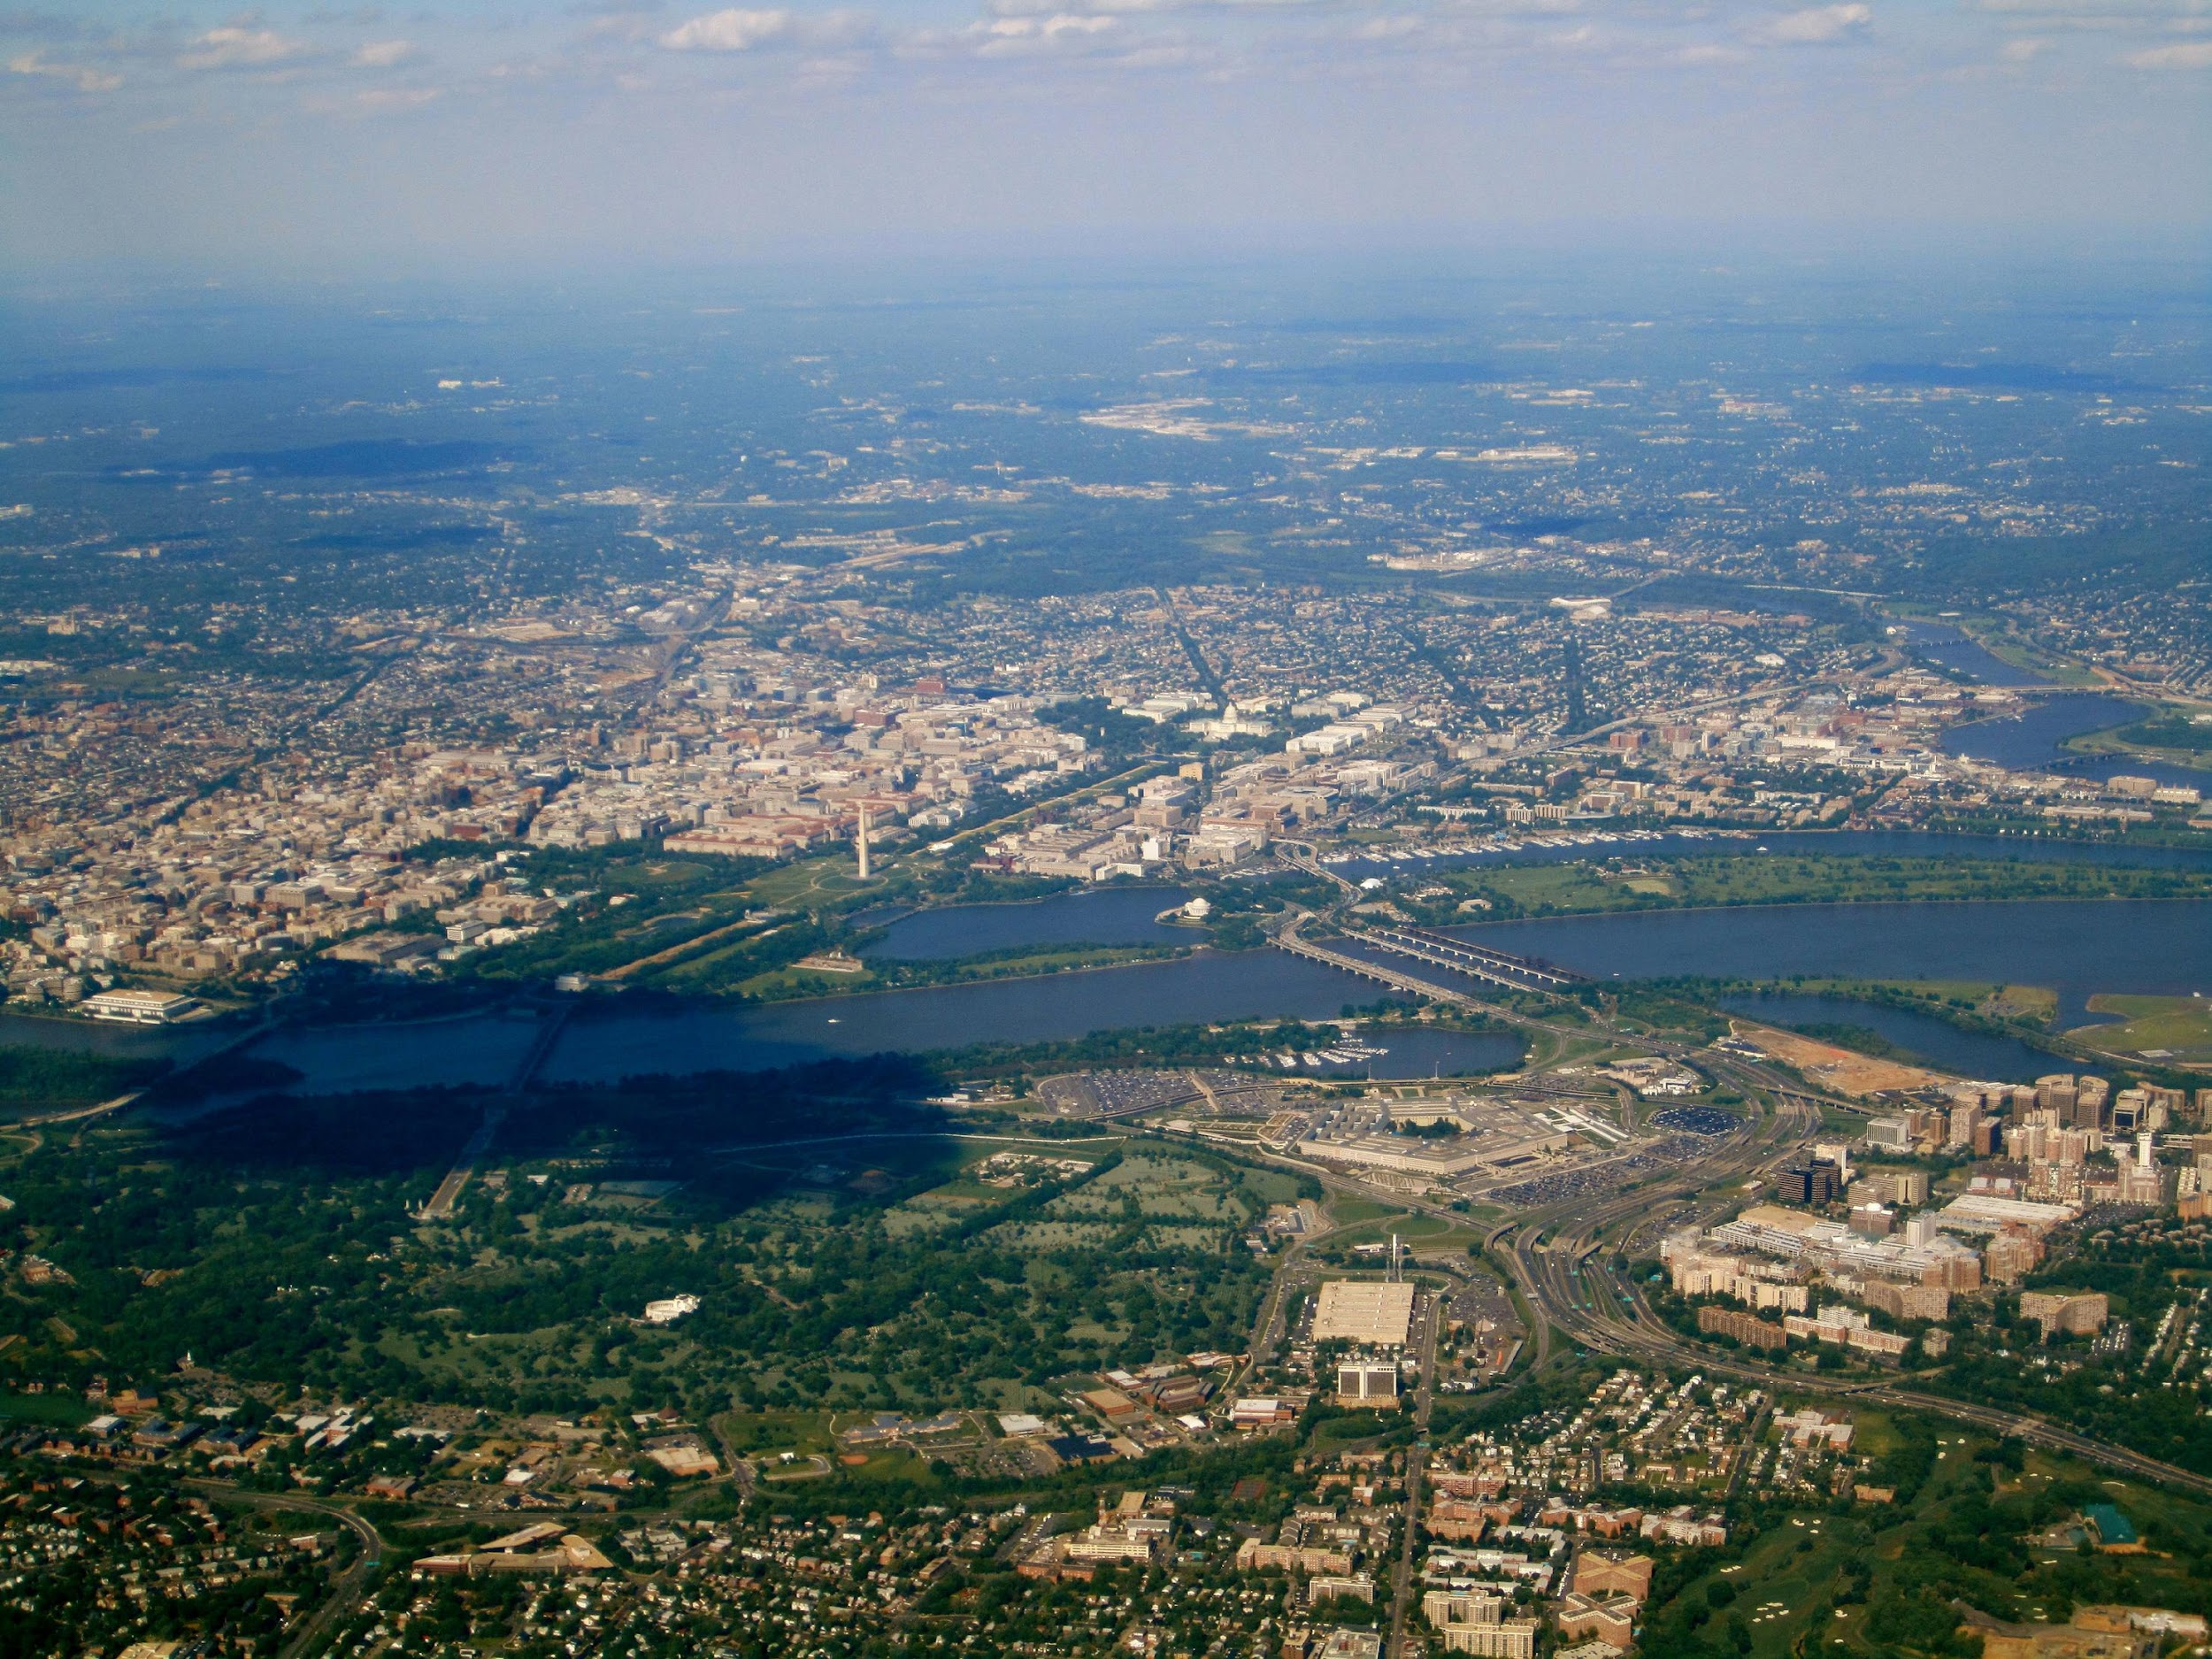
Photo courtesy of La Citta Vita on Flickr. License: CC BY-SA. © La Citta Vita. All rights reserved. This content is excluded from our Creative Commons license. For more information, see https://ocw.mit.edu/help/faq-fair-use/ .
The Justice40 Initiative
What is the Justice40 Initiative?
The Justice40 Initiative aims to ensure that 40% of the benefits of certain Federal climate, clean energy, affordable and sustainable housing, and other investments go to disadvantaged communities that are marginalized by underinvestment and overburdened by pollution.
What programs make up the Justice40 Initiative?
New programs created by the IRA, BIL, and America Rescue Plan all further Justice40, but many federal agencies have also adjusted their existing funding programs to further Justice40. The Justice40 Initiative Covered Programs List includes all 518 Justice40 programs.

Slide 19
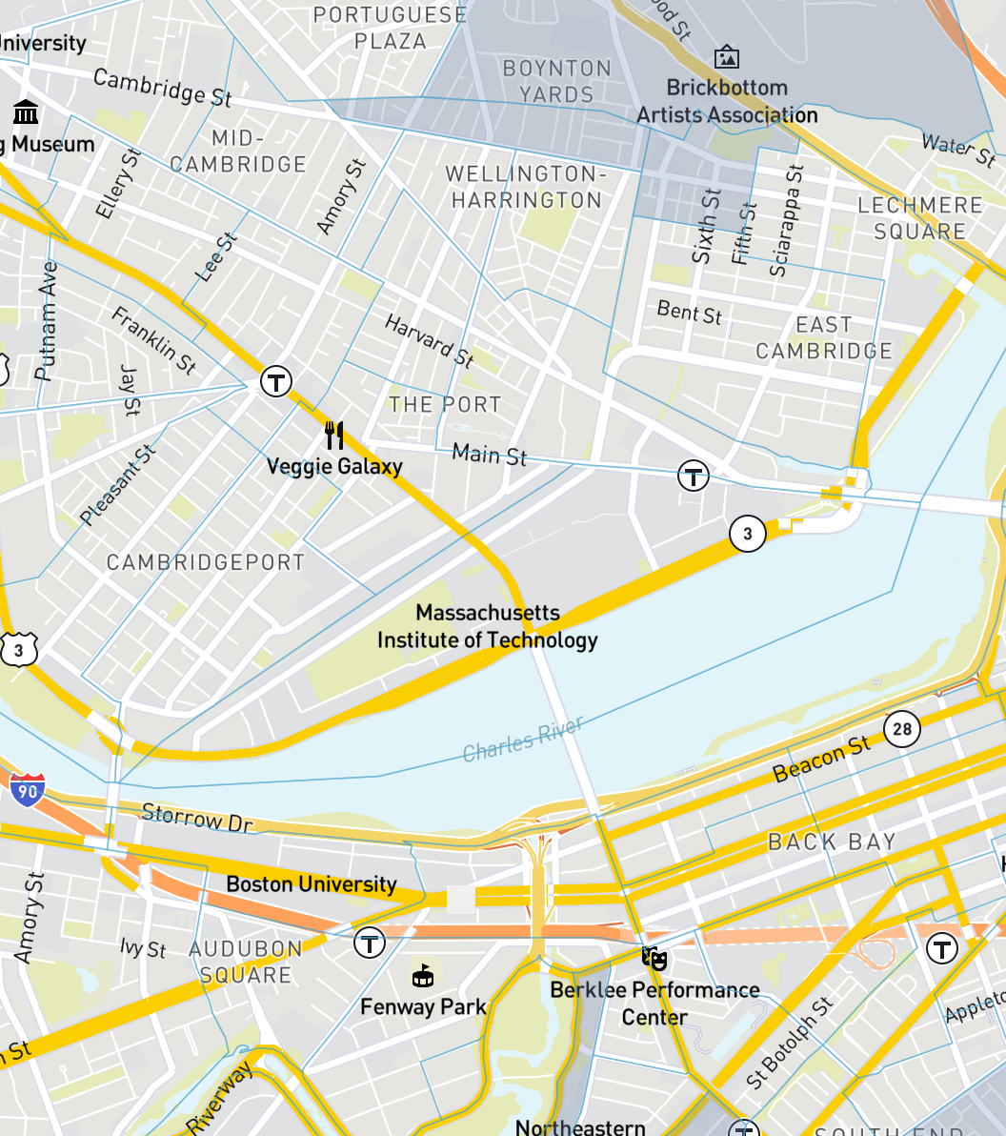
The Justice40 Initiative
How are communities involved in the Justice40 Initiative?
The White House Environmental Justice Advisory Council advises the executive administration on how to address current and historic environmental injustice. Members of the council come from diverse backgrounds, and have knowledge about or experience in environmental justice, climate change, disaster preparedness, or racial inequity.
What is the Climate and Economic Justice Screening Tool (CEJST)?
The Climate and Economic Justice Screening Tool (CEJST) is an interactive mapping tool to identify disadvantaged communities that are marginalized by underinvestment and overburdened by pollution. The CEJST is the federal government’s primary tool for identifying disadvantaged communities that are geographically defined for any covered programs under the Justice40 Initiative.
Map © source unknown. All rights reserved. This content is excluded from our Creative Commons license. For more information, see https://ocw.mit.edu/help/faq-fair-use/ .
Learn more about Justice40

Slide 20
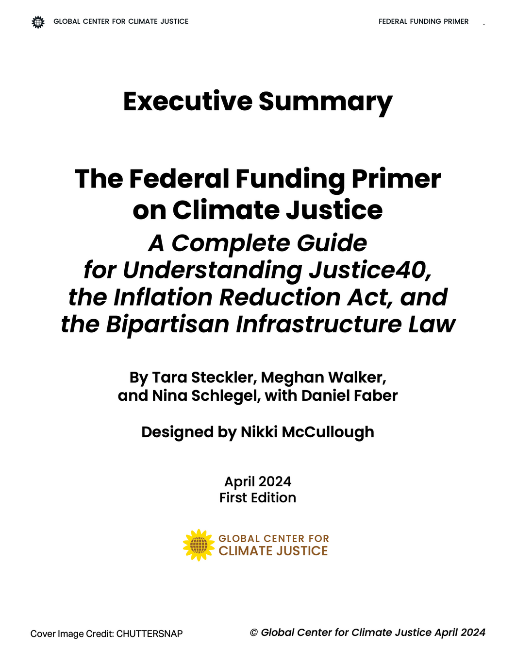
Review: The Federal Funding Primer on Climate Justice
Purpose
This Federal Funding Primer on Climate Justice provides a roadmap for navigating the funding opportunities provided by Justice40, the Inflation Reduction Act, and the Bipartisan Infrastructure Law.
“The success of the BIL, IRA, and Justice40 covered programs in advancing justice will come down to how accessible they are to our communities, and what implementation really looks like on the ground.”
© Global Center for Climate Justice. All rights reserved. This content is excluded from our Creative Commons license. For more information, see https://ocw.mit.edu/help/faq-fair-use/ .
Get access to the full primer here

Slide 21
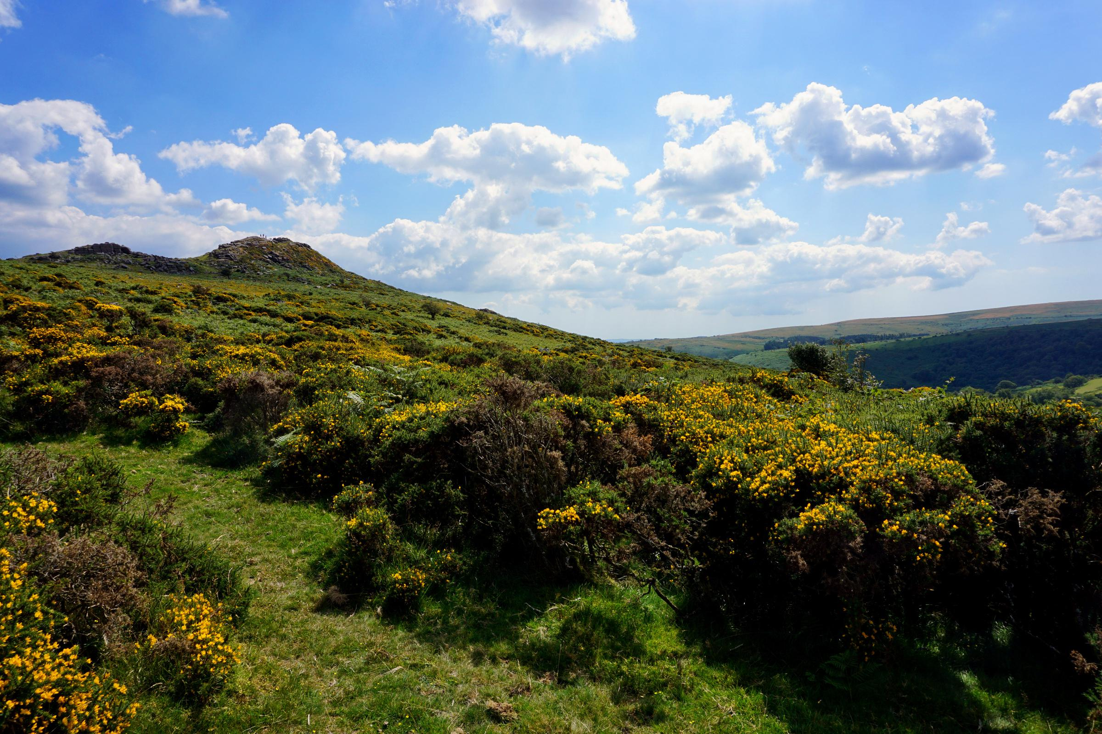
Regional & Local CJ Policy Case Studies
PART 4
Photo courtesy of barnyz on Flickr. License: CC BY-NC-ND. © barnyz. All rights reserved. This content is excluded from our Creative Commons license. For more information, see https://ocw.mit.edu/help/faq-fair-use/ .

Slide 22
ACTIVITY #3
CASE STUDIES ON LOCAL/REGIONAL LEVEL CLIMATE JUSTICE POLICY
Research your case study
Start with the initial resource provided to you, but then dig deeper by researching:
  Other perspectives on the topic of the initial resource
  Local social and political history relating to CJ policy
  More recent information relating to the topic of the initial resource or CJ policy
  Local GND/CJ policy organizations and movements
Choose a case study
In small groups of 3-5, pick one of these case studies to examine:
  Ithaca, NY
  Dekalb County, GA
  England
  Boulder Valley, CO
  Chicago, IL
Present your findings
In your small group, give a 5-minute presentation on your assigned case study. Be sure to include:
  A brief description of the topic discussed in the initial resource
  History of CJ policy in the area (if applicable)
  Recent policy developments (if applicable)
  At least 2 different (ideally local) perspectives on CJ policy
  Any GND/CJ organizations and movements you found

Slide 23
ACTIVITY #4
CASE STUDIES ON LOCAL/REGIONAL CLIMATE ACTION PLANS
Research your case study
Within your group, skim through the climate action plan for your case study, and then discuss
  The goal(s) of the climate action plan
  Its policy focuses
  To what extent justice is mentioned
Choose a case study
In small groups of 3-5, pick one of these case studies to examine:
  Boston, USA
  Hong Kong
  Nairobi, Kenya
  Los Angeles, USA
  São Paulo, Brazil
Present your findings
In your small group, give a 5-minute presentation on your assigned case study. Be sure to include:
  The goal(s) of the climate action plan
  The main policy focuses
  Your group’s evaluation of to what degree climate injustice is being/will be addressed
  Any other observations that you may have

Slide 24

Excerpted from Posters for a Green New Deal by Creative Action Network, foreword by Demond Drummer (Workman). © 2020. Illustration by Isabelle Vandeplassche. © Creative Action Network. All rights reserved. This content is excluded from our Creative Commons license. For more information, see https://ocw.mit.edu/help/faq-fair-use/ .
The Green New Deal
PART 5

Slide 25
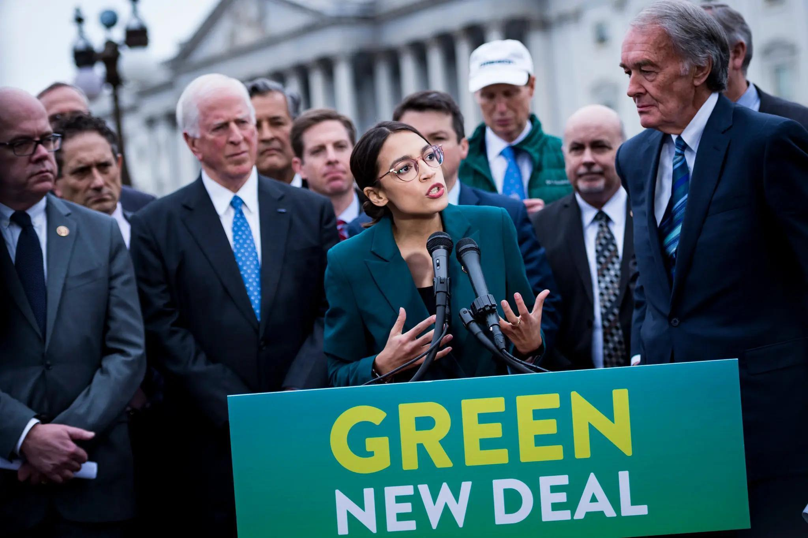
© Pete Marovich / New York Times. All rights reserved. This content is excluded from our Creative Commons license. For more information, see https://ocw.mit.edu/help/faq-fair-use/ .
Introduction to the GND
What is the Green New Deal?
The Green New Deal (GND) was origninally a proposed set of economic stimulus packages and policy initiatives that aimed to address climate change and economic inequality. It was first introduced in the United States by Congresswoman Alexandria Ocasio-Cortez and Senator Ed Markey in February 2019.
The evolution of the Green New Deal
While the GND began as a bill in the U.S. House of Representatives, it has evolved into a global movement. A GND no longer refers to one piece of legislation in one country. GNDs are being implemented at local and regional levels around the world, with some GNDs being specific to certain issues (i.e. A GND for Boston Public Schools).

Slide 26
Elements of the Green New Deal
01
02
03
04
Transitioning to renewable energy sources
Upgrading/expanding Infrastructure
Investing in a green workforce
Promoting environmental justice
The GND aims to improve energy efficiency in buildings, modernize transportation, and invest in resilient infrastructure to withstand the impacts of climate change.
The GND creates well-paying jobs in industries related to renewable energy, energy efficiency, sustainable agriculture, and other sustainability-minded fields.
The GND addresses the disproportionate impacts of climate change on marginalized communities and to ensure that the benefits of a clean energy transition are equitably distributed.
The GND emphasizes the shift away from fossil fuels and the promotion of renewable energy technologies such as solar/wind power.

Slide 27
Green New Deal Action Areas
Affordable Housing
Health + Just Recovery
Circular Economy and Zero Waste
Climate Change Adaptation
Good Jobs in a Green Economy
Food Justice + Resiliency
Energy Democracy
Decommodi-fication of Necessities
Divest + Reinvest
Sustainable + Equitable Land use
Water Justice
Transforming Institutions + Processes
Transportation Justice
Click on each action area to learn more

Slide 28

Critiques + The Red Deal
Critique from the Indigenous Environmental Network
“...we remain concerned that unless some changes are made to the resolution, the Green New Deal will leave incentives by industries and governments to continue causing harm to Indigenous communities...We can no longer leave any options for the fossil fuel industry to determine the economic and energy future of this country. And until the Green New Deal can be explicit in this demand as well as closing the loop on harmful incentives, we cannot fully endorsee the resolution.”
What is The Red Deal?
The Red Deal Indigenous Action To Save Our Earth is an action plan for decolonization in Turtle Island and beyond that is divided into three parts: End the Occupation, Heal Our Bodies, and Heal Our Planet. The Red Deal is a political plan to decolonize a world for all.
© The Red Nation. All rights reserved. This content is excluded from our Creative Commons license. For more information, see https://ocw.mit.edu/help/faq-fair-use/ .
Learn more from The Red Nation and the Indigenous Environmental Network

Slide 29
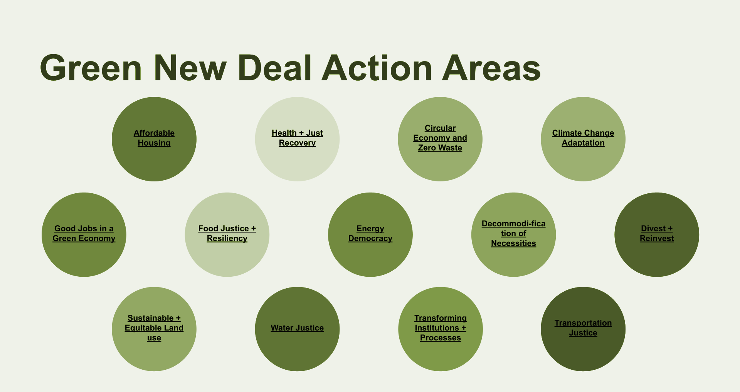
ACTIVITY #5
SMALL GROUP DISCUSSION
Analyze
Examine the policy frameworks and mechanisms employed in each case study. Identify key elements such as community engagement, inclusive decision-making processes, funding mechanisms, and the integration of social and environmental considerations.
Read and Review
Pick an action area that interests you and review the case studies and/or reports available that interest you. Take some notes to discuss your thoughts in your group.
Evaluate
Assess the outcomes and impacts of the implemented policies on addressing environmental inequities. Evaluate indicators such as improved access to clean water and air, reduced pollution, enhanced community resilience, job creation, and empowerment of marginalized groups.
Discuss
Discuss your analysis and evaluation in a small group. Be sure to share which action area that you selected.

Slide 30
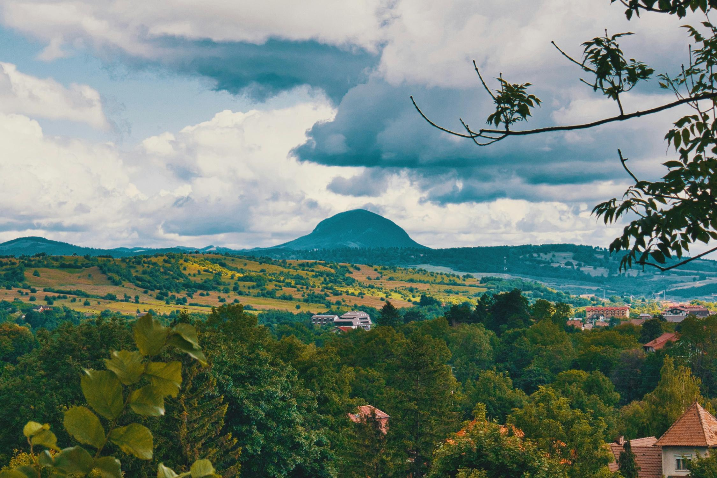
Beyond the Module
PART 6
Photo by Nomadic Julien on Unsplash

Slide 31
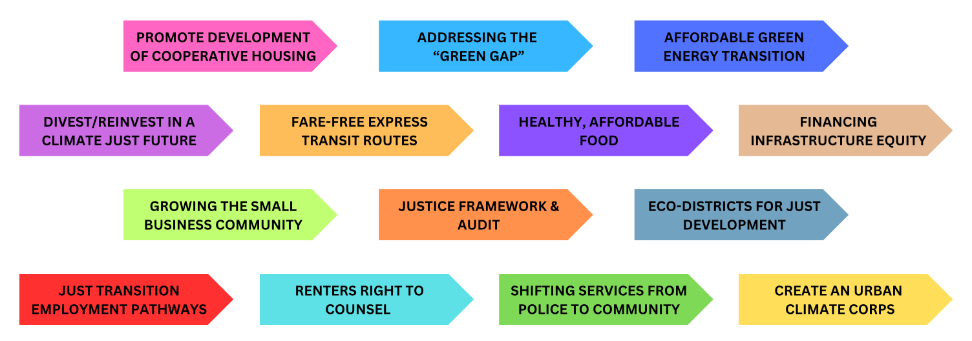
PROJECT OPTION #1
Evaluate the Effectiveness of Proposed Policies
Central Question
Knowing what you know now, can you apply the Green New Deal as a framework for your learning in class?
Instructions
  Pick a section from the Boston Green New Deal Report and do some research on the importance of issues in this space, and evaluate the effectiveness of proposed policies.
  Be prepared to discuss and present your ideas to your peers next class! You may choose any format to present (slides, infographic, video, etc.)

Slide 32
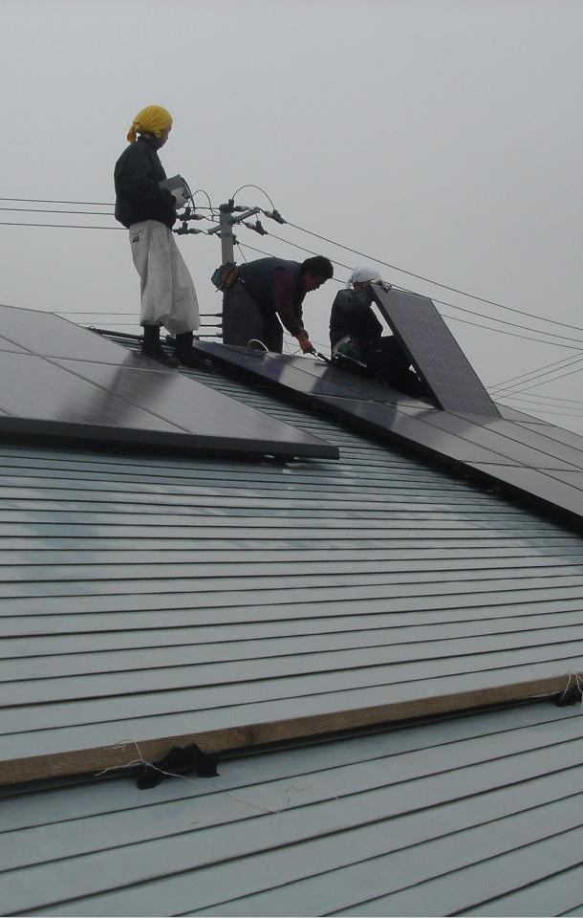
PROJECT OPTION #2
PROJECT PTION #2
Essay on the Impact of Climate Justice Policy
Prompt suggestion
Consider the impacts of a climate justice policy of your choosing. Then, pick a region, municipality, community group, or specific policy issue to limit the scope of your research. Write a 2-3 page paper on your topic, and be sure to connect your points back to the idea of climate justice. To get you started, here some examples of what your topic could be:
  The impact of the Infrastructure Reduction Act on Indigenous communities
  The impact of justice-centered environmental health policy in the Southeastern U.S.
Photo courtesy of Richard Masoner on Flickr. License: CC BY-SA. © Richard Masoner. All rights reserved. This content is excluded from our Creative Commons license. For more information, see https://ocw.mit.edu/help/faq-fair-use/ .

Slide 33
Additional Resources
  The Green New Deal Resource Hub
  The Just Transition module
  Climate Justice Alliance’s Policy Resources
  Voter Suppression and the Polluter Industrial Complex (report)
  Inflation Reduction Act Guidebook
  Bipartisan Infrastructure Law Guidebook
  Climate Action Tracker
  Global Center for Climate Justice

Slide 34

For more resources on climate and environmental justice: Please explore other modules in the Climate Justice Instructional Toolkit.

Slide 35
Module References
  Budds, D. (2019, September 19). The Green New Deal is really about designing an entirely new world. Curbed.
  C40 Cities. (n.d.). Global Green New Deal. C40.org.
  Cairney P., Timonina I., Stephan H. (2023). How can policy and policymaking foster climate justice? A qualitative systematic review. Open Res Europe 2023, 3:51.
  Carbon Neutral @ HK. (2021, October). Hong Kong’s Climate Action Plan: 2050. Carbon Neutral @ HK.
  Carman, J., Ballew, M., Verner, M., Lu, D., Low, J., Rosenthal, S., Maibach, E., Kotcher, J., Marlon, J., Leiserowitz, A. (2023, November 7). Who supports climate justice in the U.S.?. YPCCC.
  ClimatePlan SP Technical Team. (2020). Plan ClimaSP: Climate Action Plan for the Municipality of São Paulo 2020 - 2050. Cidade de São Paulo.
  Faber O’Connor, L., et. al. (2019). L.A.’s Green New Deal: Sustainable city pLAn.
  Friedman, L. (2019, February 21). What Is the Green New Deal? A Climate Proposal, Explained. The New York Times.
  Fulton County Government. (n.d.). Board of Health: Environmental Health Services & Initiatives. Fultoncountyga.gov.
  FutureLearn. (n.d.). Climate Change and Public Policy - Online Environmental Course. FutureLearn. Retrieved July 3, 2023.
  Handley, L. (2021, November 8). Pacific island minister films climate speech knee-deep in the ocean. CNBC.
  Holman, A. (n.d.). Mayor Garcetti Launches LA’s Green New Deal. EmpowerLA. Retrieved July 3, 2023.
  Imperiale, S. (2022, April 8). The Promise of the Environmental Justice for All Act. Natural Resources Defense Council.
  Indigenous Environmental Network. Talking Points on the AOC-Markey Green New Deal (GND) Resolution. 2019.
  Kane, J., Muro M., Tower, A. (2019, January 25) The Green New Deal promises jobs, but workers need to be ready to fill them. Brookings.

Slide 36
Module References
  Karlsson, M., Alfredsson, E., Westling, N. (2020). Climate policy co-benefits: a review. Climate Policy, 20:3, 292-316.
  Mock, B. (2019, February 12). How Can the Green New Deal Deliver Environmental Justice? Bloomberg.
  Nairobi City County. (2022). Climate Action Plan 2020-2050. Nairobi City County, nairobi.go.ke.
  Oxfam. The Paris Climate Agreement becomes a reality, but what needs to happen next? (2023, March 16). Www.oxfamamerica.org.
  Public Bank Los Angeles. (n.d) What's a Public Bank? publicbankla.org.
  Rayner, T., Oberthür, S., Hermwille, L. (2021). A sectoral perspective on international climate governance: Key findings and research priorities. Earth System Governance, Volume 8, 100105.
  Steckler, L., Walker, M., Schlegel, N., Faber, D. (2024, April). The Federal Funding Primer on Climate Justice: Executive Summary. Global Center for Climate Justice, 1.
  The White House. (2021, June 29) “Fact Sheet: Bipartisan Infrastructure Framework Will Address Barriers Communities of Color Face to Economic Opportunity | the White House.” The White House. Accessed 11 June 2025.
  The White House. (2022, May) “Bipartisan Infrastructure Law Guidebook.” Archive.org, The White House, Accessed 11 June 2025.
  The White House. (2024, December 19). “Justice40 Initiative | Environmental Justice | the White House.”, Accessed 11 June 2025.
  Tørstad, V., Sælen, S., Bøyum, L. (2020). The domestic politics of international climate commitments: which factors explain cross-country variation in NDC ambition?. Environmental Research Letters,15:2.
  UNDP. (2024, January 26). Loss and Damage Fund for Developing Countries. Undp.org.
  United Nations. (2015). Paris Agreement. United Nations.

Slide 37
Module References
  United Nations. (2019). Nationally Determined Contributions (NDCs) | UNFCCC. Unfccc.int.
  United Nations Climate Change. (2022, November 12). What are Nationally Determined Contributions (NDCs) under the international climate change process? Retrieved from YouTube.
  UNFCCC. (2022, October 26). Climate Plans Remain Insufficient: More Ambitious Action Needed Now. Unfccc.int.
  UNFCCC. (2022). Nationally Determined Contributions Registry. Unfccc.int.
  UNFCCC. (n.d.). The Paris Agreement. Unfccc.int.

Slide 38
MIT OpenCourseWare
https://ocw.mit.edu
RES.11-003 Climate Justice Instructional Toolkit Spring 2025
For more information about citing these materials or our Terms of Use, visit https://ocw.mit.edu/terms.

