Slide 1

DISCIPLINE-SPECIFIC MODULE
Climate Justice for
Inclusive STEM Research

Slide 2
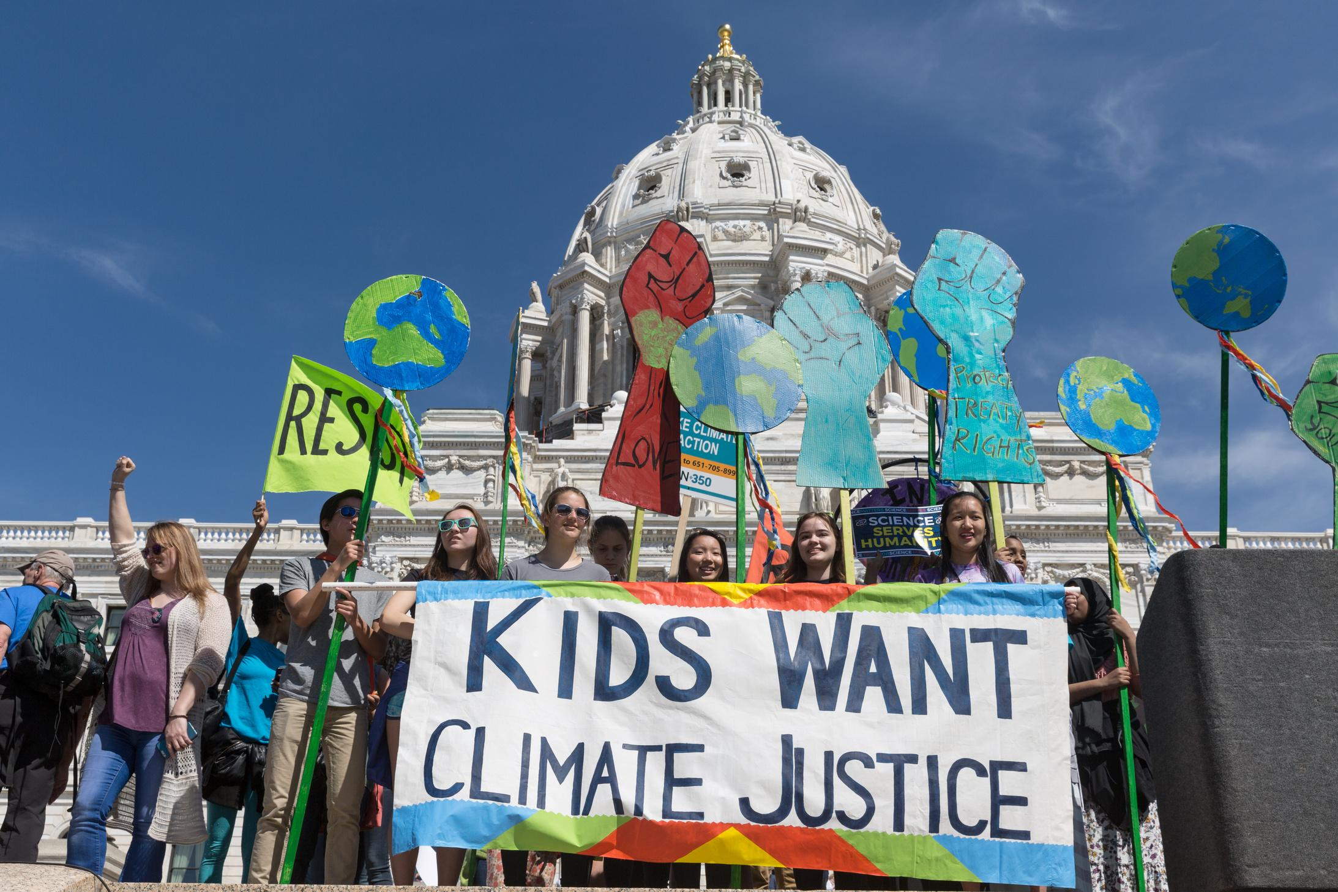
Photo courtesy of Lorie Shaull on Flickr. License: CC BY.
What’s in this module?
Contents
This module discusses the relevancy of climate justice across STEM fields and science communication. It aims to create more inclusive scientists, researchers, and communicators through a broad collection of STEM & Climate Justice case studies.
Activities
Key Resources
4 parts
13 readings
6 case studies
1 video
1 project option
  Situating the Scientist: Creating Inclusive Science Communication Through Equity Framing and Environmental Justice (Mohai et al., 2009)

Slide 3
Learning Objectives
01
02
03
04
Understand the significance of the relationship between CJ and STEM
Discuss STEM case studies centered around climate justice
Examine the different ways CJ is related to specific STEM fields
Explore current efforts bridging the gap between CJ and STEM

Slide 4
Warm up
Why is STEM important to climate justice, and why is climate justice important to STEM?
Turn to a partner or small group and brainstorm your ideas.

Slide 5
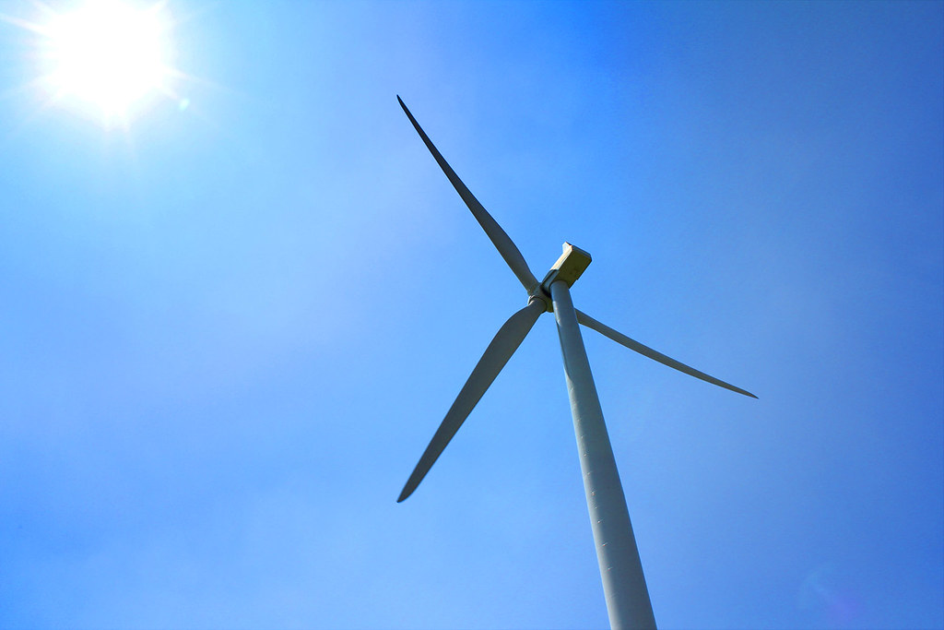
Photo courtesy of oscar t on Flickr. License: CC BY.
Connection Between STEM & Climate Justice
PART 1

Slide 6
Why STEM is Important to CJ
01
02
03
04
Sustainable technologies
Environmental monitoring
Data analysis
Interdisciplinary approaches
Engineers, scientists, and innovators in STEM fields contribute to the development of sustainable technologies. By promoting clean energy solutions, STEM professionals help support equitable access to clean energy, benefiting communities that have been disproportionately affected by fossil fuel energy.
STEM professionals play a role in monitoring environmental changes and assessing the resilience of ecosystems / communities. They provide insights into vulnerable areas, and contribute to building climate-resilient infrastructure and systems that can withstand the impacts of climate change for marginalized communities.
STEM professionals, climate scientists, meteorologists, and environmental researchers provide critical data analysis on climate change trends, causes, and impacts. Understanding the scientific basis of climate change is essential to formulating evidence-based policies that consider the needs of vulnerable communities and promote climate justice.
Addressing climate justice requires interdisciplinary collaboration. STEM professionals can work alongside social scientists, policy experts, economists, and community members to develop comprehensive strategies that tackle both the scientific and social aspects of climate change.

Slide 7
Why CJ is Important to STEM
01
02
03
04
Access to resources
Policy and governance
Collaborative problem solving
Inclusivity
Climate justice acknowledges that not all communities have equal access to resources, technology, and education. By integrating climate justice principles into STEM initiatives, we can work towards bridging these gaps and ensure that communities facing environmental challenges have the necessary tools and support to address them effectively.
STEM professionals often play a vital role in shaping climate policies and governance structures. By incorporating climate justice principles into their work, they can advocate for policies that prioritize the needs of marginalized communities and promote environmentally just practices.
Climate change is a global issue that requires collaborative efforts from scientists, engineers, policymakers, and communities. Climate justice emphasizes the importance of working together with affected communities to develop solutions that address their unique needs and concerns. By involving these communities in the process, STEM professionals can gain valuable insights and create more impactful interventions.
The STEM fields need diverse perspectives and solutions to tackle complex challenges like climate change. Climate justice recognizes the importance of including voices from different backgrounds, cultures, and regions in research and decision-making processes. By promoting inclusivity, STEM can benefit from a wider range of ideas, experiences, and knowledge, leading to more comprehensive and equitable solutions.

Slide 8
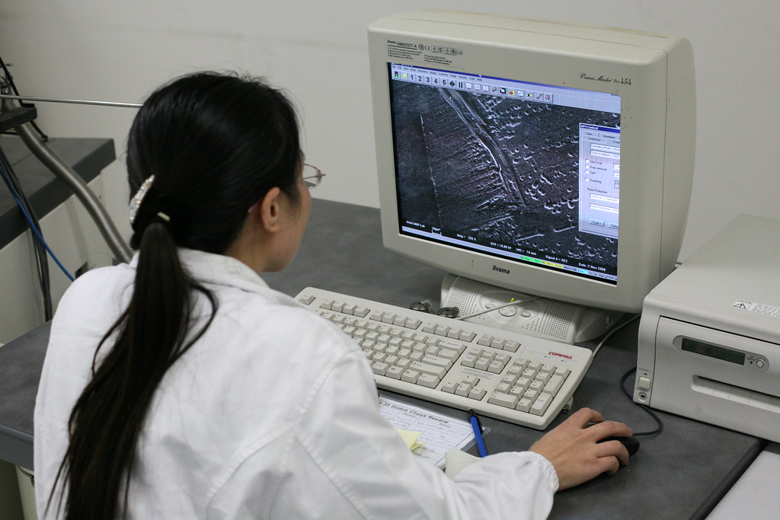
Photo by Robert Scoble on Flickr. License: CC BY.
Inclusive Science
PART 2

Slide 9
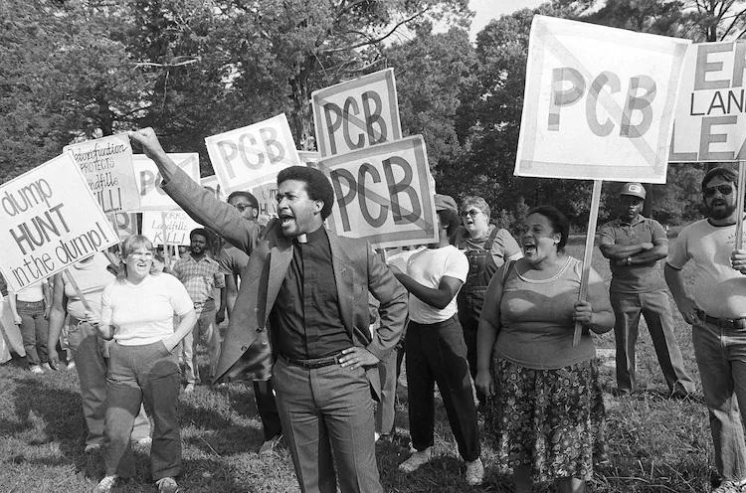
Review: Situating the Scientist
Key points
  The field of EJ and the EJ movement began after protests in Warren County, North Carolina
  Minority communities face unequal exposure, impact, enforcement, and remediation
  Climate change disproportionately impacts communities of color, indigenous people, low-income communities, and developing countries
© Greg Gibson / AP. All rights reserved. This content is excluded from our Creative Commons license. For more information, see https://ocw.mit.edu/help/faq-fair-use/ .
How could an environmental justice frame help scientists become more inclusive communicators?

Slide 10
Tips for Using CJ as a Frame for Inclusive Science
01
02
03
Become aware of their own positionality and partial perspectives
Name sources of inequity that arise from uneven power relations
Find intersections with initiatives that are rooted in the experiences of disadvantaged communities
(Polk & Diver, 2020)

Slide 11
Considering Inclusivity
Questions to ask yourself
  How do I write in a way that makes the problems disadvantaged communities face and their solutions more visible?
  How do I ground my scientific research in larger social and political contexts that make our knowledge more complete?
  How do I effectively communicate with my intended audience(s) about equity issues, as an important part of the story?
  How has my own positionality affected my research questions, research design, and communication choices?
  How do I do this in a way that does not render the knowledge and leadership of disadvantaged communities invisible?
Why are these questions important for scientists engaging in research and scientific communication? Which resonate with you? How can these questions be applied in your research/studies?
(Polk & Diver, 2020)

Slide 12
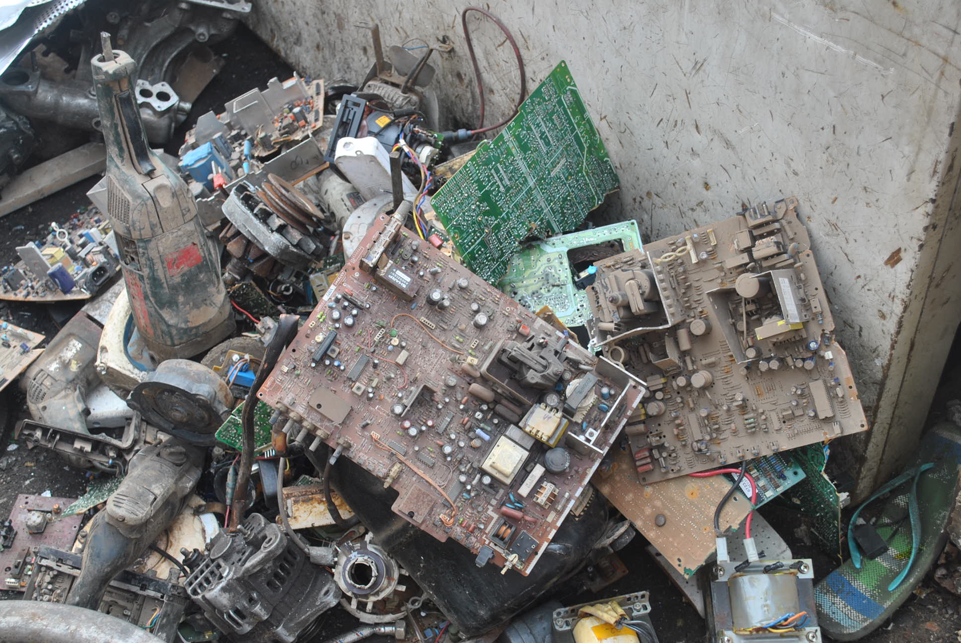
CJ-Informed STEM Research Case Studies
PART 3
Photo courtesy of Agbogbloshie Makerspace Platform on Flickr. License: CC BY-SA. This content is excluded from our Creative Commons license. For more information, see https://ocw.mit.edu/help/faq-fair-use/.

Slide 13
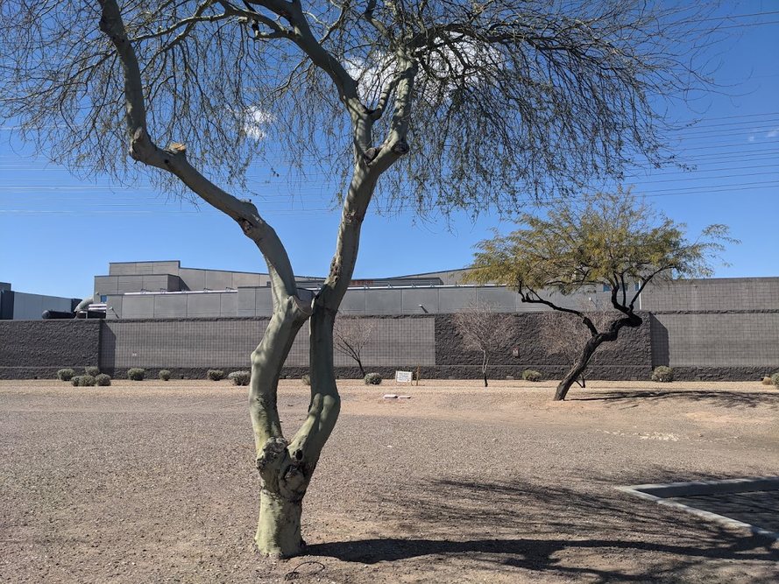
ACTIVITY #1
CLIMATE JUSTICE AND COMPUTER SCIENCE
Post-reading discussion questions
In small groups, discuss these questions:
  What could be the disproportionate impacts of the carbon footprint generated by the cloud on marginalized communities, and how can these impacts be mitigated?
  To what extent do you think corporate action surrounding cloud technology consider the principles of climate justice, and how can these policies be reimagined to better reflect such principles?
  How can the concept of climate justice inform the design and implementation of more energy-efficient computation systems, considering factors like sustainable practices and culture?
  What are the conflicts between the rapid pace of technological innovation and the aspirations of climate justice as mentioned in the case? How can these conflicts be reconciled to ensure responsible and sustainable development of the cloud?
Read
The Cloud Is Material: On the Environmental Impacts of Computation and Data Storage
A Data Center in Arizona. Photo courtesy of Steven Gonzalez Monserrate. License: CC BY-NC.

Slide 14
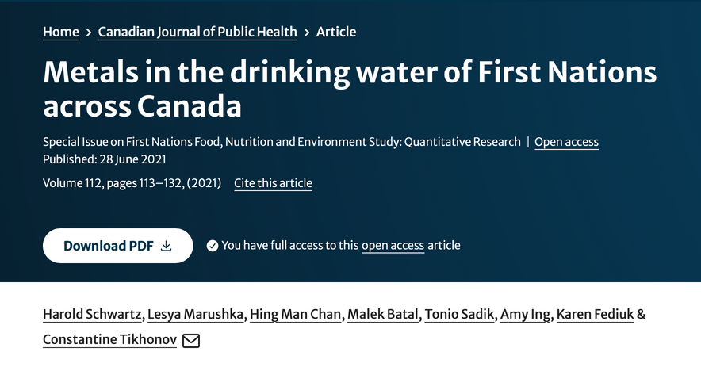
ACTIVITY #2
CLIMATE JUSTICE AND CHEMISTRY
Post-reading discussion questions
In small groups, discuss these questions:
  What innovative and sustainable water treatment technologies can be developed or adapted to effectively remove toxic metals from water sources in remote indigenous regions, taking into consideration both technical feasibility and cultural appropriateness?
  How is climate change influencing the presence and distribution of toxic metals in water sources commonly used by indigenous peoples?
  What are the potential health risks associated with long-term exposure to toxic metals such as lead, aluminum, and manganese etc. in drinking water?
  How can the discourse around toxic metal contamination in indigenous drinking water be expanded to encompass broader discussions on decolonization, environmental justice, and sustainable development in the context of changing global climates?
Read
Metals in the Drinking Water of First Nations across Canada
Image courtesy of H. Schwartz et al. License: CC BY.

Slide 15
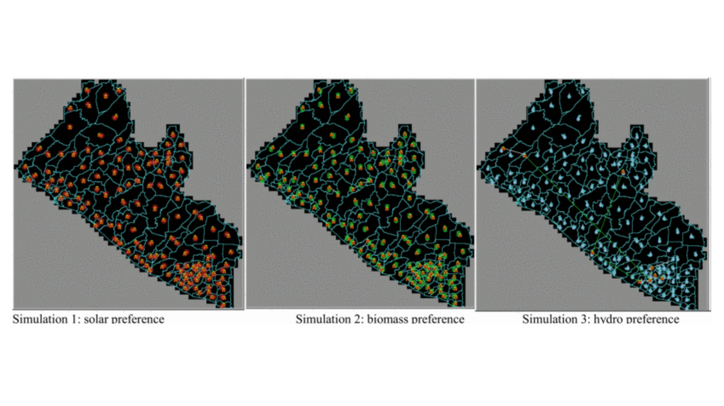
ACTIVITY #3
CLIMATE JUSTICE AND PHYSICS
Post-reading discussion questions
In small groups, discuss these questions:
  From the article, what justice-based strategies can optimize renewable energy integration into existing grids to enhance energy resilience and reduce environmental impacts?
  How do disparities in energy access across communities contribute to broader social and economic inequalities, and how can physics-informed electrification planning address these disparities?
  What factors should be considered when selecting appropriate renewable energy technologies for microgrids in diverse Sub-Saharan African contexts, taking into account local challenges, energy demand, and available resources?
  How can the deployment of renewable energy-supported microgrids in Sub-Saharan Africa be optimized to ensure that rural communities, particularly marginalized groups, have equitable access to clean and reliable energy services?
Read
An energy justice based approach for electrification planning - An agent-based model
(Tarekegne & Rouleau, 2019)
© IEEE. All rights reserved. This content is excluded from our Creative Commons license. For more information, see https://ocw.mit.edu/help/faq-fair-use/.

Slide 16
ACTIVITY #4
CLIMATE JUSTICE AND ENGINEERING
Post-reading discussion questions
In small groups, discuss these questions:
  What skills are needed for engineers to tackle climate change-related issues now and in the future?
  What changes to traditional engineering education are needed to create engineers equipped with these skills?
  How do you think about environmental justice in the context of engineering?
  Think of the courses you are taking/have already taking, what climate change education have you received? What about environmental justice? Climate justice?
  How can engineering be more inclusive?
Read
The climate is changing. Engineering education needs to change as well
Visit the Engineering Climate Justice module to learn more

Slide 17
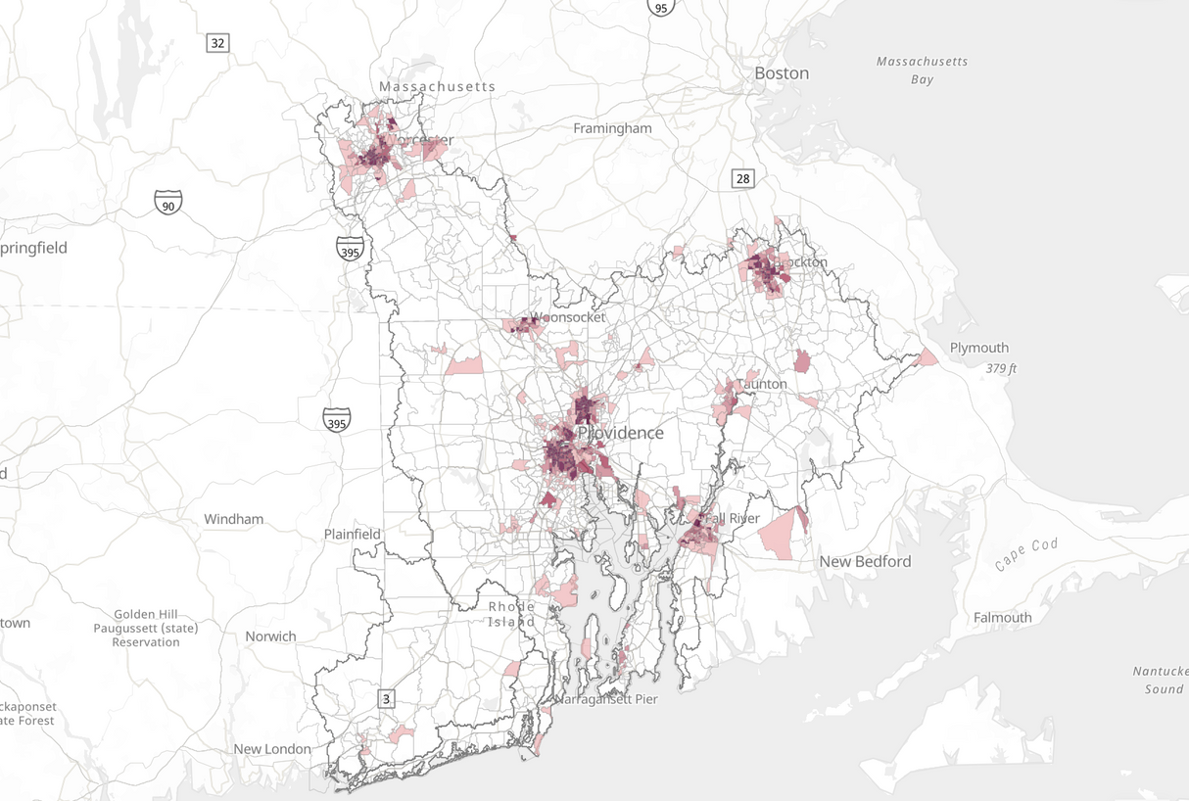
ACTIVITY #5
DATA FOR CLIMATE JUSTICE
Read
Why we need data science in the fight for climate justice
Post-reading discussion questions
In small groups, discuss these questions:
  Why is data important for the fight against climate change and for climate justice?
  How can statistics be used more responsibly?
  What is equitable data gathering and management? Can you identify it in your classes or research?
© Narragansett Bay Estuary Program. All rights reserved. This content is excluded from our Creative Commons license. For more information, see https://ocw.mit.edu/help/faq-fair-use/ .
See more data sets and tools for climate justice

Slide 18
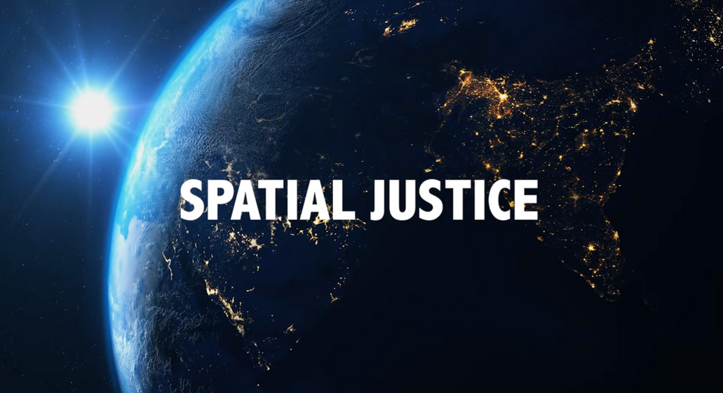
ACTIVITY #6
AEROSPACE ENGINEERING FOR SOCIAL JUSTICE
Post-reading discussion questions
In small groups, discuss these questions:
  What makes prisons susceptible to environmental injustices? How are prison injustice spatial issues?
  What STEM tools and approaches does Ufuoma use to identify environmental injustices within or around prisons?
  What are some of the injustices she unearths using space enabled technology?
  How does Ufuoma’s social identity connect with her STEM Research? How does this relate to the EJ frame discussed earlier in this module?
  Ufuoma mentions she did not want to work at Boeing or Ford - what is she referring to here?
  What does it mean to “engineer while black” - what does Ufuoma say about this?
  How is your identity either represented or not represented within STEM fields? In what ways do you connect with Ufuoma’s story?
Watch
Spatial Justice
© Daelin Brown, Phie Jacobs, and Abdullahi Tsanni Nuhu. All rights reserved. This content is excluded from our Creative Commons license. For more information, see https://ocw.mit.edu/help/faq-fair-use/.
Visit the Mapping Environmental Justice module to learn more

Slide 19
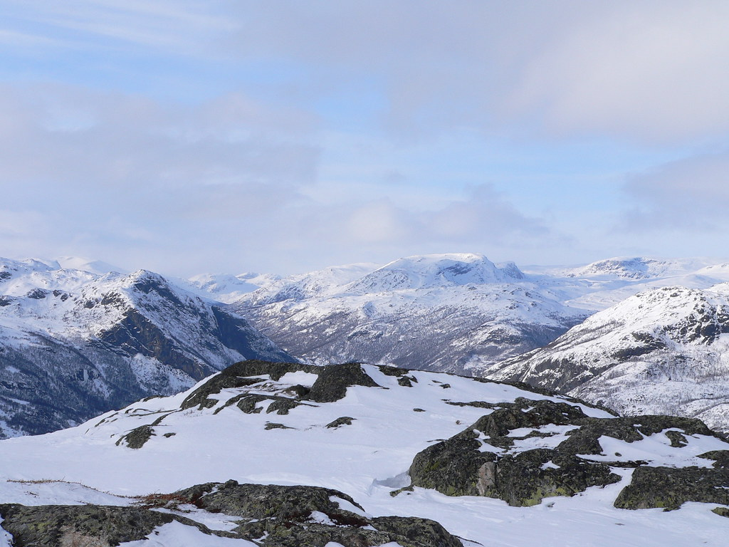
Photo courtesy of Jonas Bengtsson on Flickr. License: CC BY..
Reflect
After learning about environmental and climate justice in STEM, reflect on these questions:
  How will EJ impact your research?
  How can you be a more inclusive science communicator?
  How can CJ impact your coursework?

Slide 20
Beyond the Module
PART 4

Slide 21
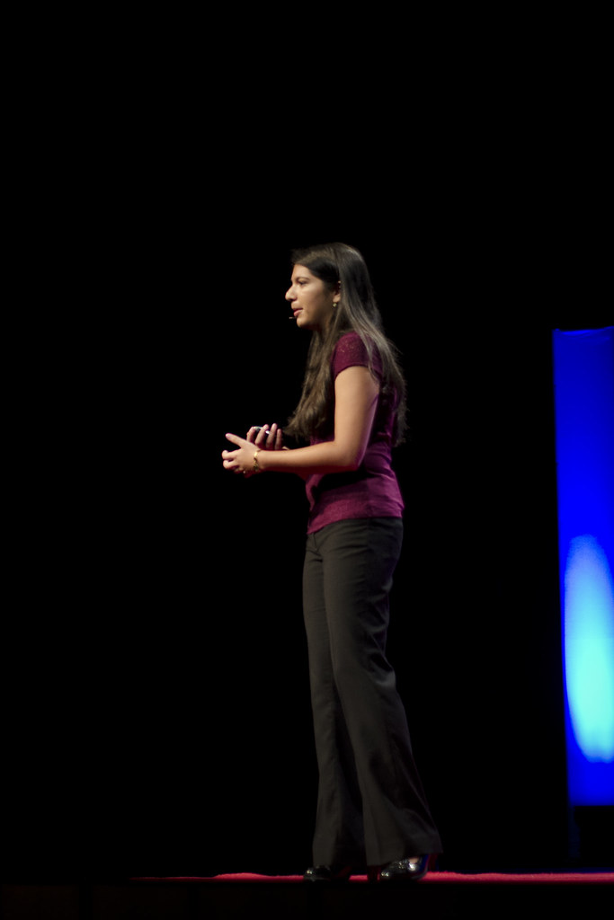
Photo by Nick Batson, courtesy of sbudoit on Flickr. License: CC BY.
PROJECT OPTION #1
Poster with Personal Climate Justice Goals
Prompt suggestion
Design a poster about how you can use climate justice in your life, research, and career, and give a 5 minute presentation of your poster.
Guiding questions
  How should climate justice be integrated as a critical part of careers in STEM?
  In what ways could CJ impact your career?
  How could technological or scientific developments be made more accessible to people experiencing climate injustices?
  What is the impact of your scientific research beyond the classroom?

Slide 22
Additional Resources
Further Reading/Watching
  Engineering for the People: Putting Peace, Social Justice, and Environmental Protection at the Heart of All Engineering (Karway, 2019)
  Gender Data Must Be the Bedrock of Climate Justice (GEDA)
  Interview of Juliana Mitkiewicz
  Current efforts to mitigate the presence of harmful chemicals in the water of the First Nations in Canada
Relevant Organizations
  National Renewable Energy Laboratory
  The Environmental Justice and Climate Resiliency Initiative
Tools + Data
  Climate Change AI
  Gender Climate Tracker
  NASA Worldview App

Slide 23
Module References
  Bethel Tarekegne & Mark Rouleau. (2019). An energy justice based approach for electrification planning - An agent-based model," IEEE Global Humanitarian Technology Conference (GHTC), Seattle, pp. 1-4.
  Carlie D. Trott, Stephanie Lam, Jessica Roncker, Emmanuel-Sathya Gray, R. Hayden Courtney & Trevor L. Even. (2023). Justice in climate change education: a systematic review. Environmental Education Research.
  Donovan, R. (n.d.). Climate justice in chemistry curricula-and beyond. American Chemical Society.
  Government of Canada. (2021, February 26). Achieving Clean Drinking Water in First Nations Communities. Www.sac-Isc.gc.ca.
  Monserrate, S. G. (2022). The Cloud Is Material: On the Environmental Impacts of Computation and Data Storage. Mit-Serc.pubpub.org, Winter 2022.
  Schwartz, H., Marushka, L., Chan, H. M., Batal, M., Sadik, T., Ing, A., Fediuk, K., & Tikhonov, C. (2021). Metals in the drinking water of First Nations across Canada. Canadian Journal of Public Health, 112(S1), 113–132.

Slide 24

For more resources on climate and environmental justice: Please explore other modules in the Climate Justice Instructional Toolkit.

Slide 25
MIT OpenCourseWare
https://ocw.mit.edu
RES.11-003 Climate Justice Instructional Toolkit Spring 2025
For more information about citing these materials or our Terms of Use, visit https://ocw.mit.edu/terms.

