Slide 1
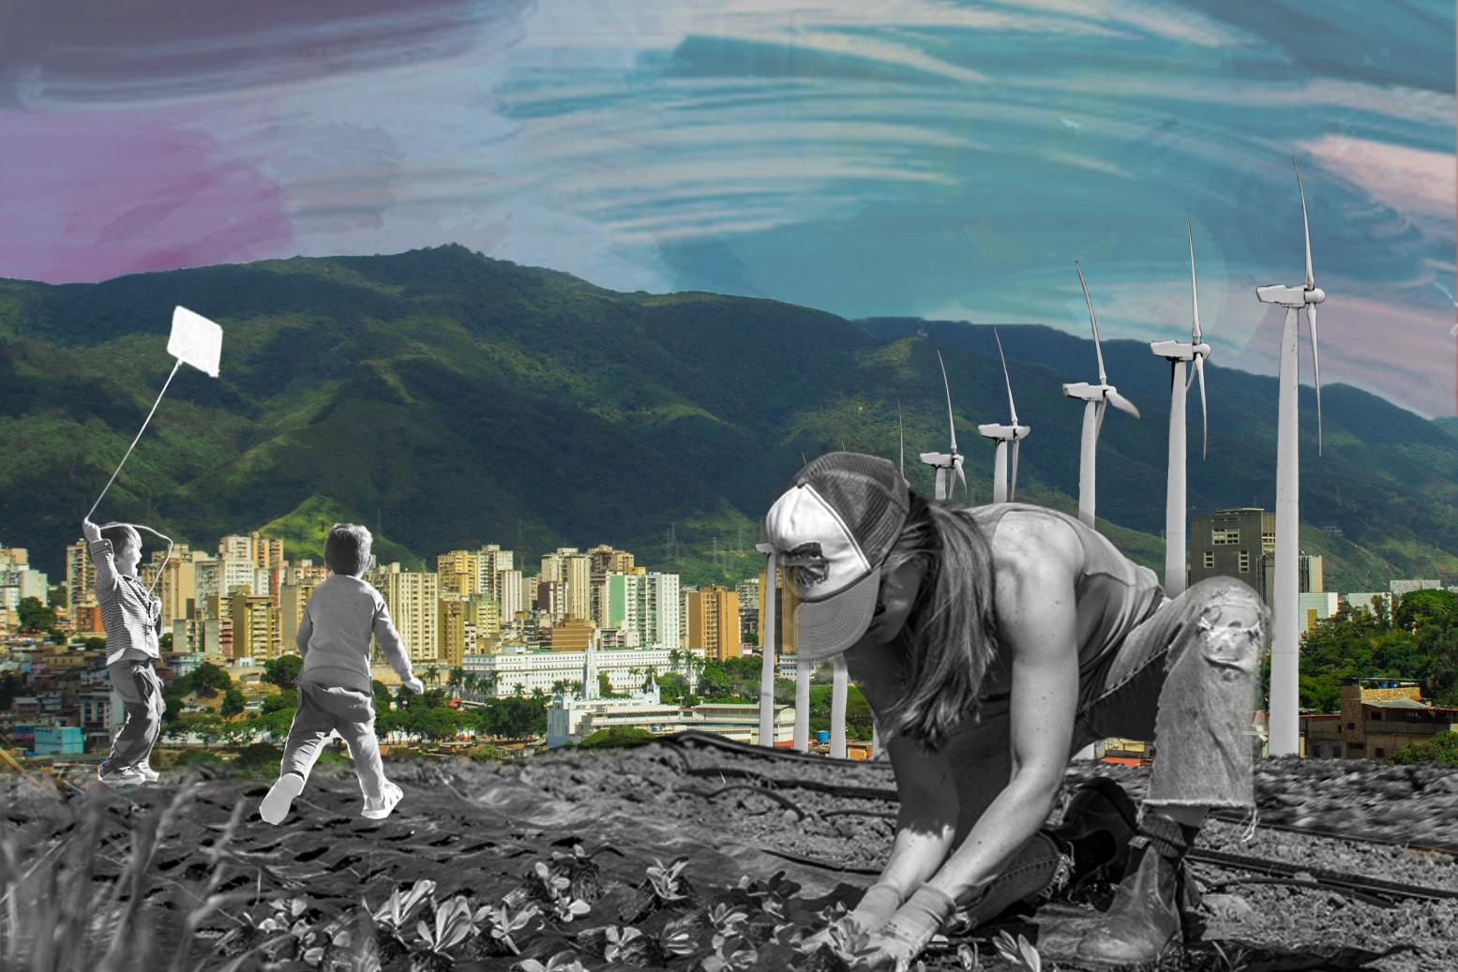

DISCIPLINE-SPECIFIC MODULE
Climate Justice &
2.0
Environmental Data

Slide 2
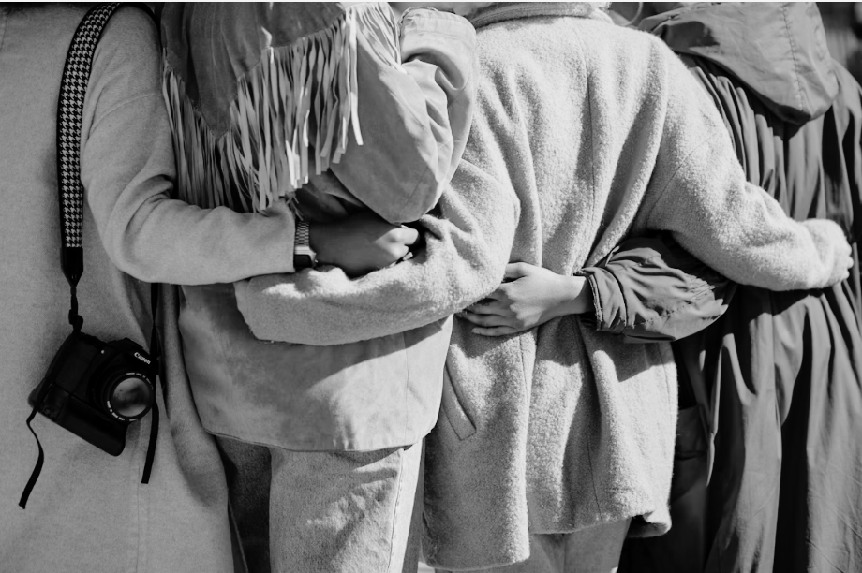
What’s in this module?
Description
This module addresses the interplay of environmental data and climate justice. It explores how current paradigms of data collection, analysis, and dissemination can both contribute to and hinder climate justice goals. Participants will learn about the ethical use and collection of climate data, the importance of community-driven data initiatives, and data gaps in areas affected by climate change.
Activities
Key Resources
5 parts
1 videos
6 readings
3 activities
5 optional projects
  What is Data Justice (Taylor, 2017)
  Importance of Community Engagement in Data Decision Making (Crawford et al., 2023)
  Indigenous Data Sovereignty: Toward an Agenda (Kukutai and Taylor, 2016)
Photo by Vonecia Carswell on Unsplash.

Slide 3
Learning Objectives
01
02
03
04
Understand different aspects of the relationship between climate justice and environmental data.
Discuss the role of community- driven data initiatives in facilitating more equitable decision-making.
Examine dominant approaches to environmental data collection.
Explore case studies, principles, and frameworks in data justice.

Slide 4
Introduction
PART 1

Slide 5
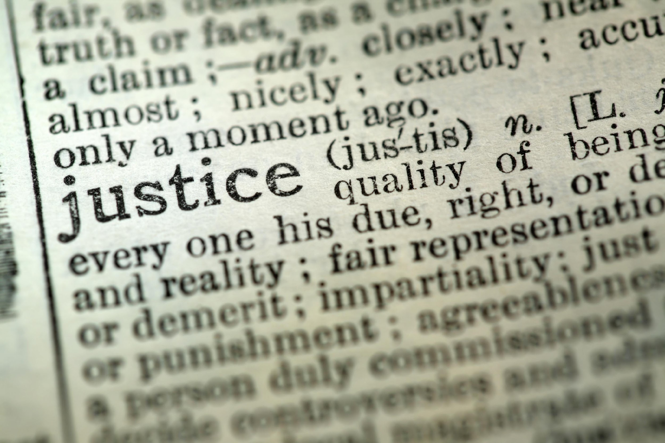
Introduction
“Climate Justice” specifically targets the systemic inequities and global implications of climate change, addressing global and systemic contributions (Mary Robinson Foundation - Climate Justice)
What is Climate Justice?
Climate justice represents a critical framework that recognizes the disproportionate impacts of climate change on marginalized communities - those who have contributed least to the climate crisis yet bear its heaviest burdens. It goes beyond mere environmental protection to ensure that those most affected by climate change receive equitable protections, resources and inclusion in climate solutions.
At its core, climate justice addresses intersecting social, economic, and political inequalities that shape how different communities experience and respond to climate impacts. For instance, when communities lack access to comprehensive air quality data, they face greater health risks due to inadequate policy interventions and resource allocation.
“Environmental justice” focuses broadly on the fair distribution of environmental benefits and burdens (Bullard, 2001).
Notes:
Defining Climate Justice
- Overview of climate justice: equity in addressing climate impacts on marginalized communities.
- Introduction to the link between climate justice and environmental data.
ADDITIONAL NOTES:
In aiming to achieve climate justice, environmental data can serve as a foundation for equitable climate policies, yet data gaps often render certain communities invisible in decision-making processes. Climate justice, therefore, demands a shift from technocratic, top-down approaches to frameworks that center the needs and perspectives of affected communities.

Slide 6
Introduction
Climate justice demands that data collection, analysis, and use must:
  Prioritize the needs and perspectives of communities most affected by climate change.
  Ensure equitable access to environmental information.
  Respect community sovereignty over local environmental data.
  Address historical data gaps that have rendered certain communities invisible.
  Challenge dominant technocratic approaches that often exclude local knowledge.
Climate Justice & Data
Environmental data - from air quality measurements to water resource monitoring and emissions tracking - forms the backbone of climate-related decision-making. However, the relationship between data and justice is complex and often problematic.
While data can inform policies and interventions, gaps or biases in data collection and analysis can reinforce existing inequalities.
  Ex. flood risk data: when vulnerable communities are excluded from comprehensive risk assessments, they often remain without adequate protection or resources for climate adaptation (Taylor, 2017).
Notes:
Data Sovereignty & Climate Justice
- Definition of data sovereignty: control over data by the communities it concerns.
-Relevance of data sovereignty in achieving climate justice.
ADDITIONAL NOTES:
As we collect, analyze, and utilize environmental data, we must recognize that these practices are not neutral but deeply embedded in power structures that have historically marginalized certain communities.

Slide 7
Introduction
Inclusive practices (see examples below) disrupt entrenched power dynamics and foster equitable outcomes as a means of addressing these inequities (Crawford et al., 2023).
Historical Context of Data and Inequities
Data collection has long been a tool of power, often wielded in ways that marginalize underrepresented groups. Environmental data practices, in this vein, have historically perpetuate inequities through:
  Exclusion of marginalized communities from data collection processes;
  Privileging Western scientific methods over traditional ecological knowledge;
  Use of data to justify environmental exploitation;
  Lack of transparency in data collection and use;
  Limited access to environmental monitoring tools and data.
Community-Based Participatory Data Collection Models
Transparent Decision-Making
Notes:
Data and Historical Inequities
- Historical context: how data collection has sometimes perpetuated environmental inequities.
- Examples of data misuse or exclusion affecting climate-vulnerable communities.
ADDITIONAL NOTES:
Safiya Noble (2018) highlights how historical data systems have perpetuated inequities, prioritizing industrial and economic data over community-specific environmental needs.
For example, data on pollution exposure has frequently excluded low-income neighborhoods, leading to skewed assessments of environmental risks.

Slide 8
Introduction
Inequities in environmental data have also been perpetuated through:
  Privileging Western scientific methods over traditional ecological knowledge
  Use of data to justify environmental exploitation
  Lack of transparency in data collection and use
  Limited access to environmental monitoring tools and data
Historical Context of Data and Inequities
As we collect, analyze, and utilize environmental data, we must recognize that these practices are not neutral but deeply embedded in power structures that have historically marginalized certain communities. Historically, marginalized communities have been systematically underrepresented in environmental datasets and collection processes. Data has long been a tool of power, often wielded in ways that perpetuate harm. This exclusion reflects and reinforces power imbalances, where data collection and analysis have been primarily controlled by government agencies, research institutions and corporations, often sidelining local voices and knowledge (Crawford et al., 2023).
Notes:
Data and Historical Inequities
The impact of these historical inequities continues today. For example, in urban planning, persistent gaps in air quality data for low-income neighborhoods often result in fewer interventions and resources for addressing pollution-related health issues.
- Historical context: how data collection has sometimes perpetuated environmental inequities.
- Examples of data misuse or exclusion affecting climate-vulnerable communities.
ADDITIONAL NOTES:
Safiya Noble (2018) highlights how historical data systems have perpetuated inequities, prioritizing industrial and economic data over community-specific environmental needs.
For example, data on pollution exposure has frequently excluded low-income neighborhoods, leading to skewed assessments of environmental risks.

Slide 9

Introduction
What is Data Sovereignty?
Data sovereignty refers to the right of communities—especially Indigenous and marginalized groups—to develop, maintain, control and protect the collection, management and (re)use of data related to their lands, resources, and people (Kukutai and Taylor, 2016).
In the context of climate justice, data sovereignty ensures that communities have ownership over environmental data that impacts their lives and futures. This principle challenges traditional top-down approaches to data collection and management that have historically prioritized external scientific agendas and excluding local voices and knowledge systems.
Photo by Markus Spiske on Unsplash
Notes:
Data Sovereignty & Climate Justice
- Definition of data sovereignty: control over data by the communities it concerns.
-Relevance of data sovereignty in achieving climate justice.
ADDITIONAL NOTES:
As we collect, analyze, and utilize environmental data, we must recognize that these practices are not neutral but deeply embedded in power structures that have historically marginalized certain communities.

Slide 10

Introduction
Data Sovereignty in Action
Marginalized communities worldwide are advocating for control over climate research impacting their lands. By incorporating traditional environmental knowledge (TEK) and ethical data practices, these communities can assert their rights and influence climate strategies.
  An example is the use of participatory research methods that prioritize community insights, ensuring data-driven decisions align with local priorities.
Photo by Carlos Muza on Unsplash
Notes:
Data and Historical Inequities
- Historical context: how data collection has sometimes perpetuated environmental inequities.
- Examples of data misuse or exclusion affecting climate-vulnerable communities.
ADDITIONAL NOTES:
Safiya Noble (2018) highlights how historical data systems have perpetuated inequities, prioritizing industrial and economic data over community-specific environmental needs.
For example, data on pollution exposure has frequently excluded low-income neighborhoods, leading to skewed assessments of environmental risks.

Slide 11
ACTIVITY #1
DATA JUSTICE MAPPING
Step 3: Environmental Justice Analysis (15 min)
Analyze the selected dataset using the following prompts:
  Impact Assessment: Which communities or groups are most impacted by the environmental issues shown in the dataset? What are the consequences of data gaps for these communities?
  Bias and Power Dynamics: Who controls the data collection and dissemination (government, private entities, etc.)? How might these power structures influence what data is collected and how it is used?
  Community Implications: How does the lack of community input or control affect the fairness of the dataset? What stories or realities might be missing due to the dataset’s limitations?
Step 1: Select Data Set (10 min)
Select an environmental dataset, such as:
  Air Quality Data (EPA Air Quality System or OpenAQ)
  Flood Risk Assessment (FEMA National Flood Hazard Layer
  Climate Vulnerability Index (ND-GAIN Urban Adaptation Assessment)
Step 2: Examine Data Set (10 min)
Step 4: Group Discussion & Recommendations (15 min)
Examine the dataset, focusing on:
  Geographical Coverage: Are certain areas or populations overrepresented or underrepresented?
  Data Gaps: What information is missing that could affect vulnerable communities?
  Demographics: Are key demographic groups included in the data?
Discuss and document insights, focusing on potential opportunities for:
  Redesign and enhancing environmental justice.
  Collaborative approaches and partnerships
Notes:
Purpose:
To critically analyze an environmental dataset, identifying biases, gaps, and power dynamics, and to reflect on how data practices impact environmental justice outcomes.
Reflection:
Each group shares one key insight or recommendation with the class.
NB: Analyzing any dataset is possible.

Slide 12
Community Driven Data Initiatives
PART 2

Slide 13


Community-Driven Data Initiatives
Terrastories is a geostorytelling application built to enable Indigenous and other local communities to locate and map their own oral storytelling traditions about places of significant meaning or value to them.
Community-driven data initiatives represent a shift in how environmental data is collected, analyzed, and used. These initiatives are led by and for communities, focusing on local needs and priorities rather than external agendas. (Community Data Dialogues).
Such initiatives empower communities by putting data tools and decision-making power in their hands. This approach not only improves the relevance and accuracy of environmental data but also supports more equitable decision-making processes (Office of Justice Programs).
Āhau is a Whānau (family) Data Platform that helps whānau-based communities (whānau, hapū, Iwi) capture, preserve, and share important information and histories into secure, whānau managed databases and servers.
Notes:
Data Sovereignty & Climate Justice
- Definition of data sovereignty: control over data by the communities it concerns.
- Relevance of data sovereignty in achieving climate justice.
ADDITIONAL NOTES: As we collect, analyze, and utilize environmental data, we must recognize that these practices are not neutral but deeply embedded in power structures that have historically marginalized certain communities.

Slide 14

Photo by Hannah Busing, on Unsplash
Just Data Practices & Participatory Approaches
Just and equitable data practices require fundamental changes in how we approach environmental data collection and use, emphasizing the ethical and equitable management of data throughout its lifecycle. These practices must be built on three core principles:
  Inclusivity
  Transparency
  Ethics
This can be achieved through participatory approaches to environmental data collection that transform communities from subjects of research into active partners in knowledge creation. These approaches include community surveys, citizen science initiatives, and local monitoring programs (González & Facilitating Power, 2023).
Notes:
Data Sovereignty & Climate Justice
- Definition of data sovereignty: control over data by the communities it concerns.
- Relevance of data sovereignty in achieving climate justice.
ADDITIONAL NOTES: As we collect, analyze, and utilize environmental data, we must recognize that these practices are not neutral but deeply embedded in power structures that have historically marginalized certain communities.

Slide 15
Principles & Frameworks
PART 3

Slide 16

Principles & Frameworks of Data Governance
Environmental data governance requires a comprehensive framework of principles that ensure ethical, responsible, and equitable data practices. Four key frameworks have emerged as essential guidelines: FPIC, CARE, FAIR, TRUST and Open Data Charter principles.
These principles work together to protect community rights while promoting accessible and usable environmental data. They represent a shift from extractive data practices to more just and equitable approaches that respect community sovereignty while enabling scientific advancement (Leonard et al., 2023).
Photo by Claudio Schwarz on Unsplash
Notes:
Data Sovereignty & Climate Justice
- Definition of data sovereignty: control over data by the communities it concerns.
- Relevance of data sovereignty in achieving climate justice.
ADDITIONAL NOTES: As we collect, analyze, and utilize environmental data, we must recognize that these practices are not neutral but deeply embedded in power structures that have historically marginalized certain communities.

Slide 17
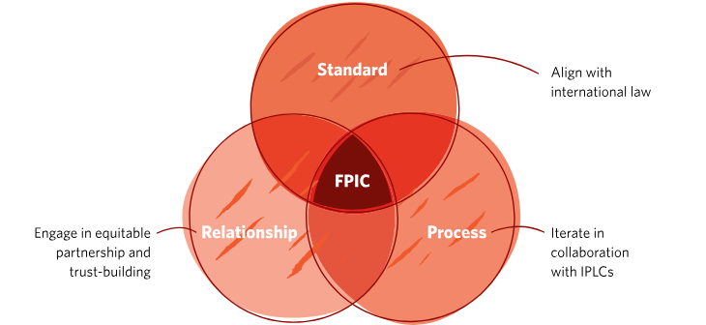
Environmental Data Principles
FPIC (Free, Prior, Informed Consent) ensures that communities have:
  Free: The right to enter into conversations and negotiations without coercion.
  Prior: The right be involved well before any decision is made about lands, resources or people.
  Informed: The right to have full information that is ongoing, easily accessible and readily available throughout the data lifecycle
  Consent: The right to say “yes” or “no” to a proposed undertaking that may affect lands, people or resources.
© The Nature Conservancy. All rights reserved. This content is excluded from our Creative Commons license. For more information, see https://ocw.mit.edu/help/faq-fair-use/.

Slide 18
Environmental Data Principles
The FAIR Principles ensure data is (FAIR, 2016):
The CARE Principles center Indigenous rights and interests (Carroll et al., 2020):
F
Findable: Easily discoverable by both humans and machines.
C
Collective Benefit: Data ecosystems must benefit communities.
A
Accessible: Available with clear access conditions.
A
Authority to Control: Communities maintain sovereignty over their data.
I
Interoperable: Can work across different platforms and applications.
R
Responsibility: Data practices support self-determination.
R
Reusable: Well-documented and ready for future use.
E
Ethics: Indigenous rights guide all data processes.

Slide 19
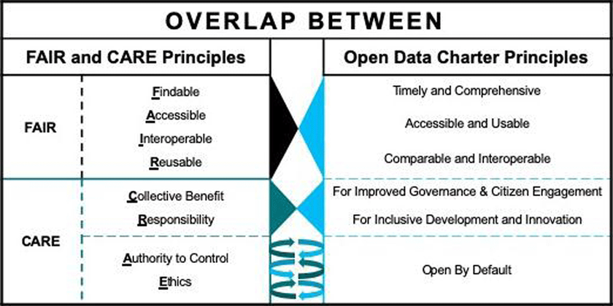
Environmental Data Principles
TRUST Framework outlines key aspects for building trust in digital repositories (Lin et al., 2020):
  Transparency in methods and processes.
  Responsibility in data governance.
  User Focus in design and implementation.
  Sustainability of data practices.
  Technology that serves community needs.
The Open Data Charter Principles provide another important framework for just and equitable environmental data practices:
  Open by Default: Data should be publicly available
  Timely and Comprehensive: Complete data released promptly
  Accessible and Usable: Easy to find and utilize
  Comparable and Interoperable: Works across different systems
  For Improved Governance and Citizen Engagement: Enhances transparency and accountability.
  For Inclusive Development and Innovation: Promotes equitable innovation and growth.
(Carroll et al., 2020)

Slide 20
ACTIVITY #2
PARTICIPATORY DATA DESIGN
Step 1: Community Needs Assessment (20 minutes)
Identify a pressing environmental issue affecting the selected community. Map existing data gaps, and identify affected stakeholders including who collects and uses the data (government agencies, community groups, private sector).
Activity Objective
To design a community-centered environmental data initiative that prioritizes equity, applying the principles discussed.
Step 2: Initiative Design (25 minutes)
Develop data collection approach on how data will be gathered (e.g., citizen science, sensor networks, etc.), create a governance structure around who will own and control the data, and plan strategies for community engagement (How will community members participate and benefit?).
Set Up
Form small groups of 3-5 participants. Each group will focus on a community (e.g., coastal town facing flooding, urban neighborhood with poor air quality).
Materials Needed:
  Access to FPIC, CARE, FAIR, TRUST and Open Data Charter guidelines.
  Flip charts or digital collaboration tools (e.g. Miro, Google Docs).
Step 3. Framework Integration (15 minutes)
Apply the FPIC, CARE, FAIR, and TRUST principles to your initiative using these guiding questions:
  How does your plan ensure Free, Prior, and Informed Consent (FPIC)?
  Which CARE principles are most relevant to your project?
  How will you make data FAIR and TRUST-compliant?
Step 4. Reflect and Discuss (10 minutes)
  What were the biggest challenges in designing a just data initiative?
  How, if at all, did applying the principles change your initial ideas?
Notes:
Additional Guiding Questions:
What are the key environmental challenges faced by this community?
What data is currently available, and what gaps exist?
How will you ensure community ownership and access to the data?
What role will local knowledge play in data collection and interpretation?

Slide 21
Current Data Paradigms
PART 4

Slide 22

Environmental Data Collection & Analysis
The dominant data paradigm emphasizes:
  Quantitative over qualitative data.
  Efficiency over equity.
  External scientific expertise over local, traditional ecological knowledge (TEK).
  Data collection without ensuring community benefit.
Dominant Approaches to Environmental Data Collection
Mainstream environmental data systems are often dominated by technocratic, top-down methodologies, including large-scale monitoring systems and automated data collection. While “big data” methodologies are often celebrated for their scale and comprehensiveness, the focus on quantity over quality often fails to capture the nuranced experiences of communities most affected by climate change.
A reliance on technology-driven approaches can lead to the marginalization of communities lacking representation in these datasets. Automated sensor networks, for instance, may prioritize high-income areas, while ignoring pollution in low-income or rural areas and perpetuating unequal access to environmental data.
Photo by Markus Spiske on Unsplash

Slide 23

ACTIVITY #3
CASE STUDY & DISCUSSION
Step 2: Discussion Questions
Discuss as a class, or in small groups, the following questions:
  How does the Chollas Creek case demonstrate the relationship between data access and community power in environmental decision-making?
  What role did data play in revealing historical patterns of environmental injustice in redlined communities?
  How do traditional versus community-led approaches to data collection differ?
  Who holds the most power in data collection and decision-making? How does this affect marginalized communities?
  How do traditional environmental data systems exclude marginalized communities from decision-making processes?
  What structural changes in data collection and sharing could help democratize environmental information?
Step 1: Watch
"Chollas: A Story of Community Partnership and Environmental Justice" by RAND Corporation
Photo courtesy of Paul Sableman on Flickr. License: CC BY.

Slide 24
Case Studies in Data Justice
PART 5

Slide 25
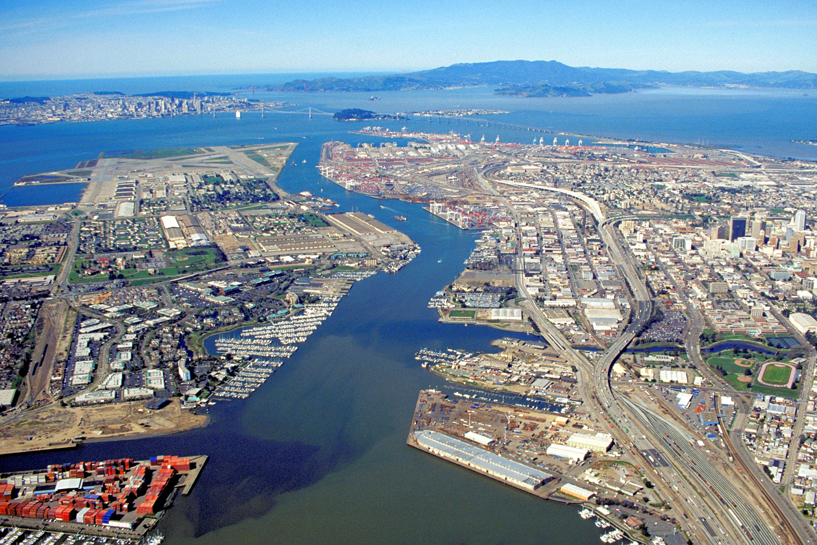
Photo courtesy of Robert Campbell on Wikinedia. License: CC BY_SA. This content is excluded from our Creative Commons license. For more information, see https://ocw.mit.edu/help/faq-fair-use/.
CASE STUDY #1
Air Quality Disparities in Urban Communities
RESOURCES
RESOURCES
Required:
  West Oakland Environmental Indicators Project (WOEIP). (http://woeip.org)
  The Crowd & The Cloud (Counting Trucks)
Supplemental:
  London et al. (2008)
  Liu et al. (2021)
  McClintock (2011)
West Oakland, California, presents an example of environmental data gaps exacerbating climate injustice. Historically, official air quality monitoring networks failed to capture neighborhood-level variations in pollution, leaving many low-income and predominantly Black communities exposed to harmful pollutants without adequate data representation.
The West Oakland Environmental Indicators Project (WOEIP), a community-led initiative, stepped in to fill this gap. By deploying localized air quality sensors, WOEIP revealed significant pollution hotspots previously undetected by state monitoring systems. The community-driven data exposed inequities, informed advocacy efforts, and catalyzed policy changes that prioritized air quality improvements in the most affected areas. This case underscores the importance of participatory data collection and the power of localized knowledge in driving climate justice outcomes.

Slide 26
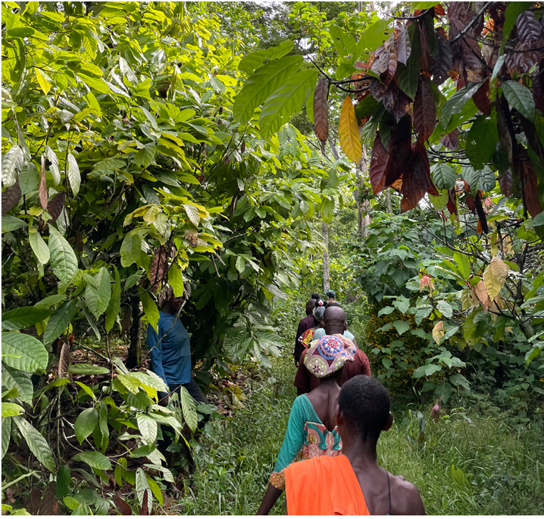
CASE STUDY #2
Data Sovereignty in Conservation Research
RESOURCES
The Bosomtwe Range Forest Reserve in Ghana exemplifies the intersection of data sovereignty and participatory research with local communities. Research led by J. Longdon (2024) highlighted how integrating Traditional Ecological Knowledge (TEK) into environmental monitoring enriched scientific understanding and fostered more sustainable forest management practices.
This research set out “to explore the benefits, harms and opportunities of ecoacoustic research – a field that combines biological, acoustic and machine learning to analyse acoustic environmental recordings and monitor wildlife – when conducted with marginalised forest communities. actively participated in data collection, ensuring that their cultural insights and priorities shaped the findings. The study’s outcomes emphasized the importance of community-driven data governance in preserving biodiversity, combating deforestation, and advancing equitable climate policies.
Required:
  The Future of Conservation Lies in Justice-led Technology (Longdon, 2024)
  Indigenous Data Sovereignty (Kukutai & Taylor, 2016)
Supplemental:
  Smith (1999)
  Berkes (2012)
© Joycelyn Longdon. All rights reserved. This content is excluded from our Creative Commons license. For more information, see https://ocw.mit.edu/help/faq-fair-use/.

Slide 27
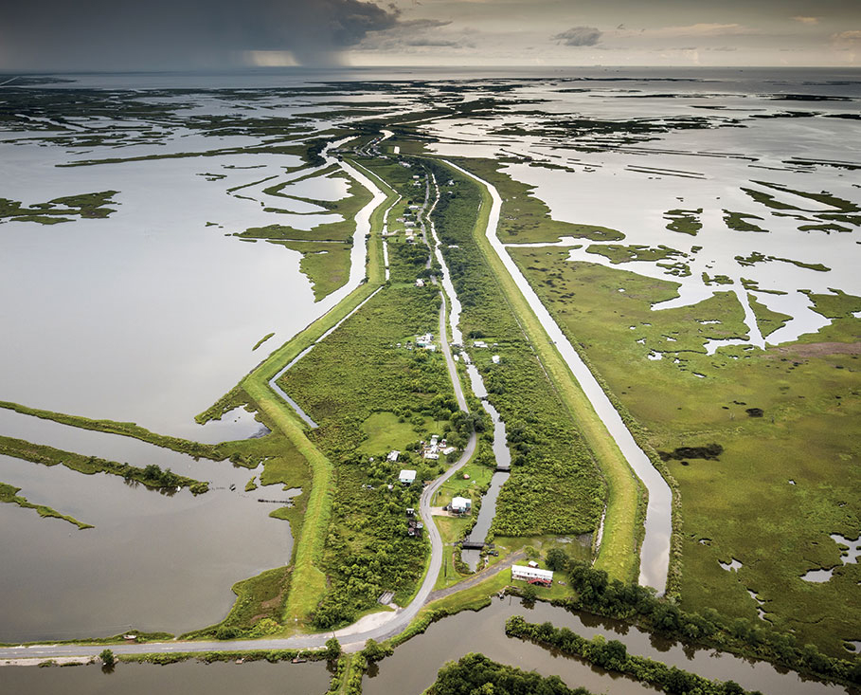
Retrieved from Isle de Jean Charles Resettlement Project
CASE STUDY #3
RESOURCES
Predictive Modeling and Climate Displacement
Required:
  Seeking Justice in an Energy Sacrifice Zone: Standing on Vanishing Land in Coastal Louisiana (Maldonado, 2018)
  The long goodbye on a disappearing, ancestral island: a just retreat from Isle de Jean Charles (Simms et al., 2021)
Supplemental:
  Fact Sheet 13: Displacement, Climate & The Data Gap - IFRC
  (In)justice in modelled climate futures: A review of integrated assessment modelling critiques through a justice lens (Rubiano Rivadeneira & Carton, 2022)
Isle de Jean Charles, a small island in Louisiana, illustrates the injustices that can arise from predictive climate modeling. Predictive models accurately forecasted the island’s vulnerability to rising sea levels and land subsidence but failed to account for the socio-cultural dimensions of displacement. Relocation plans, driven by these models, prioritized cost-effectiveness over community cohesion, resulting in fragmented displacement for the Indigenous Biloxi-Chitimacha-Choctaw tribe.
This case underscores the ethical limitations of technocratic approaches to climate data. It highlights the need for participatory modeling that integrates local knowledge and prioritizes community agency, ensuring that climate interventions promote justice and equity for displaced populations.

Slide 28
Beyond the Module
PART 6

Slide 29
PROJECT OPTION #1
Data Justice Assessment Tool
Prompt Suggestion
Develop an Environmental Data Justice Assessment Tool designed to evaluate datasets, data collection processes, and governance structures through a justice-centered lens. This tool should include criteria to assess inclusivity, community engagement, data transparency, and equitable access. Develop clear instructions for users, specifying how to score or weigh different aspects of data practices. Define the target audience - whether policymakers, environmental researchers, or community organizations - ensuring that the tool supports informed, equity-focused decision-making in environmental data governance. Include recommendations for improving data practices based on assessment outomes, emphasizing solutions that prioritize marginalized communities.
Photo by Claudio Schwarz on Unsplash
Notes:
Evaluation Criteria for Selecting Projects
When selecting the most effective projects for this module, consider:
Alignment with Learning Objectives: Projects should reinforce students’ understanding of climate justice and equitable data practices.
Practical Application: Technical projects should offer tools or frameworks that can be used in real-world scenarios.
Creativity and Engagement: Creative projects should foster storytelling, advocacy, and public engagement.
Community Focus: All projects should emphasize community participation and benefit, reflecting the principles of climate justice.

Slide 30

PROJECT OPTION #2
Climate Data Ethics Framework
Prompt Suggestion
Create a comprehensive framework that outlines ethical guidelines for collecting, sharing, and using environmental data. The framework should address issues like consent, privacy, community ownership, and transparency. Define criteria and best practices that ensure data collection aligns with climate justice principles. Identify the primary audience (e.g., researchers, policymakers, or NGOs) and include recommendations for implementation in data-driven climate projects.
Photo by Jason Goodman on Unsplash
Notes:
Evaluation Criteria for Selecting Projects
When selecting the most effective projects for this module, consider:
Alignment with Learning Objectives: Projects should reinforce students’ understanding of climate justice and equitable data practices.
Practical Application: Technical projects should offer tools or frameworks that can be used in real-world scenarios.
Creativity and Engagement: Creative projects should foster storytelling, advocacy, and public engagement.
Community Focus: All projects should emphasize community participation and benefit, reflecting the principles of climate justice.

Slide 31
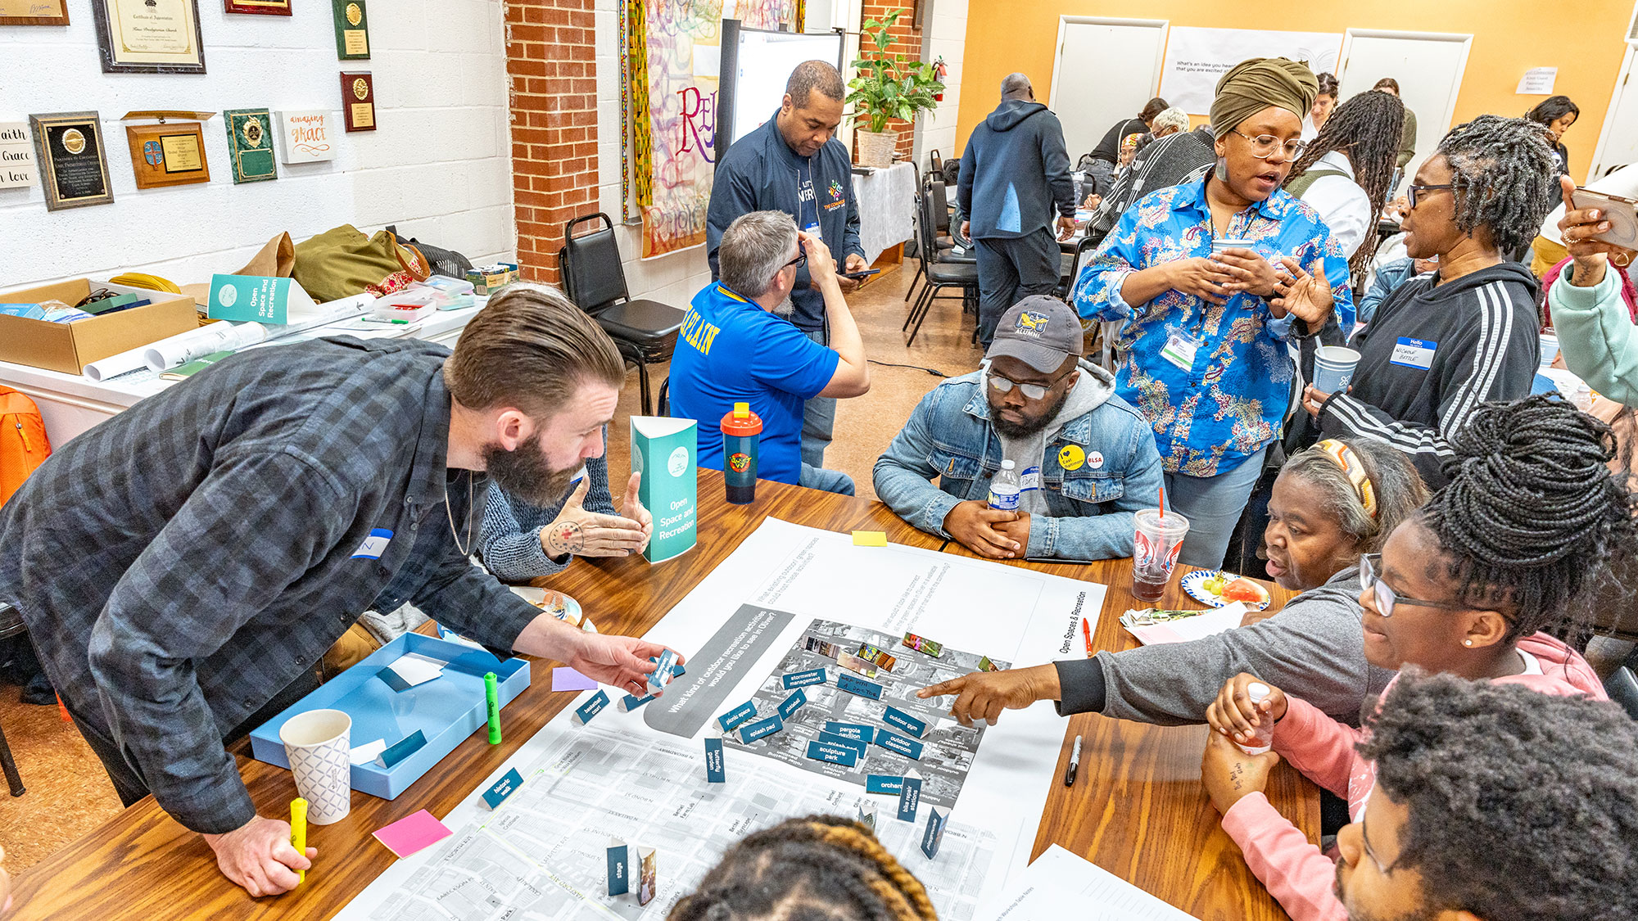
Photo by Ras Tre Subira. © Gensler. All rights reserved. This content is excluded from our Creative Commons license. For more information, see https://ocw.mit.edu/help/faq-fair-use/.
PROJECT OPTION #3
Environmental Data Equity Public Campaign
Prompt Suggestion
Develop a public engagement campaign to raise awareness about the importance of equitable environmental data practices. Specify the type of campaign—whether it’s a social media initiative, a community event series, or a policy advocacy effort. Identify key stakeholders, such as local leaders, environmental justice organizations, or community members, and craft personas representing each group’s interests and concerns. Develop messaging strategies that resonate with these stakeholders, using storytelling, infographics, or interactive elements to convey the significance of data equity. The campaign should include actionable steps for public involvement, such as signing petitions, attending workshops, or supporting community-driven data initiatives.
Notes:
Evaluation Criteria for Selecting Projects
When selecting the most effective projects for this module, consider:
Alignment with Learning Objectives: Projects should reinforce students’ understanding of climate justice and equitable data practices.
Practical Application: Technical projects should offer tools or frameworks that can be used in real-world scenarios.
Creativity and Engagement: Creative projects should foster storytelling, advocacy, and public engagement.
Community Focus: All projects should emphasize community participation and benefit, reflecting the principles of climate justice.

Slide 32

Photo by Denny Müller on Unsplash
PROJECT OPTION #4
Multimedia Project on Climate Data Justice
Prompt Suggestion
Create a multimedia narrative—such as a short film, podcast series, or digital story—exploring the theme of climate data justice. Choose a specific community or issue to highlight, focusing on how data gaps or inequities have impacted their climate resilience. The narrative should incorporate personal stories, expert interviews, or community perspectives to provide a nuanced understanding of data justice. Define the audience, whether it’s policymakers, the general public, or educational institutions, and craft your storytelling approach to engage and inform. Include a call to action that encourages viewers or listeners to advocate for equitable data practices and community-driven solutions.
Notes:
Evaluation Criteria for Selecting Projects
When selecting the most effective projects for this module, consider:
Alignment with Learning Objectives: Projects should reinforce students’ understanding of climate justice and equitable data practices.
Practical Application: Technical projects should offer tools or frameworks that can be used in real-world scenarios.
Creativity and Engagement: Creative projects should foster storytelling, advocacy, and public engagement.
Community Focus: All projects should emphasize community participation and benefit, reflecting the principles of climate justice.

Slide 33

PROJECT OPTION #5
Environmental Workshop on Climate Data Justice
Prompt Suggestion
Design a workshop for high school or college students that introduces the concept of climate data justice. Include interactive activities, such as data analysis exercises and role-playing scenarios. Create a facilitator’s guide with discussion prompts, learning objectives, and materials. Emphasize the importance of youth engagement in advocating for equitable climate data practices.
Photo by Zainul Yasni on Unsplash
Notes:
Evaluation Criteria for Selecting Projects
When selecting the most effective projects for this module, consider:
Alignment with Learning Objectives: Projects should reinforce students’ understanding of climate justice and equitable data practices.
Practical Application: Technical projects should offer tools or frameworks that can be used in real-world scenarios.
Creativity and Engagement: Creative projects should foster storytelling, advocacy, and public engagement.
Community Focus: All projects should emphasize community participation and benefit, reflecting the principles of climate justice.

Slide 34
Additional Resources
  Public Lab: Community-developed, low-cost, open-source DIY tools for environmental monitoring and public health advocacy
  Civic Laboratory for Environmental Action Research (CLEAR): A feminist, anti-colonial lab specializing in monitoring plastic pollution. You can see a video about their work, ‘Recycling Is Like a Band-Aid on Gangrene’.
  Detroit Digital Justice Coalition, “Digital Justice Principles”: Community-driven framework for technology and organizing.
  Environmental Data & Governance Initiative (EDGI): Environmental data justice and participatory science
  Data on Indoor Environmental Hazards Is Missing in National Data Collection Systems - Public Health Post
  Resisting Detached Datafication: What Toxic Prisons Teach Us about the Imperative of Restorative/Transformative Data Science for Environmental and Social Justice - Ufuoma Ovienmhada
  Jose Ramon Becerra Vera On democratizing science - Agents of Change in Environmental Justice
  US Indigenous Data Sovereignty Network, “The Governance of Indigenous Data: Organization to ensure that data for and about Indigenous nations and peoples in the US are used to advance Indigenous aspirations for collective and individual wellbeing.
  First Nations Principles of OCAP (Ownership, Control, Access, and Possession)
  EDAction and CLEAR, “Pollution is Colonialism” Statement

Slide 35
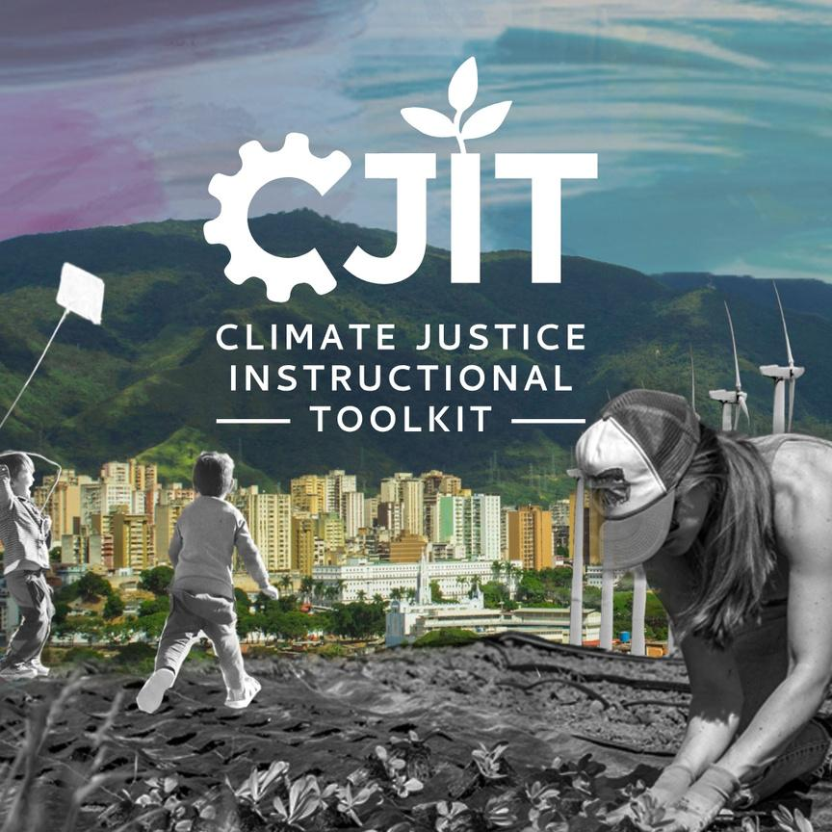
For more resources on climate and environmental justice: Please explore other modules in the Climate Justice Instructional Toolkit.

Slide 36
Module References
Stock images found on Canva were used in this module.
  Kukutai, T., & Taylor, J. (Eds.). (2016). Indigenous Data Sovereignty (1st ed.). ANU Press. https://doi.org/10.22459/CAEPR38.11.2016
  Liu, J., Clark, L. P., Bechle, M. J., Hajat, A., Kim, S.-Y., Robinson, A. L., Sheppard, L., Szpiro, A. A., & Marshall, J. D. (2021). Disparities in Air Pollution Exposure in the United States by Race/Ethnicity and Income, 1990–2010. Environmental Health Perspectives, 129(12), 127005. https://doi.org/10.1289/EHP8584
  London, J., Sze, J., & Lievanos, R. S. (2008). Problems, Promise, Progress, and Perils: Critical Reflections on Environmental Justice Policy Implementation in California. UCLA Journal of Environmental Law and Policy, 26(2). https://doi.org/10.5070/L5262019559
  Maldonado, J. K. (2018). Seeking Justice in an Energy Sacrifice Zone: Standing on Vanishing Land in Coastal Louisiana (1st ed.). Routledge. https://doi.org/10.4324/9781351002943
  McClintock, N. (2011). From Industrial Garden to Food Desert: Demarcated Devaluation in the Flatlands of Oakland, California. In A. H. Alkon & J. Agyeman (Eds.), Cultivating Food Justice (pp. 89–120). The MIT Press. https://doi.org/10.7551/mitpress/8922.003.0009
  Rubiano Rivadeneira, N., & Carton, W. (2022). (In)justice in modelled climate futures: A review of integrated assessment modelling critiques through a justice lens. Energy Research & Social Science, 92, 102781. https://doi.org/10.1016/j.erss.2022.102781
  Taylor, L. (2017). What is data justice? The case for connecting digital rights and freedoms globally. Big Data & Society, 4(2), 205395171773633. https://doi.org/10.1177/2053951717736335
  The Crowd & The Cloud. (2017, February 26). Counting Trucks (Vol. 3) [Documentary]. https://crowdandcloud.org/watch-the-episodes/episode-three
  Carroll, S. R., Garba, I., Figueroa-Rodríguez, O. L., Holbrook, J., Lovett, R., Materechera, S., Parsons, M., Raseroka, K., Rodriguez-Lonebear, D., Rowe, R., Sara, R., Walker, J. D., Anderson, J., & Hudson, M. (2020). The CARE Principles for Indigenous Data Governance. Data Science Journal, 19(1). https://doi.org/10.5334/dsj-2020-043

Slide 37
MIT OpenCourseWare
https://ocw.mit.edu
RES.11-003 Climate Justice Instructional Toolkit Spring 2025
For more information about citing these materials or our Terms of Use, visit https://ocw.mit.edu/terms.

