Slide 1

DISCIPLINE-SPECIFIC MODULE
Climate Justice in
Biology, Exposure Science,
and Epidemiology

Slide 2
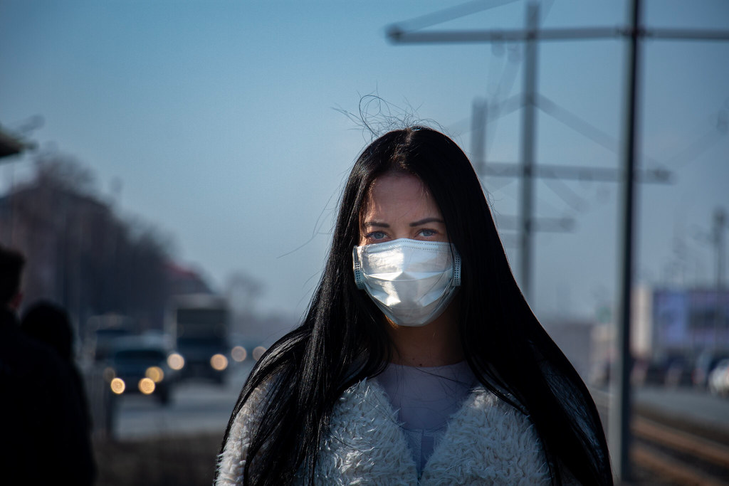
Photo courtesy of Nik Anderson on Flickr. License: CC BY.
What’s in this module?
Contents
This module demonstrates how biology can inform climate justice and how climate justice can help create more inclusive biologists. Case studies span from general biology to microbiology and epidemiology and the broader field of exposure science.
Activities
Key Resources
4 readings
1 activity
  An applied environmental justice framework for exposure science (Van Horne et al., 2022)
  Conducting Culturally Responsive Research Across Borders (Lahman, 2022)
  Pervasive structural racism in environmental epidemiology (Perry, 2021)

Slide 3
Learning Objectives
01
02
03
04
Recognize how climate justice can influence biology
Understand the CJ approach to biological research
Identify the importance of microbiology in climate science
Discover how you can address inequalities with biology

Slide 4
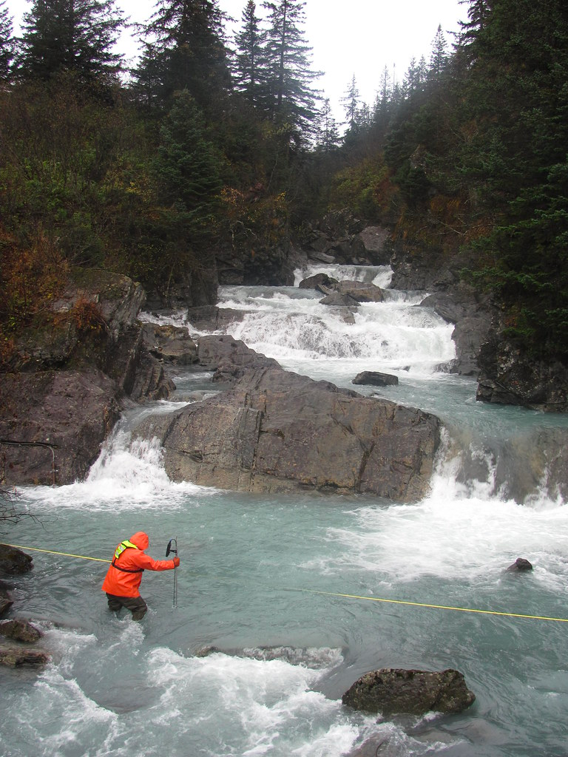
Introduction
PART 1
Public domain image courtesy of USGS.

Slide 5
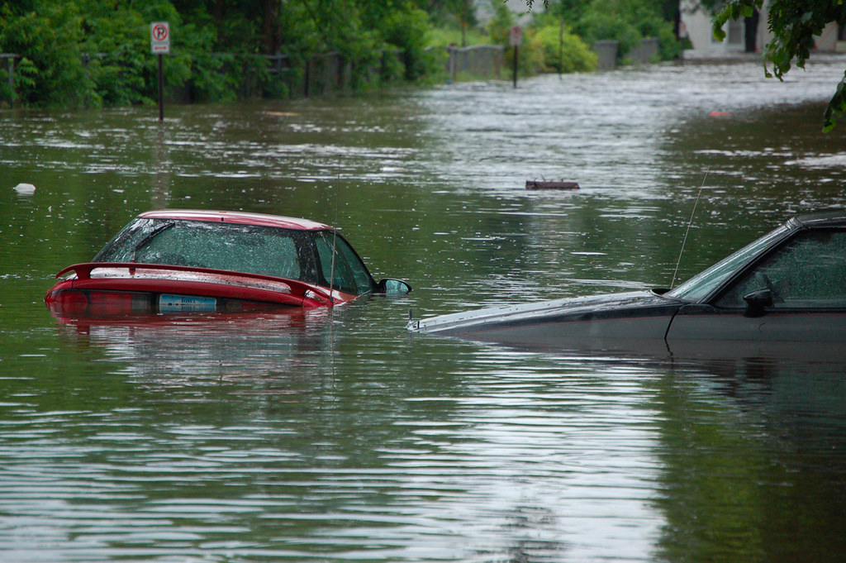
Public domain image courtesy of USGS.
What Is Climate Justice?
Definition
Climate justice is both a term and a movement which recognizes that climate change has unequal social, economic, health, and other negative impacts on people, with an emphasis on its impacts on underprivileged populations (Simmons, 2022).
Discuss with a partner
  Do you think this definition is complete? What would you add?
  Can you think of examples of climate justice in your community, country, or the world?
  How do you think biology can help the climate justice movement?

Slide 6
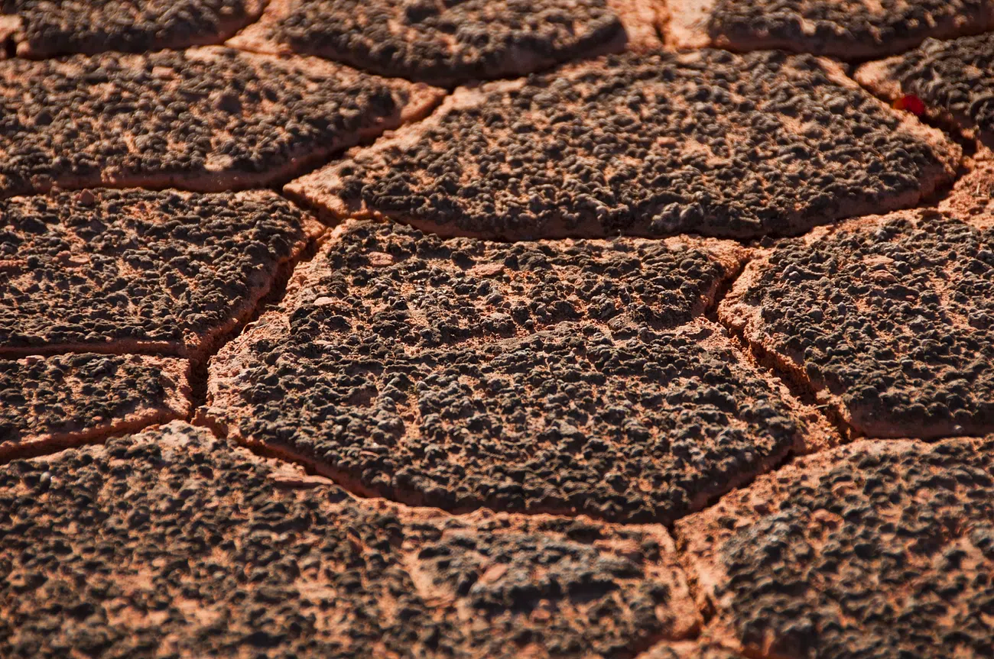
Climate Justice through Biology
Why climate justice is important in biology (iSEE)
Understanding the biological impacts of climate change is important for creating appropriate, holistic responses using:
  Soil science
  Microbiology
  Public health and epidemiology
  Animal and plant responses to heat and extreme weather
Discuss this quote as a class
“the field of science itself will have to reconcile its shameful past and revisit the reprehensible displays of racially driven confirmation bias that form its foundations” –Ayana Elizabeth Johnson, All We Can Save
"Micro-Canyonlands formed by Cyanobacterial soil": Public domain image courtesy of US National Park Service.

Slide 7
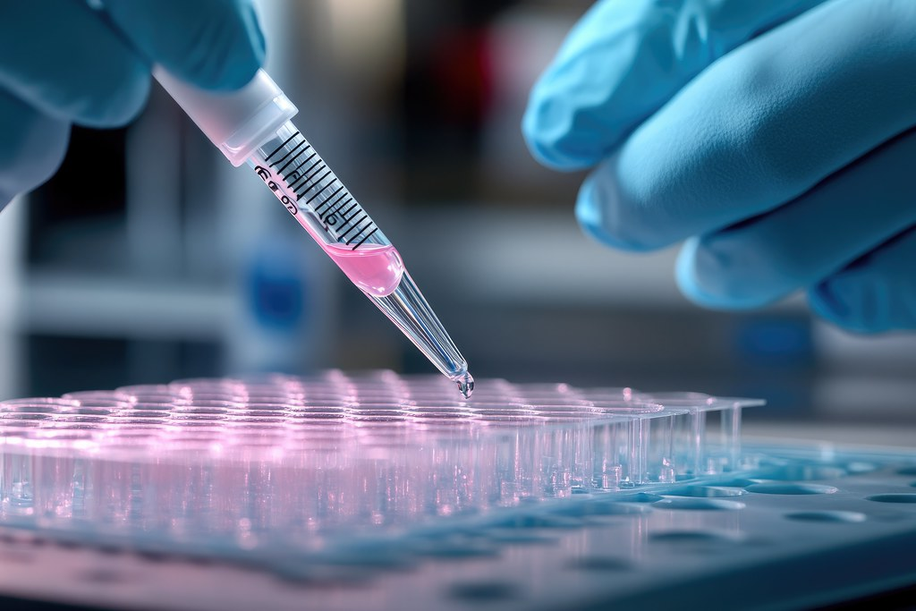
Alternative Approaches to Biology Research
PART 2
Photo courtesy of Tim Reckmann on ccnull.de. License: CC BY.

Slide 8
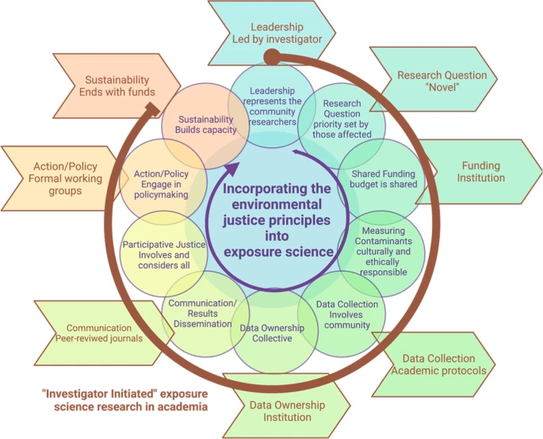
Review: An applied environmental justice framework for exposure science
How to advance biology and exposure science with CJ
  Culturally and ethically responsible research methods
  Data and knowledge sharing
  Input from many perspectives
  Including different types of knowledge
  Respecting community's rights
  prioritize research questions to benefit those most affected
Fig. 1: Roadmap for redefining exposure science strategies. (Van Horne et al., 2022) © Y. Van Horne et al. All rights reserved. This content is excluded from our Creative Commons license. For more information, see https://ocw.mit.edu/help/faq-fair-use/.

Slide 9
ACTIVITY #1
DISCUSS THE POSSIBLE IMPLICATIONS AND EFFECTS OF THE READING
Group and assign a question
Divide the class into 4 groups and assign one question to each:
  Why is this framework important for biologists?
  How does this framework better prepare biologists for working with marginalized communities?
  Why is conscious science important for communities?
  How can we include communities in the research process?
Small group discussion
In your small group, spend 5-10 minutes discussing your assigned question. Take notes as you discuss, and nominate someone from your group to share your answers with the class.
Class discussion
Allow the first group to share the answers they came up with, and then open up the discussion to the class for 5-10 minutes. Repeat this for each group.
Fig. 1: Roadmap for redefining exposure science strategies. (Van Horne et al., 2022) © Y. Van Horne et al. All rights reserved. This content is excluded from our Creative Commons license. For more information, see https://ocw.mit.edu/help/faq-fair-use/.

Slide 10
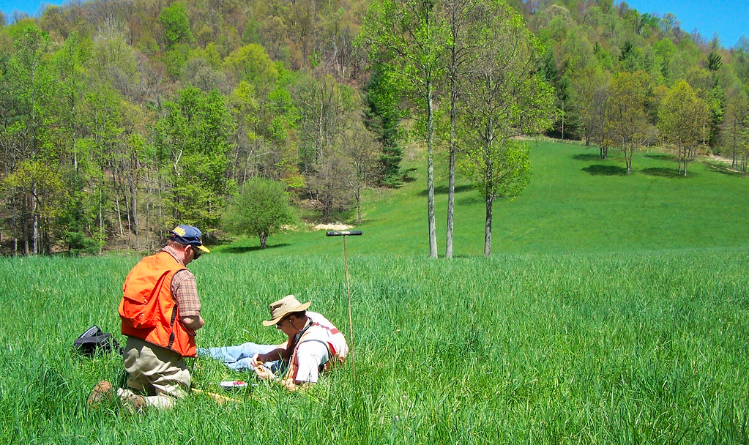
Photo courtesy of Soil Science.info on Flickr. License: CC BY.
Review: Conducting Culturally Responsive Research Across Borders
Culturally responsive research includes
  Explicit recognition, valuing, and discussion of cultural differences
  Validation of the worldviews of participants
  Explicit discussion of power differentials
  Acknowledgment that nontraditional research methods may work better with participants of differing cultural values

Slide 11
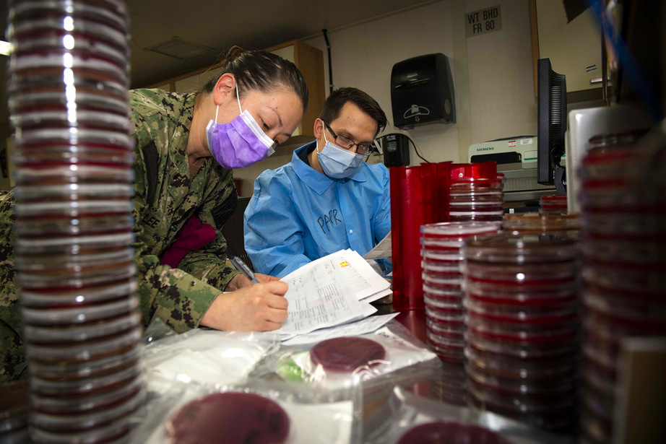
ACTIVITY #2
DISCUSS THE POSSIBLE IMPLICATIONS AND EFFECTS OF THE READING
Group and assign a question
Divide the class into 4 groups and assign one question to each:
  How can you be a more culturally responsive researcher?
  Do you think there are other guidelines not mentioned in the article?
  What is the importance of culturally responsive research?
  How is the framework for ethical exposure science similar and/or different to the guidelines to be a culturally responsive researcher?
Photo courtesy of US Navy. License: CC BY.
Small group discussion
In your small group, spend 5-10 minutes discussing your assigned question. Take notes as you discuss, and nominate someone from your group to share your answers with the class.
Class discussion
Allow the first group to share the answers they came up with, and then open up the discussion to the class for 5-10 minutes. Repeat this for each group.

Slide 12
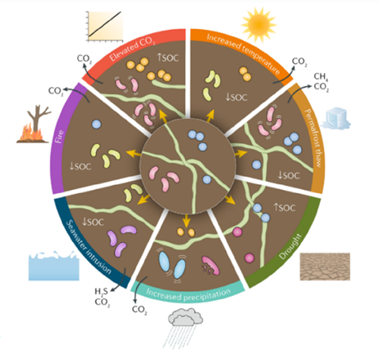
© Springer Nature Ltd. All rights reserved. This content is excluded from our Creative Commons license. For more information, see https://ocw.mit.edu/help/faq-fair-use/.
ACTIVITY #3
READ AND DISCUSS WITH A PARTNER
Read
With a partner or in small groups, read Microbiologists as Experts in Climate Change Conversations
Discuss
After you read the article, spend 5-10 discussing these questions with your partner (or group):
  How can microbiologists advance the climate change discussion?
  What can microbiologists contribute to the fight for climate justice?
Climate change induces alterations in soil microbial communities. Bacteria, archaea and fungal hyphae are impacted by changes in temperature, precipitation, storms, soil organic carbon and greenhouse gases, leading to changes in community structure as indicated in the diagram by changes in color.

Slide 13
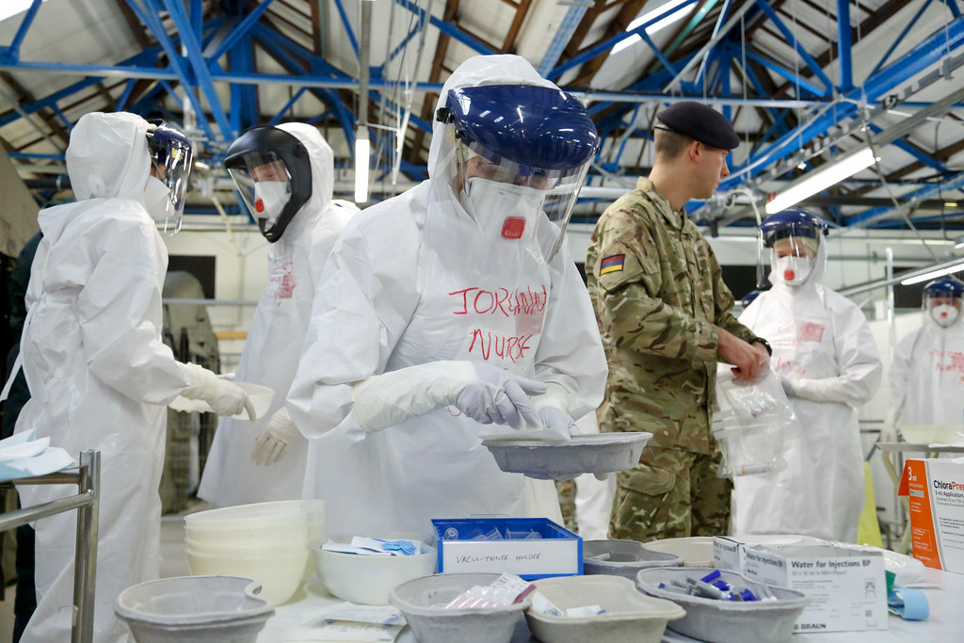
Photo courtesy of DFID - UK Department for International Development at Wikimedia. License: CC BY.
CJ in Biology Research Case Studies
PART 3

Slide 14
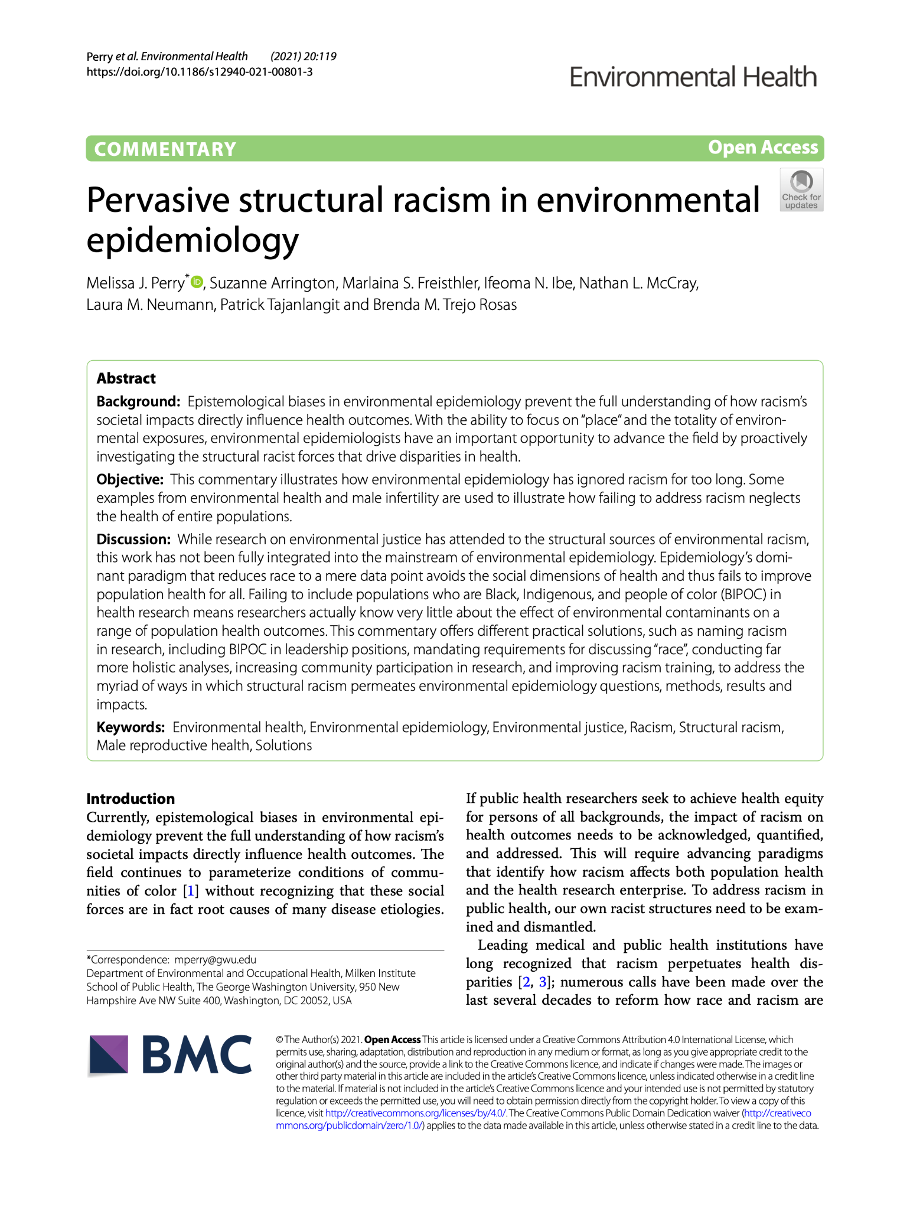
Background
From: Pervasive structural racism in environmental epidemiology
  Meta-analysis of studies of male infertility and environmental health to demonstrate how environmental epidemiology ignores racism in research and medical practice
  Paper illustrates "how failing to address racism neglects the health of entire populations"
"Failing to include populations who are Black, Indigenous, and people of color (BIPOC) in health research means researchers actually know very little about the effect of environmental contaminants on a range of population health outcomes"
© BioMed Central. All rights reserved. This content is excluded from our Creative Commons license. For more information, see https://ocw.mit.edu/help/faq-fair-use/.

Slide 15
Key Findings
01
02
03
04
Sperm counts are indicative of both fertility and general health. For decades, declines in Western sperm counts have been observed.
Almost all that is known about population sperm health comes from White men only, very little has been recorded about sperm counts among people of color.
The few studies including POCs have recorded lower semen values among Black men compared to other groups.
Environmental toxins including lead, pesticides, air pollution and plasticizers are affect sperm counts, yet there is little data from POC participants in reproductive health studies despite often bearing the greatest pollutants.
(Perry et al., 2021)

Slide 16
Solutions
01
02
03
Acknowledge racism in public health research
Include affected communities in decision-making
Develop requirements and standards for discussing race in research
Address how racism has affected research findings in the past and how systemic racism still impacts research today
BIPOC scholars must hold leadership positions in science
Create guidelines for how race and ethnicity can be used in research
04
05
06
Embrace a more holistic approach to analysis
Partner with community members to conduct research
Improve training for researchers and students
Work beyond internal discipline boundaries
Empower study participants by giving them a say in how and what research is conducted
Antiracism literacy can help researchers/professionals identify and analyze racism

Slide 17
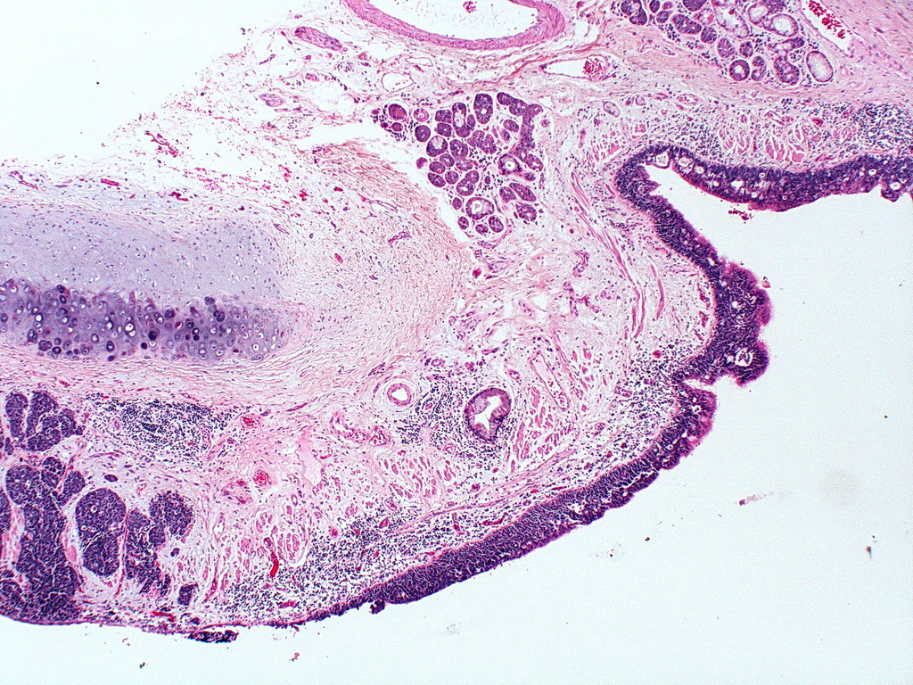
ACTIVITY #4
GROUP DISCUSSION OF THE CASE STUDY
Discuss as a class
Spend about 15 minutes as a class discussing the key takeaways, arguments, and implications of the case study.
Guiding questions
  How can we address racism in epidemiological research?
  What is missing in current research?
  How can climate change exacerbate the inequalities in research representation?
  Who is suffering as a result?
  What do you think of the conclusions do the researchers come to?
  Do you agree with the proposed solutions?
Photo courtesy of Yale Rosen on Wikimedia. License: CC BY-SA. This content is excluded from our Creative Commons license. For more information, see https://ocw.mit.edu/help/faq-fair-use/.

Slide 18
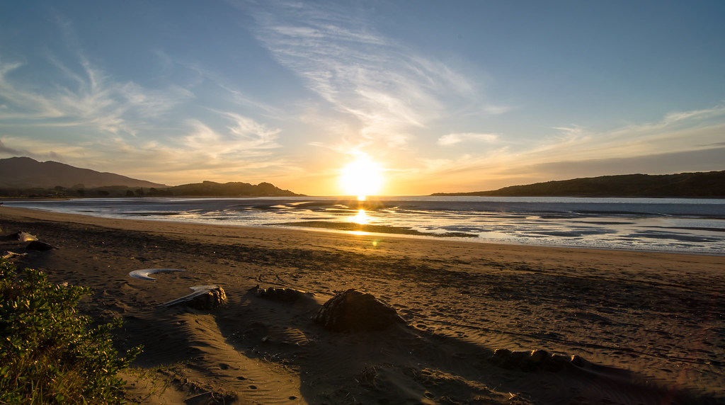
Beyond the Module
PART 3
Photo by Tom Hall on Flickr. License: CC BY.

Slide 19
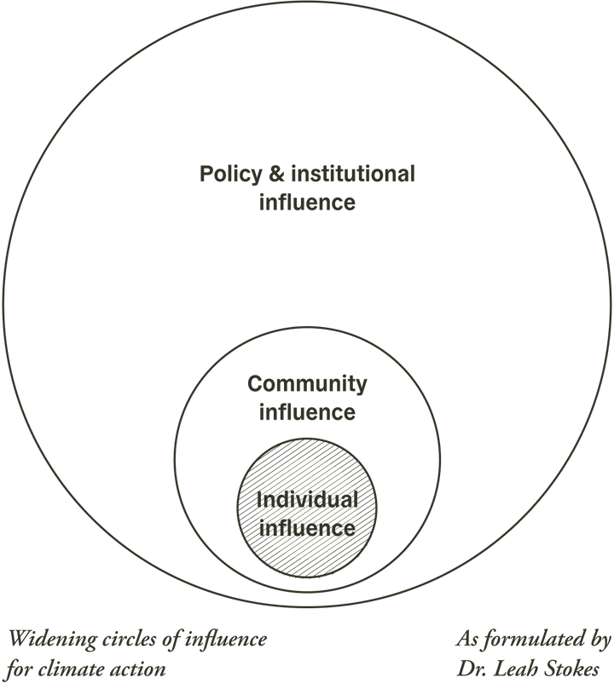
PROJECT OPTION #1
Report on Integrating Biology into Climate Action
Prompt suggestion
Using the template to the right from the All We Can Save Project, identify ways you can include biology in climate justice policy, research, and personal actions.
Write a report detailing the steps that can be taken to integrate climate justice more deeply within biology, epidemiology or exposure science research or study. Consider how this could this impact the widening circles of influence shown on the right.

Slide 20
Additional Resources
Academic Articles
  Climate and the Personal Essay — A Reading List (Martines, 2020)
  Environmental Justice (Mohai et al., 2009)
  Trends and Directions in Environmental Justice: From Inequity to Everyday Life, Community, and Just Sustainabilities (Agyeman et al., 2016)
  Evolution of the environmental justice movement: activism, formalization and differentiation (Colsa Perez et al., 2015)
  From environmental to climate justice: climate change and the discourse of environmental justice (Schlosberg & Collins, 2014)
  The Dakota Access Pipeline, Environmental Injustice, and U.S. Colonialism (Kyle Powys Whyte, 2017)
  Theorising environmental justice: the expanding sphere of a discourse (Schlosberg, 2013)
  Transforming knowledge creation for environmental and epistemic justice (Temper & Del Bene, 2016)
  Climate Justice in the US. What Next? (Dayaneni, 2009)

Slide 21

For more resources on climate and environmental justice: Please explore other modules in the Climate Justice Instructional Toolkit.

Slide 22
https://en.wikipedia.org/wiki/File:Deforestation_in_Cambodia1.jpg
https://en.wikipedia.org/wiki/File:Deforestation_in_Cambodia1.jpg
Module References
  Institute for Sustainability, Energy, and Environment. (n.d.). Physical and Biological Science. University Of Illinois Urbana-Champaign.
  Johnson, A. E., & Wilkinson, K. K. 1. (2020). All we can save: truth, courage, and solutions for the climate crisis. First edition. New York, One World.
  Perry, M. J., Arrington, S., Freisthler, M. S., Ibe, I. N., McCray, N. L., Neumann, L. M., Tajanlangit, P., Rosas, B. M. T. (2021, November 17). Pervasive structural racism in environmental epidemiology. Environmental Health.
  Robbins, A. M. (2022). Microbiologists as experts in climate change conversations. American Society for Microbiology.
  Shahbaz, H. (2023, March 14). Researcher highlights: Conducting culturally responsive research across borders. Institutional Review Board, Teachers College - Columbia University.
  Simmons, D. (2022, November 3). What is “Climate justice”? Yale climate connections. Yale Climate Connections.
  Van Horne, Y. O., Alcala, C. S., Peltier, R. E., Quintana, P. J. E., Seto, E., Gonzales, M., Johnston, J. E., Montoya, L. D., Quirós-Alcalá, L., & Beamer, P. I. (2022, March 8). An applied environmental justice framework for exposure science. Journal of Exposure Science & Environmental Epidemiology.

Slide 23
MIT OpenCourseWare
https://ocw.mit.edu
RES.11-003 Climate Justice Instructional Toolkit Spring 2025
For more information about citing these materials or our Terms of Use, visit https://ocw.mit.edu/terms.

