Slide 1
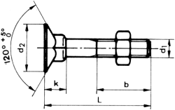
Legal Issues
Joe Hadzima
MIT S.B., M.Sc. in Management; J.D. Harvard Law (cum laude)
Senior Lecturer, MIT Sloan School of Management
Co-Founder, IPVision, Inc. and Neurostim Technologies
Former Law Firm Partner – Sullivan & Worcester LLP
For Background Education Only – NOT LEGAL ADVICE

Slide 2
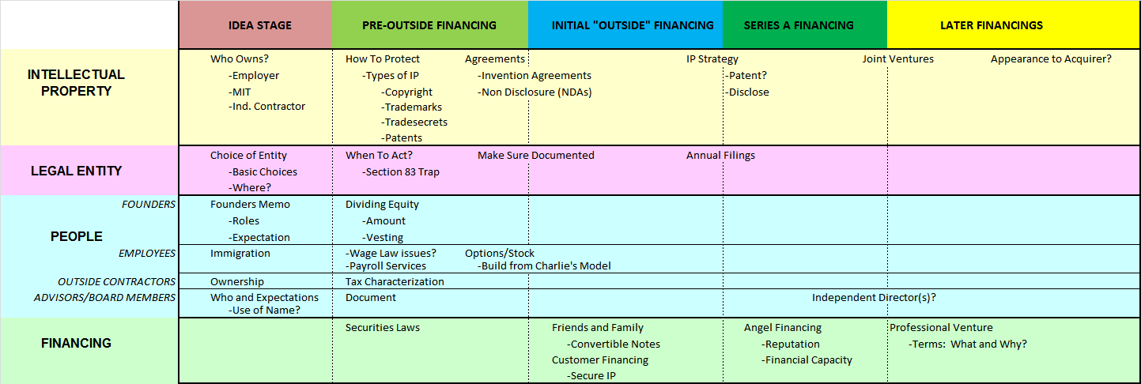
Life Cycle of a New Venture

Slide 3
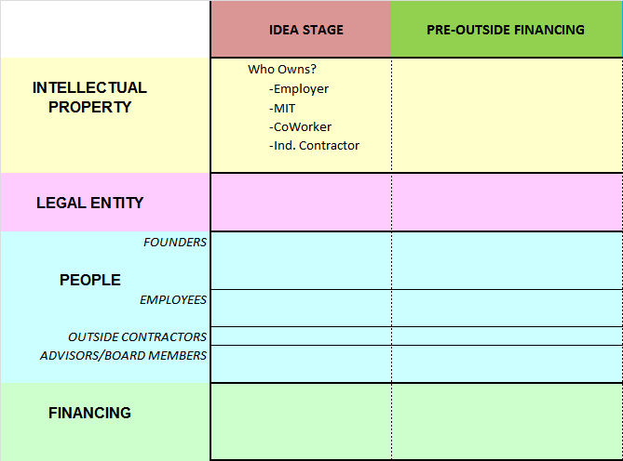
Idea Stage and Pre-Financing

Slide 4
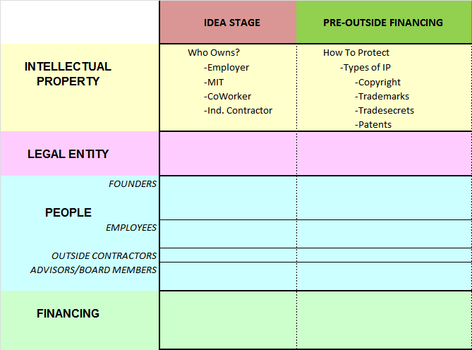
Idea Stage and Pre-Financing

Slide 5
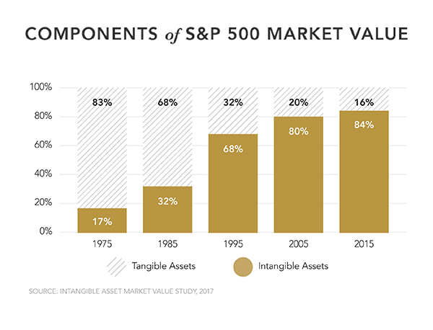
Intangibles = Increasing % of Value
© Ocean Tomo. All rights reserved. This content is excluded from our Creative Commons license. For more information, see https://ocw.mit.edu/help/faq-fair-use/

Slide 6
Types of IP Protection
None
Trade Secret
Trademark
Copyright
Patent
Combinations of Protection
  e.g. Software can be protected by Patent and Copyright
+
Cost
Can “Prevent” Others
Can Enhance Value
But Don’t “Block” Others
Cuts Both Ways
+
Duration
Country by Country – today I will focus on the U.S.

Slide 7
Trade Secret
Secrets you use to give yourself an advantage in the marketplace
  formula for Coke
  protection granted varies from state to state
  lasts as long as you can keep it secret – Nondisclosure Agreements (NDA)
For your Venture Plan/Pitch
  note that you have trade secrets - keep the secrets out of the plan/pitch

Slide 8
Trademark/Servicemark
Developing a Name for Yourself – Customers Think of You When They See/Hear the Mark. Words, Logo, Color, Sound
A Mark under which you sell Goods or Services
  House Mark - Lenovo, MGM (lion’s roar)
  Product mark – Thinkpad, Rocky (movie)
  Rights arise from use in commerce – can last forever
  Federal Registration: ™ or SM vs ® Senior Unregistered User
    Intent to Use
Pick a “fanciful” mark:
  Apple, iPod
Do NOT pick descriptive words/phrases
  Storage Technology, Analog Devices
Is the Mark available?
  Check availability at U.S. Trademark Database www.uspto.gov

Slide 9
Copyright
The right to make and prevent copies
  Arises from creating a work
  Protects the expression - NOT FUNCTION
    great fit for music, not as good a fit for software
  Federal Registration is a plus – needed to sue
  Duration: Long (70+ years)
  Cost to Register: Low ($100 - $500) Library of Congress
  Suggested Notice: “Copyright Year, Author – All Rights Reserved” (see footer of this slide) Use © once registered
For your Venture:
  Make sure you have the rights you need
    Owned by Author unless Employee or “Work for Hire”
  Check open source issue

Slide 10
Copyright - AI
Artificial Intelligence and Copyright?
  It is well established that only material that is the product of human creativity is eligible for copyright registration under U.S. law
  However, on March 15, 2023, the U.S. Copyright Office announced that works created with the assistance of artificial intelligence (AI) may be copyrightable, provided the work involves sufficient human authorship.
    such as when a human selects or arranges AI-generated material in a creative way or modifies material originally generated by AI technology.
Use of copyrighted material to train models?
https://www.copyright.gov/ai/

Slide 11
Patents = Limited Time Monopoly
A Federally granted right to any system or method that is new, non-obvious and useful
  It has to be applied for
  It has to be granted by the Patent Office (Country by Country)
Very Much Like Real Estate
  Right to Prevent Trespassers
  Prevent others from making, using, selling, or importing the patented invention
Ownership: Not = Right to Use
  Real Estate Analogy: Access Rights, Zoning, etc
Claims of Patent = Fence Around Property
Duration - U.S. = 20 years from filing

Slide 12
Coffee Cup and Handle
X
I patent a handle
You patent a vessel to hold a liquid
There can be no “handle” on the “cup” without a cross license
The owner of a patent has the right to exclude others from using his/her invention

Slide 13
Requirements to Obtain a Patent
Novel – Something “New”
  Prior Art must be cited
Useful
Patentable Subject Matter - § 101
  “process, machine, manufacture, or composition of matter, or any new and useful improvement thereof”
Not previously offered/sold or publicly described
  Enabling Disclosure
  One Year Window in U.S. Only
Not obvious “to one of ordinary skill in the art”
  Prior art “teaches against”
  Commercial success can show non-obviousness
First Inventor To File

Slide 14
Patents and New Ventures
Freedom to Make, License and Sell your Product
Does Your Company Own the Technology?
  Assigned by Inventor to Company?
  Licensed from University?
  Did it go into the Public Domain?
    Public Disclosure/On Sale Bars
What is your Strategy?
  Patenting vs. Disclosing to Prevent Others from Patenting

Slide 15
Look before you Launch:
Freedom to Operate
Does someone’s IP bar you from market entry?
  Legal/economic implications
  Investor appeal/requirement
  Freedom to operate analysis:
    Evaluation of the IP space “around” your technology
    Need to license blocking IP from third parties?
Failure to look before you launch can be fatal
  You may not be able to secure an essential license
    A direct competitor may hold blocking IP and may not be willing to negotiate a license deal
  Investors typically have no interest in “buying a law suit”
Adapted from Presentation by Tobias Brambrink, Wolf Greenfield & Sacks P.C.

Slide 16
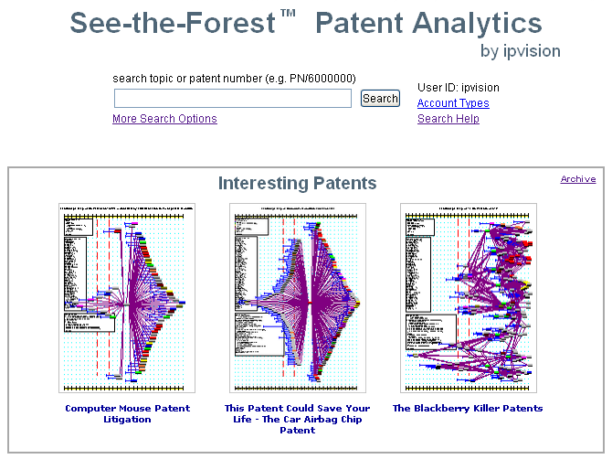
Freedom to Operate
Prior Art – Find What Is Out There Already
  see-the-forest.com

Slide 17
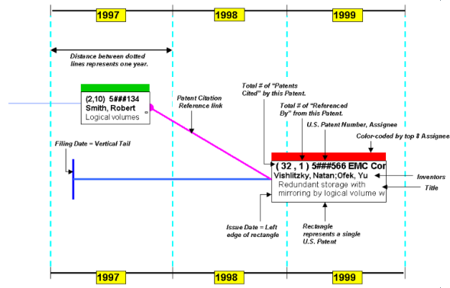
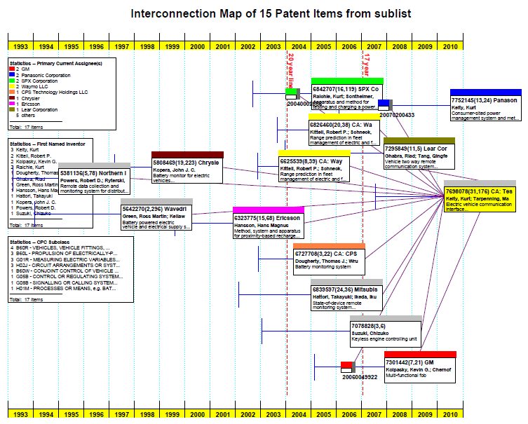
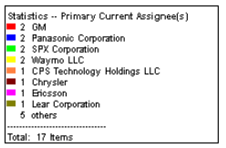
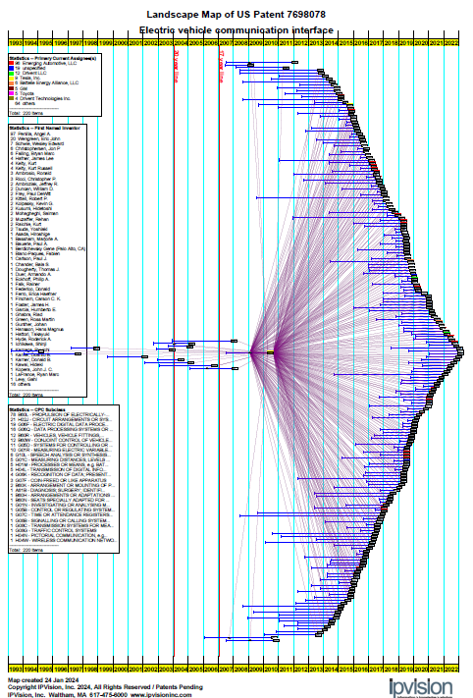
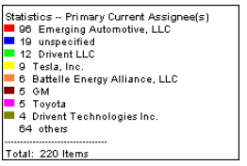
PRIOR ART PATENTS
TESLA PATENT
2010
2023

Slide 18
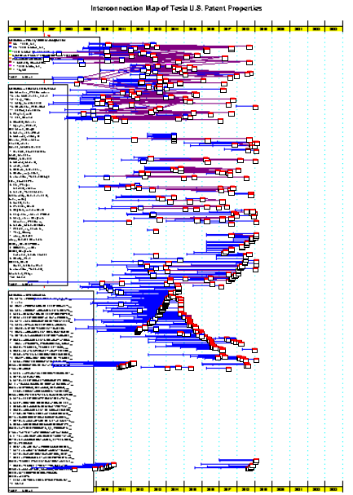
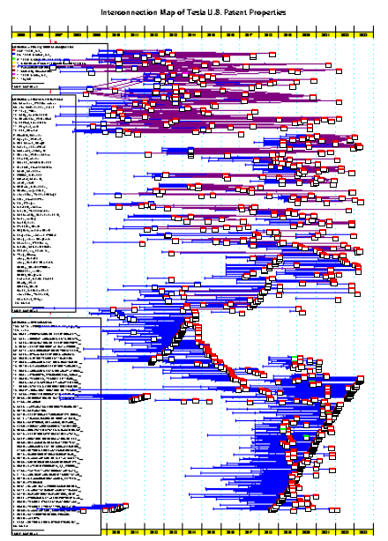
Tesla U.S. Patent Portfolio
2018 2023

Slide 19
Obtaining a Patent
The Application Process breaks down into four main projects
  Determining What to Patent
  Determining When to File
  Preparing one or more Patent Applications
  Prosecuting the Applications

Slide 20
What to Patent
Determining What to Patent
  Probably the most important step
    Do NOT ask “What can I get a patent on?”
    Ask instead “What do I want a patent on?”
      What is of commercial value to my company?
      How would my competitors use my technology?
  Compare against the prior art

Slide 21
When to File?
Determining When to File
  Before you lose U.S. or Foreign rights
    Before a public disclosure
    Before an “on sale” bar
  “First Inventor To File” Wins under AIA (America Invents Act of 2011)
    Formerly “First to Invent”
  In time to have a patent to protect your product or service

Slide 22
Provisional Patent Applications
Requires a meaningful description of the invention
  Claims NOT required
Establishes Filing Date Priority
“Protects invention” for one year – then file a utility application
Fast and Cheap ~$128 for small entity, $64 micro (Jan 2025)
Nothing happens at the PTO
BUT: What you fail to describe will not receive the filing date priority

Slide 23
What Is In A Patent?
A Patent Application is like a term paper – a set of figures and accompanying text
  Field of the Invention
  Background of the Invention
    Describe the “prior art” – what is out there
    List advantages vs. Existing - What is broken that you fix?
  Summary of the Invention
  Detailed Description
    Give examples of use
    Best Mode: What is the best way to implement your invention. This is the bargain: you get a limited time monopoly if you educate the world
  Claims
    What exactly is your invention

Slide 24
Costs
U.S. Utility Patent Applications
  $5,000 to $15,000 for preparing the application
  U.S. Filing fee is about $320/ $128/ $64
  Prosecution $5,000 to $15,000+ (you can’t control Examiner)
Foreign Patent Applications
  PCT filing fee is about $2,500 to $4,000
  PCT demand is about $1,000 to $2,500
  European Filing fee is about $6,000 to $8,000
  Japanese Filing/Trans. fee is about $7,000 to $10,000
  National Fees – it gets expensive. Government Accounting Office study: For a “small company” = $300k to $500k in 10 countries over the life of the patent

Slide 25





Disclosure as a Strategy
Avoid being “Picket Fenced”
  Picket Fence is a group of patents surrounding a patent with the purpose of “blocking” commercial implementation
Example Patent Map on Next Slide
Cap
Cap
Vessel to Hold a Liquid
Sleeve
Sleeve
Handle
Handle
Styrofoam Insulated
Styrofoam Insulated

Slide 26
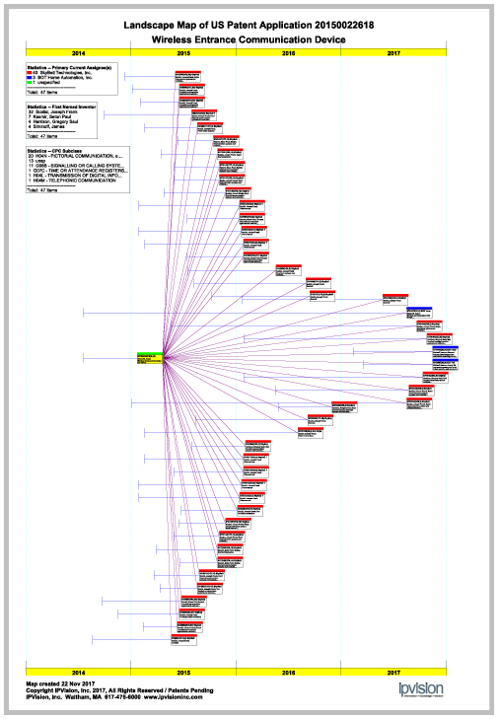

IPVision Landscape Map
Picket Fence?
This is the main patent application from Ring
The Red Top boxes are patents from SkyBell surrounding Ring
Click Map Image to view Live Map

Slide 27
Evolving Patent Strategy - Tesla
“Tesla felt compelled to create patents out of concern that the big car companies would copy our technology and then use their massive manufacturing, sales and marketing power to overwhelm. We couldn’t have been more wrong…..Tesla Motors was created to accelerate the advent of sustainable transport. If we clear a path to the creation of compelling electric vehicles, but then lay intellectual property landmines behind us to inhibit others, we are acting in a manner contrary to that goal. Tesla will not initiate patent lawsuits against anyone who, in good faith, wants to use our technology.”
Tesla Blog – June 12, 2014
Patenting to Enable a Market. Analogy to Henry Ford.
  For Non Profits – Patent to Control Use of Your Invention
© Tesla. All rights reserved. This content is excluded from our Creative Commons license. For more information, see https://ocw.mit.edu/help/faq-fair-use/

Slide 28
Goal-Oriented IP Strategy
Evaluate Your Needs
Core technology
Product
  Risk of reverse engineering
  Market exposure time/life span
  Profitability over time
Business model
  Manufacture and sell
  License/partner
Non-IP bars to market entry
  Regulatory
  Economic
Exit strategy
Adapted from Presentation by Tobias Brambrink, Wolf Greenfield & Sacks P.C.

Slide 29
Practical Advice - Checklist
Employees - Invention Disclosure and Assignment Agreements
Consultants – Consultant Agreement specifying “Work for Hire” and Ownership by You
NDAs (Non-Disclosure Agreements) with Third Parties where appropriate
Avoid Infringement
  Freedom to Operate
  Understand Patent Landscape
Preserve Patent Rights
  Provisional Patent Applications (PPA)
  Timely File Patent Applications
    First Inventor to File
    File Before Disclosing or Offering for Sale
  Avoid Being “Picket Fenced” – Consider Disclosing Inventions

Slide 30
Streamline Attorney Interactions
You are purchasing legal expertise, typically by the hour
A disciplined and focused approach will save you time and money and maximize the quality of your IP
  Understand your business goals, and what role you want IP to play
  Plan ahead and keep your attorney informed of upcoming disclosures
  Provide invention disclosures to your attorney well before publication and in a format that is easy to understand and convert into an application
  Have a clear agreement on fees/budget for a given project
  Acquire a basic understanding of IP concepts to manage attorney interactions efficiently
Leverage your technical expertise
  Identify the most relevant players and references in your field
  Explain the difference(s) between the prior art and your technology
Read Joe Hadzima’s “Ten Commandments of How to Work Effectively with Lawyers”

Slide 31
University Licensing Background
Sponsored Research: Who Pays/ Who Owns?
Bayh-Dole Act of 1980 (“BDA”)
  Prior to the enactment of Bayh-Dole, the U.S. government had accumulated 30,000 patents. Managed by U.S. govt.
  Only licensed non exclusively
  Few patents were commercialized.
    Only approximately 5% of these patents were commercially licensed.
BDA permitted Universities to Retain Ownership of IP
  Permitted universities to license exclusively
  Dramatically accelerated their commercialization
See Wikipedia

Slide 32
Bayh-Dole Act Requires Universities to:
Retain ownership of innovations created under government funding
File patents on inventions arising from government funding
Give licensing preference to small businesses
Provide government with royalty-free non-exclusive license to use, make, or have made on behalf of federal government (limited to government use)
Develop programs to commercialize these patents to benefit society
Share royalties with the inventors
Source: AUTM

Slide 33
Mission of MIT Technology Licensing Office (TLO)
Facilitate the transfer to industry of technology from MIT, Lincoln Laboratory, and Whitehead Institute, and thereby to benefit the public good through the development and subsequent sale of commercial products.
Secondary goal is to generate unrestricted funds to motivate inventors and to support research and education at MIT
tlo.mit.edu
Report to the President

Slide 34
MIT IP Ownership Policy
MIT owns the patent or copyright if:
  significant use was made of MIT facilities or
  MIT administered funds were used
  Textbooks are an exception
Never assigns ownership to a licensee or research sponsor
Guarantees sponsors first rights to inventions made using their funds
Source: TLO and Stephen Brown

Slide 35
MIT IP Ownership Policy
MIT can waive invention to inventor if
  No sponsor’s rights and
  No significant use of MIT facilities and
  No use of MIT administered funds and
  No plans to use MIT facilities to reduce to practice
Slide Credit: Stephen Brown

Slide 36
Voluntary Prosecution of non-MIT owned Inventions
Any MIT employee or student may ask to assign his or her personally owned invention to MIT.
If the TLO accepts the invention, it will be handled in the same manner as other MIT inventions, with the usual royalty-sharing arrangements.
Source: MIT TLO

Slide 37
Typical Options to Startups
Option to Obtain a License
Generally 6 months to 1 year
Assumption of ongoing patent costs
Modest up front signing fee $1K to $10K
Exclusive or Non-exclusive
Protects right to take a license
Allows for time to evaluate technology and markets
  Positioning with potential financing sources
Slide Credit: Stephen Brown

Slide 38
Typical License Financial Terms
Components
Issue fees
License Maintenance fees
Diligence
Royalty as % of Sales
Patent costs
Research sponsorship
No Equity
$50K to $150K
~50% of expected RR
Can’t leave on shelf
3% to 5%
$25K to $200K
Not required
With Equity
$5K to $50K
~50% of expected RR
Can’t leave on shelf
2% to 4%
$25K to $200K
Not required
Equity on Next Slide
Slide Credit: Stephen Brown

Slide 39
Typical Startup Equity Terms
University Gets: Single digit % of equity
% maintained thru $5M to $10M raised
Proportional anti-dilution thereafter
Future participation rights
Slide Credit: Stephen Brown

Slide 40
Typical Royalties for University Patents
Software | 5 -15%
Equipment/Medical Devices | 3 - 5%
Materials | 1 - 4%
Semiconductors (Chip Design) | 1 - 2%
Materials (Processes) | .02 - 2%
Materials (Commodities) | .01 - 1%
Pharmaceutical at clinical testing stage | 12 - 20%
Pharmaceuticals composition of matter | 8 - 10%
Diagnostics new entity | 4 - 5%
new method for old entity | 2 - 4%
Biotechnology exclusive process | 1 - 2%
non exclusive process | .025-1.5%
Slide Credit: Stephen Brown
Circa 2005

Slide 41
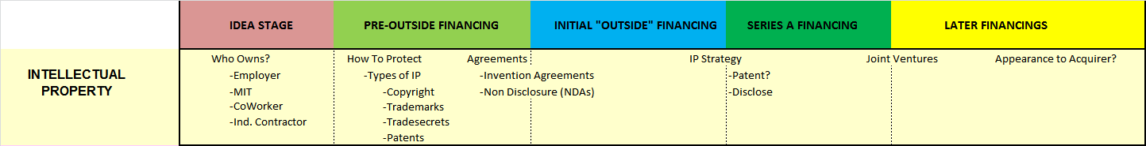
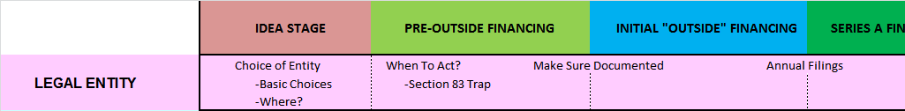
Time Line

Slide 42
Legal Form for the Venture
If you do nothing and there are more than 1 of you then you most likely are a General Partnership:
  No written agreement needed
  Joint and Several unlimited personal liability
  Ownership based on $ invested
  No outside investor wants this personal liability
In most cases, especially where outside financing will be needed, the entity of choice is a corporation – often a Delaware corporation
Why you should incorporate sooner than later:
  Avoid personal liability - Avoid “partner” liability
  Minimize Personal Taxes – Section 83 – Procrastination Issues
YouTube: Legal Forms of Doing Business in the United States

Slide 43
Legal Form for the Venture
Observing corporate formalities
  sign in the corporate name
  maintain the corporate minutes, stock records
  the challenge of picking a company name – DiVA example
Tax Considerations
  Corporation is a Person for Tax Purposes. C Corp
Making the “S” election – Subchapter S Corporation
  “pass through” treatment for tax purposes. No Corp Tax
  Qualfication: <= 100 shareholders, One Class of Stock
  some stockholders, foreign nationals, corporations, most venture capital firms will disqualify the “S”

Slide 44
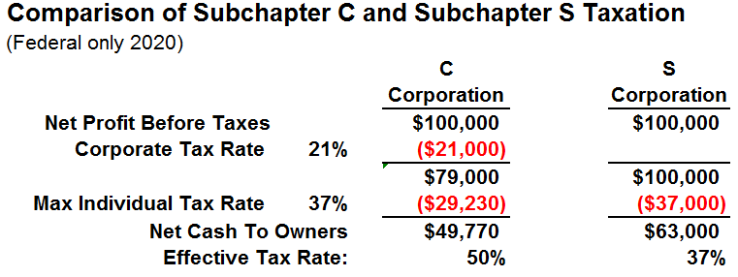
Subchapter S Taxation
But most startups have LOSSES – investing in product or service development. Why Sub S?
Because of the EXIT – saving 13+% on an acquisition

Slide 45
Beware:
Section 83 of the Internal Revenue Code
Rule:
  If you receive “property in connection with providing services”
  You have Ordinary Income (taxed up to 37%) equal to:
      Fair Market Value of Property
      minus What You Paid
Example: I will give you $1m for 50% ownership in Venture
  Let’s set up the company. What is your 50% worth?
    Fair Mkt Value = $500,000
    You Paid = 0
    Ordinary Income= $500,000
    Tax @ 40% = $200,000
    Fair Mkt Value = $1,000,000
    You Paid = 0
    Ordinary Income= $1,000,000
    Tax @ 40% = $400,000

Slide 46
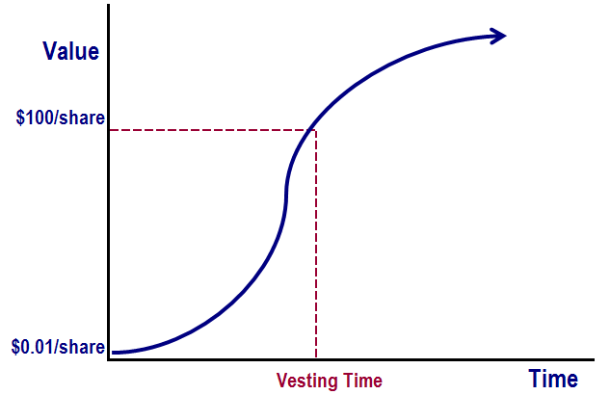
When Do You Measure §83 Income?
Typically Stock is “vested” over time, meaning that you may lose the stock if you leave. This is called a “risk of forfeiture”.
Under §83, you measure the amount of income when the shares vest:
83(b) election
  Measure Now
  File within 30 days

Slide 47
How to Avoid the §83 Trap
Separate the Time When Stock is Issued to You from the Investment by Others – i.e. Incorporate earlier, ISSUE Stock & Make 83(b) Election
Why does Stock not get issued in time?
  Too busy - Not sure who should get what
TECHNICAL
RELATIVE
IMPORTANCE
BUSINESS
TIME

Slide 48
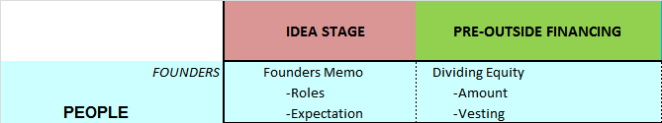
Time Line

Slide 49
Sort out the Relationship Among the Founders Up Front
Stockholders in a closely held corporation owe one another a fiduciary duty
Who sits on the Board of Directors?
Who holds what corporate titles (e.g., President, Vice President, Treasurer, Secretary)?
Who holds what functional titles (CEO, COO, CTO, etc.)?
Restrictions on Stock Transfers
  Rights of First Refusal - Tag-Along rights
  Preserve “S” treatment - Carve Out for Family Transfers
Intramural Disputes
See the “Founders’ Memo” on class website

Slide 50
Founder Equity Splits
Culture/Negotiated – Kenan Systems
Value of past contributions
Value of future contributions
  Over next 12 months – When Do You Join?
  Over next 4 years
Ownership of IP
Sacrifice & Commitment
  Individual’s external or “Market value”
Internal Equity – Assume that everyone finds out

Slide 51
Philosophy on Team Building
Work To Be Completed >> Work Completed
Compensate for both Risk and Sacrifice
Reward for getting to the End Zone
Maintain Internal Equity
EVERYONE should Vest – Typically 4 years
BUT - every situation is different and rules are made to be broken
From Charlie Tillett slides

Slide 52
Employees - Equity
Company’s stage
  Funding
  Revenue
  Liquidity
Employee’s value to company
Employee’s market value
Internal equity

Slide 53
Who gets Pie and How Big are the Slices?
What fraction of the equity goes into equity compensation pool?
  Initial Pool for 2 to 3 years; tie to Headcount Plan
  First Round Venture Financing – 12% to 18% pool – fully diluted
Who is eligible?
  Key employees
  Middle and rank-and-file employees
  Directors
  Consultants
Determining award size -- compensation experts and surveys
YouTube: Using Stock and Options as Compensation

Slide 54
Employee Specifics
(Charlie Tillett’s Slide)
Ownership % after 2 rounds of financing
  CEO 5%
  VP 1% to 2 ½ %
  Sr Manager 0.25% (1/4 of 1%)
  Sr Ind Contributor 0.1% (1/10 of 1%)
Founding management might get 2x to 3x
Founding employees might get 5x to 10x
YOU CAN ALWAYS GRANT MORE LATER

Slide 55
Equity Distribution Example
(From Charlie Tillett’s Slides)

Slide 56
Common Forms of Equity Compensation
Restricted Stock
Incentive Stock Options (ISOs) tax-qualified stock options
Nonqualified Stock Options (NQOs)

Slide 57
Restricted Stock
Stock sold or granted outright (usually when value is low)
Starts capital gains / SEC holding periods running
Subject to vesting and buyback by Company
If 83(b) election timely:
  Modest or zero income at grant
  No further income until stock sold, then capital gain
  No employer tax deduction for increase in value

Slide 58
Incentive Stock Options (ISOs)
Options complying with tax requirements
Only for employees of corporation
Exercise Price = FMV on date of grant [ IRS 409A Valuation Report ]
Typically exercise vesting over time
No tax on grant or vesting
Possible alternative minimum tax on exercise
Taxation upon stock sale--capital gain if holding period requirements met (>1yr from exercise and >2yrs grant date); no employer deduction

Slide 59
Nonqualified Stock Options (NSOs)
Complete tax freedom in design, but there may be accounting issues
  Discounted options
  Repricings
  Performance vesting
No tax on grant or vesting
Ordinary income (and employer deduction) upon exercise

Slide 60
Vesting: Conditions on Keeping what seems to have been Awarded to You
Time-based vesting
  3, 4 or 5 years?
  Monthly, quarterly, annual
Performance vesting
  Design issues
  Accounting issues
Accelerated vesting on change in control? IPO?

Slide 61
Forfeiture and Expiration of Rights
How long after employment ends may vested options be exercised? (ISO rules generally limit to 90 days)
Forfeiture if “bad boy” provisions violated
Consequences of violation of noncompetition, nonsolicitation agreements

Slide 62
Buyback Issues
Can company repurchase vested equity for fair value?
  Always?
  When employment ends?
  If covenants violated?
  Never?
See “Founders’ Memo” for further discussion

Slide 63
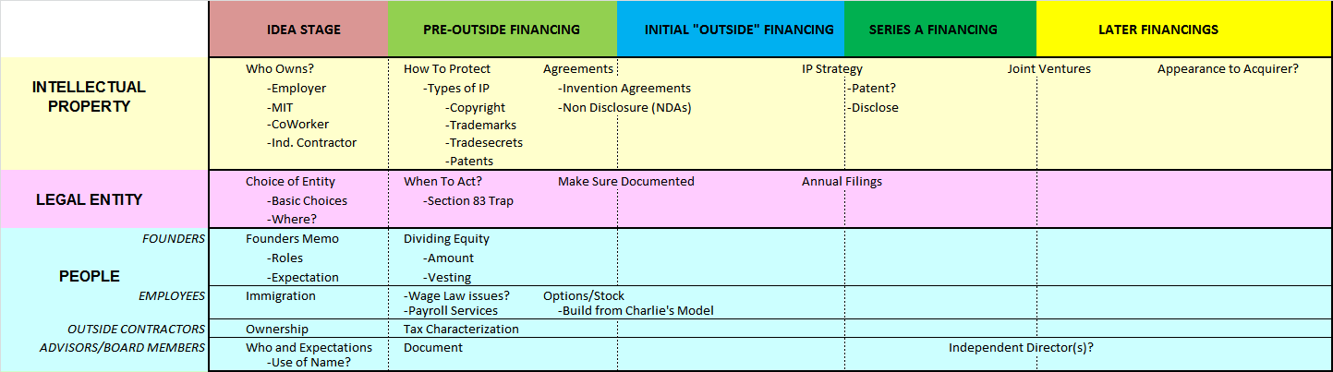
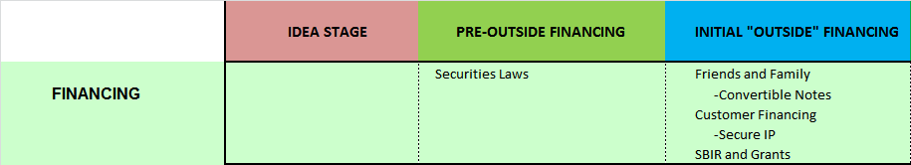
Time Line

Slide 64
Sell Securities and Raise Capital in Accordance with Law
Properly “paper” even friendly deals with friends, relatives - avoid misunderstandings
Using the Venture Plan/Pitch Deck to “sell securities” presents problems beyond VC’s, corporate investors
Under federal law all OFFERS of securities must be registered with the SEC - an expensive process - unless there is an exemption – e.g. Private Placement

Slide 65
Sell Securities and Raise Capital in Accordance with Law
Private Placements
  Use an experienced securities law attorney
  Avoid dealing with individual investors who are not “accredited” ($200K/300K annual income or $1m net worth) - max of 35 “unaccredited” investors
  Include “risk factors” in disclosure materials
  Provide a capitalization table
  SEC Rule 10b-5 - don’t make material misstatements of fact or omit to state material facts
  Legends/Control Numbering of Documents
  Regulation D: Form D Filing with SEC and States

Slide 66
Sell Securities and Raise Capital in Accordance with Law (continued)
Private Placements (continued)
  Avoid public pronouncements (newspaper articles, web site offerings, etc.)
  Blue Sky (state securities) laws differ from state to state
  Non-compliance may trigger a rescission offer, a stop order, personal liability
DON’T OFFER TO SELL SECURITIES IN A BUSINESS PLAN OR PITCH DECK ! … “We are offering 10% of the company for $2m”
Crowd Funding – Relatively New
  Relation to Later Rounds?

Slide 67
Where Do Companies Get Money?
The cartoon “Where Do Entrepreneurs Get Their Money?” was removed due to copyright restrictions. To see the video where the image originates visit “Kauffman Sketchbook–The ‘Money Game’: Where Do Entrepreneurs Get Their Money?” on YouTube.
Notes:
https://www.youtube.com/watch?v=U470xXKfDyE

Slide 68
Capital Structure Instruments
Debt
- Warrants
- Options
- Convertible
Equity

Slide 69
Capital Structure Instruments
Debt
- Warrants
- Options
- Convertible
Equity
YouTube: Capital Structure Basics

Slide 70
The Company’s Capital Structure
Debt - borrowed money
  private individuals
  banks
  other sources (e.g. vendors, customers)
  stipulated rate of interest; no significant upside
Stock
  Preferred Stock (see “Venture Capital Deal Terms” in course materials – Financing Session)
    usually given to VCs and investors
    liquidation preference
    convertible into common stock
    anti-dilution formulas
    board representation
    veto / approval rights

Slide 71
The Company’s Capital Structure - cont’d
  Common Stock
    “plain vanilla” stock
    usually given to founders / employees
    no liquidation preference / convertibility
    Residual Value after others get theirs
  Options / Warrants
    Rights to buy shares at set times for stipulated price

Slide 72
Capital Structure Instruments
Percentage of Capital Structure By Stage/Type of Company

Slide 73
Capital Structure Instruments
Percentage of Capital Structure By Stage/Type of Company

Slide 74
Convertible Note Financing
Traditionally – Bridging From One Round to Another
More Recently, to Start:
  Quickly
  Inexpensively
  Avoiding “Valuation Issues”
    Cram Downs at Series A or B
Pros and Cons – Good Discussion at:
  www.startupcompanylawyer.com
  http://www.startupcompanylawyer.com/category/convertible-note-bridge-financing/
YouTube: Investing in New Ventures

Slide 75
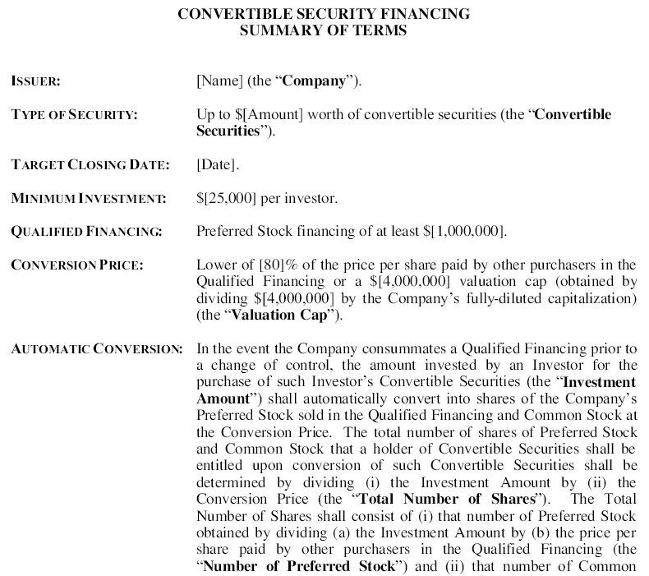
Convertible Note Financing
Cooley LLP
  https://www.cooleygo.com/convertible-debt/
Wilson Sonsini
Goodwin Proctor
  http://www.foundersworkbench.com/

Slide 76
SAFEs
Simple Agreement for Future Equity
Y-Combinator – 2013
Unlike a convertible note, a SAFE is not a loan - more like a warrant.
No interest paid and no maturity date
Not subject to the regulations that debt may be in many jurisdictions.
Valuation Caps and Discounts
https://www.cooleygo.com/glossary/safe/

Slide 77
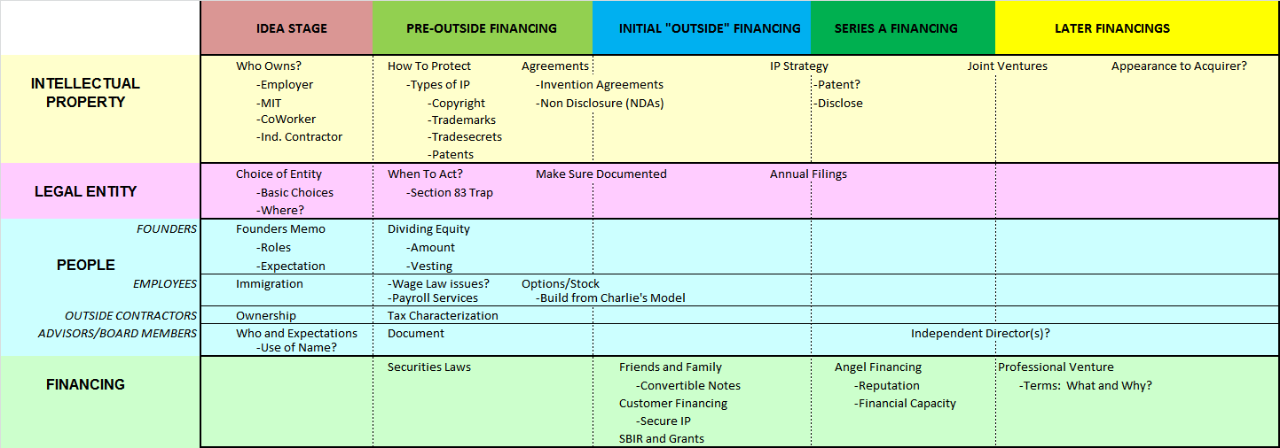
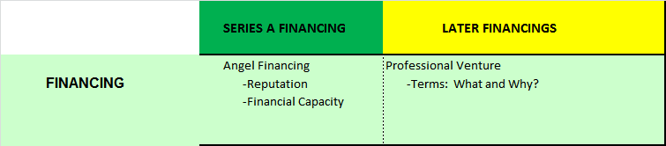
Time Line

Slide 78
A Preferred Return
Perception of the VC Investor:
  When the Investor Writes the Check he or she has done most EVERYTHING promised
  The Entrepreneur Has Done NOTHING YET
Result:
  The VC wants its money to be paid back BEFORE the Entrepreneur gets his/her return.
Instrument: CONVERTIBLE PREFERRED STOCK

Slide 79
Major Deal Elements
A Preferred Return
Protection of Valuation and Position re: Future Money
Management of the Investment
Exit Strategies

Slide 80
A Preferred Return: Dividends
Dividends: The Preferred Stock is entitled to an
annual $_______ per share dividend,
payable when and if declared by the
Board of Directors, but prior to any
payment on Common Stock; dividends are not cumulative
Dividends:
- Paid to Preferred First
- Cumulative or Accruing

Slide 81
A Preferred Return: Liquidation Preference
Liquidation Preference: The Series A Preferred will have a liquidation
preference such that proceeds on a merger, sale or
liquidation (including non-cumulative dividends) will first be paid to the Series A and will include a 10% per annum compounding guaranteed return calculated on the total amount invested.
“Straight” Liquidation Preference: The Preferred receives its original investment amount plus accrued dividends (if any) before Common receives anything. Alternative is to convert to Common and participate equally with Common.
Participating (“Double Dip”) Preferred: The Preferred first gets its liquidation preference and then shares any remaining proceeds with Common. Increasingly subject to a cap of 3X or 4X (including preference).

Slide 82
Comparison of Straight vs. Participating Preferred

Slide 83
Valuation and Participating Preferred
WHICH IS THE BETTER DEAL FOR THE FOUNDERS?
Case A: Founders sell 40% of the Company for $5m of Convertible Preferred Stock with a $5m Liquidation preference but NO participating rights. ($7.5M pre-money valuation)
Case B: Founders sell 30% of the Company for $5m of Participating Preferred Stock ($10m pre-money)

Slide 84
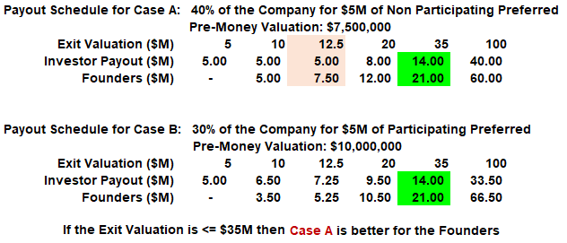
Valuation and Participating Preferred
If Exit Valuation <= $35M then Case A is better for Founders

Slide 85
A Preferred Return: Liquidation Events
Liquidation, dissolution, sale of assets
  money comes into corporation
  money paid out to stockholders to redeem stock
“Deemed liquidation”- merger or other positive event
  consideration may be stock or cash
  consideration may go directly to stockholders

Slide 86
Major Deal Elements
A Preferred Return
Protection of Valuation and Position re: Future Money
Management of the Investment
Exit Strategies

Slide 87
Protection of Valuation and Position re: Future Money
Antidilution Protection
Approval Rights

Slide 88
Protection of Valuation:
Conversion and Antidilution
Conversion: A holder of the Series A Preferred shall have the right to convert the Series A Preferred at the option of the holder, at any time, into shares of Common Stock. The total number of Common Shares into which the Series A Preferred may be converted initially will be determined by dividing the Original Purchase Price by the “Conversion Price”. The initial Conversion Price shall be the Original Purchase Price.

Slide 89
Protection of Valuation:
Conversion and Antidilution
Conversion Events: When Does Preferred Convert Into Common?
  Voluntary
  Forced: often some % of Preferred can force conversion of all
  Automatic--upon “Qualified IPO”
    minimum total offering; minimum share price (usually 3 to 5 times initial purchase price)
Conversion Ratio--initially 1:1
  Adjustments--stock splits, etc; price antidilution
  Exceptions--option pool, conversion of preferred, outstanding warrants, other existing conditions, other special exceptions

Slide 90
Protection of Valuation:
Conversion and Antidilution
Anti-Dilution: Series A shall have weighted average anti-dilution, based on a weighted average formula to be agreed, for all
securities purchased as part of this
transaction (excluding shares, options and warrants issued for management incentive and small isues for strategic purposes of
under 100,000 shares)

Slide 91
Protection of Valuation:
Conversion and Antidilution
Antidilution Adjustment increases the number of shares of Common received on conversion of Preferred
What Triggers Antidilution Adjustment?
  Issuance or “deemed issuance” of Common at less than the price the Preferred paid (or as previously adjusted)
  “Deemed issuance”--adjust upon issuance of derivative security; if common never issued, readjust later
    options, warrants
    convertible securities

Slide 92
Protection of Valuation: Antidilution
Conversion Ratio:
  Original Purchase Price/Conversion Price
    Initially OPP=CP so Conversion Ratio = 1 for 1
“Full ratchet”: Conversion Price reset to equal price at which diluting security is sold
“Weighted average”: CPnew = CPold*R
  Where R = (N + M/CPold)/(N+S)
    N = old shares outstanding (fully diluted)
    S = new shares to be issued
    M = new money ($)

Slide 93
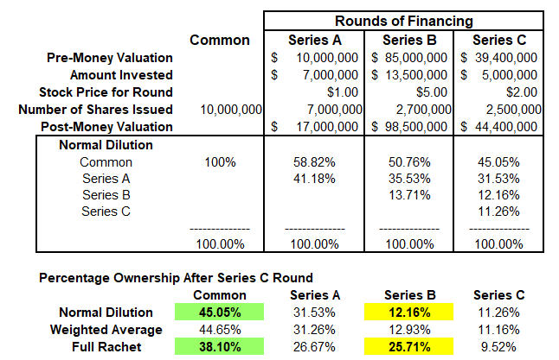
Antidilution

Slide 94
Major Deal Elements
A Preferred Return
Protection of Valuation and Position re: Future Money
Management of the Investment
Exit Strategies

Slide 95
Management of Investment
Many Venture Capital and Private Equity Funds include money raised from Pension Funds
Employee Retirement Income Security Act of 1974 (ERISA)
  Imposes Fiduciary Duties on managers of pension fund assets
  Exemption for Venture Capital Operating Company
    Must exercise “management rights” – i.e. contractual rights (running directly between the investor and the operating company) to “substantially participate in, or substantially influence the conduct of, the management” of an operating company.
    Includes right to elect one or more directors

Slide 96
Major Deal Elements
A Preferred Return
Protection of Valuation and Position re: Future Money
Management of the Investment
Exit Strategies

Slide 97
Exit Strategies
How does the VC investor get its money out?
See Beginners Guide to Venture Capital in the course materials to see how funds operate
Options for Exit:
  Public Offering – Registration Rights
  Trade Sale (Acquisition)
  Redemption Rights (leverage for sale)

Slide 98
Time Line
See “Venture Capital Terms” on Resources Page at nutsandbolts.mit.edu

Slide 99
Legal Issues
The End
  (Invoice to follow…..)

Slide 100
MIT OpenCourseWare
https://ocw.mit.edu/
15.393 Nuts and Bolts of New Ventures
IAP 2025
For information about citing these materials or our Terms of Use, visit: https://ocw.mit.edu/terms.

