Slide 1
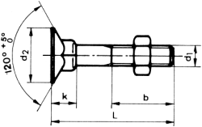
The Nuts and Bolts of New Ventures
MIT Course 15.393 (36th Year)
Joe Hadzima
(MIT S.B., M.S. in Management; J.D. Harvard Law)
Senior Lecturer, MIT Sloan School
Managing Director, Main Street Partners
jgh@mit.edu
nutsandbolts.mit.edu

Slide 2
Session 1 – Part 1
Introduction to New Ventures

Slide 3
Why Are You Here?
You don’t know anything about Entrepreneurship and want to understand what it’s about
You see something that “Sucks” and want to make it better
You have an Idea or Invention and want to bring it to life in some way – To Change The World
Being an Entrepreneur is Glamorous and I can make a lot of money

Slide 4
So Many Questions You Need To Answer
How Do I Start? What Do I Do?
What is the Problem that I am solving?
How does my Solution Solve that Problem?
"Who Cares About my Idea?" Specifically Who Cares?
  Who is my Customer?
  How do I find these people?

Slide 5
Questions You Need To Answer
How will I make money so I can have a sustainable venture - this is the Business/Venture Model
How long will it take to bring my solution to market? What will it cost? What resources will I need - people, money etc.
Will I need set up some sort of entity to do all this and attract investors and people? Corporation? LLC?

Slide 6
Questions You Need To Answer
How Do I Keep People from Stealing my Ideas?
Will I need co-founders and what will be our relationship with each other and the entity? Founders Agreement?
How will I negotiate with employees, consultants, investors, strategic partners?

Slide 7
Questions You Need To Answer
How do I figure out what I don't know?
What are the "pot holes' in the road that may come up and how will I recognize them and hopefully avoid or minimize them?
There are a lot of moving pieces here - Why Do This?

Slide 8
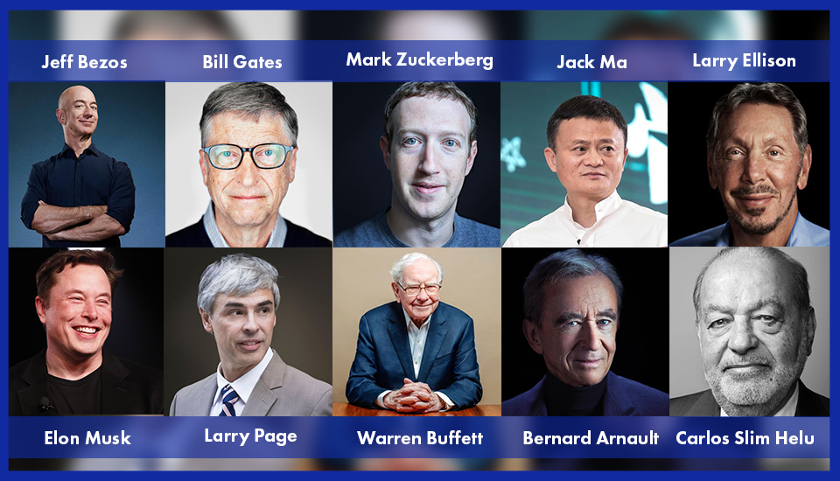
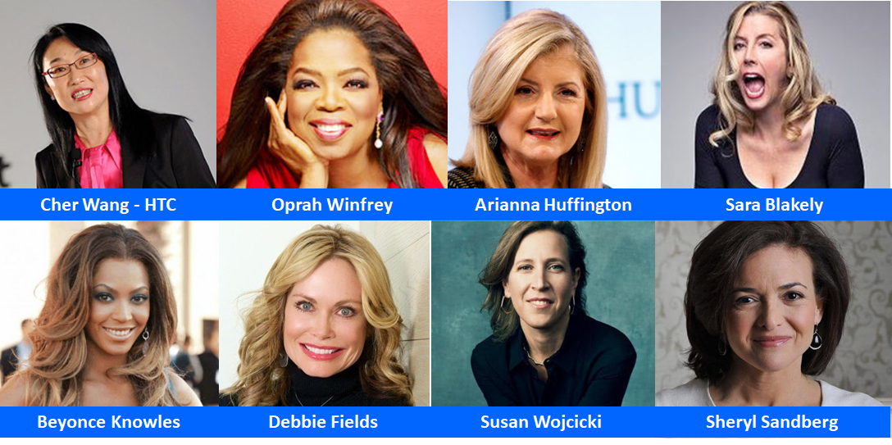
What’s The Reward?
Fame?
Fortune?
Photos © their respective copyright owners. All rights reserved.

Slide 9

The Reality
He Built a Trillion-Dollar Company. He Wouldn’t Do It Again
If he had known three decades ago what If he had known today, he never would have founded one of the world’s most valuable companies.
“If we realized the pain and suffering and how vulnerable you’re going to feel, the challenges that you’re going to endure, the embarrassment and the shame and the list of all the things that go wrong,” he said, “nobody in their right mind would do it.”
Image by European Union on Wikimedia. CC BY.
© The Wall Street Journal. All rights reserved. This content is excluded from our Creative Commons license. For more information, see https://ocw.mit.edu/help/faq-fair-use/
Jensen Huang - Nvidia

Slide 10
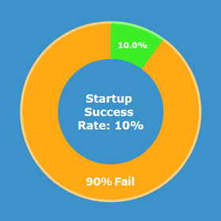
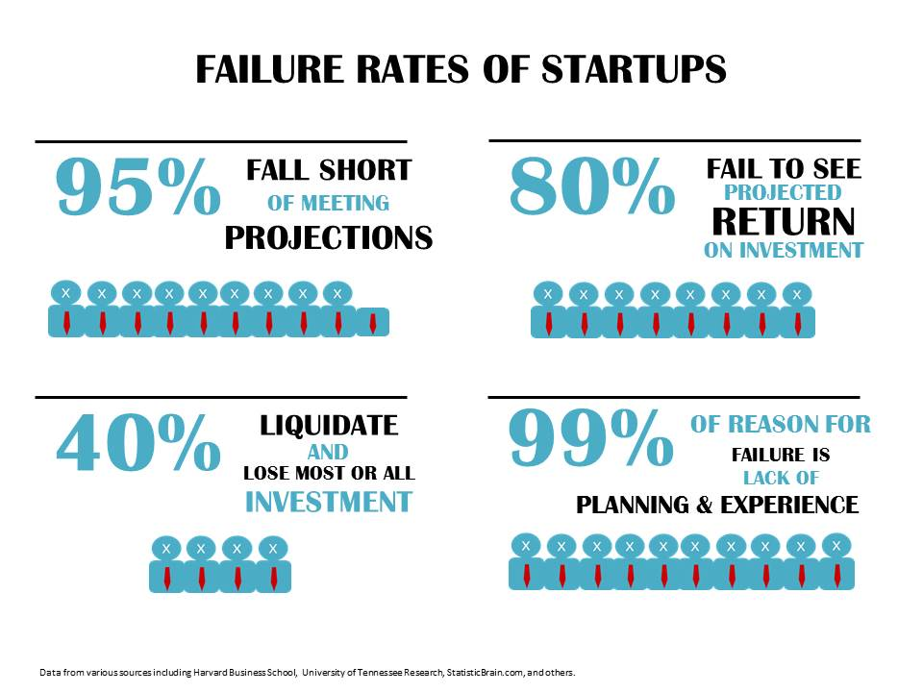
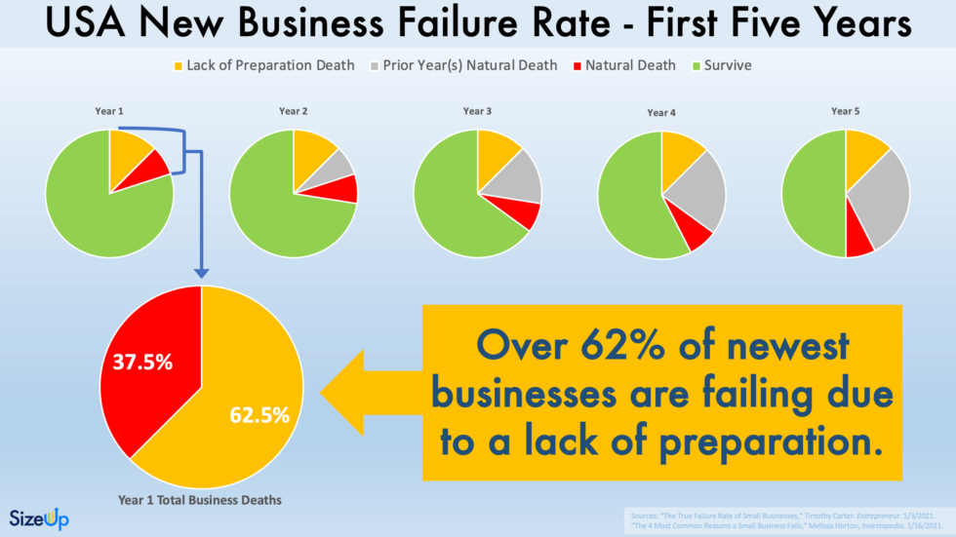
The Reality
© Advisorabbate. All rights reserved. This content is excluded from our Creative Commons license. For more information, see https://ocw.mit.edu/help/faq-fair-use/
© SizeUp, Inc. All rights reserved. This content is excluded from our Creative Commons license. For more information, see https://ocw.mit.edu/help/faq-fair-use/

Slide 11
Perhaps All Is Not Dismal?
2009 Kaufman Study
25,800 currently active companies founded by MIT alums (120K total)
Employ about 3.3 million people
Annual world revenues of $2 trillion
equivalent of the 11th largest economy in the world.

Slide 12
Why This Course?
Not About Theory -- It’s About DOING
Planning and Executing New Ventures
  Not Just Business – Sloan School of Management
Our Goal – Increase Your Probability of Success so You are in the 10% that Succeed
Entrepreneurship is a Lifetime, Incurable Disease
  Not Fatal, Highly Contagious and Transforming
  A Full Contact Sport

Slide 13
What Will You Get?
You invest 6 evenings in this course
You Get new or enhanced skills:
  How to Evaluate a venture idea from an impact and economic viewpoint
  How to figure out Who is My Customer, Who Wants What I Have?
  Where and How do I get the financial resources to launch and grow my venture?
  How do I Scale my venture and make it Sustainable?
  How do I Build and Retain a top notch Team - employees and advisers?
  How do I Negotiate deals and resolve team conflicts?
  What are the Legal Pitfalls I need to know about?
  How do I Pitch my venture idea?

Slide 14
Personal Questions For You
There are a lot of moving pieces here:
Do I Really Want To Do This?
Should I Do This?
Why Am I Doing This?
Now or Later?
Is This For Me?

Slide 15
Tonight’s Plan
Who are You?
Introduce our Teaching Team
New Ventures - Overview
Break – Team Building
Bob Jones – “Finding Your Customer”

Slide 16
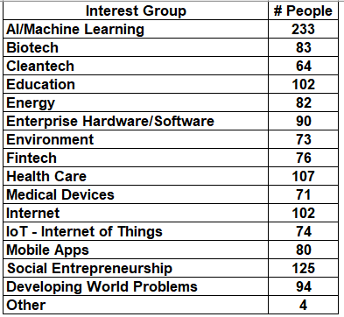
Who Are You?
Students:
  Engineering
  Science
  Architecture/Planning
  Management/Economics
  Other
Non-Student Participants:
  Alums
  Staff
  Others
H = R
E

Slide 17
Who Are We?
Highly UnPaid Volunteer Speakers Who Have Done/Are Doing What They Will Be Talking About
Teaching Assistants
  Janet Chang
  Supriya Sanjay

Slide 18
Who Are We?
Joe Hadzima
  Involved in launching 120+ new ventures
  Senior Lecturer MIT Sloan School
  Former Law Partner, Sullivan & Worcester LLP
  Founding Judge, MIT $100K Competition
  Global Chairman Emeritus, MIT Enterprise Forum, Inc.
  Managing Director, Main Street Partners
  Co-Founder and President, IPVision, Inc. and Neurostim Technologies
  jgh@mit.edu

Slide 19
Who Are We? nutsandbolts-ta@mit.edu
  Janet Chang
  2026 MIT Sloan MBA Candidate
  Deloitte Consulting - Tech, Media, and Entertainment sectors
  Psychobiology, UCLA
  Head of Operations MIT $100K Competition
  LinkedIn

Slide 20
Who Are We? nutsandbolts-ta@mit.edu
  Supriya Sanjay
  2026 MIT Sloan MBA Candidate
  Software engineer at Amazon Web Services - game-based learning tools
  Fulbright-Nehru scholarship in India - co-founded talentboard.io
  Incoming Managing Director of MIT's $100K Competition
  LinkedIn

Slide 21
Tonight’s Plan
Introduce our Teaching Team
New Ventures - Overview
Break – Team Building
Bob Jones – Finding Your Customer

Slide 22
All You Need To Do Is:
It is a Really Simple Concept ….. (whether you are doing a mobile app, a biotech company or a non-profit social developmental company):
    Create Value
    Capture/Harvest some of the Value Created (so you can do it again)

Slide 23
The 3 Whys
Why This?
  Why is this Idea Worth Pursuing or Investing In?
    Size of Market? Problem Worth Solving?
Why Now?
  Why is Now the Right Time to Do This?
    Convergence of Opportunity and Solution?
Why This Team?
  Why Do I Think These People Will Win?
    Prior Experience? Compelling Venture Model?
The 4th Why: Why Won’t This Work?

Slide 24
Lessons Learned
What Have I Learned and How I Can Help You Succeed?
4 Critical Components for Success

Slide 25
Lessons Learned
IDEAS
EXECUTION
TIMING
PEOPLE

Slide 26
What Makes an Idea Valuable?
Ideas are a Dime a Dozen
Value to Someone – Who?
How Much Value?
  Cost to Produce/Deliver
  How to Capture?
Is it Easily Copied?
IDEAS

Slide 27
IDEAS
“Vision without Execution is Hallucination”
Thomas Edision
EXECUTION
Deals I Passed Up Because of Execution
-ZipCar
-Ebay Precursor

Slide 28
IDEAS
EXECUTION
MIT Ecosystem is about Ideas + Execution: “Mens et Manus”
LESSON: Ideas + Execution are Necessary but NOT Sufficient for Success

Slide 29
IDEAS
EXECUTION
“I have lost more money & time being ahead of the curve”
Joe Hadzima
TIMING
It Can Take a Long Time to be an Overnight Success
-3D Printing =>25 Years
-Prodigy - $1B => Amazon
-Fusion => 50+ years and counting

Slide 30
IDEAS
EXECUTION
TIMING
PEOPLE
The Biggest Single Source of Failure

Slide 31
IDEAS
EXECUTION
TIMING
PEOPLE
One day Alice came to a fork in the road and saw a Cheshire cat in a tree. “Which road do I take?” she asked. “Where do you want to go?” was his response. “I don't know” Alice answered. Then, said the cat,
“It doesn't matter.”

Slide 32
IDEAS
EXECUTION
TIMING
PEOPLE
Other People Related Reasons:
-Building Team Before Understanding Customer/Market
Football Team – Basketball – Painful Pivot
-Not Knowing That You Don’t Know
E-Ink: $15M => $80M but it took $160M

Slide 33
IDEAS
EXECUTION
TIMING
PEOPLE
TECHNICAL
RELATIVE
IMPORTANCE
BUSINESS
TIME

Slide 34
IDEAS
EXECUTION
TIMING
PEOPLE
SpeechCo: All 4 Components – IPO, now in your smartphone
VideoCo: All 4 Components – Acquired in 2 years
HIV-Co: I&E&T not P – Almost failed, IPO, modest success - never reached full potential
NanoCo: I&E not T or P – Great potential, failed

Slide 35
IDEAS
IDEAS
EXECUTION
EXECUTION
TIMING
TIMING
PEOPLE
PEOPLE
Success!

Slide 36
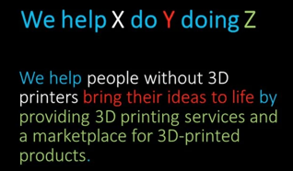
Mission / Vision Statement
Also known as the Value Proposition
One sentence that says what you do
e.g. “We help X do Y by doing Z”
X = target audience
Y = goal or problem they want to solve
Z = how you do it
Steve Blank’s XYZ
© Monday.com. All rights reserved. This content is excluded from our Creative Commons license. For more information, see https://ocw.mit.edu/help/faq-fair-use/

Slide 37
A Supported Vision
Mission/Vision Statement
1 sentence/paragraph
H = R
E
Elevator Pitch
30 seconds
Executive Summary
2-4 pages
Pitch Deck
10slides/20minutes/30pt
Reality Distortion Field
Full Plan
Financial
Projections
Technology
Intellectual
Property
Market
Analysis
Competitive
Analysis
Sales and
Distribution
Team
Detailed
Support/Foundation

Slide 38
A Dozen Real Challenges
Vinod Khosla invested in a startup that a Friend of mine co-founded. My friend ask him for guidance/advice. Vinod responded:
“You will face about a dozen real challenges in developing the technology and venture, which is common for most ventures.
5 of these you will be resourceful enough to find solutions from your background, the field/ecosystem, friends and colleagues, etc.
An additional 5 of these you and your team will be smart enough to solve yourself.”
My Friend asked “What about the remaining 2 challenges?”
“With these last 2, you had better get darn lucky.”
But
“Luck Favors the Well Prepared”
We want to help You Be Prepared!

Slide 39
Tonight’s Plan
Introduce our Teaching Team
New Ventures - Overview
Break – Team Building
Bob Jones – “Finding Your Customer”

Slide 40
BREAK Time & Interest Groups
Interest Group Meet Ups => 10-15 Minutes
  Look for signs around the room
When We Come Back
  Course Logistics
  Bob Jones – “Finding Your Customer”

Slide 41
Interest Groups - WhatsApp
Your Interests from email list signup

Slide 42
The Nuts and Bolts of New Ventures
Course Information
MIT Course 15.393
http://nutsandbolts.mit.edu (link to canvas.mit.edu on bottom of main page)
3 Credits Pass/Fail
Class Attendance Required – Canvas Quiz Attendance Codes posted each night at 9pm
Written Requirement
  - Executive Summary or Pitch Deck – Due Friday Jan 31 midnight
    -Of an Idea you are thinking about
  - Team Efforts Encouraged - Team Formation Google Sheet
    - See link at nutsandbolts.mit.edu/writingreq.php Complete by 1/25

Slide 43
Tonight’s Plan
Introduce our Teaching Team
New Ventures - Overview
Break – Team Building
Bob Jones – “Finding Your Customer”

Slide 44
Next Time
“Founder’s Journey” with Ken Zolot
“Business/Venture Models” with Rich Kivel
Check nutsandbolts.mit.edu for details and readings – also see the MIT Canvas website for the Course Reader

Slide 45
MIT OpenCourseWare
https://ocw.mit.edu/
15.393 Nuts and Bolts of New Ventures
IAP 2025
For information about citing these materials or our Terms of Use, visit: https://ocw.mit.edu/terms.

