Slide 1
SRE Economics Lecture 10
Financing Sustainable Real Estate at the Portfolio Level
Siqi Zheng
(MIT Center for Real Estate)

Slide 2
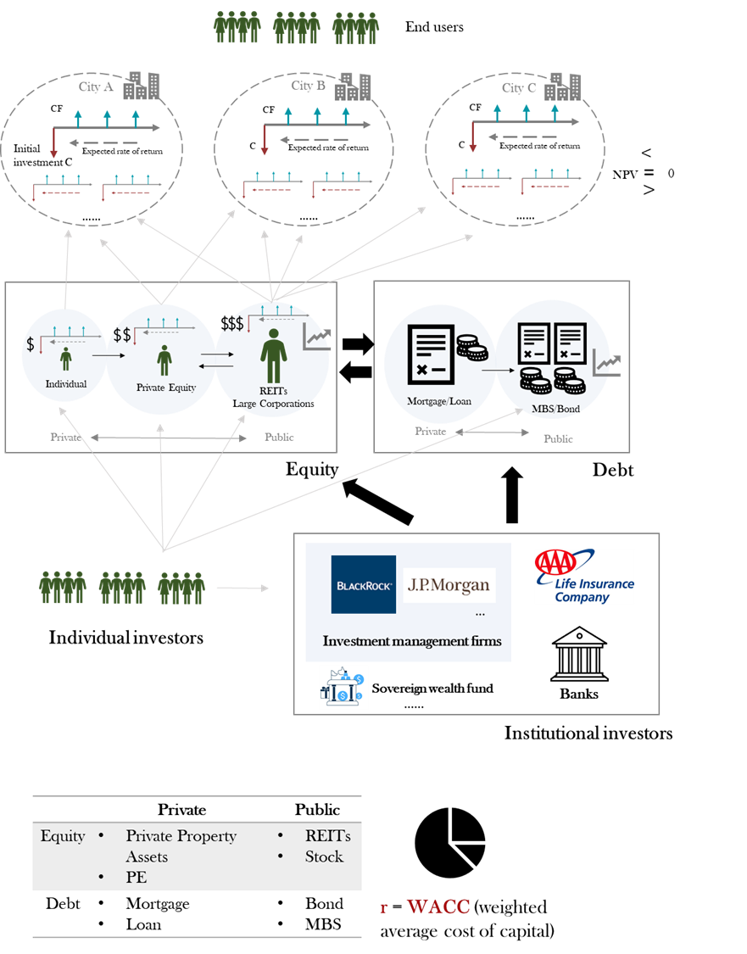
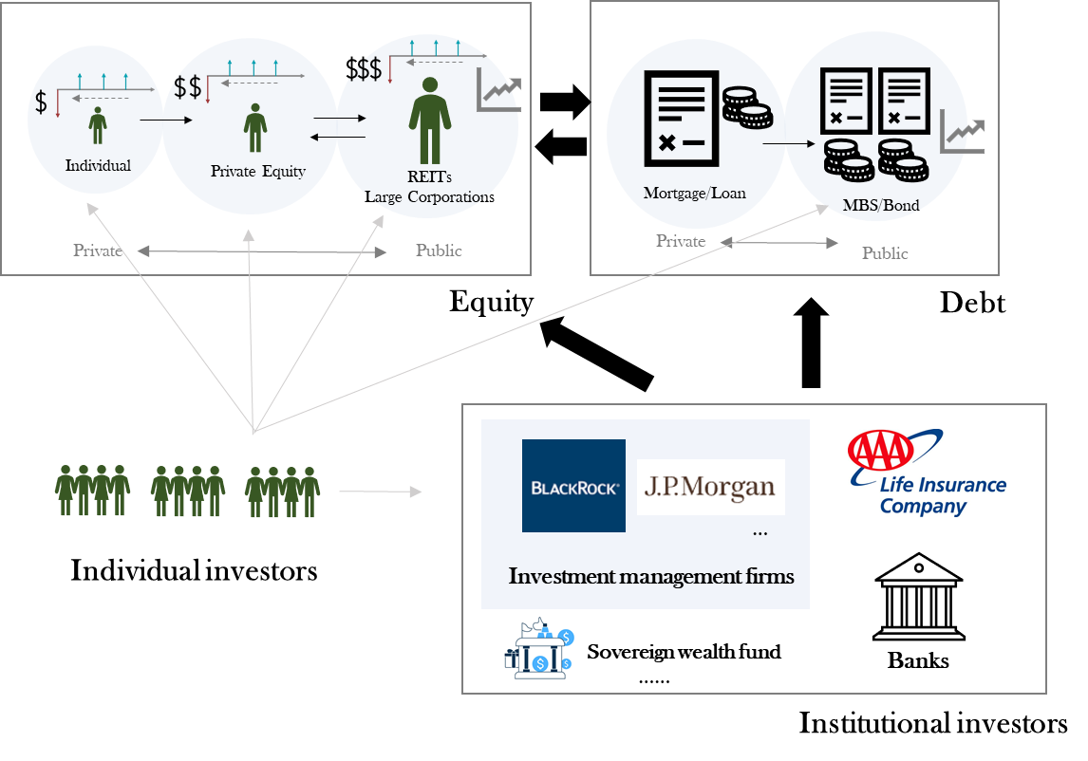
Knowledge Structure
Where we are for this class?
Portfolio finance!
Graph icon © JIPM; other clip art icons © source unknown; corporate logos © BlackRock,
JP Morgan Chase & Co., and AAA Life Insurance Co. All rights reserved. This content is
excluded from our Creative Commons license. For more information, see
https://ocw.mit.edu/help/faq-fair-use/.

Slide 3
Outline
Sustainable real estate investments at portfolio level
  Equity: Real Estate Investment Trusts (REITs)
  Debt: Green Bond
Benchmarking & Disclosure
Notes:
Paralellism

Slide 4

Real Estate Investment Trusts (REITs)
There Are Multiple Ways to Invest in Real Estate beyond Buying a Building
 | PRIVATE | PUBLIC
EQUITY | Private property assets Private equity (PE) fund | REITs Corporate Stock
DEBT | Loans Mortgages | Corporate RE Bonds Debt securities (MBS)
REITs
Corporate Bonds
Equity
Banks (mortgage or loans)
Existing equity (re-invest)
Capital market (new shareholders)
Notes:
Large and professional real estate investment companies can raise capital in multiple forms:
Bank lending: The same as small owners, they can go to the bank and ask for a mortgage on an individual property
Corporate bonds: The company gets the capital it needs and in return the investor interest payments
Equity: They can use or raise their own equity (with limitations, REITs rules and regulations)

Slide 5

Basic Structure of REITs
Buildings and people icons © source unknown. This content is excluded from our Creative Commons license. For more information, see https://ocw.mit.edu/help/faq-fair-use/.
Real Estate Investment Trust
Income generating real estate properties
(Rents + Value Appreciation)
REITs are legally obliged to distribute 90% of their Income
Investors
REIT
$ $ $ $
$ $ $ $
75%
Income be generated by Real Estate (rents/interest)
Assets must be Real Estate assets (Buildings/mortgages)
Tax benefit: REITs typically don’t pay corporate income taxes; and their earnings are passed along as dividend payments which are taxed according to the investor‘s marginal tax rate.
Notes:
Source: https://downloads.globalchange.gov/sap/sap3-3/sap3-3-final-all.pdf
﻿Tax Status and Regulatory Constraints
﻿A REIT cannot be a closely held corporation, in the sense that no five or fewer individuals (and certain trusts) may own more than 50 percent of the REIT’s stock, and there must be at least 100 different shareholders.
﻿Asset Test: Seventy-five percent or more of a REIT’s total assets must be real estate, mortgages, cash, or federal government securities, and 75 percent or more of the REIT’s yearly gross income must be derived directly or indirectly from real property (including mortgages, partnerships, and other REITs).
﻿Income Test: REITs must derive their income (at least 75 percent) from primarily passive sources like rents and mortgage interest, as distinct from short-term trading or sale of property assets.
﻿Distribution Test: At least 90 percent of a REIT’s annual taxable net income must be distributed to shareholders as dividends each year.
- Important since they need to constantly raise capital

Slide 6
Portfolio Investments in Real Estate
Real Estate Investment Trust VS Direct Real Estate
 | Advantages | Disadvantages
Direct Real Estate [Buying a Building]
REITs
High level of control over decisions
High exposure to desired market
No intermediaries
Low liquidity
High upfront investments
High risk
Requires high effort/knowledge in process selecting right properties
Highly liquid
Transparency of reporting
Easier to diversify portfolio
Long term returns similar to underlying real estate asset
High correlation in the short term with stock markets
Lower control

Slide 7
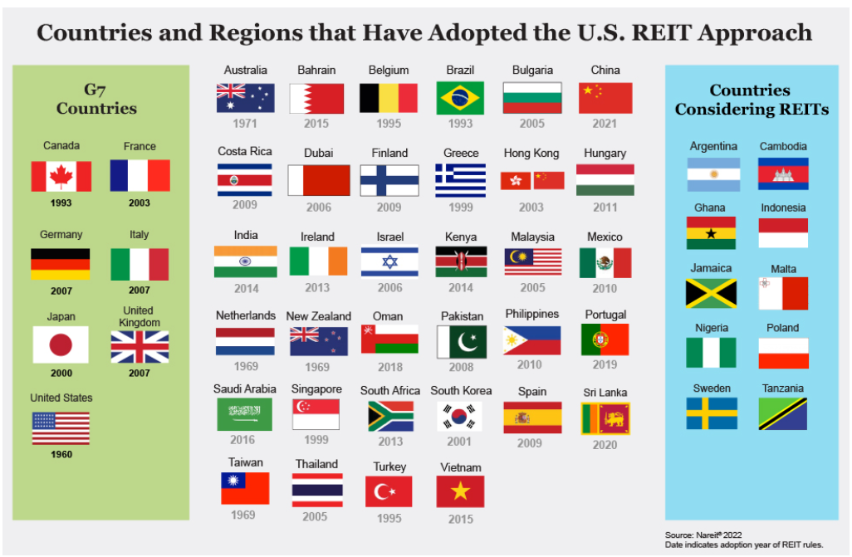
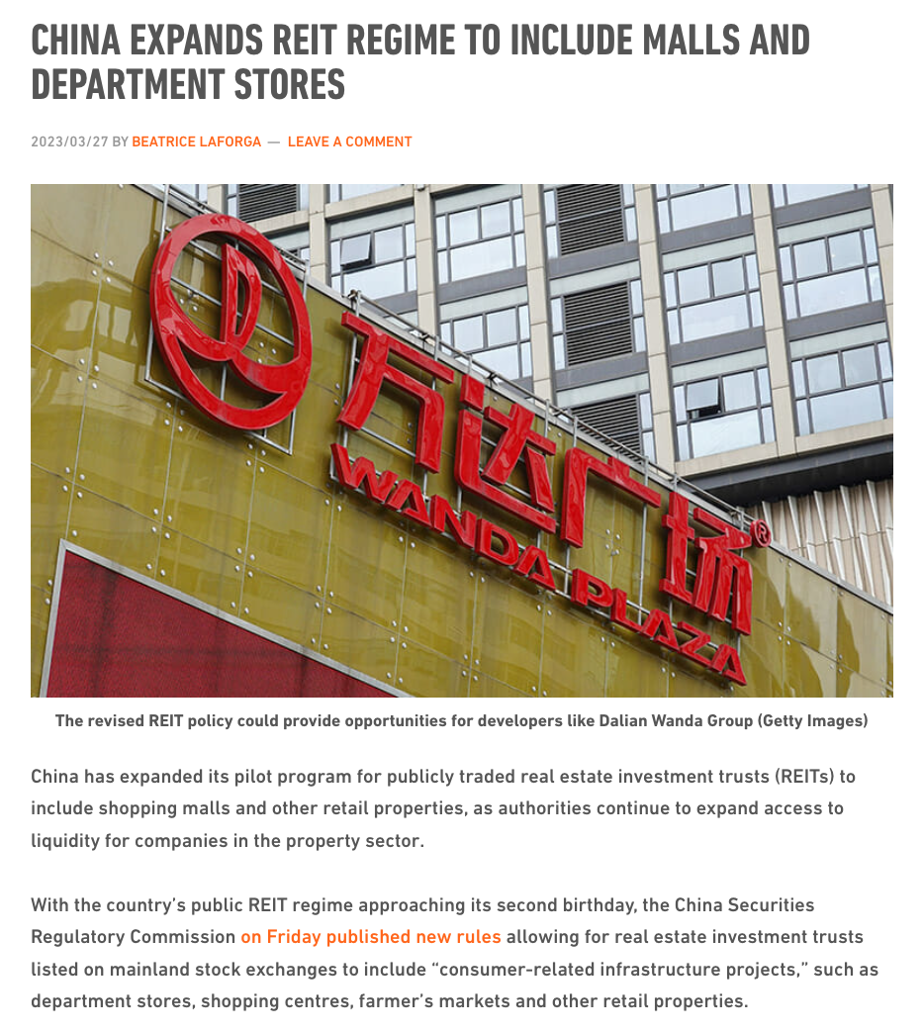
Countries and Regionals that have Adopted the US REIT Approach
Left image © NAREIT; right image © China Advertising Media Ltd. All rights reserved. This content is
excluded from our Creative Commons license. For more information, see https://ocw.mit.edu/help/faq-fair-use/.

Slide 8






Push from Institutional Investors
                64% of REIT by equity market capitalization has disclosed carbon targets in 2021, a sharp increase from 46% in 2020 (NAREIT, 2022).
Some of the most pro-ESG investors are from northern and western European countries; Middle East sovereign wealth funds care the least about ESG issues; while American institutional investors sit in the middle.
                Central bank of Norway
                Global real estate securities manager with HQs in Sydney
                Dutch pension fund investment company
                Canadian real estate investment and asset management company with HQs in Montreal
Logos © Norges Bank, APG, Allianz, Resolution Capital, Ivanhoe
Cambridge, and CPP Investment Board. All rights reserved. This
content is excluded from our Creative Commons license. For more
information, see https://ocw.mit.edu/help/faq-fair-use/.
                European multinational insurance and asset management company with HQs in Germany
                Canadian pension plan investment board
Source: Chen Zhao’s MSRED thesis
Notes:
Example investors are pro-ESG investors
Norges Bank: the central bank of Norway
APG: a Dutch pension investment company based in the Netherlands.
Allianz: A European multinational financial services company headquartered in Munich, Germany. Its core businesses are insurance and asset management.
Resolution Capital: A specialist global real estate securities manager. Headquartered in Sydney, Australia.
Ivanhoe Cambridge: a Canadian real estate company based in Montreal, Quebec. Assets around the globe. Areas of activity are investment, development, asset management, operations and leasing.
CPPIB: The Canada Pension Plan Investment Board. Canadian Crown corporation. Oversee and invest the funds contributed to and held by the Canada Pension Plan.
CRREM (Carbon Risk Real Estate Monitor): A framework that is used by activist investors and other European funds to evaluate their portfolios.
https://www.crrem.eu/
developed by the Institute for Real Estate Economics and GRESB
used by more than 1,000 institutional investors with trillions of euros of assets under management, including Allianz, CBRE and the Japanese Government Pension Investment Fund (GPIF).
Particularly useful for transition risks: CRREM informs the companies of the stranding year when an asset is no longer on track to meet the Paris Climate Goals of limiting global temperature rise to 2°C with ambition towards 1.5°C. The tool allows investors to assess their portfolios for Paris-alignment, identify assets with high risk of becoming 'stranded', and analyse the effect of retrofits.
GRESB, PCAF [Partnership for Carbon Accounting Financials], and CRREM [Carbon Risk Real Estate Monitor] are partnering up in 2021 to provide investors and banks with the guidance they need to measure and report on their financed emissions from real estate.

Slide 9
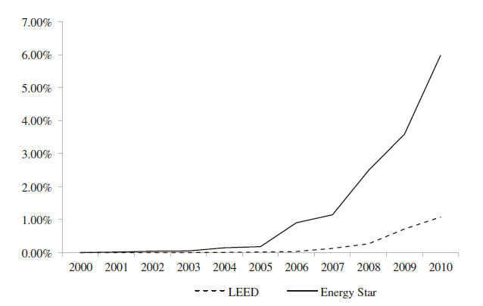
Doing Well by Doing Good? Evidence from Green REITs
                Do green assets generate higher return?
                Eichholtz et al (2012) connect the number of buildings that are green certified in REIT’s to find:
                Those REITs have larger share of green buildings have higher return on equity (ROE) or return on assets (ROA)
                They also have better stock performance in US stock market
                Endogeneity problem:
                Reverse causality/Omitted variable bias
                Well-performing companies generate higher cash flow and have excess cash that can be spend on green investments.
Diffusion of green properties in REIT portfolios
Source: Eichholtz, P., Kok, N., & Yonder, E. (2012). Portfolio greenness and the financial performance of REITs. Journal of International Money and Finance, 31(7), 1911-1929. Courtesy of Elsevier, Inc., https://www.sciencedirect.com. Used with permission.
Notes:
Source: https://downloads.globalchange.gov/sap/sap3-3/sap3-3-final-all.pdf

Slide 10
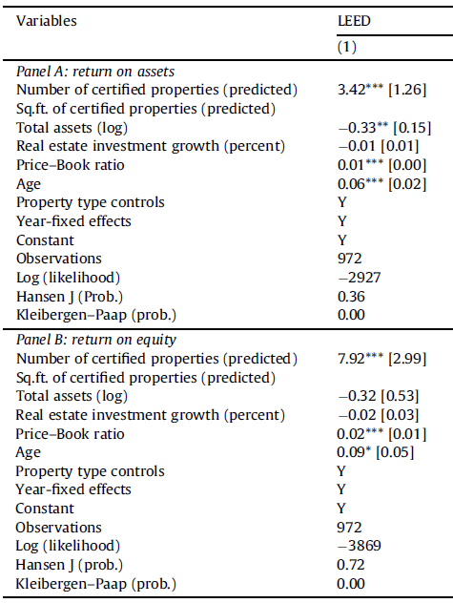

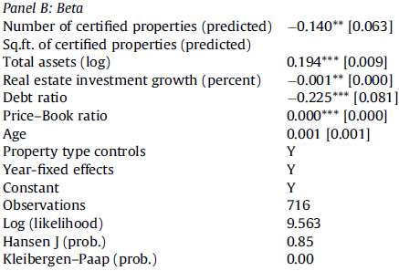
Doing Well by Doing Good? Evidence from Green REITs
                Green portfolios are more profitable portfolios.
                An increase of 1% of LEED assets of REITs:
                Operating performance
                3.5% increase in return on assets
                7.9% increase in return on equity
                Stock performance
                Lower market beta (a risk measure) by 0.14 (energy price, business cycle, regulations)
Source: Eichholtz, P., Kok, N., & Yonder, E. (2012). Portfolio greenness and the financial performance of REITs. Journal of International Money and Finance, 31(7), 1911-1929. Courtesy of Elsevier, Inc., https://www.sciencedirect.com. Used with permission.
Notes:
Reasons for lower market beta
Less exposed to energy price fluctuations and to occupancy risks.
REITs are better protected to the fluctuations of the business cycle
Regulation (transition risks)

Slide 11
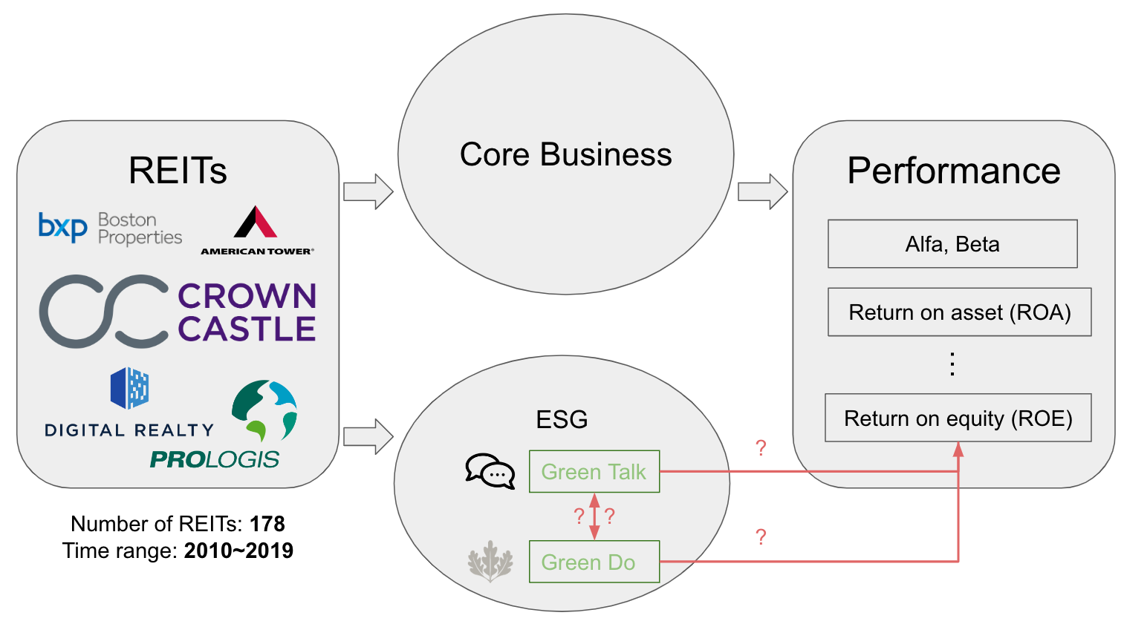
Our New Project: “Green Talking” and “Green Doing”
BXP® is a registered trademark of Boston Properties Limited Partnership; American Tower and American
Tower Corporation logos are registered trademarks of ATC IP LLC.; the Crown Castle logo is a trademark
of Crown Castle; the Digital Realty logo is a trademark of Digital Realty, Inc.; and the ProLogis logo is the
property of Prologis or its content suppliers. . All rights reserved. This content is excluded from our Creative
Commons license. For more information, see https://ocw.mit.edu/help/faq-fair-use/.

Slide 12
Outline
Sustainable real estate investments at portfolio level
  Equity: Real Estate Investment Trusts (REITs)
  Debt: Green Bond
Drivers of sustainable real estate investments
  Why do institutional investors care about sustainability and climate risks?
  Benchmarking & Disclosure
Notes:
Paralellism

Slide 13
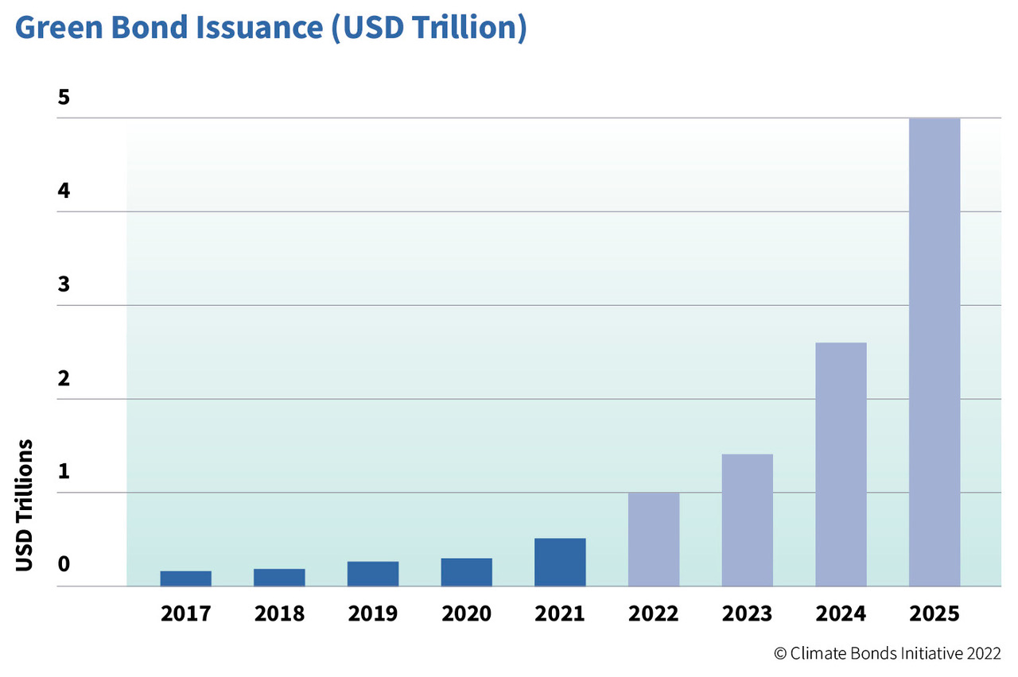



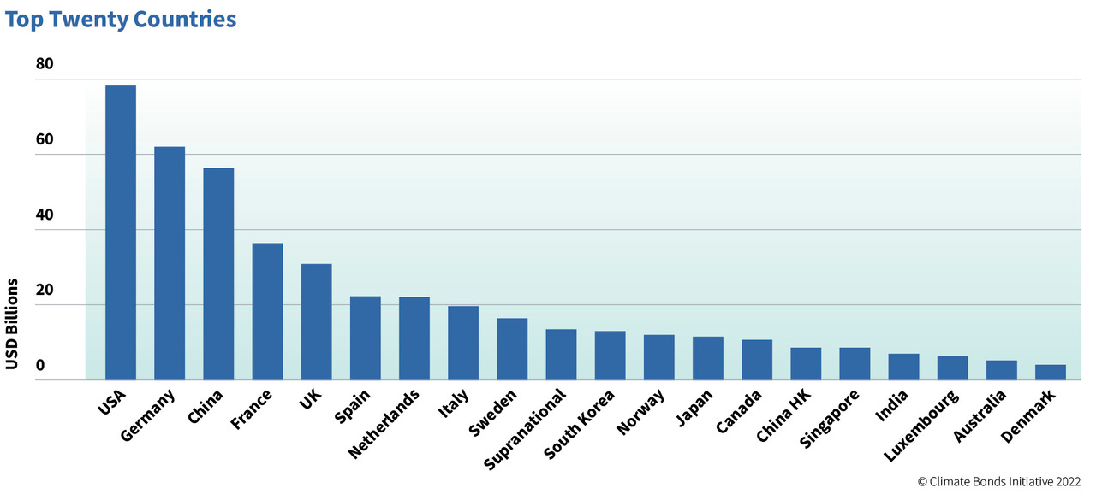

Green Bonds
Green bonds:
  Issued by governments or companies.
Only fund businesses or projects that are GREEN.
Government
Company
Bond
Promise to repay in the future with interest % in exchange for money to be used now for income-generating activities.
Source: https://www.climatebonds.net/2022/01/500bn-green-issuance-2021-social-and-sustainable-acceleration-annual-green-1tn-sight-market © Climate Bonds. All rights reserved. This content is excluded from our Creative Commons license. For more information, see https://ocw.mit.edu/help/faq-fair-use/.

Slide 14
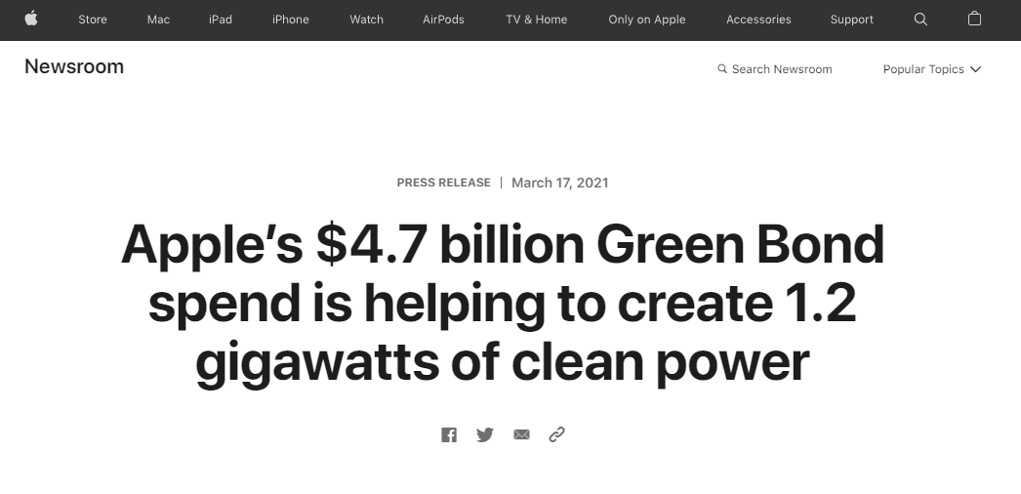

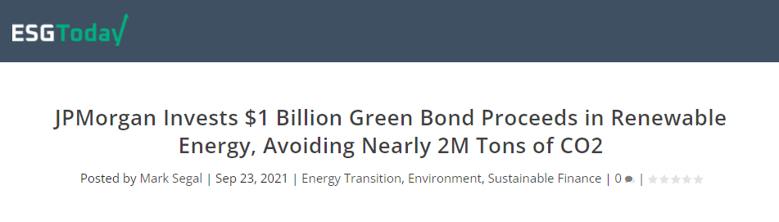
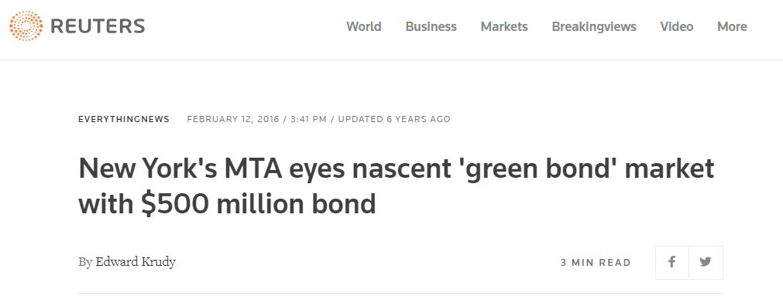

Green Bonds
Diverse issuers
Screenshots © Apple, PepsiCo, Reuters, ESG Today, and Down Jones & Co.. All rights reserved. This
content is excluded from our Creative Commons license. For more information, see https://ocw.mit.edu/help/faq-fair-use/.
Notes:
Green bond beyond real estate.

Slide 15
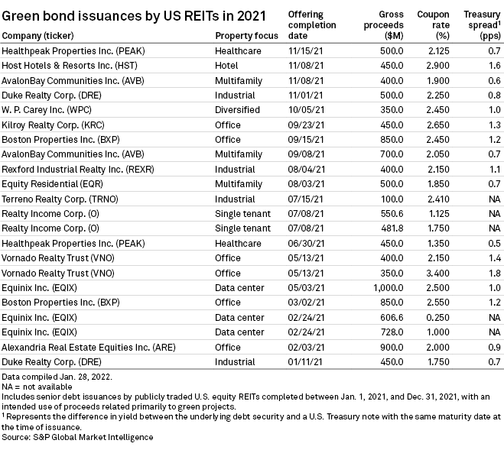
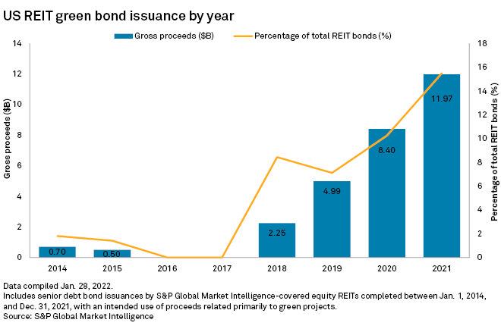
Green Bonds for REITs
Green bonds growing as a share of REIT debt issuance
Source: https://www.spglobal.com/marketintelligence/en/news-insights/latest-news-headlines/green-bond-issuance-by-us-reits-grew-in-2021-68335451
© S & P Global. All rights reserved. This content is excluded from our Creative Commons license. For more
information, see https://ocw.mit.edu/help/faq-fair-use/.

Slide 16

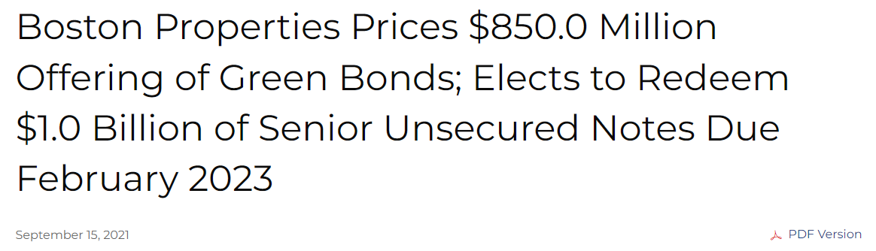
Green Bonds for REITs
© Boston Properties. All rights reserved. This content is excluded
from our Creative Commons license. For more information,
see https://ocw.mit.edu/help/faq-fair-use/.
BXP green bond history: $1.0 billion in Nov 2018, $850.0 million in June 2019, $850.0 million in March 2021, $850.0 million in Sep 2021.
The 12-year bond deal priced at a spread of 115 basis points above Treasurys to yield 2.45%.
Expect to use proceeds to repay outstanding corporate debt coming due and to fund or refinance eligible U.S. green projects.
Notes:
Source: http://ir.bostonproperties.com/news-releases/news-release-details/boston-properties-prices-8500-million-offering-green-bonds-0
https://www.marketwatch.com/story/office-giant-boston-properties-aims-for-new-12-year-green-bond-financing-11631728015

Slide 17
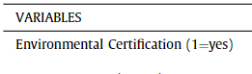
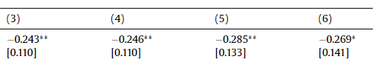
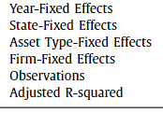
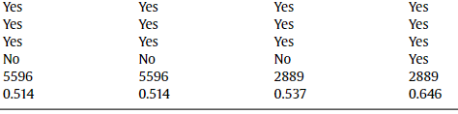

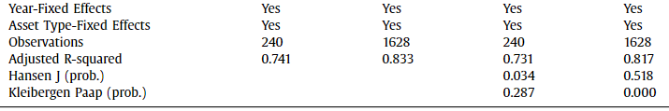
The Greenness of REITs Helps Lower Bond Spread
        Asset level: lower mortgage spread
        The spreads of mortgages on environmental certified buildings are 24 to 29 basis points lower.
        (translates into a reduction of $147,000 to $206,000 interest payment for an average commercial building)
        Portfolio level: lower bond spread
        Doubling a portfolio’s share of certified buildings (an average REIT from 3 to 6 percent) lowers the bond spread by 21 to 74 basis points.
(column 3-6: different controls)
(column 1 and 3 are origination; column 2 and 4 are secondary markets)
Eichholtz, P., Holtermans, R., Kok, N. and Yönder, E., 2019. Environmental performance and the cost of debt: Evidence from commercial mortgages and REIT bonds. Journal of Banking & Finance, 102, pp.19-32. Courtesy of Elsevier, Inc., https://www.sciencedirect.com. Used with permission.
Notes:
Basis points: https://www.investopedia.com/terms/b/basispoint.asp

Slide 18
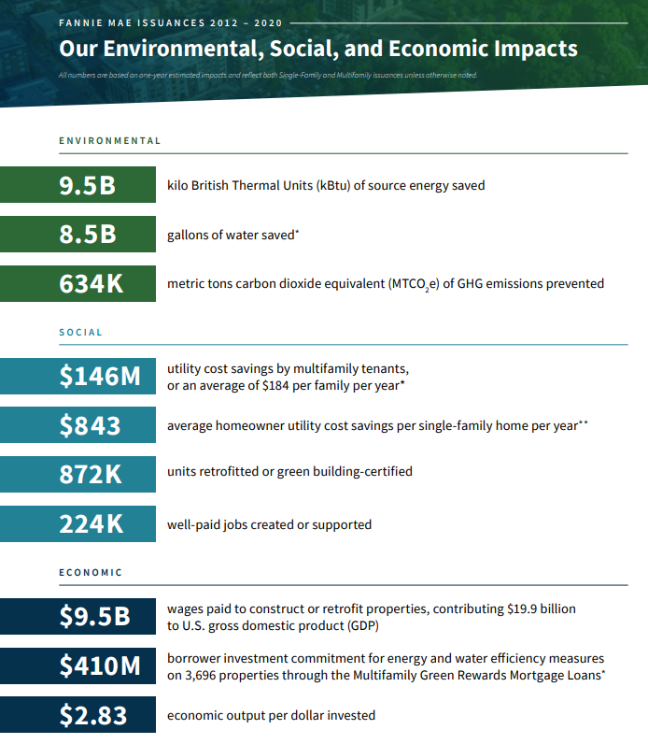
Another example: Fannie Mae Multifamily Green Bonds
Fannie Mae:
Leading provider of financing. Own 21% of the outstanding debt on multifamily properties in US.
Green Financing products
Green Rewards Mortgage Loan
Eligibility: Properties retrofitting existing properties and can reduce energy and water consumption by a combined minimum of 30% (at least 15% from energy).
Green Building Certification Mortgage Loan
Eligibility: New construction property awarded by green building certifications recognized by Fannie Mae.
  A loan that uses the above green financing products is eligible to be securitized as a Fannie Mae Green Bond.
Source: https://www.fanniemae.com/media/40246/display. © Fannie Mae. All rights reserved. This
content is excluded from our Creative Commons license. For more information,
see https://ocw.mit.edu/help/faq-fair-use/.

Slide 19
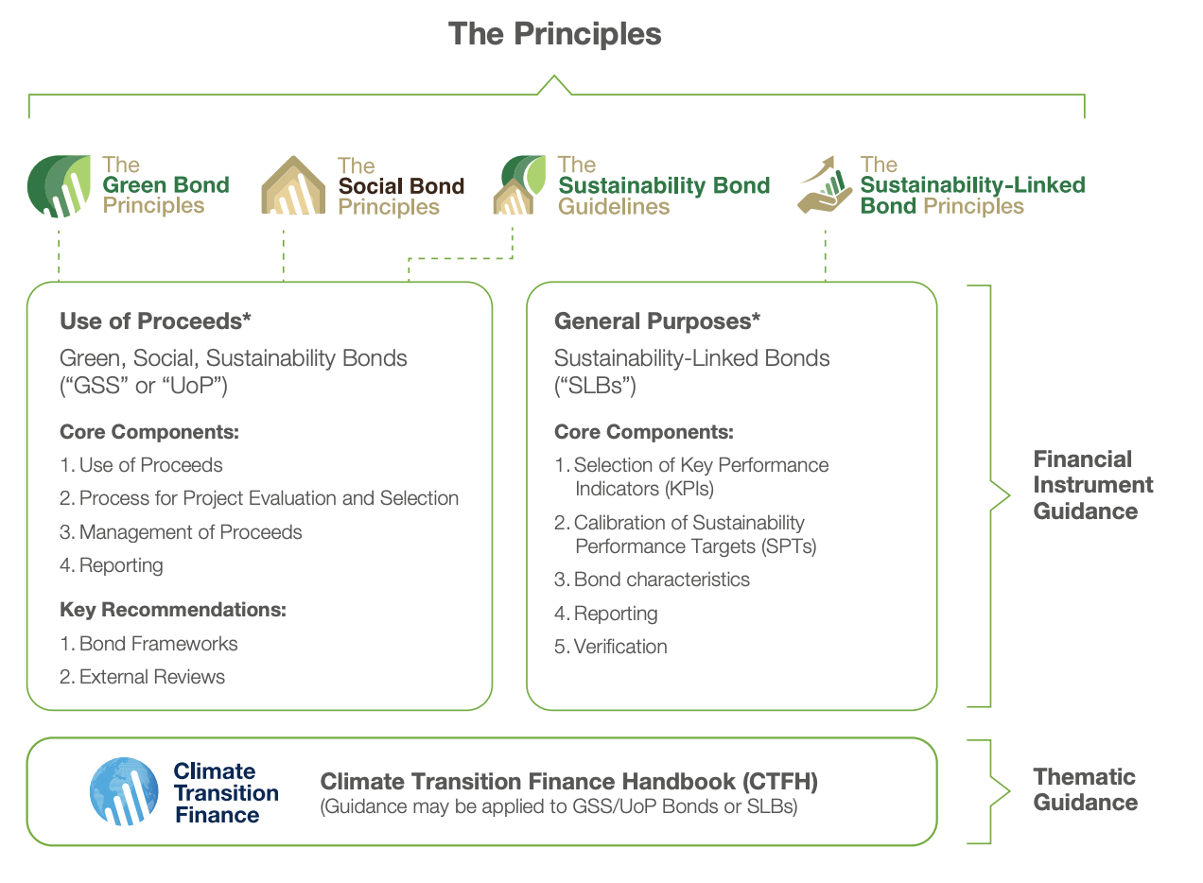
Green Bonds: How to signal the market Greenness?
Green bonds: the money raised from investors is used exclusively to finance projects that have a positive environmental impact, such as green buildings
Major investors from asset managers to insurers and pension are demanding them
  - EU deal: orders exceeded the securities available by more than 11 times
  - Green bond principles (avoid greenwashing) – making false or misleading claims about the underlying asset
© ICMA. All rights reserved. This content is excluded from our Creative Commons
license. For more information, see https://ocw.mit.edu/help/faq-fair-use/.
Notes:
https://www.weforum.org/agenda/2021/10/what-are-green-bonds-climate-change/
https://www.icmagroup.org/assets/documents/Sustainable-finance/2021-updates/Green-Bond-Principles-June-2021-140621.pdf

Slide 20
Outline
Sustainable real estate investments at portfolio level
  Portfolio investment (diversity) makes sense
  Sustainable portfolio makes sense: equity and debt
Benchmarking & Disclosure
Notes:
Paralellism

Slide 21


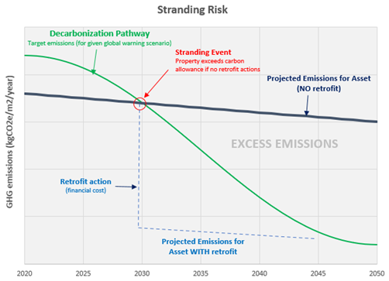
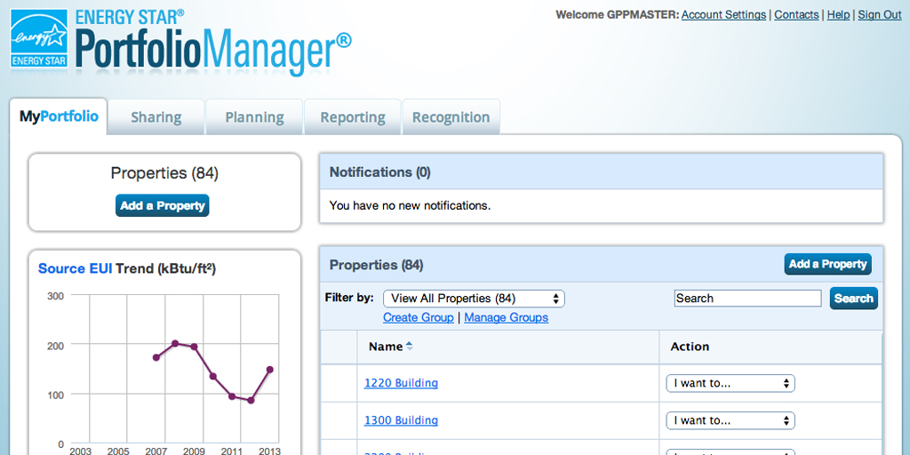



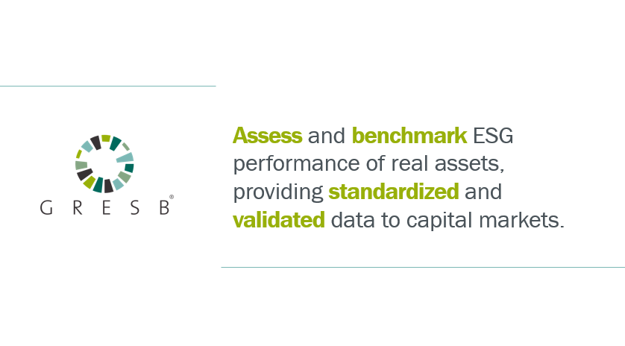

Data, Measurement, and Benchmarking
Source: Chen Zhao’s MSRED thesis
                Data acquisition: Incorporate language into lease to obligate the tenants to share utility data [EPA Portfolio Manager]
                Data integration and visualization: energy, emissions, and water data for third party validation.
                Scope 1-3 emissions calculation: [Quantis], [One Click LCA], and [EC3]
Portfolio evaluation framework and benchmarking
                Third-party assurance (“audit”): The assurance process includes sampling and verifying the data and issuing an assurance opinion.
Public domain image courtesy of US EPA.
Logos © Measurabl, DNV, Quantis, One Click LCA, EC3, CRREM, and GRESB.
All rights reserved. This content is excluded from our Creative Commons license.
For more information, see https://ocw.mit.edu/help/faq-fair-use/.
Notes:
EC3 is particularly for embodied carbon. One Click LCA provides both life cycle assessment and embodied carbon calculation.
Why measurabl cannot be the assurance?
Why DNV can make money?
Sustainability report verified by independent recognized third party is commonly required by potential investors/stakeholders.
https://www.dnv.com/services/sustainability-report-assurance-11176
DNV is the independent expert in assurance and risk management. I think they have better expertise for credible assurance of data beyond environment through audits and assessments.

Slide 22
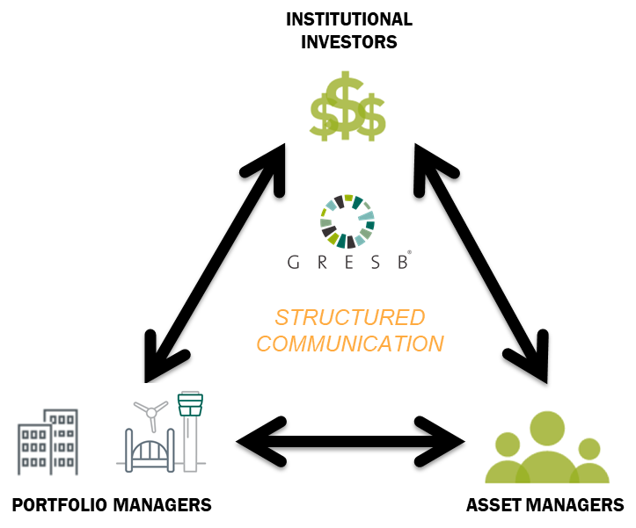
Solving information asymmetry:
Benchmarking and Disclosure
﻿Global Real Estate Sustainability Benchmark
© GRESB. All rights reserved. This content is excluded from our Creative
Commons license. For more information, see https://ocw.mit.edu/help/faq-fair-use/.
Notes:
The key message on this slide is that in addition to being a “reporting burden” for participating entities, the GRESB assessment should really be seen as communication platform between 2 groups: investors and reporting entities:
Investors can strongly rely on GRESB score and analytical tools to management their investment and engagement with their fund manager, but also
The same concept applies at reporting entity level when it comes to compared owners and developer, as the first one is the potential client of the other. As they both have GRESB in common, the assessment should definitely be seen as a way to improve the quality of communication between the two.

Slide 23
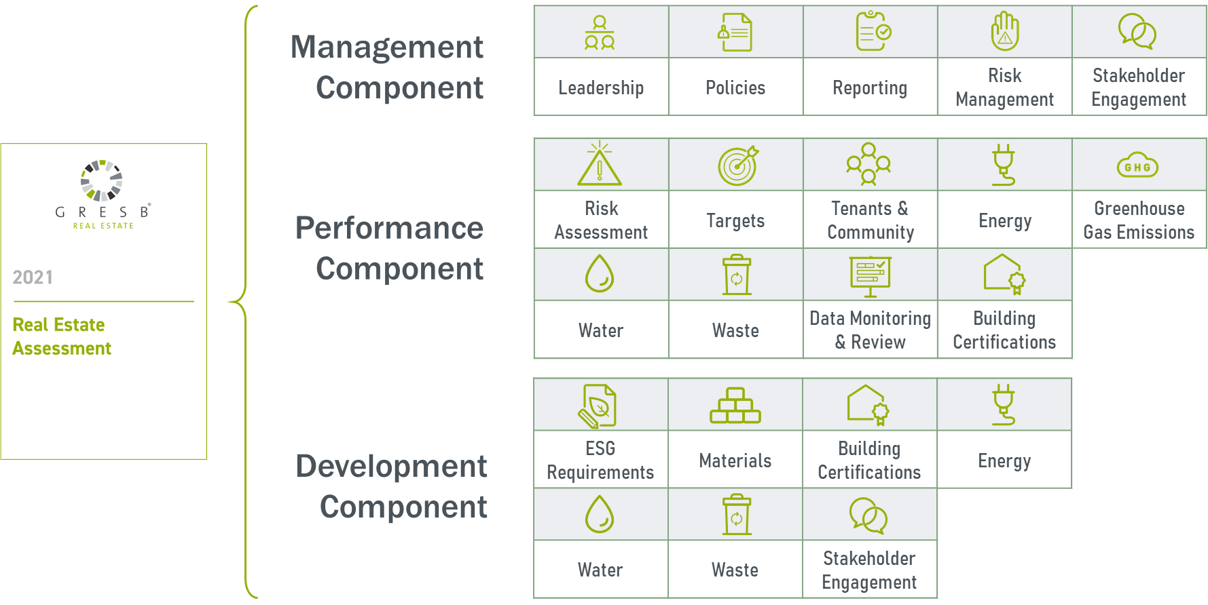
GRESB: Real Estate Assessment
© GRESB. All rights reserved. This content is excluded from our Creative
Commons license. For more information, see https://ocw.mit.edu/help/faq-fair-use/.
Notes:
o let’s deep dive into the Real Estate Assessment.
This slide provide a great overview of the structure of the Real Estate Assessment as well as the terminology that we use – which you should be familiar with to attend this presentation.
Describe the structure:
Assessment
Components – groups of indicators in the same theme
Indicators (most of them are scored, but not all)
How each indicator is structured. Our Reference Guide contains for each indicator the same structure.
Each indicator refers to a certain PILLAR of sustainability i.e. E, S or G as well as to a DIMENSIONS. Dimensions are concept we have developed to better classified indicators:
MP: qualitative indicators, involvement of management, quality of disclosure, engagement with stakeholders.
IM: quantitative indicators, performance data and metrics, improvement over time.
These dimensions are use to draw up the GRESB Module which plots participants’ score on a 2 dimensional graph with MP on the Y axis and IM on the X – next slide.

Slide 24
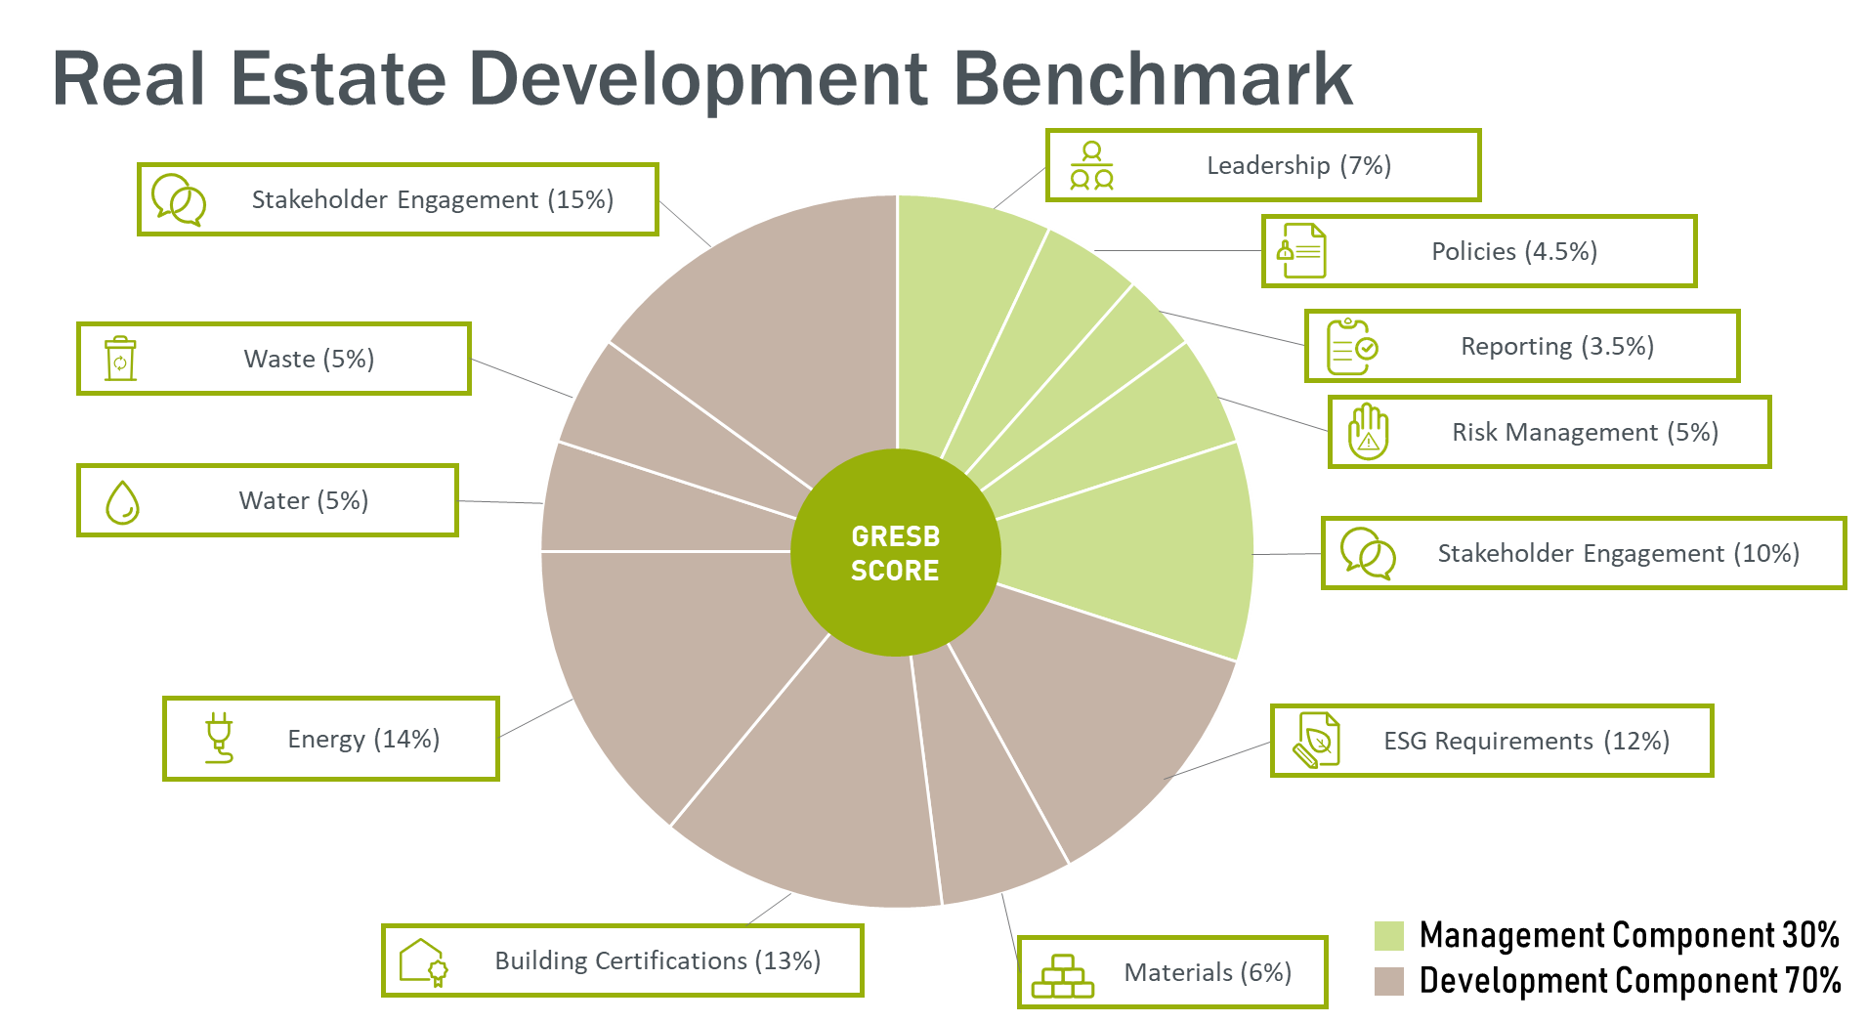
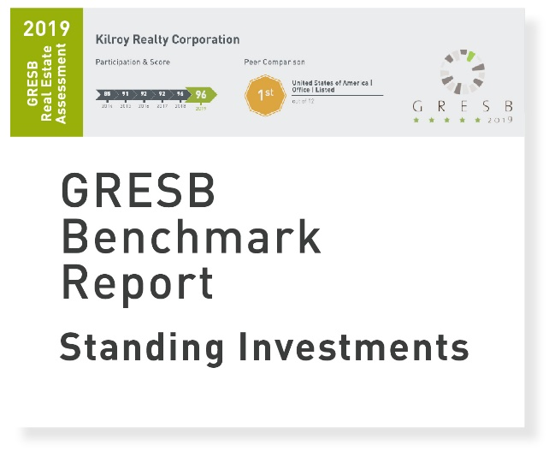
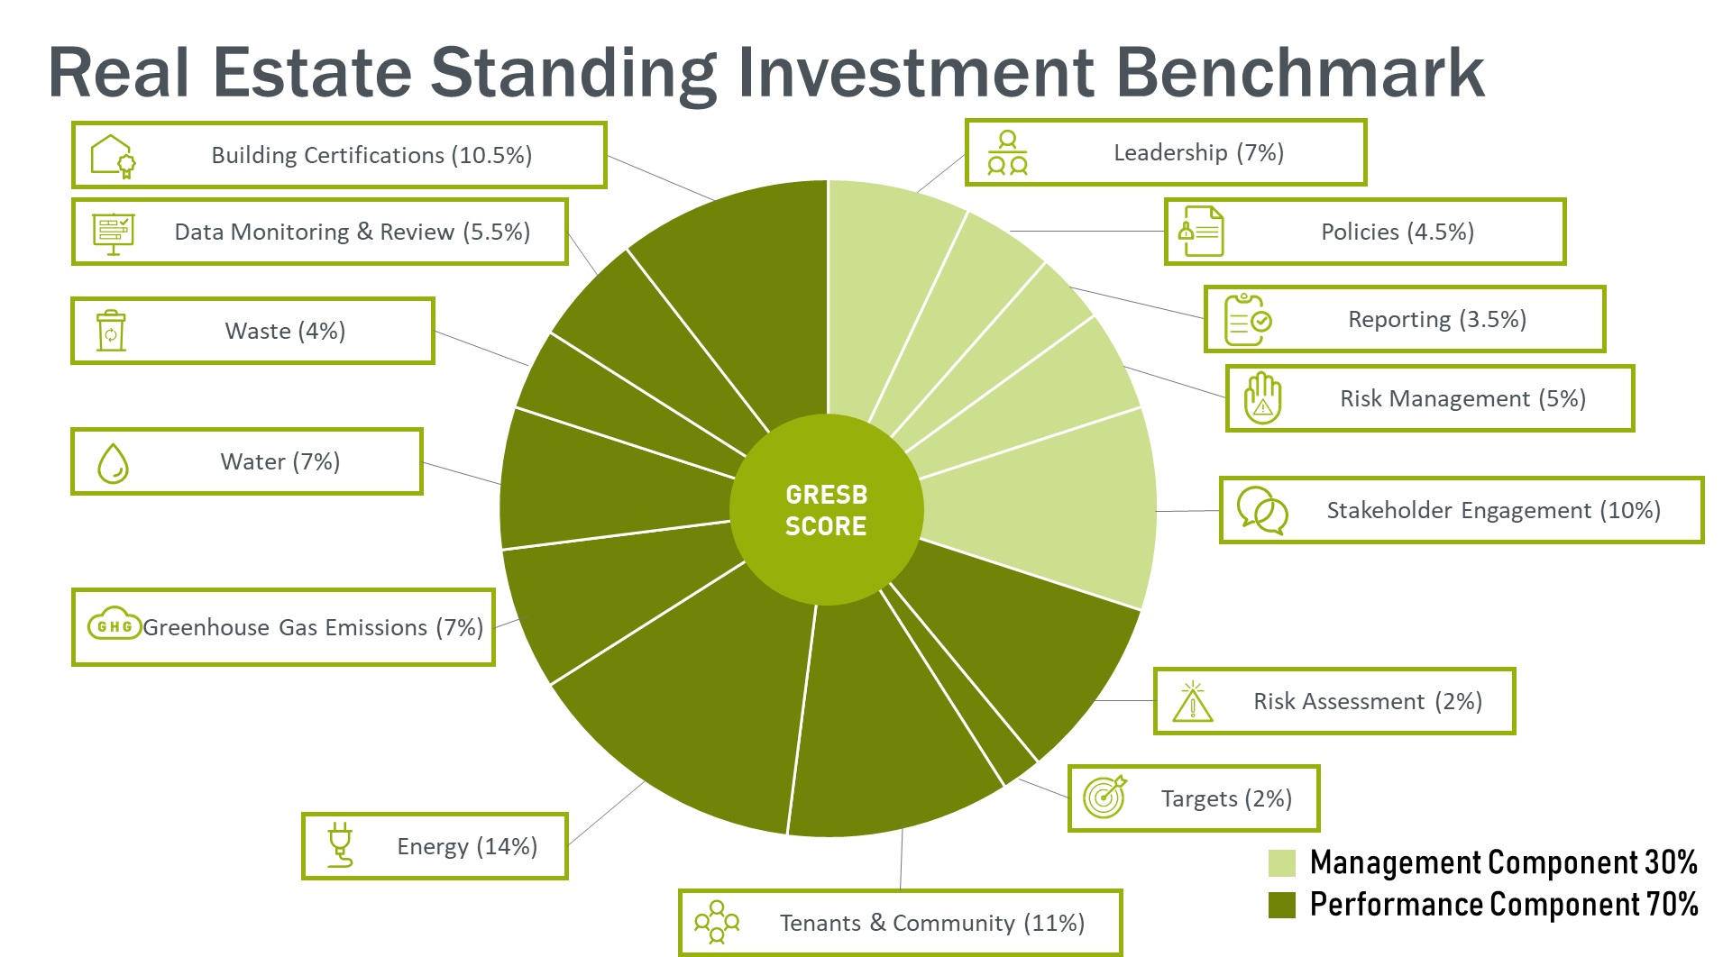
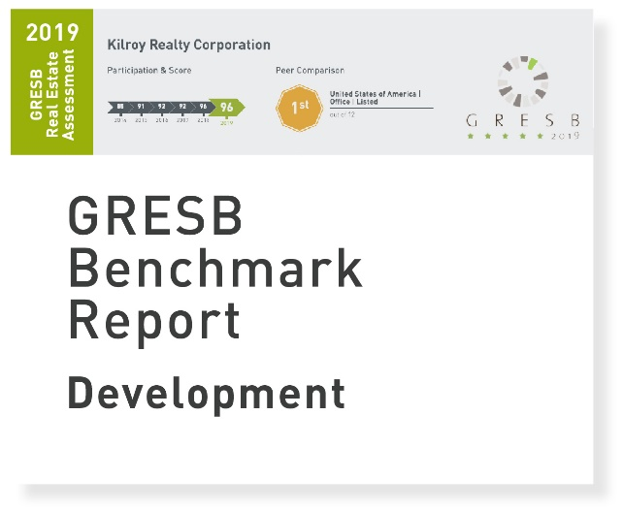
GRESB: Real Estate Assessment
Standing Investments Benchmark
PERFORMANCE COMPONENT
(70% score)
MANAGEMENT COMPONENT
(30% score)
DEVELOPMENT COMPONENT
(70% score)
Development Benchmark
© GRESB. All rights reserved. This content is excluded from
our Creative Commons license. For more information,
see https://ocw.mit.edu/help/faq-fair-use/.

Slide 25
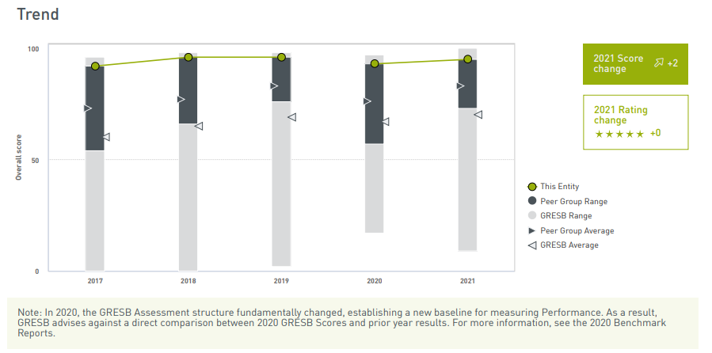
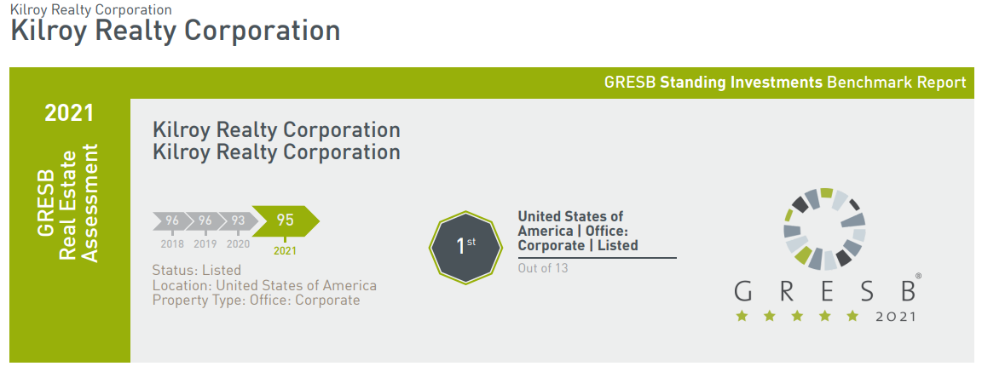
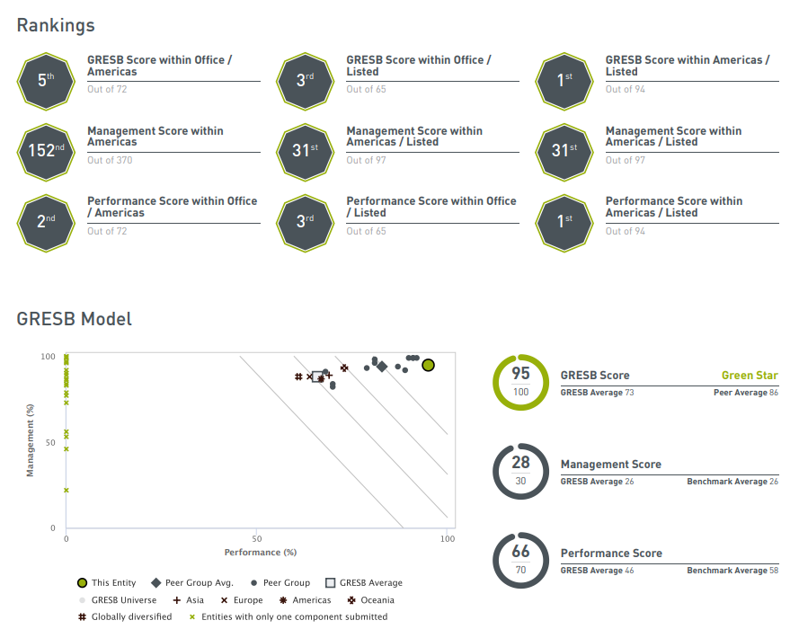
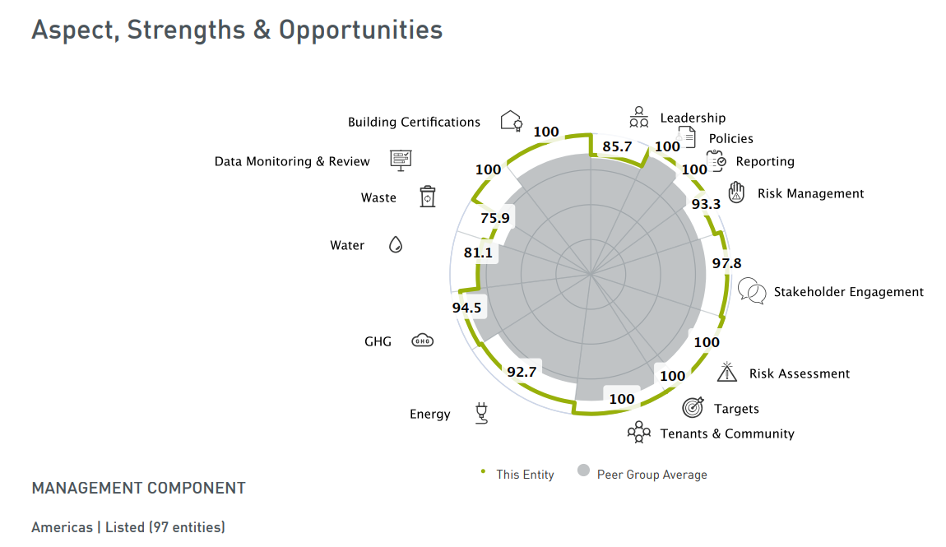
GRESB: Benchmark Report
Example: Kilroy Realty Corporation (source)
Trend analysis
Score by category
Comparisons against peer groups
© GRESB. All rights reserved. This content is excluded from our Creative Commons license. For more information, see https://ocw.mit.edu/help/faq-fair-use/.

Slide 26
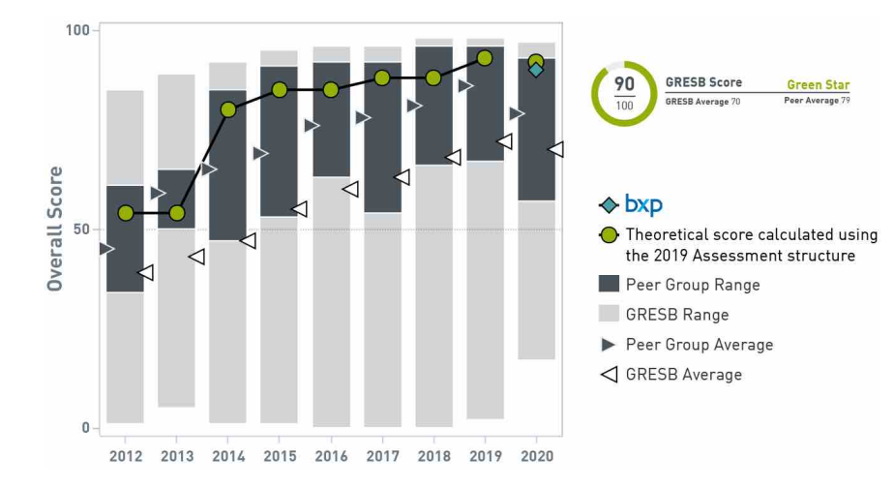
GRESB: Benchmark Report
Example: Boston Properties (source)
© Boston Properties. All rights reserved. This content is excluded from our Creative
Commons license. For more information, see https://ocw.mit.edu/help/faq-fair-use/.

Slide 27
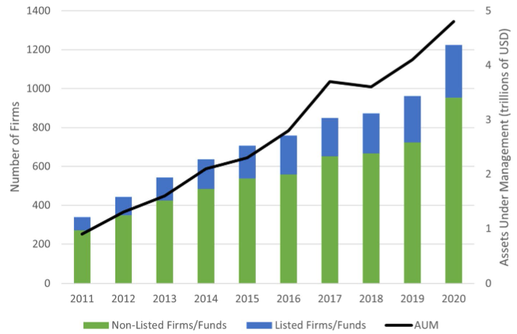
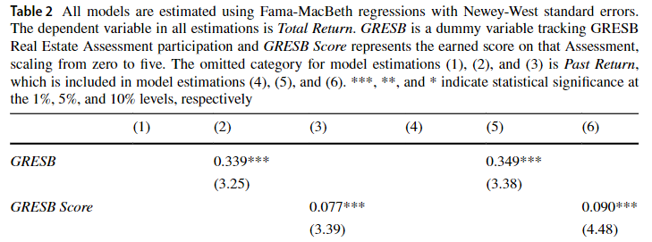
Private Equity Real Estate Return and GRESB rating
How ﻿GRESB ESG disclosure impact private equity real estate return?
﻿Substantial adoption of GRESB in private (non-listed) funds/firms.
GRESB participation and performance are both significant predictors of fund returns.
Devine, A., Sanderford, A., & Wang, C. (2022). Sustainability and Private Equity Real Estate Returns. Journal of Real Estate Finance and Economics. © Elsevier Inc. All rights reserved. This content is excluded from our Creative Commons license. For more information, see https://ocw.mit.edu/help/faq-fair-use/.
Notes:
Early studies show that relative outperformance on the GRESB benchmark translates into higher total returns for private equity funds and higher returns on assets and equity for listed property companies.

Slide 28
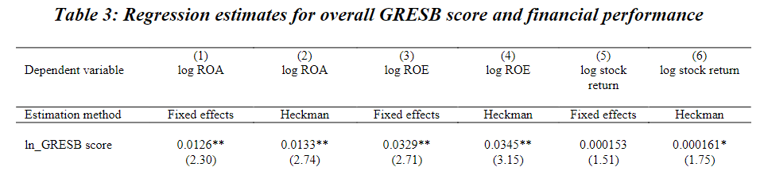
REITs Performance and GRESB rating
How ﻿GRESB ESG disclosure impact REIT performance?
﻿GRESB ESG disclosure levels are positively associated with REITs’ operational performance (ROA and ROE), while less salient for stock market performance.
Fuerst, F. (2015). The financial rewards of sustainability: A global performance study of real estate investment trusts. Available at SSRN 2619434. © Elsevier Inc. All rights reserved. This content is excluded from our Creative Commons license. For more information, see https://ocw.mit.edu/help/faq-fair-use/.
Notes:
One possible explanation of the difference between operational performance (ROA and ROE) and stock market performance is that REIT investors are not fully informed about a REIT’s sustainability activities as this information is often unavailable, unstructured, intangible and opaque, thus investors are unable to factor this information into investment expectations. A contrarian argument posits that management performance of a REITas described by its sustainability activities is generally known to investorsbut behaves in a relatively stable and predictable manner and is hencealready priced into stock prices, hence no outperformance will be observed. Further research is required to explore the empirical foundations of these opposing arguments in more depth.

Slide 29
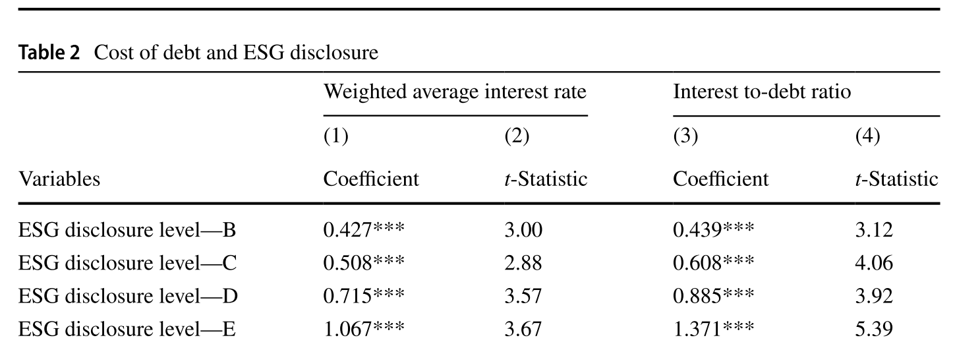
REIT Financing and GRESB rating
How ﻿GRESB ESG disclosure impact debt financing for green REITs?
﻿Strong, negative relation between ESG disclosure level and the interest payments for REITs
Higher corporate credit ratings (i.e., ﻿S&P’s AAA, BBB,…)
Feng, Z. and Wu, Z., 2021. ESG disclosure, REIT debt financing and firm value. The Journal of Real Estate Finance and Economics, pp.1-35. © Springer Nature. All rights reserved. This content is excluded from our Creative Commons license. For more information, see https://ocw.mit.edu/help/faq-fair-use/.

Slide 30
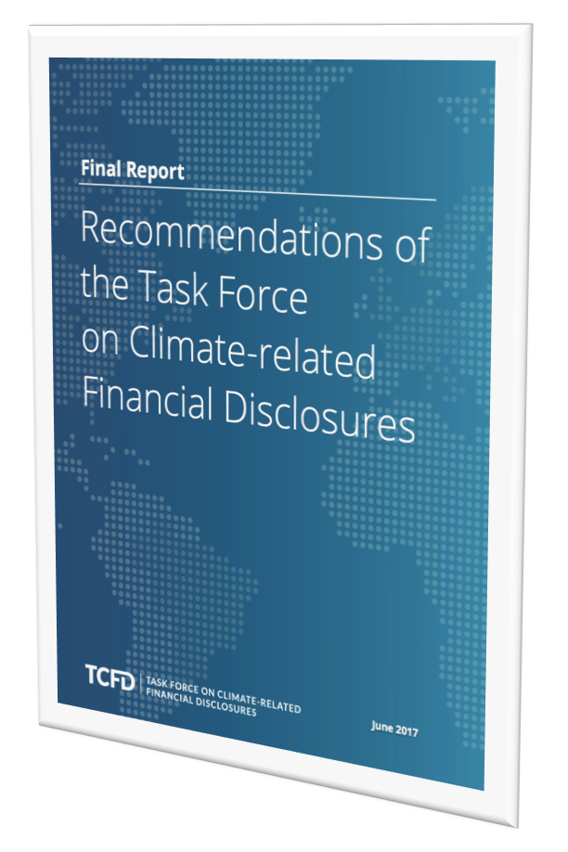
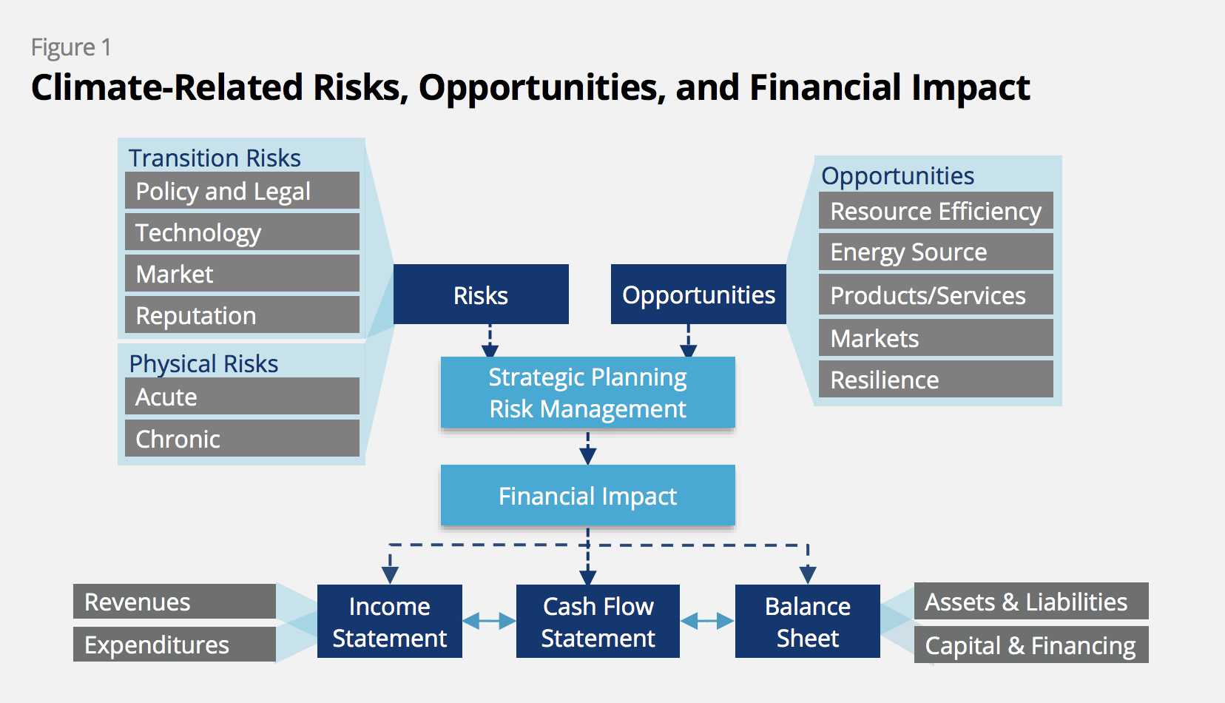
Disclosure and Reporting: TCFD
© TCFD. All rights reserved. This content is excluded from our Creative Commons license. For more information, see https://ocw.mit.edu/help/faq-fair-use/.
30
Notes:
Chris

Slide 31
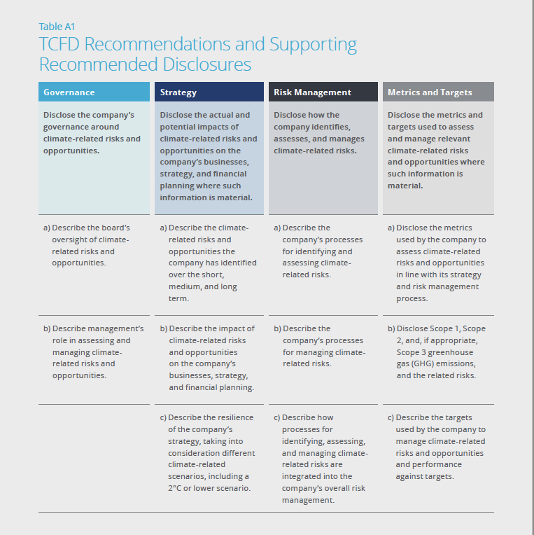
Disclosure and Reporting: TCFD
Solving information asymmetries: ﻿The role of reporting
© TCFD. All rights reserved. This content is excluded from our Creative Commons license. For more information, see https://ocw.mit.edu/help/faq-fair-use/.

Slide 32
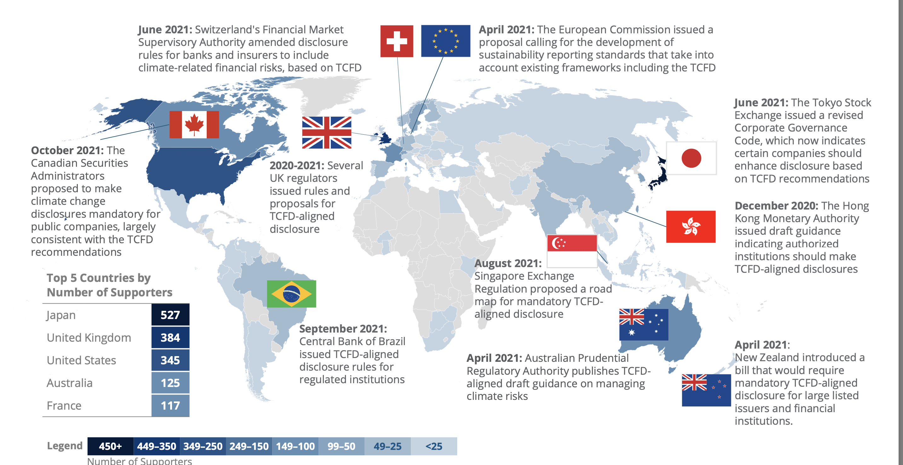
Countries mandating climate risk disclosures
© TCFD. All rights reserved. This content is excluded from our Creative Commons license. For more information, see https://ocw.mit.edu/help/faq-fair-use/.
Notes:
https://assets.bbhub.io/company/sites/60/2021/10/TCFD-Whats-New-in-2021-Webinar.pdf

Slide 33
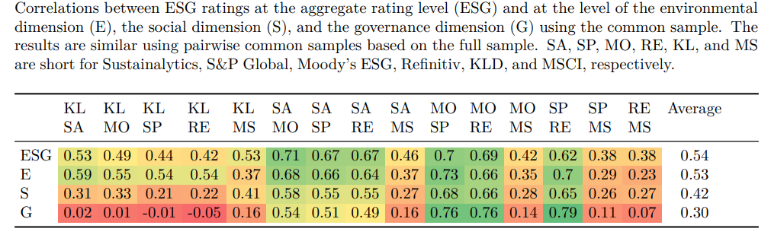
ESG Confusion
Professor Roberto Rigobon at MIT Sloan:
https://mitsloan.mit.edu/sustainability-initiative/aggregate-confusion-project
ESG data are noisy and unreliable. The correlation among six prominent ratings agencies (KLD, Sustainalytics, Moody’s ESG (Vigeo-Eiris), S&P Global (RobecoSAM), Refinitiv (Asset4), and MSCI) was on average 0.54. In comparison, mainstream credit ratings from Moody’s and Standard & Poor’s are correlated at 0.92.
Three factors driving ratings divergence: Scope, Measurement, Weights Divergence.
Rater effect: A rater’s overall view of a firm influences the measurement of specific categories.
Berg, F., Koelbel, J. F., & Rigobon, R. (2022). Aggregate confusion: The divergence of ESG ratings. Review of Finance, 26(6), 1315-1344. Table courtesy of the authors. License: CC BY.
Notes:
data from six prominent ESG rating agencies: KLD, Sustainalytics, Moody’s ESG (Vigeo-Eiris), S&P Global (RobecoSAM), Refinitiv (Asset4), and MSCI.
https://mitsloan.mit.edu/ideas-made-to-matter/why-sustainable-business-needs-better-esg-ratings
There are three factors driving ratings divergence. Scope divergence occurs when ratings are based on different attributes — for example, one rating service includes carbon emissions or labor practices while another does not — which leads to ratings inconsistencies. Measurement divergence happens when agencies measure the same attributes, but do so using different raw data, which results in different assessments. The last factor relates to weights divergence, which emerges when ESG ratings agencies take different views on the relative importance of attributes.

Slide 34
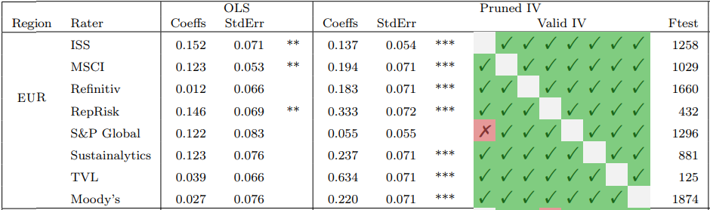
ESG Confusion
Propose two noise-correction procedures (instrument ESG ratings with ratings of other ESG rating agencies)
After correcting for attenuation bias of ESG noises, the effect of ESG performance on stock returns is stronger than previously estimated.
Other ongoing ESG improvement: https://mitsloan.mit.edu/ideas-made-to-matter/why-sustainable-business-needs-better-esg-ratings
Berg, F., Koelbel, J. F., Pavlova, A., & Rigobon, R. (2022). ESG confusion and stock returns: Tackling the problem of noise (No. w30562). National Bureau of Economic Research. Table © the authors. All rights reserved. This content is excluded from our Creative Commons license. For more information, see https://ocw.mit.edu/help/faq-fair-use/.
Notes:
data from six prominent ESG rating agencies: KLD, Sustainalytics, Moody’s ESG (Vigeo-Eiris), S&P Global (RobecoSAM), Refinitiv (Asset4), and MSCI.
https://mitsloan.mit.edu/ideas-made-to-matter/why-sustainable-business-needs-better-esg-ratings
There are three factors driving ratings divergence. Scope divergence occurs when ratings are based on different attributes — for example, one rating service includes carbon emissions or labor practices while another does not — which leads to ratings inconsistencies. Measurement divergence happens when agencies measure the same attributes, but do so using different raw data, which results in different assessments. The last factor relates to weights divergence, which emerges when ESG ratings agencies take different views on the relative importance of attributes.

