Slide 1
SRE Economics Lecture 9
Financing Sustainable Real Estate at the Asset Level
Siqi Zheng
(MIT Center for Real Estate)
Notes:
Brief recap of the econ lectures before the mid-term.
Now, we are going to explore the capital market: capital allocation to sustainable RE, vs. non-sustainable.
Use something from the recent news to motivate: Blackrock, Larry Fink, rationale.
Larry Fink’s 2020 letter to CEOs “a fundamental reshaping of finance”: “As an asset manager and fiduciary to our clients, BlackRock invests in companies on behalf of people in dozens of countries of their pensions, etc. We have a deep responsibility to promote long-term value. Climate change has become a defining factor in companies’ long-term prospects.” Awareness is rising, disclosure should be improved.
In his 2021 letter, accelerated net-zero transition: “the reallocation of capital accelerated even faster than I anticipated. In 2020, investors in mutual funds and ETFs invested $288 billion globally in sustainable assets, a 96% increase over the whole of 2019. Policy: 127 governments – responsible for more than 60% of global emissions – are considering or already implementing commitments to net zero by the mid-century”
Two levels: asset level; portfolio level.

Slide 2


Course Structure – after Spring Break
ECONOMICS | BUSINESS | DESIGN | PANELS + Final Project
ECON 1-2 Green Buildings
ECON 3 Healthy Buildings
ECON 4 Green Cities
ECON 5-7 Climate and RE
ECON 8 Policy
ECON 9 Asset-level Financing
ECON 10 Portfolio-level Financing
ECON 11 Broader capital market
BUS 1 Winthrop Center
BUS 2 425 Park Ave
BUS 3 EDGE
BUS 4 Taurus
BUS 5 Boston Properties
DES 1 Building and Urban Design Strategies
DES 2 Operation and Data Management
DES 3 Process and Modeling
P 1 Green Transition and Data Strategy
P 2 ESG Performance
Final Project
Carlos Davila
(guest-instructor)
Environmental Performance Director at KPF New York
Charles Steelman
(guest-instructor)
MSRED 2016 Graduate, MIT;
Co-Founder and Partner, Cobalt Development Partners
Left: © Carlos Davila; right © Charles Steelman. All rights reserved. This content
is excluded from our Creative Commons license. For more information, see
https://ocw.mit.edu/help/faq-fair-use/.

Slide 3



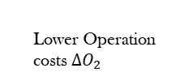


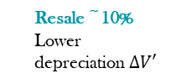




Is There a Business Case for Sustainable RE?
Developers
Owners
0 ~ 43%
Higher Sale Price $∆V$
Rental 0 ~ 17%
Occupancy 0~23%
Higher Effective Rent $∆R$
Resale ~10%
Lower depreciation $∆V′$
Benefit
Design/Construction
Sale
Tenancy
Operation
Refurbishment/Acquisition
Aggregate operating cost -14~26%
Lower Operation costs $∆O_{1}$
$$year T$$
Cost
0 ~ 12.5%
Higher Upfront cost $∆C$
0 ~ 43%
Higher Purchaing Price$∆V$
Lower discount rate i (expected rate of return, cost of capital)
Less hospital stays
Learn faster
Higher Productivity/Health/
WB $∆H$
Tenants
Operation
Tenancy
Operation
Tenancy
© source unknown. All rights reserved. This content is excluded from our Creative
Commons license. For more information, see https://ocw.mit.edu/help/faq-fair-use/.
Lower Operation costs $∆O_{2}$
Higher Rent$∆R$

Slide 4
Outline
Big picture: Sustainable finance + RE
Debt: Mortgage markets
  Mortgage markets and climate risks (-) : default risk and securitization
  Mortgage markets and sustainable buildings (+): default risk and green mortgages
Equity: Private equity funds for sustainable real estate
Notes:
Paralellism

Slide 5
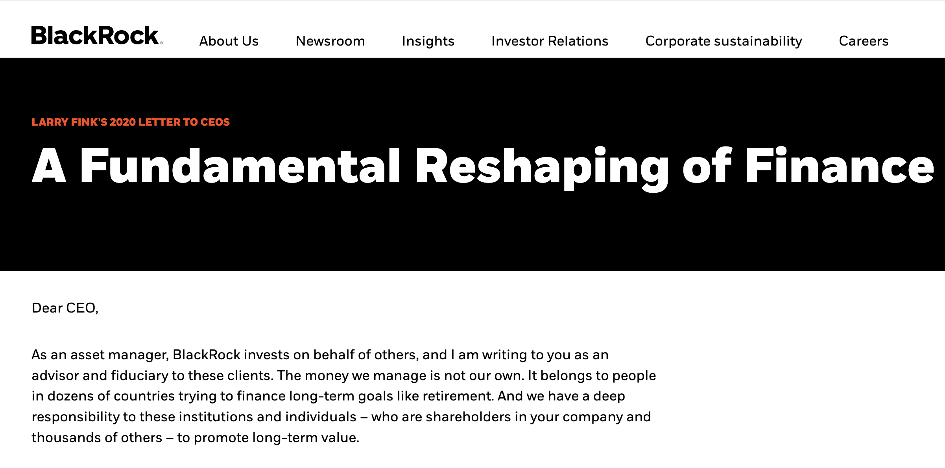

© Black Rock, Inc. All rights reserved. This content is excluded from our Creative
Commons license. For more information, see https://ocw.mit.edu/help/faq-fair-use/.

Slide 6
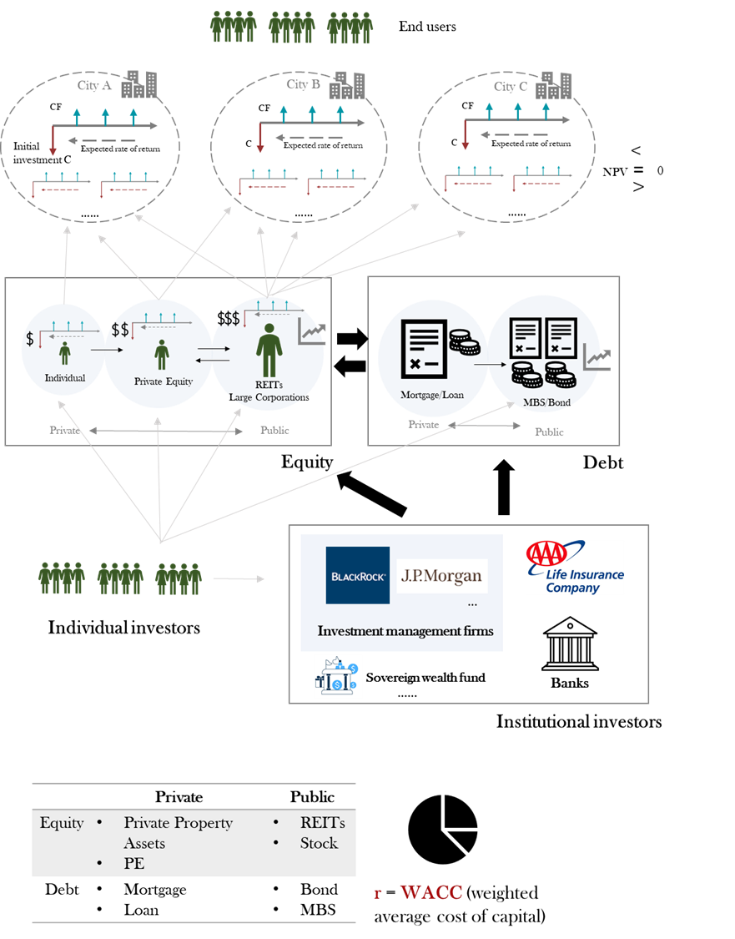
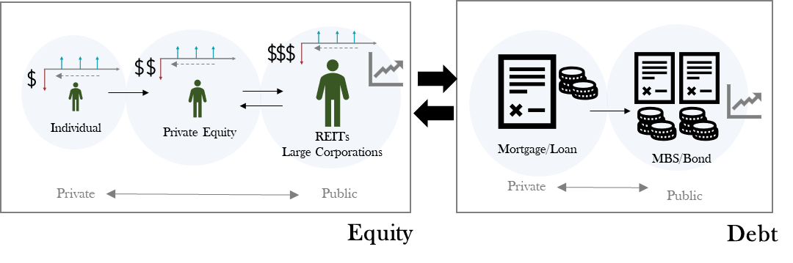
Big Picture
Where we are for this class?
Asset level financing!
Graph icon © JIPM; other clip art icons © source unknown; corporate logos © BlackRock,
JP Morgan Chase & Co., and AAA Life Insurance Co. All rights reserved. This content is
excluded from our Creative Commons license. For more information, see
https://ocw.mit.edu/help/faq-fair-use/.
Notes:
People are driving this rapid transition towards sustainability: (1) individual investors to Blackrock (their pension), M.P. Morgan… Their preferences, long-term goals, values, prosperity; (2) end-users: want healthy, energy efficient, climate resilient places to live, work, play…

Slide 7







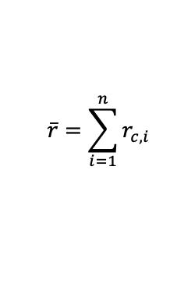




Capital Market Space Market
7
1
debt
CF
2
6
3
equity
5
4
Cost of capital
investor
$$<$$
(YES)
$$<$$
(NO)
$$\overline{r}=\sum_{i=1}^{n}{r_{c,i}}$$
$$r_{market}$$
$$=$$
$$NPV$$
$$=$$
$$0$$
(NO)
(YES)
$$>$$
$$>$$
Cost of capital
(capital’s requirement)
Market fundamentals

Slide 8
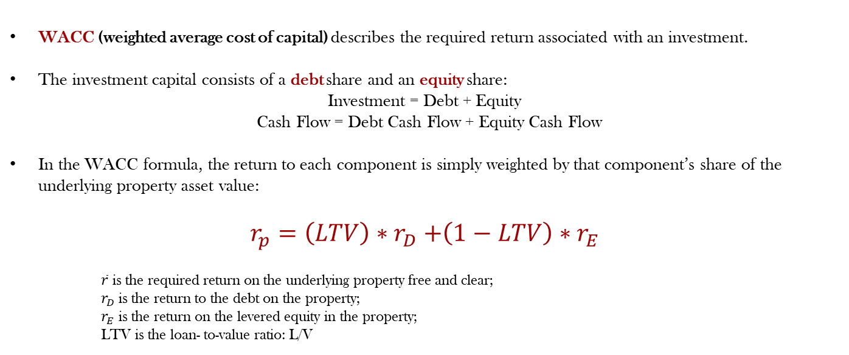
Cost of capital in real estate investments
WACC (weighted average cost of capital) describes the required return associated with an investment.
The investment capital consists of a debt share and an equity share:
Investment = Debt + Equity
﻿ Cash Flow = Debt Cash Flow + Equity Cash Flow
In the WACC formula, the return to each component is simply weighted by that component’s share of the underlying property asset value:
$$r_{p}=\left(LTV\right){∗r}_{D}+\left(1−LTV\right)∗r_{E}$$
$\overline{r}$ is the required return on the underlying property free and clear;
$r_{D}$is the return to the debt on the property;
$r_{E}$ is the return on the levered equity in the property;
LTV is the loan- to-value ratio: L/V

Slide 9




A Simplified Framework for Sustainable Finance (1)
Investor
$$$$$$$$ Capital Allocation Problem
W₁
W₂
W₃
W₄
A
B
C
D
Green Buildings
Brown Buildings
S&P 500
US Treasury Bond
Portfolio

Slide 10
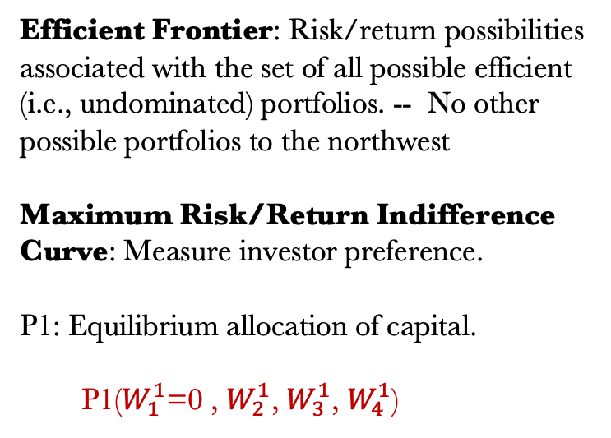
A Simplified Framework for Sustainable Finance (2)
Portfolio Theory – when there is no green building
Efficient Frontier: Risk/return possibilities associated with the set of all possible efficient (i.e., undominated) portfolios. -- No other possible portfolios to the northwest
Maximum Risk/Return Indifference Curve: Measure investor preference.
P1: Equilibrium allocation of capital.
P1($W_{1}^{1}$=0 , $W_{2}^{1}$, $W_{3}^{1}$, $W_{4}^{1}$)
Expected Return
E(r)
Indifference Curve
Efficient Frontier
S&P 500
P1
Brown Buildings
Bond
Risk
Notes:
Dashed lines: efficient return for pairwise combination of assets.

Slide 11
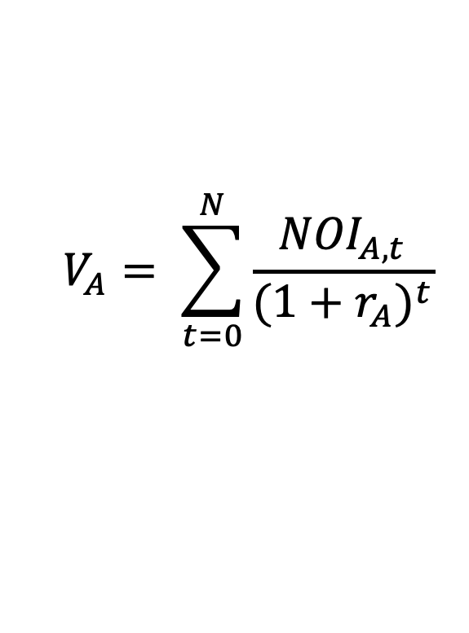
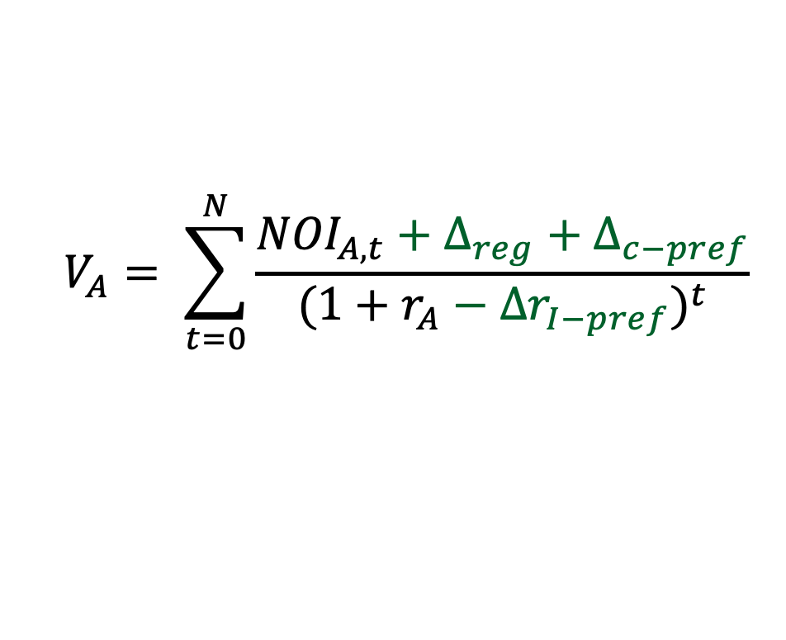
A Simplified Framework for Sustainable Finance (3)
Think about Asset A (Green Building)
Positive Externality
Regulation
Preference
$$V_{A}= \sum_{t=0}^{N}{\frac{{NOI}_{A,t}}{(1+r_{A})^{t}}}$$
(consumer)
$$V_{A}= \sum_{t=0}^{N}{\frac{{NOI}_{A,t}+∆_{reg}+∆_{c−pref}}{(1+r_{A}−{∆r}_{I−pref})^{t}}}$$
(investor)

Slide 12

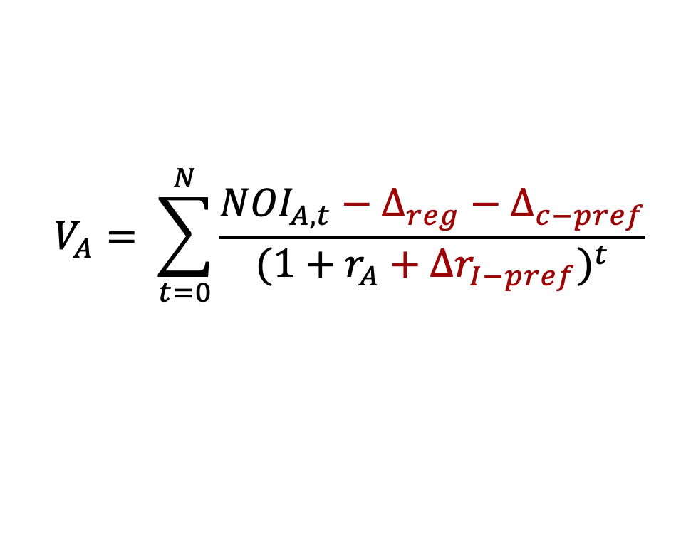
A Simplified Framework for Sustainable Finance (4)
A reverse example: Brown building or buildings in floodplain.
Negative Externality
Regulation
Preference
(consumer)
$$V_{A}= \sum_{t=0}^{N}{\frac{{NOI}_{A,t}−∆_{reg}−∆_{c−pref}}{(1+r_{A}+{∆r}_{I−pref})^{t}}}$$
$${NPV}_{A}= \sum_{t=0}^{N}{\frac{{NOI}_{A,t}}{(1+r_{A})^{t}}}$$
(investor)

Slide 13
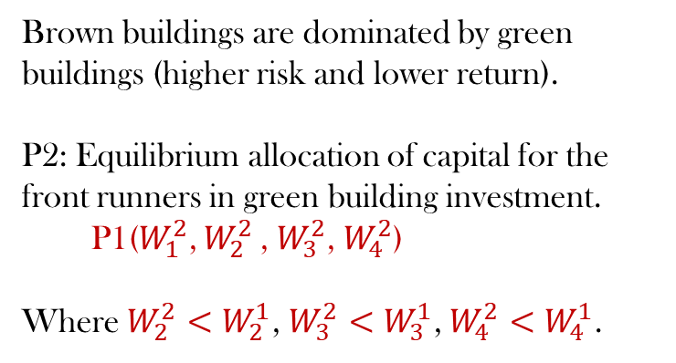
A Simplified Framework for Sustainable Finance (5)
Portfolio Theory
Expected Return
E(r)
Indifference Curve
Brown buildings are dominated by green buildings (higher risk and lower return).
P2: Equilibrium allocation of capital for the front runners in green building investment.
P1($W_{1}^{2}$, $W_{2}^{2}$ , $W_{3}^{2}$, $W_{4}^{2}$)
Where $W_{2}^{2}<$ $W_{2}^{1}$, $W_{3}^{2}<$ $W_{3}^{1}$, $W_{4}^{2}<$ $W_{4}^{1}$.
Efficient Frontier
P2
S&P 500
P1
Green Buildings
Brown Buildings
Bond
Risk

Slide 14
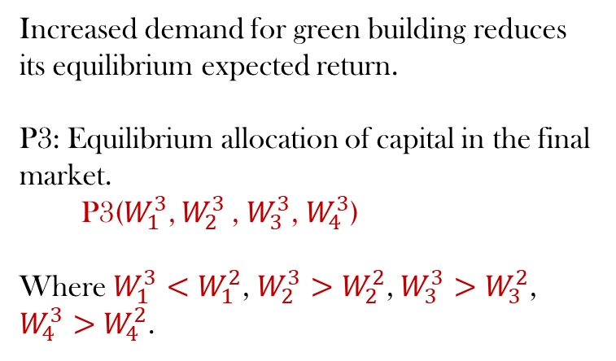
A Simplified Framework for Sustainable Finance (6)
Portfolio Theory
Expected Return
E(r)
Indifference Curve
Increased demand for green building reduces its equilibrium expected return.
P3: Equilibrium allocation of capital in the final market.
P3($W_{1}^{3}$, $W_{2}^{3}$ , $W_{3}^{3}$, $W_{4}^{3}$)
Where $W_{1}^{3}<$ $W_{1}^{2}$, $W_{2}^{3}>$ $W_{2}^{2}$, $W_{3}^{3}>$ $W_{3}^{2}$, $W_{4}^{3}>$ $W_{4}^{2}$.
Efficient Frontier
P2
S&P 500
P3
Green Buildings (front runner)
Green Buildings’ (market equi.)
P1
Brown Buildings
Bond
Risk

Slide 15

Real Estate Investment Vehicles
There Are Multiple Ways to Invest in Real Estate beyond Buying a Building
 | PRIVATE | PUBLIC
EQUITY | Private property assets Private equity (PE) fund | REITs Corporate stock
DEBT | Loans Mortgages | Debt securities (MBS) Corporate RE Bonds
Notes:
Today and next class we are going to talk about the yellow part.

Slide 16
Outline
Big picture: Sustainable finance + RE
Debt: Mortgage markets
  Mortgage markets and climate risks (-) : default risk ↑ and securitization
  Mortgage markets and sustainable buildings (+): default risk ↓ and green mortgages
Equity: Private equity funds for sustainable real estate
Notes:
Paralellism – vs. +

Slide 17
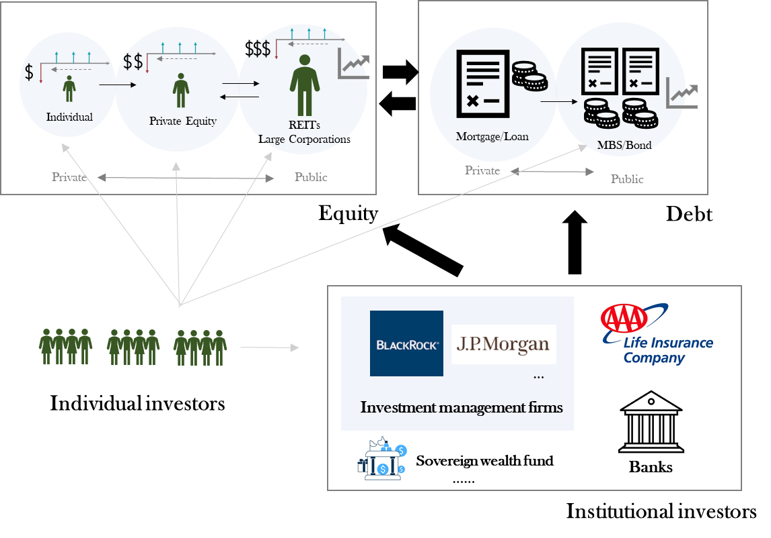
Debt Financing of Sustainable Real Estate (asset level)

Slide 18
Climate Risks in Mortgage Markets
How do we evaluate risks in mortgages?
Delinquency: Failing to make payments as required in the loan documents.
Default risk: You do not pay back your mortgage. The bank gets the house as collateral, the bank has to sell it, with the risk of losing money
$0.5M
Money bank
gets in case of default
Loan WITH
Limited Liability
$0.5M
Value of the property
Source: https://www.sciencedirect.com/science/article/pii/B9780124017436000020#f0025

Slide 19
Climate Risks in Mortgage Markets
How do we evaluate risks in mortgages?
Impacts climate risk on households and housing markets:
Local labor market
Health: Higher mortality/morbidity rate.
Income: Lower productivity.
Local quality of life
Lower subjective well-being because of air pollution, extreme temperatures, and disasters.
Lower demand for real estate
Higher migration away from the area.
Lower rent, occupancy, and real estate prices.
Money bank
gets in case of default
$0.5M
Loan WITH
Limited Liability
Climate risk
$0.5M
Value of the property
Source: https://www.sciencedirect.com/science/article/pii/B9780124017436000020#f0025
Notes:
Add an example: The paper, published in Nature Communications, (https://www.nature.com/articles/s41467-021-23810-9 ) finds that currently 267 million people worldwide live on land less than 2 metres above sea level. Using a remote sensing method called Lidar, which pulsates laser light across coastal areas to measure elevation on the Earth’s surface, the researchers predicted that by 2100, with a 1 metre sea level rise and zero population growth, that number could increase to 410 million people.
Their maps showed that 62% of the most at-risk land is concentrated in the tropics, with Indonesia having the largest extent of land at risk worldwide. These projections showed even more risk in the future, with 72% of the at-risk population in the tropics, and 59% in tropical Asia alone.
Wildfire in Indonesia → real estate value decline.

Slide 20
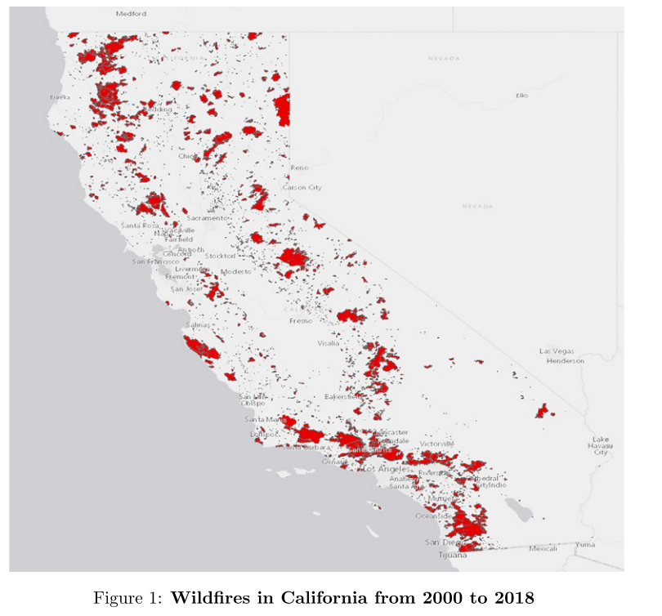
Climate Risks in Mortgage Markets
Impact of wildfires on mortgage default and delinquency
Comparison of mortgage performance in fire zones (the treatment group) with that in 1- and 2-mile rings around the fire.
After a fire, the probability of delinquency/default increases by 1.03% in the treatment group.
Those increases are larger in small fires where insurance are less coordinated.
Source: Issler, P., Stanton, R., Vergara-Alert, C., & Wallace, N. (2020). Mortgage markets with climate-change risk: Evidence from wildfires in California. Available at SSRN 3511843. © Issler et al. All rights reserved. This content is excluded from our Creative Commons license. For more information, see https://ocw.mit.edu/help/faq-fair-use/.
Notes:
﻿However, we also find a more subtle result: the level of default and foreclosure decreases in the size of the wildfire. Specifically, for big fires, the increase in the probability of delinquency is 21.3% lower in the treatment group than in the ring from the fire-zone edge to 1 mile outside the fire zone. Moreover, the increase in delinquency is 68% lower for big than for small fires. We argue that this results from the coordination externalities afforded by large fires, whereby county requirements to rebuild to current building codes and casualty-insurance-covered losses work together to assure that the rebuilt homes will be modernized and thus more valuable than the pre-fire stock of homes. This

Slide 21

The Impact on Freddie Mac and Fannie Mae
Source: http://www.freddiemac.com/research/insight/20200910_unravelling_perceptions_of_flood_risk.page?
What is the impact on Freddie Mac and Fannie Mae?
Hurricane Harvey resulted in significant home price discounts inside the 100-year floodplain.
  Before Harvey, homes inside the flood zone in Harris County, which is home to Houston, sold for 2.3 percent less than those outside the area. After Harvey hit, that discount more than doubled to 5.5 percent.
Fannie Mae and Freddie Mac, the government-sponsored, taxpayer-backed enterprises that stand behind roughly half of the nation’s $11 trillion in residential mortgages.
  Their willingness to purchase the loans on homes provides local lenders with a steady flow of cash to invest in the community.
Owner
Originator
Vast Investors
Freddie Mac; Fannie Mae
Origination
Pooling
Securitization
The Fannie Mae logo ® is a registered trademark of Fannie Mae. The Freddy Mac logo ® is a registered trademark of Fannie Mae. All rights reserved. This content is excluded from our Creative Commons license. For more information, see https://ocw.mit.edu/help/faq-fair-use/.
Notes:
Banks would lend to families in their own communities and, provided they followed certain underwriting criteria, would be eligible to sell the loans to Fannie Mae shortly thereafter, thereby clearing their balance sheet to make more loans.

Slide 22
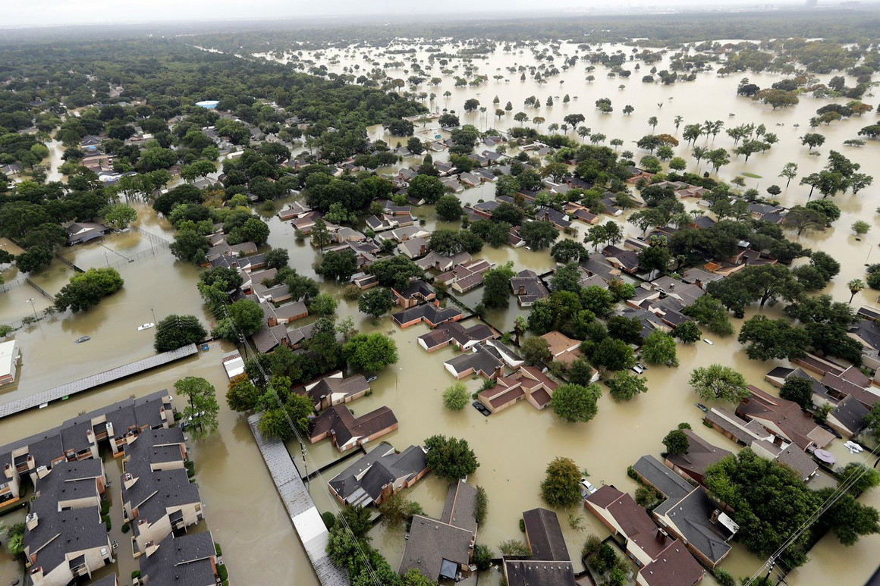
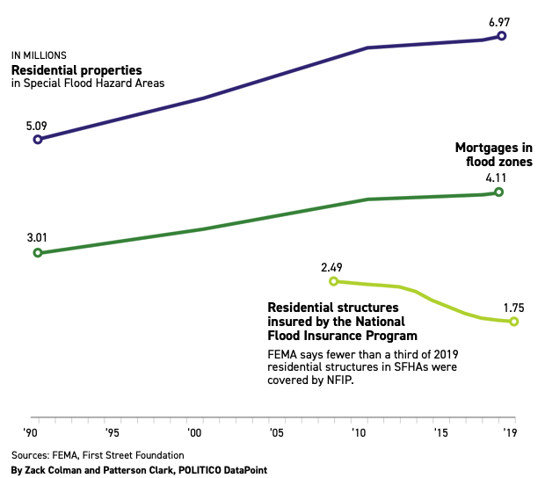
Climate change threatens U.S. mortgage market
Are we creating a new housing bubble?
Fannie and Freddie rely on another government enterprise, the National Flood Insurance Program, to cover the cost of flood damage to homes with their mortgages.
The flood insurance program itself is insolvent after years of paying out more than it collects. Homes in flood plains are overvalued by $34 billion because homebuyers don’t fully price in the high risk of climate-related disasters.
Mortgage in floodplains are rising steadily from 2006 to 2018:
  Nearly 600,000 houses were built in 100-year floodplains, bringing to 7 million homes
  300,000 mortgages were added to homes in floodplains, bringing the total number of loans to 4.1 million.
However, insurance policies in floodplains shrunk:
2.5 million residential structures insured in 2008.
Which had fallen to fewer than 1.8 million in 2019.
Source: https://www.politico.com/news/2020/06/08/borrowed-time-climate-changemortgage-market-304130 © Politico. All rights reserved.
This content is excluded from our Creative Commons license. For more information, see https://ocw.mit.edu/help/faq-fair-use/ .
Notes:
U.S. taxpayers could be on the hook for billions of dollars in climate-related property losses as the government backs a growing number of mortgages on homes in the path of floods, fires and extreme weather.
Violent storms and sunny-day flooding are on the rise, and more houses are being built on at-risk land. But fewer people are buying federally backed flood insurance despite requirements that homeowners in flood plains be insured if their mortgage is backed by taxpayers.
Fannie Mae and Freddie Mac, the government-sponsored, taxpayer-backed enterprises that stand behind roughly half of the nation’s $11 trillion in residential mortgages. For decades, the companies have bought and guaranteed home loans in floodplains and other places vulnerable to natural disasters.
To reduce risk, the companies rely on another government enterprise, the National Flood Insurance Program, to cover the cost of flood damage to homes with Fannie and Freddie mortgages. But the flood insurance program itself is insolvent after years of paying out more than it collects. When Congress tried to fix the program in 2012, it was forced to backtrack after flood insurance premiums billed to homeowners spiked.
In Massachusetts, the average flood insurance premium is $1,294 per year, for about $260,000 in coverage. However, National Flood Insurance Program (NFIP) rates are based on whether your property is in a high-risk flood zone as defined by FEMA. This average accounts for all federally sponsored flood insurance policies active in the Bay State. If your house is located in one of the special flood hazard areas identified by the Federal Emergency Management Agency's (FEMA) flood mapping system, then your mortgage lender may require you to purchase flood insurance coverage.

Slide 23
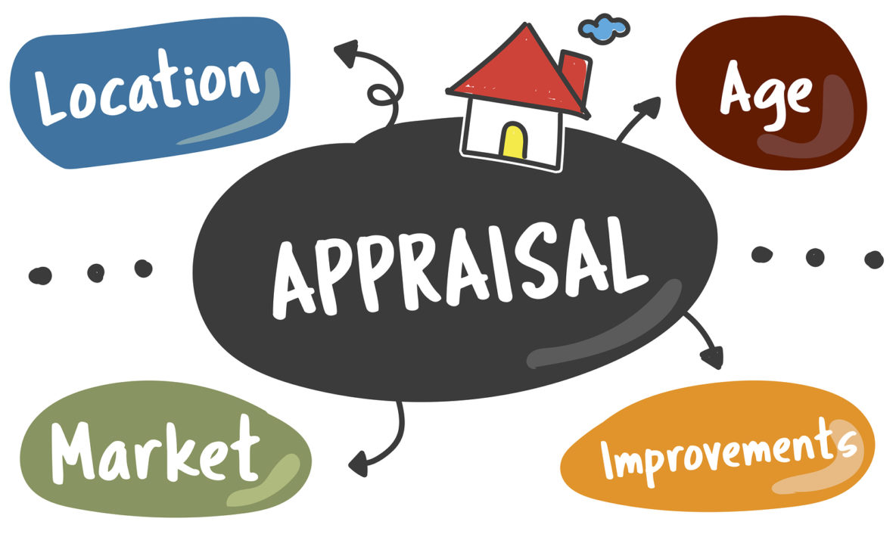

SUL Research: Climate Risk and Appraisal Values
How climate risks lead to mis-valuation of single-family homes in climate-vulnerable neighborhoods in the appraisal process
Step 1: comparing the appraisal value of homes under high climate risk with homes with low risk and otherwise similar attributes. By comparing the “climate risk discount” in the appraisal value and in the transaction value, we can examine how climate risks affect the deviation of appraisal value to the transaction value, i.e., appraisal bias.
Step 2: studying the heterogeneity in the appraisal value difference regarding information provision, actual climate shocks, and neighborhood attributes.
Climate risk?
Data:
Appraisal record and transaction record
Climate risk/shocks data
Regulatory and socio-economic data
Team: Siqi Zheng (MIT), Nils Kok (UM), Juan Palacios (MIT/UM), Dongxiao Niu (UM)
© source unknown. All rights reserved. This content is excluded from our Creative
Commons license. For more information, see https://ocw.mit.edu/help/faq-fair-use/.

Slide 24
Outline
Big picture: Equity and debt financing in sustainable real estate
Debt: Mortgage markets
  Mortgage markets and climate risks (-) : default risk ↑ and securitization
  Mortgage markets and sustainable buildings (+): default risk ↓ and green mortgages
Equity: Private equity funds for sustainable real estate
Notes:
Paralellism – vs. +

Slide 25
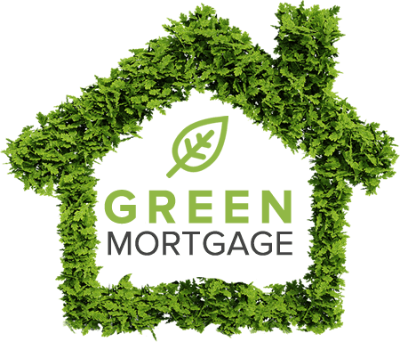
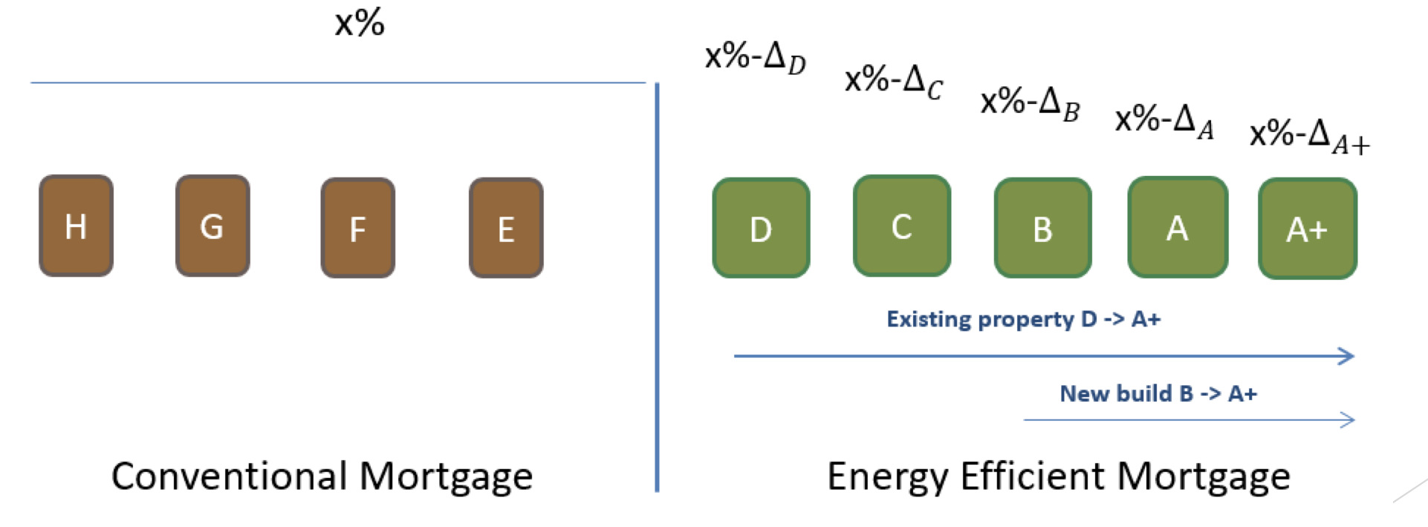
House image © source unknown. All rights reserved. This content is excluded from our Creative Commons license. For more information, see https://ocw.mit.edu/help/faq-fair-use/.
Role of green financing
What is a green mortgage?
As an incentive for the borrower to either buy a green building or to renovate an existing one to make it greener.
The bank would offer either a lower interest rate or an increased loan amount.
Why are lenders interested?
  Lower utility bills for households: The borrower is in a better financial position to be able to repay their loan, reducing the ‘probability of default’.
  Green premiums (vs. brown discount): Decrease in loan-to-value ratio.

Slide 26
A real example
Real-world Example:
Home buyers in the US go to a bank to get mortgage. They find that they might be able to use FHA’s Energy Efficient Mortgage (EEM) to finance their purchase.
If financing regular building:
Maximum allowable monthly payment at 29% is $1,450
Maximum mortgage: $207,300
(Option 1)
Total monthly income: $5,000
If financing green building:
Maximum allowable monthly payment at 33% is $1,650
Maximum mortgage: $235,900
Require a Home Energy Rating System (HERS) report from trained Energy Rater (cost $300-800).
(Option 2)
Notes:
Example source： https://www.mortgageloan.com/environment
FHA Energy Efficient Mortgage, you can qualify for up to 33% of your debt to income ratio (that's the new mortgage payment, plus any existing loan payments vs income) with an EEM but only 29% without.
Energy Efficient Mortgage Programs are supported by the same entities that back the overwhelming majority of residential mortgages in the United States: the FHA (Federal Housing Administration), the VA (Dept. of Veterans Affairs), and Fannie Mae/Freddie Mac (the conventional secondary mortgage market). Energy efficient mortgage lenders include banks, mortgage companies, savings and loans, credit unions – the same type of places you would get a regular mortgage.

Slide 27
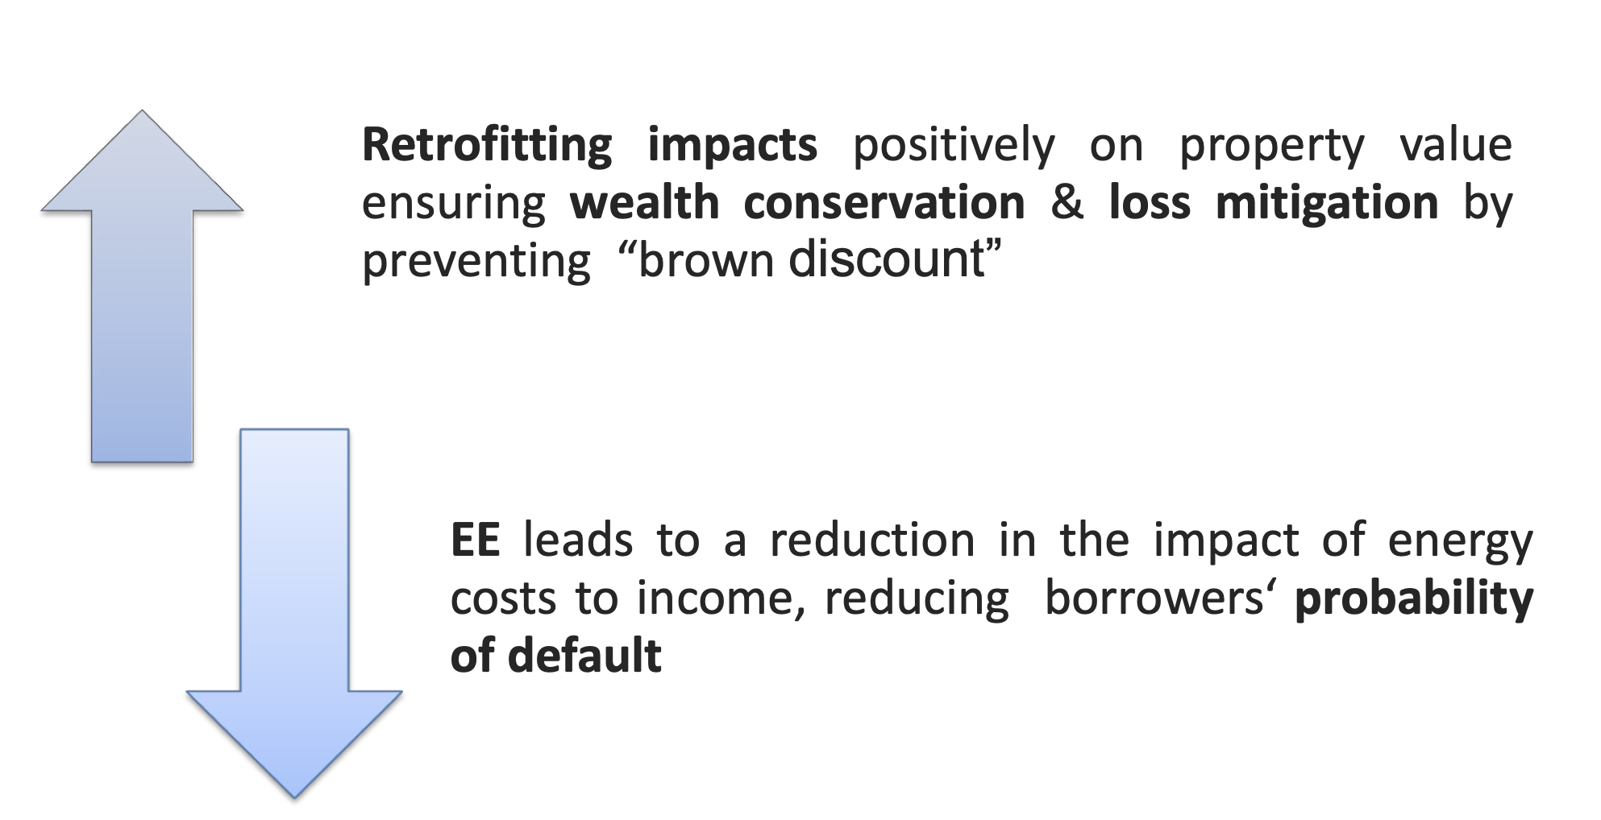
Rationale of green financing
Enhanced loan-to-value via green value
Lower probability of default
Reduced capital charges and/or increased loan size
Notes:
Retrofitting impacts positively on property value ensuring wealth conservation & loss mitigation by preventing “browndiscount

Slide 28
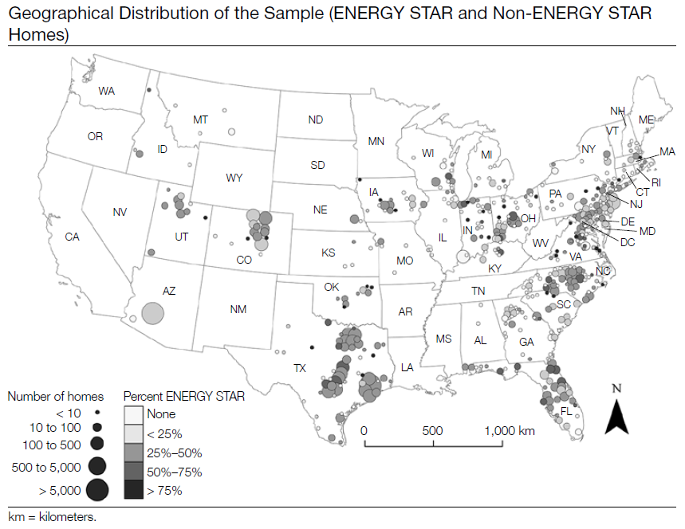
Mortgages & Sustainability: Homes
Energy Efficiency and Mortgage Performance. Evidence from US
Research Question:
Energy Efficiency → Default Risk
A national sample of 71,000 loans from CoreLogic (38 states and the District of Columbia)
Results:
      Energy Efficient houses are one-third less likely than those non-energy efficient houses to default.
Source: Kaza, N., Quercia, R. G., & Tian, C. Y. (2014). Home energy efficiency and mortgage risks. Cityscape, 16(1), 279-298. © Kaza et al. All rights reserved. This content is excluded from our Creative Commons license. For more information, see https://ocw.mit.edu/help/faq-fair-use/.
Notes:
ENERGY STAR certification is associated with substantial and significant reduction in the default and prepayment risks (Table 4).The odds of a mortgage default on an ENERGY STAR residence, ceteris paribus, are one- third less than those on a home in the control group. A mortgage on an ENERGY STAR residence is also one- fourth less likely to be prepaid.With regard to whether
the extent of energy efficiency matters (HERS rating),
the findings are consistent with expectations (Table 4). Controlling for other factors, more efficiency, measured
by a point decrease in the HERS score, is associated with
a decrease in the risk of default by 4% and in that of prepayment by 2%.This suggests that mortgages on more efficient homes exhibit even lower mortgage risks than those on their less-efficient but still ENERGY STAR-rated counterparts

Slide 29
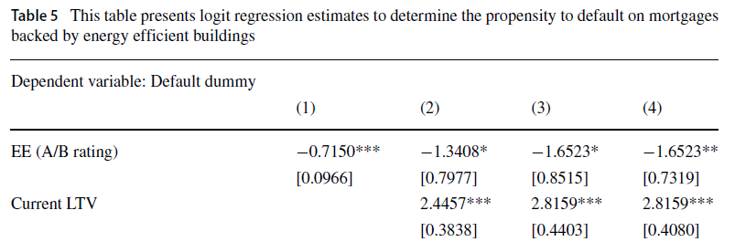
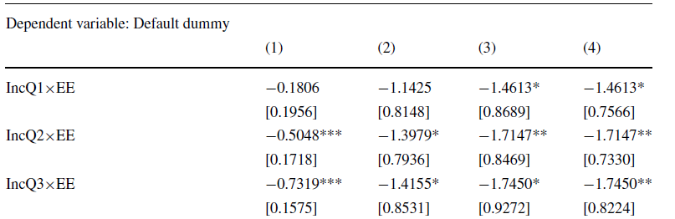
Mortgages & Sustainability: Homes
Why are green buildings less risky? Improvement in borrower’s income
Research Question:
﻿Energy Efficiency → Default Risk
Results:
  Energy efficiency is negatively related to default risk.
  Effect size larger for low income people.
Mechanisms:
Improvements in building performance helps to free-up the disposable income of households.
Left to right: increasingly stringent controls and FEs.
Billio, M., Costola, M., Pelizzon, L. et al. Buildings’ Energy Efficiency and the Probability of Mortgage Default: The Dutch Case. J Real Estate Finan Econ (2021). https://doi.org/10.1007/s11146-021-09838-0 . © Springer Nature. All rights reserved. This content is excluded from our Creative Commons license. For more information, see https://ocw.mit.edu/help/faq-fair-use/.
Notes:
https://www.investopedia.com/terms/d/dscr.asp

Slide 30
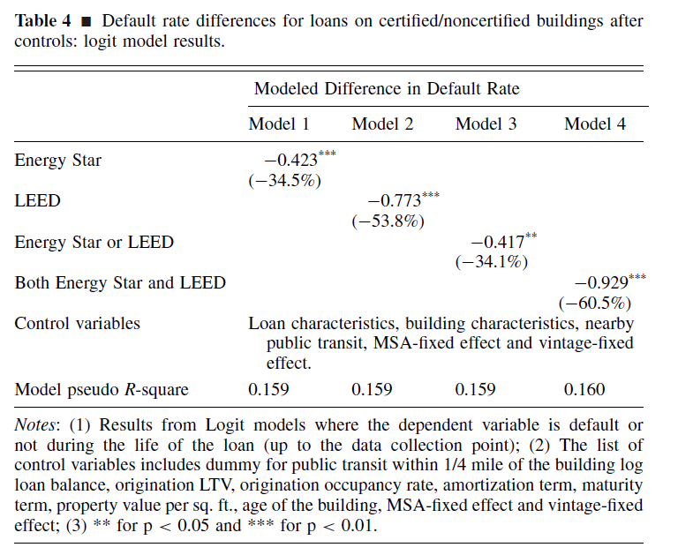
Mortgages & Sustainability: Commercial RE
How do green mortgages perform after securitization?
Research Question:
Green certification → default rate in commercial mortgage-backed securities (CMBS) market.
Method:
Compare default risk of the same loans before and after their collateral buildings became green + cross-sectional differences between green and non-green buildings.
Results:
  ﻿Energy Star buildings have 35% lower default rate than other buildings
  Buildings that were ever LEED had a 54% lower default rate than others.
  Those that were ever both Energy Star and LEED had the lowest default rate of all; nearly 61%
An, X. and Pivo, G., 2020. Green buildings in commercial mortgage‐backed securities: The effects of LEED and energy star certification on default risk and loan terms. Real Estate Economics, 48(1), pp.7-42 . © John Wiley & Sons. All rights reserved. This content is excluded from our Creative Commons license. For more information, see https://ocw.mit.edu/help/faq-fair-use/.

Slide 31
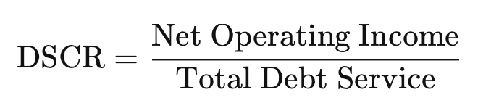
Mortgages & Sustainability
Why are green commercial buildings less risky?
Higher operating income: Higher rents or lower maintenance costs should lead to higher Debt Service Coverage Ratio (DSCR) and therefore default
2. ﻿Lower default risk from green buildings could also come through an improved equity position or LTV channel (lower cap rates)
- ﻿ Green buildings had property value appreciation higher than normal buildings
An, X. and Pivo, G., 2020. Green buildings in commercial mortgage‐backed securities: The effects of LEED and energy star certification on default risk and loan terms. Real Estate Economics, 48(1), pp.7-42
Notes:
https://www.investopedia.com/terms/d/dscr.asp

Slide 32
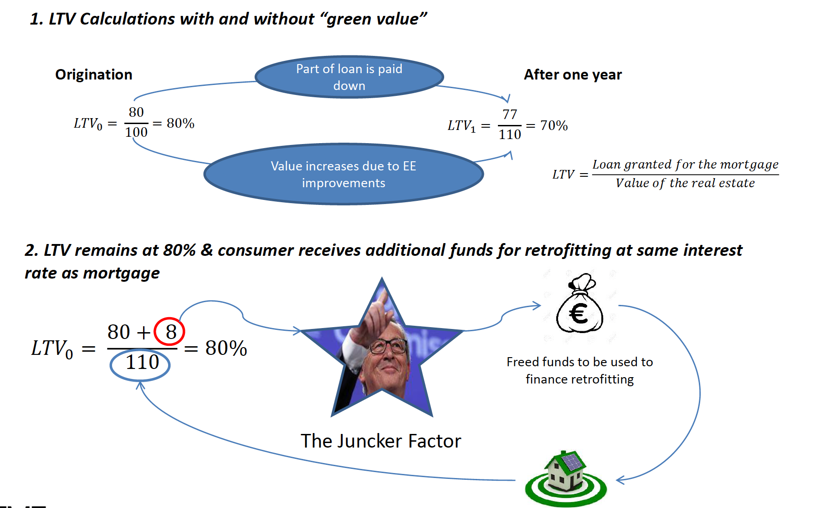
Mortgages & Sustainability
Juncker photo and clip art icons © source unknown. All rights reserved. This content is excluded
from our Creative Commons license. For more information, see https://ocw.mit.edu/help/faq-fair-use/.
Impact of energy efficiency on LTV

Slide 33
Outline
Big picture: Sustainable finance + RE
Debt: Mortgage markets
  Mortgage markets and climate risks (-) : default risk and securitization
  Mortgage markets and sustainable buildings (+): default risk and green mortgages
Equity: Private equity funds for sustainable real estate

Slide 34
Equity Financing of Sustainable Real Estate (asset level)
Graph icon © JIPM; other clip art icons © source unknown; corporate logos © BlackRock, JP Morgan Chase & Co., and AAA Life Insurance Co. All rights reserved. This content is excluded from our Creative Commons license. For more information, see https://ocw.mit.edu/help/faq-fair-use/.

Slide 35
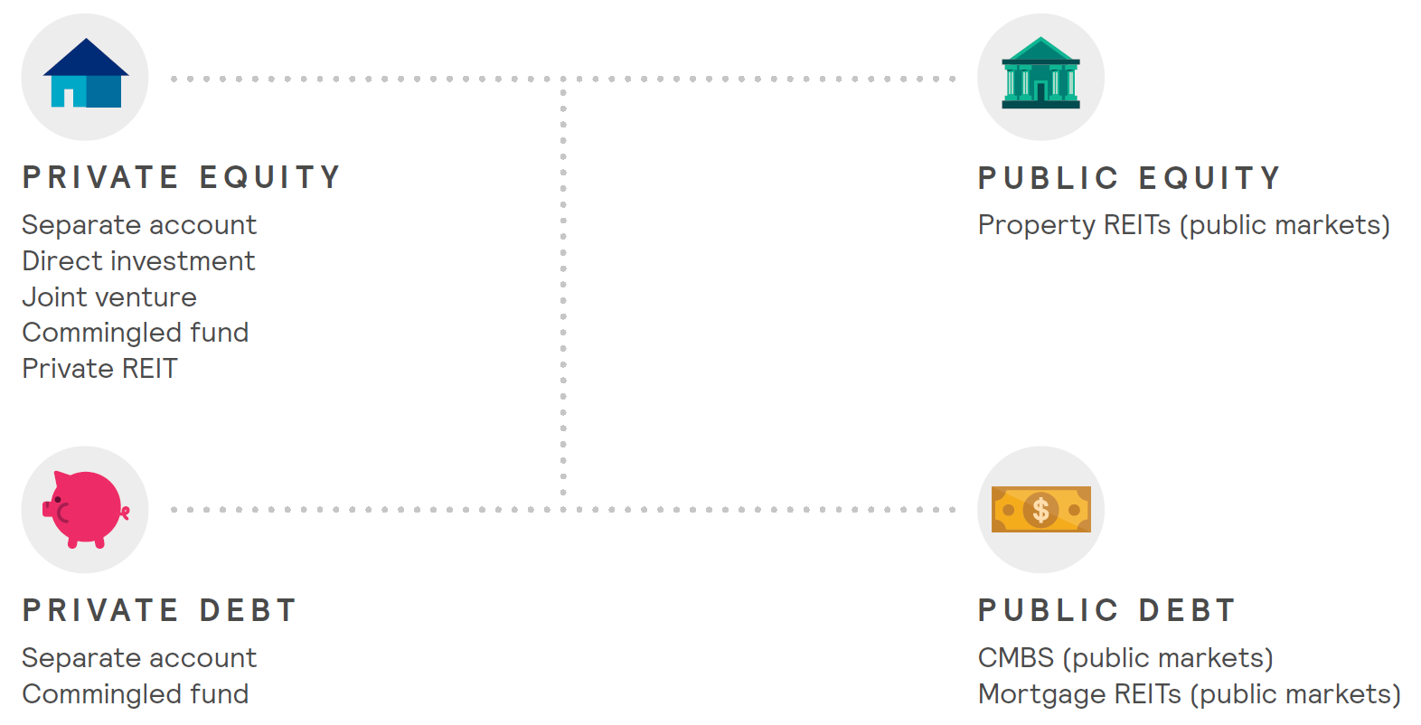
Basics of Real Estate Private Equity
Acquisition of property directly or indirectly.
It is a private, equity investment.
It is not publicly traded on the stock market nor does it invest in debt instruments, although it can take on debt against the underlying assets.
© source unknown. All rights reserved. This content is excluded from our Creative Commons license. For more information, see https://ocw.mit.edu/help/faq-fair-use/.

Slide 36
Basics of Real Estate Private Equity
Indirect investing – two types:
Commingled Fund – many investors (LPs) collectively provide the vast majority (80-100%) of the equity through a variety of potential legal structures and the manager (GP) typically co-invests (5-10%) in the fund, while also earning asset management fees.
Private REIT - same legal and corporate structure as public REITs, but shares are not registered with the SEC and therefore are not publicly traded.
Direct investing: Typically done by large, institutional investors who need to invest at-scale and are prepared to make targeted asset-by-asset investments. Three types: fully direct; separate account; joint venture.
Open Ended vs. Close Ended
Notes:
Three types of Direct investing:
Fully Direct – the investor is also the manager of the property.
Separate Account – the investor provides all of the equity and their investments are acquired and managed by a real estate investment manager for a fee.
Joint Venture – where the investor provides the vast majority (80-95%) of the equity as the sole Limited Partner (LP) and the manager co-invests (5-20%) in the property as the General Partner (GP), while also earning asset management fees.
Open Ended – there is no defined investment horizon and investors may enter and exit the fund at any point in time. Asset values are determined through appraisals on a quarterly basis because the assets continue to be held in the fund, rather than being sold and the equity distributed at the point of sale.
Close Ended – there is a defined investment horizon (generally 5-10 years, with extension options of 1-2 years) before which all of the assets of the fund will be sold and the equity and profit will be distributed to the investors. These funds are highly illiquid and investors generally expect to keep their equity in the fund for the full term.

Slide 37
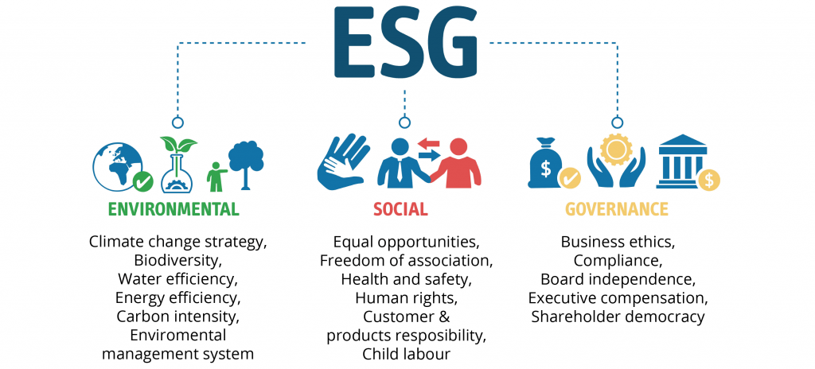
The Role of ESG in PE Investment
Conventional wisdom: “Doing well by doing good”?
ESG is broad and amorphous, notoriously hard to define! And making a better world is not a common business rationale.
“ESG isn’t about doing good for good’s sake; it’s about recognizing what customers really want and turning that into a strategy that creates tangible value.”
(source: https://www.bain.com/insights/esg-investing-global-private-equity-report-2021/)
© source unknown. All rights reserved. This content is excluded from our Creative
Commons license. For more information, see https://ocw.mit.edu/help/faq-fair-use/.

Slide 38
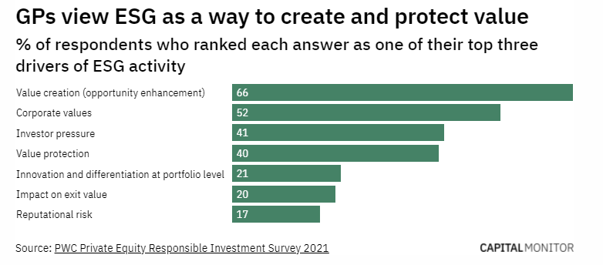
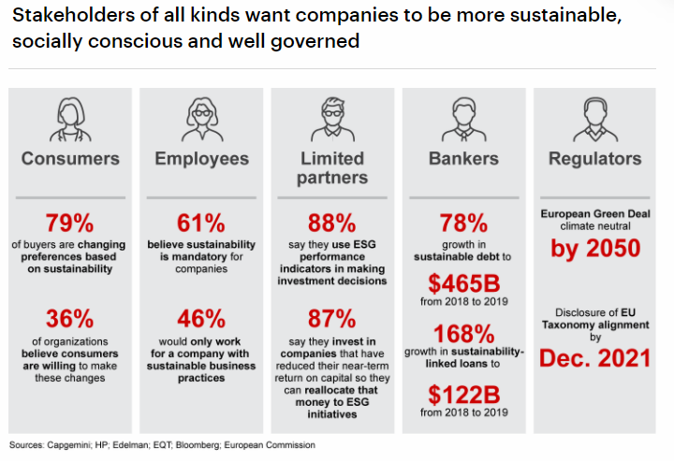
The Role of ESG in PE Investment
Top graphic © EcoVadis; bottom graphic © Bain & Co.. All rights reserved. This content is excluded from our Creative Commons license. For more information, see https://ocw.mit.edu/help/faq-fair-use/.
“Carrots”: Value Creation.
Customer: Grab market share.
79% are changing preferences based on sustainability. Differentiation.
Employee: Attract talent + loyalty.
61% believe sustainability is mandatory and nearly 50% only work for a company with sustainable business practices.
Limited Partner (LP): Get (cheaper) capital.
Financial world views ESG = less risky. 88% of LPs globally use ESG performance indicators in making investment decisions. Can lower cost of capital.
Notes:
Here we need some real examples: look into ZZ’s PE case.

Slide 39

CBRE Report: REPE’s focus on ESG
                60% of respondents to CBRE’s 2021 Global Investor Intentions Survey stated that they have already adopted ESG criteria as part of investment strategies.
Due Diligence:
Questionnaire asking transaction team to fill in environment related information (Energy, Carbon Footprint, Pollution, etc.)
ESG team to run the CREEM model for carbon
Benchmark against GRESB results for energy intensity
Investment benefits of sustainable assets:
-5% operating cost, +4% occupancy, +5% rental income, +14% sales price, -50bps yield
Acquisition:
One slide on ESG in the investment memo.
Prefer certified asset with little physical risk.
Have a grasp of Capex to mitigate risks.
Asset management & Disposition:
Decarbonization audits for asset level planning
Coordinate the timing of retrofits to minimize disruption
Hold and sell decisions are made with consideration of the decarbonization Capex required
(Source: Chen Zhao’s MSRED thesis, 2022). Logo © CBRE. All rights reserved. This content is excluded from our
Creative Commons license. For more information, see https://ocw.mit.edu/help/faq-fair-use/.

Slide 40

PE team at Harrison Street
Due Diligence:
Checklist (questionnaire) to JV partner (GP)
ESG personnel; ESG program; Physical & transition risk assessment; Building certification; Renewable energy, etc.
Mitigation plan if climate risks exist.
ESG enhance the value of the building asset and increase the investor base.
Acquisition:
Dedicated session on ESG in the investment memo.
Evaluation through 3rd party. With asset manager for retrofit potentials. (smart meters, solar potential, etc).
Asset management & Disposition:
(The firms (LP) doesn’t operate the building, but do JV partner or 3rd party operating partner.)
Capture ESG practice as part of the marketing material when selling. E.g., LEED certificate, social programs.
(Source: Chen Zhao’s MSRED thesis, 2022). Logo © Harrison Street Real Estate Capital. All rights reserved. This content
is excluded from our Creative Commons license. For more information, see https://ocw.mit.edu/help/faq-fair-use/.

Slide 41

Akrisht Pandey’s Real Estate Private Equity
© Akrisht Pandey. All rights reserved. This content is excluded from our Creative
Commons license. For more information, see https://ocw.mit.edu/help/faq-fair-use/.

