Slide 1
SRE Econ Lecture 8
Policy as a Game Changer for Sustainable Real Estate
Siqi Zheng
March 2023
(MIT Center for Real Estate)

Slide 2


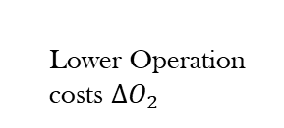


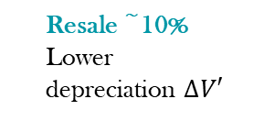
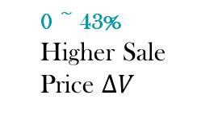

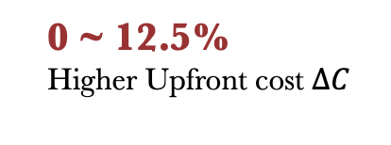
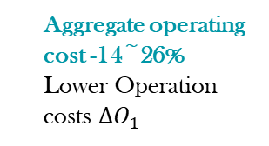
Is There a Business Case for Green Buildings?
Developers
Owners
0 ~ 43%
Higher Sale Price $∆V$
Rental 0 ~ 17%
Occupancy 0~23%
Higher Effective Rent $∆R$
Resale ~10%
Lower depreciation $∆V′$
Benefit
Design/Construction
Sale
Tenancy
Operation
Refurbishment/Acquisition
Aggregate operating cost -14~26%
Lower Operation costs $∆O_{1}$
$$year T$$
Cost
0 ~ 12.5%
Higher Upfront cost $∆C$
0 ~ 43%
Higher Purchaing Price$∆V$
Lower discount rate i (cost of capital)
Less sick days
Learn faster
Higher Productivity/Health/
WB $∆H$
Tenants
Operation
Tenancy
Operation
Tenancy
Lower Operation costs $∆O_{2}$
Higher Rent$∆R$

Slide 3
Market Failures Threaten the Three Bottom Lines
People
(Social)
Profit
(Economic)
Planet
(Environmental)
Market Failures:
Information Asymmetry
2. Split Incentive
3. Externality
Sustainable ?
Notes:
Quick recap E2, on the first two failures. Still rely on market mechanisms, but not enough. Government’s intervention is necessary. In fact, this has become a major driving force. Why? Externalities.

Slide 4
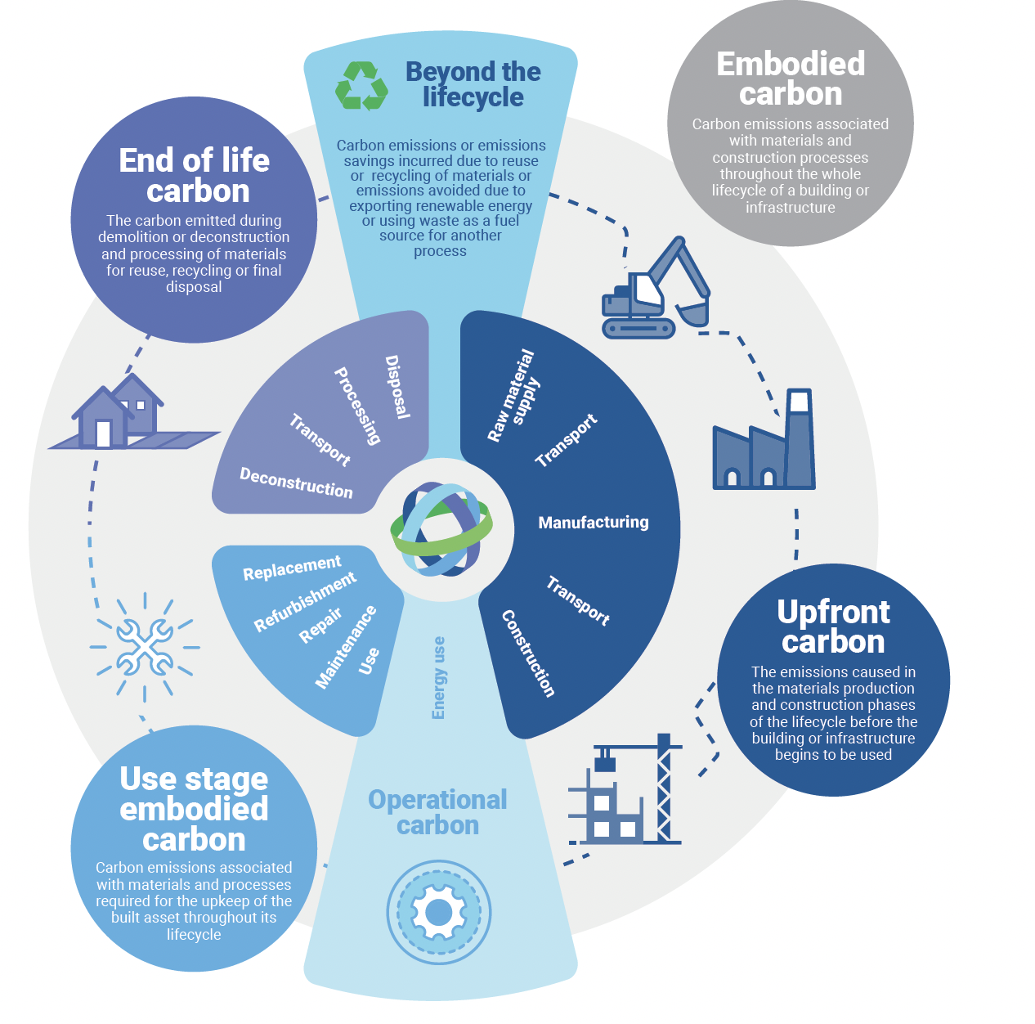
Green Buildings Generate Positive Externalities
Standard policy instruments to address positive externality:
Pigouvian subsidy or tax reduction to incentivize supply side to produce more or demand side to pay higher price.
In reality, state/county:
Tax rebates
Subsidy
Links to other planning goals
(e.g., FAR bonus smart growth, affordable housing )
Without considering externalities, equilibrium in markets will underproduce green buildings
© World Green Building Council. All rights reserved. This content is excluded from our Creative
Commons license. For more information, see https://ocw.mit.edu/help/faq-fair-use/.
Notes:
https://www.worldgbc.org/sites/default/files/WorldGBC_Bringing_Embodied_Carbon_Upfront.pdf
Bringing embodied carbon upfront
Coordinated action for the building and construction sector to tackle embodied carbon

Slide 5
Positive Externality: “Carrots”
P
Demand “subsidy”
(E.g., Mass Save Rebate for home buyers)
P
Supply “subsidy”
(E.g., FAR bonus, Tax credit for builders, etc.)
Positive externality
(Reducing carbon emission)
D2: Marginal Social Benefit
D1: Marginal Private Benefit
Q’
Q*
Green Building
Q’
Q*
Green Building
Market Equilibrium
Social Optimum
Market Equilibrium
Social Optimum
Notes:
Although subsidy is the typical economic tool, in the real world, more flexible formats of incentives are used.

Slide 6
Negative Externality: “Sticks”
to discourage brown buildings
C2: Marginal Social Cost
Supply mandates
(e.g., building codes， EE mandates)
P
P
C1: Marginal Private Cost
Negative externality
Supply “tax”
(E.g., Carbon tax,
Penalty/fine)
Q*
Q’
Brown Building
Q*
Q’
Brown Building
Social Optimum
Market Equilibrium
Social Optimum
Market Equilibrium
Notes:
Although subsidy is the typical economic tool, in the real world, more flexible formats of incentives are used.

Slide 7
The types of policies
 | MITIGATION | ADAPTATION
STICKS (Enforcement) | Minimum EE Standards (UK) Energy Performance Criteria (LL97, NYC/BERDO 2.0, Boston) EE Reporting Mandates | Climate Risk Disclosure Mandates Flood Insurance Mandates
CARROTS (Incentives) | FAR Bonus Tax Credits/Rebates EE Subsidies | Weatherization Programs
Building Codes
Notes:
2. Benchmarking and Transparency Policies: Stimulate market efficiency through transparency
Require owners to measure, report and share their energy consumption and/or certify their buildings
3. Stricter building codes
Forbidding building industry from constructing “brown’’ assets
4. Minimum energy efficiency standards
Restriction on the granting and continuation of existing tenancies for buildings not meeting energy efficiency criteria
4. Subsidize green real state investment
Mainly targeted at energy retrofits (e.g. renovation wave in Europe)
5. Energy performance criteria for existing buildings (NYC LL97)
Already implemented for commercial real estate, politically difficult/impossible for housing

Slide 8
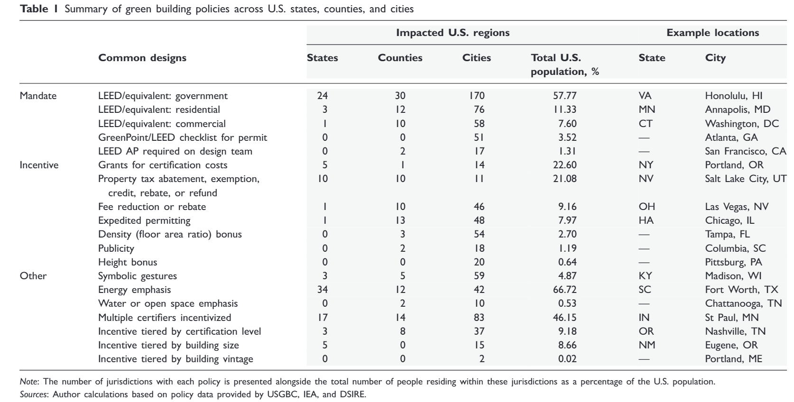
Policy
Matisoff, D. C., Noonan, D. S., & Flowers, M. E. (2016). Policy Monitor—Green Buildings: Economics and Policies. Review of Environmental Economics and Policy, 10(2), 329–346. Content courtesy of Matisoff et al. License: CC BY.
Notes:
Matisoff, D. C., Noonan, D. S., & Flowers, M. E. (2016). Policy Monitor—Green Buildings: Economics and Policies. Review of Environmental Economics and Policy, 10(2), 329–346.

Slide 9


“Carrots”: Subsidies for Retrofit
One of the key programs of the new European Green Deal is the “renovation wave”
The objective is to double the annual energy renovation rate of residential and non-residential buildings by 2030. This will result in 35 million building units renovated by 2030.
EU funding drives such investments for renovation
  The European Council agreed to endow with EUR 672.5 billion, 37% of which would be targeted to renovation investment and energy efficiency-related reforms.
Attracting private investment and stimulating green loan financing
  Member States explore innovative financing solutions as well as taxation tools to generate economic incentives to finance building renovation.
© European Commission. All rights reserved. This content is excluded from our Creative
Commons license. For more information, see https://ocw.mit.edu/help/faq-fair-use/.
Notes:
https://eur-lex.europa.eu/legal-content/EN/TXT/?qid=1603122220757&uri=CELEX:52020DC0662

Slide 10


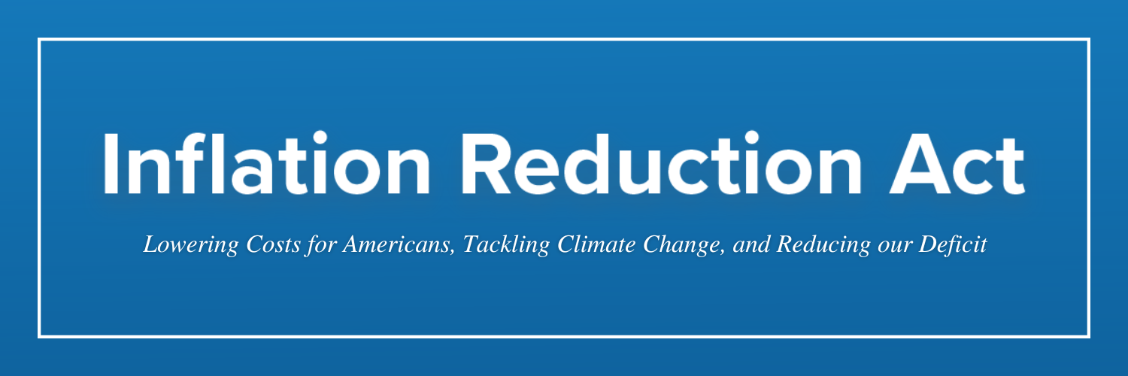
“Carrots”: Subsidies for Green Buildings
Funding opportunities for green buildings: https://archive.epa.gov/greenbuilding/web/html/funding.html#guides
Massachusetts:
Community aggregation
Solarize Massachusetts
HeatSmart Mass
Rebates and technical assistance for renewable energy projects
Hydropower
Commonwealth Wind (CommWind) Program
Left: © MassCEC; right: © MassSave. All rights reserved. This content is excluded from
our Creative Commons license. For more information, see https://ocw.mit.edu/help/faq-fair-use/.
Notes:
Solarize Massachusetts: seeks to increase the adoption of small-scale solar electricity.
HeatSmart Mass: seeks to increase the adoption of small-scale clean heating and cooling technologies
Hydropower: seeks to increase the output of the hydropower assets by providing grants to ecologically-appropriate projects.
Organics-to-Energy: (closed) subsidize organics-to-energy technologies → those that take certain types of waste – including organic materials such as food, animal or yard waste, and convert it to electricity or heat.
Commonwealth Wind (CommWind) Program: assists appropriately-sited wind energy development in Massachusetts.

Slide 11
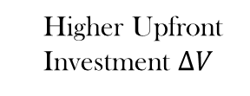


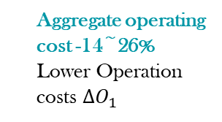

“Carrots”: Subsidies for Green Buildings
Rental 0 ~ 17%
Occupancy 0~23%
Higher Effective Rent $∆R$
Resale ~10%
Lower depreciation $∆V′$
Benefit
Design/Construction
Tenancy
Operation
Refurbishment/Acquisition
Cost
Aggregate operating cost -14~26%
Lower Operation costs $∆O_{1}$
$$year T$$
0 ~ 43%
Higher Upfront Investment $∆V$
Subsidies for green retrofits/renewable energy
Lower discount rate i (expected rate of return)
Owners’
Investment cost decrease

Slide 12
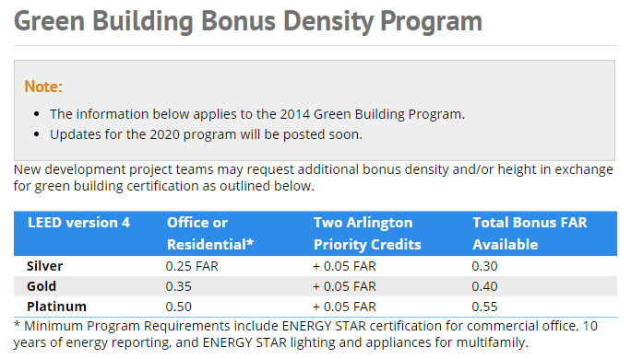
“Carrots”: Density Bonus
Some local governments adopt other formats of subsidy.
Arlington , VA : Green Building Incentive Program
Under 2020 new updates, LEED Gold becomes the minimum level of green building certification required in order to receive bonus density in the program
© Arlington County, VA. All rights reserved. This content is excluded from our Creative Commons
license. For more information, see https://ocw.mit.edu/help/faq-fair-use/.

Slide 13

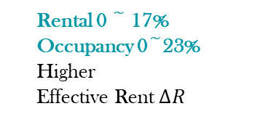
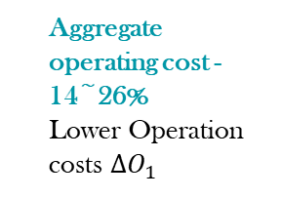
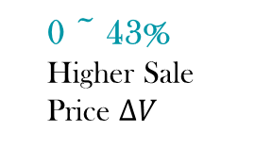


“Carrots”: Density Bonus
Density Bonus
0 ~ 43%
Higher Sale Price $∆V$
Rental 0 ~ 17% Occupancy 0~23%
Higher
Effective Rent $∆R$
Resale ~10%
Lower depreciation $∆V′$
Benefit
Design/Construction
Sale
Tenancy
Operation
Refurbishment/Acquisition
Aggregate operating cost -14~26%
Lower Operation costs $∆O_{1}$
$$year T$$
Cost
0 ~ 12.5%
Higher Upfront cost $∆C$
Higher Purchaing Price$∆V$
0 ~ 43%
Lower discount rate i (expected rate of return)

Slide 14

Balance between sustainability and affordability
Housing affordability = housing cost / household income
Total housing costs can be broken down into*:
Utilities bill
Monthly payments
“Net-Zero” and housing affordability project
If go to net-zero:
will decrease
will increase
Owners: mortgage + taxes + insurance
Renters: rent
Empirical question: Which effect will dominate?
How to mitigate the increased upfront cost?
© HBRA Massachusetts. All rights reserved. This content is excluded from our Creative
Commons license. For more information, see https://ocw.mit.edu/help/faq-fair-use/.

Slide 15
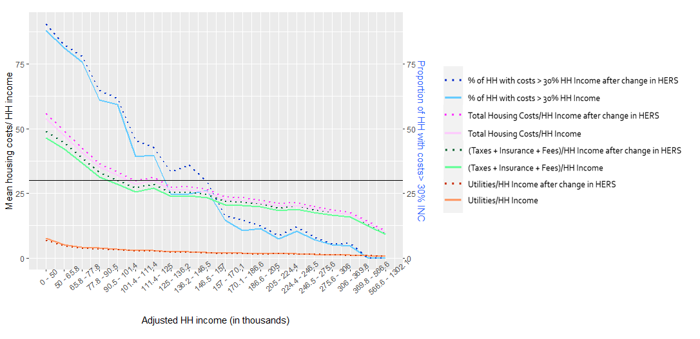
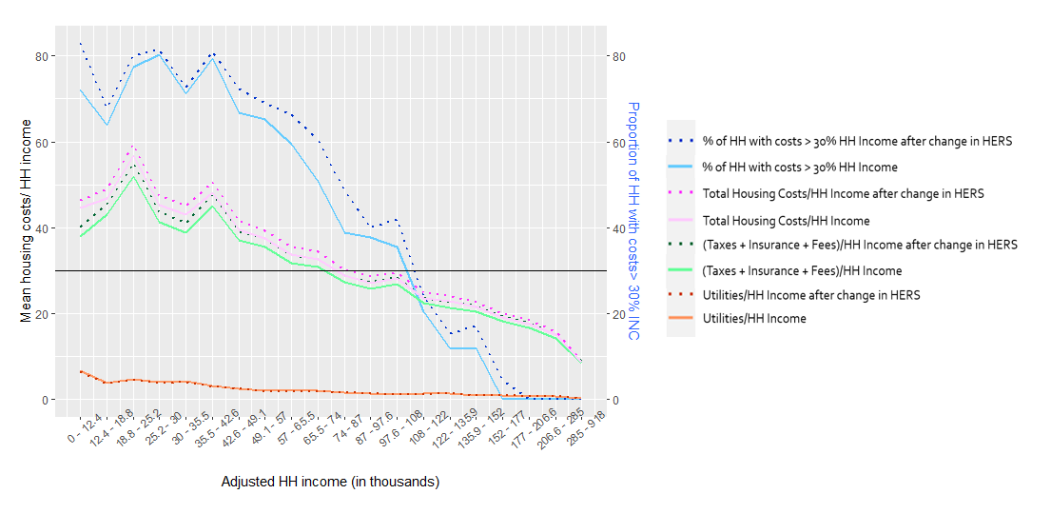
SINGLE-FAMILY HOMES: HERS SCORE 55 TO 42
MULTI-FAMILY HOMES: HERS SCORE 55 TO 42

Slide 16
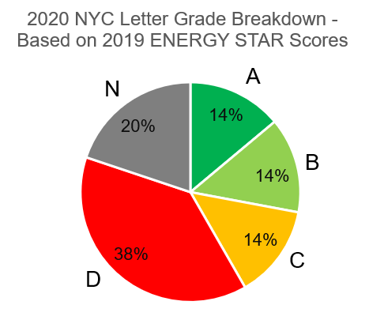
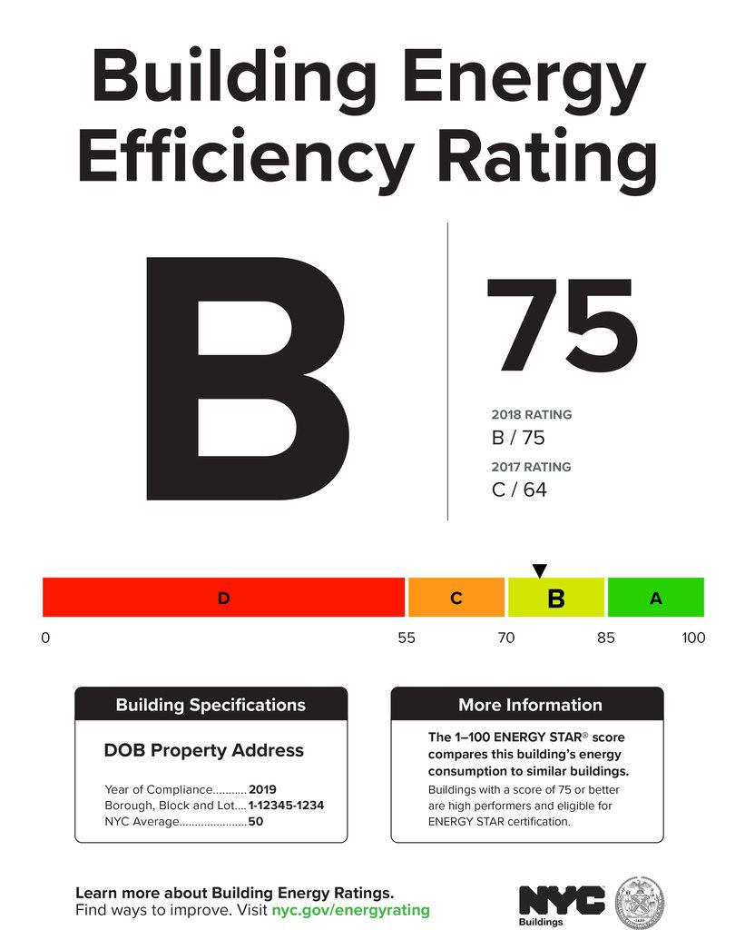
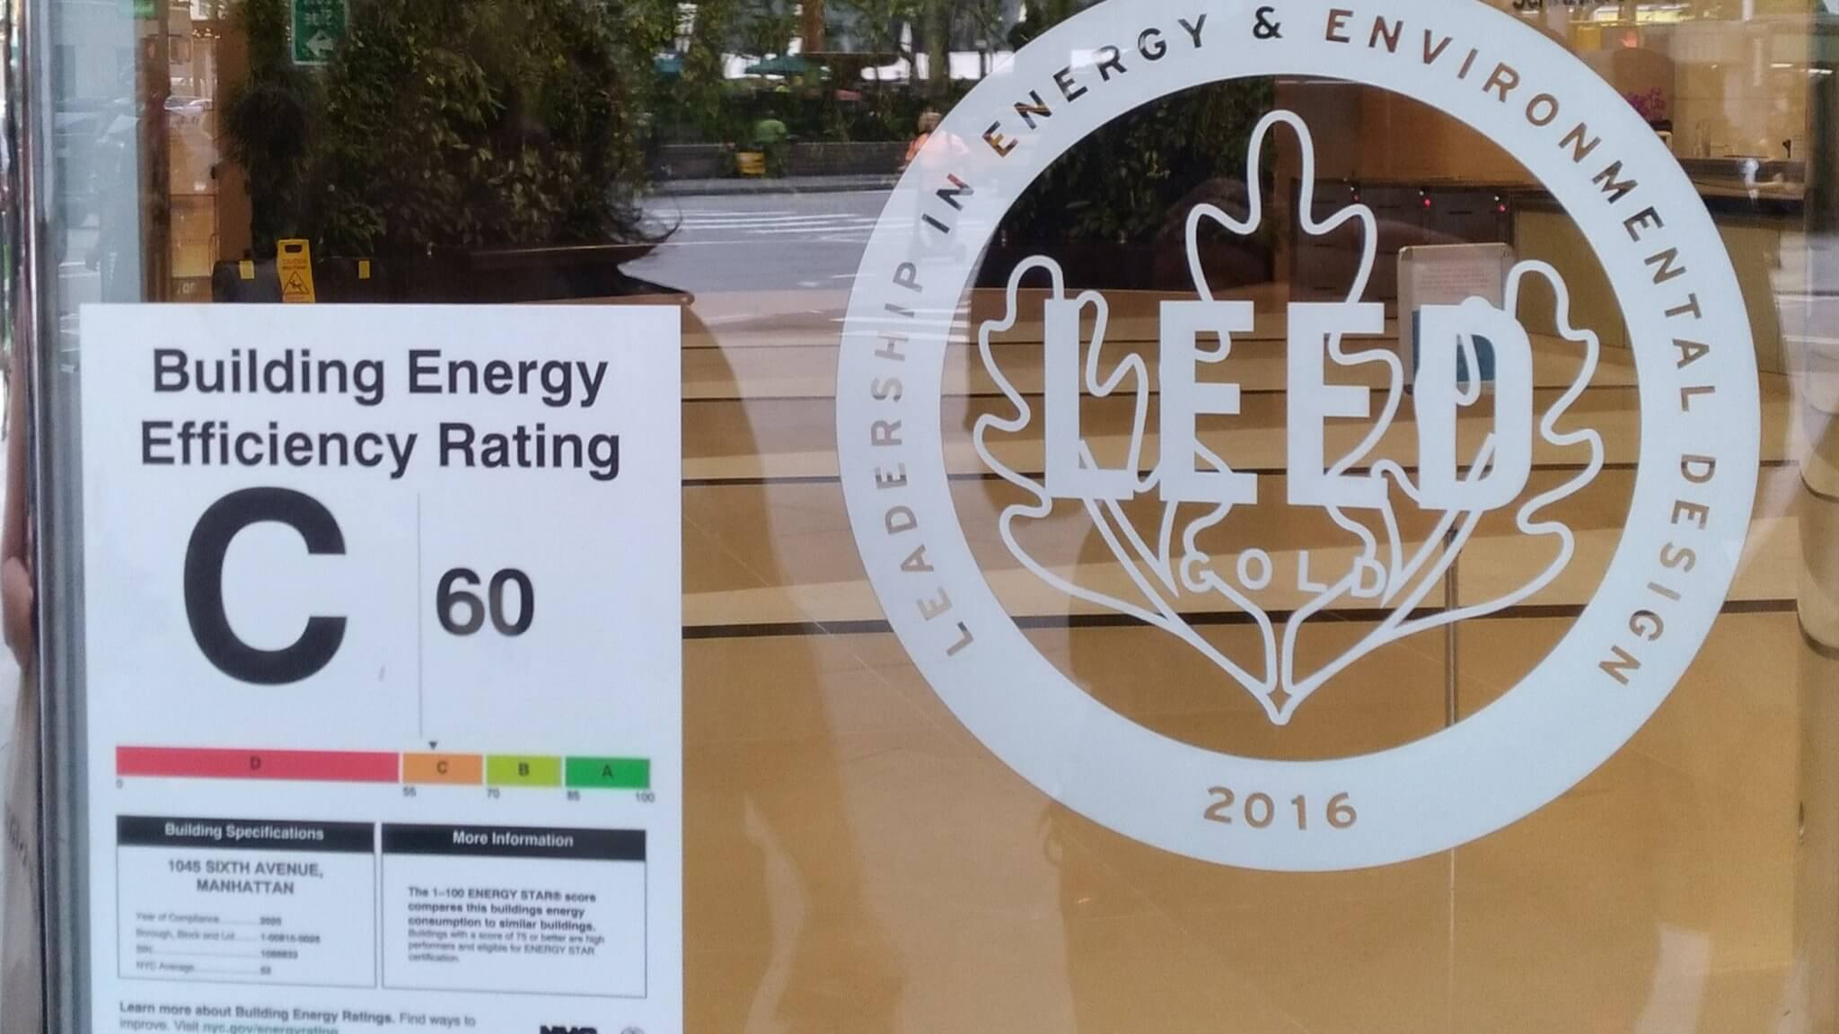
“Sticks”: Energy Efficiency Benchmark and Disclosure
Left: © City of New York; right: source unknown. All rights reserved. This content is excluded from our
Creative Commons license. For more information, see https://ocw.mit.edu/help/faq-fair-use/.

Slide 17
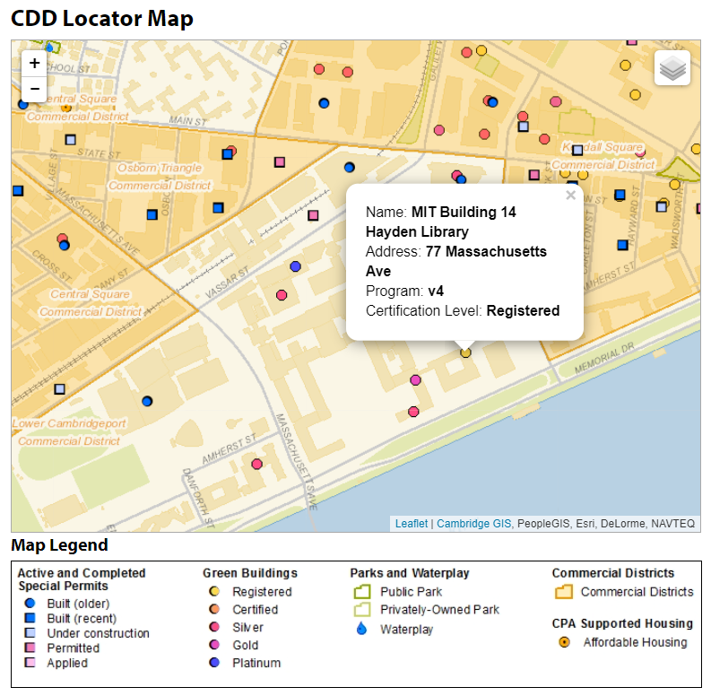
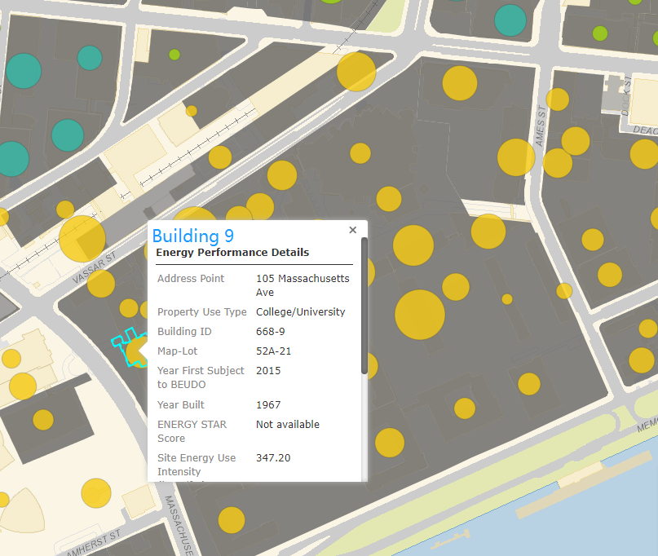

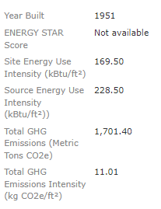
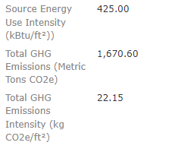
MIT Energy Use Intensity and LEED Certificates
MIT Energy Use Intensity and LEED Certificates.
2018 performance
(gets better after the retrofit)
Source: link.
Source: https://www.cambridgema.gov/CDD/cddlocatormap#map.
© City of Cambridge, MA. All rights reserved. This content is excluded from our Creative
Commons license. For more information, see https://ocw.mit.edu/help/faq-fair-use/.
Notes:
https://sustainability.mit.edu/tab/buildings
All new construction and major renovation projects at MIT must earn at least Gold Certification in the Leadership in Energy and Environmental Design (LEED) v4 Rating System.
Building 14, and 37/38 just completed sustainability enhancement renovation in 2021.
https://capitalprojects.mit.edu/projects/hayden-library-building-14
Three buildings in design: MET Wharehouse (our new School building); College of Computing and the Music Building.

Slide 18

MIT Hayden Library
LEED Gold V4 Certification
Fitwel Health Certification
Material:
“Red List Free” materials for all interior finish materials and fabrics
Water:
Use 1.0 gallon-per-flush toilets.
Energy:
  Reduce thermal loss by replacing single-pane glass in the large bay windows with high-performance sealed insulated windows.
  Update air-handling units and perimeter radiators with new controls to optimize energy use.
  Upgrade all lighting to low-energy LEDs controlled with daylight and occupancy sensors.
  EnergyStar appliances throughout the building.
Source: https://libraries.mit.edu/future-spaces/project-facts/ . © Massachusetts Institute of Technology. All rights reserved. This content is excluded from our Creative Commons license. For more information, see https://ocw.mit.edu/help/faq-fair-use/.
Notes:
https://sustainability.mit.edu/tab/buildings
All new construction and major renovation projects at MIT must earn at least Gold Certification in the Leadership in Energy and Environmental Design (LEED) v4 Rating System.
Building 14, and 37/38 just completed sustainability enhancement renovation in 2021.
https://capitalprojects.mit.edu/projects/hayden-library-building-14
Three buildings in design: MET Wharehouse (our new School building); College of Computing and the Music Building.

Slide 19
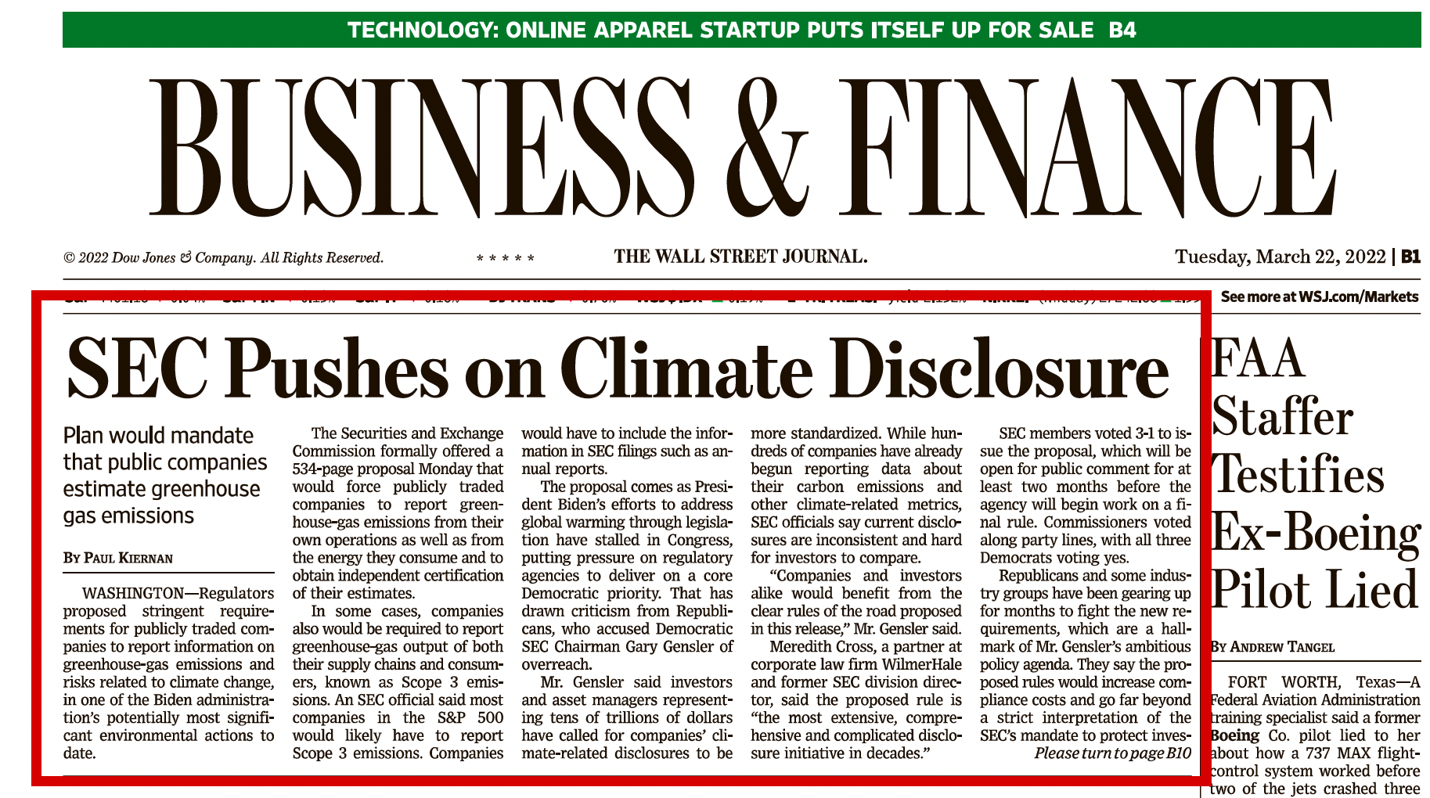
© Wall Street Journal. All rights reserved. This content is excluded from our Creative
Commons license. For more information, see https://ocw.mit.edu/help/faq-fair-use/.

Slide 20
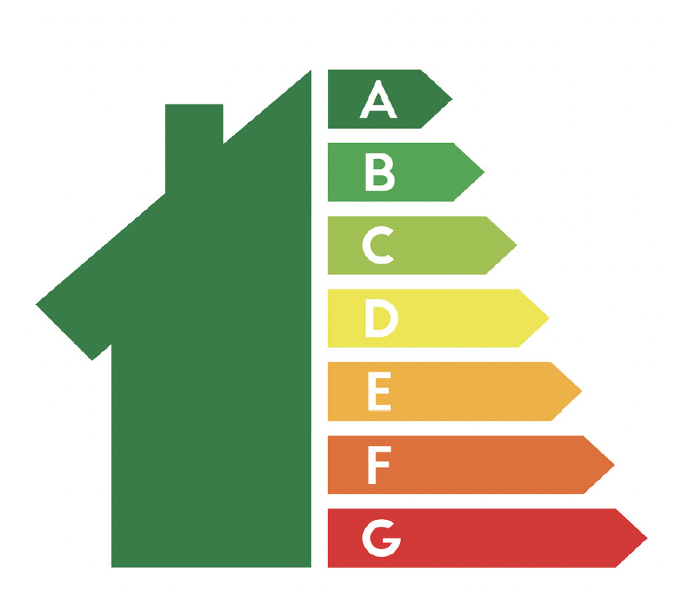
“Sticks”: Minimum Energy Efficiency Standards (MEES, UK)
Energy Performance Certificate (EPC) labels in European markets rank buildings from A (highest energy efficiency) to F (lowest energy efficiency)
Since 1 April 2020, landlords can no longer let or continue to let properties if they have an EPC rating below E
Properties with EPC rating of F or G, need to improve the property’s rating to E
© Source unknown. All rights reserved. This content is excluded from our Creative
Commons license. For more information, see https://ocw.mit.edu/help/faq-fair-use/.
Notes:
https://www.rics.org/globalassets/rics-website/media/knowledge/research/insights/mees-impact-on-uk-property-management-and-valuation-rics.pdf

Slide 21



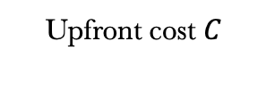


“Sticks”: Minimum Energy Efficiency Standards (MEES, UK)
When a property is non-compliant with the energy standards, asset value will be affected:
  Disruption in income flow (risk of property being vacant)
  Require a capital injection to bring the property up to standards
CF: Rental income - Operating costs (e.g. energy)
MEES
Effective Rent $R$
Depreciation $V′$
Benefit
Sale Price $V$
Sale
Tenancy
Operation
Design/Construction
Refurbishment/Acquisition
Operation costs $O_{1}$
$$year T$$
Upfront cost $C$
Cost
Purchasing Price$V$
Discount rate i (expected rate of return)
Notes:
https://www.rics.org/globalassets/rics-website/media/knowledge/research/insights/mees-impact-on-uk-property-management-and-valuation-rics.pdf
In a cash flow valuation: discount the income expected to be received over the proposed holding period back to today with appropriate discount factor
As with any increased risk, this may have a negative effect on market or investment value:
If risk can be quantified, the market value should reflect the cost of the works required to make the property compliant, including an allowance for any void period
Only insofar that a well-informed purchaser would so account for these specific costs

Slide 22
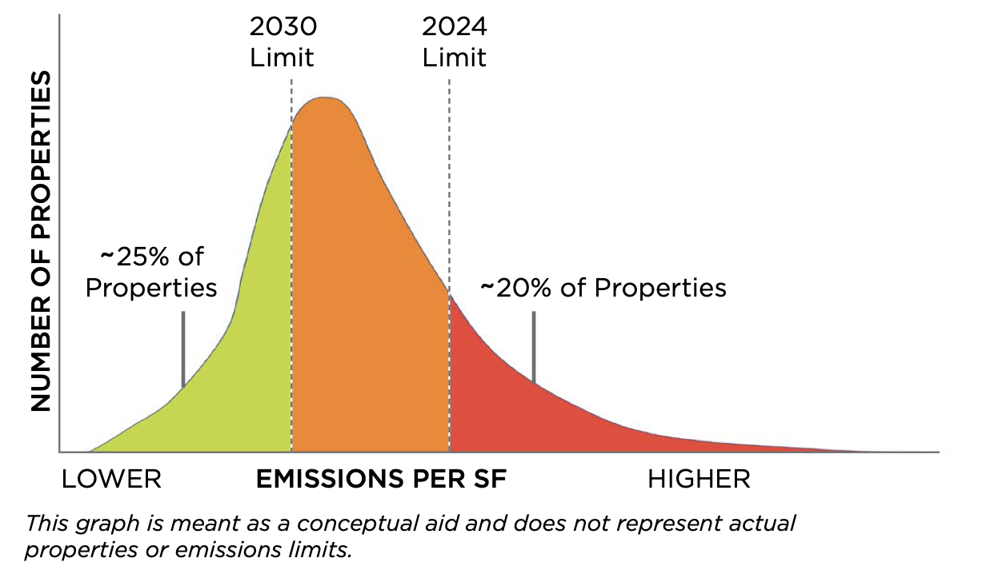
“Sticks”: Energy Performance Criteria – LL97 in NYC
The City of New York enacted Local Law 97 (LL97) in 2019
Law introduces carbon caps on 50,000 buildings and nearly 60 percent of the city’s building area: 59 percent residential and 41 percent commercial
Sets increasingly stringent limits on carbon emissions per square foot in 2024 and 2030
Emissions Distribution of Covered Properties
This graph is meant as a conceptual aid and does not represent actual properties or emissions limits.
© Verdigris Technologies. All rights reserved. This content is excluded from our Creative
Commons license. For more information, see https://ocw.mit.edu/help/faq-fair-use/.
Notes:
https://www.urbangreencouncil.org/sites/default/files/2020.07.09_urban_green_building_emissions_law_summary_revised_11.17.2020.pdf

Slide 23
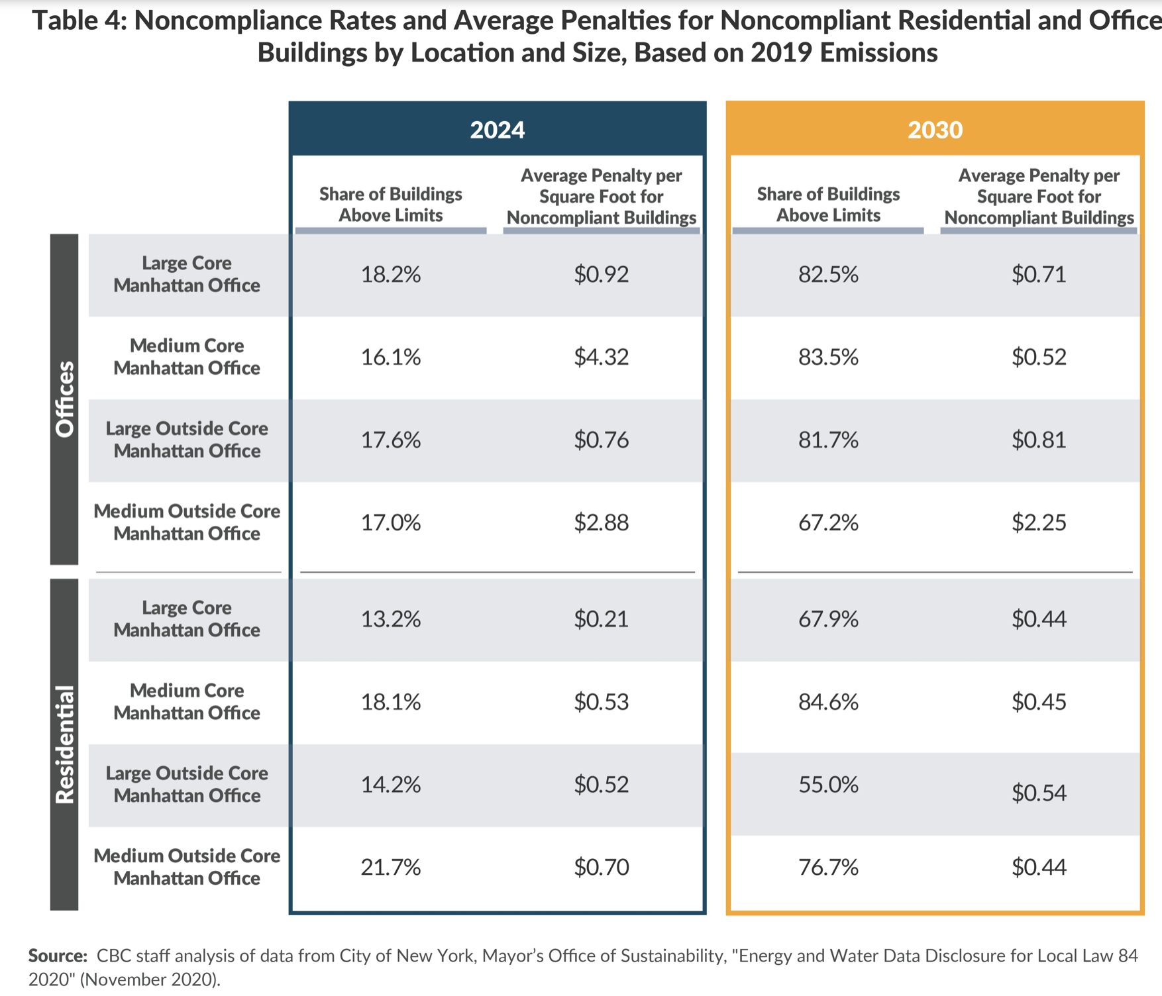
“Sticks”: Energy Performance Criteria – LL97 in NYC
With the current building stock, building owners face sizeable fines
Strong need to retrofit properties to meet targets
This will require major capital investments by building owners
  Owners will need to replace HVAC systems, building envelopes, etc. before LL97 is active, instead of in their programmed depreciation cycle
Owners have limited ability to pass these expenditures to tenants (split incentive):
  Large proportion of buildings lack smart meters at the tenant level (preventing them to give personalized contracts as a function of energy consumption)
  They need the skills and time adjust the leases
© Citizens Budget Commission. All rights reserved. This content is excluded from our Creative
Commons license. For more information, see https://ocw.mit.edu/help/faq-fair-use/.
Notes:
https://cbcny.org/research/balancing-incentives-maximize-emission-reduction
Check average rent per square meter
Link

Slide 24
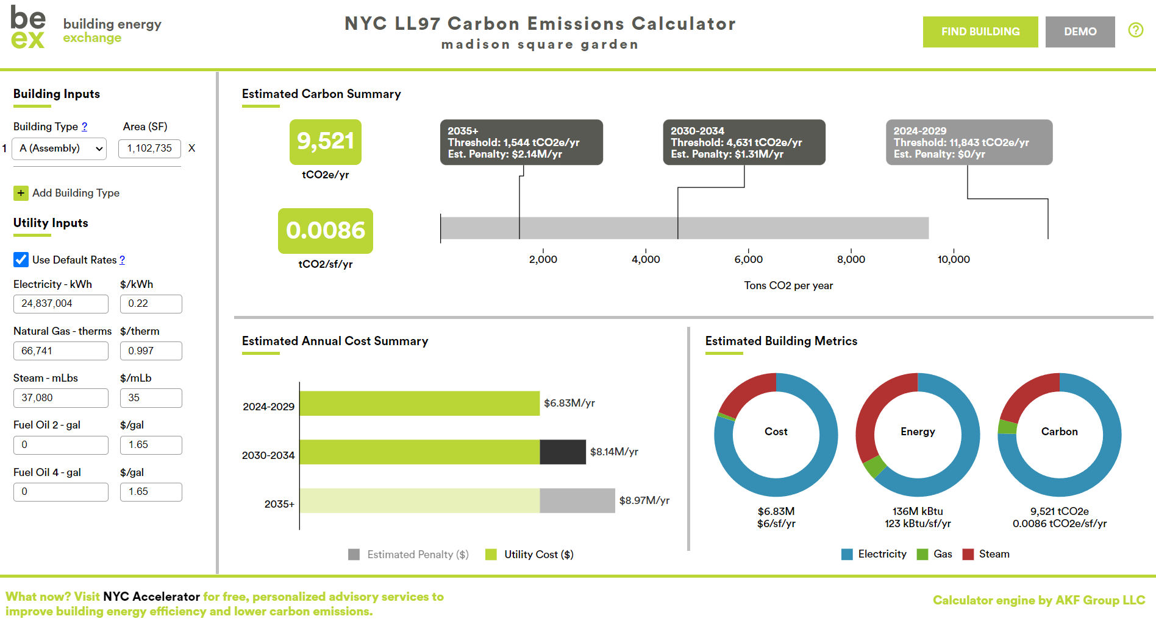
$1.31M Penalty
$2.14M Penalty
Example: Madison Square Garden
Data from 2019 As Required by LL84
https://be-exchange.org/ll97-calculator/
© Building Energy Exchange. All rights reserved. This content is excluded from our Creative
Commons license. For more information, see https://ocw.mit.edu/help/faq-fair-use/.

Slide 25
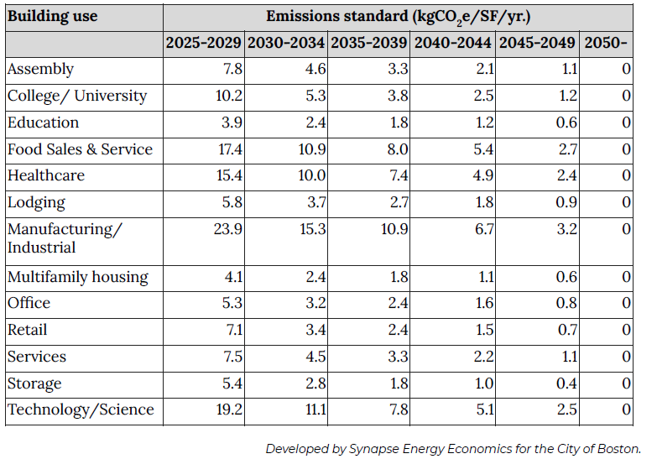
BERDO 2.0 in Boston
Boston's Building Energy Reporting and Disclosure Ordinance was amended in October 2021.
Buildings greater than 20,000 square feet or with 15 or more units are now required to meet the requirements under BERDO.
© City of Boston. All rights reserved. This content is excluded from our Creative
Commons license. For more information, see https://ocw.mit.edu/help/faq-fair-use/.

Slide 26
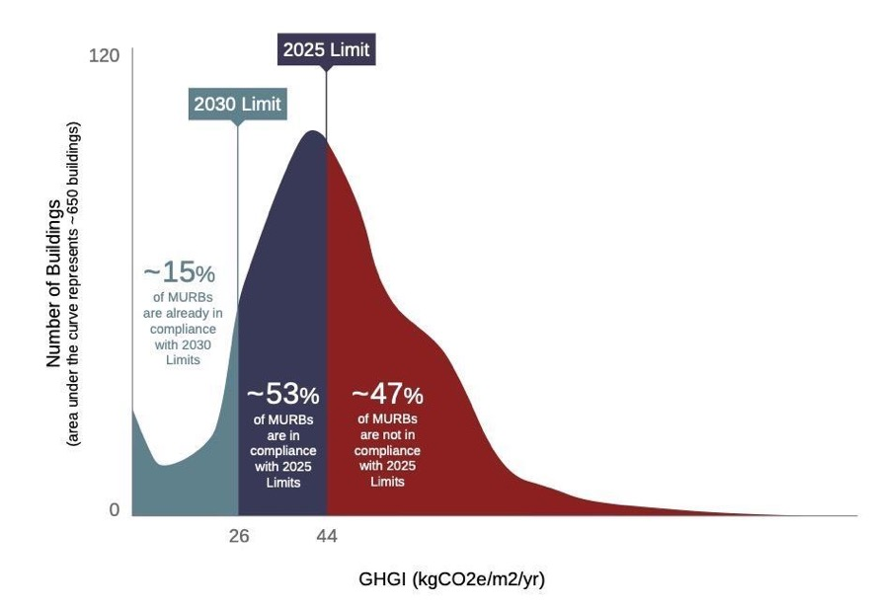
BERDO 2.0 in Boston
Boston BERDO 2.0
Sets emissions standards for buildings greater than or equal to 20,000 sq.ft.
Failure to meet standards results in payments of $234 per metric ton of CO2e
© Reshape Strategies. All rights reserved. This content is excluded from our Creative
Commons license. For more information, see https://ocw.mit.edu/help/faq-fair-use/.
Notes:
In Boston, we have a similar regulation which levies penalties on commercial buildings that emit greenhouse gases above a specified threshold.

Slide 27
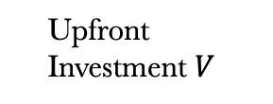



BERDO 2.0 in Boston
Would the extra penalty make costly green retrofit having benefits outweigh costs?
CF: Rental income - Operating costs (e.g. energy) - Penalty
Owners’
Benefit
Effective Rent $R$
Resale $V′$
Design/Construction
Tenancy
Operation
Refurbishment/Acquisition
$$year T$$
Operation costs $O_{1}$
Cost
Upfront Investment $V$
Penalty
Discount rate i (cost of capital)

Slide 28
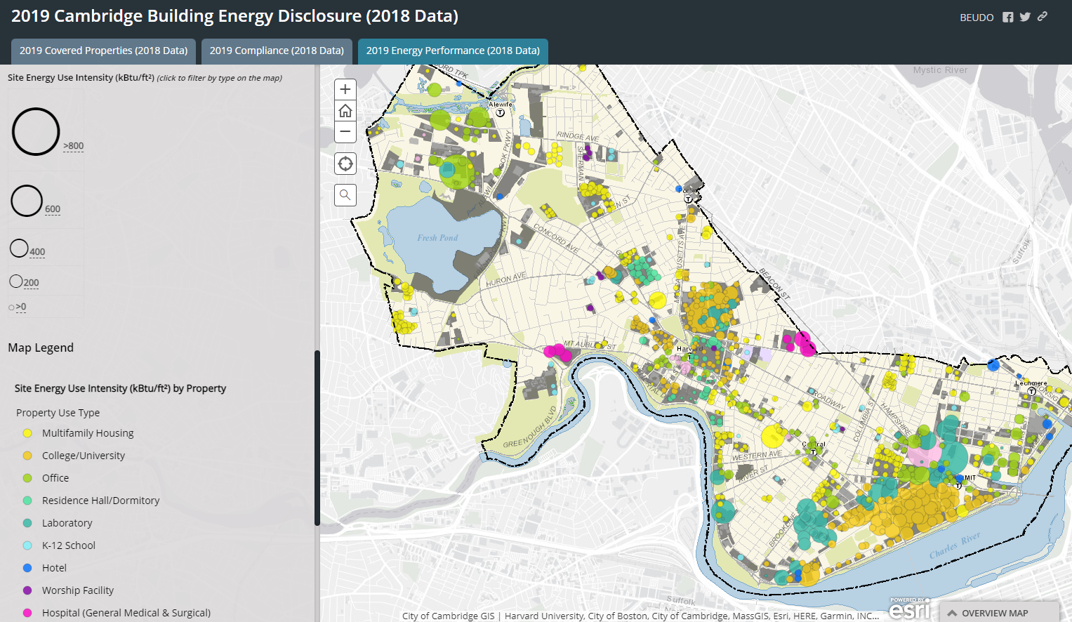
Cambridge MA: BEUDO
Cambridge Building Energy Use Disclosure Ordinance:
  BEUDO sets forth incremental decreases in GHG emissions starting in 2025
 | GHG Emissions Requirement Relative to 2018-2019 Baseline
2025 | 80%
2026 | 72%
2027 | 64%
2028 | 56%
2029 | 48%
2030 | 40%
2031 | 32%
2032 | 24%
2033 | 16%
2034 | 8%
2035 | 0%
Source: https://cambridgegis.maps.arcgis.com/apps/MapSeries/index.html?appid=8c993ecbdf4f48eab403ea36c9886ed9
Failure to comply with requirements forces buildings to purchase a $234 "Alternative Compliance Credit" for each ton of CO2 above the threshold
© City of Cambridge, MA. All rights reserved. This content is excluded from our Creative
Commons license. For more information, see https://ocw.mit.edu/help/faq-fair-use/.

Slide 29
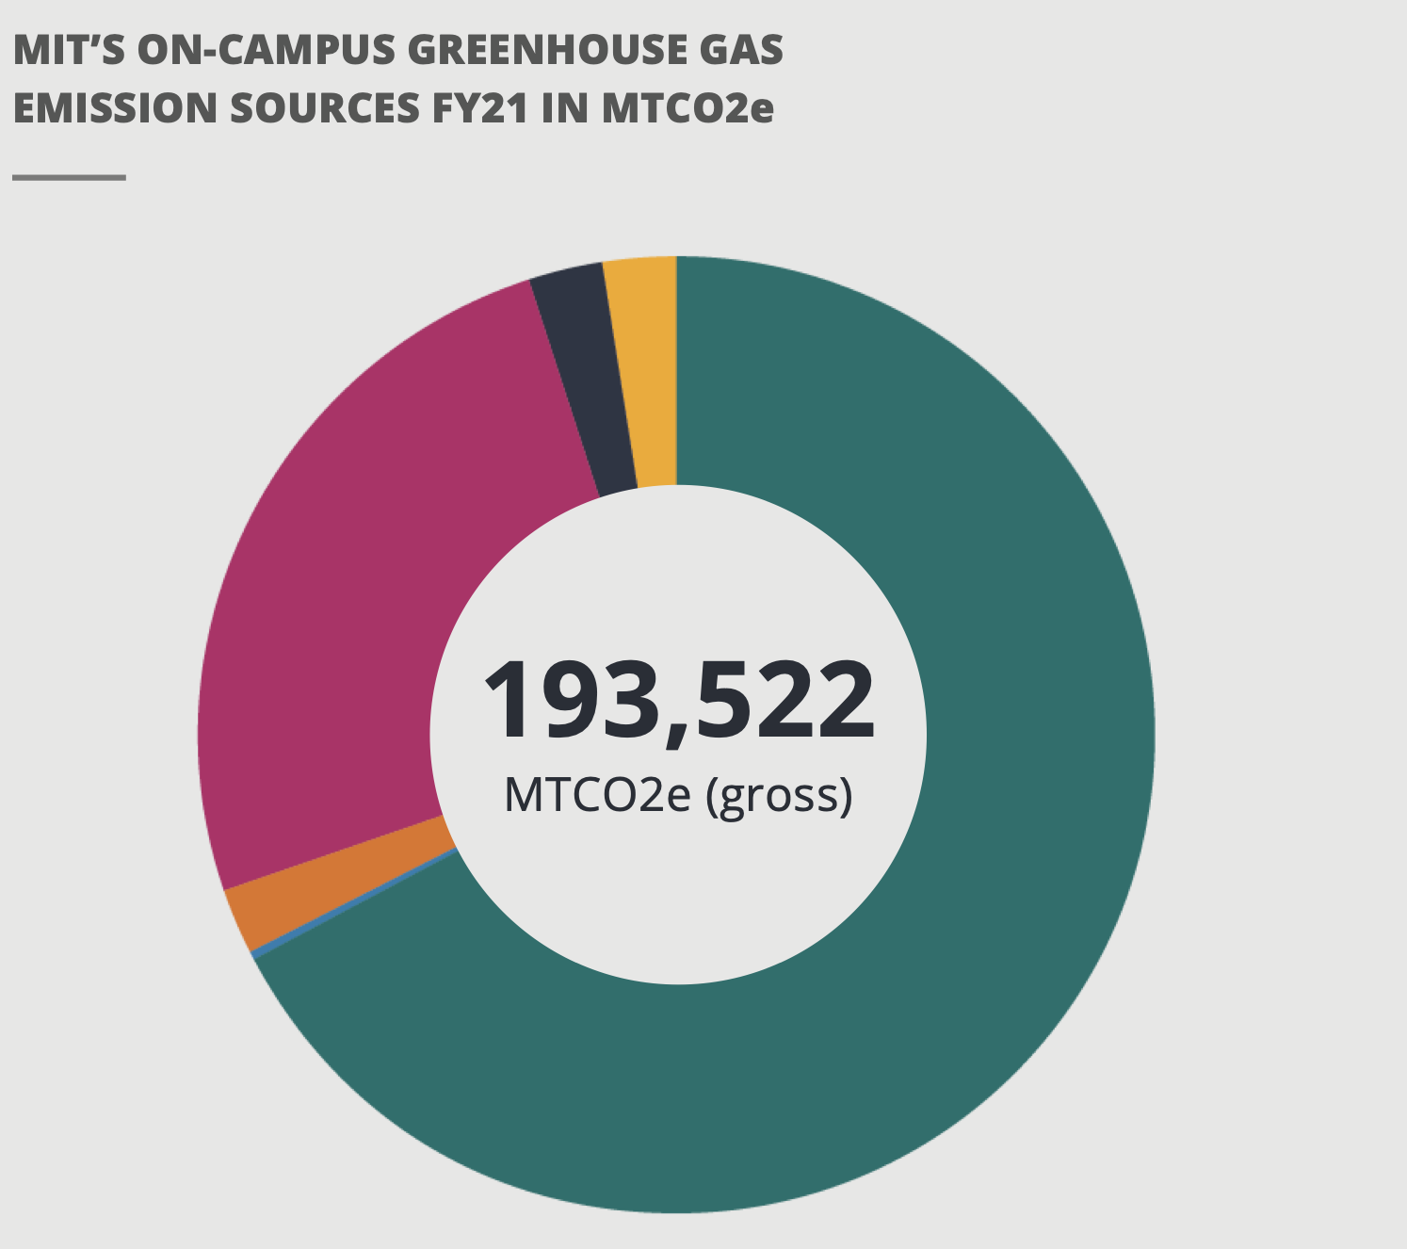
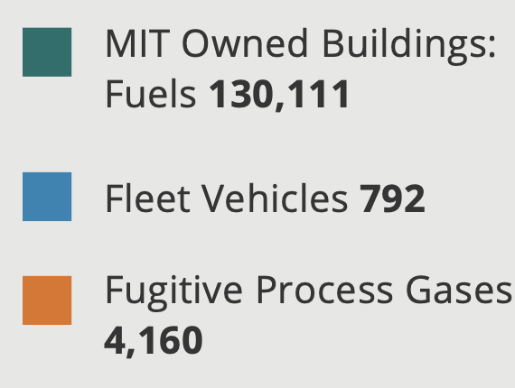
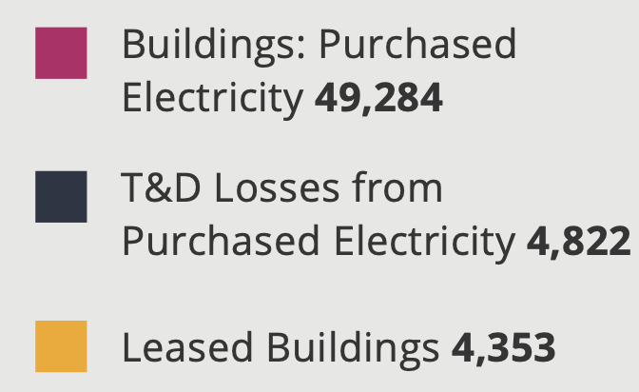
MIT Net Zero Plan
Actions:
All new buildings and major renovations required to achieve LEED Gold certification
Replacing MIT-owned vehicles with electric vehicles
Expanding electric vehicle charging stations
Installing solar panels on MIT buildings
Implementing innovative technologies (thermal batteries, geothermal exchange, microreactors, green hydrogen)
Purchasing carbon offsets
Challenges:
Replacing existing infrastructure
Importing electricity from grid vs using co-gen plant
Growing campus, energy-intensive laboratories
Costs
2026: Net zero emissions
2050: Zero direct emissions
© MIT Office of Sustainability. All rights reserved. This content is excluded from our Creative
Commons license. For more information, see https://ocw.mit.edu/help/faq-fair-use/..

Slide 30
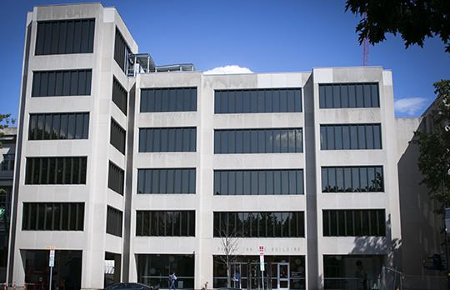

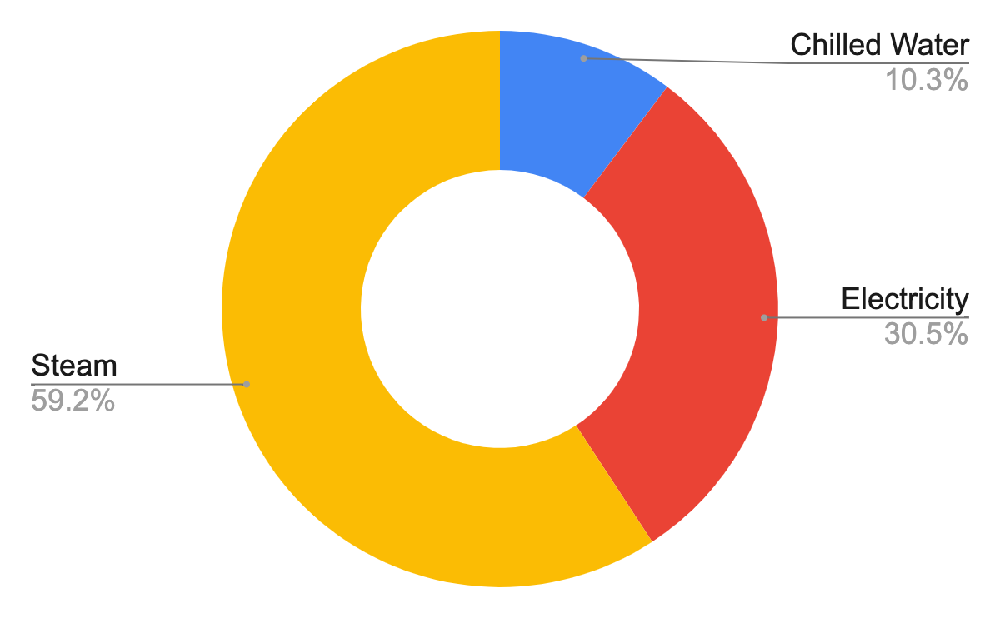
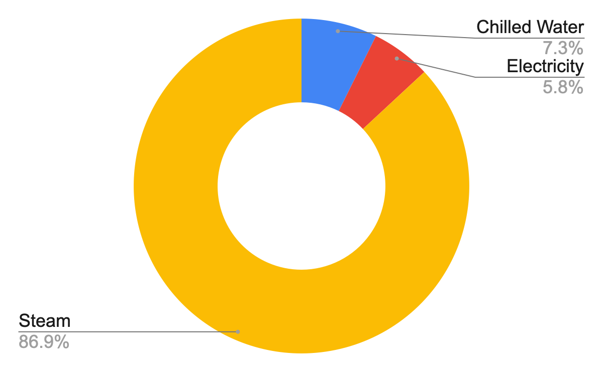
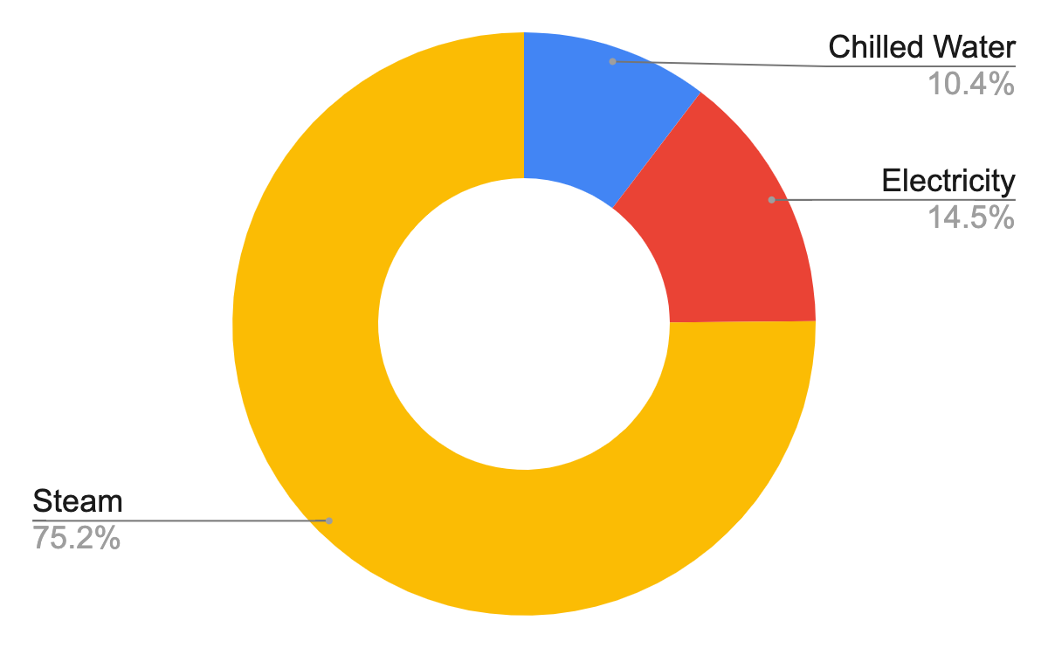
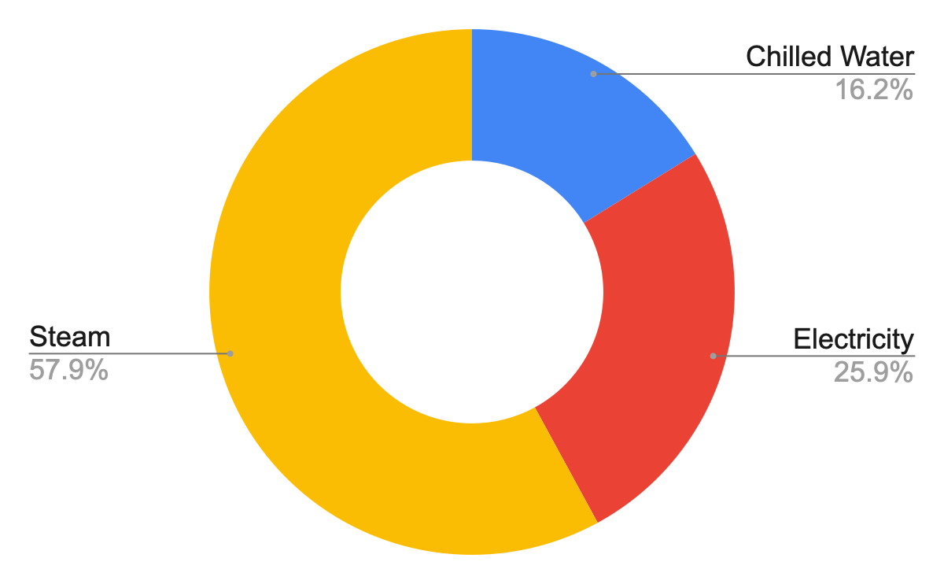
MIT Net Zero Plan
Photos © Massachusetts Institute of Technology. All rights reserved. This content is excluded from
our Creative Commons license. For more information, see https://ocw.mit.edu/help/faq-fair-use/.
Building 9
Hayden Library
2015
2021
2015
2021
16.54 kgCO2/sf
15.18 kgCO2/sf
14.51 kgCO2/sf
4.59 kgCO2/sf
Source: Energize_MIT dashboard
Notes:
Note: steam is used for water and space heating in MIT buildings.
This steam, along with electricity and chilled water, is generated from the Central Utilities Plan on campus, which is generally 10-15% more efficient than the electric and natural gas grid.
To reduce the emissions from the buildings, the demand for space and water heating needs to be reduced.
More effective insulation, envelope, and shading could be implemented to reduce the heating loads.
Additionally, the central utilities plant could also reduce their emissions by improving their energy efficiency performance, or integrating more renewable energy sources into the campus grid.
In the case of Hayden Library, electricity makes up a much larger portion of CO2 emissions.
To reduce electricity demand, more efficient lighting and equipment could be implemented.

Slide 31
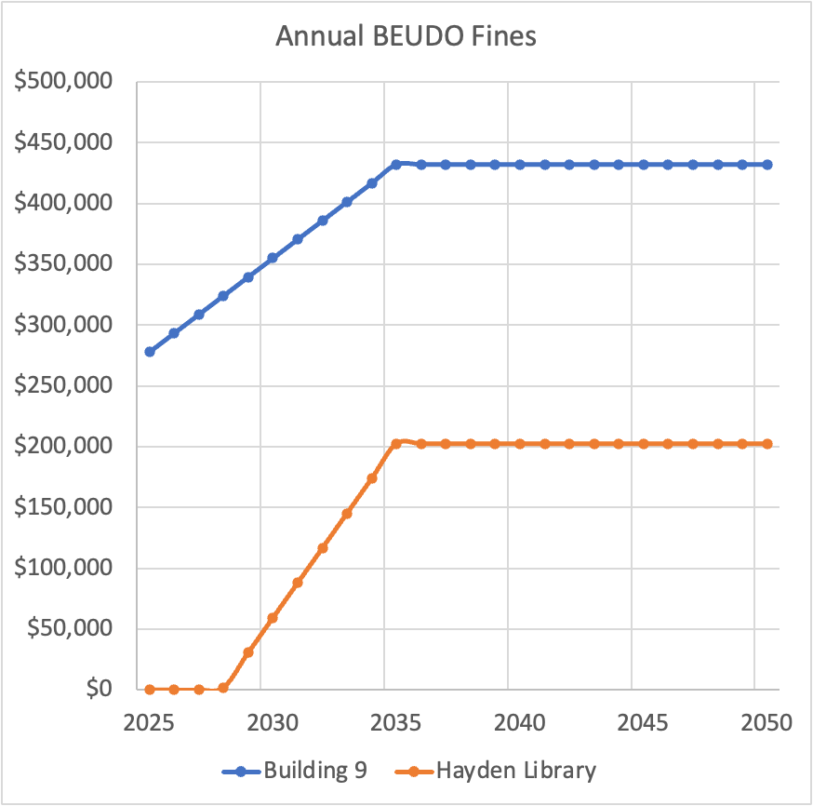
MIT Potential BEUDO Fines
BEUDO sets forth incremental decreases in GHG emissions starting in 2025:
 | GHG Emissions Requirement Relative to 2018-2019 Baseline
2025 | 80%
2026 | 72%
2027 | 64%
2028 | 56%
2029 | 48%
2030 | 40%
2031 | 32%
2032 | 24%
2033 | 16%
2034 | 8%
2035 | 0%
<- BEUDO mandates 0 GHG emissions in 2035
Failure to comply with requirements forces buildings to purchase a $234 "Alternative Compliance Credit" for each ton of CO2 above the threshold
* Assuming GHG emissions remain constant after 2021
Notes:
Note: steam is used for water and space heating in MIT buildings.
This steam, along with electricity and chilled water, is generated from the Central Utilities Plan on campus, which is generally 10-15% more efficient than the electric and natural gas grid.
To reduce the emissions from the buildings, the demand for space and water heating needs to be reduced.
More effective insulation, envelope, and shading could be implemented to reduce the heating loads.
Additionally, the central utilities plant could also reduce their emissions by improving their energy efficiency performance, or integrating more renewable energy sources into the campus grid.
In the case of Hayden Library, electricity makes up a much larger portion of CO2 emissions.
To reduce electricity demand, more efficient lighting and equipment could be implemented.

Slide 32

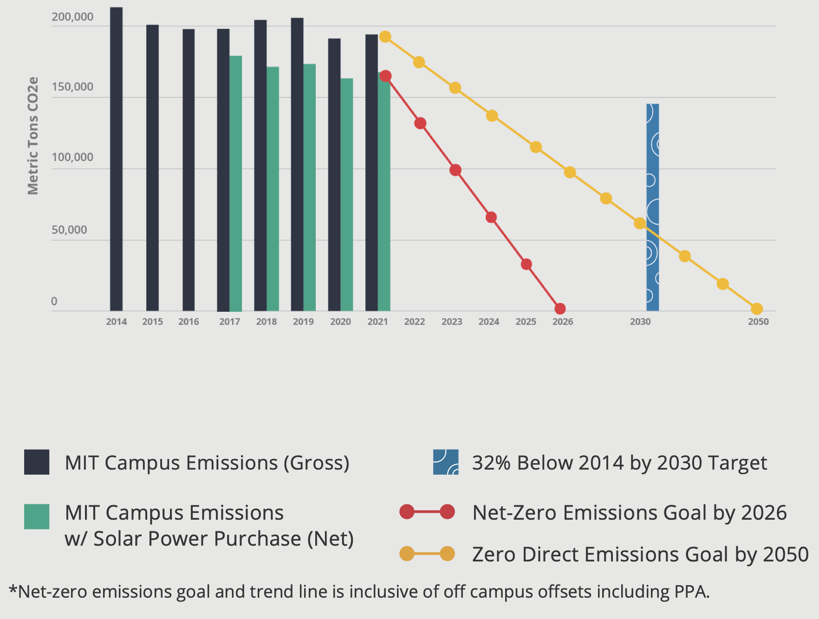
MIT Net Zero Plan & BEUDO
Will BEUDO impose penalties on MIT?
If BEUDO accepts offsets (red trend line), then MIT will face no penalties
If BEUDO does not accept offsets, then MIT could face penalties after 2030 based on direct emissions (yellow trend line)
BEUDO Cap (estimated)
Size of penalties depends on difference between cap and emissions
© MIT Office of Sustainability. All rights reserved. This content is excluded from our Creative
Commons license. For more information, see https://ocw.mit.edu/help/faq-fair-use/..

Slide 33
“Sticks”: Building Energy Codes
Energy building codes that set minimum efficiency requirements for new construction. They aim at tackling environmental externalities associated with energy use in buildings.
Energy codes cover the building itself—for example, the walls/floors/ceiling insulation, windows, air leakage, and duct leakage.
Enforcement is almost always done by building permitting process.
The introduction of building codes restricts building supply for non-compliant projects. In addition, the introduction of extra ﻿layers in permitting review process is associated with higher project uncertainty for developers, which might limit the overall supply.
Notes:
https://www.nber.org/system/files/working_papers/w24211/w24211.pdf
https://www.wbdg.org/resources/green-building-standards-and-certification-systems
https://www.energy.gov/eere/buildings/articles/energy-codes-101-what-are-they-and-what-does-role

Slide 34
“Sticks”: Energy Building Codes in NYC
2009
LL85
NYCECC Established
Allowed for City specific regulations
2011
LL1
Amendment to NYCECC
Set up more stringent standards
2014
LL4
Amendment to NYCECC
More stringent and greater separation of req’s of Residential and Commercial
2020
LL48
Amendment to NYCECC
More stringent, especially on existing buildings
2016
LL91
Amendment to NYCECC
More stringent and fully separated Res and Com, allowed for PV on small buildings
Source: Ashley. Industrial Mapping Report.

Slide 35
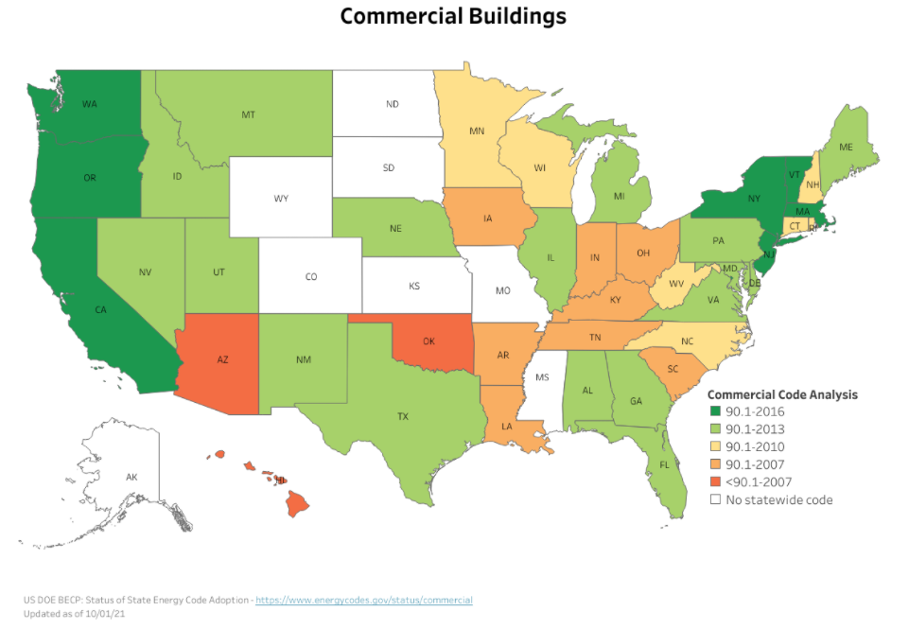
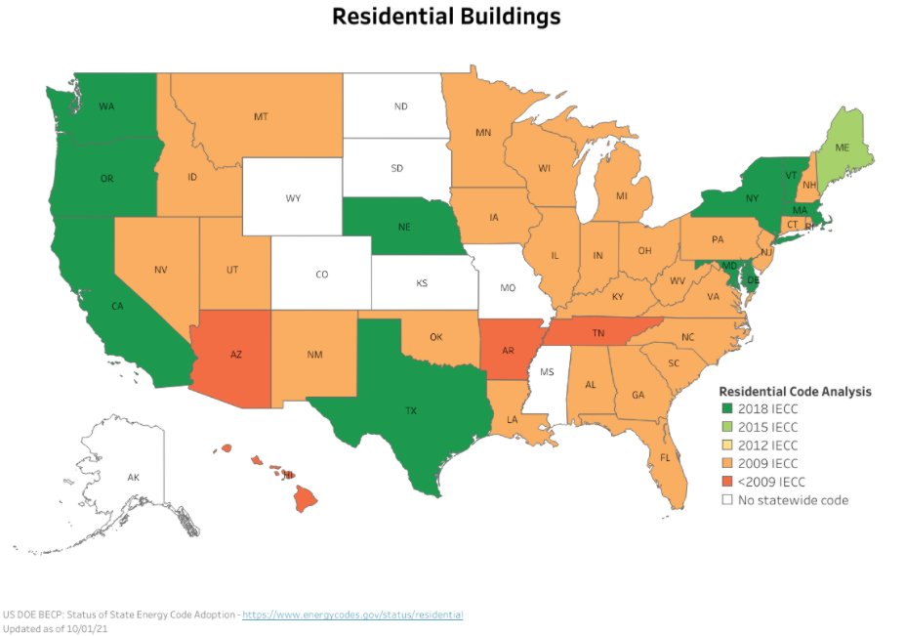
“Sticks”: US policy landscape: Building Energy Codes
State adoption is reviewed based on the national model energy codes–the International Energy Conservation Code (IECC) for residential buildings and Standard 90.1 for commercial buildings (42 USC 6833). (i.e., the equivalent stringency level)
Source: https://www.energycodes.gov/status
Public domain image courtesy of the US Department of Energy.

Slide 36
Climate resiliency investments in coastal areas

Slide 37
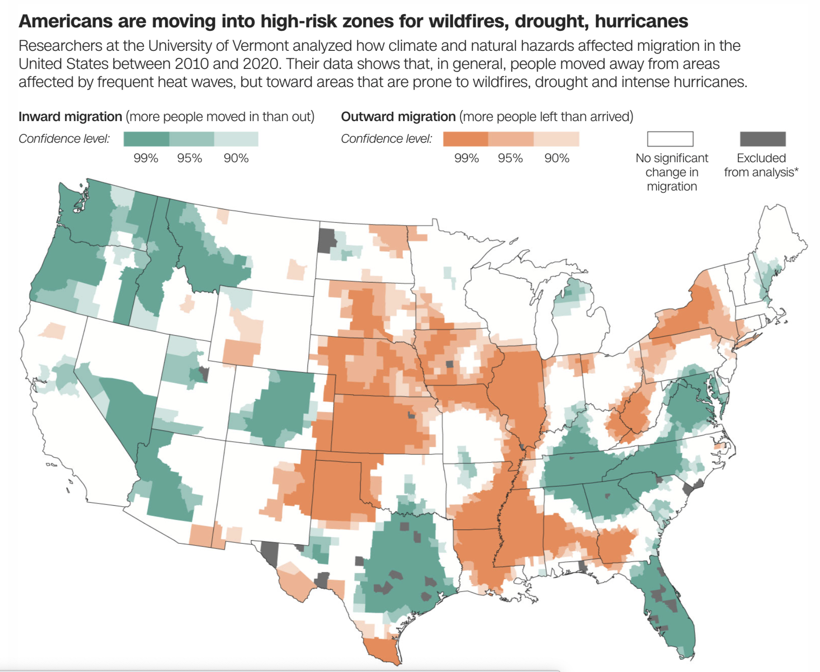
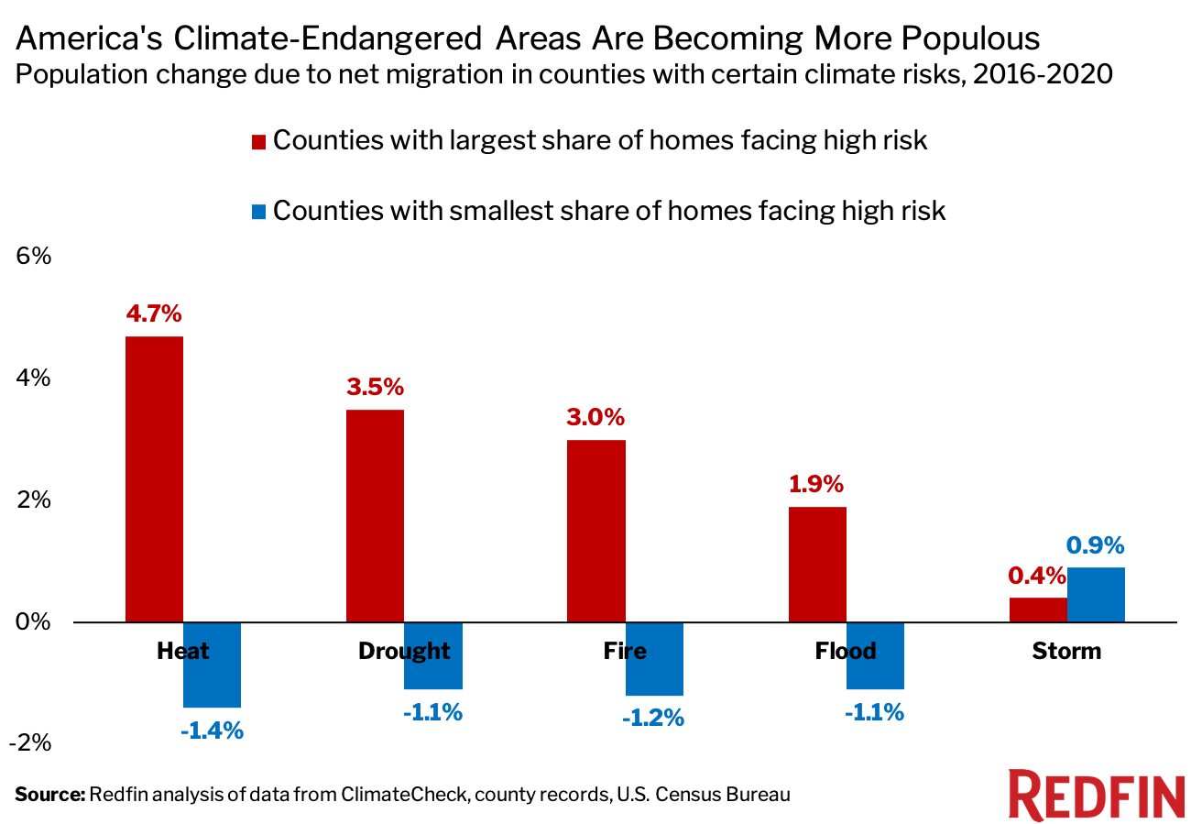
Expanding Coastal Population Escalates the Risk
© CNN. All rights reserved. This content is excluded from our Creative
Commons license. For more information, see https://ocw.mit.edu/help/faq-fair-use/.
© Redfin. All rights reserved. This content is excluded from our Creative
Commons license. For more information, see https://ocw.mit.edu/help/faq-fair-use/.
Source: https://www.cnn.com/2022/12/08/us/americans-moving-to-areas-with-high-climate-risk/index.html;
https://www.redfin.com/news/climate-migration-real-estate-2021/
Notes:
“People have been gravitating to places with severe climate risk because many of these areas are relatively affordable, have lower property taxes, more housing options or access to nature,” said Redfin Economist Sebastian Sandoval-Olascoaga. “For a lot of people, these benefits seem to outweigh the dangers of climate change. But as natural disasters become more frequent, homeowners in these areas may end up losing property value or face considerable difficulty getting their properties insured against environmental disasters.”
Climate risks are not yet substantially affecting people’s decision about where to move.
Many people – particularly retirees – are attracted to the warm climate, beaches and other quality-of-life factors that outweigh the seemingly remote risk of a life-threatening hurricane.
Beyond flood risk, people have been gravitating to places with other severe climate risks because many of these areas are relatively affordable, have lower property taxes, more housing options or access to nature.

Slide 38
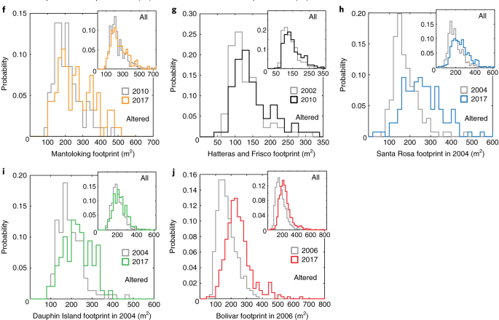
Building Back Bigger
Expanding coastal population escalates the risk.
Despite decades of regulatory efforts in the US, exposure of residential assets to hurricane damage is increasing.
Comparing plan-view footprints of individual residential buildings before and long after major hurricane strikes, the authors find a systematic pattern of ‘building back bigger’ among renovated and new properties.
Source: Lazarus, E. D., Limber, P. W., Goldstein, E. B., Dodd, R., & Armstrong, S. B. (2018). Building back bigger in hurricane strike zones. Nature Sustainability, 1(12), 759–762. © Springer Nature, Ltd. All rights reserved. This content is excluded from our Creative Commons license. For more information, see https://ocw.mit.edu/help/faq-fair-use/.
Notes:
There is also a consistent pattern of building back bigger in the coastal area of the US.

Slide 39
Developers Went to Locations with Low Climate Beliefs
Climate belief also plays a role.
Source: Barrage, L. and Furst, J., 2019. Housing investment, sea level rise, and climate change beliefs. Economics letters, 177, pp.105-108

Slide 40
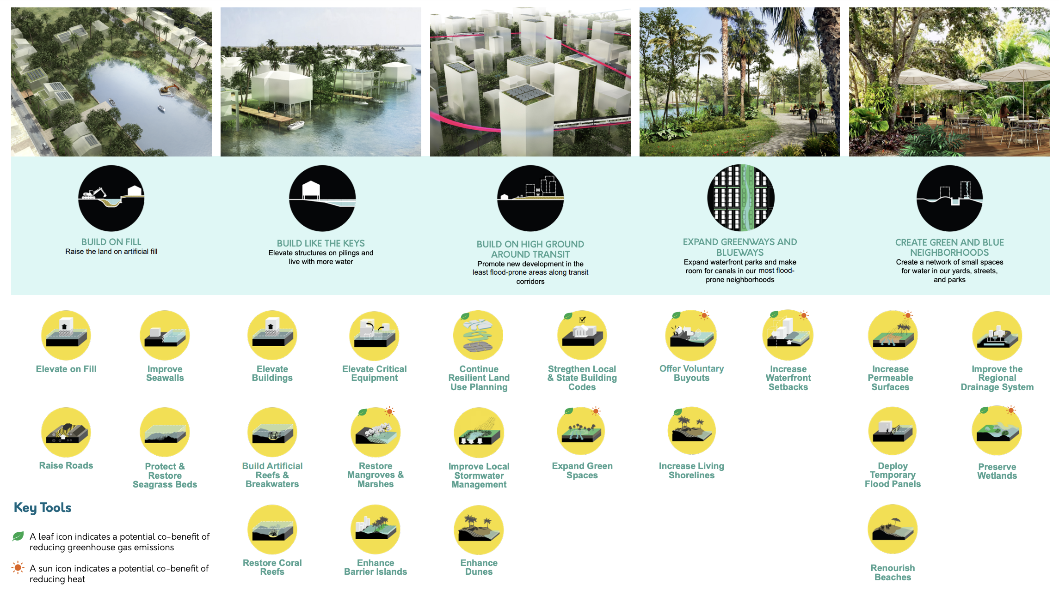
Climate Resiliency Investment Strategies
Source: https://miami-dade-county-sea-level-rise-strategy-draft-mdc.hub.arcgis.com/. © Miami-Dade County, FL. All rights reserved. This content is excluded from our Creative Commons license. For more information, see https://ocw.mit.edu/help/faq-fair-use/ .
Notes:
The story of a rich county: experiment with expensive coastal adaptation plans.

Slide 41



Leave or Rebuild? Striking Inequality
© New York Times. All rights reserved. This content is excluded from our Creative
Commons license. For more information, see https://ocw.mit.edu/help/faq-fair-use/.
Notes:
The story of a rich county: experiment with expensive coastal adaptation plans.

Slide 42

A Tale of Two Towns: Miami-Dade and NC- Fair Bluff
Rich coastal regions are also acting to prevent population loss.
Disaster experts have increasingly urged local officials to reduce their exposure by encouraging people to leave vulnerable areas. But cities and counties often resist that advice, worrying that retreat would hurt their economies and upset voters.
Example: Miami-Dade County
  An upbeat strategy for living with more water.
  With some of the most expensive coastal real estate in the world, it has an ample tax base to experiment with solutions — and also enormous economic incentive to dissuade buyers and investors from leaving.
Source: https://www.nytimes.com/2021/03/02/climate/miami-sea-level-rise.html?searchResultPosition=62 . © New York Times. All rights reserved. This content is excluded from our Creative Commons license. For more information, see https://ocw.mit.edu/help/faq-fair-use/.
Notes:
The story of a rich county: experiment with expensive coastal adaptation plans.

Slide 43


A Tale of Two Towns: Miami-Dade and NC- Fair Bluff
Repeated climate disasters cause small towns to face existential threats.
Climate shocks are pushing small rural communities, many of which were already struggling economically, to the brink of insolvency.
Example: Downward spiral of the Fair Bluff
  A small town in eastern North Carolina, hit by 19 hurricanes between 1954 and 2016
  Rather than bouncing back, repeated disasters cause residents and employers leave (aided by buyout programs), the tax base shrinks and it becomes even harder to fund basic services.
  Rebuild plan: Turn the old downtown into park and build a new downtown. Yet $10M is too much.
Source: https://www.nytimes.com/2021/09/02/climate/climate-towns-bankruptcy.html?smid=em-share. © New York Times. All rights reserved. This content is excluded from our Creative Commons license. For more information, see https://ocw.mit.edu/help/faq-fair-use/.
Notes:
The story of a poor small town: on the brink of insolvency.

Slide 44


Federal Infrastructure Investment: Moral Hazard
Federal grey infrastructure reinforces coastal development.
The 2021 Bipartisan Infrastructure Act:
Allocate $47 billion over several years for climate resiliency. Mostly to protect existing infrastructure.
Moral Hazard
Would government spending reinforce the expansion of high-risk zone?
Example: In Charleston, S.C.
  The city is considering a $1.1 billion project, largely funded with federal money, to build an eight-mile-long sea wall to protect infrastructure.
  It also has approved a development project to place thousands of new structures in the flood plain.
Source: https://www.nytimes.com/2022/10/04/opinion/hurricane-ian-coast-rebuilding.html?searchResultPosition=18 © New York Times. All rights reserved. This content is excluded from our Creative Commons license. For more information, see https://ocw.mit.edu/help/faq-fair-use/.
Notes:
Another potential reason for the lock-in in the high-risk area is the infrastructure bills for climate resilience infrastructure, which reinforces coastal development.

Slide 45

Federal Infrastructure Investment: Inequality
Billions for climate protection fuel new debate: Who deserves it most?
Historically, it is wealthier, white communities — with both high property values and the resources to apply to competitive programs — that receive the bulk of federal grants.
The new climate provisions in the infrastructure bill inject billions of dollars into competitive grant programs. Cities/counties submit applications and federal agencies rank.
  The ability of local officials to use sophisticated tools and resources to write successful applications differs.
  Communities are required to pay a share of the project — often 25 percent, which is unaffordable for struggling towns/counties.
  Cost-effective: Governments need to demonstrating the value of the property that would be protected is greater than the cost of the project, giving disadvantage to low-income neighborhoods.
Source: https://www.nytimes.com/2021/12/03/climate/climate-change-infrastructure-bill.html?searchResultPosition=35 © New York Times. All rights
reserved. This content is excluded from our Creative Commons license. For more information, see https://ocw.mit.edu/help/faq-fair-use/.
Notes:
The required process fuels inequality across cities/counties in accessing the infrastructure bill.

Slide 46



Is Managed Retreat an Option?
© New York Times. All rights reserved. This content is excluded from our Creative
Commons license. For more information, see https://ocw.mit.edu/help/faq-fair-use/.

Slide 47


Is Managed Retreat an Option?
Discussion: What would be the pros and cons of managed retreat?
What is different for managed retreat?
(1) Buyouts on a much larger scale
(greater numbers of people/whole neighborhoods)
(2) Ideally doing it before disaster strikes.
The Obama administration began experimenting with relocation after Hurricane Sandy in 2012. The program ended by President Trump.
The Federal Emergency Management Agency detailed a new program, worth an initial $500 million, with billions more to come, for large-scale relocation nationwide; A similar $16 billion program is started by The Department of Housing and Urban Development.
New Jersey has bought and torn down some 700 flood-prone homes around the state and made offers on hundreds more
Source: https://www.nytimes.com/2020/08/26/climate/flooding-relocation-managed-retreat.html © New York Times. All rights reserved. This content is excluded from our Creative Commons license. For more information, see https://ocw.mit.edu/help/faq-fair-use/.

