Slide 1
SRE Economics Lecture 7
Climate and Real Estate (3)
Topical discussions
Siqi Zheng
March 2023
(MIT Center for Real Estate)

Slide 2
Outline
Climate risks in commercial real estate markets
Insurance market crisis
Climate resiliency investments in coastal areas
Notes:
Recap Juan’s E5.

Slide 3
Climate Risks in Commercial real estate markets

Slide 4
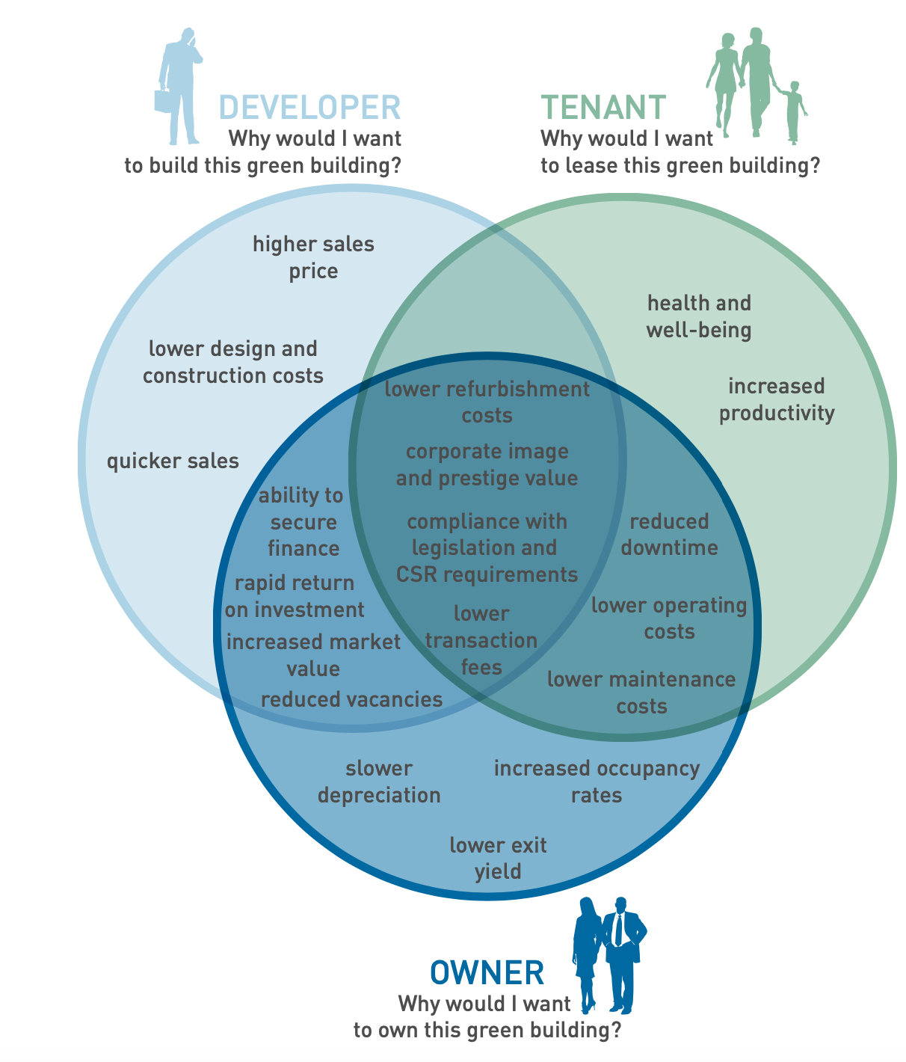
Commercial Real Estate vs. Residential
Commercial
Residential
Common ground
Physical damage
Increased insurance costs
Reduced demand
……
Commercial Real Estate
Residential
Real Estate
What are the differences?
Notes:
For instance, the belief. Any systematic difference? Not idiosyncratic, but systematic.
Ask students:

Slide 5
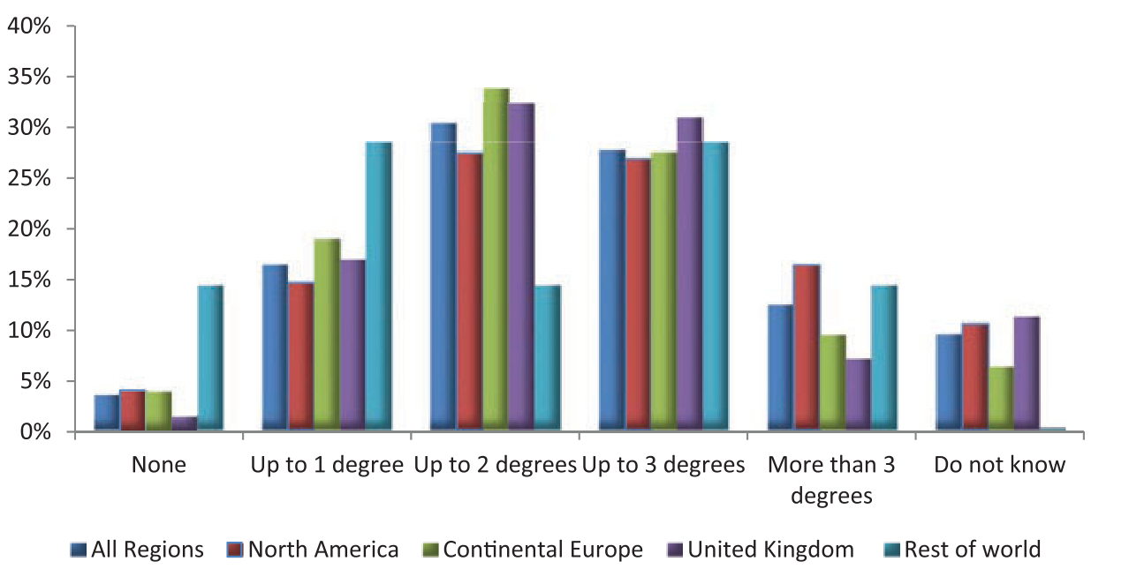
1. CRE: more sophisticated investors
Survey of ﻿439 executive about about the role of climate risks for their institutions
Expectations of Institutional Investors for the global temperature rise by the end of this century
Source: Krueger, P., Sautner, Z. and Starks, L.T., 2020. The importance of climate risks for institutional investors. The Review of Financial Studies, 33(3), pp.1067-1111. © Krueger et al. All rights reserved. This content is excluded from our Creative Commons license. For more information, see https://ocw.mit.edu/help/faq-fair-use/.
Notes:
The figure shows a widespread belief in climate change. Across all respondents, only 3% do not expect any temperature increase (compared to 12% just now, all people), 16% expect an increase by up to one degree, and 30% by up to two degrees.
Europe leads, followed by north America, and the rest of the world

Slide 6
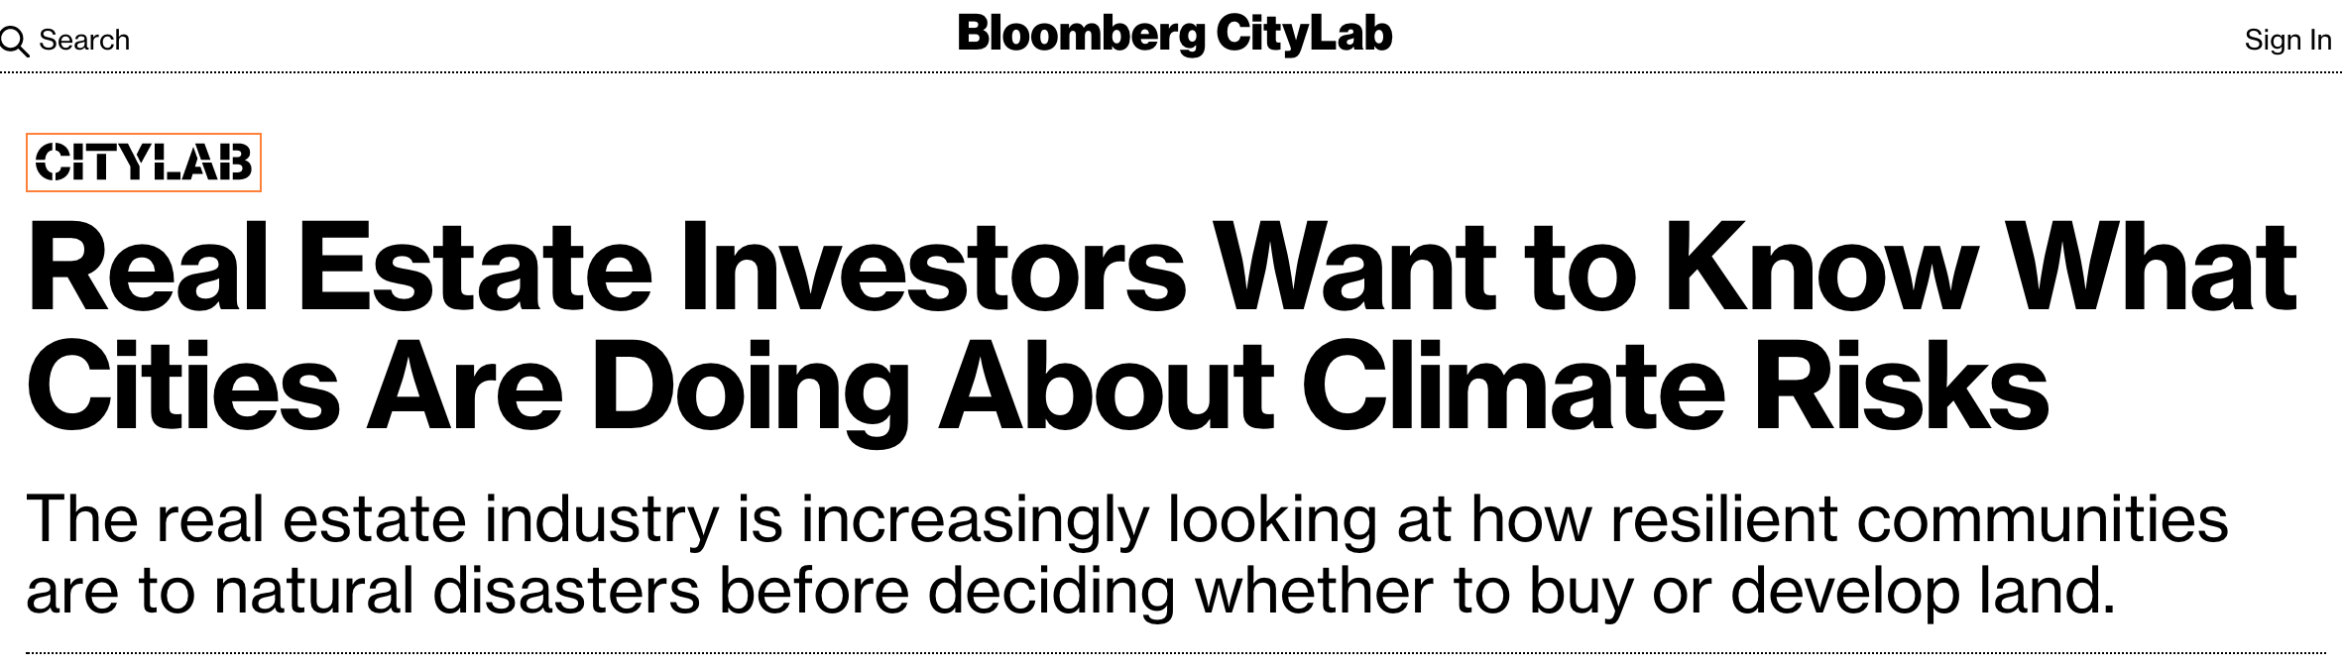


Top: © Bloomberg L.P.; middle: © Morgan Stanley; bottom: © BlackRock, Inc. All rights reserved. This
content is excluded from our Creative Commons license. For more information, see https://ocw.mit.edu/help/faq-fair-use/.
Notes:
More and more investment companies integrate climate risks into their portfolio decision-making process. What are their rationales?
First, climate Risk is an investment Risk, especially in the real estate asset class. Climate risk is location-based, as are real estate investment assets. Climate risk affects the demand and supply, the costs and prices of the products in both real estate space and capital markets. More broadly, the evidence on climate risk is compelling investors to reassess core assumptions about modern finance. They are seeking to understand both how climate risk will influence long-term economic growth and prosperity (productivity), as well as the ways that climate policy will impact prices, costs, and demand across the entire economy. This is vital for real estate investors to understand, in order to make prudent and productive capital allocation decisions.
Secondly, more and more investors and market players are putting sustainability at the center of their investment approach, including: making sustainability integral to portfolio construction and risk management; exiting investments that present a high sustainability-related risk, such as energy-intensive sectors; and launching green and low-carbon investment products. They have started to understand that long-term profitability cannot be achieved without embracing purpose and considering the needs of a broad range of stakeholders (investors, regulators, insurers, and the public) - sustainability, diversity and information transparency (and privacy).

Slide 7
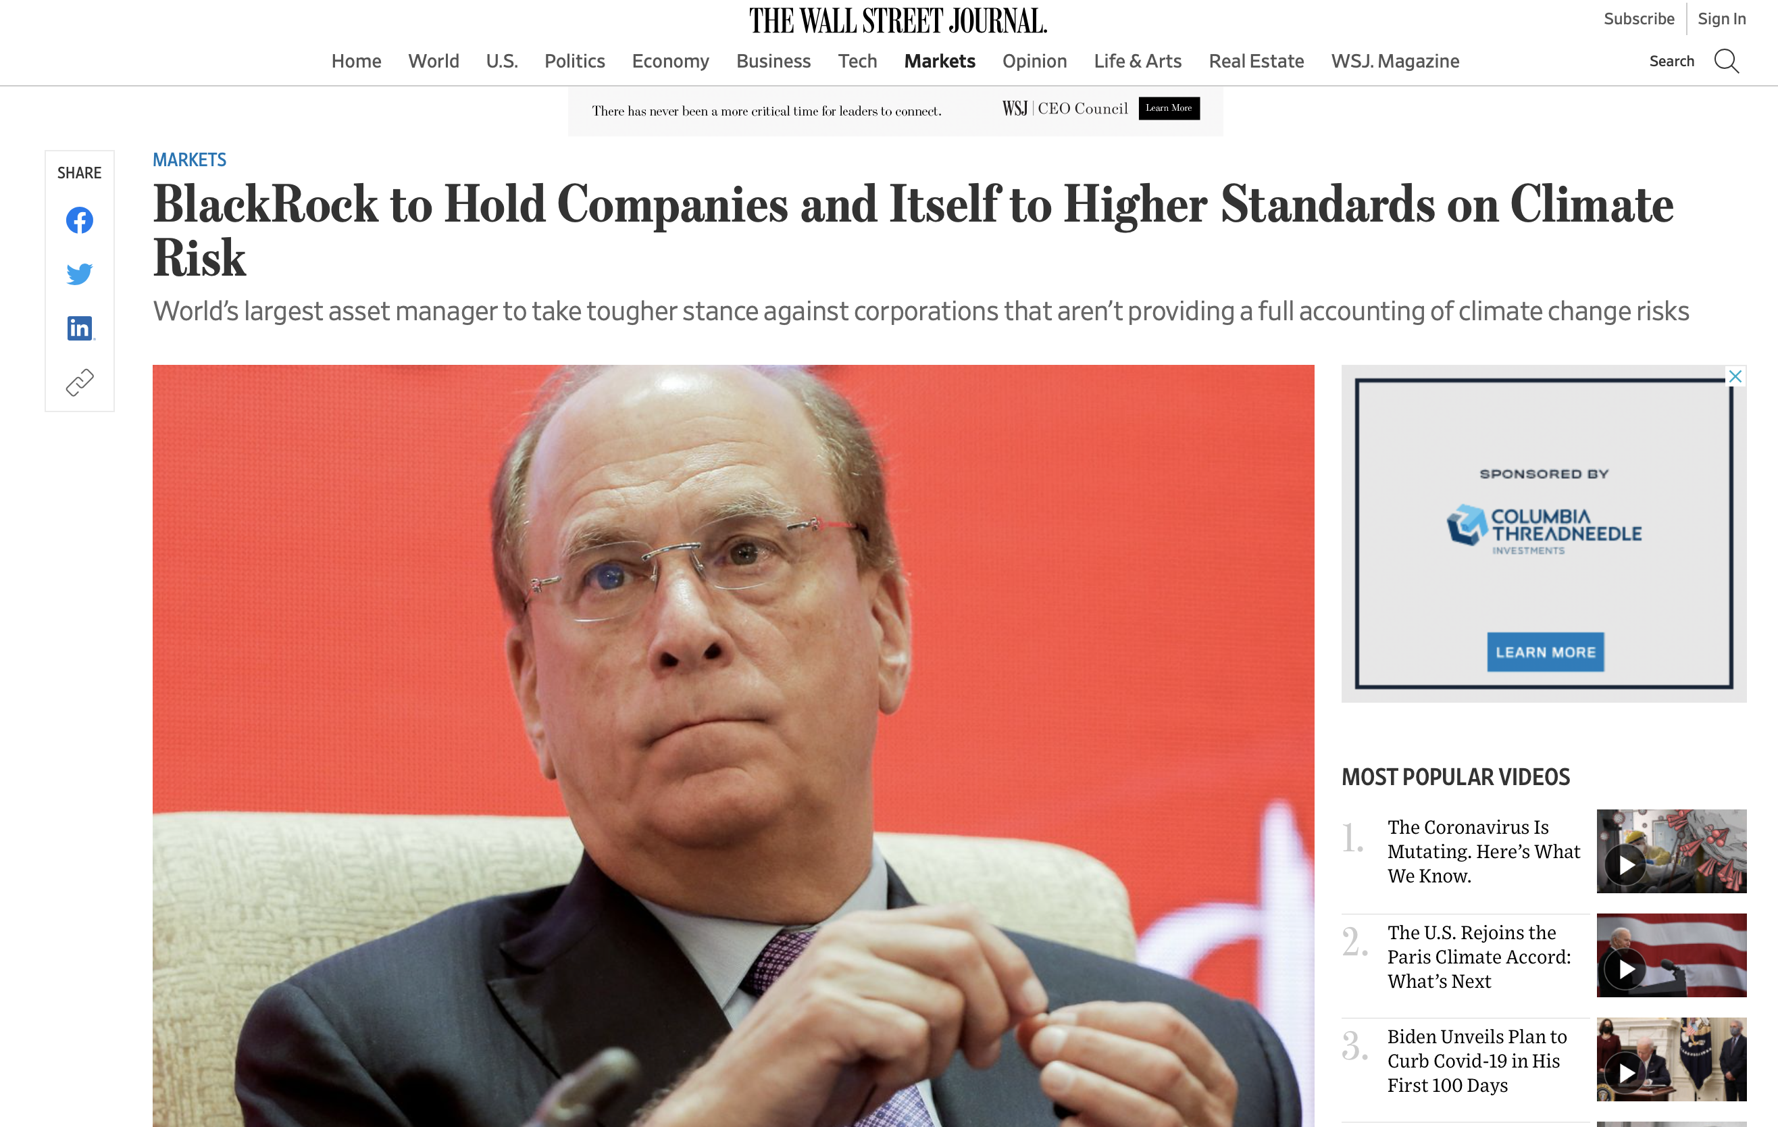
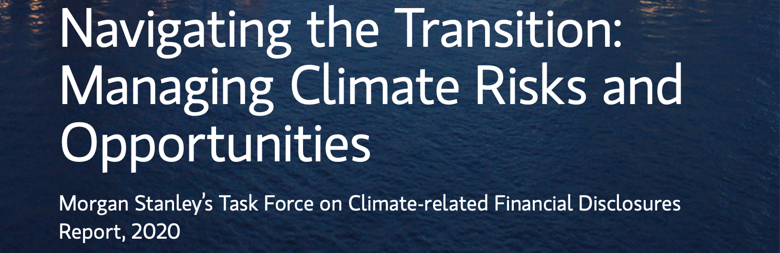
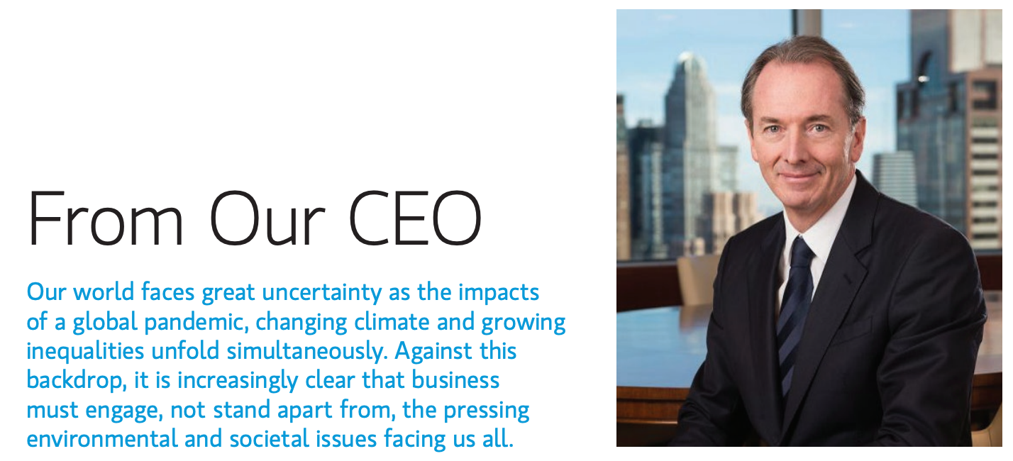
2. CRE: Corporation Image and Fiduciary Responsibility
Left © Wall Street Journal; right: © Morgan Stanley. All rights reserved. This content
is excluded from our Creative Commons license. For more information,
see https://ocw.mit.edu/help/faq-fair-use/.
Notes:
In the meantime, those big guys care more about their own reputation.
Reduced attractiveness of properties with no climate resilience/mitigation.
Investors prefer to work with companies incorporating climate risks into investment decisions.
Companies would take a tougher stance against corporations that aren’t providing a full accounting of environmental risks. The investment giants show they are doing more to address investment challenges posed by climate change.

Slide 8


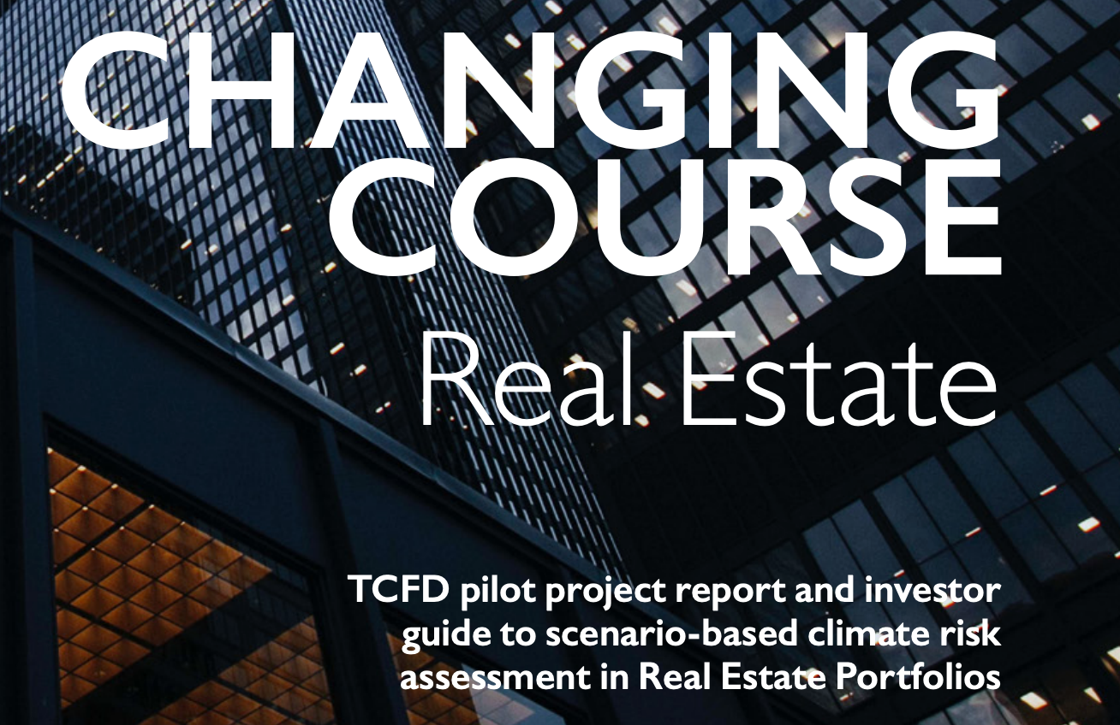
3.CRE: Higher Regulatory and Industry Standard Bars
Top: © The Cotocon Group; lower left: © GRESB B.V.; lower right: © UNEPFI. All rights reserved. This content is excluded from our
Creative Commons license. For more information, see https://ocw.mit.edu/help/faq-fair-use/.
Notes:
﻿Investors and investment managers are increasingly pushed to report to their stakeholders on climate-related financial risks.
Policy makers know those big guys have more money, and can afford more stringent regulations. So they start with those big guys.
The CRE industry is also very well organized, with big associations and leaders. They are more proactive.
﻿Global Real Estate Sustainability Benchmark (GRESB)
Assess and benchmark ESG performance of real assets, providing standardized and validated data to capital markets.
﻿Task Force on Climate-Related Disclosures (TCFD)
International forum that coordinates financial authorities to increase the stability of international markets.
Managed by the G20’s Financial Stability Board.
Mission: raise market awareness of climate-related financial risks and opportunities and to help drive consistent reporting on climate-related risks across all industries.

Slide 9
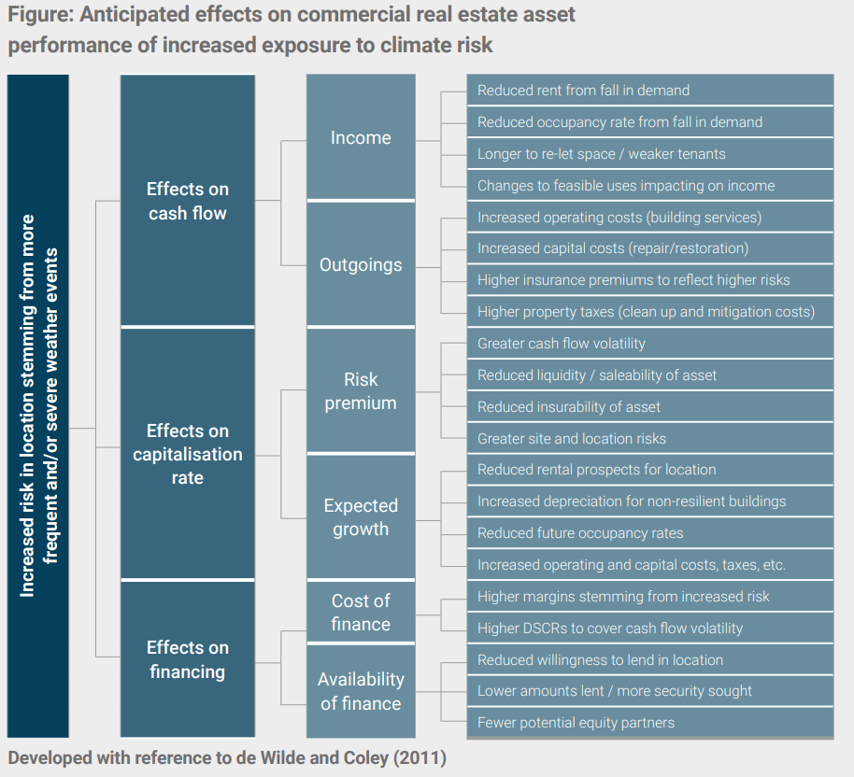

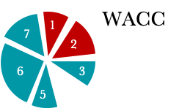
Cash flow
Reduced income
……
Increased cost
Discount rate i (cost of capital)
higher discount rate
Equity
Equity
higher finance cost
Debt
(To be covered after the midterm)
Source: Clayton, J., van de Wetering, J., Sayce, S., & Devaney, S. (2021). Climate Risk and commercial property values: a review and analysis of the literature.
© UN Environment Programme. All rights reserved. This content is excluded from our
Creative Commons license. For more information, see https://ocw.mit.edu/help/faq-fair-use/.

Slide 10
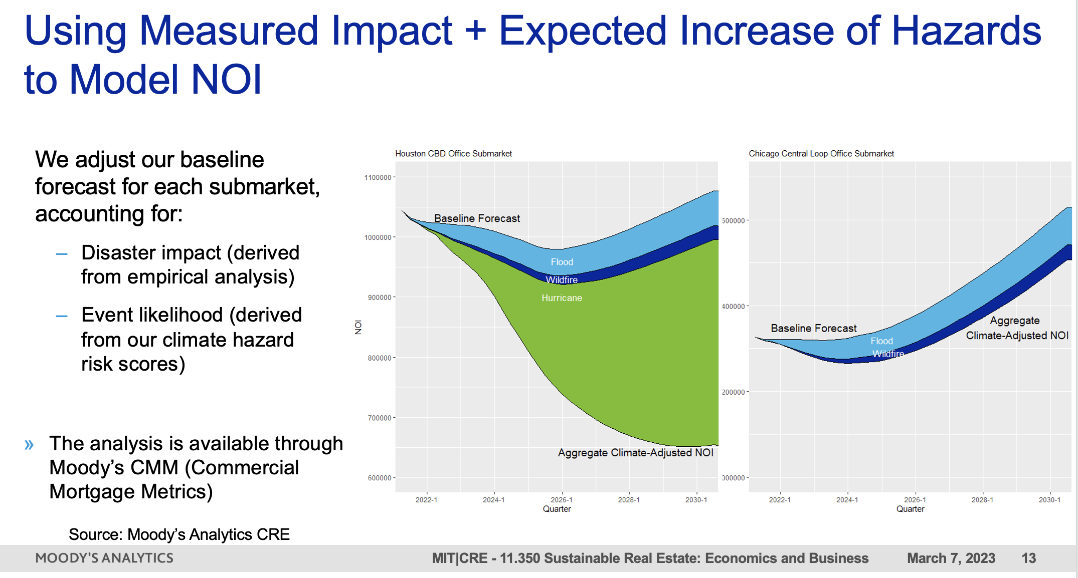
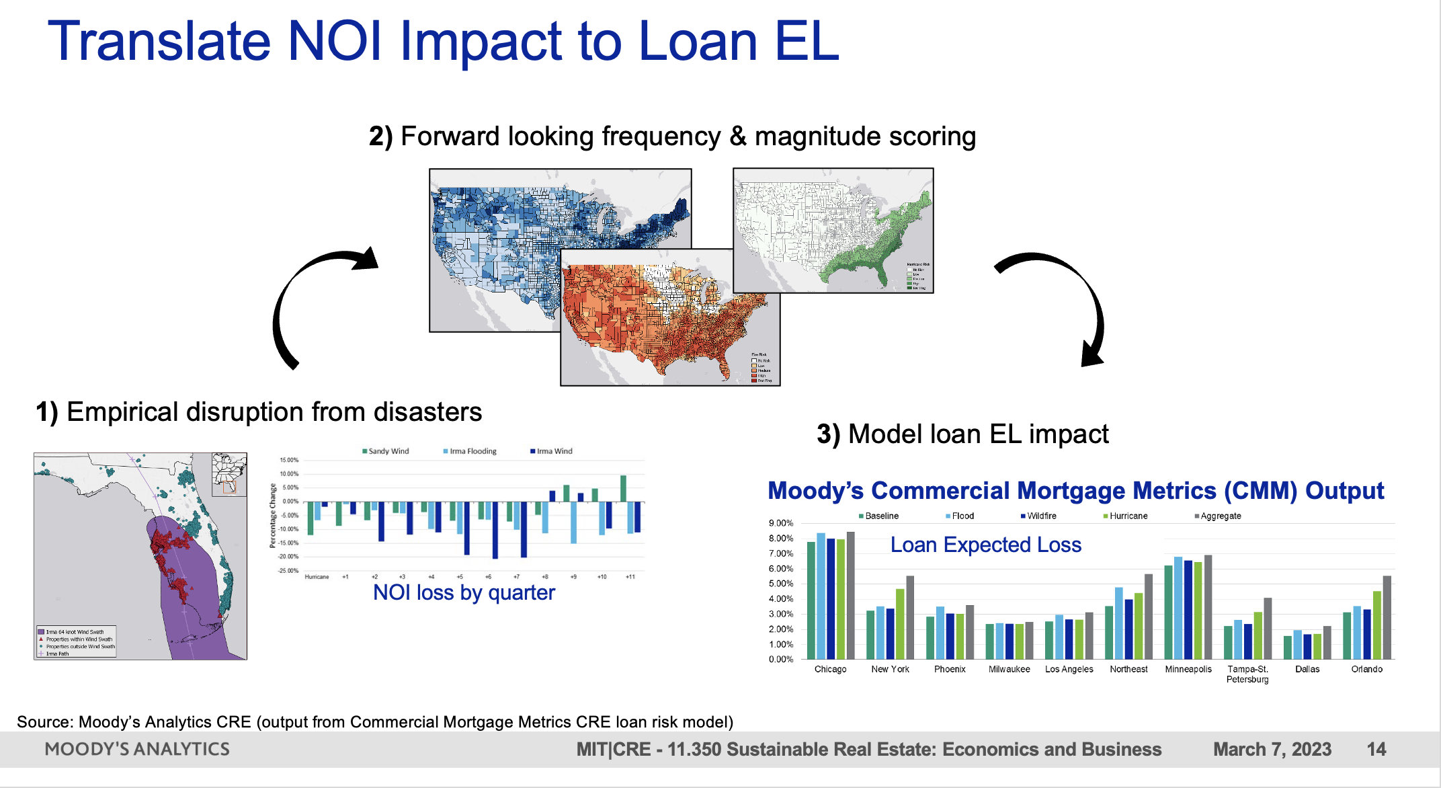
MIT/CRE + Moody’s Analytics
MIT/CRE expertise!
MIT climate scientists’ expertise!

Slide 11
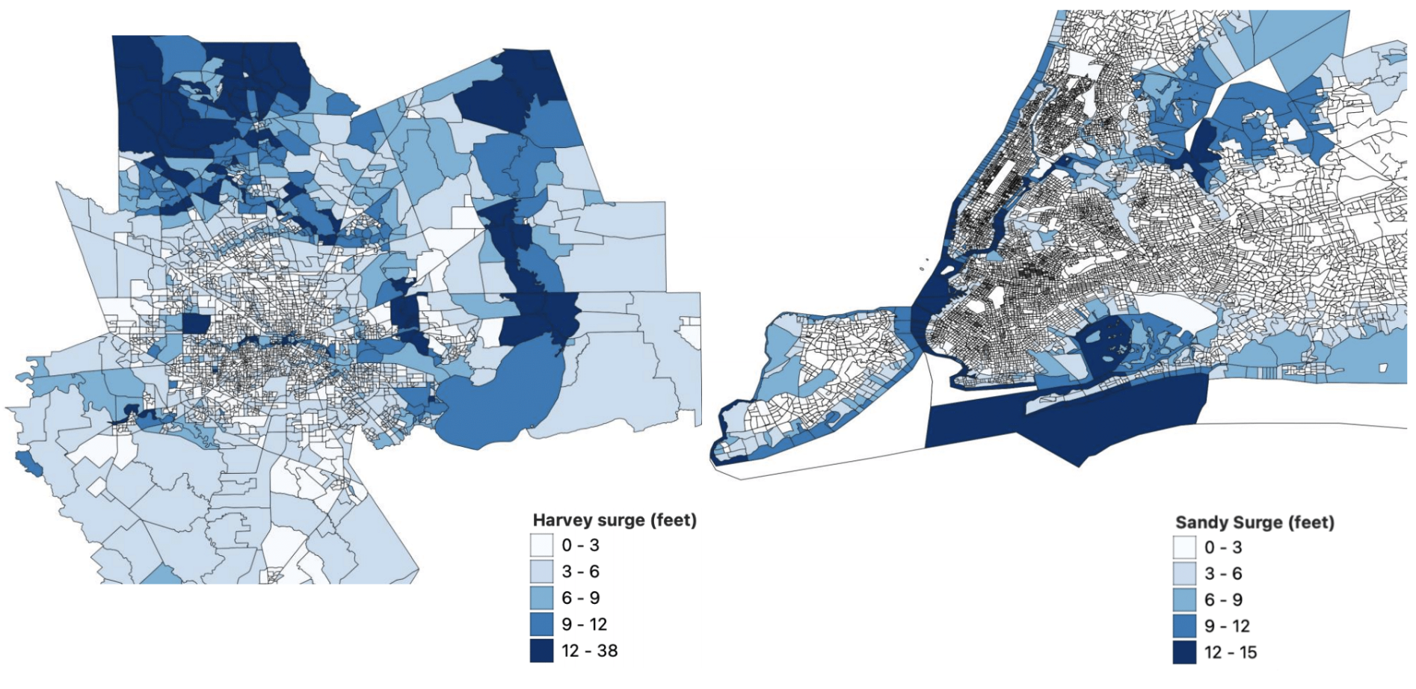
Siqi’s Research: Hurricane and CRE
Quantifying the Impacts of Climate Shocks in Commercial Real Estate Markets (Hurricane Sandy, 2012; Hurricane Harvey, 2017)
Authors: Rogier Holtermans, University of Guelph; Dongxiao Niu, Maastricht University; Siqi Zheng, MIT
Commercial real estate transactions (Real Capital Analytics)
New York 2007-2017 and Texas, 2012-2021
Transaction date, price, location, property type, quality, buyer and seller characteristics, etc.
Hurricanes (3-meter surge map from FEMA Modeling Task Force)
Final sample: 10,359 transactions in New York and 15,312 in Texas State
Notes: This Figure shows the surge level of inundation area by Census block group in Texas and New York, with a focus on Houston and New York City. The blue shades indicate surge level (feet).

Slide 12
Siqi’s Research: Hurricane and CRE
  DID model using hurricanes as a climate shock (Ortega and Taṣpınar, 2018; Gibson and Mullins, 2020, Meltzer et al., 2021)
Property damage measure (i) surge dummy; (ii) average surge level (feet) at census block level; (iii) high surge (>3 feet) and low surge dummies
Priceit = α0 + α1*Postt + α2*Surgei + α3*Surgei*post + β*Hedonicsit + Tt + σc + μict
Property transaction price per sq. ft. for property i at time t
=1 if the transaction happened after the specific hurricane (Aug 2017 for TX and Oct 2012 for NY)
Hedonics: property types, building attributes, such as age, size, number of stories, building quality, etc.
Year-quarter time trends, Census tract fixed effects
Notes:
We assume the effect in the first 24 months after hurricane shock are the most severe and “pure”. Especially for Sandy (2012), there are too many other factors influencing the market in years long after the shock. Of course, we can do robustness using alternative settings (appendix).
The repeated sales with both pre- and post-hurricane transactions account for about 8% of all properties in New York and 9.42% in Texas.

Slide 13
Baseline results – decrease in transaction price
 | Dependent Variable: Log (Price/sq. ft.)
 |  | Texas |  |  |  | New York
 | (1) | (2) | (3) |  | (4) | (5) | (6)
Post | -0.028 | -0.040 | -0.029 |  | 0.595*** | 0.594*** | 0.595***
 | (0.049) | (0.048) | (0.048) |  | (0.033) | (0.033) | (0.033)
Surge dummy | -0.093** |  |  |  | 0.043*
 | (0.040) |  |  |  | (0.025)
Post × Surge dummy | -0.033* |  |  |  | -0.009
 | (0.017) |  |  |  | (0.021)
Mean surge |  | 0.026** |  |  |  | 0.004
 |  | (0.010) |  |  |  | (0.010)
Post × Mean surge |  | -0.035*** | $4.41/sq. ft |  |  | -0.015* | $5.49/sq. ft
 |  | (0.008) | $311,500/building |  |  | (0.008) | $100,335/building
High Surge |  |  | -0.052 |  |  |  | 0.010
 |  |  | (0.042) |  |  |  | (0.033)
Low Surge |  |  | -0.143*** |  |  |  | 0.057*
 |  |  | (0.043) |  |  |  | (0.031)
Post × High Surge |  |  | -0.088*** |  |  |  | -0.033
 |  |  | (0.022) |  |  |  | (0.029)
Post × Low Surge |  |  | 0.028 |  |  |  | 0.013
 |  |  | (0.023) |  |  |  | (0.028)
Observations | 15,312 | 15,312 | 15,312 |  | 10,359 | 10,359 | 10,359
R² | 0.703 | 0.703 | 0.703 |  | 0.912 | 0.912 | 0.912
Notes: Standard errors are reported in brackets. Significance at the 0.10, 0.05, and 0.01 level is indicated by *, **, and ***.
Notes:
Overall, hurricane damages are associated with a significant drop in asset values

Slide 14
Heterogeneity: Place – Price of New news
Inconsistency between ex ante information on underlying climate risk and ex post damage from actual events
Texas
New York
Notes:
If investors learn about the future location of disasters when observing the geography of damages, then the impact of disasters on property values may be lower in areas with a prior information of flood risks. Flooding in flood zones is less likely to bring new information on disaster probabilities.

Slide 15
Heterogeneity: Place – Price of New news
Hurricane discount mainly observed outside of flood zones (New news can be costly).
Investors already capitalize flood risks into their asset value based on the flood zone designation.
 | Dependent Variable: Log (Price/sq. ft.)
 | Texas |  |  |  |  | New York
 | Inside-zone | Outside-zone | <500m | <1000m |  | Inside-zone | Outside-zone | <500m | <1000m
 | (1) | (2) | (3) | (4) |  | (5) | (6) | (7) | (8)
Post | 0.064 | -0.020 | -0.058 | -0.062 |  | 0.853*** | 0.608*** | 0.698*** | 0.628***
 | (0.202) | (0.054) | (0.080) | (0.062) |  | (0.228) | (0.033) | (0.054) | (0.040)
Mean Surge | 0.290** | 0.033* | 0.040* | 0.039** |  | -0.127 | 0.010 | 0.018 | 0.013
 | (0.117) | (0.018) | (0.024) | (0.020) |  | (0.083) | (0.010) | (0.012) | (0.010)
Post × Mean Surge | -0.019 | -0.042*** | -0.041*** | -0.039*** |  | -0.020 | -0.011 | -0.023** | -0.018**
 | (0.029) | (0.010) | (0.013) | (0.011) |  | (0.044) | (0.008) | (0.010) | (0.009)
Hedonic attributes | Yes | Yes | Yes | Yes |  | Yes | Yes | Yes | Yes
Census Tract FE | Yes | Yes | Yes | Yes |  | Yes | Yes | Yes | Yes
Year-Quarter FE | Yes | Yes | Yes | Yes |  | Yes | Yes | Yes | Yes
Observations | 1,313 | 6,582 | 10,184 | 11,575 |  | 312 | 10,809 | 3,448 | 6,518
R² | 0.811 | 0.741 | 0.731 | 0.724 |  | 0.937 | 0.915 | 0.905 | 0.910
Notes: Standard errors are reported in brackets. Significance at the 0.10, 0.05, and 0.01 level is indicated by *, **, and ***.
Notes:
Overall, hurricane damages are associated with a significant drop in asset values

Slide 16
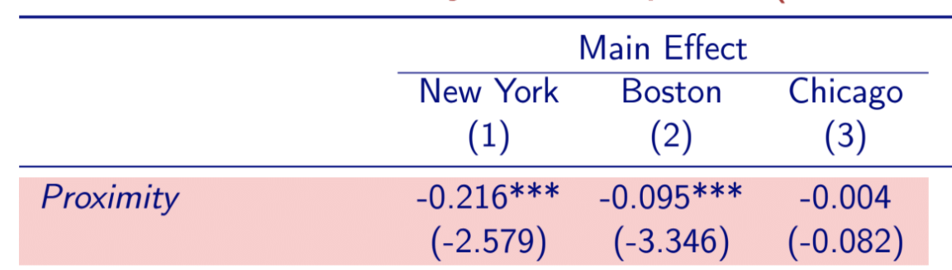
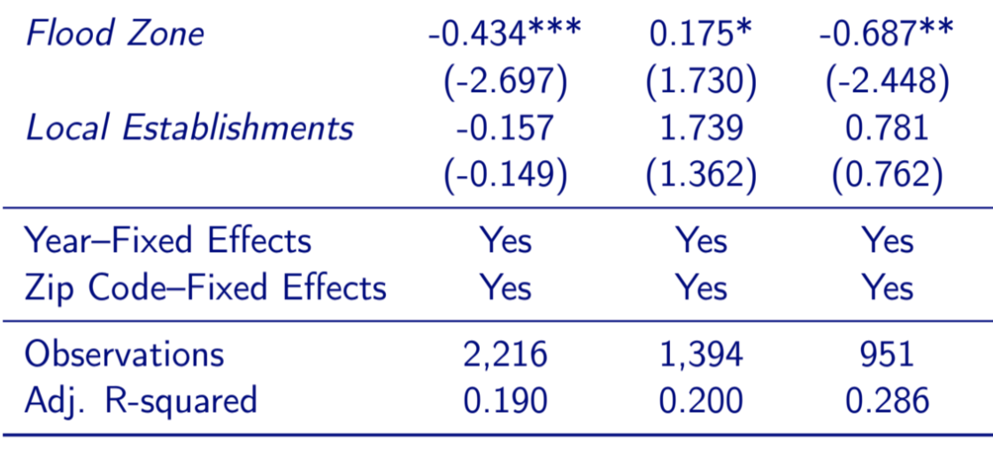
Hurricane and CRE
Proximity (to coast, elevation) lowers commercial real estate price after Hurricane Sandy
  New York directly hit by Sandy and damaged
  Boston spared by Sandy but at risk
  Chicago unaffected due to in-land waterfront location
Source: Addoum, J. M., Eichholtz, P. M. A., Steiner, E., & Yönder, E. (2021). Climate Change and Commercial Real Estate: Evidence from Hurricane Sandy. Working paper.

Slide 17
Insurance market crisis

Slide 18
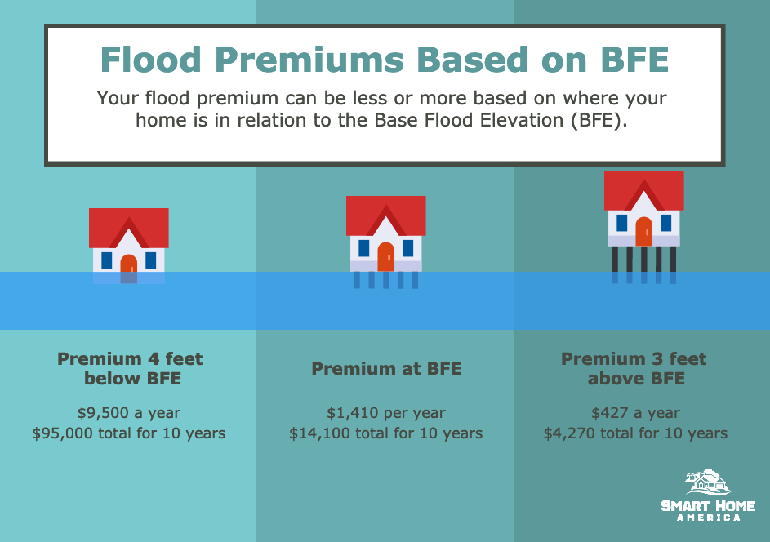
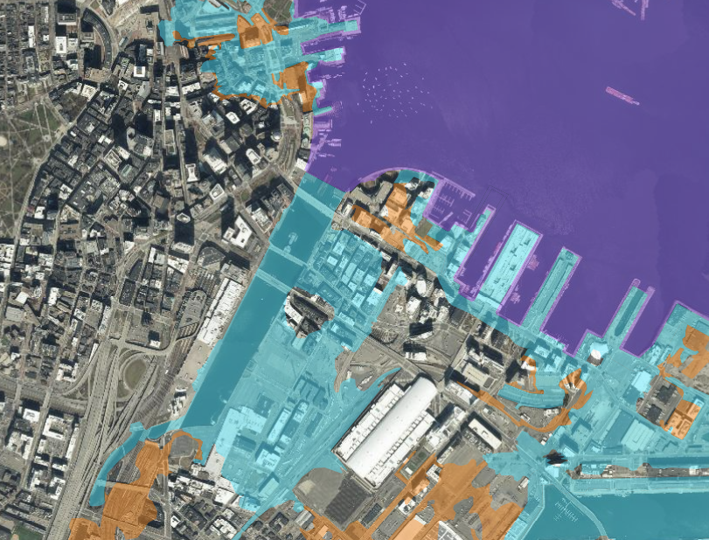
The National Flood Insurance Program (NFIP)
Introduction to the NFIP program.
Insurance rate is determined by the location of your property with respect to the flood zones.
Homeowners can reduce the insurance premium by elevating the building (example presented on the right).
Note: Calculation based on $250,000 building coverage only (does not include content). AE (high to moderate) zone, single-family, one-story structure without a basement. The calculation is based on standard NFIP deductible.
Left: © source unknown; right: © Flood Proof. All rights reserved. This content is excluded
from our Creative Commons license. For more information, see https://ocw.mit.edu/help/faq-fair-use/.
Notes:
Insurance premiums were primarily based on which flood zone you lived in according to outdated, often unreliable federal flood maps. It wasn’t uncommon for homeowners in lower-risk areas to be incorrectly placed in flood zones and overcharged by thousands of dollars. On the flip side, homeowners in actual floodplains were often being vastly undercharged for flood insurance.
Flood insurance rates are also determined by the elevation height in relation to the flood zone. If a house’s lowest floor is above the base flood elevation, its owner will pay a lower insurance premium than a neighbor whose bottom floor is below the new flood-water mark.

Slide 19
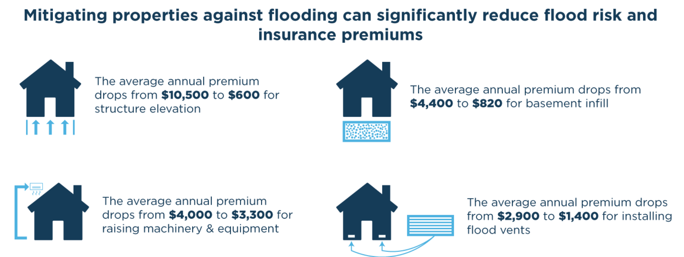
The National Flood Insurance Program (NFIP)
Introduction to the NFIP program.
Other mitigation efforts: Example of a New York building (link)
© American Flood Coalition. All rights reserved. This content is excluded from our
Creative Commons license. For more information, see https://ocw.mit.edu/help/faq-fair-use/.
Notes:
Elevation and relocation are most effective ways to reduce the insurance premium. One can also choose other mitigation efforts such as basement infill, raising utilities, or installing flood vents. These give more moderate reduction in flood rate yet could also be cheaper to implement.

Slide 20
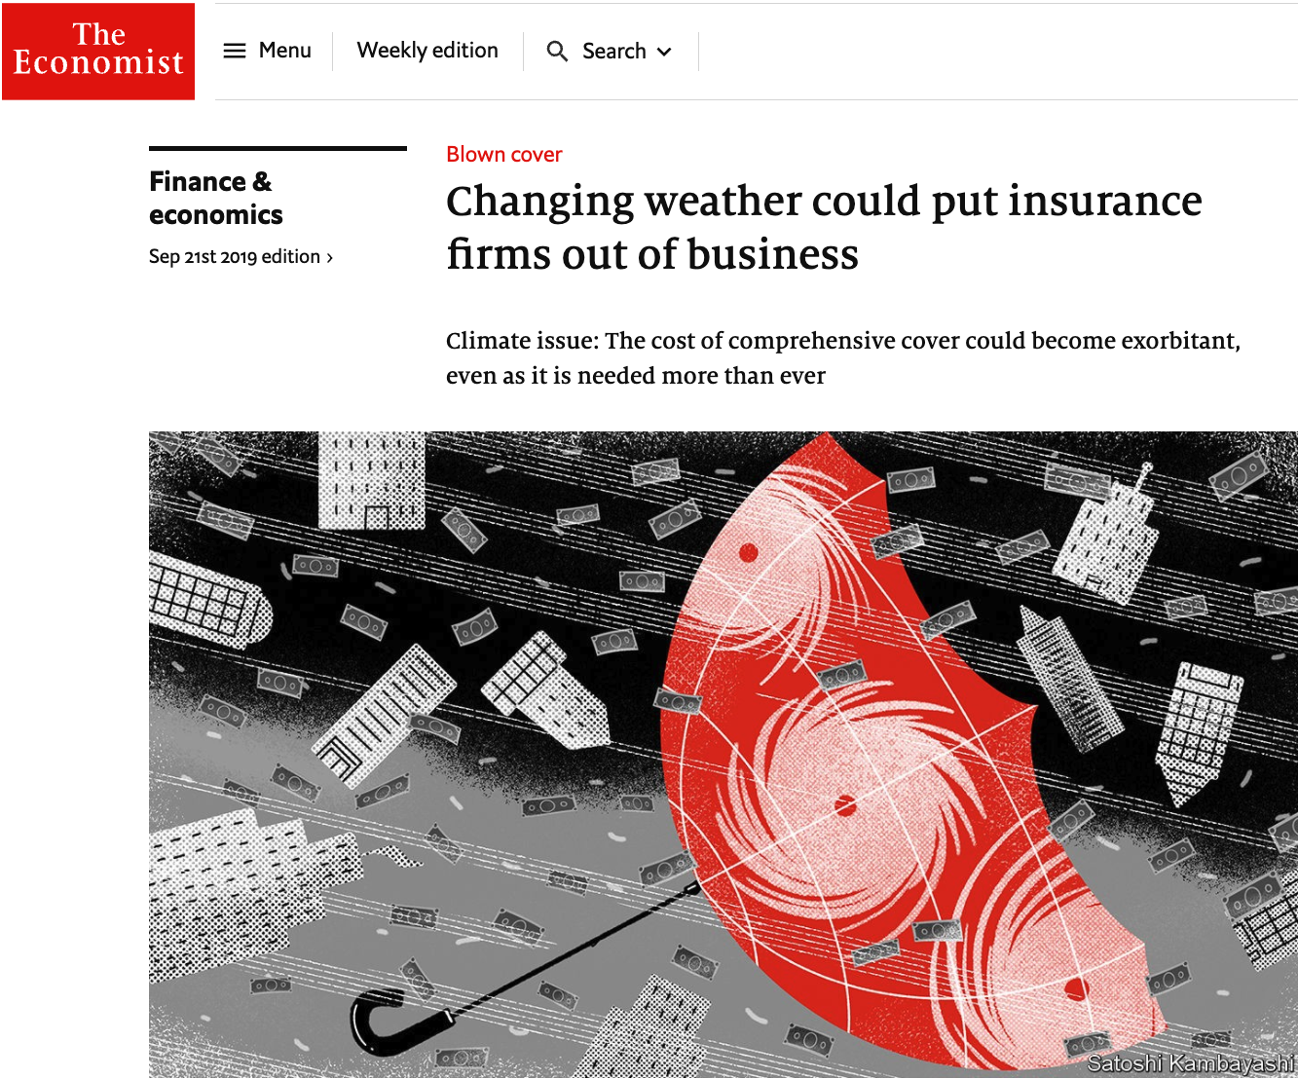
Can we insure against Climate Risk?
Discussion about the possibility of owners to insure properties against climate change.
The prevailing strategy among real estate investors to use insurance as their primary means to protect their properties against extreme weather and climate events (ULI & Heitman, 2020).
The number of disasters is growing, and the loses for insurance companies are also growing
  The basic economics of insurance companies is to stabilize income: transfer money from good times (no disaster) to bad times (disaster period)
  The increase in frequency and severity of disasters challenges the traditional business model. Consequences: Rise premiums and rise in number of uninsured properties.
Source: Swiss re (2020) Natural catastrophes in times of economic accumulation
and climate change
© The Economist. All rights reserved. This content is excluded from our Creative
Commons license. For more information, see https://ocw.mit.edu/help/faq-fair-use/.
Notes:
These two articles can be our readings:
https://www.economist.com/finance-and-economics/2019/09/19/changing-weather-could-put-insurance-firms-out-of-business?utm_source=YouTube&utm_medium=Economist_Films&utm_campaign=Link_Description&utm_term=Business_and_Finance&utm_content=Correspondent&linkId=100000008250400
https://www.swissre.com/dam/jcr:85598d6e-b5b5-4d4b-971e-5fc9eee143fb/sigma%202%202020%20_EN.pdf

Slide 21
Climate Risks in Mortgage Markets
What is the impact on Freddie Mac and Fannie Mae; and also the problem of information asymmetry
Owner
Originator
Vast Investors
Freddie Mac; Fannie Mae
Hurricane Harvey resulted in significant home price discounts inside the 100-year floodplain.
  Before Harvey, homes inside the flood zone in Harris County, which is home to Houston, sold for 2.3 percent less than those outside the area. After Harvey hit, that discount more than doubled to 5.5 percent.
Fannie Mae and Freddie Mac, the government-sponsored, taxpayer-backed enterprises that stand behind roughly half of the nation’s $11 trillion in residential mortgages.
However FMs don’t price differently loans with and without climate risk in the finance houses
  Pricing those risks is likely to introduce discrimination into the housing markets, and compromise social justice since minorities are overly exposed to certain climate risks
Origination
Pooling
Securitization
Source: http://www.freddiemac.com/research/insight/20200910_unravelling_perceptions_of_flood_risk.page?

Slide 22
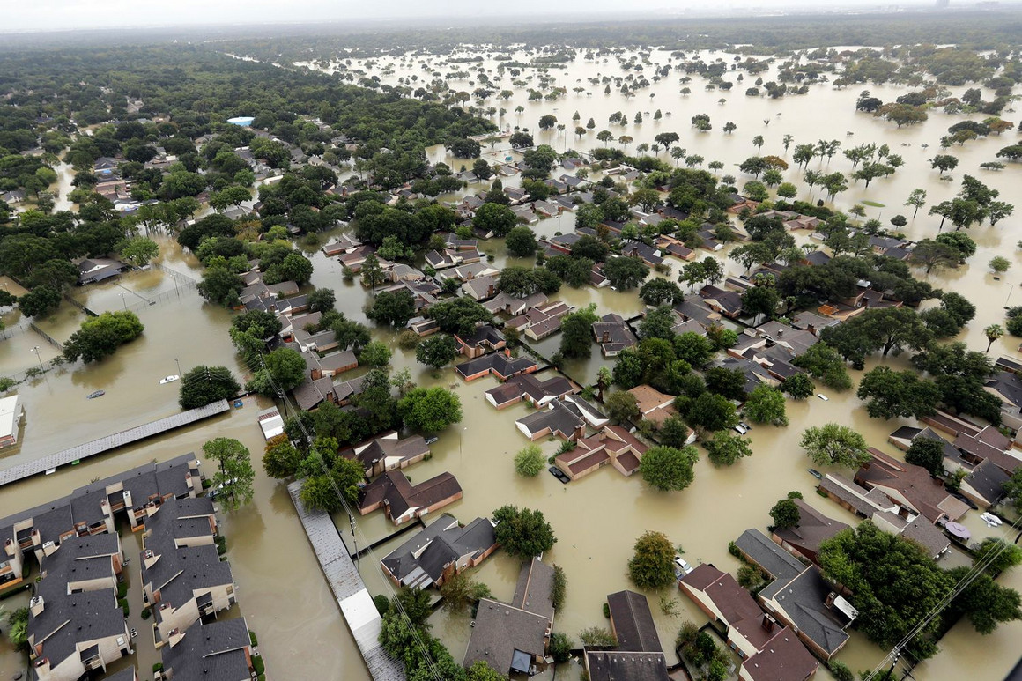
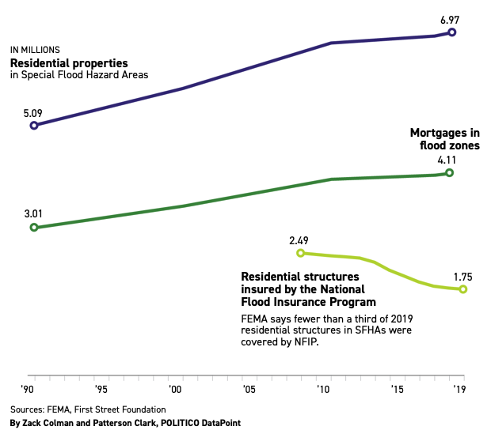
Climate change threatens U.S. mortgage market
Are we creating a new housing bubble?
Fannie and Freddie rely on another government enterprise, the National Flood Insurance Program (NFIP), to cover the cost of flood damage to homes with their mortgages. But the flood insurance program itself is insolvent after years of paying out more than it collects.
Homes in flood plains are overvalued by $34 billion because homebuyers don’t fully price in the high risk of climate-related disasters.
Mortgage in floodplains are rising steadily from 2006 onwards:
  Nearly 600,000 houses were built in 100-year floodplains, bringing to 7 million homes
  300,000 mortgages were added to homes in floodplains, bringing the total number of loans to 4.1 million.
However, insurance policies in floodplains shrunk:
2.5 million residential structures insured in 2008.
Which had fallen to fewer than 1.8 million in 2019.
Source: https://www.politico.com/news/2020/06/08/borrowed-time-climate-changemortgage-market-304130 © Politico. All rights reserved. This content is excluded from our Creative Commons license. For more information, see https://ocw.mit.edu/help/faq-fair-use/.
Notes:
U.S. taxpayers could be on the hook for billions of dollars in climate-related property losses as the government backs a growing number of mortgages on homes in the path of floods, fires and extreme weather.
Violent storms and sunny-day flooding are on the rise, and more houses are being built on at-risk land. But fewer people are buying federally backed flood insurance despite requirements that homeowners in flood plains be insured if their mortgage is backed by taxpayers.
Fannie Mae and Freddie Mac, the government-sponsored, taxpayer-backed enterprises that stand behind roughly half of the nation’s $11 trillion in residential mortgages. For decades, the companies have bought and guaranteed home loans in floodplains and other places vulnerable to natural disasters.
To reduce risk, the companies rely on another government enterprise, the National Flood Insurance Program, to cover the cost of flood damage to homes with Fannie and Freddie mortgages. But the flood insurance program itself is insolvent after years of paying out more than it collects. When Congress tried to fix the program in 2012, it was forced to backtrack after flood insurance premiums billed to homeowners spiked.
In Massachusetts, the average flood insurance premium is $1,294 per year, for about $260,000 in coverage. However, National Flood Insurance Program (NFIP) rates are based on whether your property is in a high-risk flood zone as defined by FEMA. This average accounts for all federally sponsored flood insurance policies active in the Bay State. If your house is located in one of the special flood hazard areas identified by the Federal Emergency Management Agency's (FEMA) flood mapping system, then your mortgage lender may require you to purchase flood insurance coverage.

Slide 23
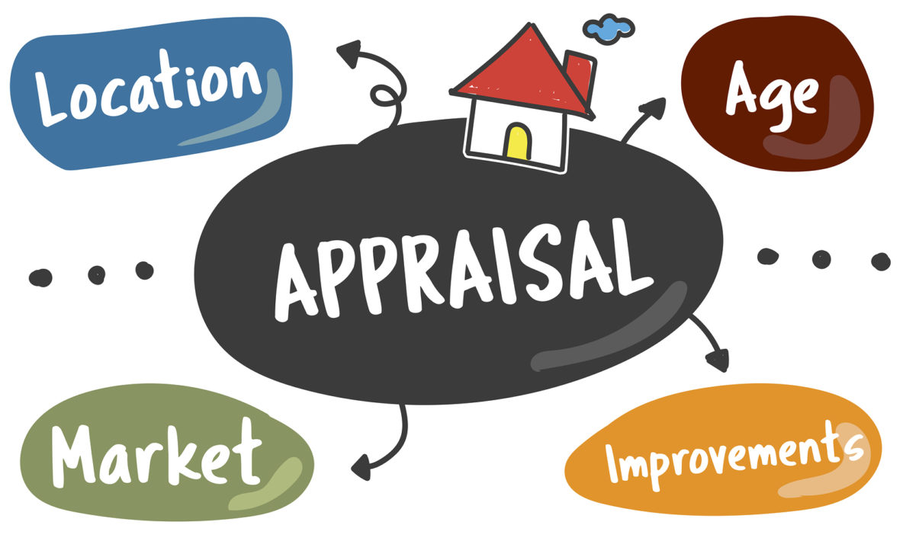

SUL Research: Climate Risk and Appraisal Values
How climate risks lead to mis-valuation of single-family homes in climate-vulnerable neighborhoods in the appraisal process
Step 1: comparing the appraisal value of homes under high climate risk with homes with low risk and otherwise similar attributes. By comparing the “climate risk discount” in the appraisal value and in the transaction value, we can examine how climate risks affect the deviation of appraisal value to the transaction value, i.e., appraisal bias.
Step 2: studying the heterogeneity in the appraisal value difference regarding information provision, actual climate shocks, and neighborhood attributes.
Climate risk?
Data:
Appraisal record and transaction record
Climate risk/shocks data
Regulatory and socio-economic data
Team: Siqi Zheng (MIT), Nils Kok (UM), Juan Palacios (MIT/UM), Dongxiao Niu (UM)
© source unknown. All rights reserved. This content is excluded from our Creative Commons
license. For more information, see https://ocw.mit.edu/help/faq-fair-use/.

Slide 24

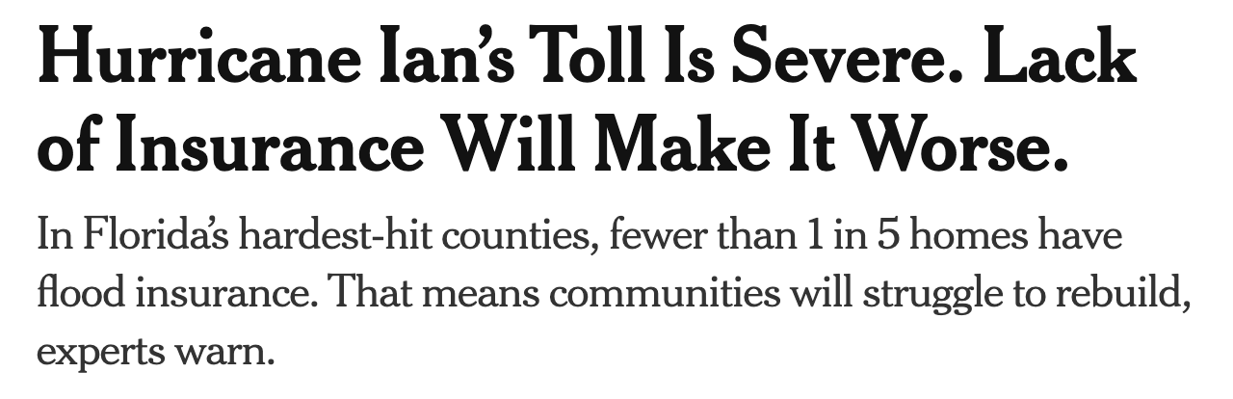
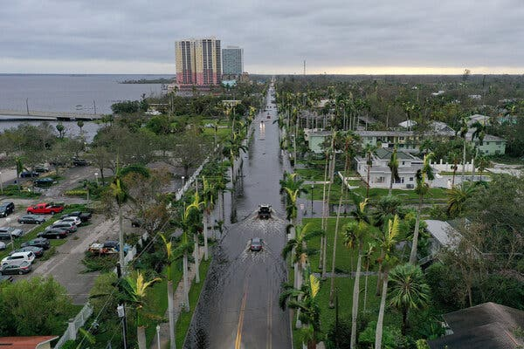
Low Take-up of Flood Insurance
© The New York Times. All rights reserved. This content is excluded from our Creative
Commons license. For more information, see https://ocw.mit.edu/help/faq-fair-use/.
Notes:
https://www.nytimes.com/2022/09/29/climate/hurricane-ian-flood-insurance.html
Today, homeowners base risk decisions on whether their property is in or out of a FEMA Special Flood Hazard Area (SFHA) to ascertain whether it is flooded or not. Even when a property is within an SFHA zone (areas with a greater than one percent annual probability of flooding), only one-third of homeowners hold policies, despite mandatory coverage for the first year of a mortgage term. This low penetration illustrates that policies are rarely renewed when no longer required by law.
Link: https://www.rms.com/blog/2020/10/20/us-flood-why-is-flood-insurance-take-up-so-low

Slide 25
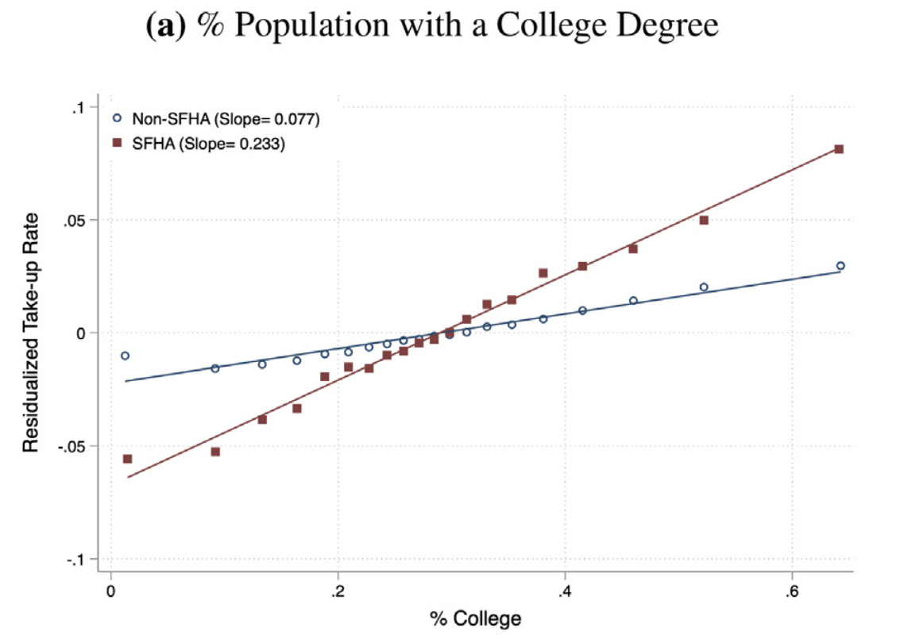
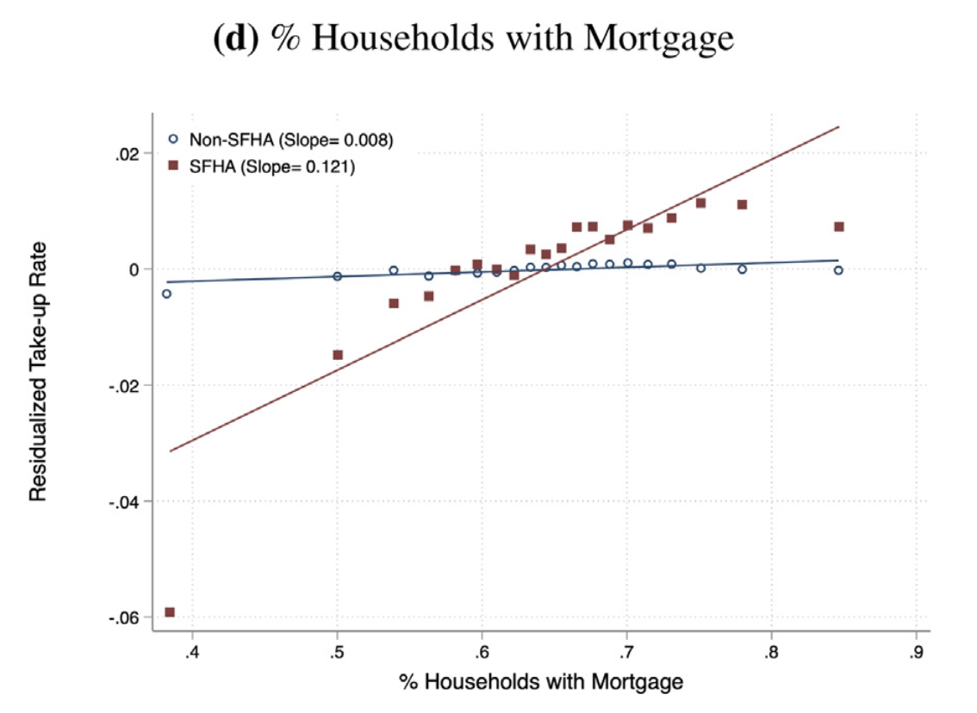
Low Take-up of Flood Insurance
Low take-up rate and inequality.
Low insurance take-up: Only 20%, among the households flooded in New York City during Hurricane Sandy and in the greater Houston area during Hurricane Harvey.
Higher take-up rate for highly educated group and for people getting mortgage within the Special Flood Hazard Area (SFHA, “flood zone”).
Problems beyond low take-up: NFIP uses broad, outdated, and inaccurate flood zone designation
  Adverse selection: High-risk households get insured.
  Rainfall-related flood risks are not considered.
  → 1/3 of flood claims are out of the SFHA
Source: Bradt, J. T., Kousky, C., & Wing, O. E. J. (2021). Voluntary purchases and adverse selection in the market for flood insurance. Journal of Environmental Economics and Management, 110, 102515.
Courtesy of Elsevier, Inc., https://www.sciencedirect.com. Used with permission.
Notes:
Flood hazard areas identified on the Flood Insurance Rate Map are identified as a Special Flood Hazard Area (SFHA). SFHA are defined as the area that will be inundated by the flood event having a 1-percent chance of being equaled or exceeded in any given year. The 1-percent annual chance flood is also referred to as the base flood or 100-year flood.
Adverse selection into the NFIP has a number of important policy implications which are likely to become increasingly salient in the coming decades: flood risk is expected to increase in many parts of the country due to climate change and the NFIP will need to price for this higher risk to ensure the fiscal solvency of the program.

Slide 26
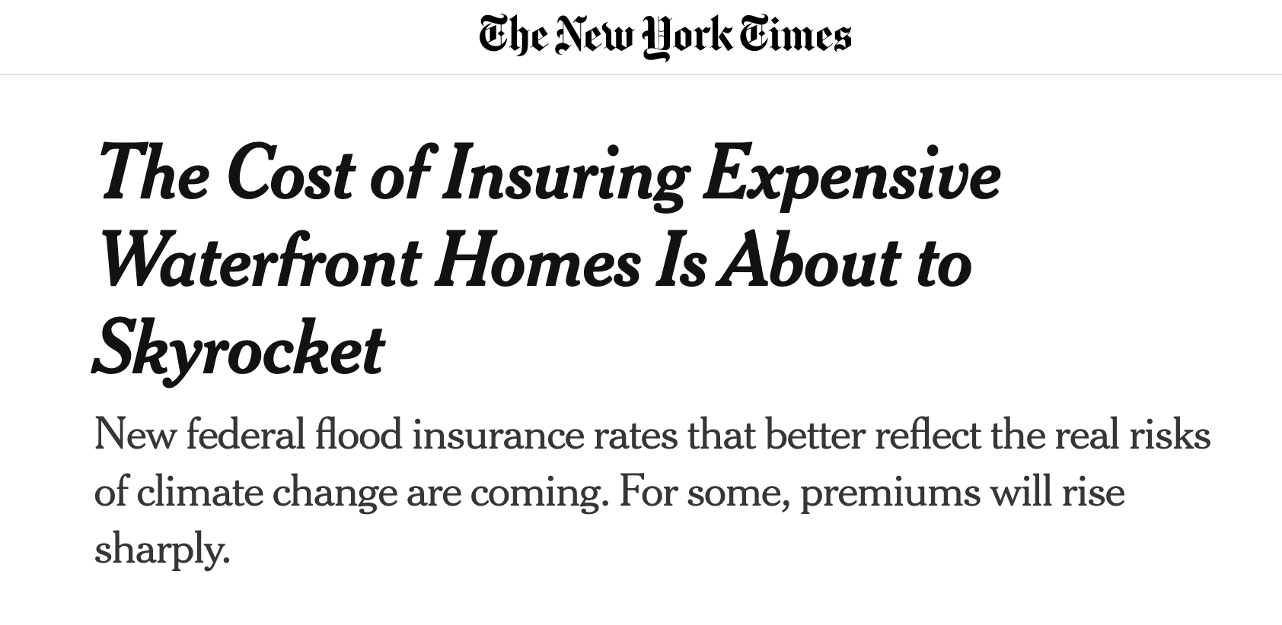
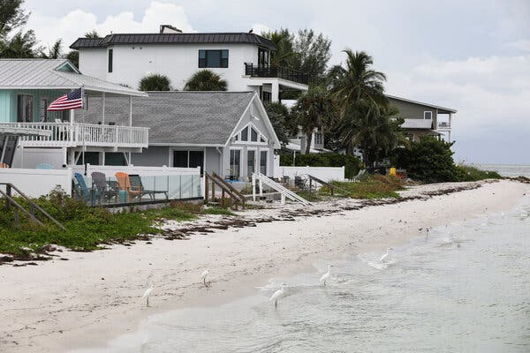
Insurance Market Regulation
“Risk Rating 2.0”: More accurate flood risk assessment and fairer price.
© The New York Times. All rights reserved.
This content is excluded from our Creative
Commons license. For more information, see
https://ocw.mit.edu/help/faq-fair-use/.
Notes:
Public insurance FEMA:
Risk Rating 2.0 will adjust the flood insurance price to fair price.
Report: https://sgp.fas.org/crs/homesec/R45999.pdf

Slide 27
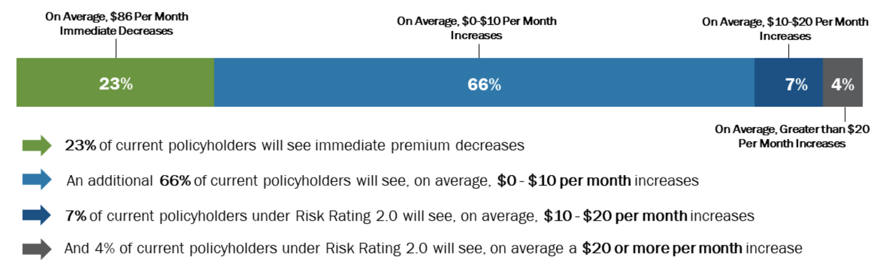
Insurance Market Regulation
“Risk Rating 2.0”: More accurate flood risk assessment and fairer price.
Public flood insurance payouts in the US have increased twentyfold in the past two decades.
High claims years beginning in 2005 and continuing with major storms in 2008, 2012, and 2017 have led the NFIP program to carry a debt exceeding $20 billion despite Congressional approval for $16 billion in debt forgiveness after Hurricane Harvey in 2017.
Since October 1, 2021 (for new policies) or Apr 1, 2022 (for renew policies): “Risk Rating 2.0”
(1) Will reflect individual property’s flood risk; (2) use the latest actuarial practices to set risk-based rates.
Source: https://www.fema.gov/flood-insurance/risk-rating. Public domain image courtesy of FEMA.
Notes:
Public insurance FEMA:
Risk Rating 2.0 will adjust the flood insurance price to fair price.
Report: https://sgp.fas.org/crs/homesec/R45999.pdf
Risk Rating 2.0 takes into account a home’s location, its size and its overall flood risk.

Slide 28
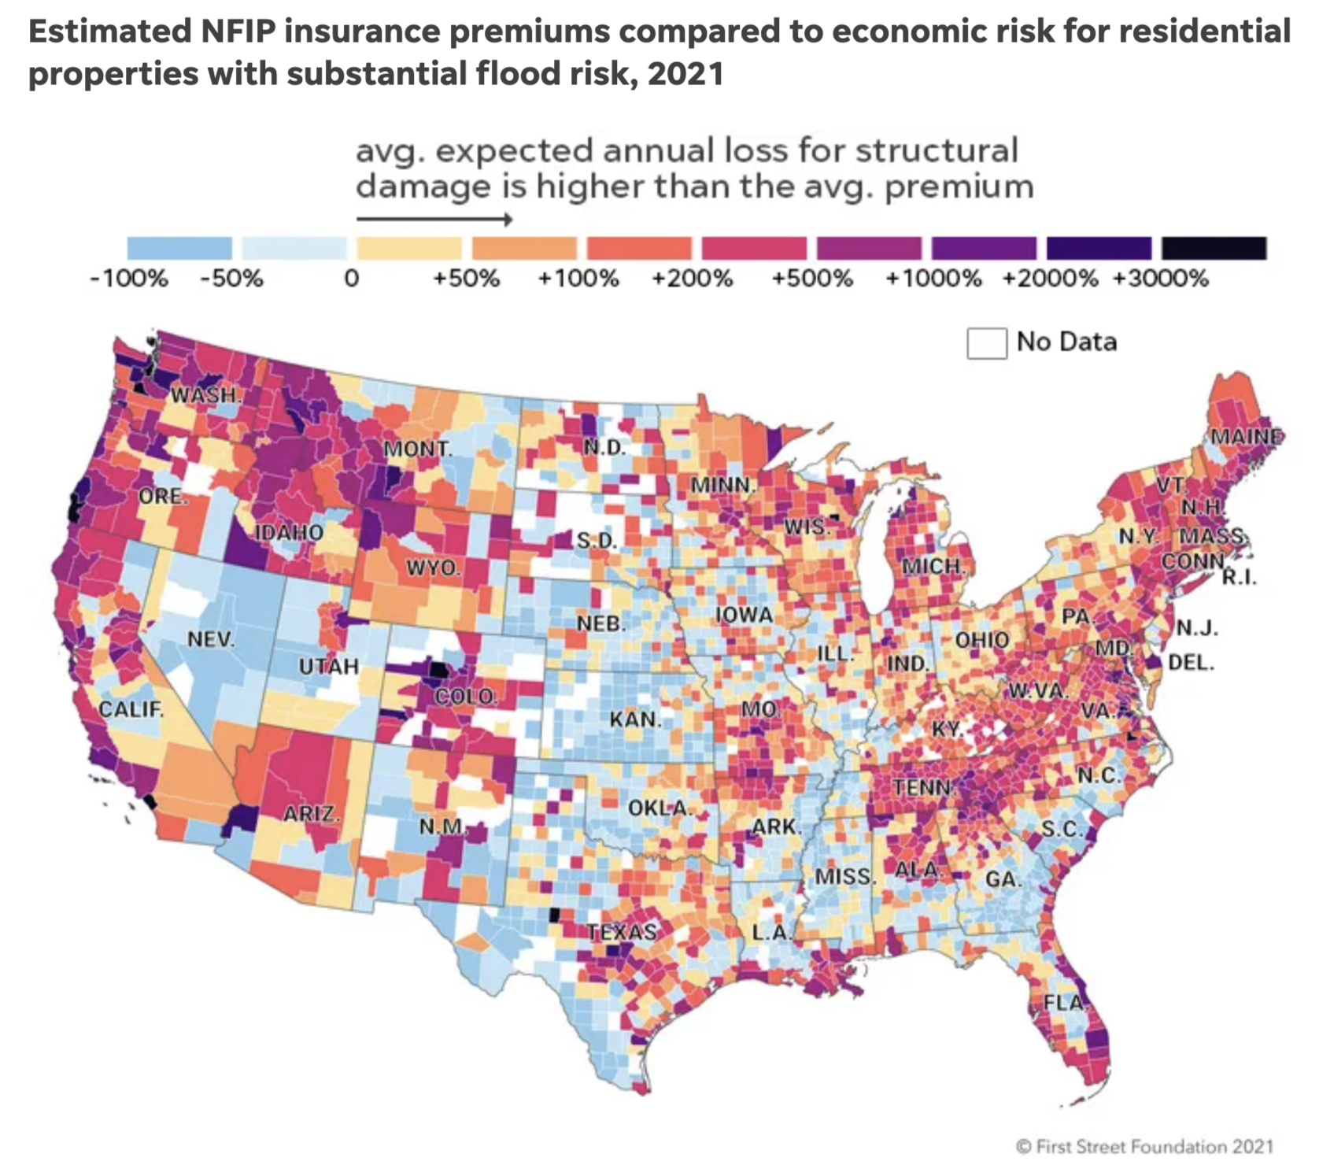
Insurance Market Regulation
Map © First Street Foundation. All rights reserved. This
content is excluded from our Creative Commons license.
For more information, see https://ocw.mit.edu/help/faq-fair-use/.
“Risk Rating 2.0”: More accurate flood risk assessment and fairer price.
A more accurate mapping of the actual flood risk for properties will create major shifts in pricing.
(picture on the right shows the NFIP mispricing)
  Largest gaps in the Southeast and Mid-Atlantic regions in places such as Florida, South Carolina and New Jersey.
However, even a modest increase could prove difficult for lower-income communities.
  Three hours to the southwest in Monongalia County, West Virginia, more than a fifth of households fall below the federal poverty level. The most severe flood-prone homes there would have to pay premiums 527% higher than today to cover the risk.
Link: https://www.usatoday.com/in-depth/news/investigations/2021/02/21/fema-flood-insurance-rates-could-spike-some-new-study-shows/6764469002/
Notes:
Some of the biggest gaps in current premiums versus actual risk appear in the Southeast and Mid-Atlantic regions in places such as Florida, South Carolina and New Jersey. Chasms also exist in pockets of California, Texas and Washington.
In the historic waterfront city of Charleston, South Carolina, for example, nearly four in 10 flood-prone homes would need to pay an average premium of $18,211 to cover the anticipated costs of flooding compared to the current average NFIP rate of $2,264, First Street data shows.
And almost every homeowner on the barrier island city of South Patrick Shores, Florida, would need to pay an average of $24,724 a year to adequately cover their risk. The average rate there now is $491, First Street data shows.
For the low-income households: FEMA itself “does not currently have the authority to implement an affordability program, nor does FEMA’s current rate structure provide the funding required to support an affordability program,” according to a recent Congressional Research Service report about Risk Rating 2.0.

Slide 29
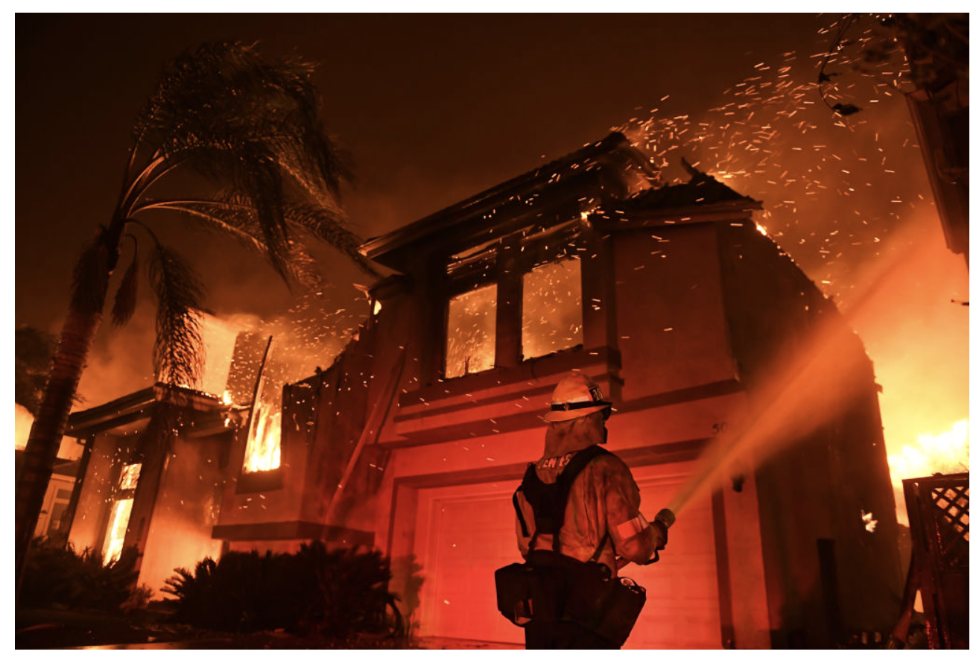
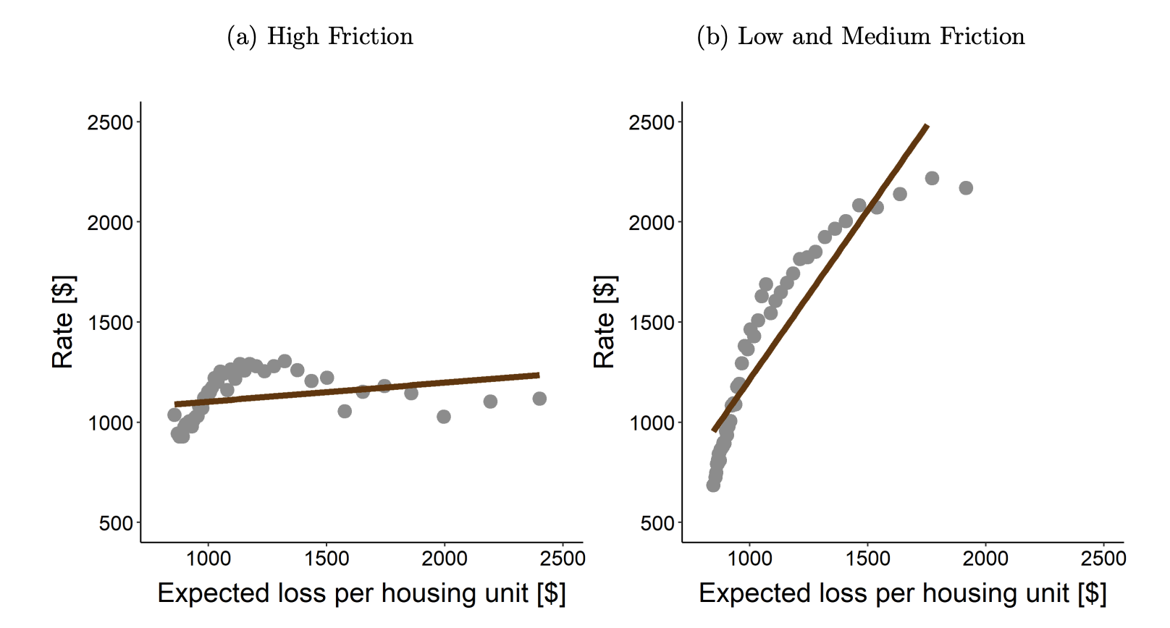
Insurance Market Regulation
© Wally Skalij/Los Angeles Times. All rights reserved. This content is excluded from our Creative
Commons license. For more information, see https://ocw.mit.edu/help/faq-fair-use/.
Insurance rate regulations cause private insurance companies to leave.
State regulations on insurance rate: Change premiums (rates) needs lengthy regulatory review and approval.
Some regulators require home-insurance rates based on historical loss experience, not projections of future losses that are determined by catastrophe modeling.
“high friction” drives the decoupling of insurance rates from underlying risks.
Insurance companies are leaving:
E.g., Insurance giants Chubb, Liberty Mutual, and AIG have announced plans to scale back their homeowner coverage in California, where they insist future climate-related losses will likely prevent them from turning a profit.
Public domain content courtesy of Federal Reserve Board.
Source 1: Oh, Sangmin S., Ishita Sen, and Ana-Maria Tenekedjieva (2022). “Pricing of Climate Risk Insurance: Regulation and Cross-Subsidies,” Finance and Economics Discussion Series 2022-064.
Source 2: https://jacobin.com/2022/02/california-wildfires-home-insurance-coverage-fossil-fuel-industry
Notes:
Private insurance under regulations of state governments:
Dilemma: affordability and financial loss from insurance companies.
More info about insurance companies leaving:
https://www.wsj.com/articles/wildfire-risk-in-california-drives-insurers-to-pull-policies-for-pricey-homes-11642593601

Slide 30
Climate resiliency investments in coastal areas

Slide 31
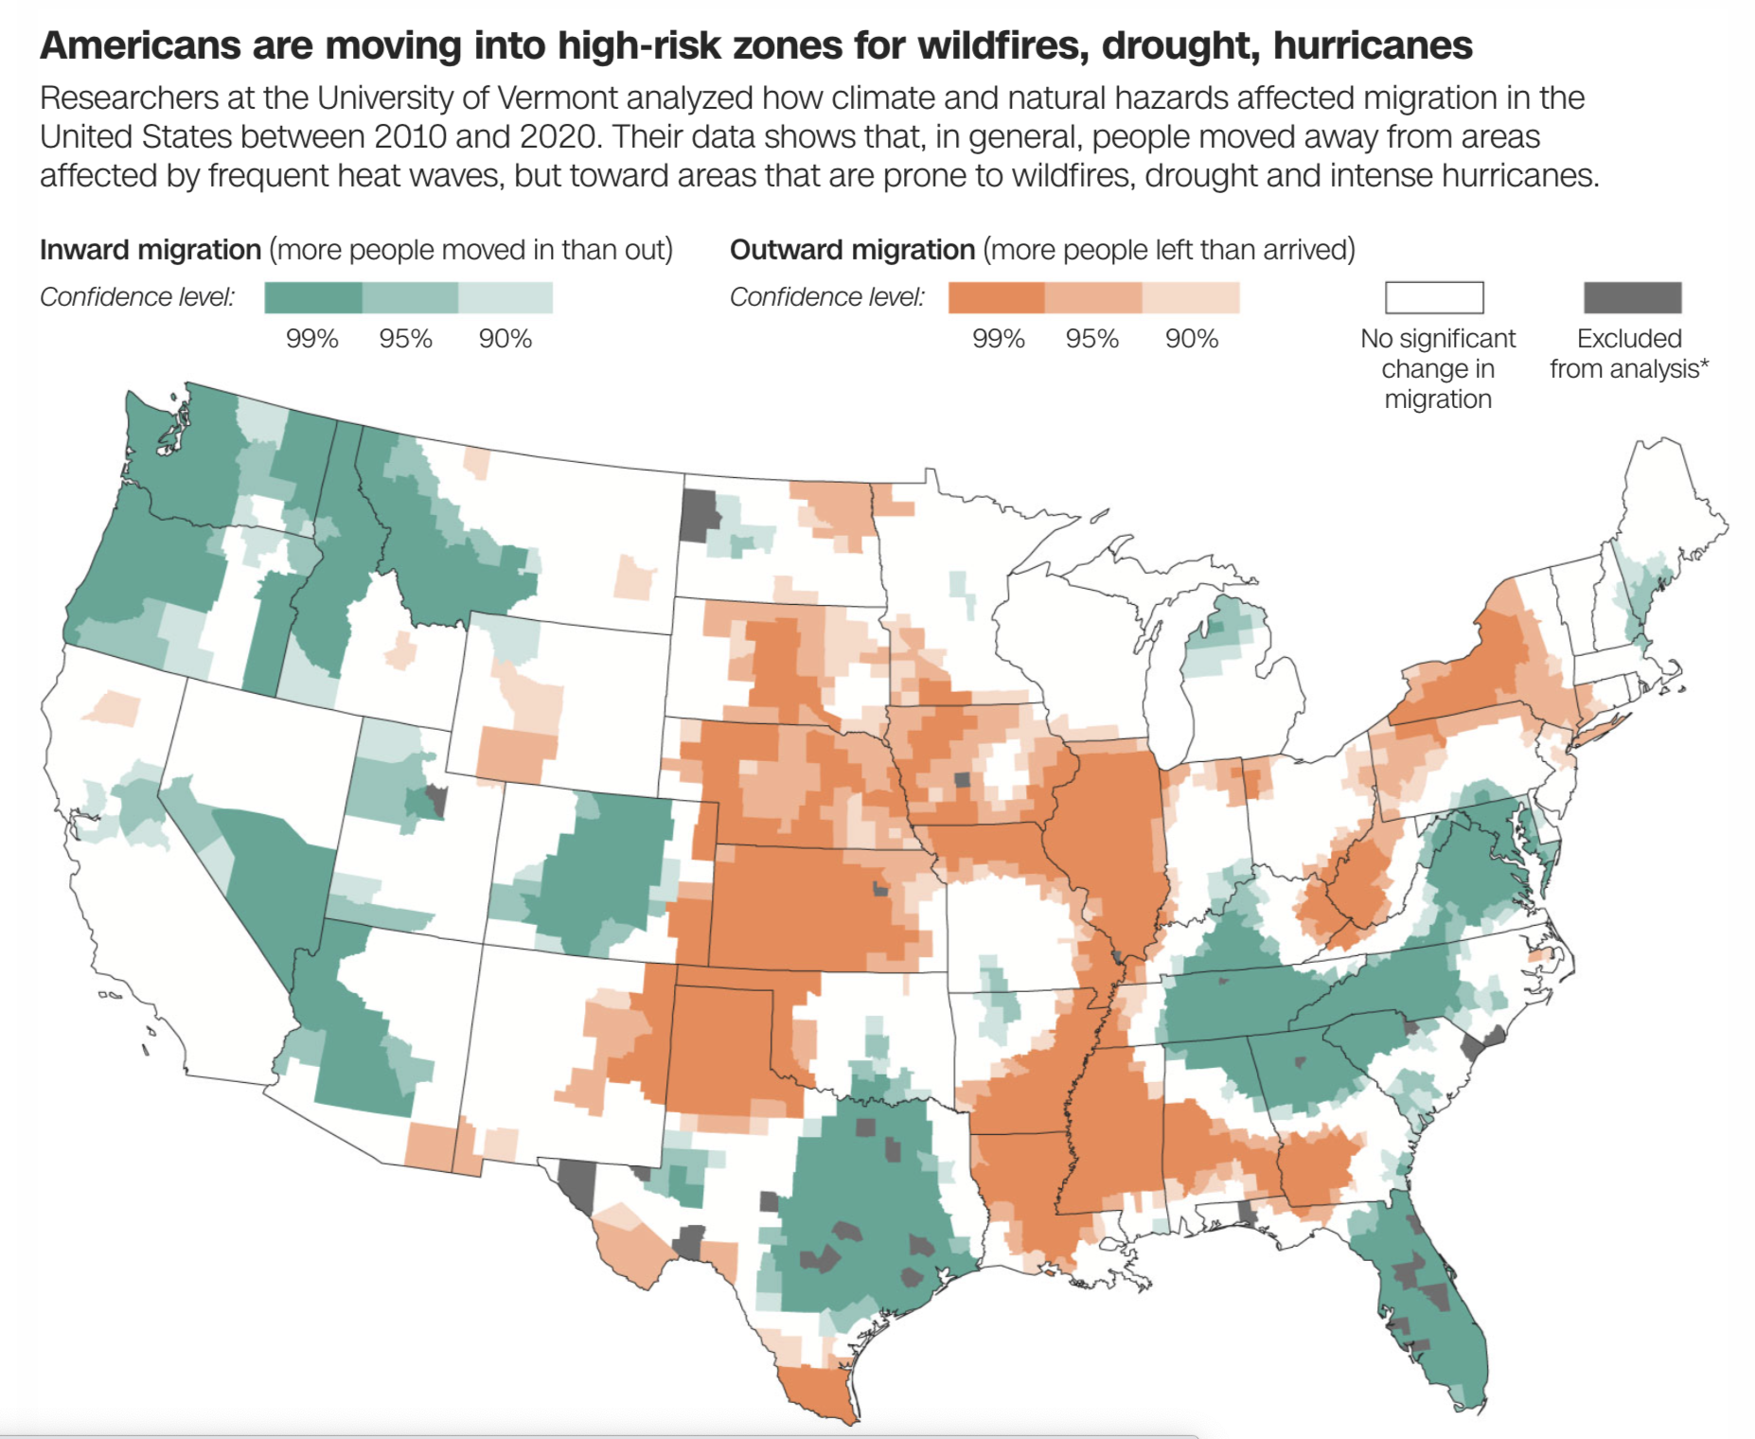
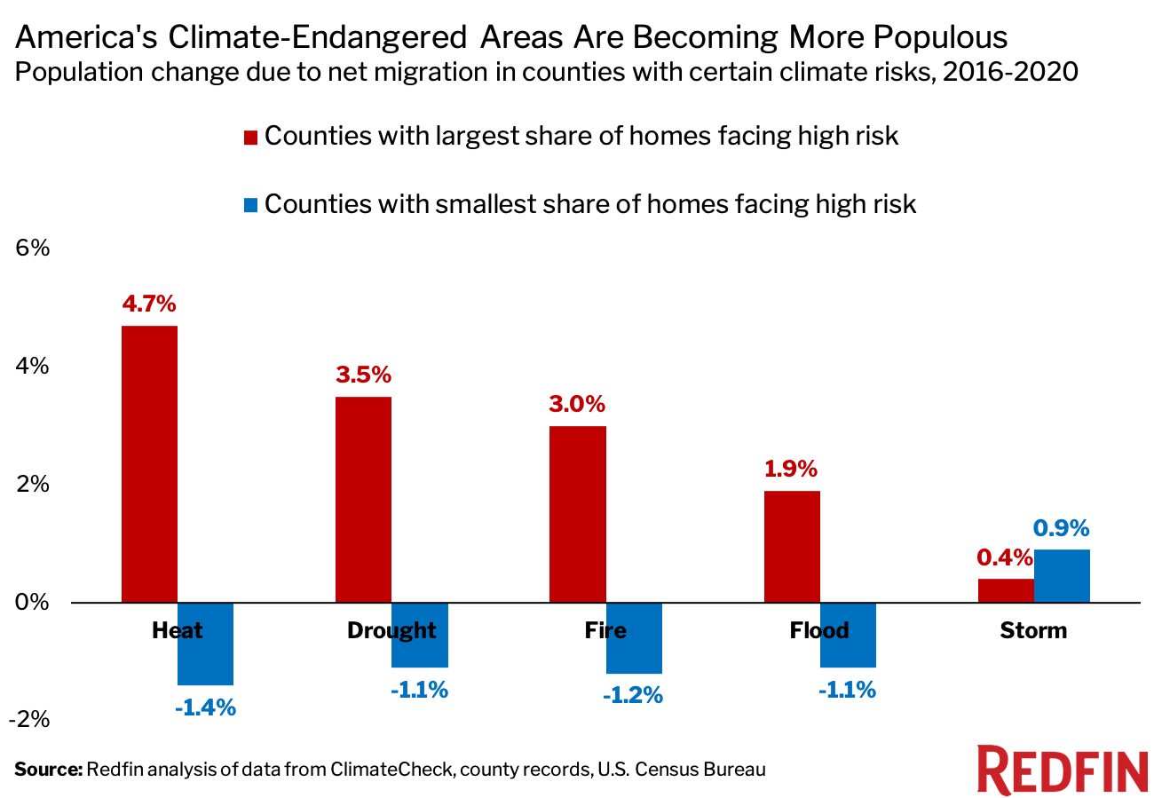
Expanding Coastal Population Escalates the Risk
© CNN. All rights reserved. This content is excluded from our Creative
Commons license. For more information, see https://ocw.mit.edu/help/faq-fair-use/.
©Redfin. All rights reserved. This content is excluded from our Creative
Commons license. For more information, see https://ocw.mit.edu/help/faq-fair-use/.
Source: https://www.cnn.com/2022/12/08/us/americans-moving-to-areas-with-high-climate-risk/index.html;
https://www.redfin.com/news/climate-migration-real-estate-2021/
Notes:
“People have been gravitating to places with severe climate risk because many of these areas are relatively affordable, have lower property taxes, more housing options or access to nature,” said Redfin Economist Sebastian Sandoval-Olascoaga. “For a lot of people, these benefits seem to outweigh the dangers of climate change. But as natural disasters become more frequent, homeowners in these areas may end up losing property value or face considerable difficulty getting their properties insured against environmental disasters.”
Climate risks are not yet substantially affecting people’s decision about where to move.
Many people – particularly retirees – are attracted to the warm climate, beaches and other quality-of-life factors that outweigh the seemingly remote risk of a life-threatening hurricane.
Beyond flood risk, people have been gravitating to places with other severe climate risks because many of these areas are relatively affordable, have lower property taxes, more housing options or access to nature.

Slide 32
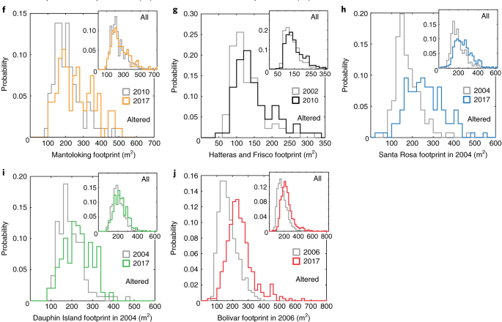
Building Back Bigger
Expanding coastal population escalates the risk.
Despite decades of regulatory efforts in the US, exposure of residential assets to hurricane damage is increasing.
Comparing plan-view footprints of individual residential buildings before and long after major hurricane strikes, the authors find a systematic pattern of ‘building back bigger’ among renovated and new properties.
Source: Lazarus, E. D., Limber, P. W., Goldstein, E. B., Dodd, R., & Armstrong, S. B. (2018). Building back bigger in hurricane strike zones. Nature Sustainability, 1(12), 759–762. © Springer Nature, Ltd. All rights reserved. This content is excluded from our Creative Commons license. For more information, see https://ocw.mit.edu/help/faq-fair-use/.
Notes:
There is also a consistent pattern of building back bigger in the coastal area of the US.

Slide 33
Developers Went to Locations with Low Climate Beliefs
Climate belief also plays a role.
Source: Barrage, L. and Furst, J., 2019. Housing investment, sea level rise, and climate change beliefs. Economics letters, 177, pp.105-108

Slide 34
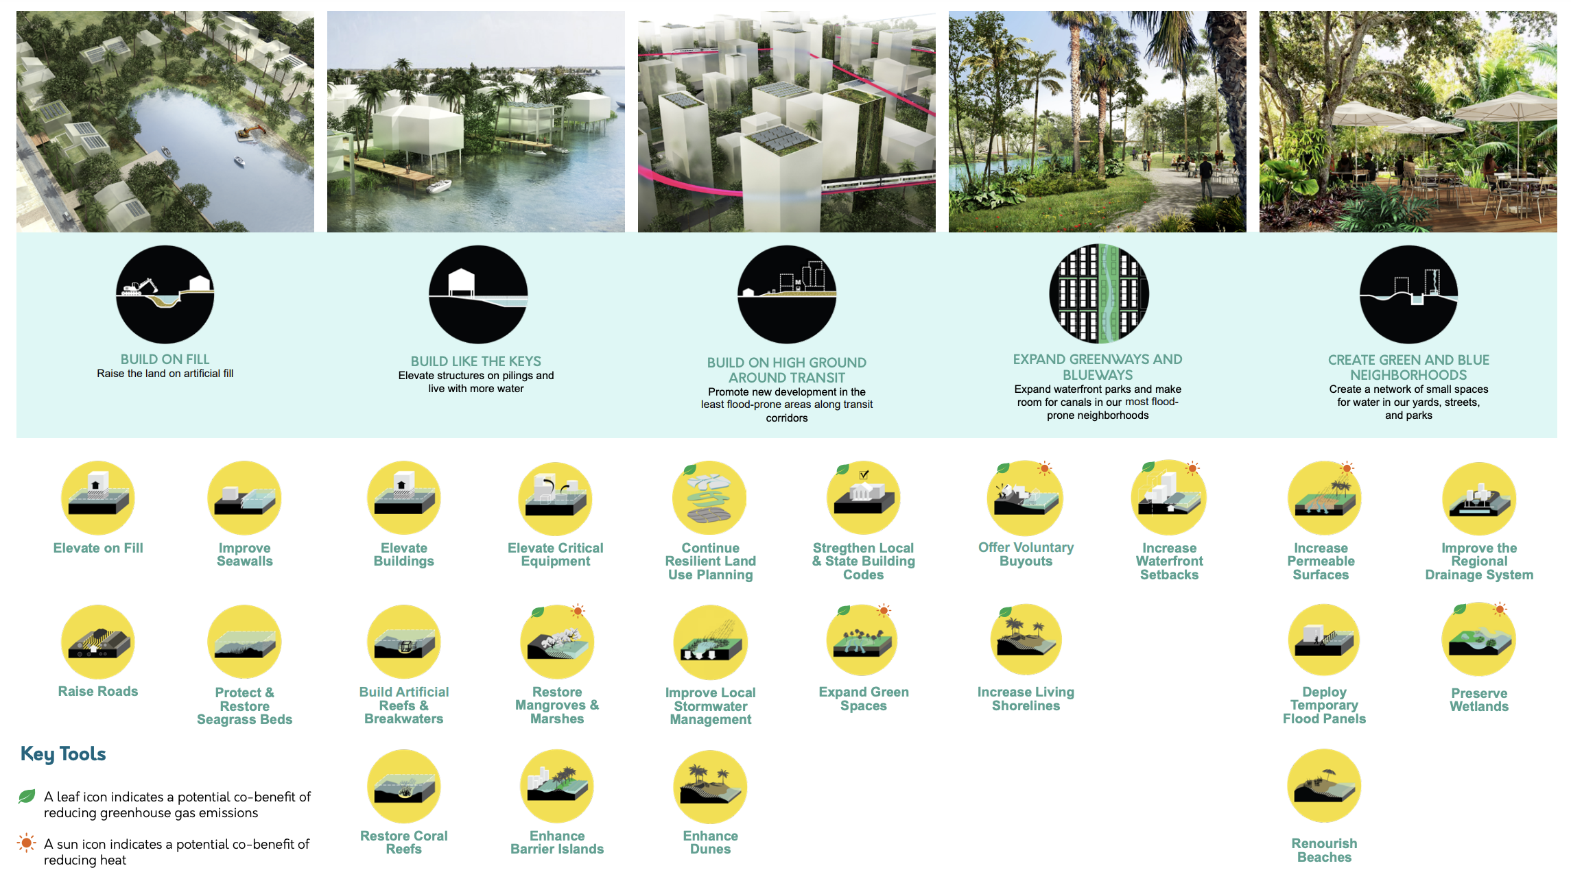
Climate Resiliency Investment Strategies
Source: https://miami-dade-county-sea-level-rise-strategy-draft-mdc.hub.arcgis.com/. © Miami-Dade County, FL. All rights reserved. This content is excluded from our Creative Commons license. For more information, see https://ocw.mit.edu/help/faq-fair-use/.
Notes:
The story of a rich county: experiment with expensive coastal adaptation plans.

Slide 35
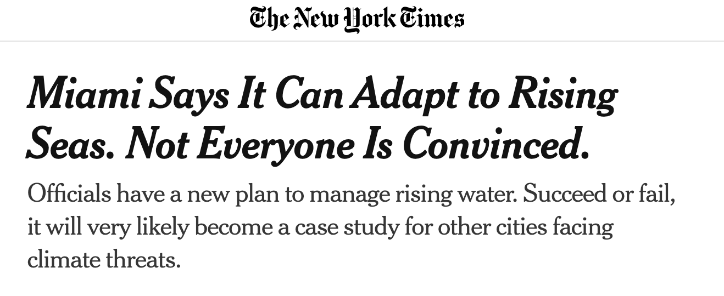
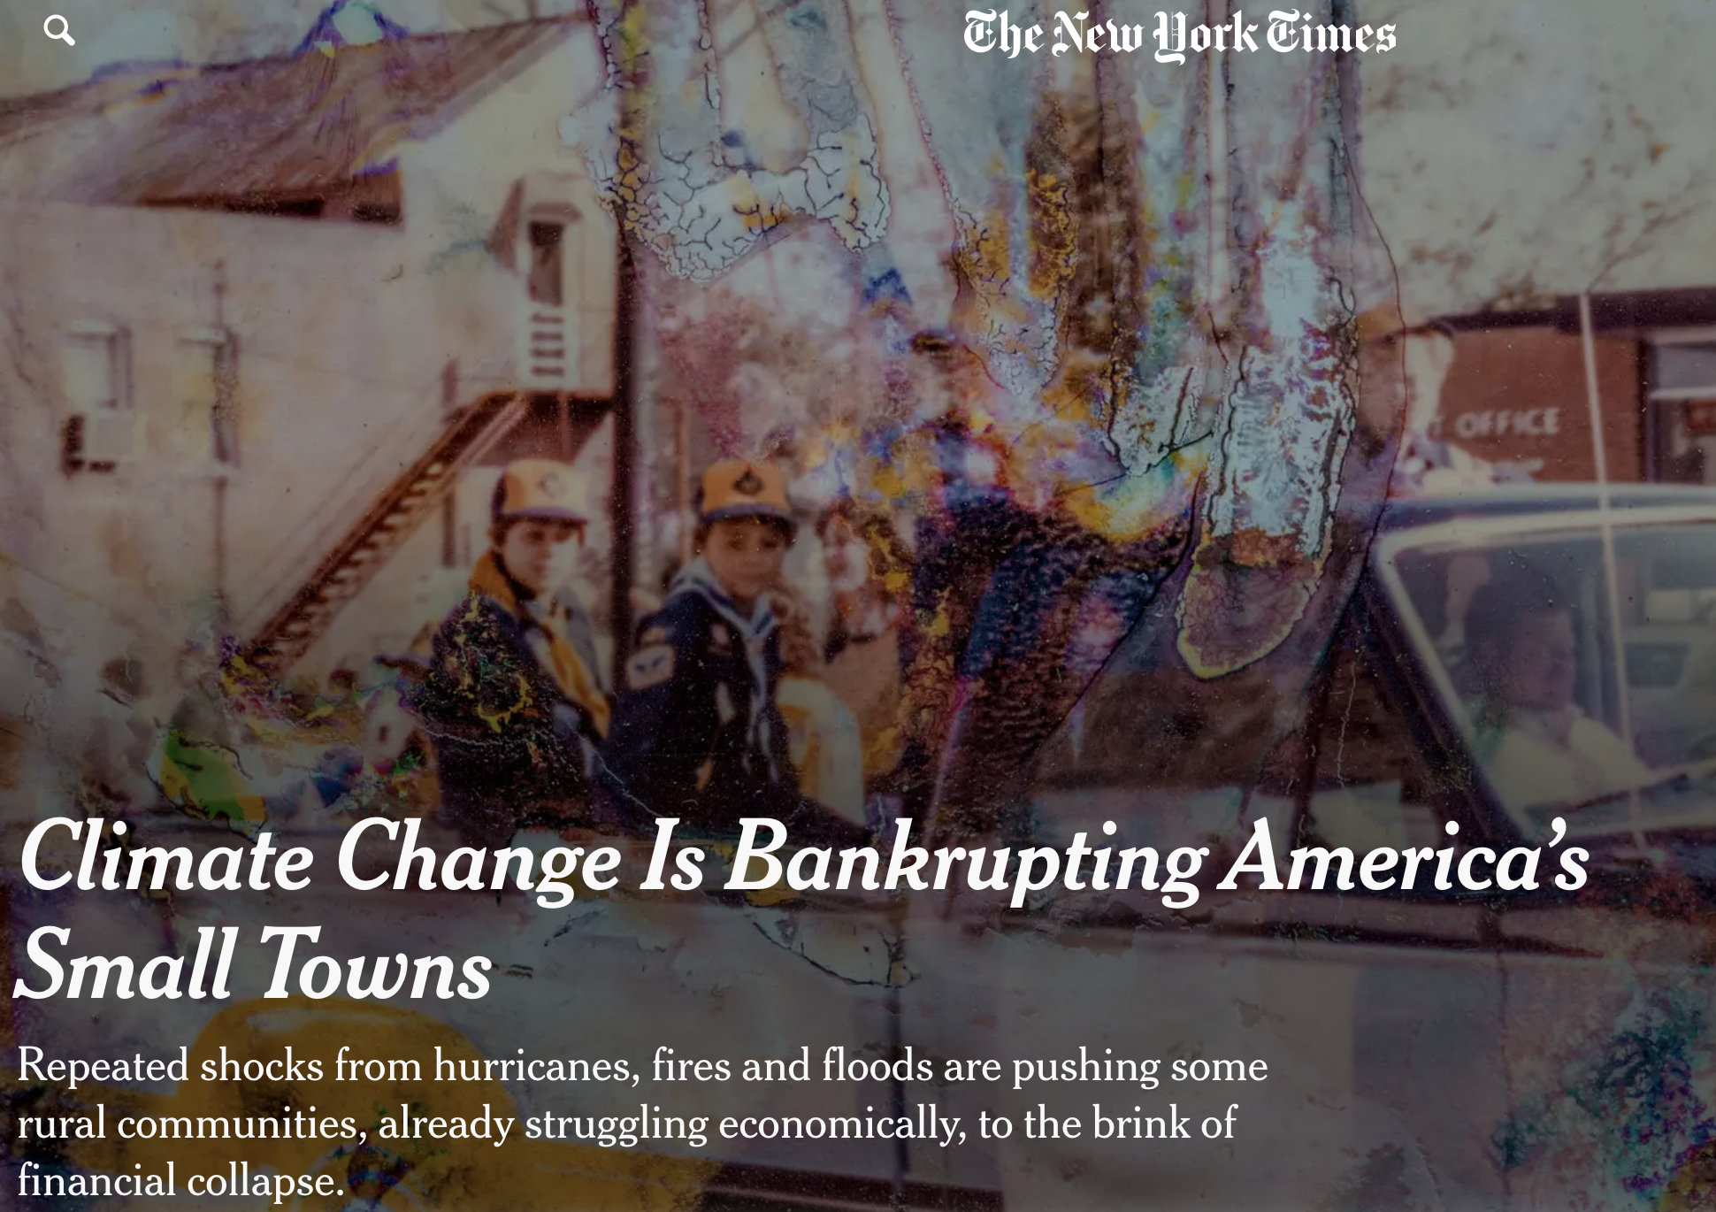
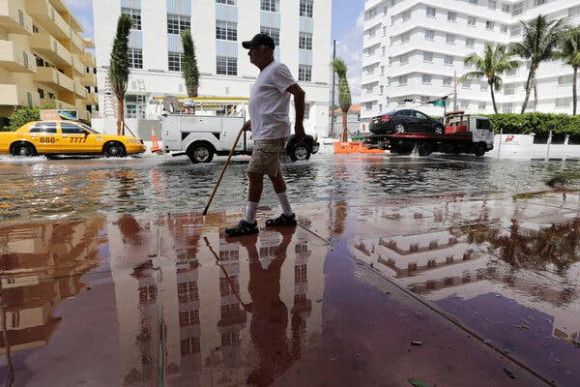
Leave or Rebuild? Striking Inequality
© New York Times. All rights reserved. This content is excluded from our Creative
Commons license. For more information, see https://ocw.mit.edu/help/faq-fair-use/.
Notes:
The story of a rich county: experiment with expensive coastal adaptation plans.

Slide 36

A Tale of Two Towns: Miami-Dade and NC- Fair Bluff
Rich coastal regions are also acting to prevent population loss.
Disaster experts have increasingly urged local officials to reduce their exposure by encouraging people to leave vulnerable areas. But cities and counties often resist that advice, worrying that retreat would hurt their economies and upset voters.
Example: Miami-Dade County
  An upbeat strategy for living with more water.
  With some of the most expensive coastal real estate in the world, it has an ample tax base to experiment with solutions — and also enormous economic incentive to dissuade buyers and investors from leaving.
Source: https://www.nytimes.com/2021/03/02/climate/miami-sea-level-rise.html?searchResultPosition=62 © New York Times. All rights reserved. This content is excluded from our Creative Commons license. For more information, see https://ocw.mit.edu/help/faq-fair-use/.
Notes:
The story of a rich county: experiment with expensive coastal adaptation plans.

Slide 37
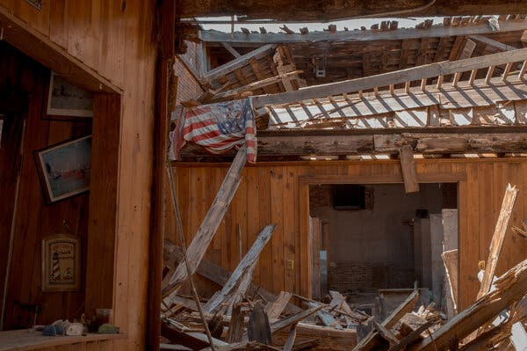

A Tale of Two Towns: Miami-Dade and NC- Fair Bluff
Repeated climate disasters cause small towns to face existential threats.
Climate shocks are pushing small rural communities, many of which were already struggling economically, to the brink of insolvency.
Example: Downward spiral of the Fair Bluff
  A small town in eastern North Carolina, hit by 19 hurricanes between 1954 and 2016
  Rather than bouncing back, repeated disasters cause residents and employers leave (aided by buyout programs), the tax base shrinks and it becomes even harder to fund basic services.
  Rebuild plan: Turn the old downtown into park and build a new downtown. Yet $10M is too much.
© New York Times. All rights reserved. This content is excluded from our Creative
Commons license. For more information, see https://ocw.mit.edu/help/faq-fair-use/.
Source: https://www.nytimes.com/2021/09/02/climate/climate-towns-bankruptcy.html?smid=em-share
Notes:
The story of a poor small town: on the brink of insolvency.

Slide 38
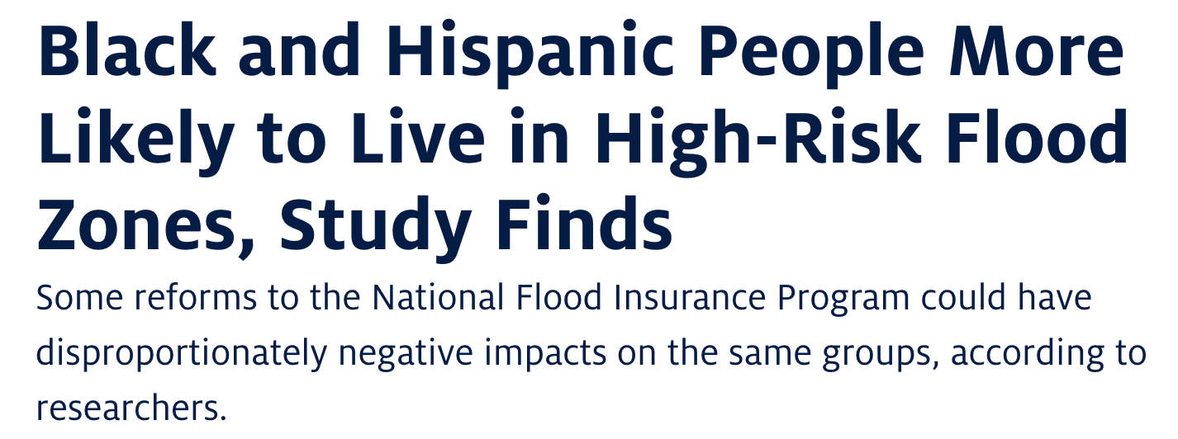
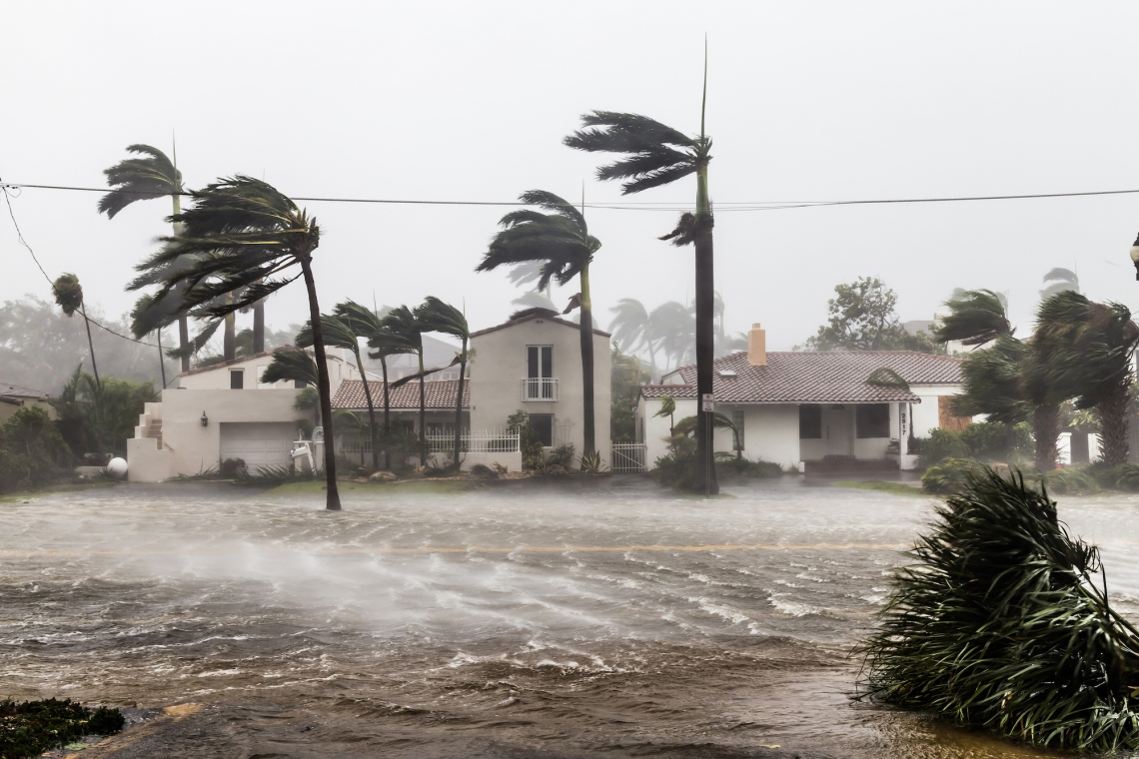
Leave or Rebuild? Striking Inequality
Income and race inequality in WTP and sorting.
Low income and minority residents are more likely to move into high risk flood zones.
  White/Asian people with low incomes are willing to pay $710 per year to avoid living in an area at high risk of flooding
  Black: $500; Hispanic: $618.
  The WTP is rising with income.
The costs of insurance price reform fall more heavily on low income and Black/Hispanic residents as a fraction of annual income.
Source: Bakkensen, L. A., & Ma, L. (2020). Sorting over flood risk and implications for policy reform. Journal of Environmental Economics and Management, 104, 102362.
© Arizona Board of Regents. All rights reserved. This content is excluded from our Creative
Commons license. For more information, see https://ocw.mit.edu/help/faq-fair-use/.

Slide 39
Federal infrastructure investment

Slide 40
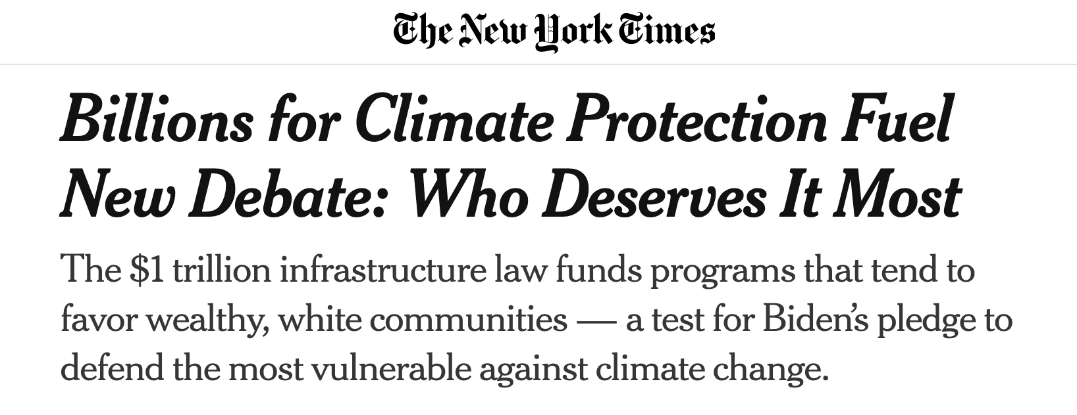

Federal Infrastructure Investment
Federal grey infrastructure reinforces coastal development.
The 2021 Bipartisan Infrastructure Act:
Allocate $47 billion over several years for climate resiliency. Mostly to protect existing infrastructure.
Moral Hazard
Would government spending reinforce the expansion of high-risk zone?
Example: In Charleston, S.C.
  The city is considering a $1.1 billion project, largely funded with federal money, to build an eight-mile-long sea wall to protect infrastructure.
  It also has approved a development on what is largely Guggenheim family land to place thousands of new structures in the flood plain.
Source: https://www.nytimes.com/2022/10/04/opinion/hurricane-ian-coast-rebuilding.html?searchResultPosition=18
© New York Times. All rights reserved. This content is excluded from our Creative
Commons license. For more information, see https://ocw.mit.edu/help/faq-fair-use/.
Notes:
Another potential reason for the lock-in in the high-risk area is the infrastructure bills for climate resilience infrastructure, which reinforces coastal development.

Slide 41
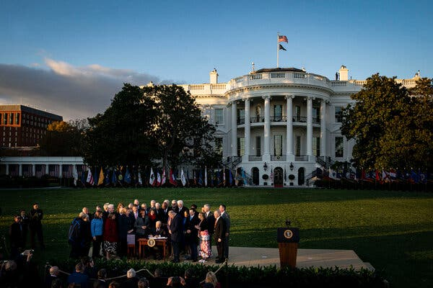
Federal Infrastructure Investment
Billions for climate protection fuel new debate: Who deserves it most?
Historically, it is wealthier, white communities — with both high property values and the resources to apply to competitive programs — that receive the bulk of federal grants.
The new climate provisions in the infrastructure bill inject billions of dollars into competitive grant programs. Cities/counties submit applications and federal agencies rank.
  The ability of local officials to use sophisticated tools and resources to write successful applications differs.
  Communities are required to pay a share of the project — often 25 percent, which is unaffordable for struggling towns/counties.
  Cost-effective: Governments need to demonstrating the value of the property that would be protected is greater than the cost of the project, giving disadvantage to low-income neighborhoods.
Source: https://www.nytimes.com/2021/12/03/climate/climate-change-infrastructure-bill.html?searchResultPosition=35. © New York Times. All rights reserved. This content is excluded from our Creative Commons license. For more information, see https://ocw.mit.edu/help/faq-fair-use/.
Notes:
The required process fuels inequality across cities/counties in accessing the infrastructure bill.

Slide 42
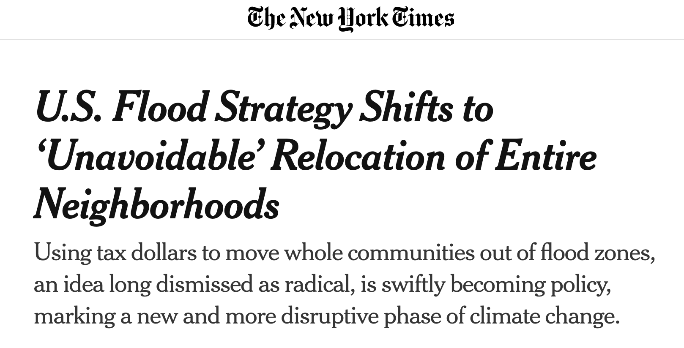
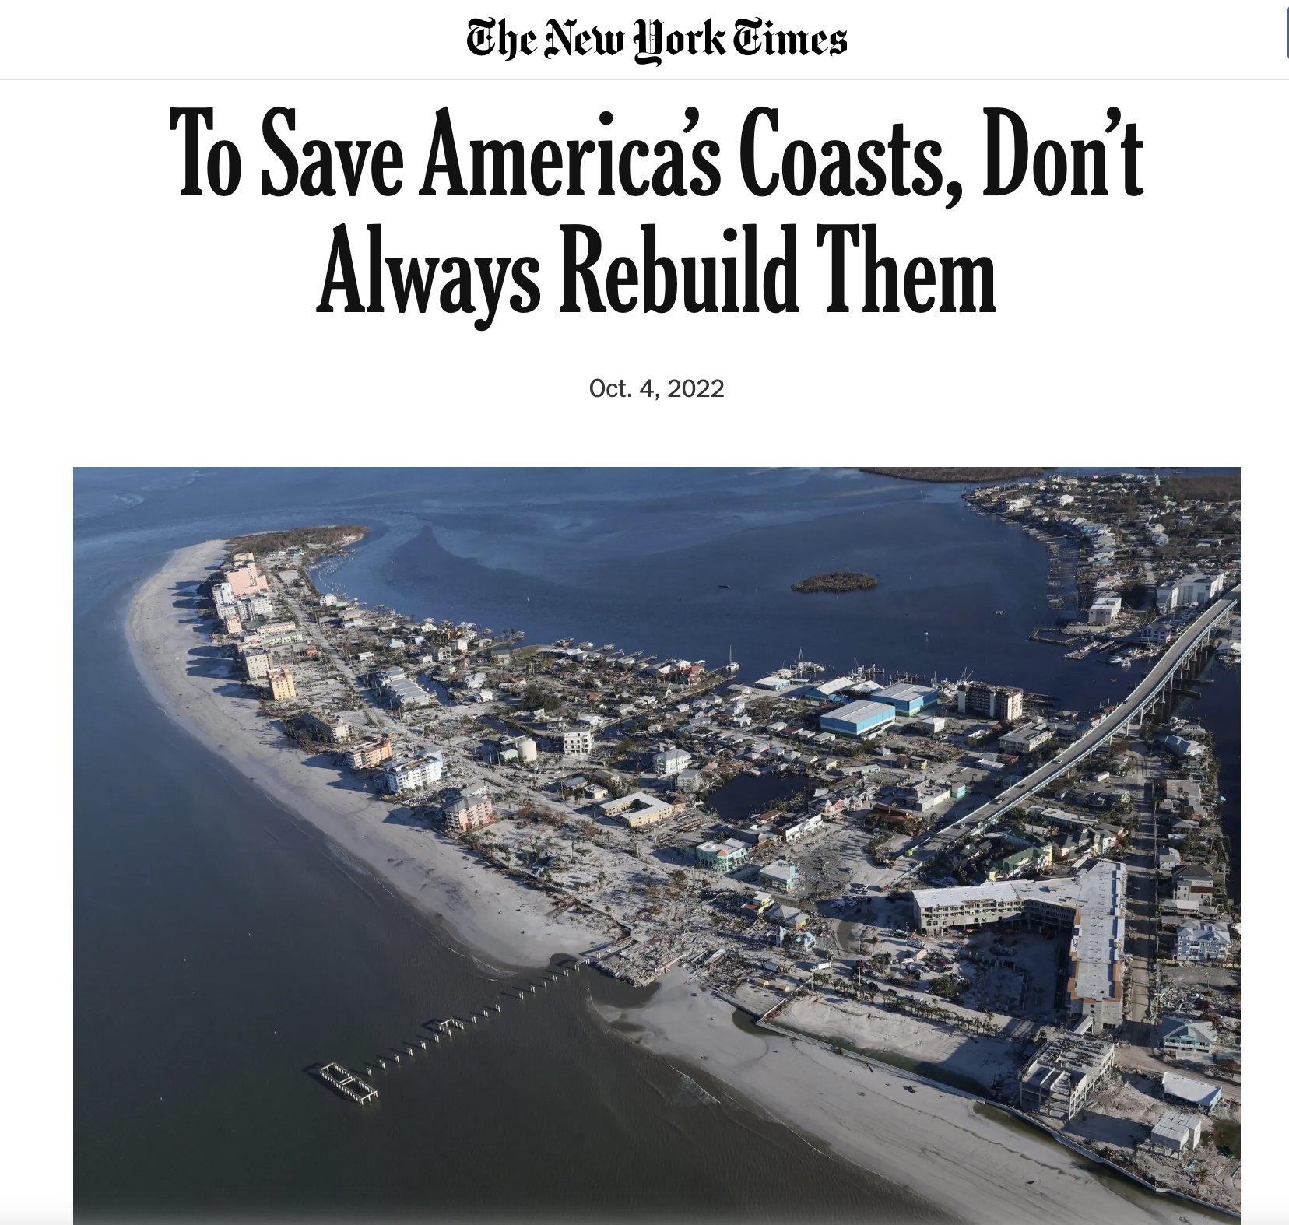
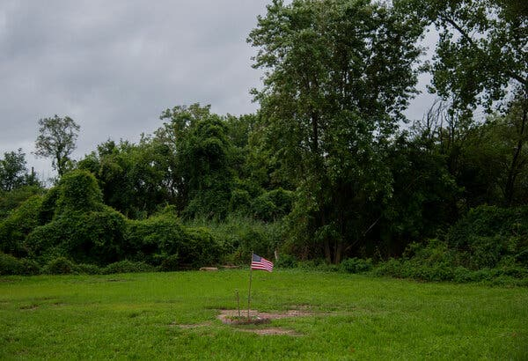
Is Managed Retreat an Option?
© New York Times. All rights reserved. This content is excluded from our Creative
Commons license. For more information, see https://ocw.mit.edu/help/faq-fair-use/.

Slide 43
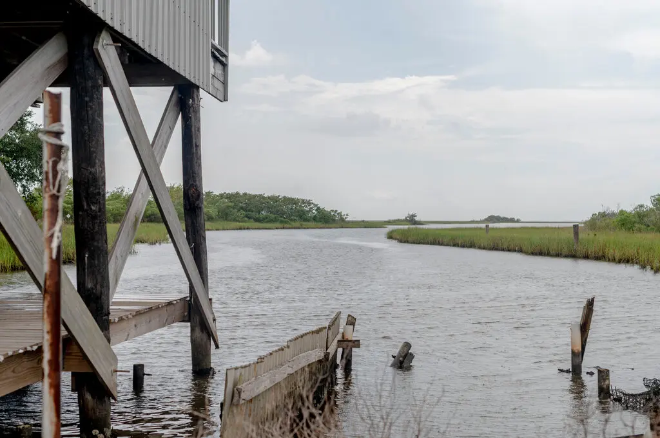
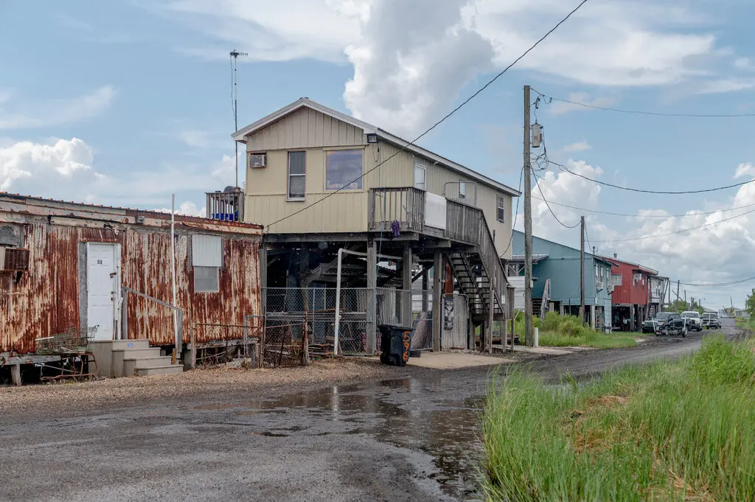
Is Managed Retreat an Option?
Discussion: What would be the pros and cons of managed retreat?
What is different for managed retreat?
(1) Buyouts on a much larger scale
(greater numbers of people/whole neighborhoods)
(2) Ideally doing it before disaster strikes.
The Obama administration began experimenting with relocation after Hurricane Sandy in 2012. The program ended by President Trump.
The Federal Emergency Management Agency detailed a new program, worth an initial $500 million, with billions more to come, for large-scale relocation nationwide; A similar $16 billion program is started by The Department of Housing and Urban Development.
New Jersey has bought and torn down some 700 flood-prone homes around the state and made offers on hundreds more
Source: https://www.nytimes.com/2020/08/26/climate/flooding-relocation-managed-retreat.html.© New York Times. All rights reserved. This content is excluded from our Creative Commons license. For more information, see https://ocw.mit.edu/help/faq-fair-use/.

