Slide 1
SRE Economics Lecture 6
Climate and Real Estate (2)
Quantifying Climate Risks’ Impacts on Real Estate Values
Siqi Zheng
March 2023
(MIT Center for Real Estate)

Slide 2
Outline
Discounting climate risks: the role of belief
Climate risks in housing markets: Hedonic and DID
Climate risks in commercial real estate markets
Notes:
Recap Juan’s E5.

Slide 3
Discounting climate riskS:
The role of belief

Slide 4

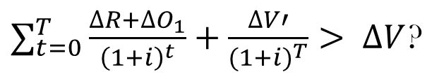




Life-Cycle Cost Analysis (LCCA)
Owner’s analytical horizon
Lower
Effective Rent $∆R$
Higher depreciation $∆V′$
Benefit
Design/Construction
Tenancy
Operation
investment
Higher Operation costs $∆O_{1}$
$$year T$$
Cost
Lower Purchase Price
$$∆V$$
Discount rate i = cost of capital
$∑_{t=0}^{T}\frac{∆R+∆O_{1}}{{\left(1+i\right)}^{t}}+\frac{∆V′}{{(1+i)}^{T}}> ∆V$?
All about the future!

Slide 5
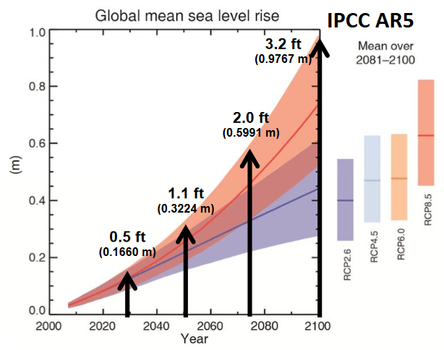
Climate Risk is a Future Risk
Climate risk is future risk, not a present risk. Key parameters to understand an uncertain future
Buying
Asset
Rents
Selling
Asset
Current bid for asset = Present value of future cash flows – Present value of expected climate damages
Costs of damages ｘ {BELIEF} / {Discount Rate}
Notes:
A Representative Concentration Pathway (RCP) is a greenhouse gas concentration (not emissions) trajectory adopted by the IPCC. Four pathways were used for climate modeling and research for the IPCC fifth Assessment Report (AR5) in 2014. The pathways describe different climate futures, all of which are considered possible depending on the volume of greenhouse gases (GHG) emitted in the years to come. The RCPs – originally RCP2.6, RCP4.5, RCP6, and RCP8.5 – are labelled after a possible range of radiative forcing values in the year 2100 (2.6, 4.5, 6, and 8.5 W/m², respectively).

Slide 6
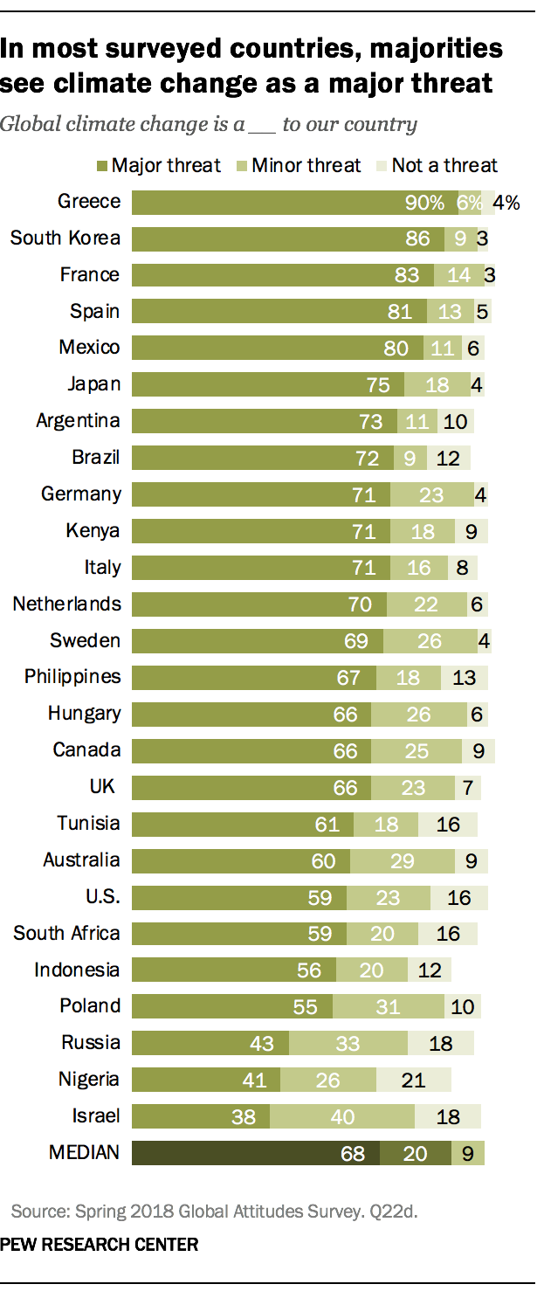
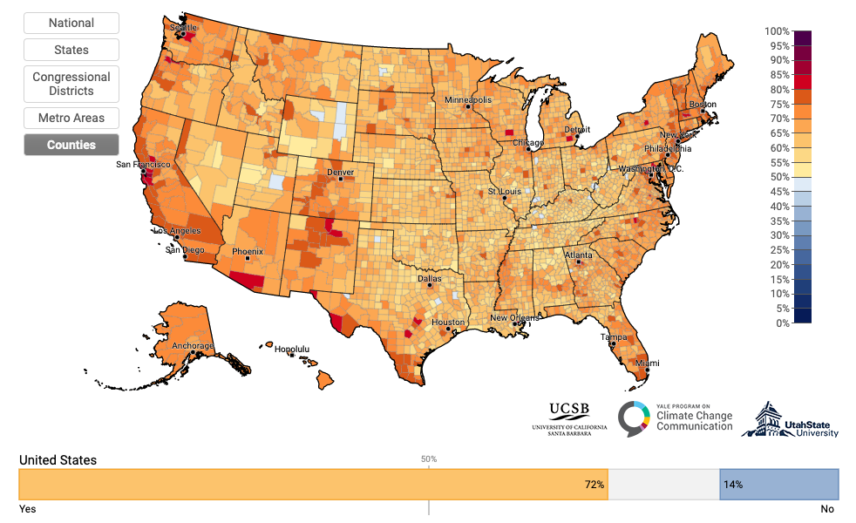
Beliefs in Global Warming
Adults who think global warming is happening, difference from national average (72%), 2021
11.350 Class (N= )
Yes
No
Source: Yale Climate Opinion Maps 2021
Left: © Yale Program on Climate Change Communication; right: © Pew Research Center . All rights reserved. This content is
excluded from our Creative Commons license. For more information, see https://ocw.mit.edu/help/faq-fair-use/.
Notes:
Here, we can do a poll in the classroom
Yale climate option survey:Model estimates in the maps were derived from public responses to the following survey questions. (n>25,000).
https://climatecommunication.yale.edu/visualizations-data/ycom-us/

Slide 7
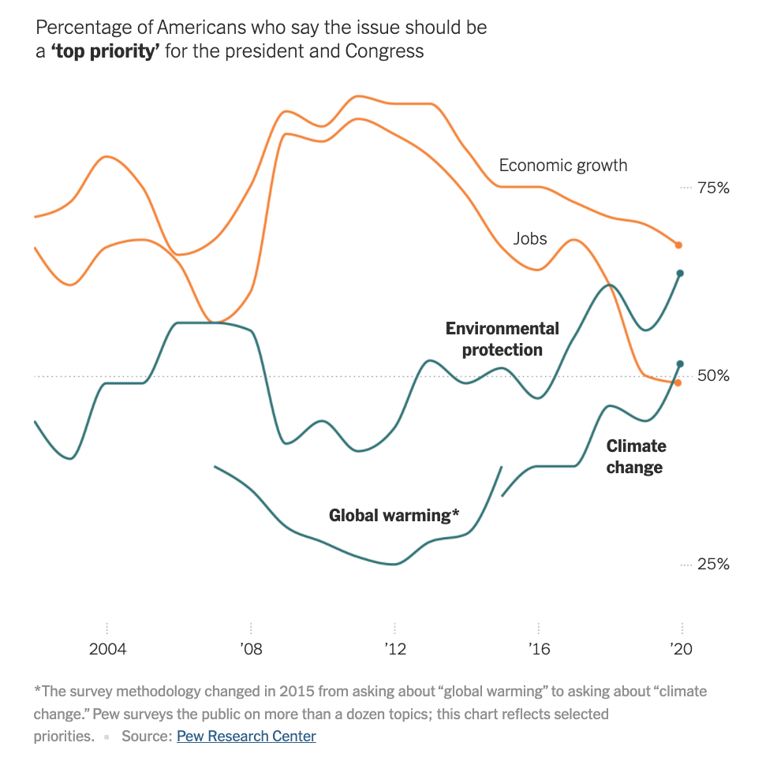
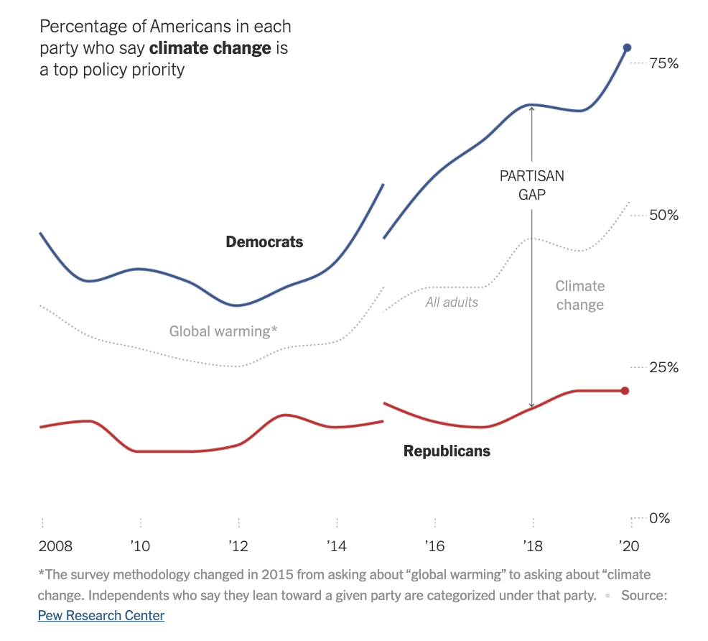
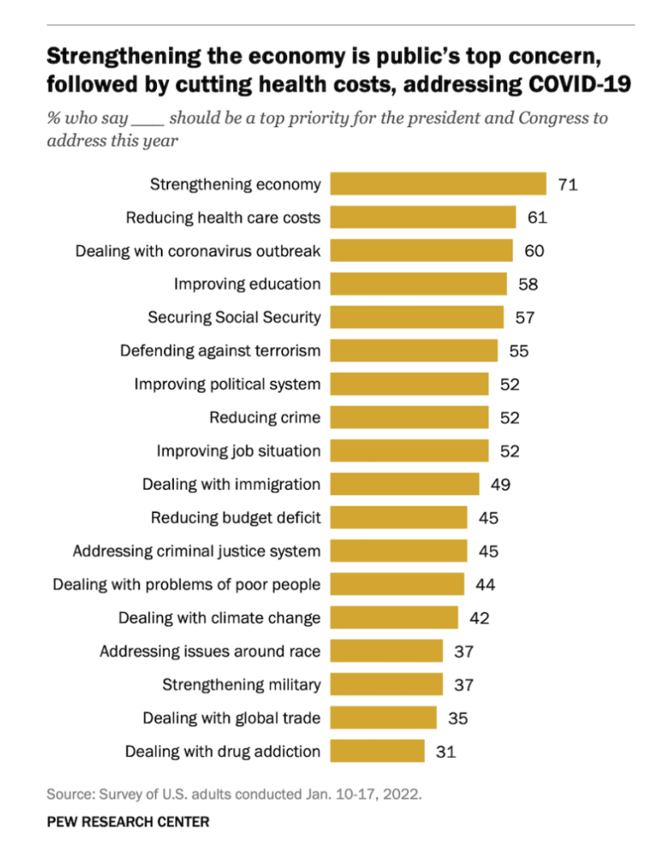
Climate Change Rises as a Public Priority. But It’s More Partisan Than Ever. (By Nadja Popovich, Feb. 20, 2020, NY TIMES)
Left: © The New York Times; right: © Pew Research Center. All rights
reserved. This content is excluded from our Creative
Commons license. For more information, see https://ocw.mit.edu/help/faq-fair-use.

Slide 8
Does Climate Change Affect Real Estate Prices?
Only If You Believe in It!
Flood risk in the US: Climate experts predict that approximately two percent of U.S. homes -- worth $882 billion -- are at risk of being underwater by 2100; in low-lying coastal regions such as Florida and Hawaii, between 10 and 12 percent of homes could be inundated.
Study Setting:
  This paper uses ﻿housing transactions from 1997 to 2017, as well as detailed home characteristics from more than 374 million public records across over 2,750 counties in Florida.
  UnderWater: A dummy equals one if the home falls into a future flood zone
  Beliefs about climate change: ﻿County level Yale Climate Opinion Maps 2016
Source: Baldauf M. et al. “Does climate change affect real estate prices? Only if you believe in it.”
Review of Financial Studies 2019.

Slide 9

Does Climate Change Affect Real Estate Prices?
Only If You Believe in It!
Hedonic model
  UnderWater: effects in counties with high (above median) and low (below median) beliefs about global warming
  is negative. The absolute value is larger for climate change believers’ neighborhoods.
Results
  A one standard deviation increase above the national mean in the percentage of climate change believers is associated with 7% larger decrease in housing prices for homes projected to be underwater.
  Due to overaction by believers, underreaction by deniers, or a combination of both.
$$β$$
Source: Baldauf M. et al. “Does climate change affect real estate prices? Only if you believe in it.” Review of Financial Studies 2019.
Notes:
https://climatecommunication.yale.edu/visualizations-data/ycom-us/

Slide 10
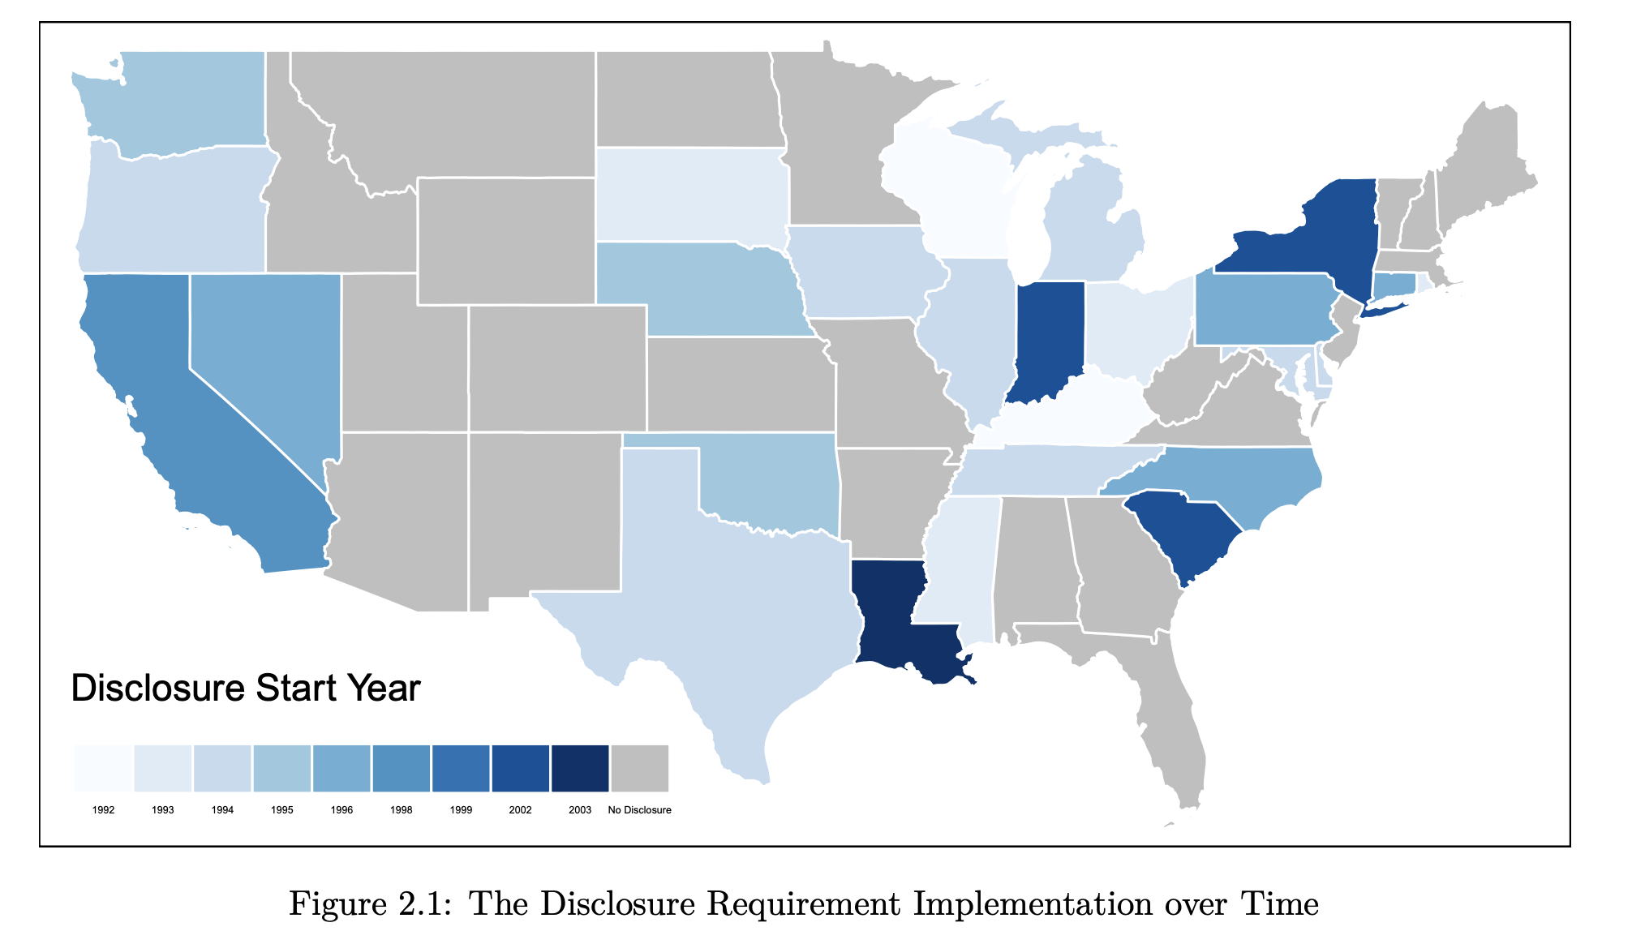
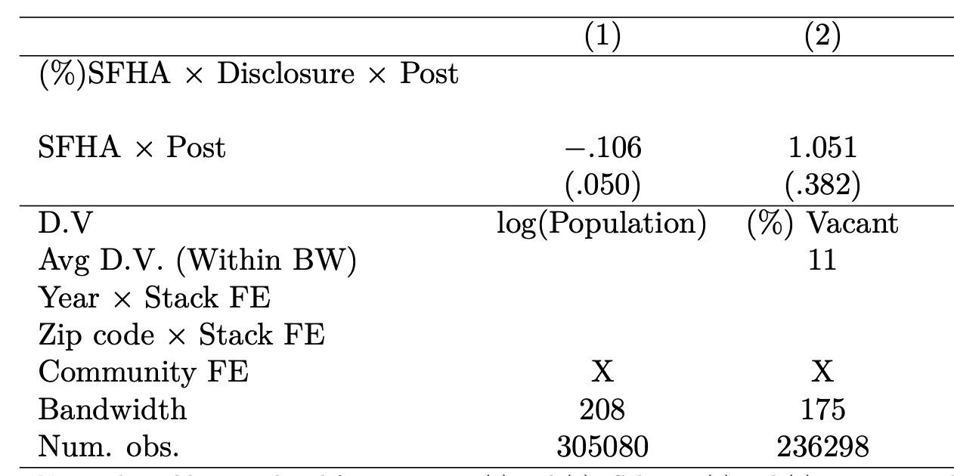
Better Information Helps
Home Seller Disclosure Requirement
  Mandate that home sellers provide buyers with detailed information of known material defects about the listed property by filling out a standardized form.
  26 states in the contiguous US implemented the disclosure requirement between 1992 and 2003 with an explicit question on flood risk.
Lower population + Higher housing vacancy
(Special Flood Hazard Area)
Source: Seunghoon Lee. Adapting to Natural Disasters through Better Information:
Evidence from the Home Seller Disclosure Requirement.. Figure courtesy of Seunghoon Lee. Used with permission.
Notes:
SFHA: Special Flood Hazard Area (SFHA)
SFHA are defined as the area that will be inundated by the flood event having a 1-percent chance of being equaled or exceeded in any given year. The 1-percent annual chance flood is also referred to as the base flood or 100-year flood.

Slide 11
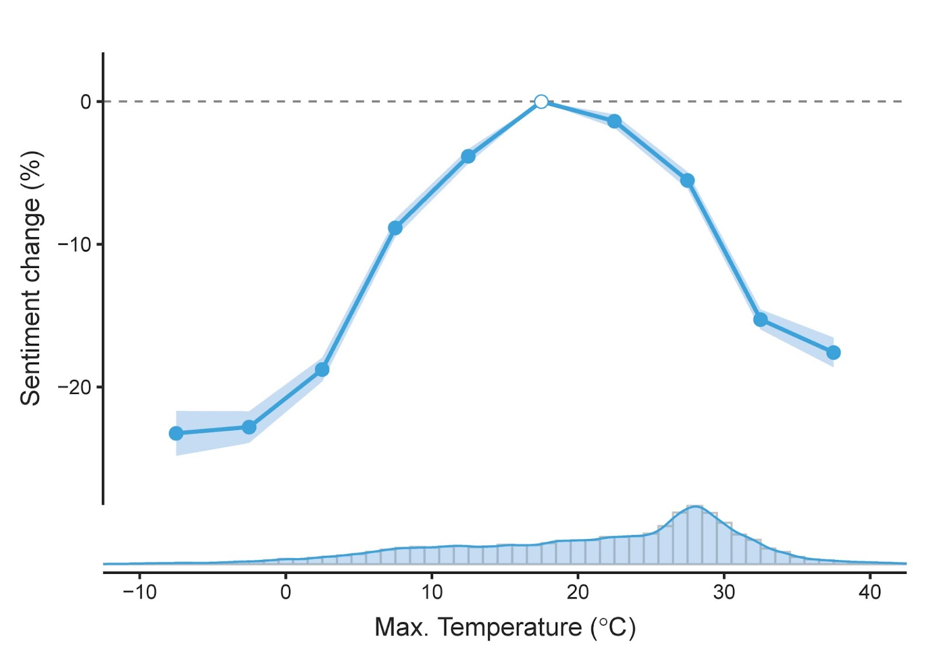
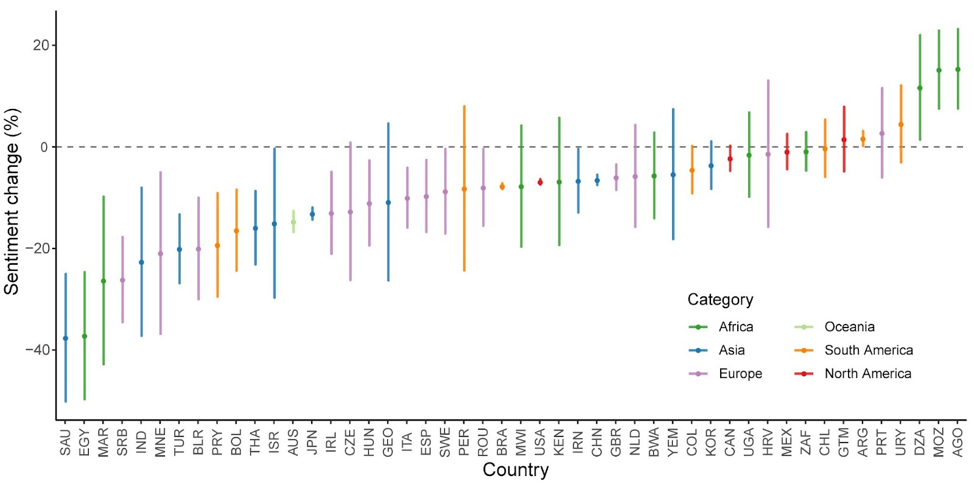
SUL Project: Climate Change and Global Sentiment
My SUL Lab’s project: Climate Change and Global Sentiment
Nature Language Processing (NLP) + Twitter data: Map how extreme temperatures affect emotional well-being worldwide.
Sentiment reduction is more universal than belief. (you are unhappy no matter whether you believe in it all not)

Slide 12

https://www.globalsentiment.mit.edu/

Slide 13
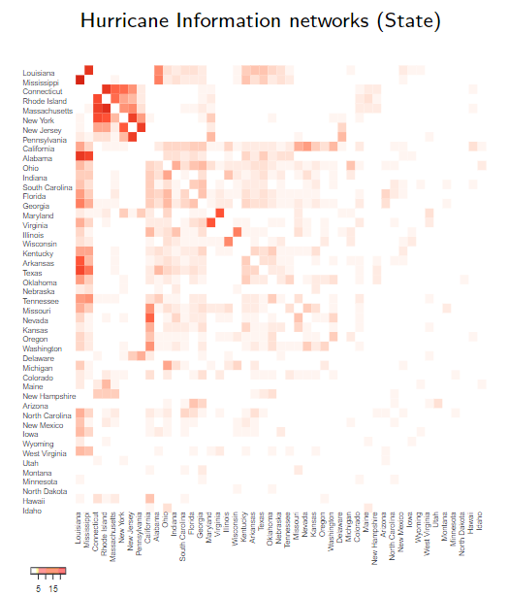
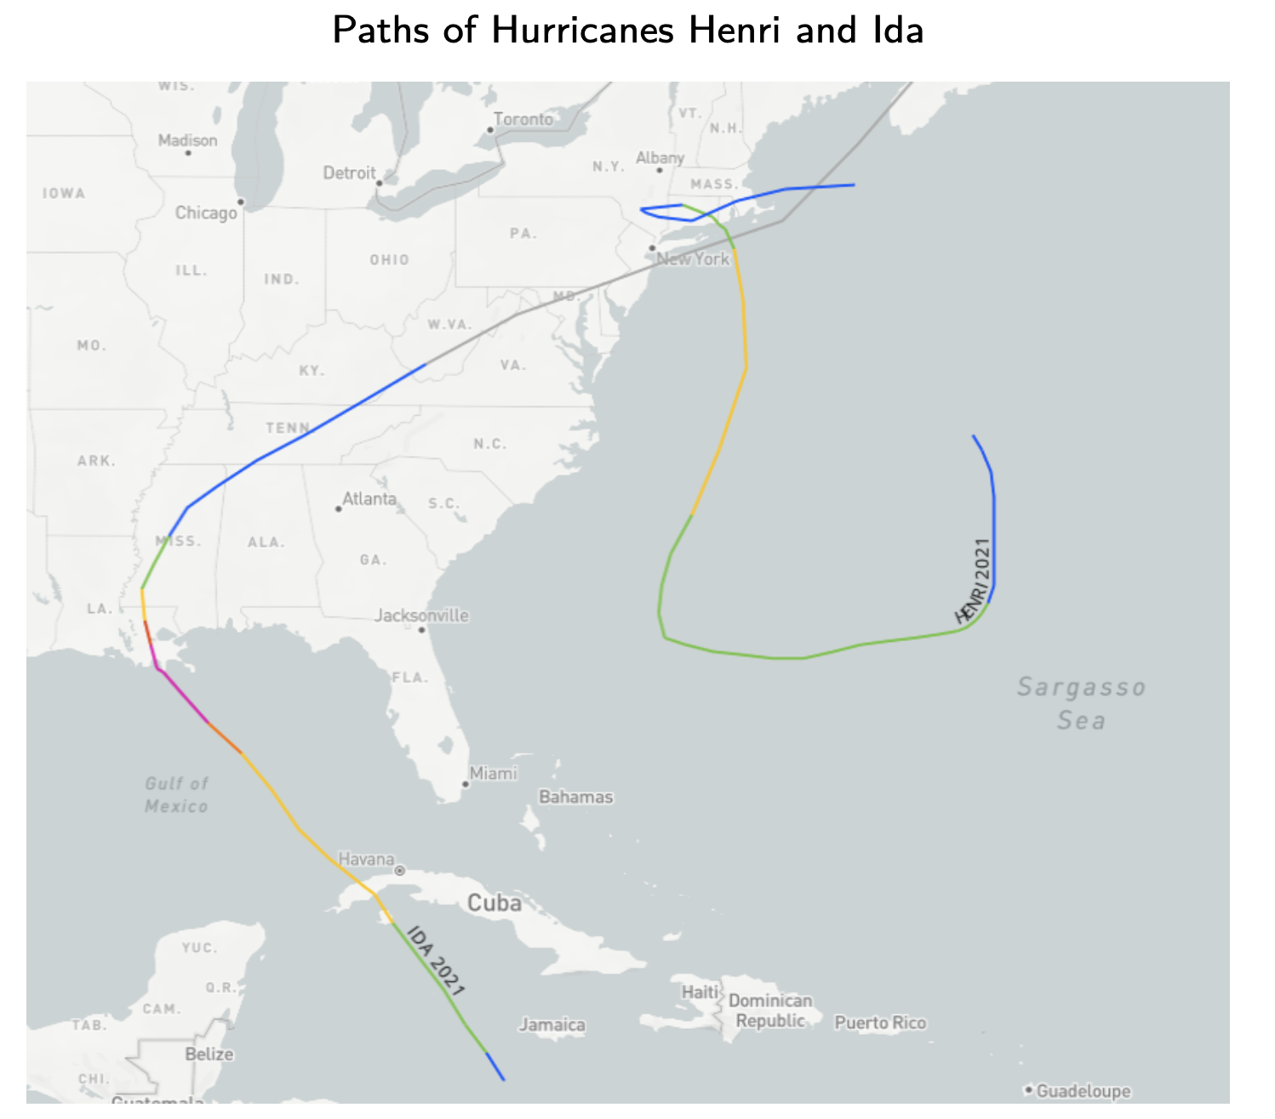
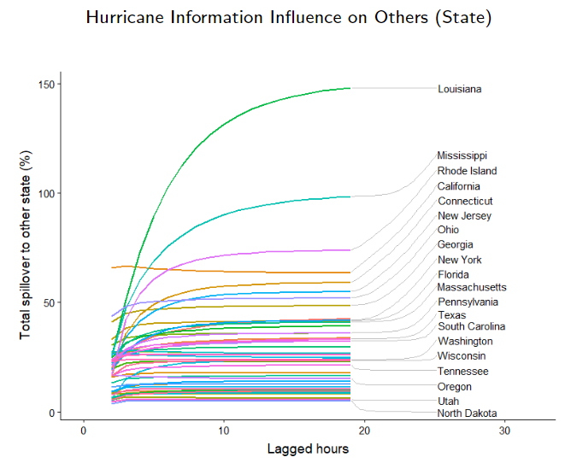
Information/belief Travels
Another ongoing project of SUL.
Information/belief travels across space after climate disasters.
Social media data + Econometrics to measure the information network.
Notes:
Areas hit by hurricane disaster are major information generators.
The spread of information largely follows social network connectivity across locations.

Slide 14
Climate Risks in Housing markets
Ortega, Francesc, and Süleyman Taṣpınar. "Rising sea levels and sinking property values: Hurricane Sandy and New York’s housing market." Journal of Urban Economics 106 (2018): 81-100.

Slide 15


Hedonic Model on Climate Risks
Use the difference in price to measure the impacts of flood risk?
Treated
(inside flood zone)
After Hurricane Sandy
-
Control
(outside flood zone)
Notes:
Properties in flood zone and non-flood zone are different: (1) adaptation infrastructure; (2) flood insurance; (3) social-demographic characteristics. (4) beliefs.

Slide 16
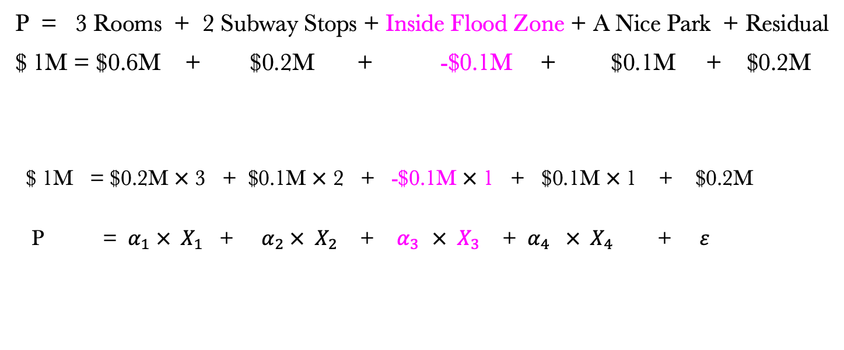
Hedonic Model on Climate Risks
P = 3 Rooms + 2 Subway Stops + Inside Flood Zone + A Nice Park + Residual
$ 1M = $0.6M + $0.2M + -$0.1M + $0.1M + $0.2M
$ 1M = $0.2M $×$ 3 + $0.1M $×$ 2 + -$0.1M $×$ 1 + $0.1M $×$1 + $0.2M
P = $α_{1} × X_{1}$ + $α_{2} × X_{2}$ + $α_{3 } × X_{3}$ + ${ α}_{4} × X_{4}$ + $ε$
Input
Output
(R²= 83%)

Slide 17
Hedonic Model on Climate Risks
P = 3 Rooms + 2 Subway Stops + Inside Flood Zone + A Nice Park + Residual
Ocean view
correlated
If we can observe and measure “Ocean view”:
$ 1M = $0.6M + $0.2M + -$0.1M + $0.1M + $0.05M + $0.15M
If we cannot observe and measure “Ocean view” and
“Inside Flood Zone = Ocean view” (extreme case):
$ 1M = $0.6M + $0.2M + -$0.1M + $0.05M + $0.1M + $0.15M
Underestimate price penalty → - $0.05M

Slide 18

Another : Difference-in-Differences (DID)
Treated
(inside flood zone)
Then, subtract the baseline trend from the time trend of pre-apple to post-apple:
-
-
-
Before Sandy
After Sandy
( ) ( )
First measure the baseline time trend from pre-orange to post-orange:
Control
(outside flood zone)
-
Then, subtract the baseline difference from the endline difference between post-apple and post-orange to get the real treatment effect
First measure the baseline difference between pre-apple and pre-orange:
-
-
-
-
( ) ( )
Notes:
Properties in flood zone and non-flood zone are different: (1) adaptation infrastructure; (2) flood insurance; (3) social-demographic characteristics. (4) beliefs.

Slide 19
Causal Framework
Random controlled Trial (RCT)
Make the estimates CAUSAL
Experimental design
Matching / Propensity Score Matching (PSM)
Quasi-experiment
(mimic randomization)
Regression Discontinuity Design (RDD)
Difference-in-Differences (DID)
Instrumental Variable (IV)
More advanced methods seeking for exogeneous variation
OLS
Non-experimental design
Simple hedonic models
Fixed Effects Regression

Slide 20
Difference-in-differences (DID)
Control group identifies the time path of outcomes that would have happened in the absence of the treatment
In this example, Y falls by Y_{c2}-Y_{c1} even without the intervention
 | Before Change | After Change | Difference
Group 1 (Treated) | Y_{t1} | Y_{t2} | ΔY_{t} = Y_{t2}-Y_{t1}
Group 2 (Control) | Y_{c1} | Y_{c2} | ΔY_{c} =Y_{c2}-Y_{c1}
Double Differences |  |  | ΔΔY ΔY_{t} – ΔY_{c}
Y
Parallel trend
Treatment effect=
(Y_{t2}-Y_{t1}) – (Y_{c2}-Y_{c1})
Y_{c1}
Y_{t1}
Y_{c2}
Properties outside of flood zone
Y_{t2}
control
treatment
Properties inside of flood zone
t₁
t₂
time
Notes:
Major condition: parallel trend. (pre-trend test)

Slide 21
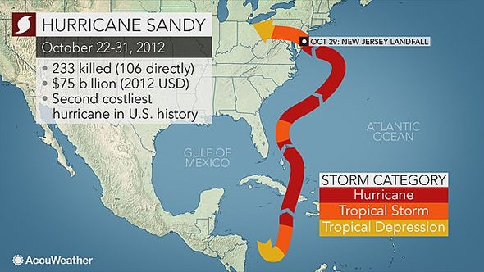
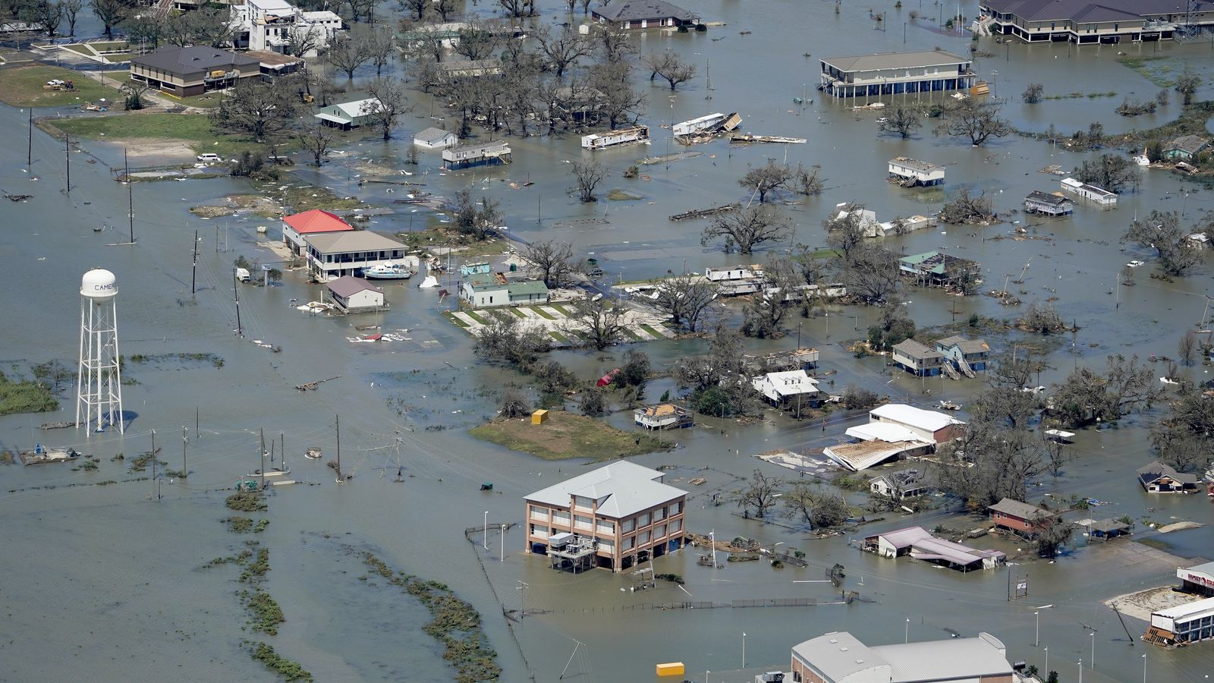
Rising Sea Level and Sinking Property Value
Research Question:
What is the impact of hurricane Sandy on the New York City housing market?
Data
All housing sales 2003-2017 (Sandy’s shock in Fall 2012);
Geocoded FEMA data on building structure damage.
Findings:
[1] Properties in the flood zone had 8% persistent price penalty after Sandy.
[2] Some heterogeneity results.
Source: Ortega, F., & Taṣpınar, S. (2018). Rising sea levels and sinking property values: Hurricane Sandy and New York’s housing market. Journal of Urban Economics, 106, 81–100.
Top: © AccuWeather Inc.; bottom: © David J. Phillip / AP. All rights reserved. This content is excluded from our Creative Commons license. For more information, see https://ocw.mit.edu/help/faq-fair-use/.

Slide 22

Rising Sea Level and Sinking Property Value
Empirical specification:
Time: Post-hurricane indicator
(Standardized DID setting)
Treatment: Sales in the flood zone
(Control: properties out of the flood zone.)
(DID setting with differential treatment intensity)
From Dam0 to Dam2: increasing damages.
(Control: properties out of the flood zone.)
Controls: property FE; quarter-year FE.

Slide 23
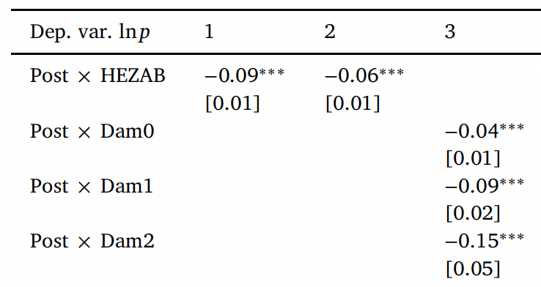
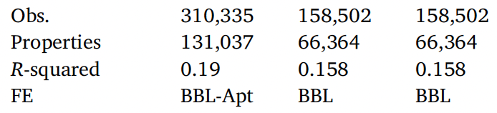
Rising Sea Level and Sinking Property Value
Hurricane Sandy has persistently reduced housing prices by 9% in the city’s flood zone, relative to similar properties in the rest of the city.
Table courtesy of Elsevier, Inc., https://www.sciencedirect.com. Used with permission.

Slide 24
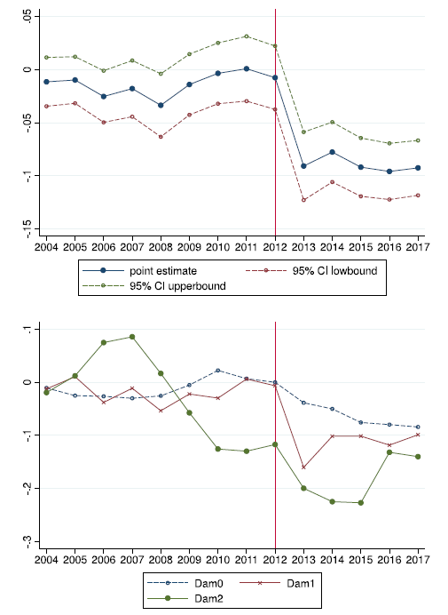

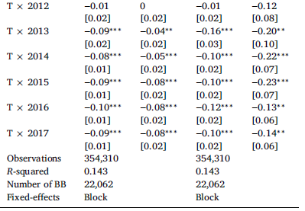
Rising Sea Level and Sinking Property Value
Overall:
Stabilizes at 8%.
High damages properties:
Large drop right after the storm and converge to the neighborhood loss.
Table and figure courtesy of Elsevier, Inc., https://www.sciencedirect.com. Used with permission.

Slide 25

Changes in Flood Risk Premium
Prior to Hurricane Fran in 1996: No market risk premium for the presence in a flood zone
After Hurricanes: Significant price differentials between houses inside and outside floodplain.
Study area: North Carolina. A 5.7% decrease of floodplain houses after Hurricane Fran and 8.8% decrease after Hurricane Floyd.
Courtesy of Elsevier, Inc., https://www.sciencedirect.com. Used with permission.
Source: Bin, O., & Landry, C. E. (2013). Changes in implicit flood risk premiums: Empirical evidence from the housing market. Journal of Environmental Economics and management, 65(3), 361-376.
Notes:
Hurricane Fran:
September 1996.
Areas affected: South Carolina, North Carolina, Virginia, West Virginia, Maryland, Pennsylvania
Hurricane Floyd:
September 1999
Areas affected: East coast of US
Study area: North Carolina.
Hurricane Fran produced millions of dollars in property damages in North Carolina. Three years later, Hurricane Floyd, one of the North Carolina’s most costly storms, made landfall.

Slide 26
Climate Risks in Commercial real estate markets

Slide 27
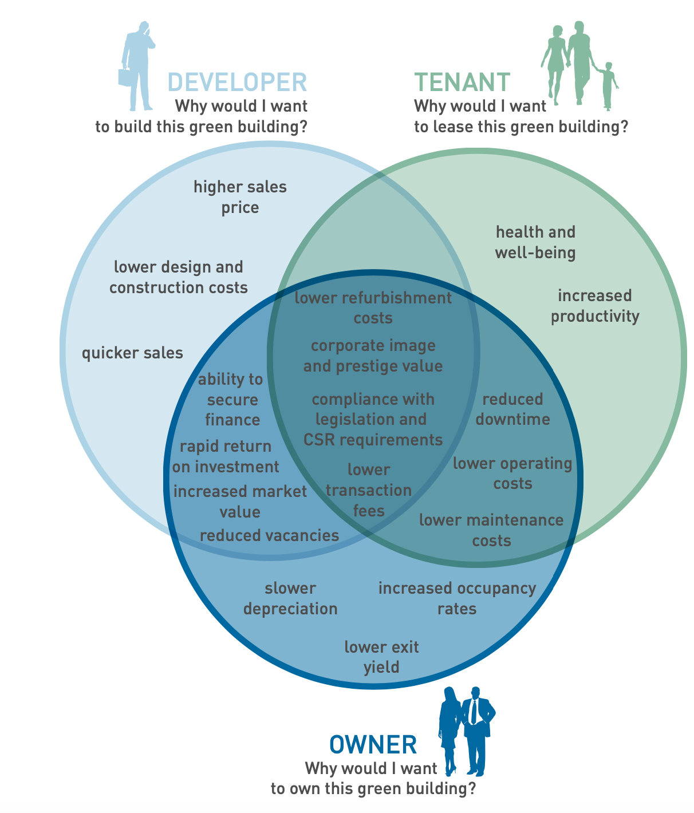
Commercial Real Estate vs. Residential
Commercial
Residential
Common ground
Physical damage
Increased insurance costs
Reduced demand
……
Commercial Real Estate
Residential
Real Estate
What are the differences?
Notes:
For instance, the belief. Any systematic difference? Not idiosyncratic, but systematic.
Ask students:

Slide 28
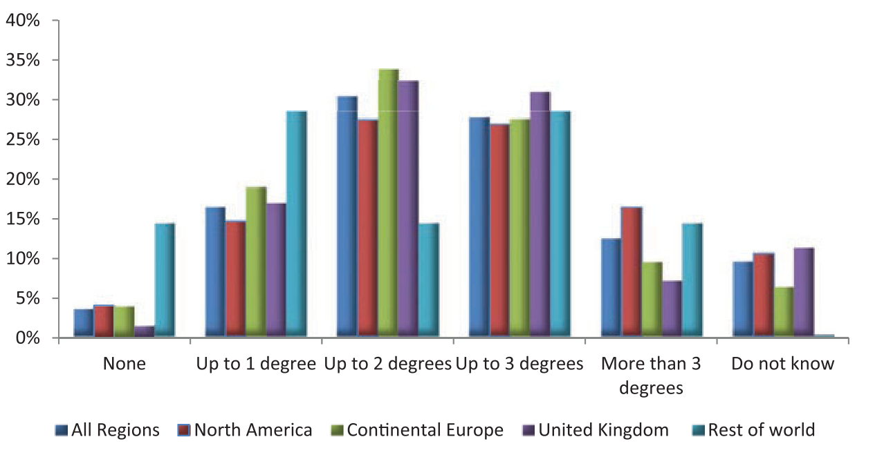
1. CRE: more sophisticated investors
Survey of ﻿439 executive about about the role of climate risks for their institutions
Expectations of Institutional Investors for the global temperature rise by the end of this century
Source: Krueger, P., Sautner, Z. and Starks, L.T., 2020. The importance of climate risks for institutional investors. The Review of Financial Studies, 33(3), pp.1067-1111. © Oxford University Press. All rights reserved. This content is excluded from our Creative Commons license. For more information, see https://ocw.mit.edu/help/faq-fair-use/.
Notes:
The figure shows a widespread belief in climate change. Across all respondents, only 3% do not expect any temperature increase (compared to 12% just now, all people), 16% expect an increase by up to one degree, and 30% by up to two degrees.
Europe leads, followed by north America, and the rest of the world

Slide 29
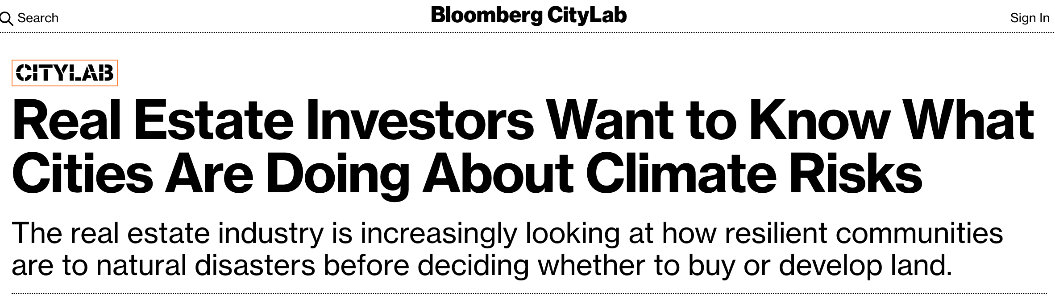


Top: © Bloomberg L.P.; center: © Morgan Stanley; bottom: © BlackRock, Inc. All rights reserved. This
content is excluded from our Creative Commons license. For more information, see https://ocw.mit.edu/help/faq-fair-use/.
Notes:
More and more investment companies integrate climate risks into their portfolio decision-making process. What are their rationales?
First, climate Risk is an investment Risk, especially in the real estate asset class. Climate risk is location-based, as are real estate investment assets. Climate risk affects the demand and supply, the costs and prices of the products in both real estate space and capital markets. More broadly, the evidence on climate risk is compelling investors to reassess core assumptions about modern finance. They are seeking to understand both how climate risk will influence long-term economic growth and prosperity (productivity), as well as the ways that climate policy will impact prices, costs, and demand across the entire economy. This is vital for real estate investors to understand, in order to make prudent and productive capital allocation decisions.
Secondly, more and more investors and market players are putting sustainability at the center of their investment approach, including: making sustainability integral to portfolio construction and risk management; exiting investments that present a high sustainability-related risk, such as energy-intensive sectors; and launching green and low-carbon investment products. They have started to understand that long-term profitability cannot be achieved without embracing purpose and considering the needs of a broad range of stakeholders (investors, regulators, insurers, and the public) - sustainability, diversity and information transparency (and privacy).

Slide 30
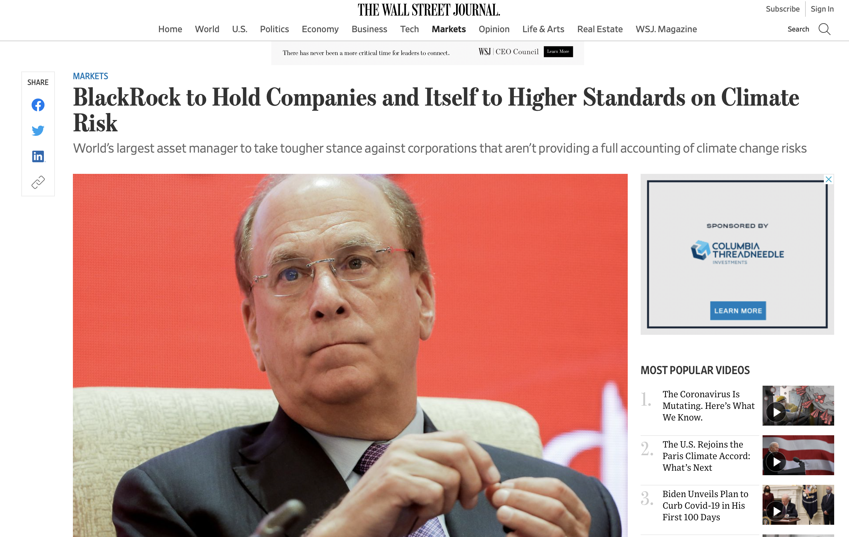
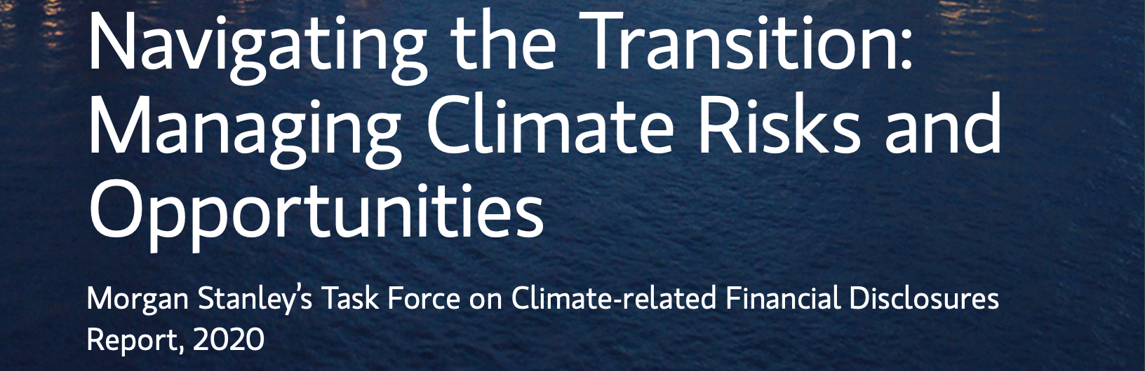

2. CRE: Corporation Image and Fiduciary Responsibility
Left: © Wall Street Journal.; right: © Morgan Stanley. All rights reserved. This content is excluded from our
Creative Commons license. For more information, see https://ocw.mit.edu/help/faq-fair-use/.
Notes:
In the meantime, those big guys care more about their own reputation.
Reduced attractiveness of properties with no climate resilience/mitigation.
Investors prefer to work with companies incorporating climate risks into investment decisions.
Companies would take a tougher stance against corporations that aren’t providing a full accounting of environmental risks. The investment giants show they are doing more to address investment challenges posed by climate change.

Slide 31
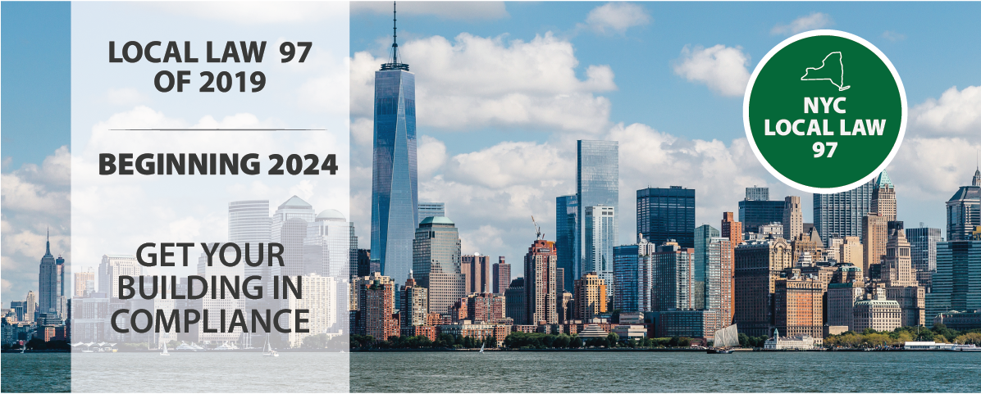

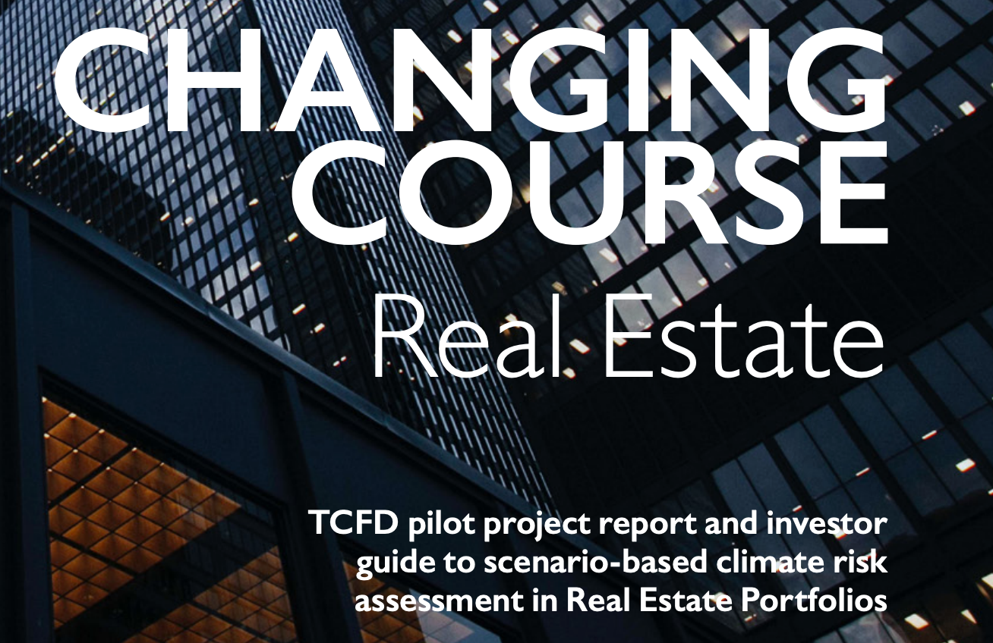
3.CRE: Higher Regulatory and Industry Standard Bars
Notes:
﻿Investors and investment managers are increasingly pushed to report to their stakeholders on climate-related financial risks.
Policy makers know those big guys have more money, and can afford more stringent regulations. So they start with those big guys.
The CRE industry is also very well organized, with big associations and leaders. They are more proactive.
﻿Global Real Estate Sustainability Benchmark (GRESB)
Assess and benchmark ESG performance of real assets, providing standardized and validated data to capital markets.
﻿Task Force on Climate-Related Disclosures (TCFD)
International forum that coordinates financial authorities to increase the stability of international markets.
Managed by the G20’s Financial Stability Board.
Mission: raise market awareness of climate-related financial risks and opportunities and to help drive consistent reporting on climate-related risks across all industries.

Slide 32
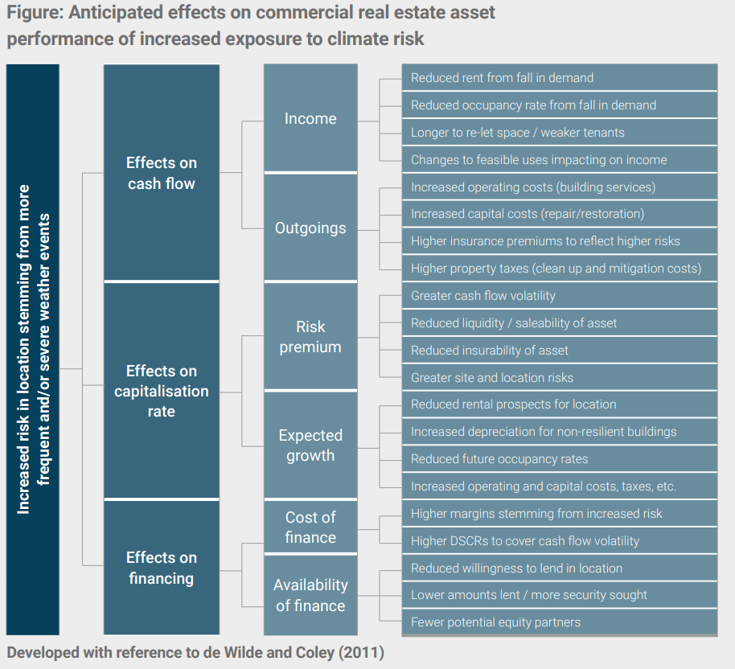

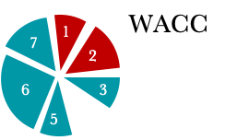
Cash flow
Reduced income
……
Increased cost
Discount rate i (cost of capital)
higher discount rate
Equity
Equity
higher finance cost
Debt
(To be covered after the midterm)
Source: Clayton, J., van de Wetering, J., Sayce, S., & Devaney, S. (2021). Climate Risk and commercial property values: a review and analysis of the literature.
© UN Environment Programme. All rights reserved. This content is excluded from our Creative
Commons license. For more information, see https://ocw.mit.edu/help/faq-fair-use/.

Slide 33
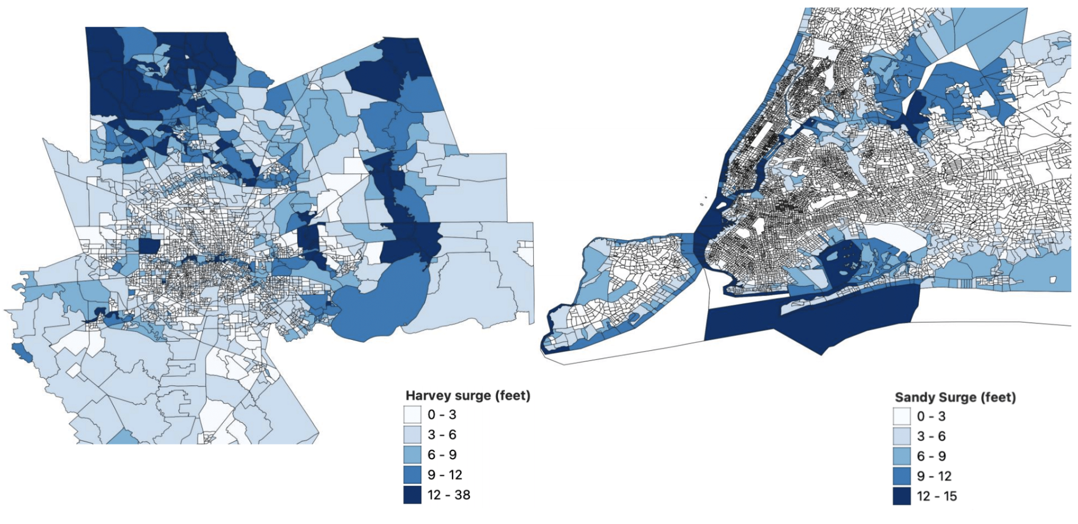
Siqi’s Research: Hurricane and CRE
Quantifying the Impacts of Climate Shocks in Commercial Real Estate Markets (Hurricane Sandy, 2012; Hurricane Harvey, 2017)
Authors: Rogier Holtermans, University of Guelph; Dongxiao Niu, Maastricht University; Siqi Zheng, MIT
Commercial real estate transactions (Real Capital Analytics)
New York 2007-2017 and Texas, 2012-2021
Transaction date, price, location, property type, quality, buyer and seller characteristics, etc.
Hurricanes (3-meter surge map from FEMA Modeling Task Force)
Final sample: 10,359 transactions in New York and 15,312 in Texas State
Notes: This Figure shows the surge level of inundation area by Census block group in Texas and New York, with a focus on Houston and New York City. The blue shades indicate surge level (feet).

Slide 34
Siqi’s Research: Hurricane and CRE
  DID model using hurricanes as a climate shock (Ortega and Taṣpınar, 2018; Gibson and Mullins, 2020, Meltzer et al., 2021)
Property damage measure (i) surge dummy; (ii) average surge level (feet) at census block level; (iii) high surge (>3 feet) and low surge dummies
Priceit = α0 + α1*Postt + α2*Surgei + α3*Surgei*post + β*Hedonicsit + Tt + σc + μict
Property transaction price per sq. ft. for property i at time t
=1 if the transaction happened after the specific hurricane (Aug 2017 for TX and Oct 2012 for NY)
Hedonics: property types, building attributes, such as age, size, number of stories, building quality, etc.
Year-quarter time trends, Census tract fixed effects
Notes:
We assume the effect in the first 24 months after hurricane shock are the most severe and “pure”. Especially for Sandy (2012), there are too many other factors influencing the market in years long after the shock. Of course, we can do robustness using alternative settings (appendix).
The repeated sales with both pre- and post-hurricane transactions account for about 8% of all properties in New York and 9.42% in Texas.

Slide 35
Baseline results – decrease in transaction price
 | Dependent Variable: Log (Price/sq. ft.)
 |  | Texas |  |  |  | New York
 | (1) | (2) | (3) |  | (4) | (5) | (6)
Post | -0.028 | -0.040 | -0.029 |  | 0.595*** | 0.594*** | 0.595***
 | (0.049) | (0.048) | (0.048) |  | (0.033) | (0.033) | (0.033)
Surge dummy | -0.093** |  |  |  | 0.043*
 | (0.040) |  |  |  | (0.025)
Post × Surge dummy | -0.033* |  |  |  | -0.009
 | (0.017) |  |  |  | (0.021)
Mean surge |  | 0.026** |  |  |  | 0.004
 |  | (0.010) |  |  |  | (0.010)
Post × Mean surge |  | -0.035*** | $4.41/sq. ft |  |  | -0.015* | $5.49/sq. ft
 |  | (0.008) | $311,500/building |  |  | (0.008) | $100,335/building
High Surge |  |  | -0.052 |  |  |  | 0.010
 |  |  | (0.042) |  |  |  | (0.033)
Low Surge |  |  | -0.143*** |  |  |  | 0.057*
 |  |  | (0.043) |  |  |  | (0.031)
Post × High Surge |  |  | -0.088*** |  |  |  | -0.033
 |  |  | (0.022) |  |  |  | (0.029)
Post × Low Surge |  |  | 0.028 |  |  |  | 0.013
 |  |  | (0.023) |  |  |  | (0.028)
Observations | 15,312 | 15,312 | 15,312 |  | 10,359 | 10,359 | 10,359
R² | 0.703 | 0.703 | 0.703 |  | 0.912 | 0.912 | 0.912
Notes: Standard errors are reported in brackets. Significance at the 0.10, 0.05, and 0.01 level is indicated by *, **, and ***.
Notes:
Overall, hurricane damages are associated with a significant drop in asset values

Slide 36
Heterogeneity: Place – Price of New news
Inconsistency between ex ante information on underlying climate risk and ex post damage from actual events
Texas
New York
Notes:
If investors learn about the future location of disasters when observing the geography of damages, then the impact of disasters on property values may be lower in areas with a prior information of flood risks. Flooding in flood zones is less likely to bring new information on disaster probabilities.

Slide 37
Heterogeneity: Place – Price of New news
Hurricane discount mainly observed outside of flood zones (New news can be costly).
Investors already capitalize flood risks into their asset value based on the flood zone designation.
 | Dependent Variable: Log (Price/sq. ft.)
 | Texas |  |  |  |  | New York
 | Inside-zone | Outside-zone | <500m | <1000m |  | Inside-zone | Outside-zone | <500m | <1000m
 | (1) | (2) | (3) | (4) |  | (5) | (6) | (7) | (8)
Post | 0.064 | -0.020 | -0.058 | -0.062 |  | 0.853*** | 0.608*** | 0.698*** | 0.628***
 | (0.202) | (0.054) | (0.080) | (0.062) |  | (0.228) | (0.033) | (0.054) | (0.040)
Mean Surge | 0.290** | 0.033* | 0.040* | 0.039** |  | -0.127 | 0.010 | 0.018 | 0.013
 | (0.117) | (0.018) | (0.024) | (0.020) |  | (0.083) | (0.010) | (0.012) | (0.010)
Post × Mean Surge | -0.019 | -0.042*** | -0.041*** | -0.039*** |  | -0.020 | -0.011 | -0.023** | -0.018**
 | (0.029) | (0.010) | (0.013) | (0.011) |  | (0.044) | (0.008) | (0.010) | (0.009)
Hedonic attributes | Yes | Yes | Yes | Yes |  | Yes | Yes | Yes | Yes
Census Tract FE | Yes | Yes | Yes | Yes |  | Yes | Yes | Yes | Yes
Year-Quarter FE | Yes | Yes | Yes | Yes |  | Yes | Yes | Yes | Yes
Observations | 1,313 | 6,582 | 10,184 | 11,575 |  | 312 | 10,809 | 3,448 | 6,518
R² | 0.811 | 0.741 | 0.731 | 0.724 |  | 0.937 | 0.915 | 0.905 | 0.910
Notes: Standard errors are reported in brackets. Significance at the 0.10, 0.05, and 0.01 level is indicated by *, **, and ***.
Notes:
Overall, hurricane damages are associated with a significant drop in asset values

Slide 38
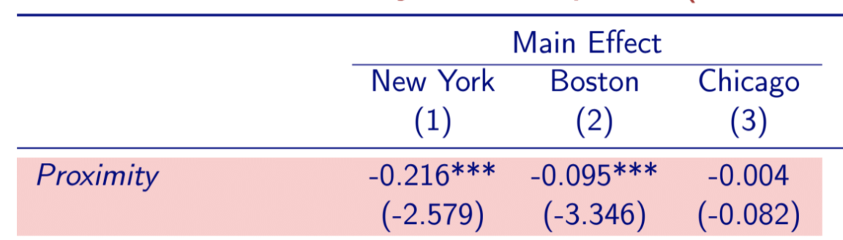
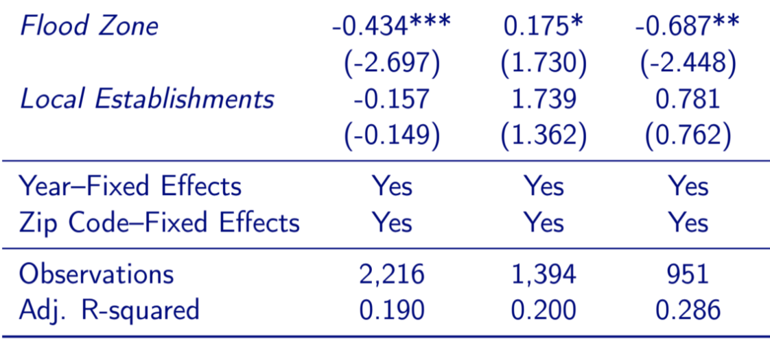
Hurricane and CRE
Proximity (to coast, elevation) lowers commercial real estate price after Hurricane Sandy
  New York directly hit by Sandy and damaged
  Boston spared by Sandy but at risk
  Chicago unaffected due to in-land waterfront location
Source: Addoum, J. M., Eichholtz, P. M. A., Steiner, E., & Yönder, E. (2021). Climate Change and Commercial Real Estate: Evidence from Hurricane Sandy. Working paper.

Slide 39
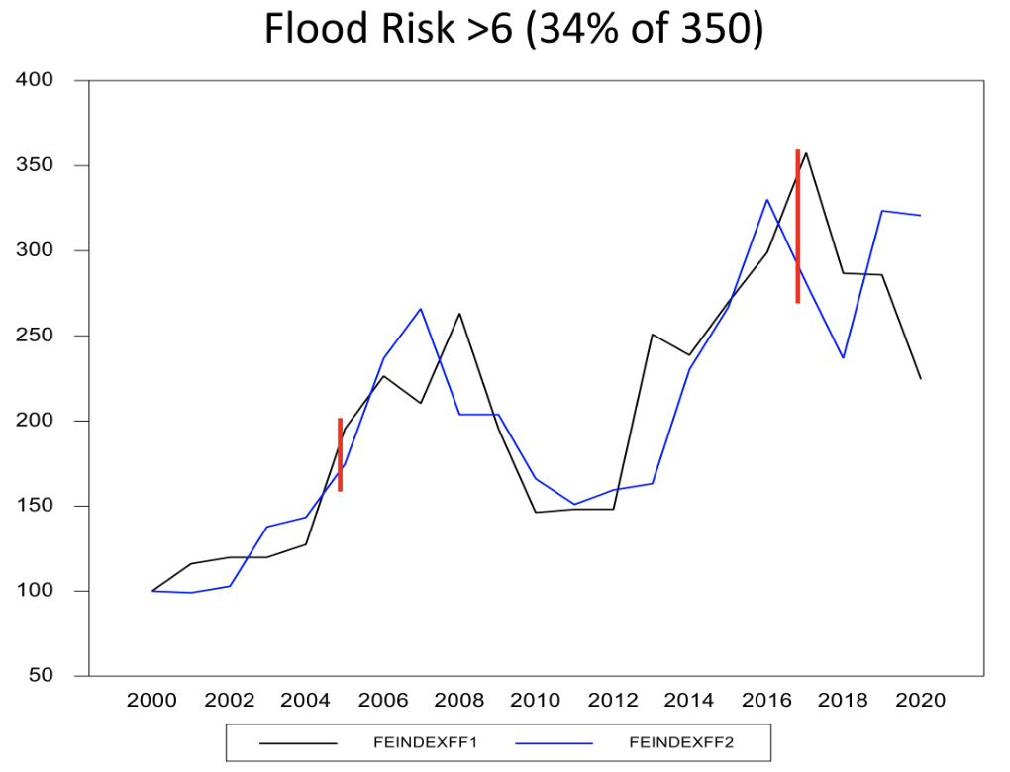
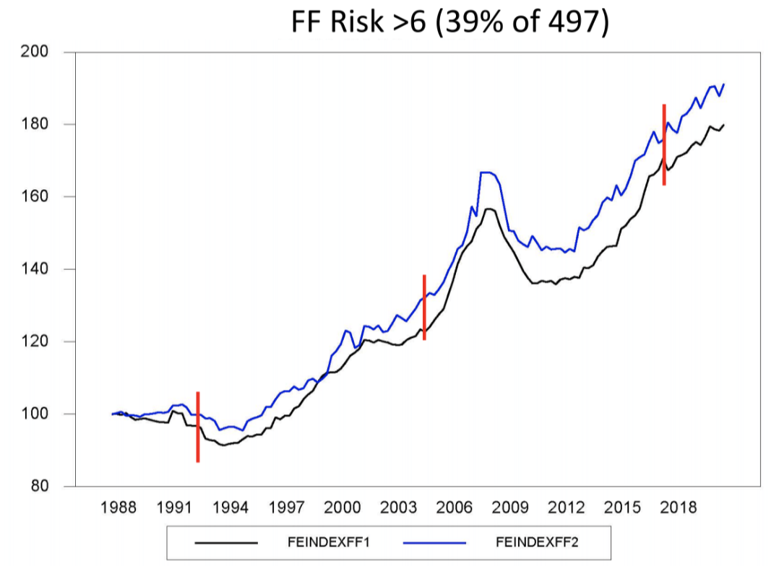
Climate Risk is a Future Risk
Price: Buildings in riskiest locations show price decline after 2017.
Rent: Buildings in riskiest locations have equal rent growth to the 61% least risky. No difference in movements around hurricanes.
Different between price and rent: Future expectations.
Price
Rent
Blue: lower risk;
Black: higher risk.
Source: William Wheaton, Anne Kinsella Thompson, Katherine Salvatori (2022). Impact of Flooding on Miami (Dade) office market properties. Figures courtesy of William Wheaton, Anne Kinsella Thompson, and Katherine Salvatori. Used with permission.

