Slide 1
Lecture
Climate Risk and Real Estate Markets
Understanding the basic impacts of climate change on real estate markets
Juan Palacios
March 2023
(MIT Center for Real Estate)
Notes:
In lecture 1, the focus is on the cash flow of green building so that students can understand the key stakeholders involved in this market and the financial value of green building for each stakeholder.
In the next lecture, we will lead the students to think about three most important market failures existed in the green building market (information failure, externality, and split incentive) and how public and private sectors work together to address these problems.

Slide 2
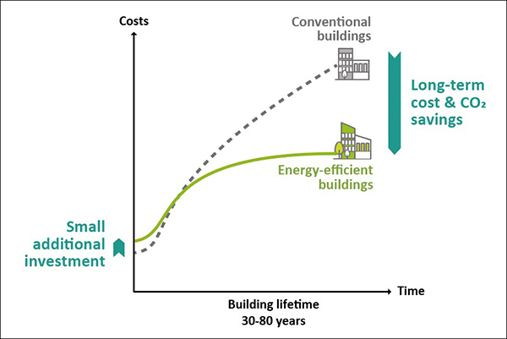




Green Building Lectures: Reduction CO2 Emissions
© IISD. All rights reserved. This content is excluded from our Creative
Commons license. For more information, see https://ocw.mit.edu/help/faq-fair-use/.
Green Building
Brown Building
Source: http://sdg.iisd.org/commentary/guest-articles/buildings-vs-the-cooling-challenge-better-building-design-to-curb-the-massive-rise-in-cooling-demand/
© source unknown. All rights reserved. This content is excluded from our Creative
Commons license. For more information, see https://ocw.mit.edu/help/faq-fair-use/.
Notes:
ULI #1: The buildings sector currently contributes nearly 40 percent of carbon emissions globally and nearly 70 percent of emissions in urban areas. This raises the an opportunity for the industry to advance sustainability at the portfolio level and also through partnerships with local policymakers. Real estate will be spending more time focusing on the intersection of buildings and climate, given the industry’s potential impact and role that can be played in being part of the solution.
Members of ULI’s Greenprint Center for Building Performance, whose portfolios collectively represent over 10,200 properties, $1.8 trillion in assets under management, and more than 2.3 billion square feet in 32 countries worldwide, are leading by example. Since Greenprint was established in 2009, its members have improved energy efficiency and reduced greenhouse gas intensity by over 34 percent, and they are on track to meet Greenprint’s current goal of achieving a 50 percent carbon reduction goal by 2030, and have set an even more ambitious goal to achieve carbon-neutral operations by 2050.

Slide 3
Outline Today’s Lecture
Basic Climate Change
  What is climate change, why and when should we care in real estate?
  Including climate change in the 4Q model
Empirical evidence: How is climate change affecting the value of real estate assets?
  Using hedonic models to estimate impacts of climate events on property markets
Impact of climate risk on real estate markets
  The role of discount rate
  Climate risk and beliefs
  Climate risk in commercial VS residential real estate
Notes:
To re-cap: (1) Planet: we are responsible (36%, 39%), we are the “target” (NYC, even 70%, LL97); (2) People: the ultimate goal for us real estate industry is to provide enough and suitable space for live-work-play, cannot just be very tiny rooms with no windows and tight insulation. Also, the turning point in the EKC, is the bottom up demand push. (3) But we cannot only have dream without a sound business strategy. Real estate developers and investors need to make money. Crucial for the private sector (80%).
We know the win-win-win is possible, the intersection is the real sustainability. Shared values. But, due to the capability gap, or market failures, these three bubbles won’t intersect. With good intension, but constrained capability; or with bad intension, “green washing”.

Slide 4
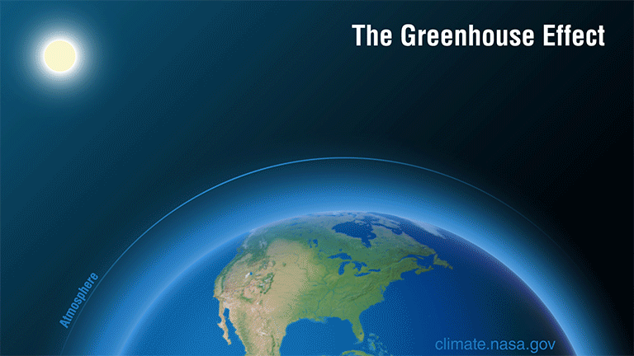
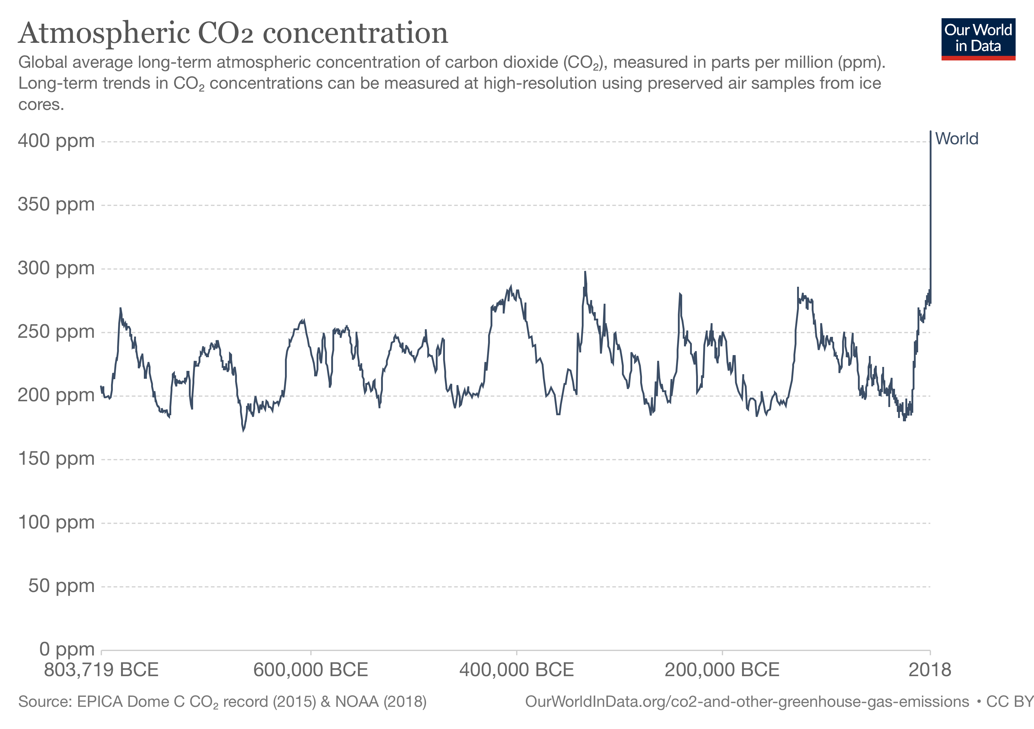
Courtesy of NOAA / Our World in Data. Used with permission.
Public domain image courtesy of NASA/JPL- CalTech.

Slide 5
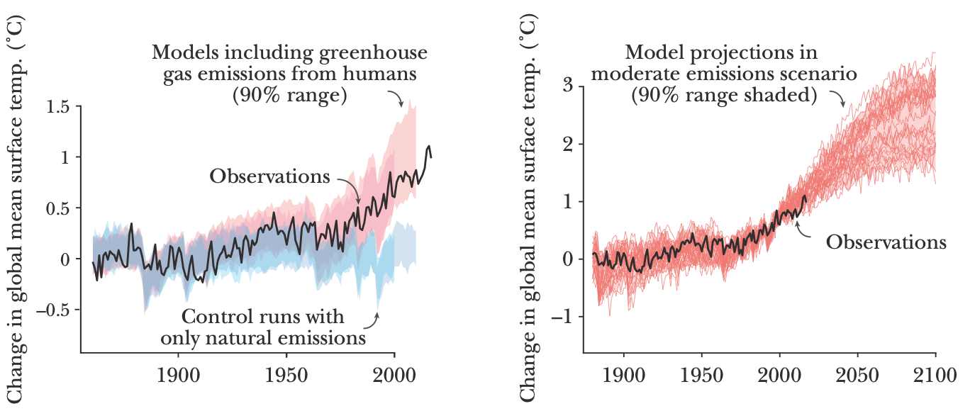
Is Climate Changing?
Source: Hsiang, S., & Kopp, R. E. (2018). An economist's guide to climate change science. Journal of Economic Perspectives, 32(4), 3-32.
© AEA. All rights reserved. This content is excluded from our Creative
Commons license. For more information, see https://ocw.mit.edu/help/faq-fair-use/.

Slide 6
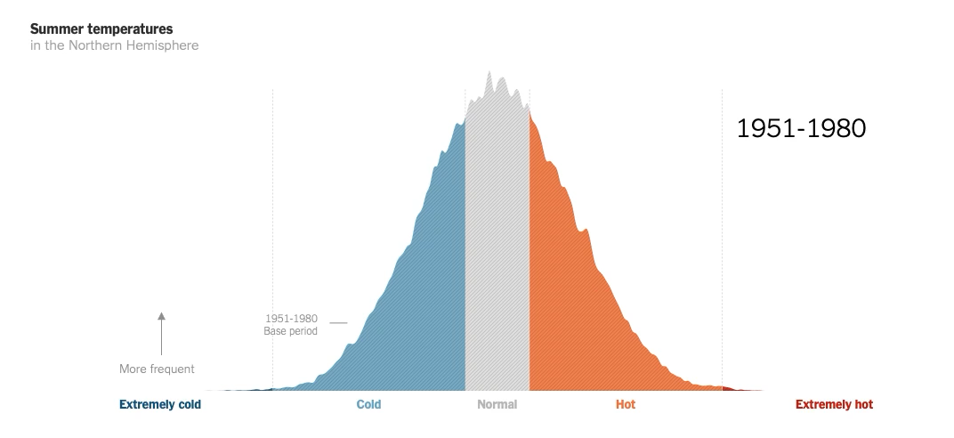
Weather, climate, and climate change
Source: New York Times ” Teach About Climate Change With These 24 New York Times Graphs” © New York Times. All rights reserved. This content is excluded from our Creative Commons license. For more information, see https://ocw.mit.edu/help/faq-fair-use/.

Slide 7
Weather, climate, and climate change
Climate describes long-term status of the atmosphere, ocean, and freshwater systems (including ice) and their complex interactions
  Common measure: 30 year averages of weather (surface temperatures and precipitations)
Climate change refers to changes in long term trends:
  Change in expectations/forecasts/beliefs: Key for real estate investments, with holding periods usually covering several decades
© David Hone. All rights reserved. This content is excluded from our Creative
Commons license. For more information, see https://ocw.mit.edu/help/faq-fair-use/.
Notes:
UN Intergovernmental Panel on Climate Change (IPCC):
The United Nations body for assessing the science related to climate change
“Provides assessments on climate change, its implications and potential future risks, as well as to put forward adaptation and mitigation options.”
Are human activities causing climate change? Steps:
Detection: Is there a change in the distribution of environmental variables?
Attribution to human activity. Simulation based analysis. How would the climate be without human activity? → Counterfactual

Slide 8
Is Our Climate Changing? Roadmap of Uncertainty in Climate Models
Statements of the Intergovernmental Panel on Climate Change (IPCC) on Detection and Attribution of Global Climate Change
First Assessment Report (1990) | “Unequivocal detection of the enhanced greenhouse effect from observations is not likely for a decade or more.”
Second Assessment Report (1995) | “The balance of evidence suggests a discernible human influence on global climate.”
Third Assessment Report (2001) | “Most of the observed warming over the last 50 years is likely to have been due to the increase in greenhouse gas concentration.”
Fourth Assessment Report (2007) | “Most of the observed increase in global average temperatures since the mid-20th century is very likely due to the observed increase in anthropogenic greenhouse gas concentrations.”
Fifth Assessment Report (2013) | “It is extremely likely that human influence has been the dominant cause of the observed warming since the mid-20th century.”
Sixth Assessment Report (2021) | “Climate change is already affecting every region on Earth, in multiple ways. The changes we experience will increase with additional warming.”
Source: Hsiang, S., & Kopp, R. E. (2018). An economist's guide to climate change science. Journal of Economic Perspectives, 32(4), 3-32.

Slide 9
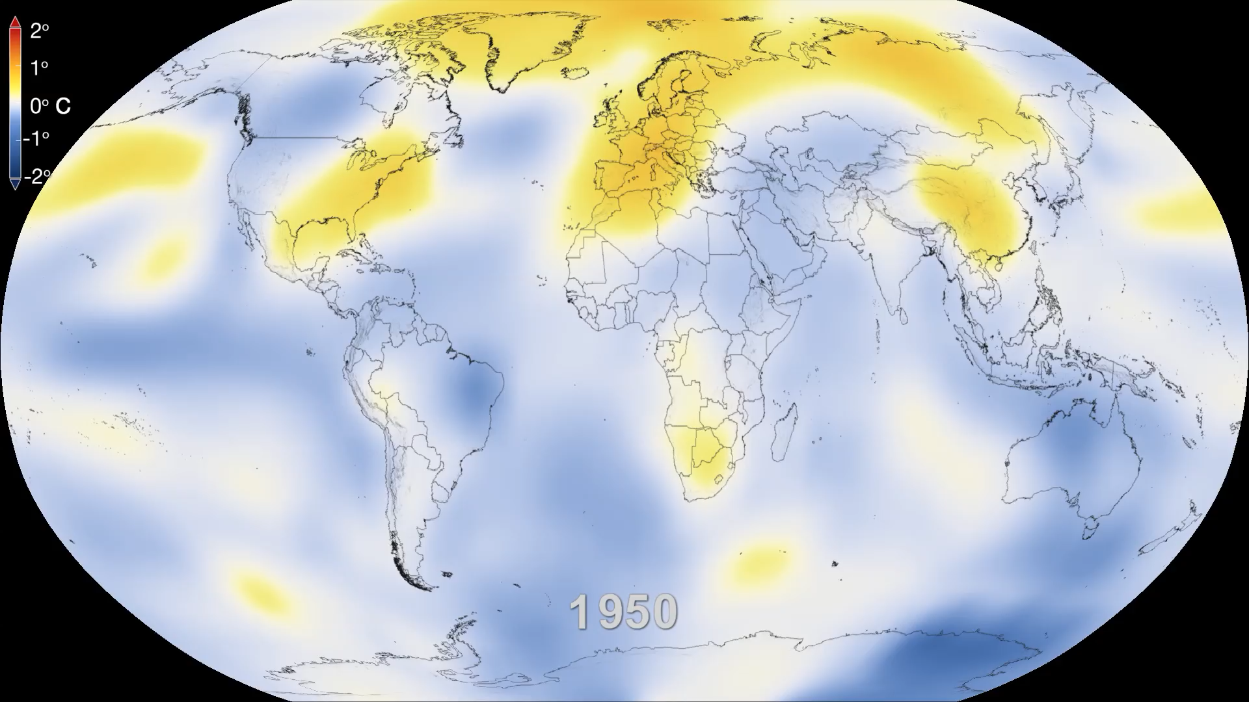
Weather, Climate, and Climate Change
Increase in frequency and severity of heat waves:
Public domain content courtesy of NASA/GSFC.

Slide 10
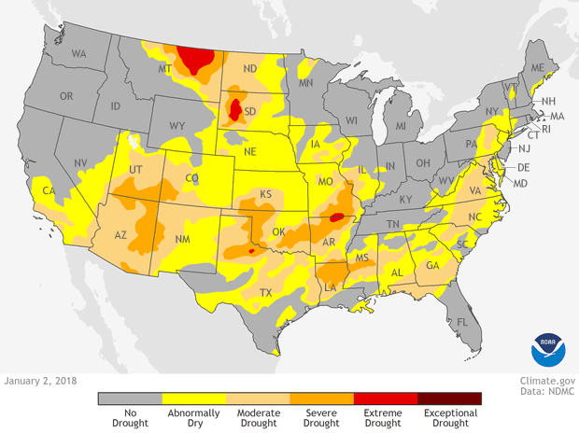
Weather, Climate, and Climate Change
Increase in frequency of droughts:
Public domain content courtesy of NOAA. Used with permission.

Slide 11
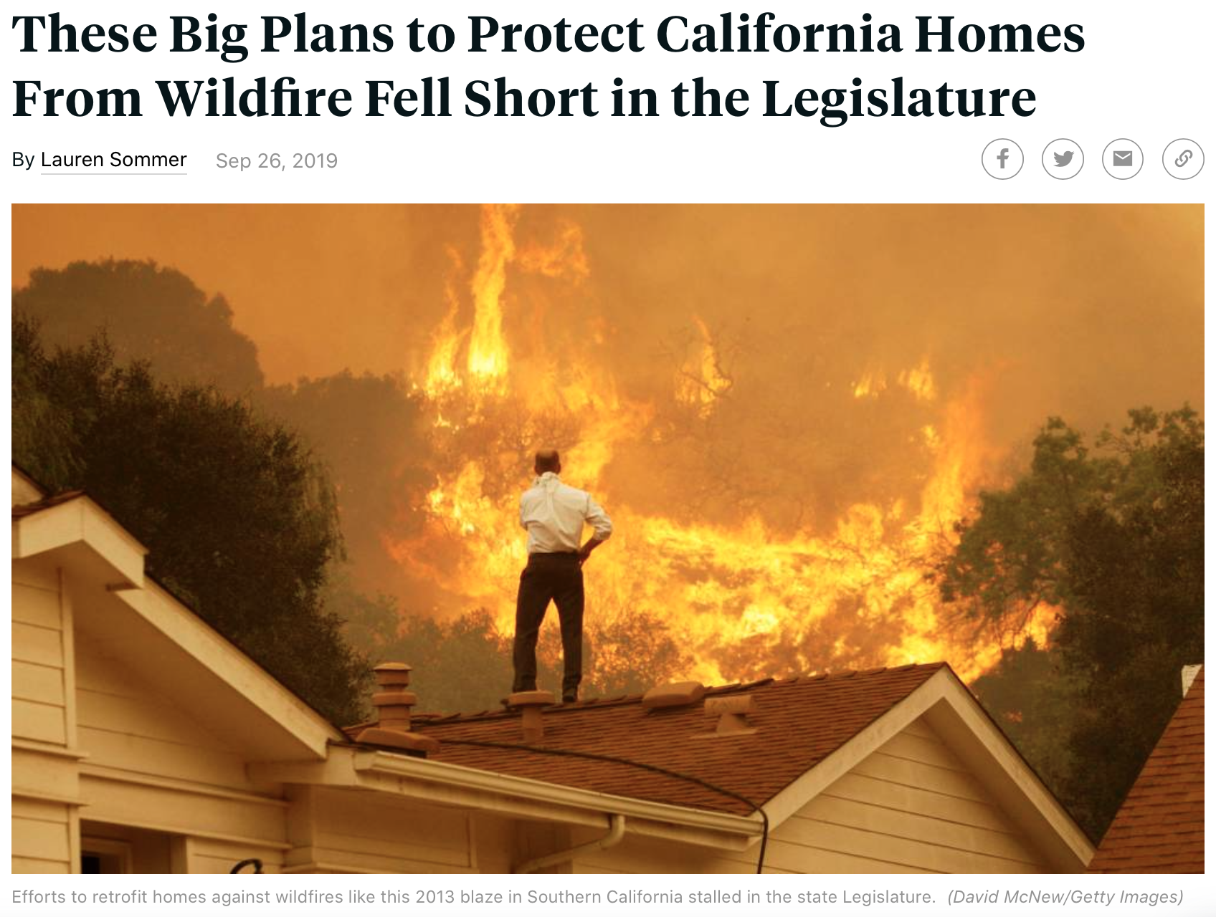
Weather, Climate, and Climate Change
Increase in frequency of wildfires in regions like California:
2020 wildfire potential
High
Low
Non-burnable lands*
and open water
Left: © KQED (https://www.kqed.org/science/1948013/california-lawmakers-plans-to-protect-homes-from-wildfire-fall-short).; photo ©
David McNew via Getty Images; right: © National Geographic.. All rights reserved. This content is excluded from our Creative
Commons license. For more information, see https://ocw.mit.edu/help/faq-fair-use/.
Notes:
https://www.kqed.org/science/1948013/california-lawmakers-plans-to-protect-homes-from-wildfire-fall-short

Slide 12
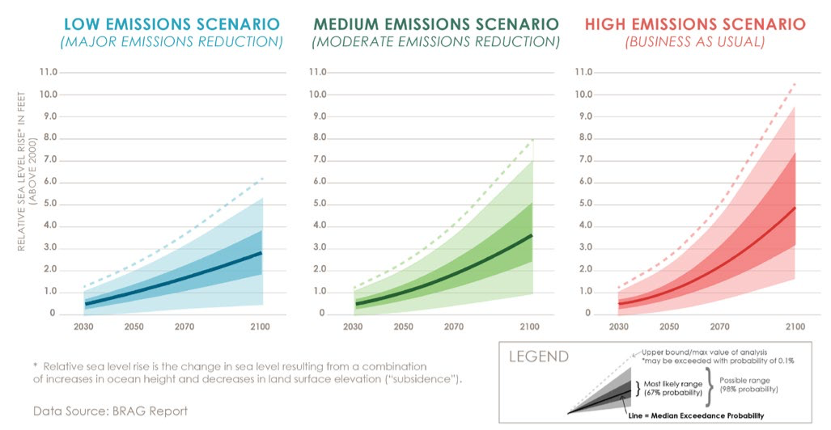
Weather, Climate, and Climate Change
Global warming is causing soils in the polar regions that have been frozen for as much as 40,000 years to melt
Some of the sea level rise is due to melting glaciers and ice sheets which add water to the oceans that was once trapped on land.
Left: Public domain image courtesy of NOAA. Right: © City of Boston / BRAG. All rights reserved. This content is
excluded from our Creative Commons license. For more information, see https://ocw.mit.edu/help/faq-fair-use/.
Notes:
First Street:
https://assets.firststreet.org/uploads/2020/06/first_street_foundation__first_national_flood_risk_assessment.pdf
FEMA = 8M Properties

Slide 13
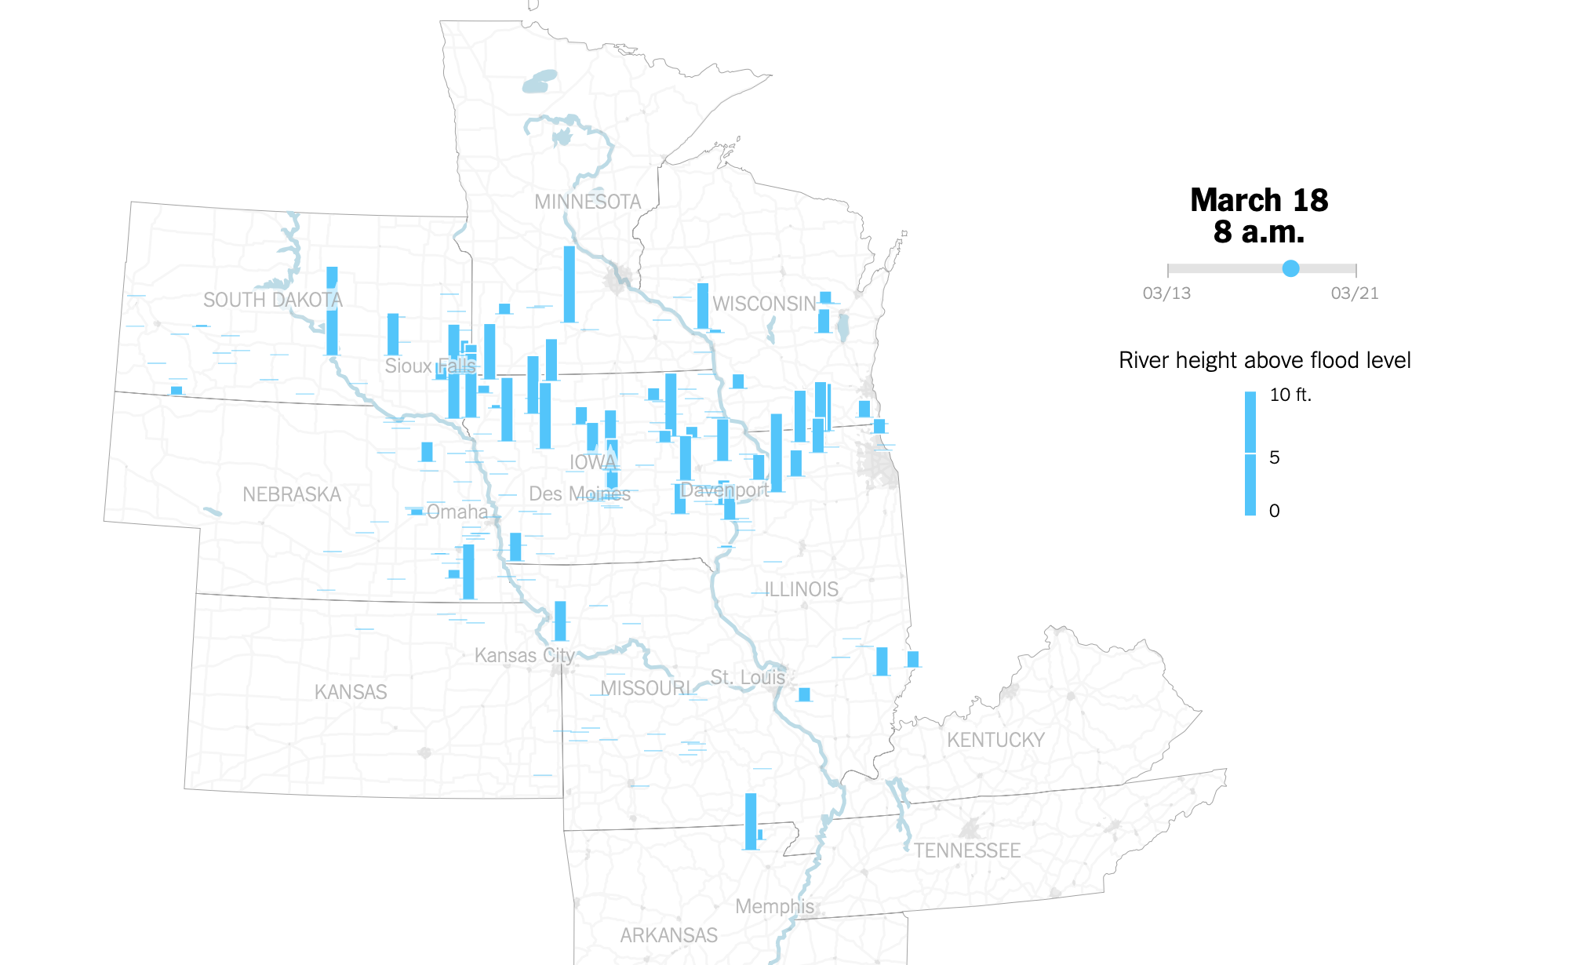
Weather, Climate, and Climate Change
Extreme rainfall accumulations have increased by a factor of 2-4 in the Northeast United States:
2020 wildfire potential
High
Low
Non-burnable lands*
and open water
Left: Public domain content courtesy of NOAA. Right: © New York Times. All rights reserved. This content is
excluded from our Creative Commons license. For more information, see https://ocw.mit.edu/help/faq-fair-use/.
Notes:
Martinez‐Villalobos, C., and J.D. Neelin. (2018), Shifts in Precipitation Accumulation Extremes during the Warm Season over the United States, Geophys. Res. Lett., 45. https://doi.org/10.1029/2018GL078465
https://www.climate.gov/news-features/event-tracker/soggy-summer-mid-atlantic-2018
https://www.nytimes.com/interactive/2019/03/19/us/midwest-flooding.html?action=click&module=RelatedLinks&pgtype=Article

Slide 14
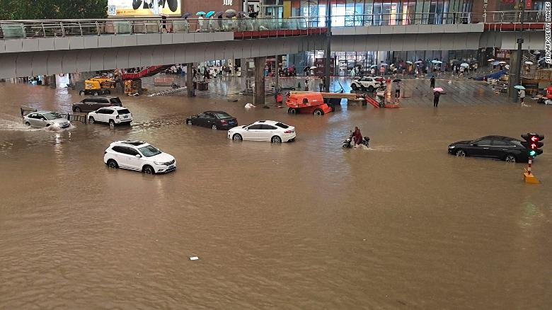
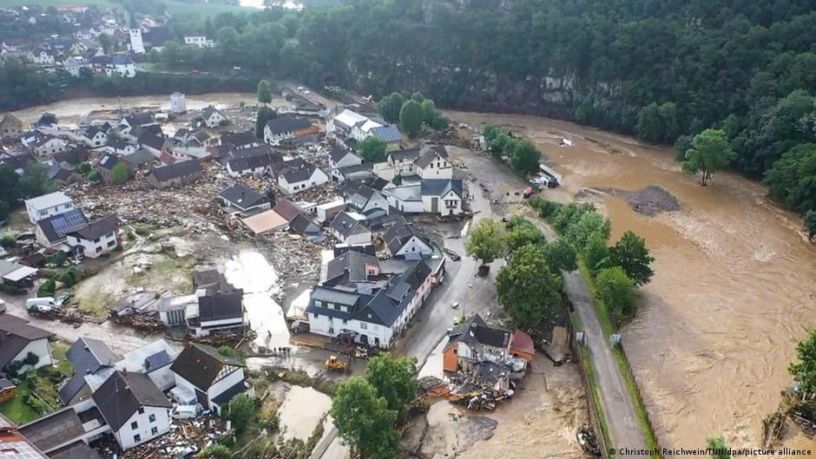
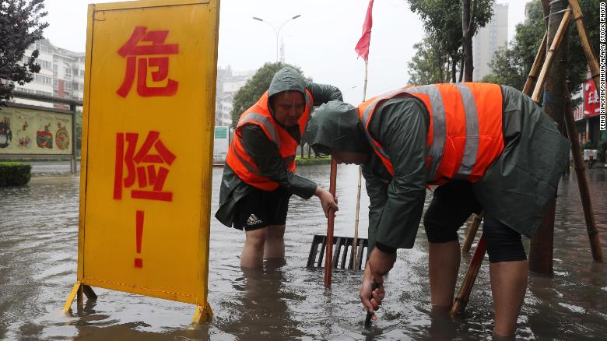
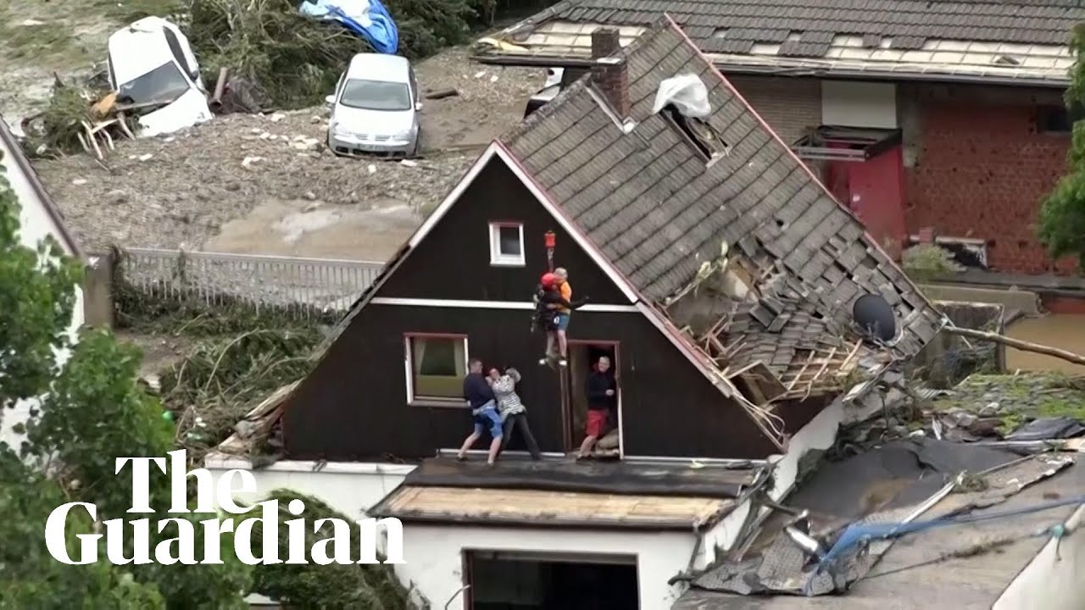
Weather, Climate, and Climate Change
Zhengzhou (China)
July 21, 2021
Germany
July 15, 2021
© The Guardian. All rights reserved. This content is excluded from our
Creative Commons license. For more information, see https://ocw.mit.edu/help/faq-fair-use/.
Notes:
https://www.climate.gov/news-features/understanding-climate/climate-change-minimum-arctic-sea-ice-extent

Slide 15
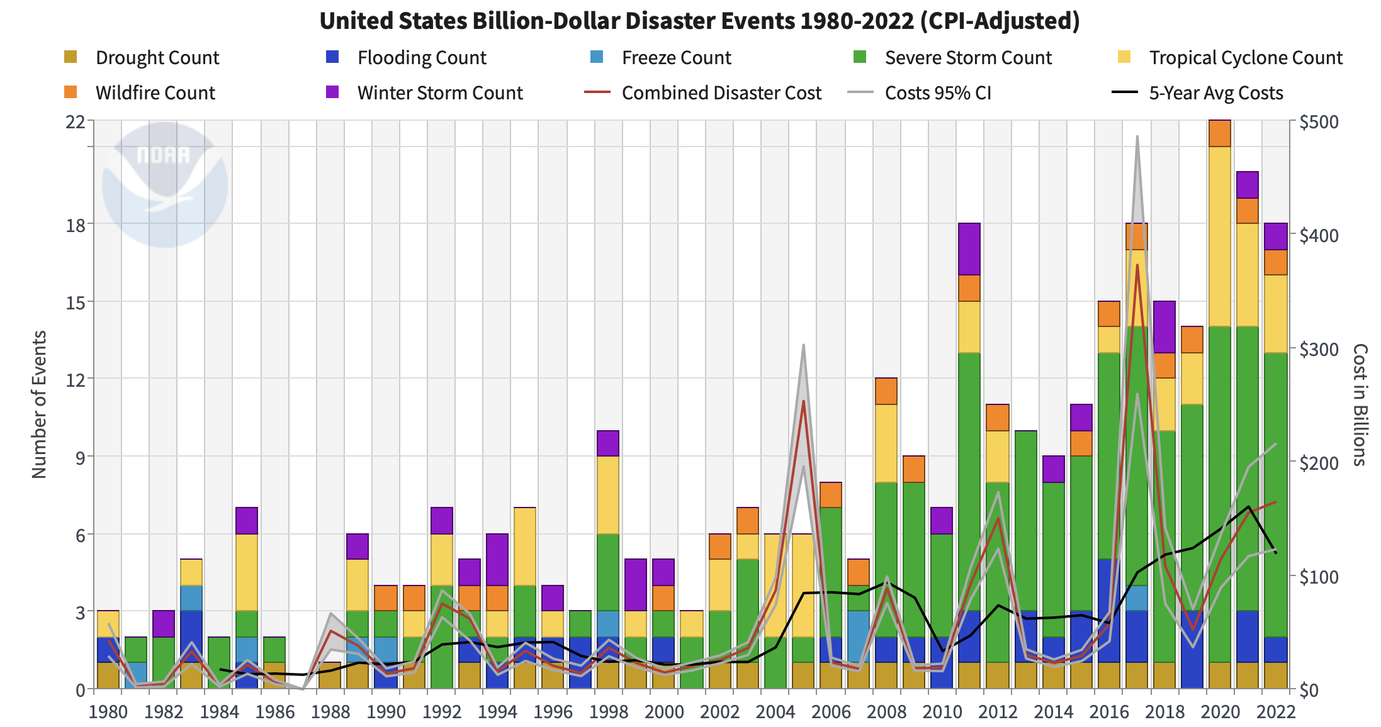
Evolution of Damages Climate Disasters
Public domain content courtesy of NOAA.
Notes:
The history of billion-dollar disasters in the United States each year from 1980 to 2020, showing event type (colors), frequency (left-hand vertical axis), and cost (right-hand vertical axis. The number and cost of weather and climate disasters is rising due to a combination of population growth and development along with the influence of human-caused climate change on some type of extreme events that lead to billion-dollar disasters. NOAA Climate.gov image, based on NCEI data.

Slide 16
Climate Risk in Real Estate Markets
Physical risk
Capable of directly affecting buildings
Acute Climate Risk: Catastrophic events.
Chronic Climate Risk: Changes in weather patterns.
Transition risk
Indirect risk for buildings: Economic shifts, regulatory changes, and the changing availability and price of resources.
Market risks
Reputation and market position
Policy and regulation
Resource availability
Notes:
Source: https://downloads.globalchange.gov/sap/sap3-3/sap3-3-final-all.pdf

Slide 17
Physical risks: Acute vs Chronic Physical Risks
Capable of directly affecting buildings & occupants
Chronic Climate Risk: Changes in weather patterns.
  Rising sea levels
  Rising average temperatures
Acute Climate Risk: Catastrophic events.
  Wild fires
  Heat waves
  Storms
  Floods
Average changes in weather [experience]:
Frequent events, affecting our daily life now
Damages are not catastrophic
Tail Events [expectation]:
Infrequent events, often projected to happen in
the (far) future by climate models (e.g. 100 years):
Damage are extreme

Slide 18
Transition Risks
Transition risks: regulatory changes, economic shifts, and the changing availability and price of resources.
Market risks: markets vulnerable to climate change will become less desirable over time. Rising capital costs to pay for building and maintaining infrastructure to manage climate risks.
        Reputation and market position: Growing stakeholder preference to work with companies incorporating climate risk into investment decisions, and consumer preference for real estate products incorporating climate mitigation.
Policy and regulation: Regulations to address climate change—e.g., climate risk disclosure, tougher building standards, carbon pricing, emissions caps, changes to subsidies—as well as changing policies for providing funding for infrastructure or rebuilding after major events.
Resource availability
Notes:
Source: https://downloads.globalchange.gov/sap/sap3-3/sap3-3-final-all.pdf

Slide 19
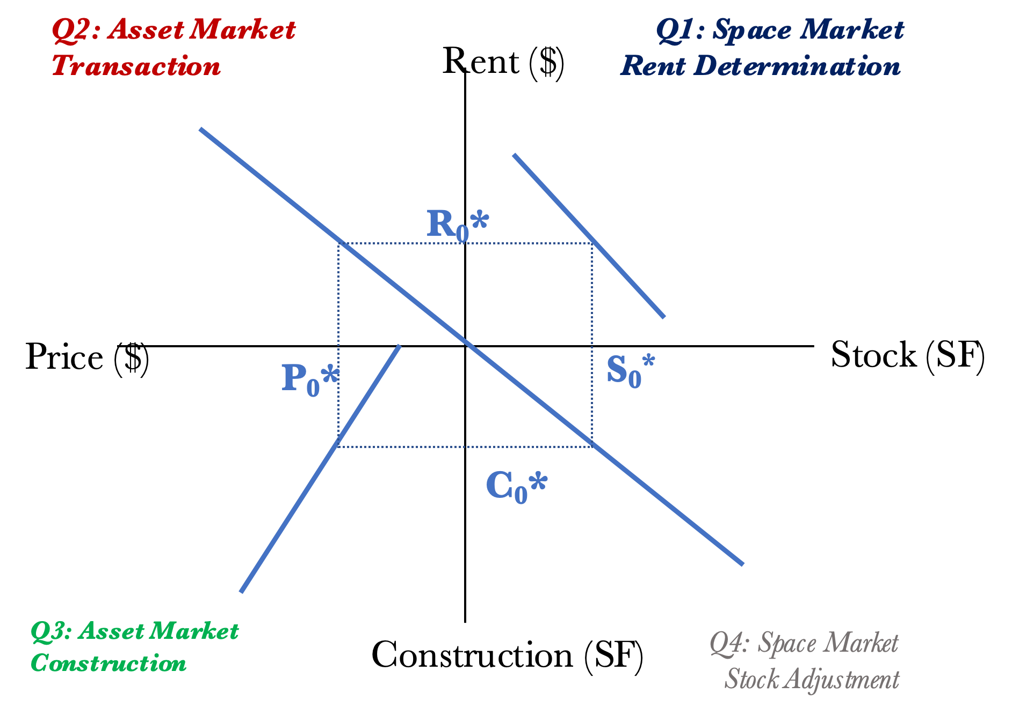
The “Real Estate System”: Interaction of the Space Market, Asset Market, & Development Industry
Q1: SPACE MARKET
LOCAL
SUPPLY
DEMAND
&
ADDS
(Landlords)
(Tenants)
NATIONAL
NEW
ECONOMY
RENTS
&
OCCUPANCY
FORECAST
FUTURE
DEVELOPMENT
INDUSTRY
ASSET MARKET
IF
IS
SUPPLY
YES
DEVELPT
CASH
(Owners
PROFITABLE
FLOW
Selling)
?
CAPI
TAL
PROPERTY
MKT
MKTS
CONSTR
MARKET
REQ’D
D
EMAND
COST
VALUE
CAP
(Investors
INCLU
RATE
Buying)
LAND
= Causal flows.
= Information gathering & use.
Geltner, D., Miller, N.G., Clayton, J. and Eichholtz, P., 2001. Chapter 2. Commercial real estate analysis and investments (Vol. 1, p. 642). Cincinnati, OH: South-western.

Slide 20
Four Quadrant Model: Drop in Demand
Q2: Asset Market
Transaction
Q1: Space Market
Rent Determination
Rent ($)
Reduction in demand of assets by tenants
  Impacts on attractiveness of the asset
  Impacts on occupants (health, behavior, performance)
  Impacts on amenities
R₀*
R₁*
Price ($)
P₁*
S₀*
Stock (SF)
P₀*
S₁*
C₁*
C₀*
Q3: Asset Market
Construction
Construction (SF)
Q4: Space Market
Stock Adjustment

Slide 21
Impact of Climate on Demand for Assets
Introducing the problem of households using the hedonic-model:
Price _{h} = B’ House Characteristics_{h} + B’ Location (physical) Amenities_{h} + B’ Climate_{h}
Household value the access to physical amenities within and ‘’around’’ the house
Individuals sort to locations based on their preferences for climate amenities (e.g. warm and cold weather)
  As climate changes, the weather also changes introducing new sorting (migration), and changing the demand for cities
Notes:
https://www.sciencedirect.com/science/article/pii/S0095069617305843#!
https://www.sciencedirect.com/science/article/pii/S0094119096920276

Slide 22
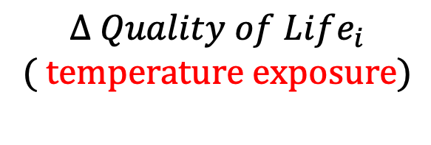

Impact of Climate on Demand for Assets
Roback (1982): Housing Price (Rent) is the ticket to a city
$$Δ {Rent}_{i} = Δ Wage_{i} + Δ Quality of Life_{i}$$
How much more people are willing to pay to live in city i
How much more people earn here
How much more people value the quality-of-life here
$$= Δ Wage_{i} + Δ{Rent}_{i}$$
$$Δ Quality of Life_{i}$$
( $temperature exposure)$
  $Δ$: Premium relative to benchmark level
Notes:
How many days do I have to work in the city to live there.

Slide 23
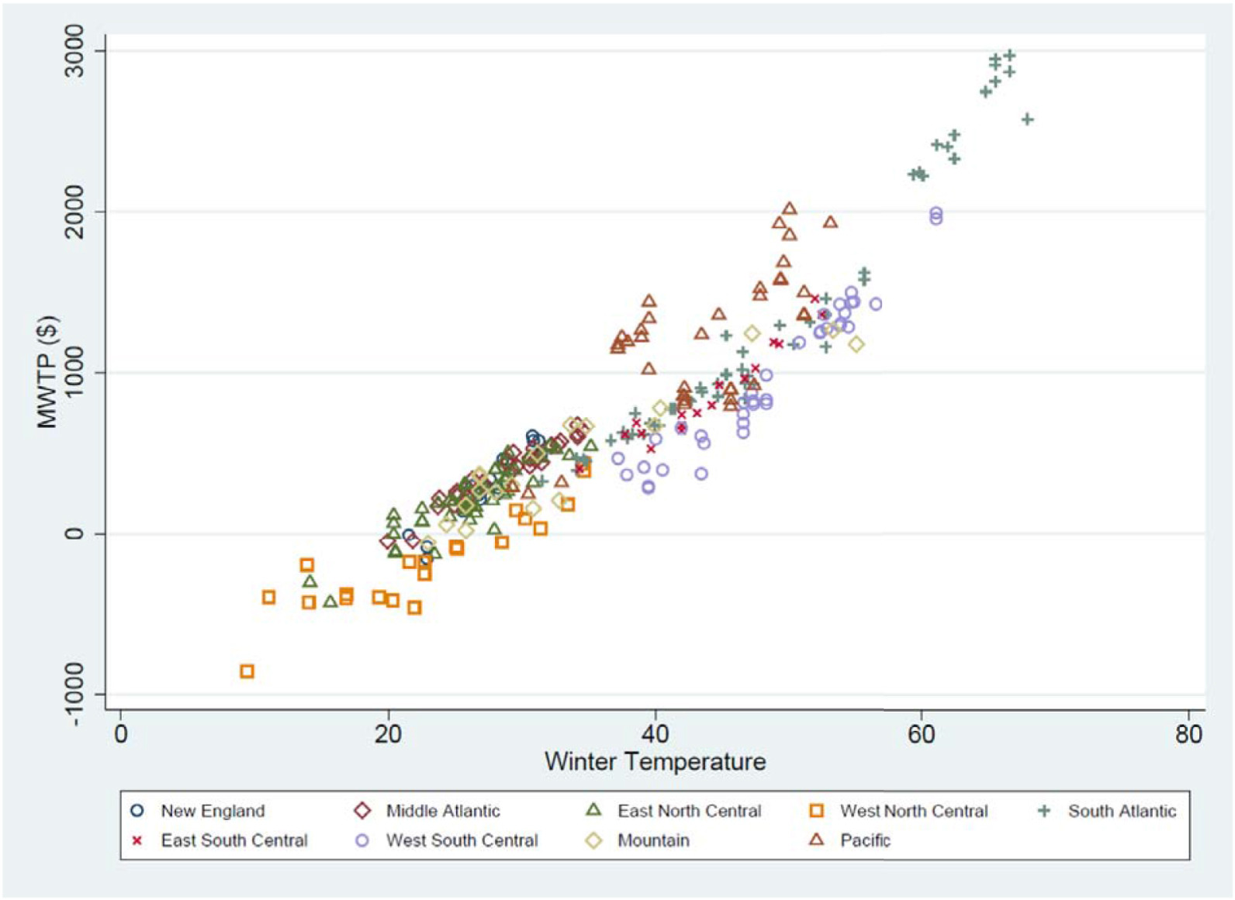
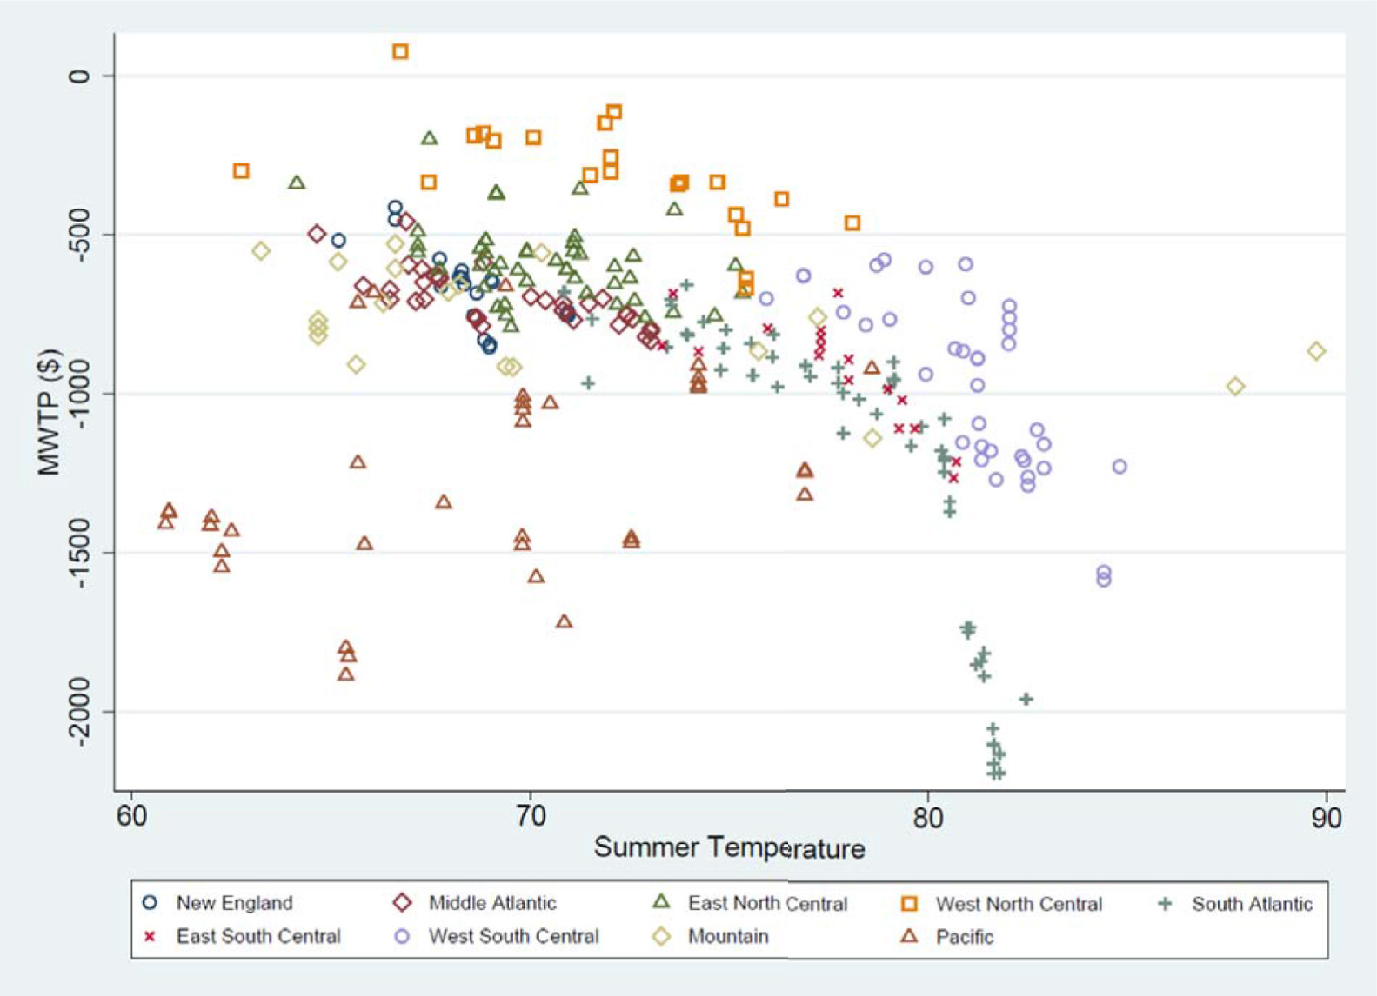
Impact of Climate on Demand for Assets
Source: Sinha, P., Caulkins, M.L. and Cropper, M.L., 2018. Household location decisions and the value of climate amenities. Journal of Environmental Economics and Management, 92, pp.608-637. Courtesy of Elsevier, Inc., https://www.sciencedirect.com. Used with permission.
Notes:
https://www.sciencedirect.com/science/article/pii/S0095069617305843#!
https://www.sciencedirect.com/science/article/pii/S0094119096920276
LINK TO Quality of life

Slide 24
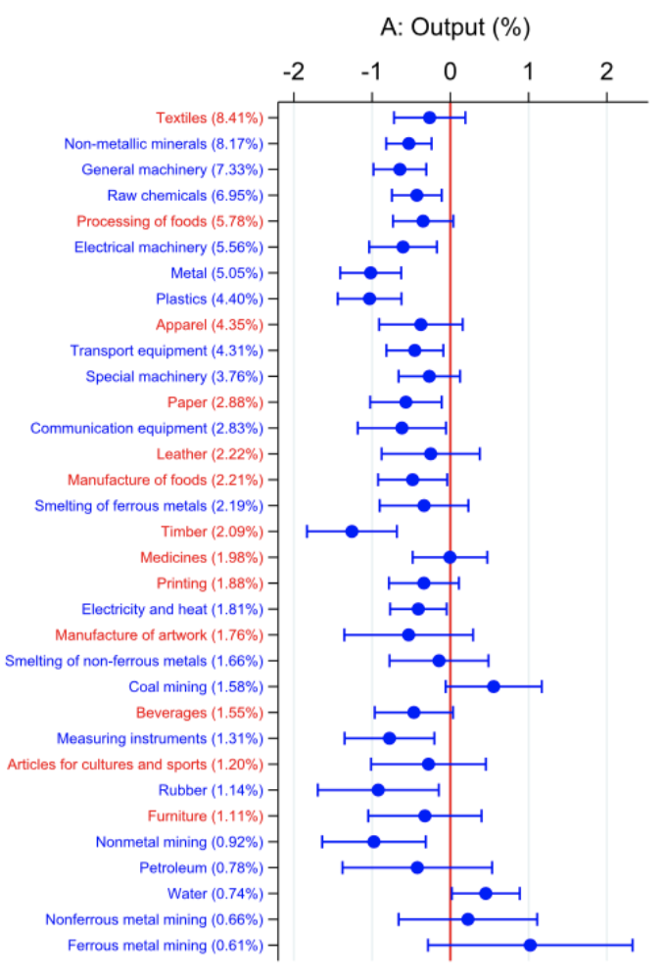
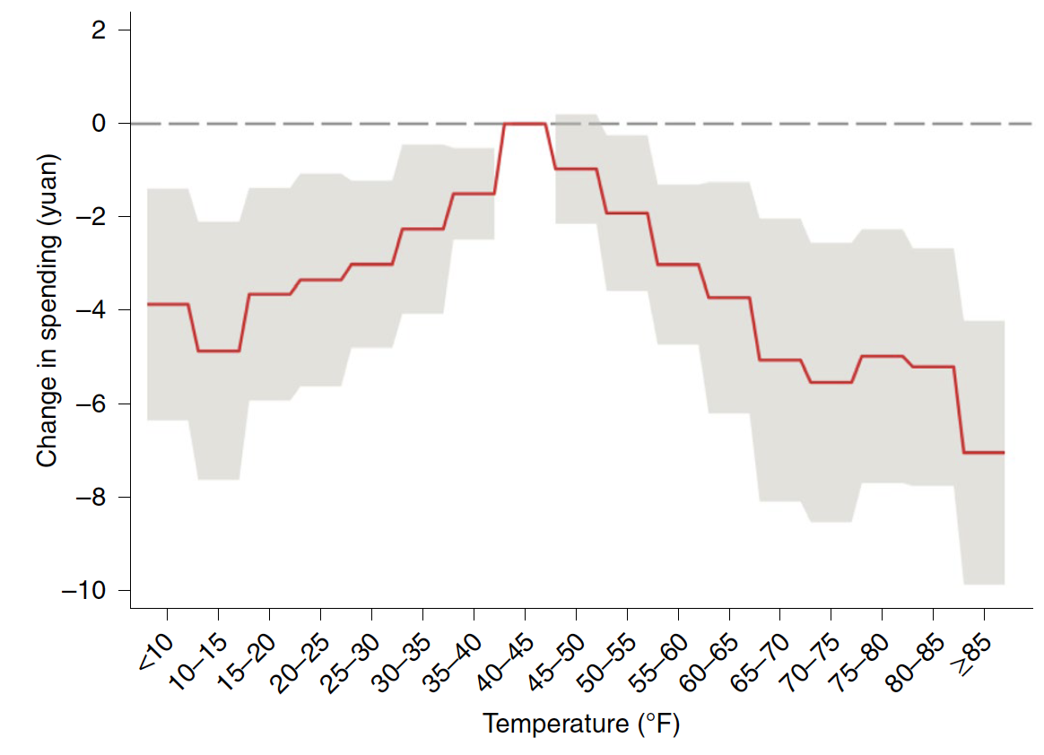
Impact of Climate on Demand for Assets
Retail Sector: Changes in Demand
Changes in productivity
Estimated effects (in %) of a day with temperatures
above 90 °F on output for each manufacturing subsector.
¥12.1 million and ¥6.9 million losses per day per city on average in days of 85° F (30° C)
Lai, W., Li, S., Liu, Y., & Barwick, P. J. (2022). Adaptation mitigates the negative effect of temperature shocks on household consumption. Nature Human Behaviour, 6(6), 837-846.
© Springer Nature Ltd. All rights reserved. This content is excluded from our Creative
Commons license. For more information, see https://ocw.mit.edu/help/faq-fair-use/.
Source: Zhang, P., Deschenes, O., Meng, K., & Zhang, J. (2018). Temperature effects on productivity and factor reallocation: Evidence from a half million Chinese manufacturing plants. Journal of Environmental Economics and Management, 88, 1-17. Courtesy of Elsevier, Inc., https://www.sciencedirect.com. Used with permission.
Notes:
https://www.sciencedirect.com/science/article/pii/S0095069617305843#!
https://www.sciencedirect.com/science/article/pii/S0094119096920276
LINK TO Quality of life

Slide 25
Four Quadrant Model: Capital Markets
Q2: Asset Market
Transaction
Q1: Space Market
Rent Determination
Rent ($)
Increase in asset level risk:
  Greater operating expenses due to increases in insurance costs and maintenance cots
  Greater awareness by investors and lenders on the risks associated with climate exposure
  (e.g., Task Force on Climate-related Financial Disclosures)
R₁*
R₀*
Price ($)
P₁*
S₀*
Stock (SF)
P₀*
S₁*
C₁*
C₀*
Q3: Asset Market
Construction
Construction (SF)
Q4: Space Market
Stock Adjustment

Slide 26









“Apple-to-Apple” Comparison in Flooding Risk Pricing
High Flooding Risk
Real flood Risk
(Treatment Effect)
$-0.1M
$ 1 M
$1.1M
$ 0.85 M
Counterfactual
Low Flooding Risk
Bias $0.25M
$ +0.15 M ← Naive flooding
risk discount?

Slide 27
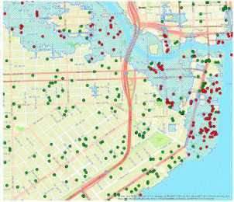
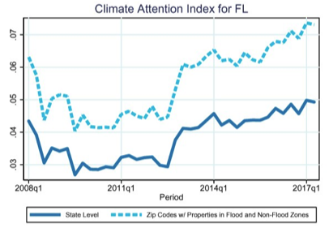
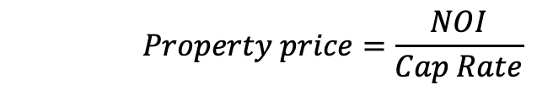
Adjustment in Risk Perception of Properties
Data on the universe of property transactions from Florida, New Jersey, North Carolina, and South Carolina
Measuring submarket attention to flooding risk via “Climate Attention Index”: proportion of for-sale listings with property descriptions that contain climate change risk works: “FEMA,” “floodplain,” and “flood risk.”
Hedonic price model estimating FEMA flood zones x Climate Attention Index to estimate price discounts associated with sea level risk on house prices (long term horizon) and rents (short term horizon)
Figure showing properties in the FEMA flood zone
(blue shaded area)
 | Doubling attention to flood risk in flood zone
Changes in Prices | - 2.9%
Changes Rents | 0%
    $$Property price=\frac{NOI}{Cap Rate}$$
Source: Giglio, Stefano, et al. "Climate change and long-run discount rates: Evidence from real estate." The Review of Financial Studies 34.8 (2021): 3527-3571. © S. Giglio et al. All rights reserved. This content is excluded from our Creative Commons license. For more information, see https://ocw.mit.edu/help/faq-fair-use/.

Slide 28
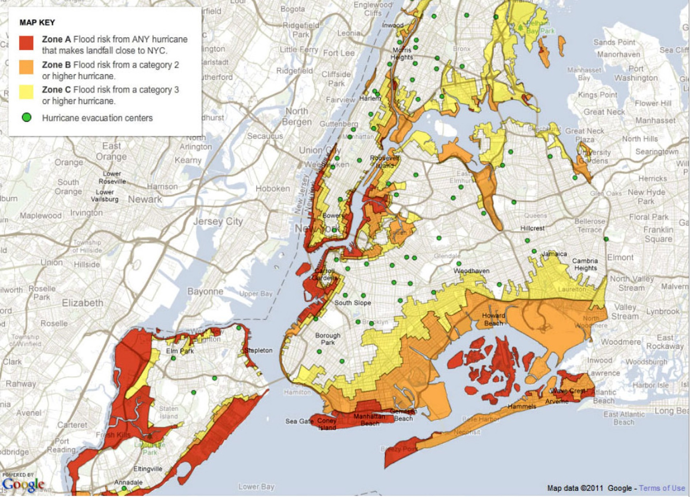
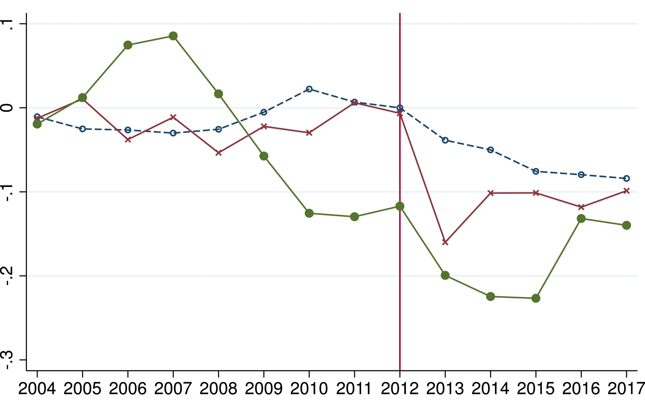
Learning from Hurricane Sandy:
Adjustment in Risk Perception of Properties after Climate Disasters
Hurricane Sandy (2012): a powerful hybrid (tropical/extratropical) cyclone, causing the highest water level in at least 300 years in the New York City metropolitan area:
  Damages amounting to over $19 billion
Estimation price discounts after hurricane Sandy:
  Discounts from 17% to 22% in properties that suffered damage, that gradually rebounded to ~9% discount as repairs took place
  Persistent drops in prices by about 9% in flood zones among properties that suffered no damage
  Why?
    Sandy may have led to a change in beliefs: increase probability of massive flooding events, reducing the willingness to pay for living in flood-prone areas
Hurricane Flood Risk Zones in NYC
Changes in home prices
Properties without damage
Properties with minor damage
Properties with major damage
Source: Ortega, F. and Taṣpınar, S., 2018. Rising sea levels and sinking property values: Hurricane Sandy and New York’s housing market. Journal of Urban Economics, 106, pp.81-100. Courtesy of Elsevier, Inc., https://www.sciencedirect.com. Used with permission.

Slide 29
Impact of Climate on Development Market
Q2: Asset Market
Transaction
Q1: Space Market
Rent Determination
Rent ($)
R₁*
R₀*
Price ($)
P₀*
S₀*
Stock (SF)
P₁*
S₁*
C₁*
Increase in cost of construction:
  Greater site remediation (flood walls, drainage)
  More expensive materials (better equipped for floods, storms, wildfires, etc.)
C₀*
Q3: Asset Market
Construction
Construction (SF)
Q4: Space Market
Stock Adjustment

Slide 30
Impact of Climate on Development Market
Q2: Asset Market
Transaction
Q1: Space Market
Rent Determination
Rent ($)
R₁*
R₀*
Price ($)
P₀*
S₀*
Stock (SF)
P₁*
S₁*
C₁*
Increase in cost of construction:
  Greater site remediation (flood walls, drainage)
  Supply chain disruptions: More expensive materials (better equipped for floods, storms, wildfires, etc.)
C₀*
Q3: Asset Market
Construction
Construction (SF)
Q4: Space Market
Stock Adjustment

Slide 31
Depreciation: Impact of Climate on Supply of Assets
Rent ($)
R₁*
R₀*
Price ($)
Stock (SF)
P₁*
P₀*
S₁*
S₀*
Climate change shrinks the probability that the infrastructure and the land survive each year:
  Build less-durable capital
  In equilibrium, any particular building will spend less time in the maintained state after climate change
  This results in higher stock depreciation
C₀*
C₁*
Construction (SF)
Source: Bunten, D. and Kahn, M.E., 2017. Optimal real estate capital durability and localized climate change disaster risk. Journal of Housing Economics, 36, pp.1-7

Slide 32
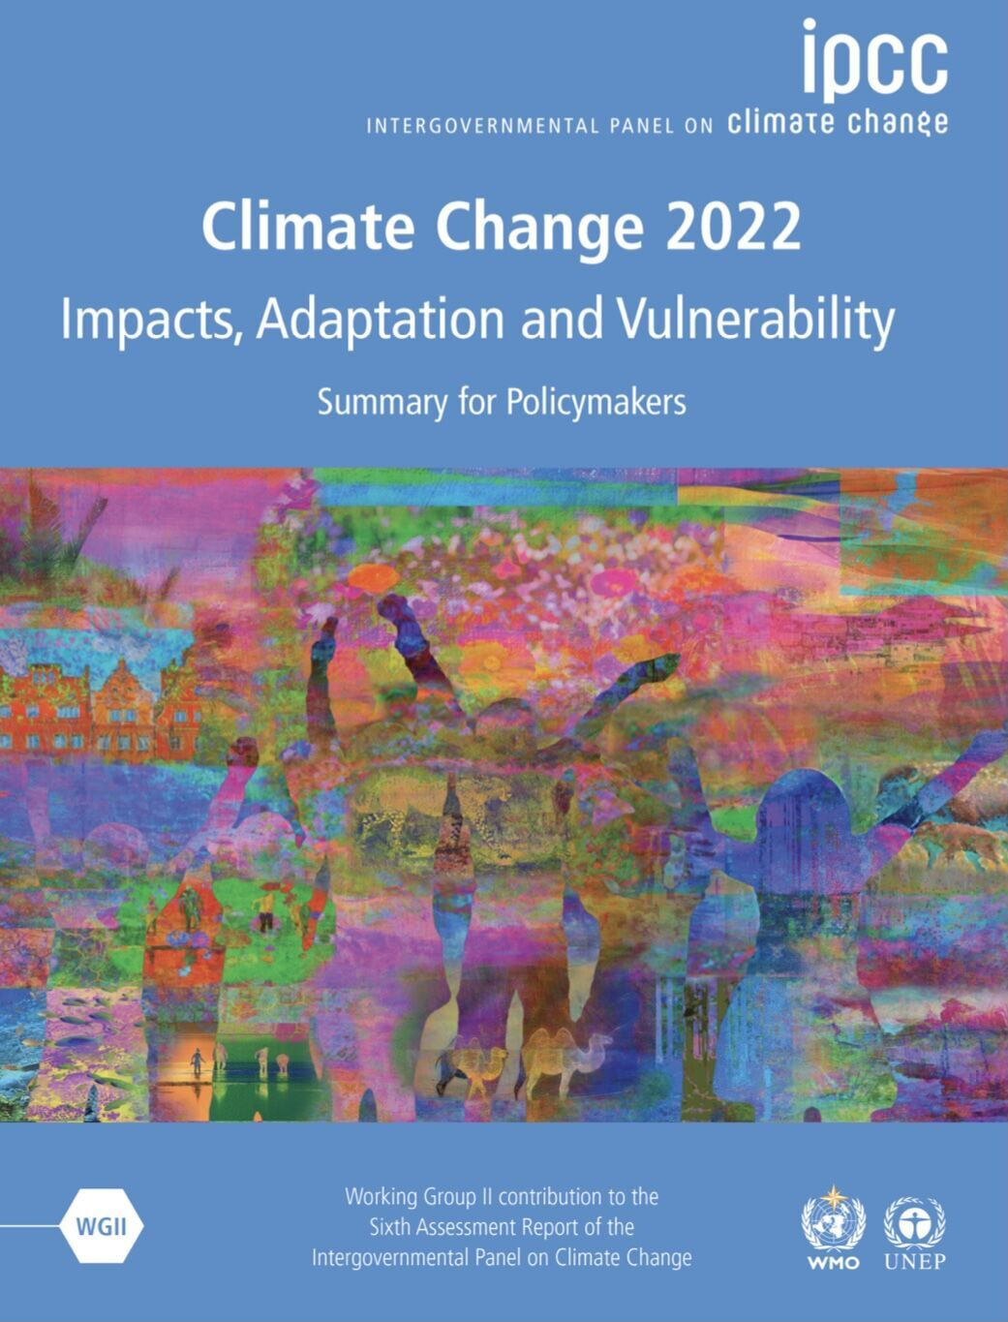
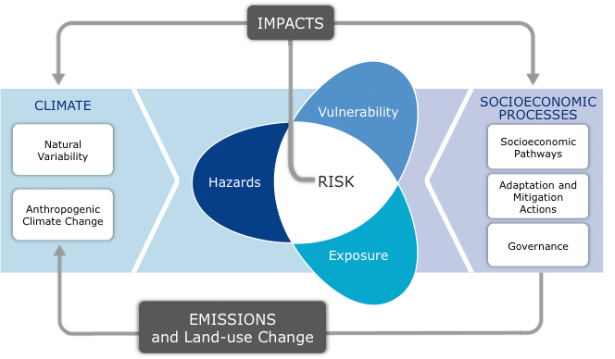
Climate Resilience: Adapting to Climate Change
© Intergovernmental Panel on Climate Change. All rights reserved. This content is excluded from our
Creative Commons license. For more information, see https://ocw.mit.edu/help/faq-fair-use/.

Slide 33
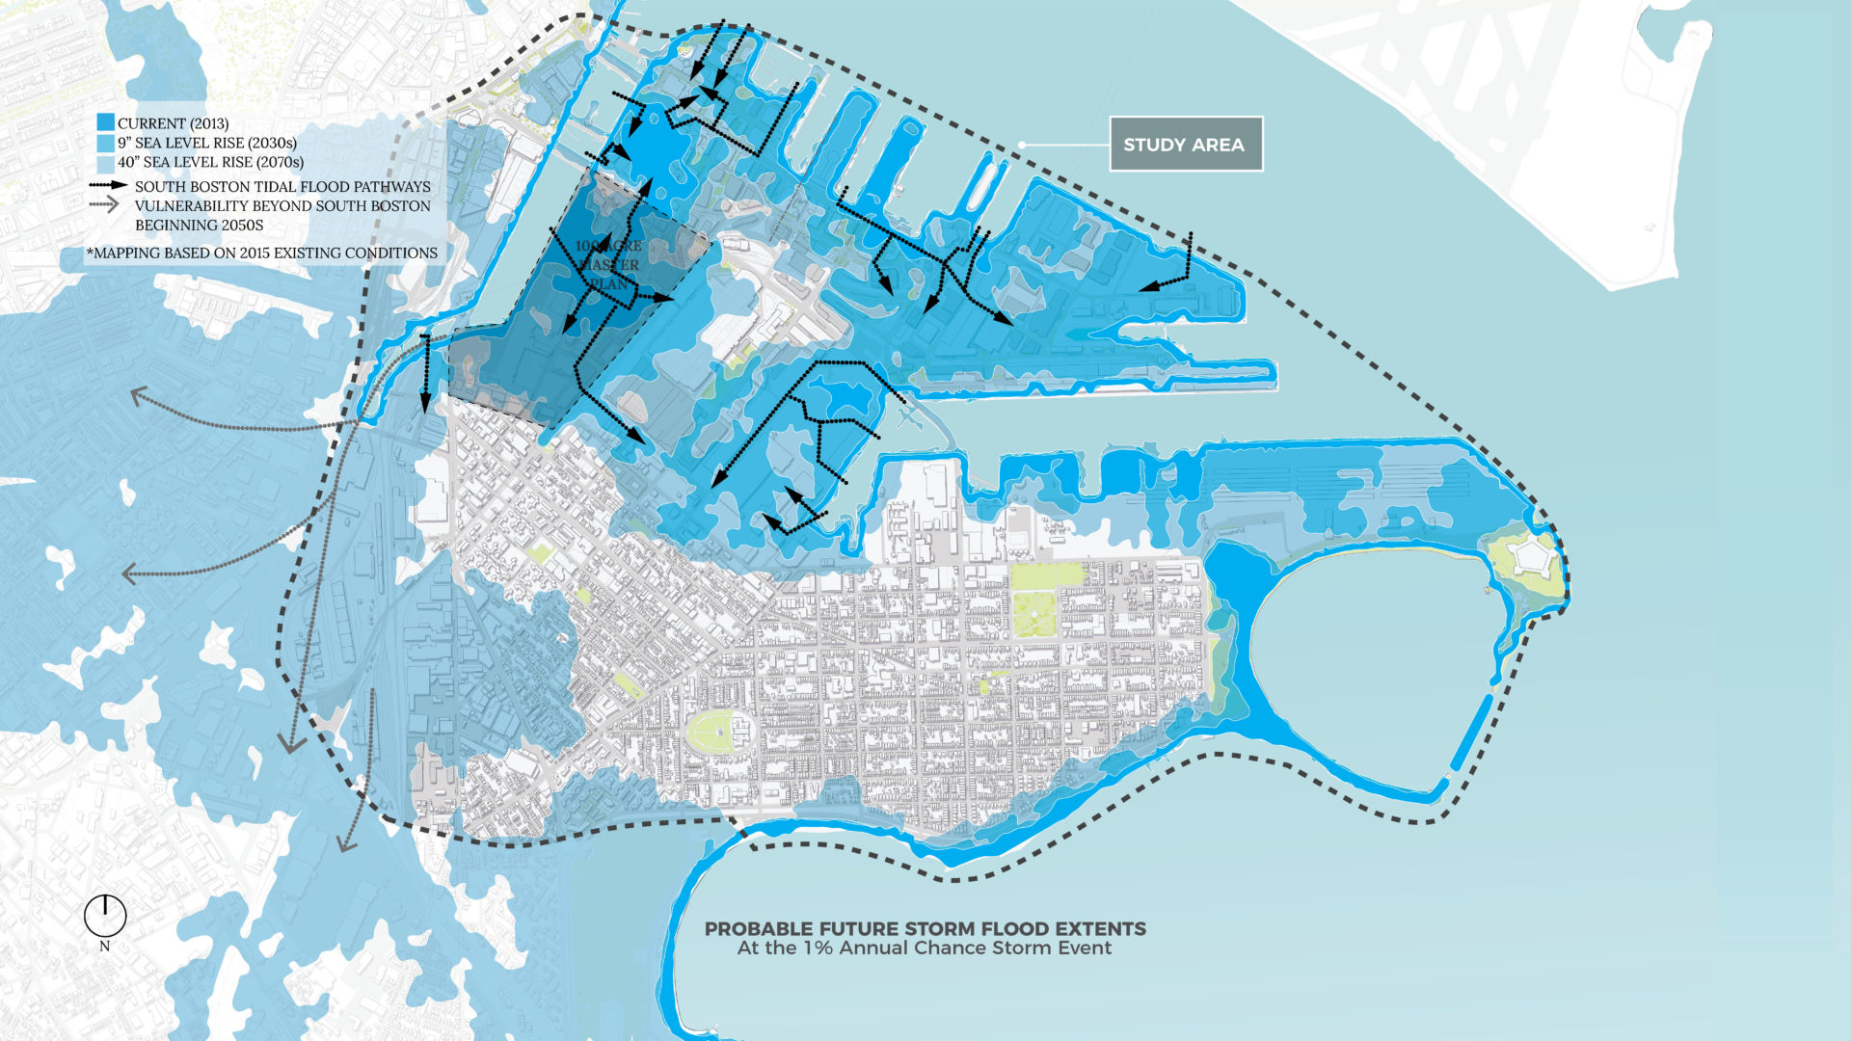
Climate Resilience: Seaport Boston Risks
© City of Boston. All rights reserved. This content is excluded from our Creative
Commons license. For more information, see https://ocw.mit.edu/help/faq-fair-use/.
Elevation→ | NO SEA LEVEL RISE (2013) | 9 INCHES OF SEA LEVEL RISE (2030s) | 21 INCHES OF SEA LEVEL RISE (2050s) | 40 INCHES OF SEA LEVEL RISE (2070s)
NUMBER OF PEOPLE EXPOSED | 980 | 2,500 | 7,300 | 40,200
NUMBER OF BUILDINGS EXPOSED | 60 | 280 | 920 | 5,140
EXPECTED DIRECT PHYSICAL DAMAGES & RELOCATION COSTS | $140 million | $1.2 billion | $2.8 billion | $8.1 billion
Source: City of Boston (2018). Coastal resilience solutions for Boston
Notes:
https://www.boston.gov/sites/default/files/embed/file/2018-09/climatereadysouthboston_execsum_v9.1s_web.pdf

Slide 34
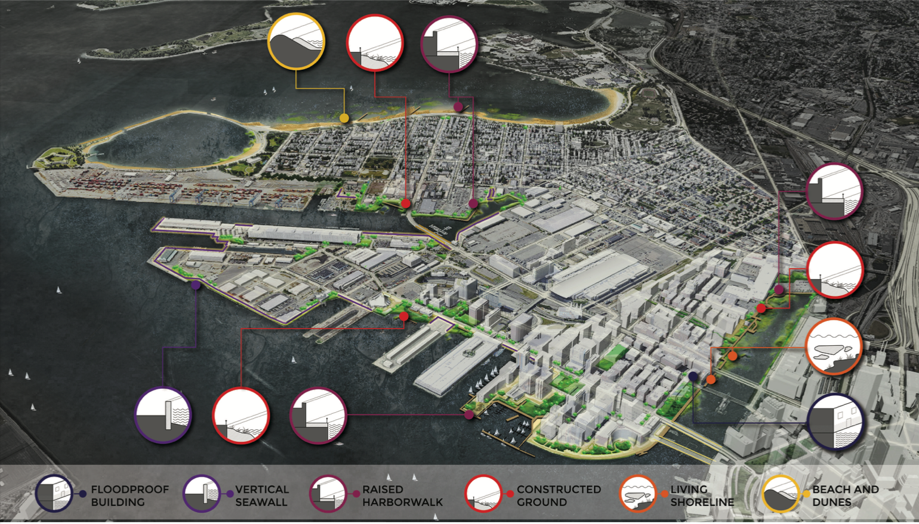
© City of Boston. All rights reserved. This content is excluded from our Creative
Commons license. For more information, see https://ocw.mit.edu/help/faq-fair-use/.
Climate Resilience: Seaport Boston (Costly) Investments
 | Implementation Cost | Annual Maintenance Cost
Fort Point Channel | $108M to $197M | $1.6M to $3.0M
South Boston Waterfront | $25M to $150M | $0.4M to $2.3M
Seaport Boulevard | $37M to $161M | $0.6M to $2.4M
Raymond L. Flynn Marine Park and Reserved Channel | $132M to $228M | $2.0M to $3.4M
South Boston Neighborhood | $210M to $299M | $3.2M to $4.5M
Total | $521M to $1.0B | $7.8M to $15.2M
Source: City of Boston (2018). Coastal resilience solutions for Boston

Slide 35
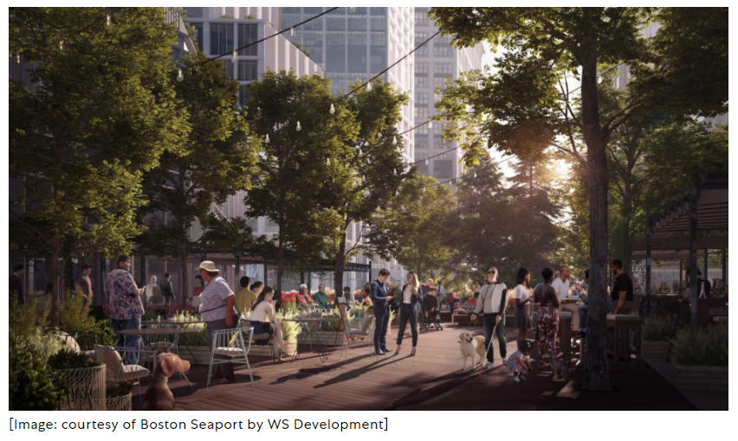
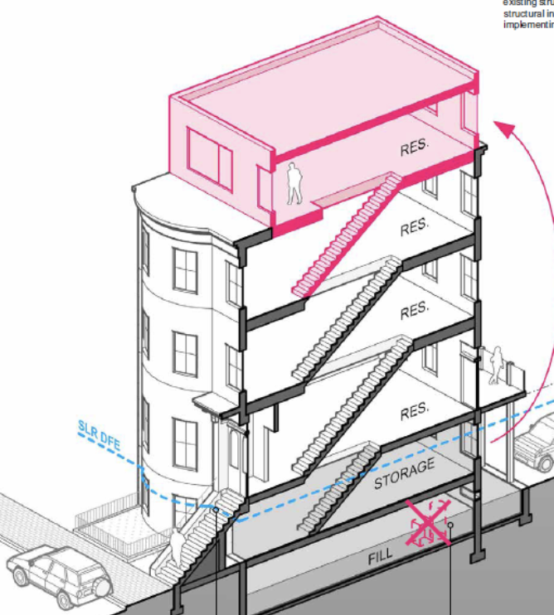
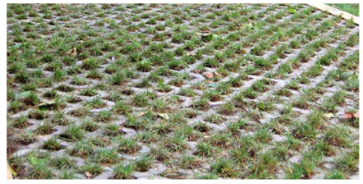








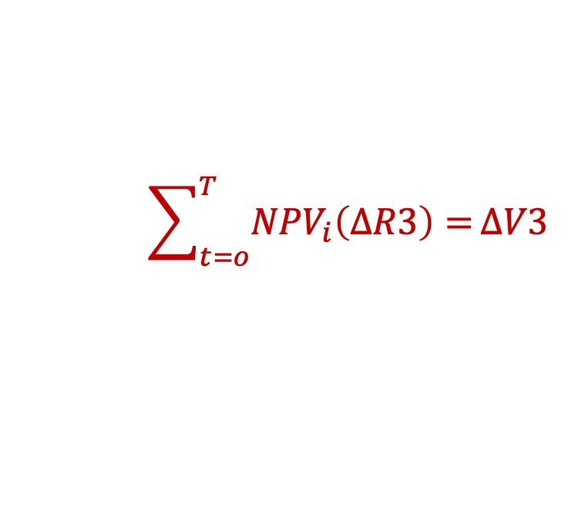




Decision Making for Climate Resilience Investments
$$∆R3 (climate resiliency)$$
$$∆R2$$
$$∆R1$$
R: Rent
……
i
30 years
Boston Seaport Development Plan
$$∆O$$
© WS Development. All rights reserved. This content is excluded from our Creative Commons license. For more information, see https://ocw.mit.edu/help/faq-fair-use/.
$$>$$
O: Energy bill + Maintenance cost
$$\sum_{t=o}^{T}{{NPV}_{i}\left(∆R3\right)=}∆V3$$
$$<$$
$$∆V1$$
1. Profits occurring in very long term
(60 years, 100 years,…)
$$∆V2$$
$$∆V3$$
$$∆R3$$
$$∆V3$$
2. Profits are uncertain (i.e. likelihood
hurricane hitting Boston,…), based on
climate model predictions
Left: © source unknown; right: © BPDA. All rights reserved. This content
is excluded from our Creative Commons license. For more information,
see https://ocw.mit.edu/help/faq-fair-use/.
Notes:
Flood risk in the US: Climate experts predict that approximately two percent of U.S. homes -- worth $882 billion -- are at risk of being underwater by 2100; in low-lying coastal regions such as Florida and Hawaii, between 10 and 12 percent of homes could be inundated.
Hurricane Sandy: 2002 NY, 8% long term property price decrease.
Improving resilience to the impacts of climate change is a complex and evolving challenge for real estate investors. Risks such as rising seas, flooding, severe storms, and heat stress are increasingly highlighting the vulnerability of not only individual assets and locations within cities, but also entire metropolitan areas.
Figure source: https://toolkit.climate.gov/topics/built-environment/buildings-and-structures
Permeable pavement: pavement areas that infiltrate storm water, reducing runoff and potential flooding
Locate critical system upstairs

Slide 36
Discounting Climate Risk: Case Seaport in Boston
As an example, assume that an investment to avoid flooding costs $1 billion, and is expected to avoid environmental damages worth $8.1 billion in 50 years.
  At a discount rate of 3%, the present value of those damages is $1.8 billion and the project seems appealing.
  At a 5%, the present value of the investment drops by an order of magnitude to $700 million, and the project no longer appears attractive.
Long run discount rates observed in housing markets are around 2.6% (Giglio et al., 2021)
Sources: (1) City of Boston (2018). Coastal resilience solutions for Boston
(2) Giglio, Stefano, et al. "Climate change and long-run discount rates: Evidence from real estate." The Review of Financial Studies 34.8 (2021): 3527-3571.

Slide 37
Lecture
Climate Risk and Real Estate Markets
Understanding the basic impacts of climate change on real estate markets
Juan Palacios
March 2023
(MIT Center for Real Estate)
Notes:
In lecture 1, the focus is on the cash flow of green building so that students can understand the key stakeholders involved in this market and the financial value of green building for each stakeholder.
In the next lecture, we will lead the students to think about three most important market failures existed in the green building market (information failure, externality, and split incentive) and how public and private sectors work together to address these problems.

Slide 38
Four Quadrant Model
Q2: Asset Market
Transaction
Q1: Space Market
Rent Determination
Rent ($)
R*
S*
Stock (SF)
Price ($)
P*
C*
Q3: Asset Market
Construction
Construction (SF)
Q4: Space Market
Stock Adjustment
Geltner, D., Miller, N.G., Clayton, J. and Eichholtz, P., 2001. Chapter 2. Commercial real estate analysis and investments (Vol. 1, p. 642). Cincinnati, OH: South-western

Slide 39
The Space Market: Demand Effects
Tenant demand for space is a function of:
Rent per square meter (changes within demand curve)
Willingness to pay (WTP): Desirability (shifts in position of demand curve)
  Changes in quality of housing amenities (proximity to work, quality of schools, parks, restaurants, neighbors, etc.)
  Changes in demographics
  Changes in preferences for assets
  …
In the short term, supply is fixed at a pre-existing stock, S* resulting in rent at R*
Rent ($)
R*
Stock (SF)
S*
Geltner, D., Miller, N.G., Clayton, J. and Eichholtz, P., 2001. Chapter 2. Commercial real estate analysis and investments (Vol. 1, p. 642). Cincinnati, OH: South-western

Slide 40
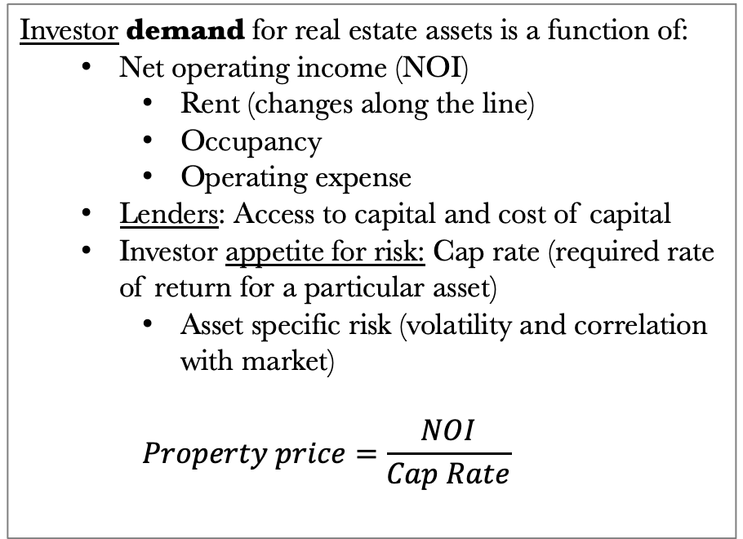
The Asset Market: Owners
Investor demand for real estate assets is a function of:
  Net operating income (NOI)
    Rent (changes along the line)
    Occupancy
    Operating expense
  Lenders: Access to capital and cost of capital
  Investor appetite for risk: Cap rate (required rate of return for a particular asset)
    Asset specific risk (volatility and correlation with market)
    $$Property price=\frac{NOI}{Cap Rate}$$
Rent ($)
R*
Price ($)
P*
Geltner, D., Miller, N.G., Clayton, J. and Eichholtz, P., 2001. Chapter 2. Commercial real estate analysis and investments (Vol. 1, p. 642). Cincinnati, OH: South-western

Slide 41
The Asset Market: New Construction
New construction:
  Site acquisition
  Construction Costs
Price ($)
P*
C*
Construction
(SF)
Geltner, D., Miller, N.G., Clayton, J. and Eichholtz, P., 2001. Chapter 2. Commercial real estate analysis and investments (Vol. 1, p. 642). Cincinnati, OH: South-western

Slide 42
The Asset Market: Stock Adjustment
Depreciation of building stock:
  In the long run, in the absence of new construction, older space will be removed from the market (i.e., depreciation):
    Abandoned
    Demolished
    Repurposed to other usages
  In the long term, a certain amount of construction is necessary to maintain the stock in the long run
S*
Stock (SF)
C*
Construction (SF)
Geltner, D., Miller, N.G., Clayton, J. and Eichholtz, P., 2001. Chapter 2. Commercial real estate analysis and investments (Vol. 1, p. 642). Cincinnati, OH: South-western

