Slide 1
SRE Economics Lecture 4
From Green Buildings to Green Cities
Pricing Environmental Features & Supporting Decision Making
Siqi Zheng
March 2023
(MIT Center for Real Estate)

Slide 2
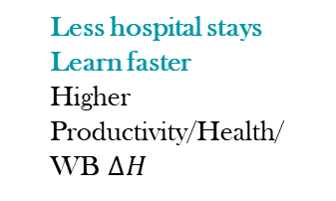

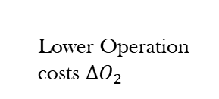


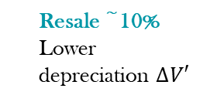
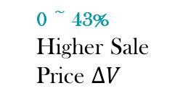
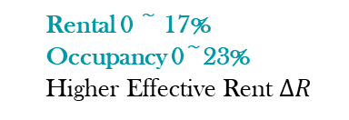
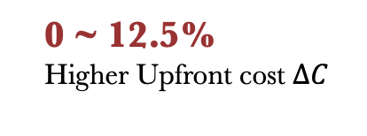
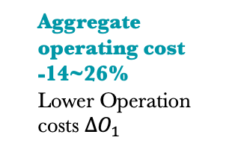
Is There a Business Case for Green/Healthy Buildings?
Developers
Owners
0 ~ 43%
Higher Sale Price $∆V$
Rental 0 ~ 17%
Occupancy 0~23%
Higher Effective Rent $∆R$
Resale ~10%
Lower depreciation $∆V′$
Benefit
Design/Construction
Sale
Tenancy
Operation
Refurbishment/Acquisition
Aggregate operating cost
-14~26%
Lower Operation costs $∆O_{1}$
$$year T$$
Cost
0 ~ 12.5%
Higher Upfront cost $∆C$
0 ~ 43%
Higher Purchaing Price$∆V$
Lower discount rate i (cost of capital)
Less hospital stays
Learn faster
Higher Productivity/Health/
WB $∆H$
Tenants
Operation
Tenancy
Operation
Tenancy
Lower Operation costs $∆O_{2}$
Higher Rent$∆R$

Slide 3
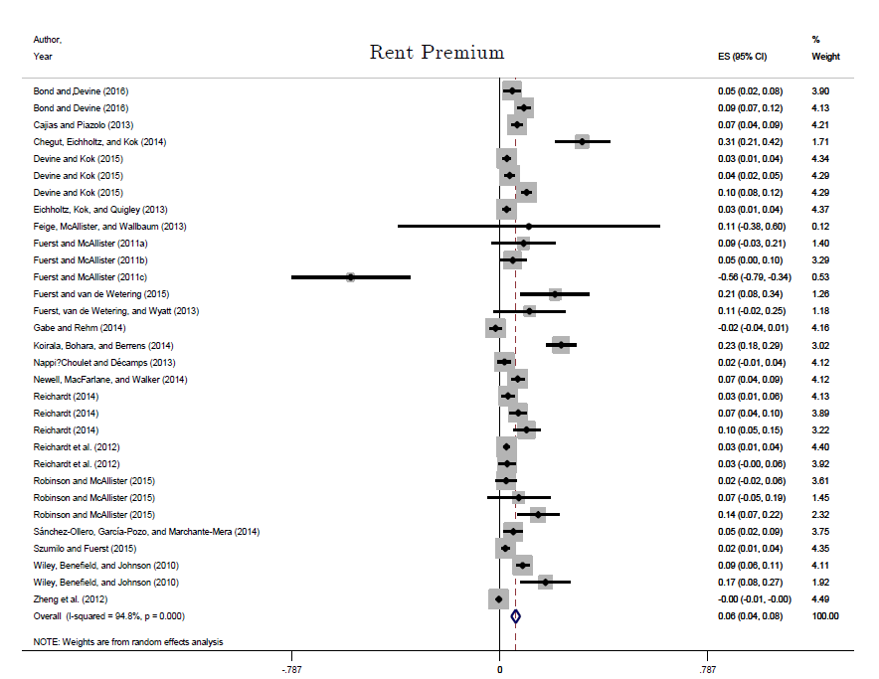
Rental Premium of Green Building
Dalton and Fuerst (2018): meta analysis of green real estate rents
Overall significant rent premium of 6%
5.4% commercial
8.2% residential
Studies also find 5% - 9% higher occupancy rates for commercial real estate.
© Informa UK Ltd. All rights reserved. This content is excluded from our
Creative Commons license. For more information, see https://ocw.mit.edu/help/faq-fair-use/.

Slide 4
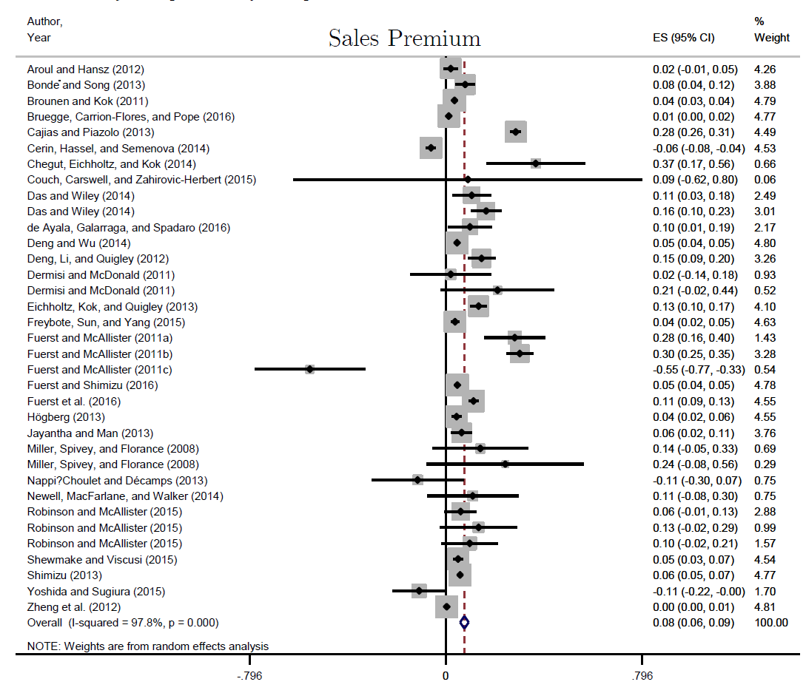
Price Premiums of Green Building
Dalton and Fuerst (2018) also look at evidence sales prices
Overall price premium of 7.6%
For commercial 11.5%
For residential 5.5%
© Informa UK Ltd. All rights reserved. This content is excluded from our
Creative Commons license. For more information, see https://ocw.mit.edu/help/faq-fair-use/.

Slide 5
Outline
Estimating Green Building Premium: Hedonic Pricing Techniques
Pricing Green Amenities in Cities
  Within-city
  Across-city
Decision Making: Business & Policy
Notes:
Ask: has anyone heard of “hedonic pricing”. This is how I make a living! My first paper, today I will talk about.
Logic flow today: green buildings → green amenities in a city → green amenities across cities.
Basic assumption: people vote with “feet” (in addition to “vote with hands”). Free mobility, free choice.
In fact, greenness is a non-market good, but it is embodied so much in real estate product and location. That is why this technique can be used in both policy evaluation, and business decision.

Slide 6
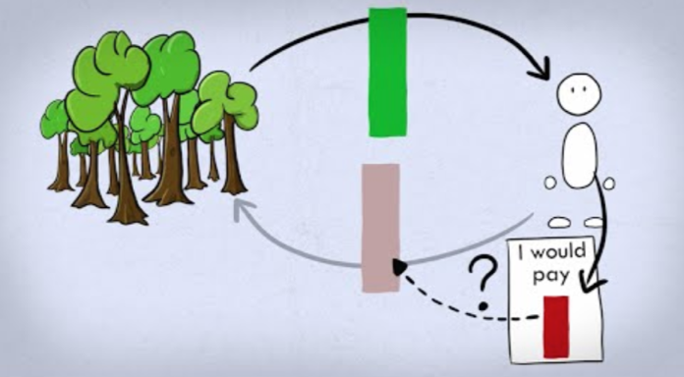
Hedonic Pricing Technique
Stated preference and revealed preference
  Stated preference: using survey techniques to elicit willingness to pay for a marginal improvement or for avoiding a marginal loss.
  Revealed Preference: linking with observed purchase behaviors with the attributes of a product.
Hedonic pricing model is a revealed preference method of estimating demand or value of market and non-market attributes.
Stated preference:
https://www.youtube.com/watch?v=__xzmIG4L8s
© Conservation Strategy Fund. All rights reserved. This content is excluded from our
Creative Commons license. For more information, see https://ocw.mit.edu/help/faq-fair-use/.
Notes:
Before getting into the hedonic technique, first let me introduce the high level two major approaches to measure consumers’ demand for a non-market good.
Hedonic belongs to the 2nd approach. Not just in real estate market. But also in the labor market – risk premium for certain job types (mining, global companies’ overseas offices in dirty and dangerous places – Iraq during the war time)

Slide 7
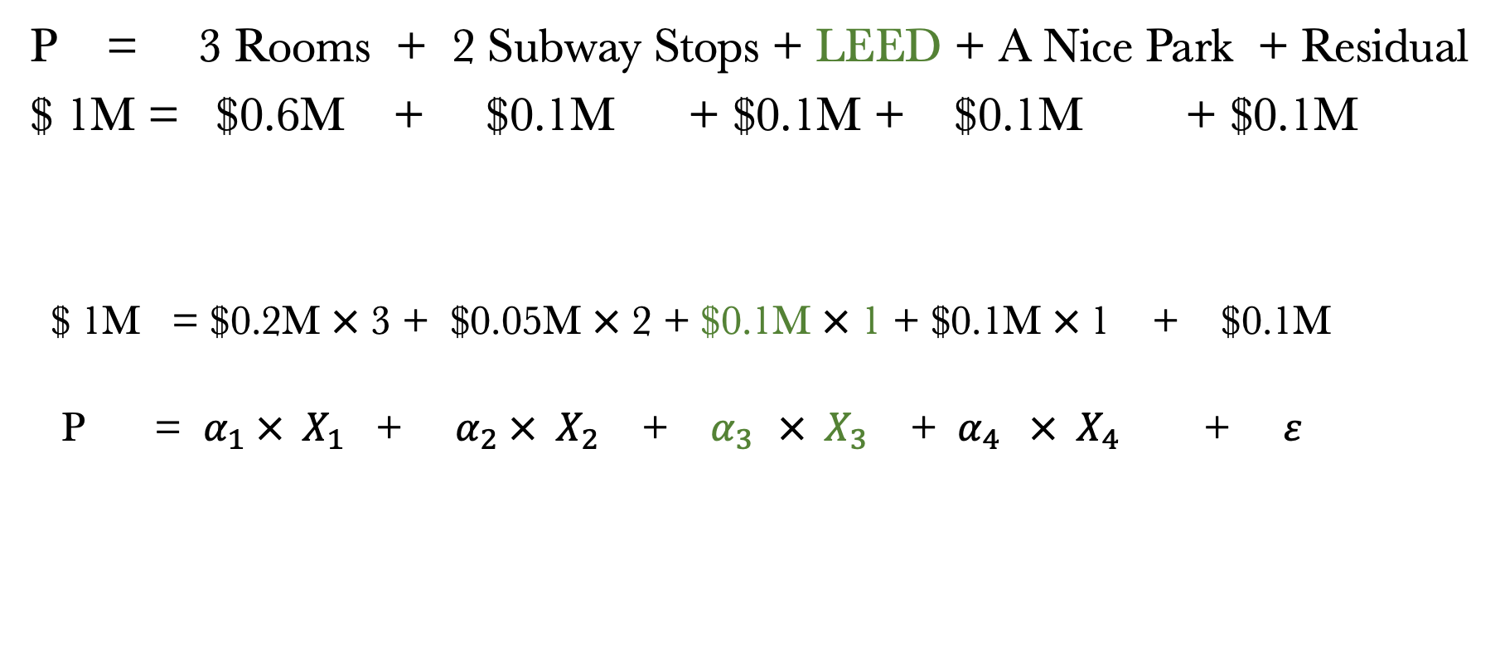
Hedonic Model - “Decomposition”
The price of a housing unit as the sum of the implicit values of its various “attributes”.
P = 3 Rooms + 2 Subway Stops + LEED + A Nice Park + Residual
$ 1M = $0.6M + $0.1M + $0.1M + $0.1M + $0.1M
$ 1M = $0.2M $×$ 3 + $0.05M $×$ 2 + $0.1M $×$ 1 + $0.1M $×$1 + $0.1M
P = $α_{1} × X_{1}$ + $α_{2} × X_{2}$ + $α_{3 } × X_{3}$ + ${ α}_{4} × X_{4}$ + $ε$
Input
Output
(R²= 83%)

Slide 8
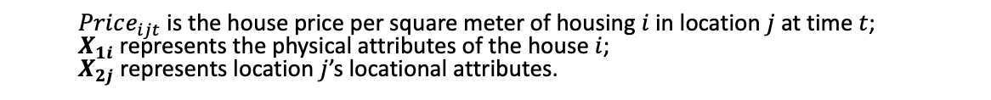
Hedonic Model - “Decomposition”
Example
Log(Price) = 0.05 living rooms
(the number of living rooms)
+ 0.03 bathrooms
(the number of bathrooms)
+ 0.08 subway
(dummy: within 1-mile subway buffer)
+ 0.05 green park
(dummy: within 1-mile park buffer)
+ …
$$Log(Price_{ijt})=X_{1i}β_{1}+X_{2j}β_{2}+U_{ijt}$$
Quantity of an attribute
Implicit price of an attribute (%)
  $Price_{ijt}$ is the house price per square meter of housing $i$ in location $j$ at time $t$;
  $X_{1i}$ represents the physical attributes of the house $i$;
  $X_{2j}$ represents location $j$’s locational attributes.

Slide 9

Estimate Green Building Premium
Ordinary Least Square (OLS)
Example: Green label in office building (by Fuerst and McAllister 2009)
$$Log\left(Price_{ijt}\right)=X_{1i}β_{1}+X_{2j}β_{2}+U_{ijt}$$
 | Log(rent/sf)
Other variables | YES
LEED | 0.06**
Energy Star | 0.06***
Obs. | 10,970
$${X′}_{1i}{β′}_{1}+β_{g}Green$$
Green Premium
Dummy (green = 1, otherwise = 0)
Or categorical variables, such as LEED {Silver, Gold, Platinum}

Slide 10

Hedonic Model
Winthrop Center team can collect the data of nearby property transactions and estimate a hedonic model.
Log(Price) = 0.3 View
(view from the window)
+ 0.05 Green
(energy efficiency and other green attributes)
+ 0.1 Health
(air quality, indoor comfort, etc.)
+ …
Sell
Condo
LEED GOLD
Passive House
+ WELL
+ LEED Platinum
Log(Price) = 0.01 View
(view from the window)
+ 0.2 Green
(energy efficiency and other green attributes)
+ 0.15 Health
(air quality, indoor comfort, etc.)
+ …
Lease
Office
Challenges?

Slide 11
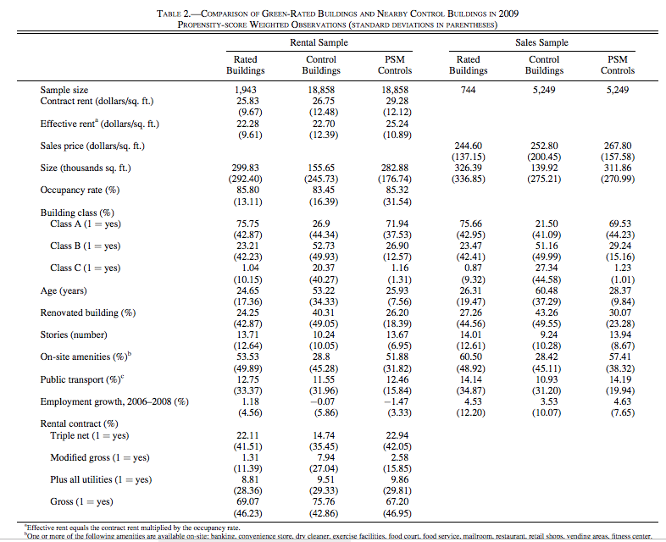

How to make an “Apple-to-Apple” Comparison
Eichholtz, P., Kok, N., & Quigley, J. M. (2013). The Economics of Green Building. The Review of Economics and Statistics, 95(1), 50-63.
Fruit photos © source unknown. All rights reserved. This content is excluded from our Creative Commons license. For more information, see https://ocw.mit.edu/help/faq-fair-use/.

Slide 12




Price difference USD 1M
Clip art icons on this and following slides © source unknown. All rights reserved. This content is excluded from our Creative Commons license. For more information, see https://ocw.mit.edu/help/faq-fair-use/.
Fruit photos © source unknown. All rights reserved. This content is excluded from our Creative Commons license. For more information, see https://ocw.mit.edu/help/faq-fair-use/.

Slide 13


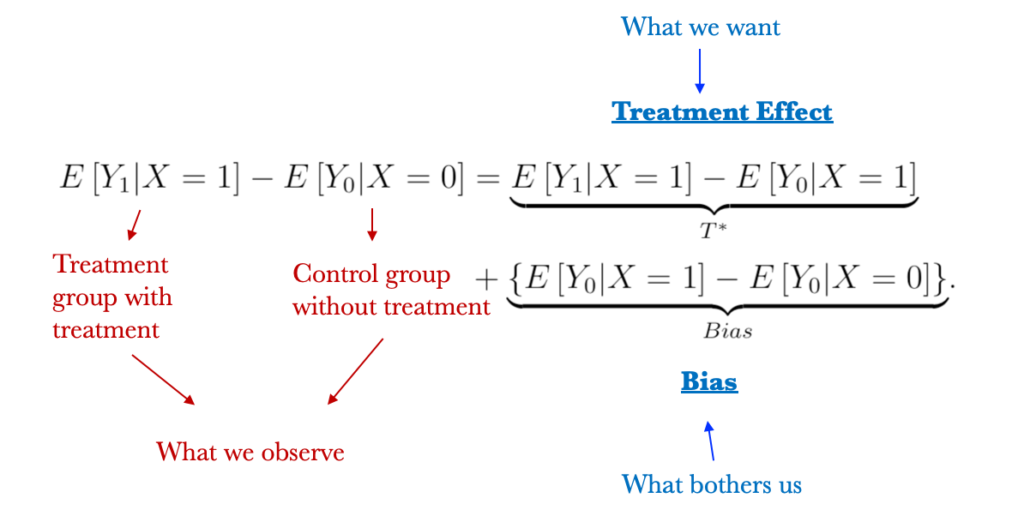






A Big Picture of Causal Inference
Fundamental problem of causal inference:
we cannot observe the “counter-factual”
LEED Building
Effect of LEED
Bias
Counterfactual
Brown Building

Slide 14


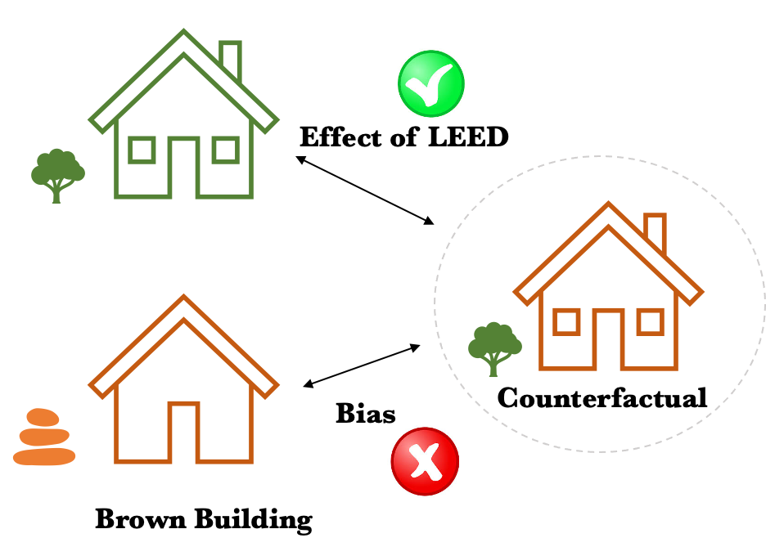
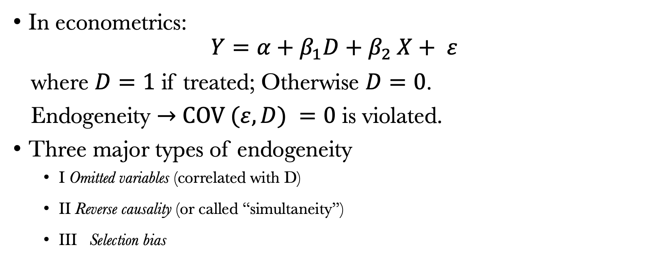
Key Challenge to Causal Inference: Endogeneity
In econometrics:
$Y=α+β_{1}D+β_{2} X+ ε$
where $D=1$ if treated; Otherwise $D=0$.
Endogeneity $→$ $COV (ε, D) =0$ is violated.
Three major types of endogeneity
  I Omitted variables (correlated with D)
  II Reverse causality (or called “simultaneity”)
  III Selection bias
Fruit photos © source unknown. All rights reserved. This content is excluded from our Creative
Commons license. For more information, see https://ocw.mit.edu/help/faq-fair-use/.
Notes:
Treatment effect of interest: LEED → Rent
OVB: key endogeneity here. Green buildings are likely to be more luxury, built or operated by famous companies with better expertise, management skill, etc., thus have other attributes leading to higher rent.
The other issues are relatively minor, but might still play a role here.
Reverse Causality:
Rent is high → landlord has more revenue → go green
Selection Bias:
The sample could be biased. For example, housing price index – we only have the data for transacted houses, but not the entire stock. Or, we only have data from RCA, which are for large commercial real estate. The results thus might not hold for small residential properties.

Slide 15
Seeking Apple-to-Apple Comparison
Field Exp.
Random controlled Trial (RCT)
Experimental design
Matching
Field Exp.
Quasi-experiment
(mimic randomization)
Difference-in-Differences (DID)
Natural Exp.
Regression Discontinuity Design (RDD)
Instrumental Variable (IV)
More advanced methods seeking for exogeneous variation
OLS
Non-experimental design
Fruit photos © source unknown. All rights reserved. This content is excluded from our Creative Commons license. For more information, see https://ocw.mit.edu/help/faq-fair-use/.
Fixed Effects Regression

Slide 16

RCT on Healthy-Building’s Impacts
CO₂ = 800 ppm
A
👩🏽
B
👩🏼
CO₂ = 2,000 ppm
Notes:
Source days sick leave: https://onlinelibrary.wiley.com/doi/abs/10.1034/j.1600-0668.2000.010004212.x

Slide 17



RCT on Healthy-Building’s Impacts
A
👩🏽
B
👩🏼
CO₂ = 800 ppm
CO₂ = 2,000 ppm
Notes:
Source days sick leave: https://onlinelibrary.wiley.com/doi/abs/10.1034/j.1600-0668.2000.010004212.x

Slide 18

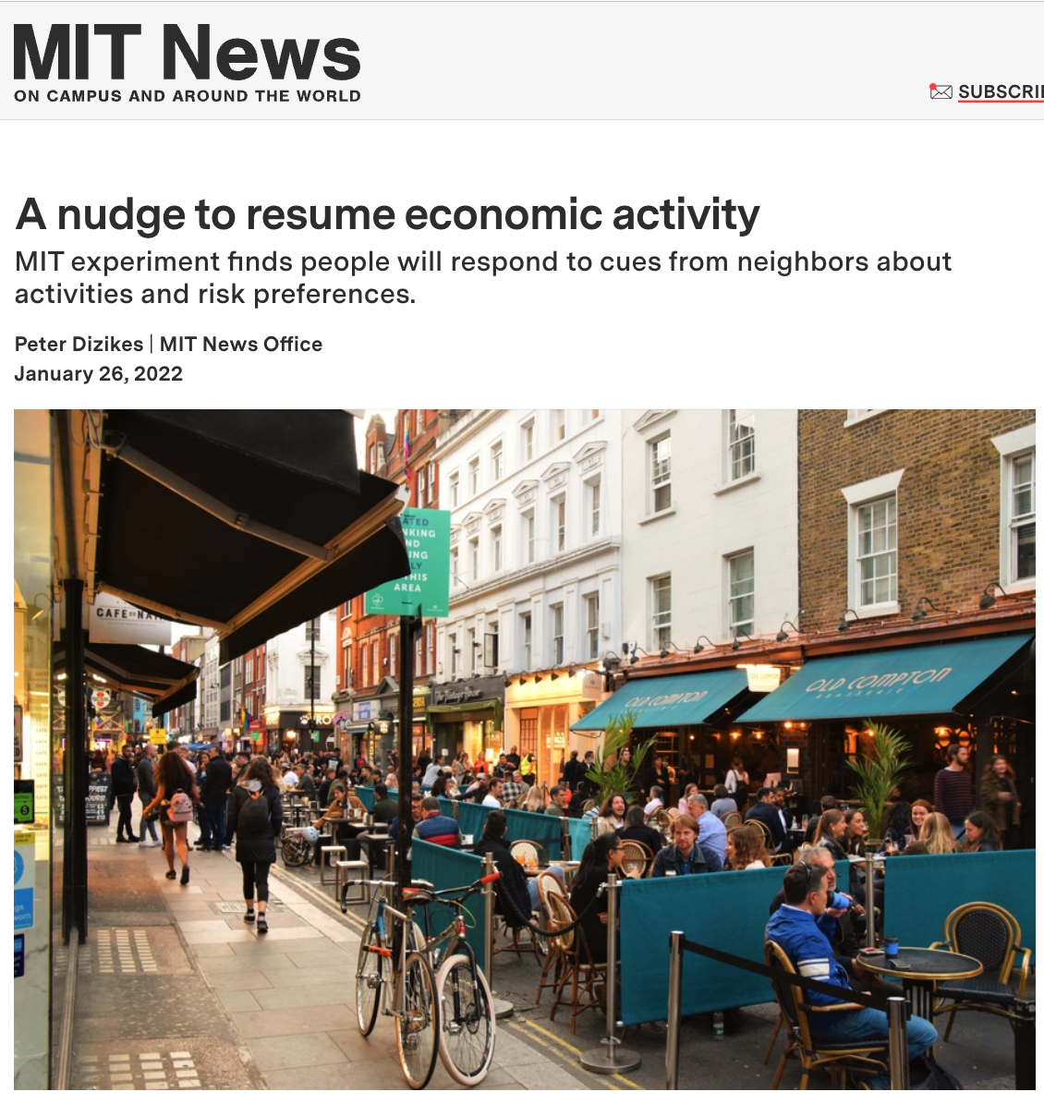
RCT on Healthy-Building’s Impacts
CO₂ = 800 ppm
A
👩🏽
B
👩🏼
VS
CO₂ = 2,000 ppm
Top: © PNAS; bottom: © Massachusetts Institute of Technology. All rights reserved. This content is excluded from our Creative
Commons license. For more information, see https://ocw.mit.edu/help/faq-fair-use/.
Notes:
Source days sick leave: https://onlinelibrary.wiley.com/doi/abs/10.1034/j.1600-0668.2000.010004212.x

Slide 19
Matching: Seeking Apple-to-Apple Comparison
Twins
Geographic matching
Propensity score matching (PSM)
0.2 square miles
20,801 observations
1,943 clusters
Cluster 1
Cluster 3
Cluster 2

Slide 20
How to make an “Apple-to-Apple” comparison?
Fruit photos © source unknown. All rights reserved. This content is excluded from our Creative Commons license. For more information, see https://ocw.mit.edu/help/faq-fair-use/.
© Massachusetts Institute of Technology. All rights reserved. This content is excluded from our
Creative Commons license. For more information, see https://ocw.mit.edu/help/faq-fair-use/.

Slide 21
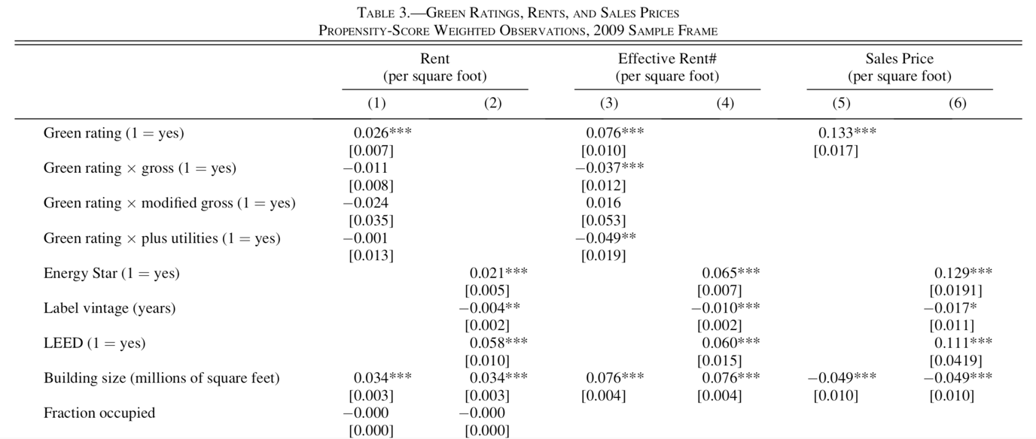
© Massachusetts Institute of Technology. All rights reserved. This content is excluded from our
Creative Commons license. For more information, see https://ocw.mit.edu/help/faq-fair-use/.

Slide 22
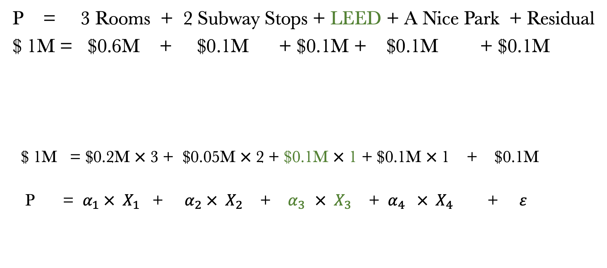
Consider the Bias in Hedonic Model
P = 3 Rooms + 2 Subway Stops + LEED + A Nice Park + Residual
$ 1M = $0.6M + $0.1M + $0.1M + $0.1M + $0.1M
$ 1M = $0.2M $×$ 3 + $0.05M $×$ 2 + $0.1M $×$ 1 + $0.1M $×$1 + $0.1M
P = $α_{1} × X_{1}$ + $α_{2} × X_{2}$ + $α_{3 } × X_{3}$ + ${ α}_{4} × X_{4}$ + $ε$
Input
Output
(R²= 83%)

Slide 23
Consider the Bias in Hedonic Model
P = 3 Rooms + 2 Subway Stops + LEED + A Nice Park + Residual
fancy
correlated
If we can observe and measure “fancy”:
$ 1M = $0.6M + $0.1M + $0.1M + $0.1M + $0.05M + $0.05M
If we cannot observe and measure “fancy”, and “LEED = fancy” (extreme case):
$ 1M = $0.6M + $0.1M + $0.1M + $0.05M + $0.1M + $0.05M
Overestimate → $0.15M

Slide 24
“Apple-to-Apple” Comparison
LEED Building
Treatment effect of LEED
(Green Premium)
$0.1M
$ 1 M
$0.9M
$ 0.85 M
Counterfactual
Brown Building
Bias $0.05M
$ 0.15 M ← Green Premium?

Slide 25
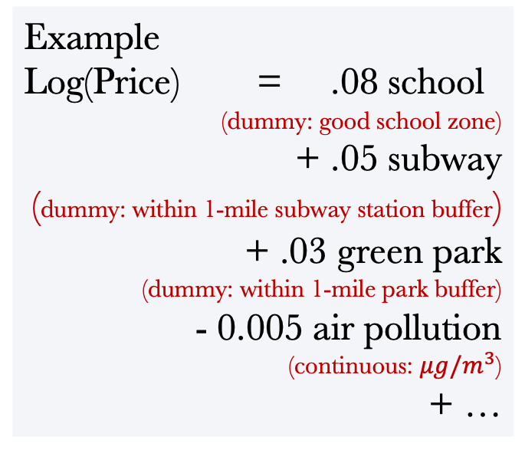
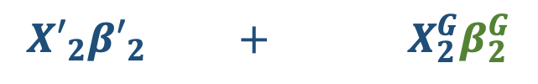
Pricing Green Amenities: Within-City
Again, Hedonic Model
$$Log\left(Price_{ijt}\right)=X_{1i}β_{1}+X_{2j}β_{2}+U_{ijt}$$
Example
Log(Price) = .08 school
(dummy: good school zone)
+ .05 subway
(dummy: within 1-mile subway station buffer)
+ .03 green park
(dummy: within 1-mile park buffer)
- 0.005 air pollution
(continuous: $μg/m^{3}$)
+ …
$${X′}_{2}{β′}_{2} + X_{2}^{G}β_{2}^{G}$$
WTP for 1 extra unit of an amenity
Other locational attributes:
- School
- Transit
Restaurants
……
Green Amenities:
- Green Space
- Clean Air
- Walkability
Health Facilities
……
Notes:
Move to green amenities.
Decomposition of real estate value to land value (location) and structure value. Sometimes the former is 50%.

Slide 26
Siqi’s Research
Zheng , S., & Kahn, M. E. (2008). Land and residential property markets in a booming economy: New evidence from Beijing. Journal of Urban Economics, 63(2), 743-757.
  Research Question: To present new evidence on real estate price gradient (and land price gradient) with respect to various location attributes and local public goods in Beijing’s nascent free housing market.
  Data: Pooled cross-sectional housing transactions and land sales.
Notes:
“

Slide 27
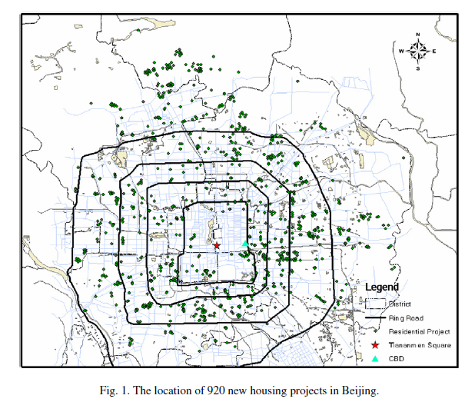
Dependent variable 1: housing prices
Courtesy of Elsevier, Inc., https://www.sciencedirect.com. Used with permission.
Notes:
“

Slide 28
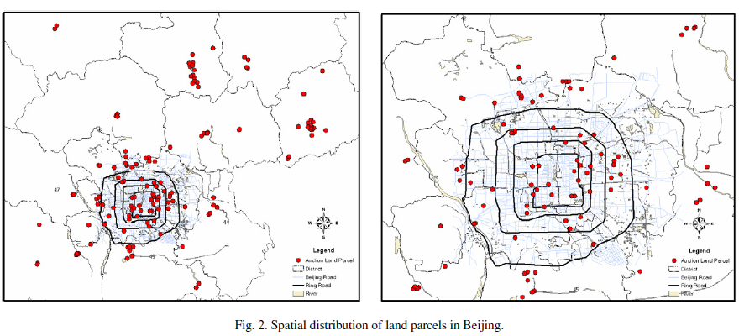
Dependent variable 2: land prices
Courtesy of Elsevier, Inc., https://www.sciencedirect.com. Used with permission.
Notes:
“

Slide 29
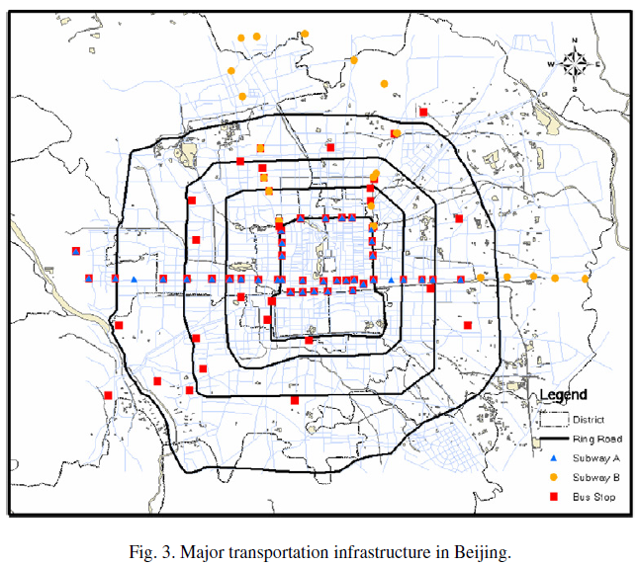
Local public goods: subway and bus stops
Courtesy of Elsevier, Inc., https://www.sciencedirect.com. Used with permission.
Notes:
“

Slide 30
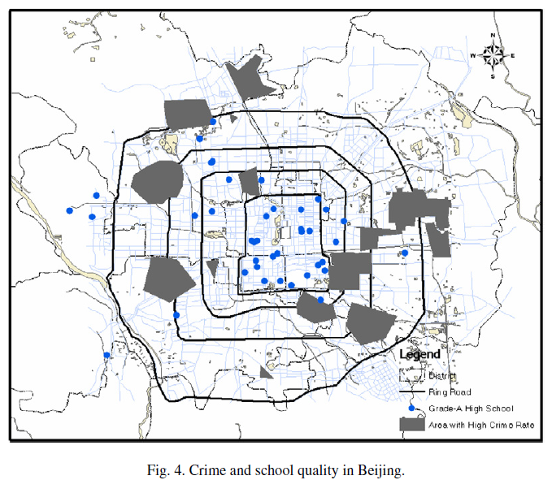
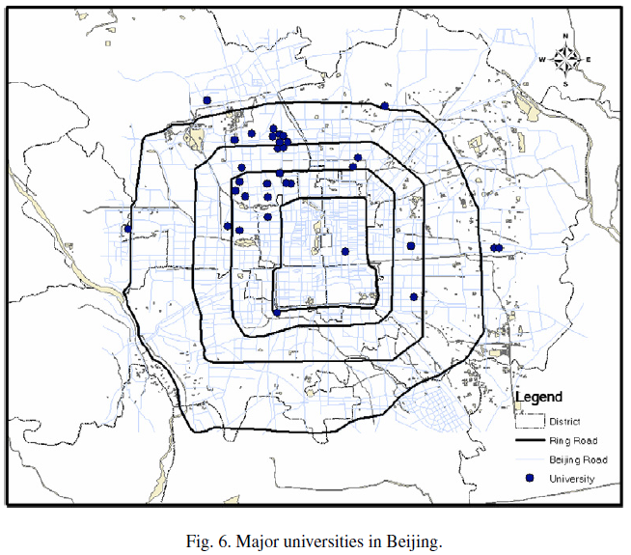
Local public goods: crime, school, university
© Elsevier B.V.. All rights reserved. This content is excluded from our Creative
Commons license. For more information, see https://ocw.mit.edu/help/faq-fair-use/.
Notes:
“

Slide 31
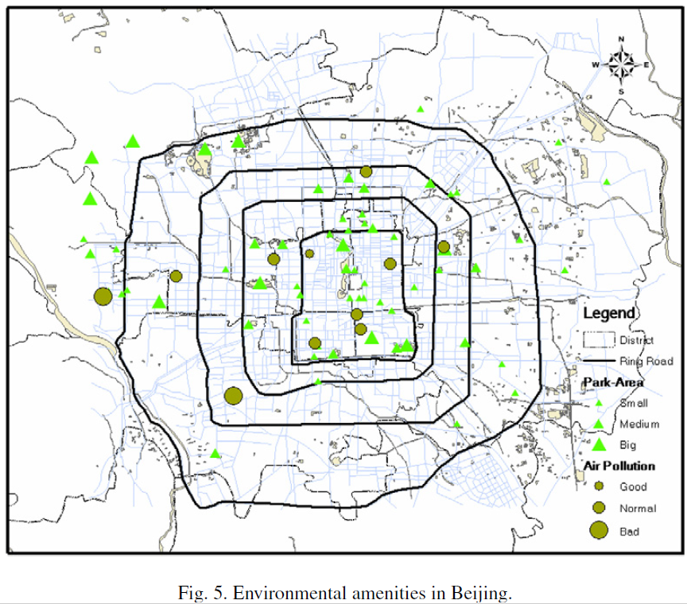
Local public goods: environmental amenities
© Elsevier B.V.. All rights reserved. This content is excluded from our Creative Commons license. For more information, see https://ocw.mit.edu/help/faq-fair-use/.
Notes:
“

Slide 32
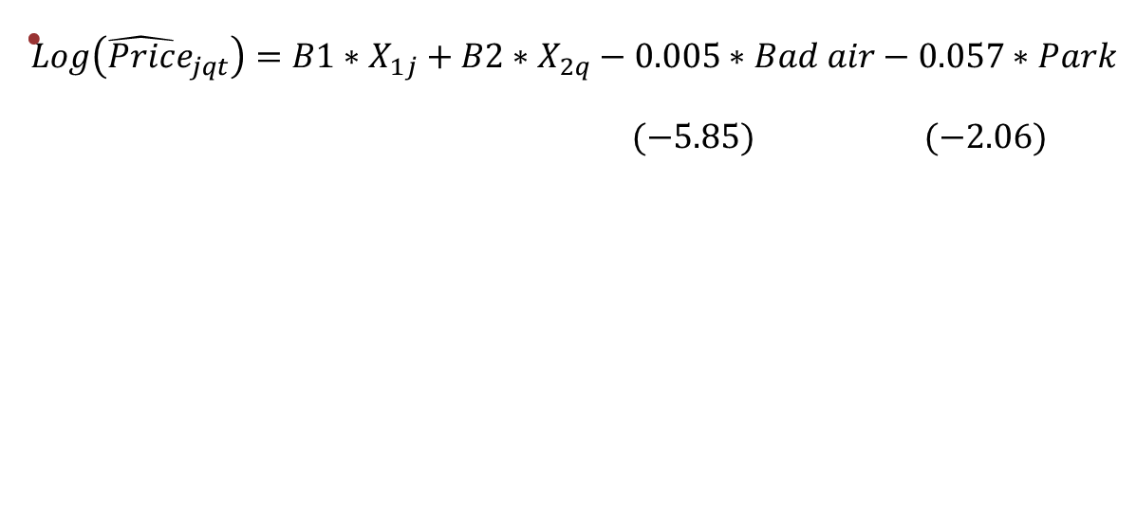
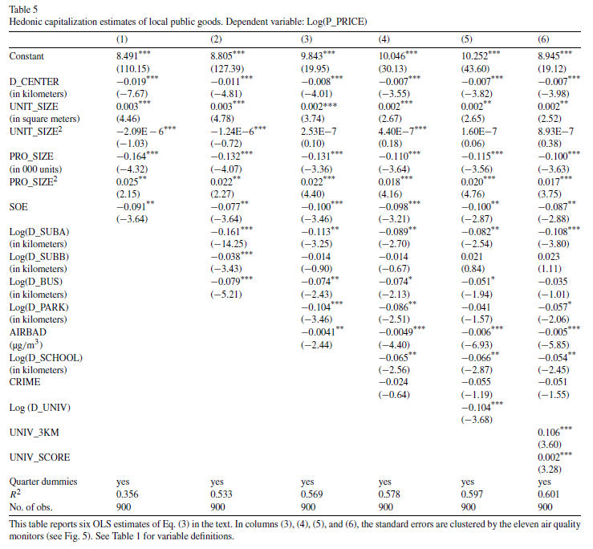
Pricing Green Amenities: Within-City
Environmental amenities are important set of local public goods.
proximity to fast public transit, clean air, high-quality schools, major universities, and environmental amenities are capitalized into real estate prices.
A 10 microgram per cubic meter increase in PM10 reduces home prices by 5%
© Elsevier B.V.. All rights reserved. This content is excluded from our Creative
Commons license. For more information, see https://ocw.mit.edu/help/faq-fair-use/.
Notes:
“

Slide 33
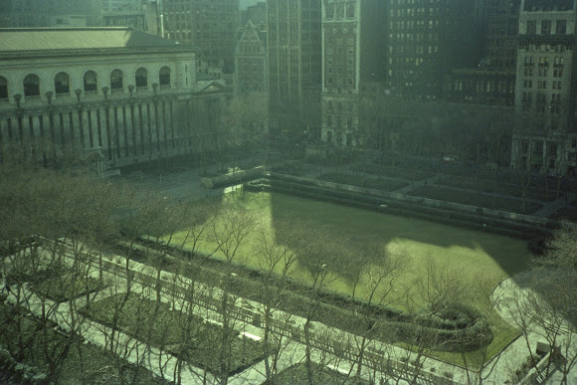
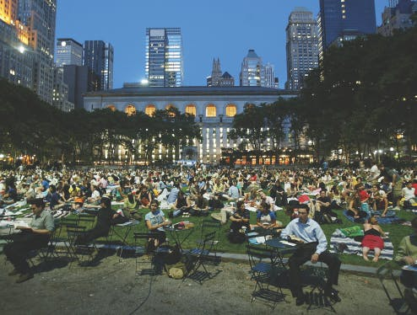
Hedonic Method in Business Decision
Bryant Park and W. R. Grace Building, 1980s – 2000s, NYC
© source unknown. All rights reserved. This content is excluded from our Creative Commons license. For more information, see https://ocw.mit.edu/help/faq-fair-use/.
This image is in the public domain.
1983
2019
Photos: https://livingnewdeal.org/projects/bryant-park-new-york-ny/
https://bryantpark.org/blog/life-of-bryant-bryant-parks-transformation-into-the-center-of-midtown
Notes:
Hedonic models also explained why the real estate industry could and should invest in parks and open spaces.
A dilemma of green amenities such as parks and open spaces is that: developers and property owners anticipate benefits for private properties, yet public resources to create and operate these spaces are limited. In fact, many large U.S. cities have a substantial backlog in deferred maintenance for parks.
Increasingly, owners and developers are filling the gap by building, operating, or funding open spaces, inspired by some famous examples such as the Bryant Park in midtown Manhattan.
By 1979, New York seemed to have given up Bryant Park for lost as an urban amenity, as well as an historic site. Bryant Park by then was a site with active drug trade, crime, a persistent urine odor and overflowing trash cans.
In 1980 a group of civic-minded New Yorkers, property owners, and neighbors decided to rescue the park, and set up the Bryant Park Restoration Corporation. They spent seven years negotiating with the New York City Department of Parks and Recreation before they succeeded in getting a 15-year lease, which began in 1988. (The lease was subsequently renewed for another five years.) The BPRC immediately closed the park for five years of rebuilding.
After Bryant Park was completed and reopened in 1992, the park renovation and its new management structure had created a strong amenity for the local office market. Today, the park boosts a winter marketplace, summertime film series, singles bars and fitness programs.
The owners of the W. R. Grace Building across the street, invested $3 million in the park that was part of a private renovation program. In return, Building saw asking rents climbing from $35 to $75/SF from 1990 to 2002, which was increased by 114%. The rate far outperformed surrounding submarkets Times Square, Grand Central, and Rockefeller markets, which increased by 40~70% in the same period.
The high demand for office space in the building also represented in its 100% leased space as of April 2002. As better tenants moved in, the credit profiles of buildings improved, and market value of real estate increased.
In total, the renovated park has associated with Grace Building’s $19.5 million increase in annual rental revenue and $216 million building valuation increase.
No public money has been spent on the park since 1996. Taxpayers aren’t footing the bill for the park’s $4 million annual budget, which is all privately raised. To date, over 590 Privately Owned Public Spaces (POPS) have been built at over 380 buildings across New York City. These public spaces are primarily located in Manhattan, but are increasingly being developed in the other boroughs, particularly Brooklyn and Queens, as the commercial office markets expand. Combined, POPS provide over 3.8 million square feet of additional public space in the City – equivalent to roughly nine Bryant Parks or Union Squares.

Slide 34
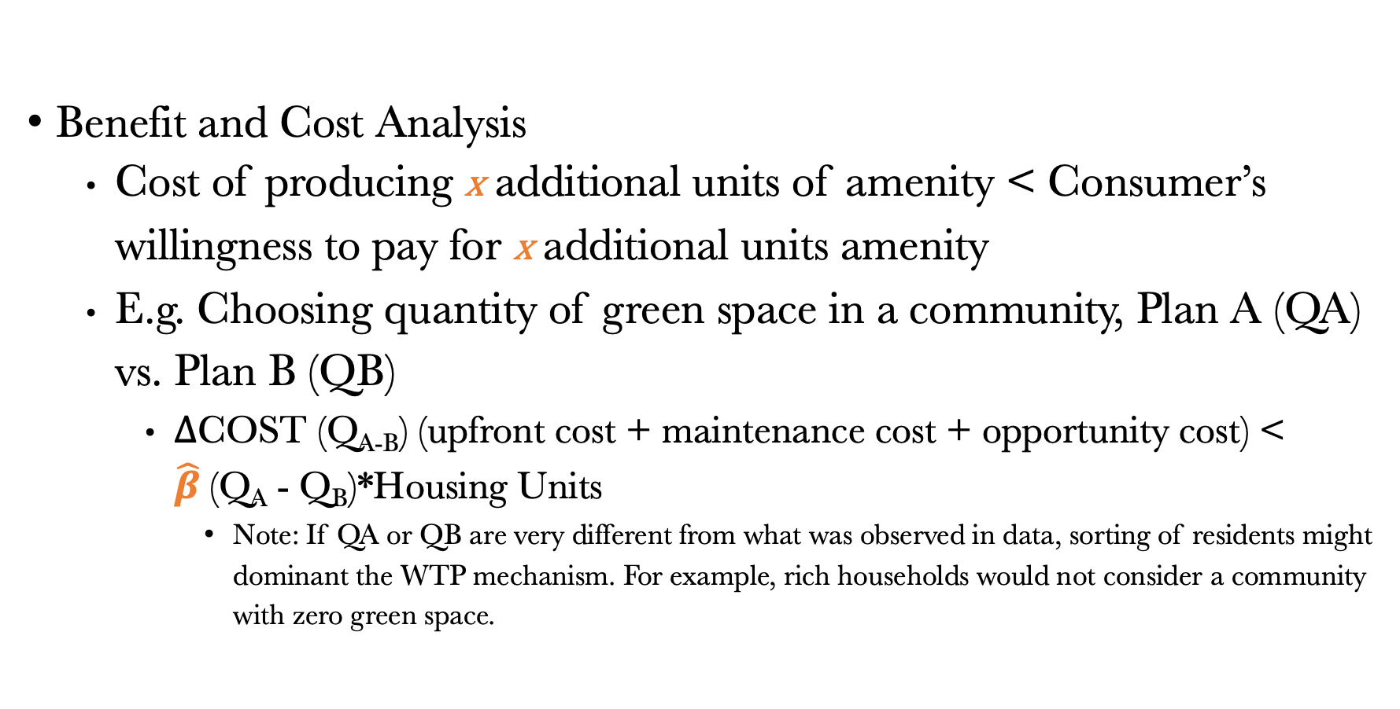
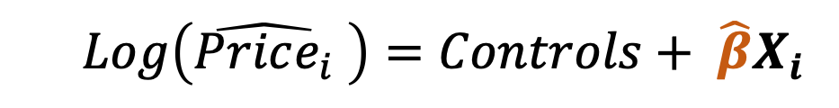
Hedonic Method in Business Decision
  $$Log\left(\hat{Price_{i}} \right)=Controls+ {\hat{β}X}_{i}$$
Benefit and Cost Analysis
  Cost of producing x additional units of amenity < Consumer’s willingness to pay for x additional units amenity
  E.g. Choosing quantity of green space in a community, Plan A (QA) vs. Plan B (QB)
    $Δ$COST (Q_{A-B}) (upfront cost + maintenance cost + opportunity cost) < $\hat{β}$(Q_{A} - Q_{B})*Housing Units
      Note: If QA or QB are very different from what was observed in data, sorting of residents might dominant the WTP mechanism. For example, rich households would not consider a community with zero green space.
Notes:
After you calculate the benefit, you can compare with the cost and do a BCA.
This is just the very basic rationale to do this.
One subtle point here is “heterogeneous preference” – different population groups have different WTPs. Sorting.

Slide 35
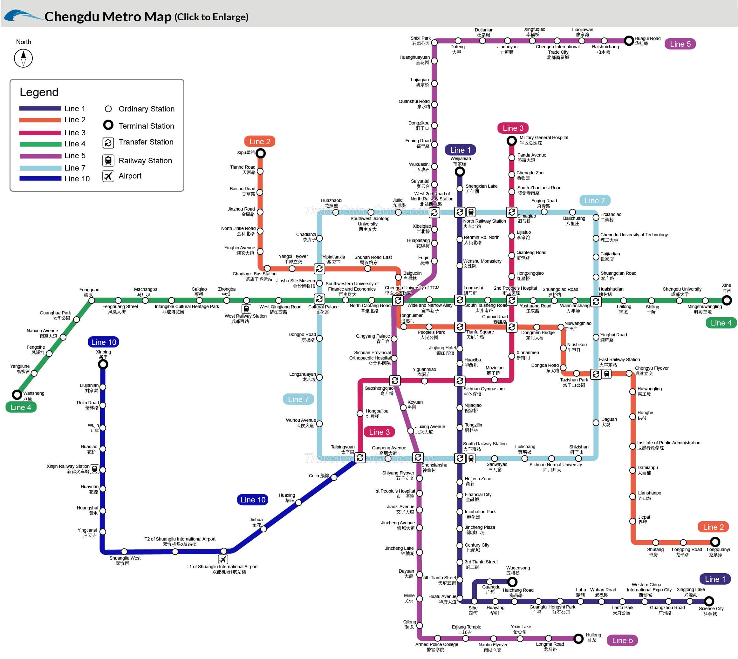
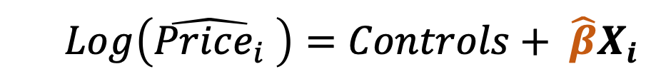
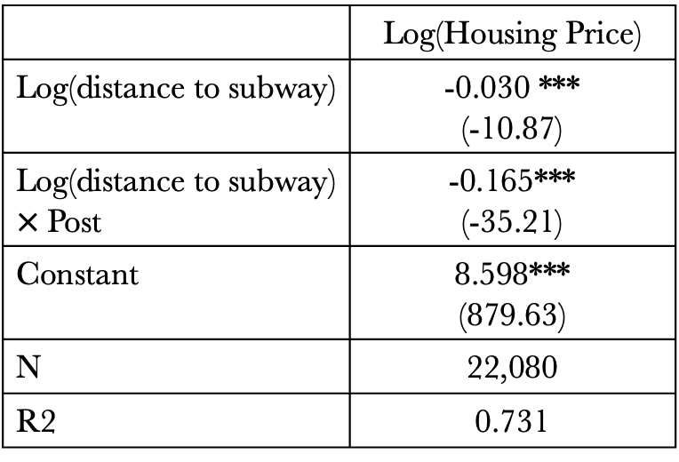
The 1st Subway Line in Chengdu, China
  $$Log\left(\hat{Price_{i}} \right)=Controls+ {\hat{β}X}_{i}$$
 | Log(Housing Price)
Log(distance to subway) | -0.030 *** (-10.87)
Log(distance to subway) $×$Post | -0.165*** (-35.21)
Constant | 8.598*** (879.63)
N | 22,080
R2 | 0.731
Housing price
Distance to subway (km)
-2
0
2
Note: ***p<0.01, ** p<0.05, * p<0.1, t value in brackets.
Map © source unknown. All rights reserved. This content is excluded from our Creative
Commons license. For more information, see https://ocw.mit.edu/help/faq-fair-use/.

Slide 36
Hedonic Method in Infrastructure Decision
Distance (km) | Price premium | Base value (RMB/m2) | House areas (hectare) | Total value (billion RMB)
0-0.5 | 14% | 7304.29 | 553.21 | 5.7
0.5-1 | 7.4% | 7304.29 | 583.17 | 3.2
1-1.5 | 7.5% | 7304.29 | 392.29 | 2.1
Total |  |  |  | 10.96
The results indicate building the new subway line in Chengdu can generate $11B RMB benefit, measured by people’s increased willingness to pay for the houses close to stations.
Government can thus think about a tailored “value capture” mechanism to recover the infrastructure cost from nearby real estate developers.

Slide 37
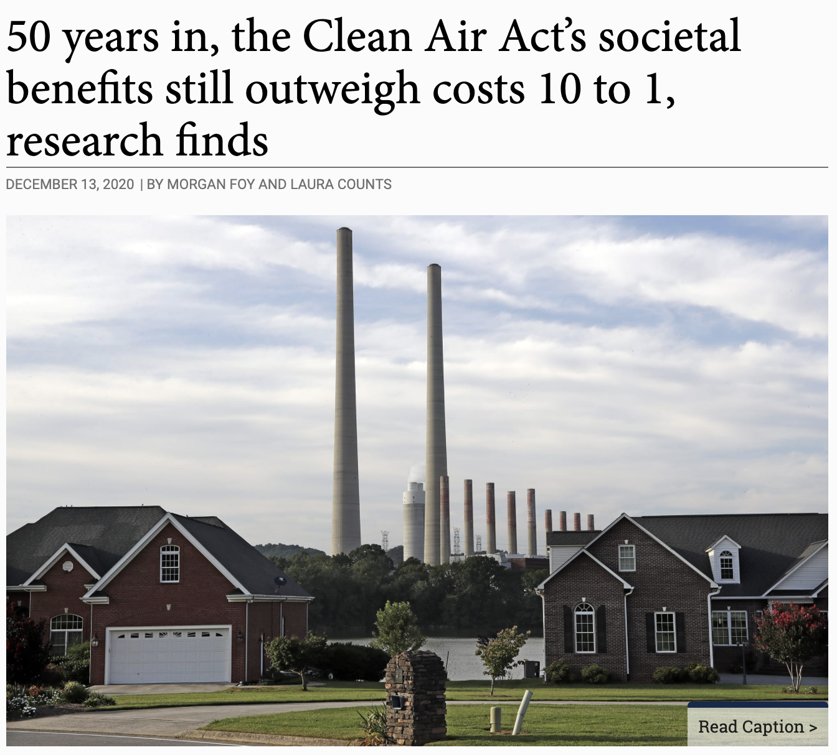
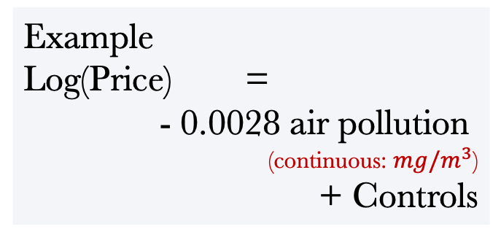
Hedonic Method to Support Policy Making: Clean Air Act
Example
Log(Price) =
- 0.0028 air pollution
(continuous: $mg/m^{3}$)
+ Controls
19 million homes in non-attainment counties, Average home value = $86,900 (1970, in 2001 $)
10 units reduction in TSP -> $2,400 value increase per home
Total WTP = $45 billion
Larger tax base → higher property tax
Image © UC Regents. All rights reserved. This content is excluded from our Creative
Commons license. For more information, see https://ocw.mit.edu/help/faq-fair-use/.
Notes:
Benefit-Cost-Analysis (BCA) The 1970 Clean Air Act
The property value calculation based on hedonic models can also be used for large-scale policy analysis. The dynamics in property price over time and cross places help policy makers to infer the value of some public goods that people cannot directly observe market price. For example, hedonic methods are widely used to evaluate air quality policies, such as the Clean Air Act.
Before 1970, the responsibility of regulating air pollution was primarily put on state governments. In the absence of federal legislation, few states found it in their interest to impose strict regulations on polluters within their jurisdictions. Concerned with the detrimental health effects of persistently high concentrations of total suspended particulates(TSPs) and other air pollutants, Congress passed the Clean Air Act Amendments (CAAAs) of 1970.
The centerpiece of the CAAAs is the establishment of the National Ambient Air Quality Standards, for five pollutants. On a yearly basis, EPA assigns each county to either nonattainment or attainment status for each of the pollutants, based on whether the relevant standard is exceeded. The federal TSPs standard is violated if either of two thresholds is exceeded: (1) the annual geometric mean concentration exceeds 75mg/m3, or (2) the second-highest daily concentration exceeds 260mg/m3.
In nonattainment counties, states are required to develop plant-specific regulations for every major source of pollution. The1977 amendments added the requirement that any increase in emissions from new investment be offset by a reduction in emissions from another source within the same county. States are also mandated to set emissions limits on existing plants in nonattainment counties. On the contrary, regulations in attainment counties are less stringent, especially on smaller and existing plants.
Due to the regulatory design, most of the air pollutants being regulated, for example ozone, TSPs and SO2 concentrations declined more in counties that were nonattainment counties than in attainment counties.
Taking advantage of the difference in air quality improvement cross attainment and nonattainment counties, scholars have used the hedonic model to evaluate the value of clean air captured in local properties.
From the hedonic model, each unit of TSPs reduction was capitalized into property values at a rate of about 0.28 percent ($\hat{β}$). Using the average reduction at around 10-unit in mean TSPs in nonattainment counties, and the average value of a house in mid-decade non-attainment counties in 1970 was $86,900 (in 2001 dollars), mean housing values increased by roughly $2,400 in these counties. There were about 19 million houses in these nonattainment counties (the Census Bureau’s Public-Use Microdata Samples (PUMS) estimates). Multiplying the average increase in housing value with the total number of households implies that the WTP for the reductions in TSPs is approximately $45 billion in late 1970s.
This figure is useful for local governments, since it provides a monetary measure of the local benefits of regulation. It is easy for the government to calculate the new tax base from increasing properties values. In a short-run cost-benefit analysis, the government can also compare this gain with the loss in tax when polluting plants shutted down or reduced scale of production. When taking societal gains such as lower mortality into consideration, the benefits outweigh cost about 10 to 1 according to Berkeley researchers.
References:
https://newsroom.haas.berkeley.edu/research/50-years-in-the-clean-air-acts-societal-benefits-still-outweigh-costs-10-to-1-research-finds/
https://www.epa.gov/clean-air-act-overview/benefits-and-costs-clean-air-act-1990-2020-second-prospective-study

Slide 38
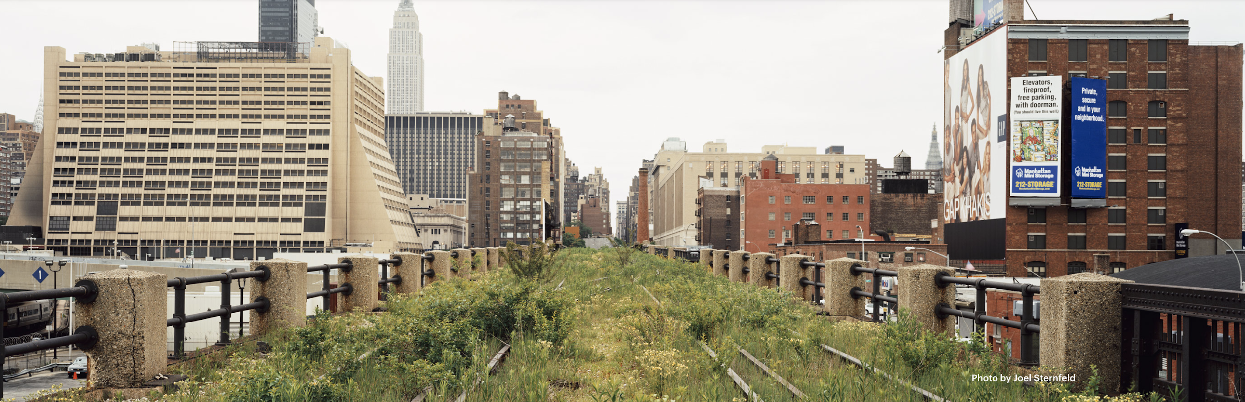
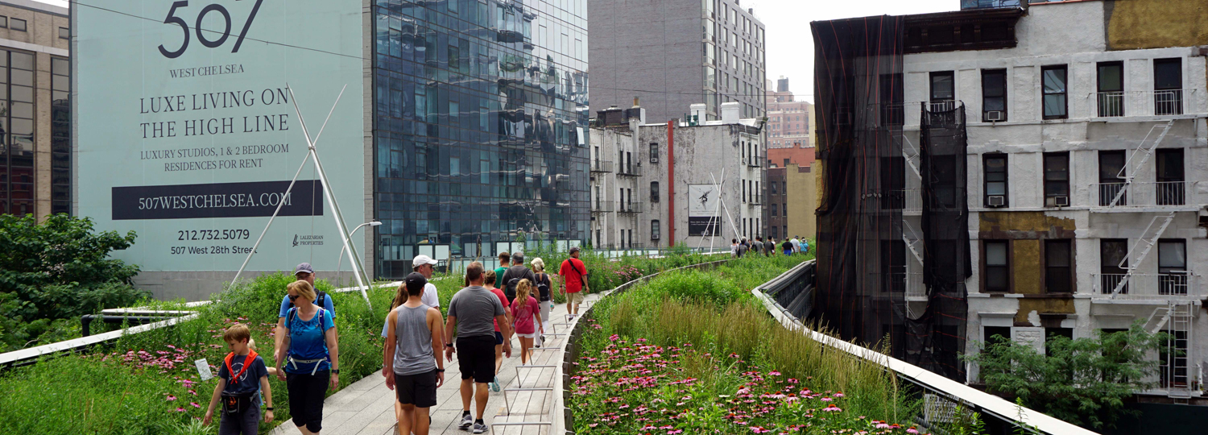
Environmental Gentrification
Top photo © Joel Sternfeld; bottom photo © DETAIL. All rights reserved. This content is excluded from
our Creative Commons license. For more information, see https://ocw.mit.edu/help/faq-fair-use/.
WTP
Rich households have higher WTP
Poor households have lower WTP
Occupied by the rich
Occupied by the poor
D*
Green Amenity
The High Line Park
(West Chelsea, Manhattan)
Notes:
Urban greening projects can set off rounds of gentrification, dramatically altering housing opportunities and communities--A famous case of such kind is the High Line Park in the West Chelsea of Manhattan promoted by former Mayor Bloomberg around 2005.
Before then, West Chelsea was home to a mix of working-class residents, a handful of meatpacking places, and light-industrial businesses. The neighborhood was nicknamed as “gasoline alley” for decades, for its clustered auto-related establishments such as garages and auto repair shops. In the early 2000s, surrounding residential properties were valued 8 percent below the overall median for Manhattan.
The High Line changed all that. The fancy park above the hubbub soon became a must-to-see for tourists. Opened the first phase in 2009, in 2011, the park attracted 3.7 million visitors, and only half of them New Yorkers. Glass-clad high-rises, trendy hotels and design boutiques began rising up alongside the park.
Between 2003 and 2011, property values near the park increased 103 percent. Neighborhood mainstays were priced out. Bear Auto Shop was out after decades; the Olympia parking garage, after 35 years, closed when its rent reportedly quintupled. Brownfeld Auto, on West 29th Street near 10th Avenue, lost its lease after nearly a century. Today it’s still a hole in the ground. Its third-generation owner, Alan Brownfeld, blamed the High Line for taking away the thriving business he’d inherited from his grandfather. Once-thriving restaurants like Hector’s diner, a local favorite since 1949, have lost their customer base.
The effects of the High Line could go beyond affordability. Brands such as Stella McCartney (This retailer of the designer's luxe women's fashions & accessories, 4-min walk from the High Line), complained that they can’t compete with global chains like Sephora, which are muscling into the area’s commercial space.
The ecosystem was pushed to a new equilibrium: The high rises for the elite, along with a few exclusive locales like the Standard Hotel. Chain stores and tourist-friendly restaurants will cater to the crowds of passers-by and passers-through.
Some environmental activists and scholars (Winifred Curran and Trina Hamilton) have created the term “just green enough”. It’s the notion of making a neighborhood more livable without triggering gentrification. One of the “just green enough” examples the community used a lot is the Newtown Creek Nature Walk in Greenpoint, Brooklyn. The small park sits between the creek and a sewage treatment facility, and it consists largely of concrete paths. Some critics dubbed it “the ironic nature walk.” Nevertheless, the modest park is popular with residents but not a draw for tourists or other neighborhood newcomers.

Slide 39
Fruit photos © source unknown. All rights reserved. This content is excluded from our
Creative Commons license. For more information, see https://ocw.mit.edu/help/faq-fair-use/.

