Slide 1
Lecture E3
The Economics of Healthy Buildings
The role of buildings in shaping human health
Juan Palacios
Feb 2023
(MIT Center for Real Estate)
Notes:
In lecture 1, the focus is on the cash flow of green building so that students can understand the key stakeholders involved in this market and the financial value of green building for each stakeholder.
In the next lecture, we will lead the students to think about three most important market failures existed in the green building market (information failure, externality, and split incentive) and how public and private sectors work together to address these problems.

Slide 2
Triple Bottom Lines
People
(Social)
Profit
(Economic)
Planet
(Environmental)
Lecture today
bearable
profitable
sustainable
viable
Notes:
To re-cap: (1) Planet: we are responsible (36%, 39%), we are the “target” (NYC, even 70%, LL97); (2) People: the ultimate goal for us real estate industry is to provide enough and suitable space for live-work-play, cannot just be very tiny rooms with no windows and tight insulation. Also, the turning point in the EKC, is the bottom up demand push. (3) But we cannot only have dream without a sound business strategy. Real estate developers and investors need to make money. Crucial for the private sector (80%).
We know the win-win-win is possible, the intersection is the real sustainability. Shared values. But, due to the capability gap, or market failures, these three bubbles won’t intersect. With good intension, but constrained capability; or with bad intension, “green washing”.

Slide 3
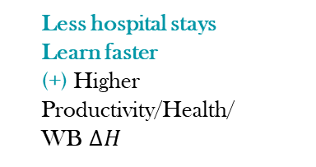

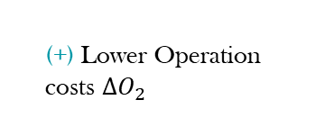


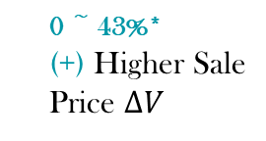

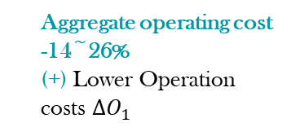
Is There a Business Case for Green Buildings?
Developers
Owners
0 ~ 43%*
(+) Higher Sale Price $∆V$
Rental 0 ~ 17%*
Occupancy 0~23%
(+) Higher
Effective Rent $∆R$
Aggregate operating cost -14~26%
(+) Lower Operation costs $∆O_{1}$
Resale ~10%^{[1]}
(+) Lower depreciation $∆V′$
Benefit
Design/Construction
Sale
Tenancy
Operation
Refurbishment/Acquisition
$$year T$$
Cost
Lower discount rate i (cost of capital)
(+)
Why are tenants willing to pay higher rent for being in a green certified building?
  Lower energy costs and lower operation costs
  Lower environmental damages
  More productive employees
    Employees sick less often than in conventional buildings
    Employees are more productive
Less hospital stays
Learn faster
(+) Higher
Productivity/Health/
WB $∆H$
(+) Lower Operation costs $∆O_{2}$
Operation
Tenancy
Operation
Tenancy
(-) Higher Rent$∆R$
Tenants
Notes:
Resale: [1] Green Mark (GM) system, green premium is 4% for first sale, and increased to 10% for resale. Ref: Deng, Yongheng, and Jing Wu. 2014. “Economic Returns to Residential Green Building Investment: The Developers’ Perspective.” Regional Science and Urban Economics 47 (July): 35–44.

Slide 4
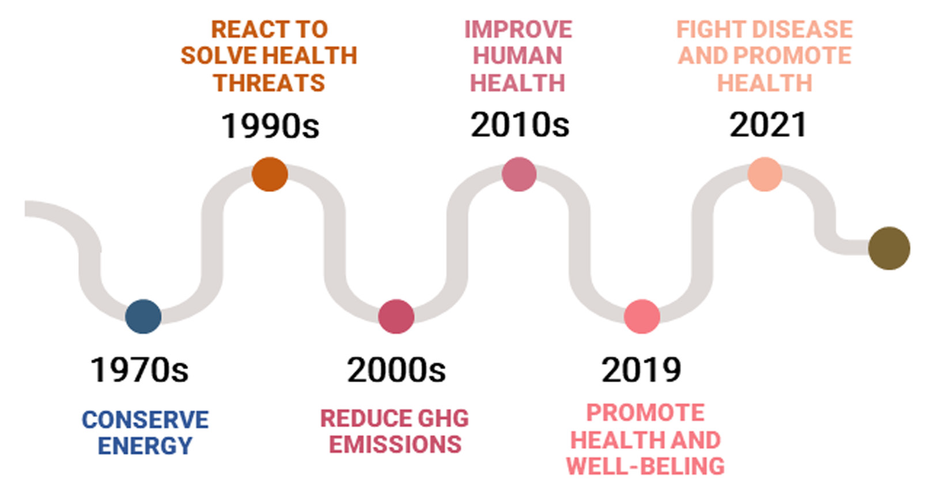
The Roadmap of Green Building Certifications
Figure courtesy of Licina, Wargocki, et al. Used with permission. License: CC BY.
Source: Licina, D., Wargocki, P., Pyke, C., & Altomonte, S. (2021). The future of IEQ in green building certifications. Buildings and Cities, 2(1), pp. 907–927. DOI: https://doi.org/10.5334/bc.148

Slide 5
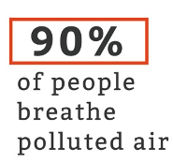
Environment & Health: Air Pollution
Air pollution causes 4.2 million premature deaths worldwide (WHO)
Public domain image courtesy of NASA.
Notes:
https://www.npg-rsp.ch/fileadmin/npg-rsp/Themen-Bibliothek/Fachthemen/Hemp_2004_Presenteeism.pdf
Researchers have also tried to quantify the impact of disease in general on workplace pro- ductivity. Using the same methodology em- ployed to gauge the costs of depression and pain—a yearlong telephone survey of 29,000 working adults, dubbed the American Produc- tivity Audit—Stewart’s research team calcu- lated the total cost of presenteeism in the United States to be more than $150 billion per year. Furthermore, most studies confirm that presenteeism is far more costly than illness- related absenteeism or disability. The two Jour- nal of the American Medical Association studies, for example, found that the on-the-job pro- ductivity loss resulting from depression and pain was roughly three times greater than the absence-related productivity loss attributed to these conditions. That is, less time was actually lost from people staying home than from them showing up but not performing at the top of their game.

Slide 6
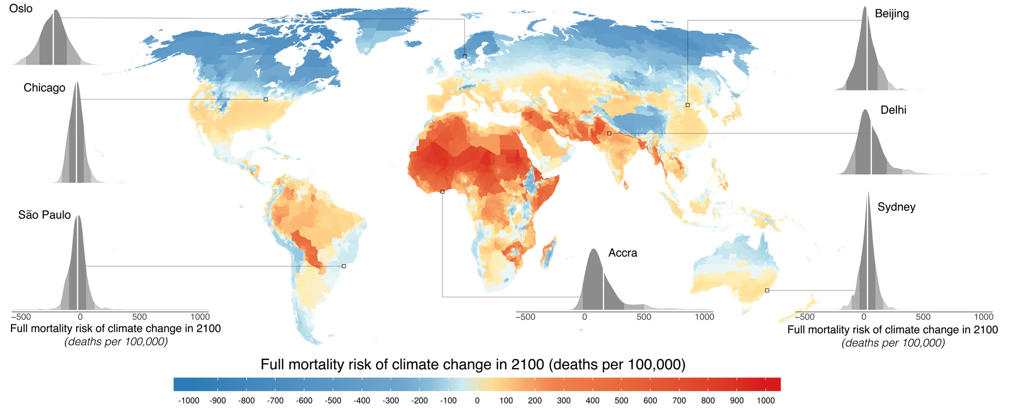
Environment & Health: Heat & Cold
Temperature stress causes 5 million premature deaths a year
© UN Development Programme. All rights reserved. This content is excluded from our Creative
Commons license. For more information, see https://ocw.mit.edu/help/faq-fair-use/.

Slide 7

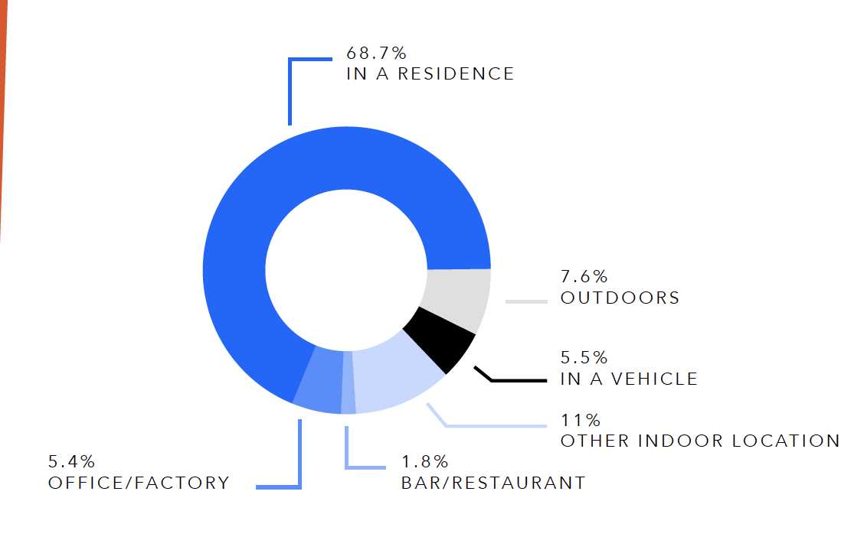
The Role of Buildings: 90% Time Indoors
Source: Klepeis et al. (2001)
Left: Image courtesy of Pixabay. Image free for use under the Pixabay Content License. Right: © Springer Nature Ltd. All rights reserved.
This content is excluded from our Creative Commons license. For more information, see https://ocw.mit.edu/help/faq-fair-use/.
Notes:
https://www.npg-rsp.ch/fileadmin/npg-rsp/Themen/Fachthemen/Hemp_2004_Presenteeism.pdf
Researchers have also tried to quantify the impact of disease in general on workplace pro- ductivity. Using the same methodology em- ployed to gauge the costs of depression and pain—a yearlong telephone survey of 29,000 working adults, dubbed the American Produc- tivity Audit—Stewart’s research team calcu- lated the total cost of presenteeism in the United States to be more than $150 billion per year. Furthermore, most studies confirm that presenteeism is far more costly than illness- related absenteeism or disability. The two Jour- nal of the American Medical Association studies, for example, found that the on-the-job pro- ductivity loss resulting from depression and pain was roughly three times greater than the absence-related productivity loss attributed to these conditions. That is, less time was actually lost from people staying home than from them showing up but not performing at the top of their game.

Slide 8
...and “indoor” isn’t always so great
Source: American Housing Survey

Slide 9
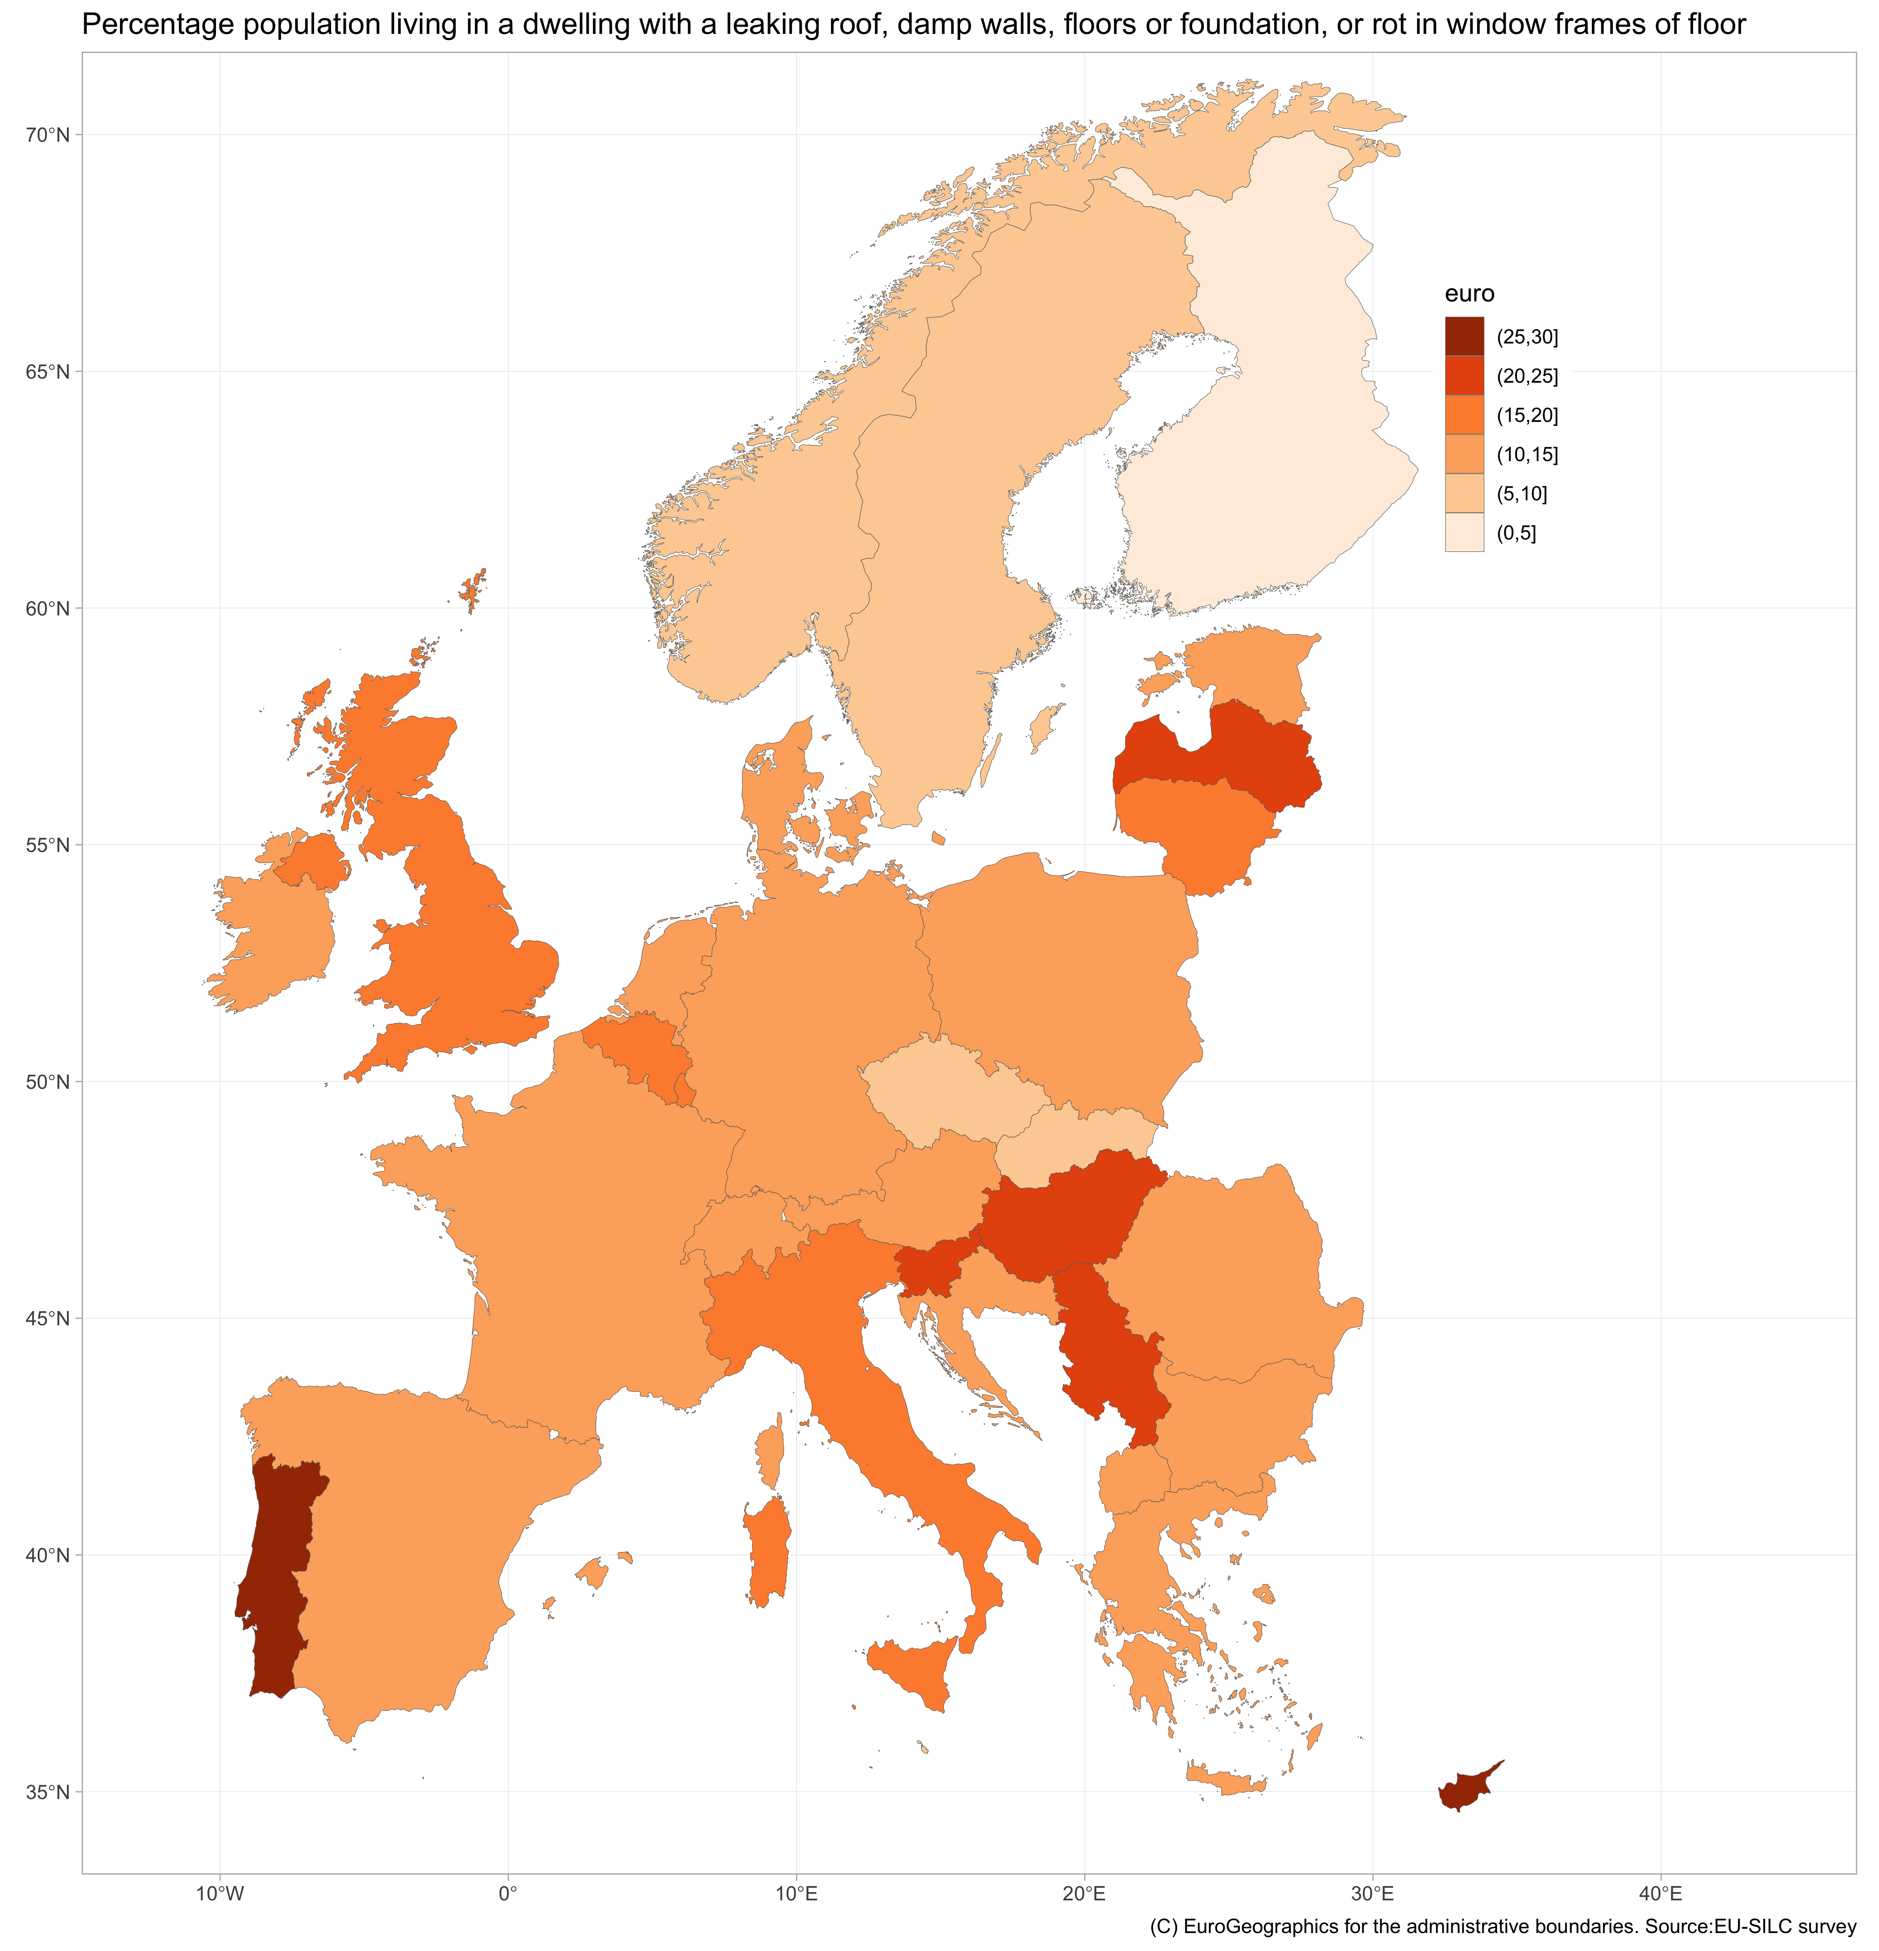
...and “indoor” isn’t always so great
13% of households in the European Union live if deficient dwellings
Energy poverty: ~ 34 million Europeans unable to afford to heat their homes properly (pre Ukraine crisis)
Large body of evidence associating temperature shocks to cardiovascular problems and other risk factors
Putting pressure on health care systems. Rising costs of health care in most OECD countries (~10% GDP)

Slide 10
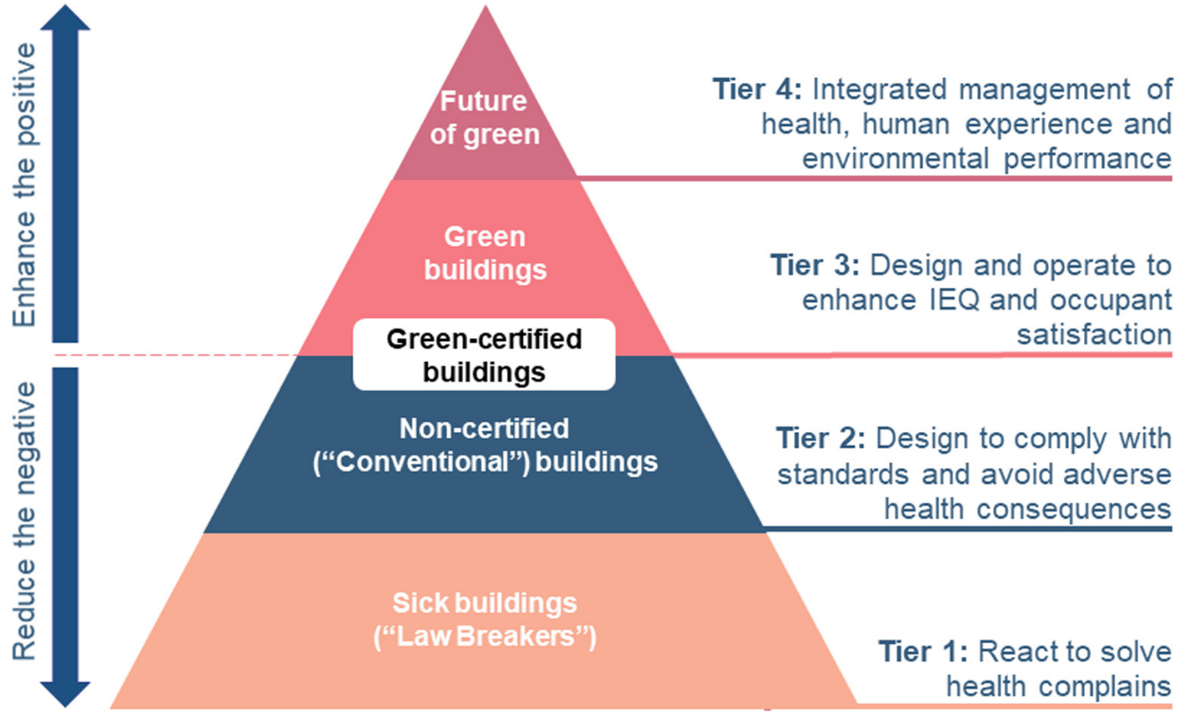
The Roadmap of Green Building Certifications
Health Promotion
Health Promotion
Disease prevention
Source: Licina, D., Wargocki, P., Pyke, C., & Altomonte, S. (2021). The future of IEQ in green building certifications. Buildings and Cities, 2(1), pp. 907–927. DOI: https://doi.org/10.5334/bc.148. Figure courtesy of Licina, Wargocki, et al. Used with permission. License: CC BY.

Slide 11
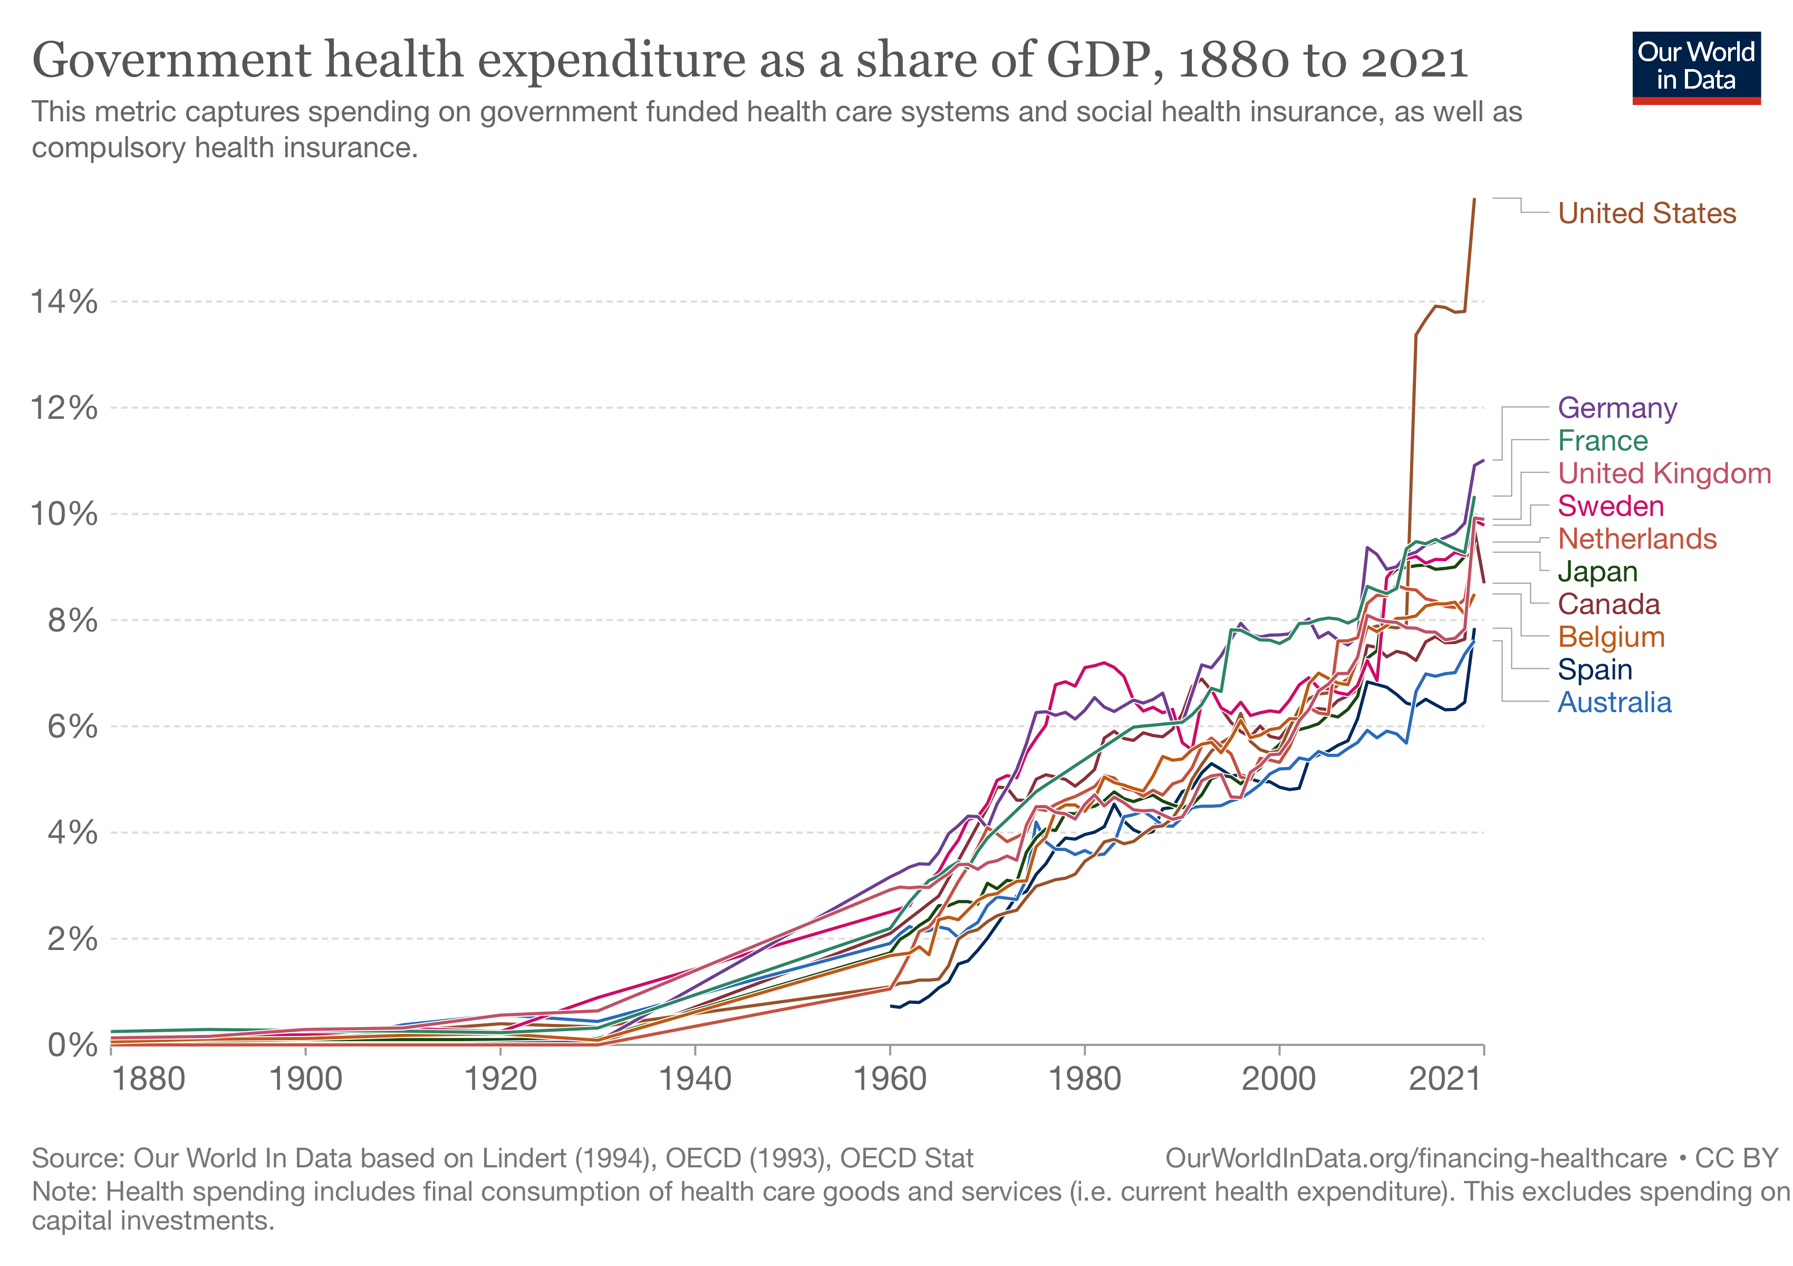
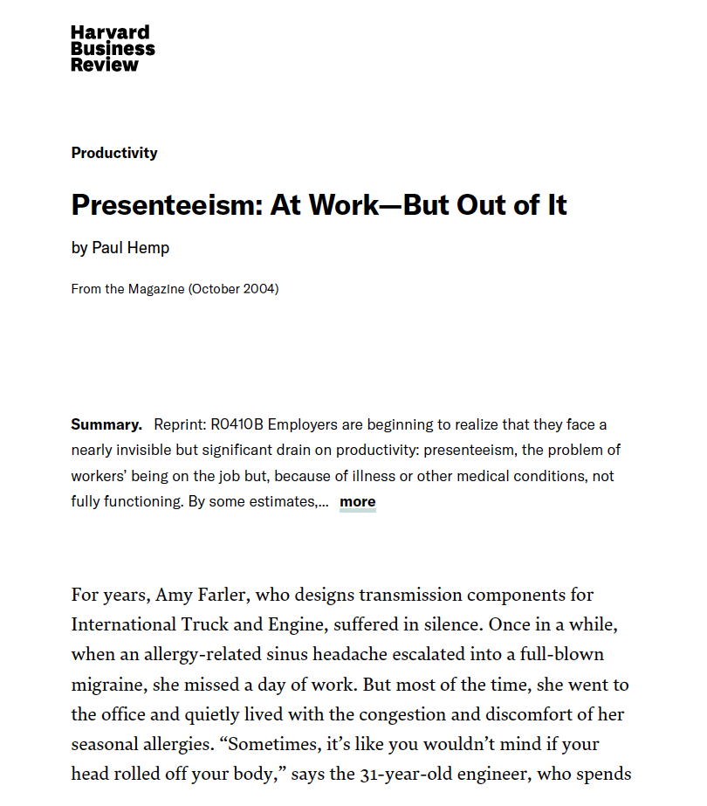
Role of Health for Public Sector and Business
Presenteeism in the United States: +$150 billion/year
Left: Figure courtesy of Our World in Data. License: CC BY. Right: © Harvard Business School Publishing. All rights reserved. This content
is excluded from our Creative Commons license. For more information, see https://ocw.mit.edu/help/faq-fair-use/.
Notes:
https://www.npg-rsp.ch/fileadmin/npg-rsp/Themen/Fachthemen/Hemp_2004_Presenteeism.pdf
Researchers have also tried to quantify the impact of disease in general on workplace pro- ductivity. Using the same methodology em- ployed to gauge the costs of depression and pain—a yearlong telephone survey of 29,000 working adults, dubbed the American Produc- tivity Audit—Stewart’s research team calcu- lated the total cost of presenteeism in the United States to be more than $150 billion per year. Furthermore, most studies confirm that presenteeism is far more costly than illness- related absenteeism or disability. The two Jour- nal of the American Medical Association studies, for example, found that the on-the-job pro- ductivity loss resulting from depression and pain was roughly three times greater than the absence-related productivity loss attributed to these conditions. That is, less time was actually lost from people staying home than from them showing up but not performing at the top of their game.

Slide 12
Learning Outcomes
  The bottom line in healthy building investment strategies:
    Impacts on occupant health and productivity
    The role of health in tenants’ income statements
  Owner and developer perspective on healthy building strategies:
    Barriers to adoption
    Life cycle analysis of healthy buildings
  Healthy & green buildings
Notes:
To re-cap: (1) Planet: we are responsible (36%, 39%), we are the “target” (NYC, even 70%, LL97); (2) People: the ultimate goal for us real estate industry is to provide enough and suitable space for live-work-play, cannot just be very tiny rooms with no windows and tight insulation. Also, the turning point in the EKC, is the bottom up demand push. (3) But we cannot only have dream without a sound business strategy. Real estate developers and investors need to make money. Crucial for the private sector (80%).
We know the win-win-win is possible, the intersection is the real sustainability. Shared values. But, due to the capability gap, or market failures, these three bubbles won’t intersect. With good intension, but constrained capability; or with bad intension, “green washing”.

Slide 13
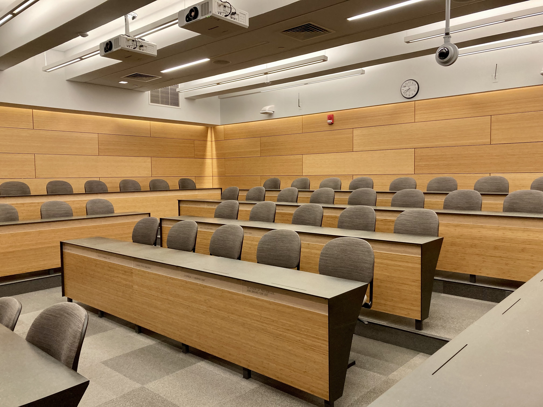
Healthy-Building Strategies
What can MIT CRE do to this classroom to promote health and performance of students?
Notes:
Source days sick leave: https://onlinelibrary.wiley.com/doi/abs/10.1034/j.1600-0668.2000.010004212.x

Slide 14
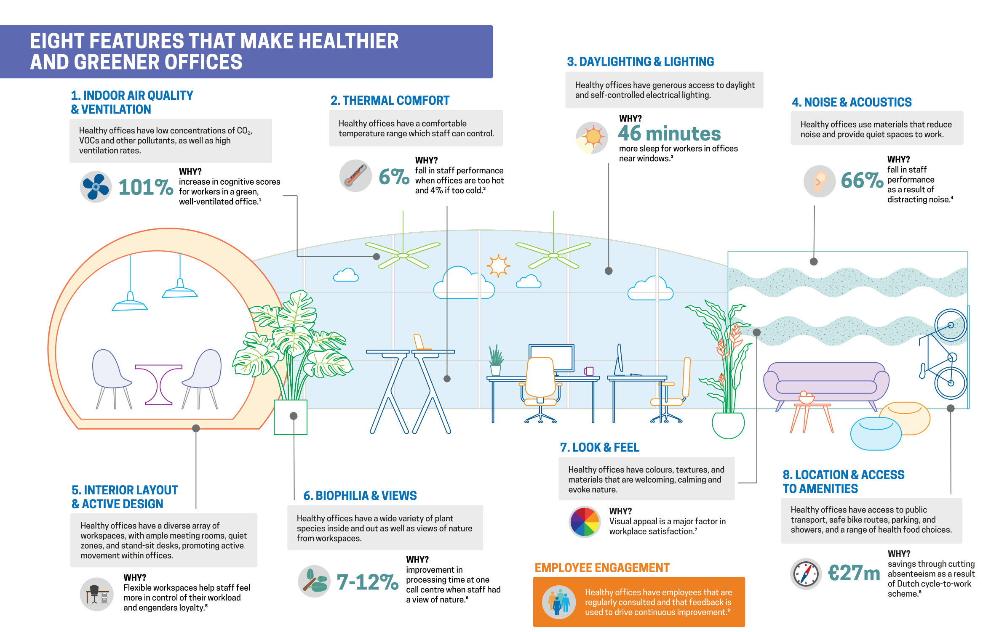
Healthy-Building Strategies
© World Green Building Council. All rights reserved. This content is excluded from our
Creative Commons license. For more information, see https://ocw.mit.edu/help/faq-fair-use/.
Source WGBC (2016). BUILDING THE BUSINESS CASE: Health, Wellbeing and Productivity in Green Offices
Notes:
Source days sick leave: https://onlinelibrary.wiley.com/doi/abs/10.1034/j.1600-0668.2000.010004212.x

Slide 15
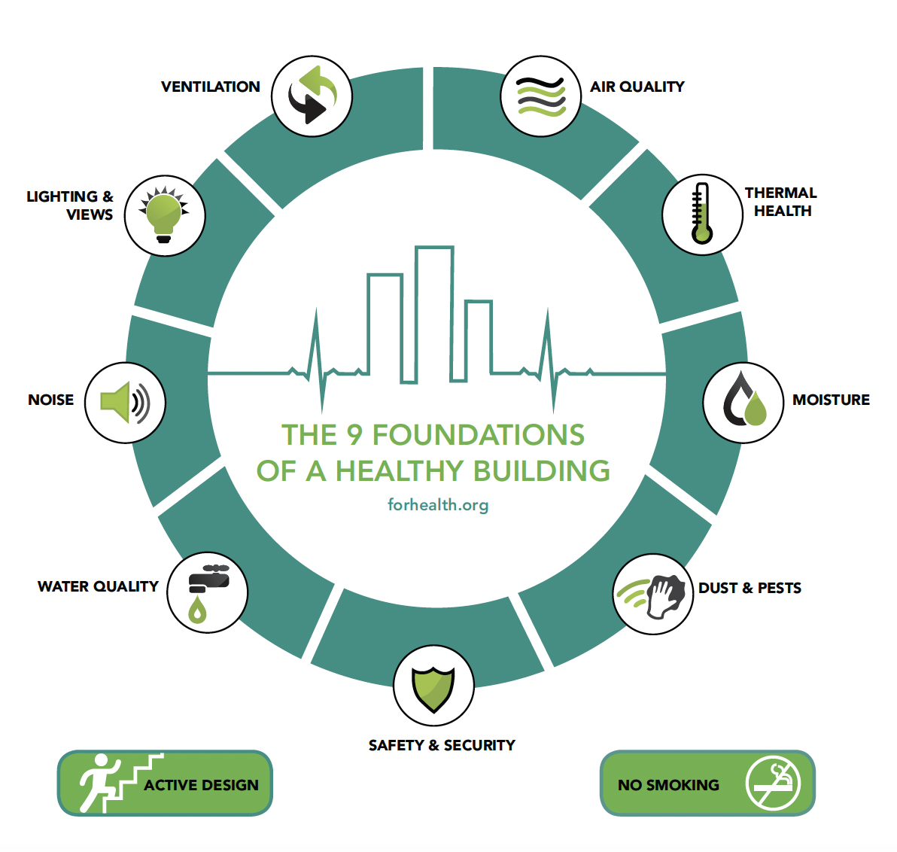
Healthy-Building Strategies
9 foundations of healthy buildings (link here) ©2023 For Health. All rights reserved. This content is excluded from our Creative Commons license. For more information, see https://ocw.mit.edu/help/faq-fair-use/.
Notes:
Source days sick leave: https://onlinelibrary.wiley.com/doi/abs/10.1034/j.1600-0668.2000.010004212.x

Slide 16
Concentration of Environmental Threat(s)
Duration of Exposure
Frequency of Exposure
Evaluating Impact Healthy Building Strategies
What influences the appearance of meaningful/costly health impacts in buildings?
(1) Assessment:
Measurement of
environmental hazards
Evaluating exposure against
industry standards
(2) Attribution:
Occupancy measurements:
  How long and how often are occupants exposed?
Establishing fair comparison groups: “Apple to apple” comparisons
Notes:
The left side (assessment) is comparable to the analysis of energy efficiency investments.

Slide 17
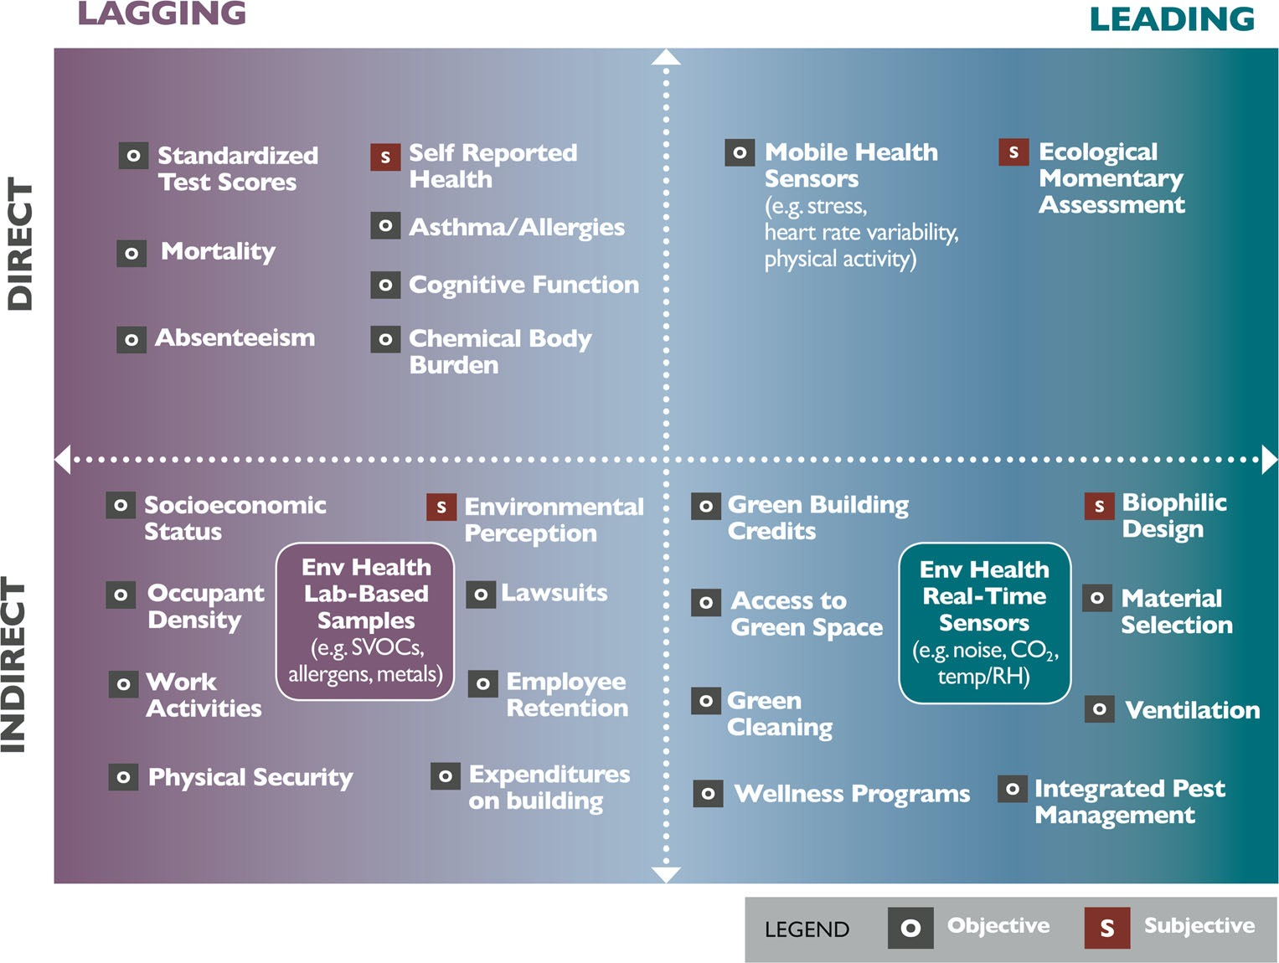
Assessment: Smart & Healthy Buildings
Sensor technology and the increase in digitalization of buildings give us the opportunity to create the data to evaluate interventions
  Data from buildings: Indoor environmental quality sensors
  Data from people: Wearables, surveys, movement sensors, smartphone data, …
How do we design studies to evaluate impacts of healthy building attributes?
    To assess the impact of healthy-building aspects, we need to think carefully about how we stablish fair benchmarks in our building
Source: Allen, J.G., MacNaughton, P., Laurent, J.G.C., Flanigan, S.S., Eitland, E.S. and Spengler, J.D., 2015. Green buildings and health. Current environmental health reports, 2(3), pp.250-258. © Joseph G. Allen,corresponding author Piers MacNaughton, Jose Guillermo Cedeno Laurent, Skye S. Flanigan, Erika Sita Eitland, and John D. Spengler (Source: https://www.ncbi.nlm.nih.gov/pmc/articles/PMC4513229/). CC-BY License (http://creativecommons.org/licenses/by/4.0/)
Notes:
Source days sick leave: https://onlinelibrary.wiley.com/doi/abs/10.1034/j.1600-0668.2000.010004212.x

Slide 18
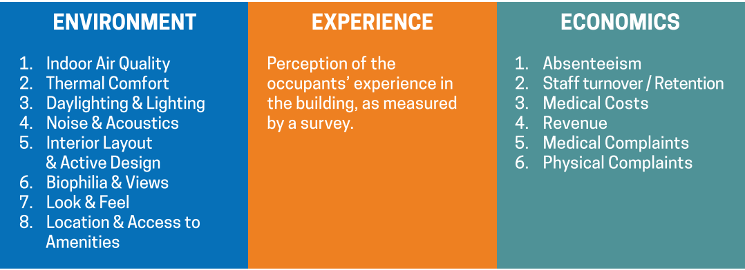
Attribution: Challenge to Estimate Impact
Easier to monitor / manipulate
Less connected to the bottom line (occupants/tenants)
Difficult to monitor / manipulate
More connected to the bottoms line (occupants/tenants)
OWNER/BUILDING-MANAGER
TENANT
Source WGBC (2016). BUILDING THE BUSINESS CASE: Health, Wellbeing and Productivity in Green Offices. © World Green Building Council. All rights reserved. This content is excluded from our Creative Commons license. For more information, see https://ocw.mit.edu/help/faq-fair-use/.
Notes:
Source days sick leave: https://onlinelibrary.wiley.com/doi/abs/10.1034/j.1600-0668.2000.010004212.x

Slide 19




Attribution: “Apple-to-apple” comparisons
Challenges to assessing impacts of health in buildings:
Outdoor factors: Indoor environmental quality is the result of multiple factors: outdoor amenities, design of homes,…
Occupants are different in income, education, value of health, … across buildings, introducing challenges to compare health or performance outcomes
+5% Health + Performance

Slide 20
Indoor Air Quality & Cognitive Performance
Cognitive Performance / Decision Making
Twenty-four participants spent 6 full work days (0900-1700 hours) in an environmentally controlled office space, blinded to test conditions.
On different days, they were exposed to artificially elevated carbon dioxide (CO₂) levels independent of ventilation.
On average, cognitive scores were 61% higher on the day with 945 in the room and 101% higher on the two days with 550 in the room than with 1450 ppm
Similar effects found in school settings, where students score lower in tests after exposure to high levels of CO₂ during semester (Palacios et al., 2023)
1450
945
550
Source: Allen, J.G., MacNaughton, P., Satish, U., Santanam, S., Vallarino, J. and Spengler, J.D., 2016. Associations of cognitive function scores with carbon dioxide, ventilation, and volatile organic compound exposures in office workers: a controlled exposure study of green and conventional office environments. Environmental health perspectives, 124(6), pp.805-812. This image is in the public domain.
Notes:
Source days sick leave: https://onlinelibrary.wiley.com/doi/abs/10.1034/j.1600-0668.2000.010004212.x

Slide 21
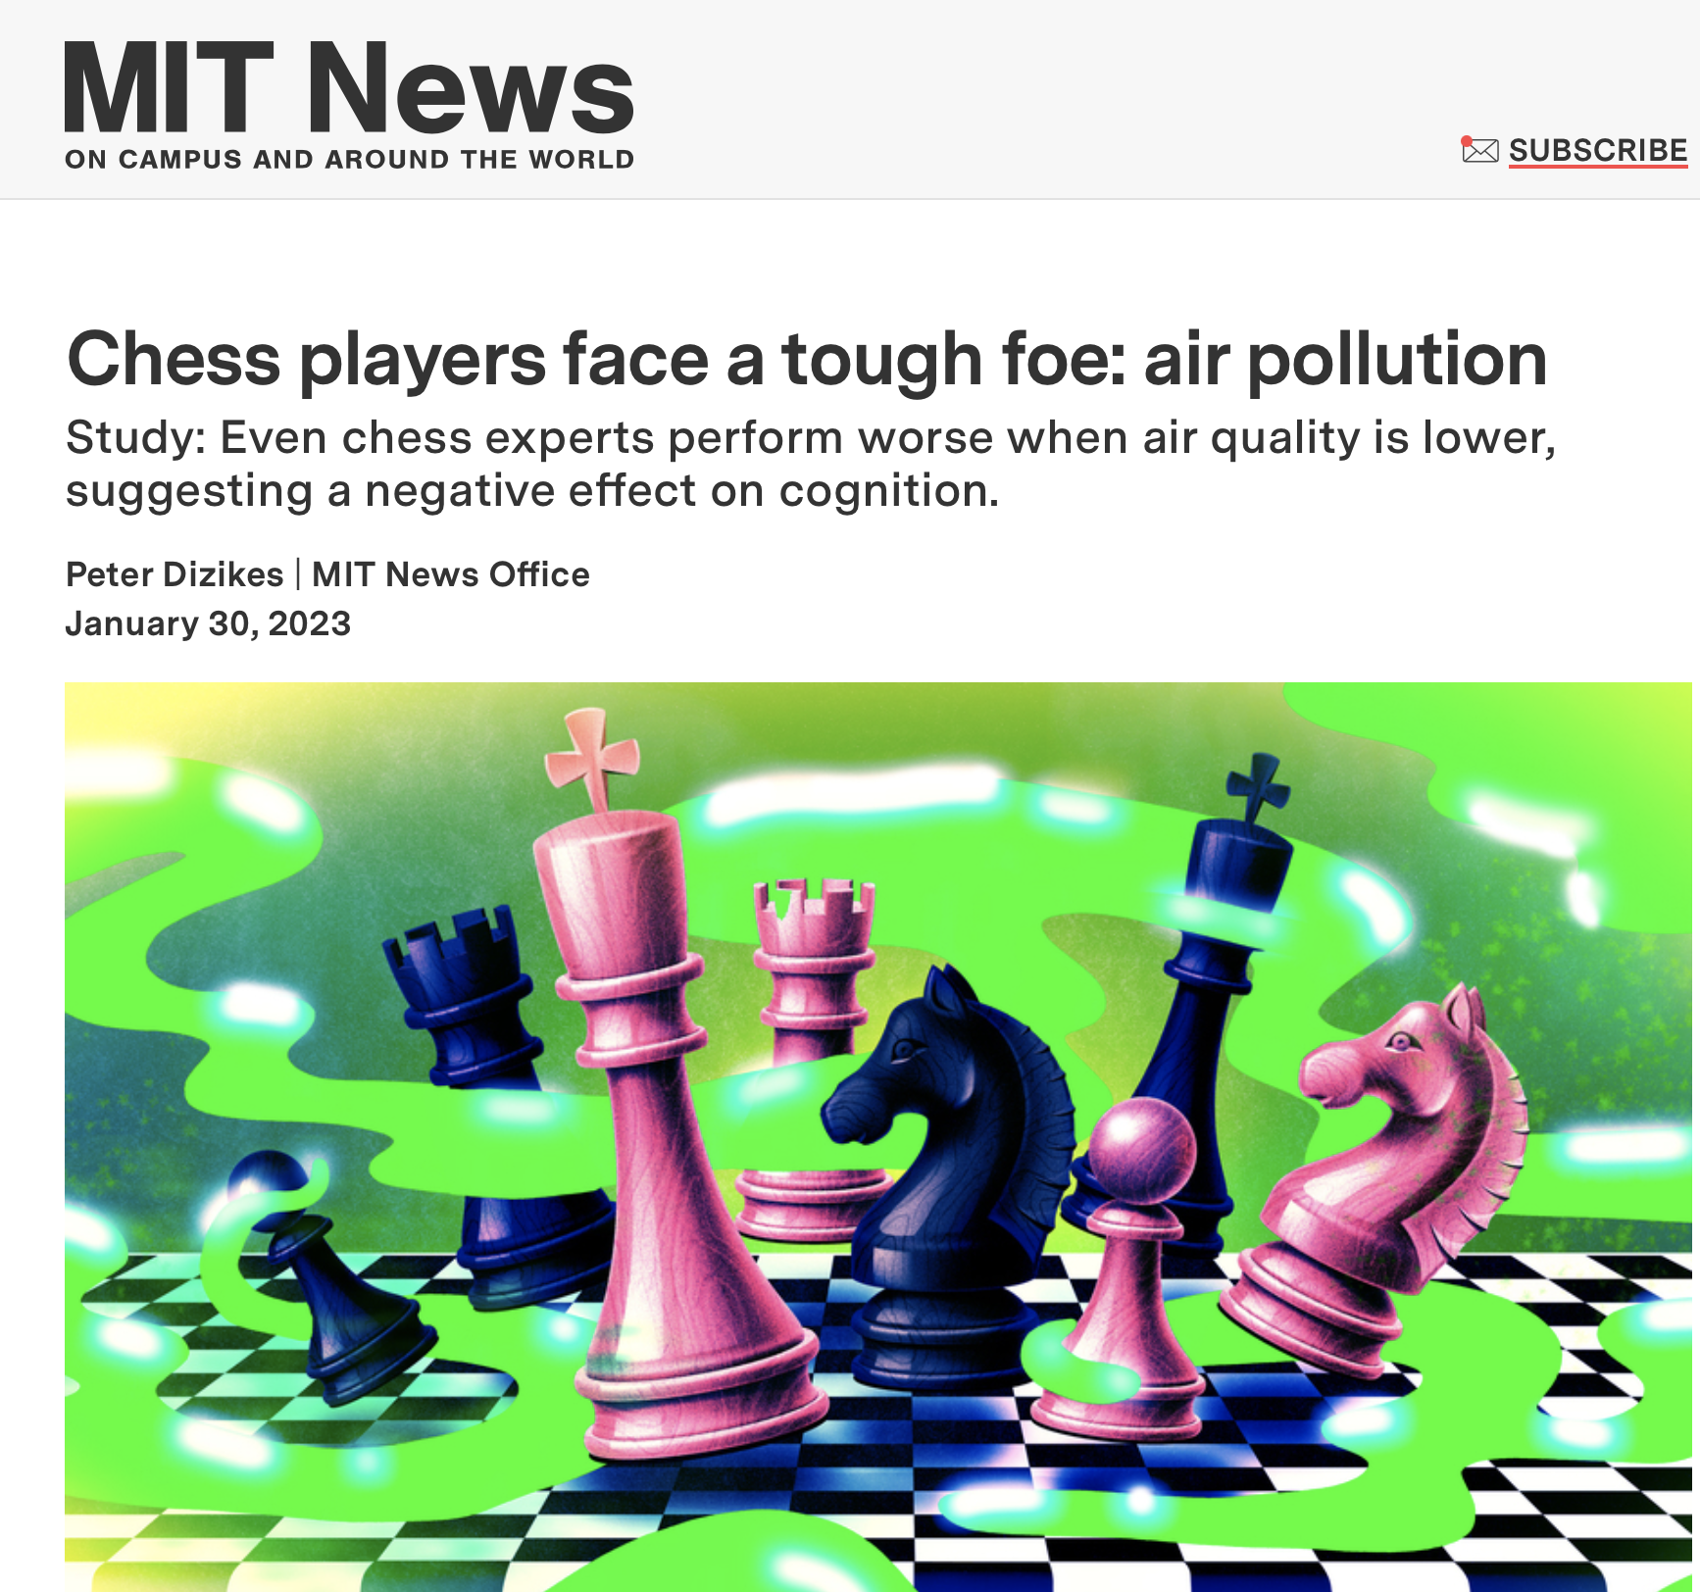
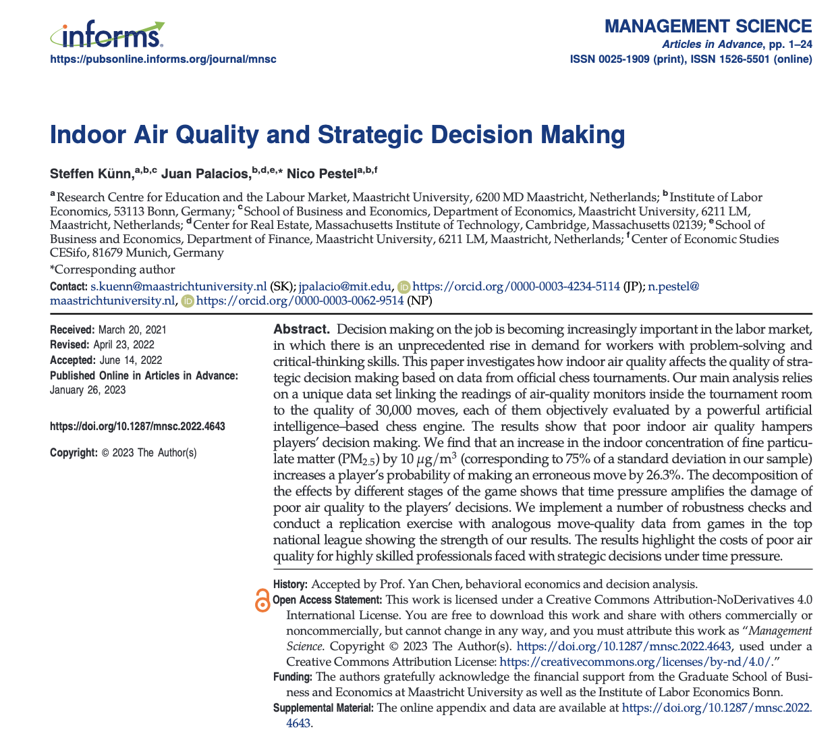
Indoor Air Quality & Decision Making
Exposure to fine particulate matter:
  Increases the probability that chess players make an error increases by 2.1 percentage points.
  The magnitude of those errors increases by 10.8 percent.
Implications for managers: finding a right move in chess is a complex cognitive task, where players need to find the optimal strategy across dozens of possibilities.
Similar effects found in: Judges, call center workers, factory workers, students, baseball empires, etc.
MIT News article © Massachusetts Institute of Technology. All rights reserved. This content is excluded from
our Creative Commons license. For more information, see https://ocw.mit.edu/help/faq-fair-use/.
Notes:
Source days sick leave: https://onlinelibrary.wiley.com/doi/abs/10.1034/j.1600-0668.2000.010004212.x

Slide 22
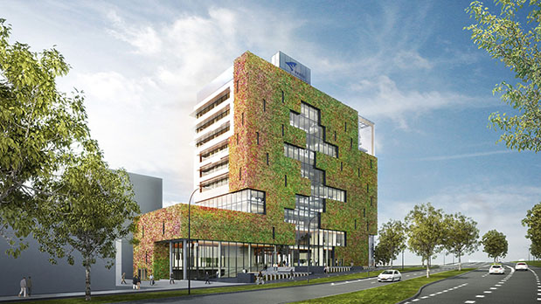
Estimating Building Impacts on Health
Study to estimate the benefits of a move to healthy building by a real team of 1,400 employees
Constructed in the 1980s
No ventilation system
Ventilation based on the principles of
natural circulation
Green wall
Source: Palacios J, Eichholtz P, Kok N (2020) Moving to productivity: The benefits of healthy buildings. PLoS ONE 15(8): e0236029. https://doi.org/10.1371/journal.pone.0236029. Photos © source unknown. All rights reserved. This content is excluded from our Creative Commons license. For more information, see https://ocw.mit.edu/help/faq-fair-use/.
Notes:
Source days sick leave: https://onlinelibrary.wiley.com/doi/abs/10.1034/j.1600-0668.2000.010004212.x

Slide 23
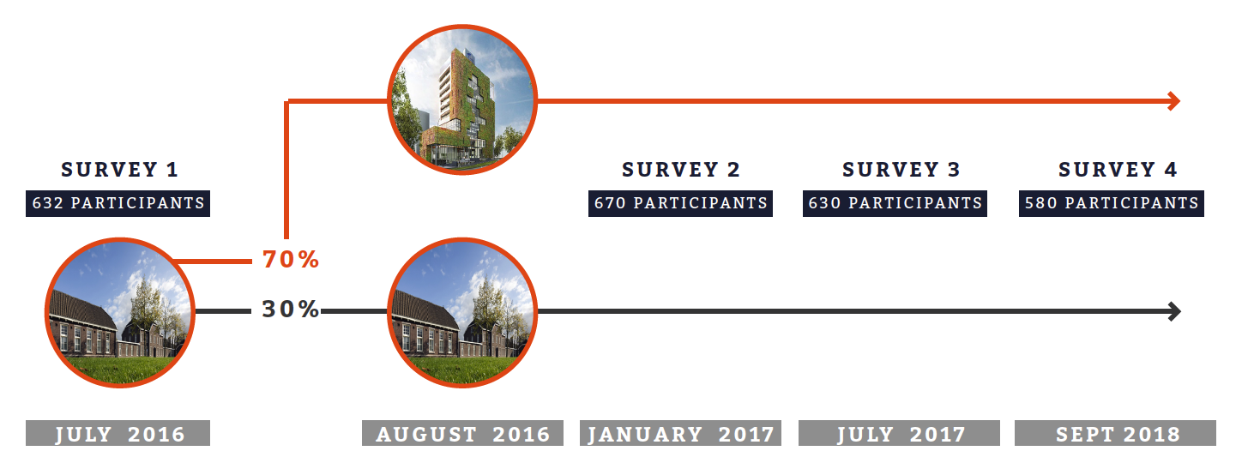
Estimating Building Impacts on Health
Source: Palacios J, Eichholtz P, Kok N (2020) Moving to productivity: The benefits of healthy buildings. PLoS ONE 15(8): e0236029. https://doi.org/10.1371/journal.pone.0236029
Notes:
Source days sick leave: https://onlinelibrary.wiley.com/doi/abs/10.1034/j.1600-0668.2000.010004212.x

Slide 24
Estimating Building Impacts on Health
Moving date
Source: Palacios J, Eichholtz P, Kok N (2020) Moving to productivity: The benefits of healthy buildings. PLoS ONE 15(8): e0236029. https://doi.org/10.1371/journal.pone.0236029
Notes:
Source days sick leave: https://onlinelibrary.wiley.com/doi/abs/10.1034/j.1600-0668.2000.010004212.x

Slide 25

Cost-Benefit Analysis
Is the building profitable for the tenant (municipality)?
Marginal benefit in building
management and exploitation
Marginal benefit in sick
leave reduction:
Extra costs for sustainable attributes
(green + healthy):
Wages: €54 million/year
- 43% of FTEs sick at least once/year
- Average sick leave: 5 days
- 2% reduction in sick leave yields
savings of €25,000/year
€17 million
€2.5 million capitalized
€3.4 million

Slide 26
The Business Case for Corporate Tenants
How important is productivity for companies? Let’s compare their annual costs:
1%
9%
90%
  $3 for utilities
  $30 for rent
  $300 for payroll
Source: World Green Building Council (2014) Health, Wellbeing & Productivity in Offices. The next chapter for green building
Notes:
To re-cap: (1) Planet: we are responsible (36%, 39%), we are the “target” (NYC, even 70%, LL97); (2) People: the ultimate goal for us real estate industry is to provide enough and suitable space for live-work-play, cannot just be very tiny rooms with no windows and tight insulation. Also, the turning point in the EKC, is the bottom up demand push. (3) But we cannot only have dream without a sound business strategy. Real estate developers and investors need to make money. Crucial for the private sector (80%).
We know the win-win-win is possible, the intersection is the real sustainability. Shared values. But, due to the capability gap, or market failures, these three bubbles won’t intersect. With good intension, but constrained capability; or with bad intension, “green washing”.

Slide 27
Impacts of Health on ﻿Income Statements
Consider a simplified example of a company that is considering whether to improve the indoor air quality in their buildings
  Increased air quality in the building (i.e., ventilation rates + filtration)
The company will need to evaluate the costs and benefits associated with the decision
  Higher ventilation rates require higher energy expenditures
  Indoor air-quality improvements have been associated in the medical literature with higher performance among employees driven by:
    Lower sick leave (e.g., sick building syndrome)
    Higher performance (e.g., higher cognitive performance)
Notes:
To re-cap: (1) Planet: we are responsible (36%, 39%), we are the “target” (NYC, even 70%, LL97); (2) People: the ultimate goal for us real estate industry is to provide enough and suitable space for live-work-play, cannot just be very tiny rooms with no windows and tight insulation. Also, the turning point in the EKC, is the bottom up demand push. (3) But we cannot only have dream without a sound business strategy. Real estate developers and investors need to make money. Crucial for the private sector (80%).
We know the win-win-win is possible, the intersection is the real sustainability. Shared values. But, due to the capability gap, or market failures, these three bubbles won’t intersect. With good intension, but constrained capability; or with bad intension, “green washing”.

Slide 28
Impacts of Health on ﻿Income Statements
  Consultancy company of 40 employees
  USD 75,000 per year
  Considers to double ventilation rate
    From 20 cfm/person to 40 cfm/person
    Increase in energy costs:
      USD 40 per person per year
 | Baseline situation
Revenue | $6,000,000
Payroll | $(3,000,000)
Rent | $(300,000)
Utility | $(30,000)
Other expenses | ﻿$(1,000,000)
Source: Allen, J.G. and Macomber, J.D., 2020. Chapter 4. Healthy buildings: How indoor spaces drive performance and productivity. Harvard University Press.
Notes:
To re-cap: (1) Planet: we are responsible (36%, 39%), we are the “target” (NYC, even 70%, LL97); (2) People: the ultimate goal for us real estate industry is to provide enough and suitable space for live-work-play, cannot just be very tiny rooms with no windows and tight insulation. Also, the turning point in the EKC, is the bottom up demand push. (3) But we cannot only have dream without a sound business strategy. Real estate developers and investors need to make money. Crucial for the private sector (80%).
We know the win-win-win is possible, the intersection is the real sustainability. Shared values. But, due to the capability gap, or market failures, these three bubbles won’t intersect. With good intension, but constrained capability; or with bad intension, “green washing”.

Slide 29
Impacts of Health on ﻿Income Statements
 | Baseline | △Energy costs |  |  | Baseline + Healthy Building
Revenue | $6,000,000
Payroll | $(3,000,000)
Rent | $(300,000)
Utility | $(30,000) | $(1,600) |  |  | $(31,600)
Other expenses | ﻿$(1,000,000)
Total increase in energy costs:
40 per person per year → 40 x 40 = $1,600
Source: Allen, J.G. and Macomber, J.D., 2020. Chapter 4. Healthy buildings: How indoor spaces drive performance and productivity. Harvard University Press.
Notes:
To re-cap: (1) Planet: we are responsible (36%, 39%), we are the “target” (NYC, even 70%, LL97); (2) People: the ultimate goal for us real estate industry is to provide enough and suitable space for live-work-play, cannot just be very tiny rooms with no windows and tight insulation. Also, the turning point in the EKC, is the bottom up demand push. (3) But we cannot only have dream without a sound business strategy. Real estate developers and investors need to make money. Crucial for the private sector (80%).
We know the win-win-win is possible, the intersection is the real sustainability. Shared values. But, due to the capability gap, or market failures, these three bubbles won’t intersect. With good intension, but constrained capability; or with bad intension, “green washing”.

Slide 30
Impacts of Health on ﻿Income Statements
 | Baseline | △Energy costs | △Payroll |  | Baseline + Healthy Building
Revenue | $6,000,000
Payroll | $(3,000,000) |  | $19,000 |  | $(2,981,000)
Rent | $(300,000)
Utility | $(30,000) | $(1,600) |  |  | $(31,600)
Other expenses | ﻿$(1,000,000)
Benefits:
1. Fewer days of sick leave, on average:
1.6 days of sick leave associated with doubling ventilation rate → 1.6 /250 = 0.64%
Increase in time that workers are able to work, due to less sick leave.
In monetary terms: 0.0064 x 3,000,000 = 19,000
Source: Allen, J.G. and Macomber, J.D., 2020. Chapter 4. Healthy buildings: How indoor spaces drive performance and productivity. Harvard University Press.
Notes:
Source days sick leave: https://onlinelibrary.wiley.com/doi/abs/10.1034/j.1600-0668.2000.010004212.x

Slide 31
Impacts of Health on ﻿Income Statements
 | Baseline | △Energy costs | △Payroll | △Revenue | Baseline + Healthy Building
Revenue | $6,000,000 |  |  | $120,000 | $6,120,000
Payroll | $(3,000,000) |  | $19,000 |  | $(2,981,000)
Rent | $(300,000) |  |  |  | $(300,000)
Utility | $(30,000) | $(1,600) |  |  | $(31,600)
Other expenses | ﻿$(1,000,000) |  |  |  | $(1,000,000)
Benefits:
2. Higher productivity:
Evidence literature: 2% higher productivity among employees
Translates to 2% higher production in the company → 0.02 x 6,000,000 = 120,000
Source: Allen, J.G. and Macomber, J.D., 2020. Chapter 4. Healthy buildings: How indoor spaces drive performance and productivity. Harvard University Press.
Notes:
Source days sick leave: https://onlinelibrary.wiley.com/doi/abs/10.1034/j.1600-0668.2000.010004212.x

Slide 32
Impacts of Health on ﻿Income Statements
 | Baseline | △Energy costs | △Payroll | △Revenue | Baseline + Healthy Building Scenario
Revenue | $6,0000,000 |  |  | $120,000 | $6,120,000
Payroll | $(3,000,000) |  | $19,000 |  | $(2,981,000)
Rent | $(300,000) |  |  |  | $(300,000)
Utility | $(30,000) | $(1,600) |  |  | $(31,600)
Other expenses | ﻿$(1,000,000) |  |  |  | $(1,000,000)
Net income before tax | $1,670,000 |  |  |  | $1,807,400
Change |  |  |  |  | $137,400
Change in income statement (pre taxes):
Healthy-Building Scenario - Baseline = $1,807,400 - 1,670,000 = 137,400
Source: Allen, J.G. and Macomber, J.D., 2020. Chapter 4. Healthy buildings: How indoor spaces drive performance and productivity. Harvard University Press.
Notes:
Source days sick leave: https://onlinelibrary.wiley.com/doi/abs/10.1034/j.1600-0668.2000.010004212.x

Slide 33
Impacts of Health on ﻿Income Statements
 | Baseline | △Energy costs | △Rent | △Payroll | △Revenue | Baseline + Healthy Building Scenario
Revenue | $6,0000,000 |  |  |  | $120,000 | $6,120,000
Payroll | $(3,000,000) |  |  | $19,000 |  | $(2,981,000)
Rent | $(300,000) |  | $(51,000) |  |  | $(351,000)
Utility | $(30,000) | $(1,600) |  |  |  | $(31,600)
Other expenses | ﻿$(1,000,000) |  |  |  |  | $(1,000,000)
Net income before tax | $1,670,000 |  |  |  |  | $1,756,400
Change |  |  |  |  |  | $86,400
This increase in net income is larger than the largest rent increase documented in green building literature
(17%, upper bound from green building lecture)
Source: Allen, J.G. and Macomber, J.D., 2020. Chapter 4. Healthy buildings: How indoor spaces drive performance and productivity. Harvard University Press.
Notes:
Source days sick leave: https://onlinelibrary.wiley.com/doi/abs/10.1034/j.1600-0668.2000.010004212.x

Slide 34
Projected Costs and Benefits for US Offices
﻿A study uses past academic estimates and energy models to provide projections of benefits and costs linked to providing more ventilation for the entire U.S. office building portfolio
Three scenarios:
  Baseline: Minimum ventilation rate recommended by ASHRAE
  25% above the baseline: $13B in economic benefits
  87.5% above the baseline: $37B in economic benefits
*Notes: Figures in billions of dollars
Source: Fisk, W.J., Black, D. and Brunner, G., 2012. Changing ventilation rates in US offices: Implications for health, work performance, energy, and associated economics. Building and environment, 47, pp.368-372.
Notes:
Source days sick leave: https://onlinelibrary.wiley.com/doi/abs/10.1034/j.1600-0668.2000.010004212.x

