Slide 1
SRE Economics Lecture 2
The Economics of Green Buildings (2)
Siqi Zheng
Feb 2023
(MIT Center for Real Estate)

Slide 2
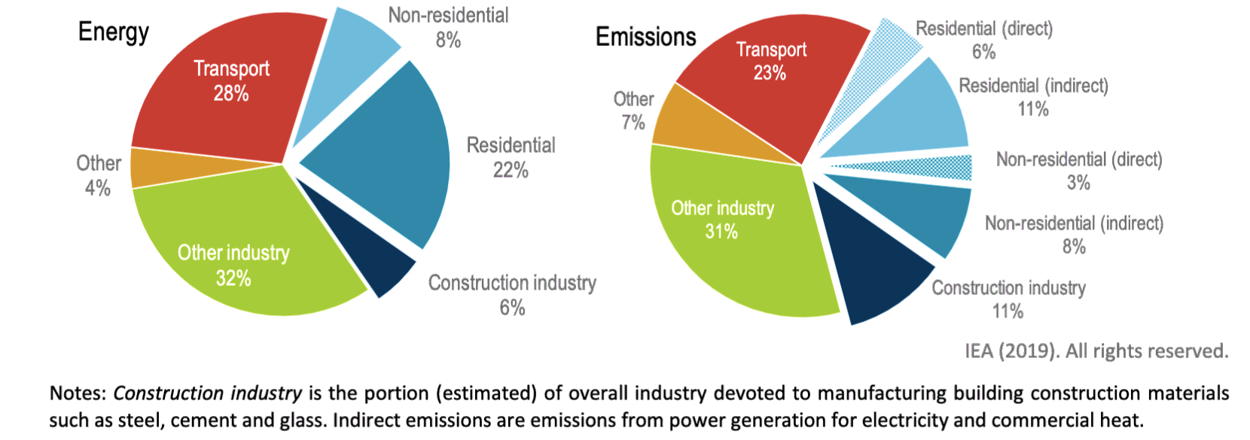

We are responsible, and we are also the target
(embodied carbon)
Global Alliance for Buildings and Construction , “The 2019 Global Status Report for Buildings and Construction”
© United Nations Environment Programme. All rights
reserved. This content is excluded from our Creative Commons
icense. For more information, see https://ocw.mit.edu/help/faq-fair-use/.

Slide 3


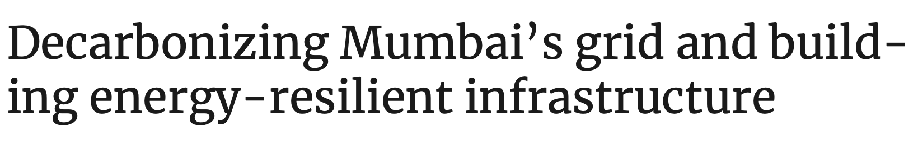
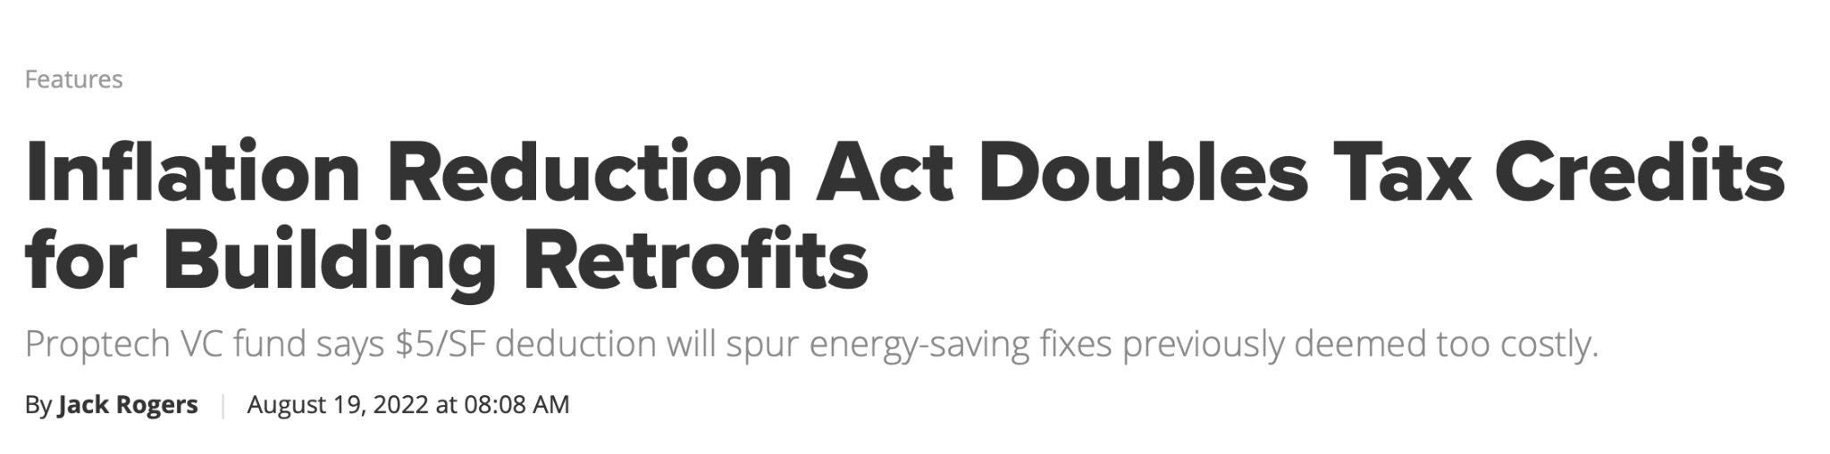
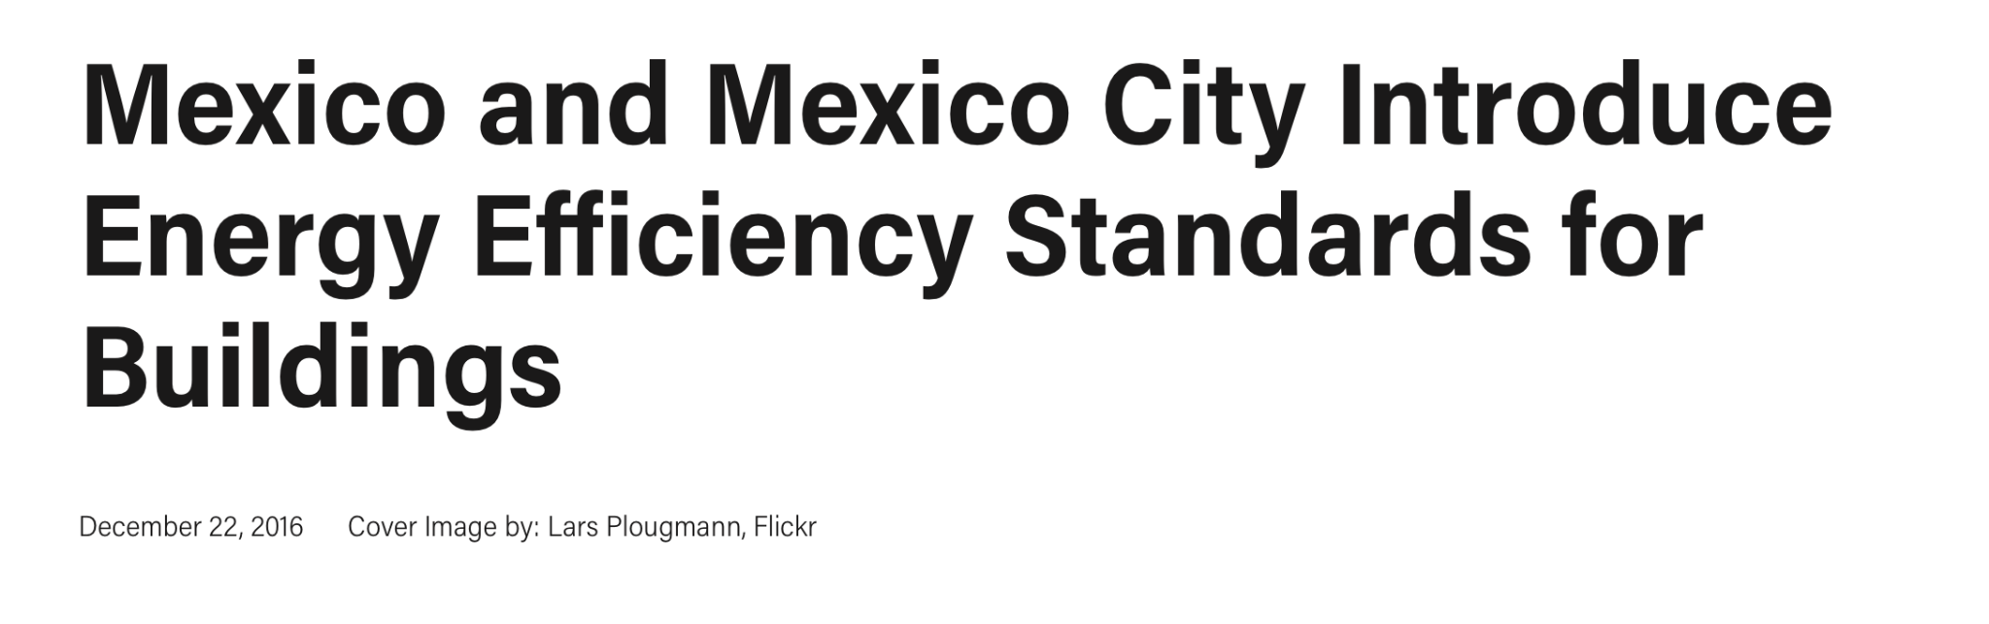
Policy pressure to decarbonize across the globe
© World Green Building Council, European Commission, Maharashtra Climate Outlook, World Resources Institute, and GlobeSt.com. All rights
reserved. This content is excluded from our Creative Commons license. For more information, see https://ocw.mit.edu/help/faq-fair-use/.
Notes:
Many nations and cities around the world are introducing legislation and incentive programs to accelerate building decarbonization
In colder climates such as the northeastern US, heating is a major source of greenhouse gas emissions and policies are aggressively targeting the decarbonization of heating
In other climates, policies are aiming to further decarbonize activities such as cooling, cooking, and heating water through energy efficiency improvements
Moreover, in countries with developing infrastructure, improving the energy efficiency of buildings can avoid the need to build additional power plants and transmission and distribution infrastructure

Slide 4
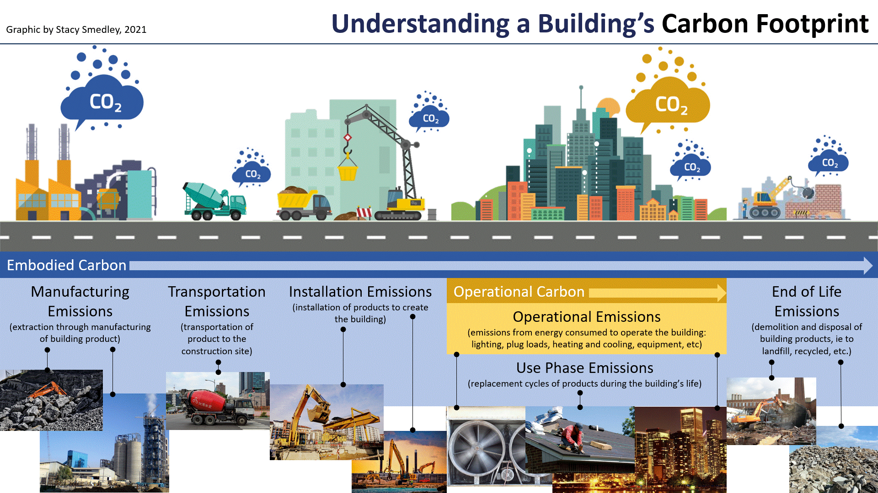
Used with permission.

Slide 5
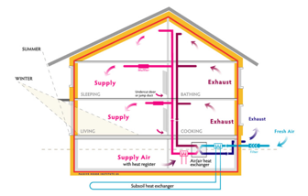
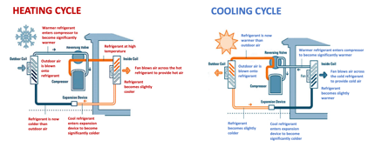
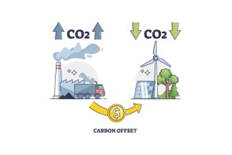
Three major strategies for building decarbonization (operational carbon)
Improve energy efficiency
  Better energy conservation (insulation) and more efficient operations, e.g., passive house.
Switch to renewable energy: onsite and offsite
  Solar panels, offsite renewable energy procurement
  Electrification: gas-based heating → electricity-based heating (heat pump)
  Purchase carbon offsets
Top image © Passive House Institute US; center and bottom images © source unknown; All rights reserved. This content is excluded from our
Creative Commons license. For more information, see https://ocw.mit.edu/help/faq-fair-use/.

Slide 6
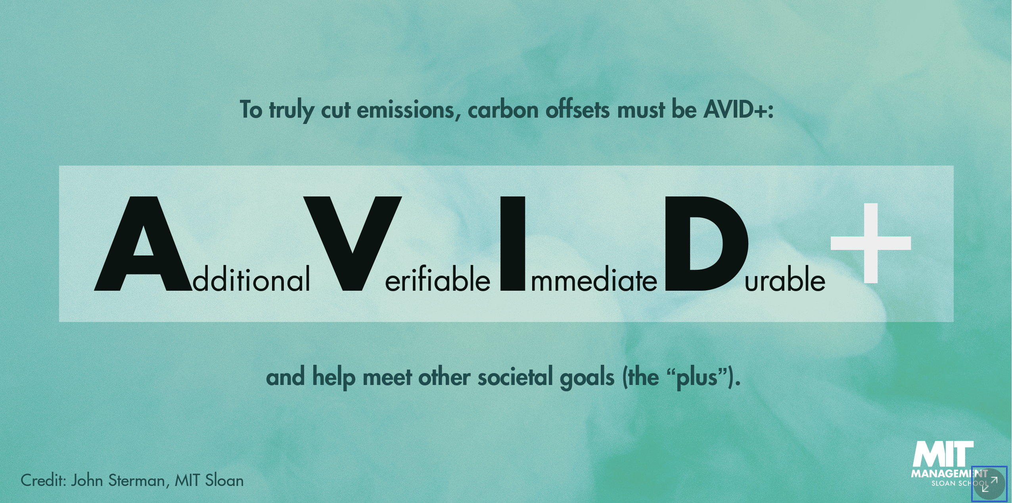




Carbon Offsets
Logos © and trademarks owned by California Air Resources Board, GE, Credit Suisse, and Delta Air Lines. All rights reserved. This
content is excluded from our Creative Commons license. For more information, see https://ocw.mit.edu/help/faq-fair-use/.
AVID+ slide courtesy of John Sterman. Used with permission.
Challenges:
Additionality (offsetting carbon that would not have been offset anyways
Effectiveness of offsets in reducing emissions
Offsets may be based on questionable assumptions / modeling
Difficulty in measuring / verifying impact of offsets
Duration of offsets does not match the lifecycle of CO2 being offset
Additional: Must reduce emissions that would not otherwise be cut.
Verifiable: Emission reduction must be verifiable.
Immediate: Emissions cut today are worth more than emissions cut in the future.
Durable: Offsets must last as long as CO2 stays in the atmosphere (century or more).
+(Plus): Offsets should contribute to other societal issues such as employment, equity, or public health.
Notes:
Main challenge with carbon offsets is the issue of additionality
E.g.: if you pay someone to preserve a grove, but they were never actually planning to cut it down, then you are not offsetting emissions.
https://www.nytimes.com/2022/05/18/climate/offset-carbon-footprint-air-travel.html
A Berkeley study found that 82% of carbon credits issued by the California Air Resources Board do not represent true emissions reductions
These offsets reduced timber harvesting in CA, but this causes an increase in timber harvesting elsewhere to meet timber demand. This effect was not considered.
https://gspp.berkeley.edu/assets/uploads/research/pdf/Policy_Brief-US_Forest_Projects-Leakage-Haya_4.pdf
In a 2016 study by the EU commission, it found that 85% of carbon reduction offset projects were unlikely to meet their reduction claims
https://web.archive.org/web/20171101130231/https://ec.europa.eu/clima/sites/clima/files/ets/docs/clean_dev_mechanism_en.pdf
Credit Suisse
Has claimed to be “carbon neutral” for more than a decade
An analysis by Bloomberg on more than Credit Suisse’s carbon offset transactions found that most offsets were based on carbon offsets that experts rate as “useless”
https://www.bloomberg.com/graphics/2022-carbon-offsets-renewable-energy/#xj4y7vzkg
Delta Airlines
Claimed to be ”carbon neutral” since 2020.
Largest source of offsets came from investing in a wind farm in the Dominican Republic.
Experts found that the wind farm would have been built anyways. So it is not really offsetting emissions since the wind farm would have been built without the help of the offsets.
https://www.bloomberg.com/graphics/2022-carbon-offsets-renewable-energy/#xj4y7vzkg
General Electric
purchased more than 800,000 credits (equivalent to 800,000 tons of CO2 offset) from a wind farm in China
But this wind farm was already subsidized by China and likely would have been built anyways.

Slide 7
Technology side:
Passive house
Building electrification: heat pump

Slide 8
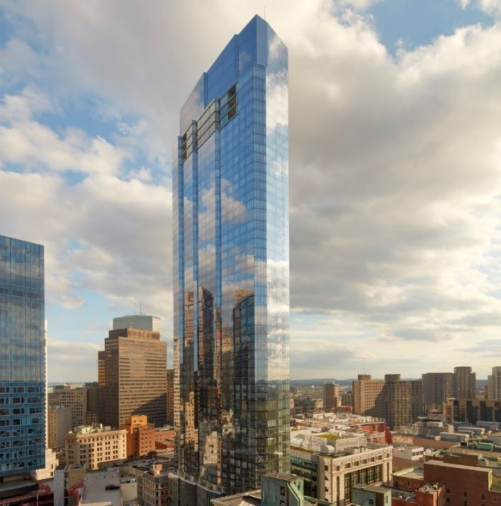
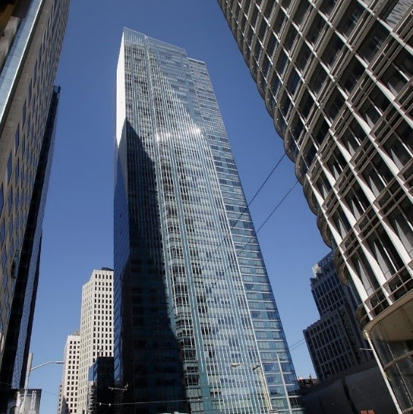
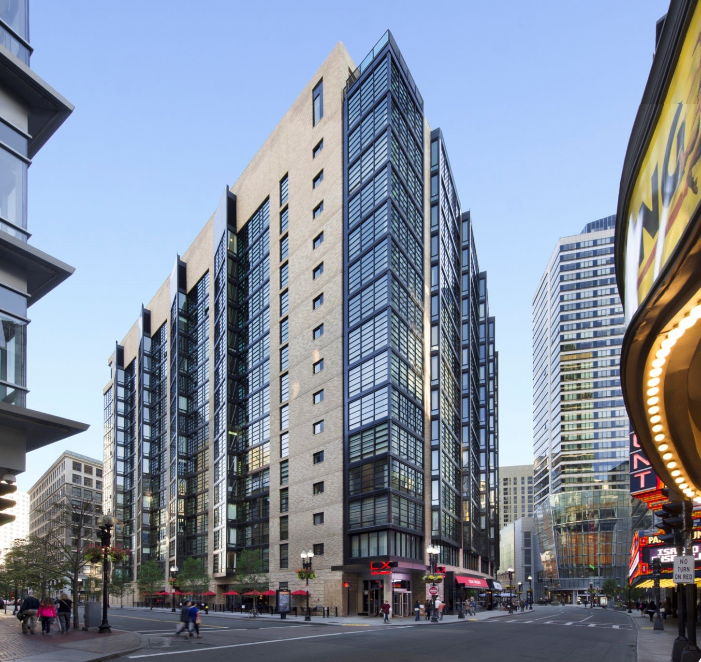
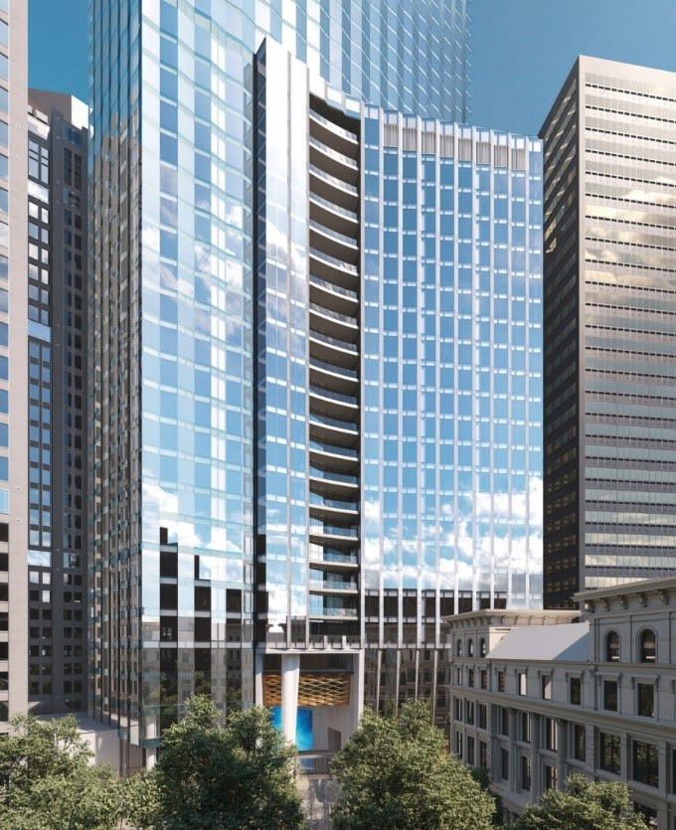
Millennium Partners
© Handel Architects. All rights reserved. This content is excluded from our Creative
Commons license. For more information, see https://ocw.mit.edu/help/faq-fair-use/.
WINTHROP CENTER, 2022
Location: Boston
MILLENNIUM PLACE (HAYWARD PLACE), 2013
Location: Boston
Sustainability
Passive House
WELL Gold and LEED Platinum
Focused on job creation, downtown revitalization
MILLENNIUM TOWER, 2008
Location: San Francisco
Focused on ultra-luxury furnishes and amenities for wealthy condo owners
(2016: had sunk 16 inches and tilted)
MILLENNIUM TOWER, 2017
Location: Boston
Focused on ultra-luxury + health and wellness
(two-story club, the largest residence-only fitness center)
Source: Ashley Katz. Industry Mapping of Sustainable Real Estate.
Notes:
2008 SF: Architect: Handel Architects. Two towers: 12-story tower and 58-story tower. Fully sold out by 2013. Allegedly had sunk 8.3 inches by 2009. By May 2016, “had sunk 16 inches into the earth and tilted over 15 inches at its tip and 2 inches at the base”
2013 Boston: Architect: Handel Architects. 390,000SF with 256-unit residential units. 15-story tower. Focused on job creation, downtown revitalization. Job started post-recession. Needed to get mayor on board through jobs created in new construction
2017 Boston: Architect: Handel Architects. 685-foot high mixed-use residential tower. 60-stories high with 442 condos. Replaced the “Big Hole” – a partially excavated site. Mayor considered this site “perhaps his No. 1 development priority”.
2022 Winthrop: 812,000 SF of office space and 572,000SF comprised of 321 luxury condos. Largest Passive House Institute certified office building in the world when completed (estimated for 2022). Estimates 65% less energy than similarly-sized Boston projects. Estimates 30%-50% more fresh air than comparable buildings. Greater access to natural light.

Slide 9
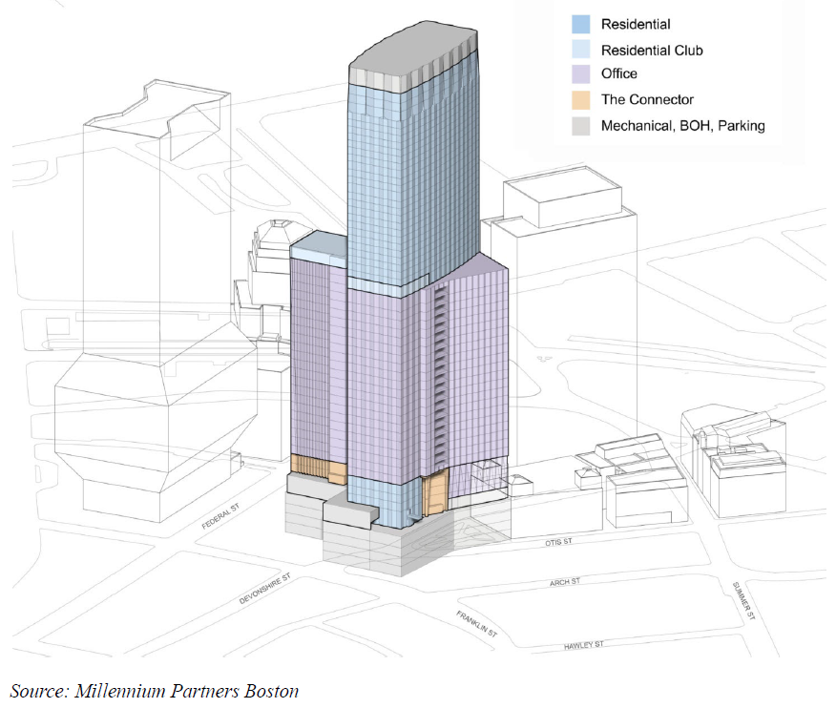




Winthrop Center
Sell
Condo
LEED Gold
Passive House
+ WELL Gold
+ LEED Platinum
Lease
Office
Logos © Passive House Institute US, US Green Building Council, and International Well Building Institute; skyscraper © Millennium Partners.
All rights reserved. This content is excluded from our Creative Commons license. For more information, see https://ocw.mit.edu/help/faq-fair-use/.

Slide 10



LEED + WELL
 | LEED
Full Name | Leadership in Energy and Environmental Design
Launch Date | 1998
Governing Body | US Green Buildings Council (USGBC)
Certification By | Green Business Certification Institute (GBCI)
Countries Covered | 176
Ratings | Certified Silver Gold Platinum
Assessment | USGBC
Schemes | New Construction; Existing: Operations and Maintenance; Commercial; Interiors; Core & Shell; Schools; Retail; Healthcare; Homes; Neighborhood Development
Left: © US Green Building Council; right: © International Well Building Institute. All rights reserved. This content
is excluded from our Creative Commons license. For more information, see https://ocw.mit.edu/help/faq-fair-use/.
Notes:
USGBC: A private non-profit organization. The SAT is wholly owned, developed, and published by the College Board, a private, not-for-profit organization in the United States.
The GRE is owned and administered by Educational Testing Service (ETS).

Slide 11
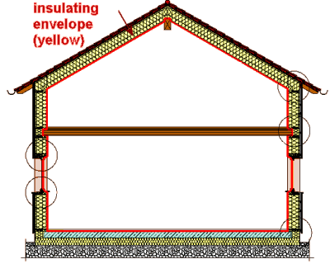


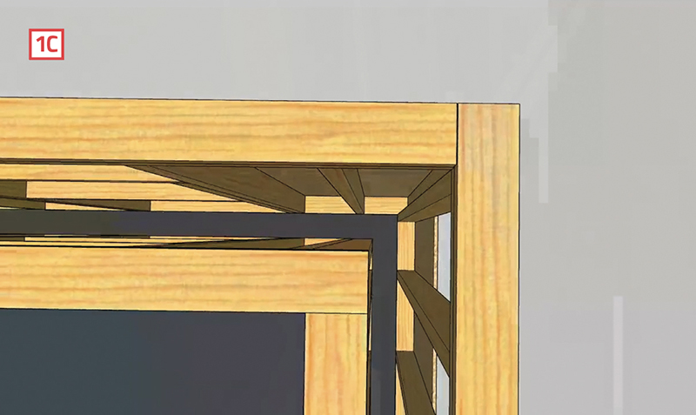
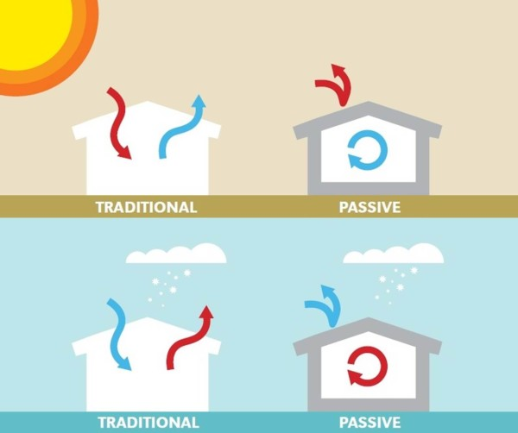
Passive House Technology
Images below © source unknown. All rights reserved. This content is excluded from our Creative Commons license. For more information, see https://ocw.mit.edu/help/faq-fair-use/.
Additional Cost
(Estimated cost premium +3-10%)
Highly Insulated Building Envelope
(Continuous layer and high-performance and double/triple-glazed windows)
Continuous Air Sealed Layer
(Add air barriers such as high-performance tapes to control heat energy loss, unwanted heat gain, and infiltration of pollutants)
Eliminate Thermal Bridges
(Use double stud walls to reduce pathway of heat energy to travel through the envelope from inside to outside)
Heat Recovery Ventilation
(controlled ventilation and heat exchanger to remove smell, air pollutants, excess humidity)
+ Window Orientation
(Orientation of windows depending on the location, e.g., south-facing for heat gain)
Image source: Passive House Alliance. © Passive House Institute US;. All rights reserved. This content is excluded from our
Creative Commons license. For more information, see https://ocw.mit.edu/help/faq-fair-use/.
Notes:
You are not living in a plastic bag! Heat recovery ventilation (HRV) is a key.
HRV: conditioning the air before the air comes in (for example, in the winter it heats up the cold air before letting the air in the room)

Slide 12
Passive House: Benefits
Benefit
Energy Saving
90% reduction in heating energy
(due to insulation, air tight, and high performance window)
Resilience
Lower energy demand means better resilience to power outages during climate disasters.
Health
Not living in a plastic bag just controlled ventilation! The balanced ventilation systems supply filtered fresh air.
Comfort
Stable indoor temperature, fresh air, quiet, dust free, no unwanted moisture …
Reputation
If you move earlier and get a certificate :)
Image source: Passive House Alliance. © Passive House Institute US. All rights
reserved. This content is excluded from our Creative Commons license. For
more information, see https://ocw.mit.edu/help/faq-fair-use/.
Notes:
Passive House is a high level of building energy performance. It has never been done on the scale of Winthrop before. THIS IS THE FIRST ONE.

Slide 13

Winthrop Center
Comparative
Advantage
Benefit
Increased rent and occupancy rate
LEED Gold
Effective Rent (rent, occupancy)
($44.7M/yr)
Green | View
Green | View
Covid shock
Tenancy
Operation
Time
$$30 Years$$
Cost
Upfront Cost ($1.3 B)
Reduced utility cost
(~$300k)
3-10% when planned
Passive House
+ WELL Gold
+ LEED Platinum
Operation Cost
($7.3M/yr)
+ 3-10%
(1-3%)
1-3% when implemented
Time
Notes:
Reconcile with the Healthy Building section and the case.
Passive House is a high level of building energy performance. It has never been done on the scale of Winthrop before. THIS IS THE FIRST ONE.
Our office leases are triple net leases, so any Landlord utility savings is passed back to the Tenant. However, when we did a quick model on this back in 2017 and comparing a 'code' building to our Passive House building resulted in a total utility savings of about $300,000, roughly $120k of that being on the Landlord side.

Slide 14
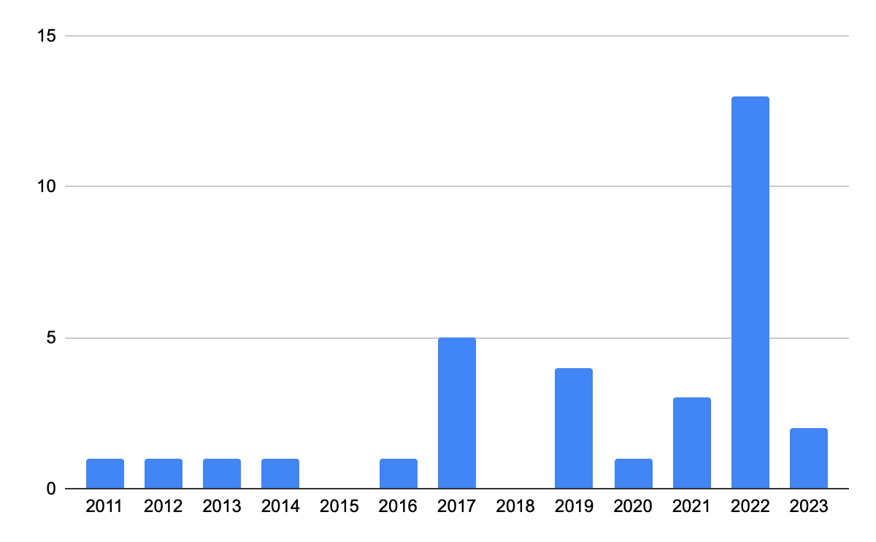
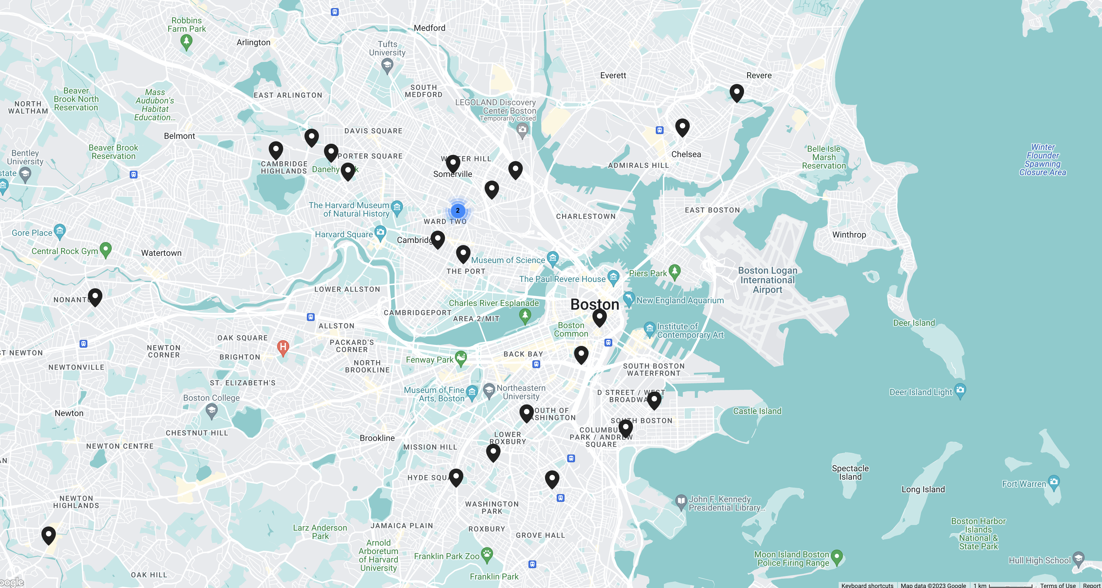
Passive Houses in the Boston Area
Number of Passive Houses Built in MA by Year
Source: www.PassiveHouseMA.org/projects. © Passive House Massachusetts. All rights reserved. This content is excluded from our Creative Commons license. For more information, see https://ocw.mit.edu/help/faq-fair-use/.

Slide 15
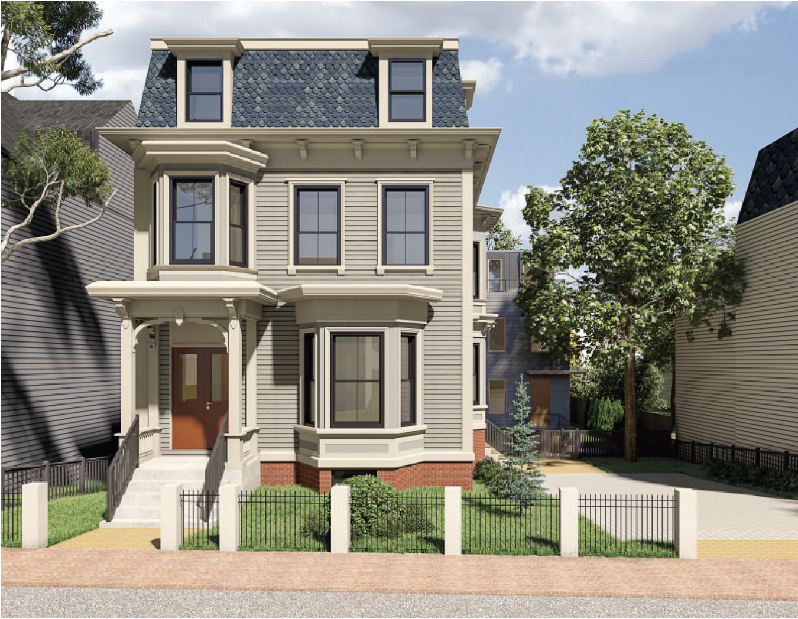
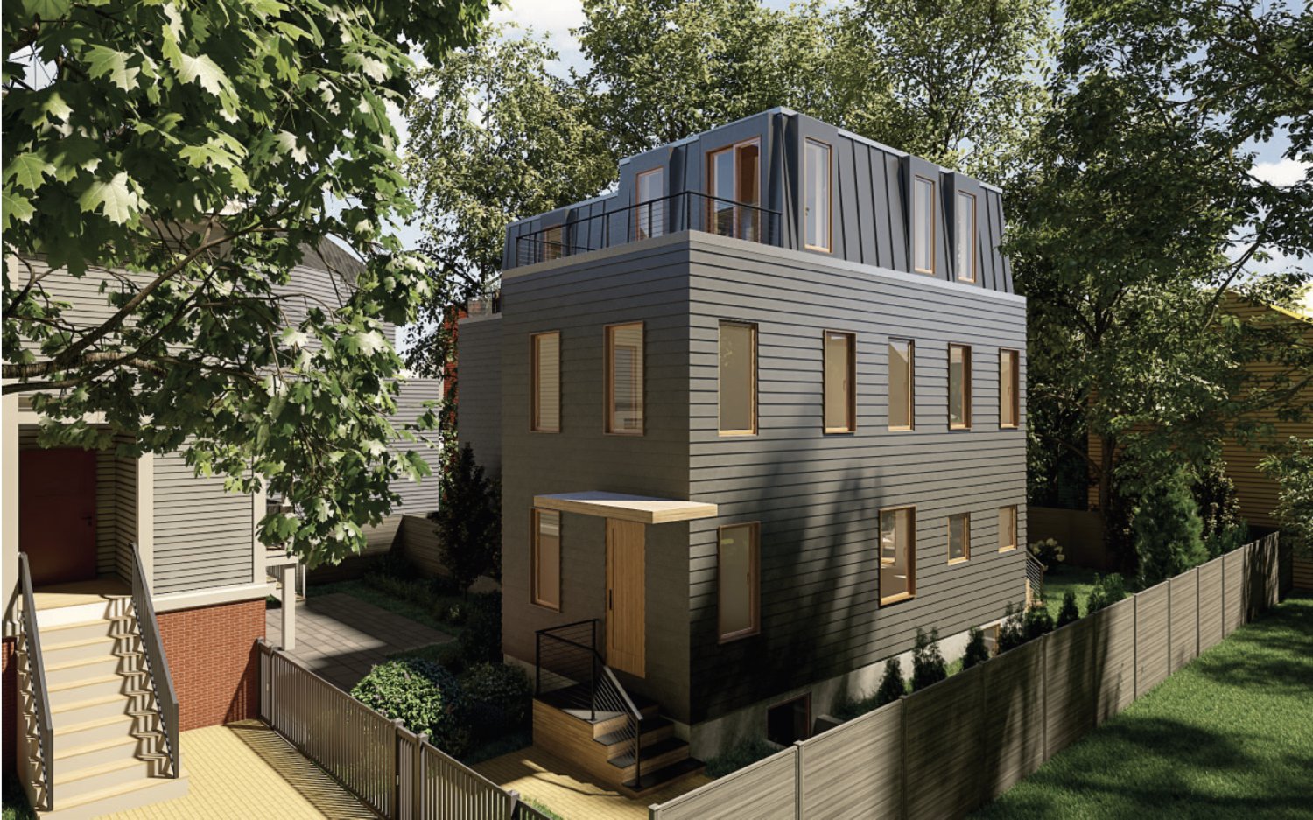
Passive House: 12 Fayette Street
Features:
Super insulated, airtight construction
Triple pane windows
Heat recovery ventilation
Efficient heating and cooling systems
Reduced thermal bridging
80% reduction in energy use relative to similar houses built to the current building code
Inman Square
© source unknown. All rights reserved. This content is excluded from our Creative Commons license. For more information, see https://ocw.mit.edu/help/faq-fair-use/.
Notes:
Passive House is a high level of building energy performance. It has never been done on the scale of Winthrop before. THIS IS THE FIRST ONE.

Slide 16


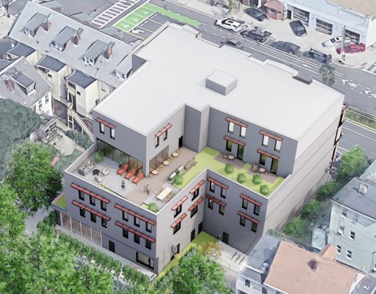
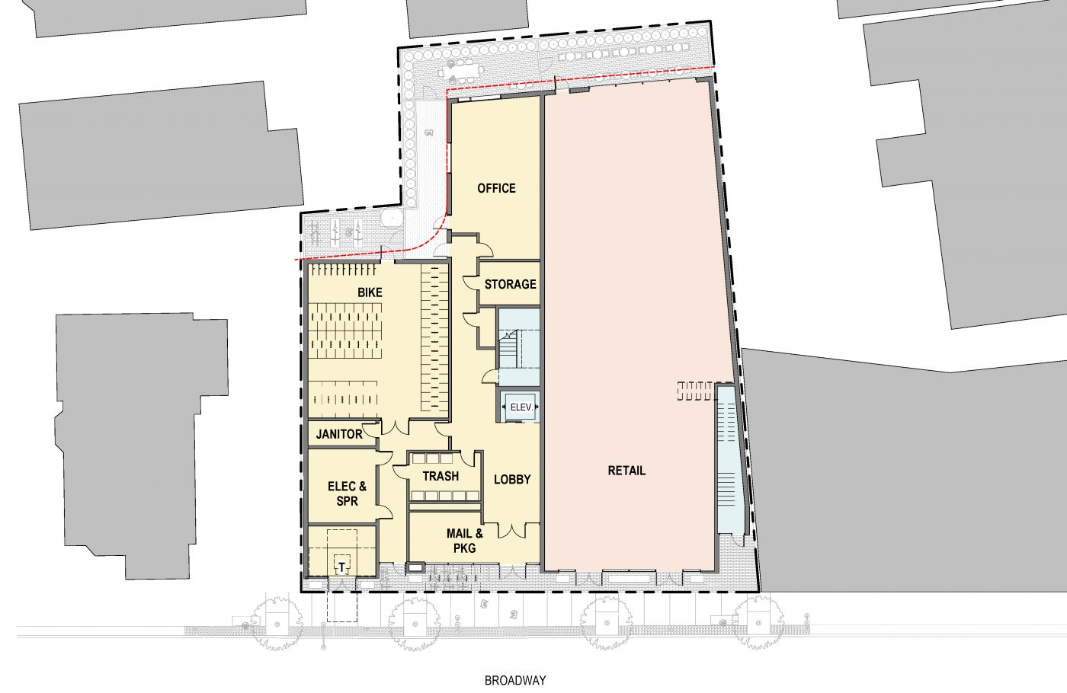

Passive House: 152 – 158 Broadway
Features:
Five-story, mixed use commercial / residential building
Façade provides shading to reduce cooling loads
Low embodied carbon of construction materials
Highly efficient, 100% electric
© Utile Design. All rights reserved. This content is excluded from our Creative Commons
license. For more information, see https://ocw.mit.edu/help/faq-fair-use/.
Somerville, MA
Logos of programs overseen by the U.S. government: in the public domain.
Notes:
Passive House is a high level of building energy performance. It has never been done on the scale of Winthrop before. THIS IS THE FIRST ONE.

Slide 17

Passive House: 71 Bow St
Features:
Airtight insulation
High performance windows
Heat recovery ventilation
Highly efficient heating
Solar ready
Union Square
80% reduction in energy use relative to similar houses built to the current building code
Source © ZRE Development. All rights reserved. This content is excluded from our Creative Commons license. For more information, see https://ocw.mit.edu/help/faq-fair-use/.
Notes:
Passive House is a high level of building energy performance. It has never been done on the scale of Winthrop before. THIS IS THE FIRST ONE.

Slide 18
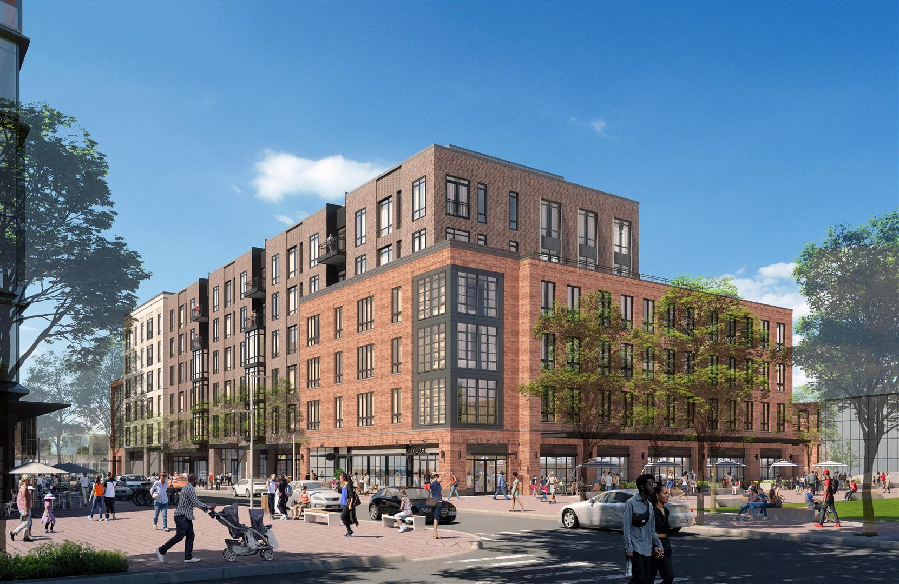



Passive House: Northland Newton Development
Features:
Largest passive house residential community in the US
LEED Gold building standards
Efficient use of daylighting
Highly efficient heating
Solar energy
Kent Gonzales (MSRED 1985)
Left: © Kent Gonzales; above: © Newton Northland Development. All rights reserved. This content is excluded from our Creative Commons license. For more information, see https://ocw.mit.edu/help/faq-fair-use/.

Slide 19
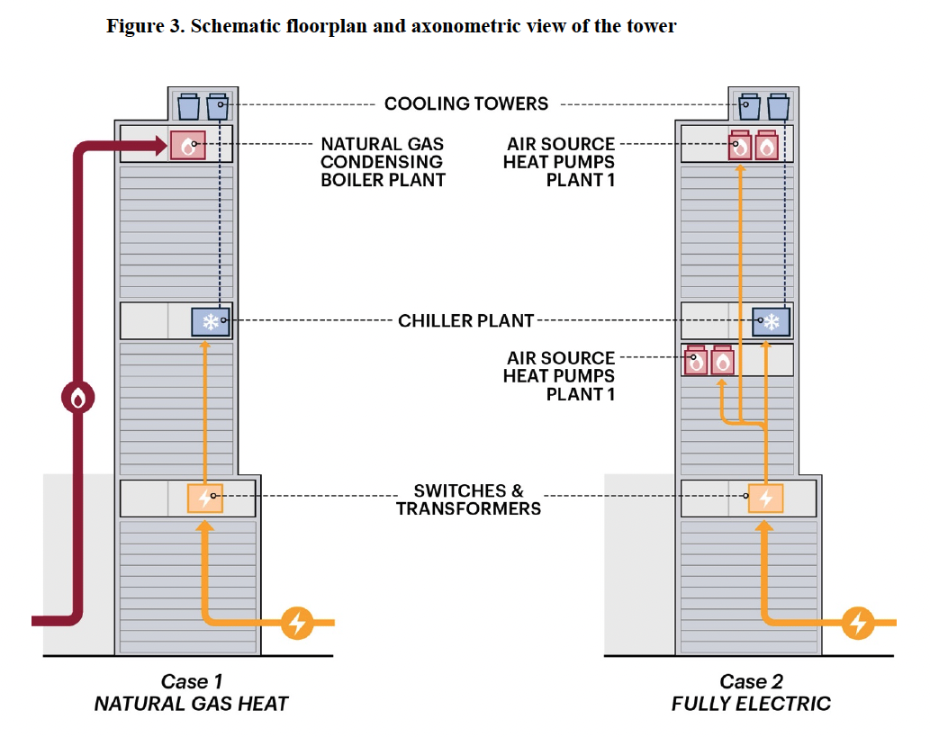
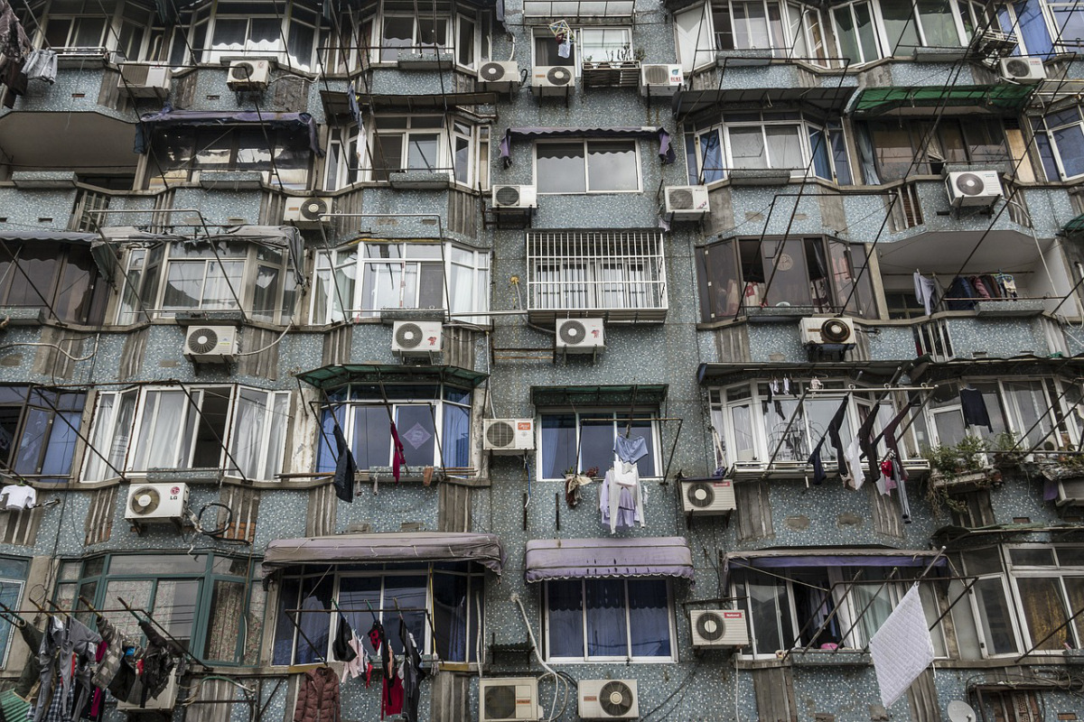
Electrification: Pathway to Net Zero
© Sławomir Kowalewski. Via Pixabay. Image free for use.
Cooling
Heating
© source unknown. All rights reserved. This content is excluded from our Creative
Commons license. For more information, see https://ocw.mit.edu/help/faq-fair-use/.

Slide 20
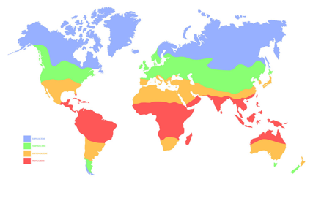

Images © source unknown. All rights reserved. This content is excluded from our Creative
Commons license. For more information, see https://ocw.mit.edu/help/faq-fair-use/.
Heat pump technology
Temperate Climates
Highly efficient heating and cooling
Eliminates need for separate heating + cooling systems
Health benefits from reduced natural gas use
Improved occupant comfort from reduced noise and better humidity control
Polar / Subpolar
Temperate
Subtropical
Tropical
Subtropical / Tropical Climates
Highly efficient cooling (especially as compared to window ACs)
Improved occupant comfort from reduced noise and better humidity control
Notes:
Heat pumps can provide energy efficiency benefits in not just moderate and cold climates.
Heat pumps also provide efficient cooling (as efficient as the top-performing ACs on the market)
Compared to central cooling systems, heat pumps provide similar AC performance
Compared to window ACs, heat pumps provide significantly higher AC performance (as much as 40%)
In continental / polar climates:
Heat pumps can significantly reduce cost of heating compared to natural gas furnaces
They also provide health benefits from reducing the burning of natural gas
In very cold climates, current heat pump technology is not as efficient, and may need to be paired with a natural gas system (hybrid system)
But technology is advancing to make heat pumps perform better in very cold climates
In temperate / dry climates:
Heat pumps can significantly reduce cost of heating compared to natural gas furnaces
Many buildings in moderate climates also rely on electric resistance heating, which is significantly more expensive than heat pump heating
Eliminate need for separate cooling and heating systems
Provide health benefits from reducing the burning of natural gas
Reduce noise compared to window AC units
In tropical climates:
Heat pumps provide cooling as efficiently as the most efficient ACs on the market
Heat pump systems are significantly more efficient than window AC units
Compared to window ACs, heat pumps are better at dehumidifying air, and thus improving comfort
Heat pumps are less noisy than window AC units
Cities
Beijing: temperate
Mumbai: tropical
NYC, Boston: temperate
New Orleans: subtropical
Cooling:
Hot air from inside the home is blown through the coil heat exchanger, which contains a cold liquid refrigerant, providing cold air into the home.
Since heat was removed from the air and transferred into the liquid refrigerant, the refrigerant now becomes warmer.
The refrigerant then moves through a compressor to get even warmer, at which point it is hotter than the outdoor air.
Since the refrigerant is now hotter than the outdoor air, it becomes cooler once it comes into contact with the outdoor air.
Now the refrigerant is a bit cooler, and then it gets even colder when it passes through the expansion valve.
The cycle is complete, and the cold refrigerant is used to cool the air in the home, as described in Step 1.
Heating:
Cold air from inside the home is blown through the coil heat exchanger, which contains a warm liquid refrigerant, providing warm air into the home.
Since heat was removed from the refrigerant and transferred into the air , the refrigerant now becomes cooler.
The refrigerant then moves through an expansion valve to get even cooler, at which point it is colder than the outdoor air.
Since the refrigerant is now colder than the outdoor air, it becomes warmer once it comes into contact with the outdoor air.
Now the refrigerant is a bit warmer, and then it gets even warmer when it passes through the compressor.
The cycle is complete, and the warm refrigerant is used to heat the air in the home, as described in Step 1.

Slide 21
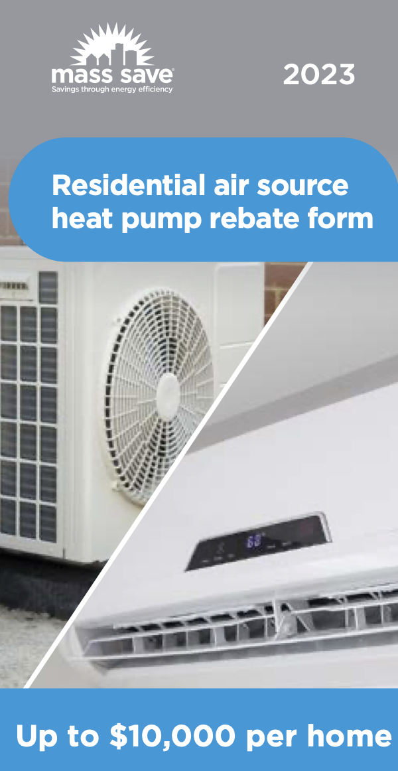
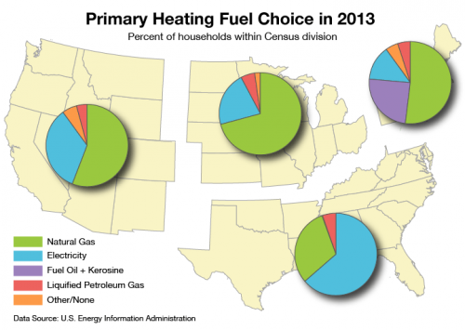
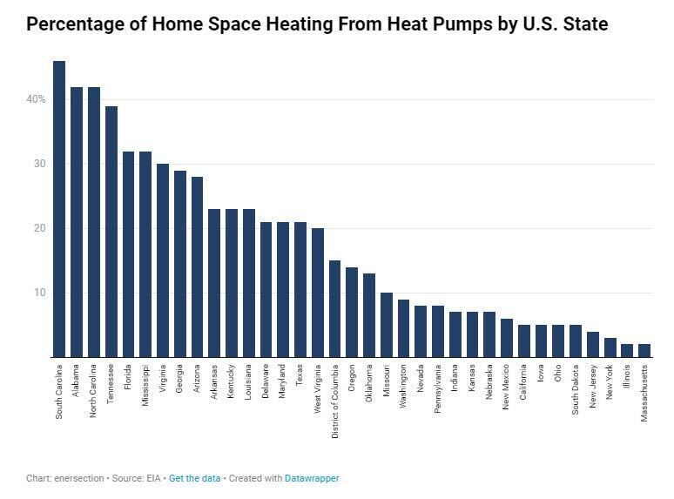

Heat pump adoption in Massachusetts
Favorable conditions for heat pumps
Technological improvement
Unfavorable conditions for heat pumps
Cold climate / high heating loads
High equipment / labor costs
High electricity prices
Low natural gas prices
Utility / govt subsidies
Building envelope improvements
Tax credits / exemptions
MA
Top left © MassSave.; upper right © Climate Central; lower right © enersection.; lower left © source unknown. All rights reserved. This content is excluded from our Creative Commons license. For more information, see https://ocw.mit.edu/help/faq-fair-use/.
Notes:
The economics of electrifying homes in MA depends on energy prices, technological performance and costs, and government incentives
Due to its cold climate, high heating requirements, and high electricity prices, heat pumps are not as cost-effective in the northeast as they are in other places in the US, particularly in the South.
Cold climate double whammy – heat pumps perform less efficiently at colder temperatures, and also colder temperatures require higher heating loads.
In states where heat pumps are more difficult to adopt, subsidies are needed from utilities and governments to help offset the capital costs of installing a heat pump.
In MA, the state awards up to $10,000 per home for installing a heat pump
Federally, the Inflation Reduction act provides up to $3,200 in tax credits for implementing energy conservation measures such as adopting heat pumps
For commercial buildings, there are less of these subsidies, making it even more difficult to adopt heat pumps

Slide 22
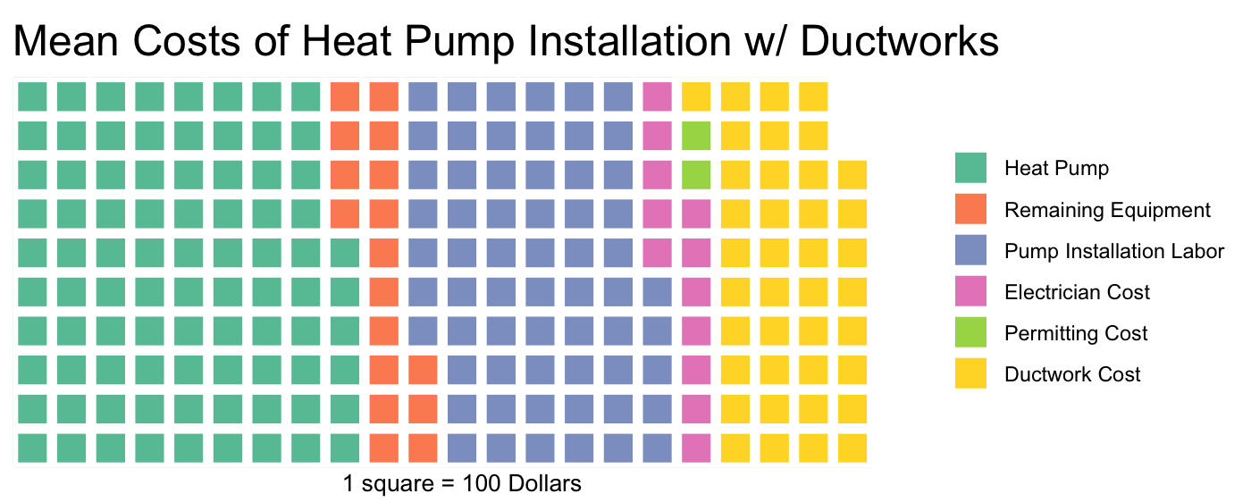
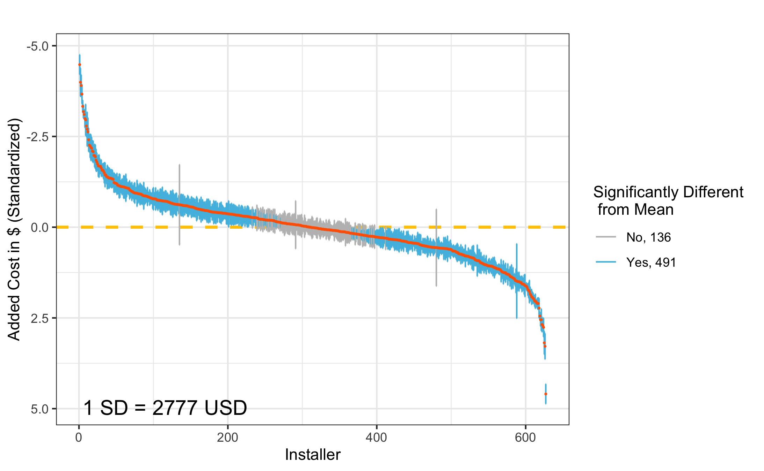

Heat pump costs
Added cost of heat pump installation by installer
(Total $≈$ $22k)
Typical MA residential heat pump subsidy (~$10k)
The cost of installing a heat pump varies significantly among installers
Notes:
Each point represents a contracting company’s estimated added cost, with 95% confidence intervals.
Contractors colored in blue indicate a significant added cost above or below the mean.
Majority of contractors significantly deviate from the mean (491 versus 136)
One standard deviation here represents $2,777 in added costs, with the average heat pump installation in the home being $10,132.

Slide 23





The economics of adopting decarbonization technologies
OR
OR
Benefit
Design/Construction
Tenancy
Operation
Refurbishment/Acquisition
OR
Cost
Penalty
Discount rate i (expected rate of return)
Fully electric building cash flow
© source unknown. All rights reserved. This content is excluded from our Creative
Commons license. For more information, see https://ocw.mit.edu/help/faq-fair-use/.

Slide 24
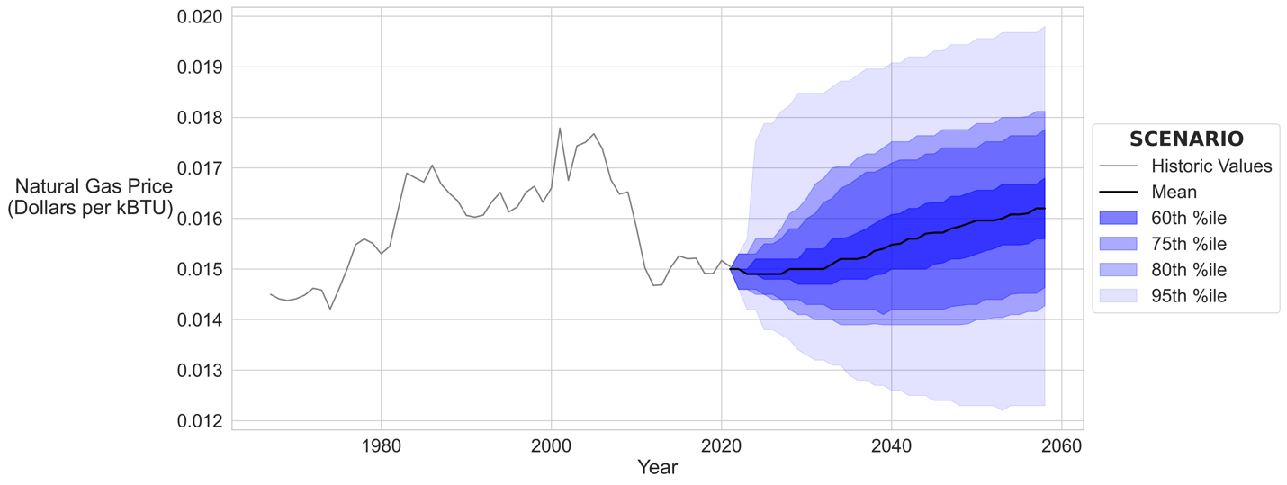
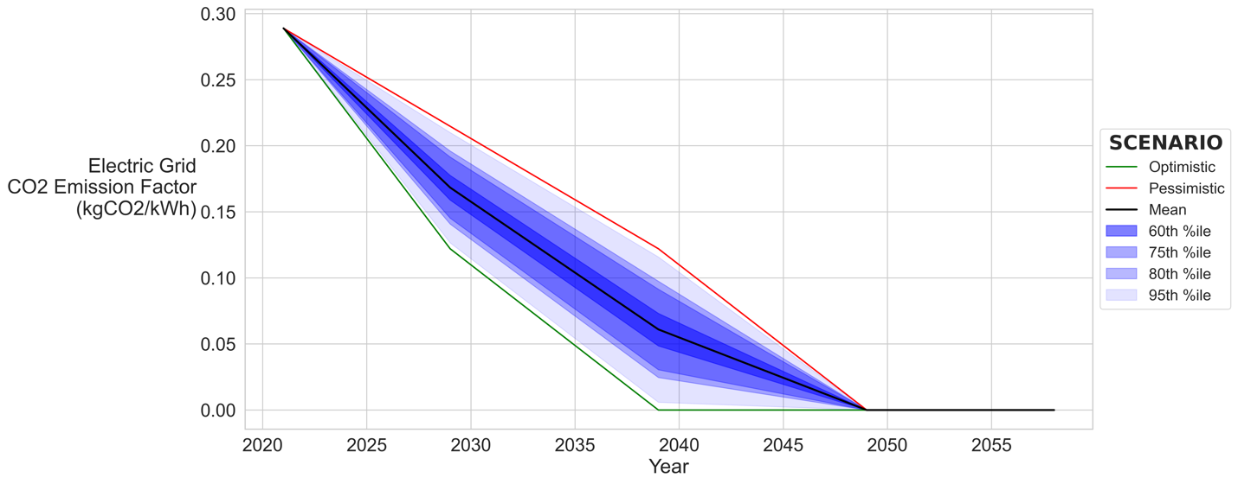
More Uncertainties
Natural Gas Prices
Rate of Grid Decarbonization

Slide 25
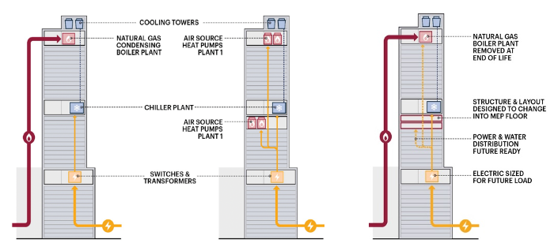
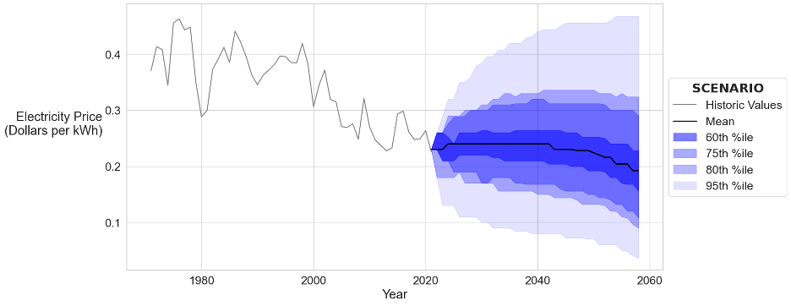
Quantifying the financial value of building decarbonization technology under uncertainty
Three design options:
And a whole lot of uncertainty:
Natural Gas Prices
Electricity Prices
Rate of Grid Decarbonization
Building energy use
Technological development
Energy efficiency market premiums
Equipment performance / costs
And more…
Option A
Building with natural gas heating systems
Option B
Building with fully electric heating systems
Option C
Building with the flexibility to fully electrify in the future
© source unknown. All rights reserved. This content is excluded from our Creative
Commons license. For more information, see https://ocw.mit.edu/help/faq-fair-use/.
In 10,000 different future scenarios, which design option is most profitable most often?

Slide 26
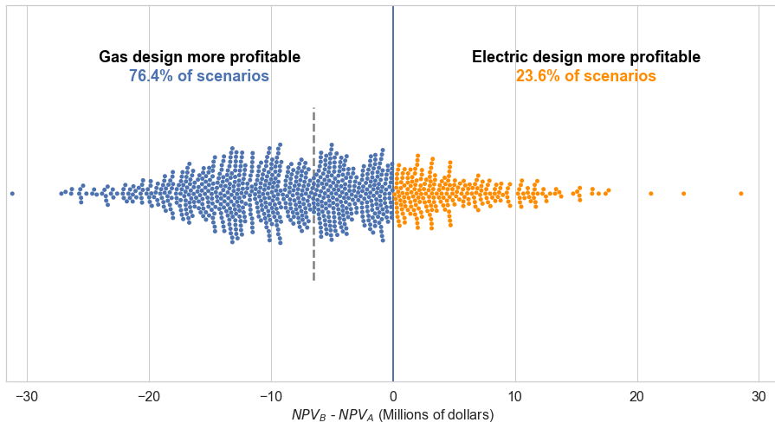
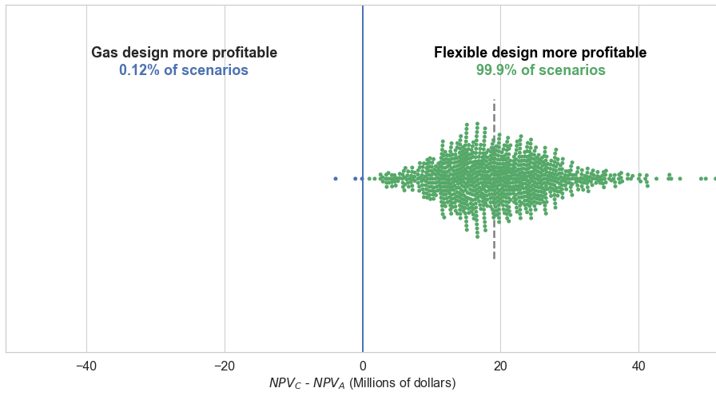
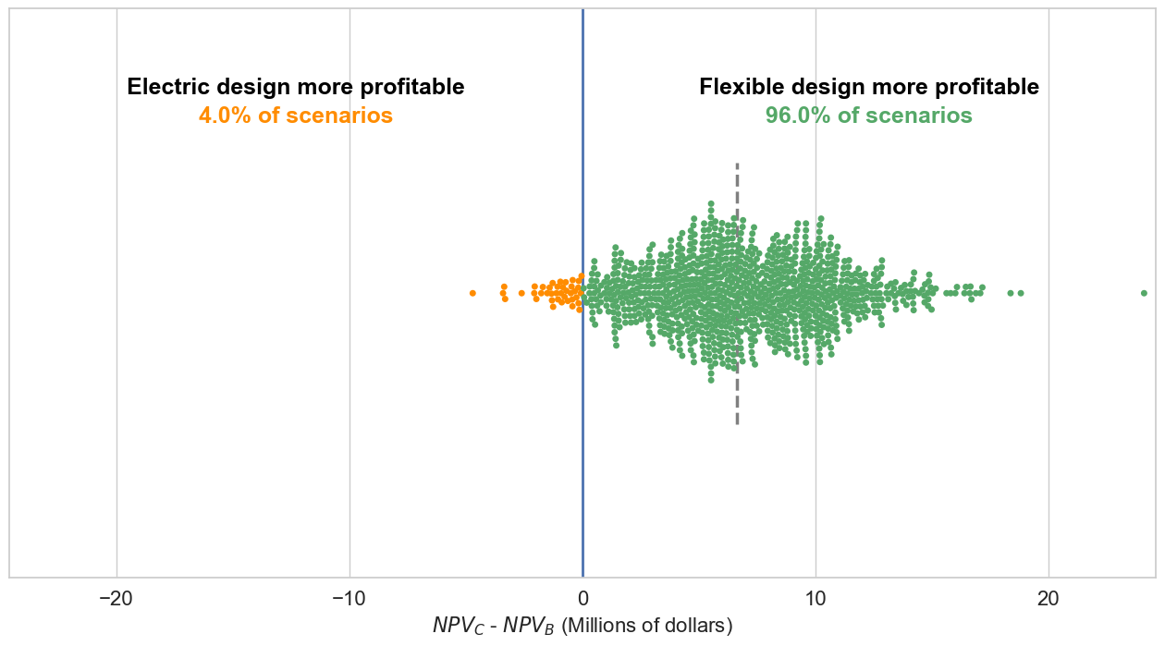
Quantifying the financial value of building decarbonization technology under uncertainty
Results
Each point represents the difference in NPVs of two design options in one scenario
The greater the number of points on one design option’s side, the higher the probability that it will be more profitable across different scenarios

Slide 27
people side: landlord vs. tenant
Split incentive and green lease
Scope 1-2-3: whose carbon it is?

Slide 28


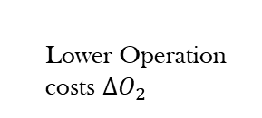


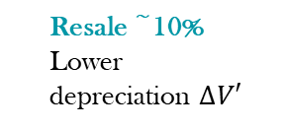
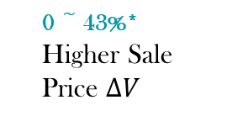

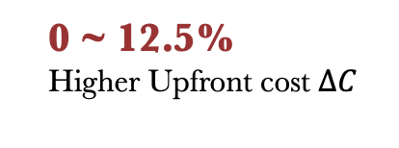
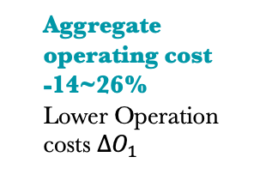
Is There a Business Case for Green Buildings?
Developers
Owners
0 ~ 43%*
Higher Sale Price $∆V$
Rental 0 ~ 17%*
Occupancy 0~23%
Higher Effective Rent $∆R$
Resale ~10%
Lower depreciation $∆V′$
Benefit
Design/Construction
Sale
Tenancy
Operation
Refurbishment/Acquisition
Aggregate operating cost
-14~26%
Lower Operation costs $∆O_{1}$
$$year T$$
Cost
0 ~ 12.5%
Higher Upfront cost $∆C$
0 ~ 43%*
Higher Purchaing Price$∆V$
Lower discount rate i (cost of capital)
Less hospital stays
Learn faster
Higher Productivity/Health/
WB $∆H$
Tenants
Operation
Tenancy
Operation
Tenancy
Lower Operation costs $∆O_{2}$
Higher Rent$∆R$

Slide 29

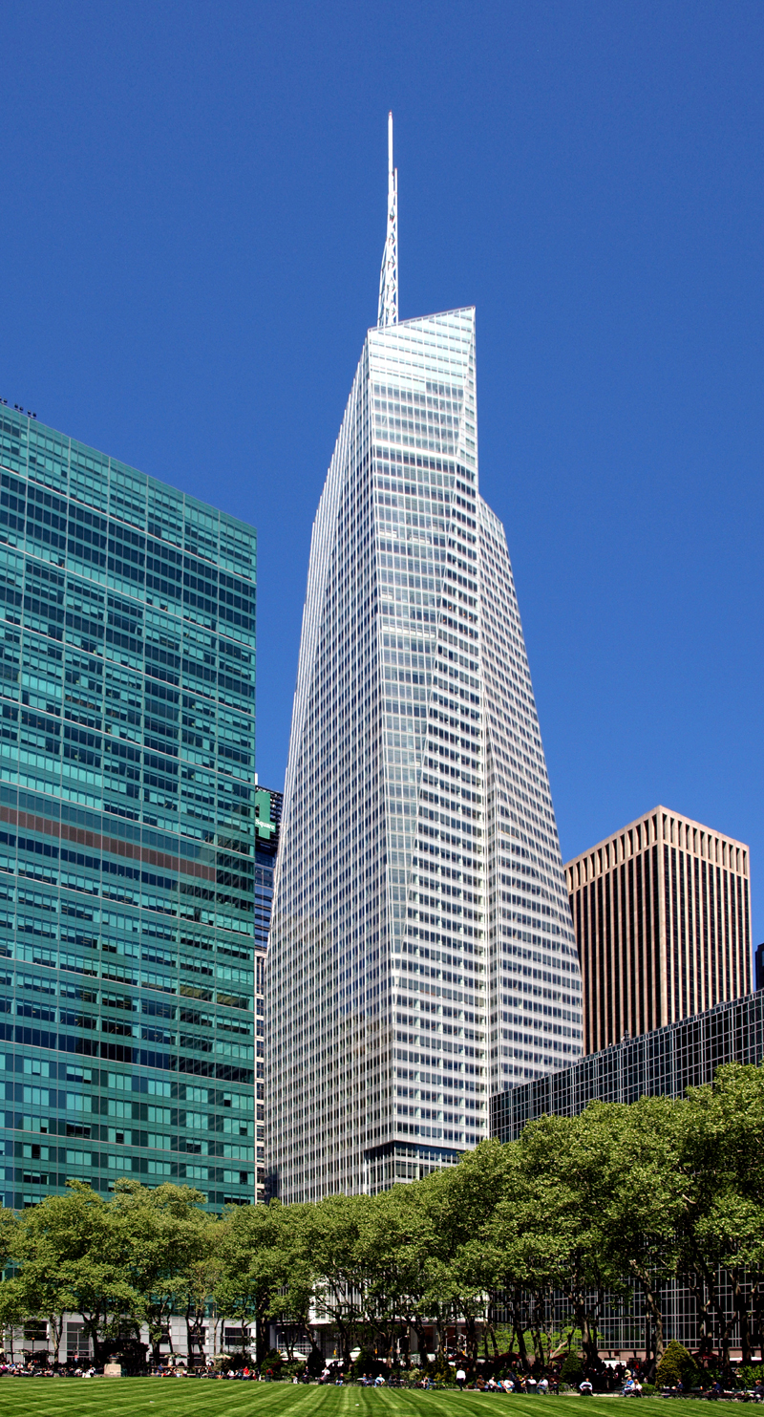
Performance Gaps
Actual energy consumption >> projected energy consumption
  Gas, electricity, energy cost: up to +125%, +275%, +235% (ARUP, 2013)
Possible reasons
  Energy models don’t consider behaviors
  Construction/operation practice don’t follow design intent
  Split incentives
Possible solutions?
Headline © The New Republic; photo © source unknown. All rights reserved. This content is excluded
from our Creative Commons license. For more information, see https://ocw.mit.edu/help/faq-fair-use/.
Notes:
Ask students.
When the Bank of America Tower opened in 2010, the press praised it as one of the world’s “most environmentally responsible high-rise office building.” LEED Platinum certification—the first ever for a skyscraper.
the Bank of America Tower produces more greenhouse gases and uses more energy per square foot than any comparably sized office building in Manhattan. It uses more than twice as much energy per square foot as the 80-year-old Empire State Building. It also performs worse than the Goldman Sachs headquarters, maybe the most similar building in New York—and one with a lower LEED rating.
LEED is designed for developers who have either no clue or no control over what their tenants might do inside the building.
The biggest drain on energy in the Bank of America Tower is its trading floors, those giant fields of workstations with five computer monitors to a desk. Assuming no one turns these computers off, in a year one of these desks uses roughly the energy it takes a 25-mile-per-gallon car engine to travel more than 4,500 miles. The servers supporting all those desks also require enormous energy, as do the systems that heat, cool, and light the massive trading floors beyond normal business hours. These spaces take up nearly a third of the Bank of America Tower’s 2.2 million total square feet, yet the building’s developer and architect had no control over how much energy would be required to keep them operational.
Split incentive: If the lease is not the net lease – tenants have no incentive to save energy.

Slide 30
Who should pay the energy bill?
Lease types and expense matrix of tenants:
 | Triple net | Double net | Single net | Full Service Gross
Base rent | Y | Y | Y | Y
Utilities and operating costs | Y | Y | Y
Property taxes | Y | Y | Y
Insurance | Y | Y
Maintenance & repair costs | Y
In terms of energy efficiency, what will be the problems?

Slide 31


Split incentive: Who should pay the energy bill?
If tenants pay the bill (such as the “triple net lease”, NNN)
Net Lease
Owner
Does not pay the energy bill thus will not benefit if they pay for energy efficiency upgrades
Tenants
Do pay the energy bill but do not own the building, thus usually hesitant to make long-term investment on someone else’s building.
Gross Lease
Similarly, for buildings with a full-service lease structure (i.e., no additional expenditure for utility):
The owner wants to keep the energy cost down
Tenants have no incentive to save energy as they pay the flat rate.

Slide 32
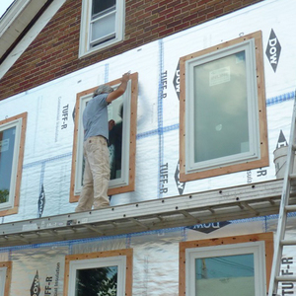
Case: Green Retrofit in Rockville, Maryland
Lundberg owns an old building that he leases to some tenants.
He has had an energy audit and identified some retrofit opportunities to substantially reduce energy use.
Should he go for it?
After class reading: HBS case 9-212-067 “Edward Lundberg and the Rockville Building: Energy Efficiency Finance in Commercial Real Estate”
Image © source unknown. All rights reserved. This content is excluded from our Creative
Commons license. For more information, see https://ocw.mit.edu/help/faq-fair-use/.
Notes:
It would be a good activity to let the students work with the excel to understand the case thoroughly.
→ If not going to teach in class, I will guide them through the excel sheet in recitation.

Slide 33
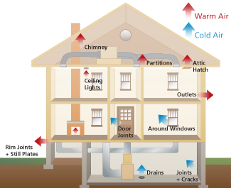
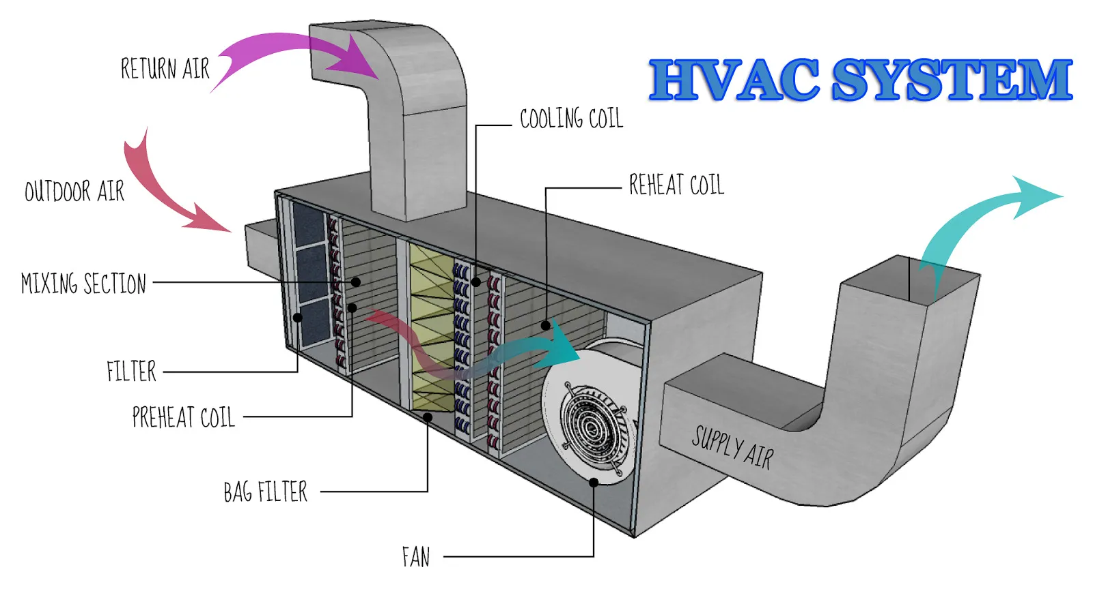


Case: Rockville Building
Retrofit opportunities identified in energy audit:
Projected cost and benefit:
COST: $4-8/SF
BENEFIT: 30% Energy Saving
Improve building weatherization
(sealing up air leaks and adding insulation)
Install more efficient HVAC system
Install more efficient lighting system
Retro-commissioning
(improve control system for HVAC, add motion sensors to lighting, etc.)
Top: image is in the public domain. Bottom images © source unknown. All rights reserved. This
content is excluded from our Creative Commons license. For more information, see https://ocw.mit.edu/help/faq-fair-use/.

Slide 34
Case: Rockville Building
Retrofit Assumption |  |  | Property Assumption
Forecast EE saving | 30% |  | Total sqaure feet | 200,405
Choice of EE retrofits | DIY Equity |  | Rental rate, $/SF, net lease | $41.37
Actual Energy Savings, Variation relative to forecast | 0% |  | Occupancy rate | 85%
Rent premium from retrofit, % change | 0% |  | Rental rate annual escalation | 3%
Change in occupancy rate from retrofit, %-point change | 0% |  | Maintenance & repairs cost escalation | 3%
Energy cost annual escalation | 3% |  | Tenant share of energy costs | 90%
Energy demand escalation | 2% |  | Owner share of energy costs | 10%
Upfront capital costs of EE project, $/SF | $6.00 |  | Average energy intensity, kWh/SF/yr | 30
Upfront capital costs of EE project, $ total | $1,202,430.00 |  | Price per kWh, $ | $0.11
Owner Cost of Capital Assumptions:
DIY Equity | 15%
Notes:
Let the students open the excel sheet and walk them through the real cash flow.
First the input needed:
Red: Key projections about the retrofit cost and benefit.
Blue: Key assumptions on energy price and demand.

Slide 35
Pro Forma – Baseline
BASE CASE - PRO FORMA - NO RETROFIT |  | Year | 0 | 1 | … | 10
Baseline electrical demand (total, kWh) |  |  | 6012150 | 6132393 |  | 7328777
Energy price, $/kWh |  |  | $0.11 | $0.11 |  | $0.15
Total energy cost, entire building |  |  | $661,337 | $694,800 |  | $1,083,419
Rent, $/SF |  |  | $41.37 | $42.61 |  | $55.60
Occupancy |  |  | 85% | 85% |  | 85%
Revenues
Gross rents possible |  |  | $8,290,755 | $8,539,477 |  | $11,142,081
Parking revenue |  |  | $509,040 | $509,040 |  | $509,040
Vacancy allowance |  |  | ($1,319,969) | ($1,357,278) |  | ($1,747,668)
Effective gross revenue |  |  | $7,479,826 | $7,691,240 |  | $9,903,453
Operating expenses
Energy cost, owner only |  |  | $66,134 | $69,480 |  | $108,342
Maintenance & repairs, owner | rate ($/SF/yr) | 0.5 | $100,203 | $103,209 |  | $134,664
Other expenses (taxes, G&A, insure, etc.) | rate ($/SF/yr) | 7.65 | $1,533,098 | $1,533,098 |  | $1,533,098
Total operation expenses |  |  | $1,699,434 | $1,705,787 |  | $1,776,104
Cash flow from operations |  |  | $5,780,391 | $5,985,453 |  | $8,127,349
Cap rate | 8%
Property value |  |  |  |  |  | $101,591,864
Notes:
Traditional cash flow analysis: work the students through the key elements.

Slide 36
Pro Forma – Retrofit Impact (TOTAL)
EE RETROFIT IMPACT | DIY Equity |  | Year | 0 | 1 | … | 10
TOTAL BUILDING IMPACT (LANDLORD AND TENANTS)
Annual kWh reduction (forecast) |  |  |  |  | 1,839,718 |  | 2198633
Annual kWh reduction (realized) |  |  |  |  | 1,839,718 |  | 2198633
Revenue improvement
Improvements from higher rent |  |  |  |  | - |  | -
Improvements from higher occupancy |  |  |  |  | - |  | -
Total rent improvements |  |  |  |  | - |  | -
Cost savings
Energy cost savings (forecast) |  |  |  |  | $208,440 |  | $325,026
Energy cost savings (realized) |  |  |  |  | $208,440 |  | $325,026
Upfront capital costs |  |  |  | - $1,202,430
CF impact TOTAL |  |  |  | - $1,202,430 | $208,440 |  | $325,026
NPV TOTAL | $39,470 | $39,470
Cost of capital, owner | 15% | 15%
Green retrofit seems fruitful!
Notes:
Let the students open the excel sheet and walk them through.

Slide 37
Case: Rockville Building
Is the analysis above missing something?
Split Incentive under a NNN lease:
  Audit showed clear energy saving benefits, which outweighs the investment cost. BUT,
  Tenants get energy saving benefits.
  Owners bear the upfront capital investment cost
Notes:
Capital finance challenge: due to the uncertainty of energy savings from a retrofit, future energy saving projections cannot be used as collateral.

Slide 38
Pro Forma – Retrofit Impact (Landlord vs. Tenants)
EE RETROFIT IMPACT | DIY Equity | Year | 0 | 1 | … | 10
OWNER
Improvement rent revenue
Energy cost savings | owner's share | 10% |  | $20,844 |  | $32,503
Total CF from Ops improvement |  |  | $0 | $20,844 |  | $32,503
Upfront capital costs | owner's share | 100% | - $1,202,430
Cash Flow impact, Owner |  |  | - $1,202,430 | $20,844 |  | $32,503
NPV | - $937,085
Cost of capital, owner | 15%
PV of property value improvement* | $100,427
* Assuming sale in year 10 |  |  |  |  |  | $406,282
TENANTS
Rent increase, tenants |  |  |  | - | - | -
Energy cost savings, tenants | tenant's share | 90% |  | $187,596 |  | $292,523
CF impacts, Tenants |  |  | $0 | $187,596 |  | $292,523
NPV | $1,271,789
cost of capital, tenants | 10%

Slide 39







Win-Lose
Owner’s analytical horizon
No change in rent
Lower depreciation $∆V′$
Benefit
Tenancy
Operation
investment
Lower Operation Costs $∆O_{1}$
$$year T$$
Cost
Higher upfront
investment cost $∆V$
Owner NPV:
- $937,085
(10% Energy saving)
(100% capital cost)
Operation
No change in rent
Lower Operation Costs $∆O_{2}$
Tenant NPV:
+$1,271,789
(90% Energy saving)
Tenant’s analytical horizon
Solutions?

Slide 40




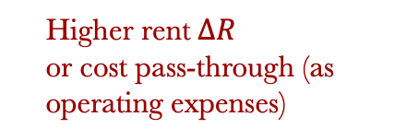









Green Lease: Cost Pass-Through (Cost Recovery)
  34% of commercial leases already have some green lease conditions with another 40% planning to sign by 2025 (source).
  Logic of green lease:
Higher effective rent $∆R$
or cost recovery
Owner
Benefit
Operation
Cost
$$year 1$$
$$…$$
$$year T$$
$$year T+1$$
$$…$$
Tenant
Payback period
$$Energy efficiency$$
$$investment ∆V$$
Tenant enjoys full benefit of energy saving after payback
$$year T+1$$
$$…$$
$$year T$$
$$…$$
$$year 1$$
Lower operation costs $∆O_{2}$
Higher rent$∆R$
or cost pass-through (as operating expenses)

Slide 41
Pro Forma – Retrofit Impact (After Cost Pass-through)
The owner can increase rent
  Not too high so that for tenants: Rent increase < Energy saving benefit
EE RETROFIT IMPACT | DIY Equity | Year | 0 | 1 | … | 10
OWNER
Revenue improvement
Incremental rent, $/SF | rent increase | 2.7% | - | $1.15 |  | $1.50
Improvement in gross rent |  |  | - | $230,566 |  | $300,836
Vacancy allowance |  |  | - | - $34,585 |  | -$45,125
Increase in effective rent revenue |  |  | - | $195,981 |  | $255,711
Cost savings
Energy cost savings | owner's share | 10% |  | $20,844 |  | $32,503
Total CF from Ops improvement |  |  | $0 | $216,825 |  | $288,213
Upfront capital costs | owner's share | 100% | -$1,202,430
Cash Flow impact, Owner |  |  | - $1,202,430 | $216,825 |  | $288,213
NPV | $11,299
Cost of capital, owner | 15%
PV of property value improvement* | $890,524
* Assuming sale in year 10 |  |  |  |  |  | $3,602,667
TENANTS
Rent increase, tenants |  |  | - | - $195,981 |  | - $255,711
Energy cost savings, tenants | tenant's share | 90% |  | $187,596 |  | $292,523
CF impacts, Tenants |  |  | - | - $8,385 |  | $36,812
NPV | $49,885
cost of capital, tenants | 10%
Notes:
Before displaying this: Can let the students play with the rent increase percentage in the excel to come up with the best rent setting strategy.

Slide 42






Win-Win
Owner’s analytical horizon
(+2.7%)
Higher
Effective Rent $∆R$
Lower depreciation $∆V′$
Benefit
Tenancy
Operation
investment
Lower Operation Costs $∆O_{1}$
$$year T$$
Cost
(10% Energy saving)
Owner NPV:
$11,299
Higher upfront
investment cost $∆C$
Cost pass-through
through rent
Operation
Lower Operation Costs $∆O_{2}$
Higher Rent$∆R$
(90% Energy saving)
Tenant NPV:
$49,885
Tenant’s analytical horizon

Slide 43
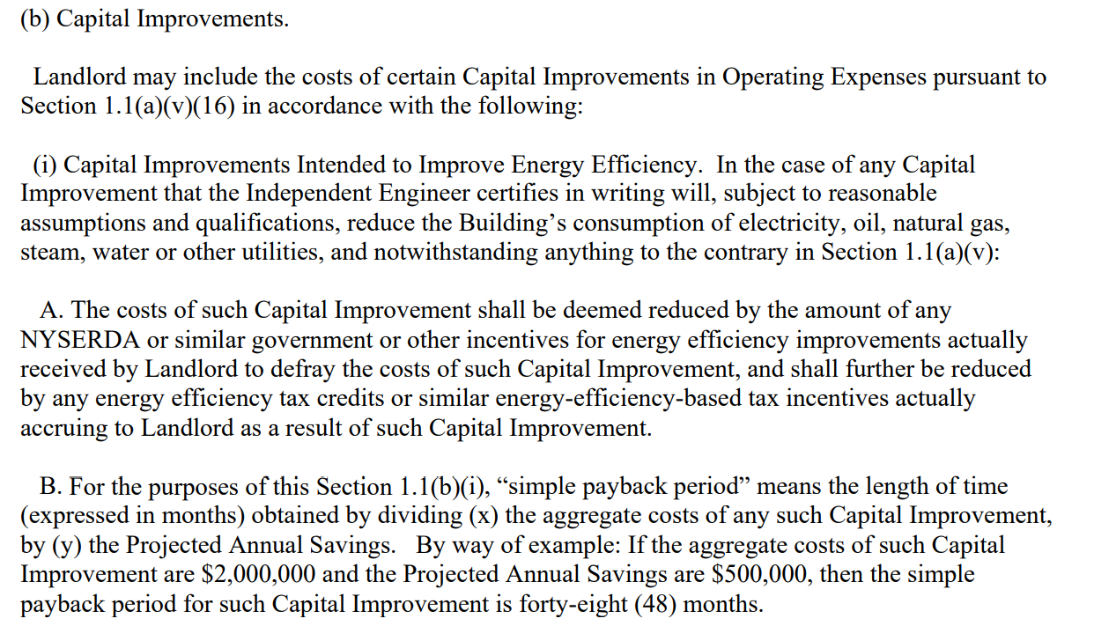
Green Lease Clauses
Define the types of capital cost can be recovered from operation expenses.
The cost recovery should deduct government subsidies.
The cost recovery should base on projected energy saving within payback period.
Source: http://www.nyc.gov/html/gbee/downloads/pdf/eac_overview.pdf . © City of New York. All rights reserved. This content is
excluded from our Creative Commons license. For more information, see https://ocw.mit.edu/help/faq-fair-use/.
Notes:
In normal leases, leasing and capital expenditure (i.e., expenditures for anything beyond normal wear and tear) are more likely to benefit the landlord and should not be paid by tenants.
The key for cost pass-through green lease: turn certain types of capital improvement expenditure (which intended to improve energy efficiency) into the reimbursable expenses.
Can add underperformance buffer the clause.
What are the uncertainties in the current cash flow analysis?
Energy cost (e.g., policies like carbon tax)
Achieved energy saving of the retrofit
Tenants willingness-to-pay for rent (e.g., demand for green; risk aversion)
Policy mandates on energy efficiency
……
2. Are there alternative leasing strategies to pass-through the cost? What are the pros and cons?

Slide 44

Green Lease Mini Case I
Brandywine Realty Trust: one of the largest full-service integrated real estate companies in the nation. [cost pass-through + submetering clause]
Provide financial evidence
Show tenants the cost and utility savings.
Monitoring the performance
Make the cost pass-through spreading over time for the tenants. If the upgrade underperform, reduce the repay amount and extend repayment period.
Address tenant turnover
If a tenant moves out before fully repaid, new tenant assumes the payback obligation.
Case Source. © Brandywine Realty Trust. All rights reserved. This content is excluded from our
Creative Commons license. For more information, see https://ocw.mit.edu/help/faq-fair-use/.
Notes:
This case addresses how to get tenants on board through making sure they gain from this deal.
Case:
https://www.imt.org/wp-content/uploads/2018/02/brandywine_case_study_10-15-12.pdf

Slide 45

Green Lease Mini Case II
Brixmor Property Group: publicly traded real estate investment trust (REIT); owns and operates the nation’s largest open-air shopping centers in 36 states.
In the lease:
Brixmor (landlord) can install renewable energy systems.
→ partner with Blue Sky Utility
Tenants
  need to purchase electricity from the landlord/ landlord designee.
  Need to install submeters.
© Blue Sky Utility. All rights reserved. This content is excluded from our Creative
Commons license. For more information, see https://ocw.mit.edu/help/faq-fair-use/.
Notes:
Landlords can work with renewable energy companies to achieve the upgrades.
Case:
https://www.dropbox.com/s/cdwxca2k74o8gqm/Green-Lease-Leaders-Using-the-Lease-to-Drive-Innovation-and-Clean-Energy.pdf?dl=0

Slide 46





A new pressure on both landlords and tenants
Google Headquarters, 325 Main Street, Cambridge MA
Landlord
Public companies need to report Scope 1 and Scope 2 emissions, and in some cases also Scope 3 emissions.
Left: © Wall Street Journal; top right and BXP logo: © and trademark of Boston Properties; Google logo trademark of
Google/Alphabet. All rights reserved. This content is excluded from our Creative Commons license. For more information,
see https://ocw.mit.edu/help/faq-fair-use/.
Tenant

Slide 47

Used with permission.

Slide 48
 | Scope 1 | Scope 2 | Scope 3
 | BXP has the operational control; Google does not.
(landlord) | Fuel combustion | Purchased electricity
(tenant) |  |  | Fuel combustion Purchased electricity
 | BXP does not have the operational control; Google has.
(landlord) |  |  | Fuel combustion Purchased electricity
(tenant) | Fuel combustion | Purchased electricity
“bxp” and Google logos are trademarks of Boston Properties and Google/Alphabet respectively.
https://ghgprotocol.org/sites/default/files/standards_supporting/Categorizing%20GHG%20Emissions%20from%20Leased%20Assets.pdf

