Slide 1
SRE Economics Lecture 1
The Economics of Green Buildings (1)
Siqi Zheng
Feb 2023
(MIT Center for Real Estate)
Notes:
In lecture 1, the focus is on the cash flow of green building so that students can understand the key stakeholders involved in this market and the financial value of green building for each stakeholder.
In the next lecture, we will lead the students to think about three most important market failures existed in the green building market (information failure, externality, and split incentive) and how public and private sectors work together to address these problems.

Slide 2
Triple Bottom Lines
People
(Social)
Profit
(Economic)
Planet
(Environmental)
bearable
profitable
sustainable
viable
Lecture today
Notes:
To re-cap: (1) Planet: we are responsible (36%, 39%), we are the “target” (NYC, even 70%, LL97); (2) People: the ultimate goal for us real estate industry is to provide enough and suitable space for live-work-play, cannot just be very tiny rooms with no windows and tight insulation. Also, outside stakeholders: the city, the pop globally. (3) But we cannot only have dream without a sound business strategy. Real estate developers and investors need to make money. Crucial for the private sector (80%).
We know the win-win-win is possible, the intersection is the real sustainability. Shared values. But, due to the capability gap, or market failures, these three bubbles won’t intersect. With good intension, but constrained capability; or with bad intension, “green washing”. -- next lecture. When the three bubbles won’t intersect, any solution?
Two game changers

Slide 3
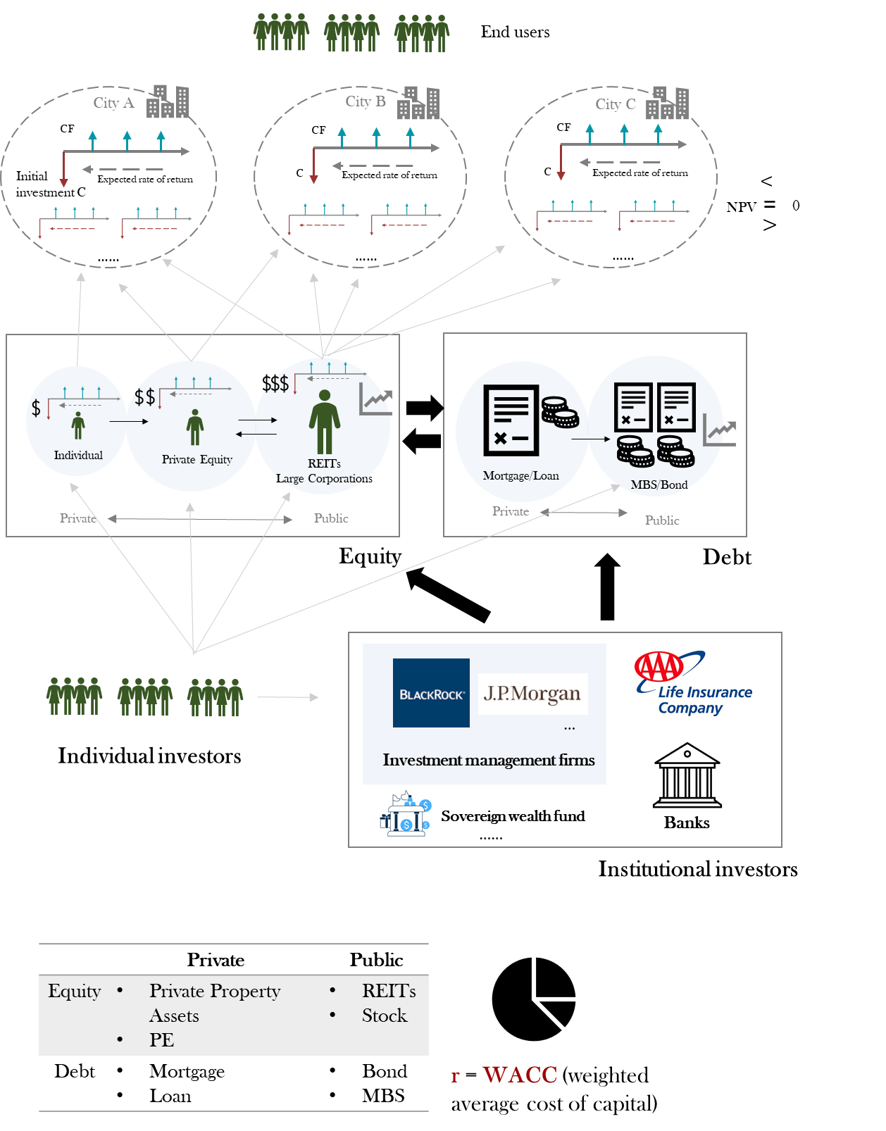
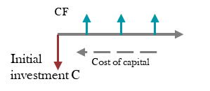
Knowledge Structure
Where we are for this class?
A building!

Slide 4
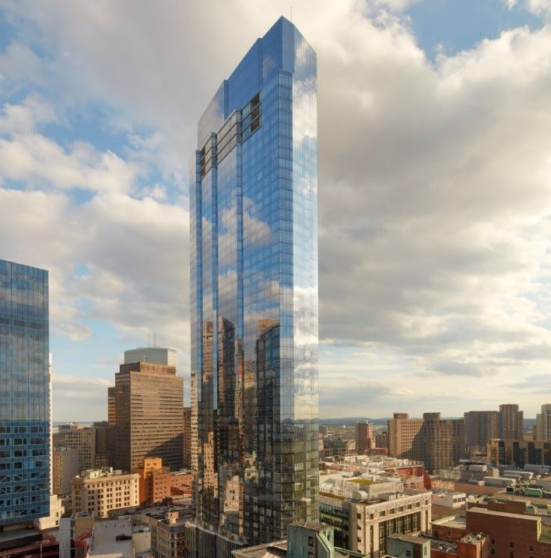
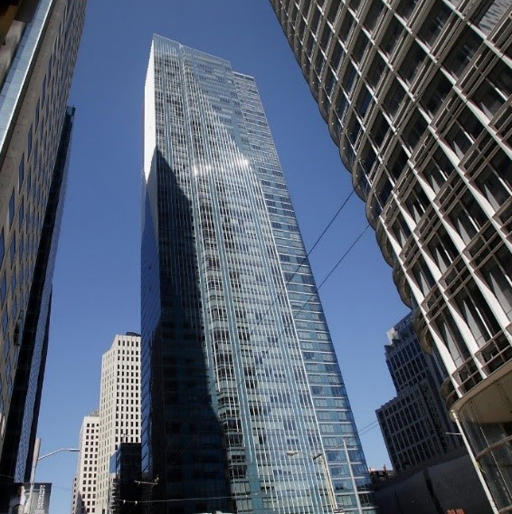
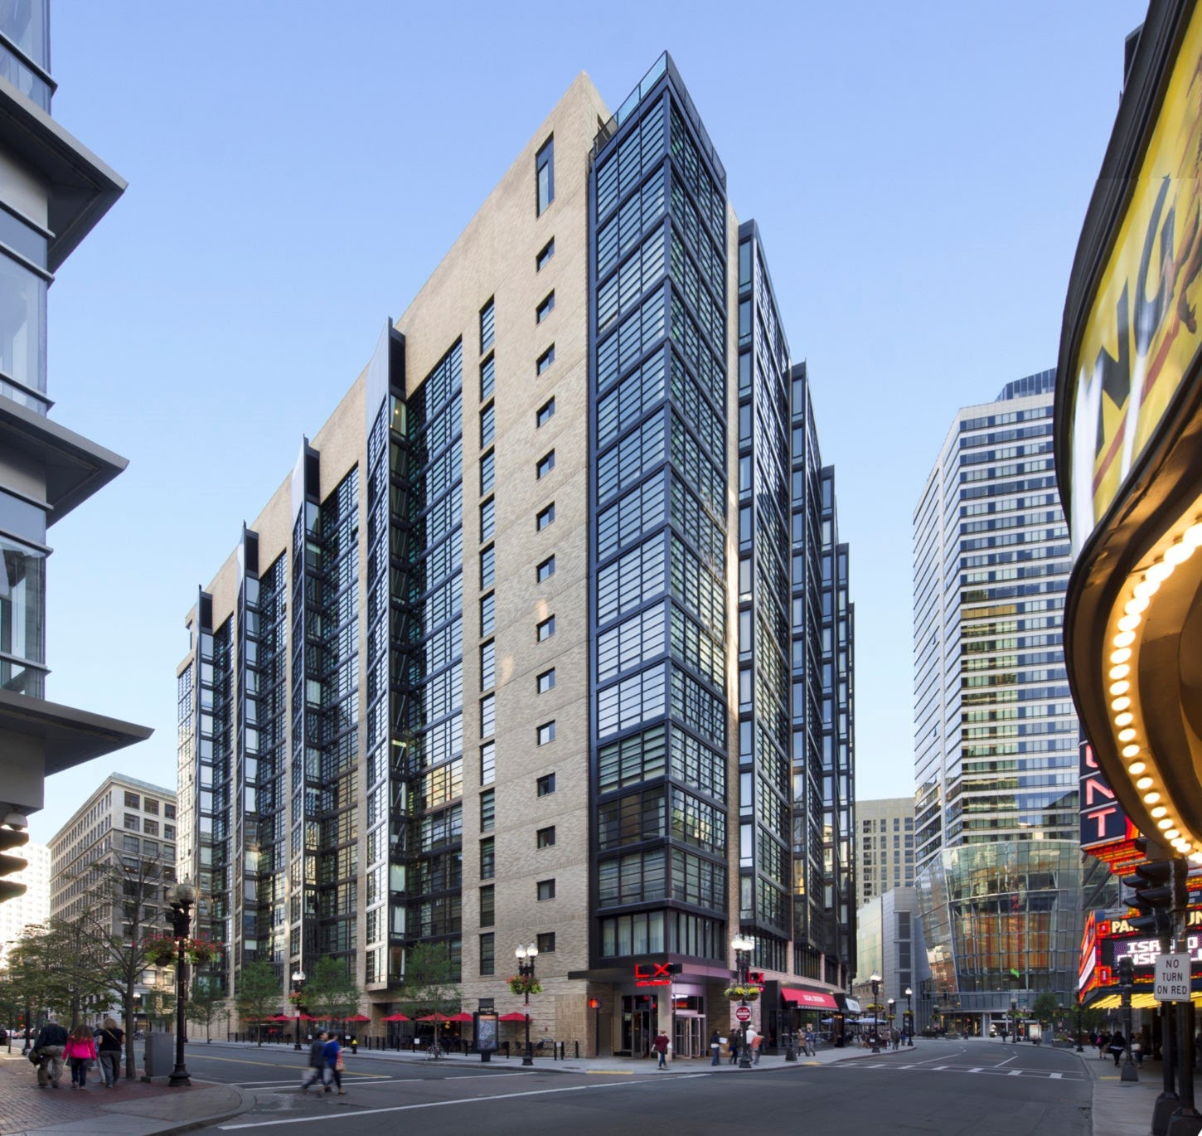
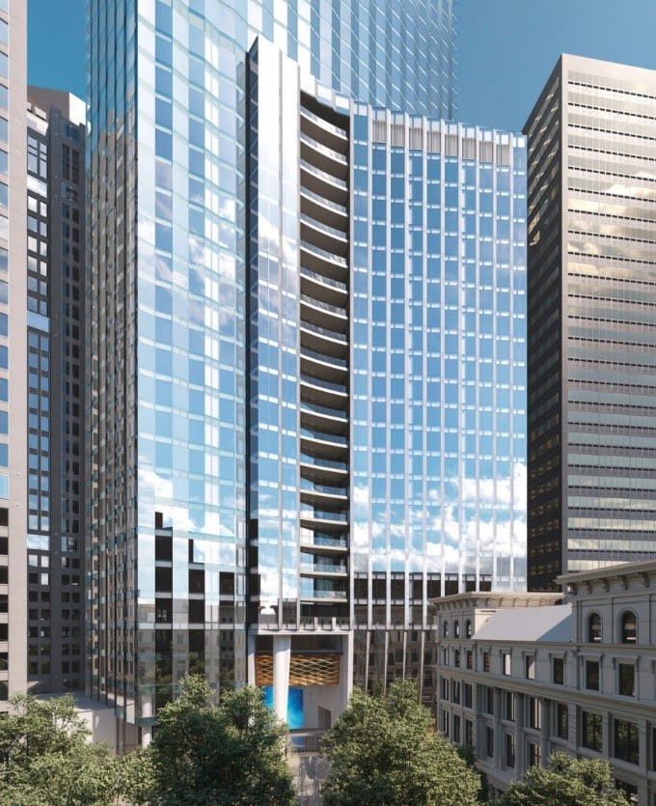
Millennium Partners
WINTHROP CENTER, 2022
Location: Boston
MILLENNIUM PLACE (HAYWARD PLACE), 2013
Location: Boston
Sustainability
Passive House (office)
WELL Gold and LEED Platinum
Focused on job creation, downtown revitalization
MILLENNIUM TOWER, 2008
Location: San Francisco
Focused on ultra-luxury furnishes and amenities for wealthy condo owners
(2016: had sunk 16 inches and tilted)
MILLENNIUM TOWER, 2017
Location: Boston
Focused on ultra-luxury + health and wellness
(two-story club, the largest residence-only fitness center)
Photos © Handel Architects. All rights reserved. This content is excluded from our Creative
Commons license. For more information, see https://ocw.mit.edu/help/faq-fair-use/..
Notes:
2008 SF: Architect: Handel Architects. Two towers: 12-story tower and 58-story tower. Fully sold out by 2013. Allegedly had sunk 8.3 inches by 2009. By May 2016, “had sunk 16 inches into the earth and tilted over 15 inches at its tip and 2 inches at the base”
2013 Boston: Architect: Handel Architects. 390,000SF with 256-unit residential units. 15-story tower. Focused on job creation, downtown revitalization. Job started post-recession. Needed to get mayor on board through jobs created in new construction
2017 Boston: Architect: Handel Architects. 685-foot high mixed-use residential tower. 60-stories high with 442 condos. Replaced the “Big Hole” – a partially excavated site. Mayor considered this site “perhaps his No. 1 development priority”.
2022 Winthrop: 812,000 SF of office space and 572,000SF comprised of 321 luxury condos. Largest Passive House Institute certified office building in the world when completed (estimated for 2022). Estimates 65% less energy than similarly-sized Boston projects. Estimates 30%-50% more fresh air than comparable buildings. Greater access to natural light.

Slide 5
How market may work

Slide 6
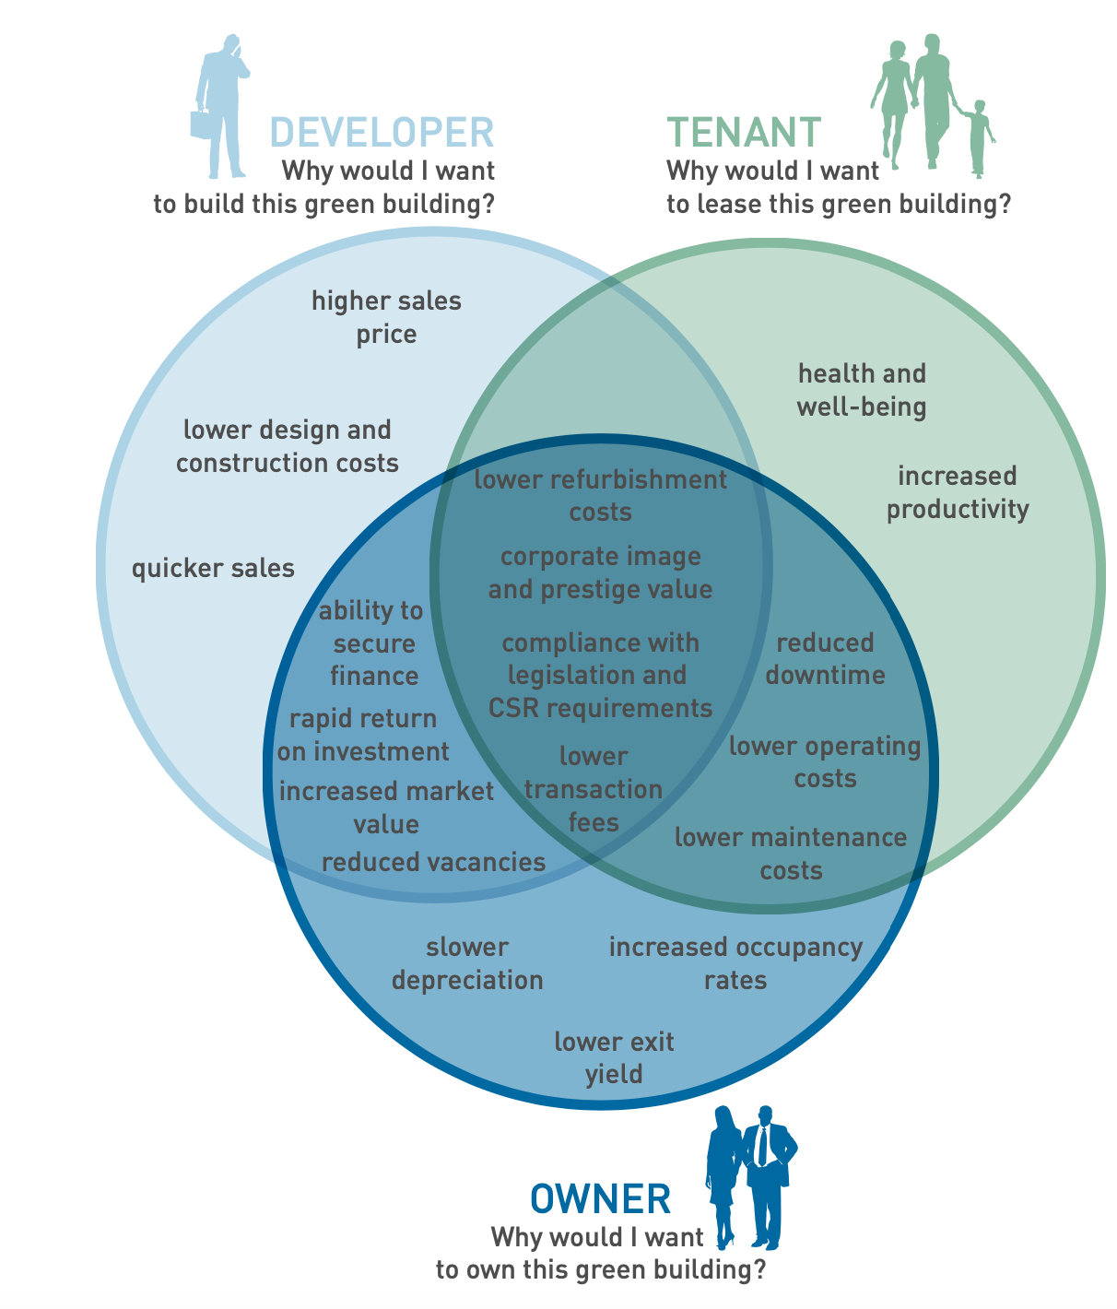
Higher sales price
Not too high design & construction costs
Health & well-being
ESG
Corporate image
Increased productivity
Quicker sales
Lower financing cost
Legislation &
requirement
Lower operating costs
Higher market value
Slower depreciation
Lower retrofit cost
Higher ROI

Slide 7
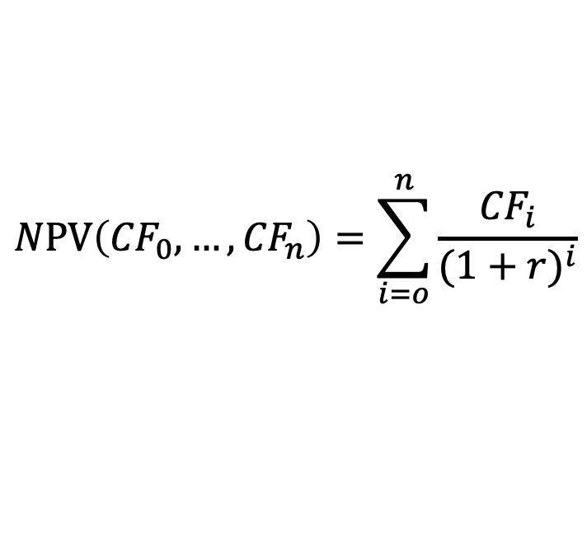
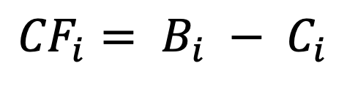
Cost Benefit Analysis (CBA)
Decision-making process:
  If B>C (NPV>0): support the action, or B/C >1 when C!=0.
  Otherwise, oppose the action.
Cash flow for each period:
$$NPV\left({CF}_{0}, …, {CF}_{n}\right)=\sum_{i=o}^{n}{\frac{{CF}_{i}}{{(1+r)}^{i}}}$$
Risk
$${CF}_{i}= B_{i} − C_{i}$$
Discount rate: cost of capital
Notes:
Here I introduce two analytical tools. First is CBA. Very intuitive and straight-forward. The key point is that buildings are durable good. 70 years. So need discounting;
Three commonly used equations when assessing the investment in real estate project are: net present value; internal rate of return, and discounted payback period.
in the meantime, future is uncertain, so need to incorporate risk. Later we will talk about risk – one merit of green buildings is risk-mitigation.

Slide 8
What will green buildings affect?
Hypothetical Pro-forma
Owner perspective: (compare PV with the purchasing price)
Year: | 0 | 1 | … | 10 | 11
Item:
Potential gross income (Rent/SF × Square feet) |  | 50,000.00 | … | 59,754.63 | 60,949.72
Vacancy allowance (Vacancy rate × PGI) |  | 4,000.00 |  | 4,780.37 | 4,875.98
Effective gross income |  | 46,000.00 |  | 54,974.26 | 56,073.74
Operating expenses (OpEx) |  | 17,500.00 |  | 20,914.12 | 21,332.40
Net operating income (NOI) |  | 28,500.00 |  | 34,060.14 | 34,741.34
Capital improvement expenditure (CapEx) |  | 4,275.00 |  | 5,109.02 | 5,211.20
Net cash flow (NOI - CapEx) |  | 24,225.00 |  | 28,951.12 | 29,530.14
Reversion (only in last year and years of partial sales) |  |  |  | 579,022.35
Net cash flow incl. reversion |  | 24,225.00 |  | 607,973.47
PV @ 8% | $443,979.91
Last year CF/Cap rate (6%)
Green Building
Notes:
Goes to next slide to show the impacts from Green Building.

Slide 9
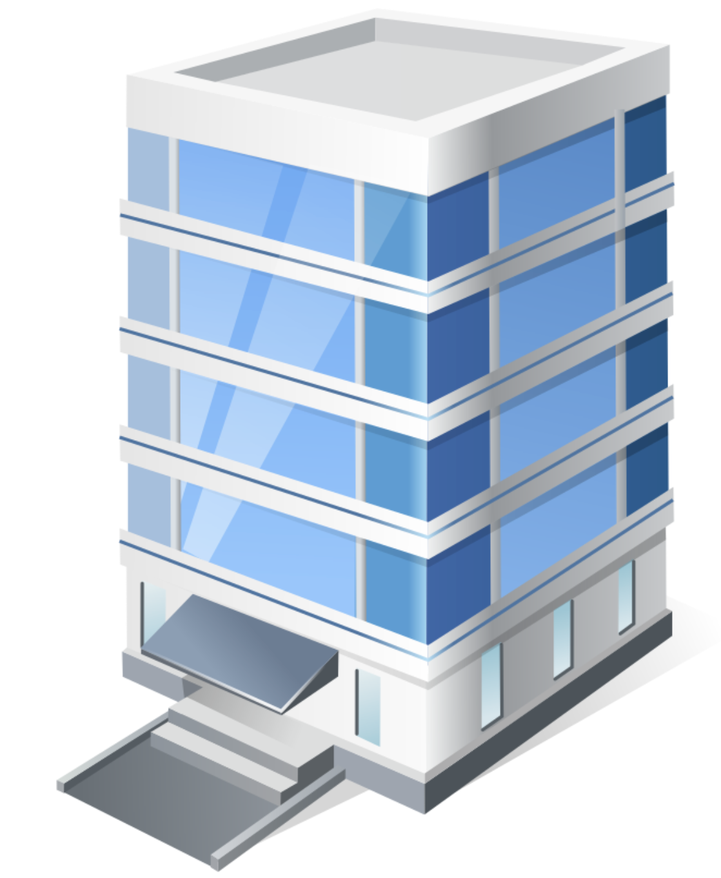
What will green buildings affect?
Hypothetical Pro-forma
Owner perspective: (compare PV with the purchasing price)
Year: | 0 | 1 | … | 10 | 11
Item:
Potential gross income (Rent/SF × Square feet) |  | 50,000.00 | … | 59754.63 | 60949.72
Vacancy allowance (Vacancy rate × PGI) |  | 4,000.00 |  | 4780.37 | 4875.98
Effective gross income |  | 46,000.00 |  | 54,974.26 | 56,073.74
Operating expenses (OpEx) |  | 17,500.00 |  | 20914.12 | 21332.40
Net operating income (NOI) |  | 28,500.00 |  | 34,060.14 | 34,741.34
Capital improvement expenditure (CapEx) |  | 4,275.00 |  | 5109.02 | 5211.20
Net cash flow (NOI - CapEx) |  | 24,225.00 |  | 28,951.12 | 29,530.14
Reversion (only in last year and years of partial sales) |  |  |  | 579,022.35
Net cash flow incl. reversion |  | 24,225.00 |  | 607,973.47
PV @ 8% | $443,979.91
(Tenant) Health + Productivity + Energy saving
Energy saving
Lower depreciation
A hypothetical office building
Lower risk, Lower cost of capital
Higher NPV and thus higher Willingness-to-pay (WTP)
Last year CF/Cap rate (6%)
Lower risk, Lower cap rate
Image © source unknown. All rights reserved. This content is excluded from our
Creative Commons license. For more information, see https://ocw.mit.edu/help/faq-fair-use/.
Notes:
Here, ask students.
“Effective gross income” increase: not only rent per sq. ft. increase, but also vacancy rate decrease.

Slide 10
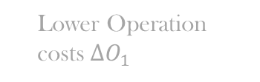

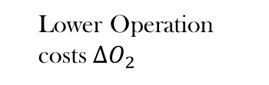
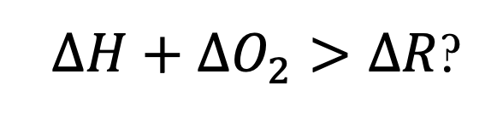
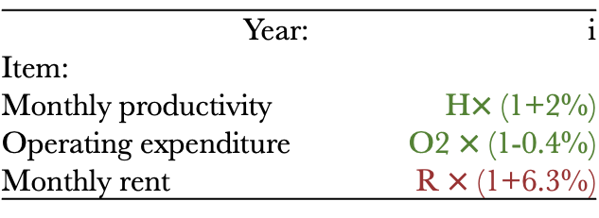

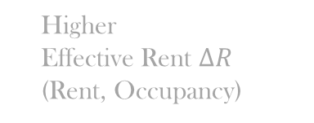
Life-Cycle Cost Analysis (LCCA) in Green Buildings
Higher
Effective Rent $∆R$
(Rent, Occupancy)
Benefit
Design/Construction
Tenancy
Operation
investment
Lower Operation costs $∆O_{1}$
Cost
$∆H+∆O_{2}>∆R$?
=
Higher
Productivity/Health/WB $∆H$
Tenancy
Operation
Tenancy
Higher Rent$∆R$
Lower Operation costs $∆O_{2}$
Year: | i
Item:
Monthly productivity | H$×$ (1+2%)
Operating expenditure | O2 $×$ (1-0.4%)
Monthly rent | R $×$ (1+6.3%)
Tenant’s analytical horizon
Any other benefits?
Notes:
Here is the tenant.
O2
Ask student about the externality?
Externality: Carbon emission. – we need the forth stakeholder: government. Later we will touch on that.

Slide 11
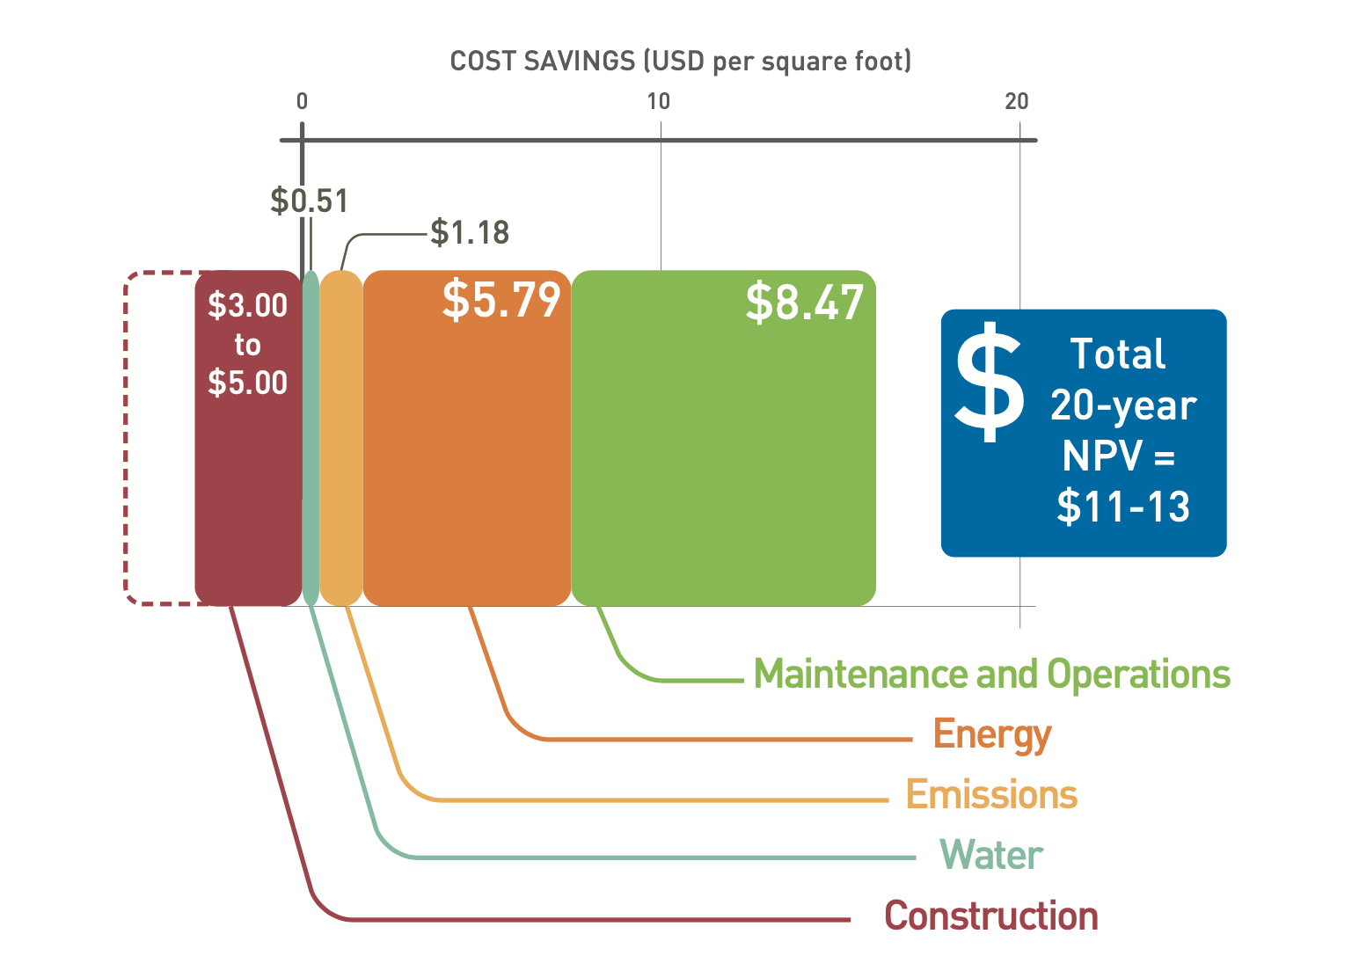
Why do green buildings have smaller operating costs?
Energy & Resource savings
+
Maintenance cost reduction
Net present value analysis of the operational cost benefits of 33 LEED certified buildings
© World Green Building Council. All rights reserved. This content is excluded from our Creative Commons license. For more information, see https://ocw.mit.edu/help/faq-fair-use/.
Notes:
Why green buildings have smaller maintenance and operation cost?
Green building systems have better monitoring technologies and smart metering so they are run more efficiently with less hiccups.
Their lifespan might be longer because they are operated and maintained more efficiently, so there is less wear and tear (article).
In general you associate the monitoring and smart metering with an improved Building Management System (BMS) — in high performance buildings, the BMS tends to be more advanced.

Slide 12
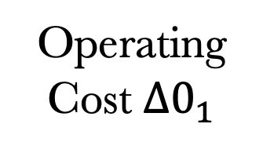

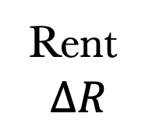
Operating Cost Split
Energy & Resource savings
+
Maintenance cost reduction
Human Capital Cost: Productivity/Health/Well-being
Owners
Tenants
Tenants
(company)
Operating Cost $∆0_{1}$
Lease contract
(“Split Incentive” in the next lecture)
Operating Cost $∆0_{2}$
Rent
$$∆R$$
“Healthy Buildings” lecture
WGBC.2013.“THE BUSINESS CASE FOR GREEN BUILDING: A Review of the Costs and Benefits for Developers, Investors and Occupants”
Notes:
Triple net lease.
The problem with the split incentive: where the investor or owner of the building who would pay for the upgrades in energy and water systems does not get potentially the return on the energy investment. Or there is a payoff for hallway lights and light electrical systems over a long-event horizon.
ZZ’s survey.

Slide 13
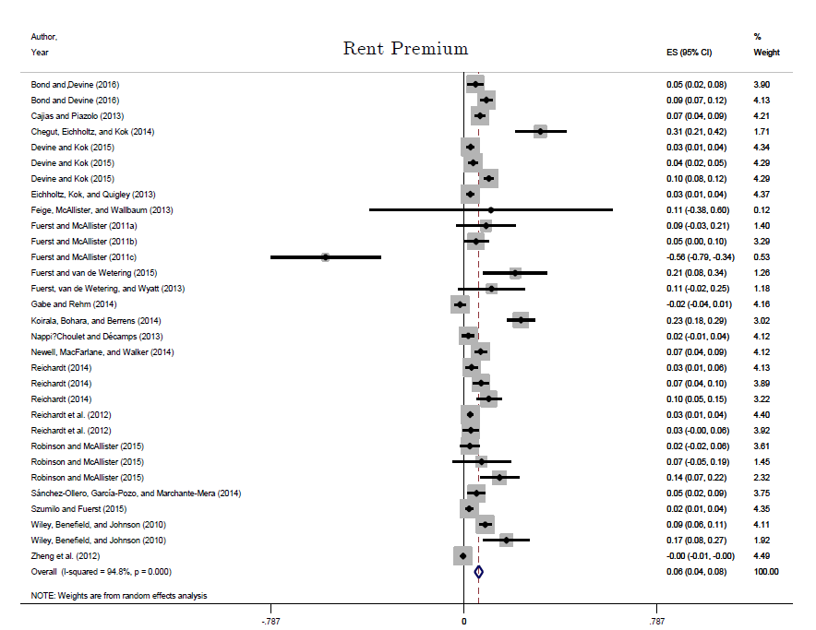
Rental Premium of Green Building
Dalton and Fuerst (2018): meta analysis of green real estate rents
Overall significant rent premium of 6%
5.4% commercial
8.2% residential
Studies also find 5% - 9% higher occupancy rates for commercial real estate.
© Informa UK Ltd. All rights reserved. This content is excluded from our Creative Commons
license. For more information, see https://ocw.mit.edu/help/faq-fair-use/.
Notes:
Triple net lease.
The problem with the split incentive: where the investor or owner of the building who would pay for the upgrades in energy and water systems does not get potentially the return on the energy investment. Or there is a payoff for hallway lights and light electrical systems over a long-event horizon.
ZZ’s survey.

Slide 14




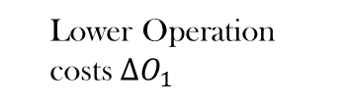
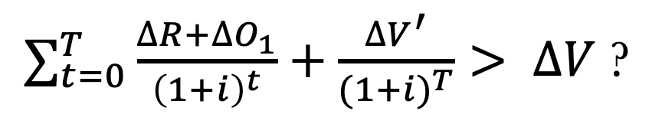

Life-Cycle Cost Analysis (LCCA) in Green Buildings
Owner’s analytical horizon
Higher
Effective Rent $∆R$
(Rent and Occupancy)
Higher Sale Price
$$∆V$$
Lower depreciation $∆V′$
Benefit
Design/Construction
Tenancy
Operation
Reversion
investment
=
$$year T$$
Higher Purchase
Price $∆V$
Lower Operation costs $∆O_{1}$
Cost
Discount rate i = cost of capital
$∑_{t=0}^{T}\frac{∆R+∆O_{1}}{{\left(1+i\right)}^{t}}+\frac{∆V^{′}}{{(1+i)}^{T}}> ∆V$ ?
What about the risk?
Notes:
Here, ask students.
Here is owner’s perspective.
O1: The split of operating cost: Tenants in offices, retail or industrial spaces in the majority of markets pay a “triple net lease” (A triple net lease (triple-Net or NNN) is a lease agreement on a property whereby the tenant or lessee promises to pay all the expenses of the property including real estate taxes, building insurance, and maintenance.)-- the tenant would be responsible for the utility bills of their own space. Owners pay for the energy in public space such as hallways and elevators and maintain big mechanical systems (HAVC, hot water, waste water)
Lower depreciation: smaller functional obsolescence (market likes green buildings more and more), and also physical depreciation (more adaptive to the local climate; easier to maintain).

Slide 15
Risk Mitigation
Regulatory Risks: “Brown discount”
  Case: NYC Local Law 97
Market Risks: Green buildings have:
  Lower cap rate
  Higher resilience during down times
Physical Risks
  Higher resilience against climate and other environmental risks
Notes:
Lower market risks: Imagine energy price will rise over time; more and more consumers want green buildings;

Slide 16
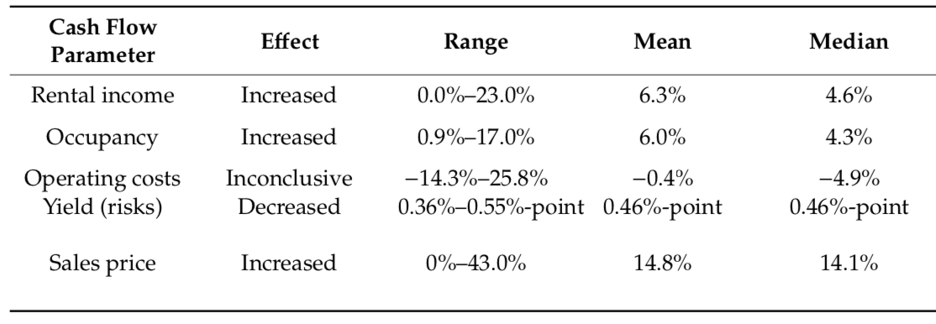

Why do green buildings have higher asset value?
Higher WTP;
Higher Sales Price
Higher rents, higher occupancy, lower turnover $∆R$
Lower operating cost$∆O_{1}$
Lower expected rate of return i
Sample: 71 reviewed publications 2008-2019, mainly in US, UK, AUS, CAN markets. (Leskinen, Vimpari and Junnil, 2020). © MDPI. All rights reserved. This content is excluded from our Creative Commons license. For more information, see https://ocw.mit.edu/help/faq-fair-use/.
Notes:
Now we move on to the owner’s perspective – if they are willing to pay higher price, the developer will be happy. But why they are willing to pay higher price? Three possible reasons.
Higher rents/occupancy/lower turnover: more popular to tenants. They are willing to pay more --> later we will look into them.
Lower operating cost --> energy, maintenance, human capital --> later we will look into them
Lower yield → lower risk.
We can see the mean value of price premium – 14.8%. Higher than the cost premium – there is a business case. But remember we have a wide range, for both price premium and cost premium.

Slide 17






Market average vs. individual decision-maker
Adopters
Benefit
$$∆R1$$
$$∆V1$$
$$∆O$$
Non-adopters
Trade-offs
Cost

Slide 18
Hypothetical Pro-forma
Green Building:
Higher purchasing price
Rental revenue ↑ 6.3%
Occupancy ↑ 6%
Operating cost ↓ 0.4%
Cost of capital↓ 0.46%
Should the owner willing to purchase a green building for $50,000 extra?
Owner perspective: (compare PV with the purchasing price) GREEN BUILDING
Year: | 0 | 1 | … | 10 | 11
Item:
Potential gross income (Rent/SF × Square feet) |  | 53150.00 | … | 63519.17 | 64789.55
Vacancy allowance (Vacancy rate × PGI) |  | 1318.12 |  | 1575.28 | 1606.78
Effective gross income |  | 51831.88 |  | 61943.89 | 63182.77
Operating expenses (OpEx) |  | 18528.09 |  | 22142.78 | 22585.64
Net operating income (NOI) |  | 33303.79 |  | 39801.11 | 40597.13
Capital improvement expenditure (CapEx) |  | 4995.57 |  | 5970.17 | 6089.57
Net cash flow (NOI - CapEx) |  | 28308.22 |  | 33830.95 | 34507.56
Reversion (only in last year and years of partial sales) |  |  |  | 732800.26
Net cash flow incl. reversion |  | 28308.22 |  | 766631.20
PV @ 7.5% | $564,113.22
(Traditional building PV) $443,979.91
Last year CF/Cap rate

Slide 19
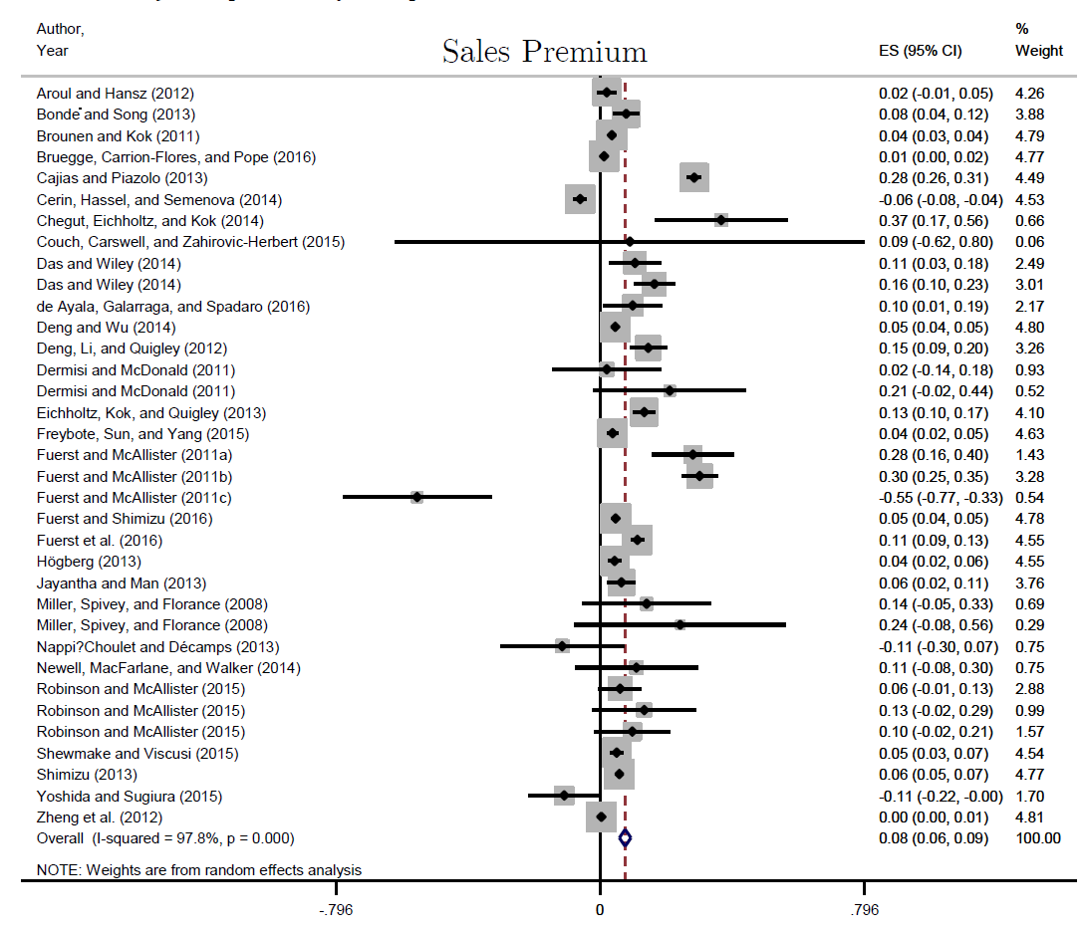
Higher Market Value of Green Building
Dalton and Fuerst (2018) also look at evidence sales prices
Overall price premium of 7.6%
For commercial 11.5%
For residential 5.5%
© Informa UK Ltd. All rights reserved. This content is excluded from our Creative Commons license. For more information, see https://ocw.mit.edu/help/faq-fair-use/.
Notes:
Triple net lease.
The problem with the split incentive: where the investor or owner of the building who would pay for the upgrades in energy and water systems does not get potentially the return on the energy investment. Or there is a payoff for hallway lights and light electrical systems over a long-event horizon.
ZZ’s survey.

Slide 20
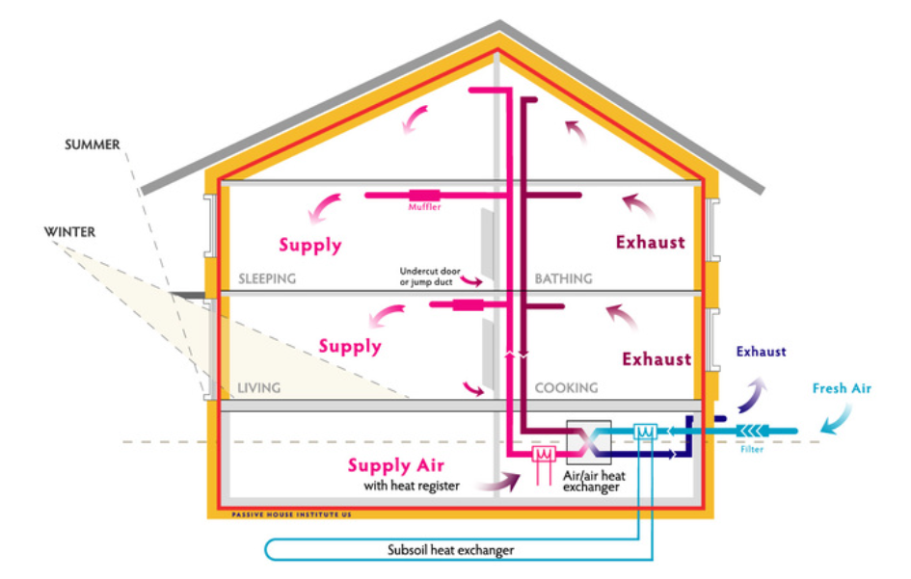
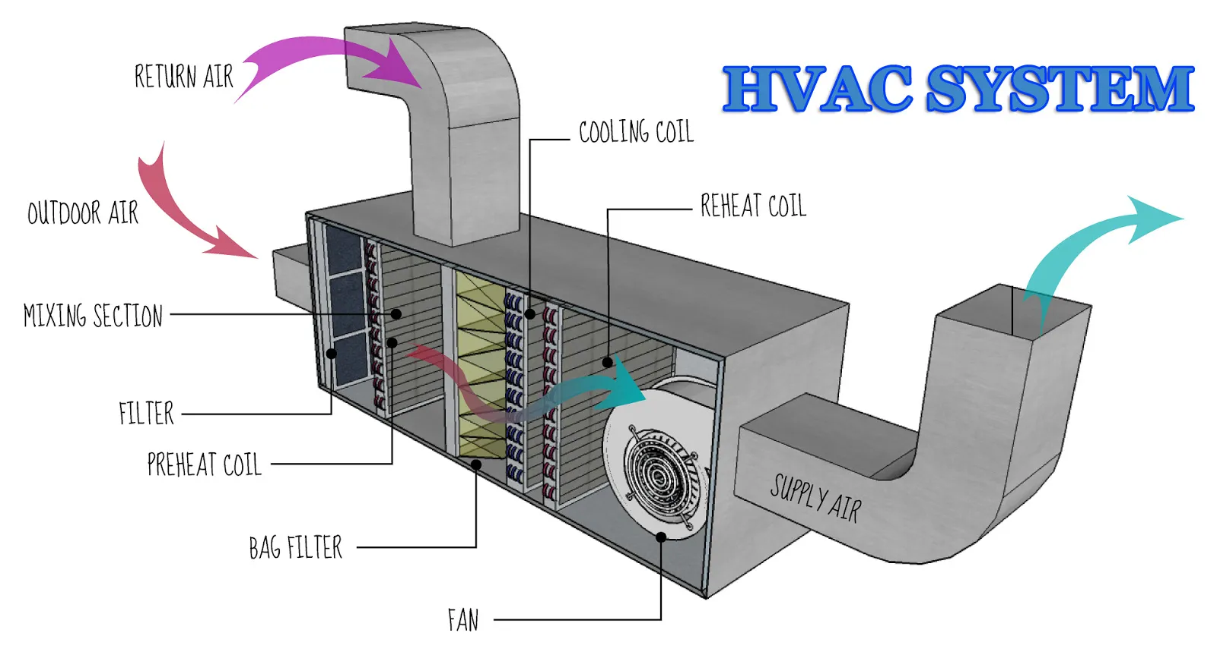
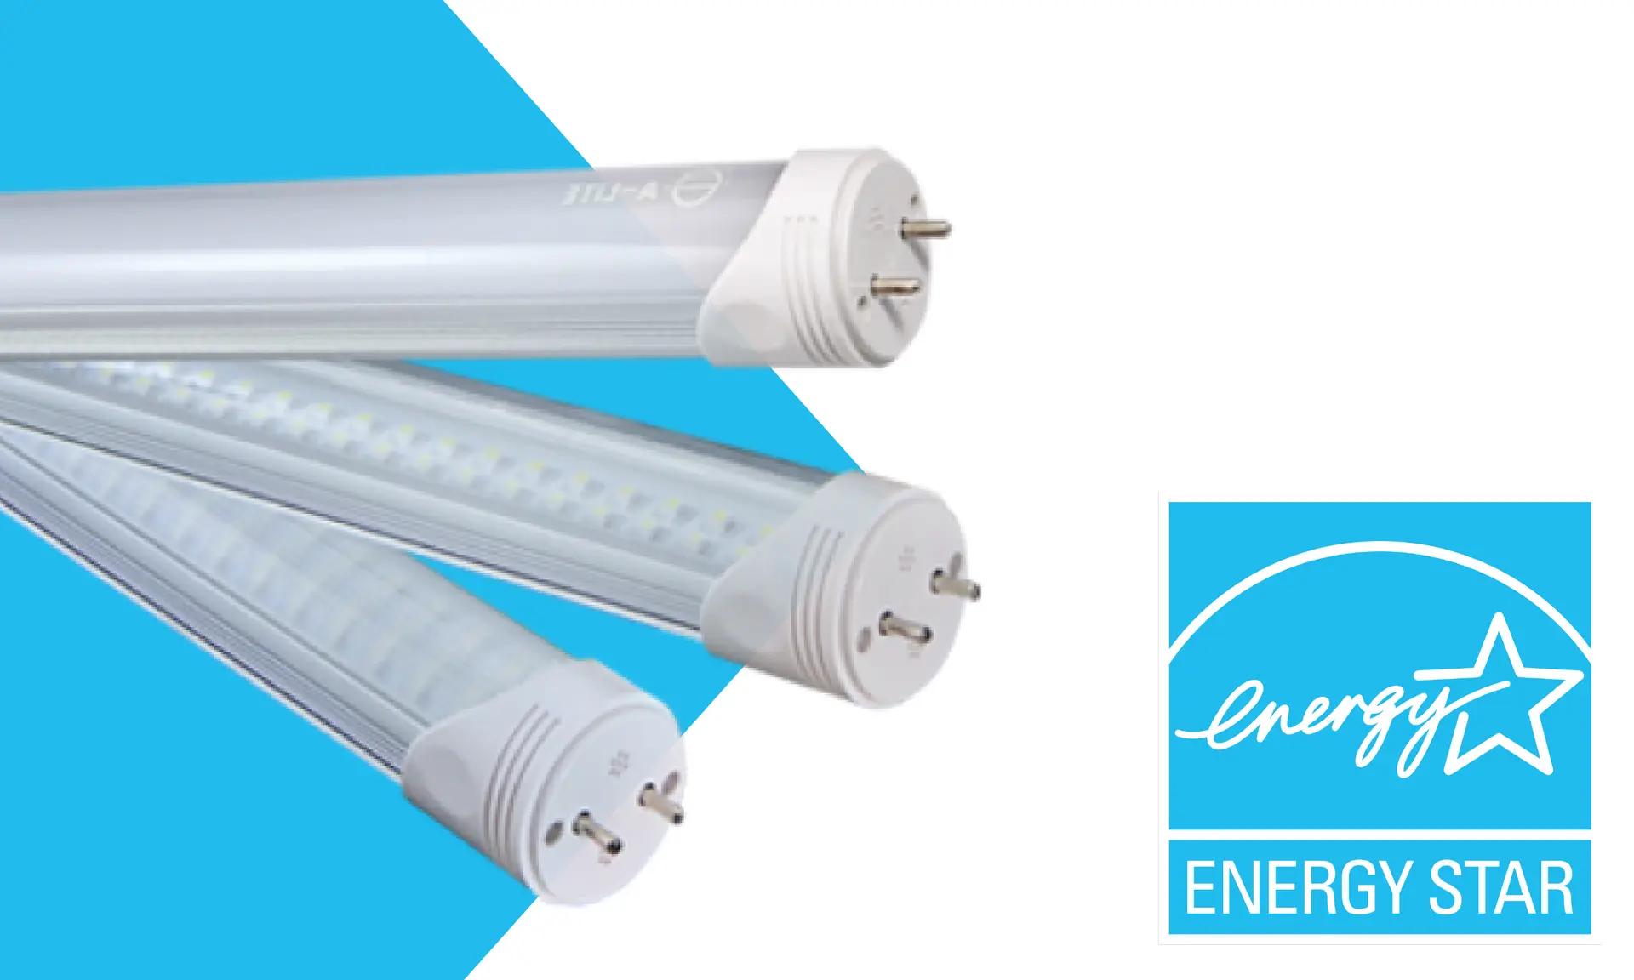

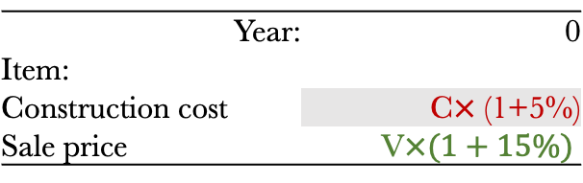

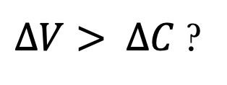

Life-Cycle Cost Analysis (LCCA) in Green Buildings
Developer’s evaluation horizon
Higher Sale Price $∆V$
Benefit
Design/Construction
Sale
Tenancy
Operation
Refurbishment/Acquisition
=
Cost
Higher Purchase
Price $∆V$
Higher Upfront
Cost $∆C$
$∆V> ∆C$ ?
Year: | 0
Item:
Construction cost | C$×$ (1+5%)
Sale price | V$×(1+15\%)$
House cross section © Passive House Institute US; HVAC system and light bulb images © source unknown. All rights reserved. This content is excluded from our Creative Commons license. For more information, see https://ocw.mit.edu/help/faq-fair-use/.

Slide 21
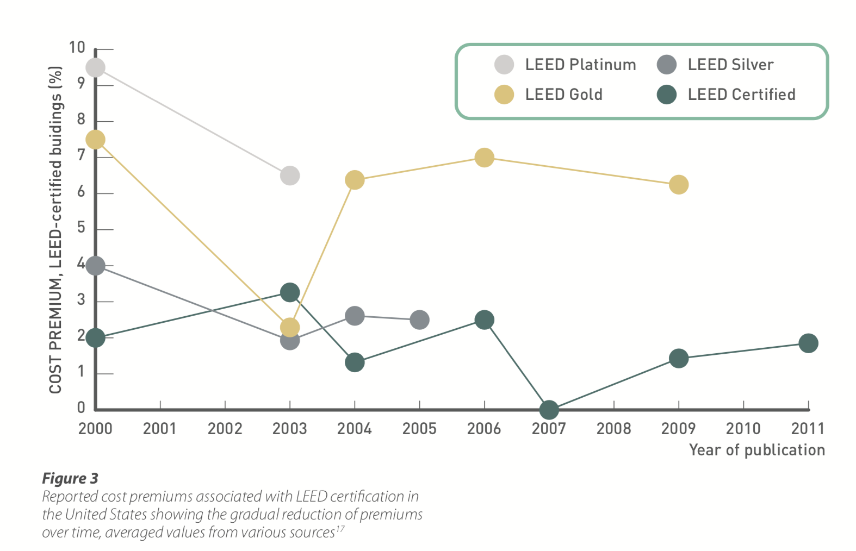
Why do green buildings have higher design & construction Costs?
Decreasing Costs for Green Building Over Time
0% to 12.5%
Cost premium for new green buildings (actual costs based on various studies)
0.3% to 12.8%
Cost premium for green retrofits (actual costs based on various studies)
Cost premium
3-10% when planned
1-3% when implemented
Time
Winthrop Center Passive House cost premium
WGBC.2013.“THE BUSINESS CASE FOR GREEN BUILDING: A Review of the Costs and Benefits for Developers, Investors and Occupants”
© World Green Building Council. All rights reserved. This content is excluded from our Creative
Commons license. For more information, see https://ocw.mit.edu/help/faq-fair-use/.
$$∆C=f(skills, innovation, supply chain)$$
Notes:
Sustainable Design – Carlos’s lectures. Two levels:
Passive design strategies (FREE): utilize what nature provides for free to keep buildings comfortable without the need of purchased energy. Sun, wind, temperature: the orientation, the window/door shape and direction. →heating, cooling, ventilation, day light
(2) Active design strategies: use purchased energy (electricity, gas) to keep buildings comfortable. Mechanical systems: HVAC (heat pumps, ventilation, air conditioning), water system.
Green design: heat recovery and natural ventilation; grey water reutilization, rainwater harvesting, Solar panel, wind turbines.
You need to hire a consulting firm and you need special expertise → increase cost;
Construction – you need some specific green products: solar panels, water-efficient plumbing fixtures and fittings.
Why in some cases (although not many) the cost premium is zero ? Passive design FREE.
It is a function of three major factors –
skills, now more of common knowledge, from consulting firm to in-house. Integrated design Process (IDP);
innovation: new green products, more efficient and cheaper, such as solar panel;
supply chain: more supplies and efficient supply chain – China is the largest producer of solar panels and wind turbines.

Slide 22
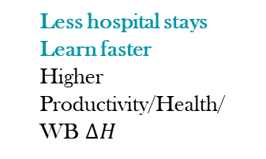

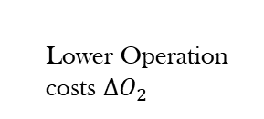


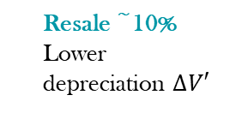
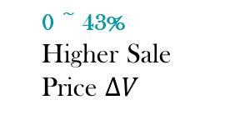

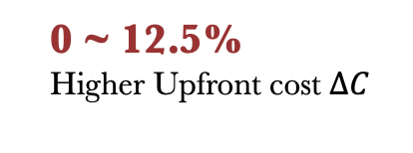
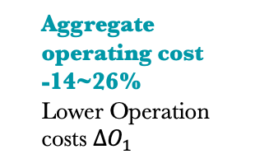
Is There a Business Case for Green Buildings?
Developers
Owners
0 ~ 43%
Higher Sale Price $∆V$
Rental 0 ~ 17%
Occupancy 0~23%
Higher Effective Rent $∆R$
Resale ~10%
Lower depreciation $∆V′$
Benefit
Design/Construction
Sale
Tenancy
Operation
Refurbishment/Acquisition
Aggregate operating cost
-14~26%
Lower Operation costs $∆O_{1}$
$$year T$$
Cost
0 ~ 12.5%
Higher Upfront cost $∆C$
0 ~ 43%
Higher Purchaing Price$∆V$
Lower discount rate i (cost of capital)
Less hospital stays
Learn faster
Higher Productivity/Health/
WB $∆H$
Tenants
Operation
Tenancy
Operation
Tenancy
Lower Operation costs $∆O_{2}$
Higher Rent$∆R$

Slide 23
Higher sales price
Lower design & construction costs
Health & well-being
ESG
Corporate image
Increased productivity
Quicker sales
Lower financing cost
Legislation &
requirement
Lower operating costs
Higher market value
Slower depreciation
Lower retrofit cost
Higher ROI
Notes:
https://www.thecotocongroup.com/nyc-local-law-97/
Large cities tend to be more aggressive in regulating the building sector, since building is the single largest sector of emission in large cities. For example, buildings emission accounts 70% CO2 emission in NYC, recalling the national average 39%. Thus, regulating buildings is the most feasible way for cities to achieve GHG reduction claims. One recent example of such is the ambitious NYC Local Law 97.
The law Announced by Mayor Bill De Blasio in May 2019, as part of the Climate Mobilization Act, aiming at an 80% GHG reduction by 2050. One of the central piece is Local Law 97, a groundbreaking climate legislation that limits carbon emissions on private buildings over 25,000 square feet. It sets thresholds (caps), on a per square foot basis, for greenhouse gas emissions from buildings beginning in 2024, with increasingly stringent limits set in 2030.

Slide 24
How market may fail

Slide 25
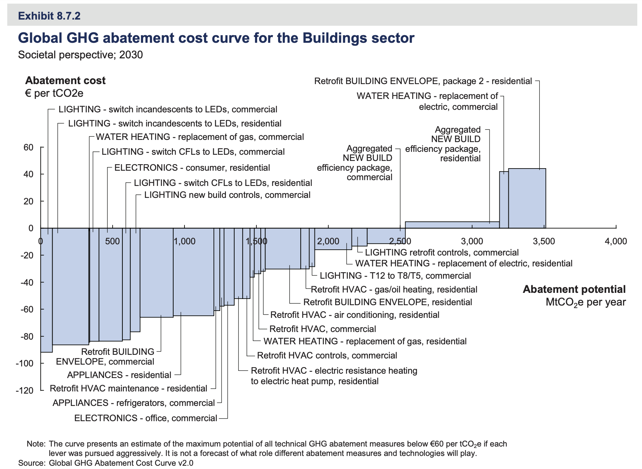
Negative Lifecyle Cost: Market Opportunity Unexploited
Mckinsey:
“Carbon emissions in the Building sector can be substantially reduced, either with net economic benefits or at low cost.”
Why are the vast negative cost green opportunity unexploited?
© McKinsey & Co. All rights reserved. This content is excluded from our Creative
Commons license. For more information, see https://ocw.mit.edu/help/faq-fair-use/.
Notes:
https://www.mckinsey.com/~/media/mckinsey/dotcom/client_service/sustainability/cost%20curve%20pdfs/pathways_lowcarbon_economy_version2.ashx

Slide 26
Market Failures Threaten the Three Bottom Lines
People
(Social)
Profit
(Economic)
Planet
(Environmental)
Market Failures:
Information Asymmetry
2. Split Incentive (Econ Lecture 2)
3. Externality (Econ Lecture 8)
Sustainable?

Slide 27
Information Matters!
Do people really understand the ‘greenness’?
  Benefit underestimated
  Cost overestimated
Information & knowledge matter!
Supply =
Marginal cost
P*
P’
Demand =
Marginal benefit
Q’
Q*
An example of undersupply
(Buyers underestimate the benefit)
Notes:
Due to two distinct features: (1) Information asymmetry – supply side always has more information; (2) durability – the benefit is for the future many decades! But the cost is upfront.

Slide 28
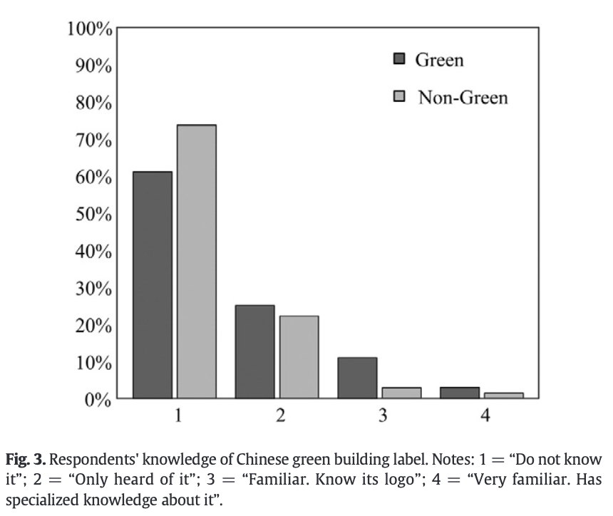
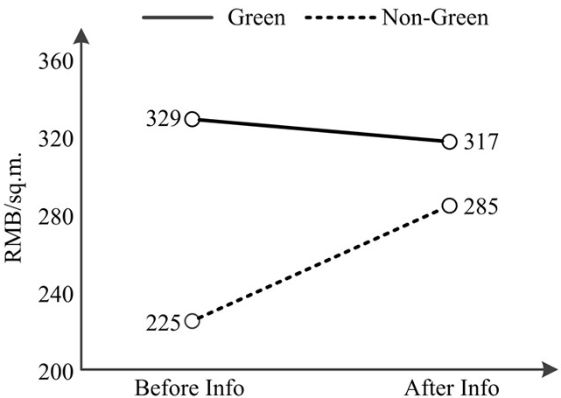
Siqi’s Research: Information and WTP for Green Buildings
“The Role of Public Information in Increasing Homebuyers’ Willingness-to-Pay for Green Housing: Evidence from Beijing.” (Zhang, Sun, Liu and Zheng 2016, Ecological Economics)
Information & knowledge matter!
Courtesy of Elsevier, Inc., https://www.sciencedirect.com. Used with permission.

Slide 29
Information Asymmetry
Even if people do understand the benefit in theory, can they distinguish green product?
Indoor air quality/ energy efficiency
  Experience good
  Quality of good only observed after consumption
Sustainble materials/ toxic materials
  Credence good
  Quality cannot be observed even after consumption
Notes:
Experience good: a person. From a CV, it is very hard to judge.

Slide 30
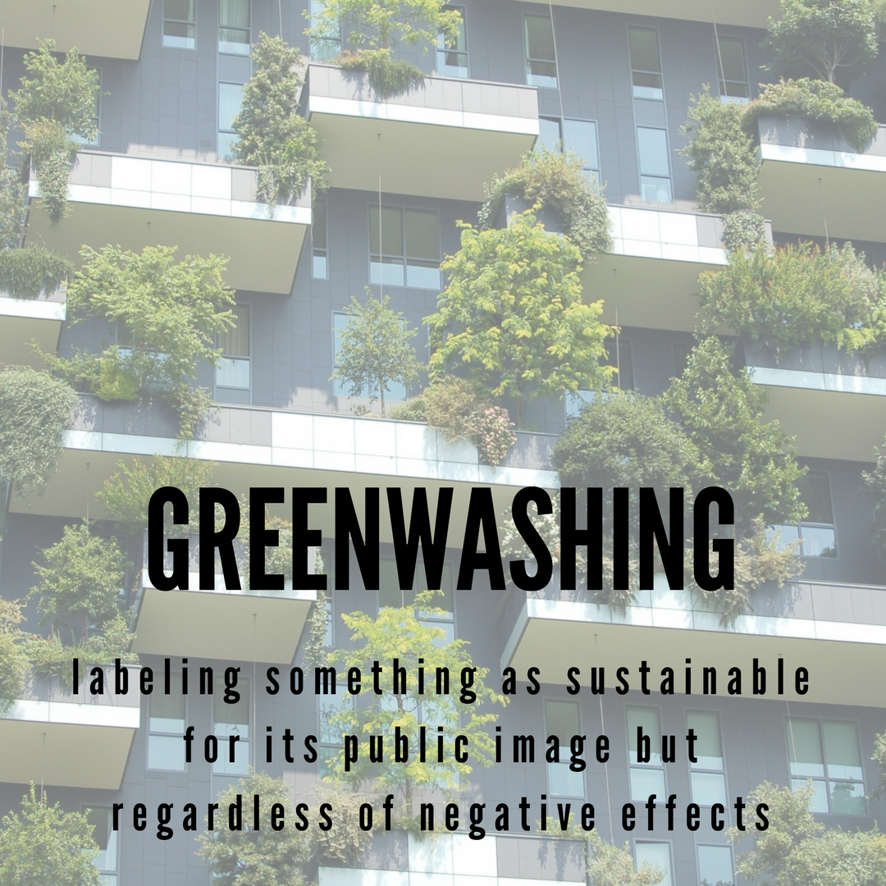
Image © source unknown. All rights reserved. This content is excluded from our Creative Commons license. For more information, see https://ocw.mit.edu/help/faq-fair-use/.
Any misleading claims regarding the environmental practices of a company or the environmental benefits of a product or service.
Being advertised as an competitive advantage (selling point).
Notes:
They know consumers want green products. This is a selling point to make more money. But they only do this in a superficial or even fake way – just an “image”. They just put plants in balconies to showcase; or have very fancy pictures and terms in the brochure. This becomes a big issue due to the intrinsic feature of RE: information asymmetry.
Bike rack
NYT example: https://www.nytimes.com/2009/08/31/science/earth/31leed.html
The Federal Building in downtown Youngtown, Ohio: has LEED certification, but hardly energy efficient.
Did not score high enough to qualify for the Energy Star label (which ranks buildings after looking at a year’s worth of utility bills.)
Reason: (modeling != reality) The building’s cooling system, a major gas guzzler, was one culprit. (gaming the point) Another was its design: to get its LEED label, it racked up points for things like native landscaping rather than structural energy-saving features.
LEED has made the change in 2009 that all newly constructed buildings to provide energy and water bills for the first five years of operation as a condition for certification. The label could be rescinded if the data is not produced.

Slide 31
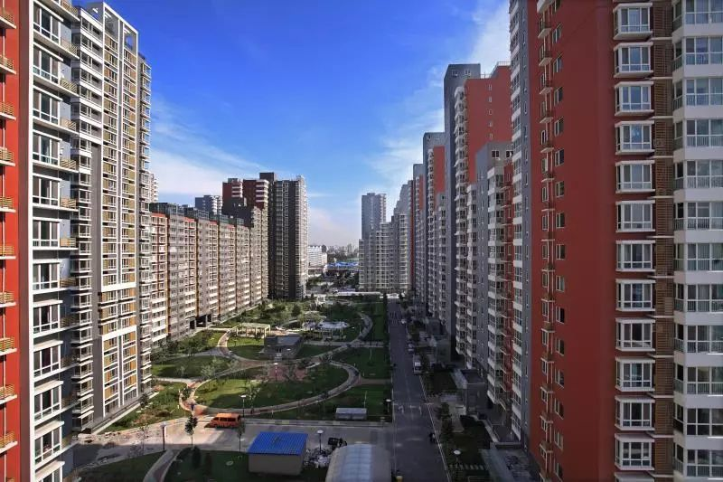
Siqi’s Research: Greenwashing in China’s Real Estate Market
“The Nascent Market for ‘Green’ Real Estate in Beijing.” (Siqi Zheng, et al., 2012, European Economics Review)
  Early 2000: no official green certificate in China. We used Google to construct each development project’s “self-advertised” green index.
  We find:
    Presale stage: a significant price premium
    Resale and rental stages: this premium disappeared
© source unknown. All rights reserved. This content is excluded from our Creative
Commons license. For more information, see https://ocw.mit.edu/help/faq-fair-use/.

Slide 32


Information asymmetry creates the market for lemons
Adverse selection
Developer
Buyer (with information)
Buyer (without information)
Cost:
$1.25 million
WTP:
$1.4 million
WTP:
$1.2 million
Cost:
$0.95 million
WTP:
$1 million
Developer earns:
$0.15 million for green building
$0.05 for other buildings
Developer only develop non-green buildings → buyer’s WTP drop to $ 1 million
Notes:
Simple case:
Two buildings with identical outlook and both argue that they have good performance
(no mechanism to ensure truth-telling)
Developer 1: true green building→ value $1.4 million
Developer 2: fake green building → value $1 million
Buyer: cannot distinguish, thus willing to pay $1.2 million.
If the reserve price of developer 1 is above $1.2 million: only developer 2 will sell. Green building market will break down.
If the reserve price of developer 1 is below $1.2 million: both developers will sell. Yet developer 2 earns more thus fewer developers have the incentive to go green.

Slide 33
Information asymmetry creates the market for lemons
Green building market breaks down stage by stage.
Stage 1: high efficiency developers exit
Low efficiency WTP
Stage 1: WTP without information
High efficiency WTP
Equilibrium
Stage 2: medium efficiency developers exit
Low efficiency WTP
Stage 2: WTP without information
Mid efficiency WTP
High efficiency WTP exited
Notes:
Generalized model: Akerlof (1970) competitive screening model
Quality of good [ $\underline{θ}$- $\overline{θ}$]
Seller’s reserve price: r(θ)
Buyer’s payoff: θ-p
Suppose r(θ)≤ θ for all θ. (buyer value the building more than its cost)
If quality observable:
All buildings are traded; p(θ)$∈$ [r(θ), θ]
If quality unobservable:
Proposition: If r($\overline{θ}$) > E[θ], no efficient competitive equilibrium exists.
(i.e., sellers value the best good more than buyers value the average good.)
The highest quality good is not traded due to asymmetric information.

Slide 34

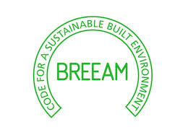
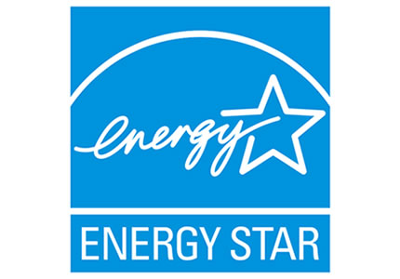

The role of certificates: Solving Information Asymmetry
﻿What are the requirements for certificates to solve market failure:
  Must clearly differentiate green buildings from others
    And be impossible for non-green buildings to be certified (green washing)
  More valuable to customers than the costs of obtaining certification
    Reasonable costs + accurate assessment of premiums associated with certifications
Logos © the respective certification agencies. All rights reserved. This content is excluded from our Creative
Commons license. For more information, see https://ocw.mit.edu/help/faq-fair-use/.
Notes:
Analogy: for a student, standard tests: SAT, GRE, GMAT…

Slide 35
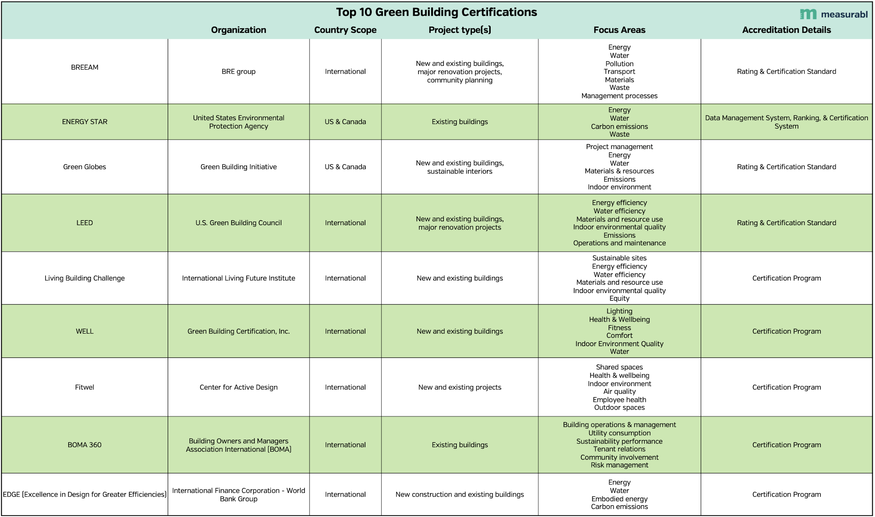
© Measurabl, Inc. All rights reserved. This content is excluded from our Creative
Commons license. For more information, see https://ocw.mit.edu/help/faq-fair-use ./
Notes:
Popular certification programs

Slide 36
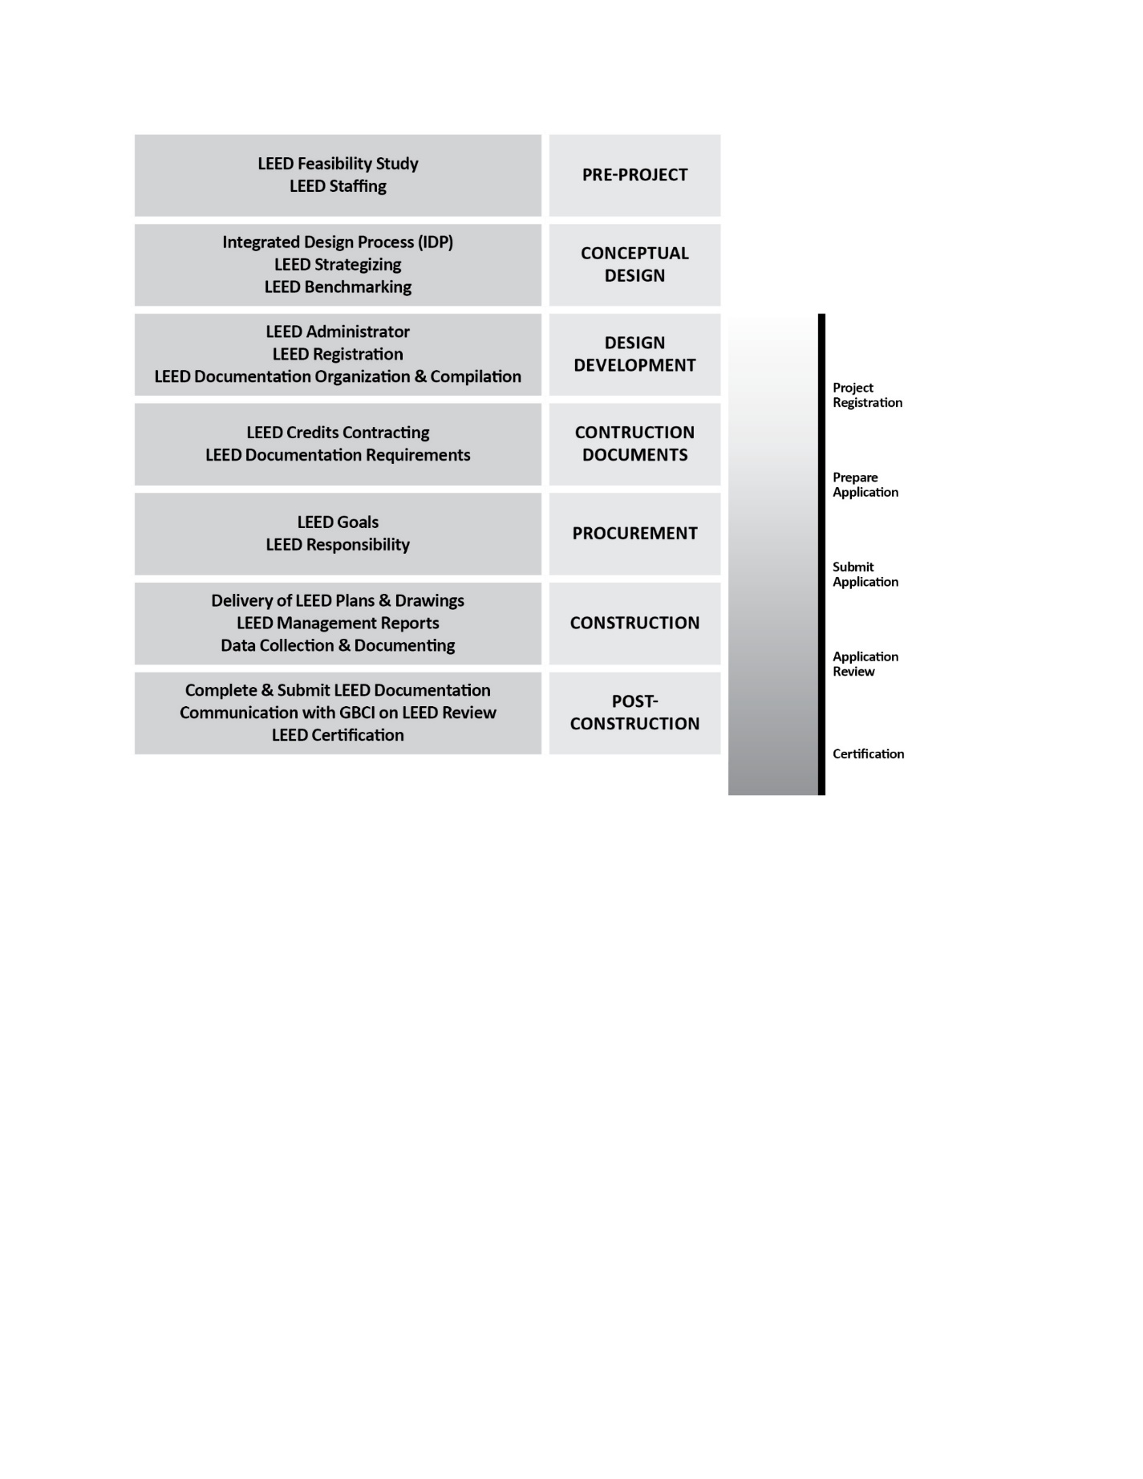
LEED Certificate
Procedures and schemes
 | LEED
Full Name | Leadership in Energy and Environmental Design
Launch Date | 1998
Governing Body | US Green Buildings Council (USGBC)
Certification By | Green Business Certification Institute (GBCI)
Countries Covered | 176
Ratings | Certified Silver Gold Platinum
Assessment | USGBC
Schemes | New Construction Existing: Operations and Maintenance Commercial Interiors Core & Shell Schools Retail Healthcare Homes Neighborhood Development
© source unknown. All rights reserved. This content is excluded from our Creative
Commons license. For more information, see https://ocw.mit.edu/help/faq-fair-use/
Notes:
USGBC: A private non-profit organization. The SAT is wholly owned, developed, and published by the College Board, a private, not-for-profit organization in the United States.
The GRE is owned and administered by Educational Testing Service (ETS).

Slide 37
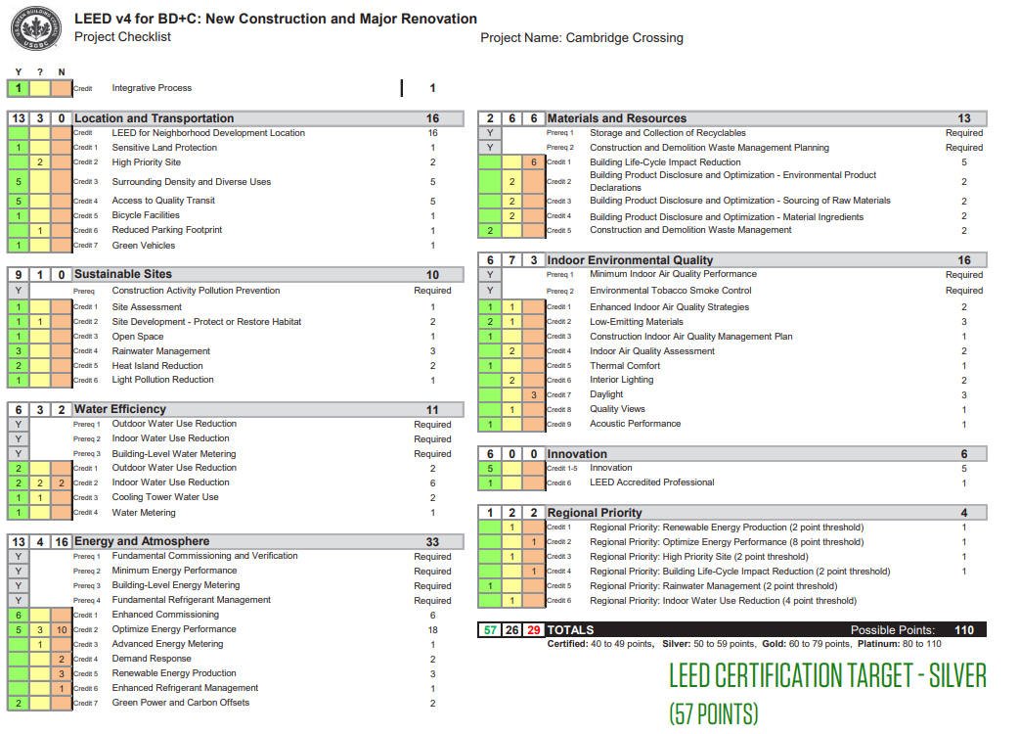
LEED Certificate
Checklist based process
Ratings:
  Certified (40-49);
  Silver (50-59);
  Gold (60-79);
  Platinum (80+)
Source: link
© City of Cambridge. All rights reserved. This content is excluded from our Creative
Commons license. For more information, see https://ocw.mit.edu/help/faq-fair-use/.

Slide 38
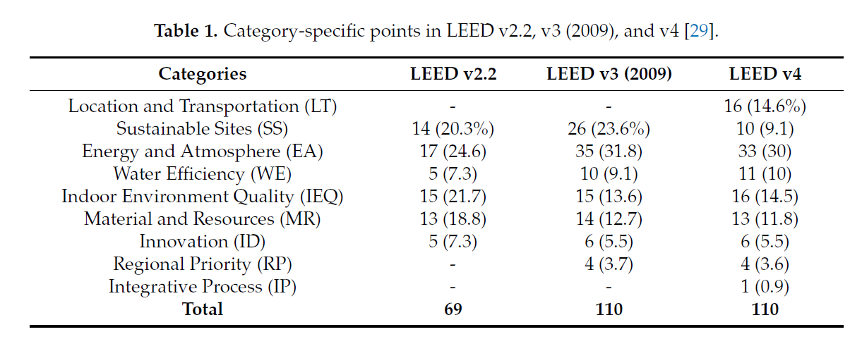
LEED Certificate
Evolution
  LEED v1.0 (1998): only for New Construction (NC)
  LEED NC v2.0 (2001)
  LEED NC v2.2 (2005)
  LEED v3 (2009)
  LEED v4 (2013)
  LEED v4.1 (2017)
Category-specific points
  Energy related: about 30%
  Increasing attention on location
Source: Amiri, A., Ottelin, J., & Sorvari, J. (2019). Are LEED-certified buildings energy-efficient in practice?. Sustainability, 11(6), 1672. © 2019 by the authors. Licensee MDPI, Basel, Switzerland. This article is an open access article distributed under the terms and conditions of the Creative Commons Attribution (CC BY) license (http://creativecommons.org/licenses/by/4.0/).
Notes:
Some of the biggest concerns with LEED over the years is not considering site location (for example gaining points for putting in bike racks and repair stations despite being located 25 miles from the nearest residential area so no one will use them).

Slide 39
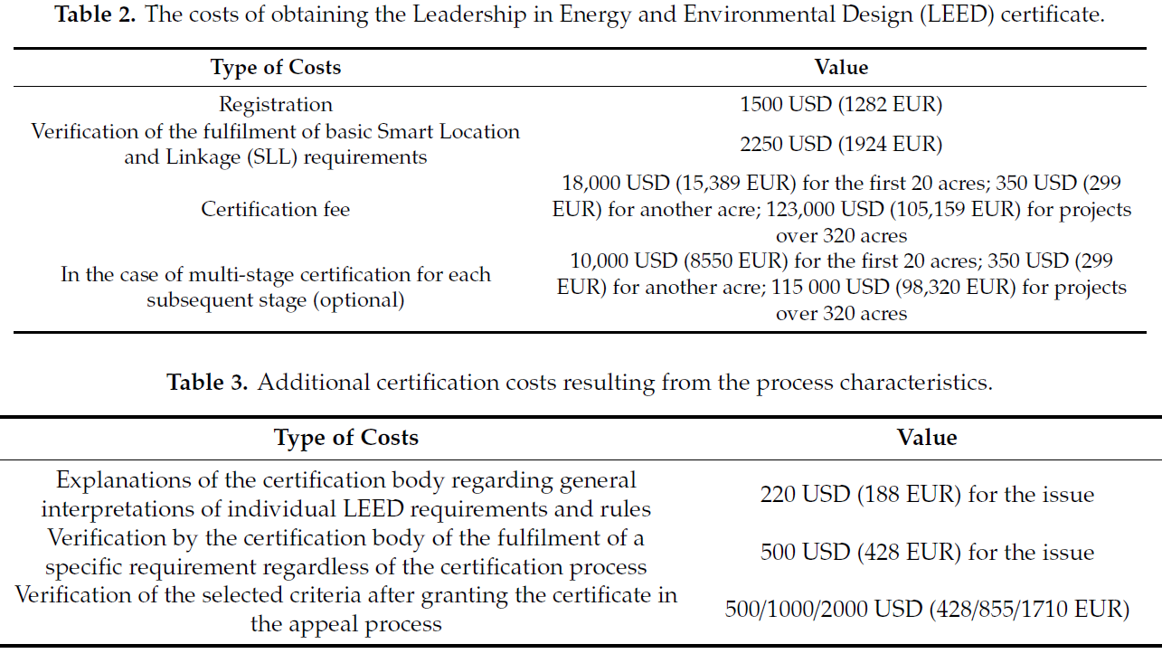

LEED Certificate
Remaining problems:
(1) High cost; (2) Not include embodied carbon; (3) Actual utility bill not used to decertify.
Cost of BREEAM
Cost of LEED
Source: https://www.breeam.com/wp-content/uploads/sites/3/2018/01/FS021-Rev-23-BREEAM-In-Use-Fee-Sheet-2-1-1.pdf © BREEAM. All rights reserved. This content is excluded from our Creative Commons license. For more information, see https://ocw.mit.edu/help/faq-fair-use/.
Source: https://www.mdpi.com/2071-1050/11/8/2359. © MDPI. All rights reserved.
This content is excluded from our Creative Commons license. For more information,
see https://ocw.mit.edu/help/faq-fair-use/.
Notes:
Some of the biggest concerns with LEED over the years is not considering site location (for example gaining points for putting in bike racks and repair stations despite being located 25 miles from the nearest residential area so no one will use them).
https://www.forbes.com/sites/realspin/2014/04/30/leed-certified-buildings-are-often-less-energy-efficient-than-uncertified-ones/?sh=2d2e6c362554
“Unsurprisingly, research shows that LEED-certified buildings are often less energy-efficient than their uncertified counterparts… By comparison, consider Energy Star, the U.S. Environmental Protection Agency’s (EPA) own green building rating system. Unlike LEED, buildings must submit actual utility bills before they can claim the Energy Star seal. It shouldn’t come as a surprise, therefore, that comparisons have shown no correlation between LEED certification and a high Energy Star score.”

Slide 40
Rental Premiums for Green-Certified Buildings
2008
2009
2010
2011
2012
2013
Source: World Green Building Council (2013). The Business Case for Green Building.
Notes:
Empirical studies.

Slide 41

Benchmarking and Transparency Policies
﻿Difficulties in evaluating green buildings: multiple certifications make difficult to evaluate “greenness” across buildings and incorporate it in investment decisions
The US and EU are implementing benchmarking mandates where owners need to disclose:
Energy certification of their assets
Actual energy consumption
This provides full transparency to the market, and creates a platform for regulation
Benchmarking programs and policies in the US
This image is in the public domain.
Notes:
https://iopscience.iop.org/article/10.1088/1748-9326/8/3/035018/pdf

Slide 42

Energy Benchmark Goals
Estimated Block Level Annual Energy Consumption
NYC
2009
LL84
Benchmarking
Requirement for buildings to report energy and water usage annually
2018
LL33
Grading System
Established scoring for buildings to be rated on energy efficiency and for grade to be displayed in each building
2019
LL95
Amendment to Grading System
Made grading system more stringent and requires grade to be displayed at public entrances
Source: https://qsel.columbia.edu/nycenergy/ . © Quadracci Sustainable Engineering Lab,
Columbia University. All rights reserved. This content is excluded from our Creative
Commons license. For more information, see https://ocw.mit.edu/help/faq-fair-use/.
Notes:
LL84: done through Energy Star Portfolio Manager
LL33: Score= Energy Star efficiency score
LL95: More strict

Slide 43
Energy Benchmark Goals in NYC
2009
LL84
Benchmarking
Requirement for buildings to report energy and water usage annually
2018
LL33
Grading System
Established scoring for buildings to be rated on energy efficiency and for grade to be displayed in each building
2019
LL95
Amendment to Grading System
Made grading system more stringent and requires grade to be displayed at public entrances

Slide 44



Left and top right: © City of New York; lower right: © source unknown All rights reserved. This content
is excluded from our Creative Commons license. For more information, see https://ocw.mit.edu/help/faq-fair-use/.
Energy Benchmark Goals

Slide 45

Benchmarking and Transparency Policies
Cambridge Building Energy Use Disclosure Ordinance:
  Require owners of larger buildings to track and report annual energy use to the City and publicly disclose the data
Certificates: In the EU, 2002/91/EC Directive Member States to ensure that when buildings are constructed, sold or rented out EPC (Energy Performance Certificate) must be disclosed
Source: https://cambridgegis.maps.arcgis.com/apps/MapSeries/index.html?appid=8c993ecbdf4f48eab403ea36c9886ed9
© City of Cambridge, MA. All rights reserved. This content is excluded from our Creative Commons license. For more information, see https://ocw.mit.edu/help/faq-fair-use/.

Slide 46





MIT Energy Use Intensity and LEED Certificates
MIT Energy Use Intensity and LEED Certificates.
2018 performance
(gets better after the retrofit)
Source: link.
Source: https://www.cambridgema.gov/CDD/cddlocatormap#map.
© City of Cambridge, MA. All rights reserved. This content is excluded from our Creative
Commons license. For more information, see https://ocw.mit.edu/help/faq-fair-use/.
Notes:
https://sustainability.mit.edu/tab/buildings
All new construction and major renovation projects at MIT must earn at least Gold Certification in the Leadership in Energy and Environmental Design (LEED) v4 Rating System.
Building 14, and 37/38 just completed sustainability enhancement renovation in 2021.
https://capitalprojects.mit.edu/projects/hayden-library-building-14
Three buildings in design: MET Wharehouse (our new School building); College of Computing and the Music Building.

Slide 47

MIT Hayden Library
© Massachusetts Institute of Technology. All rights reserved. This content is excluded from our Creative
Commons license. For more information, see https://ocw.mit.edu/help/faq-fair-use/.
LEED Gold V4 Certification
Fitwel Health Certification
Material:
“Red List Free” materials for all interior finish materials and fabrics
Water:
Use 1.0 gallon-per-flush toilets.
Energy:
  Reduce thermal loss by replacing single-pane glass in the large bay windows with high-performance sealed insulated windows.
  Update air-handling units and perimeter radiators with new controls to optimize energy use.
  Upgrade all lighting to low-energy LEDs controlled with daylight and occupancy sensors.
  EnergyStar appliances throughout the building.
Notes:
https://sustainability.mit.edu/tab/buildings
All new construction and major renovation projects at MIT must earn at least Gold Certification in the Leadership in Energy and Environmental Design (LEED) v4 Rating System.
Building 14, and 37/38 just completed sustainability enhancement renovation in 2021.
https://capitalprojects.mit.edu/projects/hayden-library-building-14
Three buildings in design: MET Wharehouse (our new School building); College of Computing and the Music Building.

Slide 48

© Wall Street Journal. All rights reserved. This content is excluded from our Creative
Commons license. For more information, see https://ocw.mit.edu/help/faq-fair-use/.

